Slide 1
Introduction to HEC-HMS
Jay Pak, Ph.D., P.E.
Watershed Scale Sediment and Post-fire Hydrology/Debris Flow Analysis Specialist
Thomas Brauer, P.E.
Hydrologic Engineering Center
Notes:
Hi this is Tom Brauer from the Hydrologic Engineering Center. In this video I’m going to give a basic introduction to HEC-HMS. We’ll talk about some capabilities and limitations of the program.

Slide 2
Agenda
HEC-HMS Overview
Building a Basin Model
Building a Meteorologic Model
Running a Simulation
Results
Simulation Types

Slide 3
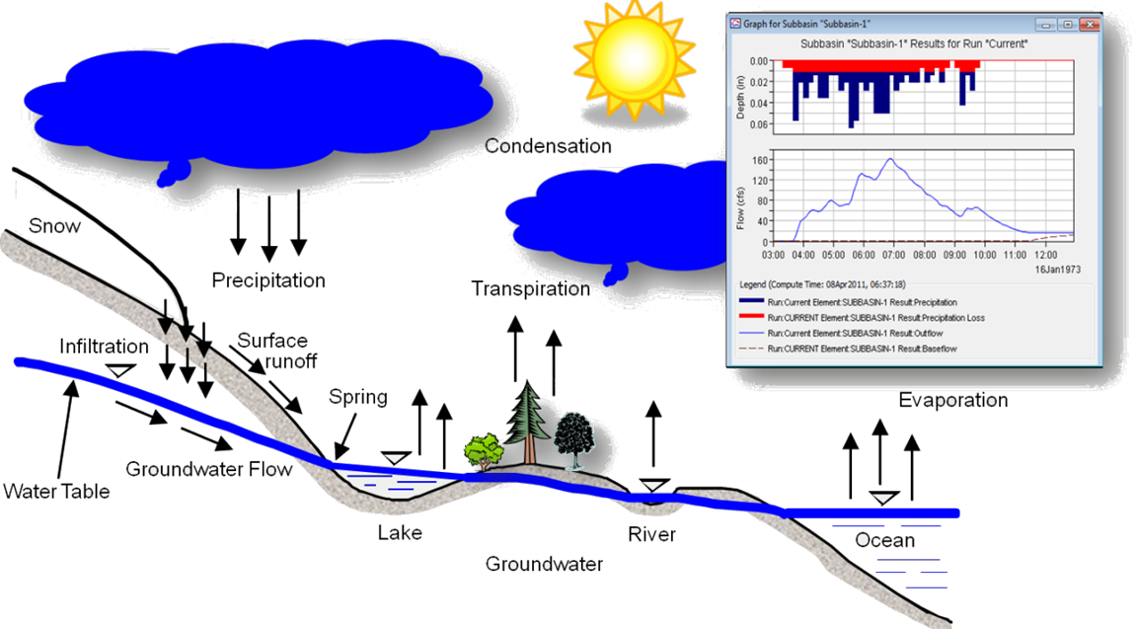
Hydrologic Modeling System
Program Limitations?
Only simple baseflow methods w/o link to an Aquifer model
Notes:
The Hydrologic modeling system is designed to simulate surface-water hydrology. The program can, and has, been used to model temperate and tropical hydrology around the world.
If you’ve taken a hydrology class, this image should be familiar. What we see is a diagram of the hydrologic cycle. For each hydrologic process, HMS provides a range of mathematical model options to model the process.
To ease the modeling process HEC-HMS provides a rich graphical user interface including
a map of the watershed,
point-and-click functionality for entering and updating data
and graphical, and tabular, displays of simulation results.
One model limitation I will mention here is the groundwater representation in HEC-HMS. We do have simple baseflow methods, but we currently do not link directly to an aquifer model. Some losses and baseflow methods calculate a volume, that percolates through as deep aquifer recharge, which could be passed to an aquifer model. Some of our planned work is to include a simplified groundwater flow modeling option in HEC-HMS.

Slide 4
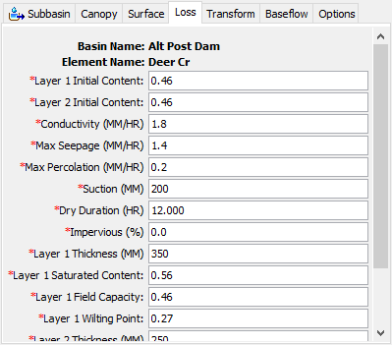
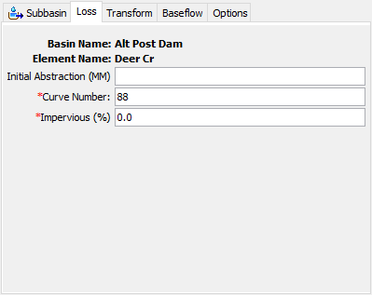
Empirical or physical
SCS Curve Number Loss Method
Layered Green & Ampt Loss Method
Modeling Choses based on? Data, Goals, and Time & Budget
Model Limitation? Model Coupling (ET & Infiltration, GW, etc.)
Notes:
For each hydrologic process, HEC-HMS provides a range of mathematical model options to model the process. In this example we show the same subbasin “Deer Cr” parameterized with two different loss models. The SCS Curve Number loss method on the left is very empirical. The Layered Green & Ampt loss method on the right is physically based.
You, the user, are able to make modeling choices based on:
How much data you have
What your study goals are
And how much time you have
One model limitation worth mentioning here is model coupling. Consider evapotranspiration and infiltration. In reality, you can’t have one without the other. Because you are able to select different modeling methods for each element in the program, it is difficult to couple processes. The way we minimize errors is to use small time steps. Some methods use an adaptive time step to perform computations at time steps less than the selected computation time interval.

Slide 5
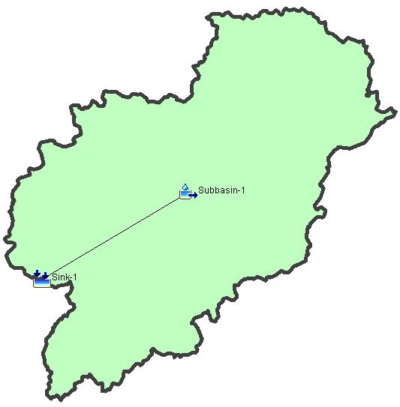
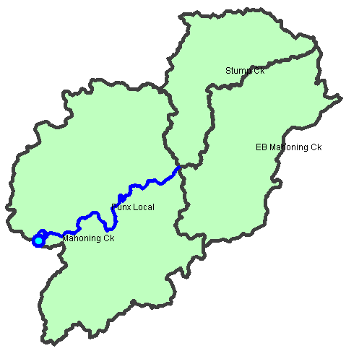
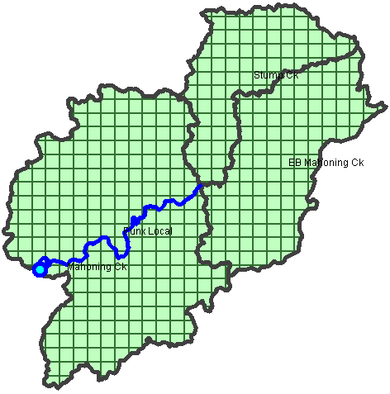
Subbasin-average or Gridded
Notes:
HEC-HMS can model both subbasin-average and gridded subbasins, and can model both at the same time.
The images on this slide represent some common modeling configurations in HEC-HMS. In the case on the left the entire modeling domain is represented with a single set of parameters for each hydrologic process. In the case in the middle the basin is divided into three subbasins. Each subbasin can be parameterized with unique values. In the case on the right, the basin is divided into gridded subbasins where each grid cell can have unique parameterizations.
It is common practice to define gridded precipitation and temperature boundary conditions and compute excess precipitation, and infiltration, on a per grid cell basis.

Slide 6
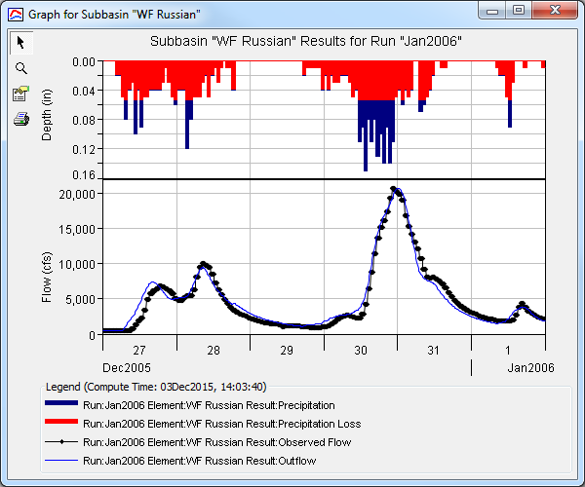
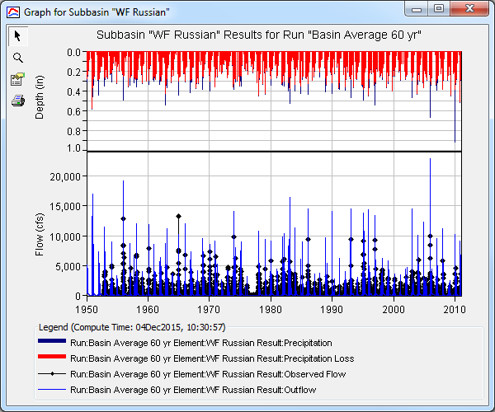
Event OR Continuous
Limitations?
Constant & time-variable parameters
Notes:
"Event" simulation is only concerned with hydrology during and immediately after a storm.
"Continuous" simulation includes events and the time between them, modeling up to several decades at a time.
In the case of HEC-HMS, the program can simulate both event and continuous hydrology.
There is no master switch in HEC-HMS that decides between event and continuous, it comes down to the modeling methods that are selected. Event models typically include just precipitation in the meteorologic model. Continuous simulations include potential evapotranspiration in the meteorologic model and a loss rate method that tracks soil moisture such as deficit & constant or soil moisture accounting.
A limitation that I will mention is constant vs variable parameters. In HEC-HMS, all but a few parameters are constant. A few things are allowed to change during the year, for instance, plant canopy can use an annual pattern. Some of our ongoing work is adding time-variable parameters to some of the infiltration methods. Once that work is complete we will probably look for other areas to apply time-variable parameters.

Slide 7
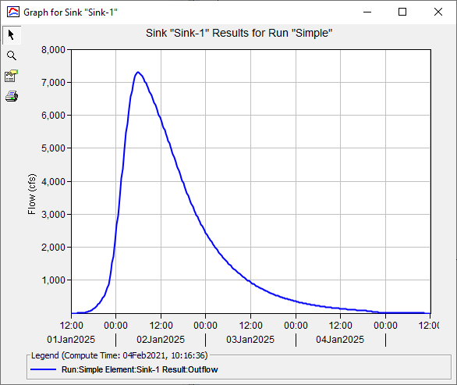
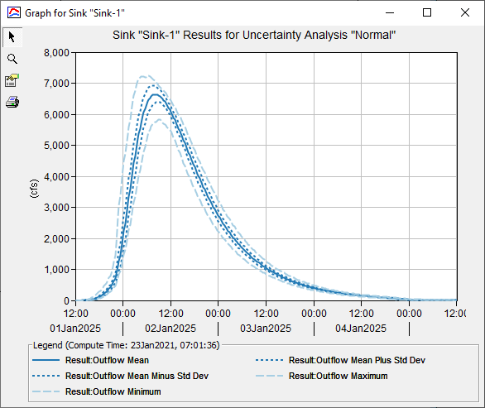
Deterministic or Stochastic
Monte Carlo simulation option: From a deterministic model to create probabilistic output
Notes:
We’ve talked about how, for each hydrologic process in HEC-HMS, there is a range of mathematical model options. The reality is that each of these modeling options is deterministic. In a deterministic model, we fix a set of parameters, and initial conditions, and the model runs.
There is a Monte Carlo simulation option in the program that allows us to take a deterministic model and create probabilistic output. One of our ongoing research areas is a probabilistic parameter estimation tool that allows us to estimate uncertainty in model parameters.

Slide 8
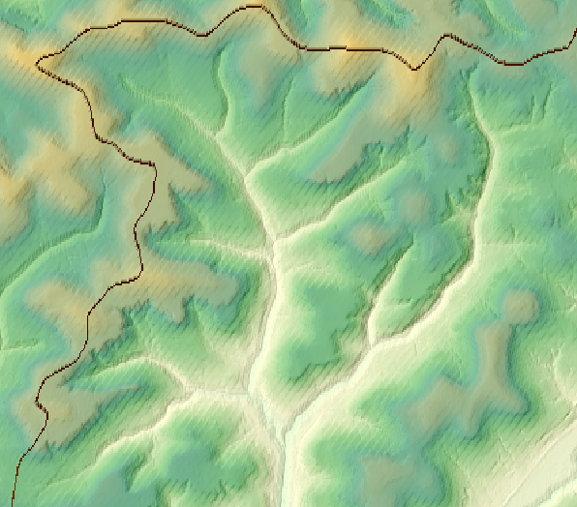
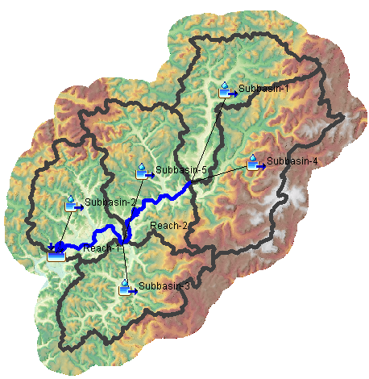
GIS Processing
Terrain modification
Sink fill and flow direction
Subbasin and reach delineation
Subbasin and reach splitting and merging
Subbasin and reach characteristics
Notes:
In addition to the program’s hydrologic modeling capability, HEC-HMS provides GIS processing capability to assist in the hydrologic modeling process.
GIS capability includes:
Terrain modification that allows you to build walls and burn streams into your terrain
Sink fill, and flow direction, terrain processing
Subbasin and reach delineation
Subbasin and reach splitting and merging
And subbasin and reach characteristics computation, such as longest flowpath and basin relief

Slide 9
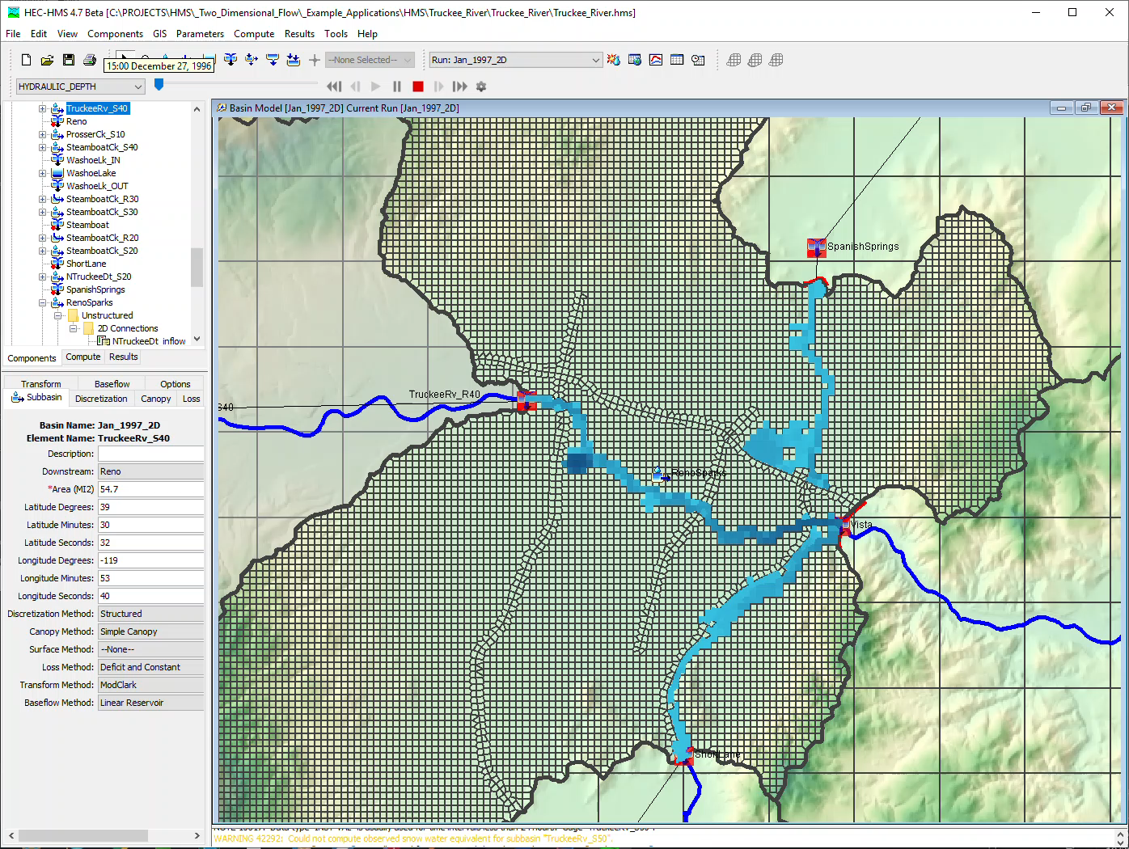
Hydraulic modeling
Notes:
Backwater and flow reversal and dendritic stream systems are problematic for many traditional hydrologic approaches.
The new 2D-Diffustion Wave transform method can be used in areas where flows might deviate from the main channel then return to the channel. A great example of this is in the Truckee River near Reno, 1997 event simulation shown here.
In cases where there is backwater in a reach, the Modified Puls routing method can helpful. In the Modified Puls routing method storage discharge relationships for the reach are informed by a hydraulic analysis.

Slide 10
Building a basin model
Notes:
Hi, this is Tom Brauer from the Hydrologic Engineering Center. This is the first video in a series of videos where I’m going to build a basic HEC-HMS model. In this video I’m going to create a new project, and build a basin model. As we go through the process you should gain familiarity with HEC-HMS project components.

Slide 11
steps:
Create a new Project
Create a new Basin model
Add Hydrologic Elements to the Basin model
Select Modeling Methods
Parametrize Modeling Methods
Notes:
Here are the list of steps that we will take to create our basin model.

Slide 12
steps:
Create a new Project
Create a new Basin model
Add Hydrologic Elements to the Basin model
Select Modeling Methods
Parametrize Modeling Methods
Notes:
First, I’m going to create a new project.

Slide 13
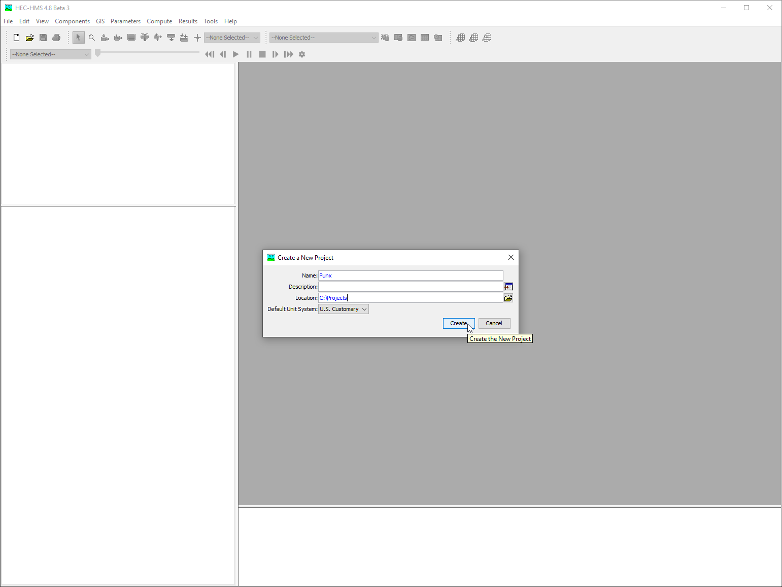
Create a new project
Notes:
To create a new project select File | New. In the Create a New Project dialog give the project a name and a location. You can optionally choose the default unit system.

Slide 14
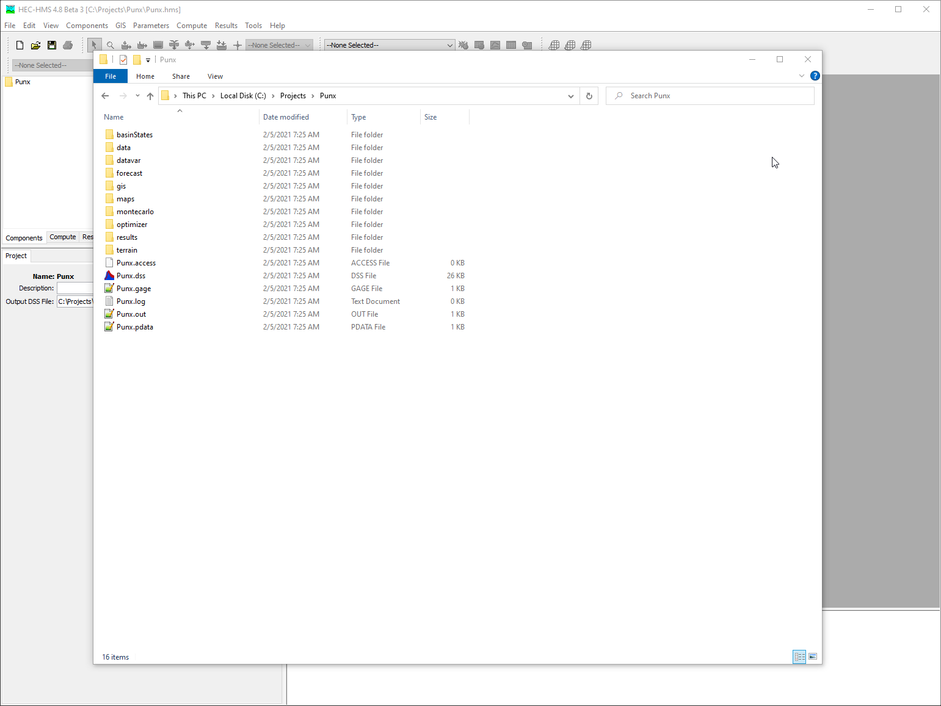
Create a new project
Notes:
If I browse to my project in File Explorer you will notice that it is a subdirectory on my computer. The subdirectory goes by the name of my project. If you want to share the project, you can zip the subdirectory and send to others. It’s important to keep data references internal to the project to keep the project portable. We recommend using the data subdirectory of the project to store data. If you zip a project with external data references and send it to a colleague, it’s likely they won’t have everything they need to interact with the project.

Slide 15
steps:
Create a new Project
Create a new Basin model
Add Hydrologic Elements to the Basin model
Select Modeling Methods
Parametrize Modeling Methods
Notes:
The next step is to create a new basin model.

Slide 16
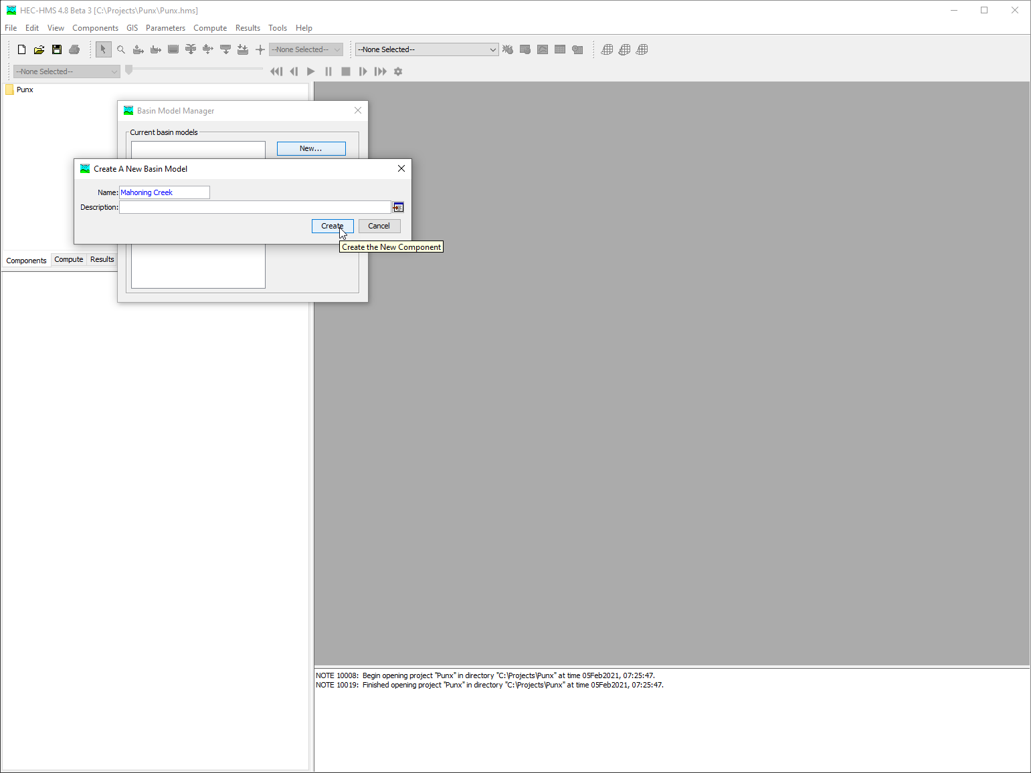
Create a new basin model

Slide 17
steps:
Create a new Project
Create a new Basin model
Add Hydrologic Elements to the Basin model
Select Modeling Methods
Parametrize Modeling Methods
Notes:
Next I’m going to add hydrologic elements to the basin model.

Slide 18
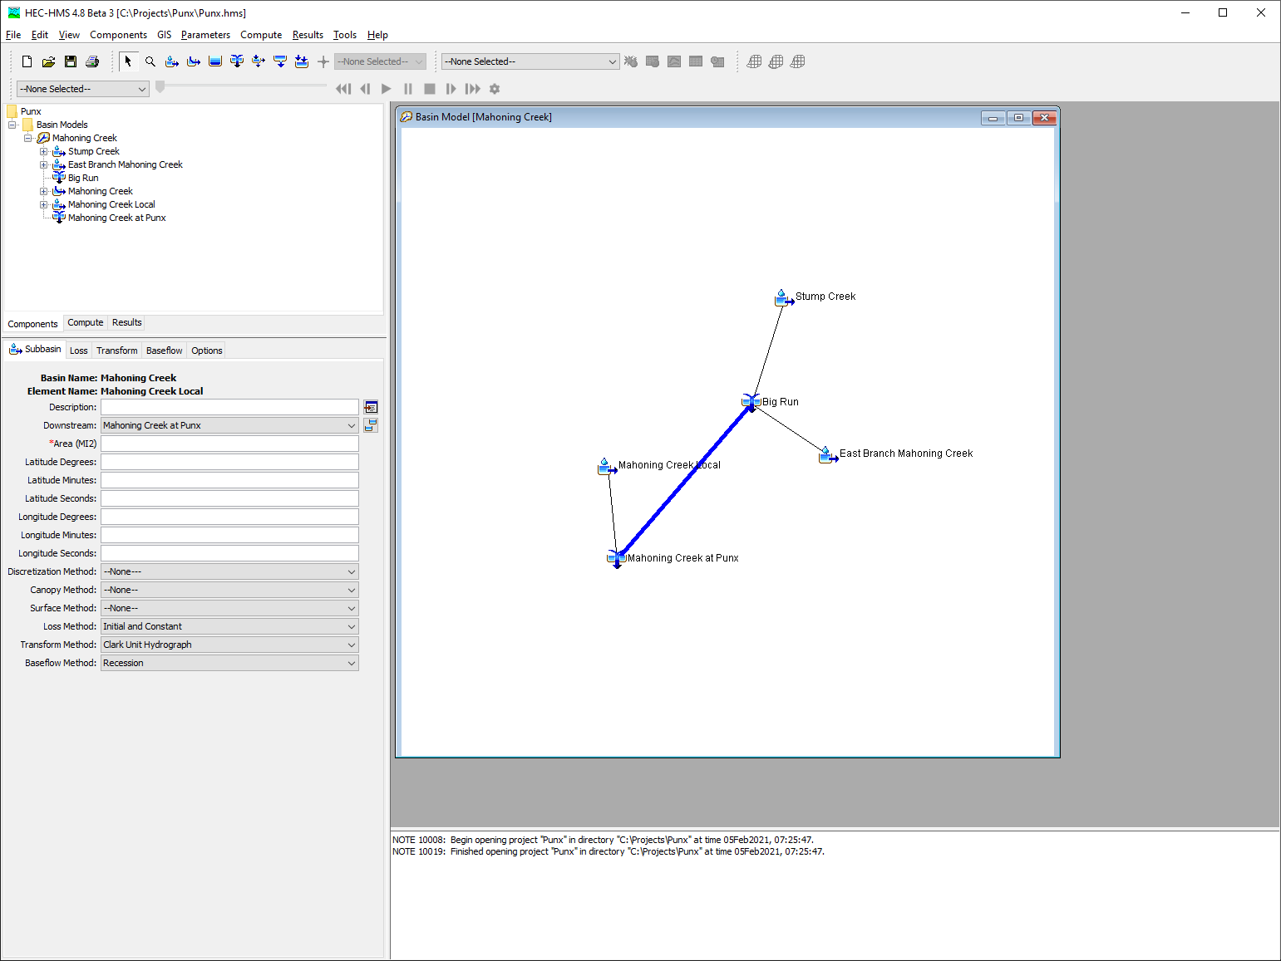
Add hydrologic elements
Notes:
The basin model gives the physical description of the watershed. There are 7 different sub-components:
Subbasins: these are watershed catchments that capture rainfall over the land surface
Reaches: these represent rivers and streams
Reservoirs: these can be natural lakes or simply operated dams
Junctions: these provide a confluence of flow from two elements. You don’t have to use junctions to bring flow together but it gives you additional visualization options. In practice we use them quite frequently.
Diversions: these can model bifurcations and withdrawals
Sources: these can be springs or output from another, upstream, model
Sinks: these can be outlets or terminal lakes
We can have as few or as many elements as we would like. We hook elements together in a way that represents the way water is flowing in our watershed.
Most of the time 1/3 elements are subbasins, 1/3 are reaches, and the remaining elements are a mix of reservoirs, diversions, and junctions.
In my basin I’m going to use three subbasins, two junctions, and one reach to represent the watershed.

Slide 19
steps:
Create a new Project
Create a new Basin model
Add Hydrologic Elements to the Basin model
Select Modeling Methods
Parametrize Modeling Methods
Notes:
Now I’m going to select my modeling methods.

Slide 20
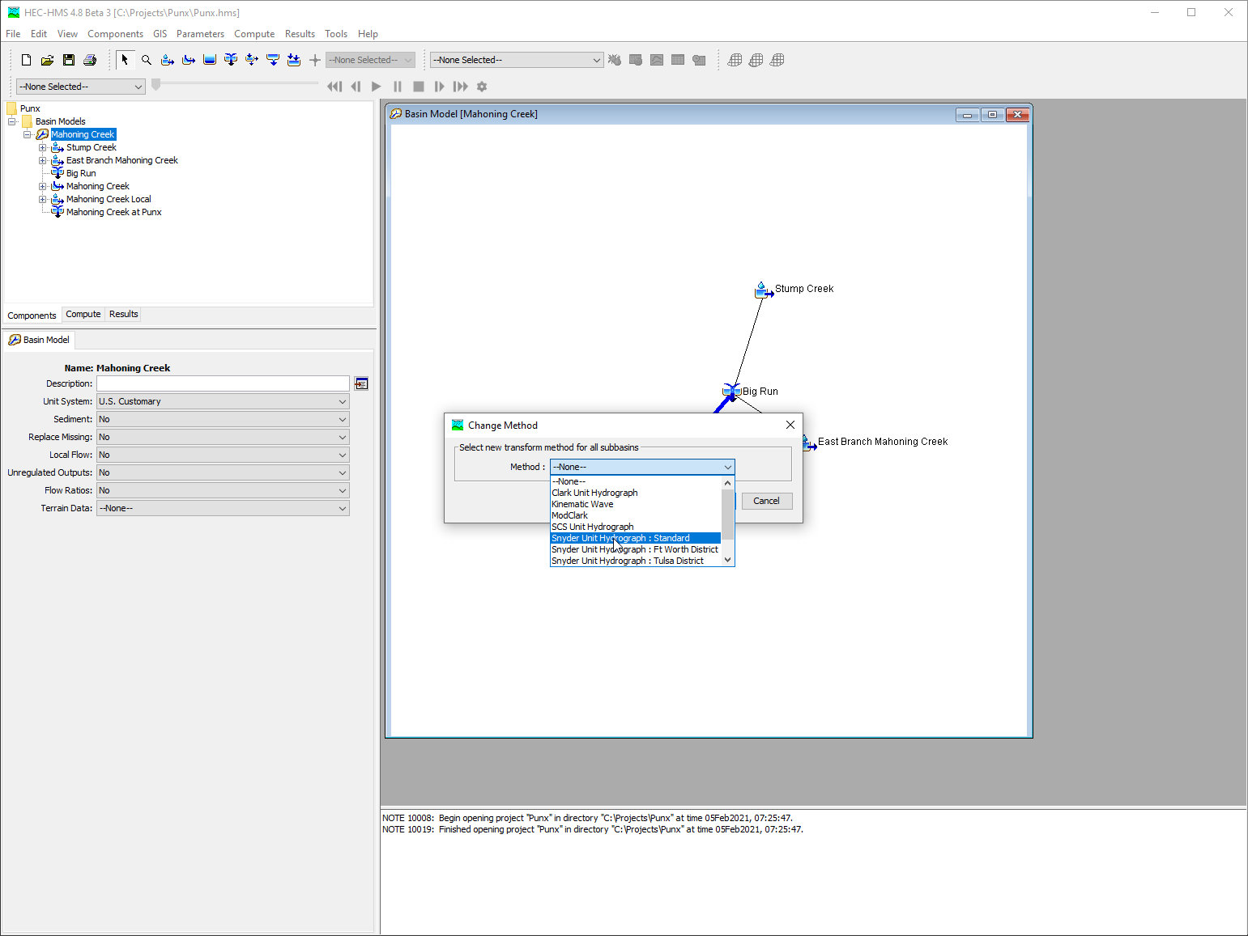
Select modeling methods
Notes:
For my subbains, I’m going to use the Initial and Constant Loss method, the Snyder Unit Hydrograph method, and the Recession baseflow method. For my reach I’m going to use the lag routing method. I can change modeling methods for all elements on the parameters menu.

Slide 21
steps:
Create a new Project
Create a new Basin model
Add Hydrologic Elements to the Basin model
Select Modeling Methods
Parametrize Modeling Methods
Notes:
Now I’m going to parameterize my modeling methods.

Slide 22
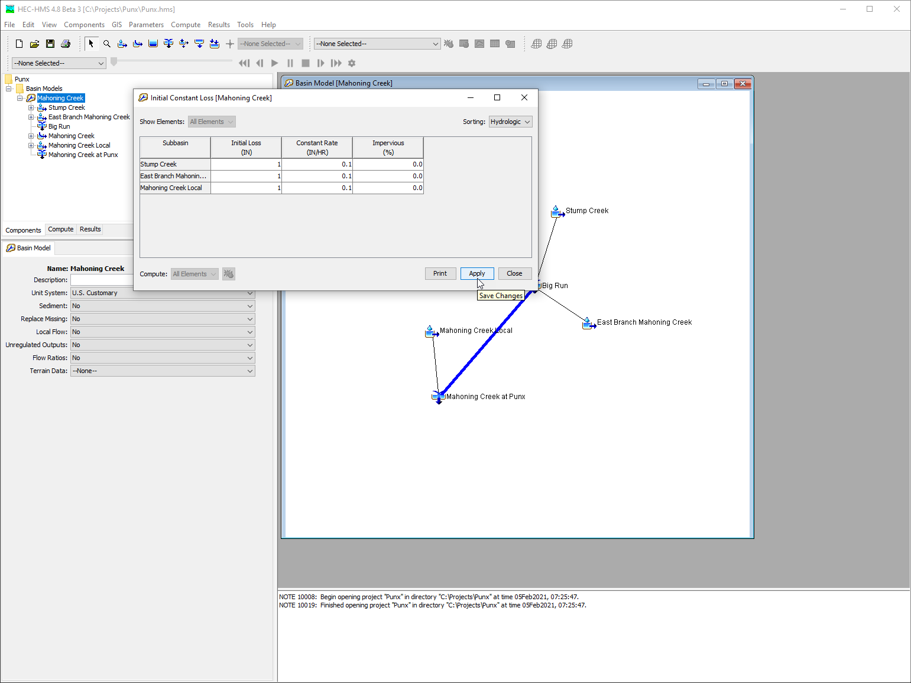
Parameterize modeling methods
Notes:
I can parameterize modeling methods using the component editor or the global parameter editor. If I’m parameterizing multiple elements at a time I find the global editors most efficient. You can access the global editors by selecting the basin model in the watershed explorer, and then selecting the parameters menu. I’m going to edit my subbaisn, loss, transform, and baseflow methods globally. Since I only have one reach, I’m going to parametrize it in the component editor.

Slide 23
steps:
Create a new Project
Create a new Basin model
Add Hydrologic Elements to the Basin model
Select Modeling Methods
Parametrize Modeling Methods
Notes:
In the video we created a new Project, we then created a new basin model, added hydrologic elements to the basin model, selected modeling methods, and then parameterized the modeling methods. In the next video I’m going to add precipitation gages to my project, and add a meteorlogic model.

Slide 24
Building a Meteorologic model
Notes:
Hi, this is Tom Brauer from the Hydrologic Engineering Center. This is the second video in a series of videos where I’m going to build a basic HEC-HMS model. In the first video we created a new project, and a basin model. In this video I’m going to add precipitation gages to my project, then build a meteorologic model. As we go through the process you should gain familiarity with HEC-HMS project components.

Slide 25
steps:
Create new Precipitation Gages
Parameterize gages
Create a new Meteorologic Model
Select Modeling Methods
Parameterize Modeling Methods
Notes:
Here are the list of steps that we will take.

Slide 26
steps:
Create new Precipitation Gages
Parameterize gages
Create a new Meteorologic Model
Select Modeling Methods
Parameterize Modeling Methods
Notes:
First I’m going to create precipitation gages to be used in my Meteorologic model.

Slide 27
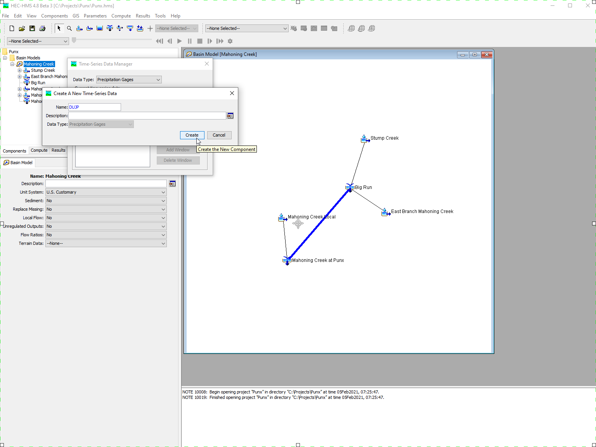
Create Precipitation gages
Notes:
Select Components | Time-series data manager. In the Time-series data manager, add new precipitation gages.

Slide 28
steps:
Create new Precipitation Gages
Parameterize gages
Create a new Meteorologic Model
Select Modeling Methods
Parameterize Modeling Methods
Notes:
Next I’m going to parameterize my gages.

Slide 29
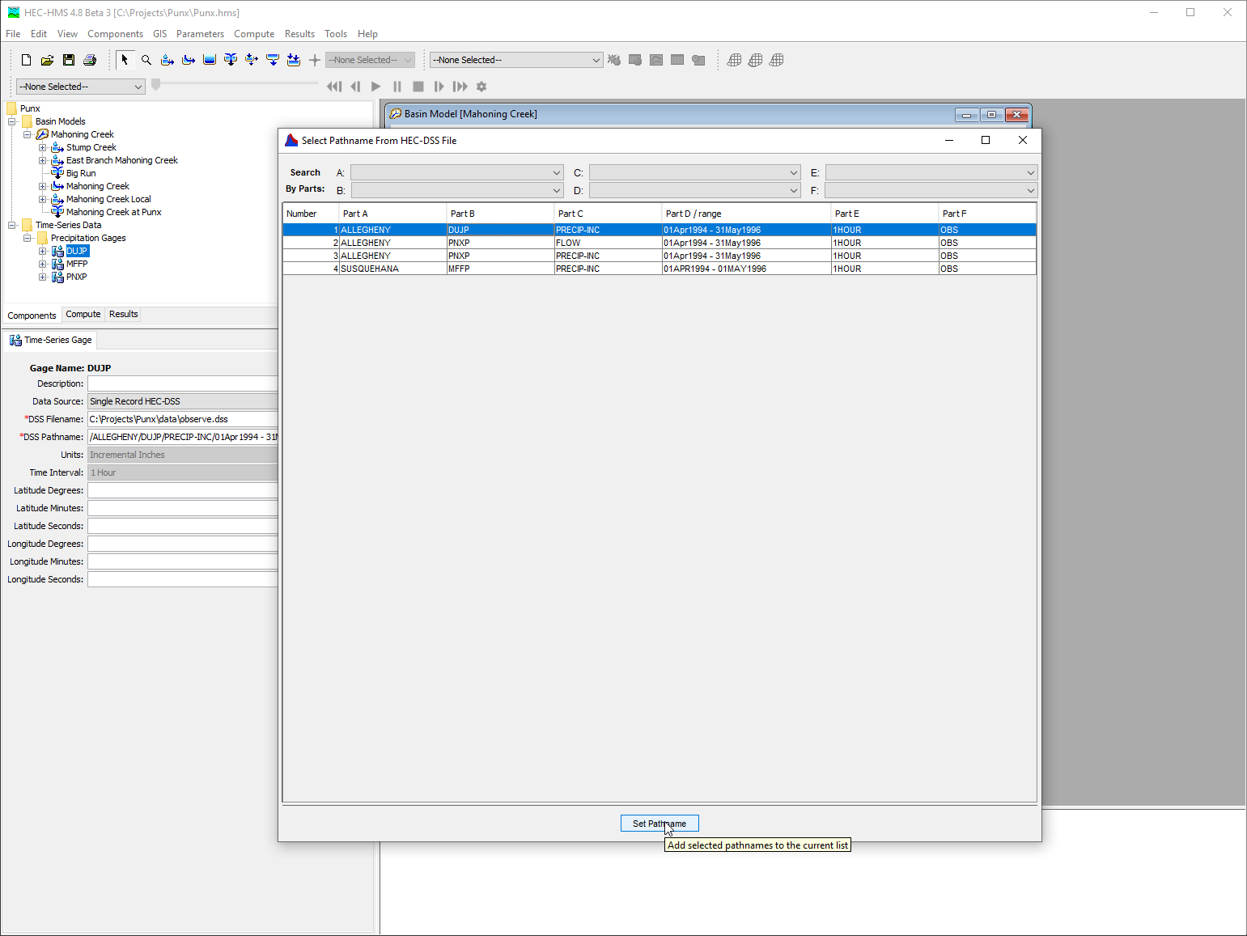
Parameterize gages
Notes:
Internalize HEC-DSS file to project. Browse to the precipitation gages in the watershed explorer, add references to DSS file.

Slide 30
steps:
Create new Precipitation Gages
Parameterize gages
Create a new Meteorologic Model
Select Modeling Methods
Parameterize Modeling Methods
Notes:
Now I’m going to create a new meteorologic model.

Slide 31
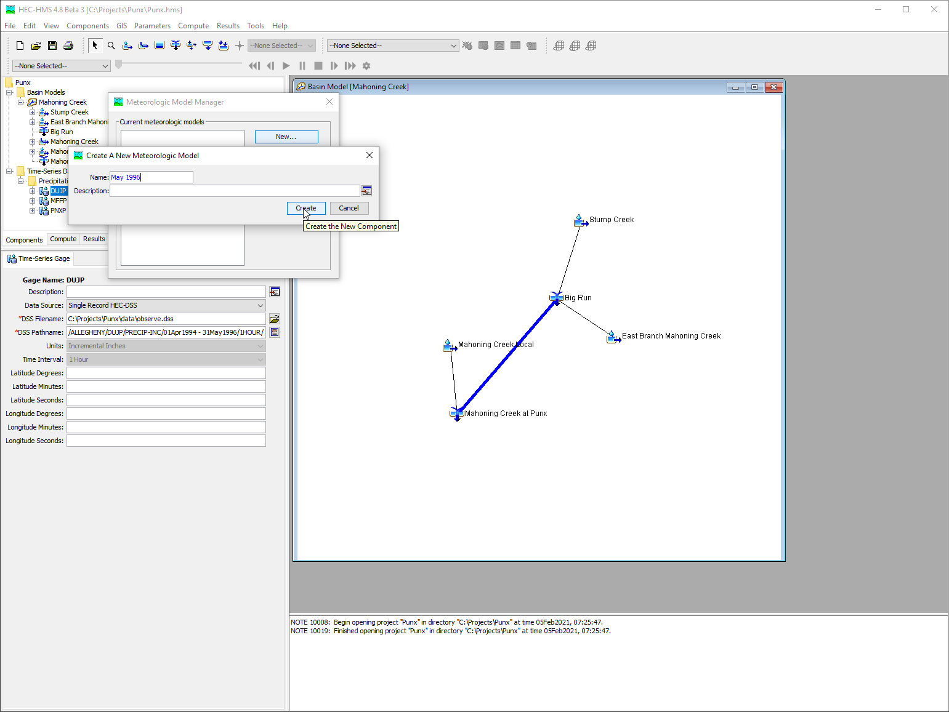
Create a meteorologic model

Slide 32
steps:
Create new Precipitation Gages
Parameterize gages
Create a new Meteorologic Model
Select Modeling Methods
Parameterize Modeling Methods
Notes:
Now I’m going to select modeling methods in the meteorologic model.

Slide 33
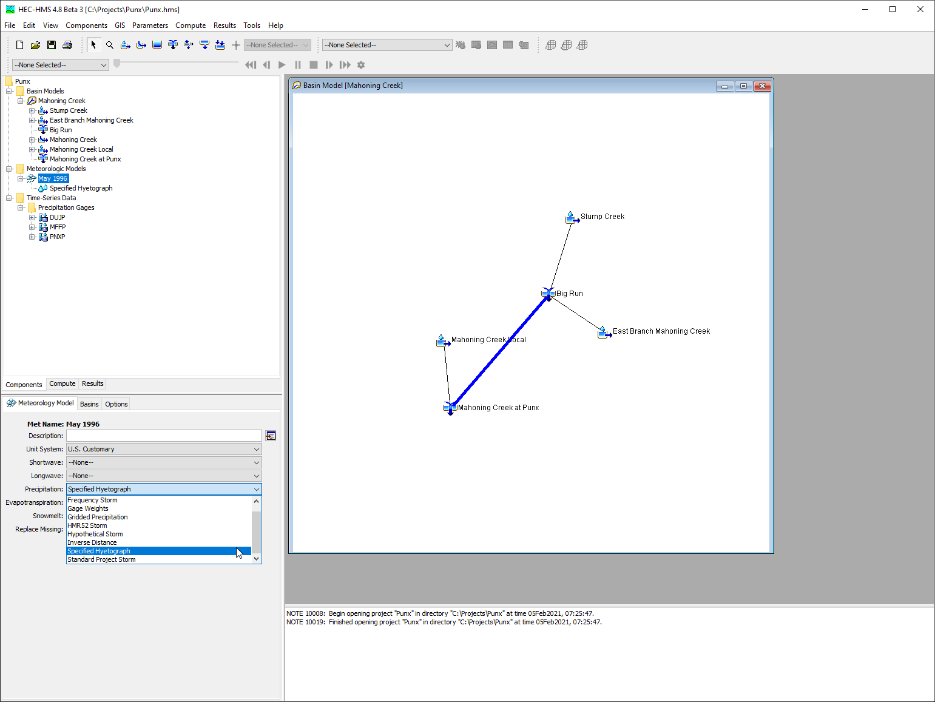
Select modeling methods
Notes:
Navigate to the May 1996 meteorologic model in the watershed explorer. Select the specified hyetograph precipitation method in the component editor.

Slide 34
steps:
Create new Precipitation Gages
Parameterize gages
Create a new Meteorologic Model
Select Modeling Methods
Parameterize Modeling Methods
Notes:
Now I’m going to parameterize the meteorologic model.

Slide 35
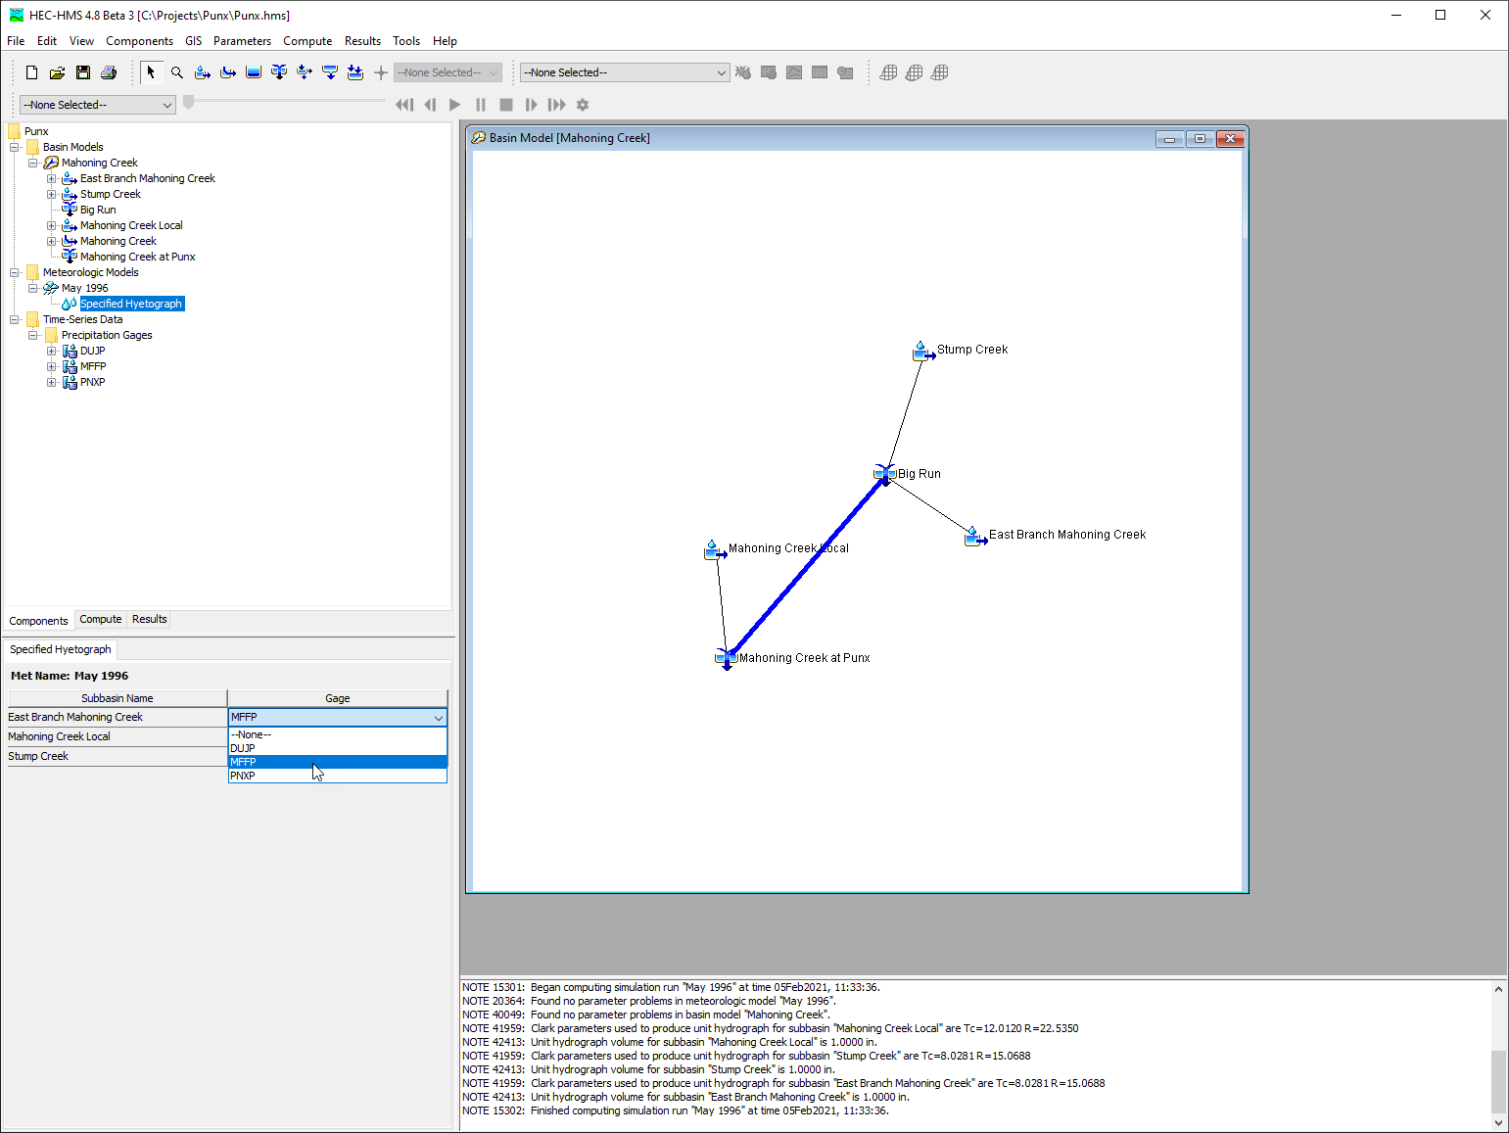
Parameterize meteorologic model
Notes:
Connect the meteorologic model to the basin by selecting the meteorologic model in the watershed explorer. Select the basins tab and include subbasins for the basin model. Now, navigate to the specified hyetograph node in the watershed explorer. In the component editor link precipitation gages. The meteorologic model is now parameterized.

Slide 36
steps:
Create new Precipitation Gages
Parameterize gages
Create a new Meteorologic Model
Select Modeling Methods
Parameterize Modeling Methods
Notes:
In this video we added new precipitation gages to our project, we referenced data records from an HEC-DSS file, we created a new meteorologic model and linked our precipitation gages to the meteorologic model as specified hyetographs. In the next video, we’ll create a control specification, and a compute.

Slide 37
Running a simulation
Notes:
Hi, this is Tom Brauer from the Hydrologic Engineering Center. This is the third and final video in a series of videos where I’m going to build a basic HEC-HMS model. In the first video I created a new project, and a basin model. In the second video I added precipitation gages and created a meteorologic model. In this video I’m going to create a control specification and compute a simulation run.

Slide 38
steps:
Create new Control Specification
Create Simulation Run
Compute the Simulation Run
View Results
Notes:
Here are the list of steps that we will take.

Slide 39
steps:
Create new Control Specification
Create Simulation Run
Compute the Simulation Run
View Results
Notes:
First we’ll create a new control specification.

Slide 40
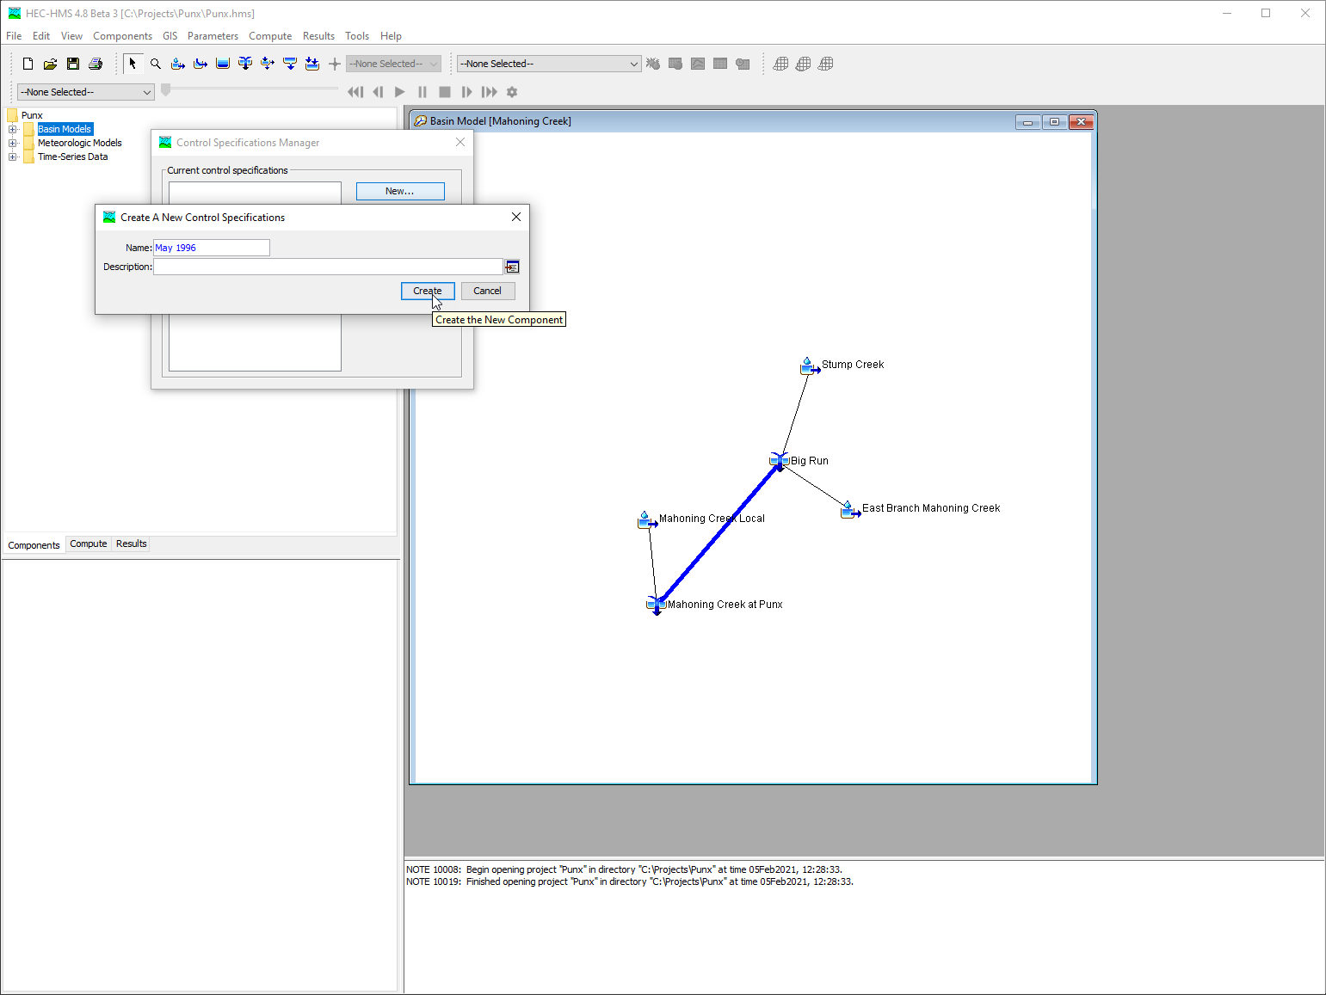
Create control specification
Notes:
Control Specifications define the temporal resolution and extent of a simuation. To create a new control specification, select Components | Control Specifications Manager. In the Control Specifications Manger select New. Name the control specification after the event being modeled. Navigate to the Control Specification in the watershed explorer. Parameterize the control specification in the component editor.

Slide 41
steps:
Create new Control Specification
Create Simulation Run
Compute the Simulation Run
View Results
Notes:
Next I’m going to create a simulation run.

Slide 42
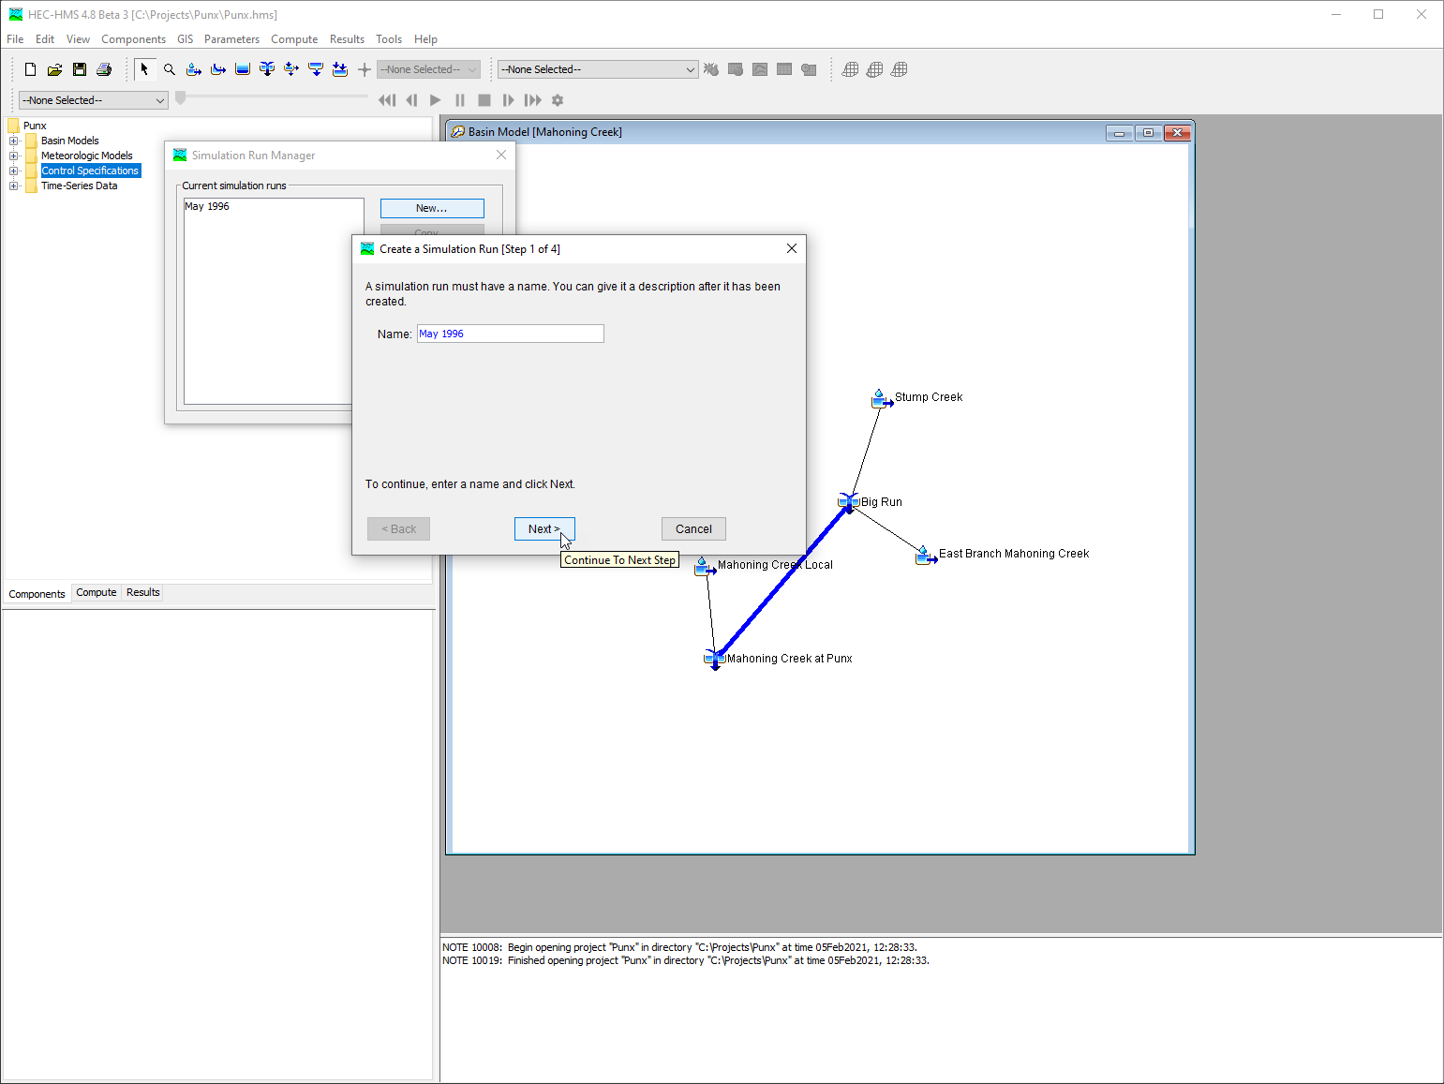
Create a simulation run
Notes:
A simulation run is the combination of a basin model, a meteorologic model, and a control specification. To create a simulation run select Compute | Simulation Run Manager. In the Simulation Run Manager select New. Name the simuation run after the event being modeled. Select a basin model, a meteorologic model, and a control specification.

Slide 43
steps:
Create new Control Specification
Create Simulation Run
Compute the Simulation Run
View Results
Notes:
Now I’m going to compute the simulation run.

Slide 44
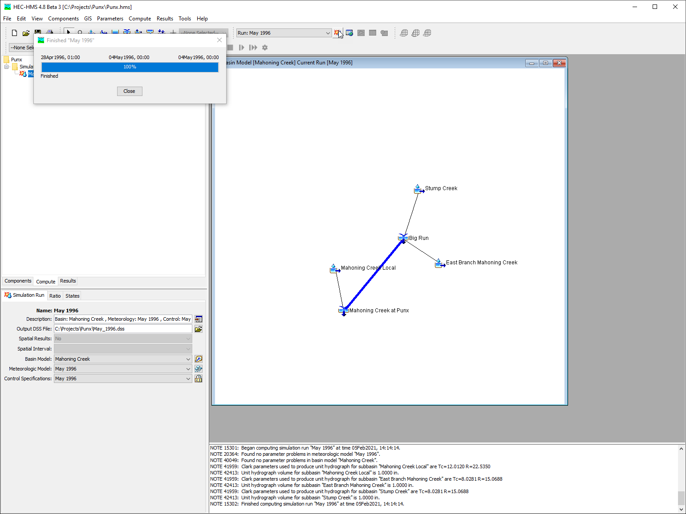
Compute the simulation
Notes:
There are several ways to compute the simulation run in HEC-HMS. The easiest is to select the simulation run in the compute toolbar, and click the compute button. If I have the simulation run selected I can also compute from the compute menu. Another option is to compute from the compute tab in the watershed explorer.

Slide 45
steps:
Create new Control Specification
Create Simulation Run
Compute the Simulation Run
View Results
Notes:
Now I’m going to view results.

Slide 46
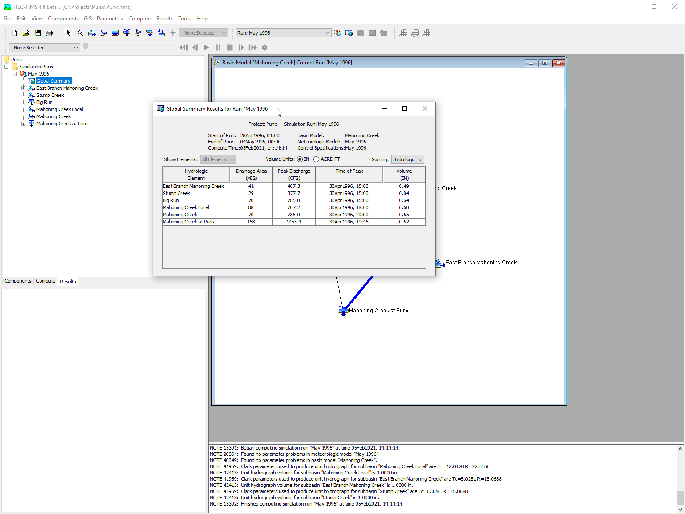
View Results
Notes:
There is an entire video dedicated to viewing results so refer to that video for more in depth coverage. In this video I’m going to navigate to the results tab of the watershed explorer. From the results tab I can access a global summary table, and element results.

Slide 47
steps:
Create new Control Specification
Create Simulation Run
Compute the Simulation Run
View Results
Notes:
This concludes the three video series on creating a basic HEC-HMS model. In the first video we created a new project, and a basin model, in the second video, we added precipitation gages and a meteorologic model, and in this video we created a control specification and computed a simulation run. Finally, we viewed the results from our simulation run.

Slide 48
Viewing Results in HEC-HMS
Notes:
Hi, this is Tom Brauer from the Hydrologic Engineering Center. In this video I’m going to go over some of the different result displays in HEC-HMS. I’ll also demonstrate different ways to access the results in the program. Finally, I’ll show how to access results from the backing HEC-DSS database.

Slide 49
Five Result Displays in HMS:
Global summary table
Element graph
Element summary table
Element time series
Spatial Results
Notes:
Here are the five result displays we’ll go over. The first is a global summary table. The next three are results displays for a single hydrologic element. Finally we’ll look at spatial results.

Slide 50
Five Result Displays in HMS:
Global summary table
Element graph
Element summary table
Element time series
Spatial Results
Notes:
First, the global summary table.

Slide 51
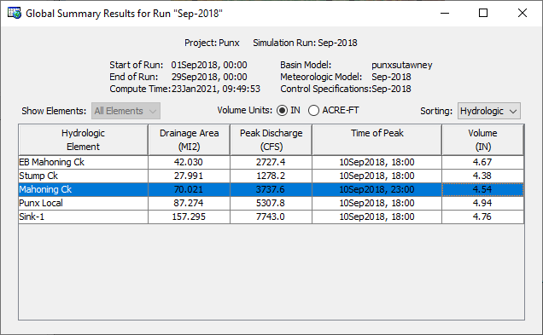
Notes:
The table includes one row for each element in the basin model and columns for element name, drainage area, peak flow, time of peak flow, and total outflow volume.
Results can be shown as a depth or a volume. Also, elements can be sorted in alphabetic or hydrologic order.

Slide 52
Five Result Displays in HMS:
Global summary table
Element graph
Element summary table
Element time series
Spatial Results
Notes:
Next, we will look at the element graph.

Slide 53
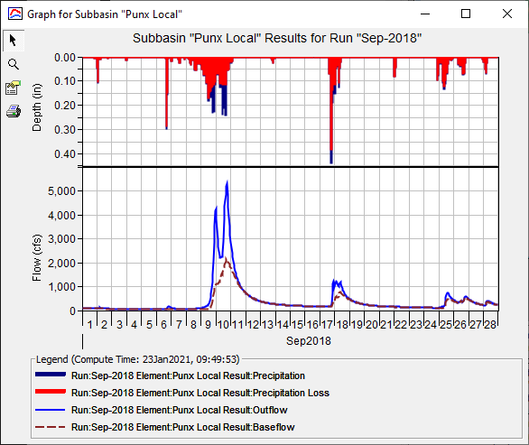
Notes:
The information included in the graph varies by element type, but always includes outflow. Optional items such as observed flow, computed stage, and observed stage are also included when present.

Slide 54
Five Result Displays in HMS:
Global summary table
Element graph
Element summary table
Element time series
Spatial Results
Notes:
Next, we’ll look at the element summary table.

Slide 55
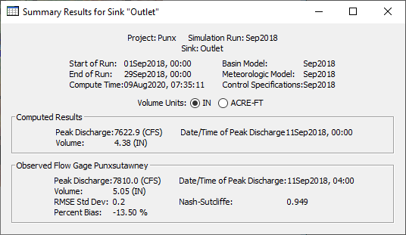
Notes:
The information included in the summary table varies by element type but always includes the peak flow, time of peak flow, and outflow volume. If observed data are available, then information about the observed data are presented, as well as goodness-of-fit statistics which describe the degree of agreement between the simulated time-series and the observed data.
Results can be shown as a depth or a volume.

Slide 56
Five Result Displays in HMS:
Global summary table
Element graph
Element summary table
Element time series
Spatial Results
Notes:
Next, we will look at the element time-series.

Slide 57
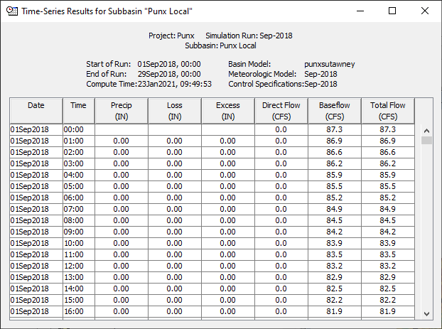
Notes:
The time-series table includes the same information as the graph but in numerical format. Data from the table can be copied to the clipboard and pasted wherever.

Slide 58
Five Result Displays in HMS:
Global summary table
Element graph
Element summary table
Element time series
Spatial Results
Notes:
Finally, let’s look at the spatial result display.

Slide 59
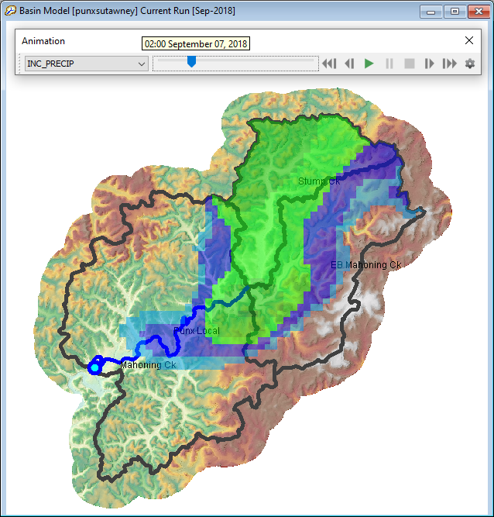
Notes:
Spatial results give a spatial representation of select variables from a compute. Currently a single spatial variable can be viewed at a time. You can pause and step through the simulation frame-by-frame or playback the simulation in a continuous loop.
For spatial variables to appear in the animation toolbar, spatial results must be turned on for the compute. More on that in the second part of this video.

Slide 60
Five WAYS to Access results in HMS:
Watershed explorer Results tab
Right-click option in basin map
Compute toolbar
Results menu
Animation Toolbar
Notes:
In this part of the video, I’m going to demonstrate five different ways to access results in HEC-HMS.

Slide 61
Five WAYS to Access results in HMS:
Watershed explorer Results tab
Right-click option in basin map
Compute toolbar
Results menu
Animation Toolbar
Notes:
The first way that I’ll demonstrate accessing results, is the Watershed explorer Results tab.

Slide 62
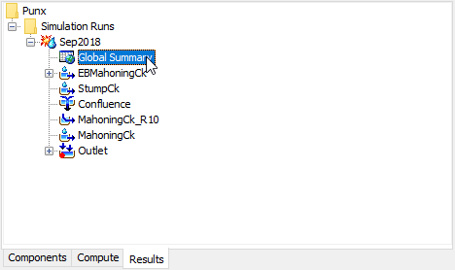

Slide 63
Five WAYS to Access results in HMS:
Watershed explorer Results tab
Right-click option in basin map
Compute toolbar
Results menu
Animation Toolbar
Notes:
The next way I’ll demonstrate accessing results, is from a right-click option in the Basin Map.

Slide 64
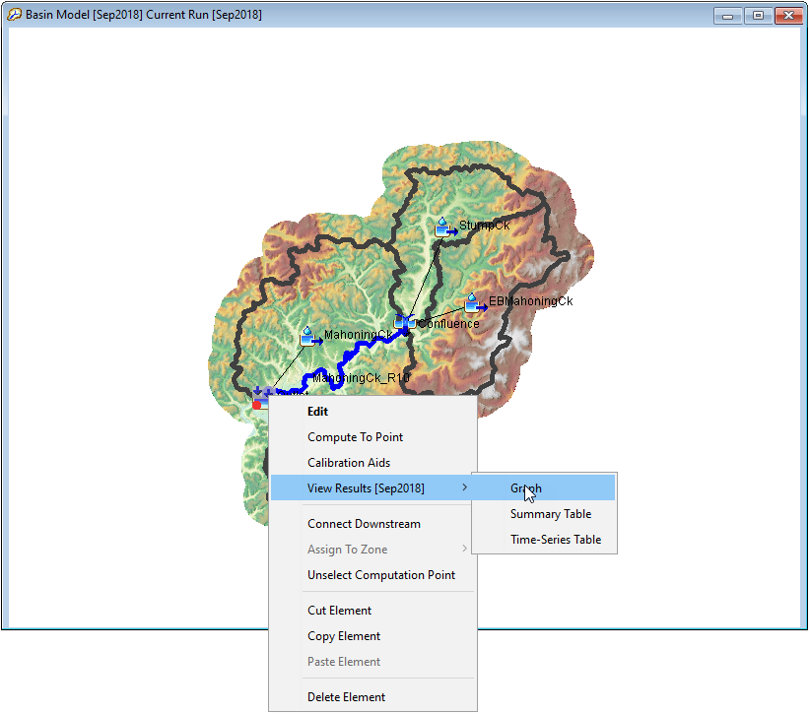

Slide 65
Five WAYS to Access results in HMS:
Watershed explorer Results tab
Right-click option in basin map
Compute toolbar
Results menu
Animation Toolbar
Notes:
The next way I’ll demonstrate accessing results, is from the compute toolbar.

Slide 66
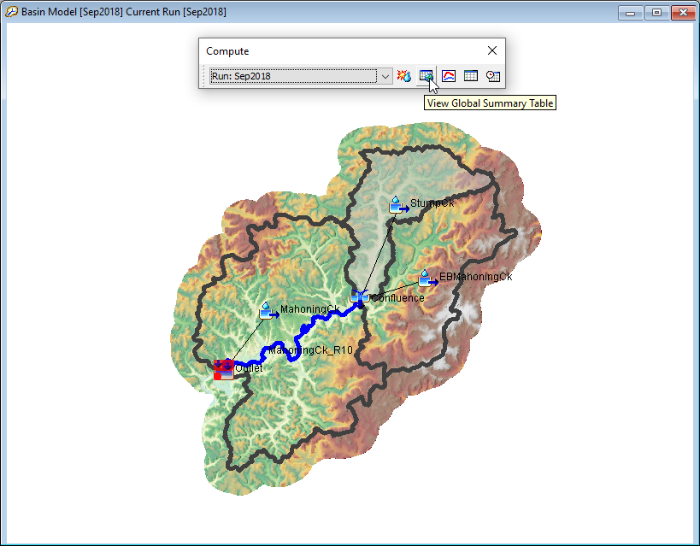

Slide 67
Five WAYS to Access results in HMS:
Watershed explorer Results tab
Right-click option in basin map
Compute toolbar
Results menu
Animation Toolbar
Notes:
The next way that I’ll demonstrate accessing results, is from the results menu.

Slide 68
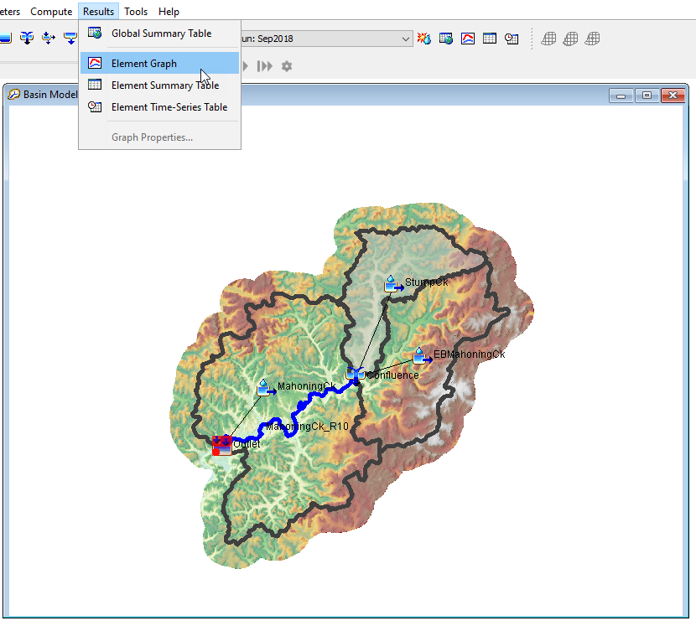

Slide 69
Five WAYS to Access results in HMS:
Watershed explorer Results tab
Right-click option in basin map
Compute toolbar
Results menu
Animation Toolbar
Notes:
Finally, now I’m going to show how to access spatial results from the animation toolbar.

Slide 70
Notes:
To view spatial results you must turn spatial results on in the compute component editor. You can optionally select a spatial results interval that is different from your computation time step.
You can use the animation toolbar to select the different spatial results available and step through each time step.

Slide 71
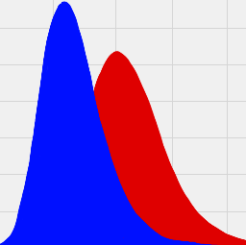
Accessing the results HEC-DSS file
Notes:
Finally, I’m going to demonstrate how to access results from the backing HEC-DSS database file.

Slide 72
HEC-HMS Simulation Types
Notes:
Hi, this is Tom Brauer from the Hydrologic Engineering Center and in this video I’m going to talk about the 5 simulation types that are available in HEC-HMS.

Slide 73
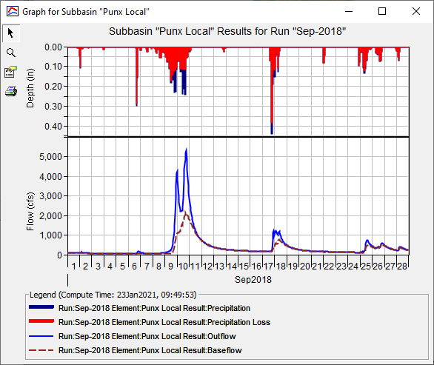
Simulation Run
Simulation Run
Meteorologic Model
Basin Model
Control Specifications
Special Options:
Precipitation or Outflow Ratio Scaling Option
Save States & Start States Option
Notes:
The simplest and most commonly used simulation type is the simulation run. A simulation run is the combination of a basin model, a meteorologic model, and control specifications. The basin model describes the hydrology on the land surface. The meteorologic model describes the atmospheric conditions over the basin. The control specifications define the temporal extent and resolution of the simulation.
Some special options available in a simulation run include precipitation and outflow ratio scaling, an option to save model states at the end of a simulation, and an option to start the simulation with states that were saved from a previous run.

Slide 74
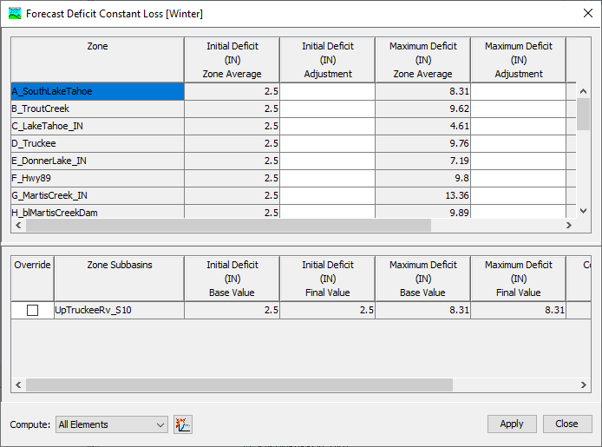
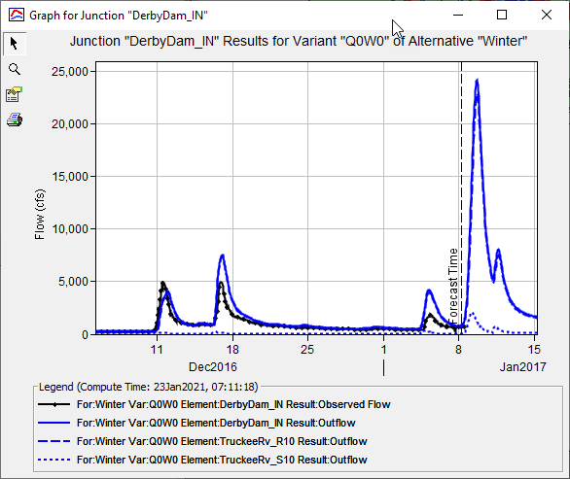
FORECAST ALTERNATIVE
Notes:
The next simulation type is a forecast alternative. Forecasting typically includes the simulation of past and future conditions. In a forecast, a “look back period“ is used to calibrate the model, before moving into forecast period. Because forecasting is typically a time-sensitive process, the forecasting alternative includes many specialized zone and initialization editors help rapidly calibrate model.

Slide 75
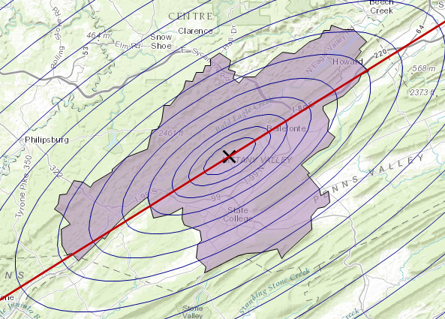
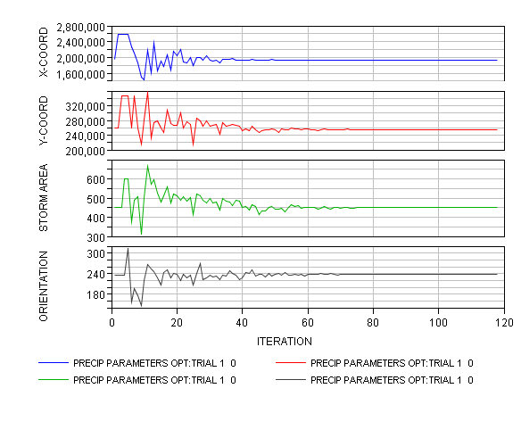
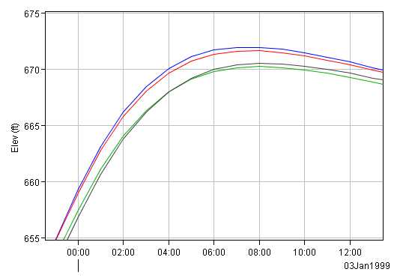
Optimization Trial
Good estimates for some parameters such as:
Infiltration parameters or initial conditions,
Unit hydrograph parameters,
Baseflow parameters or initial conditions,
Channel routing parameters.
Recommendations:
Used in the middle of the calibration process
After initial parameter estimates & before manual fine
Notes:
The Optimization Trial can automatically estimate parameters when observed stream flow data is available. The Optimization Trial uses an "Objective function" to measure how well the computed and observed flow hydrographs match. The "Search method" uses the objective function as input to an algorithm that determines how to adjust parameter values to find the optimum match.
Optimization can provide good estimates for some parameters such as:
Infiltration parameters or initial conditions,
Unit hydrograph parameters,
Baseflow parameters or initial conditions,
And, some routing parameters.
Optimization can be used in the middle of the calibration process, that is, after initial parameter estimates have been made, and before manual fine tuning to arrive at final model parameters.
In the example on this slide, the optimization trial has been used to maximize reservoir pool elevation, by adjusting storm area, location, and orientation.

Slide 76
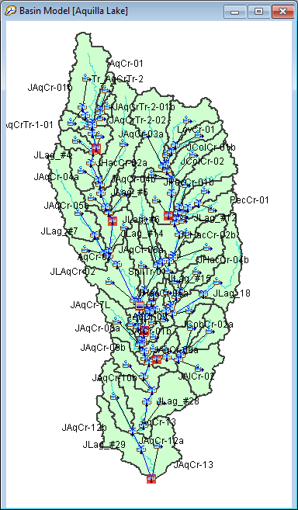
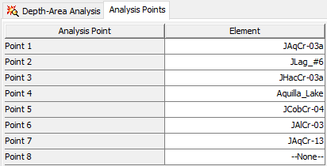
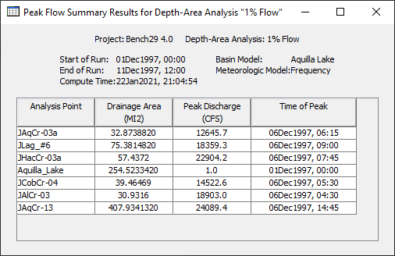
Depth-Area Analysis
Notes:
Next, the Depth-area analysis. The Frequency Storm and Hypothetical Storm options in HEC-HMS can be used for estimating flows for design storms such as the 100-yr storm or other return intervals. Part of the design storm procedure usually involves reducing point rainfall depths by some depth-area relationship. It is common to assume the storm area is equal to the drainage area at the analysis point, then reduce the point rainfall depth accordingly. The depth-area analysis is helpful when there are multiple analysis points in the basin. For each analysis point in the basin, HMS determines the area upstream, and reduces the point rainfall depth according to the area upstream.
On the left we see a basin with multiple locations of interest highlighted in red. On the top right we see the locations have been specified in the depth area analysis component editor. On the bottom right we see results for each analysis point including the drainage area, the peak discharge, and the time of peak.

Slide 77
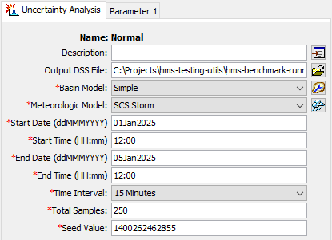
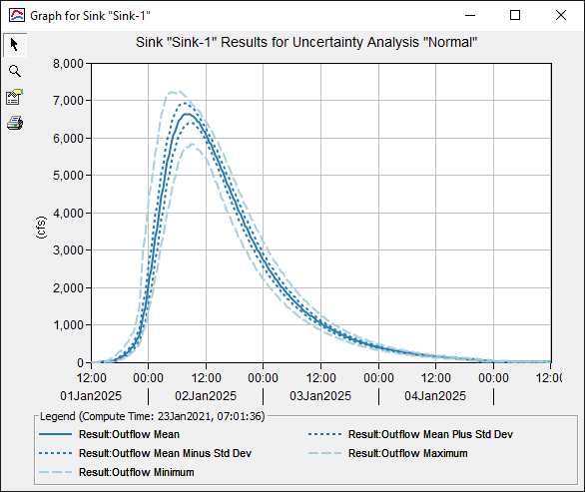
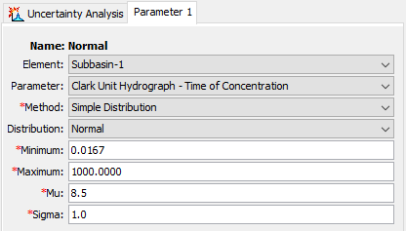
Uncertainty Analysis
- 9 Different Analytical Probability distribution Functions in HEC-HMS (Beta, Gamma, Gumbel, etc.)
https://www.hec.usace.army.mil/confluence/hmsdocs/hmsum/4.8/assessing-model-uncertainty/uncertainty-analyses
Notes:
Finally, the uncertainty analysis. The uncertainty analysis uses the Monte Carlo method to estimate uncertainty in model parameters. The uncertainty analysis creates many alternative models of the watershed using an automated sampling procedure. Each sample model is created by sampling the model parameters according to their individual probability distribution. Each sample model is then simulated to obtain a watershed response corresponding to the sampled parameter values. All of the responses from all of the samples can be analyzed statistically to evaluate the uncertainty in the simulated watershed response.

Slide 78

FOR MORE…
Notes:
This concludes the presentation the five simulation types in HEC-HMS. For more resources on HEC-HMS check out the HEC-HMS documentation website.

