Slide 1
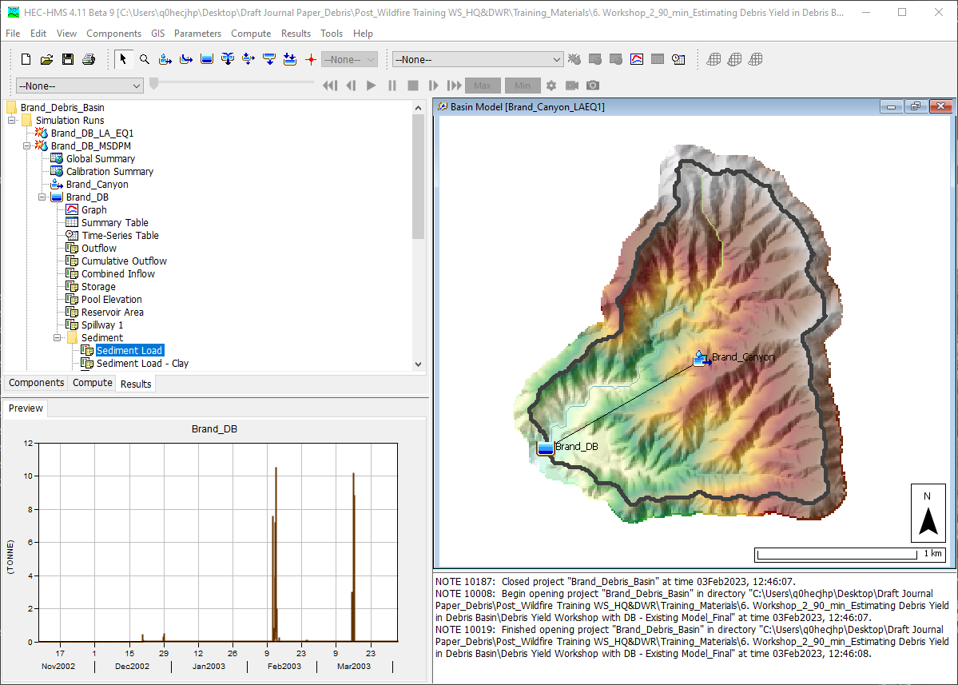
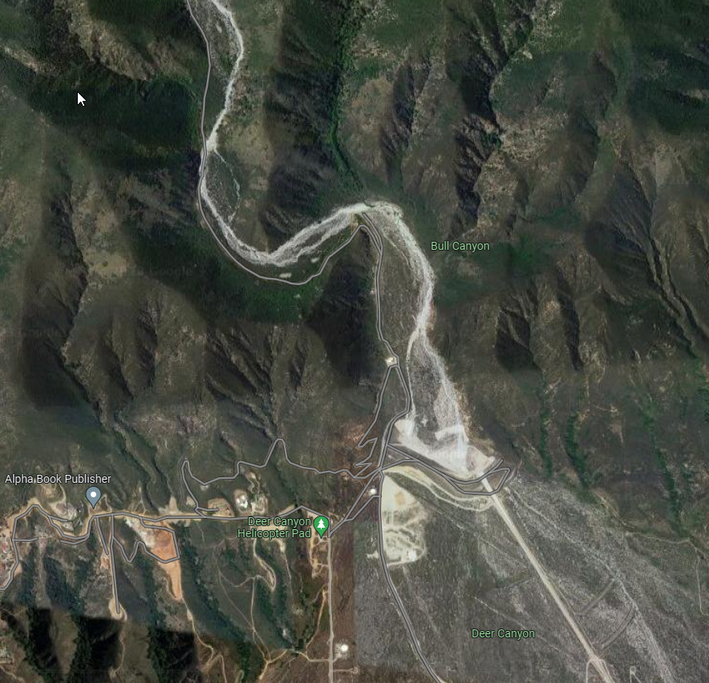
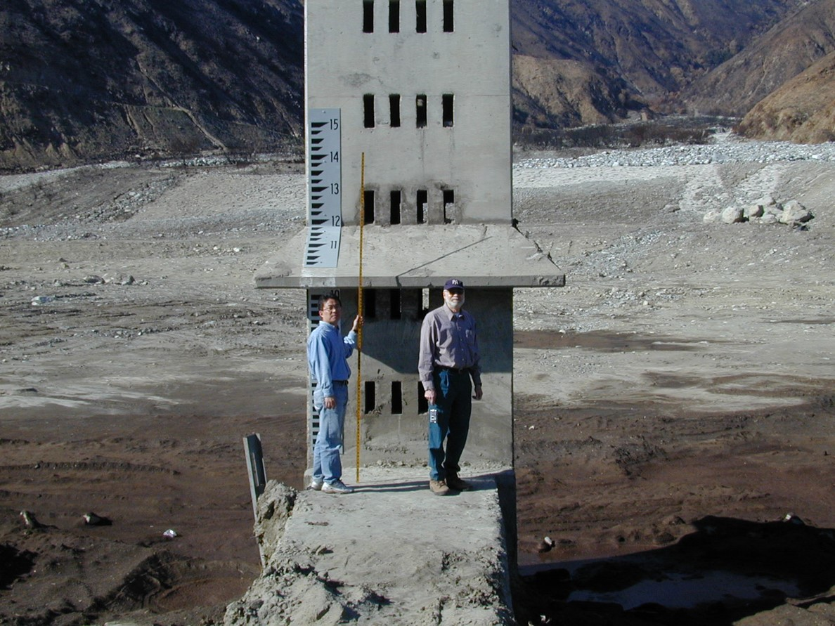
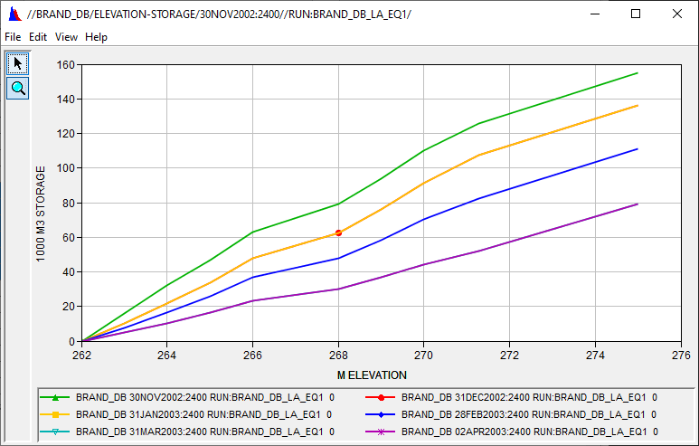


Debris Reservoir Routing Analysis
Aerial Photo for Deer Creek Debris Basin (Google Map)
Deer Creek Debris Basin: Clean-Out (210,277 yd³) Condition after 25 DEC 2003 event (0.95 in/hr)
Jay Pak, Ph.D., P.E.
Watershed Scale Sediment and Post-Fire Hydrology/Debris Flow Analysis Specialist, USACE IWR-HEC

Slide 2
overview
Fire Impacts on Debris Basin and Reservoir
Data Requirement for Reservoir Element
Reservoir Volume Reduction Process
Two Trap Efficiency Methods
Chen Sediment Trap
Brune Sediment Trap
Two Volume Reduction Options
V-Shape
Elongated Taper
Case Studies:
Brand Debris Analysis with Debris Basin
Large Reservoir Volume Reduction Analyses without Fires
Need To Improve for Reservoir Routing Analysis

Slide 3
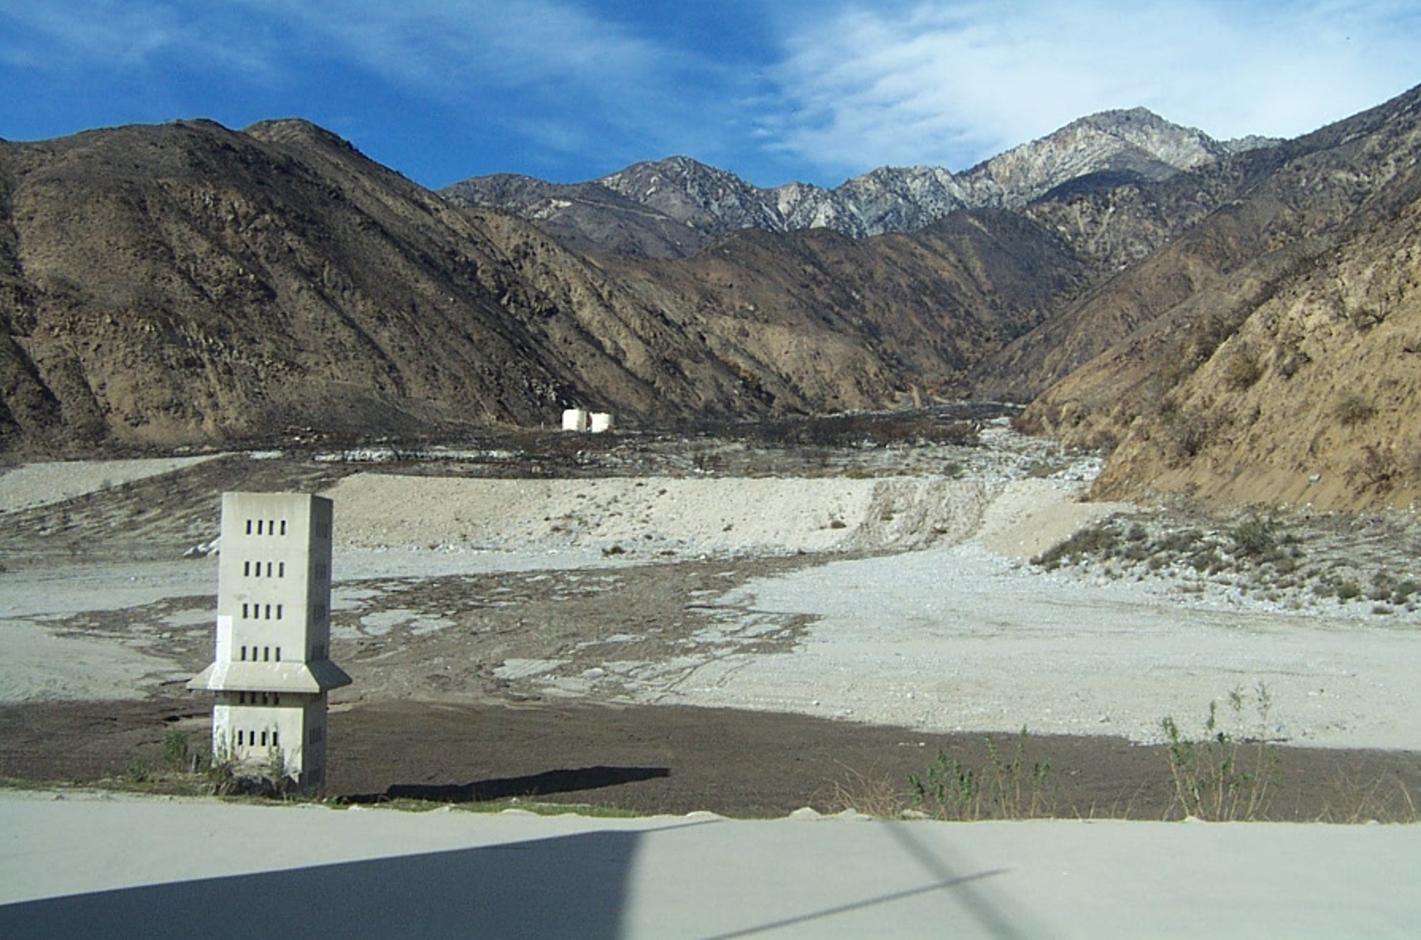
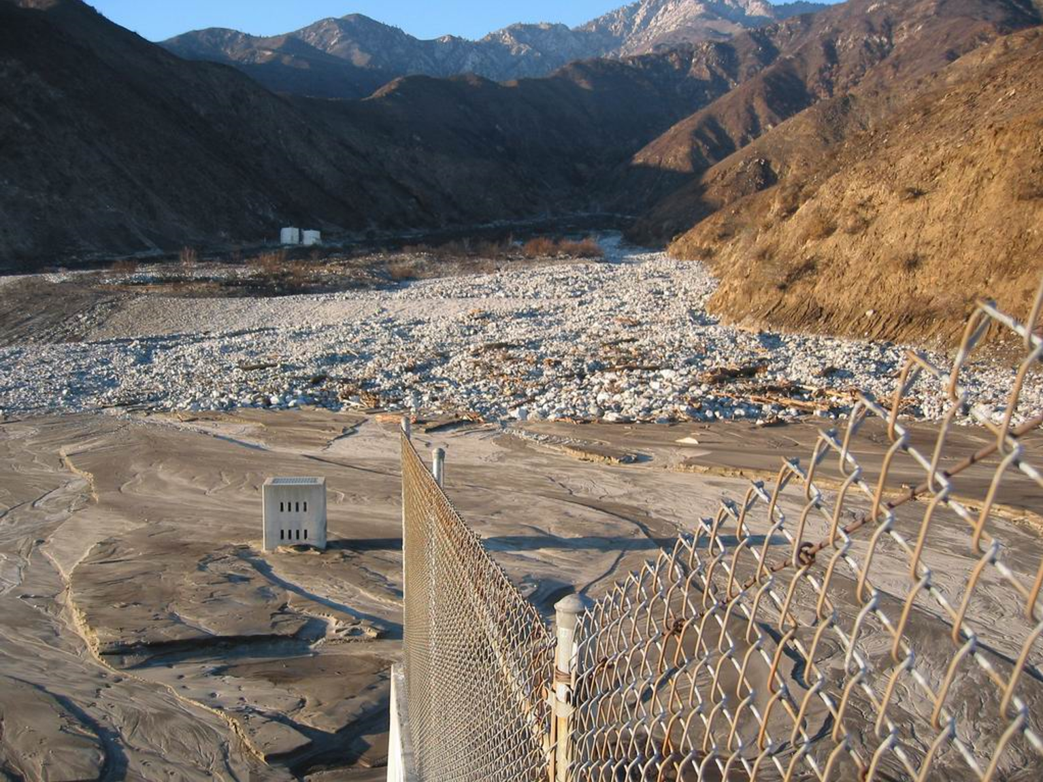
Fire impacts on debris basin and reservoir
Source: Morris and Fan (1998), Reservoir Sedimentation Handbook
Do we have the proper tools to simulate debris flow for the debris basin/reservoir (FIRO)?

Slide 4
overview
Fire Impacts on Debris Basin and Reservoir
Data Requirement for Reservoir Element
Reservoir Volume Reduction Process
Two Trap Efficiency Methods
Chen Sediment Trap
Brune Sediment Trap
Two Volume Reduction Options
V-Shape
Elongated Taper
Case Studies:
Brand Debris Analysis with Debris Basin
Large Reservoir Volume Reduction Analyses without Fires
Need To Improve for Reservoir Routing Analysis

Slide 5
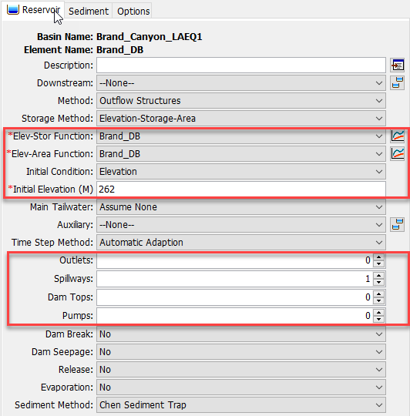
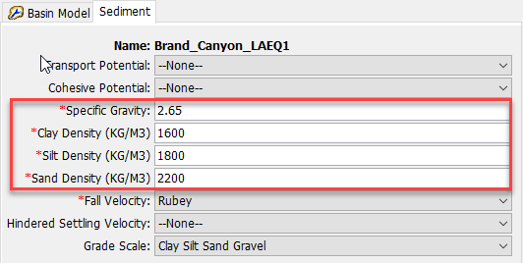
Data requirement FOR RESERVOIR ELEMENT
Soil Gradation Curve, Specific Gravity, and Density
Elevation - Storage Curve
Elevation - Area Curve
Reservoir/Debris Basin Physical Information (Spillway, Outlet Structure, etc.)
Measured Debris Yield Amount (Truck Count, Survey)/Reservoir Survey Data
Reservoir Inflow/Outflow including Sediment Data etc.

Slide 6
overview
Fire Impacts on Debris Basin and Reservoir
Data Requirement for Reservoir Element
Reservoir Volume Reduction Process
Two Trap Efficiency Methods
Chen Sediment Trap
Brune Sediment Trap
Two Volume Reduction Options
V-Shape
Elongated Taper
Case Studies:
Brand Debris Analysis with Debris Basin
Large Reservoir Volume Reduction Analyses without Fires
Need To Improve for Reservoir Routing Analysis

Slide 7
HEC-HMS Post-Fire Hydrology & Debris Flow Analysis Features
Subbasin
Subbasin Outlet
Reach
Reach Outlet
LADM EQ 1
Debris Routing
(SDR+ Muskingum)
Bulk Flow
MSDPM
Bulk Flow
USGS-LT
USGS-EA
LADM EQs 2-5
Reservoir
Reservoir Outlet
Volume Reduction
Bulk Flow
Dynamic Infiltration Loss Method (Pak & Lee)
Chen & Brune Trap Efficiency Methods
Settling Velocity (Hindered)

Slide 8
RESERVOIR sediment ROUTING PROCESSES
Watershed Outlet/Channel Outlet
Reservoir
Reservoir Outlet
Channel
Brune Sediment Trap
Volume Ratio
Fall Velocities:
Rubey
Van Rijn
Toffaleti
Report 12
Richardson and Zaki (1954)
Kumbhakar (2017)
Chen Sediment Trap
100% Sediment Trap
0% Sediment Trap
Specified Sediment Trap
Reservoir Volume Reduction (Updating E-A & E-S curves)

Slide 9
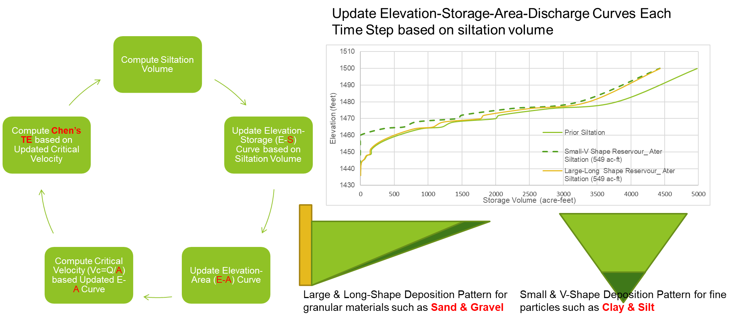
Reservoir Volume Reduction Process
Clay & Slit: Only 1-Option (V-Shape)
Sand & Gravel: 2-Optopn (V-Shape or Elongated Taper)

Slide 10
Chen’s Sediment Trap (Chen 1975)
Critical settling velocity
Trapping Efficiency
Stratified (quiescent) reservoir (upper bound)
Mixed (turbulent) reservoir (lower bound)
The settling velocity is computed using the method selected for the Basin Model.
The critical settling velocity is computed as the discharge rate (Q) from the reservoir divided by the surface area (A). The computations are performed separately for each grain size class or subclass.

Slide 11
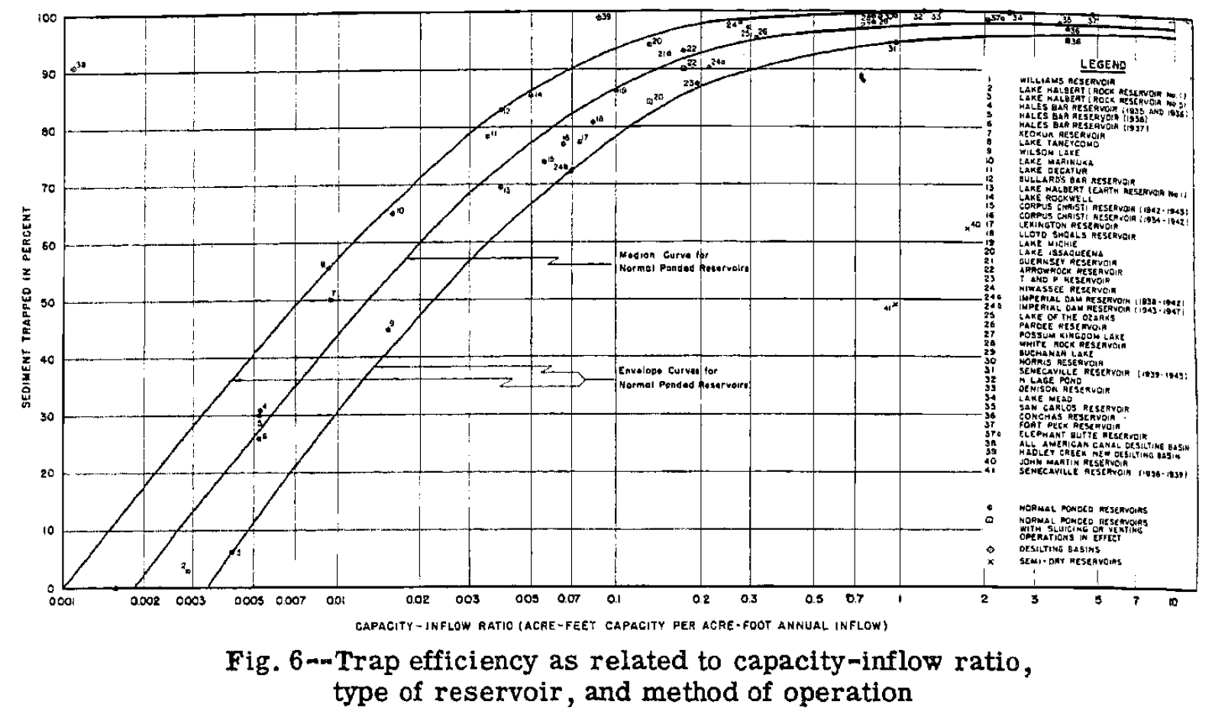

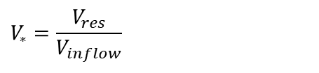
Brune’s Sediment Trap (Brune 1953)
Capacity/Annual Inflow Ratio
V_{res} = Reservoir Capacity
V_{inflow} = Annual Inflow (A user specified initial value is required)
Trapping Efficiency
a = Coefficient (Low=95, Medium=97, High=100)
b = Coefficient (Low=5.37, 6.42, High=7.71)
$$V_{∗}=\frac{V_{res}}{V_{inflow}}$$
$$TE=a\left[1−2e^{−bV_{∗}^{0.35}}\right]$$

Slide 12
Methodology
Sediment deposition
Suspended sediment
Outflow sediment

Slide 13

Reservoir volume reduction calculation process
$$Trap Efficiency \left(TE\right):by Chen or Brune Methods$$
Sediment Inflow
Clay = 200 T/d
Silt = 70 T/d
Sand = 1 T/d
Trap Efficiency (TE)
Clay = 0.7
Silt = 1
Sand = 1
Suspended Sediment =
Sediment Inflow-Sediment Deposit
Clay = 60 T/d
Silt = 0 T/d
Sand = 0 T/d
Sediment Outflow
Clay = 60 T/d
By
Volume Ratio
X
Update E-A & E-V curves for Reservoir Volume Reduction (V-Shape & Elongated Taper)
Sediment Deposit=Sediment Inflow X TE
Silt = 140 T/d
Sand = 70 T/d
Gravel = 1 T/d
Bottom Layer

Slide 14
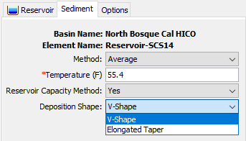
Chen Sediment Trap
The trap efficiency can be estimated by comparing the settling velocity of the sediment to a critical settling velocity (Chen, 1975).
Method: Select a Fixed Temperature or a Temperature Time-Series Gage.
Reservoir Capacity Method: the option for simulating the dynamic reservoir/debris basin volume reduction;
Yes: two deposition shape options (V-Shape and Elongated Taper) .
V-Shape update the elevation-storage curve and elevation-area curve from the reservoir bottom elevation based on the siltation volume by each grain size (Clay, Silt, Sand, and Gravel) at each time step.
Elongated Taper update the elevation-storage curve and elevation-area curve from the reservoir bottom for fine particles (Clay and Silt) and from the reservoir top elevation for the granular materials (sand and gravel) based on the siltation volume at each time step.

Slide 15
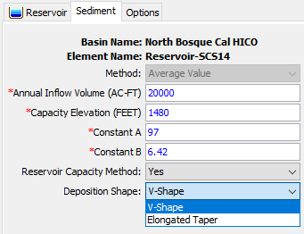
Brune Sediment Trap
Brune (1953) developed the curve with the relation between trap efficiency and reservoir capacity-annual inflow ratio (C/I).
Annual Inflow Volume: the mean annual inflow volume to the reservoir.
Capacity Elevation: the elevation of reservoir at the reservoir capacity.
Constant A: 95 to 100.
Constant B: 5.37 to 7.71.
Reservoir Capacity Method: the option for simulating the dynamic reservoir/debris basin volume reduction;
Yes: two deposition shape options (V-Shape and Elongated Taper) .
V-Shape update the elevation-storage curve and elevation-area curve from the reservoir bottom elevation based on the siltation volume by each grain size (Clay, Silt, Sand, and Gravel) at each time step.
Elongated Taper update the elevation-storage curve and elevation-area curve from the reservoir bottom for fine particles (Clay and Silt) and from the reservoir top elevation for the granular materials (sand and gravel) based on the siltation volume at each time step.

Slide 16
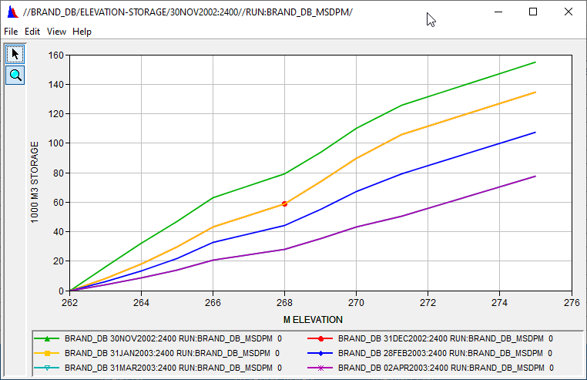
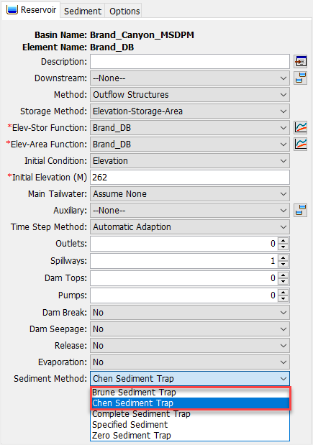
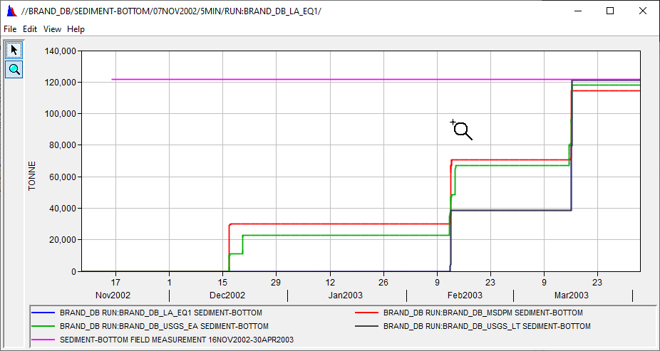
HEC-HMS GUI for two sediment trap efficiency Methods

Slide 17
overview
Fire Impacts on Debris Basin and Reservoir
Data Requirement for Reservoir Element
Reservoir Volume Reduction Process
Two Trap Efficiency Methods
Chen Sediment Trap
Brune Sediment Trap
Two Volume Reduction Options
V-Shape
Elongated Taper
Case Studies:
Brand Debris Analysis with Debris Basin
Large Reservoir Volume Reduction Analyses without Fires
Need To Improve for Reservoir Routing Analysis

Slide 18
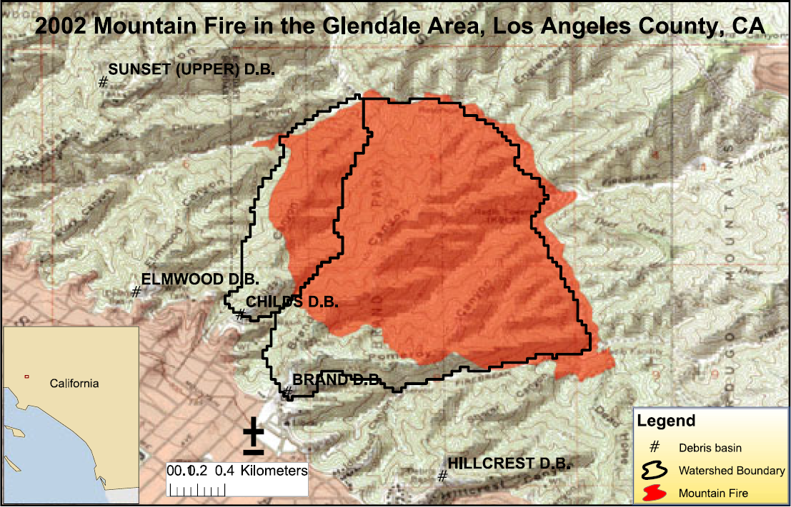

Slide 19
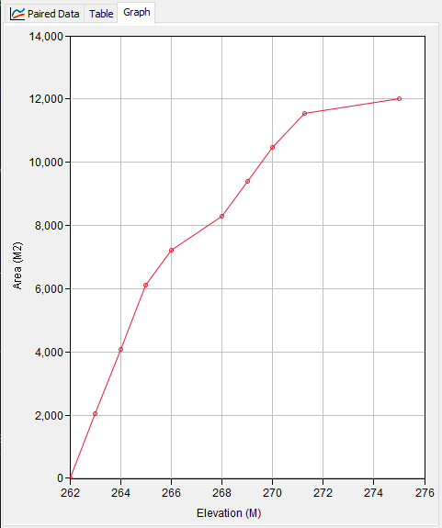
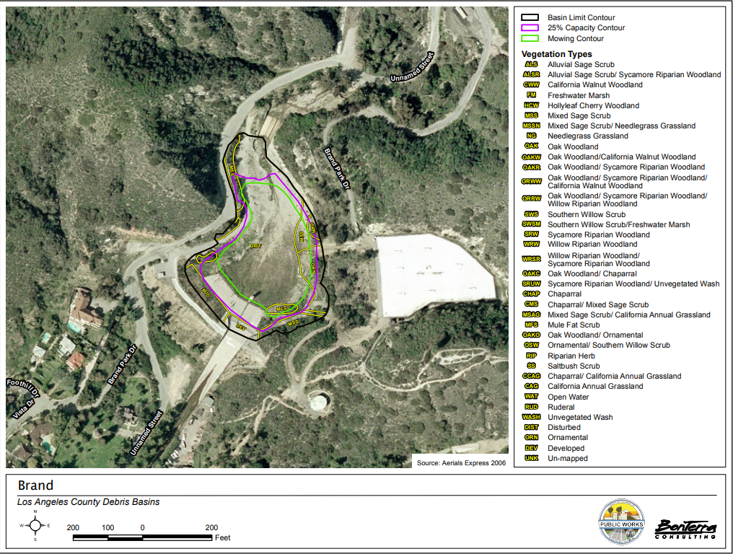
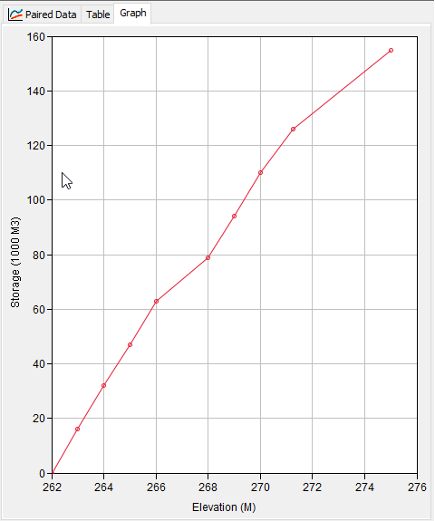
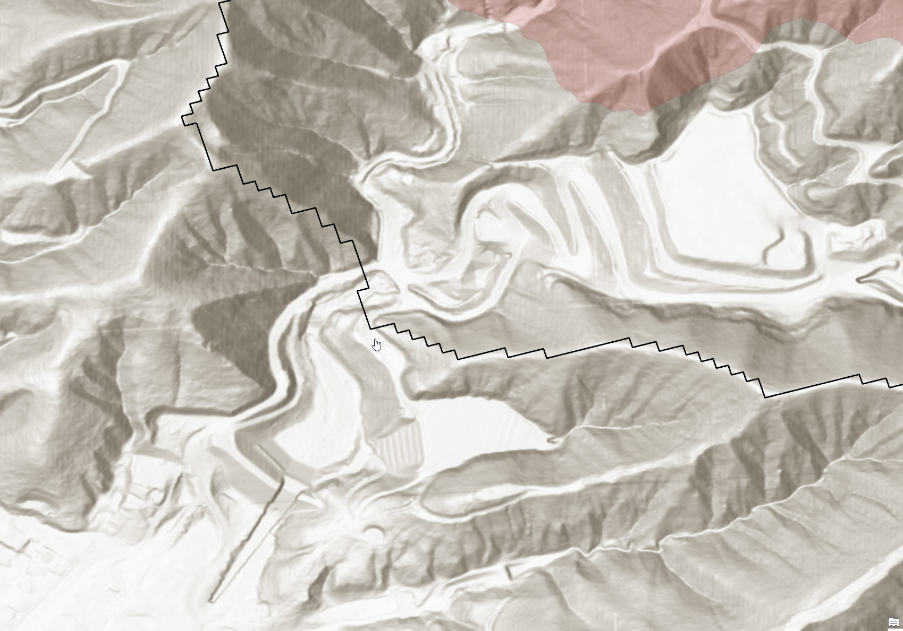
Estimation of E-A & E-S Curves

Slide 20
Summary of simulation results
Debris Yield Method | Area (km²) | A-T Factor | Relief Ratio (m/km) | Relief (m) | Fire Factor Method | Burn Date | Burn %/Burn area (km²) | Flow Rate Threshold (m³/s) | Max. 1-hr Rainfall Intensity (mm/hr) | Total Min. Rainfall Amount (mm)
LA District Method EQ 1 | 2.6263 | 1 | 216.21 | N/A | Pak & Lee Fire Factor | 02 Sep 2002 | 90% | 4.8 | N/A | N/A
MSDPM | 2.6263 | 1 | 216.21 | N/A | Pak & Lee Fire Factor | 02 Sep 2002 | 90% | 1.00 | 7.11 | 40.00
USGS EA | 2.6263 | N/A | N/A | 620.268 | N/A | N/A | 2.36367 km² | 1.75 | N/A | N/A
USGS LT | 2.6263 | N/A | N/A | 620.268 | N/A | N/A | 2.36367 km² | 4.5 | N/A | N/A

Slide 21
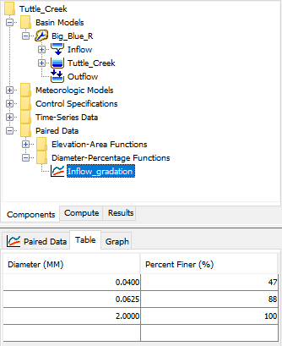
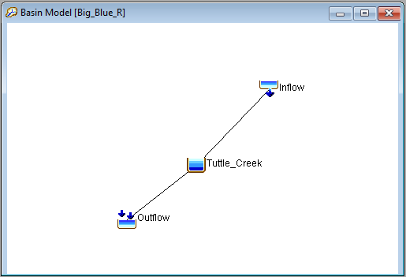
HMS Models for Large Reservoir Volume Reduction
Basin Model
Inflow element
Reservoir element
Outflow element
Inflow Element
Daily sediment loads taken from the Kansas Watershed Study
Incoming gradation from USGS measurements

Slide 22
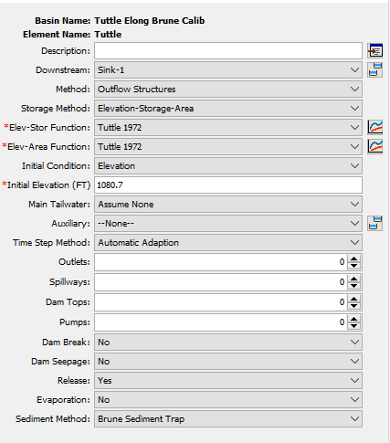
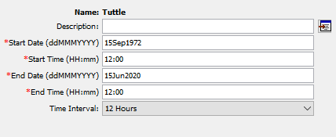
HMS Models (https://www.hec.usace.army.mil/confluence/pages/viewpage.action?pageId=51479129)
Reservoir Element
Initial elevation-storage and elevation-area tables
Trapping Efficiency: both the Brune and Chen methods tested
Deposition Shape: both the V-shape and Elongated tested
Outflow: specified release
Control Specifications
Timestep: 12 hours
Simulation period
Tuttle Creek: 1972-2020
Kanopolis: 1960-2017
Perry: 1979-2009

Slide 23
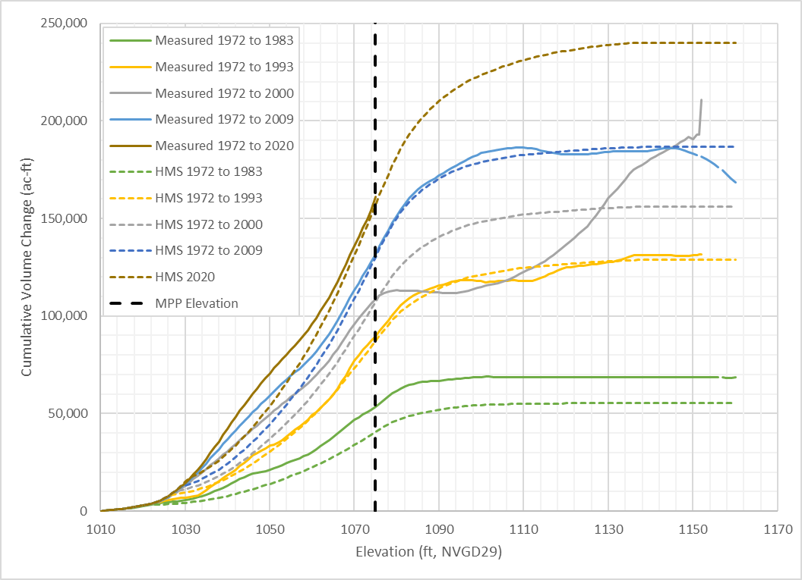
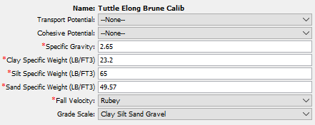
Tuttle Creek Results
Calibration Method
Shifted majority of fine and silt fraction to sand
Maintained volume balance by lowering sand and clay specific weights
Final gradation was 5% clay and 95% sand
Models further calibrated by adjusting sand specific weight
Measured data may have errors

Slide 24
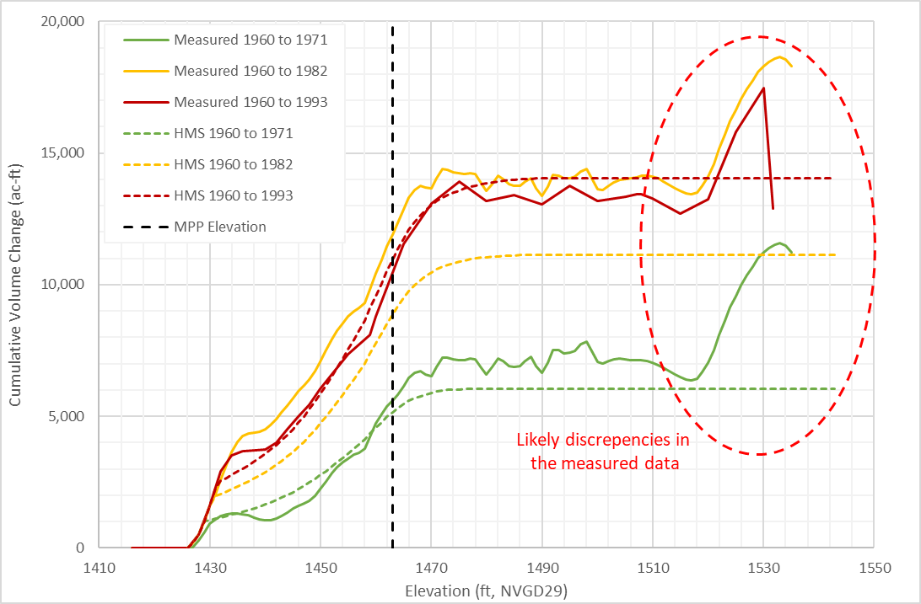
Kanopolis Results (older Surveys)
Calibration
Applied same methodology as for Tuttle Creek
Kanopolis showed more deposition at lower elevations
Final gradation was 10% clay and 90% sand.
Errors in the observed data.

Slide 25
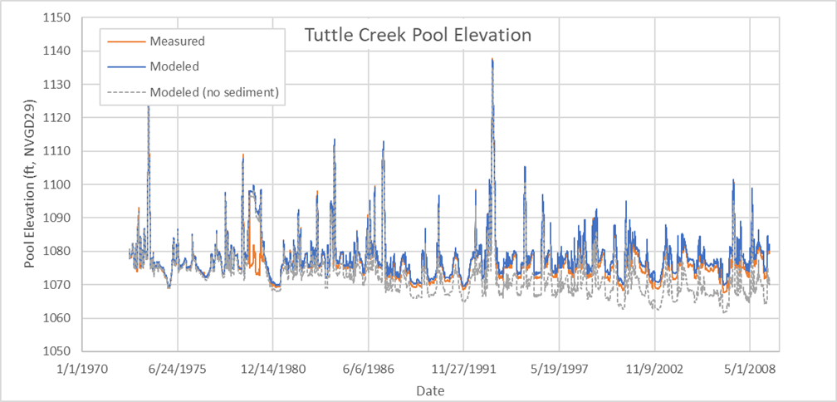
Pool Elevation
Modeled pool elevation matched well with observed
Without sediment, the model underpredicts stage by as much as 9 feet

Slide 26
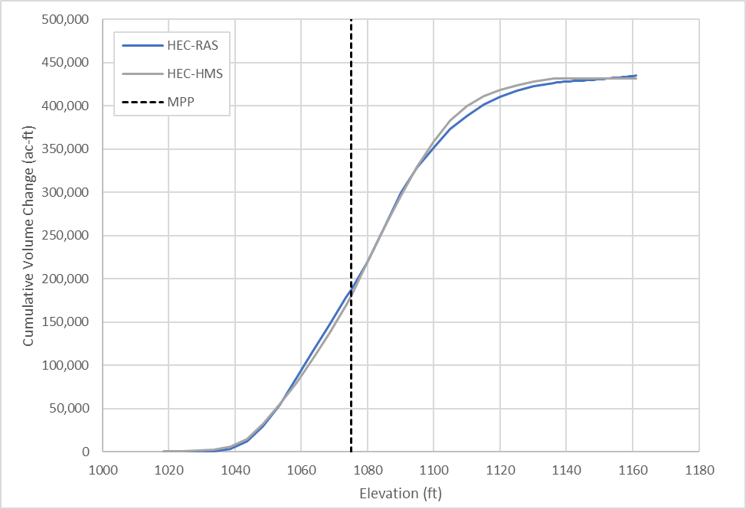
HEC-RAS Comparison
HEC-RAS Model
1D quasi-unsteady sediment
Same inputs for incoming sediment load
Calibrated to the 2009-2020 period
Comparison
Both model agreed relatively well
HEC-RAS deposits more sediment at higher elevations

Slide 27
Looking for Dataset with wildfire events: Please contact me (jay.h.pak@usace.army.mil) if you have field data.
Willow Ck Reservoir, CO
Detroit Lake, OR
Source: Morris and Fan (1998), Reservoir Sedimentation Handbook

Slide 28
overview
Fire Impacts on Debris Basin and Reservoir
Data Requirement for Reservoir Element
Reservoir Volume Reduction Process
Two Trap Efficiency Methods
Chen Sediment Trap
Brune Sediment Trap
Two Volume Reduction Options
V-Shape
Elongated Taper
Case Studies:
Brand Debris Analysis with Debris Basin
Large Reservoir Volume Reduction Analyses without Fires
Need To Improve for Reservoir Routing Analysis

Slide 29
Need to improve for Reservoir Element
New Mexico
Reservoir Shape Factor for the large and long shape Reservoir
Reservoir sediment routing analysis with the reservoir rule base option
Intake Tower Outlet Structure (without sediment outflow)
Applications of long-term sediment analysis under fire conditions for the large reservoirs
Sediment Flushing Options of Reservoirs

Slide 30
references
Morris, G.L. and Fan, J., 1998. Reservoir Sedimentation. Handbook, McGraw-Hill Book Co., New York. (https://www.engr.colostate.edu/~pierre/ce_old/classes/CE716/ResSedHandbook1_01.pdf)
Chen, C.N. 1975. Design of sediment retention basins. Proceedings of the National Symposium on Urban Hydrology and Sediment Control. 285-298.
Brune, G.M., 1953. Trap Efficiency of Reservoir. Trans. AGU, V. 34-3, 407-418 June 1953.
Richardson, J.F. and Zaki, W.N. 1954. Sedimentation and fluidisation, Part I, Trans., Inst. Chem. Engrs., 32(1), 35–53.
Kumbhakar, M. Kundu, S., Ghoshal, K. 2017. Hindered settling velocity in particle-fluid mixture: A theoretical study using Richardson and Zaki the entropy concept. J. Hydraul. Eng. 143(11): 1-8.

Slide 31
Questions and Feedback
POC: Jay Pak, jay.h.pak@usace.army.mil

