Slide 1
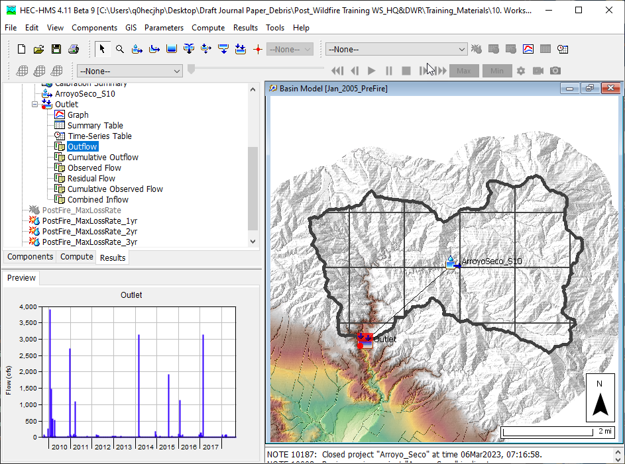
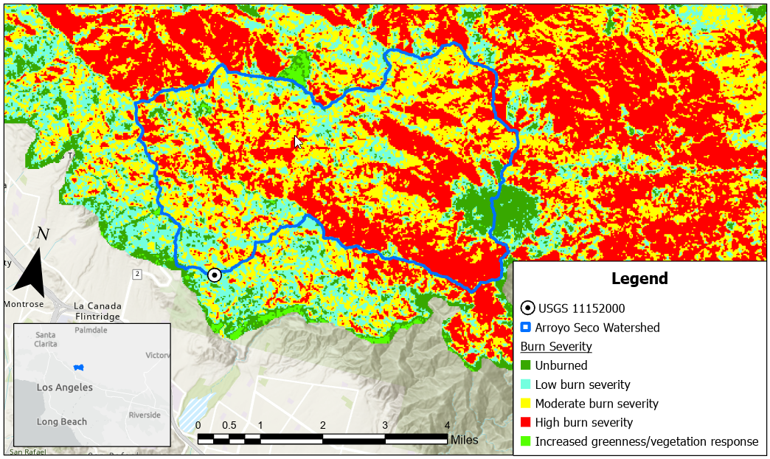


Post-wildfire hydrologic analysis
Jay Pak, Ph.D., P.E.
Watershed Scale Sediment and Post-Fire Hydrology/Debris Flow Analysis Specialist, USACE IWR-HEC

Slide 2
overview
    Challenges to the Post-Wildfire Hydrologic Analysis
    Data Requirement
    Post-Wildfire Hydrology Models (event & continuous models)
      Sigle-Event & Frequent Event Storm Models
        Static Loss Methods: SCS CN Loss Method
      Continuous Models
        Dynamic Loss Methods: Pak & Lee Decay Factor (Pak and Lee, 2008)
    Case Studies:
      Arroyo Seco Post-Wildfire Hydrology Analysis
    Need To Improve for Post-Wildfire Hydrology Analysis

Slide 3
wildFire impacts on Hydrologic cycle
The wildfire effect will decay over time (dynamic system).
WILDFIRE
Vegetation
Evaporation/Evapotranspiration
Upper Soil Layer (hydrophobic conditions, water repellency, infiltration rate, etc.)
Runoff Peak & Volume (momentum, energy, time of peak, lag, etc.)
Earth’s surface (Burn Scar, landslide, debris flow. erosion, deposition, etc.)
Water Quality (ash, sediment, drinking water resources, treatment, aquatic habitats, etc.)
Considerations for post-wildfire hydrology analysis
  Event or Continuous (Static/Dynamic Simulation)
  Flow or Flow+Sediment/Debris

Slide 4
HEC-HMS Post-Fire Hydrology & Debris Flow Analysis Features
Subbasin
Subbasin Outlet
Reach
Reach Outlet
LADM EQ 1
Debris Routing
(SDR+ Muskingum)
Bulk Flow
MSDPM
Bulk Flow
USGS-LT
USGS-EA
LADM EQs 2-5
Reservoir
Reservoir Outlet
Volume Reduction
Bulk Flow
Dynamic Surface Infiltration Loss Method (Pak & Lee) with some of existing loss methods
Chen & Brune Trap Efficiency Methods
Settling Velocity (Hindered)

Slide 5
overview
    Challenges to the Post-Wildfire Hydrologic Analysis
    Data Requirement
    Post-Wildfire Hydrology Models (event & continuous models)
      Sigle-Event & Frequent Event Storm Models
        Static Loss Methods: SCS CN Loss Method
      Continuous Models
        Dynamic Loss Methods: Pak & Lee Decay Factor (Pak and Lee, 2008)
    Case Studies:
      Arroyo Seco Post-Wildfire Hydrology Analysis
    Need To Improve for Post-Wildfire Hydrology Analysis

Slide 6
Data requirement
Rainfall Data
Evaporation Data for Long-Term Simulation
Flow Gage Data (Pre- & Post-Fire)
Soil Burn Severity Map
Soil Properties data for Pre- & Post Fire (Hydraulic Conductivity, SWR, Sorptivity, etc.)

Slide 7
overview
    Challenges to the Post-Wildfire Hydrologic Analysis
    Data Requirement
    Post-Wildfire Hydrology Models (event & continuous models)
      Sigle-Event & Frequent Event Storm Models
        Static Loss Methods: SCS CN Loss Method
      Continuous Models
        Dynamic Loss Methods: Pak & Lee Decay Factor (Pak and Lee, 2008)
    Case Studies:
      Arroyo Seco Post-Wildfire Hydrology Analysis
    Need To Improve for Post-Wildfire Hydrology Analysis

Slide 8
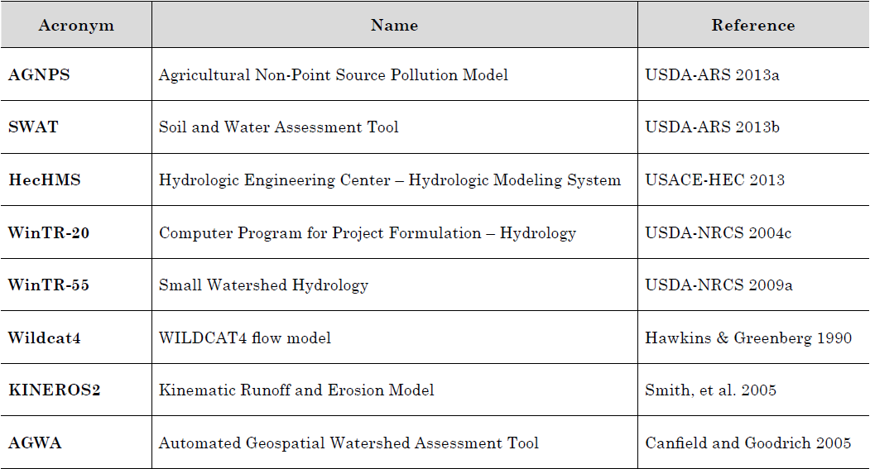
Event Post-wildfire hydrology models
Event Models
  SCS CN Method with Post-Fire CN Values
Source: Hydrologic Analyses of Post-Wildfire Conditions, USDS, NRCS, Hydrology Technical Note No.4, Aug 2016
(https://directives.sc.egov.usda.gov/OpenNonWebContent.aspx?content=39877.wba)

Slide 9
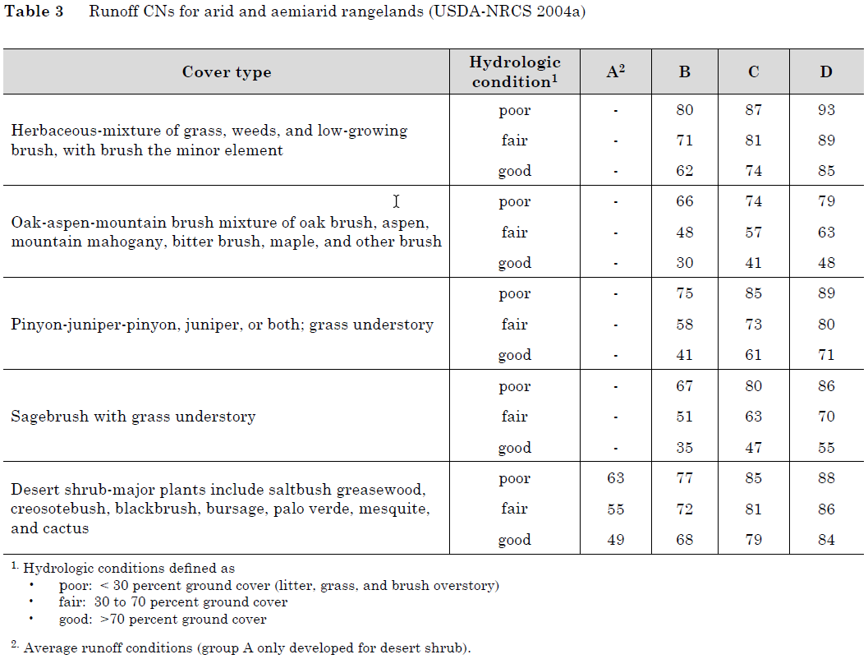
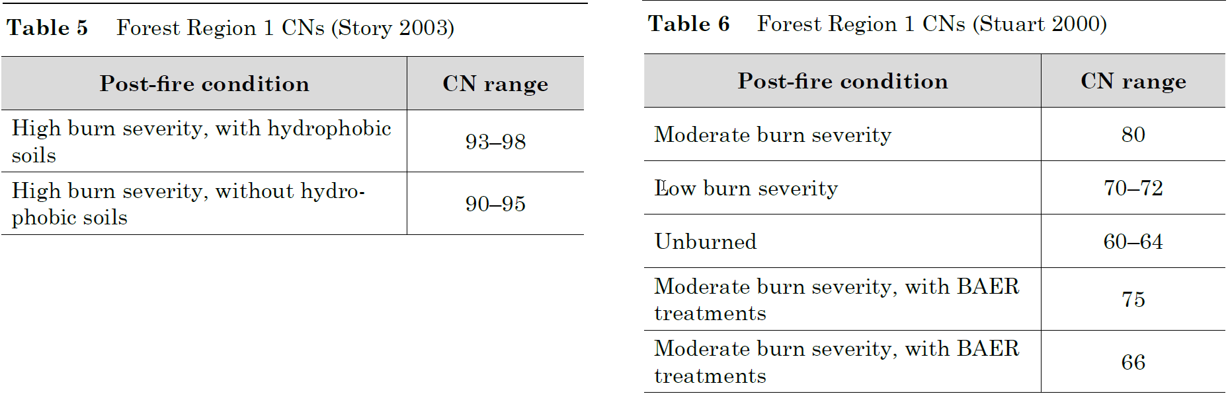
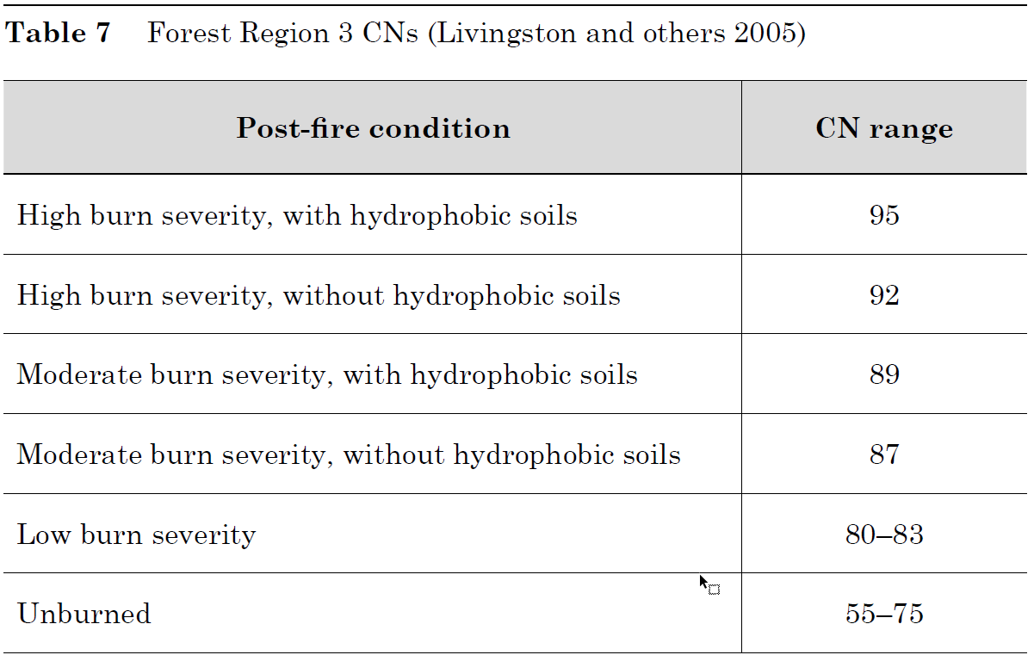
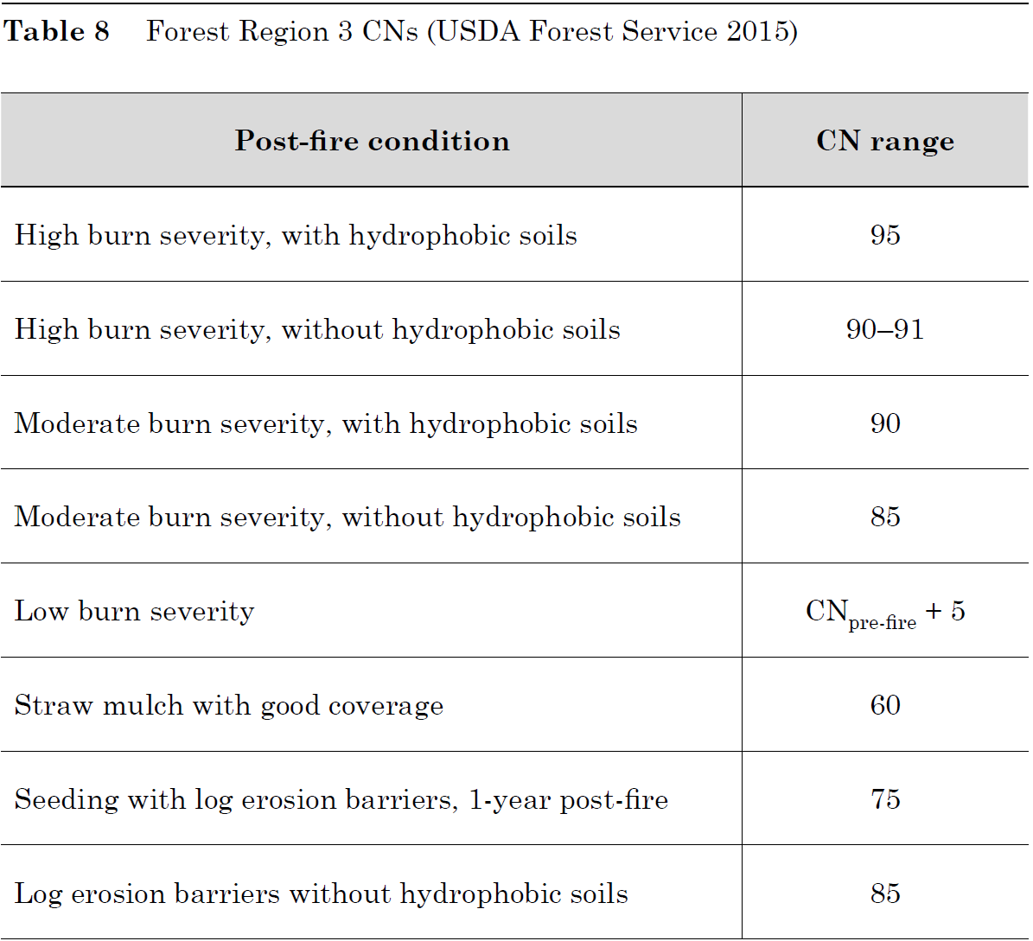
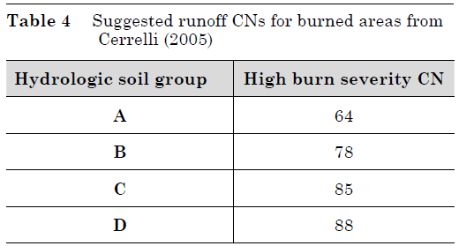
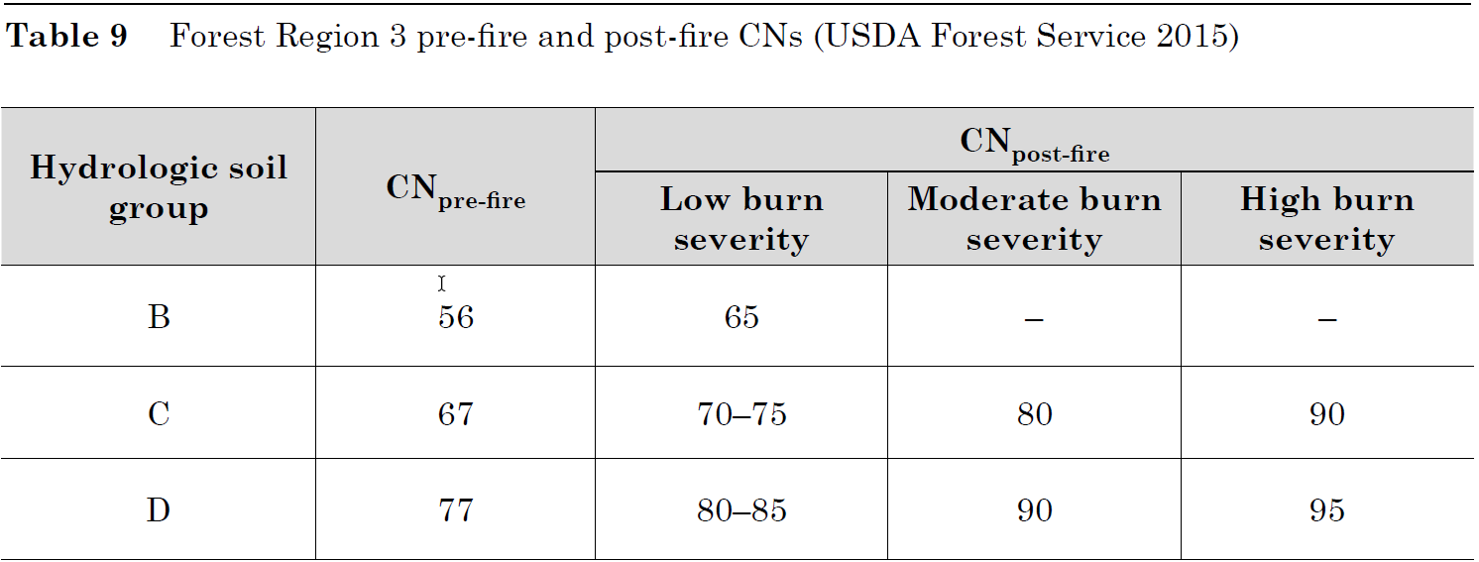
Adjustment of CN for wildfire effects
Source: Hydrologic Analyses of Post-Wildfire Conditions, USDS, NRCS, Hydrology Technical Note No.4, Aug 2016
(https://directives.sc.egov.usda.gov/OpenNonWebContent.aspx?content=39877.wba)
Notes:
Region 1: WA and OR
Region 3: AZ and NM

Slide 10
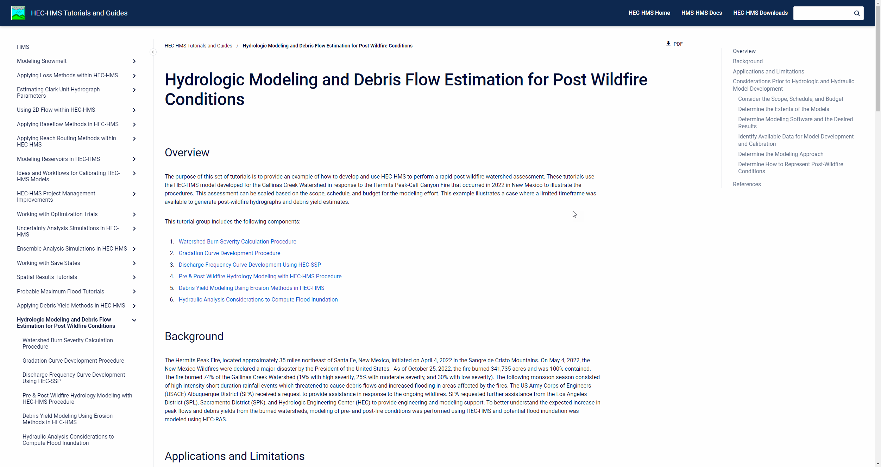
SOP with HEC-HMS
    Hydrologic Modeling and Debris Flow Estimation for Post Wildfire Conditions
Prepared by SPA, SPK, SPL, and HEC

Slide 11
Limitations of the post-wildfire
Hydrologic model
Limitations of the CN Method
  Lack of Field Data in burned catchments
  Little Research adequate to determine best-fit runoff CNs
    CN values are still not well known for burned conditions
    Spatial variability of soil-cover complexes/soil-burn severities
Limitations of the Post-Wildfire Runoff Models
  Lack or understanding the difference between pre-fire versus post-fire
    Time of Concentration
    Lag
    Velocity
    Infiltration
    Manning’s roughness coefficients, etc.
Recommendation: Use the Regional Post-Wildfire CN values if applicable.
Source: Hydrologic Analyses of Post-Wildfire Conditions, USDS, NRCS, Hydrology Technical Note No.4, Aug 2016
(https://directives.sc.egov.usda.gov/OpenNonWebContent.aspx?content=39877.wba)

Slide 12
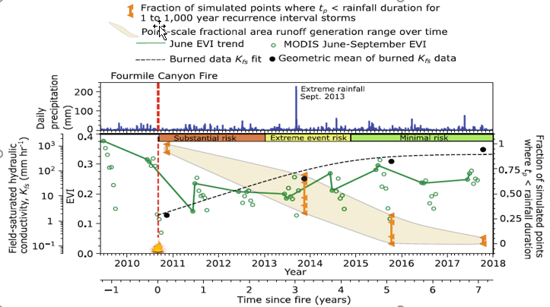
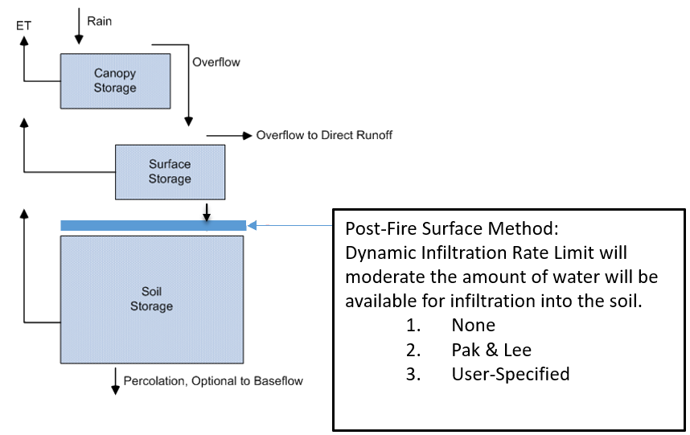
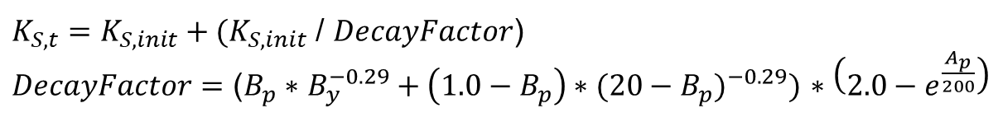
Continuous Post-wildfire hydrology models
Dynamic Infiltration Loss method (Pak & Lee) under Fire condition
$K_{S,t}=K_{S,init}+(K_{S,init}$ / $DecayFactor$)
$DecayFactor$ $=$ ($B_{p}∗$ $B_{y}^{−0.29}+{\left(1.0−B_{p}\right)∗(20−B_{p})}^{−0.29})$ $∗\left(2.0−e^{\frac{A_{p}}{200}}\right)$
Ks,t is the dynamic infiltration rate t days after the burn
Ks,init is the initial infiltration limit (i.e. the infiltration value immediately after the wildfire).
Bp is the fraction of the watershed that was burned (0≤Bp≤1)
By is the number of years since the burn date (0≤By≤10 where By is a real number), Ap is the number of antecedent effective precipitation events.
Source: (Brian A Ebel, 2020) Temporal evolution of measured and simulated infiltration following wildfire in the Colorado Front Range, USA: Shifting thresholds of runoff generation and hydrologic hazards

Slide 13
overview
    Challenges to the Post-Wildfire Hydrologic Analysis
    Data Requirement
    Post-Wildfire Hydrology Models (event & continuous models)
      Sigle-Event & Frequent Event Storm Models
        Static Loss Methods: SCS CN Loss Method
      Continuous Models
        Dynamic Loss Methods: Pak & Lee Decay Factor (Pak and Lee, 2008)
    Case Studies:
      Arroyo Seco Post-Wildfire Hydrology Analysis
    Need To Improve for Post-Wildfire Hydrology Analysis

Slide 14
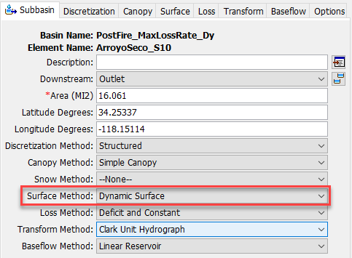
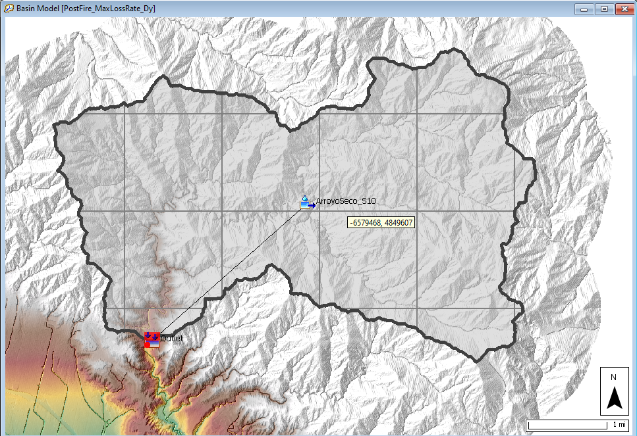
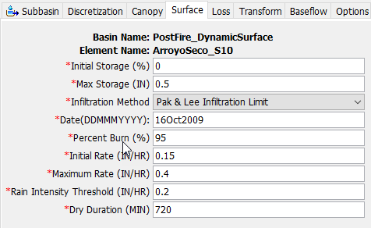
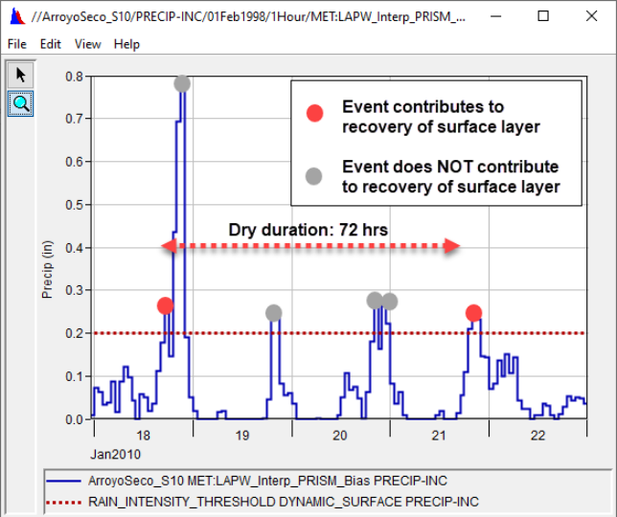
Arroyo Seco Watershed
The Initial Storage describes the percentage of the surface storage that is full of water at the beginning of the simulation.
The Max Storage represents the maximum amount of water that can be held on the soil surface before surface runoff begins.
The Max Storage is specified as an effective depth of water.
The Initial Rate is the initial loss rate of the surface layer during the first storm event after the burn.
The Maximum Rate is the loss rate that the surface layer recovers after 10 years.
The Date of Burn and Percent Burn parameters can be found from the Burned Area Emergency Response (BAER) Program and Monitoring Trends in Burn Severity (MTBS) datasets.
A tutorial demonstrating calculation of watershed burn severity can be found here: Watershed Burn Severity Calculation Procedure.
The Dry Duration describes the required time between precipitation events exceeding the Rain Intensity Threshold
that must occur for the events to contribute to the recovery of the surface layer.

Slide 15
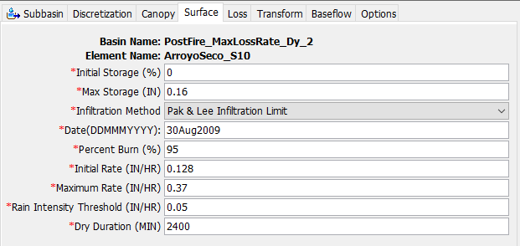
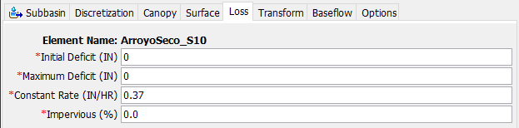
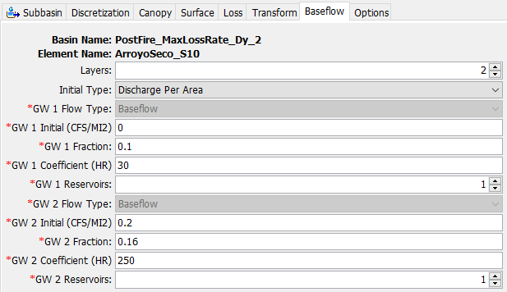
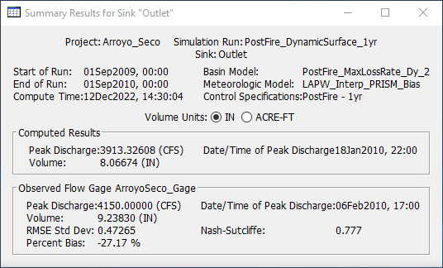
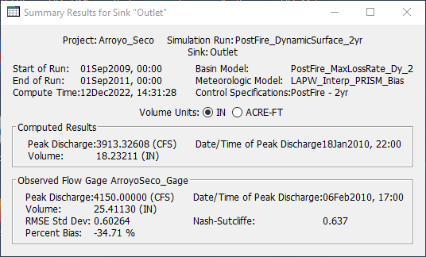
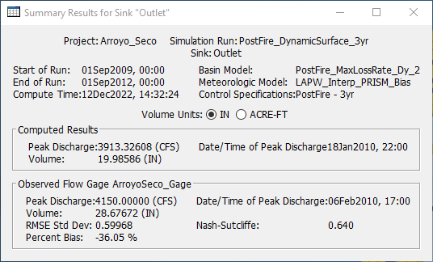
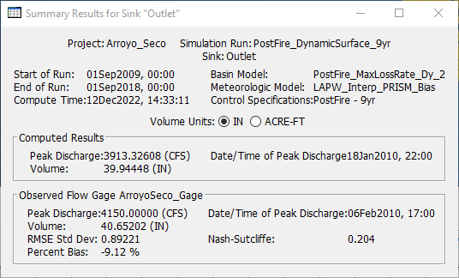
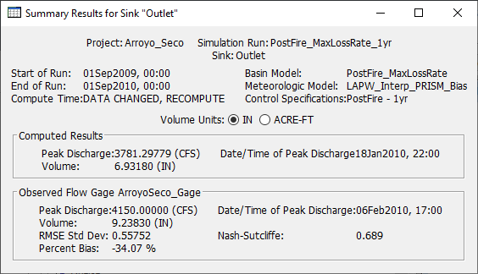

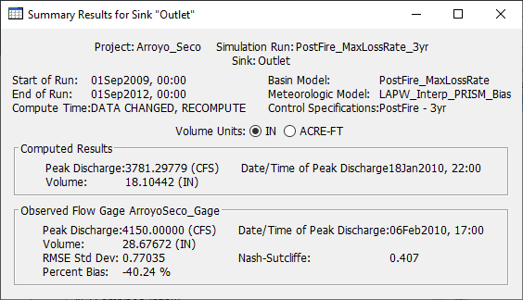
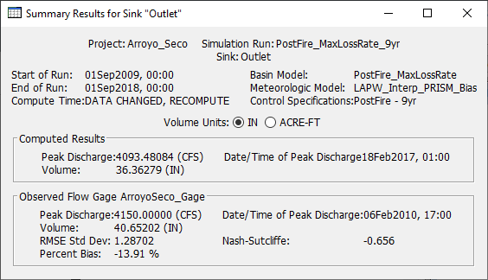
Comparison with/without Dynamic Infiltration Loss Method

Slide 16
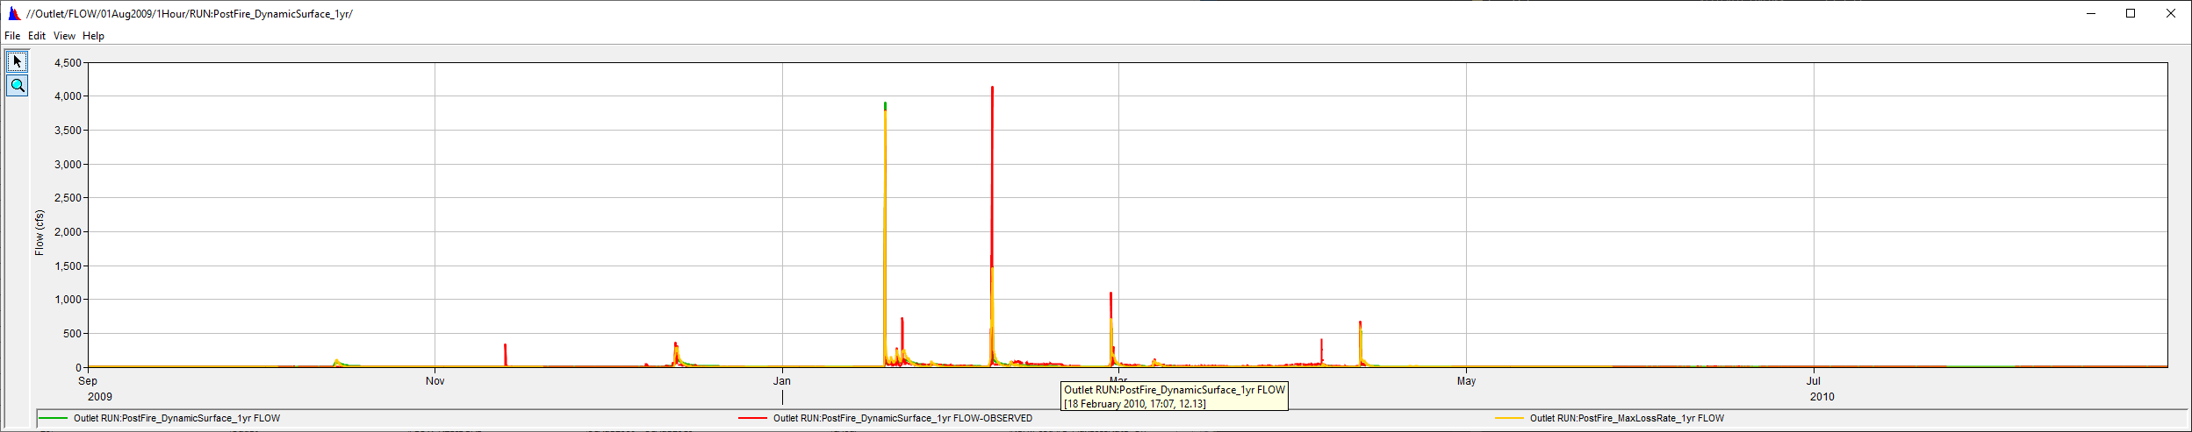
1-Year Comparison

Slide 17
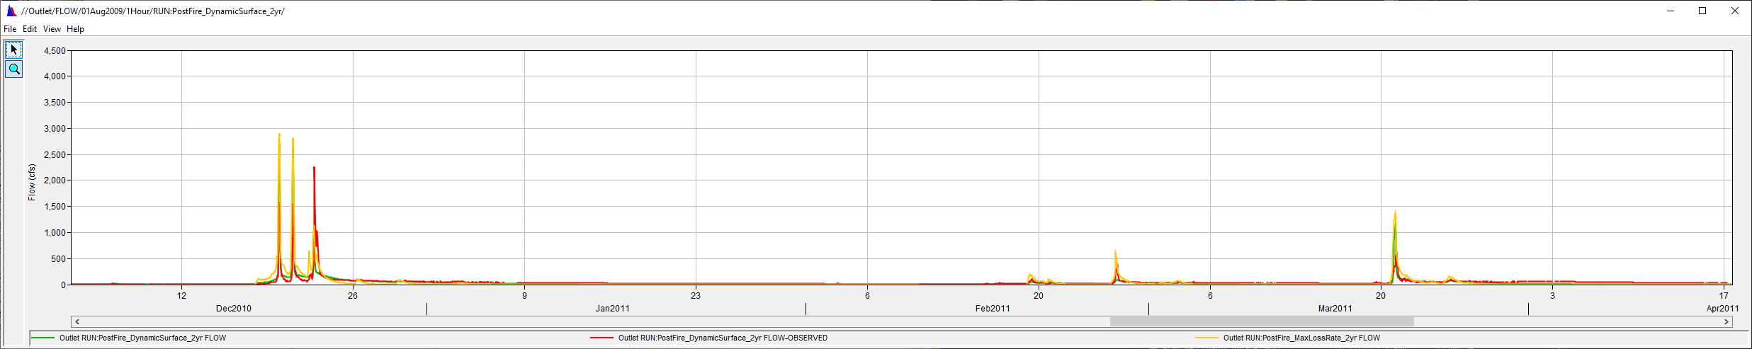
2-Year Comparison

Slide 18
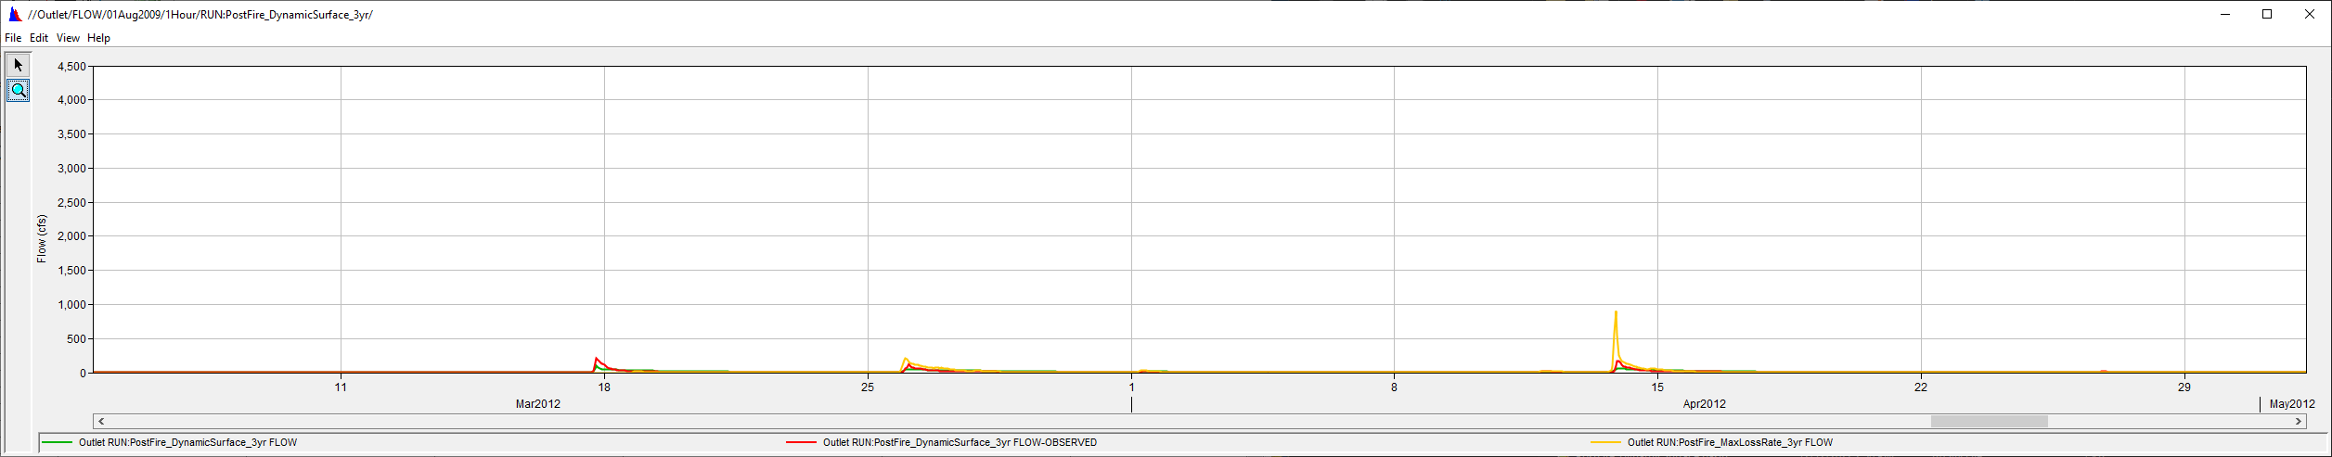
3-Year Comparison

Slide 19
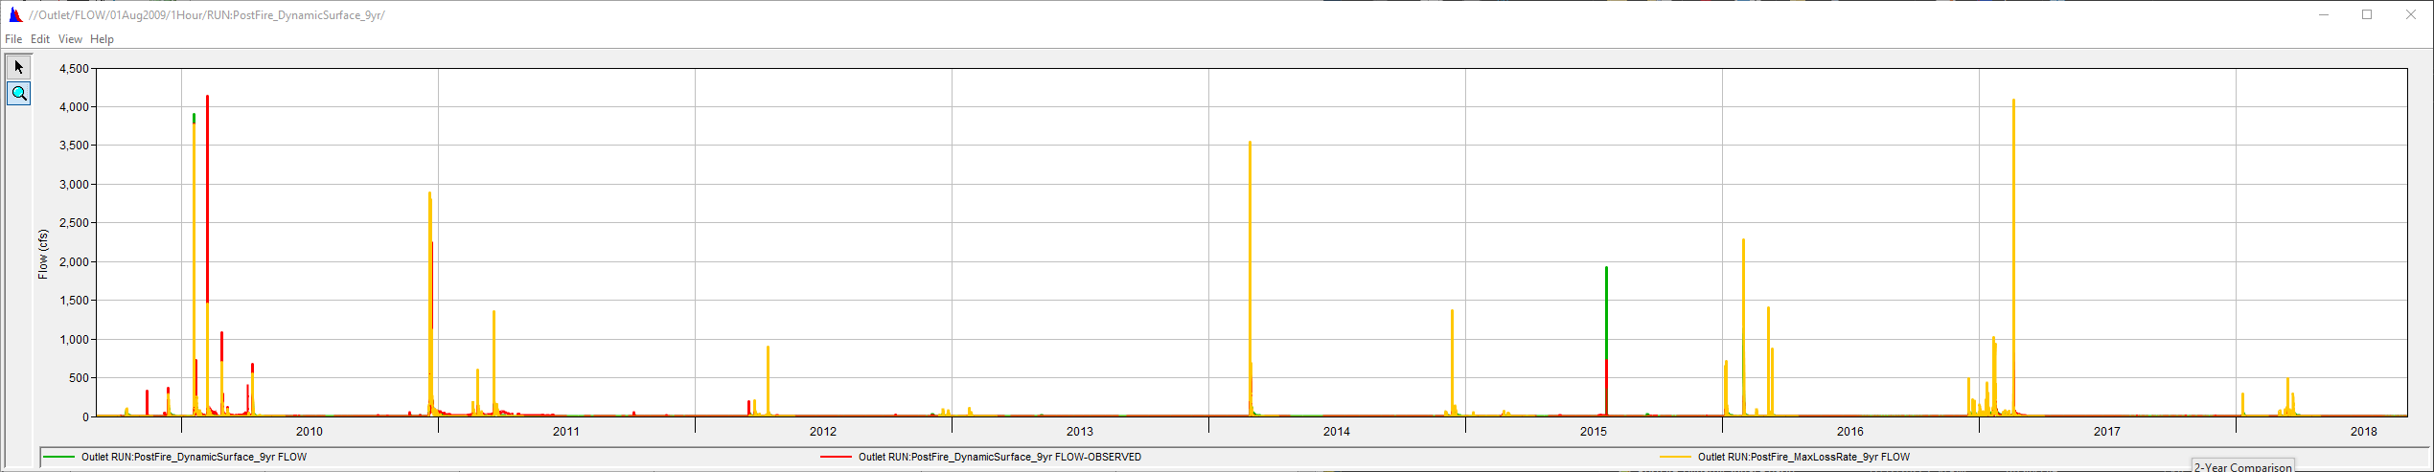
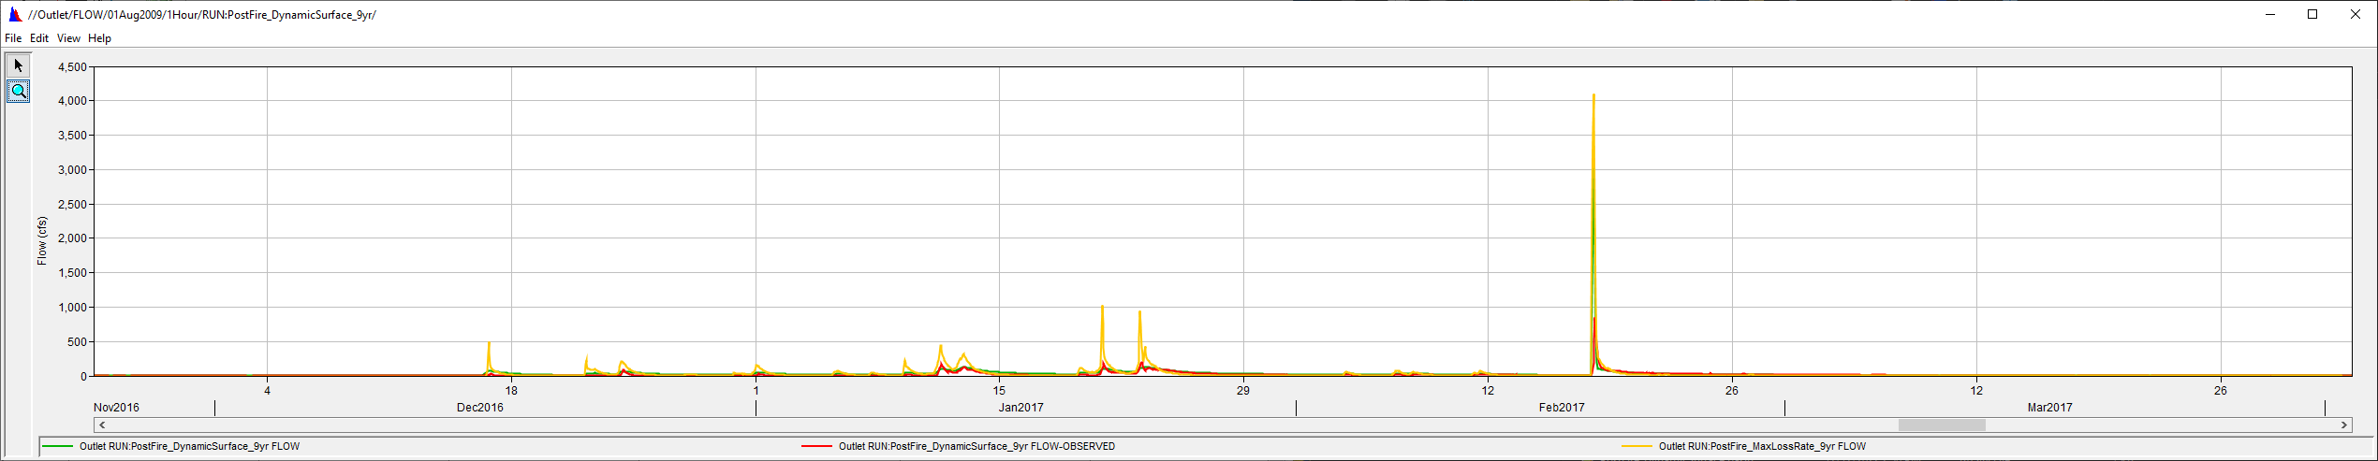
9-Year Comparison

Slide 20
overview
    Challenges to the Post-Wildfire Hydrologic Analysis
    Data Requirement
    Post-Wildfire Hydrology Models (event & continuous models)
      Sigle-Event & Frequent Event Storm Models
        Static Loss Methods: SCS CN Loss Method
      Continuous Models
        Dynamic Loss Methods: Pak & Lee Decay Factor (Pak and Lee, 2008)
    Case Studies:
      Arroyo Seco Post-Wildfire Hydrology Analysis
    Need To Improve for Post-Wildfire Hydrology Analysis

Slide 21



Need to improve for post-wildfire hydrology analysis
New Mexico
Develop a Sorptivity Modified Green & Ampt Infiltration Loss Method (Shillito and Berli, 2020) in HEC-HMS
Develop a Surface Runoff Models based on the sorptivity, because sorptivity is a direct measure of soil water repellency (SWR). (Shillito et al., 2020)
$$I=Kt+ ψ∆θln\left(1+\frac{I}{ψ∆θ}\right)$$
Using
$$I=Kt+ \frac{S^{2}}{2K}ln\left(1+\frac{I2K}{S^{2}}\right)$$
Total infil = I = 1 cm
t = measured time
$S^{2}=2KψΔθ$
(Philip, 1957)
Total infiltration = I = St^{1/2} + Kt
At short time: I = St^{1/2}
Rearranging: S = I/t^{1/2}
where
I = cumulative infiltration, K = hydraulic conductivity, ψ = the effective suction at the wetting front, Δθ= change in soil water content, S = sorptivity, and t = time

Slide 22
references
Ebel, A.E., 2020. Temporal evolution of measured and simulated infiltration following wildfire in the Colorado Front Range, USA: Shifting thresholds of runoff generation and hydrologic hazards. Journal of Hydrology 585 (2020) 124765 (https://doi.org/10.1016/j.jhydrol.2020.124765)
Hydrologic Analyses of Post-Wildfire Conditions, USDS, NRCS, Hydrology Technical Note No.4, Aug 2016 (https://directives.sc.egov.usda.gov/OpenNonWebContent.aspx?content=39877.wba)
Pak, J.H. and Lee, J.J., 2008. A Statistical Sediment Yield Prediction Model Incorporating the Effect of Fires and Subsequent Storm Events (https://onlinelibrary.wiley.com/doi/10.1111/j.1752-1688.2008.00199.x)
Philip, J. R. (1957). The theory of infiltration: 4. Sorptivity and algebraic infiltration equations. Soil science, 84(3), 257-264.
Shillito, R.M. et al., 2020.Quantifying the Effect of Subcritical Water Repellency on Sorptivity: A Physically Based Model (https://agupubs.onlinelibrary.wiley.com/doi/epdf/10.1029/2020WR027942)

Slide 23
Questions and Feedback
POC: Jay Pak, jay.h.pak@usace.army.mil

