Slide 1
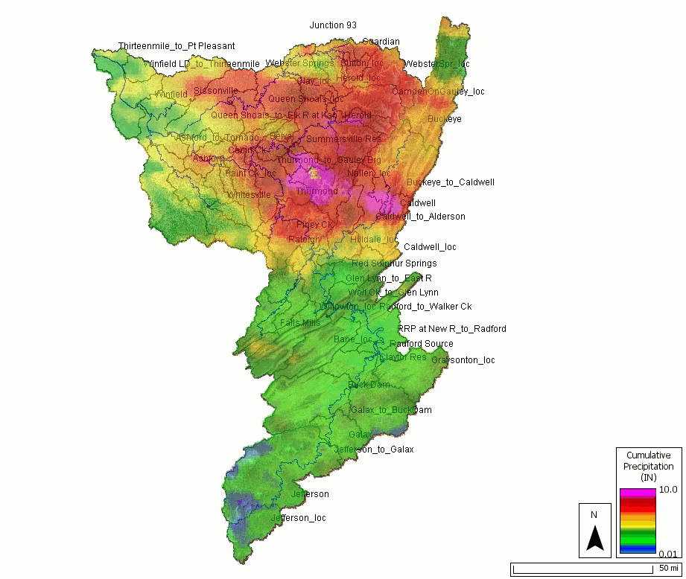
Overview of Hydrologic Modeling in HEC-HMS
Notes:
\We have been making lots of changes and updates to HMS over the past 3 years. The image here is one of the new features showing gridded rainfall in HMS so you can see how rainfall is distributed over time.
HMS is a rainfall-runoff modeling software that can perform both event based and continuous based simulations. We have methods for performing snowmelt modeling as well as handling evapotranspiration. HMS has been commonly used for estimating flows for flood risk analysis. So you will see HMS commonly used in real time operations and planning level studies.
This presentation is going to be a crash course in HEC-HMS and we’ll be presenting information that falls in both basic and advance methods and that’s because within debris yield analysis, you will need to use basic and advanced features. It can feel overwhelming but the main point of this lecture is more highlight features in HMS that are commonly used in Debris Yield analysis and resources for learning more. We are not talking about debris yield methods yet. This is to help set the stage for us to talk about debris yields estimation.
I think its important to set this expectation, there’s going to be a lot but we’ll point out the features most commonly used features in hms that can be applied to debris yield and links to resources to learn more.

Slide 2
Outline
Resources for HEC-HMS class materials
Discuss the difference between event and continuous modeling
Calibration & validation
Setting up frequency storm and hypothetical storm meteorological models
Setting up continuous simulation models
Notes:
One of the main points of this presentation is to point you guys to our online documentation. Over the past three years, we’ve really expanded our hms documentation. There’s a lot of information I won’t be able to cover in depth so I would encourage you guys to bookmark these links.
The second thing we’ll talk about is event event modeling and continuous modeling. What are the differences and what hydrologic features are important to consider when you do this type of modeling. In our debris modeling, we will be doing both event and continuous
The next topic will be on calibration and validation. In any type of hydrologic modeling, you’ll want to do some calibrating or validating to have confidence in your model
Setting up the frequency storm and hypothetical storm models. This is related to creating design storms, such as the 1% AEP or 10% AEP. A lot of emergency applications for debris flow modeling typically uses a design storm. We will have a workshop on creating a design storm in HMS.
Then lastly, we will talk about setting up a continuous model.

Slide 3
Resources to quickly create an HEC-HMS project
Basic HEC-HMS
  Delineate watershed and configure a simulation
Advanced HEC-HMS
  Continuous simulation, Frequency/Hypothetical storms, Frequency analysis, Optimization, and Uncertainty analysis
Hydrologic Modeling and Debris Flow Modeling SOP
Notes:
This page here provides links to our basic and advance hms classes. At HEC, we offer basic and advance hms class throughout the year. You have to pay to join the class but our materials and agenda are all publicly available.
Our last link is the Debris Flow Modeling SOP that was created just this year and walks you through how to perform a debris flow analysis in HMS. Our workshop will cover about 60-70% of the SOP. The SOP will touch on gradation curve development, CN adjustments, and frequency curves which we won’t be able to touch on in this class but we have this link provided for you.

Slide 4
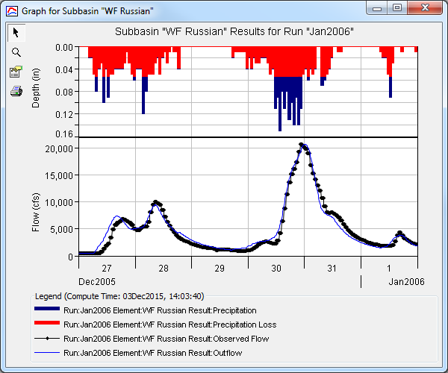
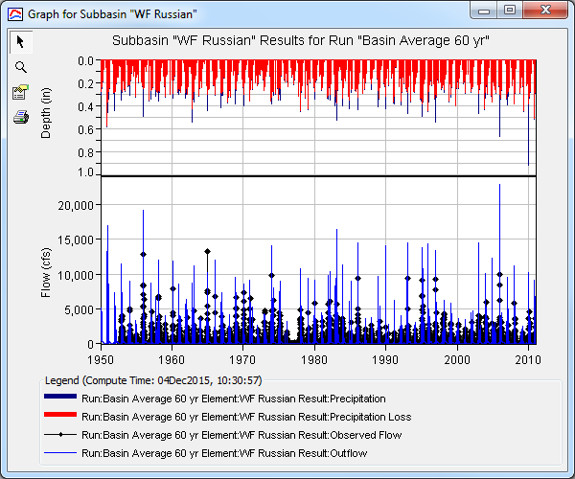
Event or Continuous modeling
An event model simulates a single storm
    Event infiltration models do not include modeling soil moisture
A continuous model simulates multiple events
    Continuous infiltration models simulate the drying processes that occur in the soil between precipitation events
    Baseflow methods are increasingly important because most of the hydrograph is defined by inter-storm flow characteristics
Notes:
An event model is a simulation that is performed for a single storm. You can have multiple rain events within a storm. In the image, you can see there’s three rainfall events all part of the same storm system. You can also think of events in time, so an event model will typically be on the order of a few hours to maybe a week.
Continuous simulation models multiple events and typically will typically be on the order of months to years in terms of time. There are hydrologic processes that become critical when you start looking at longer time scales. Infiltration is one of them, where you will have a drying processes due to evapotranspiration. Baseflow methods are also important (also the case in event modeling) but baseflow could be the dominant flow mechanism when looking at longer time periods. This could be important for water supply purposes.

Slide 5
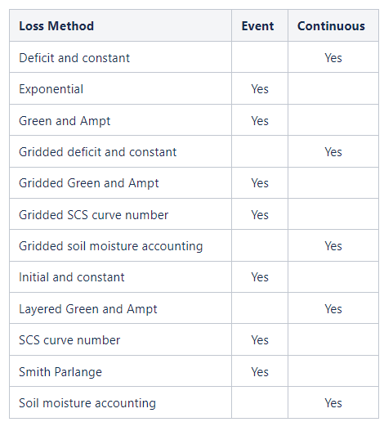
Method Selection for Event and Continuous Modeling
Baseflow Method | Event | Continuous
Bounded Recession | Yes
Constant Monthly |  | Yes
Linear Reservoir | Yes | Yes
Nonlinear Boussinesq | Yes
Recession | Yes | Yes
Notes:
Within event and continuous modeling, there are modeling methods that are more appropriate to use than others. Taking a step back, one of the unique features of HMS is we provide a variety of methods for users to select from. Other hydrologic models will tend to have prescribed methods or just a few selections while in HMS, we let you choose.
That being said, we have methods listed here that are better suited for continuous modeling and methods better suited for event modeling.

Slide 6
Calibration
“Calibration is the estimation and adjustment of model parameters and constants to improve the agreement between model output and a data set.” -Rykiel (1996)
Work from upstream to downstream
Adjust one parameter at a time
Adjust uncertain parameters (sensitivity analysis)
Look for physical evidence
Event calibration success
  Focus: peak, timing, volume for event, performance metrics
Continuous calibration
  Focus: volume, performance metrics, flow-frequency
Notes:
When developing a hydrologic model, we tend to emphasize making sure to calibrate your model.
We listed here a few guidelines for calibrating.
Working from upstream to downstream,
adjust one parameter at a time,
adjust uncertain parameters,
use physical evidence for making adjustments – looking at your soil data and land use data to inform you on how to make adjustments
careful not to adjust parameters just to receive a certain result. - the final parameters you selected make sense for the basin
With event calibration, what you use to assess success could be focusing on matching the hydrograph peak, the timing of the peak, and volume. With continuous simulation, success could be volume, looking a performance metrics, and/or flow-frequency curves.

Slide 7
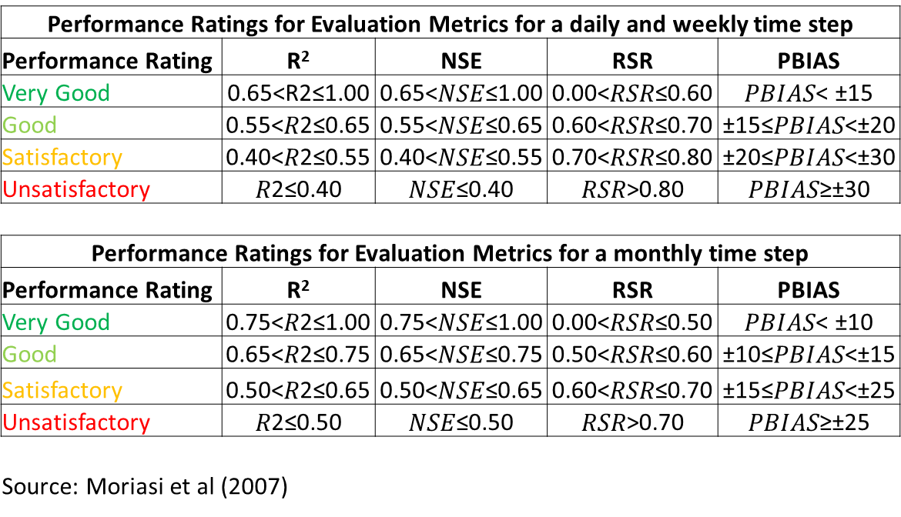
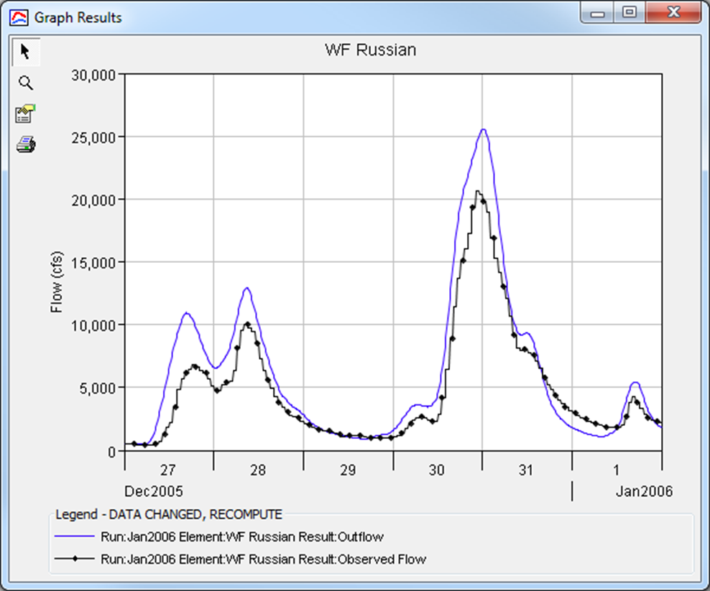

Evaluating Model Output
In general, the modeler should try to reproduce observed peaks, timing, and volume
Statistics used for model evaluation:
  Coefficient of Determination (R²)
  Nash-Sutcliffe Efficiency (NSE)
  Root Mean Square Error (RSR)
  Percent Bias (PBIAS)
Notes:
When we are evaluating model success, purely looking at how well simulated data and observed data match could lead to some subjectivity. One person can see the model results and think they nailed it while a reviewer can look at it and ask the modeler to try again. One means of removing subjectivity is using performance metrics to quantify how well a model is performing. There are 4 performance metrics that we show in HMS, R^2, NSE, RSR, and PBIAS.
These are from a paper by Moriasi 2007 that recommended looking at these metrics together to assess model performance. In the table, we have rating based off the metrics. In order for you to achieve a Very Good, you need to hit all of these metrics.

Slide 8
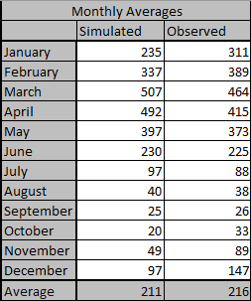

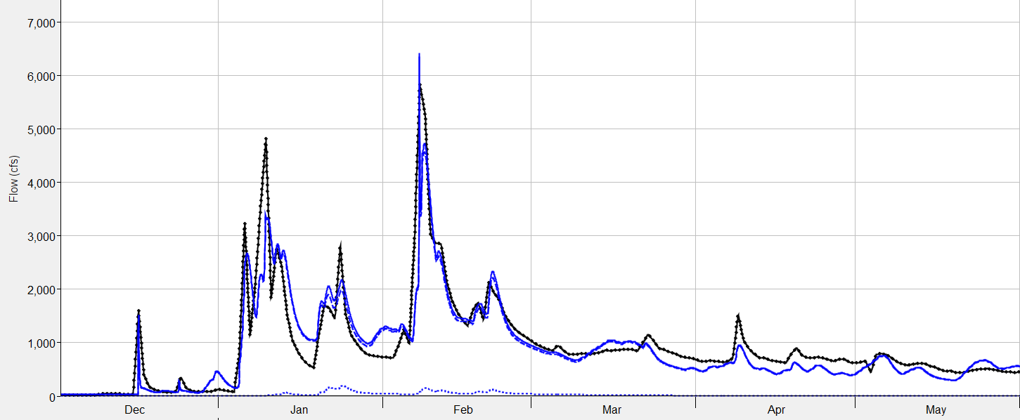
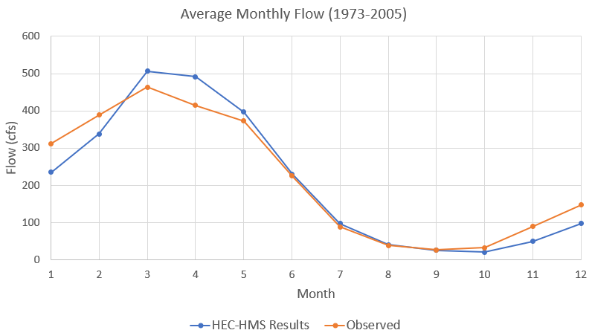
Calibration – Continuous Simulation Example
Calibration for a long-term continuous simulation:
Instead of evaluating every flood peak, look at trends
Compute monthly average metrics
  Average flow
  Average SWE
Period of record flow-frequency analysis
Notes:
Here are techniques for evaluating continuous simulation models. Because we could be simulating long periods, it can be more effective to look at trends versus every peak flow value. We call these trends runoff signatures
You can look at monthly average flow or monthly average SWE.

Slide 9
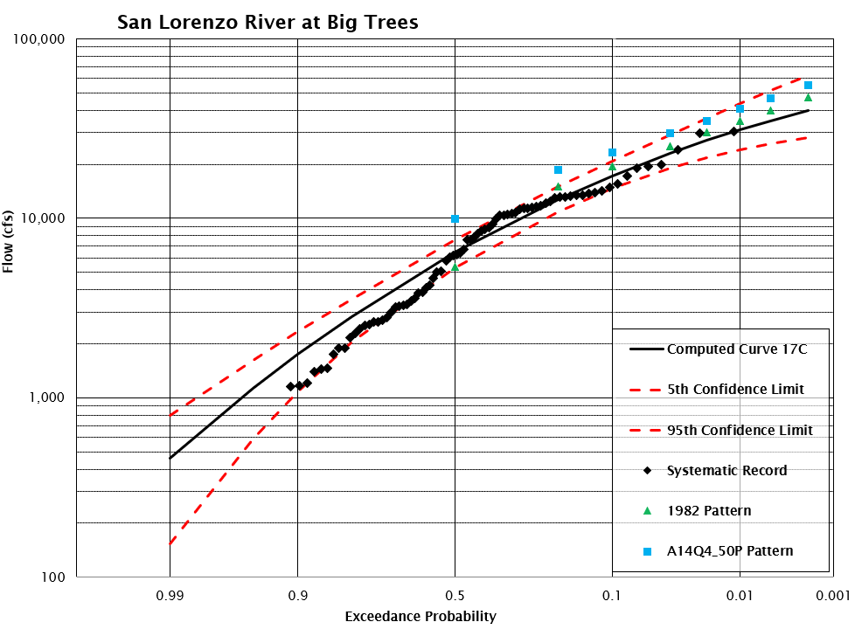
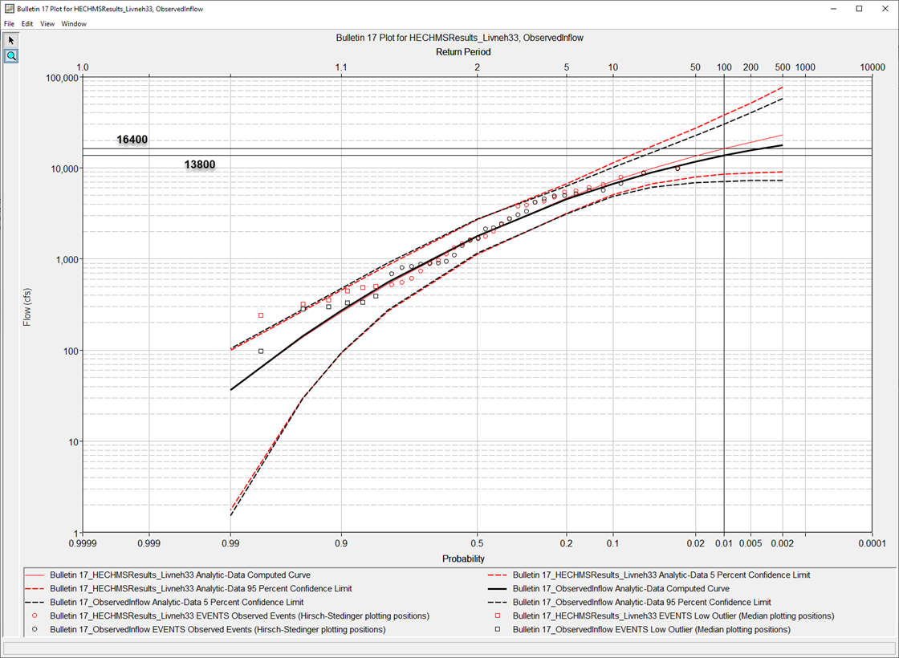
Calibration – Discrete events and continuous simulation
Annual maximum peak flows from a period-of-record simulation
Single discrete probability-based events
Notes:
Or you can compute a flow frequency curve based off your model results and compare them to your observed results (as shown on the right). Only need to match the maximum annual flow values rather than every peak value.
The figure to the left is showing how you can “calibrate” to a frequency curve using event modeling. This is where you would create a design storm, such as the 1% AEP, assume your 1% AEP equals your 1% AEP flow, and adjust your model parameters until they match.

Slide 10
Validation
“(Validation is) when a model that has been calibrated for one data set is evaluated against a different data set of the same variables, at the same site as used in the calibration (the classical ‘split-record test’).” –Bevan and Young (2003)
Validation events or period should of same or similar duration with similar behavior to calibration period (e.g. wet/dry cycles)
Boundary conditions will change, model parameters will remain unchanged from calibrated model (except for initial condition, initial conditions are event specific!)
Evaluate performance metrics in the same way as calibration
If validation fails, go back to calibration – reconsider processes and parameterization
Notes:
We typically recommend you calibrate to 3 events if you’re doing event modeling. Then validate to at least 2 events. Validation is where after you’ve calibrated, you simulate another storm with the calibrated model parameters and you are not making any more tweaks. You are checking your modeled parameters against another storm to see if your parameters can consistently give you reliable results.
Validation events should be of he same or similar duration and behavior. If you calibrated to a thunderstorm event and applied 3 day rainfall as your validation, you shouldn’t expect the model to perform well
Initial conditions are event specific. From our perspective, you can change your initial conditions such as initial soil state or initial reservoir state. But the model parameters that describe the hydrograph formation should not change.
You should evaluate the performance of your validation. You should set up the success criteria BEFORE validating. Its cheating if you set it up after.
Lastly, if your validation fails, go back to your mode parameters and see if there are changes you could make.

Slide 11
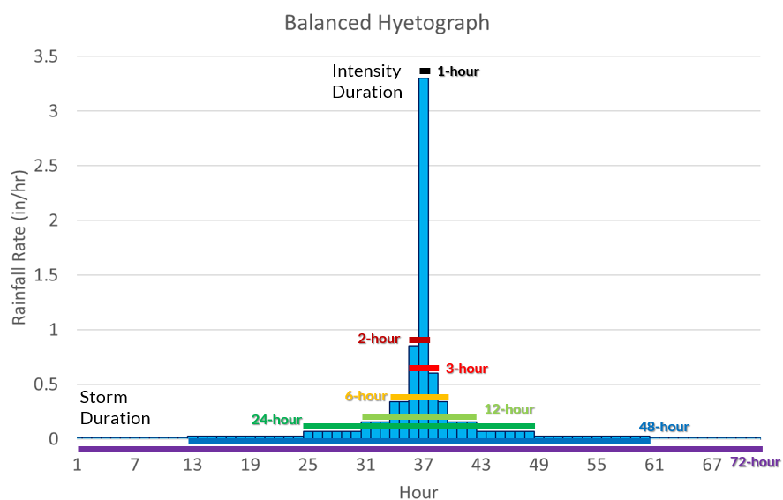
Frequency Storm Method
Design storms have been used in debris flow emergency operations to assess potential flood risks
Creates a synthetic storm where all durations use the same frequency depth
      1-hour, 6-hour, 12-hour, 1-day, 2-day, etc. all have same frequency
    Precipitation depths are nested
    Probability of rainfall equals probability of flow - “AEP neutral”
Storm area is critical
“Nested Storm”
Notes:
We’ll be going over two methods in HMS that give you the ability to create design storms. Design storms are synthetic storms (made up storm) where you decide what the temporal distribution, the storm duration, and the rainfall depths.
In debris flow emergency operations, we’ve seen users create some type of design storm to determine potential flood damage. The case that I’ve seen is the 50%, 10% AEP and they generate flood plains maps based on those rainfall events.
The first method we have is the frequency storm. The frequency storm creates a storm where all durations use the same frequency depth. That means if you are creating a 1% AEP 72 hour storm duration, the 1-hr depth, 3-hr depth, 6-hr depths all come from the 1% frequency depth. You sometimes hear the term nested storm.
You assume that the probability of your rainfall is the probability of your flow, so the 1% AEP rain produces the 1% AEP flow.
Precipitation depths are nested, meaning your 6-hr depth holds the 3-hr and 1-hr depths.
Your storm area is very important to determine areal reduction.

Slide 12
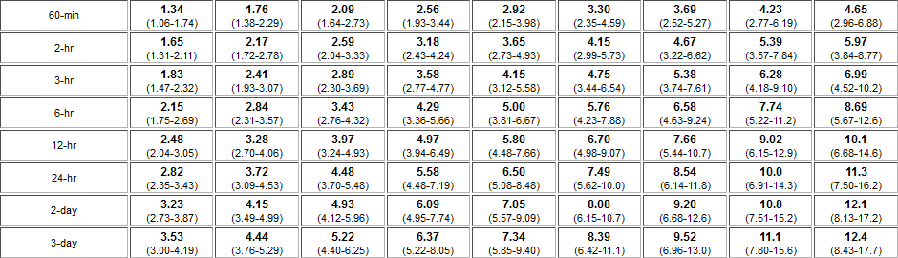
Frequency Storm Data
Intensity Duration
Storm Duration
Multiple durations and depths
Notes:
To obtain the depths for the frequency storm method, we go to NOAA Atlas 14, click on the state you’re interested in, then find the location to get your depths.

Slide 13
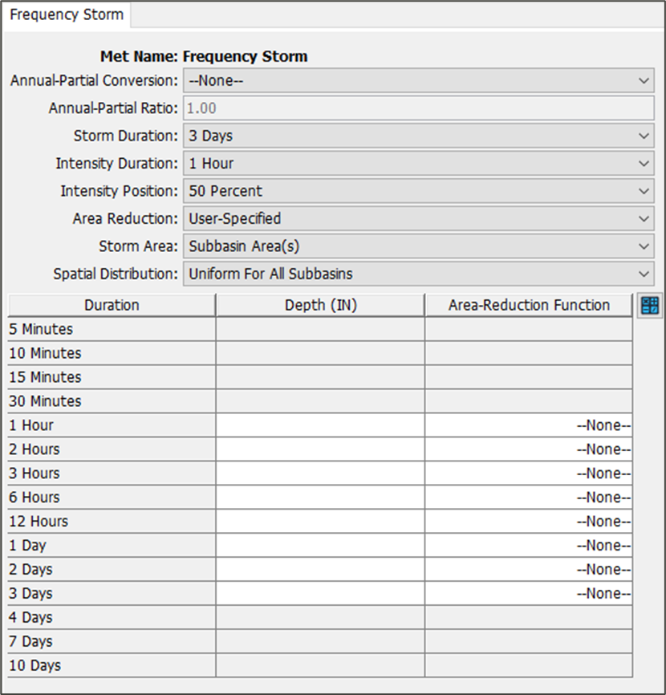
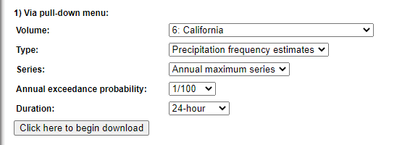
Frequency Storm Key Settings
Storm duration→ total storm duration
Intensity duration→ shortest precipitation increment
Intensity position→ timing of peak precipitation
Area reduction→ point-to-area reduction method
Storm area→ determines area reduction
Spatial distribution→ equal or variable depths
Depth-Duration Data – Atlas 14 for most of U.S.
https://hdsc.nws.noaa.gov/hdsc/pfds/pfds_gis.html
Calculator
Don’t use the Annual-Partial conversion setting unless it’s for a legacy project!
Notes:
Some terminology when setting up this method.
Storm duration refers to the total storm duration so how long the storm is
Intensity Duration refers to the shortest precipitation increment. We allow you to enter depths as short as 5 minutes to 6 hrs
Intensity Position refers to the timing of the peak precipitation. We give you a couple of options on where to place the highest precipitation depth. 50% places the highest depth in the middle
Area reduction refers to the point to area reduction method. In the past, we only had TP 40 as the reduction method. We now give a user specified option.
Spatial distribution refers to how you want to vary the depths. We give a equal or variable depths options. Equal means for your entire watershed, you give it just one set of depths. For variable, you can assign different depths for each subbasin. The variable option is more detailed and more appropriate if you have a large watershed with large changes in precipitation. This is very common in California with the orographic effects of terrain. Fortunately, we have this calculator option that lets you process gridded precipitation-frequency depths and computes the basin average depths for you. In your workshop, you will get a chance to use this button.

Slide 14
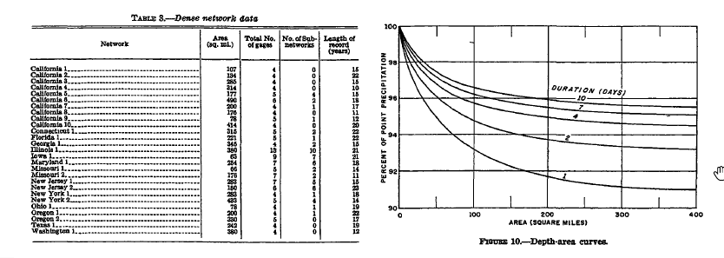
Depth Area Reduction
TP 29 (precursor for TP 40) was based on a limited dataset using several rain gage networks with short record lengths.
NOAA mentioned updates to depth-area reduction information for some time now.
Notes:
The depths you get from NOAA Atlas 14 are point depths. It’s not an area depth. Depth area reduction reduces your point rainfall depths you get from NOAA atlas 14 based on a given area, typically your watershed area. To properly apply frequency estimate from NOAA atlas 14, you need to apply areal reduction factors to go from a point depth to an areal depth. The most commonly used areal reduction factors are from TP-29. At this time, with respects to any national reduction factors, TP-29 is what is currently available. NOAA has been saying they will be updating TP-40 at some point but its not clear when this will happen.
For a typical storm composition, we tend to have a small area with high intense rainfall. Moving further away from the intense rainfall, you could still have intense rainfall but less than the center. As you move further away from the center of the storm, your rainfall intensity decreases. Areal reduction was designed to reduce AEP point depths to reflect the reduction in depth as you increase in your area.

Slide 15
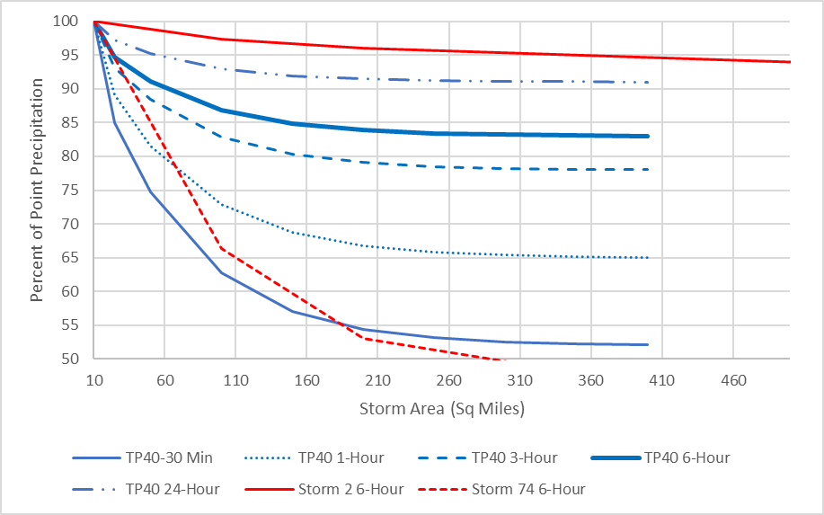
Depth Area Reduction
Additional precipitation data and additional data collection options (radar) allow modelers to create site specific depth area reduction information
Variability in Area-Reduced Precipitation for 1-inch over 200 square miles:
TP-40 – 0.84 inches
Storm 2 – 0.96 inches
Storm 74 – 0.53 inches
Notes:
With radar data, its easier to create your own site specific area reduction curves for storms. You may be inclined to go with TP-40 which is what’s been used for the past 60 years but you can see there’s quite a bit of variability whether you choose TP-40 versus other storms.
If you are able to get newer reduction curves, we give you the option to add those into HMS.

Slide 16
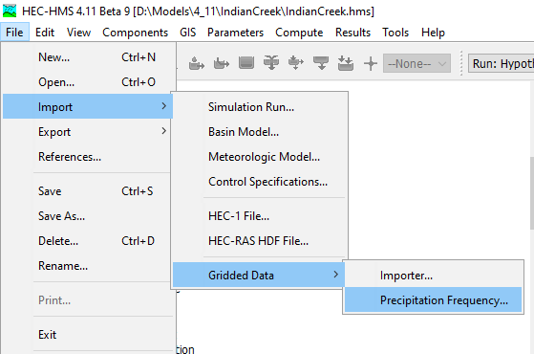
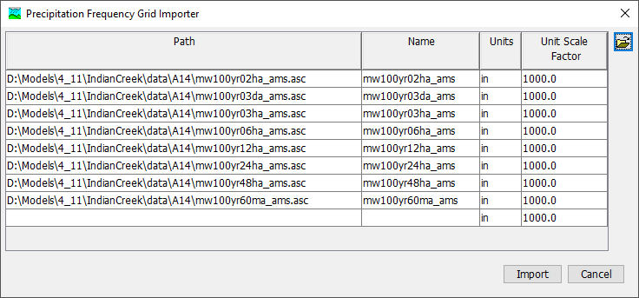
Importing Precipitation Frequency Data
Manually download Atlas 14 precipitation frequency grids to your computer
Use the HEC-HMS Precipitation Frequency Grid Importer to import the grids into your project
  Set the name, units, and scale factor
  HEC-HMS will create grid objects that can be used in both the Frequency Storm and Hypothetical Storm models
Notes:
In the past, for you to perform design storms, you would need to download NOAA grids and go to a different GIS software to calculated AEP depths. We’ve made that process much simpler now so you no longer need to go to ArcMap or QGIS.
You can bring these grids in their native format.

Slide 17
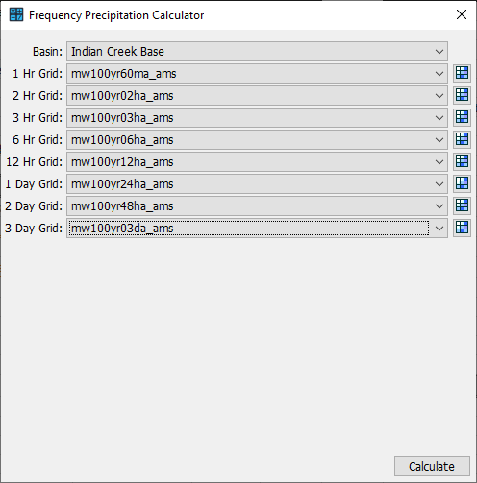
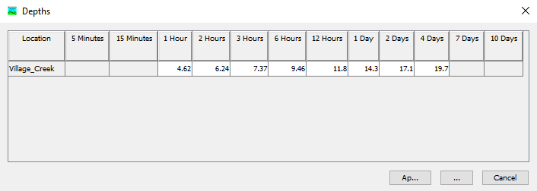
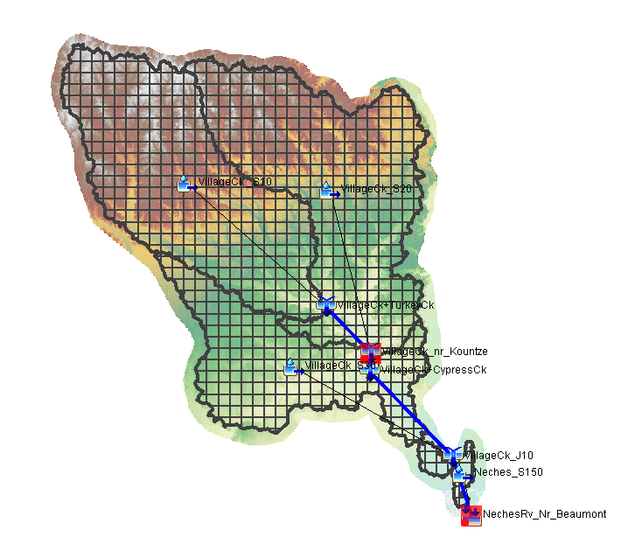
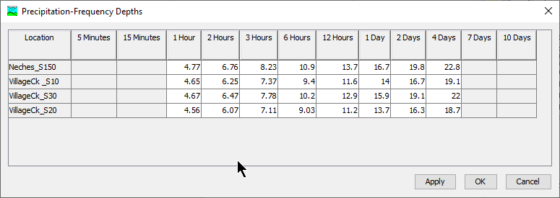
Frequency Storm Calculator
HEC-HMS will compute watershed or subbasin average precipitation depths using subbasin polygons and precipitation frequency grids.
Validating Precipitation Grid Sampling for Hypothetical and Frequency Storm
Notes:
And perform spatial computes. So you can compute the basin average or you can compute the average for every subbasin. And you can compute the depths for multiple durations. If you’ve done this by hand before, you know this could take a couple days. Now, you can do this in literally minutes.

Slide 18
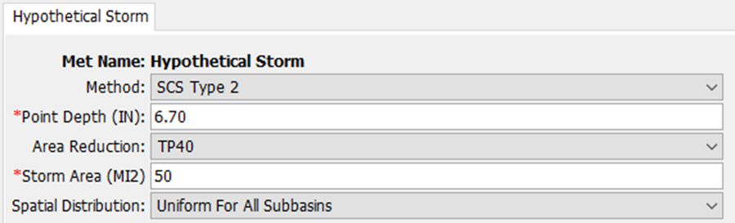
Hypothetical Storm Method
Creates a synthetic storm based on a single duration (depth)
You must define a time-pattern to distribute the total storm depth
    Probability of rainfall equals probability of flow - “AEP neutral”
Storm area is critical
Uniform or variable depths for subbasins
Notes:
The next design storm method available in HMS is the Hypothetical Storm method. This used to be called the SCS method, which followed SCS method for creating a design storm. We’ve since generalized the method and gave users more options to customize.
This method creates a storm based off just one duration. In the Frequency Storm method, you needed multiple depths to create a storm. This method just requires 1 depth.
You define a time pattern to distribute the storm depth. You can use a predefined pattern from SCS method or use a user specified pattern.
Similar to the frequency storm, you assume the probability of the rainfall equals the probability of the flow.
You need to assign a storm area for areal reduction purposes and you can specify the basin average depths to be for the whole basin or for individual subbasins.

Slide 19
Hypothetical Storm Data
One duration, one depth

Slide 20
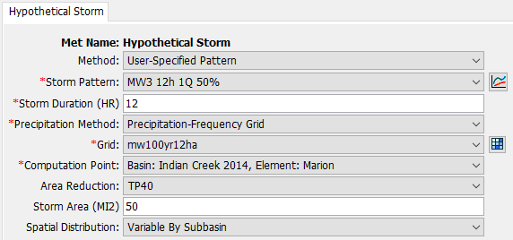
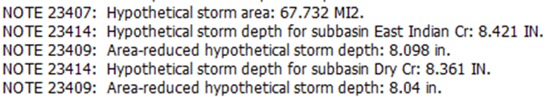
User-Specified Pattern
You must create a temporal pattern
Set the Storm Duration
HEC-HMS will read Precipitation Frequency grids
Depth Area Reduction
    HEC-HMS Computes precipitation above each computation point
    Gets drainage area at the computation point and applies area reduction
Notes:
If you choose your own temporal distribution, you’ll need to create one
Similar to Frequency Storm, we have the calculator so you can compute the basin average depths in hms
Depth Area reduction is applied to the rainfall depth. If you are using a precip-freq grid, the areal reduction is based off the area above the selected computation point.

Slide 21
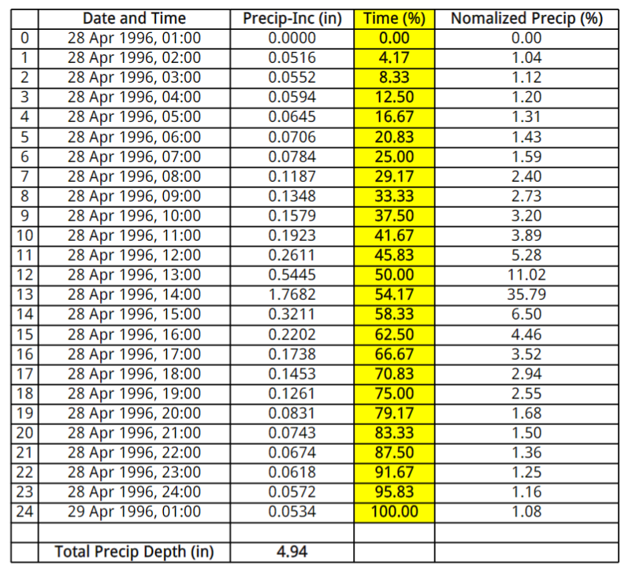
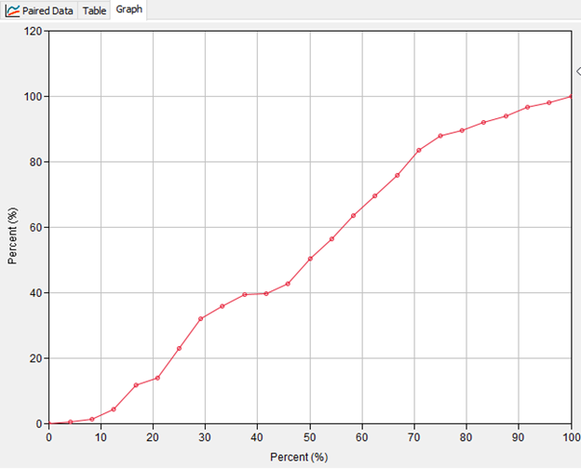
Temporal Patterns
Notes:
This is showing how to create your own temporal pattern. If you have a storm pattern that you want to use, this would be the way to do it in HMS. You normalize time and depth. When you input the pattern, you use the Percent Pattern paired data.

Slide 22
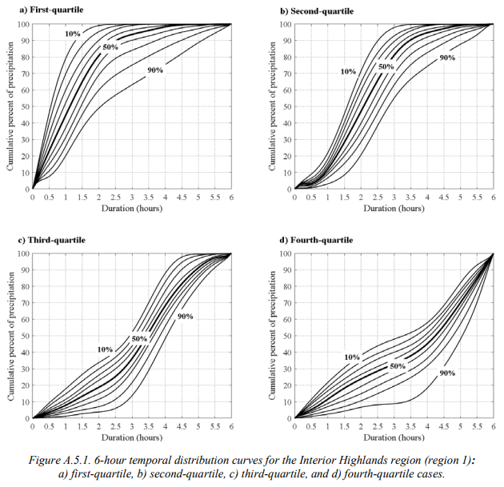
Total Storm Depth Approach (idealized patterns)
Atlas 14 contains regional temporal patterns. There are 36 patterns for 4 storm durations (6hr, 12hr, 24hr and 96hr), the patterns are broken up into quartiles.
The quartile represents when the peak precipitation occurred.
Within each quartile, 9 percentage curves were created by smoothing results from cumulative precipitation curves of historical events ("probabilities of occurrence of precipitation totals were computed at each hour").
Notes:
Another way to get predesigned temporal patterns is to use NOAA Atlas 14 idealized patterns. Atlas 14 created regional patterns. There are 36 patterns each for storm durations 6, 12, 24, and 96 hours. An example is shown for the 6-hr duration, 36 patterns. Each quartile has 9 patterns. The quartile represents when the peak rainfall happens. These percentage curves were created by smoothing cumulative precipitation curves of historical events.
Probabilities of occurrence of precipitation totals were computed at each hour. So at the 1 hour, you have multiple cumulative values at this duration. You compute various percentiles at each hour, then connect the dots to get your smoothed percentile patterns.

Slide 23
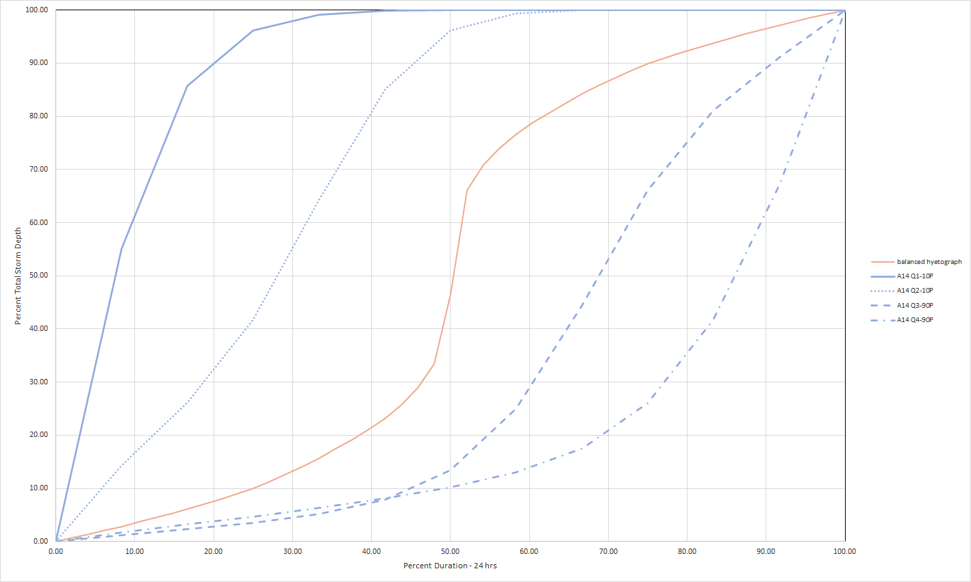
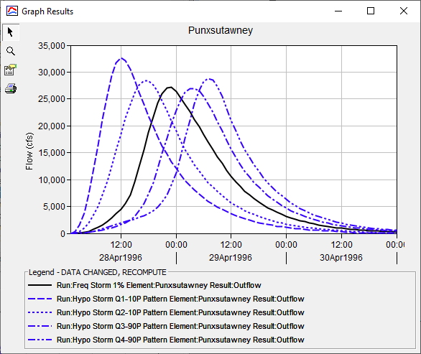
Nested vs. Idealized pattern Comparison
Comparison of 24-hour temporal patterns, worst case scenarios from Atlas 14 and the nested volume approach
Some Atlas 14 temporal patterns generate higher flow hydrographs than the nested volume approach, most Atlas 14 temporal patterns generate lower peak flows than the nested volume approach
Notes:
A comparison between using frequency storm approach, which has the pyramid shaped hyetograph, and the NOAA Atlas 14 temporal patterns.
In this example, we’re comparing 4 other patterns.
Two of the storms we have the peak happening early, then two with the peak happening later
In the case where you have early peak, we have largest peak values versus when the peak happens later.
Hypothetical storms are more flexible since you have the option for assigning temporal patterns and you just need one depth. Frequency storm, you have a limited temporal selection and you need to put in a lot more depths.

Slide 24
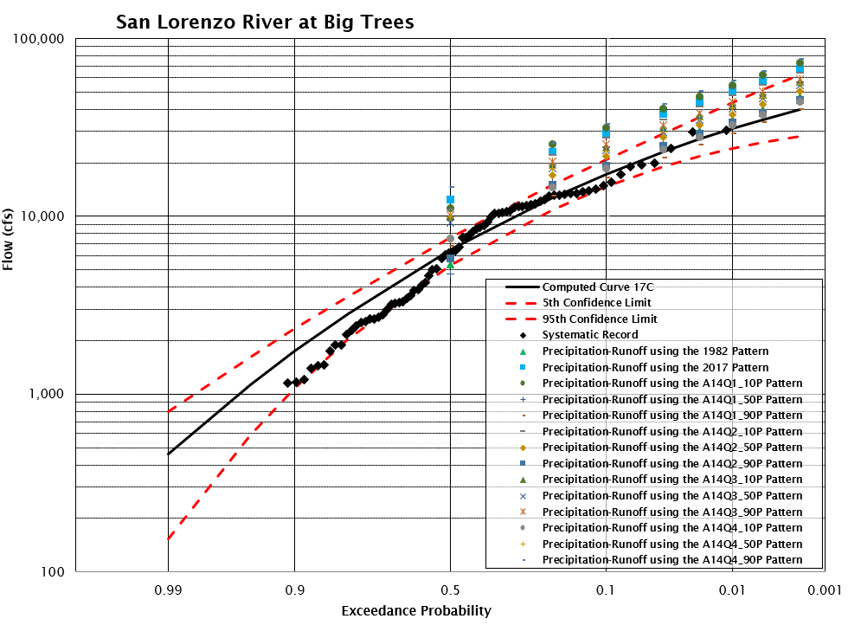
Additional Information
Combining flow-frequency estimates
Initial conditions
Use equation 9-2 in Bulletin 17C to combine frequency curves from multiple sources
Notes:
Some ways to calibrate your frequency storm is to compare the results to a flow frequency curves.
Flow frequency curves are statistical representations of the flow distribution. We have guidance on creating flow frequency curves using Bulletin 17C.
At HEC, [ask audience if they know what software is called] we have a software called SSP that follows Bulletin 17C to create these curves
When calibrating your parameters, you’ll likely be changing the initial conditions. More common events, likely the result of drier conditions. More rare events, wetter conditions
Other parameters can be unit hydrograph. You can have higher peaks happening with larger and larger rainfall
We have a method call Variable Clark unit hydrograph which dynamically adjusts your parameters based on the rainfall depth
If you feel confident about your model and the results, you could combine your modeled results with your observed data to improve the fit of your frequency curve. We know you need a lot of data to create reliable frequency curves for rare frequencies, not a luxury we typically have. You can supplement the curve with modeled results.

Slide 25
Continuous Simulation
Notes:
Before moving onto continuous simulation.
We wanted to bring up continuous simulation since a couple of our workshops are doing continuous simulation and looking at how the soil infiltration changes over a course of 3 to 10 years after a wild fire. Continuous simulation is when you are modeling longer time periods, typically a month out to decades. There are hydrologic processes that are important to consider when modeling

Slide 26
Modeling requirements
The meteorologic model must be configured with precipitation and evapotranspiration.
Subbasins must use a canopy method. The plant canopy is the mechanism for extracting water from the soil.
Subbasins must use a loss method that tracks soil moisture state, i.e. Soil Moisture Accounting, Deficit and Constant, or Layered Green and Ampt.
Use baseflow methods that conserve mass such that volumes do not increase above inputs volumes, i.e. Linear Reservoir Baseflow.
Notes:
In HMS, the meteorological model, must be configured with precipitation and evapotranspiration.
According to DWR estimates 61% annually based on DWR.
Subbasins must use the canopy method. Canopy is the mechanism for extracting water from the soil. Typically, in event modeling, we ignore canopy. It gets lumped in with soil loss. But with long term simulation, you can’t ignore this.
Subbasins must use a loss method that tracks soil moisture. In HMS, we have three methods that can do this.
Lastly, consider baseflow methods that conserve mass. What we mean is the amount of water in the system is preserved, we are doing a proper water budgeting. There are some popular baseflow methods, such as the Recession, that do not take into account the actual rainfall volume, so you could have more water volume in the system than actual rainfall.

Slide 27
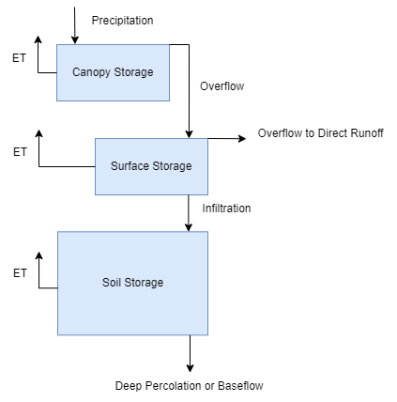
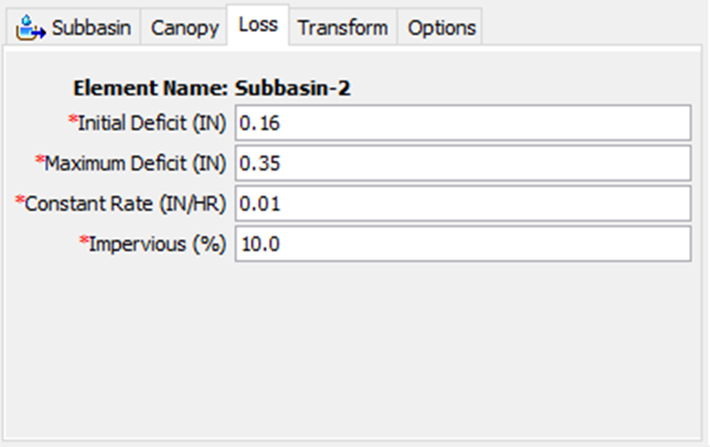
Deficit and Constant
Initial conditions:
    Initial deficit
Parameters:
    Maximum deficit
    Percolation rate
    Percent impervious area
Notes:
Bullet point 3 was talking about using a loss method that accounts for moisture states. Deficit and Constant is one of the loss methods that tracks moistures states. It’s a pretty simple method that contains 4 parameters.
There’s the initial state of the soil,
There’s the max deficit – how much water can the soil hold
The constant soil rate – once the initial deficit is satisfied, the rate of infiltration is set by this parameter
Impervious – the percentage of the subbasin that doesn’t have infiltration.
The diagram to the right describes the different losses that can occur once rain falls.
Rainfall falls, some of the rain can get trapped by canopy, anything over the storage will overflow or throughfall onto the surface.
The surface has a storage as well, if there’s enough rain to overcome the surface storage, you then have infiltration. Whatever is not infiltrated will be part of direct runoff.
The Deficit and Constant method describes the soil storage layer, not the other layers.

Slide 28
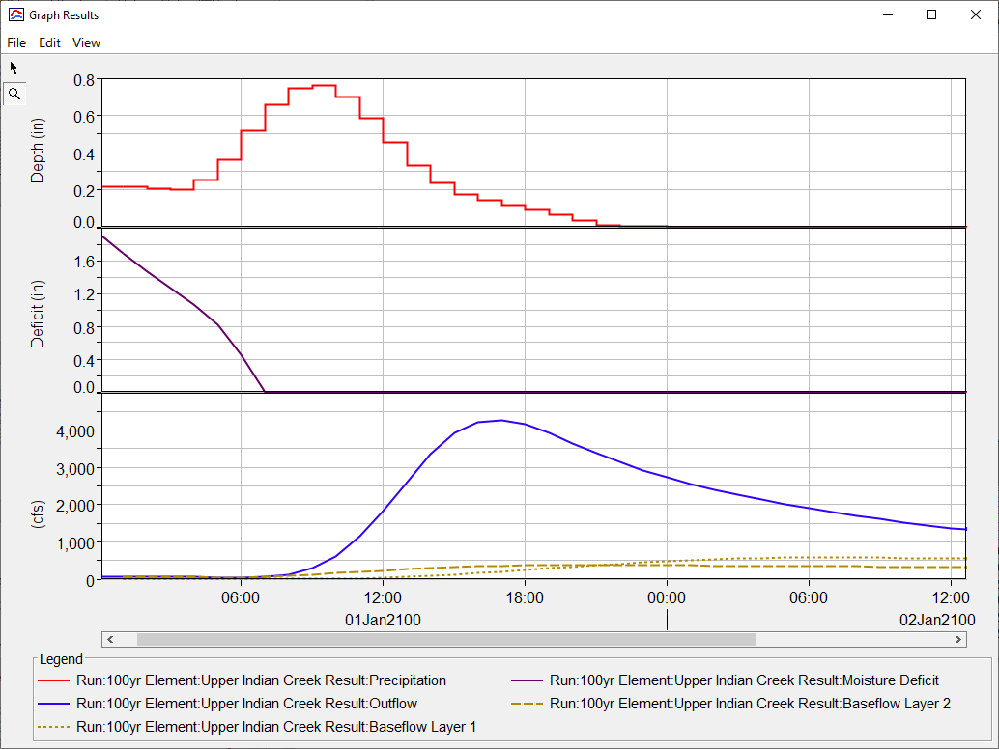
Percolation and Evapotranspiration
Precipitation fills canopy storage first. Precipitation that exceeds the canopy storage capacity will overflow and be added to the surface.
The deficit is the amount of water that will infiltrate before surface runoff can begin.
Percolation only occurs when the soil is saturated, the moisture deficit must be reduced to zero.
Evapotranspiration is computed by the plant canopy component.
Precipitation
Soil Moisture Deficit
Flow
Notes:
This slide describes what I just said about the diagram
First three point I talked about from the diagram [read slide]
Percolation only happens when the soil is saturated (moisture deficit is equal to zero)
What that means is percolated water is sent over to the baseflow layer
The rate at which is moves over is based on the constant rate. You can have a high constant rate, but your total hydrograph volume could still be high because of baseflow
Evapotranspiration will dry the soil which increases your moisture deficit. When there is no rain, the rate moisture is being drawn out into the atm is based on the compute ET

Slide 29
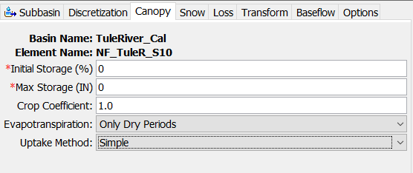
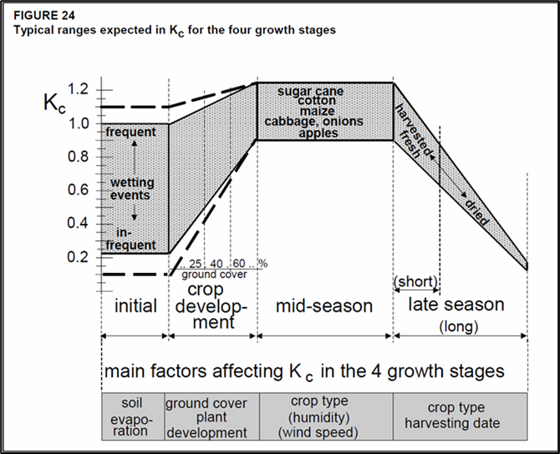
Plant Canopy
There will be no evapotranspiration from the soil unless the plant canopy is enabled.
The Crop Coefficient can be used to increase/decrease evapotranspiration based on the vegetation type.
An uptake method must also be selected in the plant canopy.
The uptake method determines how water is extracted from the soil.
The Simple approach extracts at the potential evapotranspiration rate provided by the meteorologic model. It works with all three methods.
The Tension Reduction approach reduces extraction as the soil becomes drier. It is traditionally applied with soil moisture accounting but could be used with Layered Green Ampt.
Notes:
There is no ET unless the plant canopy layer is enabled
The crop coefficient is a parameter that can be adjusted to increase or decrease evapotranspiration.
An uptake method must be selected for plant canopy. The uptake method determines how water is extracted from the soil
The Simple method extracts at the potential evapotranspiration rate
Tension Reduction reduces the extraction as the soil becomes drier. Works with Soil Moisture Accounting and Layered Green and Ampt
Capillary forces, more area for the water to attach to.

Slide 30
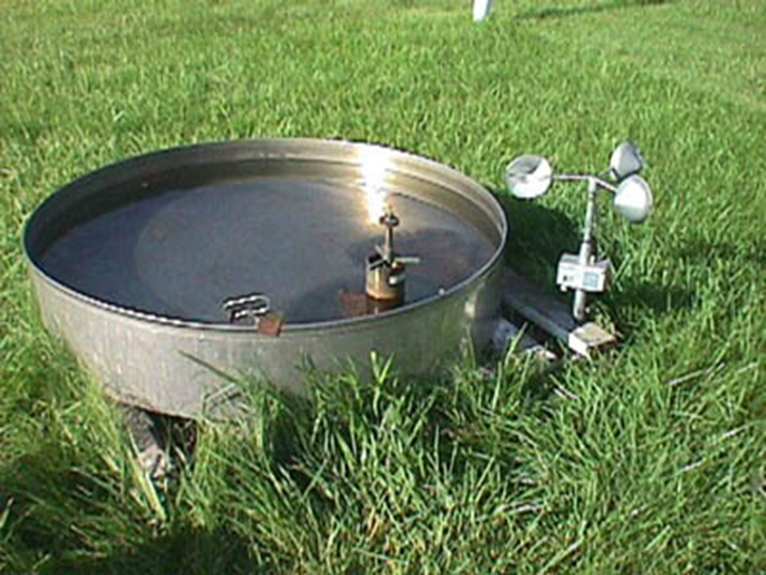
Configuration Requirements
Method | Temperature | Shortwave | Longwave
Monthly Average | No | No | No
Hamon | Yes | No | No
Hargreaves | Yes | Yes | No
Penman-Monteith | Yes | Yes | Yes
Method | Humidity | Windspeed
Monthly Average | No | No
Hamon | No | No
Hargreaves | No | No
Penman-Monteith | Yes | Yes
Notes:
We have 4 methods for computing ET. The level of complexity increases from top to bottom.

Slide 31
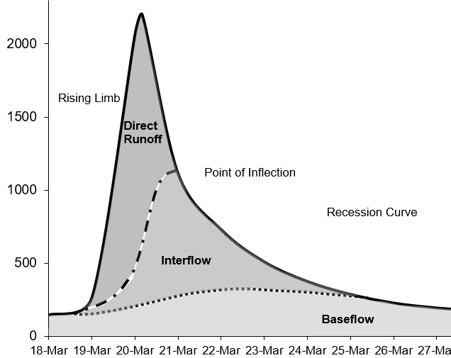
Baseflow in HEC-HMS
In many cases, direct runoff accounts for the flood magnitude. Baseflow is an important process to consider for modeling runoff volume.
Baseflow is comprised of runoff that infiltrates into the ground, flows down gradient, and then flows back onto the land surface in small channels, streams, and rivers.
Baseflow includes interflow and baseflow (or saturated groundwater flow). There are different paths water takes when moving through the ground.
Notes:
Last topic we’ll discuss is on baseflow. Figure to our right shows the components to a hydrograph. Direct runoff is the runoff from on the surface after you’ve accounted for your canopy, surface, and soil losses. The excess precip is transformed to direct runoff. Interflow and baseflow reflect the slower moving water that travel below the surface.
Interflow is generally still the result of a recent storm system. Baseflow, however, could be water storage from months ago. If you were to go to the Sacramento river, the flow would be baseflow conditions.
Not all systems will have groundwater baseflow. This is what distinguishes perennial and ephemeral systems and how high the water table rises. Drought conditions can affect baseflow. If there’s been a prolonged period of time without rain, the existing water storage could dry up and affect perennial systems.

Slide 32
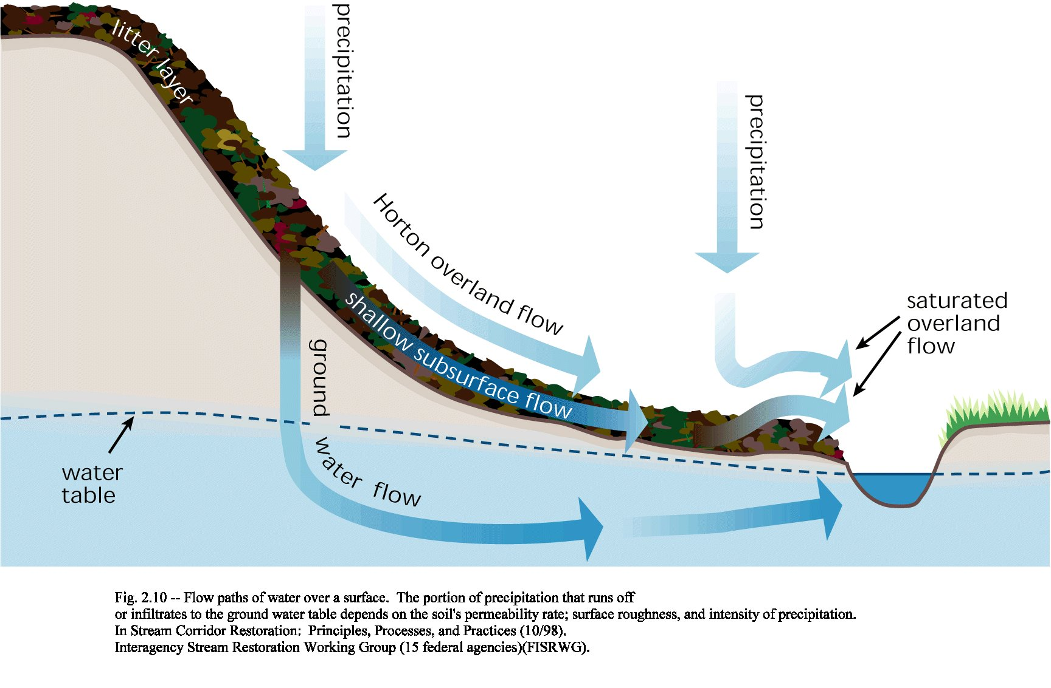

Slide 33
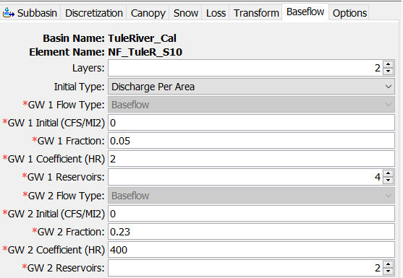
Linear Reservoir Baseflow
The linear reservoir baseflow method is designed to work with all loss methods.
All losses in the Initial and Constant, Curve Number, and Green and Ampt loss methods are available to the Linear Reservoir Baseflow.
Only percolation(represents saturated conditions) in the Deficit and Constant, SMA, and Layered Green and Ampt methods is routed to the Linear Reservoir Baseflow.
Canopy
Deficit/Constant
Moisture Deficit
Constant Loss Rate
Linear Reservoir Baseflow
Layer 1
Layer 2
Layer 3
Notes:
One of our favorite baseflow methods is the linear reservoir baseflow method.
Designed to work with all loss methods
For initial and constant, curve number, and green & ampt all of the loss is available to the linear reservoir baseflow
This means anything infiltrated will go to baseflow. There is no soil moisture accounting happening
Only percolation in the Deficit and Constant, SMA, and Layered Green and Ampt is routed to Linear Reservoir Baseflow

Slide 34
Summary
Resources to quickly create an HEC-HMS project
Discuss the difference between event and continuous modeling
Calibration & validation
Setting up frequency storm and hypothetical storm meteorological models
Setting up continuous simulation models
Notes:
Discussed resources available to create a HEC-HMS project
In our first workshop, you’ll get a chance to create your first HMS model
Talked about event vs continuous modeling
There are hydrologic processes you want to make sure you are modeling when doing continuous – setting up canopy method for ET and selecting appropriate methods
Talked about calibrating and validating event and continuous models
Make sure to use performance metrics to determine if your model is successful
Setting up the frequency storm and hypothetical storm methods
Then setting up a continuous simulation model

Slide 35
Hypothetical Storm Tools
Simulation types that automate application of storm area to the Frequency and Hypothetical Storm meteorologic models
  Depth-Area Analysis Compute
      Compute flows for same frequency at multiple locations
      Allows storm area to vary
  Frequency Analysis Compute
      Compute multiple frequency flows for a location
      You define the analysis point for the frequency analysis, the drainage area is used for the storm area
      Summarize and plot results
Notes:
More cool tools in HMS that you can use for frequency storm analysis. These computes are designed to help with reducing repeat computes.

Slide 36
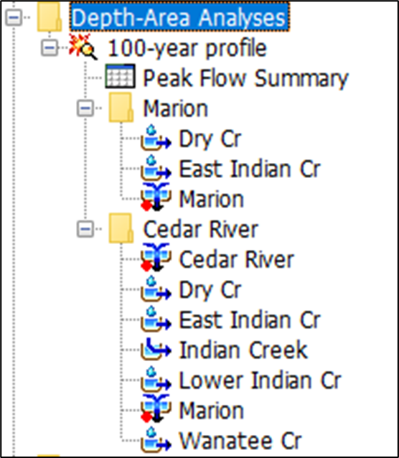
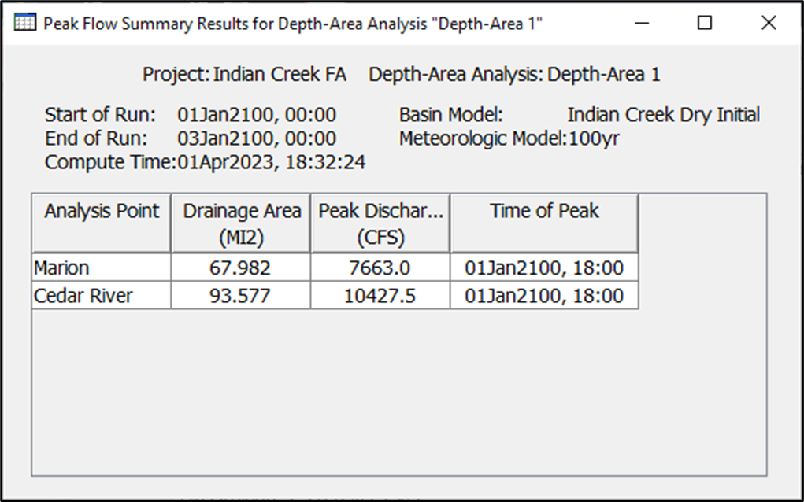
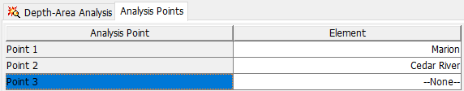
Depth-Area Analysis
Iterates over analysis points
Updates meteorologic model with drainage area
Notes:
Depth Area Analysis Compute – this works for both frequency storm and hypothetical storm method. This compute lets you compute multiple frequency values in the same watershed based off index locations. If you had a large watershed where you wanted to know the 10% AEP at 10 different junctions, you just need to set this up a Depth Area Analysis Compute and you can get the results at all 10 locations. Otherwise, you have to setup 10 different simulations and change the area for the reduction factor

Slide 37
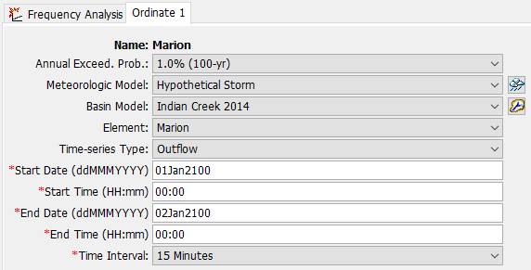
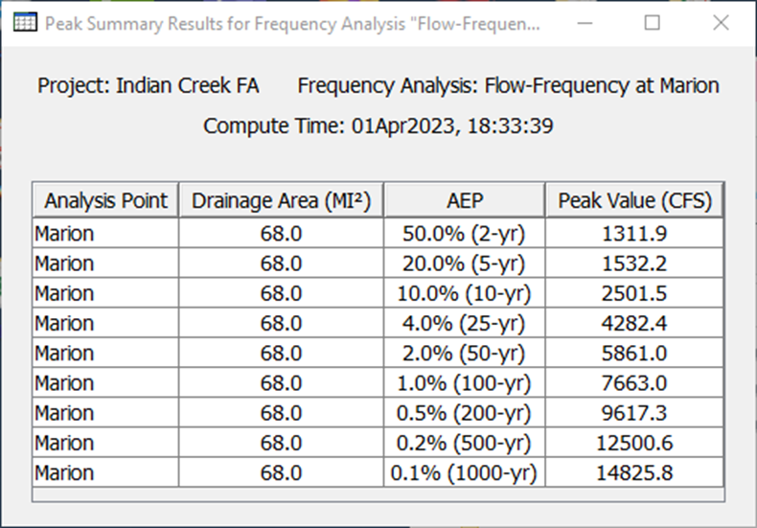
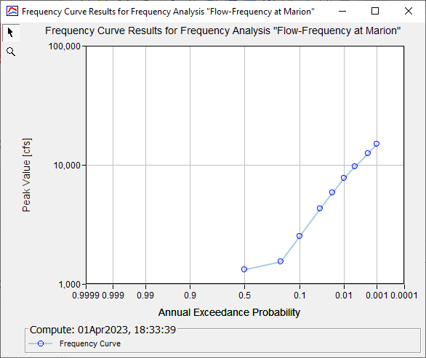
Frequency Analysis
Define frequency ordinates for an element
Updates meteorologic model with drainage area at element
Summarizes results – frequency curve
Notes:
Frequency Analysis Compute – we just talked about computing the same frequency at different locations. This lets you compute multiple frequencies at the same location.
Lets say you want to compute the 2-yr, 10-yr, 50-yr, and 100-yr all in the same compute, this lets you do this.
This is the same storm area but you can vary the rainfall depths at the same location
At the end, you can create a compute frequency curve.

