Slide 1
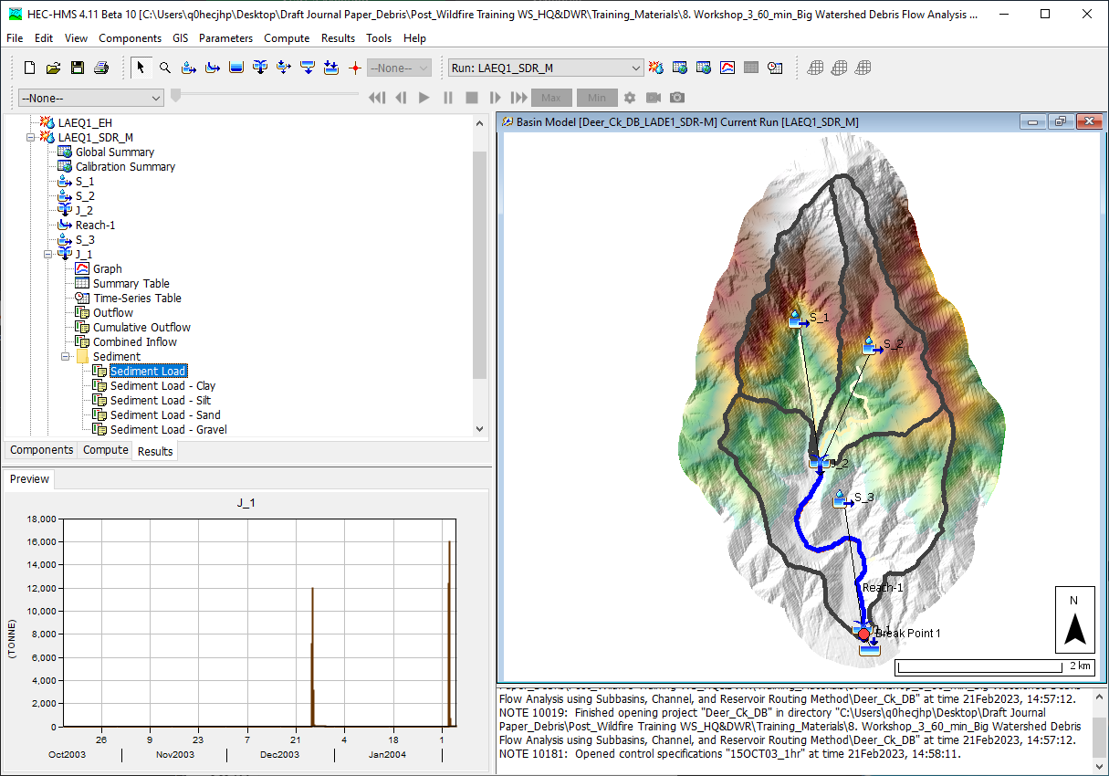
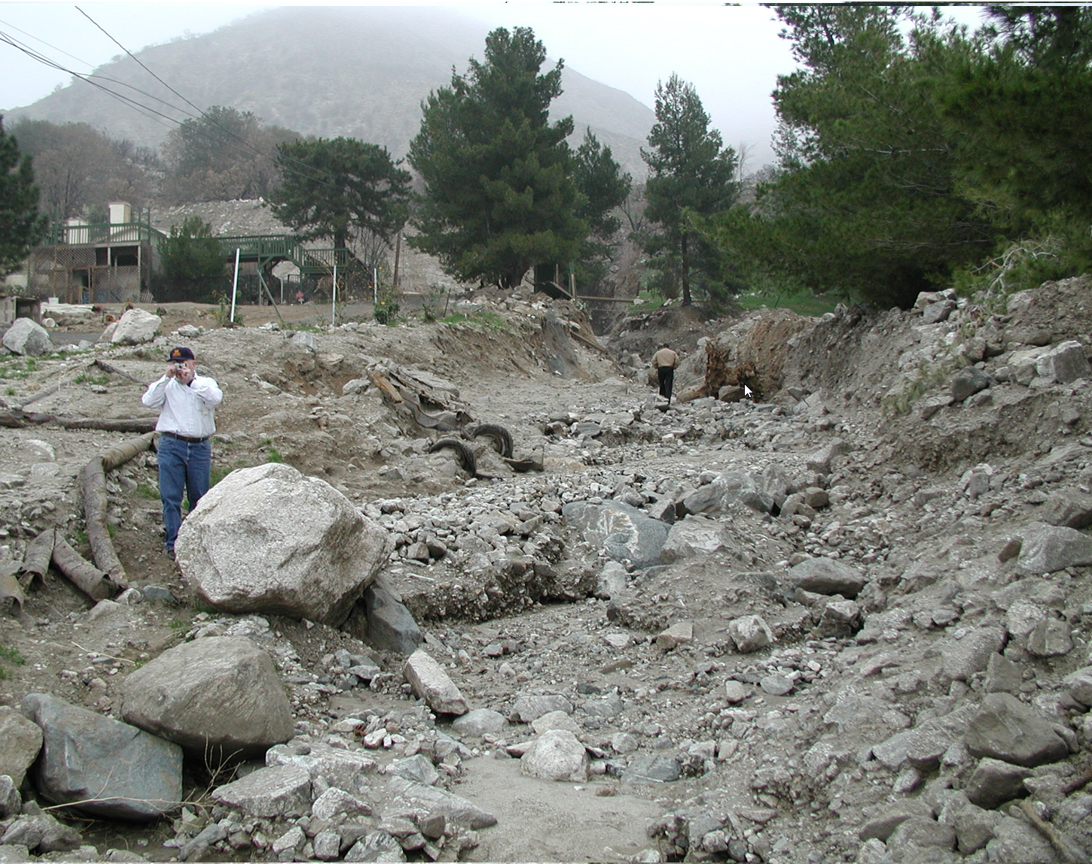
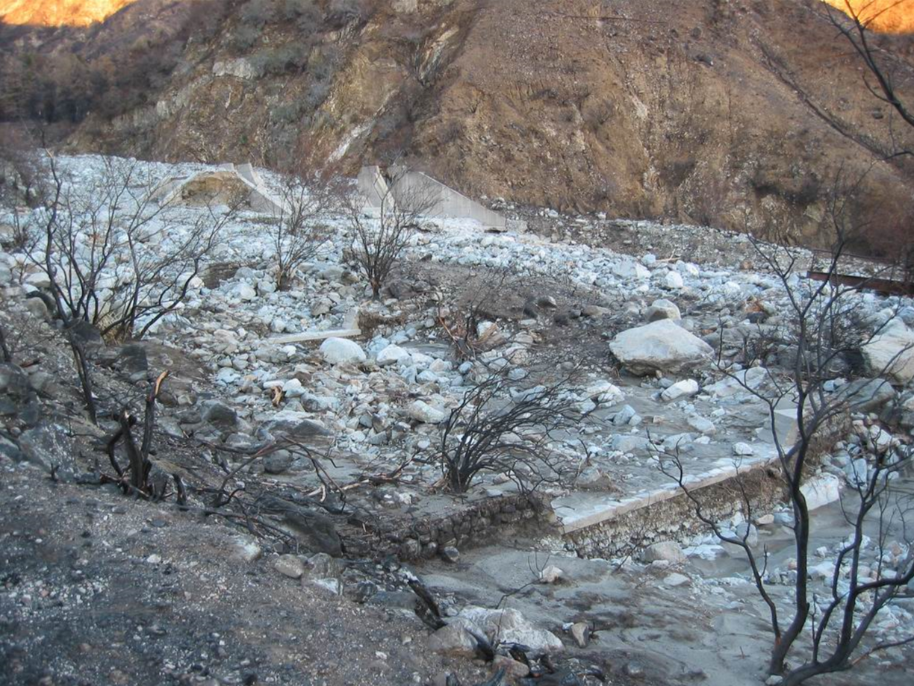
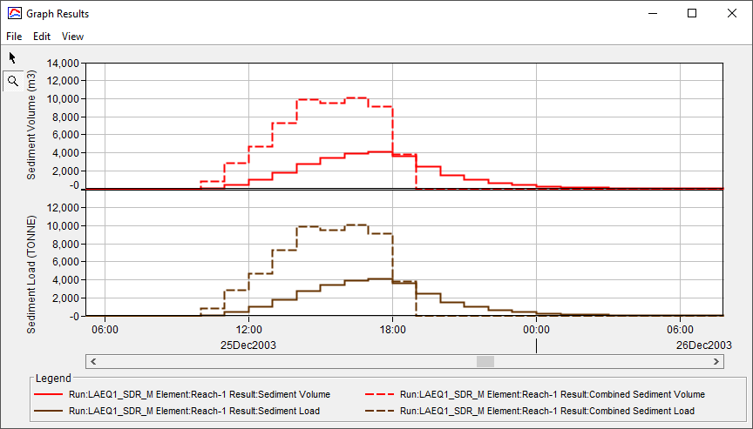


Debris Channel Routing Analysis
Devore Area: Site visit after 25 DEC 2003 event (0.88 in/hr)
Deer Creek Upstream Channel: Post-Fire & Post-Flood Condition after 25 DEC 2003 event (0.95 in/hr)
Jay Pak, Ph.D., P.E.
Watershed Scale Sediment and Post-Fire Hydrology/Debris Flow Analysis Specialist, USACE IWR-HEC

Slide 2
overview
    Fire Impacts on Main Channels
    Data Requirement for Reach Element
    Hydrology Debris Routing Method
      Reach Sediment/Debris Routing Process
        Sediment Continuity
        Transport Potential: 8 functions (SDR for Debris Flow)
        Transport Capacity
      Sediment Channel Routing: 5 Methods (Muskingum for Debris Flow)
    Case Studies:
      Deer Creek Debris Flow Analysis
    Need To Improve for Reach Routing Analysis

Slide 3
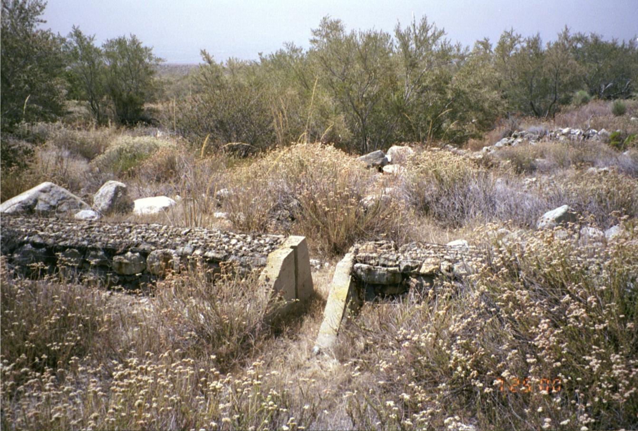
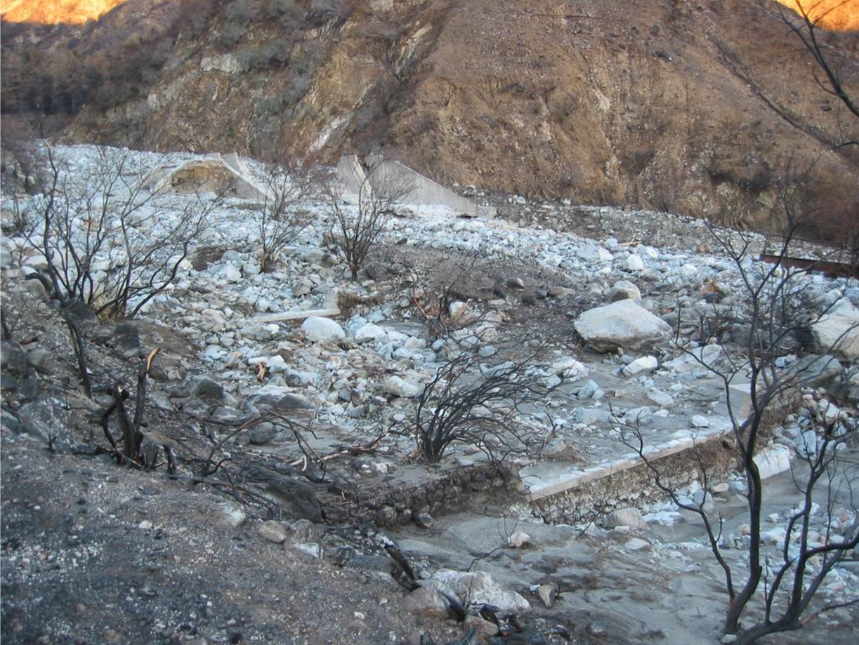
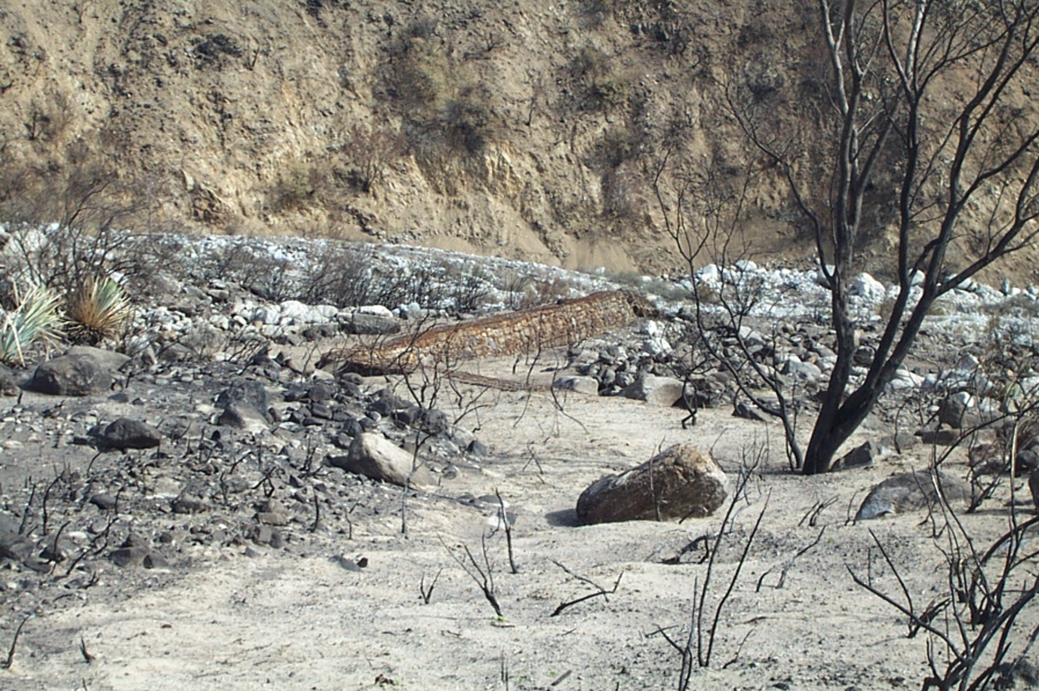
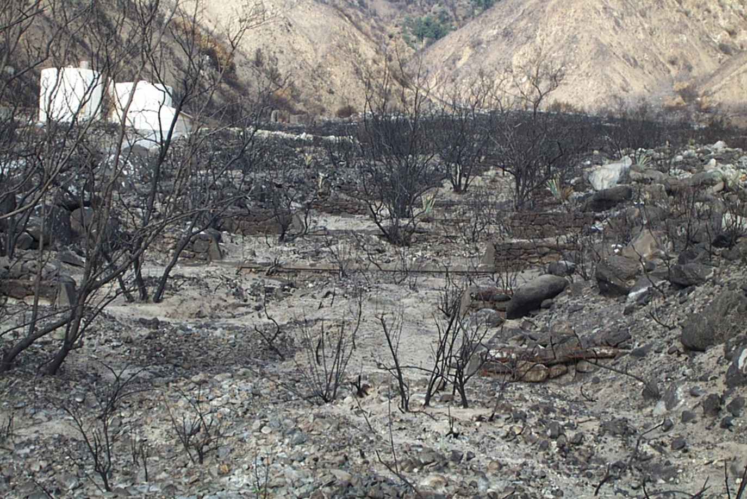
Fire impacts on main Channels (Deposition)
Deer Creek Debris Basin
City of Rancho Cucamonga, CA
Pre-Fire Condition
Post-Fire & Pre-Flood Condition
Post-Fire & Post-Flood Condition

Slide 4
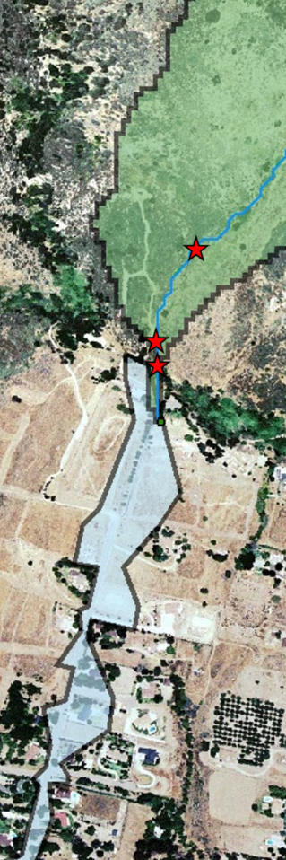
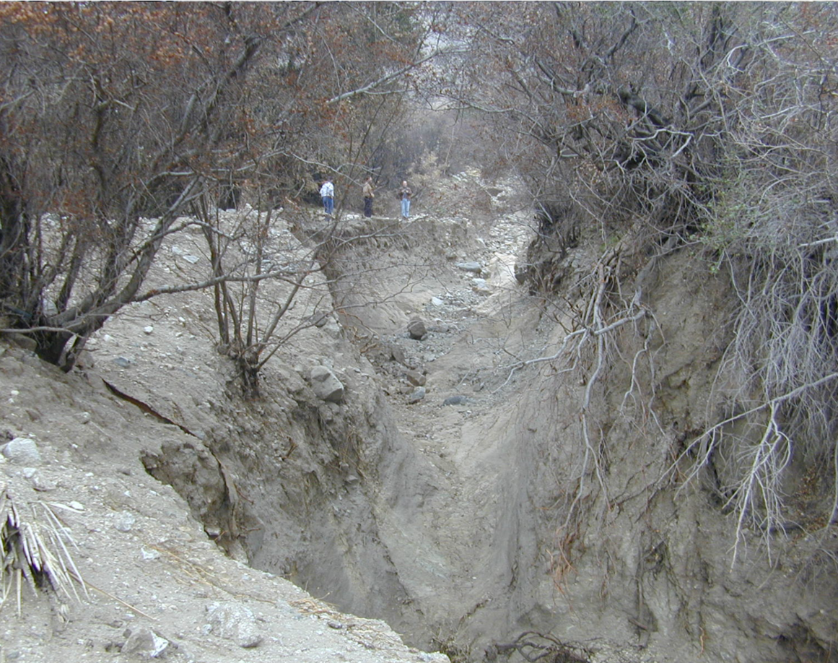
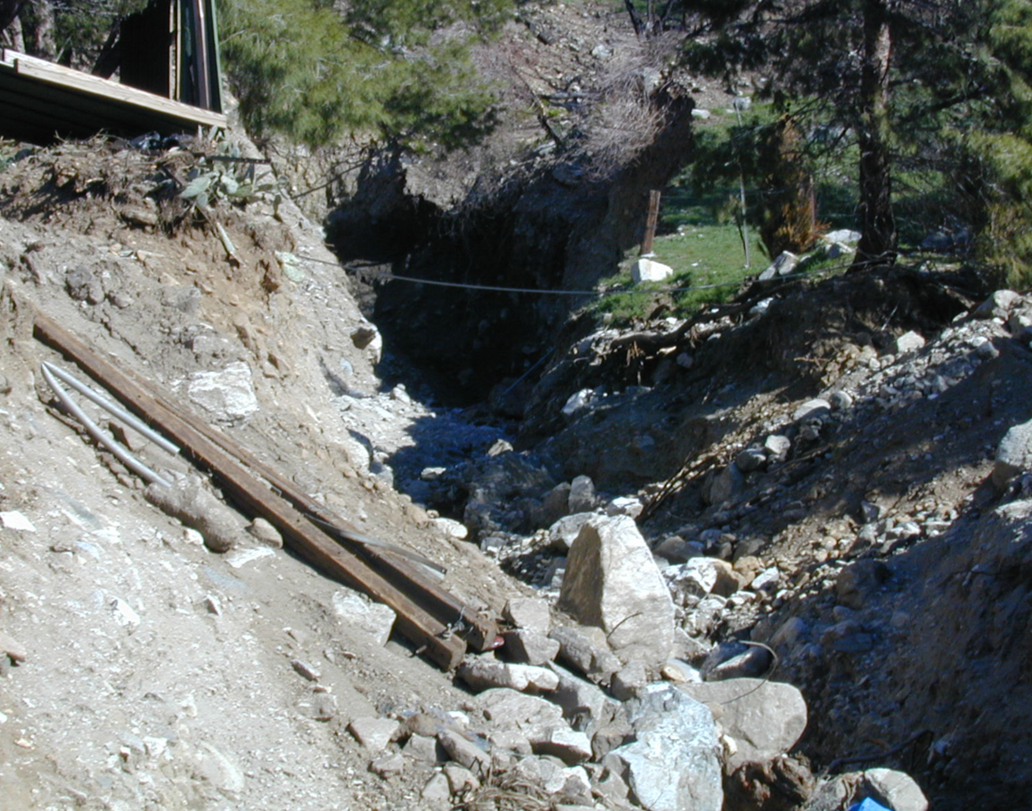
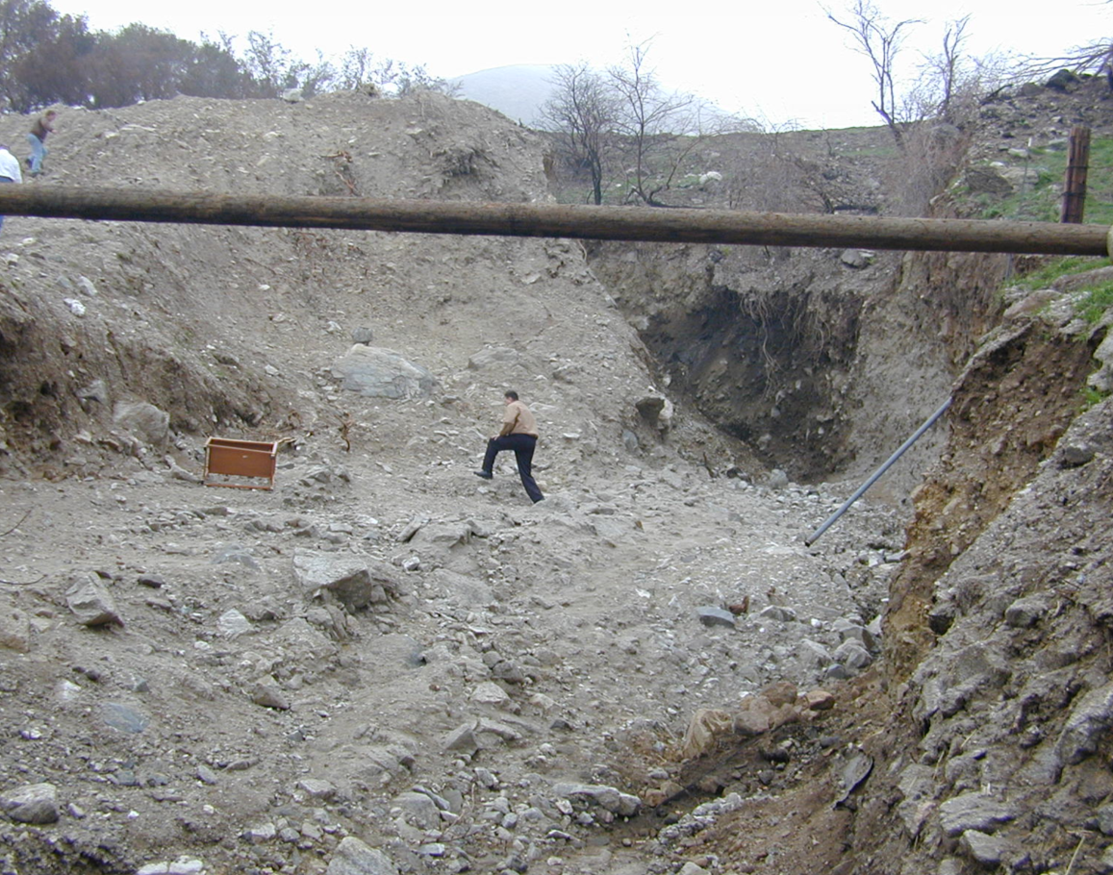
Fire impacts on main Channels (erosion)
Site Visit After December 25, 2003 Storm
Devore Area Debris Disaster

Slide 5
overview
    Fire Impacts on Main Channels
    Data Requirement for Reach Element
    Hydrology Debris Routing Method
      Reach Sediment/Debris Routing Process
        Sediment Continuity
        Transport Potential: 8 functions (SDR for Debris Flow)
        Transport Capacity
      Sediment Channel Routing: 5 Methods (Muskingum for Debris Flow)
    Case Studies:
      Deer Creek Debris Flow Analysis
    Need To Improve for Reach Routing Analysis

Slide 6
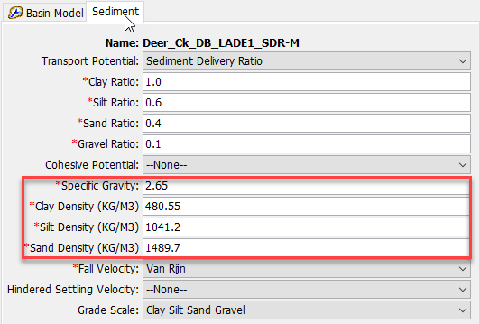
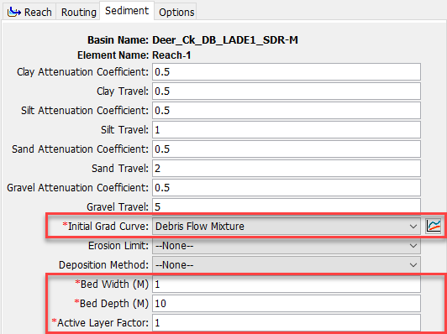
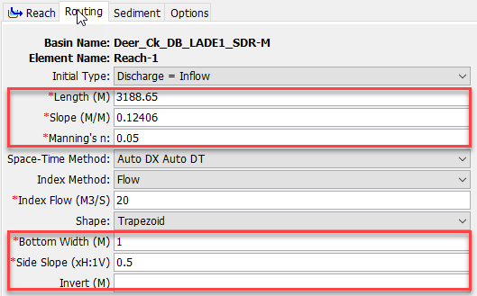
Data requirement FOR reach ELEMENT
Soil Gradation Curve, Specific Gravity, and Density
Rough Channel Geometry Data (Length, Slope, Manning’s n, Closs Section, etc.)
Flow Gage Data (Pre- & Post-Fire)
Measured Debris Yield/Sediment Data

Slide 7
overview
    Fire Impacts on Main Channels
    Data Requirement for Reach Element
    Hydrology Debris Routing Method
      Reach Sediment/Debris Routing Process
        Sediment Continuity
        Transport Potential: 8 functions (SDR for Debris Flow)
        Transport Capacity
      Sediment Channel Routing: 5 Methods (Muskingum for Debris Flow)
    Case Studies:
      Deer Creek Debris Flow Analysis
    Need To Improve for Reach Routing Analysis

Slide 8
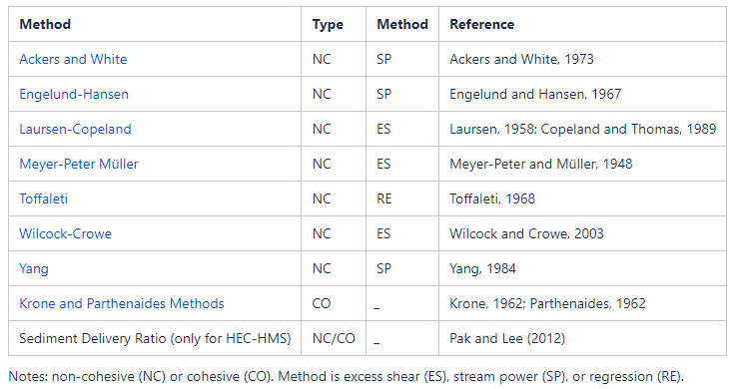
Sediment transport potential Methods in HEC-HMS

Slide 9
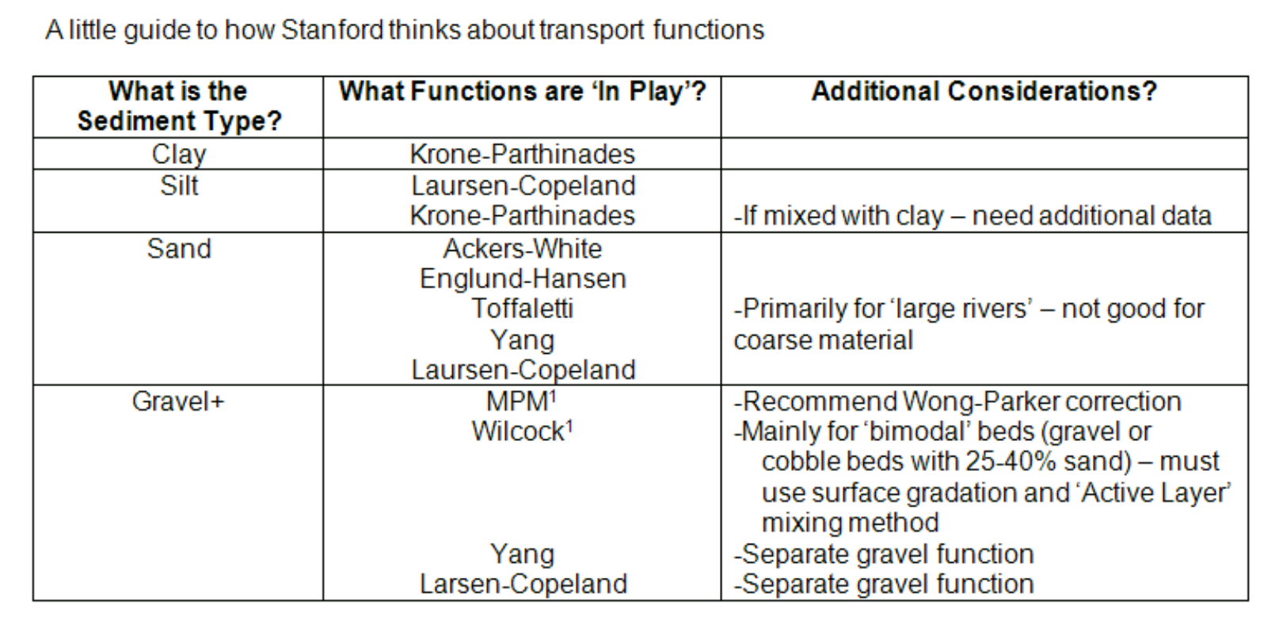
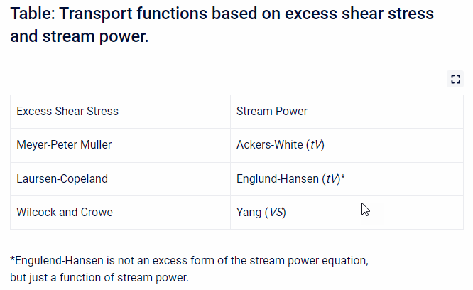
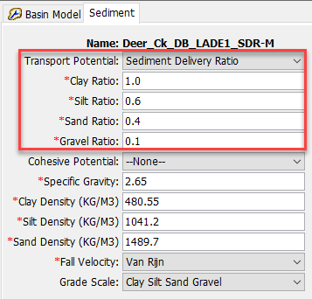
Transport Potential Functions
Debris/Hyper-Concentration Flow | SDR | -User specified Value for each grain class
Sources: HEC-RAS 1D Sediment Transport User’s Manual (https://www.hec.usace.army.mil/confluence/rasdocs/rassed1d/1d-sediment-transport-technical-reference-manual/computing-transport-capacity)

Slide 10
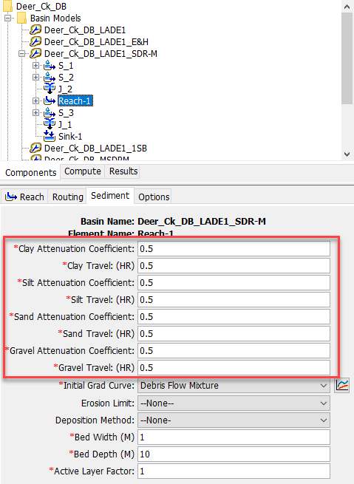
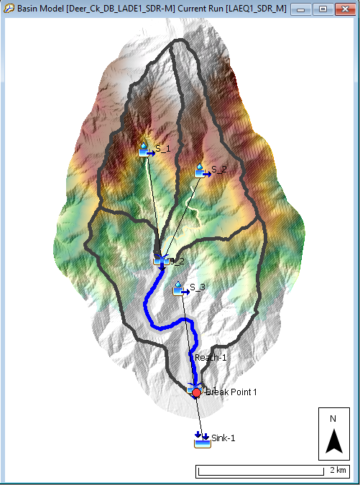
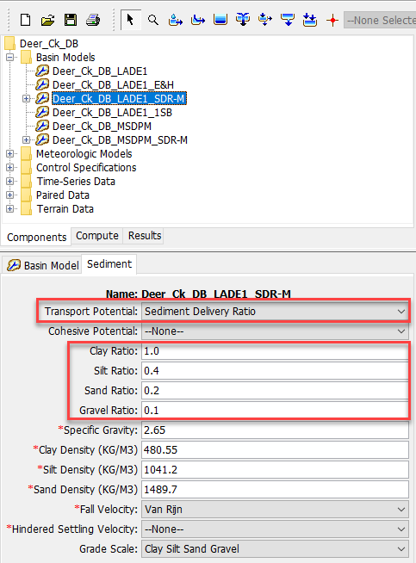
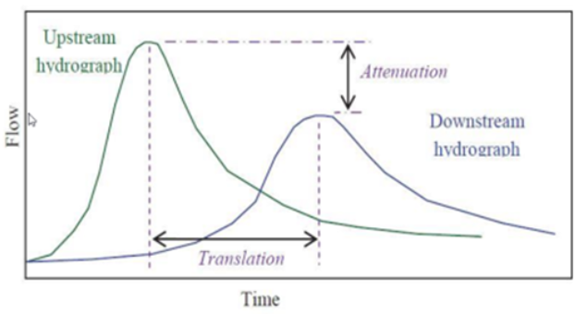
Hydrologic Debris Routing Method
Current HEC-HMS Sediment Channel Routing Methods
  7-Transport Potential Functions based on the Exner equation from HEC-RAS
    Very sensitive to Numerical stability
    Design for the River Sediment Transport Analysis not for debris flow situations
    Need more research to provide a guidance
A Simple Debris Routing method (Hydrology Concept) to manually control erosion and deposition for the steep channels in a mountain watershed
  User Specified Sediment Delivery Ratio (SDR) (deposition and erosion):
      O_{sed} = SDR X I_{sed} (Pak and Lee, 2011)
  Muskingum Routing method (Translation and Attenuation)
Notes:
Ackers-White, Englund-Hansen, Laursen (Copeland), Myer-Peter-Müller, Toffaleti, Yang (Sand and Gravel), & Wilcock

Slide 11
Reach sediment/debris ROUTING PROCESS
Watershed
Watershed Outlet
In-Channel
Channel Outlet
None
None
Power Function
None
MUSLE
7- Transport Function (Non-Cohesive)
BUWO
Uniform
Equilibrium
Enrichment Ratio
LADM EQ 1
Krone & Parthenadies (Cohesive)
MSDPM
Volume Ratio
USGS-LT
SDR (Debris Flow)
Linear Reservoir
USGS-EA
Fall Velocities:
Rubey
Van Rijn
Toffaleti
Report 12
Richardson & Zaki
Kumbhakar
None
Fischer’s Dispersion EQ.
LADM EQs 2-5
Deposition Limiter
Erosion Limiter
Muskingum
2-Layer Conceptual Sediment Reservoir

Slide 12
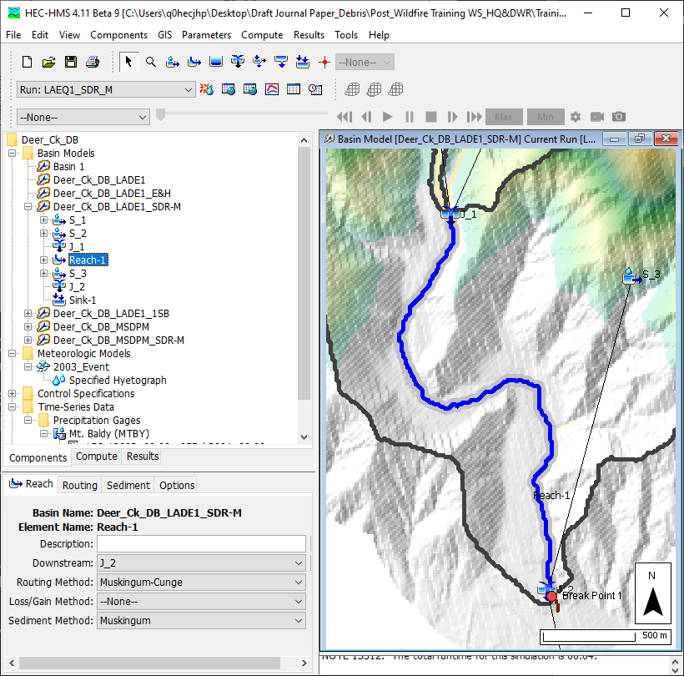
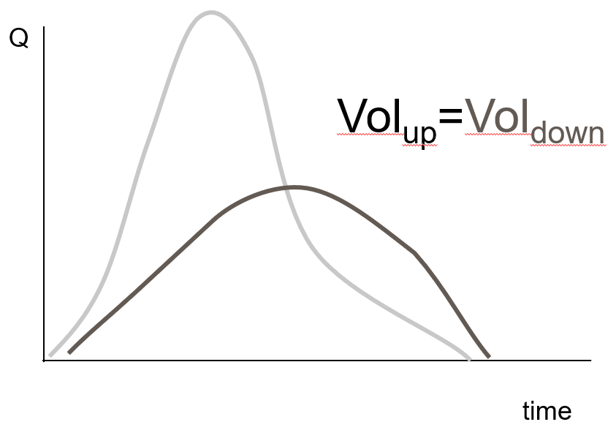
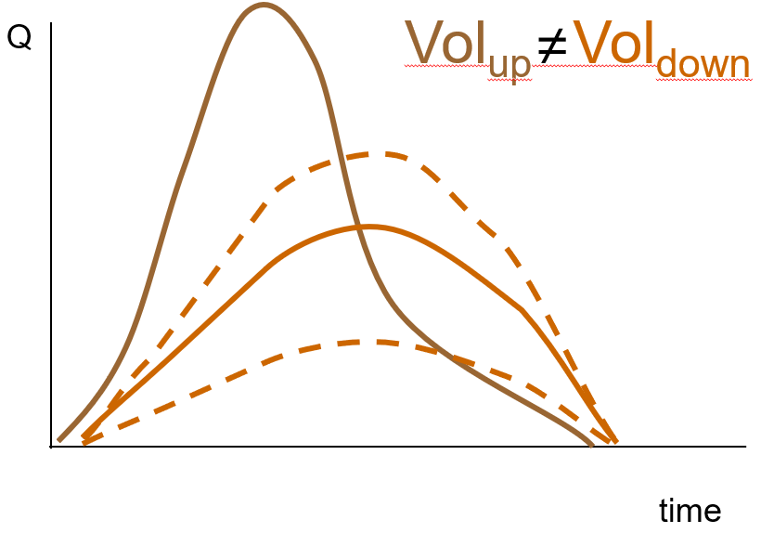
Reach debris ROUTING
Flow Routing
Sediment Routing
  Volume Control (SDR)
  Lag & Attenuation (Muskingum)

Slide 13
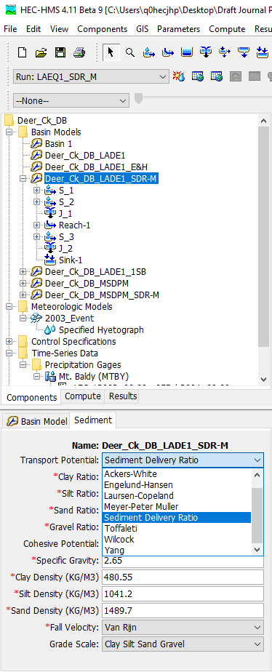
Transport Potential Functions
Ackers-White
Englund-Hansen
Laursen (Copeland)
Myer-Peter-Müller
Toffaleti
Yang (Sand and Gravel)
Wilcock
Sediment Delivery Ratio (SDR)
Note: Basin Level Variable
Sources: HEC-RAS 1D Sediment Transport User’s Manual (https://www.hec.usace.army.mil/confluence/rasdocs/rassed1d/1d-sediment-transport-technical-reference-manual/computing-transport-capacity)

Slide 14
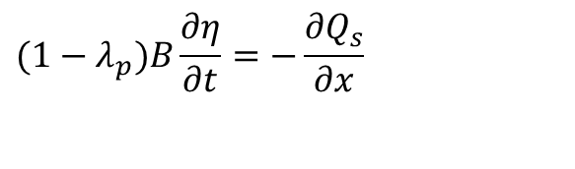
Sediment Continuity: Exner Equation
B = channel width
η = channel elevation
λ_{p} = active layer porosity
t = time
x = distance
Q_{s} = transported sediment load
The Exner equation simply states that the difference between sediment entering and leaving a control volume must be stored or removed from storage.
$$(1−λ_{p})B\frac{∂η}{∂t}=−\frac{∂Q_{s}}{∂x}$$
Q
Bed Rock
Sources: HEC-RAS 1D Sediment Transport User’s Manual (https://www.hec.usace.army.mil/confluence/rasdocs/rassed1d/1d-sediment-transport-technical-reference-manual/sediment-continuity)

Slide 15
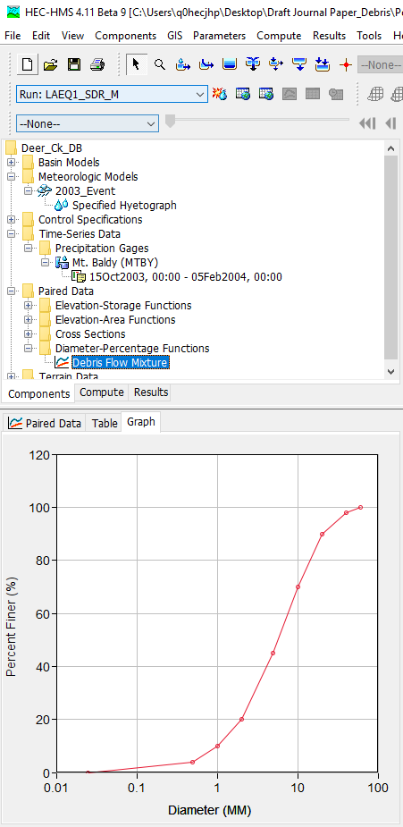

Transport Capacity
Bed Material and Inflowing Load divided into separate grain classes (up to 20)
Transport Potential is calculated for each grain size
Transport Capacity (Existing 7-transport Potential Functions) = (Transport Potential for each grain size) X (fraction of that material in active layer of bed)
SDR is not function of fraction of each grain size material in active layer of bed)
Transport Potential = Transport Capacity
Where:
T_{c} = Total transport capacity
N = number of grain size classes
β_{j} = % of active layer composed of material in grain size class “j”
T_{j} = Transport potential computed for 100% of the material grain class “j”
$$T_{c}=\sum_{j=1}^{n}{β_{j}T_{j}}$$

Slide 16


Potential/Capacity Example for Existing 7-Function
Transport Potential
  Silt = 1,000 T/d
  Sand = 100 T/d
  Gravel = 10 T/d
Transport Capacity
  Silt =
  Sand =
  Gravel =
Transport Capacity
  Silt = 100 T/d
  Sand =
  Gravel =
Transport Capacity
  Silt = 100 T/d
  Sand = 70 T/d
  Gravel =
Transport Capacity
  Silt = 100 T/d
  Sand = 70 T/d
  Gravel = 2 T/d
_____________
Total = 172 T/d
Silt = 10%
Sand = 70%
Gravel = 20%
Active Layer
Inactive Layer

Slide 17
A Sediment Continuity Example
Inflowing Load
Silt = 200 T/d
Sand = 70 T/d
Gravel = 1 T/d
Surplus or Deficit
  Silt =
  Sand =
  Gravel =
100 T/d
0 T/d
-1 T/d
Transport Capacity
  Silt = 100 T/d
  Sand = 70 T/d
  Gravel = 2 T/d

Slide 18
A Potential/Capacity Example for SDR
Sediment Inflow X SDR =
Transport Potential = Transport Capacity
Inflowing Load
Silt = 100 T/d
Sand = 70 T/d
Gravel = 10 T/d
SDR
Silt = 1.2
Sand = 1
Gravel = 0.5
Transport Capacity
  Silt = 120 T/d
  Sand = 70 T/d
  Gravel = 5 T/d
X
=
Silt = 10%
Sand = 70%
Gravel = 20%
Surplus or Deficit
  Silt =
  Sand =
  Gravel =
Active Layer
-20 T/d
0 T/d
Inactive Layer
5 T/d
Note: SDR is not function of fraction of each grain size material in active layer of bed however the bottom layers (active and inactive layers) will be updated based on erosion and deposition.

Slide 19
Limitation of Simplified HMS Approach
Time 1
Time 2
HMS
Deposit
Capacity_{t1} = Capaicity_{t2}
Time 1
Time 2
RAS
Deposit
Capacity_{t1} < Capaicity_{t2}
Which will Deposit more in time step 3?

Slide 20
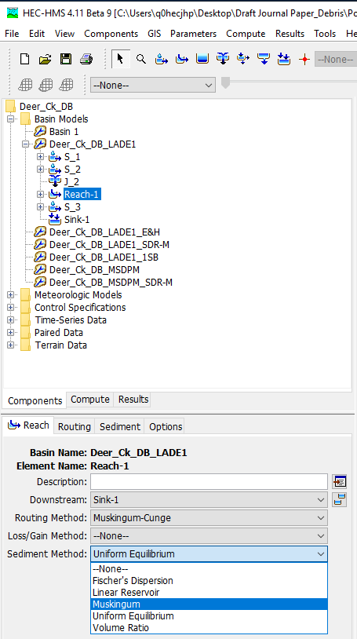
Sediment Channel Routing
Fisher’s
Linear Reservoir
Uniform Equilibrium
Volume Ratio
Muskingum

Slide 21
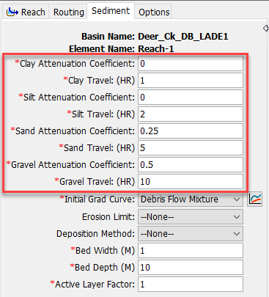
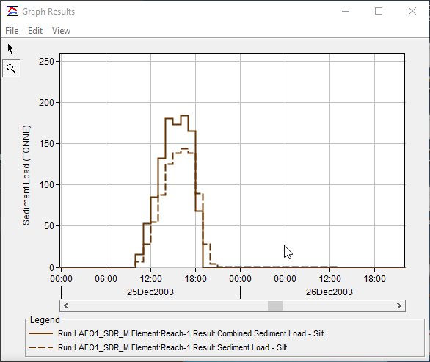
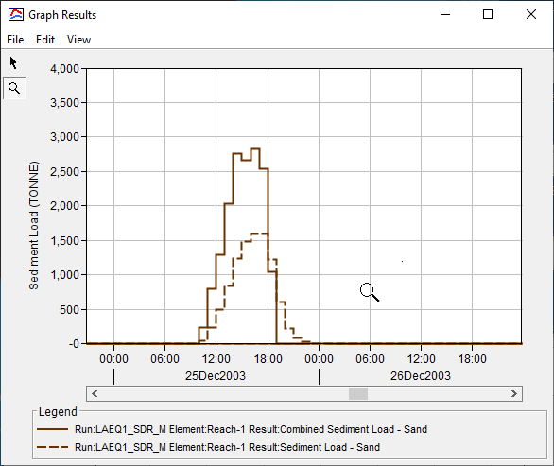
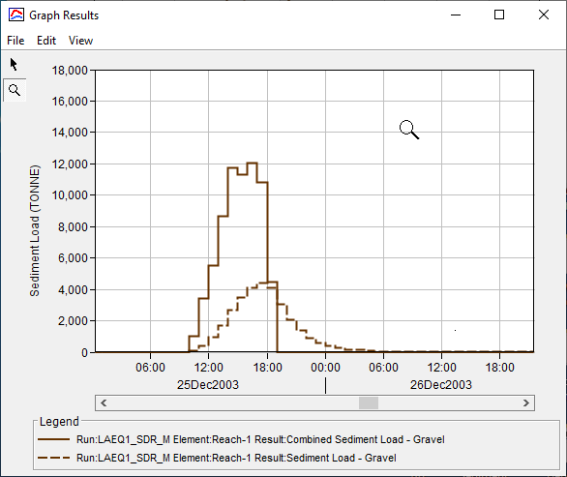
Muskingum Sediment Routing Methods
where: K = Travel Time of the floodwave through the reach (User Input Parameter)
X = Dimensionless Weighting Factor, range from 0.0 to 0.5 (User Input Parameter)
Del t = Time Interval
Notes:
X is a dimensionless coefficient that lacks a strong physical meaning. This parameter must range between 0.0 (maximum attenuation) and 0.5 (no attenuation). For most stream reaches, an intermediate value is found through calibration.

Slide 22
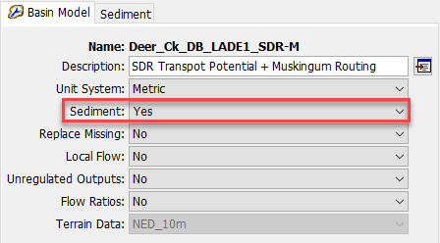
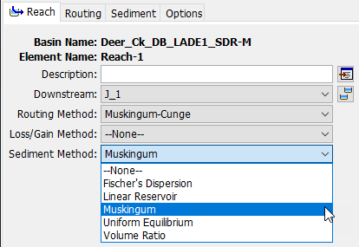
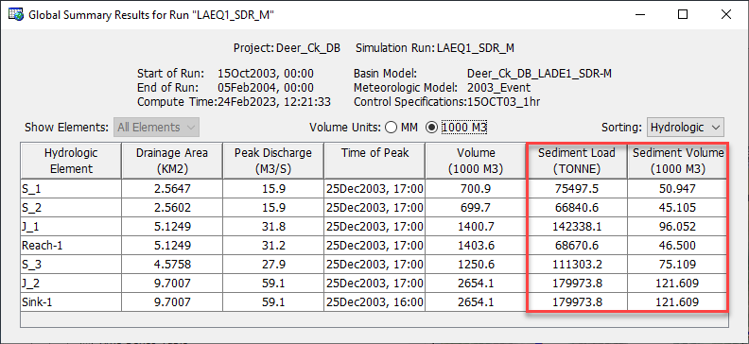
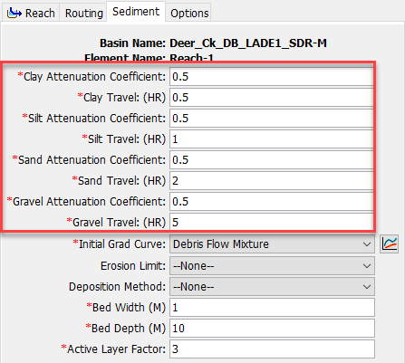
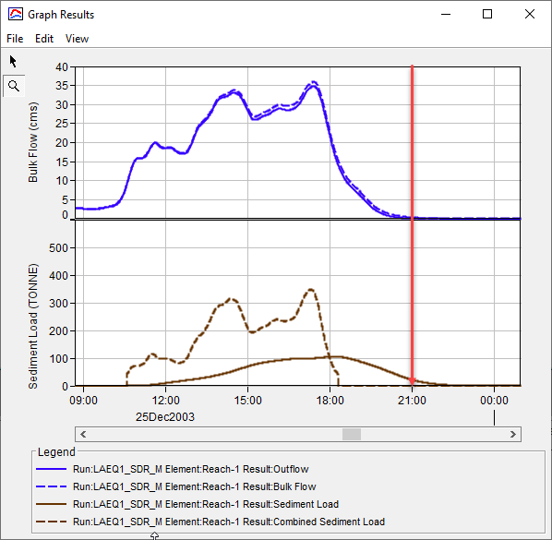
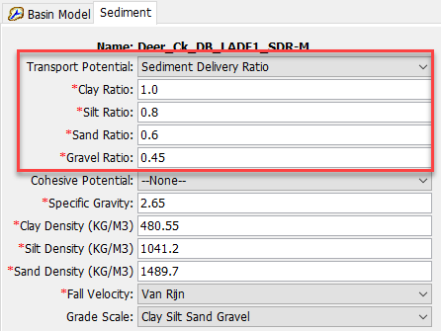
HEC-HMS GUI for SDR & Muskingum

Slide 23
overview
    Fire Impacts on Main Channels
    Data Requirement for Reach Element
    Hydrology Debris Routing Method
      Reach Sediment/Debris Routing Process
        Sediment Continuity
        Transport Potential: 8 functions (SDR for Debris Flow)
        Transport Capacity
      Sediment Channel Routing: 5 Methods (Muskingum for Debris Flow)
    Case Studies:
      Deer Creek Debris Flow Analysis
    Need To Improve for Reach Routing Analysis

Slide 24
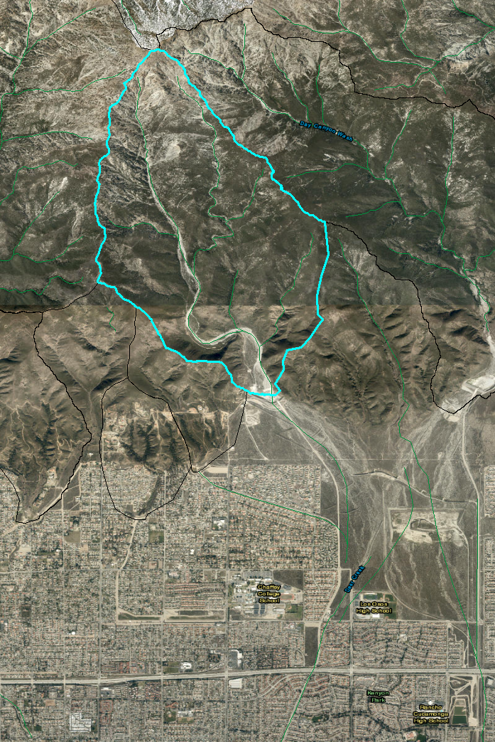
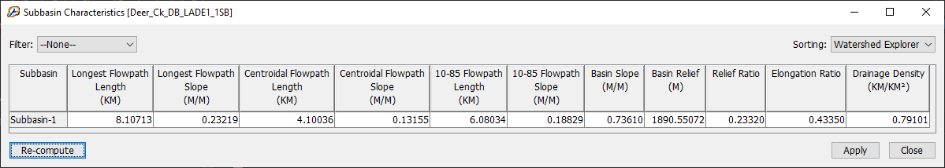
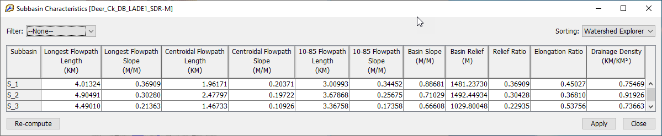
Debris routing case study: Deer Creek
Area: San Bernardino Mountains
Fire: Padua, Grand Prix & Old Fires (October and November 2003), 36,826 ha
Drainage area: 966 ha (3.7 mile²), 100% Burn by Grand Prix Fire
Relief Ratio (m/km): 244
Precipitation Gages: Mt. Baldy (MTBY)
Simulation Period: Oct 15, 2003 – Feb 4, 2004
Measured Debris Yield: 120,112 m³ (USACE, 2005)
Questions?
  Which Debris Yield Method?
  1-Subbasin or Multi-Subbasin?

Slide 25
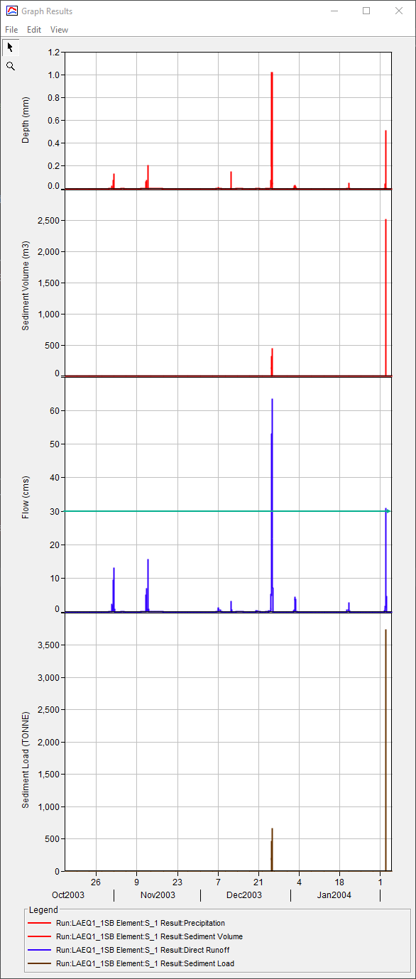
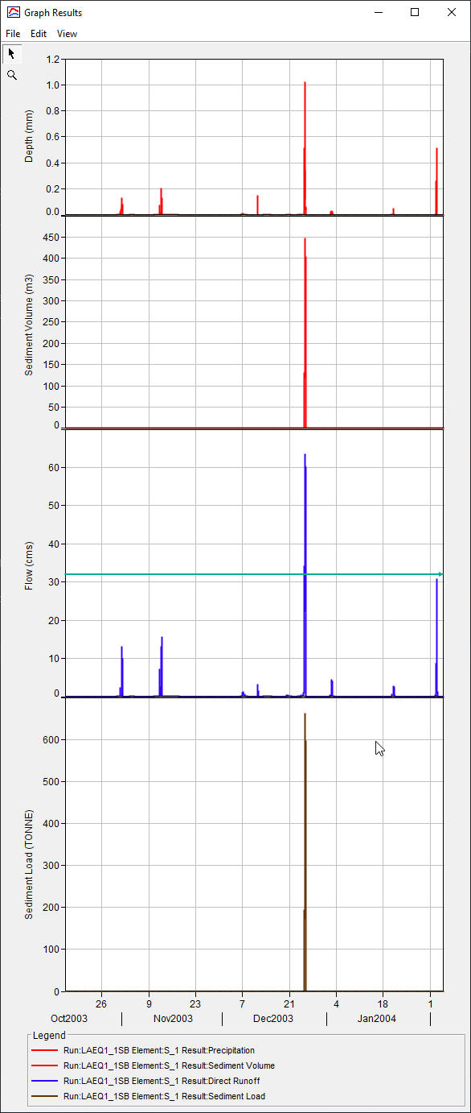
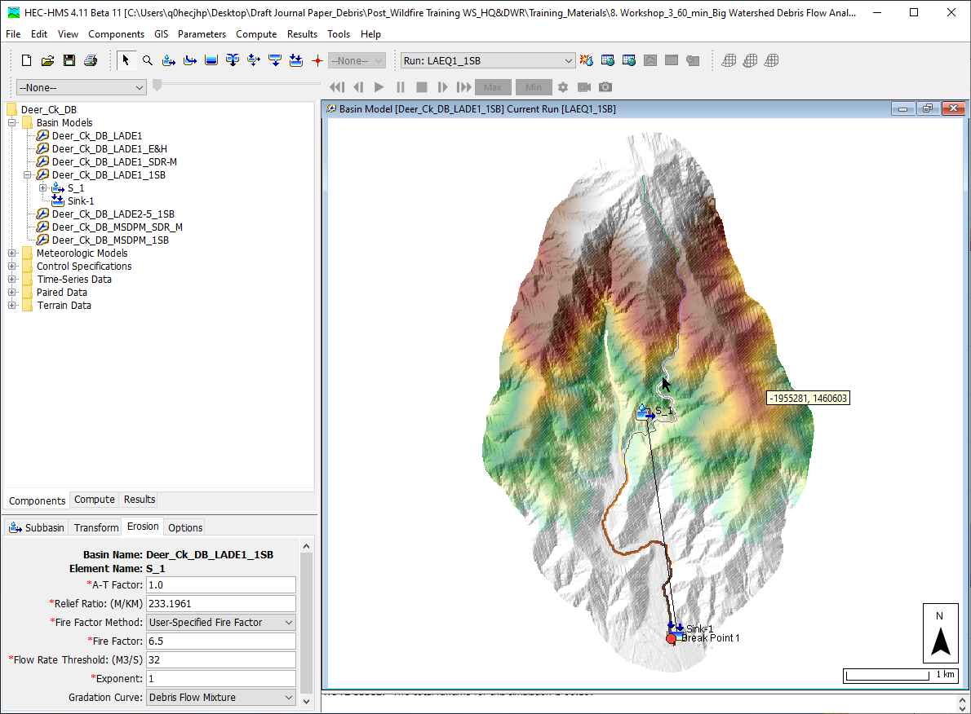
1-Subbasin with LA Debris EQ1
Relief Ratio (m/Km) | Flow Rate Threshold (m³/s) | Measured Debris Yield (m³) | Estimated Debris Yield (m³) | Difference (%)
233.2 | 30 | 122,112 | 191,479 | 59
233.2 | 32 | 122,112 | 114,582 | -5

Slide 26
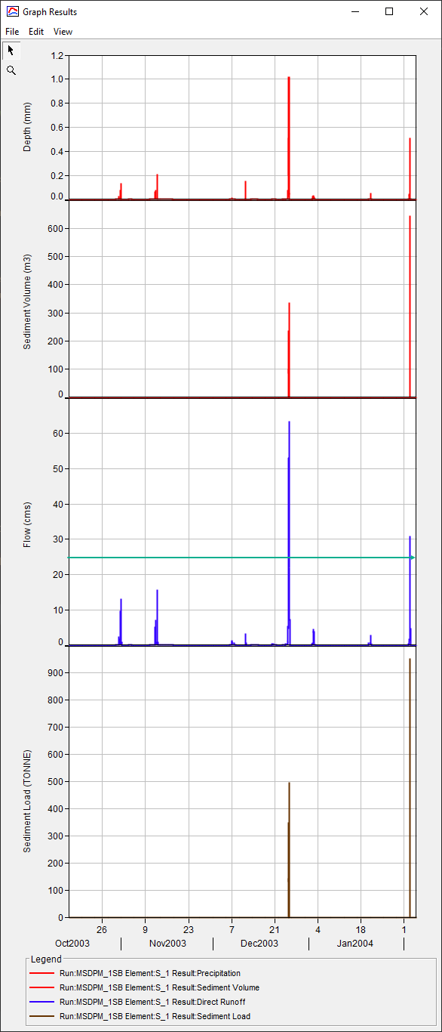
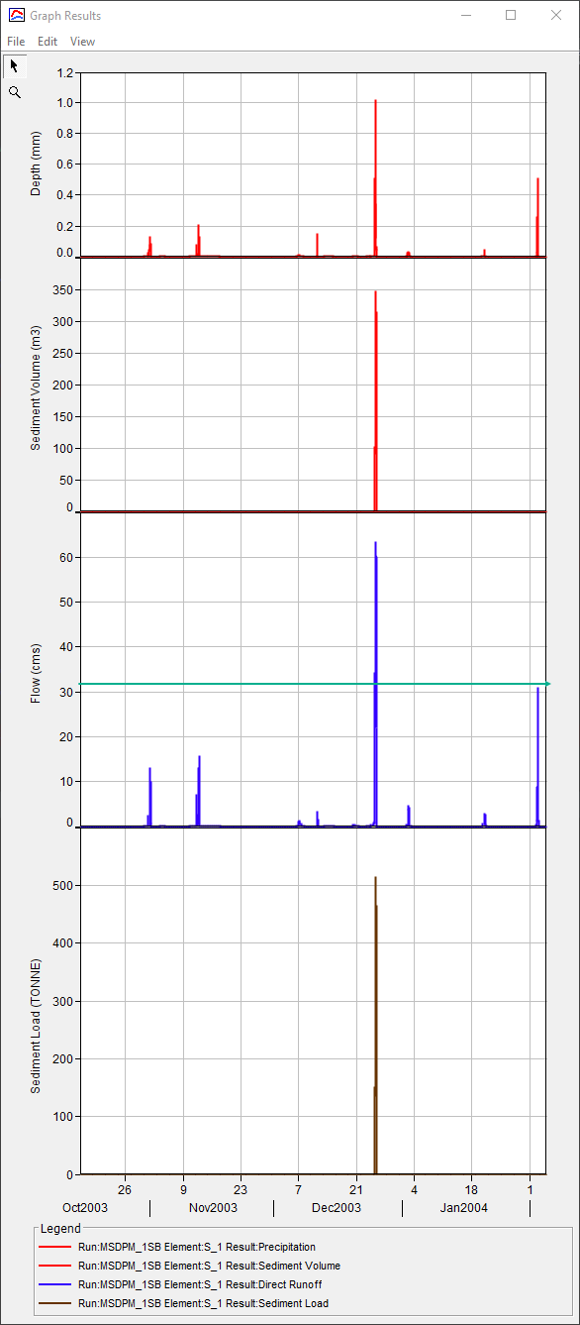
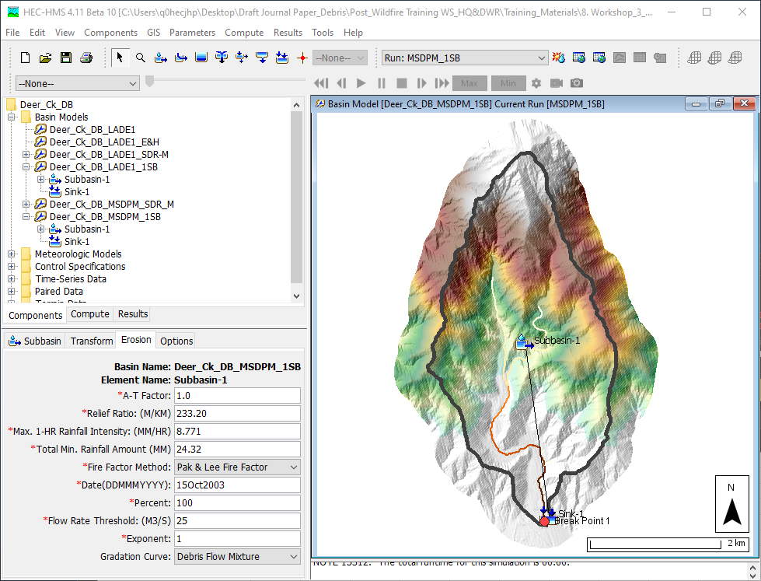
1-Subbasin with MSDPM
Relief Ratio (m/Km) | TMRI (mm/hr) | TMRA (mm) | Flow Rate Threshold (m³/s) | Measured Debris Yield (m³) | Estimated Debris Yield (m³) | Difference (%)
233.2 | 8.771 | 24.32 | 25 | 122,112 | 152,385 | 27
233.2 | 8.771 | 24.32 | 32 | 122,112 | 89,074 | -26

Slide 27




3-Subbasin (LAEQ 1) & 1-ReacH (SDR & M)
Element | Relief Ratio (m/Km) | Flow Rate Threshold (m³/s) | Burn Percentage (%) | Fire Factor Type/Burn Date
S_1 | 369.09 | 6 | 100 | Pak & Lee/ 15Oct2003
S_2 | 304.28 | 6 | 100 | Pak & Lee/ 15Oct2003
S_3 | 229.35 | 10 | 100 | Pak & Lee/ 15Oct2003
Element | Clay SDR | Silt SDR | Sand SDR | Gravel SDR
Reach-1 | 1.0 (NA) | 0.6 | 0.4 | 0.1
Measured Debris Yield: 120112 M³, Difference: -0.6%

Slide 28




3-Subbasin (MSDPM) & 1-ReacH (SDR & M)
Element | Relief Ratio (m/Km) | Flow Rate Threshold (m³/s) | Max. 1-hr Rainfall Intensity (mm/hr) | Total Min. Rainfall Amount (mm) | Burn (%) | Fire Factor Type/Burn Date
S_1 | 369.09 | 0.03 | 6.8163 | 20.665 | 100 | Pak & Lee/ 15Oct2003
S_2 | 304.28 | 0.03 | 7.5787 | 22.132 | 100 | Pak & Lee/ 15Oct2003
S_3 | 229.35 | 0.03 | 8.8514 | 24.468 | 100 | Pak & Lee/ 15Oct2003
Element | Clay SDR | Silt SDR | Sand SDR | Gravel SDR
Reach-1 | 1.0 (NA) | 0.61 | 0.41 | 0.21
Measured Debris Yield: 120112 M³, Difference: -0.3%

Slide 29
overview
    Fire Impacts on Main Channels
    Data Requirement for Reach Element
    Hydrology Debris Routing Method
      Reach Sediment/Debris Routing Process
        Sediment Continuity
        Transport Potential: 8 functions (SDR for Debris Flow)
        Transport Capacity
      Sediment Channel Routing: 5 Methods (Muskingum for Debris Flow)
    Case Studies:
      Deer Creek Debris Flow Analysis
    Need To Improve for Reach Routing Analysis

Slide 30
More Concerns for Debris Flow Channel Routing
Hydrologic Approach or Hydraulic Approach
Event or Continuous
Static or Dynamic Input Parameter
Newtonian or Non-Newtonian
Terrain and Topography:
  Slope and Elevation Changes: Analyzing the steepness of the terrain and variations in elevation is crucial for understanding how debris may flow downhill and accumulate.
  Plugging: Identifying potential choke points or areas where debris could become obstructed, leading to blockages or increased hazard downstream.
  Head Cut: Recognizing areas where head cuts or erosion may initiate, potentially triggering debris flows.
  Landslide Potential: Assessing the susceptibility of the terrain to landslides, as landslides can serve as debris sources and impact routing dynamics.
Question: Are you adequately equipped with the necessary data, information, and resources?
Simplification, guided by informed engineering judgment and backed by knowledge and experience, aims to streamline and eliminate unnecessary complexities.

Slide 31


Need to improve for reach element
New Mexico
Sediment Model Restructure: To move basin-level variables to element-level variables.

Slide 32
references
HEC-RAS 1D Sediment Transport User’s Manual (https://www.hec.usace.army.mil/confluence/rasdocs/rassed1d/1d-sediment-transport-user-s-manual)
Pak, J.H. and Lee, J.H., 2012. A Hyper-Concentrated Sediment Yield Prediction Model Using Sediment Delivery Ratio for Large Watersheds. KSCE Journal of Civil Engineering 16(5):883-891. (https://link.springer.com/article/10.1007/s12205-012-1588-3)
U.S. Army Corps of Engineers (2005). Analyses of the debris and sedimentation impacts at selected debris basins associated with the wildfires of 2003 and the December 25, 2003 storm: Hydrology and Hydraulics Section, U.S. Army Corps of Engineers, Los Angeles District, After Action Report DRAFT, p. 39.

Slide 33
Questions and Feedback
POC: Jay Pak, jay.h.pak@usace.army.mil

