Slide 1
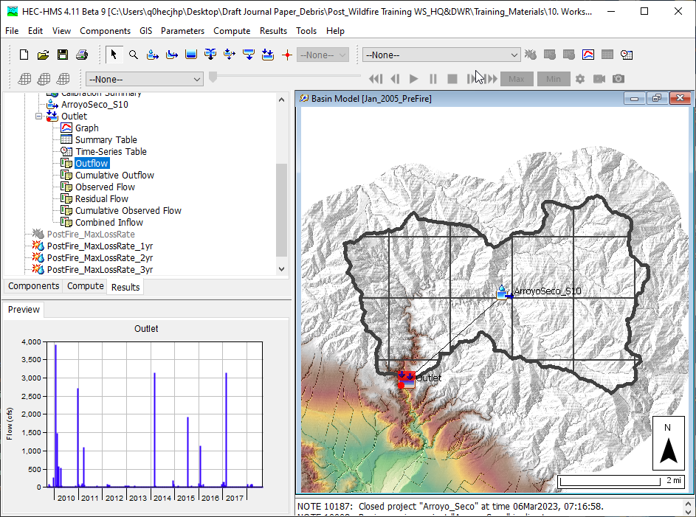
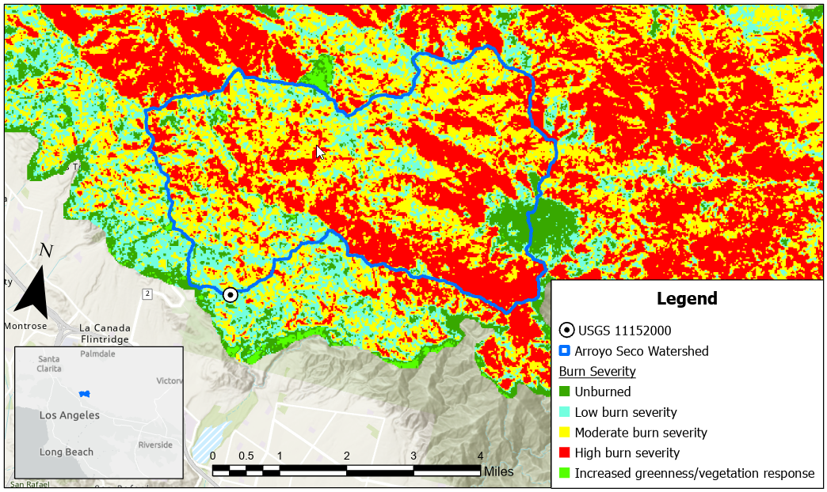


Post-wildfire hydrologic analysis
Jay Pak, Ph.D., P.E.
Watershed Scale Sediment and Post-Fire Hydrology/Debris Flow Analysis Specialist, USACE IWR-HEC

Slide 2
overview
    Challenges to the Post-Wildfire Hydrologic Analysis
    Data Requirement
    Post-Wildfire Hydrology Models (event & continuous models)
      Sigle-Event & Frequent Event Storm Models
        Static Loss Methods: SCS CN Loss Method
      Continuous Models
        Dynamic Loss Methods: Pak & Lee Decay Factor (Pak and Lee, 2008)
    Case Studies:
      Arroyo Seco Post-Wildfire Hydrology Analysis
    Need To Improve for Post-Wildfire Hydrology Analysis

Slide 3
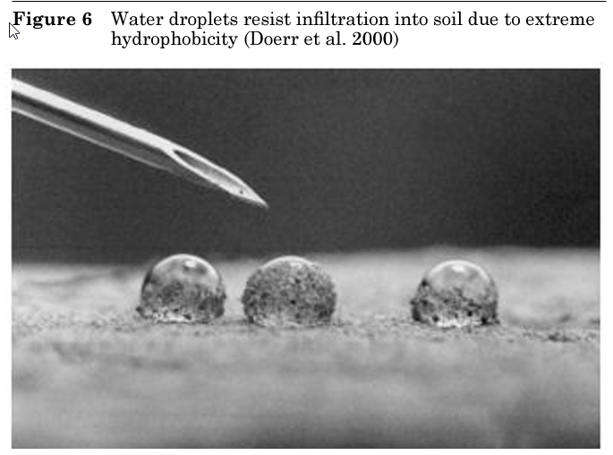
wildFire impacts on Hydrologic cycle
The wildfire effect will decay over time (dynamic system).
WILDFIRE
Vegetation
Upper Soil Layer (hydrophobic conditions, water repellency, infiltration rate, etc.)
Evaporation/Evapotranspiration
Runoff Peak & Volume (momentum, energy, time of peak, lag, etc.)
Earth’s surface (Burn Scar, landslide, debris flow. erosion, deposition, etc.)
Water Quality (ash, sediment, drinking water resources, treatment, aquatic habitats, etc.)
Considerations for post-wildfire hydrology analysis
  Event or Continuous (Static/Dynamic Simulation)
  Flow or Flow+Sediment/Debris

Slide 4
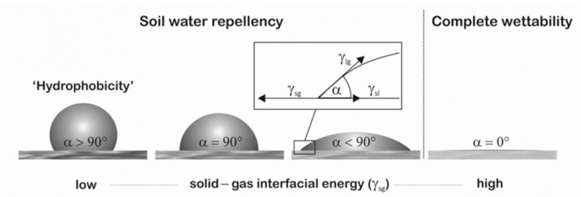
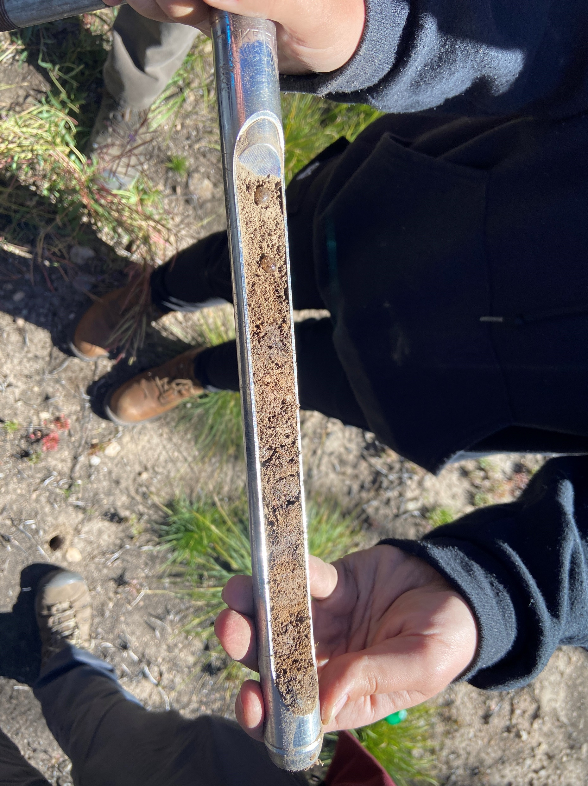
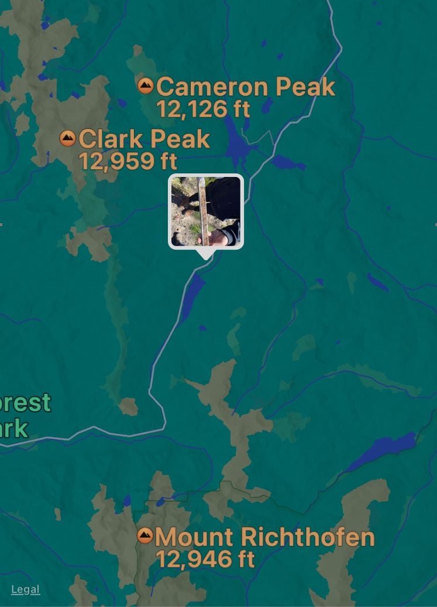
Water Drop Test (7SEP23) on Sevier Burn Site: Cameron Peak Fire (13Aug20 – 2DEC20)

Slide 5
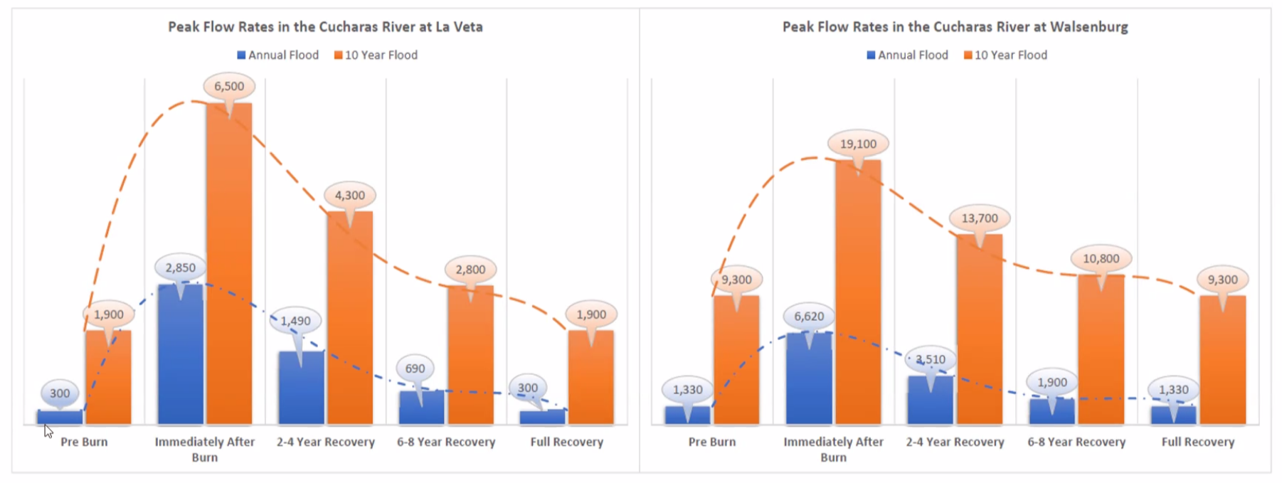
Spring creek fire (2018, Fort Garland & La Veta, Co) – pre & post HMS results
New Mexico
From Dr. Gerald Blacker AAWRE Free Webinar (January 26, 2023) on Introduction to HEC-HMS and its Applications for Floods after Fire

Slide 6
HEC-HMS Post-Fire Hydrology & Debris Flow Analysis Features
Subbasin
Subbasin Outlet
Reach
Reach Outlet
LADM EQ 1
Debris Routing
(SDR+ Muskingum)
Bulk Flow
MSDPM
Bulk Flow
USGS-LT
USGS-EA
LADM EQs 2-5
Reservoir
Reservoir Outlet
Volume Reduction
Bulk Flow
Dynamic Surface Infiltration Loss Method (Pak & Lee) with some of existing loss methods
Chen & Brune Trap Efficiency Methods
Settling Velocity (Hindered)

Slide 7
overview
    Challenges to the Post-Wildfire Hydrologic Analysis
    Data Requirement
    Post-Wildfire Hydrology Models (event & continuous models)
      Sigle-Event & Frequent Event Storm Models
        Static Loss Methods: SCS CN Loss Method
      Continuous Models
        Dynamic Loss Methods: Pak & Lee Decay Factor (Pak and Lee, 2008)
    Case Studies:
      Arroyo Seco Post-Wildfire Hydrology Analysis
    Need To Improve for Post-Wildfire Hydrology Analysis

Slide 8
Data requirement
Rainfall Data
Evaporation Data for Long-Term Simulation
Flow Gage Data (Pre- & Post-Fire)
Soil Burn Severity Map
Soil Properties data for Pre- & Post Fire (Hydraulic Conductivity, SWR, Sorptivity, etc.)

Slide 9
overview
    Challenges to the Post-Wildfire Hydrologic Analysis
    Data Requirement
    Post-Wildfire Hydrology Models (event & continuous models)
      Sigle-Event & Frequent Event Storm Models
        Static Loss Methods: SCS CN Loss Method
      Continuous Models
        Dynamic Loss Methods: Pak & Lee Decay Factor (Pak and Lee, 2008)
    Case Studies:
      Arroyo Seco Post-Wildfire Hydrology Analysis
    Need To Improve for Post-Wildfire Hydrology Analysis

Slide 10

Post-wildfire hydrology management
“Existing methods for adjusting CNs to account for wildfire effects are for the most part based heavily upon the hydrologic judgment of practitioners who have studied burned watersheds.”
- USDS (2016)
The SCS-CN method:
Computations are efficient;
Required soil type, land use, and management practices are readily available
It produces satisfactory runoff estimates

Slide 11
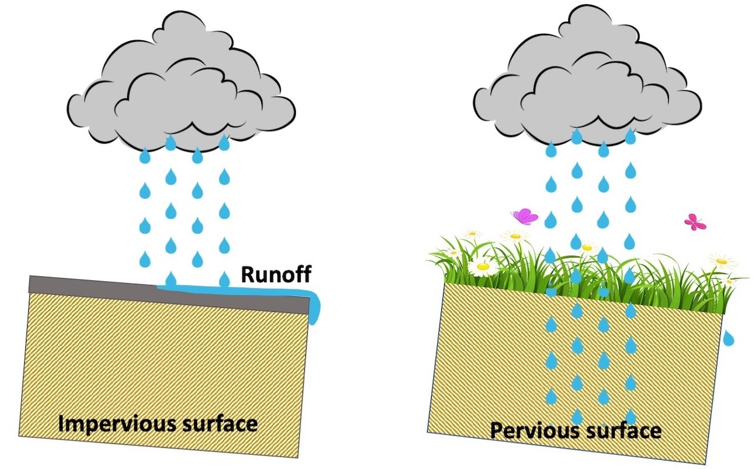

Curve number (CN)
Originally developed by examining rainfall runoff data from small agricultural watersheds (1 to 2,000 acres (0.001 to 3 mi²)).
Lumped parameter which represents watershed characteristics such as soil type, land use, hydrologic conditions, and initial soil moisture.
Runoff curve numbers can be any value from 0 (deep gravels) to 100 (smooth impervious surface), but for practical applications fall within a limited range of about 40 to 98.
The runoff curve number for a given soil-cover type is not a constant but varies from storm to storm, and even within the storm.
$$CN=\frac{1,000}{10+S}$$
CN = Curve Number
S = potential maximum retention (inches)
From Mr. Jose Paredez, ERDC University CHL & HEC Update Webinar (July 28, 2023)
Notes:
The NRCS CN method assigns a representative runoff curve number for a given soil and cover type for design purposes.

Slide 12
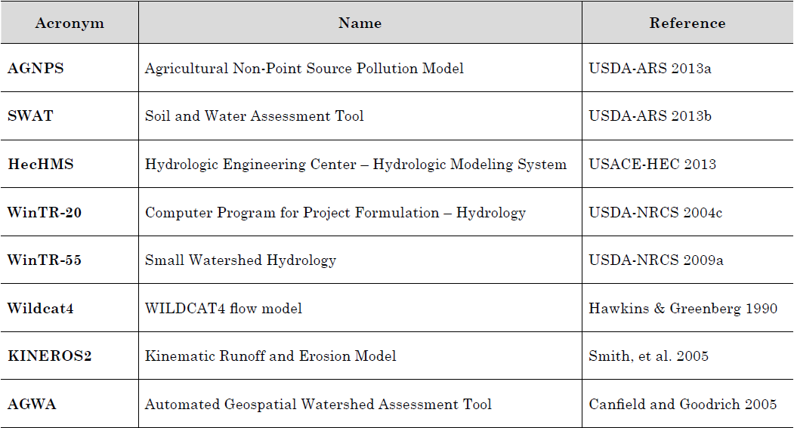
Event Post-wildfire hydrology models
Event Models
  SCS CN Method with Post-Fire CN Values
Source: Hydrologic Analyses of Post-Wildfire Conditions, USDS, NRCS, Hydrology Technical Note No.4, Aug 2016
(https://directives.sc.egov.usda.gov/OpenNonWebContent.aspx?content=39877.wba)

Slide 13
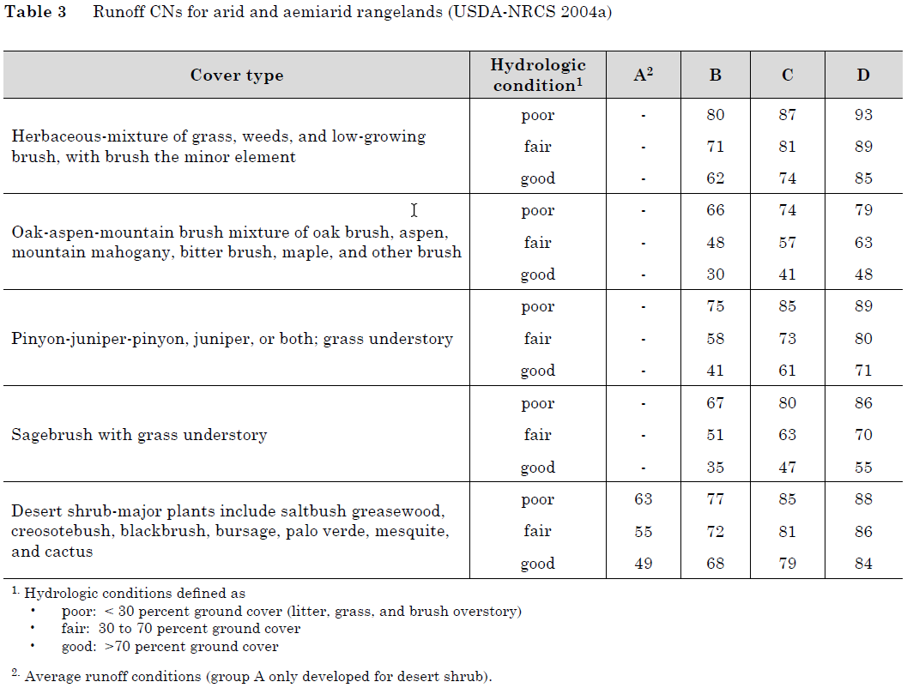
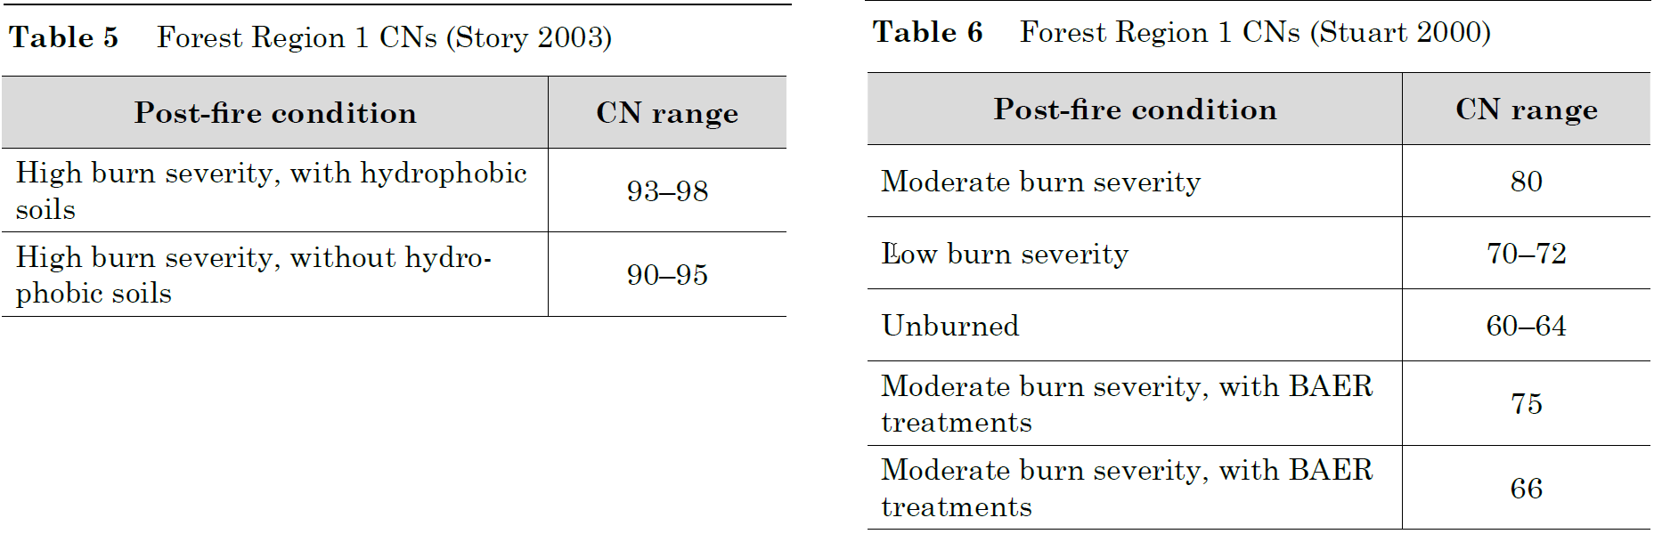
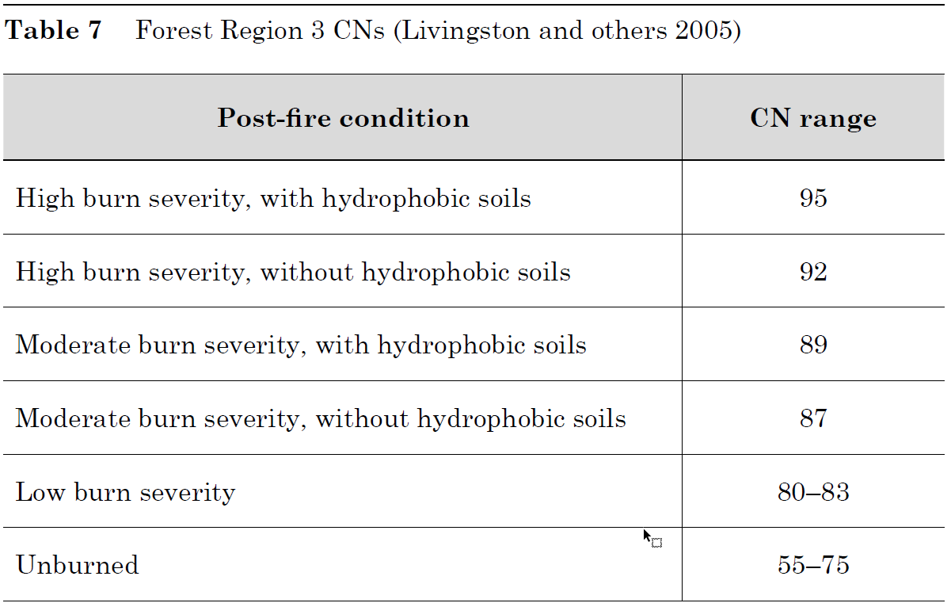
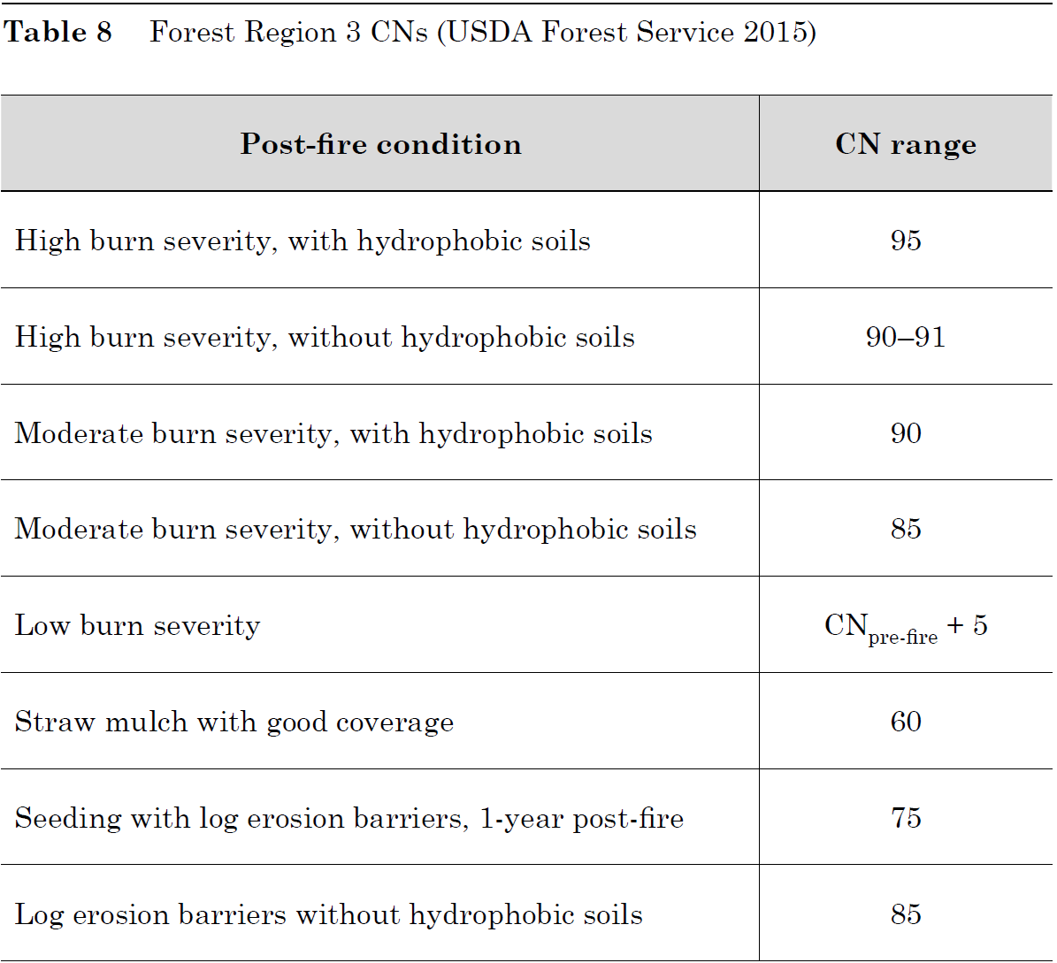
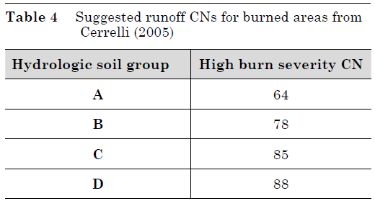
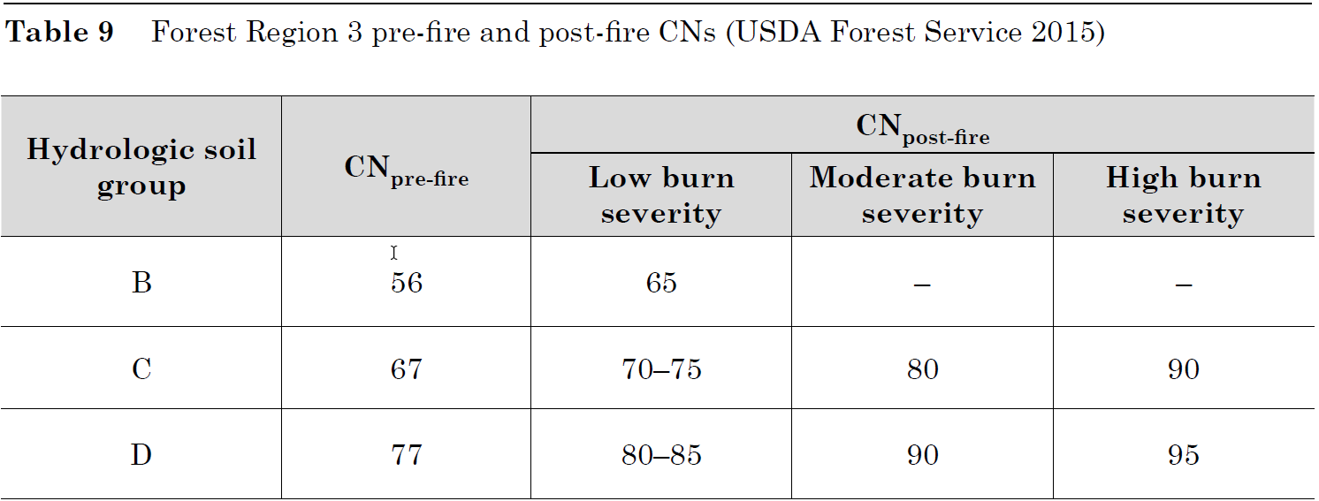
Adjustment of CN for wildfire effects
Source: Hydrologic Analyses of Post-Wildfire Conditions, USDS, NRCS, Hydrology Technical Note No.4, Aug 2016
(https://directives.sc.egov.usda.gov/OpenNonWebContent.aspx?content=39877.wba)

Slide 14
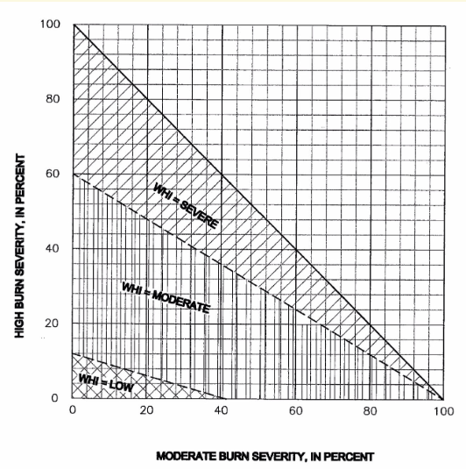
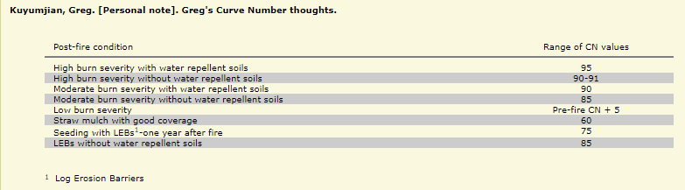
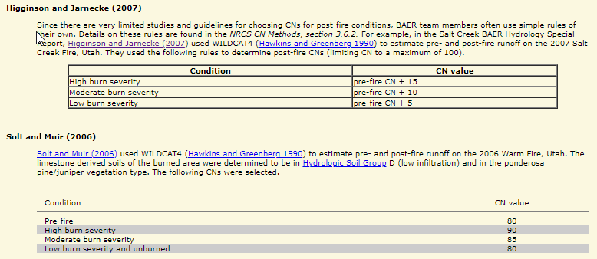
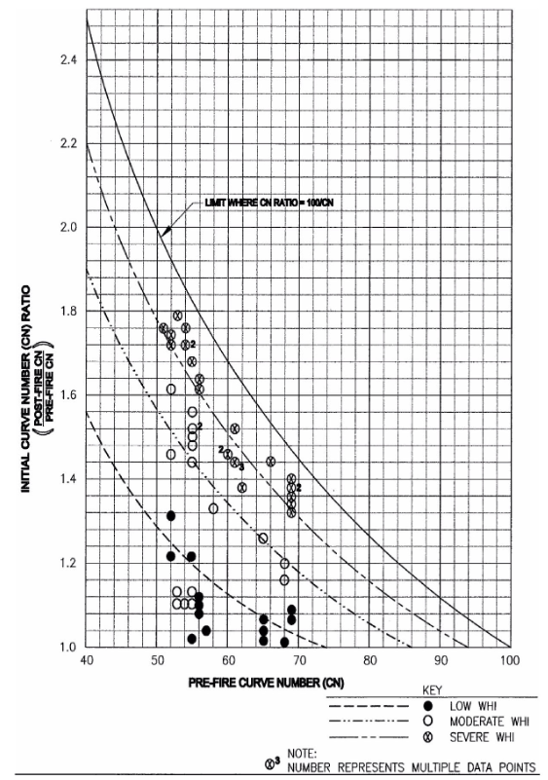
Adjustment of CN for wildfire effects
(Continued)
Source: Burned Area Emergency Response Tools
(https://forest.moscowfsl.wsu.edu/BAERTOOLS/ROADTRT/Peakflow/CN/supplement.html)
Livingston and others (2005)

Slide 15
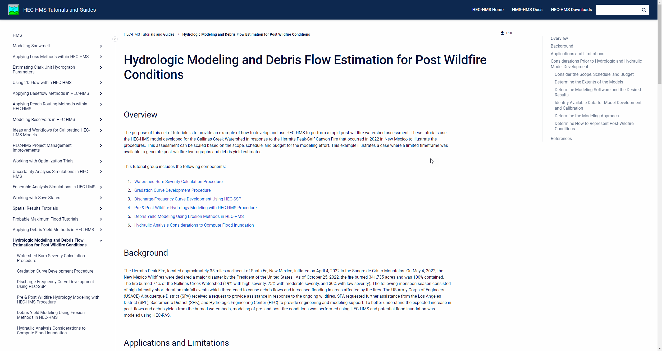
SOP with HEC-HMS
    Hydrologic Modeling and Debris Flow Estimation for Post Wildfire Conditions
Prepared by SPA, SPK, SPL, and HEC

Slide 16
Limitations of the post-wildfire
Hydrologic model
Limitations of the CN Method
  Lack of Field Data in burned catchments
  Little Research adequate to determine best-fit runoff CNs
    CN values are still not well known for burned conditions
    Spatial variability of soil-cover complexes/soil-burn severities
Limitations of the Post-Wildfire Runoff Models
  Lack or understanding the difference between pre-fire versus post-fire
    Time of Concentration
    Lag
    Velocity
    Infiltration
    Manning’s roughness coefficients, etc.
Recommendation: Use the Regional Post-Wildfire CN values if applicable.
Source: Hydrologic Analyses of Post-Wildfire Conditions, USDS, NRCS, Hydrology Technical Note No.4, Aug 2016
(https://directives.sc.egov.usda.gov/OpenNonWebContent.aspx?content=39877.wba)

Slide 17
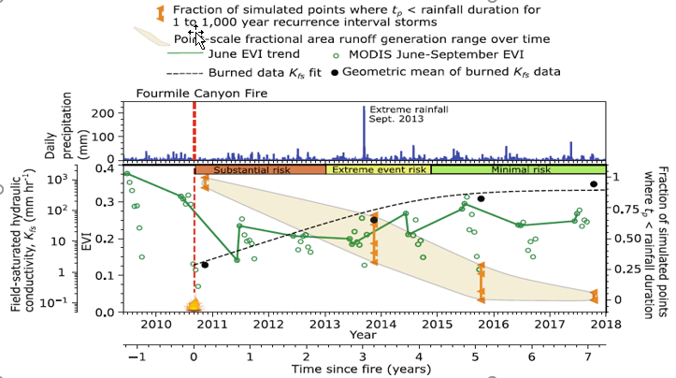
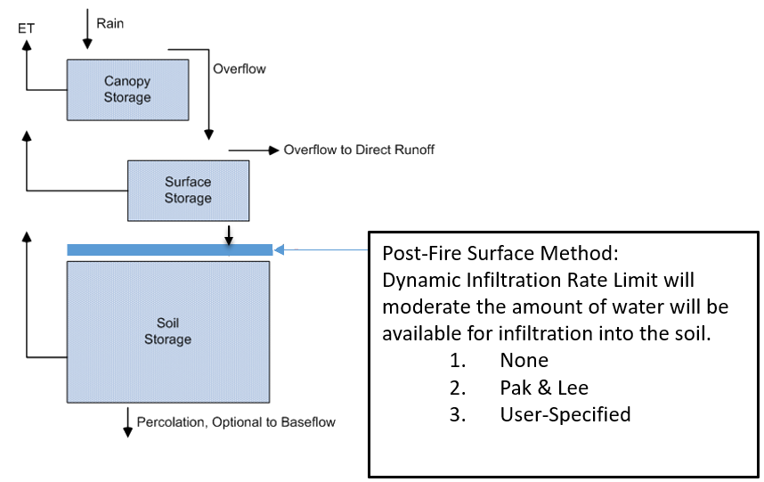
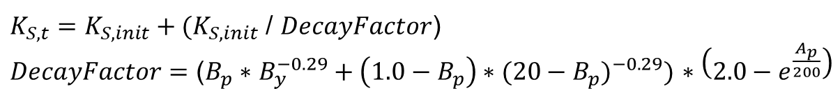
Continuous Post-wildfire hydrology models
Dynamic Infiltration Loss method (Pak & Lee) under Fire condition
$K_{S,t}=K_{S,init}+(K_{S,init}$ / $DecayFactor$)
$DecayFactor$ $=$ ($B_{p}∗$ $B_{y}^{−0.29}+{\left(1.0−B_{p}\right)∗(20−B_{p})}^{−0.29})$ $∗\left(2.0−e^{\frac{A_{p}}{200}}\right)$
Ks,t is the dynamic infiltration rate t days after the burn
Ks,init is the initial infiltration limit (i.e. the infiltration value immediately after the wildfire).
Bp is the fraction of the watershed that was burned (0≤Bp≤1)
By is the number of years since the burn date (0≤By≤10 where By is a real number), Ap is the number of antecedent effective precipitation events.
Source: (Brian A Ebel, 2020) Temporal evolution of measured and simulated infiltration following wildfire in the Colorado Front Range, USA: Shifting thresholds of runoff generation and hydrologic hazards

Slide 18
overview
    Challenges to the Post-Wildfire Hydrologic Analysis
    Data Requirement
    Post-Wildfire Hydrology Models (event & continuous models)
      Sigle-Event & Frequent Event Storm Models
        Static Loss Methods: SCS CN Loss Method
      Continuous Models
        Dynamic Loss Methods: Pak & Lee Decay Factor (Pak and Lee, 2008)
    Case Studies:
      Arroyo Seco Post-Wildfire Hydrology Analysis
    Need To Improve for Post-Wildfire Hydrology Analysis

Slide 19
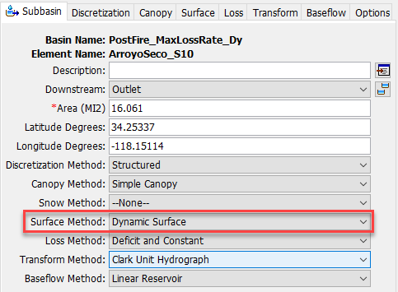
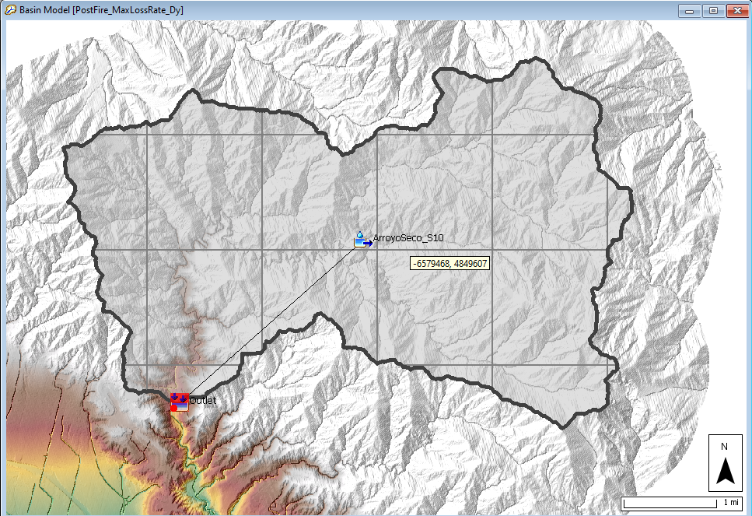
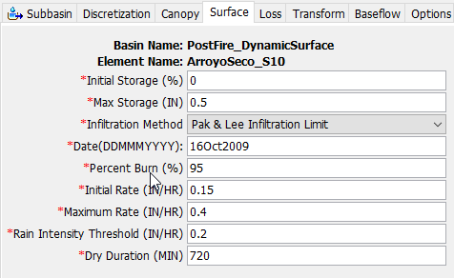
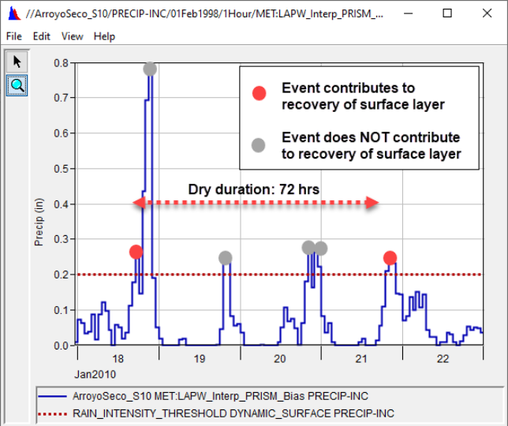
Arroyo Seco Watershed
The Initial Storage describes the percentage of the surface storage that is full of water at the beginning of the simulation.
The Max Storage represents the maximum amount of water that can be held on the soil surface before surface runoff begins.
The Max Storage is specified as an effective depth of water.
The Initial Rate is the initial loss rate of the surface layer during the first storm event after the burn.
The Maximum Rate is the loss rate that the surface layer recovers after 10 years.
The Date of Burn and Percent Burn parameters can be found from the Burned Area Emergency Response (BAER) Program and Monitoring Trends in Burn Severity (MTBS) datasets.
A tutorial demonstrating calculation of watershed burn severity can be found here: Watershed Burn Severity Calculation Procedure.
The Dry Duration describes the required time between precipitation events exceeding the Rain Intensity Threshold
that must occur for the events to contribute to the recovery of the surface layer.

Slide 20
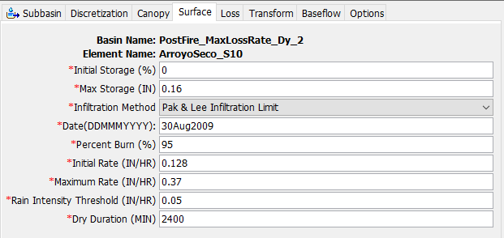
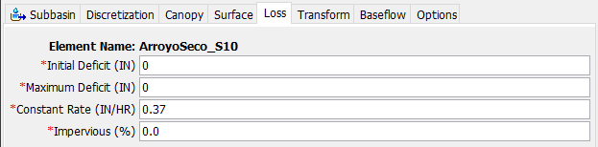
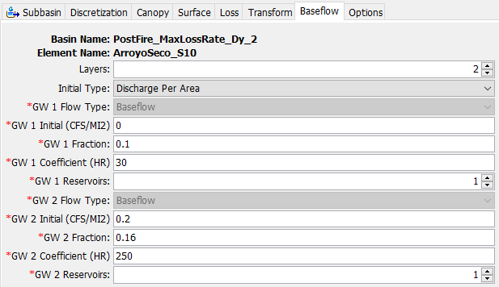
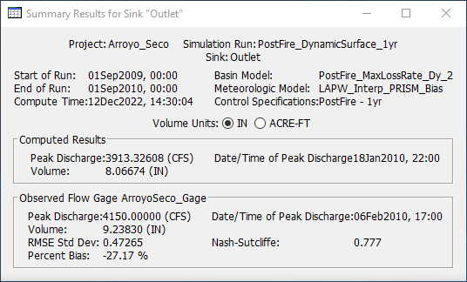
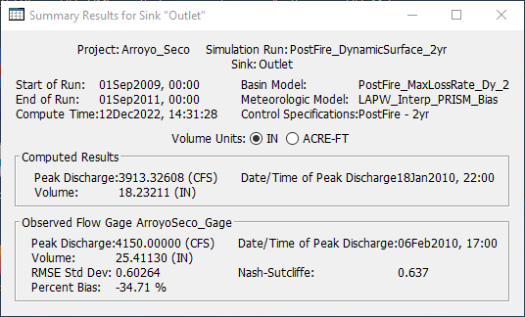
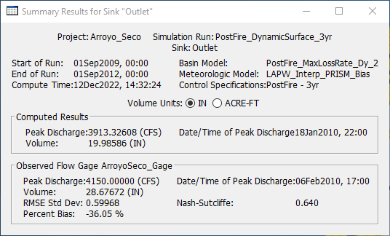
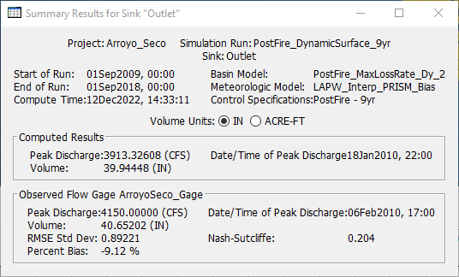
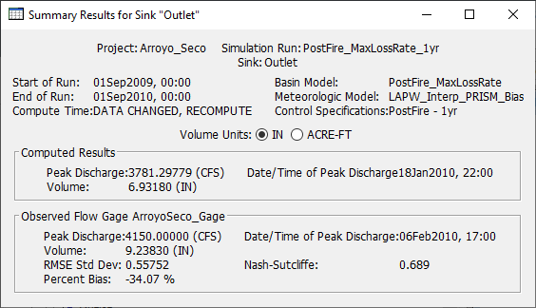

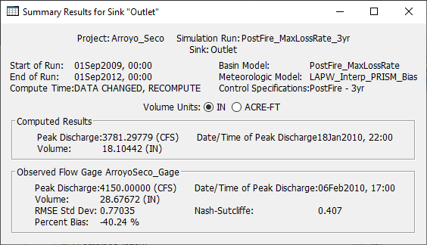
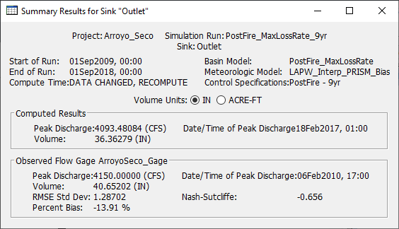
Comparison with/without Dynamic Infiltration Loss Method

Slide 21
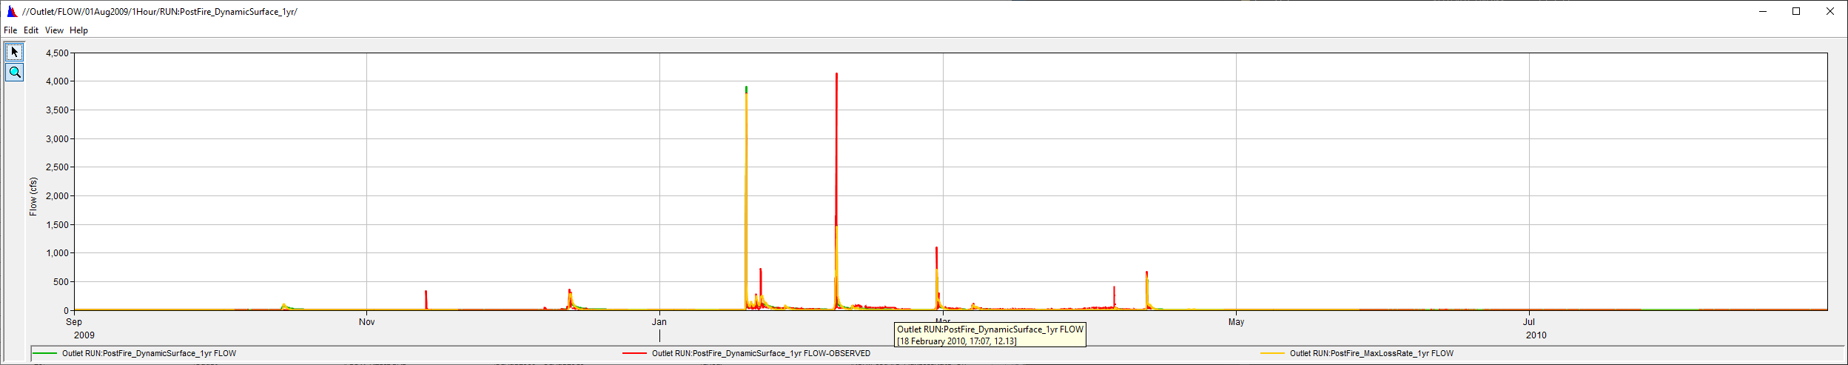
1-Year Comparison

Slide 22
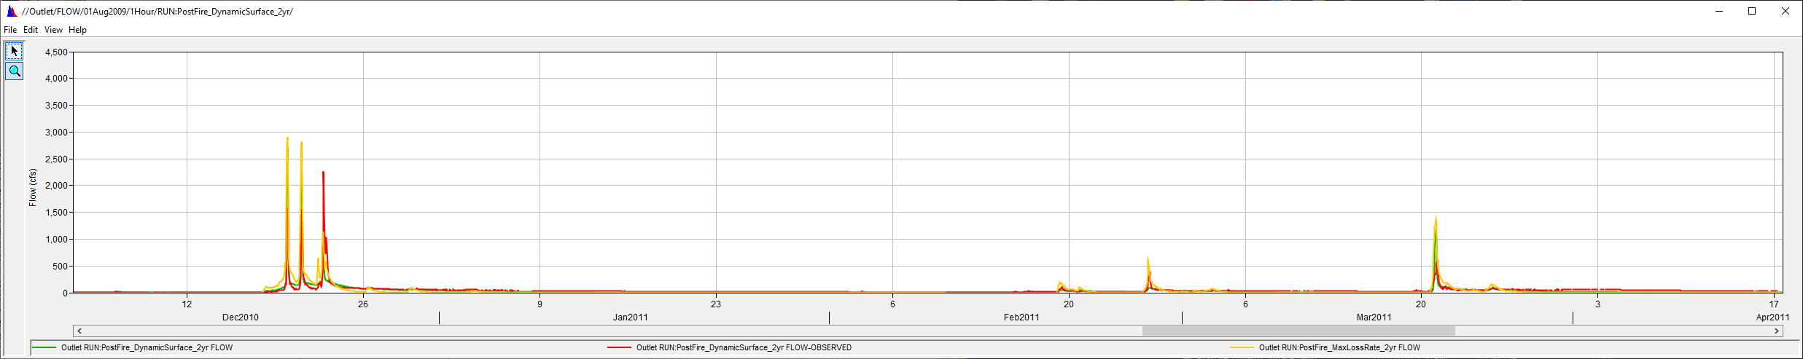
2-Year Comparison

Slide 23
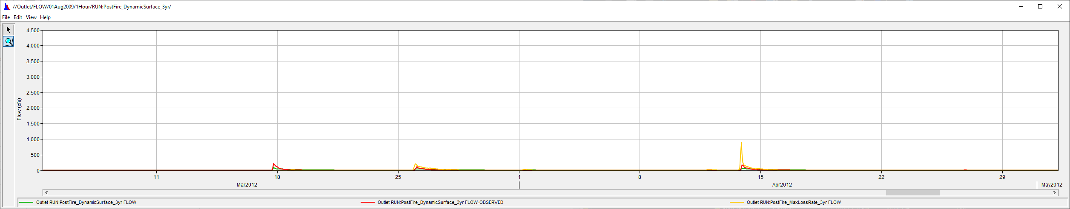
3-Year Comparison

Slide 24
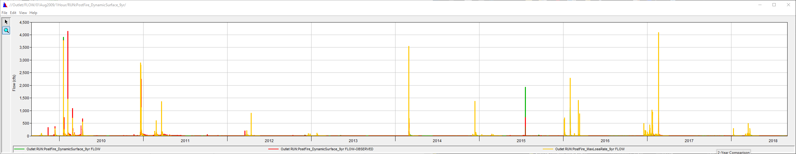
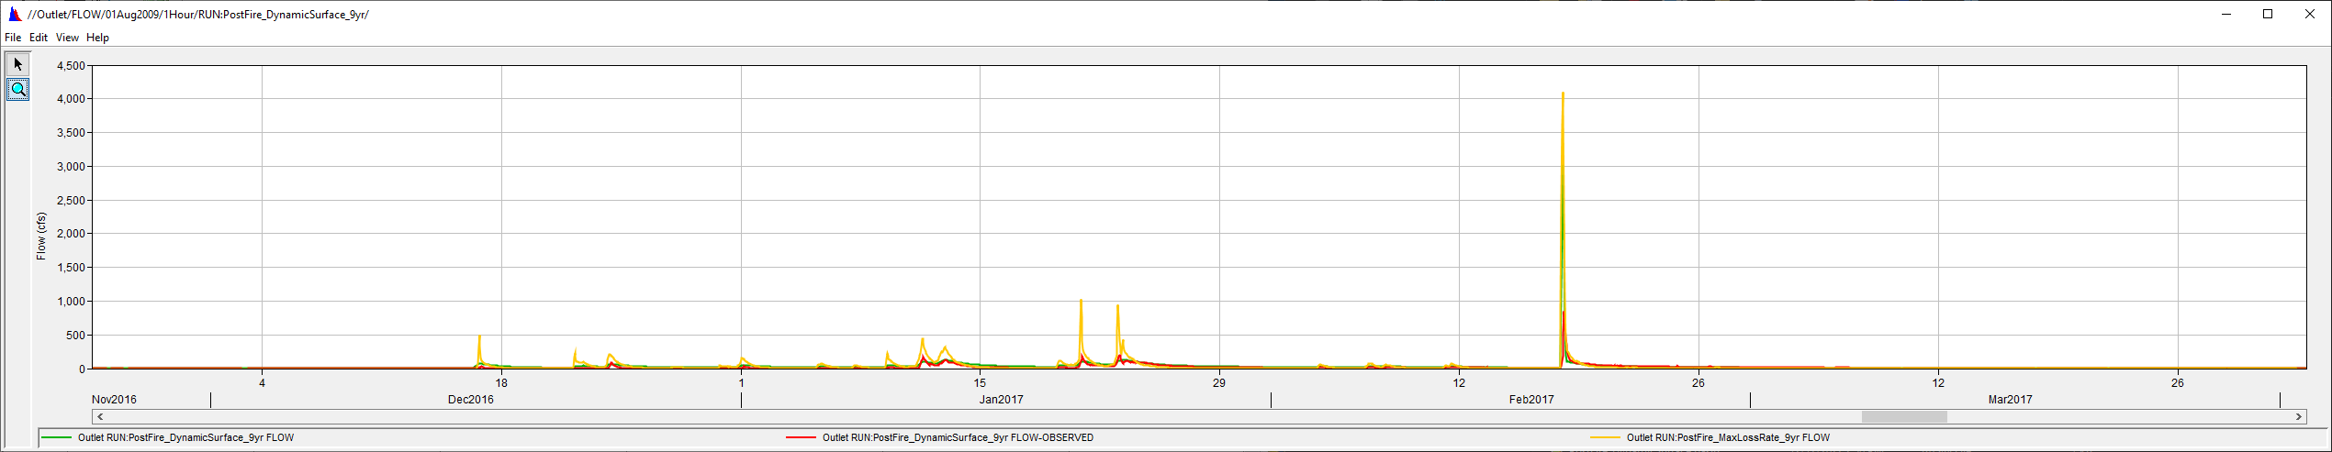
9-Year Comparison

Slide 25
overview
    Challenges to the Post-Wildfire Hydrologic Analysis
    Data Requirement
    Post-Wildfire Hydrology Models (event & continuous models)
      Sigle-Event & Frequent Event Storm Models
        Static Loss Methods: SCS CN Loss Method
      Continuous Models
        Dynamic Loss Methods: Pak & Lee Decay Factor (Pak and Lee, 2008)
    Case Studies:
      Arroyo Seco Post-Wildfire Hydrology Analysis
    Need To Improve for Post-Wildfire Hydrology Analysis

Slide 26
Study Motivation
“Existing methods for adjusting CNs to account for wildfire effects are for the most part based heavily upon the hydrologic judgment of practitioners who have studied burned watersheds.”
- USDS (2016)

Slide 27



Future development plan
New Mexico
Develop a Modified Green & Ampt Infiltration Loss Method (Shillito and Berli, 2020) in HEC-HMS
Develop a Surface Runoff Models based on the sorptivity, because sorptivity is a direct measure of soil water repellency (SWR). (Shillito et al., 2020)
$$I=Kt+ ψ∆θln\left(1+\frac{I}{ψ∆θ}\right)$$
Using
$$I=Kt+ \frac{S^{2}}{2K}ln\left(1+\frac{I2K}{S^{2}}\right)$$
Total infil = I = 1 cm
t = measured time
$S^{2}=2KψΔθ$
(Philip, 1957)
Total infiltration = I = St^{1/2} + Kt
At short time: I = St^{1/2}
Rearranging: S = I/t^{1/2}
where
I = cumulative infiltration, K = hydraulic conductivity, ψ = the effective suction at the wetting front, Δθ= change in soil water content, S = sorptivity, and t = time

Slide 28
HEC-HMS Modified Green and Ampt Infiltration Guidance
Part II: Addition to EM1110-2-1417, Sorptivity values for model parameter initialization (Draft version)
Note: Preliminary Information – Subject to Revision, Not for Citation or Distribution.
EM1110-2-1417
31 Aug 94
Table 6.2 (mod) Texture Class Estimates (from Rawls and Brakensiek, 1982 and Rawls, Brakensiek and Saxton, 1982) (Sorptivity data calculated from Kumar and Malik, 1990 or currently unpublished field measurements)
Texture class | Sample size | (Columns for Total porosity, Residual saturation, Bubbling pressure, pore size distribution, and γ from original table) |  | Saturated hydraulic conductivity Ks cm/hr | hf cm | Sorptivity^{1,2, 3} cm/s^{-1/2} (median and range)
 |  |  |  |  |  | S_{0,0} | Post-wildfire Sorptivity⁴ (Sorptivity adjusted for burn severity)
 |  |  |  |  |  |  | low | moderate | high
Sand |  |  |  | 21.00 | 10.6 | 0.37 (0.34, 0.53) | 0.30 (0.27, 0.42) | 0.19 (0.17, 0.27) | 0.07 (0.07, 0.11)
Loamy sand |  |  |  | 6.11 | 14.2 | 0.35 (0.35, 0.41) | 0.28 (0.28, 0.33) | 0.18 (0.18, 0.21) | 0.07 (0.07, 0.08)
Sandy loam |  |  |  | 2.59 | 22.2 | 0.28 (0.24, 0.38) | 0.23 (0.16,0.30) | 0.15 (0.12, 0.19) | 0.06 (0.05, 0.08)
Loam |  |  |  | 1.32 | 31.5 | 0.32 | 0.26 | 0.16 | 0.06
Silt loam |  |  |  | 0.68 | 40.4 | 0.19 | 0.15 | 0.10 | 0.04
Sandy clay loam |  |  |  | 0.43 | 44.9 | NDA | NDA | NDA | NDA
Clay loam |  |  |  | 0.23 | 44.6 | 0.37 | 0.30 | 0.19 | 0.07
Silty clay loam |  |  |  | 0.15 | 58.1 | 0.24 | 0.19 | 0.12 | 0.05
Sandy clay |  |  |  | 0.12 | 63.6 | 0.25 (0.21, 0.28) | 0.20 (0.17, 0.22) | 0.13 (0.11, 0.14) | 0.05 (0.04, 0.06)
Silty clay |  |  |  | 0.09 | 64.7 | NDA | NDA | NDA | NDA
Clay |  |  |  | 0.06 | 71.4 | NDA | NDA | NDA | NDA
Silt |  |  |  |  |  | NDA | NDA | NDA | NDA
NOTE: The sorptivity (S_{0,0}) values shown assume dry initial moisture conditions and no hydrophobicity 1 First line is the median value, second line shows the (min, max) values 2 Single value entries indicate only one data value available 3 NDA = No Data Available 4 Sorptivity reduction for burn severity based on Parsons et al., 2010; Dyrness, 1976; Shillito et al., 2020

Slide 29
More Concerns for post-fire hydrology Modeling
Short-term or Long-term
Static or Dynamic Input Parameter for Long-term
Antecedent Soil Moisture Conditions
Soil Properties Change and Recover: hydrophobicity (water repellency)
  Increased the risk of flash flooding and debris flow
Vegetation Loss and Recover
Modeling Challenges: due to the dynamic and nonlinear nature of the processes involved.
Data Availability
Mitigation Measures: mulching, straw wattles, silt fences, check dams, revegetation, monitoring, early warning system, debris removal, etc.
Climate Change: Change the Wildfire and Rainfall Pattern and Frequency
Etc.

Slide 30
references
Ebel, A.E., 2020. Temporal evolution of measured and simulated infiltration following wildfire in the Colorado Front Range, USA: Shifting thresholds of runoff generation and hydrologic hazards. Journal of Hydrology 585 (2020) 124765 (https://doi.org/10.1016/j.jhydrol.2020.124765)
Higginson, Brad; Jarnecke, Jeremy. 2007. Salt Creek BAER-2007 Burned Area Emergency Response. Provo, UT: Uinta National Forest; Hydrology Specialist Report. 11 p.
Hydrologic Analyses of Post-Wildfire Conditions, USDS, NRCS, Hydrology Technical Note No.4, Aug 2016 (https://directives.sc.egov.usda.gov/OpenNonWebContent.aspx?content=39877.wba)
Pak, J.H. and Lee, J.J., 2008. A Statistical Sediment Yield Prediction Model Incorporating the Effect of Fires and Subsequent Storm Events (https://onlinelibrary.wiley.com/doi/10.1111/j.1752-1688.2008.00199.x)
Philip, J. R. (1957). The theory of infiltration: 4. Sorptivity and algebraic infiltration equations. Soil science, 84(3), 257-264.
Shillito, R.M. et al., 2020.Quantifying the Effect of Subcritical Water Repellency on Sorptivity: A Physically Based Model (https://agupubs.onlinelibrary.wiley.com/doi/epdf/10.1029/2020WR027942)
Solt, Adam; Muir, Mark. 2006. Warm Fire--hydrology and watershed report. Richfield, UT: U.S. Department of Agriculture, Forest Service, Intermountain Region, Fishlake National Forest. 9 p.

Slide 31
Questions and Feedback
POC: Jay Pak, jay.h.pak@usace.army.mil

