Slide 1
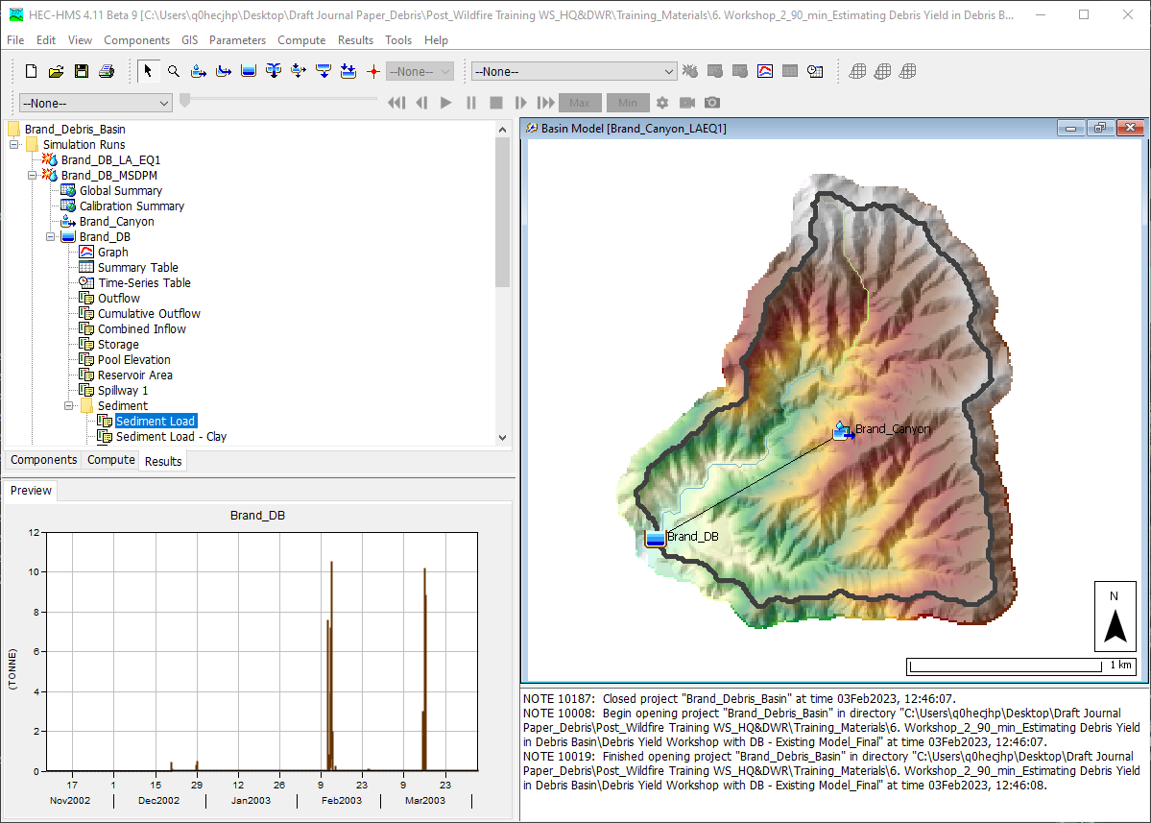
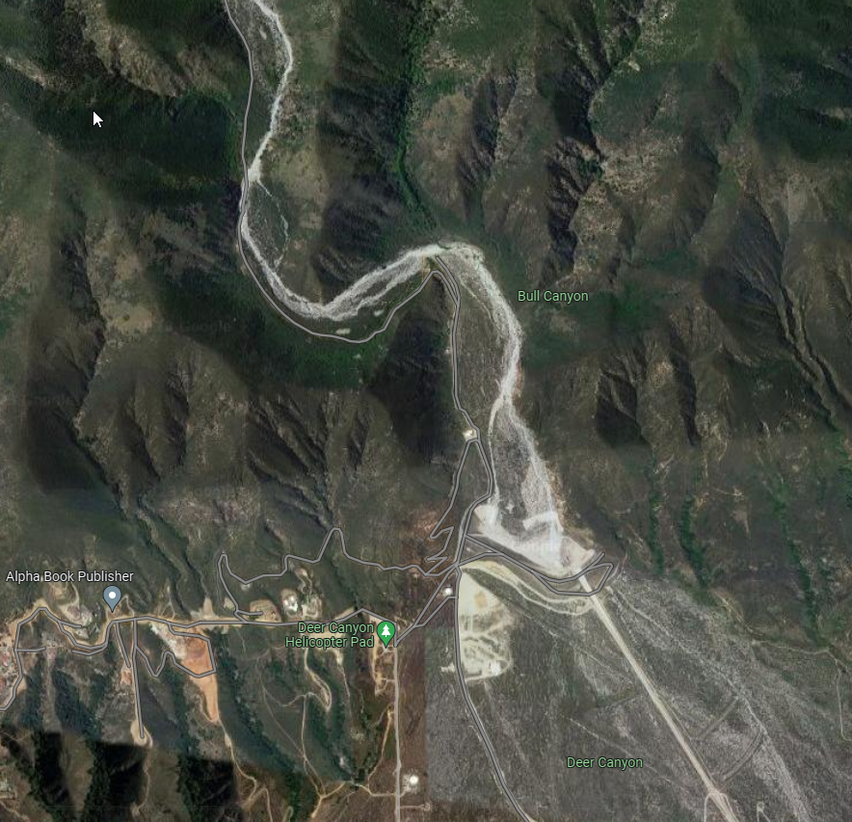
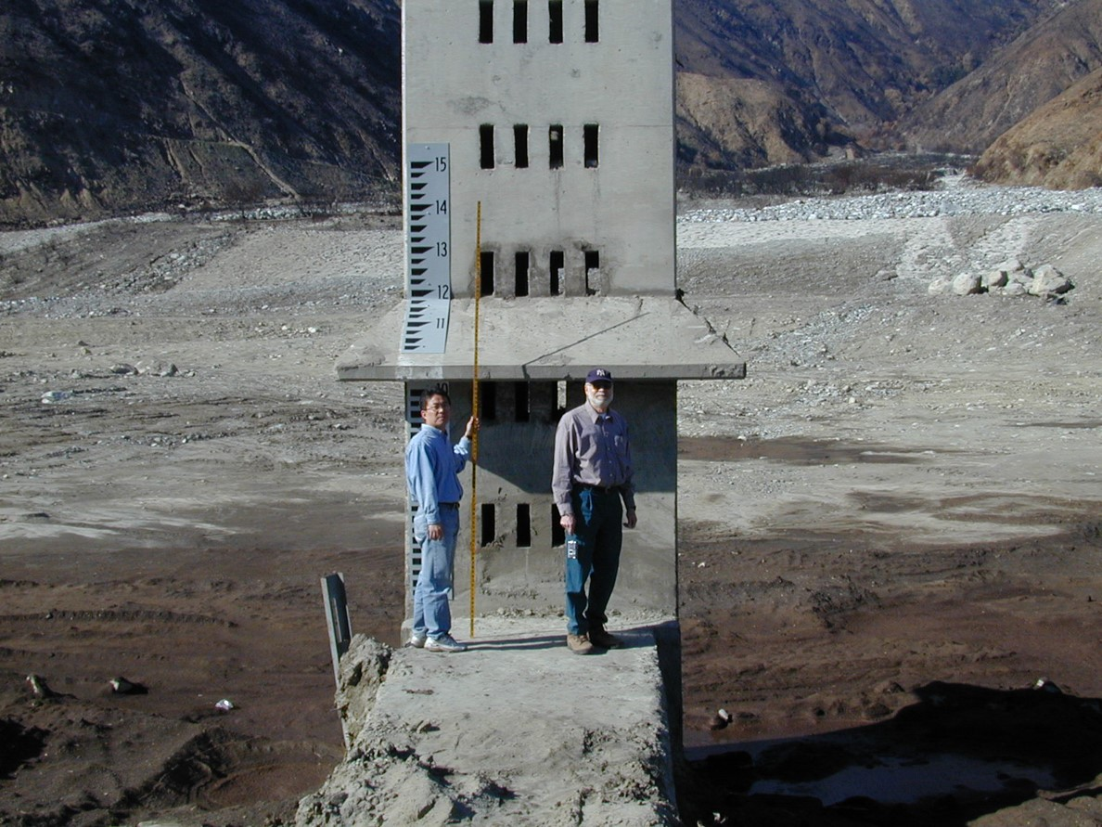
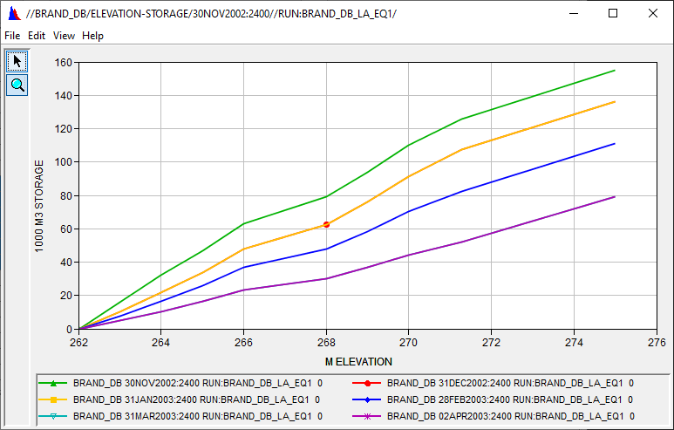


Debris Reservoir Routing Analysis
Aerial Photo for Deer Creek Debris Basin (Google Map)
Deer Creek Debris Basin: Clean-Out (210,277 yd³) Condition after 25 DEC 2003 event (0.95 in/hr)
Jay Pak, Ph.D., P.E.
Watershed Scale Sediment and Post-Fire Hydrology/Debris Flow Analysis Specialist, USACE IWR-HEC

Slide 2
overview
    Fire Impacts on Debris Basin and Reservoir
    Data Requirement for Reservoir Element
    Reservoir Volume Reduction Process
      Two Trap Efficiency Methods
        Chen Sediment Trap
        Brune Sediment Trap
      Two Volume Reduction Options
        V-Shape
        Elongated Taper
    Case Studies:
      Brand Debris Analysis with Debris Basin
      Large Reservoir Volume Reduction Analyses without Fires
    Need To Improve for Reservoir Routing Analysis

Slide 3
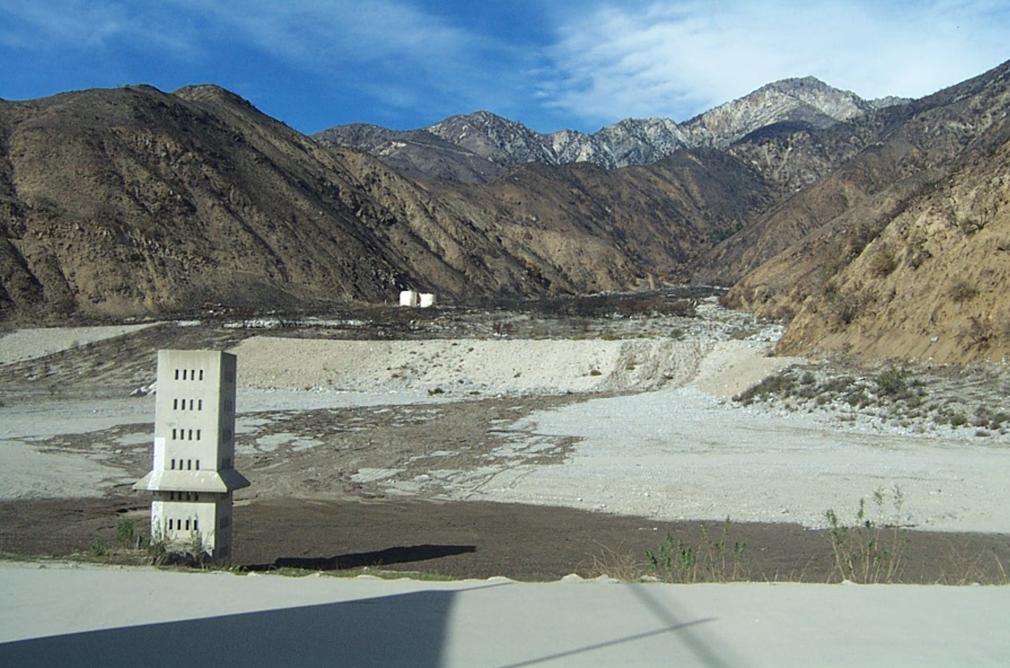
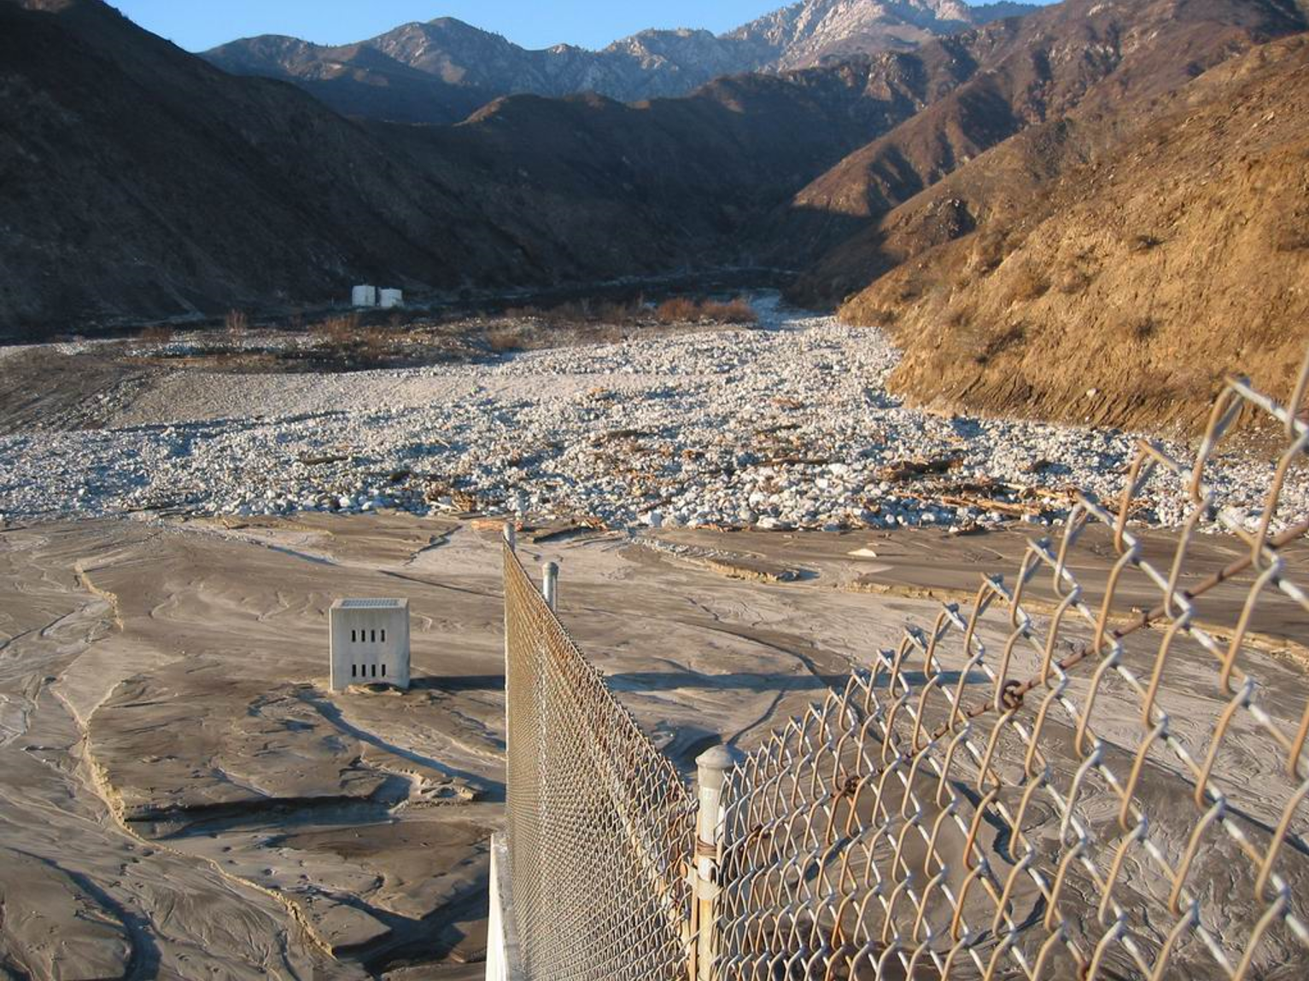
Fire impacts on debris basin and reservoir
Source: Morris and Fan (1998), Reservoir Sedimentation Handbook
Increased Sedimentation
Water Quality Issues
Structural Damage
Increased Flooding Risk
Vegetation Loss
Mitigation:
Erosion Control
Sediment Removal
WQ Monitoring
Infrastructure Repair
Do we have the proper tools to simulate debris flow for the debris basin/reservoir (FIRO)?

Slide 4
overview
    Fire Impacts on Debris Basin and Reservoir
    Data Requirement for Reservoir Element
    Reservoir Volume Reduction Process
      Two Trap Efficiency Methods
        Chen Sediment Trap
        Brune Sediment Trap
      Two Volume Reduction Options
        V-Shape
        Elongated Taper
    Case Studies:
      Brand Debris Analysis with Debris Basin
      Large Reservoir Volume Reduction Analyses without Fires
    Need To Improve for Reservoir Routing Analysis

Slide 5
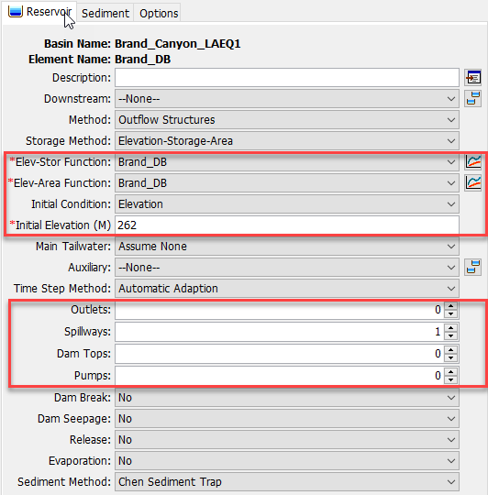
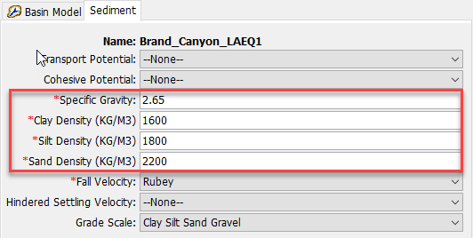
Data requirement FOR RESERVOIR ELEMENT
Soil Gradation Curve, Specific Gravity, and Density (based on field measurement)
Elevation - Storage Curve
Elevation - Area Curve
Reservoir/Debris Basin Physical Information (Spillway, Outlet Structure, etc.)
Measured Debris Yield Amount (Truck Count, Survey)/Reservoir Survey Data
Reservoir Inflow/Outflow including Sediment Data etc.

Slide 6
overview
    Fire Impacts on Debris Basin and Reservoir
    Data Requirement for Reservoir Element
    Reservoir Volume Reduction Process
      Two Trap Efficiency Methods
        Chen Sediment Trap
        Brune Sediment Trap
      Two Volume Reduction Options
        V-Shape
        Elongated Taper
    Case Studies:
      Brand Debris Analysis with Debris Basin
      Large Reservoir Volume Reduction Analyses without Fires
    Need To Improve for Reservoir Routing Analysis

Slide 7
HEC-HMS Post-Fire Hydrology & Debris Flow Analysis Features
Subbasin
Subbasin Outlet
Reach
Reach Outlet
LADM EQ 1
Debris Routing
(SDR+ Muskingum)
Bulk Flow
MSDPM
Bulk Flow
USGS-LT
USGS-EA
LADM EQs 2-5
Reservoir
Reservoir Outlet
Volume Reduction
Bulk Flow
Dynamic Infiltration Loss Method (Pak & Lee)
Chen & Brune Trap Efficiency Methods
Settling Velocity (Hindered)

Slide 8
RESERVOIR sediment ROUTING PROCESSES
Watershed Outlet/Channel Outlet
Reservoir
Reservoir Outlet
Channel
Brune Sediment Trap
Volume Ratio
Fall Velocities:
Rubey
Van Rijn
Toffaleti
Report 12
Richardson and Zaki (1954)
Kumbhakar (2017)
Chen Sediment Trap
100% Sediment Trap
0% Sediment Trap
Specified
Sediment Trap
Reservoir Volume Reduction (Updating E-A & E-S curves)

Slide 9
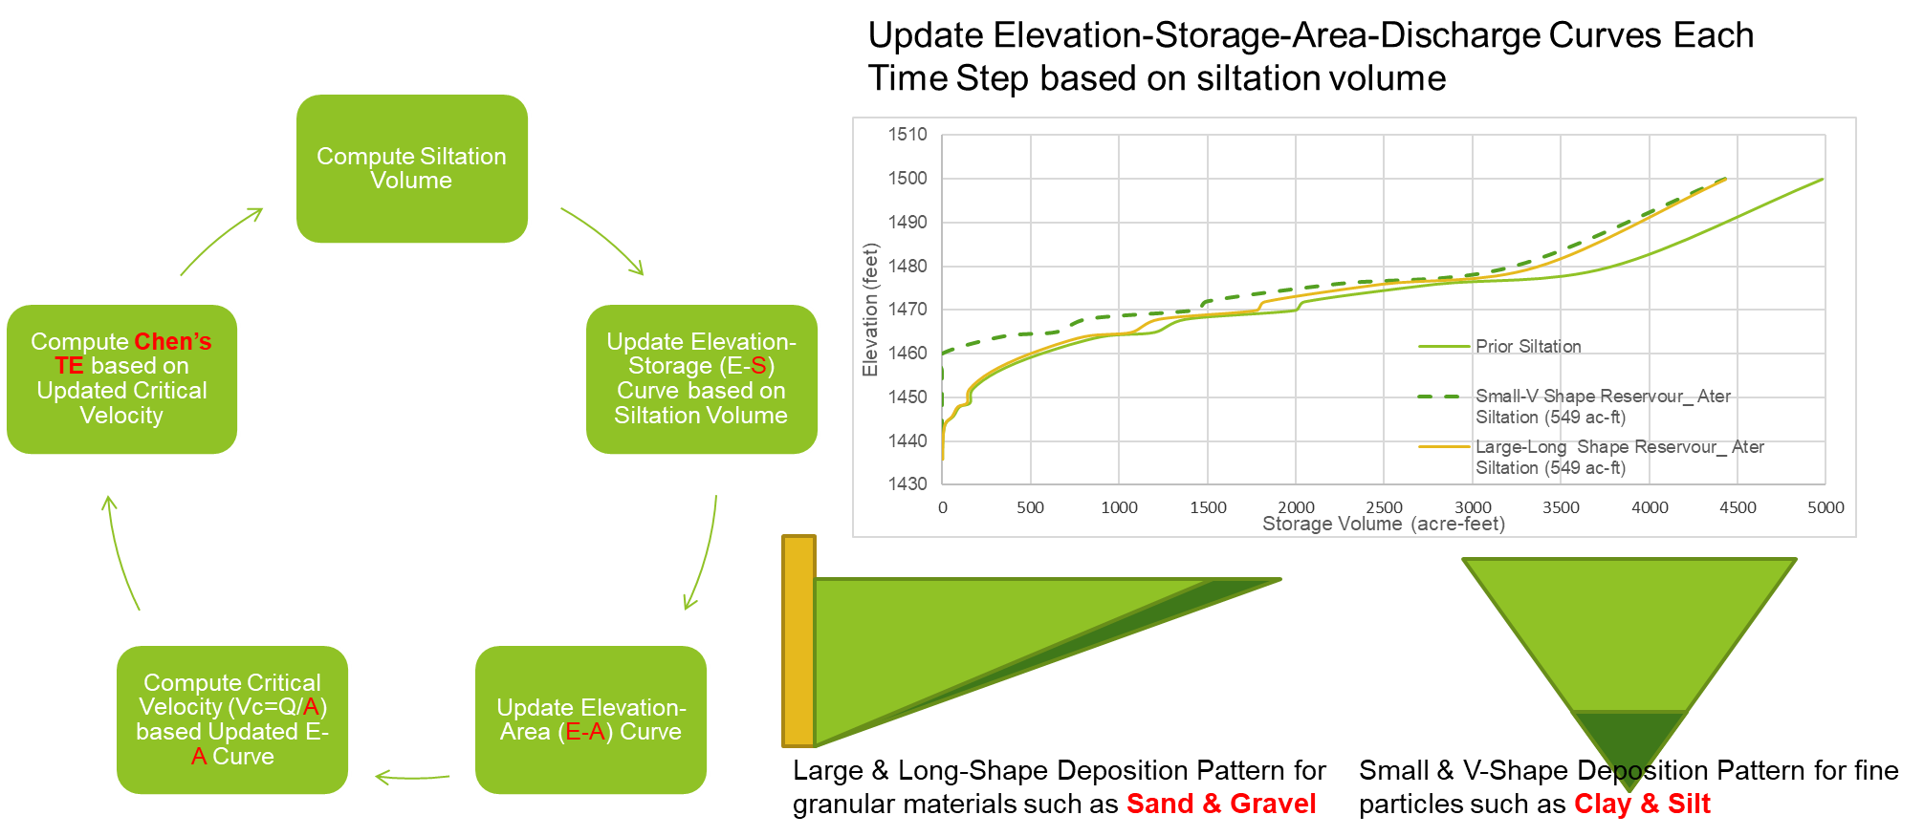
Reservoir Volume Reduction Process
Clay & Slit: Only 1-Option (V-Shape)
Sand & Gravel: 2-Optopn (V-Shape or Elongated Taper)

Slide 10
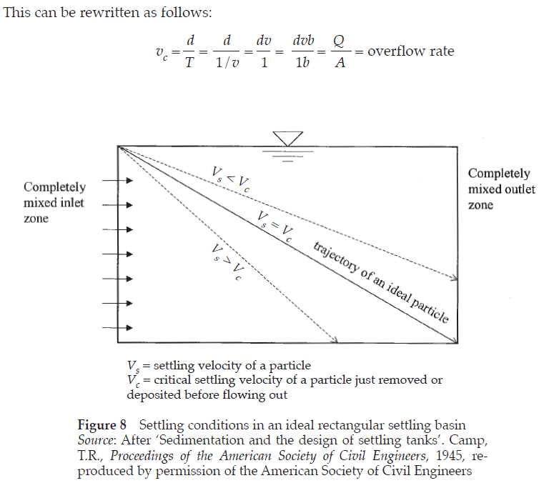
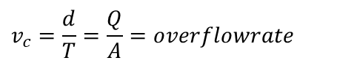
Chen’s Sediment Trap (Chen 1975)
Critical settling velocity
Trapping Efficiency
    Stratified (quiescent) reservoir (upper bound)
    Mixed (turbulent) reservoir (lower bound): Chen, 1975
      The settling velocity is computed using the method selected for the Basin Model.
      The critical settling velocity is computed as the discharge rate (Q) from the reservoir divided by the surface area (A). The computations are performed separately for each grain size class or subclass.
$$v_{c}=\frac{d}{T}=\frac{Q}{A}=overflowrate$$
Source: Verstraeten, G and Poesen, J., Estimating trap efficiency of small reservoirs and ponds: methods and implications for the assessment of sediment yield, Progress in Physical Geography 24, 2 (2000), pp. 219-251.

Slide 11
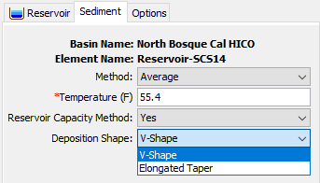
Chen Sediment Trap
The trap efficiency can be estimated by comparing the settling velocity of the sediment to a critical settling velocity (Chen, 1975).
    Method: Select a Fixed Temperature or a Temperature Time-Series Gage.
    Reservoir Capacity Method: the option for simulating the dynamic reservoir/debris basin volume reduction;
      Yes: two deposition shape options (V-Shape and Elongated Taper) .
        V-Shape update the elevation-storage curve and elevation-area curve from the reservoir bottom elevation based on the siltation volume by each grain size (Clay, Silt, Sand, and Gravel) at each time step.
        Elongated Taper update the elevation-storage curve and elevation-area curve from the reservoir bottom for fine particles (Clay and Silt) and from the reservoir top elevation for the granular materials (sand and gravel) based on the siltation volume at each time step.
Note: In a future version, we will introduce two deposition pattern choices for each grain size to enhance precision.

Slide 12
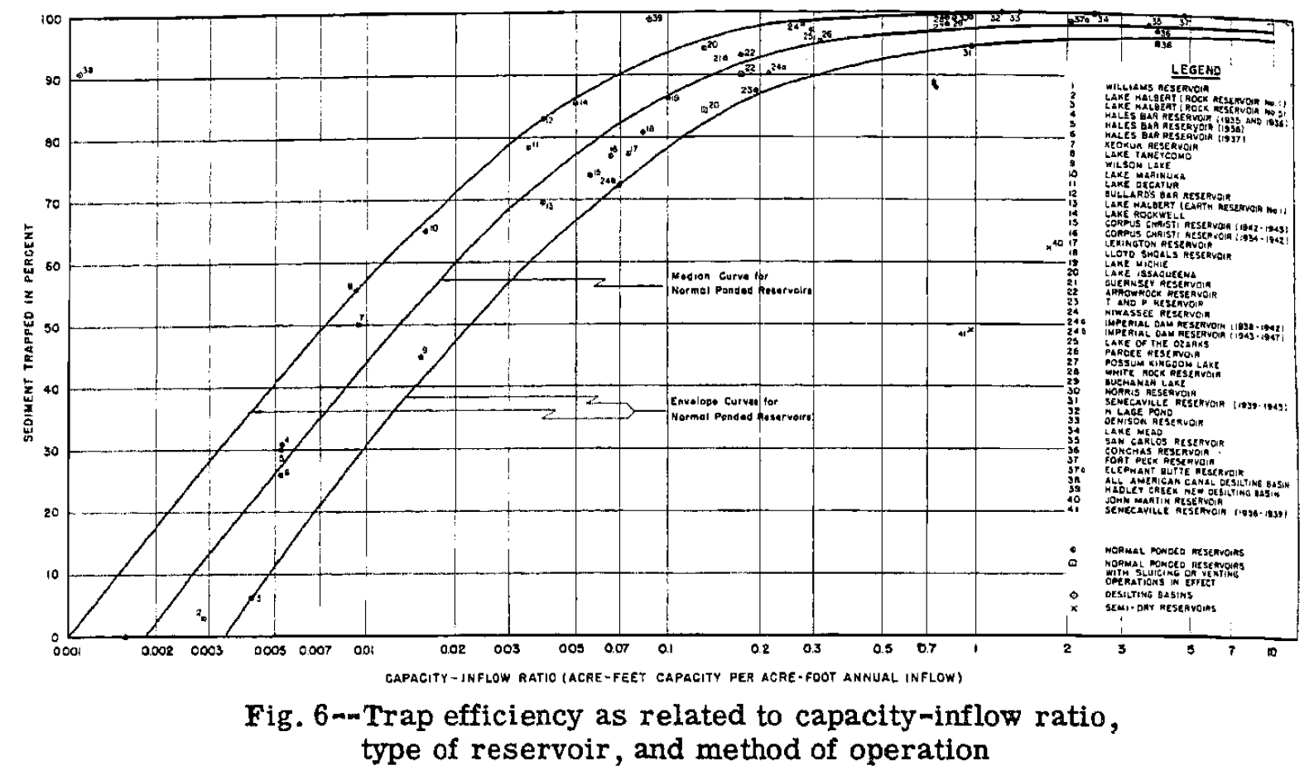

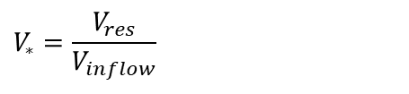
Brune’s Sediment Trap (Brune 1953)
Capacity/Annual Inflow Ratio
      V_{res} = Reservoir Capacity
      V_{inflow} = Annual Inflow (A user specified initial value is required)
Trapping Efficiency
      a = Coefficient (Low=95, Medium=97, High=100)
      b = Coefficient (Low=5.37, 6.42, High=7.71)
$$V_{∗}=\frac{V_{res}}{V_{inflow}}$$
$$TE=a\left[1−2e^{−bV_{∗}^{0.35}}\right]$$

Slide 13
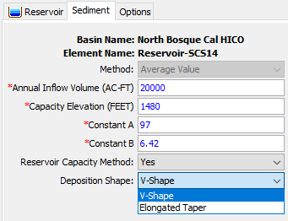
Brune Sediment Trap
Brune (1953) developed the curve with the relation between trap efficiency and reservoir capacity-annual inflow ratio (C/I).
    Annual Inflow Volume: the mean annual inflow volume to the reservoir.
    Capacity Elevation: the elevation of reservoir at the reservoir capacity.
    Constant A: 95 to 100.
    Constant B: 5.37 to 7.71.
    Reservoir Capacity Method: the option for simulating the dynamic reservoir/debris basin volume reduction;
      Yes: two deposition shape options (V-Shape and Elongated Taper) .
        V-Shape update the elevation-storage curve and elevation-area curve from the reservoir bottom elevation based on the siltation volume by each grain size (Clay, Silt, Sand, and Gravel) at each time step.
        Elongated Taper update the elevation-storage curve and elevation-area curve from the reservoir bottom for fine particles (Clay and Silt) and from the reservoir top elevation for the granular materials (sand and gravel) based on the siltation volume at each time step.
Note: In a future version, we will introduce two deposition pattern choices for each grain size to enhance precision.

Slide 14
Methodology
Sediment deposition
Suspended sediment
Outflow sediment

Slide 15

Reservoir volume reduction calculation process
$$Trap Efficiency \left(TE\right):by Chen or Brune Methods$$
Sediment Inflow
Clay = 200 T/d
Silt = 70 T/d
Sand = 1 T/d
Trap Efficiency (TE)
Clay = 0.7
Silt = 1
Sand = 1
Suspended Sediment =
Sediment Inflow-Sediment Deposit
Clay = 60 T/d
Silt = 0 T/d
Sand = 0 T/d
Sediment Outflow
Clay = 60 T/d
By
Volume Ratio
X
Update E-A & E-V curves for Reservoir Volume Reduction (V-Shape & Elongated Taper)
Sediment Deposit=Sediment Inflow X TE
Silt = 140 T/d
Sand = 70 T/d
Gravel = 1 T/d
Bottom Layer

Slide 16
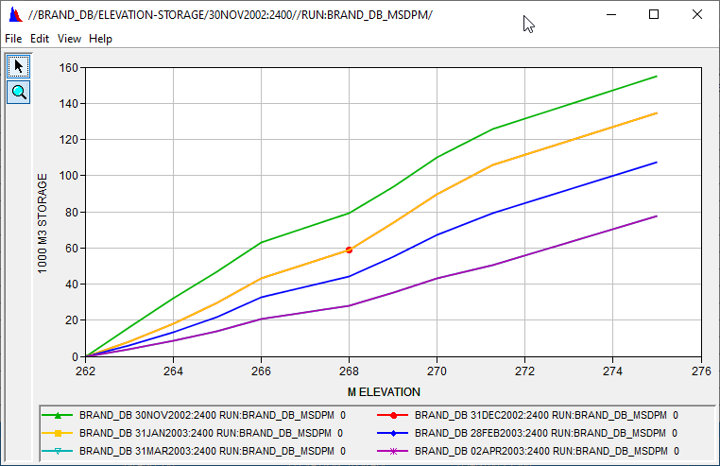
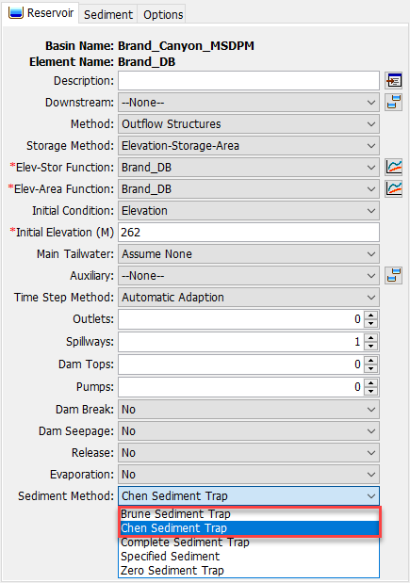
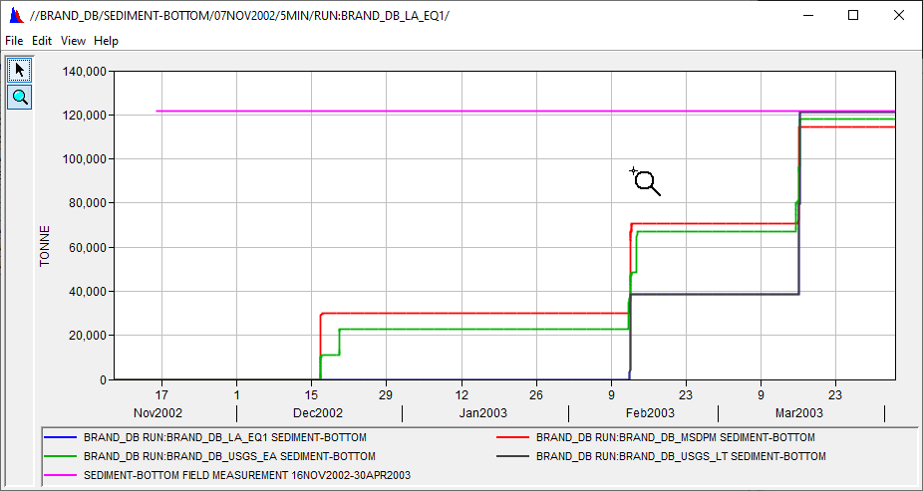
HEC-HMS GUI for two sediment trap efficiency Methods

Slide 17
overview
    Fire Impacts on Debris Basin and Reservoir
    Data Requirement for Reservoir Element
    Reservoir Volume Reduction Process
      Two Trap Efficiency Methods
        Chen Sediment Trap
        Brune Sediment Trap
      Two Volume Reduction Options
        V-Shape
        Elongated Taper
    Case Studies:
      Brand Debris Analysis with Debris Basin
      Large Reservoir Volume Reduction Analyses without Fires
    Need To Improve for Reservoir Routing Analysis

Slide 18
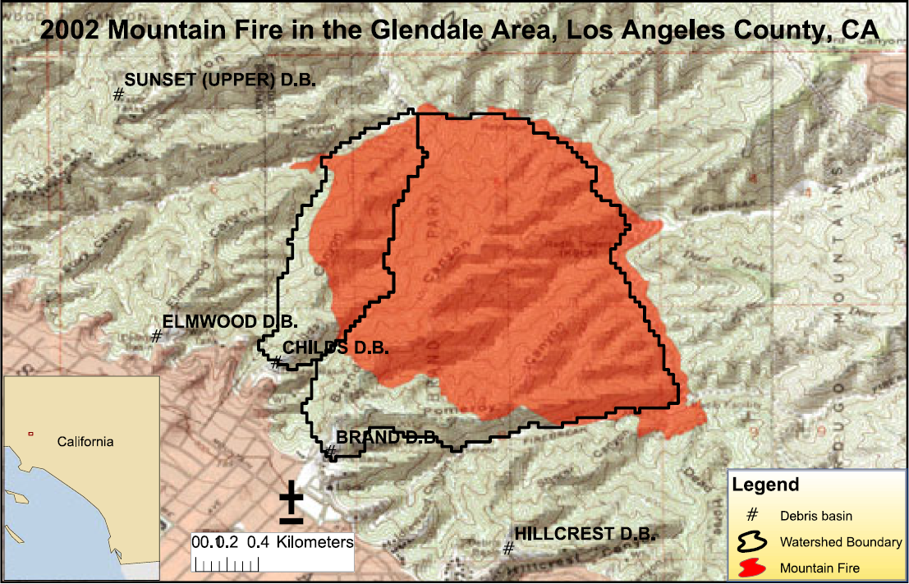

Slide 19
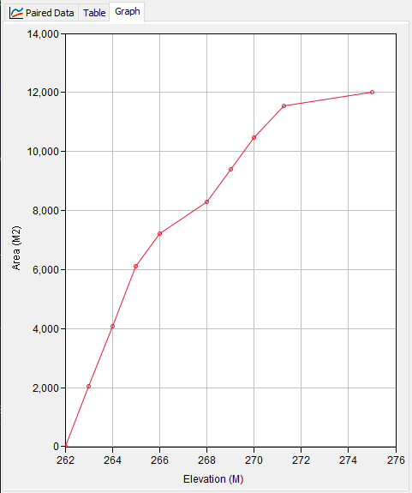
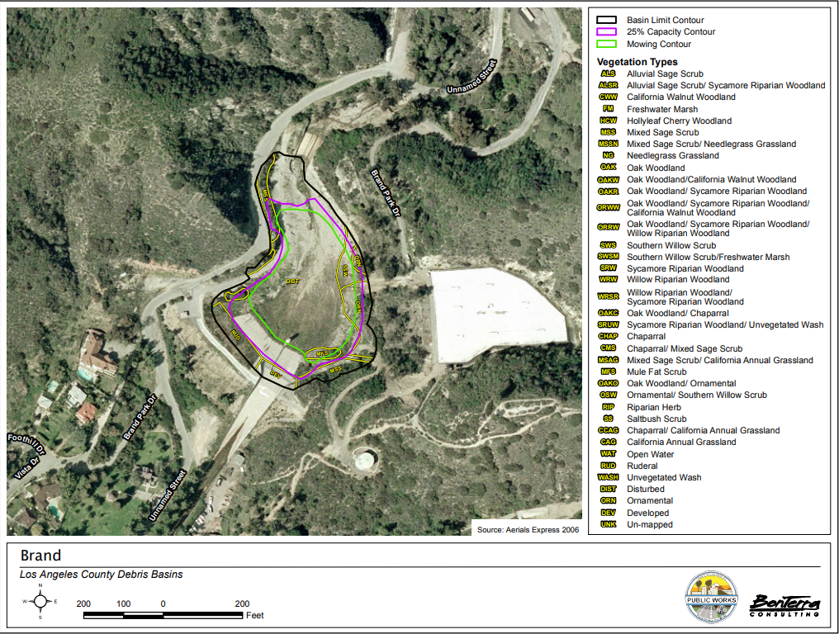
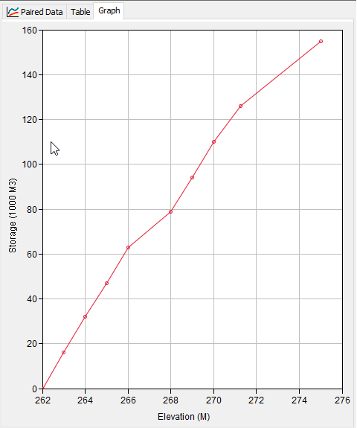
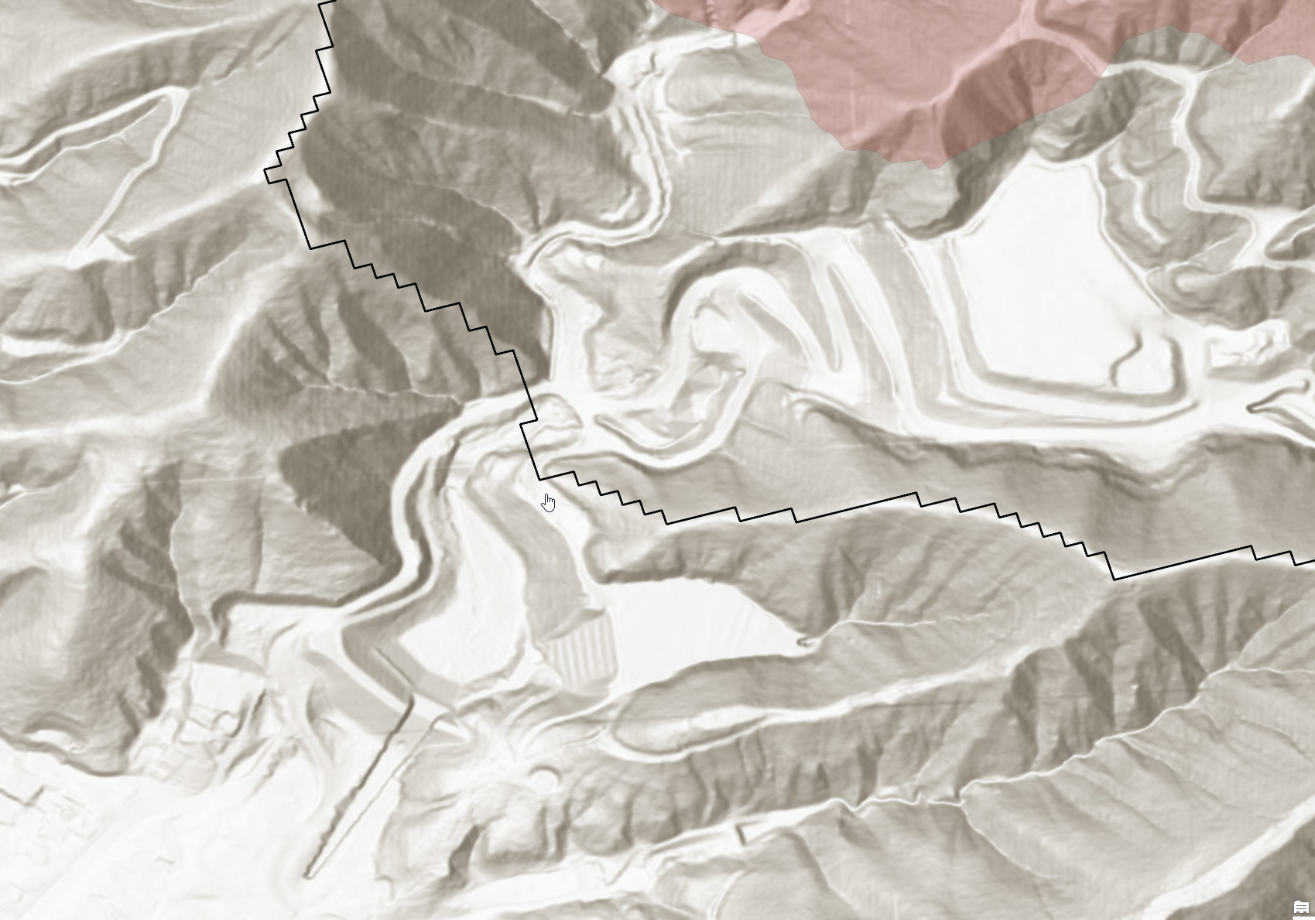
Estimation of E-A & E-S Curves

Slide 20
Summary of simulation results
Debris Yield Method | Area (km²) | A-T Factor | Relief Ratio (m/km) | Relief (m) | Fire Factor Method | Burn Date | Burn %/Burn area (km²) | Flow Rate Threshold (m³/s) | Max. 1-hr Rainfall Intensity (mm/hr) | Total Min. Rainfall Amount (mm)
LA District Method EQ 1 | 2.6263 | 1 | 216.21 | N/A | Pak & Lee Fire Factor | 02 Sep 2002 | 90% | 4.8 | N/A | N/A
MSDPM | 2.6263 | 1 | 216.21 | N/A | Pak & Lee Fire Factor | 02 Sep 2002 | 90% | 1.00 | 7.11 | 40.00
USGS EA | 2.6263 | N/A | N/A | 620.268 | N/A | N/A | 2.36367 km² | 1.75 | N/A | N/A
USGS LT | 2.6263 | N/A | N/A | 620.268 | N/A | N/A | 2.36367 km² | 4.5 | N/A | N/A

Slide 21
Debris Basin Operation & Maintenance
The Operation and Maintenance Program is one of the District's highest priority ongoing programs. It involves normal operation of the District's basins, channels, and other flood protection facilities and the routine and emergency maintenance and repair of these facilities. Maintenance of channels, debris basins, dams and storm drain facilities prevents minor storm problems from becoming major flood problems. (https://www.countyofsb.org/2156/Operation-Maintenance)
How should we establish a priority list for debris basin cleanouts?
What are the current capacities of our debris basins?
What are the expected debris yield amounts based on forecasted rainfall?
Do you have the appropriate tools or resources available to provide answers to these questions?

Slide 22
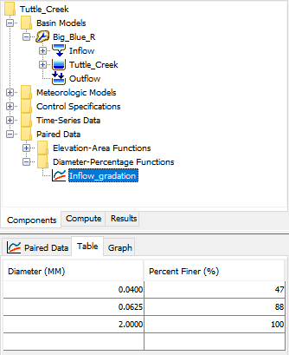
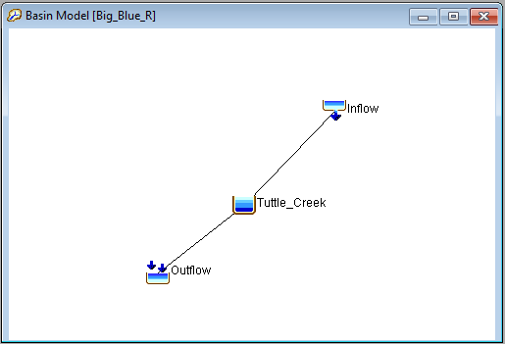
HMS Models for Large Reservoir Volume Reduction
Basin Model
  Inflow element
  Reservoir element
  Outflow element
Inflow Element
  Daily sediment loads taken from the Kansas Watershed Study
  Incoming gradation from USGS measurements

Slide 23
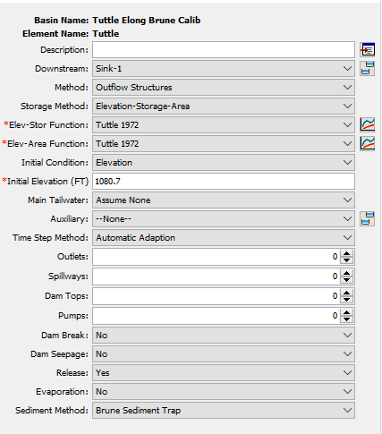
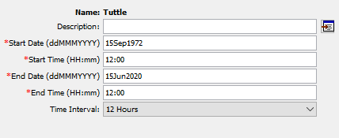
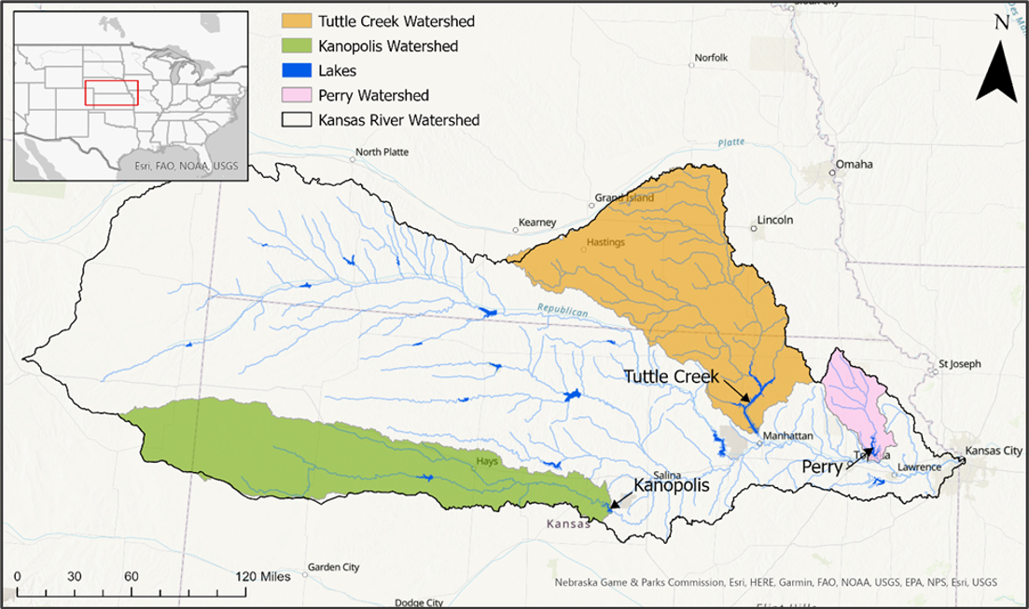
HMS Reservoir Sedimentation Models
(Webinar: Reservoir Sedimentation (https://www.hec.usace.army.mil/confluence/pages/viewpage.action?pageId=51479129))
Reservoir Element
Initial elevation-storage and elevation-area tables
Trapping Efficiency: both the Brune and Chen methods tested
Deposition Shape: both the V-shape and Elongated tested
Outflow: specified release
Control Specifications
Timestep: 12 hours
Simulation period
  Tuttle Creek: 1972-2020
  Kanopolis: 1960-2017
  Perry: 1979-2009

Slide 24
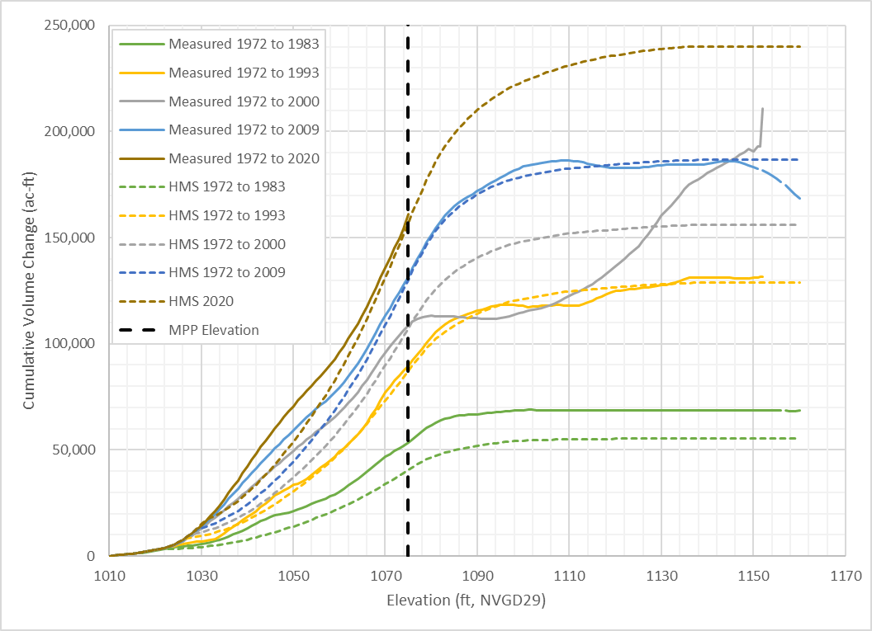
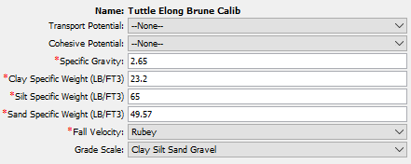
Tuttle Creek Results
Calibration Method
Shifted majority of fine and silt fraction to sand
Maintained volume balance by lowering sand and clay specific weights
Final gradation was 5% clay and 95% sand: NG (Measured: Clay:47%, Silt:41%, Sand:12%)
Models further calibrated by adjusting sand specific weight
Measured data may have errors

Slide 25
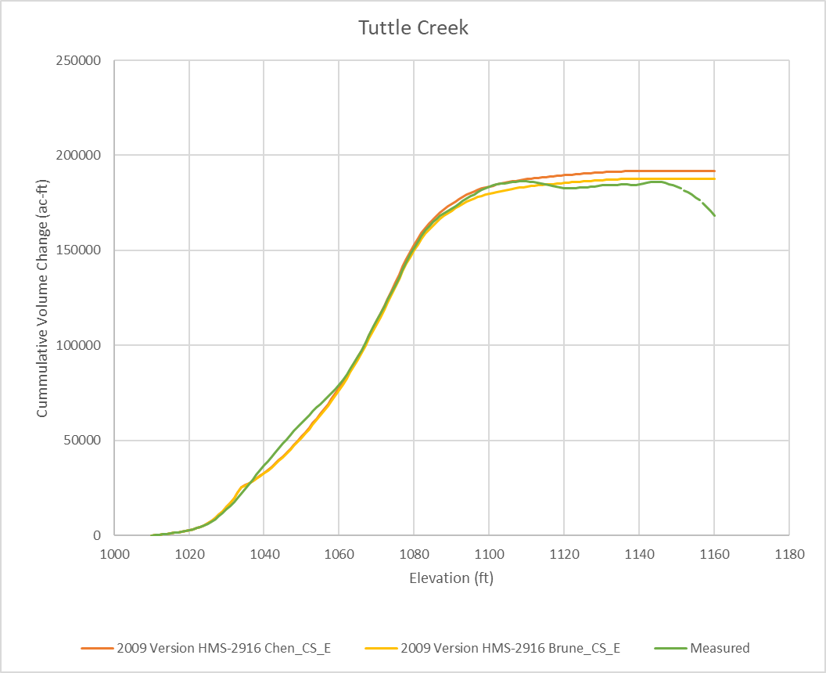
Updated Tuttle Creek Results (Research)
Calibration Method
Shifted majority of fine and silt fraction to sand (NO)
Maintained volume balance by lowering sand and clay specific weights (NO)
Final gradation was 5% clay and 95% sand: (NO) (Using Measured: Clay:47%, Silt:41%, Sand:12%)
Models further calibrated by adjusting sand specific weight (NO)
Elongated Taper Pattern was selected for each grain size (Using the "quick and simple experimental code" for this testing.).

Slide 26
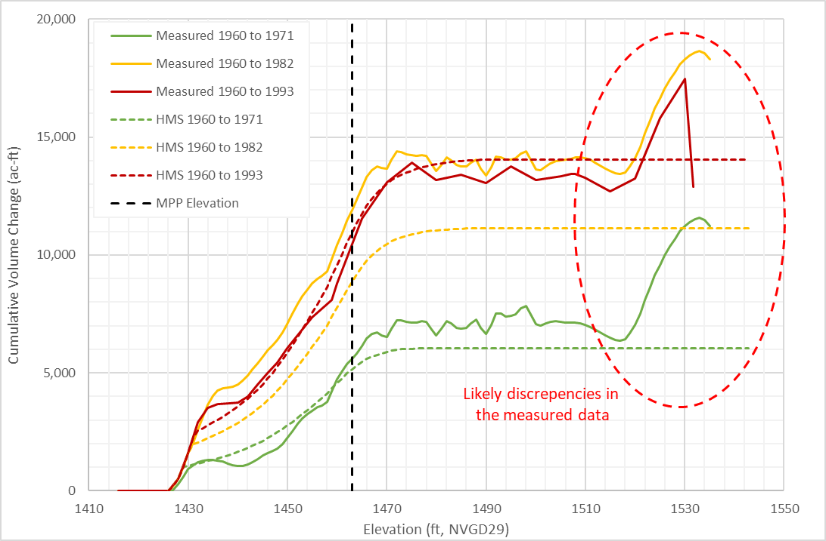
Kanopolis Results (older Surveys)
Calibration
Applied same methodology as for Tuttle Creek
Kanopolis showed more deposition at lower elevations
Final gradation was 10% clay and 90% sand.
Errors in the observed data.

Slide 27
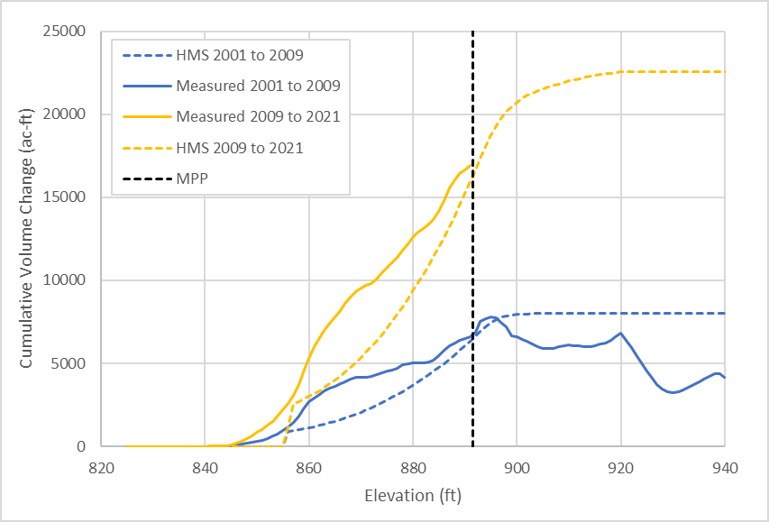
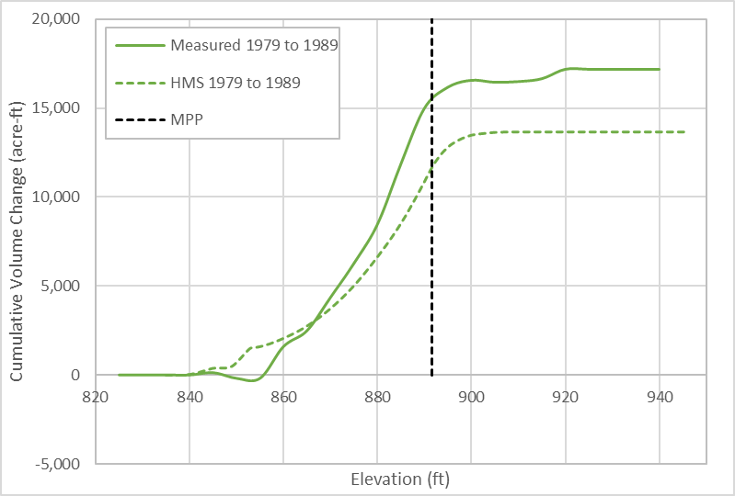
Perry Results
Calibration
Applied same methodology as for Tuttle Creek
Final gradation was 9% clay and 91% sand
Survey data may have errors
Newer surveys
Older surveys

Slide 28
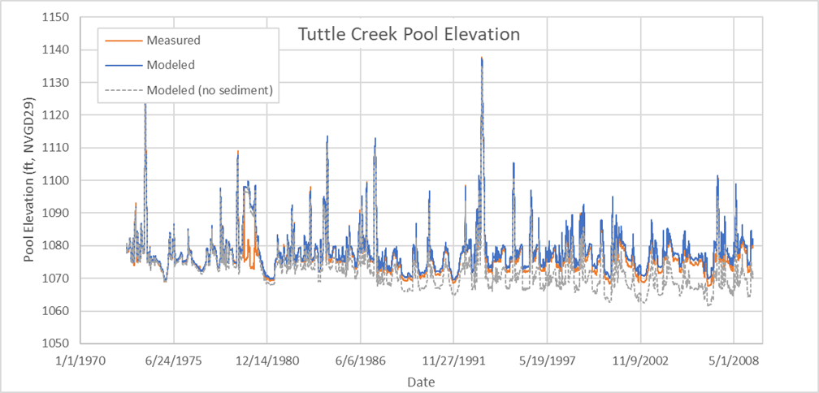
Pool Elevation
Modeled pool elevation matched well with observed
Without sediment, the model underpredicts stage by as much as 9 feet

Slide 29
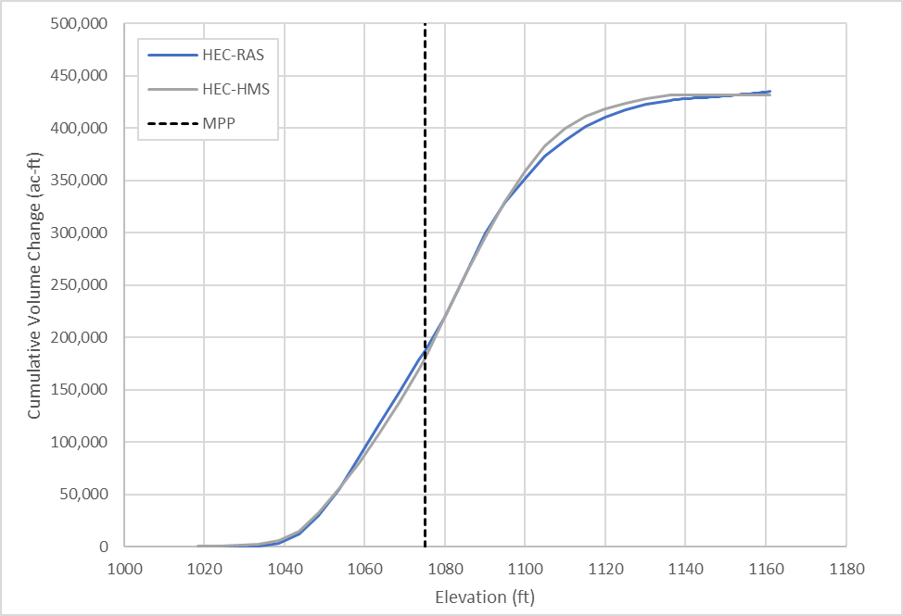
HEC-RAS Comparison
HEC-RAS Model
1D quasi-unsteady sediment
Same inputs for incoming sediment load
Calibrated to the 2009-2020 period
Comparison
Both model agreed relatively well
HEC-RAS deposits more sediment at higher elevations

Slide 30
Looking for Dataset with wildfire events: Please contact me (jay.h.pak@usace.army.mil) if you have field data.
Willow Ck Reservoir, CO
Detroit Lake, OR
Source: Morris and Fan (1998), Reservoir Sedimentation Handbook

Slide 31
overview
    Fire Impacts on Debris Basin and Reservoir
    Data Requirement for Reservoir Element
    Reservoir Volume Reduction Process
      Two Trap Efficiency Methods
        Chen Sediment Trap
        Brune Sediment Trap
      Two Volume Reduction Options
        V-Shape
        Elongated Taper
    Case Studies:
      Brand Debris Analysis with Debris Basin
      Large Reservoir Volume Reduction Analyses without Fires
    Need To Improve for Reservoir Routing Analysis

Slide 32
Need to improve for Reservoir Element
New Mexico
Reservoir deposition pattern option for each grain size (Minor Code Development & Case Studies)
Reservoir Flushing Operation Tools
Reservoir sediment routing analysis with the reservoir rule base option (Case Studies)
Intake Tower Outlet Structure (Research, Code Development, & Case Studies)
Applications of long-term sediment analysis under fire conditions for the large reservoirs (Case Studies)

Slide 33
references
Morris, G.L. and Fan, J., 1998. Reservoir Sedimentation. Handbook, McGraw-Hill Book Co., New York. (https://www.engr.colostate.edu/~pierre/ce_old/classes/CE716/ResSedHandbook1_01.pdf)
Chen, C.N. 1975. Design of sediment retention basins. Proceedings of the National Symposium on Urban Hydrology and Sediment Control. 285-298.
Brune, G.M., 1953. Trap Efficiency of Reservoir. Trans. AGU, V. 34-3, 407-418 June 1953.
Verstraeten, G and Poesen, J., Estimating trap efficiency of small reservoirs and ponds: methods and implications for the assessment of sediment yield, Progress in Physical Geography 24, 2 (2000) pp. 219-251
Richardson, J.F. and Zaki, W.N. 1954. Sedimentation and fluidisation, Part I, Trans., Inst. Chem. Engrs., 32(1), 35–53.
Kumbhakar, M. Kundu, S., Ghoshal, K. 2017. Hindered settling velocity in particle-fluid mixture: A theoretical study using Richardson and Zaki the entropy concept. J. Hydraul. Eng. 143(11): 1-8.

Slide 34
Questions and Feedback
POC: Jay Pak, jay.h.pak@usace.army.mil

