Slide 1
Reservoir Modeling Methodologies
Jay H. Pak, Ph.D., P.E.
Sr. Research Hydraulic Engineer
US Army Corps of Engineers
Hydrologic Engineering Center

Slide 2
Purpose
Understand and apply appropriate reservoir modeling techniques in HEC-HMS

Slide 3
Outline
Reservoir element overview
Specified release
Outflow curves
Outflow structures
Rule-based routing
Reservoir Sediment Routing

Slide 4
Reservoir Element Overview

Slide 5
Reservoir Routing
A hydrological process used to predict the temporal changes in water storage, inflow, and outflow of a reservoir. This process relies on elevation-area and elevation-storage curves to understand the relationship between the water level (elevation) and both the surface area and volume of the reservoir.

Slide 6

Reservoir Element
One of the seven basin model element types
One upstream element
Up to two downstream elements
  Main
  Auxiliary
Five routing methods
  None, Outflow Curve, Outflow Structures, Rule-Based Operations, Specified Release

Slide 7
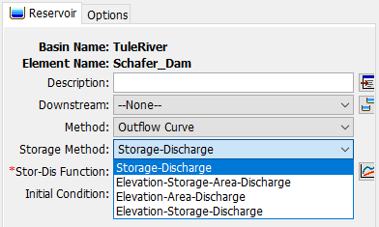
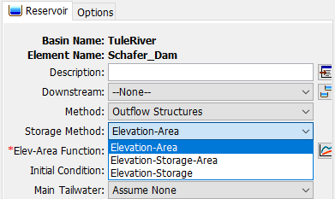

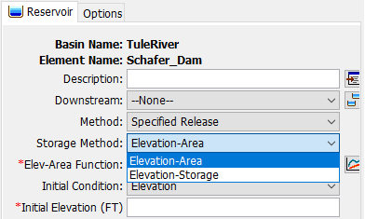
Geometry (Storage Method)
Reservoir computes the continuity equation
Outflow Curve | Outflow Structures | Rule-Based Operations | Specified Release
Elevation-Area-Discharge | Elevation-Area | Elevation-Area | Elevation-Area
Elevation-Storage-Area-Discharge | Elevation-Storage | Elevation-Storage | Elevation-Storage
Elevation-Storage-Discharge | Elevation-Storage-Area | Elevation-Storage-Area
Storage-Discharge (Simplest Option)
Sediment Routing Available Method

Slide 8
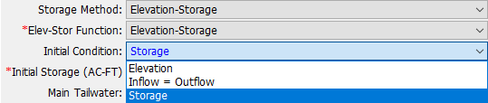
Initial Conditions
State information required for simulation start
Available options depend on selected storage method
  Storage (simplest)
  Elevation
  Discharge
  Inflow = Outflow
Notes:
The Discharge method is available for outflow curves – since storage and outflow are 1:1 related, the initial storage can be determined
The Inflow = Outflow method takes the inflow to the reservoir at the beginning of the simulation and determines the pool elevation necessary to cause that outflow through the outlet structures. The pool elevation is then used in the elevation-storage curve to determine the matching storage.

Slide 9
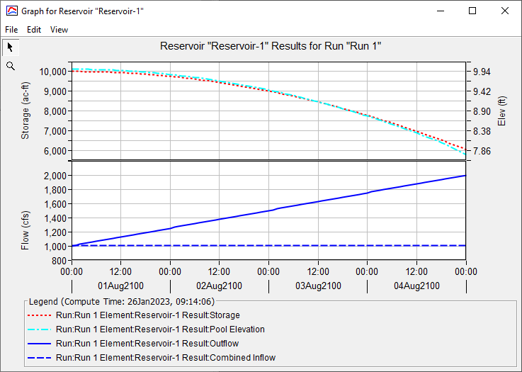
Simulation Results
Notes:
The top plot is for geometry – it shows the reservoir’s storage and elevation for the simulation. Not all routing methods will have an elevation plot, but all of them must compute storage.
The bottom is for flow – the reservoir inflow is dashed, and outflow is solid.

Slide 10
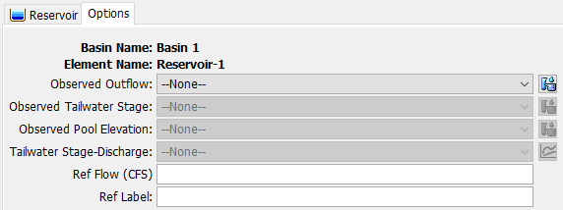
Reservoir Options Tab
Notes:
Observed outflow allows you to set a discharge gage as an observed flow series that you can compare your results to
Observed tailwater stage lets you set a stage gage as an observed stage time series that you can compare computed tailwater stages to (requires a tailwater rating curve)
Observed pool elevation is pretty self-explanatory
Tailwater stage-discharge lets you set a rating curve for the tailwater – this can be important for computing hydraulic structure submergence.
The reference flow and label are for making a nice label on your simulation results graph.

Slide 11
Best Practices
Use a junction upstream and downstream of your reservoir
Calibrate/validate your model isolating out the reservoir first
  Use Specified Release method to pass the right flows downstream
Keep it simple
  HMS is not ResSim

Slide 12
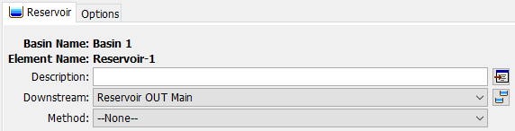
“None” Routing Method
“--None--” will pass flow downstream with no routing

Slide 13
Specified Release

Slide 14
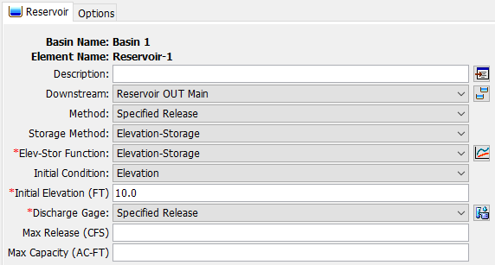
Specified Release
Used when the outflow from a reservoir is known
Elevation/storage computed from simulated inflow and specified outflows

Slide 15
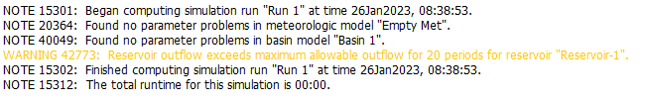
Specified Release
Outflow specified as a discharge gage
Optional settings: Max Release, Max Capacity
  Settings do not alter outflows, only produce warnings

Slide 16
Specified Release – When to Use?
Calibration/validation phase of model construction
Releases are determined by something external to HMS

Slide 17
Outflow Curves

Slide 18
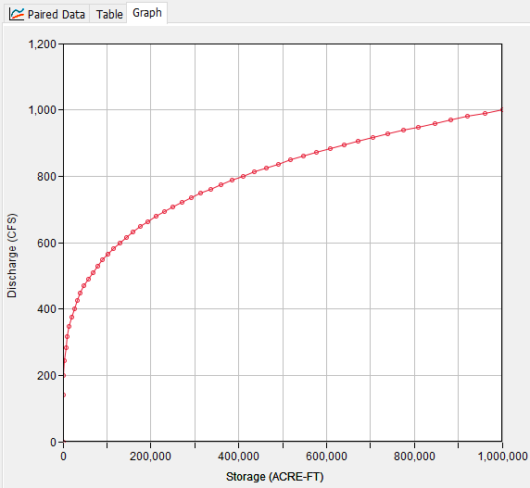
Outflow Curves
Reservoir outflow is determined solely by storage
Ideal for reservoirs with no gates/operations
Can be “calibrated” to represent more complex reservoirs
Notes:
This gets quite a bit of use for detention basin design – most have simple geometry and outflow relationships that makes modeling them very easy.

Slide 19
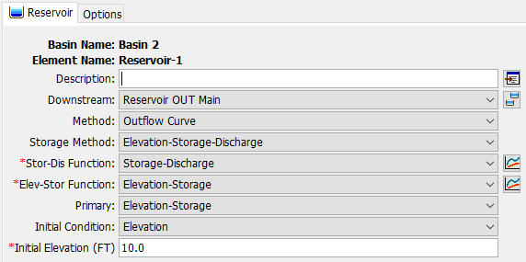
Outflow Curves – Storage Method
Simplest option is the Storage-Discharge storage method
Other methods will compute elevation
Notes:
The “Primary” setting just determines the interpolation scheme. The Outflow Curve method builds a big table for all the geometry variables involved, and the one set as “primary” determines the initial configuration of the table (what rows the other tables are interpolated to.)

Slide 20
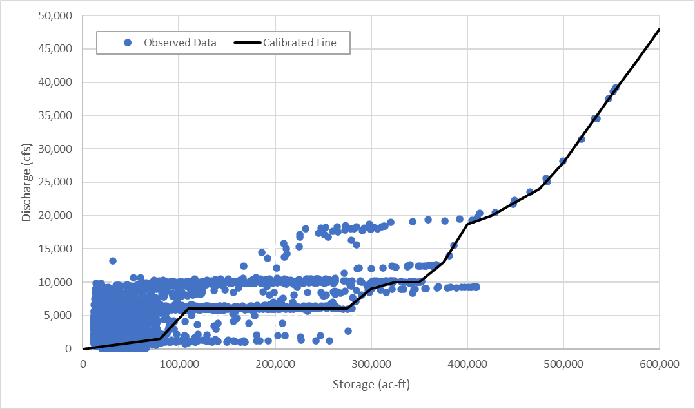
Outflow Curve Calibration
Works best when operations are simple
Iterative process
  Build curve
  Run simulation
  Check stage/storage/
  outflow
  Modify curve

Slide 21
Outflow Curves – When to Use?
Outflow is always the same for a given storage
  Ungated outlets/spillways, dam tops, etc.
Operations can be reasonably simplified to a single curve
Long Term Reservoir Volume Reduction Analysis

Slide 22
Outflow Structures

Slide 23
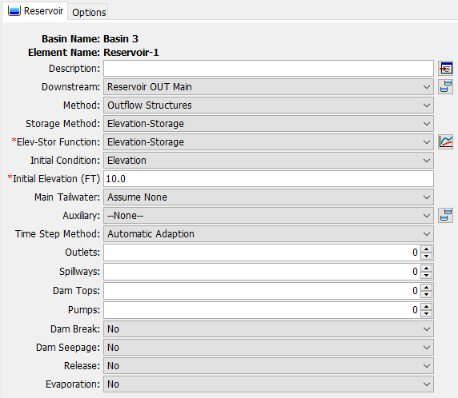
Outflow Structures
Outflow computed by a collection of hydraulic structures
  Outlets
  Spillways
  Dam tops
  Pumps
Simulate other kinds of outflows
  Dam breaks
  Dam seepage
  Time-series releases
  Monthly Evaporation

Slide 24
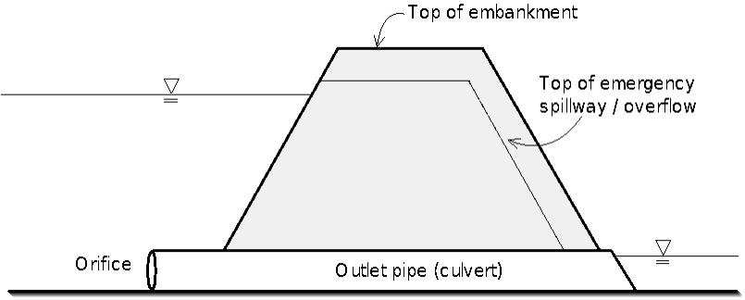
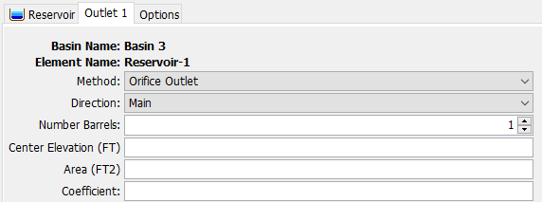
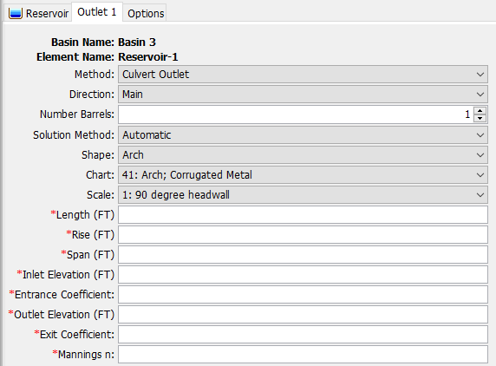
Outlets
Orifice Outlet
Culvert Outlet
Always submerged
Can flow partially full
https://www.hec.usace.army.mil/confluence/hmsdocs/hmstrm/modeling-reservoirs/outlets

Slide 25
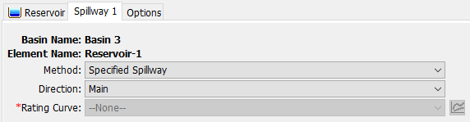
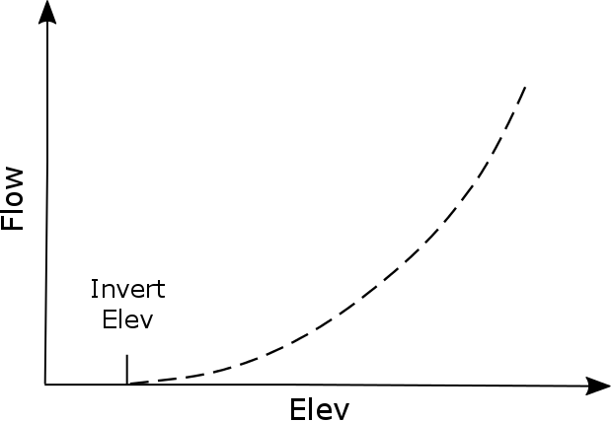
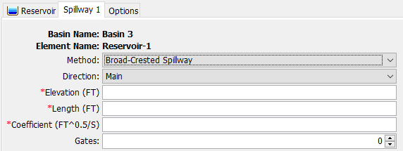
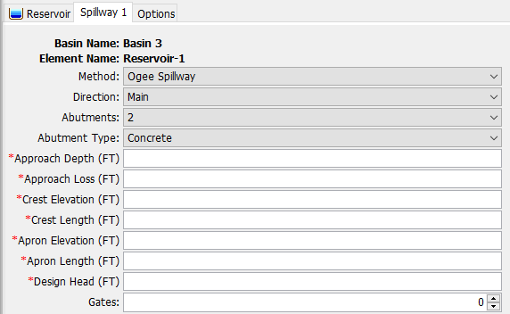
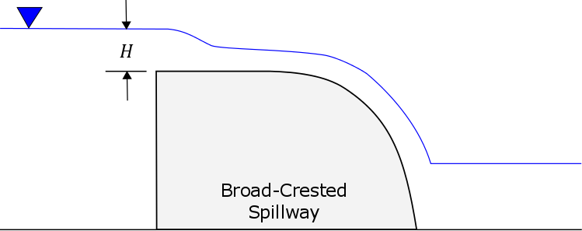
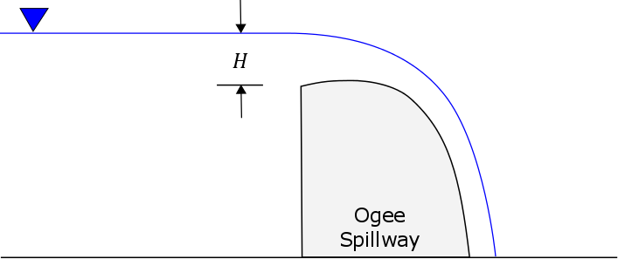
Spillways
Specified
Broad-Crested
Ogee
https://www.hec.usace.army.mil/confluence/hmsdocs/hmstrm/modeling-reservoirs/spillways

Slide 26
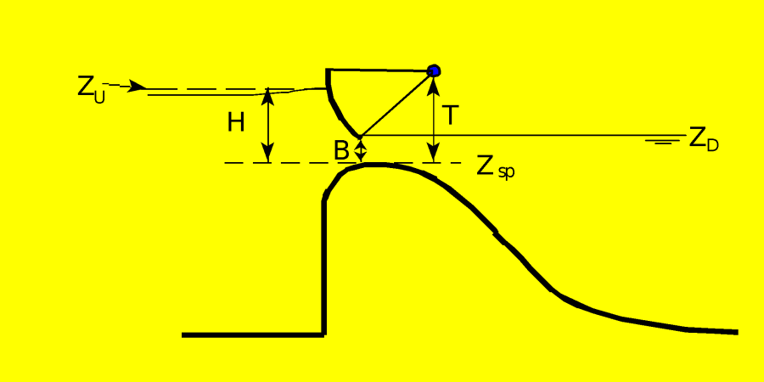
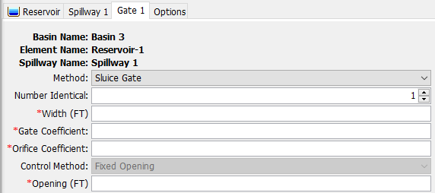
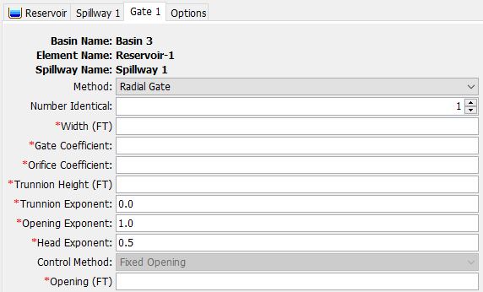
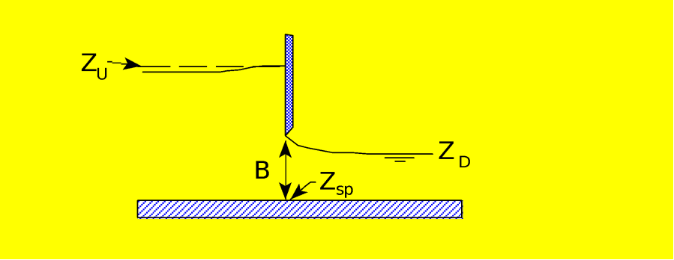
Spillway Gates
Sluice Gate
Radial Gate
https://www.hec.usace.army.mil/confluence/hmsdocs/hmstrm/modeling-reservoirs/spillways
Notes:
Note that the only control method is “Fixed Opening” – the gates do not move during the simulation. This will compute the hydraulics through a gate at a fixed setting.

Slide 27
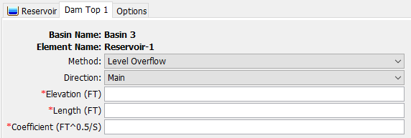
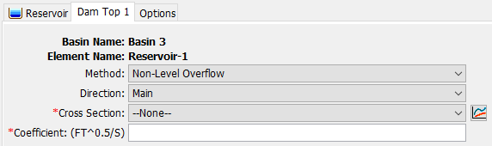
Dam Tops
Level
Non-Level
https://www.hec.usace.army.mil/confluence/hmsdocs/hmstrm/modeling-reservoirs/dam-tops

Slide 28
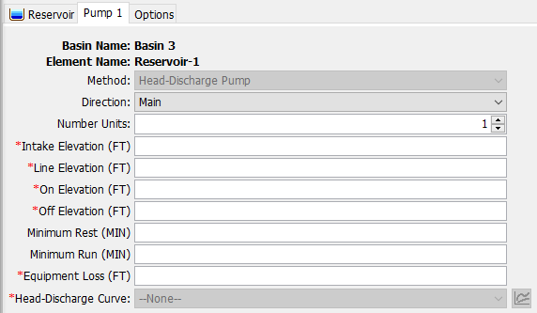
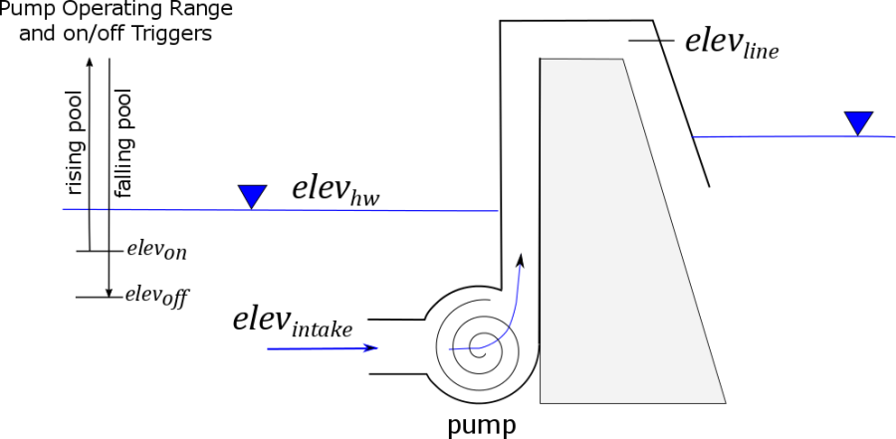
Pumps
https://www.hec.usace.army.mil/confluence/hmsdocs/hmstrm/modeling-reservoirs/pumps

Slide 29
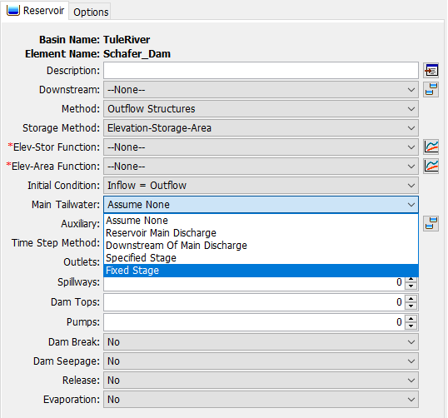
Tailwater
Controls determination of submergence for structures
5 options:
  Assume None
  Reservoir Main Discharge (requires rating curve, E-D)
    Computed (Elevation) at outlet – no backwater
  Downstream of Main Discharge (requires rating curve, E-D)
    Computed (Elevation) at next element downstream
  Specified Stage (requires stage time series)
  Fixed Stage

Slide 30
Outflow Structures – When to Use?
Complex combination of ungated hydraulic structures
Need to compute dam breaks, seepage, or evaporation

Slide 31
Rule-Based Reservoir Routing

Slide 32
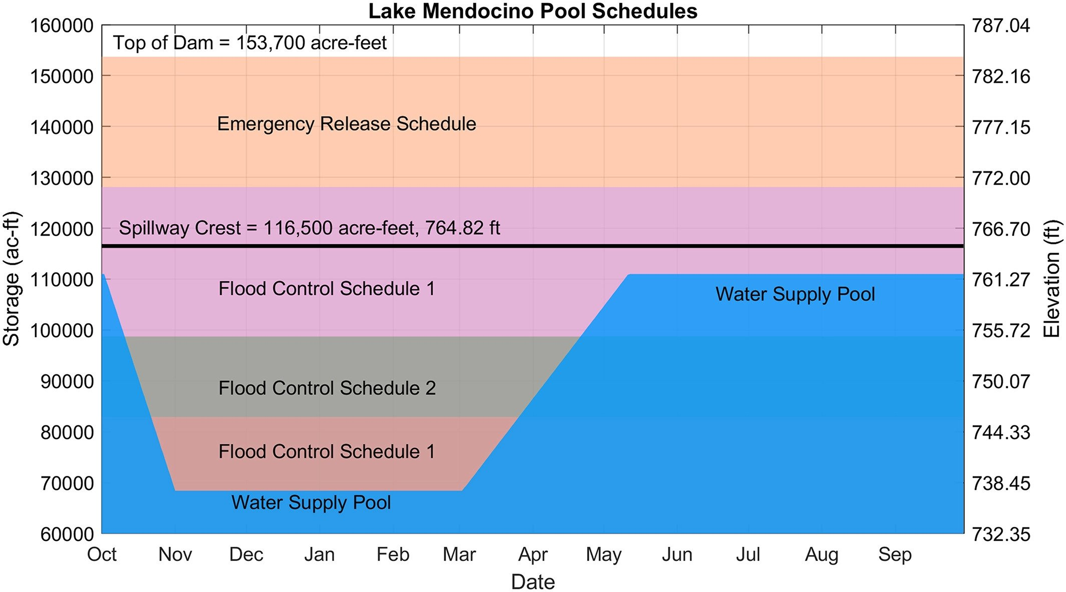
Guide Curve Operations
Above the Guide Curve
  increase releases as necessary (or possible) to lower the pool elevation to the Guide Curve.
Below the Guide Curve
  reduce releases as necessary (or possible) to raise the pool elevation to the Guide Curve.
At the Guide Curve
  release “just enough” to maintain the pool elevation at the Guide Curve
Notes:
There are three states in guide curve ops.
You can be right on the guide curve (see the yellow dot.) For the day of the year, the reservoir has the desired storage.
You can be above the guide curve (see the blue dot.) For the day of the year, the reservoir is storing more than desired.
You can be below the guide curve (see the orange dot.) For the day of the year, the reservoir is storing less than desired.

Slide 33
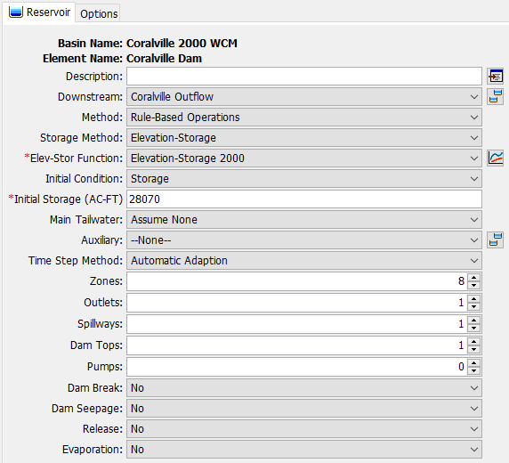
Rule-Based Reservoir Routing
Extension of Outflow Structures routing method
Uses rules and operable structures to determine releases
Zones determine what rules are applied
  Reservoir elevation
  Day of the year

Slide 34
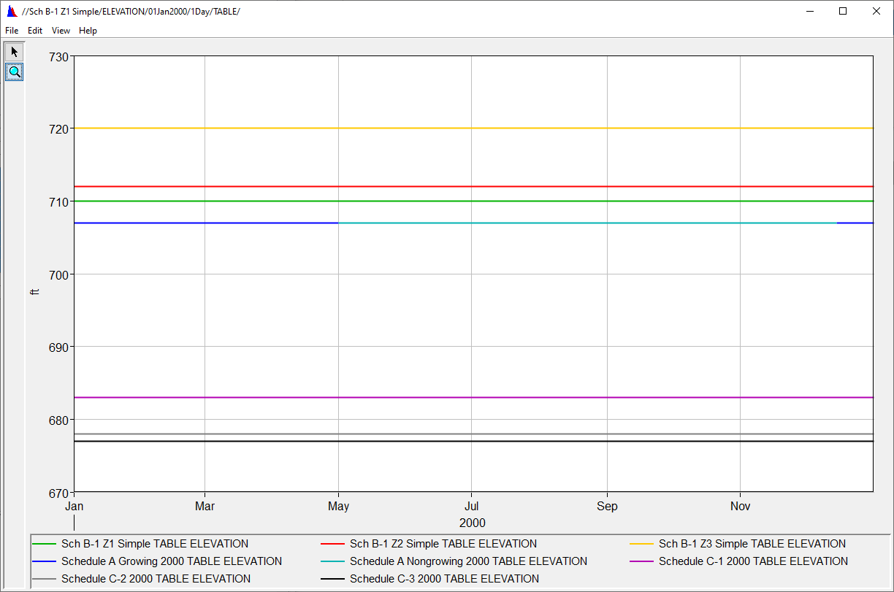
Zones
A grouping of homogeneous rules
Defined by an elevation range and day of year for each zone
  Finds first Maximum Elevation curve above the current elevation/day
Need at least one for operations to work

Slide 35
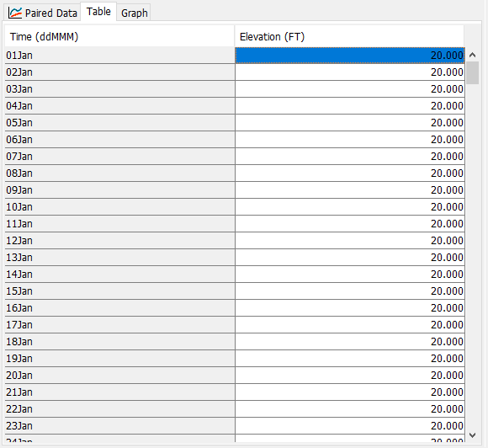
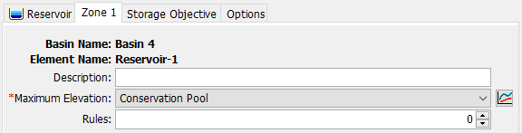
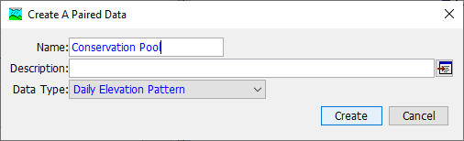
Maximum Elevation
Each Zone is defined by a maximum elevation, which is a Daily Elevation Pattern Paired Data curve.

Slide 36
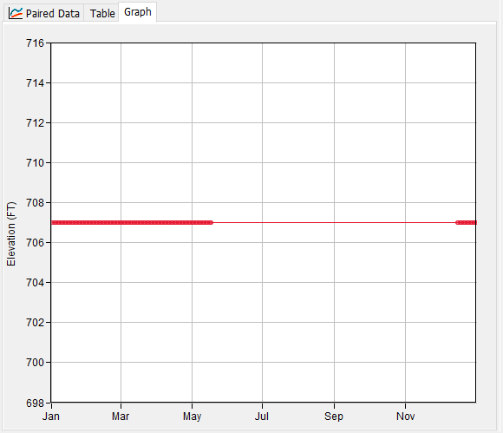
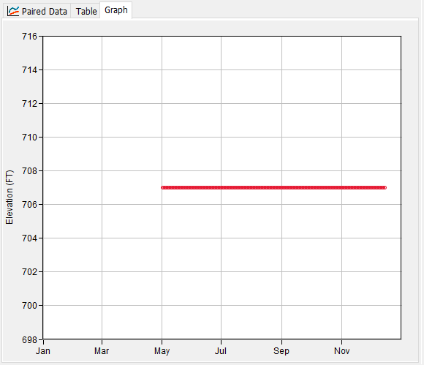
Maximum Elevation
Schedule A Non-Growing Season
Daily Elevation Pattern Paired Data
Top zone should cover entire range of elevations and dates
Curve does not need to be defined for every day of the year
  If nothing defined, zone will not be used for that day
Schedule A Growing Season
Notes:
In the example on the right, a regulation manual calls its basic flood operations “Schedule A”. The dam has the potential to cause agricultural damages, so maximum releases are limited during the growing season compared to the non-growing season, so despite these having the same overall elevation (707 ft) the rules they contain would be different.

Slide 37
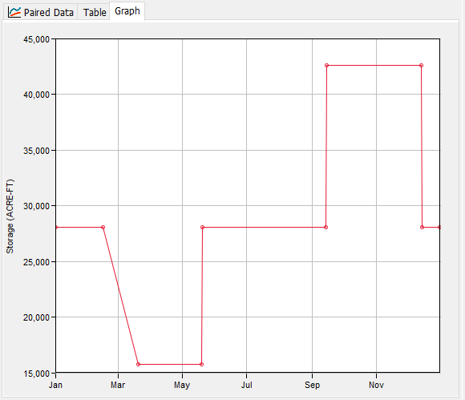
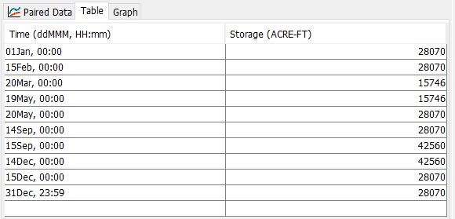
Storage Objective (Guide Curve)
For every day of the year, what is the desired storage?
Currently able to be defined for each zone
  May change to a single guide curve for the Dam in the future
  Recommend using only one for all zones unless you have really specific needs
Interpolates between points
Needs to cover entire year
Flood Pool
Conservation Pool

Slide 38
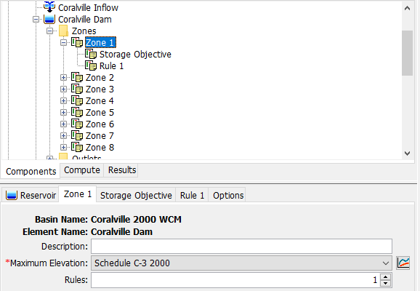
Rules
Added via Zone
Rules are specific to a single zone

Slide 39
Rule Types (10)
Type | Limits | Operation
Main Release | Min, Max, Specified | Sets a target for releases in the main direction
Auxiliary Release | Min, Max, Specified | Sets a target for releases in the auxiliary direction
Downstream Flow* | Min, Max, Specified | Sets a target for an element downstream
Rate of Flow Change | Max | Limits how much releases can change per each time
*requires iterative trial releases

Slide 40
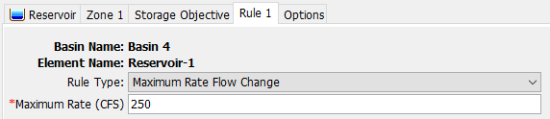
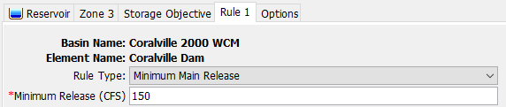
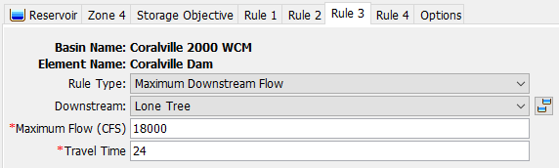
Rules
No limit to what you can specify
Try not to make them conflict

Slide 41
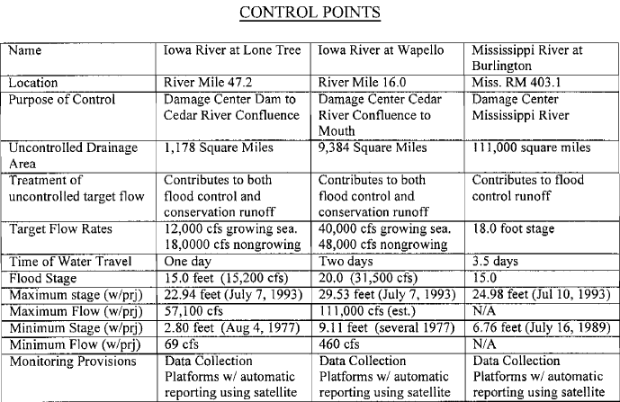
Downstream Controls
Require iterative trial releases
Significantly add to simulation time
Keep them as simple as possible

Slide 42
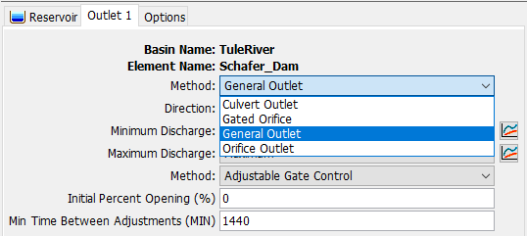
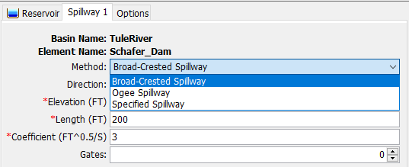
Outflow Structures
All features of Outflow Structures method available
Only some structures have parts that can be operated
  Outlets
    General Outlet
    Gated Orifice
  Broad-Crested and Ogee Spillways
    Radial Gates
    Sluice Gates

Slide 43
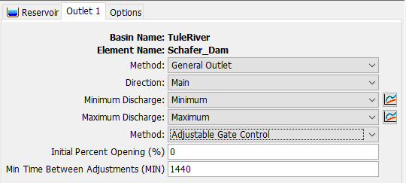
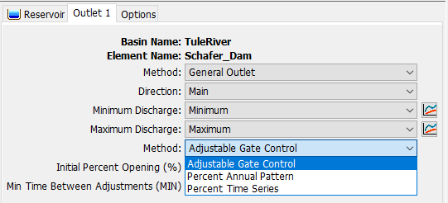
General Outlet
Gate Control Methods

Slide 44

Gated Orifice Outlet

Slide 45


Gated Spillway
Operable sluice and radial gates for Broad-Crested and Ogee spillways

Slide 46
Calibration
Isolate reservoir by using a source element with a timeseries gage
Calibration by adjusting rules
  These may deviate from the regulation manual
  Add other rules or settings for stability
    Rate of change rules help even if not included in WCM
Calibration by adjusting structures
  Adjust rating curves for outlets or spillways using simple methods

Slide 47
Rule-Based Reservoir Routing –
When to Use?
Storage target and releases vary seasonally
Complex rules and operable structures determine releases
You might be surprised how effective simple guide curve operations can be for many models!

Slide 48
Reservoir Sediment Routing

Slide 49

Tuttle Creek Results with Reservoir Volume Reduction

Slide 50
RESERVOIR sediment ROUTING PROCESSES
Watershed Outlet/Channel Outlet
Reservoir
Reservoir Outlet
Channel
Brune Sediment Trap
Volume Ratio
Fall Velocities:
Rubey
Van Rijn
Toffaleti
Report 12
Hindered Settling Velocity:
Richardson and Zaki (1954)
Kumbhakar (2017)
Chen Sediment Trap
100% Sediment Trap
0% Sediment Trap
Specified
Sediment Trap
Dynamic Reservoir Volume Reduction (Updating E-A & E-S curves)
2-Deposition Shape Option for Each Grain Size (V-Shape or Elongated Taper)

Slide 51
Questions?

