Slide 1
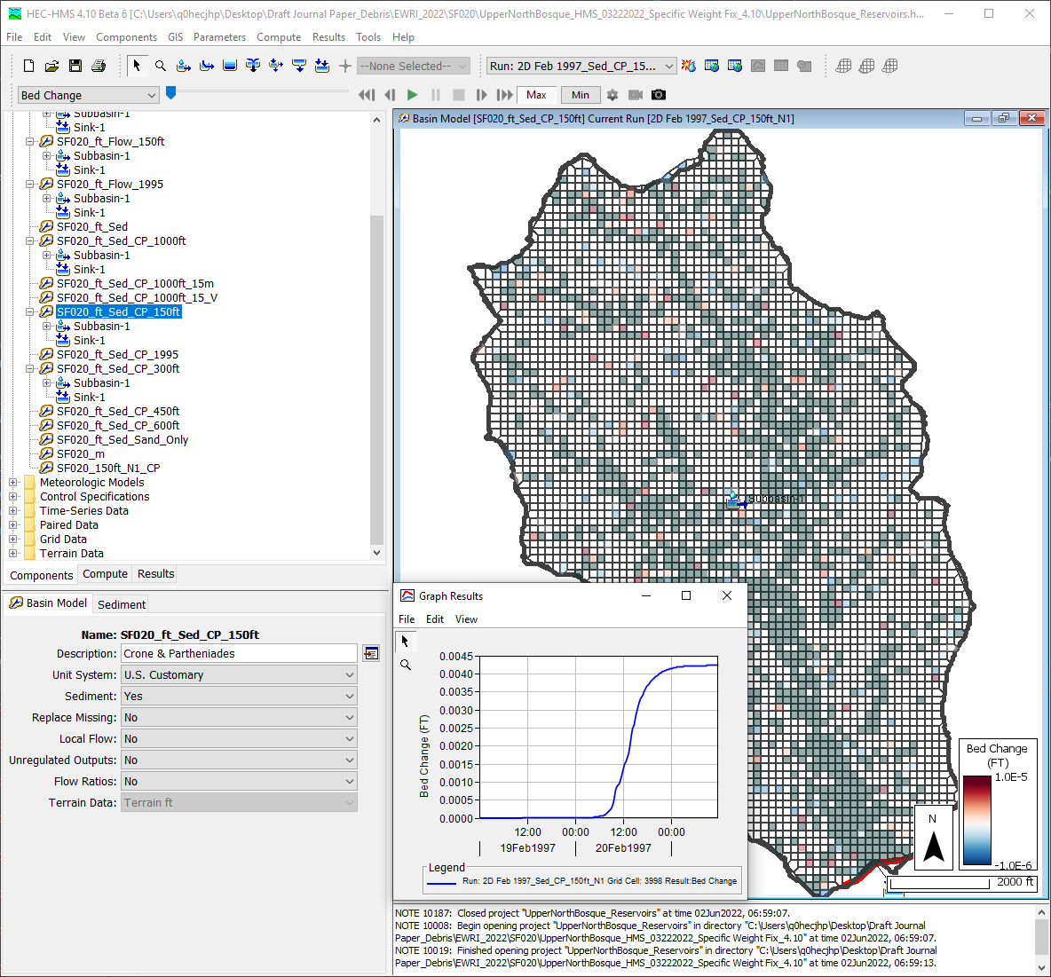
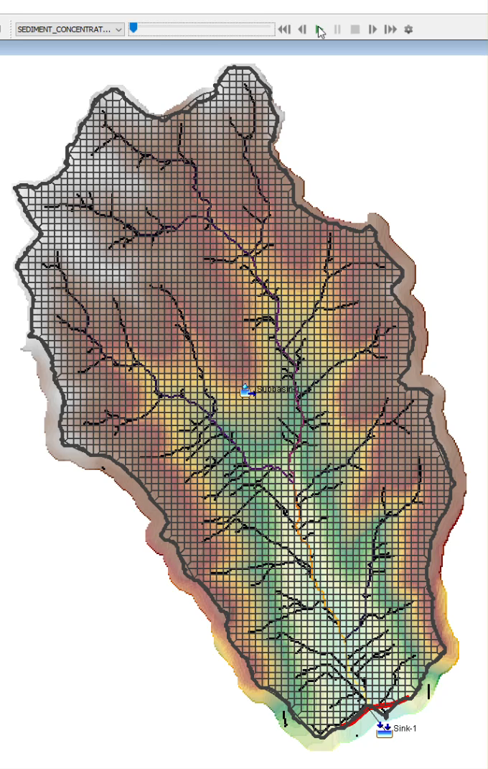
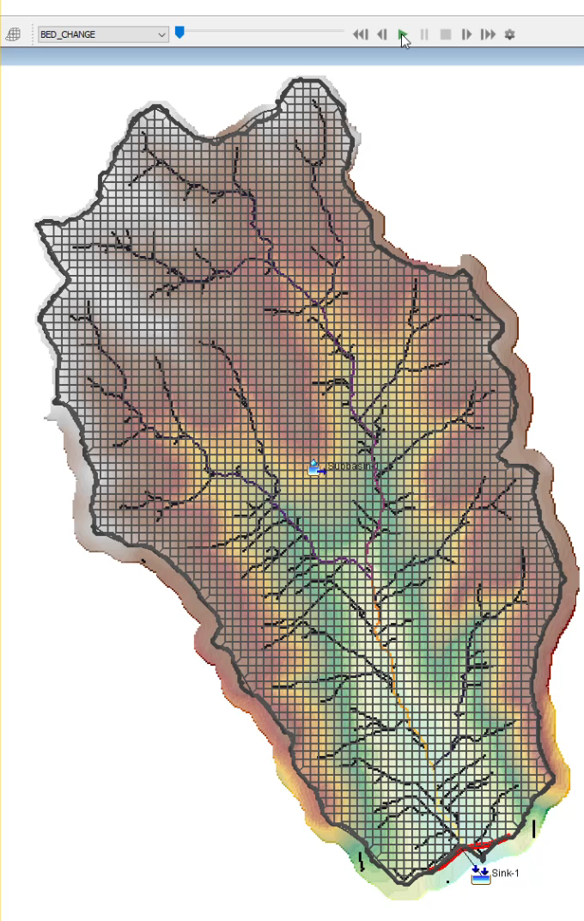
Surface Erosion Modeling Application
with the Hydrologic Modeling System
(HEC-HMS)
Jay Pak, PhD, P.E.
Hydrologic Engineering Center

Slide 2
Introduction
Why do we need the surface erosion model?
  While sediment rating curves are useful for specific purposes, surface erosion models provide a more detailed, predictive, and process-based approach to understanding and managing erosion, particularly in complex and changing environments.

Slide 3
Sediment Rating Curve
Pros
Cons
Simplicity
Empirical Basis
Wide Application
Useful for Long-Term Studies
Cost-Effective
Data Availability (like Discharge records)
Accuracy Affected by various factors
  Seasons
  Sampling Frequency
  Land use Change
  Climate Change Effects
    Rainfall Pattern & Intensity
    Wildfire Effects, etc.
Source: ChatGPT

Slide 4
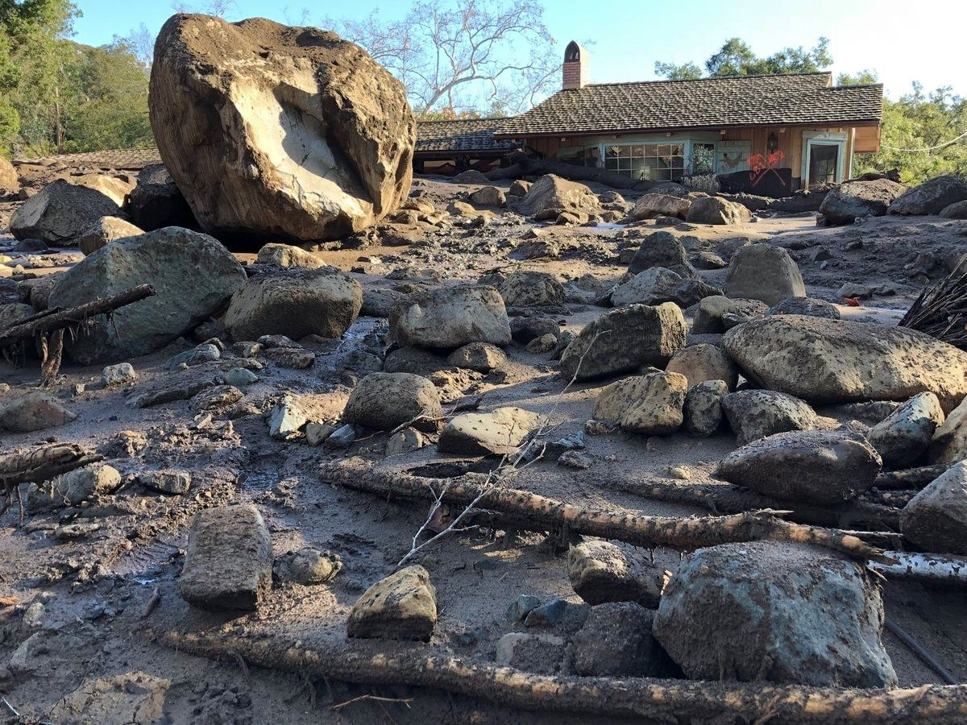
Overview
Case Study: UNBRW, TX
  Lumped Model
  2D Model
Damaged Home in the Montecito, CA (JAN 9, 2018)
Source: https://www.arcgis.com/apps/MapJournal/index.html?appid=541c23aa483b48978d1bc9904a6fb14d
Notes:
Within this presentation:
Discuss why we added the 2D flow and sediment transport capabilities to HEC-HMS
Go over some of the technical background and significance of these features
Then, we’ll demo these new capabilities within the software
We’ll finish with tech transfer documentation, discussion of our next steps and planned future improvements, and take questions

Slide 5
Watershed Sediment Case Study:
Study Site and Relevant Data
Area: Approximately 921 km² (BO070, Hico)
The UNBRW is 98% rural with the primary land uses being rangeland (43%), forage fields (23%), and dairy waste application fields (7%) (McGarland and Hauck, 1999).
Predominant soil types: fine sandy loams and clay loams (Ward et al., 1992).
The watershed receives an average annual precipitation of 750 mm and an average daily temperature ranges 6ºC in winter to 28ºC in summer (McFarland and Hauck, 1999).
Elevation in the watershed range from 299 m to 495 m.
  68 subbasins
  40 reservoirs

Slide 6
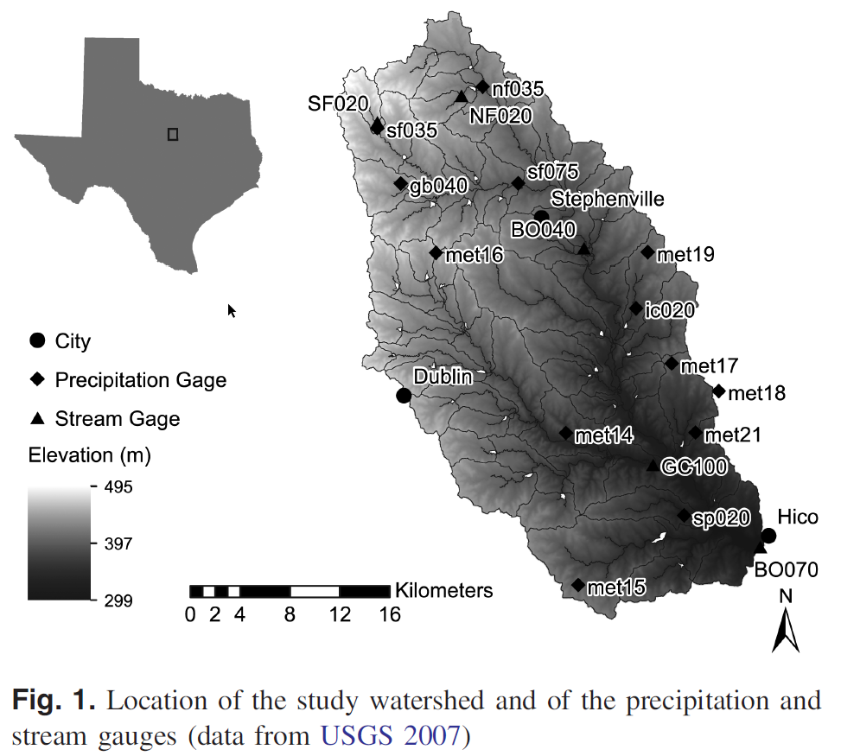
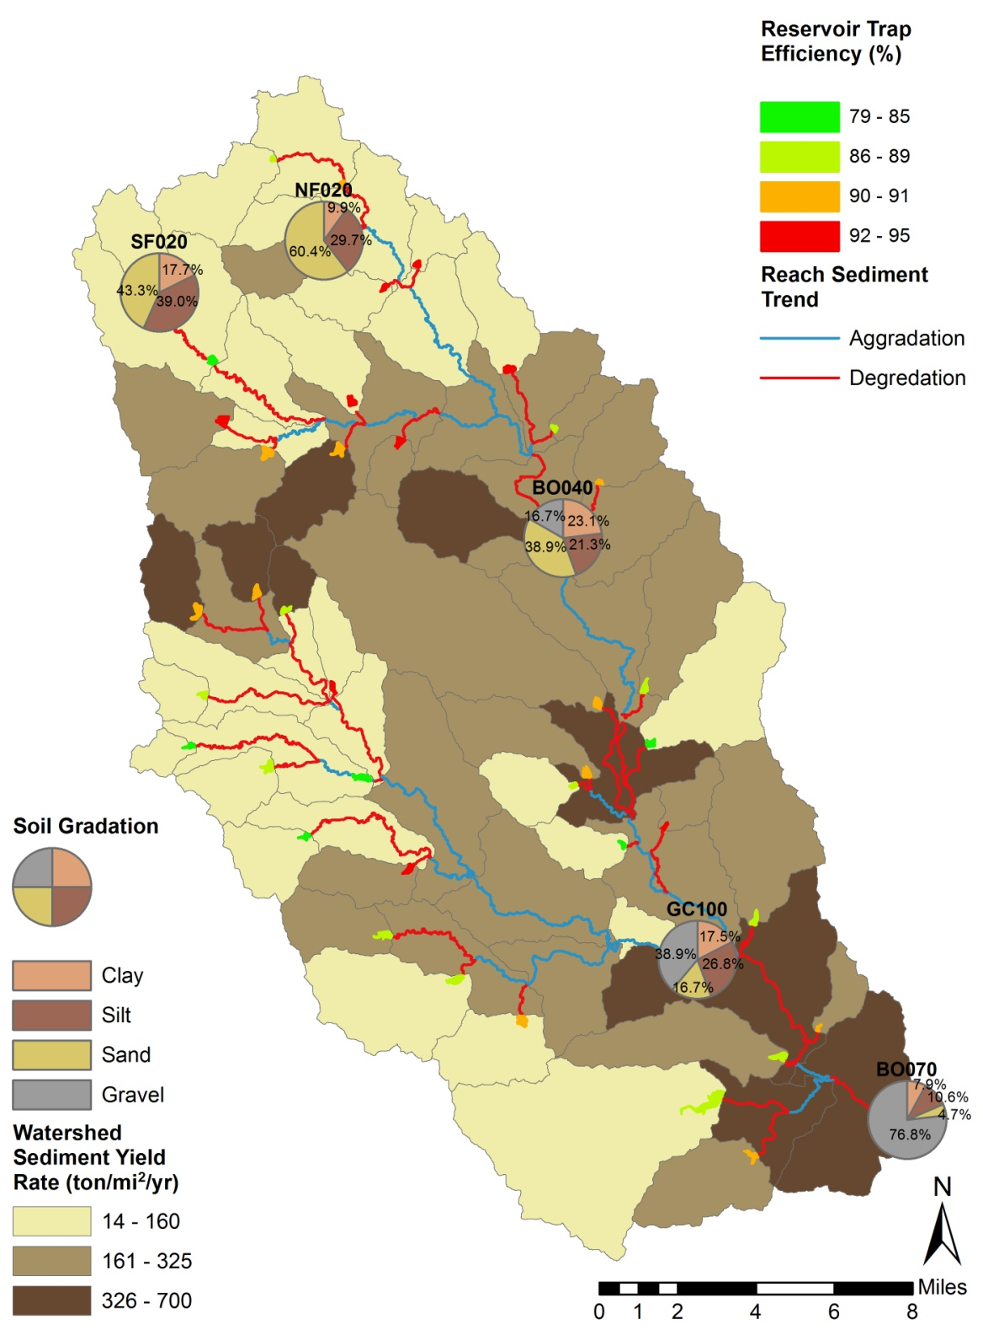
Location of 5 Stream Gage Sites

Slide 7
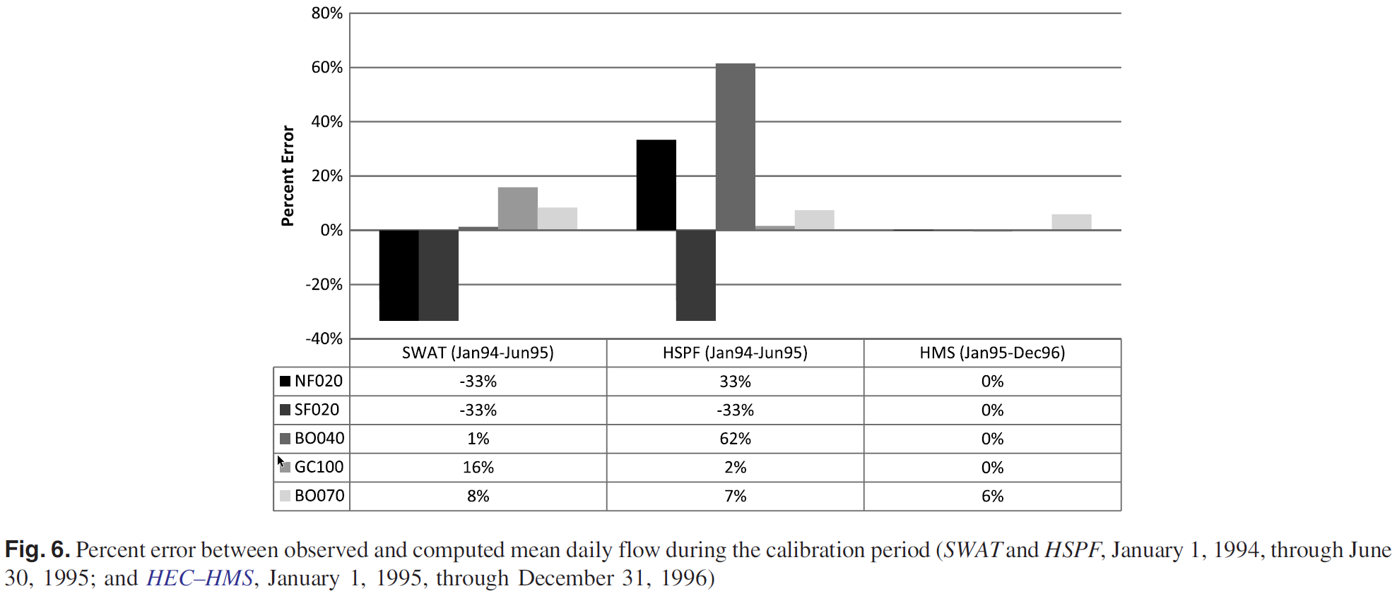
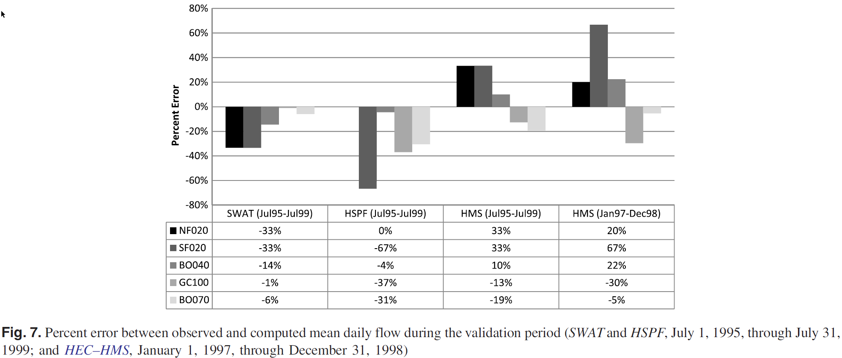
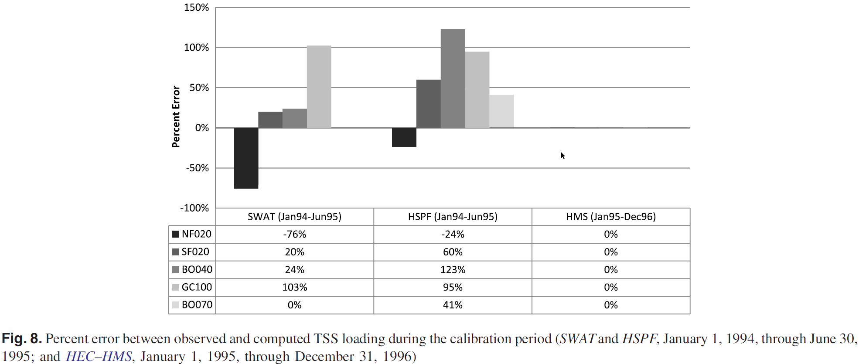
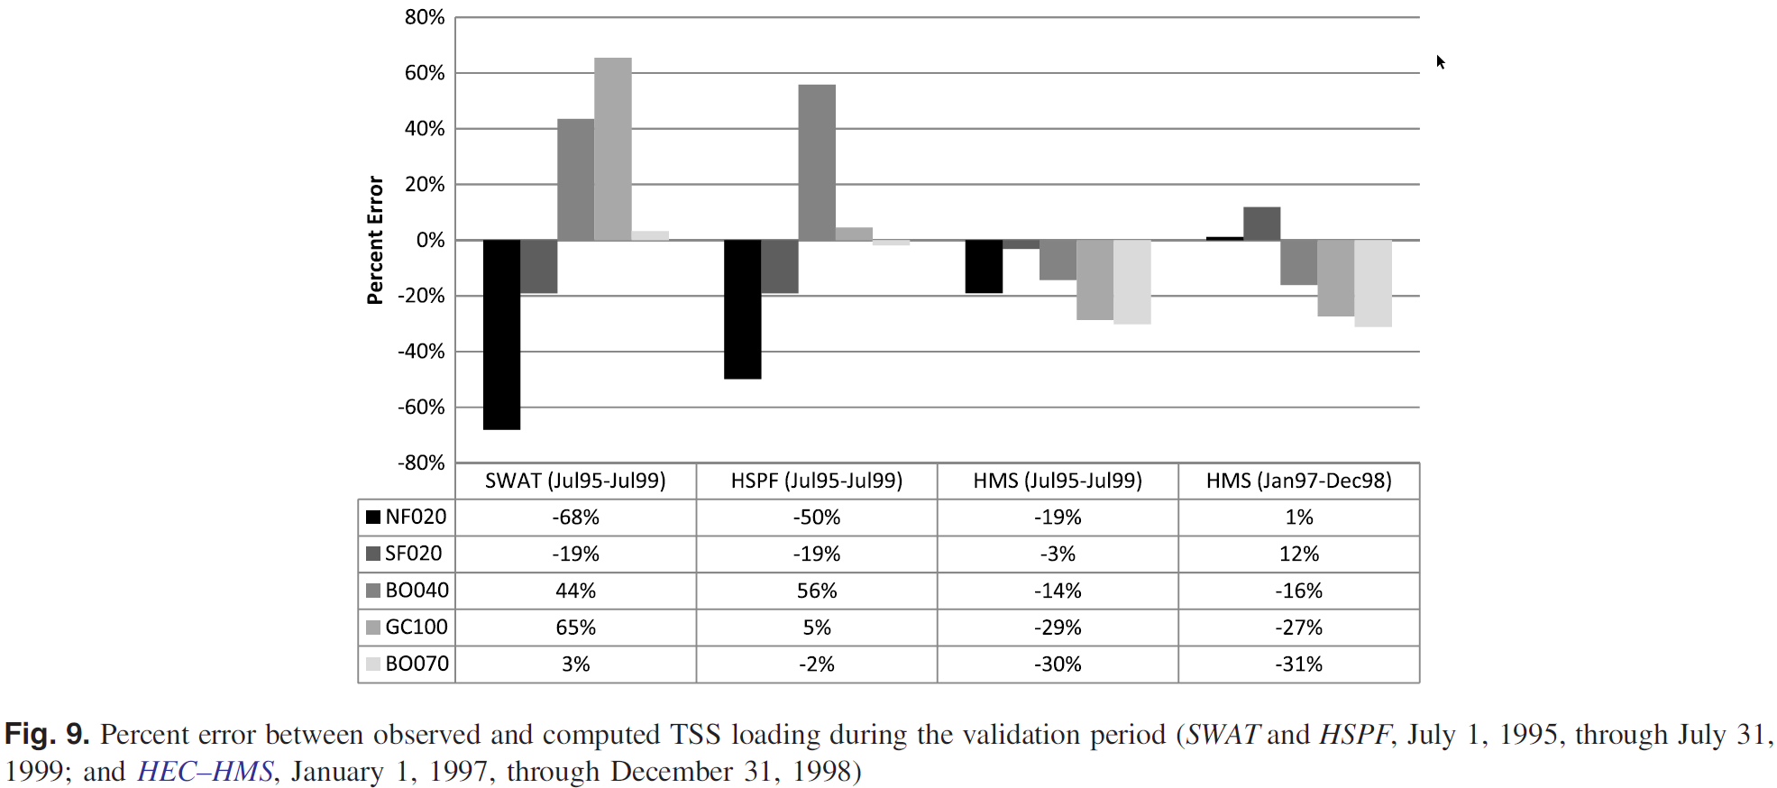
Comparison
(SWAT, HSPF, and HEC-HMS)

Slide 8
2D Surface Erosion
To highlight the 2D surface erosion modeling tools within HEC-HMS
Shared computational 2D solver engine
between HEC-HMS and HEC-RAS
Release 2D capabilities for multiple platforms
8
Notes:
We set out to implement the 2D solver that was pioneered by the HEC-RAS team within HEC-HMS as part of a USACE R&D project
This would expose the 2D solver to a new array of hydrologic applications
As improvements are made to the solver, both teams benefit and the solver becomes more robust
We also set out to release the 2D flow and sediment transport capabilities to a wide range of platforms including Windows, MacOS, and Linux

Slide 9
Why Do We Need the 2D Sediment Transport Method in HEC-HMS?
  Advantages
Disadvantages
Specially distributed result
  Guide for Sediment TMDL & BMPs
  Sediment Catch Basin Design (Locations & Load Amounts)
  Use remote sensing data (LIDAR, Aerial Photo, etc.) & soil gradation data for calibration & validation
Time and Cost Issues (Longer Run time:16.5 hours – 3.3 mi², 150ft X150ft, 2-yr, 1 min, 1-core) (CPU@2.40GHz)
Solutions
Selecting proper grid size and time step with minimizing precision loss (18.5 minutes – 3.3 mi^{2,} 1000ft X 1000ft, 2-yr, 15-min, 8-core)

Slide 10
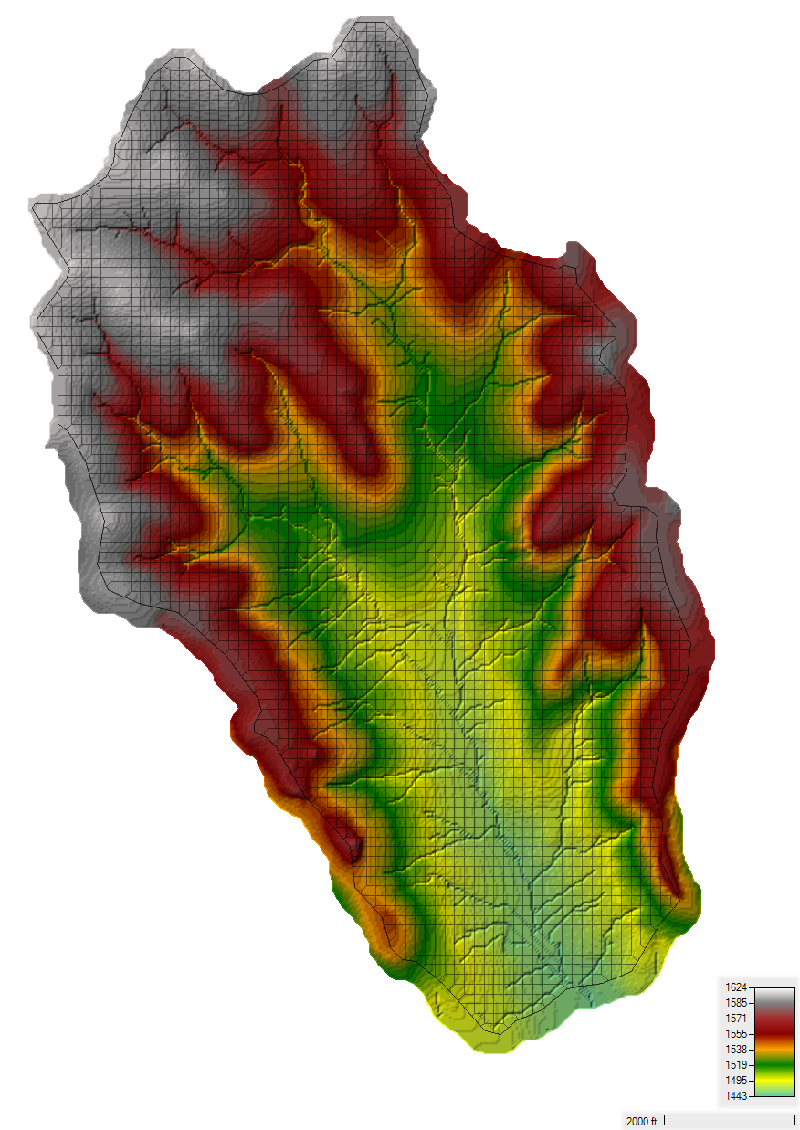
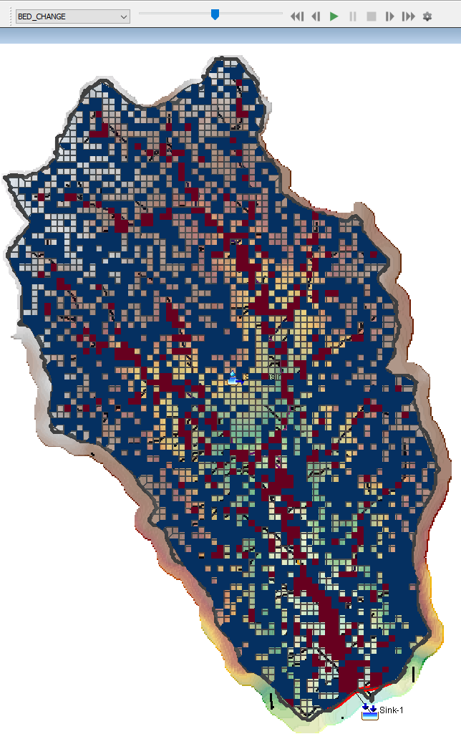
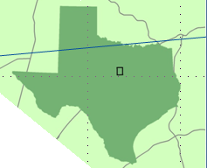
Case Study: UNBRW SF020
Lumped Model Results
2-D Results
Outlet
2-D STM Results
Water Depth
Flow Velocity
Concentration
Bed Change
Precipitation: 750 mm/year
Soil Type: fine sandy loams
2D Area: 3.3 mi² (8.5 km²)
Elevation: 1457 ft – 1624 ft (444 m – 495 m)
Terrain Model: 10 m DEM
Grid Cell Number: 4035
Grid Cell Size: 150 ft X 150 ft
Notes:
14 Precipitation Gages & 5 Stream Gages
356 mi2

Slide 11
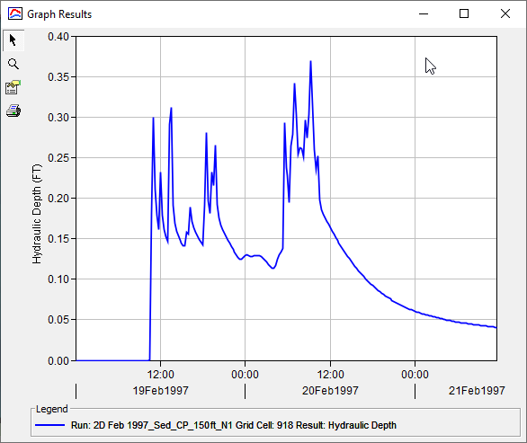
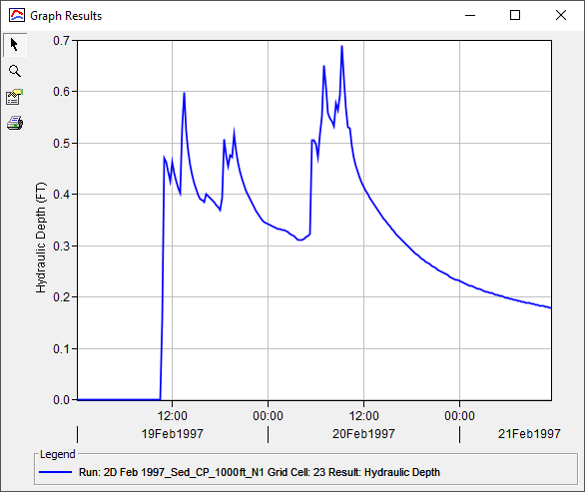
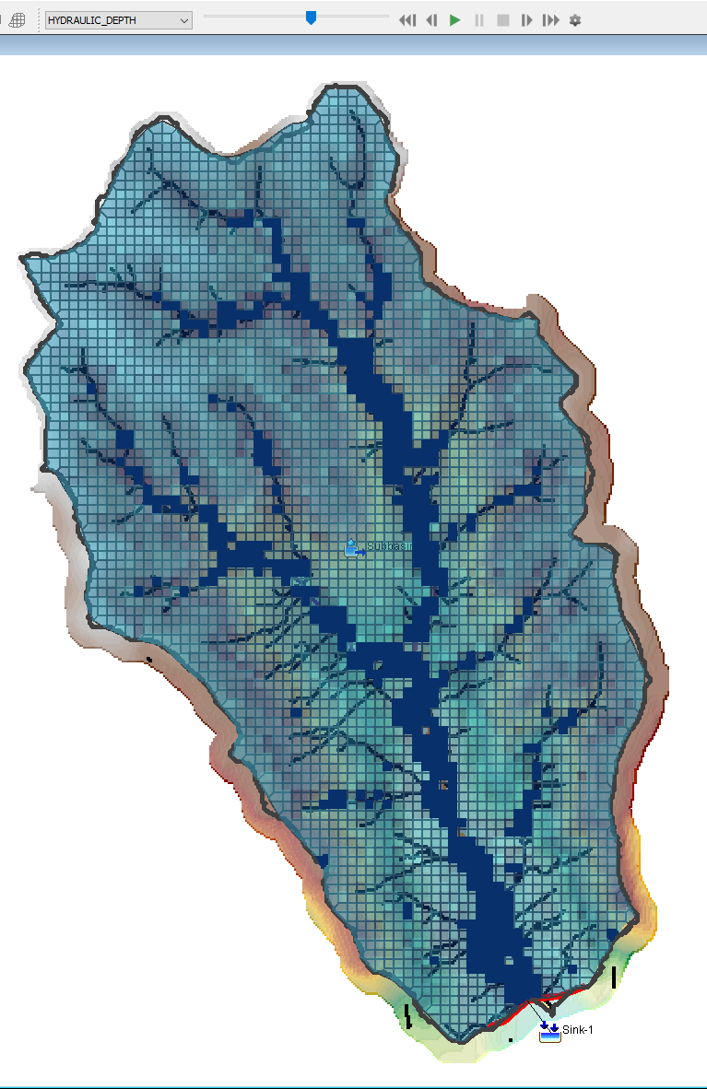
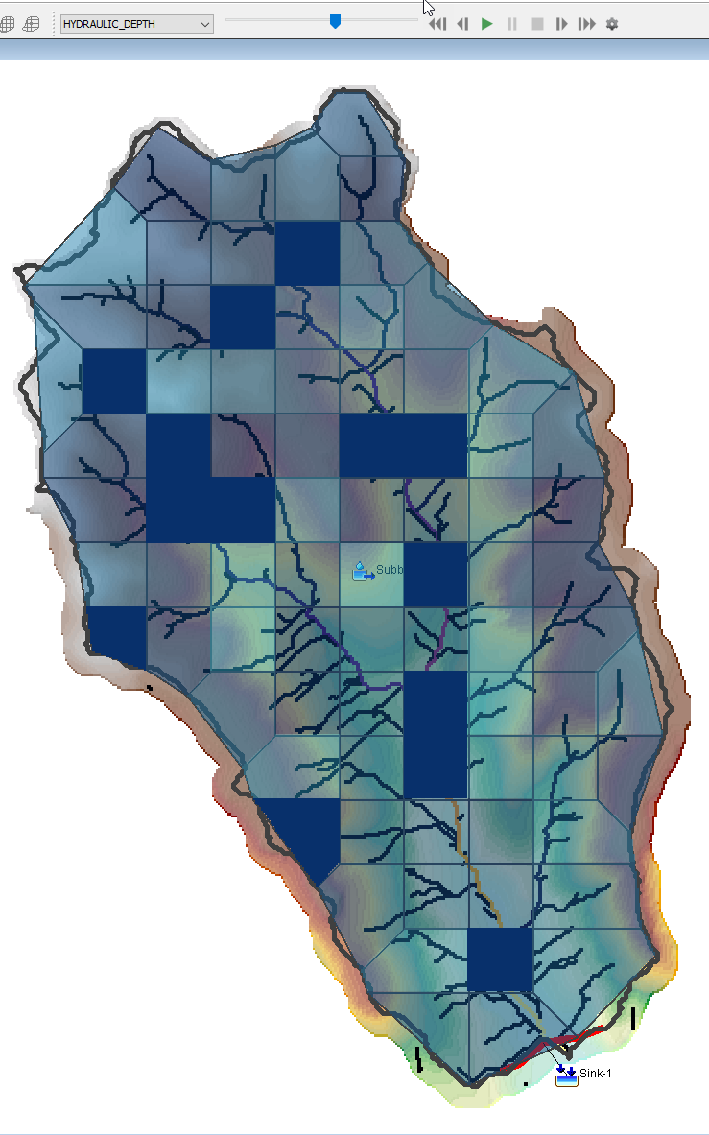
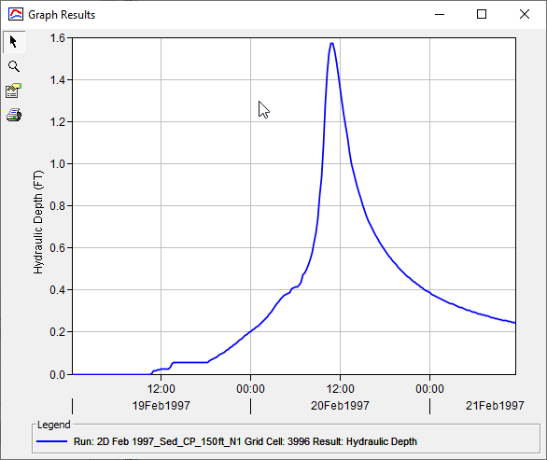
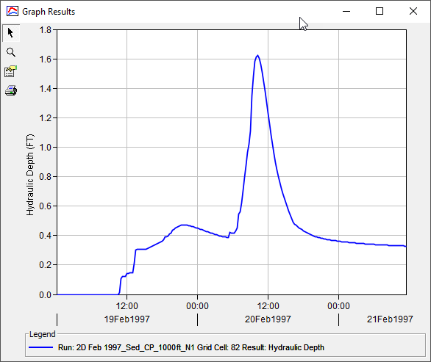
2D Flow Results (HEC-HMS 6.9 bETA 6)
150 ft X 150 ft
1000 ft X 1000 ft

Slide 12
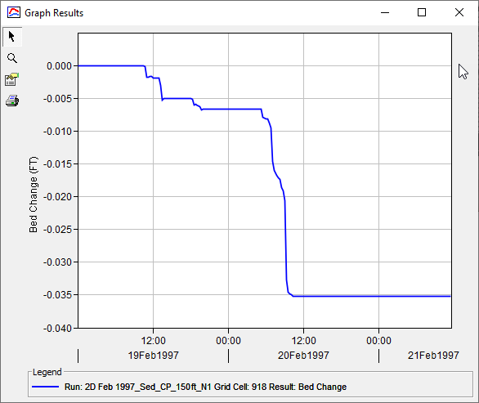
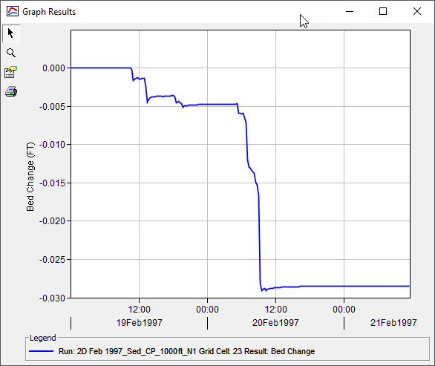
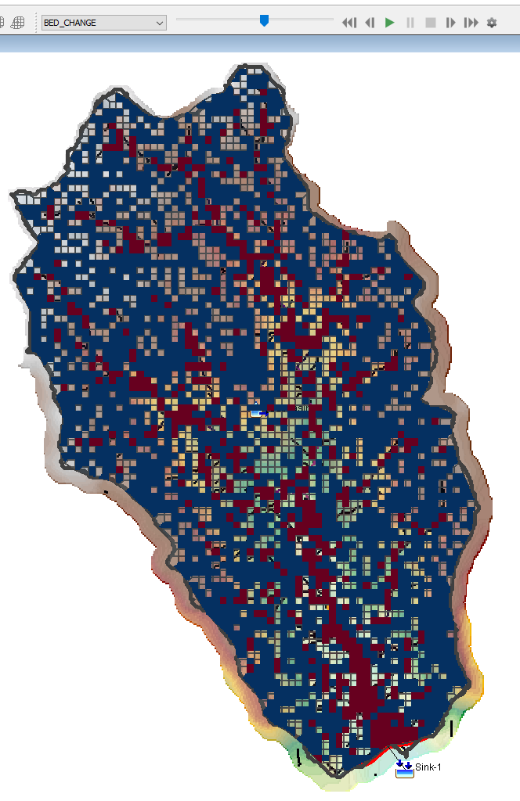
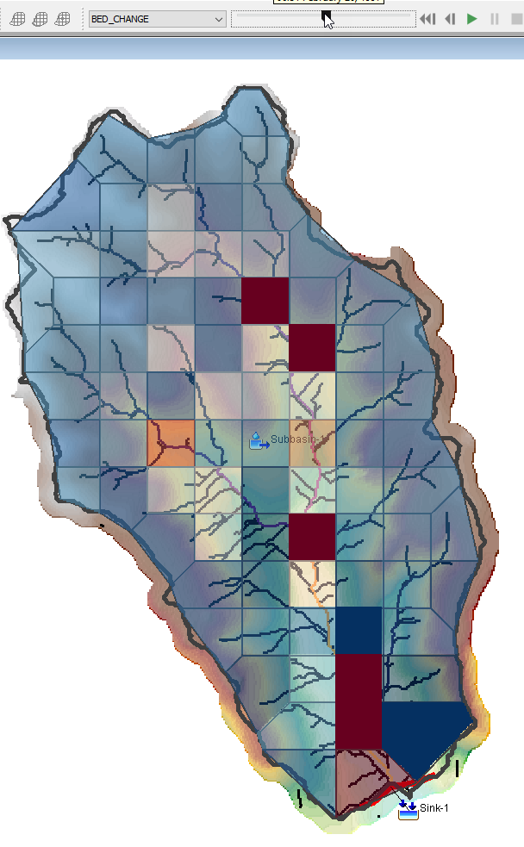
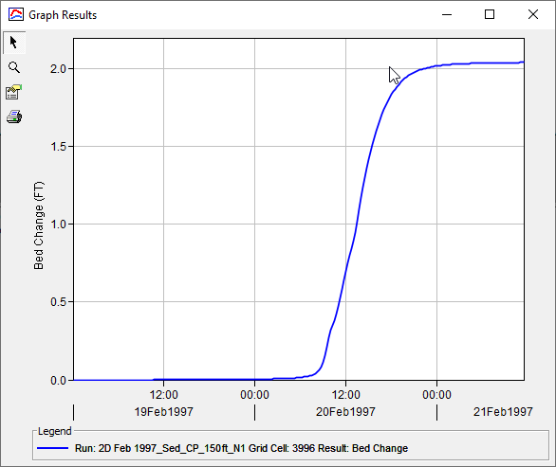
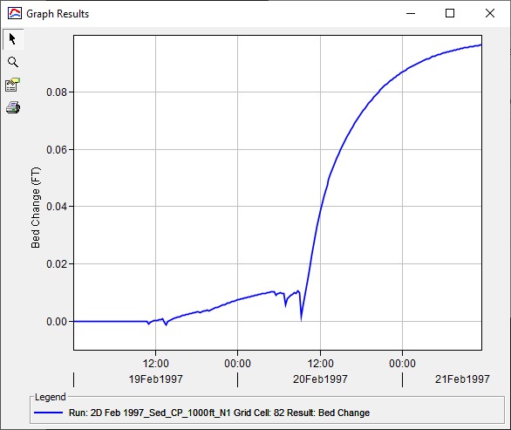
2D Sediment results (HEC-HMS 6.9 bETA 6)
150 ft X 150 ft
1000 ft X 1000 ft

Slide 13
animation results (HEC-HMS 6.9 bETA 6)

