Slide 1
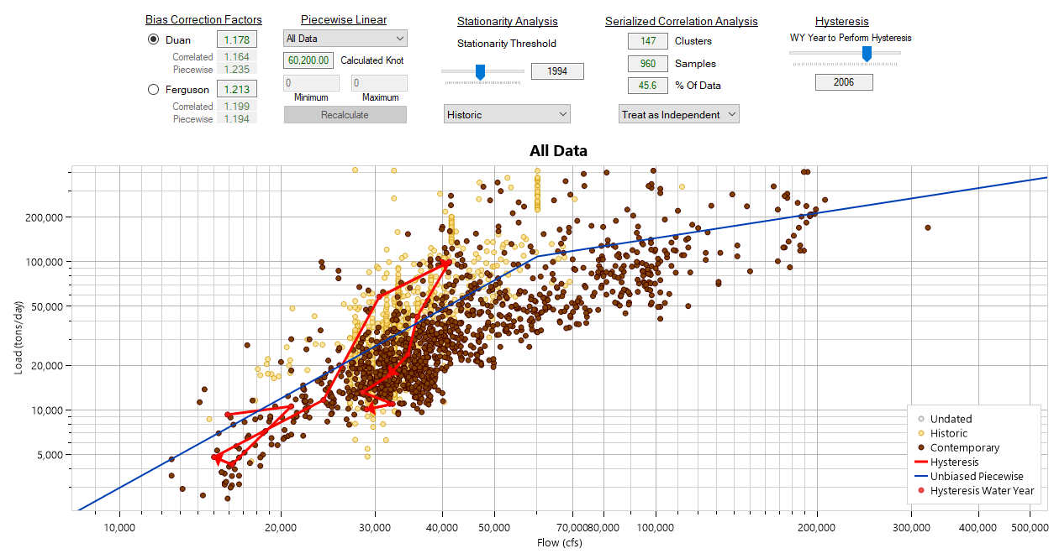



Sediment Rating Curve Analysis Tool
Stanford Gibson, PhD and Zach Morris
Hydrologic Engineering Center

Slide 2
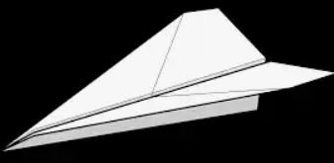
Folded into a paper-airplane quiz by
John Shelley, Ph.D., P.E.

Slide 3
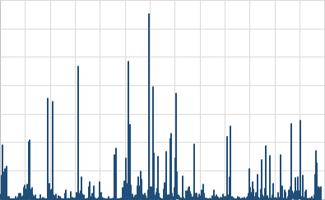
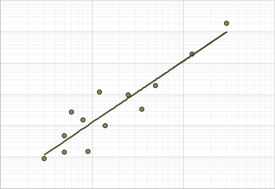
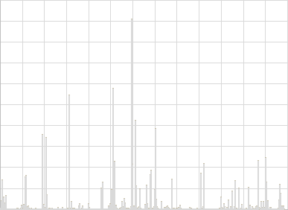
Flow (cfs)
Time
+
→
Load (tons)
Flow (cfs)
Load (tons)
Time

Slide 4
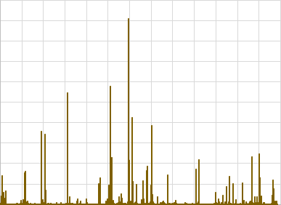
Flow (cfs)
Flow (cfs)
Time
Load (tons)
Time
+
→
+
→
Load (tons)
Time
Load (tons)
Flow (cfs)
Time

Slide 5
Flow (cfs)
Flow (cfs)
Time
Load (tons)
Time
+
→
+
→
Load (tons)
Time
Load (tons)
Flow (cfs)
Time

Slide 6
Instructions
Make a paper airplane
Write your name (or an awesome codename) on it
Write your quiz answers
Throw your airplane into the target

Slide 7
QUIZ

Slide 8
Will an Excel Power Fit…
Load = aQ^{b}
1)
A. Predict w/o bias
Load
Power fit
C. Under Predict Load
So you should adjust up
    A. …Predict Loads Without Bias?
    B. …Over Predict Loads?
    C. …Under Predict Loads?
B. Over Predict Load
So you should adjust down
Flow

Slide 9
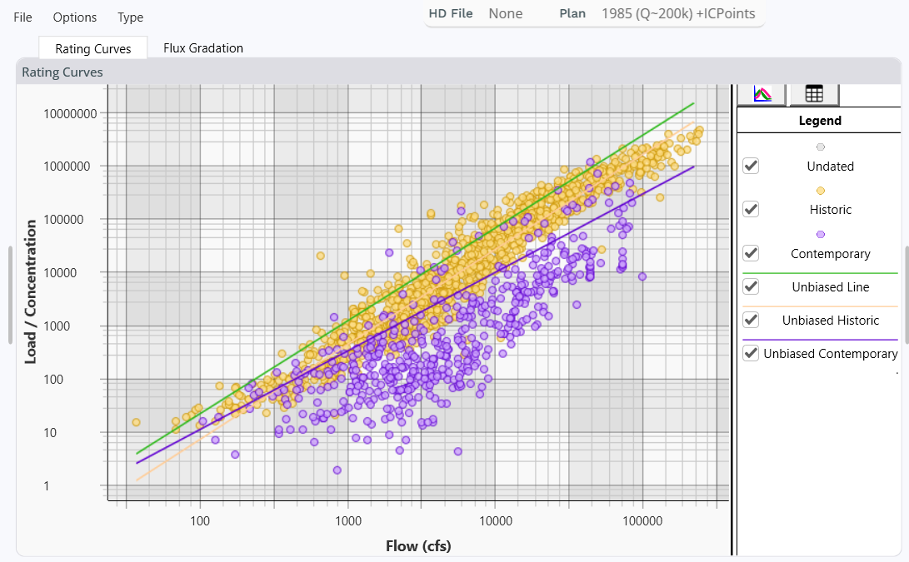
2)
Data that looks like this is an example of…
A-Hysteresis
B- The “knot”
C- Non-stationarity
Arkansas River, Tulsa

Slide 10
3)
What might cause this effect?
Load = aQ^{b}
Arkansas River, Tulsa

Slide 11
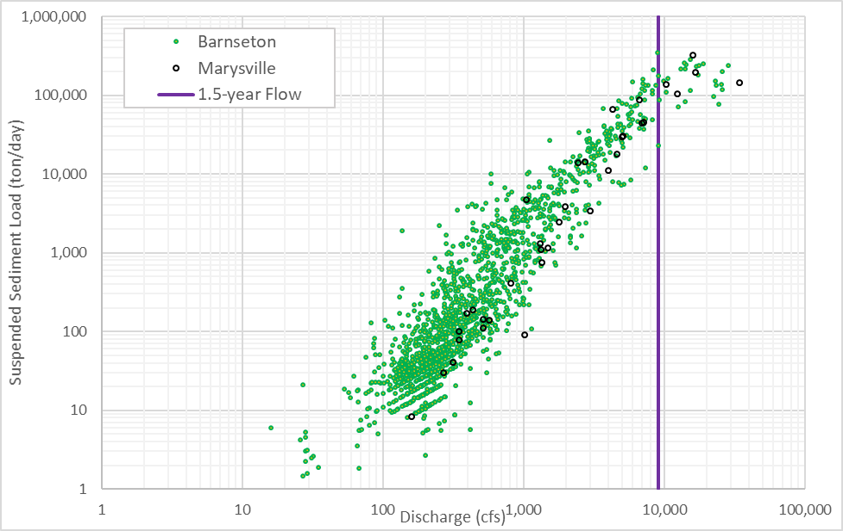

“Bent” Rating Curves
4)
What happens if you fail to include a knot in your rating curve
where the data appears to flatten out?
A- Nothing much, so few events occur in the higher-flow range anyway
B- Most likely underpredict load
C- Most likely overpredict load
D- Depends on the number of replicates
Smoky Hill River, KS
Big Blue River, KS
Analysis by Dr. John Shelley
From Kansas River Basin- Sedimentation Existing Conditions Summary

Slide 12
Throw your airplane quiz into the target

Slide 13
Will an Excel Power Fit…
Load = aQ^{b}
A. Predict w/o bias
Load
Power fit
C. Under Predict Load
So you should adjust up
    A. …Predict Loads Without Bias?
    B. …Over Predict Loads?
    C. …Under Predict Loads?
B. Over Predict Load
So you should adjust down
Flow

Slide 14
Will an Excel Power Fit…
Load = aQ^{b}
1)
A. Predict w/o bias
Load
Power fit
C. Under Predict Load
So you should adjust up
    A. …Predict Loads Without Bias?
    B. …Over Predict Loads?
    C. …Under Predict Loads?
B. Over Predict Load
So you should adjust down
Flow

Slide 15
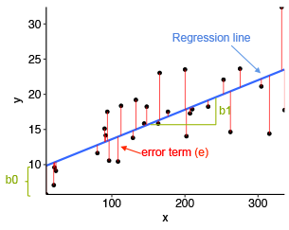
Brief Review: Simple Linear Regression
Least Mean Square Error Analysis
The Line Y = b0+b1 X
Minimizes the Square of the Residuals (e)
Sediment Rating Curves
tend to take the form of power functions
Load = a Flow^{b}
^{Where b=1.5 to 2.5}
Image Credit: https://nextjournal.com/intelrefinery/simple-linear-regression

Slide 16
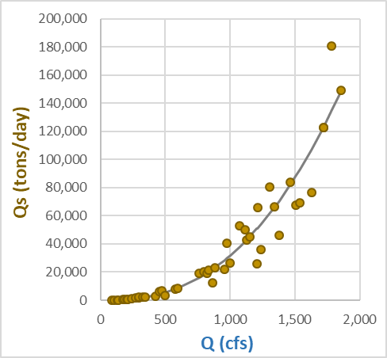
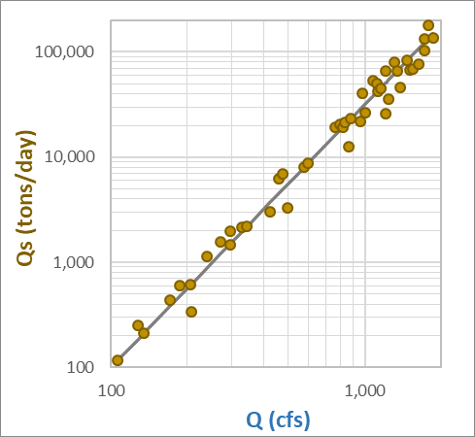
Qs = a Q^{b} → Log Qs = Log a + b Log Q
Load = 0.001 Flow^{2.5}
Qs = 0.001 Q^{2.5}

Slide 17
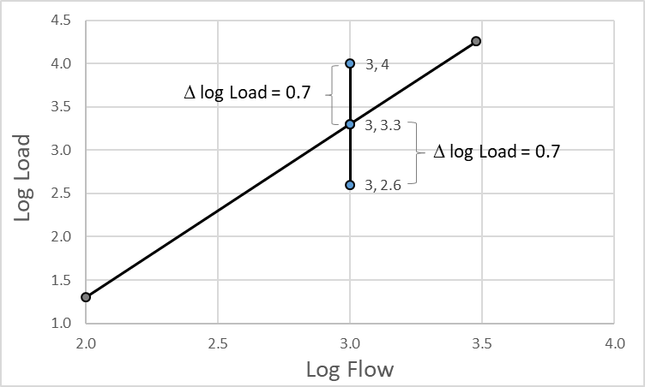
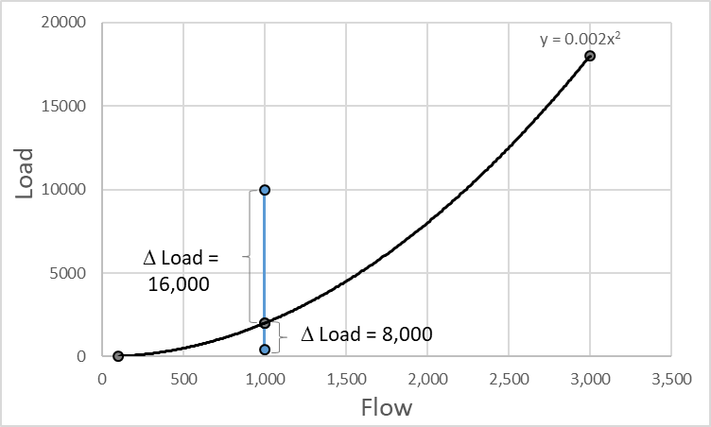

Slide 18

Qs = E a Q^{b}
$$E=\frac{1}{N}\sum_{i=1}^{N}{\left.exp(ln({Qs}_{i}(obs)−ln(aQ^{b}\right)}$$
Bias Correction increases sediment load by 32%
Duan, N. (1983). “Smearing estimate: A nonparametric retransformation method.” Journal of the American Statistical Association, 78(383), 605–610.

Slide 19
2)
Data that looks like this is an example of…
A-Hysteresis
B- The “knot”
C- Non-stationarity
Arkansas River, Tulsa

Slide 20
2)
Data that looks like this is an example of…
A-Hysteresis
B- The “knot”
C- Non-stationarity
Arkansas River, Tulsa

Slide 21
3)
What might cause such a non-stationarity?
Load = aQ^{b}
Arkansas River, Tulsa

Slide 22
3)
What might cause such a non-stationarity?
Load = aQ^{b}
Upstream dam
Catastrophic flood
Arkansas River, Tulsa

Slide 23
“Bent” Rating Curves
4)
What happens if you fail to include a knot in your rating curve
where the data appears to flatten out?
A- Nothing much, so few events occur in the higher-flow range anyway
B- Most likely underpredict load
C- Most likely overpredict load
D- Depends on the number of replicates
Smoky Hill River, KS
Big Blue River, KS
Analysis by Dr. John Shelley
From Kansas River Basin- Sedimentation Existing Conditions Summary

Slide 24
“Bent” Rating Curves
4)
What happens if you fail to include a knot in your rating curve
where the data appears to flatten out?
A- Nothing much, so few events occur in the higher-flow range anyway
B- Most likely underpredict load
C- Most likely overpredict load
D- Depends on the number of replicates
Smoky Hill River, KS
Big Blue River, KS
Analysis by Dr. John Shelley
From Kansas River Basin- Sedimentation Existing Conditions Summary

Slide 25
Workshop

