Slide 1
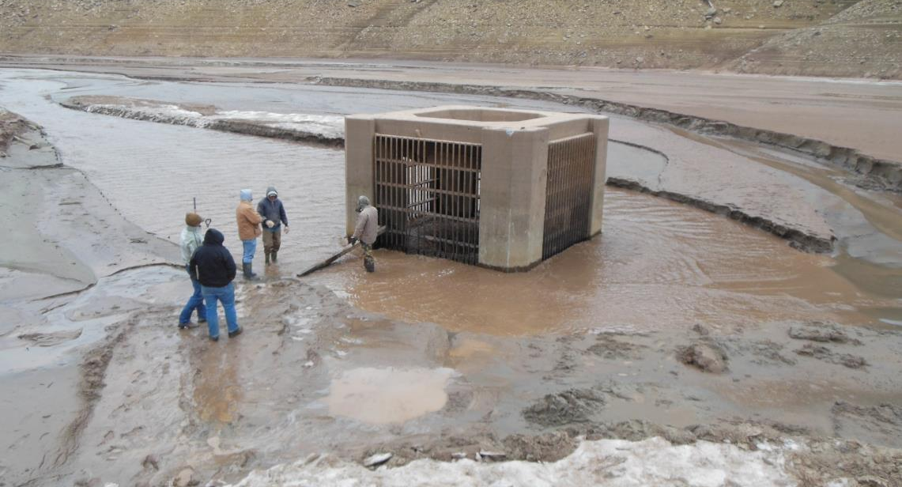
Creating the Future Without Project Scenario: Introduction and Trendlines
John Shelley, Ph.D., P.E.
August 2024
“The views, opinions and findings contained in this report are those of the authors(s) and should not be construed as an official Department of the Army position, policy or decision, unless so designated by other official documentation.”
Tuttle Creek Lake prior to filling.

Slide 2
Timeline For Sedimentation Analysis
Original
Existing Condition
+25 years without sediment management
+25 years with sediment management
+50 years without sediment management
+50 years with sediment management

Slide 3
Timeline For Sedimentation Analysis
Scenario | Cost Avoided (Net Present Value)
FWOP | $300M
FWP | $110M
Difference | $190M
Original
Existing Condition
+25 years without sediment management
+25 years with sediment management
There are several ways this might be set up. But ultimately there will be some decision-making process that uses dollars to compare FWOP to FWP.
+50 years without sediment management
+50 years with sediment management

Slide 4
How to determine the Future Without Sediment Management?
Trendline
Sediment Budget (HMS)
Numerical Model

Slide 5
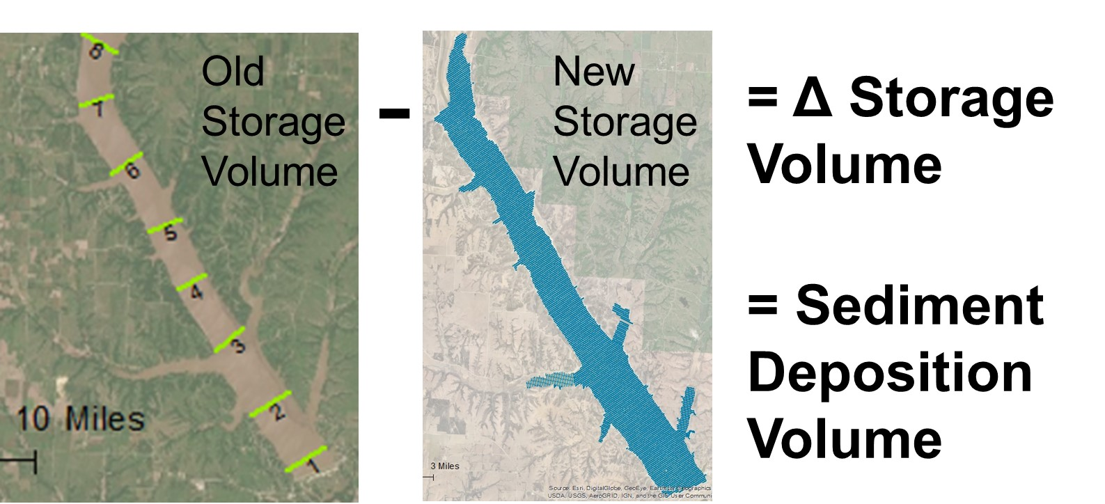
How to determine the Future Without Sediment Management?
Trendline
Sediment Budget
Numerical Model
Qs = Δ Vol / Years
Future deposition = Qs * Years

Slide 6
In-Class EXAMPLE
Based on the following pool volumes for Tuttle Creek Lake, estimate the remaining multipurpose pool volume in 2074.
Year | Multipurpose Pool Volume (ac-ft) | Flood Control Pool Volume (ac-ft) | Data Type
1962 | 424,312 | 1,942,705 | Sedimentation Ranglines
1973 | 388,598 | 1,937,366 | Sedimentation Ranglines
1983 | 335,100 | 1,922,085 | Sedimentation Ranglines
1993 | 298,883 | - | Sedimentation Ranglines, partial survey
2000 | 280,137 | 1,870,735 | Sedimentation Ranglines
2009 | 257,014 | 1,884,312 | Single beam sonar 250 ft spacing, LiDAR

Slide 7
Answers?

Slide 8
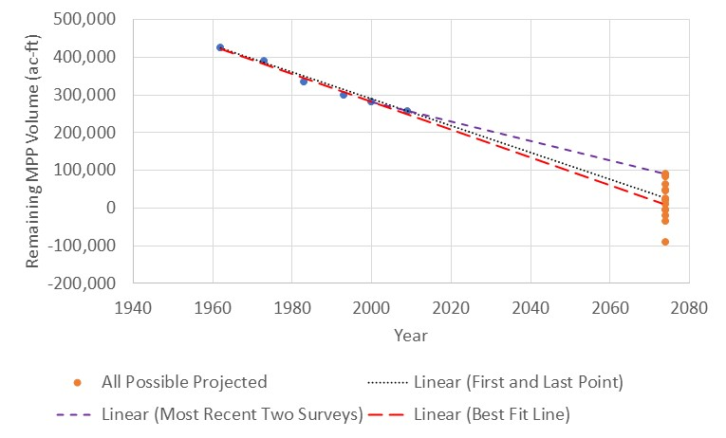
Which two data points did you use?

Slide 9
Why is the Deposition rate so different between time periods?

Slide 10
Why is the Deposition rate so different between time periods?
Differences in flow
Depletions
Shifts in land use
Channel evolution → Lower loads for later stages
Upstream dams
Wildfires
Climate change

Slide 11
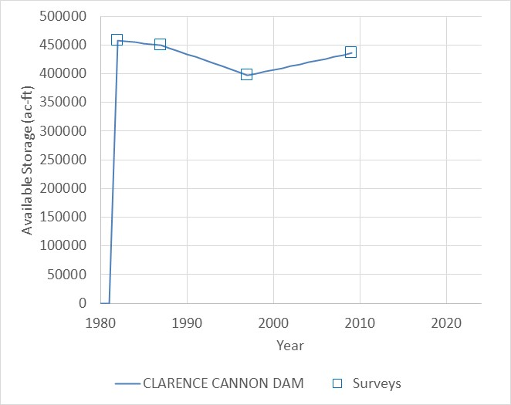
What is going on here?

Slide 12
What is going on here?
Possibilities
Pool raise (reallocation from flood storage to conservation pool storage)
Change in survey methods (rangelines to surface-based)
Actual sediment removal (probably not)

Slide 13
How do you project a trendline?

Slide 14
How do you project a trendline?
Options
Compute the annual loss rate from earlier, more consistent measurements
Use the annual rate from earlier time periods with similar methods and no pool raises
Apply that annual rate to the most recent, accurate data point

Slide 15
How do you project a trendline?
Options
For a pool raise: recompute the storage volume of the higher pool over time
What might be the problem with this approach?
Notes:
Problem with this are-
The fact that you are now raising the water level in the lake will lead to higher trapping efficiency. So this is probably an underestimation.

Slide 16
How do you project a trendline?
Options
For a changed survey method:
Re-analyze the new survey using the old method
Then apply the new annual rate starting at the most recent, new survey
Notes:
Problem with this are-
The fact that you are now raising the water level in the lake will lead to higher trapping efficiency. So this is probably an underestimation.

Slide 17
How do you project a trendline?
Options
For sediment removal:
Add the volume removed back in to compute the annual sedimentation rate
Then apply the adjusted annual rate starting at the most recent, new survey
Notes:
Problem with this are-
The fact that you are now raising the water level in the lake will lead to higher trapping efficiency. So this is probably an underestimation.

Slide 18
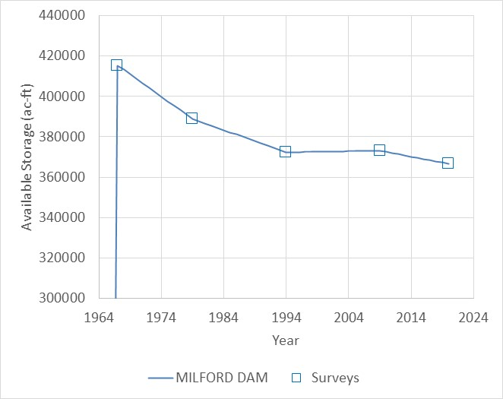
What’s Going On Here?
What causes the increase in volume from 1994 to 2009?
What causes the dramatic drop in annual sedimentation rate from 2009 to 2020 compared to 1967 to 1979?
Which rate should you use to project?
Why might that be a problem?
SRL
Overall:
-919 ac-ft/year
-2211 ac-ft/year
SRL
SRL
DSB
DSB
-590 ac-ft/year
Survey Type:
SRL = Sediment Rangelines
DBS = Dense Bathymetric Survey

Slide 19

Sequential steps for more accurate answers
Geomorphic Feedbacks
Numerical Modeling
Sediment Budget
Rating Curve/Trapping Efficiency Analysis
Trendlines
Volume Change Analysis
Quick (2 days)
Screening
Where overall deposition is low
No feedbacks
No changed conditions
Medium (2 weeks)
Where overall deposition is high
Trapping efficiency feedback
Can include changed conditions
Can assess some sluicing/routing/flushing options
Long (4 months)
Where overall deposition is high
Trapping efficiency and upstream deposition feedbacks
Can include changed conditions
More accurate for delta progression, full and partial drawdown flushes
Notes:
Image generated by DALL-E.

Slide 20
Three Basic Approaches to Future Volume Projection
Trendline extrapolation
Sediment budget
Numerical modeling

Slide 21
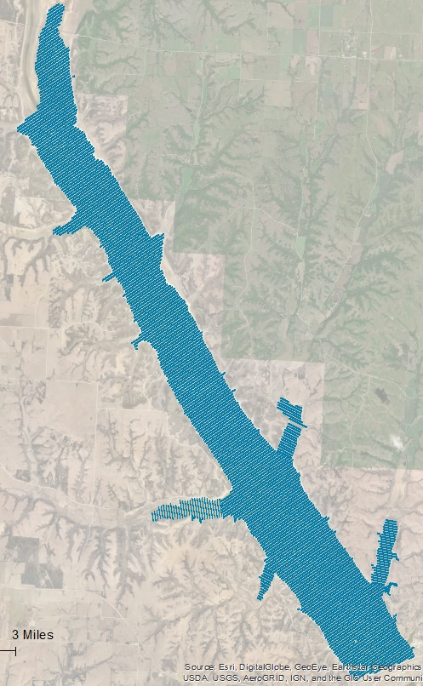
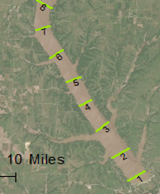
Reservoir Sedimentation Prediction
1. Compile the history of storage loss in the lakes
-
=
Deposition

Slide 22
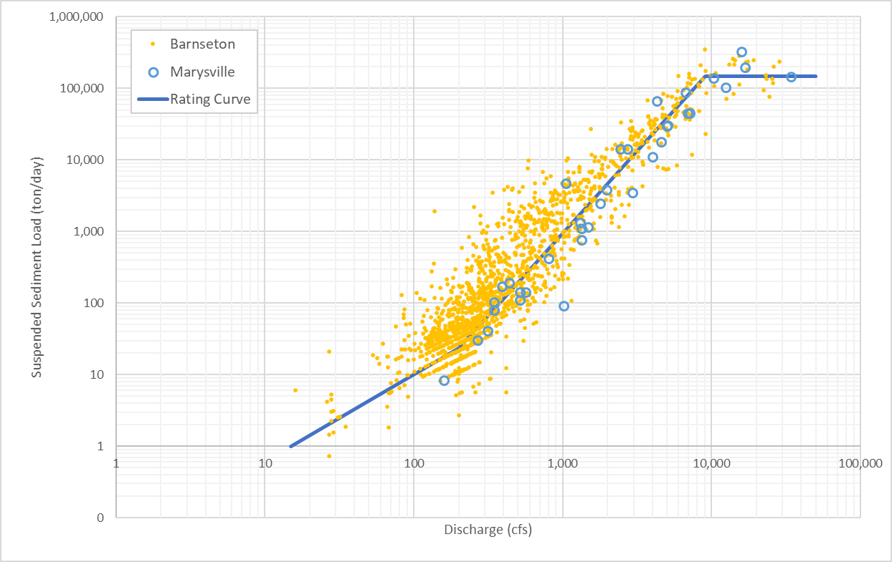
Sediment Budget Sedimentation Prediction
2. Develop flow/load relationship for the incoming rivers(s)
Big Blue River- Upstream of Tuttle

Slide 23
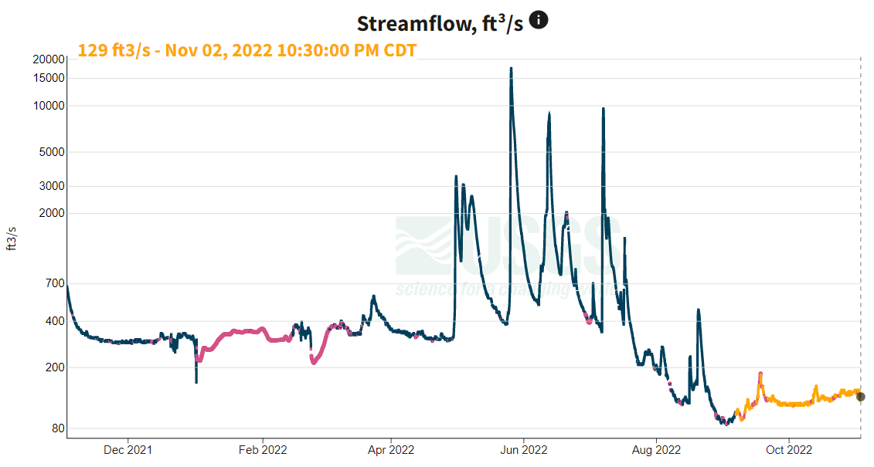
Reservoir Sedimentation Prediction
3. Run the time series of daily flows through the flow/sediment rating curve
Daily Water Inflow
Daily Sediment Inflow
Flow/Sediment Rating Curve

Slide 24
Reservoir Sedimentation Prediction
4. Apportion a percentage to the flood pool based on historic surveys.
(This percentage actually increases over time as the delta grows and induces backwater. This type of geomorphic feedback requires modeling.)

Slide 25

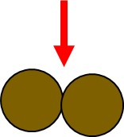
Reservoir Sedimentation Prediction
5. Apply a trapping efficiency.
The trapped percentage decreases over time as the residence time of the water decreases.

Slide 26
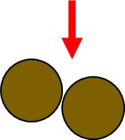
Reservoir Sedimentation Prediction
6. Apply bulk densities
Tons * 2000 = lbs
lbs* ɣ (in ft³/lb) = ft³

Slide 27
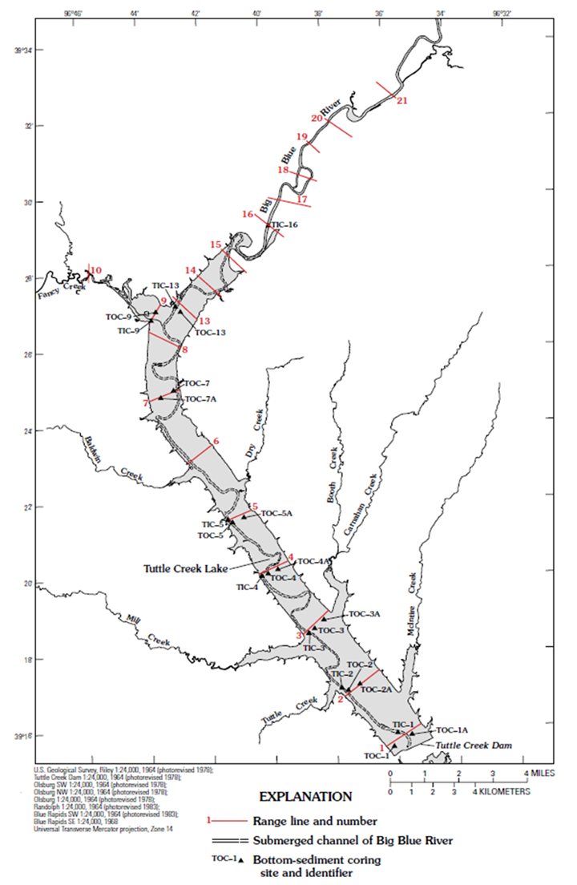
Bulk Density
Easy to measure– look for old reports
Segment | In Channel Bottom Mass (lbs) | In Channel Bulk Density (pcf) | Out of channel Bottom Mass (lbs) | Out of Channel Bulk Density (pcf)
Dam-1 | 47,600,000 | 36.6 | 610,000,000 | 30.2
1 to 2 | 1,310,000,000 | 37.3 | 6,160,000,000 | 30.2
2 to 3 | 3,890,000,000 | 39.1 | 10,700,000,000 | 26.8
3 to 4 | 3,330,000,000 | 36.1 | 5,240,000,000 | 26.2
4 to 5 | 2,850,000,000 | 34.9 | 6,850,000,000 | 30.3
5 to 6 | 3,620,000,000 | 37.7 | 9,130,000,000 | 31.6
6 to 7 | 6,990,000,000 | 46.3 | 14,600,000,000 | 33.9
7 to 8 | 5,740,000,000 | 46.3 | 20,300,000,000 | 36.3
8 to 13 | 4,310,000,000 | 46.3 | 22,800,000,000 | 48.4
13 to 14 | 4,570,000,000 | 54.9 | 17,900,000,000 | 64.3
14 to 15 | 5,090,000,000 | 57.9 | 21,100,000,000 | 64.3
15 to 16 | 9,210,000,000 | 57.9 | 21,900,000,000 | 64.3
16 to 17 | 1,900,000,000 | 60.8 | 14,500,000,000 | 64.3
17 to 18 | 5,440,000,000 | 60.8 | 14,500,000,000 | 64.3
18 to 19 | 4,370,000,000 | 60.8 | 5,120,000,000 | 64.3
19 to 20 | 3,050,000,000 | 60.8 | 2,940,000,000 | 64.3
20 to 21 | 4,560,000,000 | 60.8 | 7,460,000,000 | 64.3
USGS 1999

Slide 28
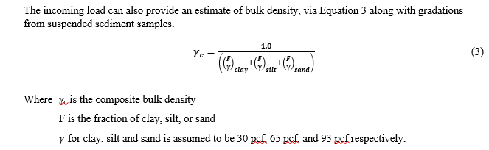
Bulk Density- Estimate Based on Incoming Sediment Gradations

Slide 29
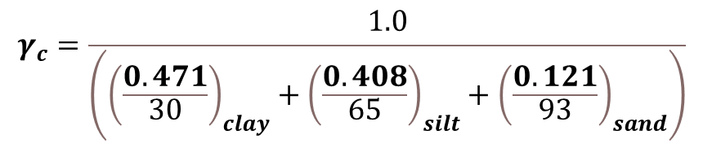
Bulk Density- Estimate Based on Incoming Sediment Gradations
Parameter | Value
Years | 1962 - 2019
Total Incoming Sediment (tons) | 310,192,634
Total Incoming Clay Fraction | 47.1 %
Total Incoming Silt Fraction | 40.8 %
Total Incoming Sand Fraction | 12.1 %
$$γ_{c}=\frac{1.0}{\left({\left(\frac{0.471}{30}\right)}_{clay}+{\left(\frac{0.408}{65}\right)}_{silt}+{\left(\frac{0.121}{93}\right)}_{sand}\right)}$$
$$γ_{c}=42.9 pcf$$

Slide 30
Bulk Density- Estimate Based on Reservoir Bed Gradation

Slide 31
Bulk Density- Estimate Based ON
YOUR BEST GUESS

Slide 32
Reservoir Sedimentation Prediction
7. Compare to measured sediment volumes
8. Calibrate the sediment rating curve so the computed deposition = the measured over many time periods
Time Period | Surveyed (ac-ft) | Computed (ac-ft) | Calculated / Surveyed
1963-1972 | 40,898 | 42,907 | 1.05
1972-1983 | 68,773 | 61,557 | 0.90
1983-2000 | 124,411 | 126,015ª | 1.01
2000-2009^{b} | 23,123 | 23,367 | 1.01
Total (1963-2000) | 234,082 | 230,479 | 0.98
Surveyed and Computed Deposition at Tuttle Creek Lake
ªFP deposition calculated using mean bulk density
^{b}Surveyed and computed are for the MPP. Change in survey method makes FP deposition unreliable.

Slide 33
Rating Curve: Simple Power Function?
Qs=aQ^{b}

Slide 34
Qs=aBDEQ^{b}
Unbiassed correction
Bedload %
Ungaged area
Location of the knot (bend in the rating curve)
Uncertainty in the rating curve (especially at the high end)
Bulk density estimate
Error in surveys

Slide 35
Why choose the sediment budget approach?
Trendline Analysis Limitation
Incorporate into Sediment Budget Analysis
Differences in flow
Depletions
Shifts in land use
Channel evolution → Lower loads for later stages
Upstream dams
Wildfires
Climate change
Flow time series
Flow time series
Rating curve
Rating curve
Rating curve/flow time series
Rating curve/flow time series
Flow time series

Slide 36
Sediment Budget Approach for Tuttle Creek Lake
Time Period | Surveyed (ac-ft) | Computed (ac-ft) | Calculated / Surveyed
1963-1972 | 40,898 | 42,907 | 1.05
1972-1983 | 68,773 | 61,557 | 0.90
1983-2000 | 124,411 | 126,015ª | 1.01
2000-2009^{b} | 23,123 | 23,367 | 1.01
Total (1963-2000) | 234,082 | 230,479 | 0.98

Slide 37
Tools
HEC-RAS rating curve calculator
2. HEC-HMS reservoir sediment tool
Download Coupled Q, C Qs data
Flow Times Series
Sediment Time Series
Storage Elevation Curve
Daily Flow
Bulk Density
New Storage Elevation Curve

Slide 38

Questions?
Notes:
Image from Dall-E: Question marks floating into a lake, digital art

