Slide 1
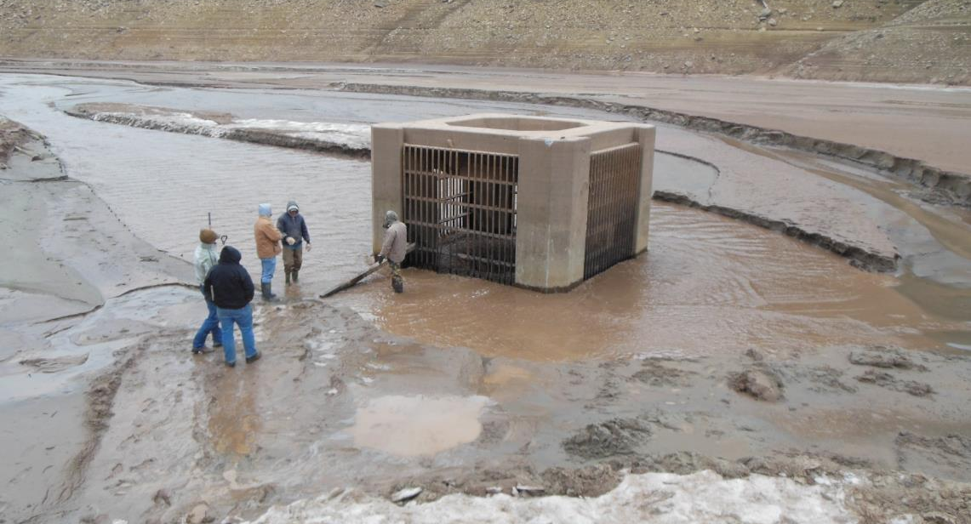
Reservoir Sedimentation Management
Hydrosuction
John Shelley, Ph.D., P.E.
August 2024
“The views, opinions and findings contained in this report are those of the authors(s) and should not be construed as an official Department of the Army position, policy or decision, unless so designated by other official documentation.”
Tuttle Creek Lake prior to filling.

Slide 2
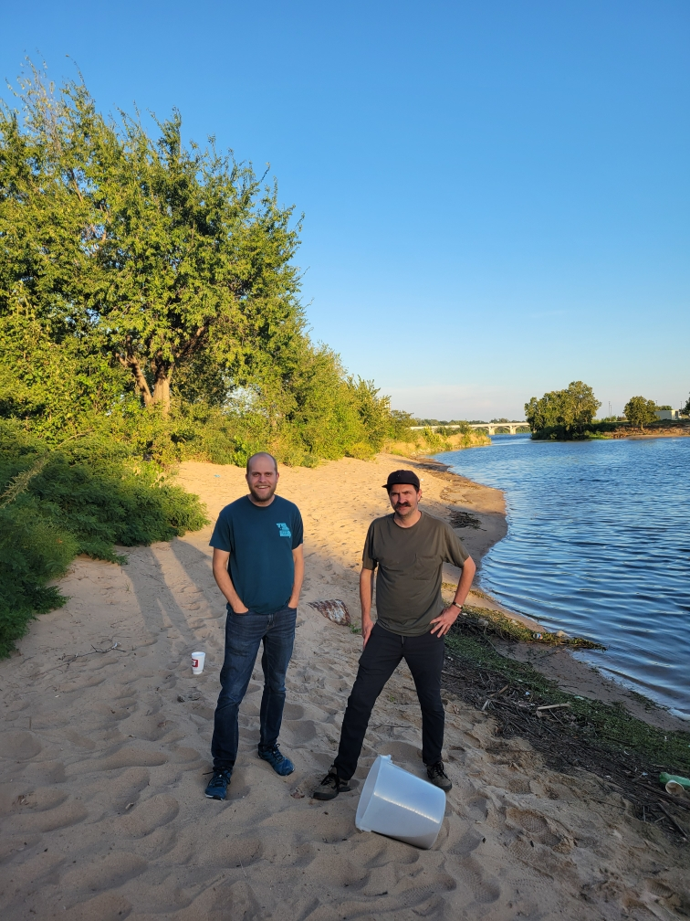
Bucket and Sand Model
Nathan and Trey collecting sand from the Arkansas River. Picture by Mark Morris.

Slide 3
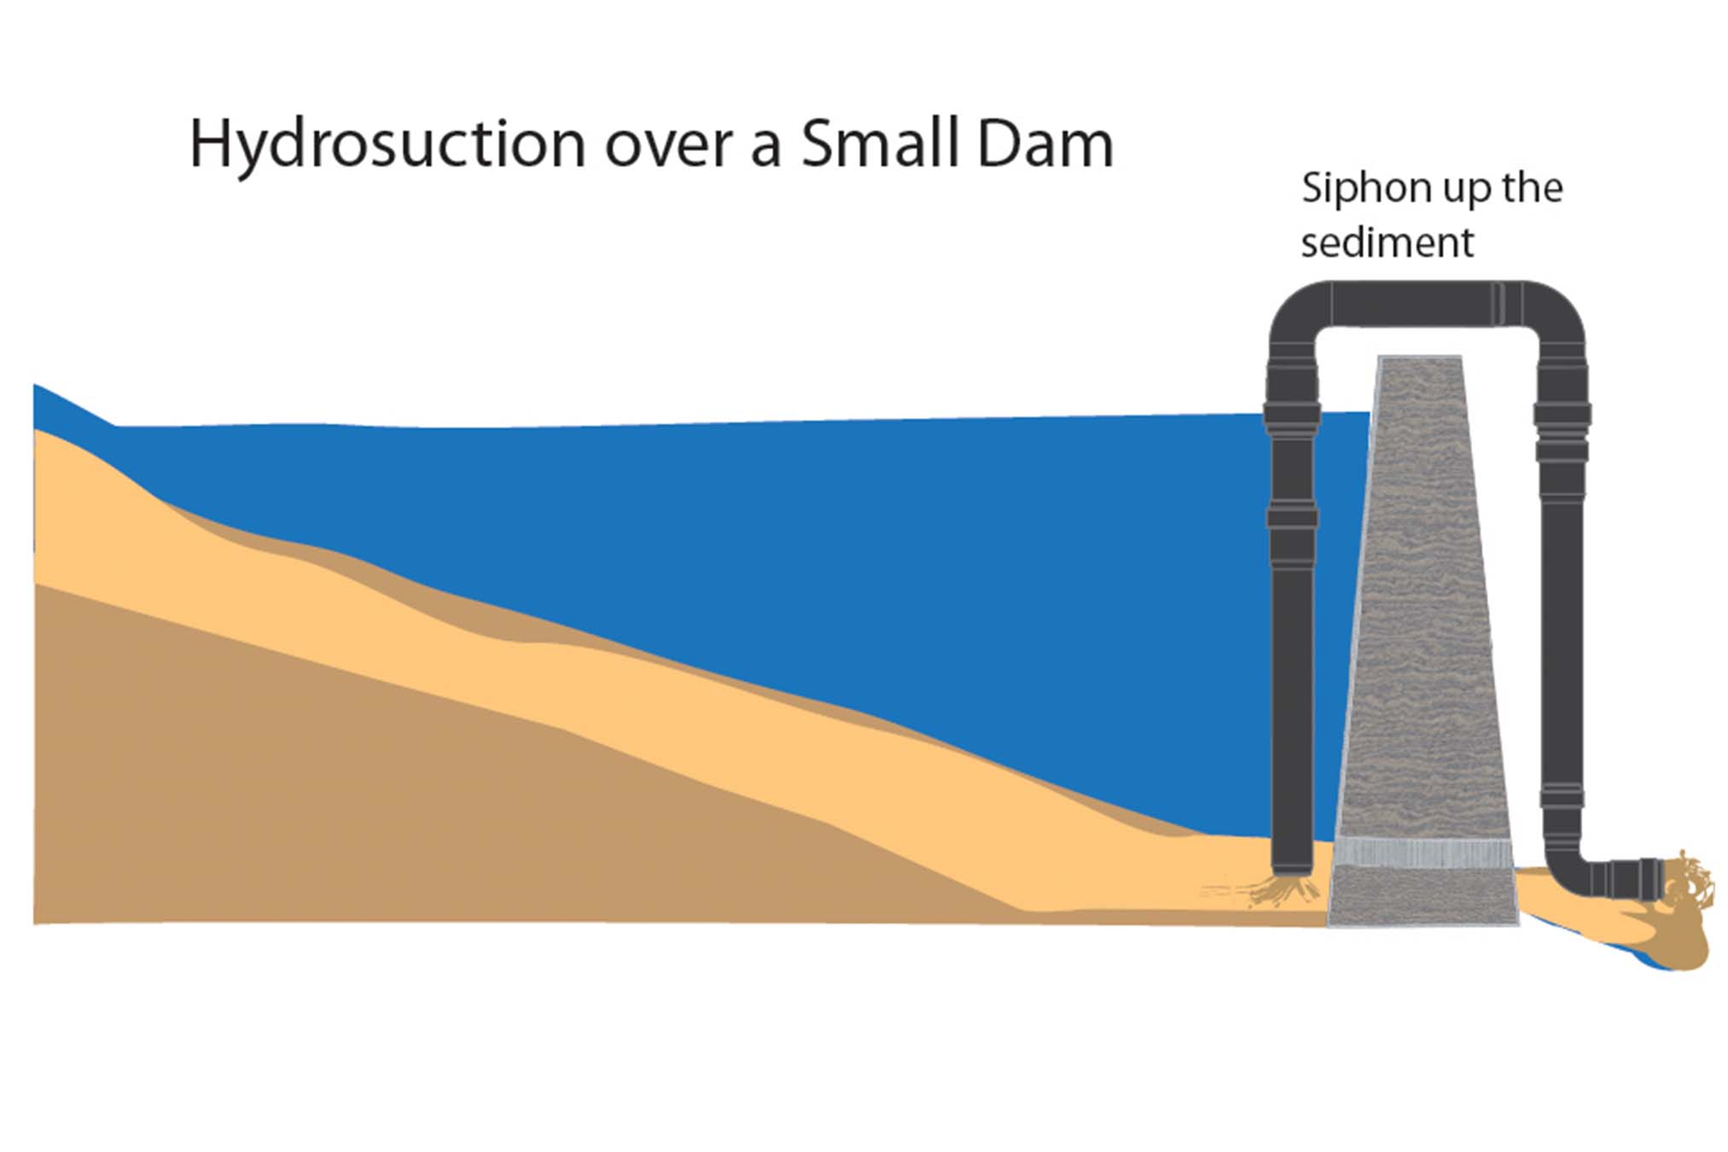
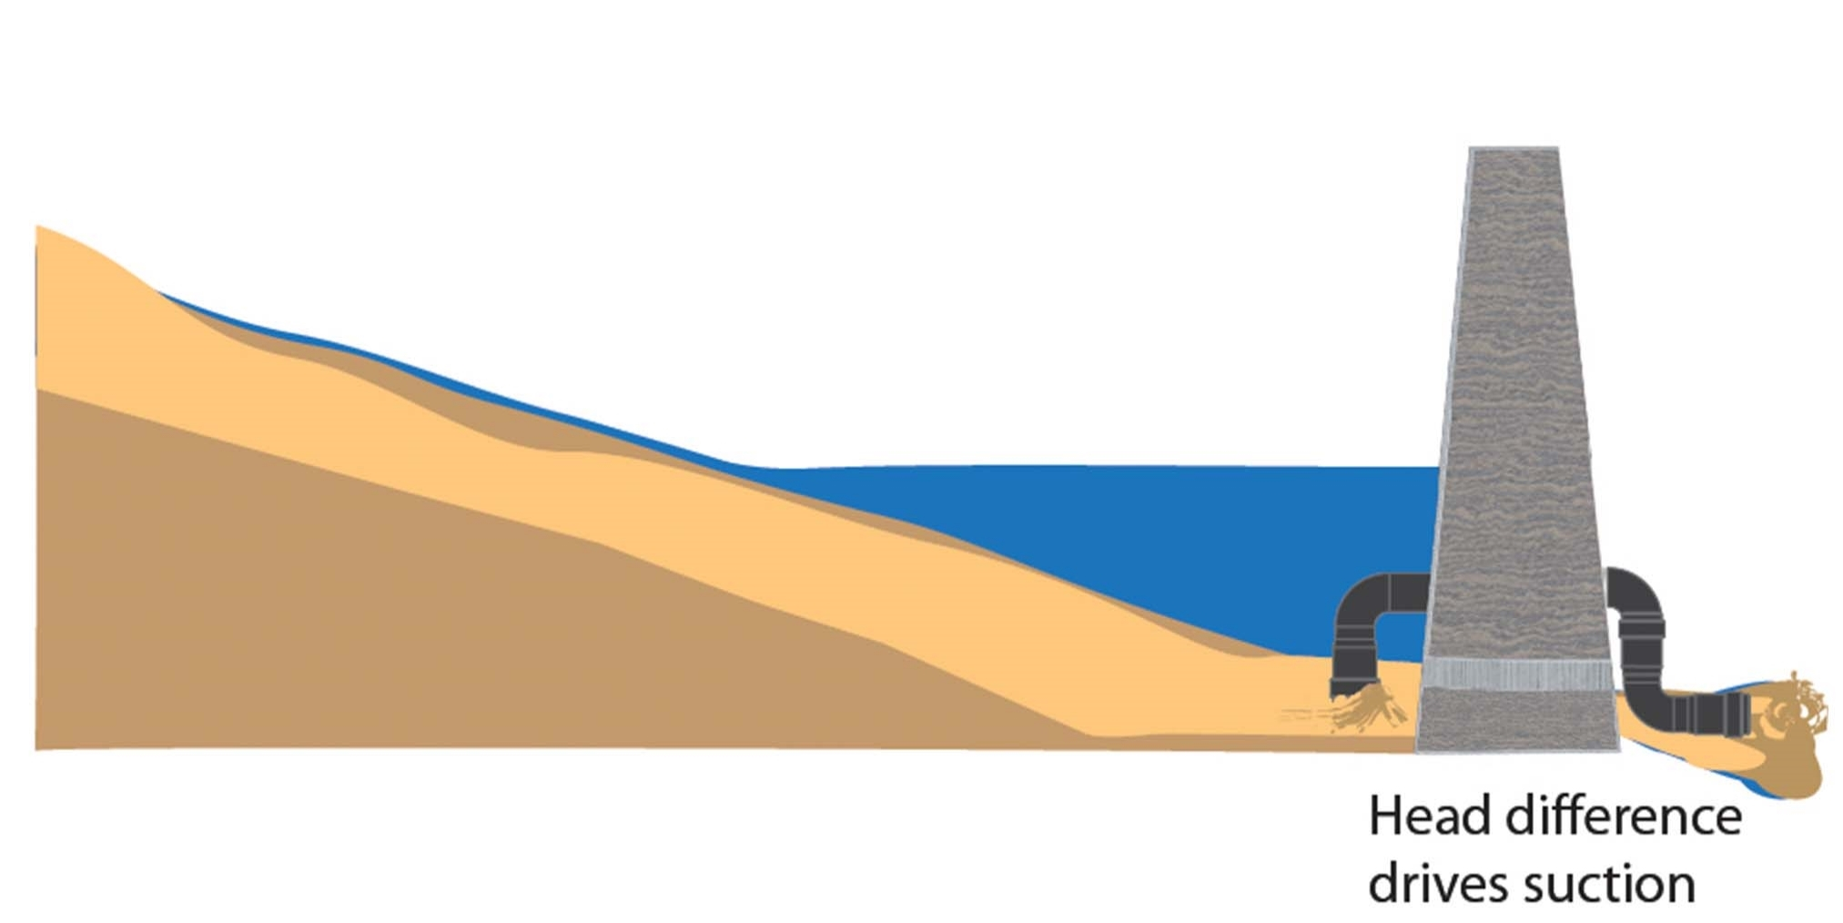

Slide 4
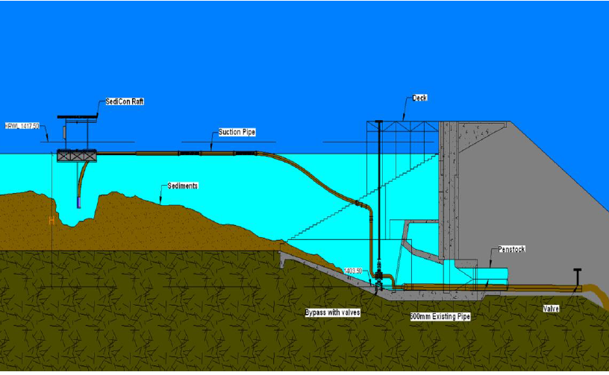
El Canada Reservoir (Guatelama) Hydrosuction
El Canada Graphics: SediCon

Slide 5
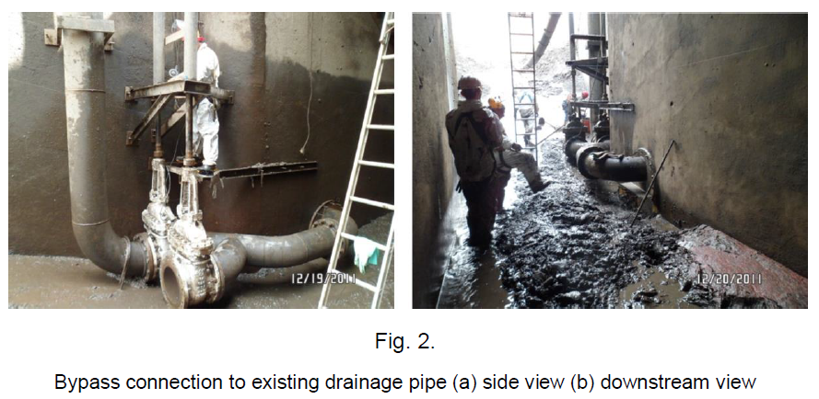
El Canada Hydrosuction- Connecting to Existing Conduit

Slide 6
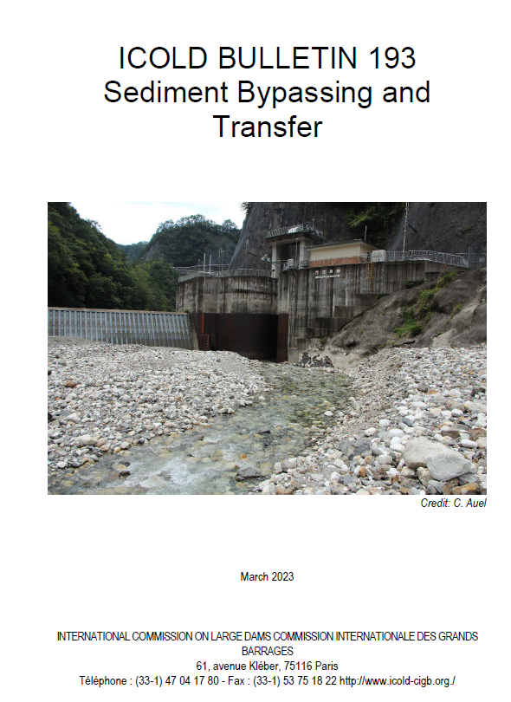
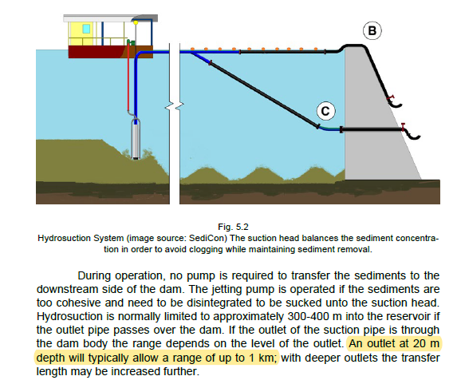

Slide 7
Analysis
Will coarser sediments settle out in the pipe and plug it?
How much sediment will the hydrosuction system transport out of the lake?

Slide 8
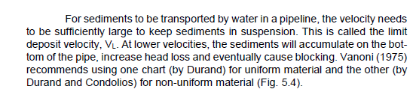
Limit Velocity (From ICOLD Bul. 193)

Slide 9
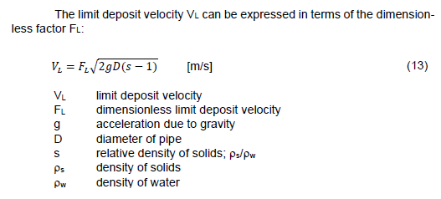
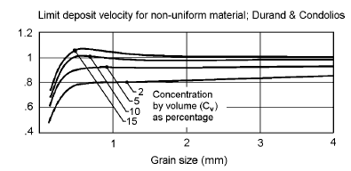
Limit Velocity
Answers the question: What is the slowest velocity in the pipe to avoid sediment settling (which could lead to plugging)?
Really only applies to non-cohesive sediment (sands and gravels).
F_{L}

Slide 10
Limit Velocity Exercise
What is the limit velocity for d50 = 0.25 mm in a 0.5 m hydrosuction pipe that is 10% solids by volume?
F_{L}

Slide 11
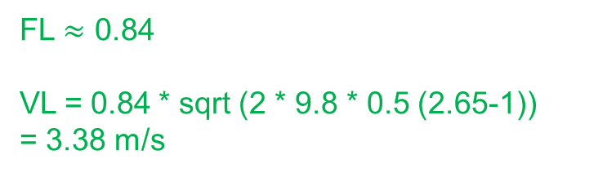
Limit Velocity Exercise
What is the limit velocity for d50 = 0.25 mm in a 0.5 m hydrosuction pipe that is 7% solids by volume?
FL $≈$ 0.84
VL = 0.84 * sqrt (2 * 9.8 * 0.5 (2.65-1))
= 3.38 m/s
F_{L}

Slide 12
Analysis
Will coarser sediments settle out in the pipe and plug it?
How much sediment will the hydrosuction system transport out of the lake?
Compute the flow of the water out of the pipe, with some adjustment to viscosity
Assume a % solids

Slide 13
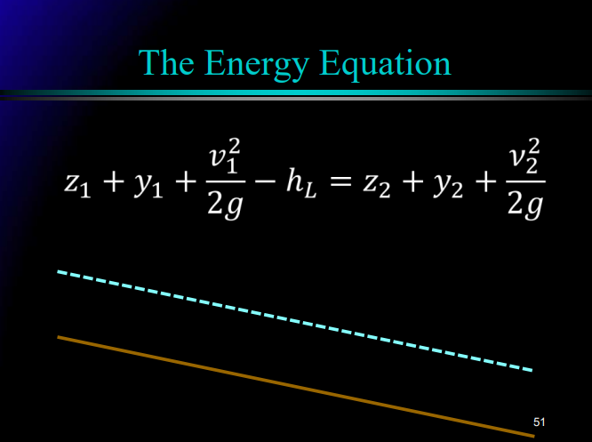

Slide 14
y₁
1
y₂
2
Z₁
Z₂

Slide 15
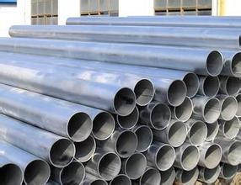
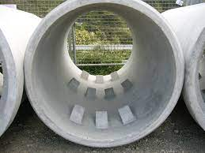
Losses Depends on the Pipe And the Fluid
Smooth pipe = less losses
Rough pipe = high losses
Low viscosity liquid (i.e. water) = low losses
High viscosity liquid (i.e. honey) = high losses
Friction losses: (h_{L}/L) * length of the pipe

Slide 16
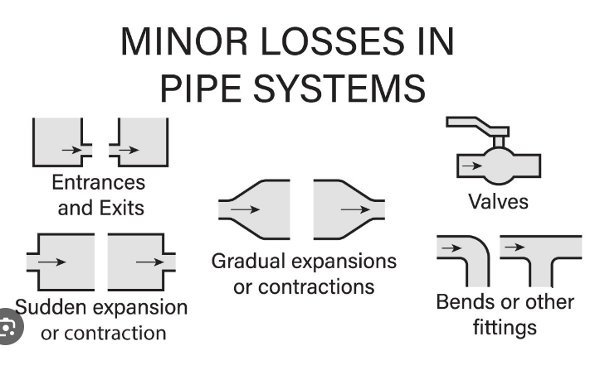
M x v²/2g
https://www.youtube.com/watch?app=desktop&v=WMtiH5LyOYI

Slide 17
Workshop: LPP
Data:
Time series of pool elevations
Sediment characterization
Pipe length
Pipe type
Analysis Steps
Assume a concentration of sediment
Calculate viscosity
Create a pool height—water flow rating curve using pipe flow equations
Multiply by concentration to generate a pool height—sediment discharge rating curve
Use bulk density to convert from sediment discharge to volume of sediment removed
Use the time series of pool heights and the rating curve to compute a time series of sediment removal

Slide 18
Workshop Pre-Requisites
The workshop assumes you know how to do various tasks in Excel, including:
Plot a trendline
Use the solver tool
Do a “sumif” function

Slide 19
What Concentration of Sediment in the Pipeline?
% Solids (By Volume) | Reservoir | Location | Sediment Type | Entrainment Mechanism | Reference
12 | El Canada (Year 1) | Guatemala | Clay | Water-jetting | Jimenez, Figueroa, and Jacobsen, 2015
9 | El Canada (Year 2) | Guatemala | Clay | Water-jetting | Jimenez, Figueroa, and Jacobsen, 2015
8 | El Canada (Year 3) | Guatemala | Clay | Water-jetting | Jimenez, Figueroa, and Jacobsen, 2015
3 | Djindiouia | Algeria | Silt and clay | Cutter-head powered by a turbine on the outlet pipe | Fan, 1985
15 | Xiao Hua-shan | China |  | Water-jetting | Hotchkiss and Huang, 1995.
We will assume 10% solids for the workshop.

Slide 20
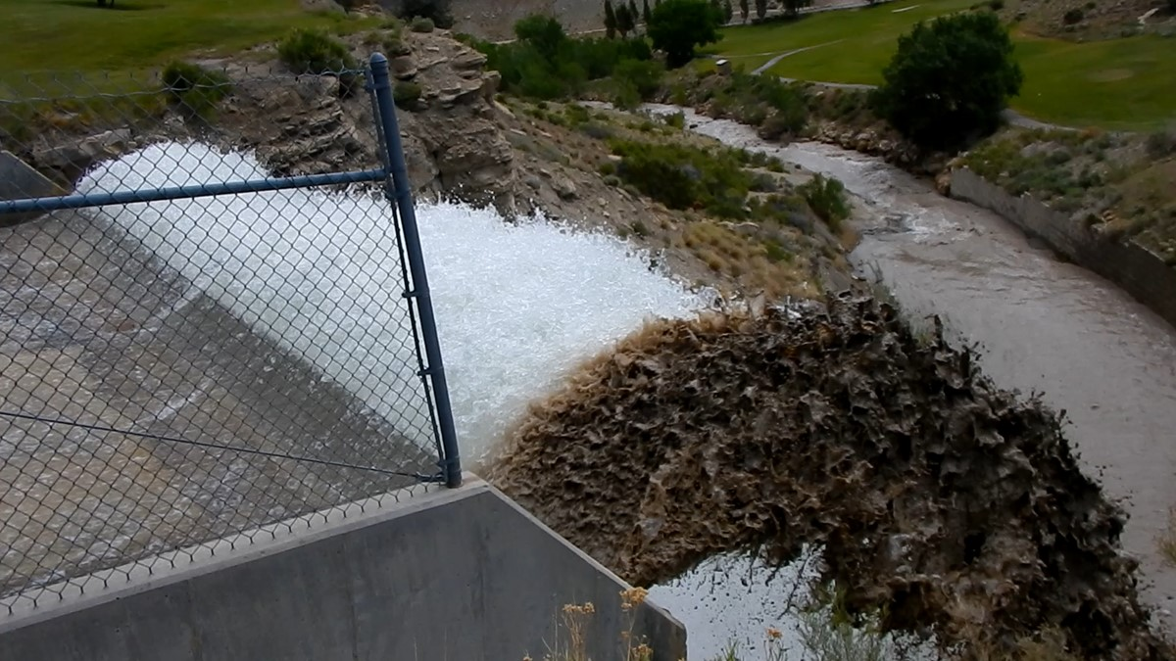
Questions?

Slide 21
Practical Constraints
Minimum releases
Volume of deposition till pre-impoundment
Distance from dam

Slide 22
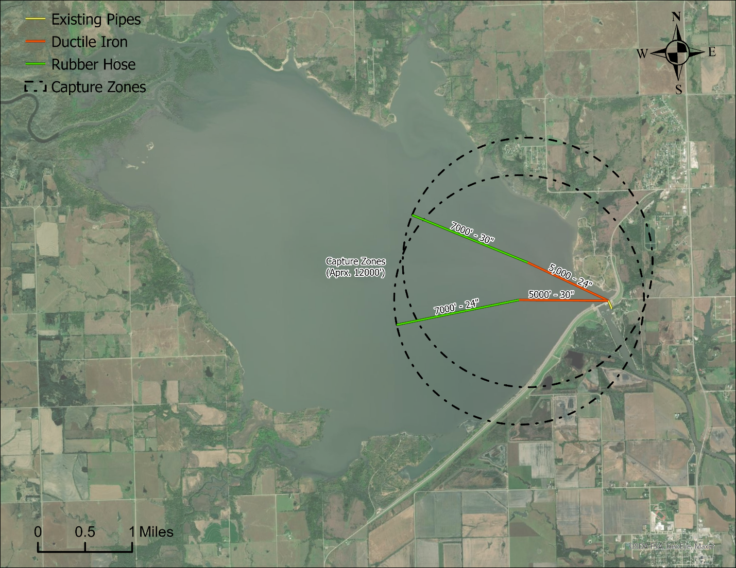
Example- John Redmond, KS

Slide 23
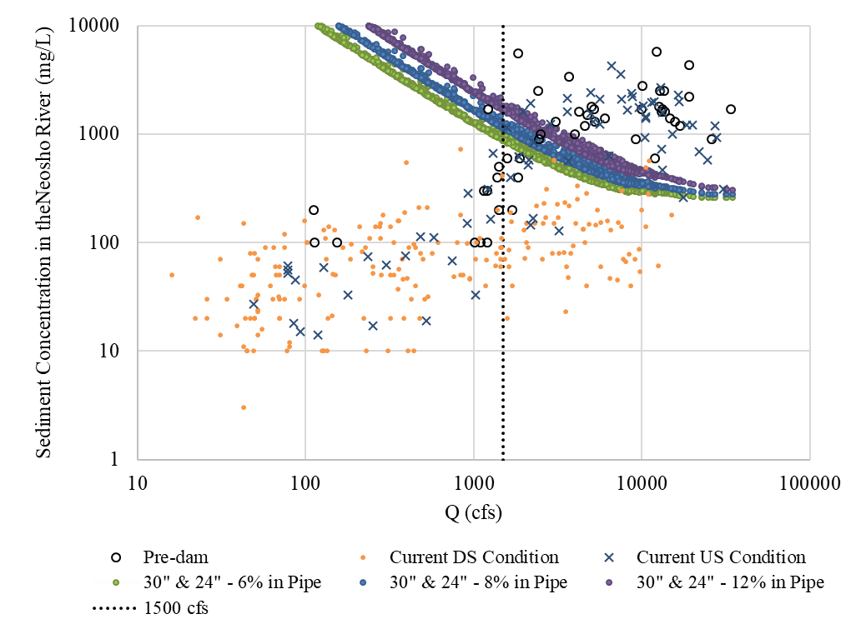
Environmental Limit

Slide 24
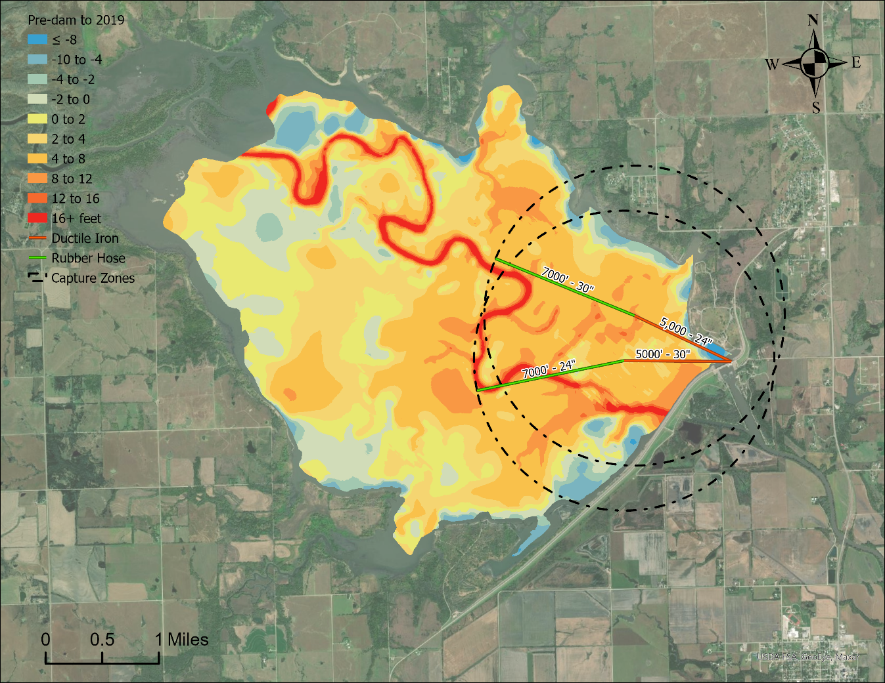
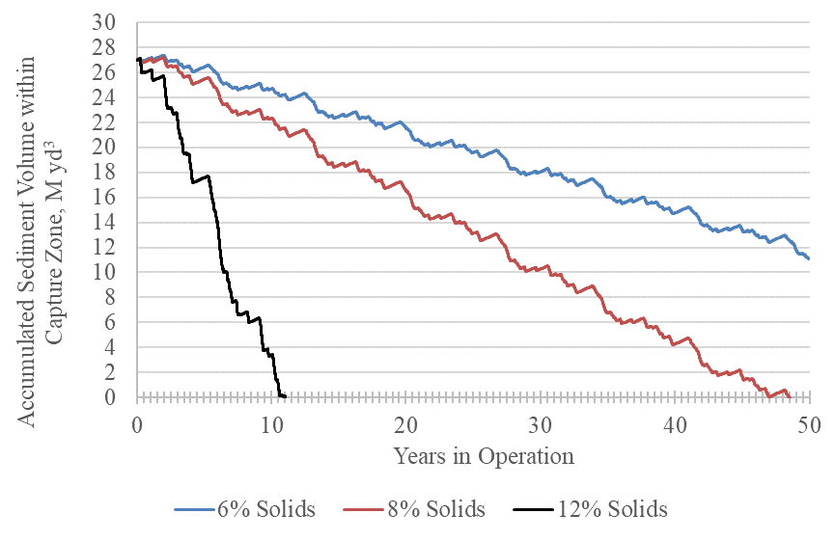
How much deposition is available for removal?

Slide 25
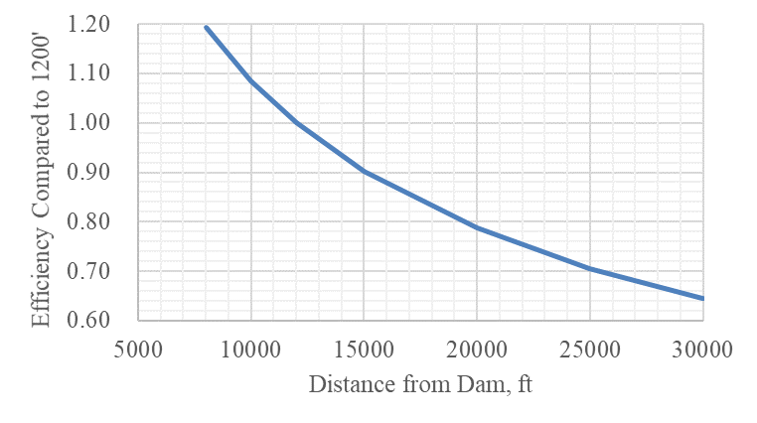
The further away you are, the less effective your hydrosuction system will be
John Redmond

Slide 26
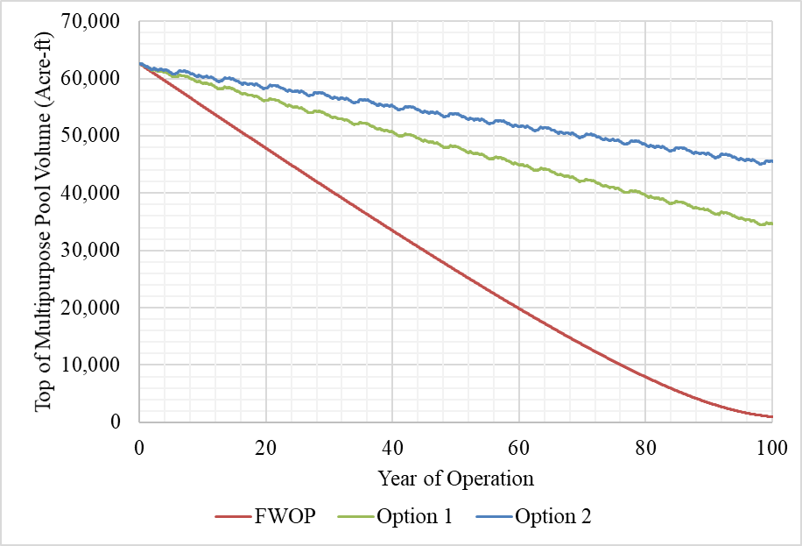
John Redmond- Storage Impacts Over Time

Slide 27
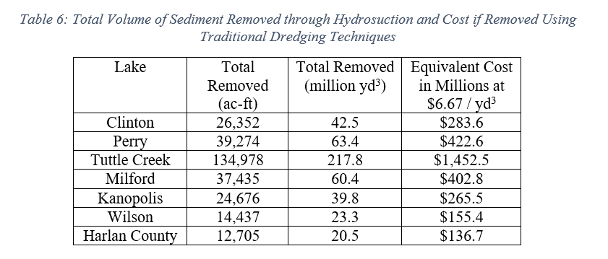
Other Kansas Lakes
Note: Equivalent costs based on 2018 John Redmond dredging rates without adjusting for inflation.

