Slide 1
HEC-RAS
Results Visualization
Mark Jensen
Cameron Ackerman, P.E., D.WRE
USACE, Institute for Water Resources, Hydrologic Engineering Center

Slide 2
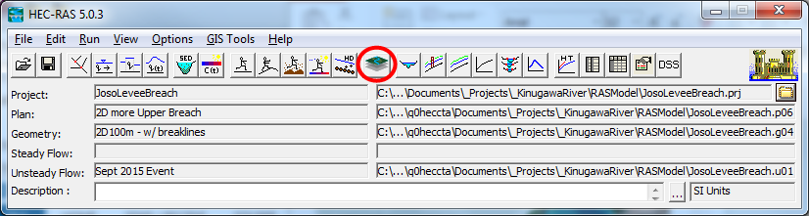
Overview
How do we visualize RAS results?
How do we debug our model?
How do we compare different plans?
Notes:
Once we’ve run a model, our goal is to validate and improve it. To do this, we’ve provided a new window – RAS Mapper. This is where you will do most of your post-compute work. We’ve tried to create a full, standalone GIS experience so you never have to leave RAS to view geospatial results.

Slide 3
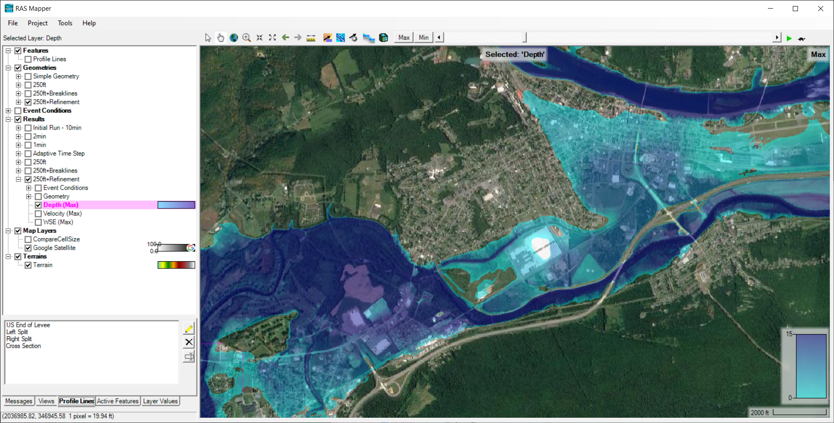
HEC-RAS Mapper
View Tools
Animation Controls
Layers List
View Area
Status Area

Slide 4
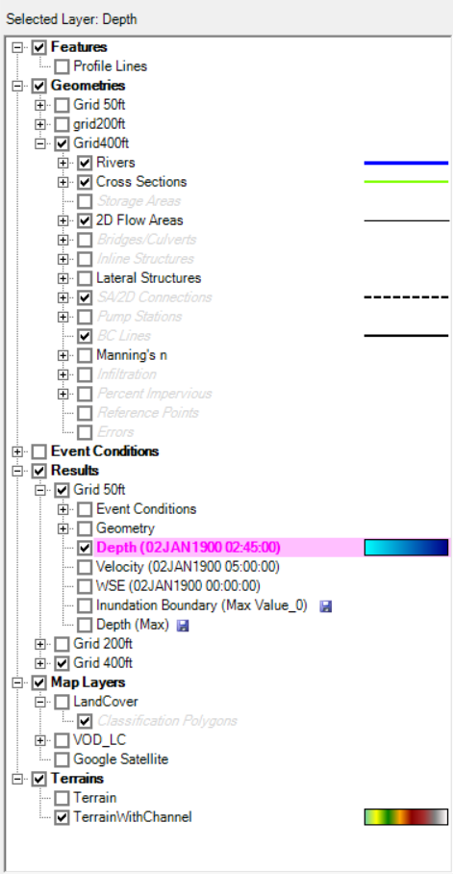
Layers List
Symbology is shown to the right of any checked layers.
Profile Lines
Geometries
Results
Map Layers
Terrains
The selected layer is highlighted in magenta.
Notes:
There are 4 main groups in the layer window: Geometries, Results, Map Layers, Terrains. Every data layer that is checked in the layer window will be rendered in the RAS Mapper view window (all parents in the tree must be checked as well)
Items in the tree render top-down: Geometries draws above Results, draws above Map Layers, etc. Similarly, “Velocity (Max)” will draw above “Depth (Max)”
Geometries:
These layers store all of your RAS geometry elements (Rivers, Meshes, etc.) and work from the .g01 and .g01.hdf files.
Results:
These layers store all of your computed RAS results, as well as a copy of the geometry used to create it. Results can be viewed by adding maps of different types (Depth, Velocity, etc). The save icon indicates a map is stored on disk. The red asterisk indicates something is wrong – hover your mouse to see more information.
Map Layers:
These include any custom user layers, as well as web imagery and land cover layers.
Terrains:
These layers store the processed RAS elevation rasters

Slide 5
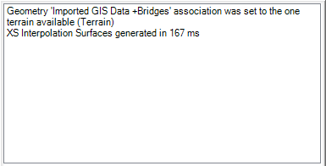
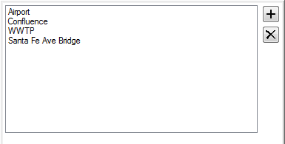
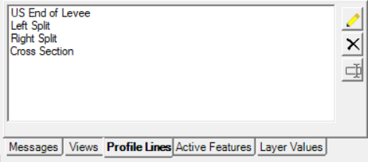
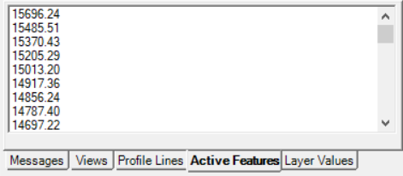
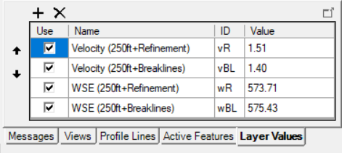
Status Area
Messages – What just happened
View – Quickly zoom to predefined areas
Profile Lines – Access results at specific locations
Active Features – Quick access to features in layer
Layer Values – Watch values for multiple results

Slide 6
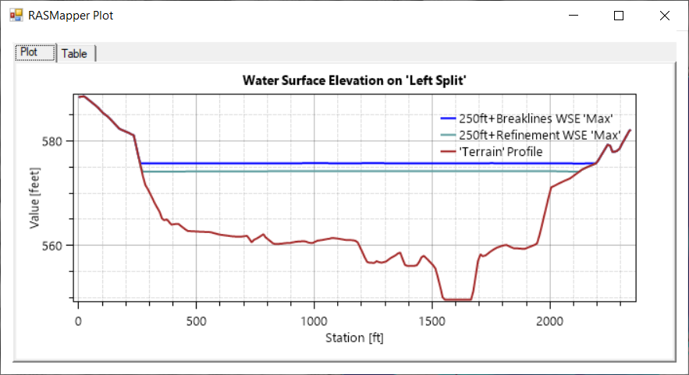
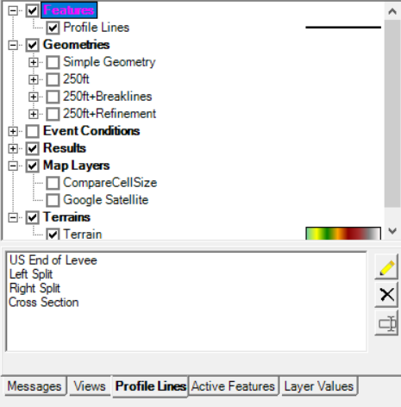
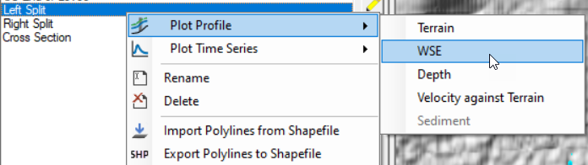
Profile Lines
User-defined/editable features

Slide 7
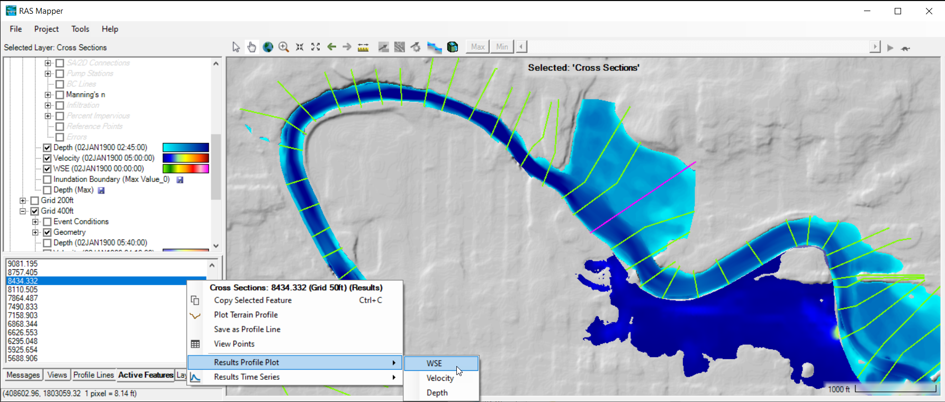
Active Features

Slide 8
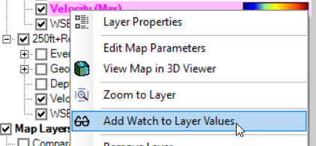
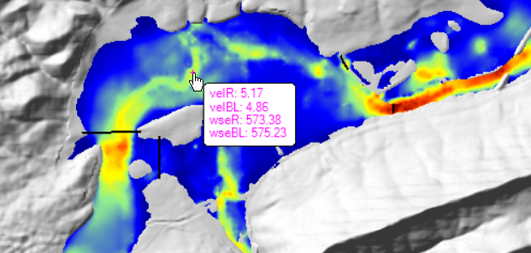
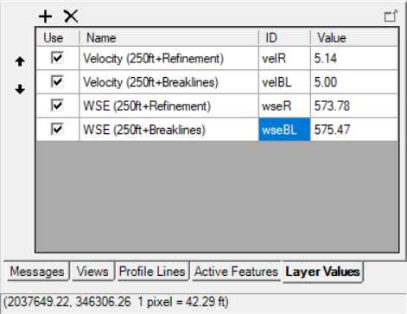
Watch Layer Values

Slide 9
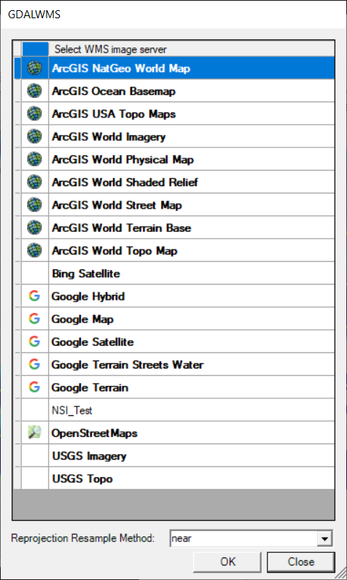
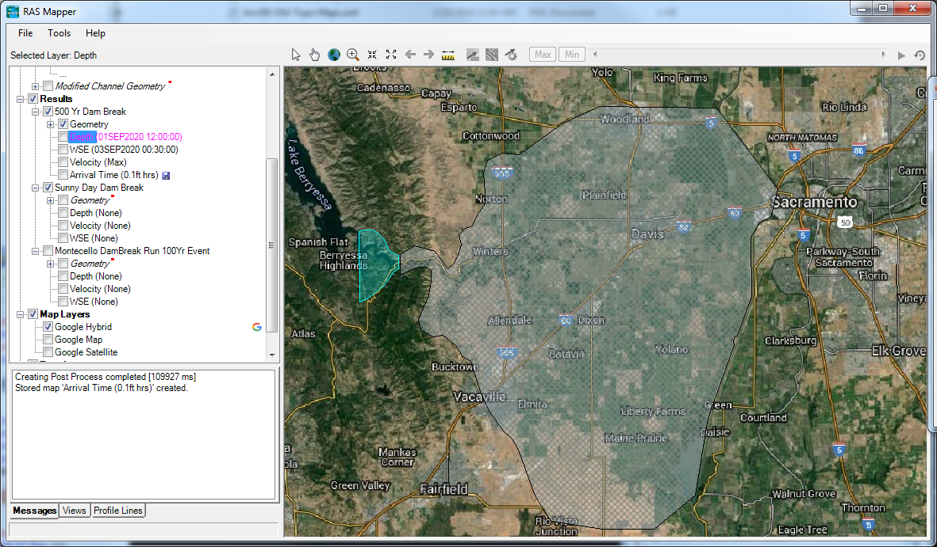
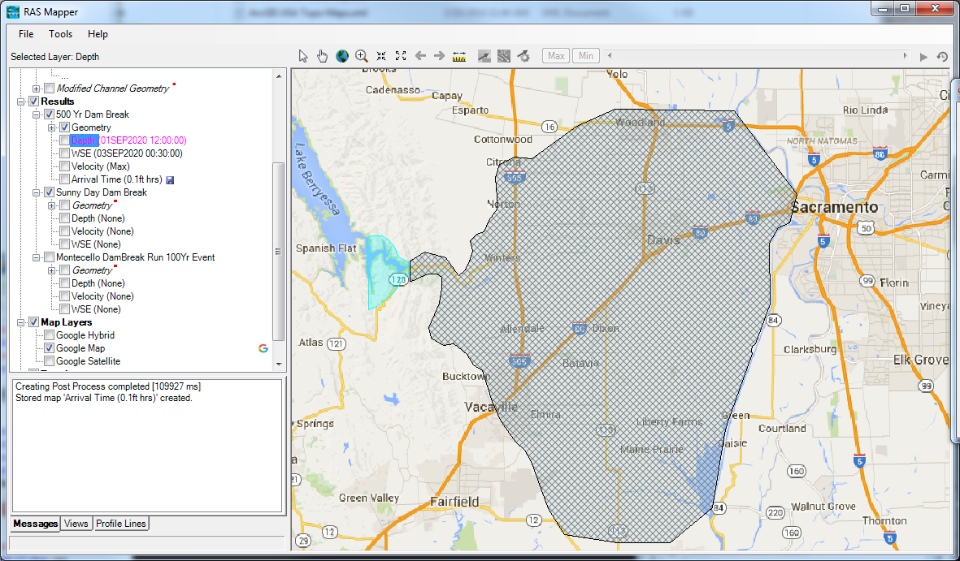
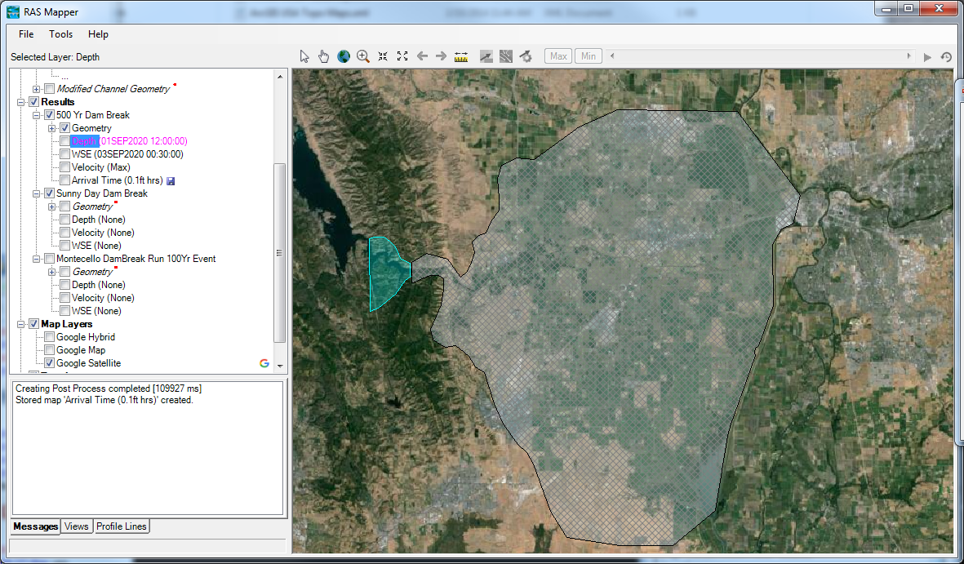
Web Imagery
Notes:
*Add your own WMS server to the list! See
$(LocalAppData)\HEC\Mapping\XML\

Slide 10
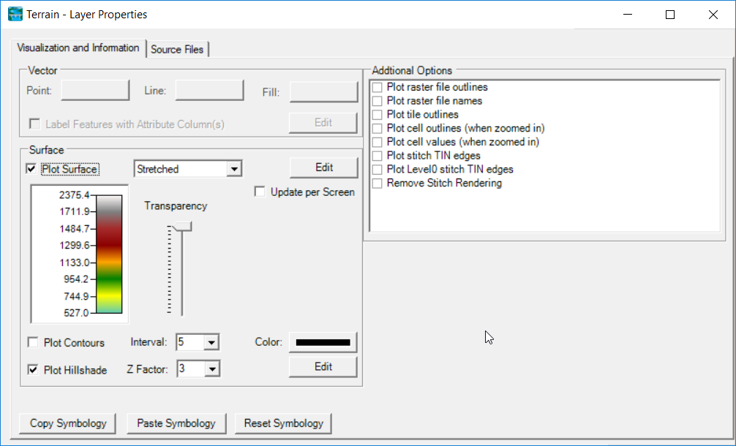
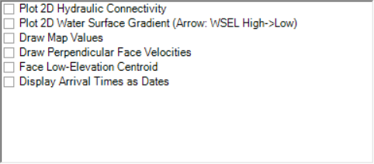
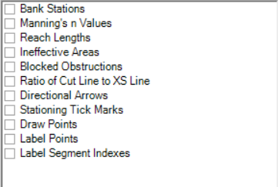
Plot Options
Terrain
Depth, WSE
River, Cross Sections
Notes:
When you view the terrain’s layer properties, this is the window. It allows you to adjust the terrain rendering – you can change the color palette, add or remove hillshade, and add contours
Color palette isn’t enough to determine elevation changes if you’re zoomed into a small area – hillshade and contours add good contextual elevation information.
Hillshade is used to exaggerate terrain for visualization
Combined with contours to ID ridges and slopes
Computed on the fly – as you change them, you can view the updated imagery

Slide 11
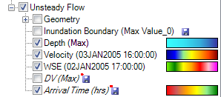
Results Mapping
Dynamic Mapping – on-the-fly mapping
  Animation of results without waiting
Stored Maps – results written to file
* = There was a problem reading data

Slide 12
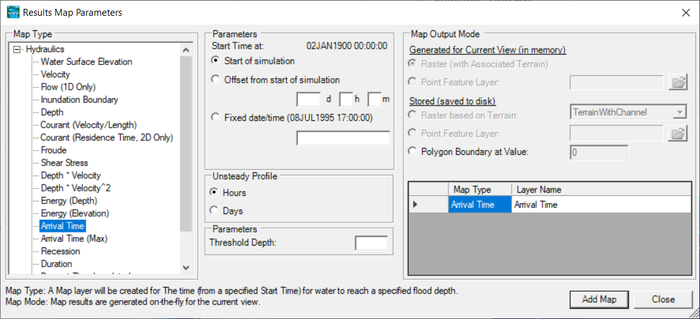
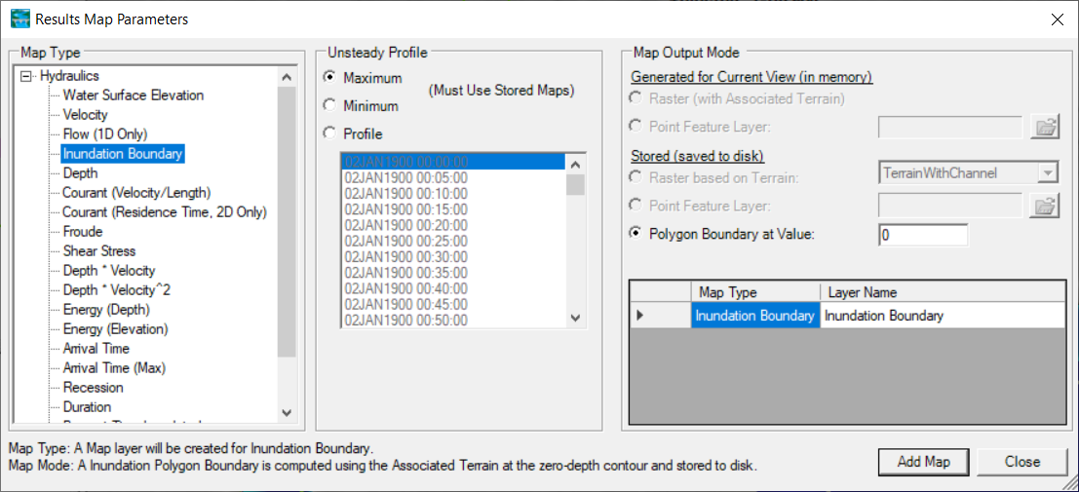
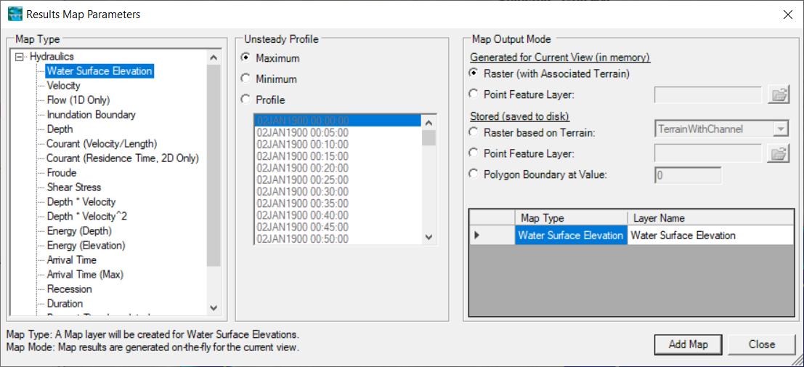
Results Mapping
Map Type | Profile/Parameter | Mode
Default maps: Depth, Water Surface Elevation, Velocity
Notes:
To Bring up the window shown above, right click on one of the Plan titles under the Results layer, then select Add new Results Map Layer. As shown in the Figure above, the Results Map Parameter window has three sections to select from. On the left is the “Map Type”, where you select the parameter you want to map (create a layer for). After a parameter is picked, the middle section of the window (Unsteady Profile) is used to pick the profile type: Maximum (Max stage everywhere regardless of time); Minimum (Min stage everywhere regardless of time); or a specific date and time (results at that specific instance in time). If a map is going to be displayed dynamically (computed in memory and displayed on-the-fly), it does not matter what you pick for the profile, you will be able to dynamically visualize all the profiles. If a map needs to be created as a static map (a results or depth grid written to a file), then the specific profile you pick will be used for that static map. The last thing to select on the window is the “Map Output Mode”. The map output mode is where you select whether the map will be a Dynamic layer, or else it will be a Stored map layer. Dynamic layers get computed on the fly as needed and can be animated through the time steps of the solution. Dynamic maps are the most useful for visualizing the results. Stored maps only need to be created when you want to create a depth grid, or other layer type, that you want written to the hard disk.
By default, after a successful HEC-RAS model run, there will be map layers called “Depth” “Water Surface Elevation” and “Velocity”. The Depth layer can be used to visualize the model results in an inundation mapping form (e.g. two dimensional map of the geometry, with water and other layers on top of it). The Depth layer will be computed and displayed on-the-fly (Dynamic mapping), meaning it computes it in memory and displays it as needed. The underlying terrain used for computing depths is based on the view scale of the map. If you are zoomed in (large-scale mapping) the base (raw) data will be used for computing depths; however, if you are zoom out (small-scale mapping) a resampled version of the terrain is used. Therefore, the displayed depths may change slightly based on the scale at which the user is zoomed. By default, the depth layer is not a pre-computed depth grid stored on your hard disk.

Slide 13
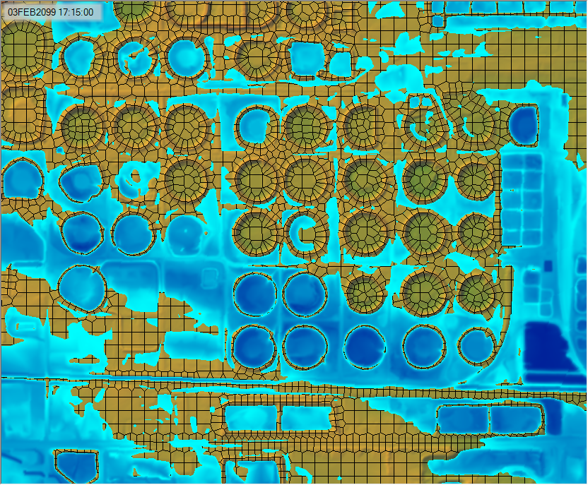
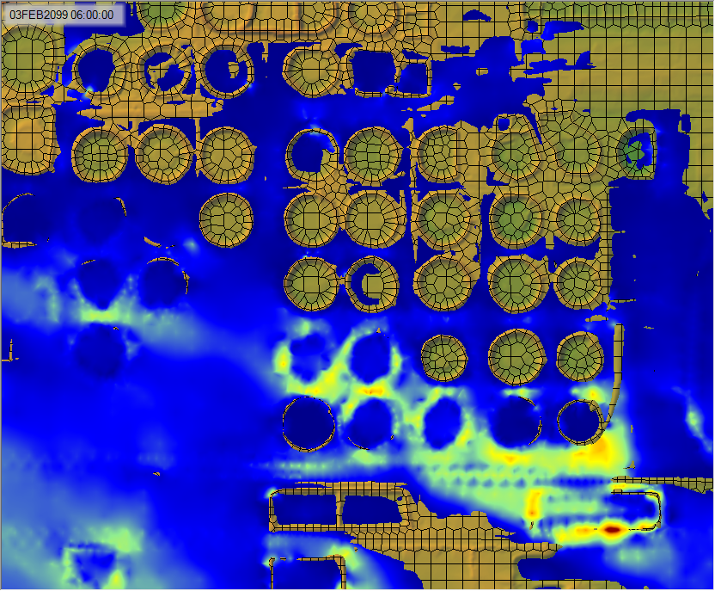
Example Maps
Depth
Velocity
Notes:
Example depth map - we can show where to dedicate resources for flood protection based on which holding areas were submerged.
Velocity dataset, later timestep – shows velocity increasing as the water constricts between holding areas and across levees

Slide 14
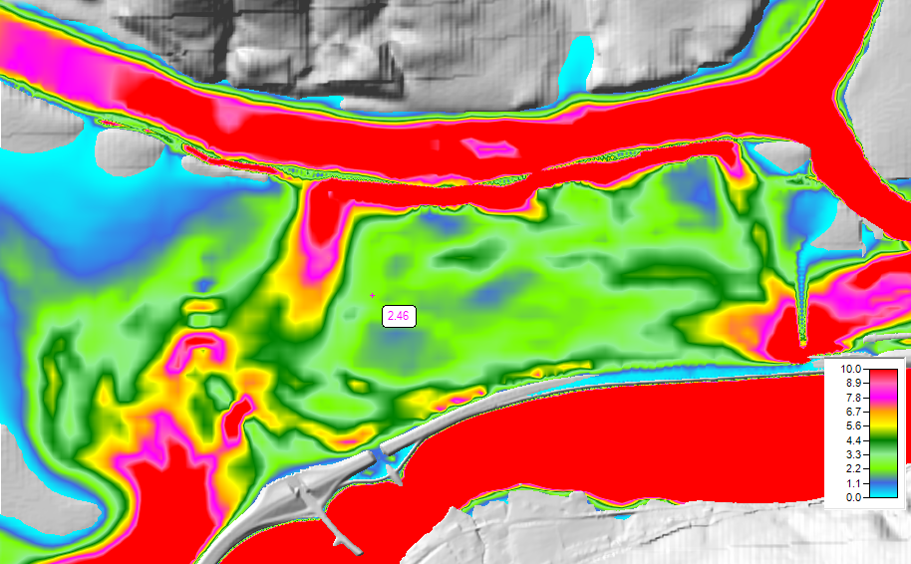
Hazard Mapping
Notes:
We can compute map hazards on the flood plain with
D*V
D*V^2
Stream Power
Shear Stress

Slide 15
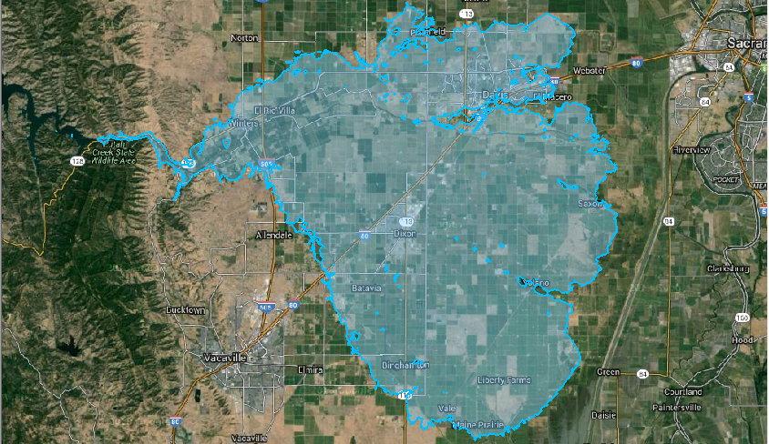
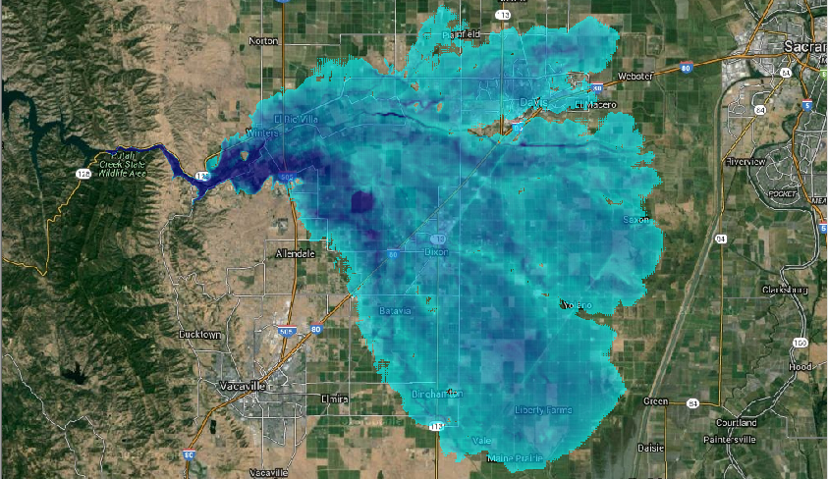
Inundation Boundary

Slide 16
Map Types – Dynamic vs Stored
Dynamic: Computed on-the-fly
  Smooth: Computes to screen-resolution
  Doesn’t use disk space
Stored: Computed to terrain resolution
  Stored to disk
  Faster rendering for slow map types
Notes:
Best practice – use dynamic maps unless you have a reason not to do so.
If you need to submit a map to a supervisor, it has to be stored.
If you need to use it in another software package, it has to be stored.
If you’re mapping some computationally intensive types (Arrival-Time, Duration, etc.) then it should be stored. (RAS defaults to stored maps for these map types)
Almost all other situations – use dynamic mapping. You can quickly change timesteps on the fly, animate, and it doesn’t clutter your disk with extra files.

Slide 17
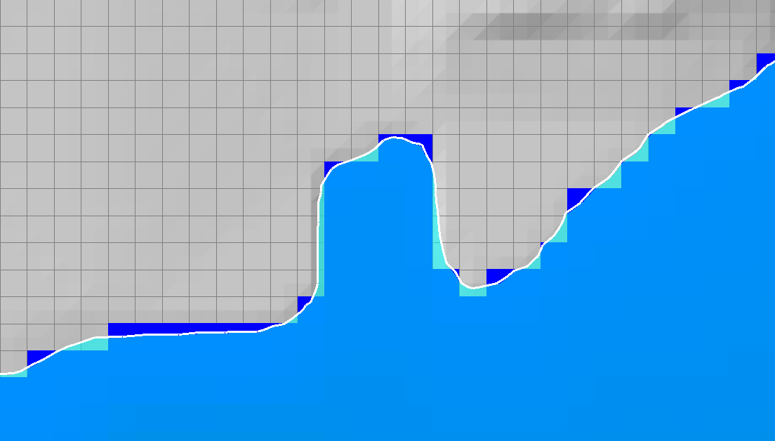
Dynamic vs Stored Results
Dynamic results plot values for the current pyramid level. Boundaries are defined based on interpolation.
Stored results have a single value per cell.
Notes:
There can be important differences in the computed values between the dynamic results and the stored raster information. Dynamic maps differ in that they are a surface created through the interpolation of values; therefore, as the user moves the mouse in the display the interpolated value for the corresponding location will be displayed. This is in contrast to viewing a raster in a typical GIS where the reported value will be that for the entire grid cell.
For dynamic depth results, the values reported to the user at a specific map location may change depending on the zoom level. This is because for dynamic mapping, the terrain pyramid level used for evaluating the ground surface elevation is dependent on how far the user has zoomed in or out on the map. Even while zoomed in so that the base data are used for analysis, the map results will not be identical, especially at the floodplain boundary. This is because for the stored depth grid the cell is considered either wet or dry. For a dynamic map, the flood boundary is determined by interpolating the elevations values and intersecting the interpolated water surface with the interpolated terrain elevations for the boundary. The dynamic map will, therefore, result in a “smooth” floodplain boundary.

Slide 18
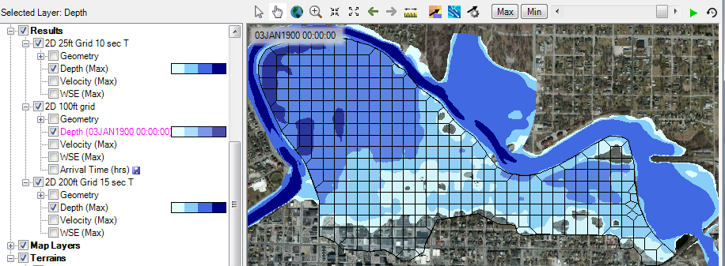
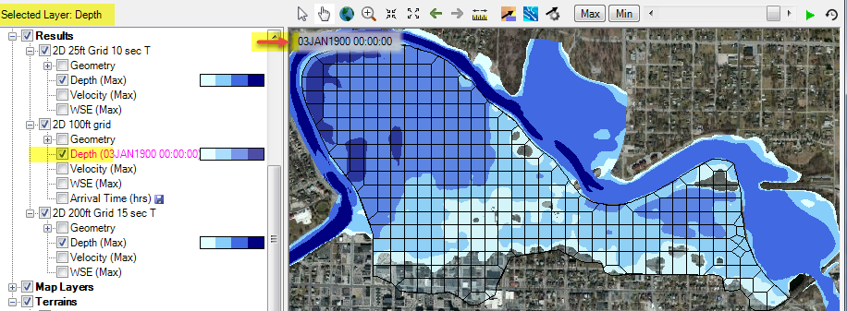
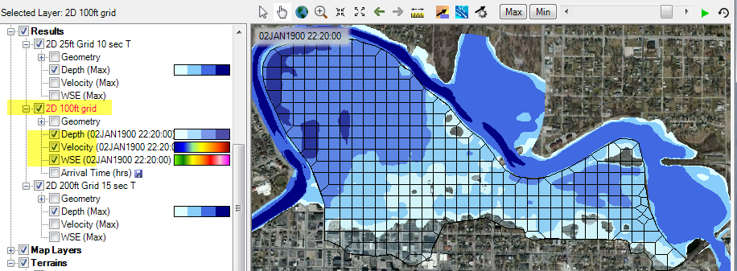
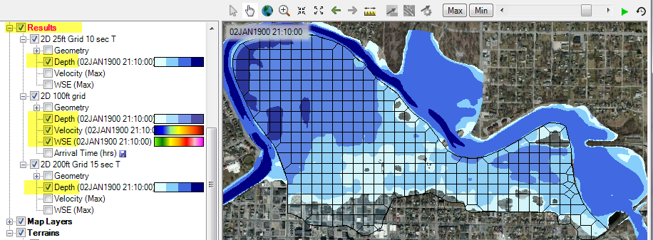
Dynamic Mapping
Animation Toolbar – works on selected layer or group and syncs the timestep

Slide 19
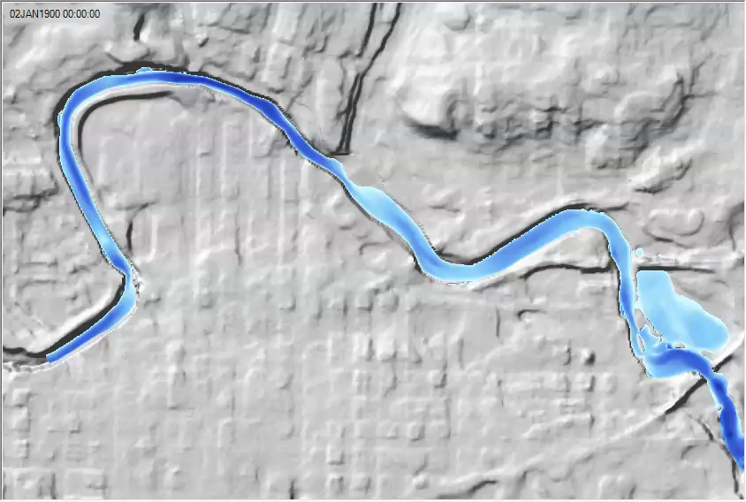
Dynamic Mapping - Animation

Slide 20
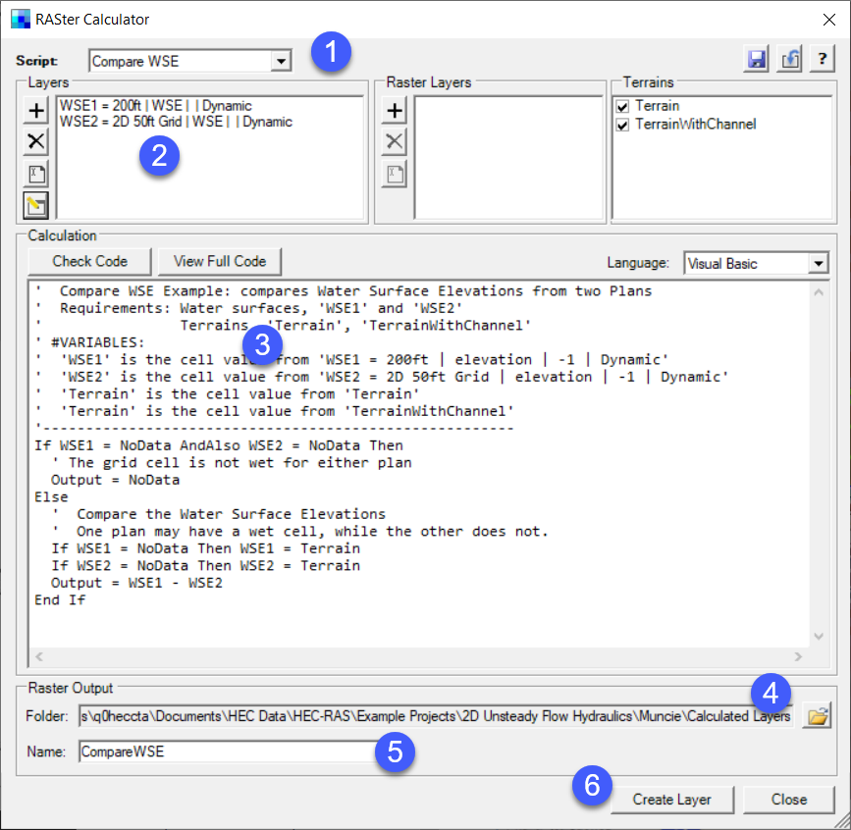
Calculated Layer
RASter Calculator
Custom scripting code to use
multiple results
Works with RAS Results and Terrains
Works with Rasters on disk

Slide 21
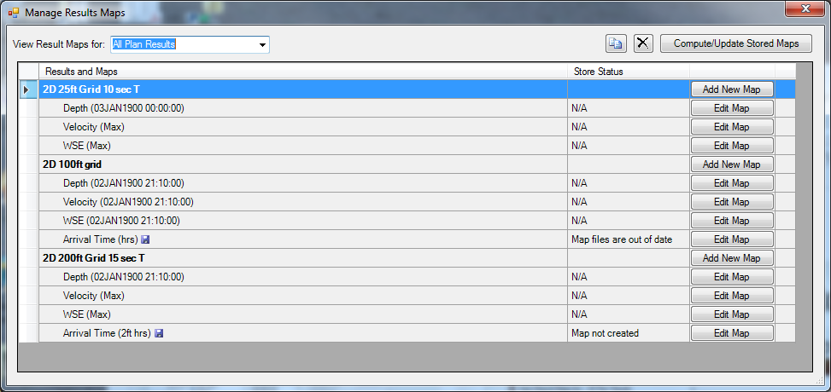
Stored Maps
Notes:
Results | Manage Results Maps

Slide 22
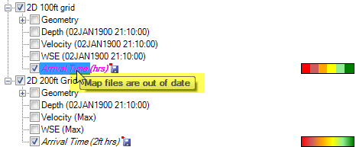
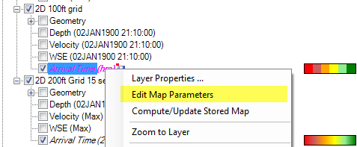
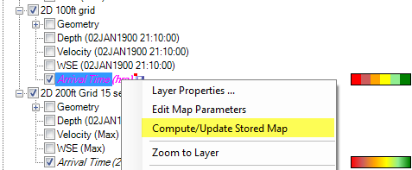
Stored Maps
Map status message on cursor tool tip
Right-click options:
Edit Map Parameters
Compute Map

Slide 23
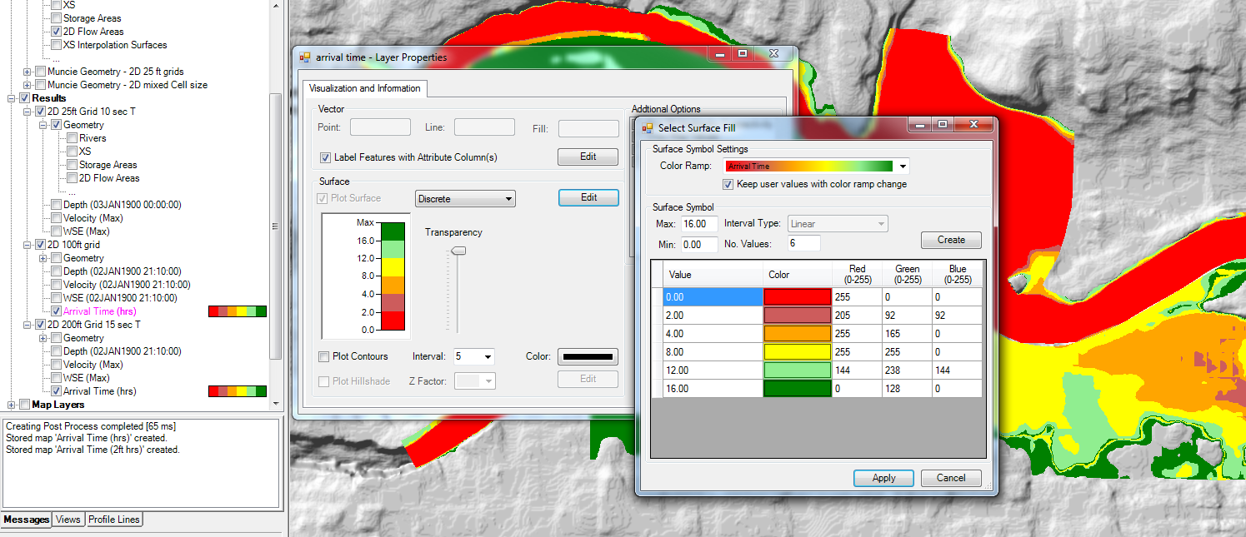
Results Layer Properties

Slide 24
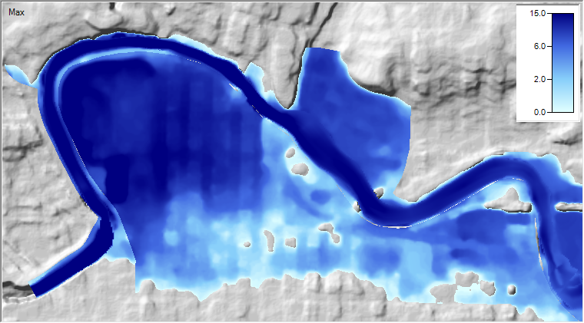
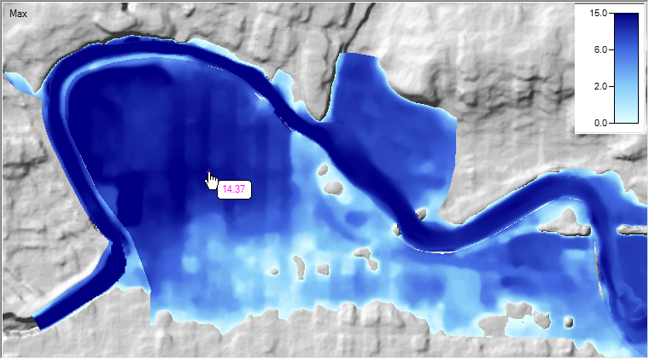
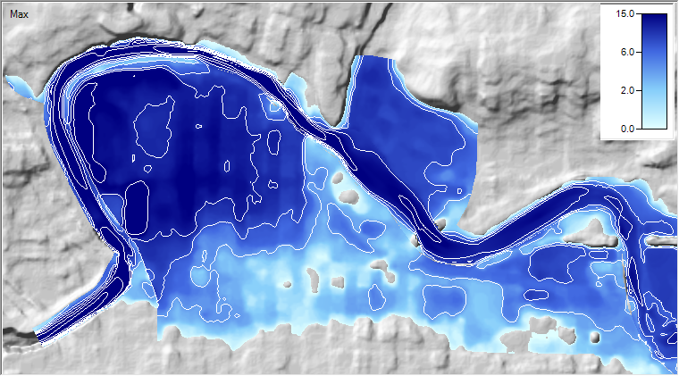
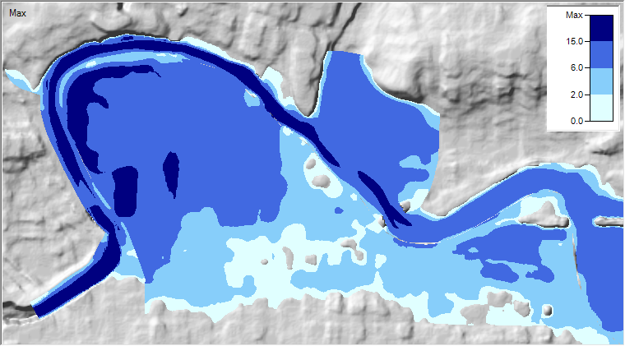
Results Visualization

Slide 25
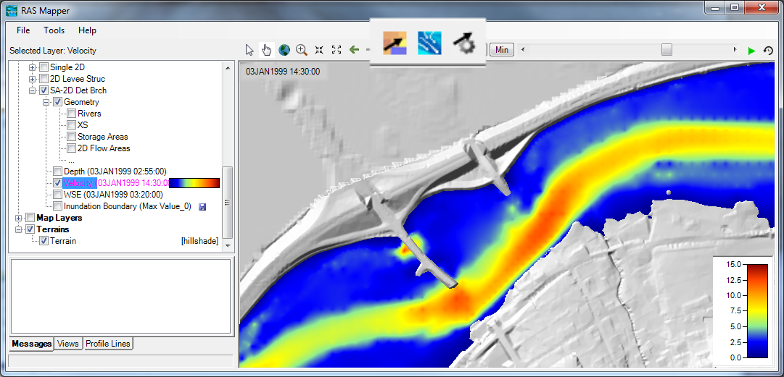
Velocity Results

Slide 26
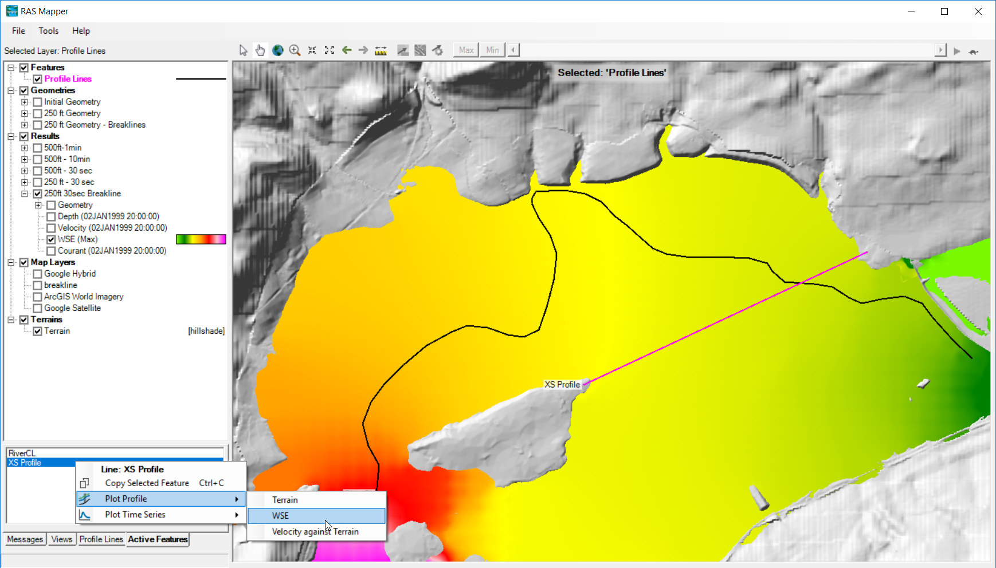
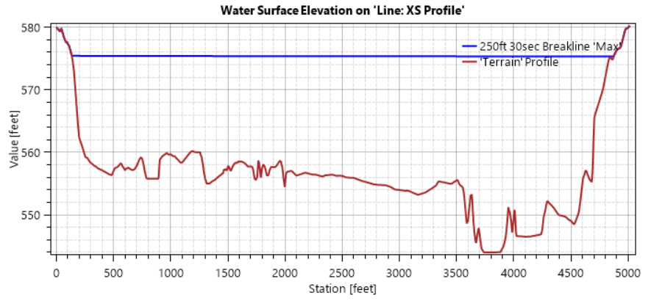
Profile Lines
Notes:
Right-click any profile line, and select from any available maps to render across that profile line. (Available maps must be ‘on’ in the layer window)
Terrains automatically draw underneath any WSE profile plots.

Slide 27


Profile Line - Comparison
Turn on multiple result maps
Choose a Profile (i.e. ‘Max’)
Choose Plot Time Series or Plot Profile
Notes:
You can compare multiple profile lines by changing the selected layer – note that ‘Results’ is selected in the image above. Any child layers (like the 2 that are checked in the tree below it) can compare their WSE in a single plot window.

Slide 28
Questions?

