Slide 1
Channel Modification and Terrain Modification
Cameron Ackerman, P.E., D.WRE
USACE, Institute for Water Resources, Hydrologic Engineering Center

Slide 2
Overview
Channel Merging via Graphical XS Editior
Channel Modification Tool
Elevation Update Tool
Terrain Merging from Existing Cross Sections
Terrain Modifications

Slide 3
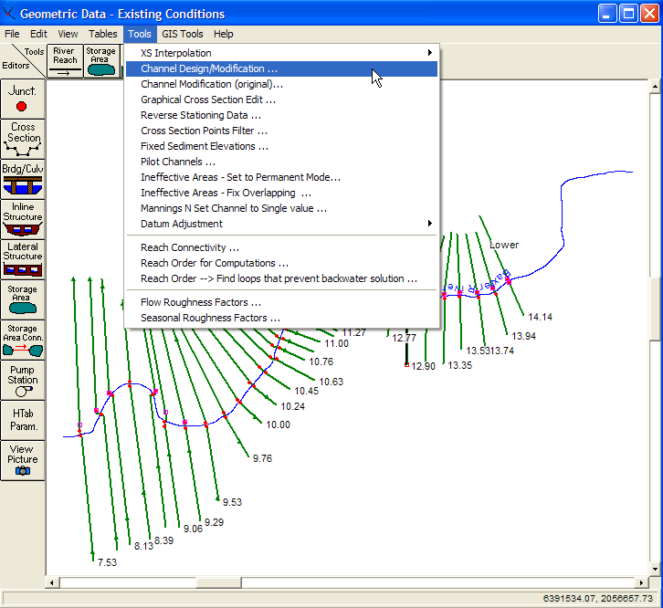
Channel Design/Modification
Geometric model must be developed for the existing system.
The channel modification routine will work from the existing geometry file.
Channel Design/Modification, a Geometry Data Tool, is selected to obtain the data entry window.

Slide 4
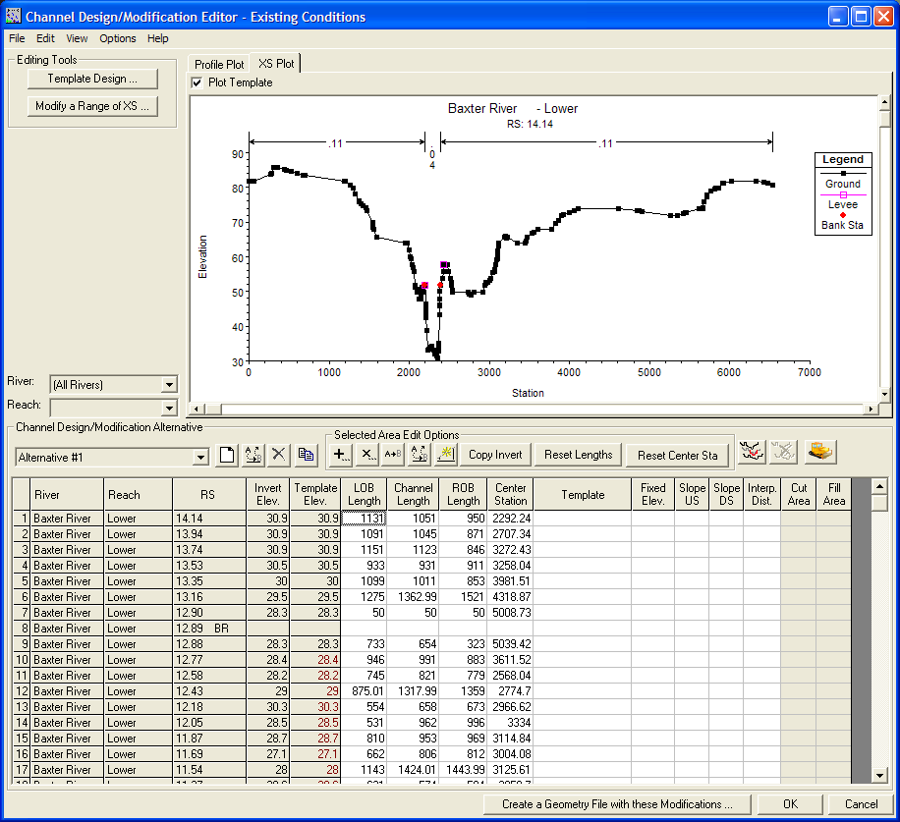
Channel Design/Modification
Editing Tools
Graphical Display
Modification Data

Slide 5
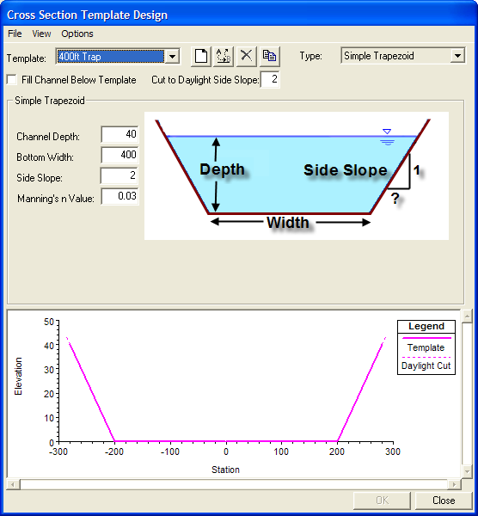
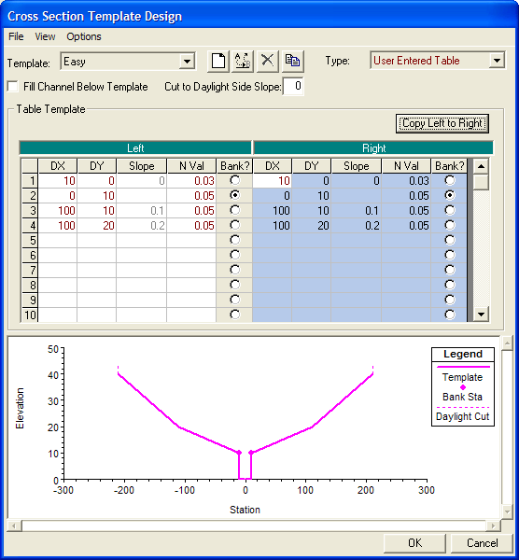
Template Design Editor
Trapezoid
User Defined Table

Slide 6
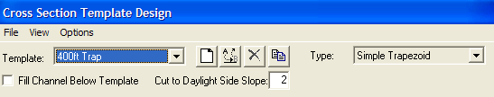
Template Design Editor
Fill Channel Below Template
If checked, the channel will be filled up to the lower bank-station elevation before the cut is applied. If not, the template will only cut; therefore, area outside the template will remain.
Cut to Daylight Side Slope
Extends the template up through the existing cross section at the specified side slope

Slide 7
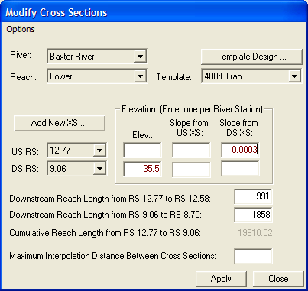
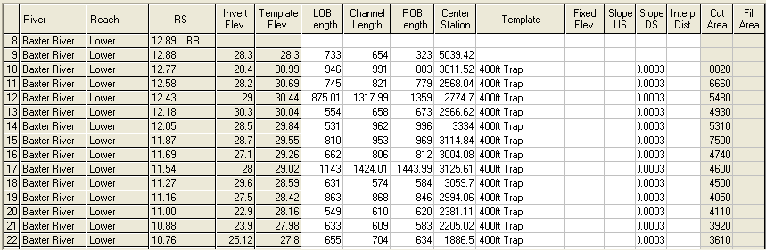
Modify a Range of XS
Select a Template
Add a New XS
Range of Cross Sections
Set the Elevation
  Fixed
  Slope from U/S or D/S
Interpolate
Edit Modifications directly

Slide 8
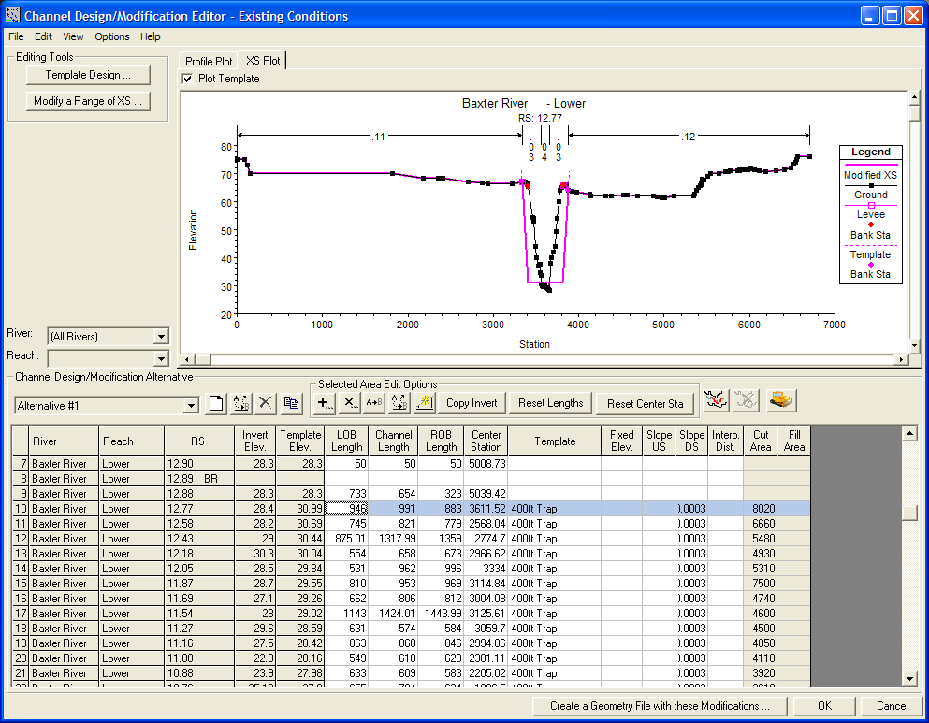
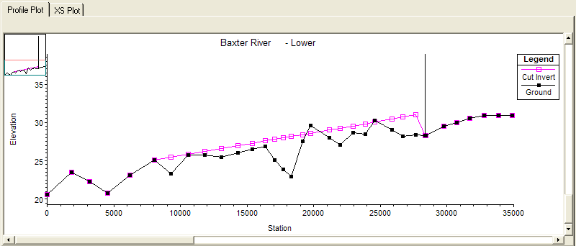
Channel Design/Modification

Slide 9
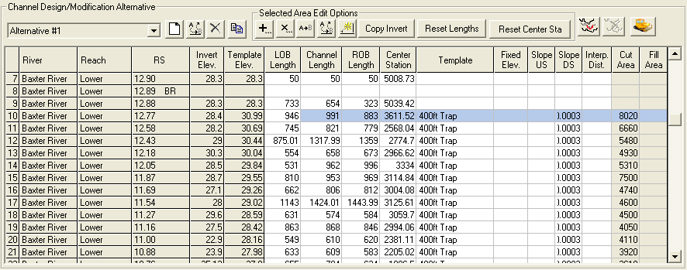
Channel Design/Modification
Alternative – alternatives allow for “testing” of several different channel designs (template shape and elevations).
Notes:
Entire set of modifcations applied to the existing conditions geometry.

Slide 10

Channel Design/Modification
River, Reach, RS – Identifies the cross section.
Invert Elev. – Minimum elevation of the cross section in the main channel.
Template Elev. – Elevation at which the Template willl be applied. Computed from the Fixed Elev. field and Slope fields.

Slide 11
Channel Design/Modification
LOB Length, Channel Length, ROB Length – Downstream Reach Lengths read in from the existing cross sections. User may overwrite data with new reach lengths.
Center Station – Used to apply Template cut. Station is computed (initially) from center of bank stations.

Slide 12
Channel Design/Modification
Template – Name of Template to be applied at the cross section
Fixed Elevation – Elevation at which to apply Template. Value is applied to Template Elev.
Slope US – Template Elev. is computed based on applying a Slope from the U/S cross section.
Slope DS – Template Elev. is computed based on applying a Slope from the D/S cross section.

Slide 13
Channel Design/Modification
Interp. Dist. – Interpolation Distance to be applied when creating the new geometry.
Cut Area – Area of cross section that will be removed.
Fill Area – Area of cross section that will be filled.

Slide 14

Channel Design/Modification
Selected Area Edits - Add, multiply, set, replace, interpolate
Copy Invert – Compute the invert (minimum elevation between bank stations) and apply to Template Elev.
Reset Lengths – Reset the downstream reach lengths.
Reset Center Station – Compute the center station between the bank stations.
Insert River Station – Inserts a River Station into the table. Cross section information is interpolated from bounding sections and Channel Length.
Remove River Station – Removes an “inserted” River Station.

Slide 15
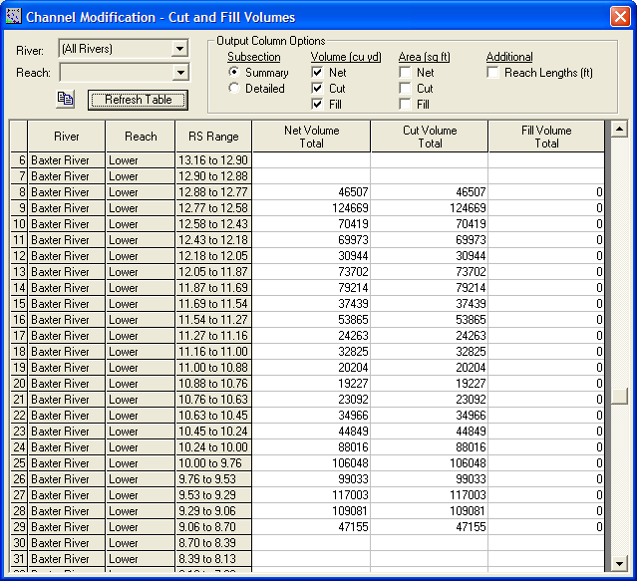
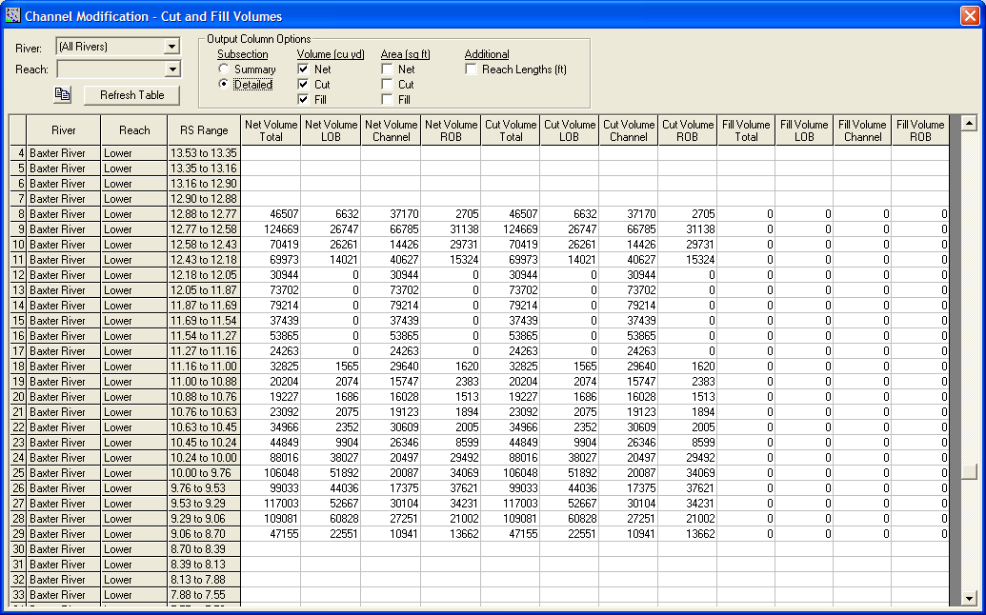
Channel Design/Modification
Cut and Fill Volumes

Slide 16
XS Elevation Update
Update of Cross Sections using Elevation Point Data.
Allows for merging of bathymetric survey data and LiDAR data collection.
Important for mobile bed river systems.
Easy method for combining point data without requiring use of GIS.

Slide 17
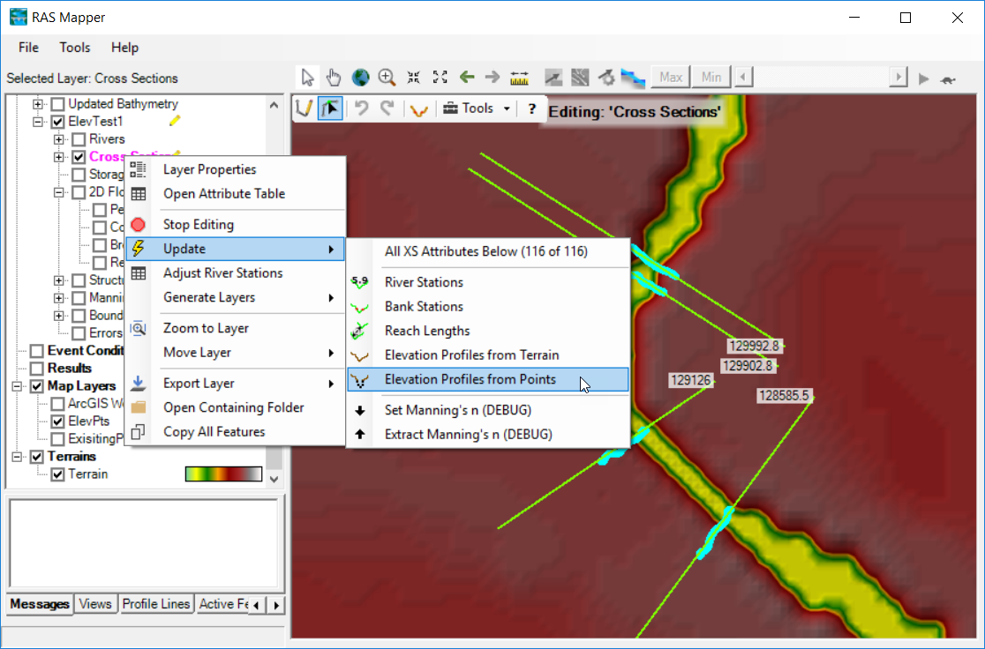
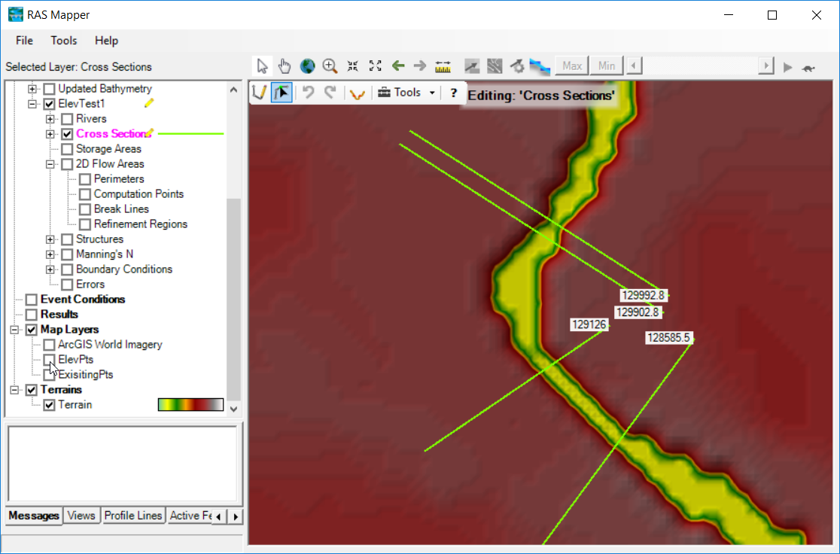
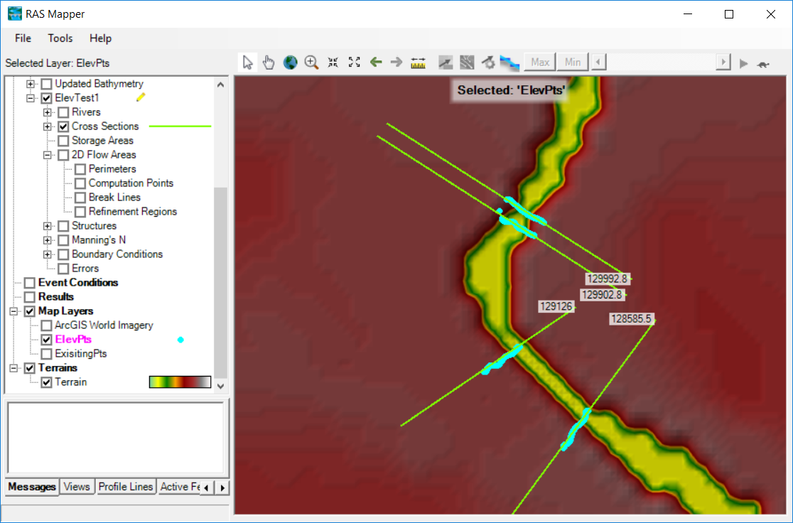
Elevation Update

Slide 18
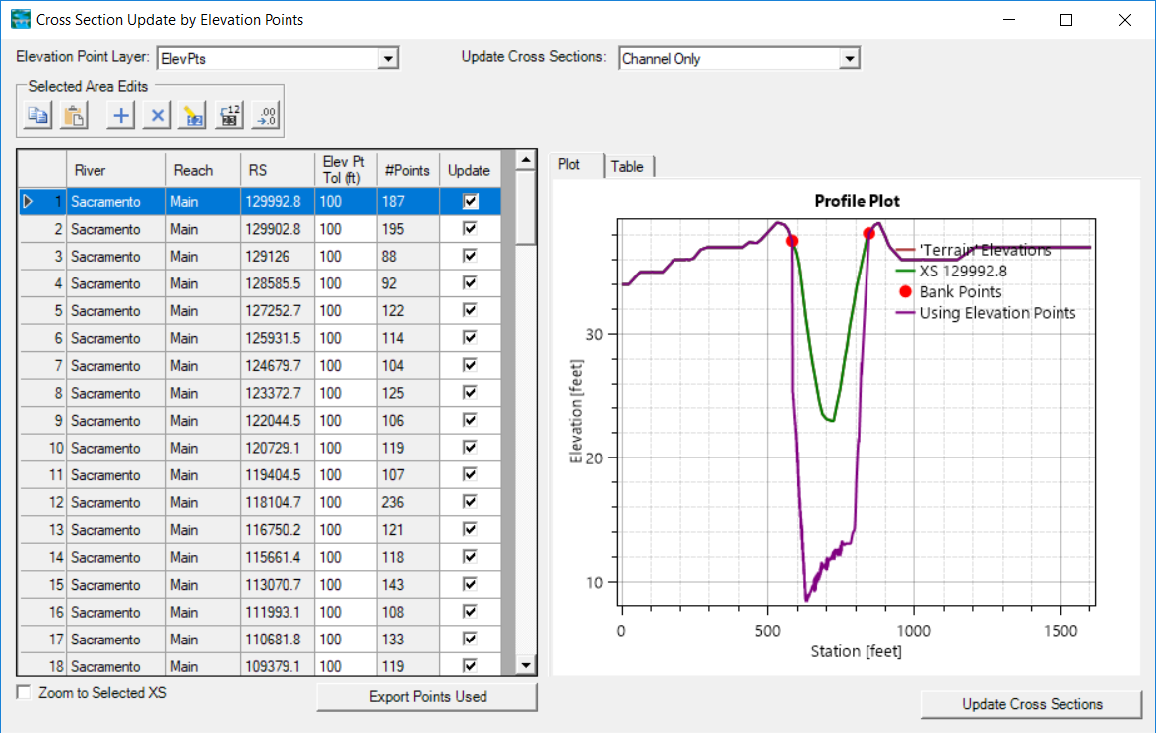
Elevation Update Editor

Slide 19
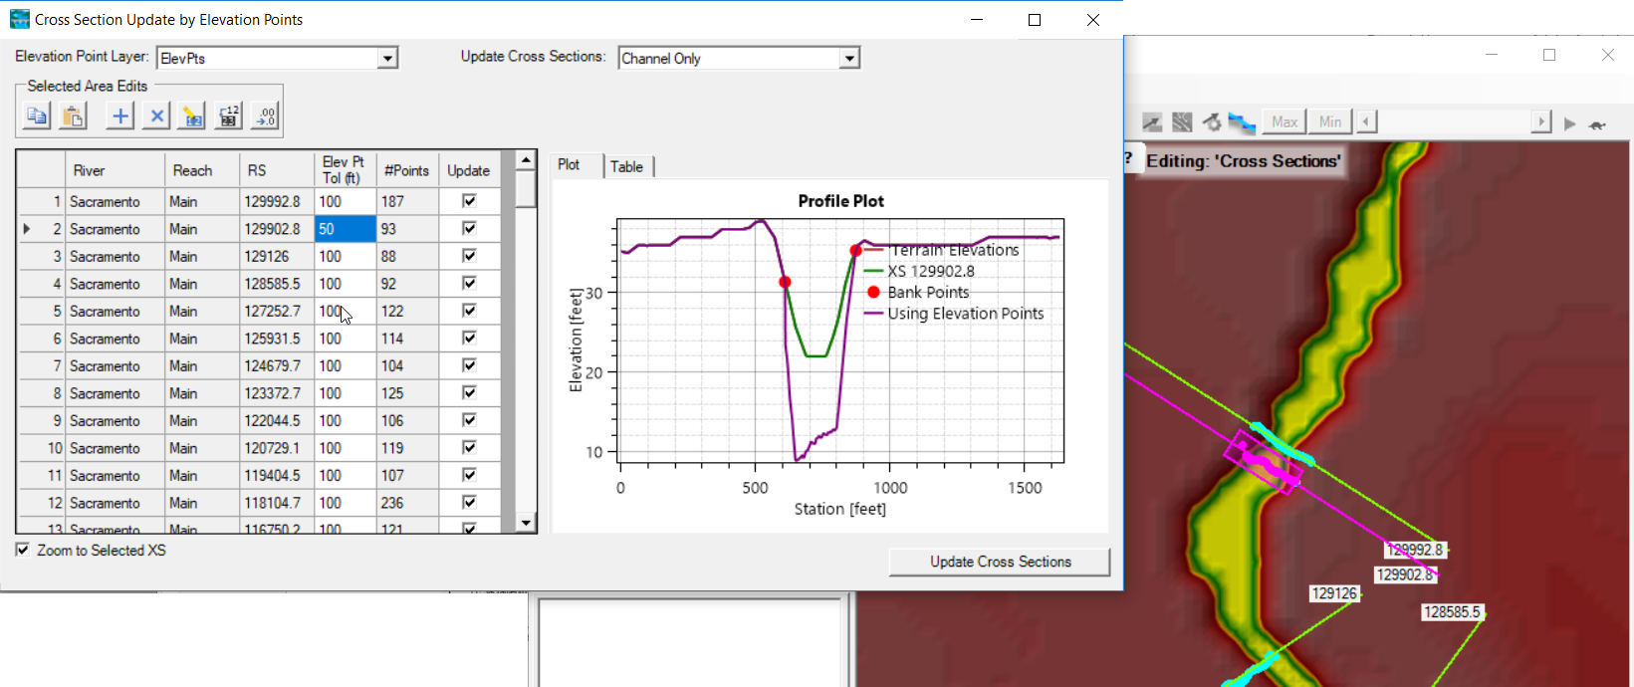
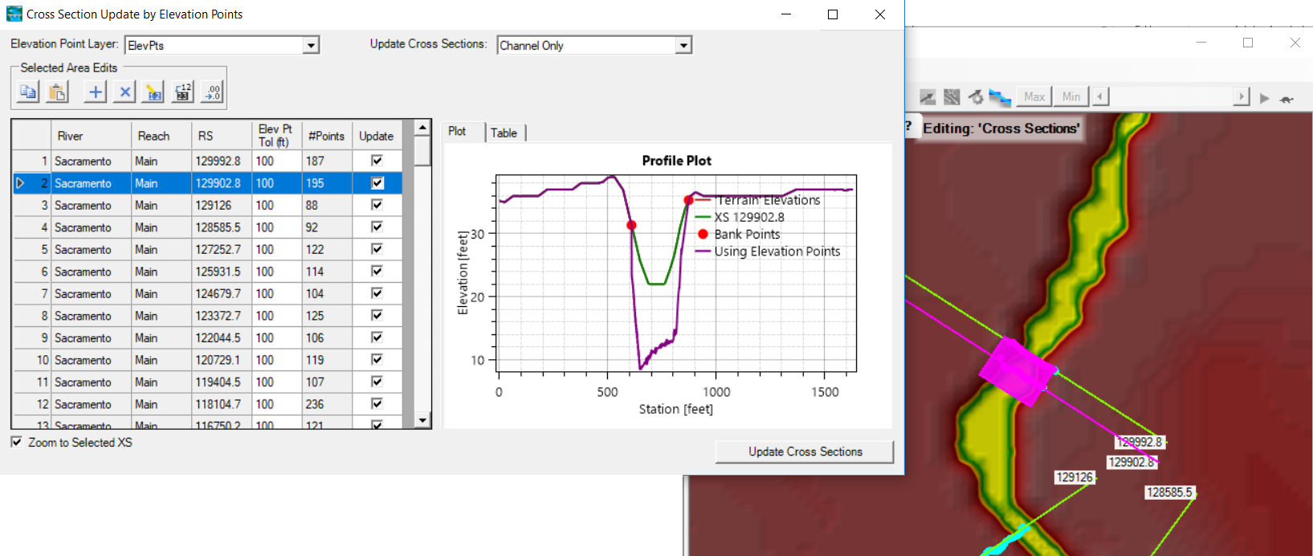
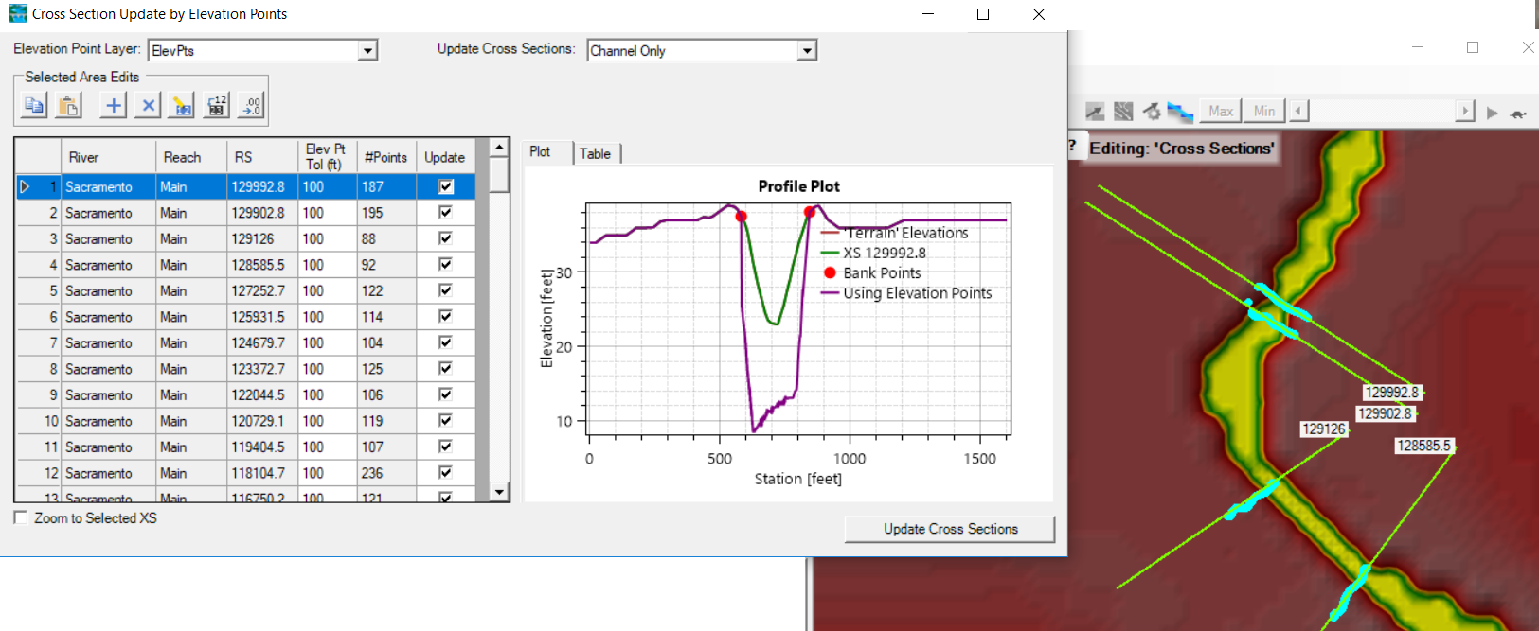
Elevation Update Editor

Slide 20
Terrain Modification
Terrain Replacement using Existing Cross Sections
Terrain Modification Tools

Slide 21
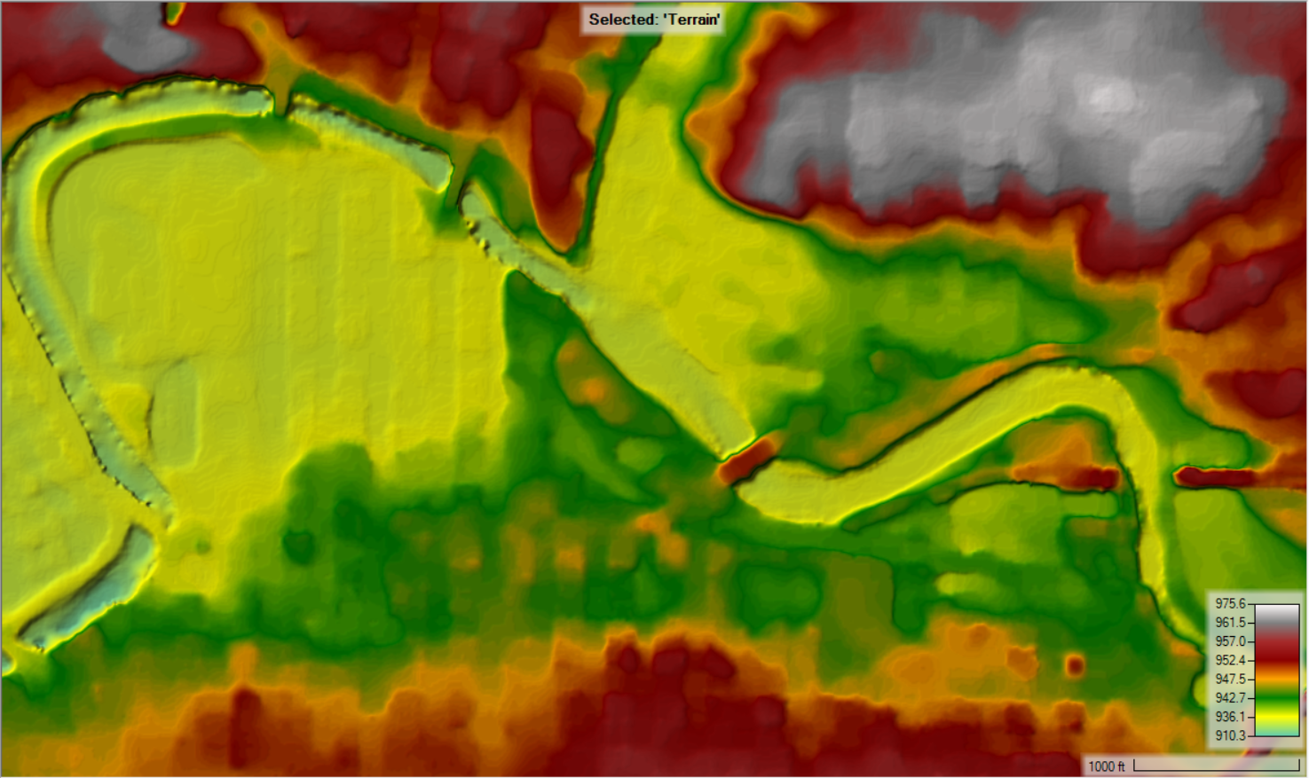
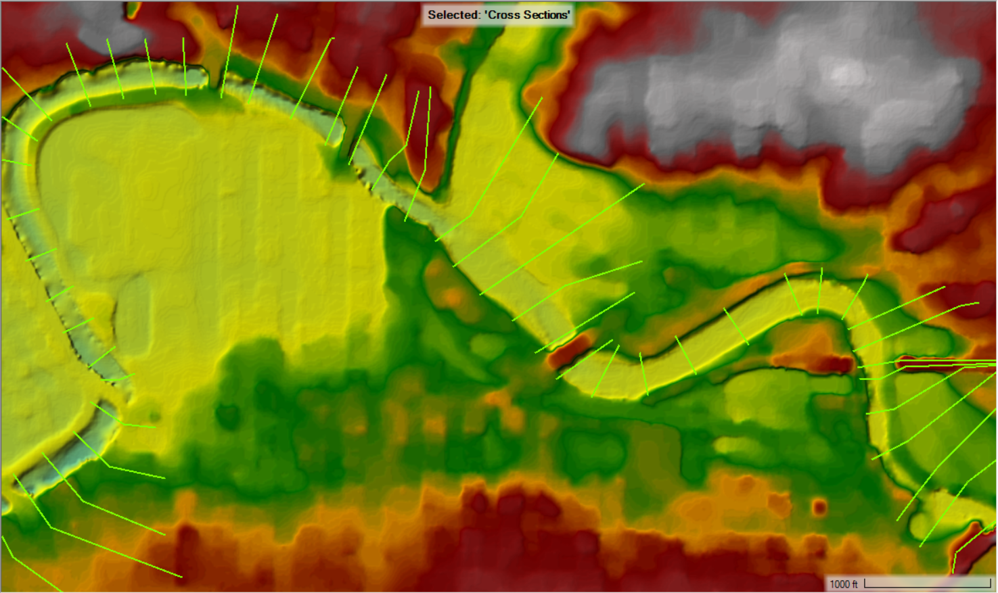

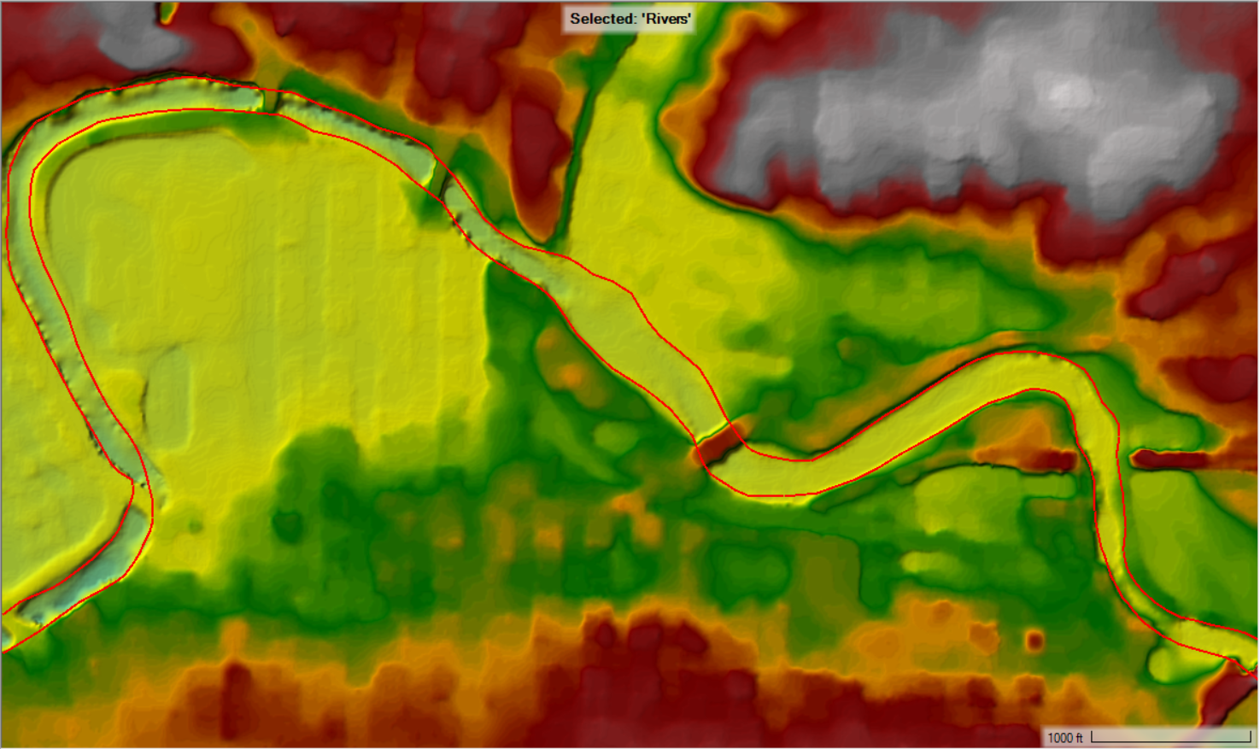
Channel Data

Slide 22
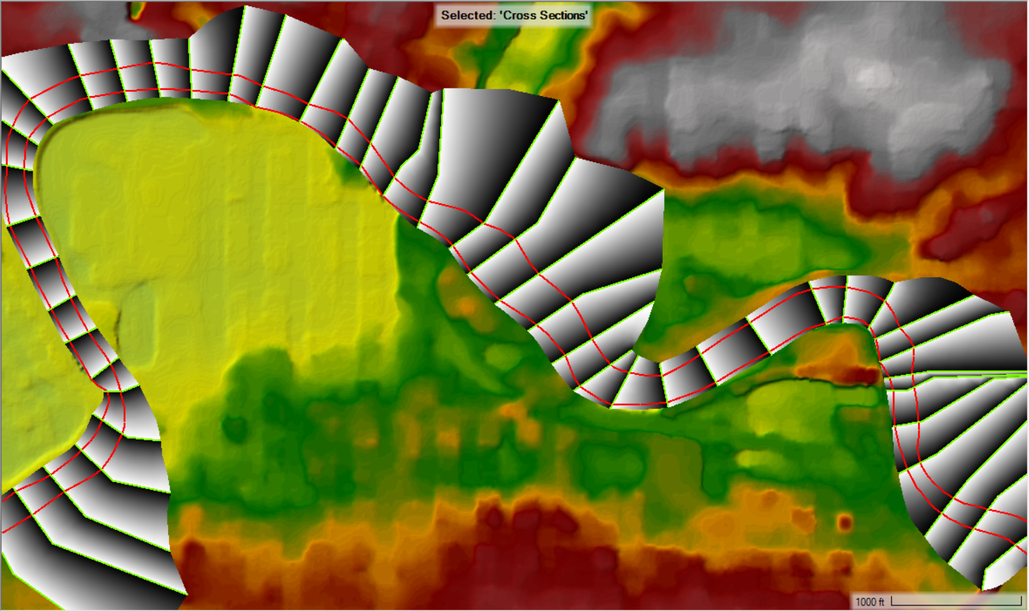
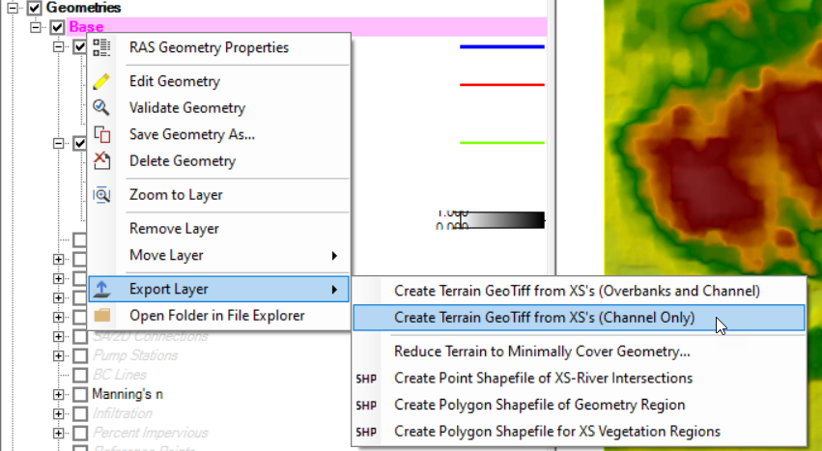
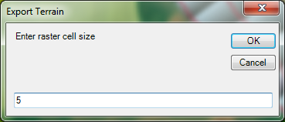
Export of Channel Data

Slide 23
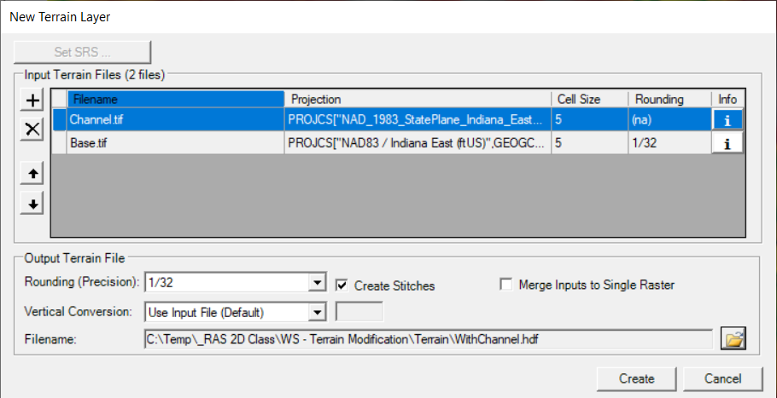
Create New RAS Terrain with Channel
Create New RAS Terrain
Set Priority – Channel data is highest

Slide 24
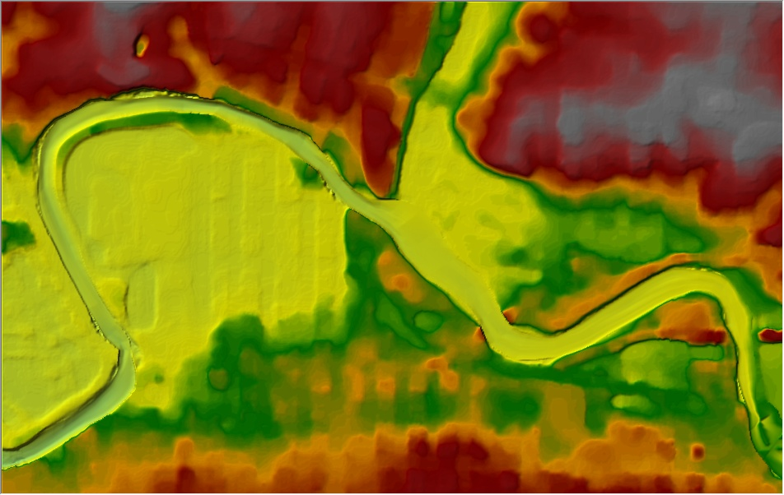
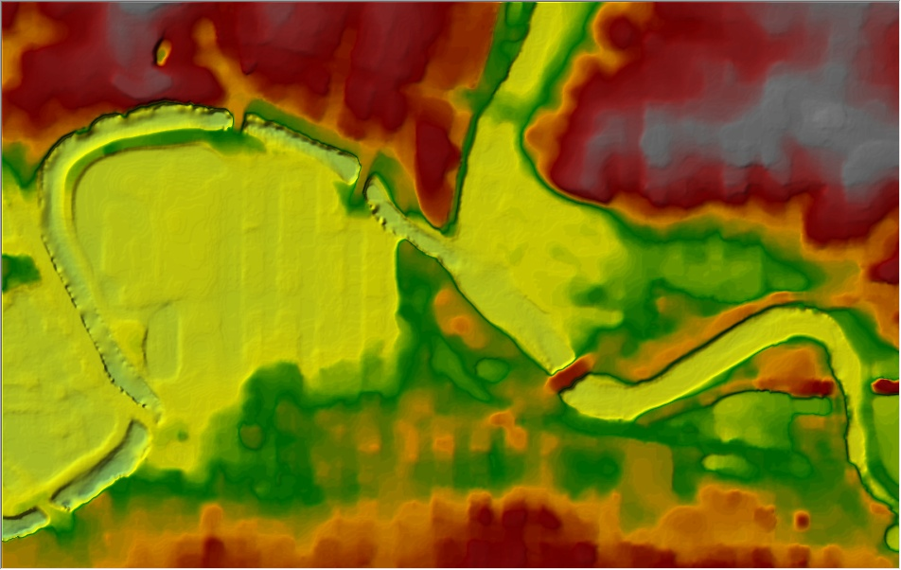
Terrain with Channel
Notes:
Here is an example of a terrain layer with bridge information in the terrain and a picture of the same terrain but with the cross sections used to create a channel raster and then add into the terrain layer.

Slide 25
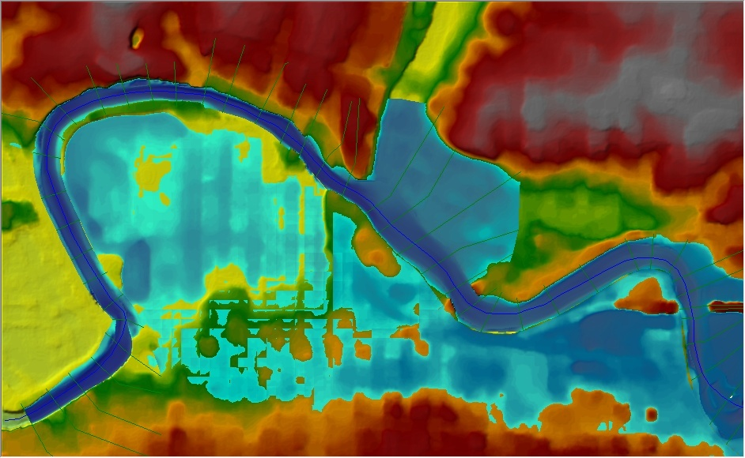
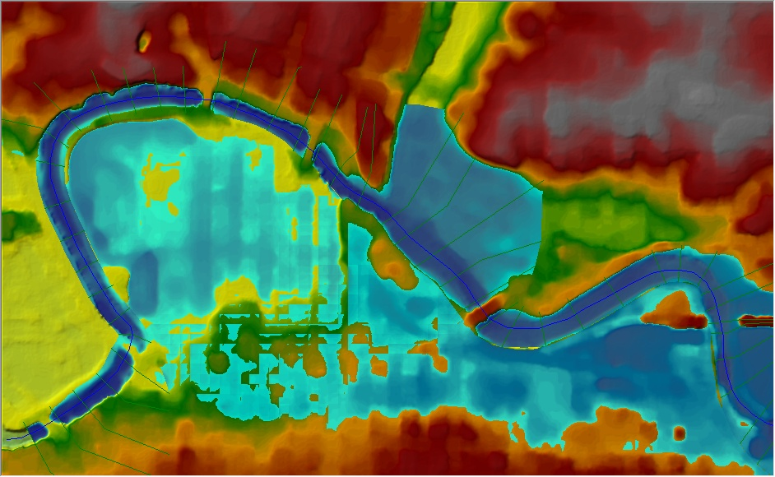
Inundation Mapping
Notes:
Here is an example of a terrain layer with inundation mapping both with bridge information in the terrain and with terrain that has channel information.

Slide 26
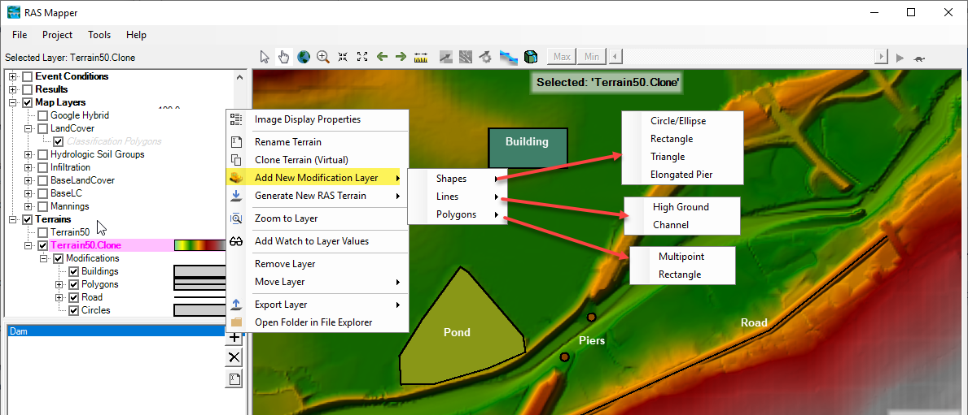
Terrain Modifications
Vector Overrides to Terrain Layer
  Simple Shapes (Piers), Lines (Channel, Roads, Levees), Polygons (Areas, Buildings)
Notes:
Copy Modifications between Terrain Layers
Use existing Editing Tools! (Copy/Paste/Import …)

Slide 27
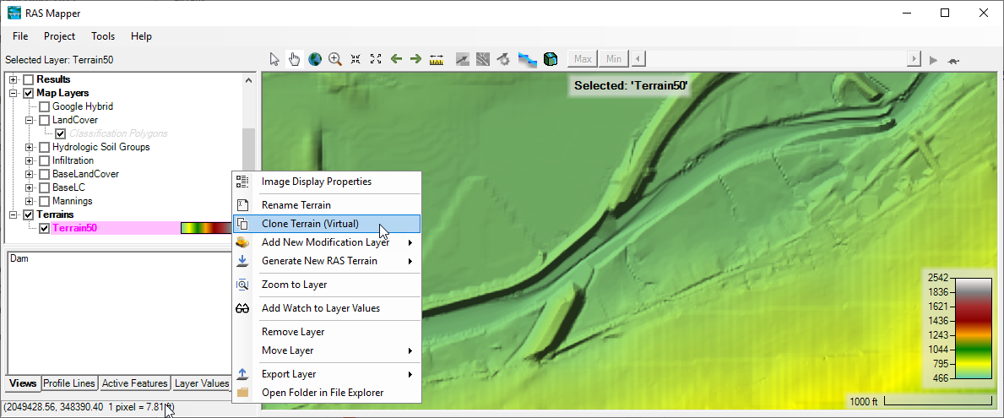
Terrain Clone
Virtual copy of the Terrain
No duplication of elevation dataset (large)
Vector additions stored in a separate file (the terrain clone)

Slide 28
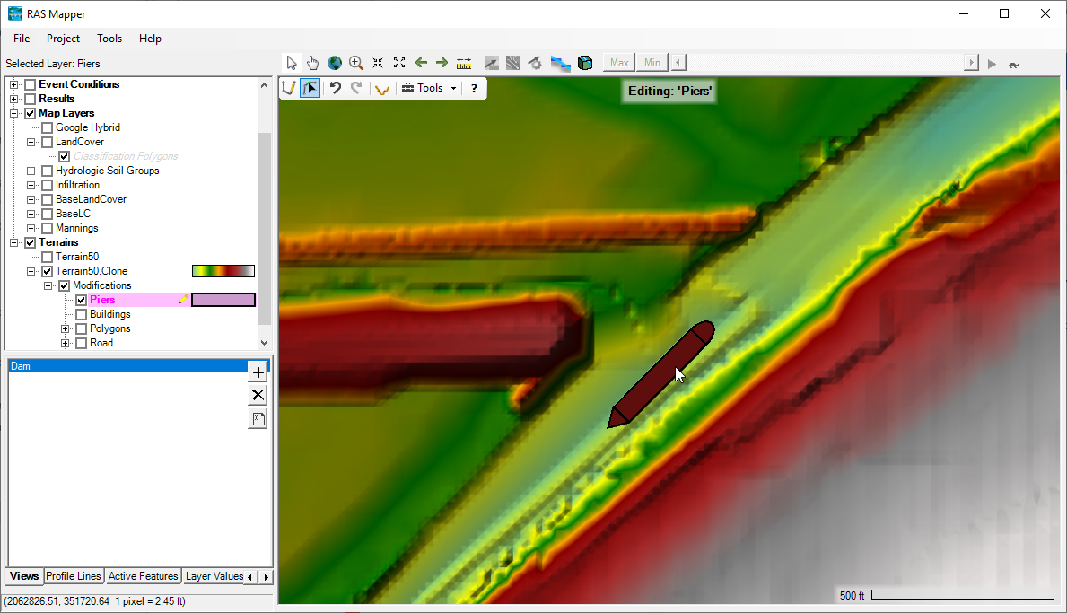
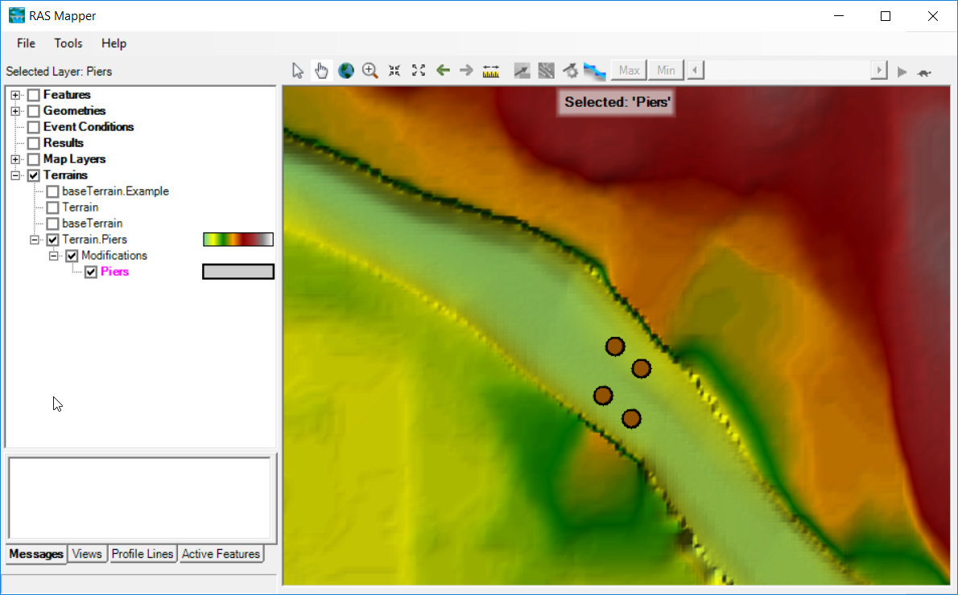
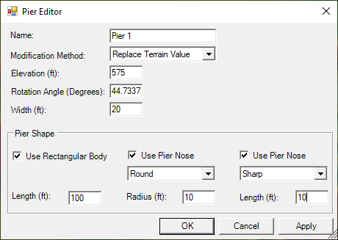
Shapes - Piers

Slide 29
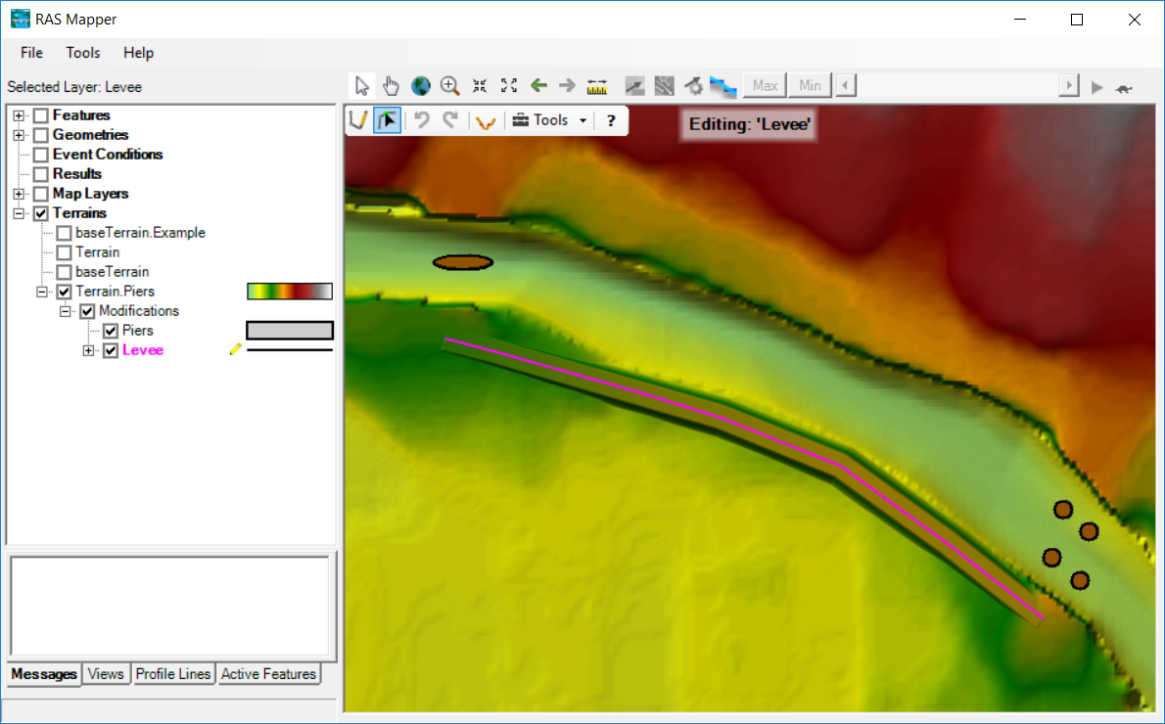
Lines - High Ground

Slide 30
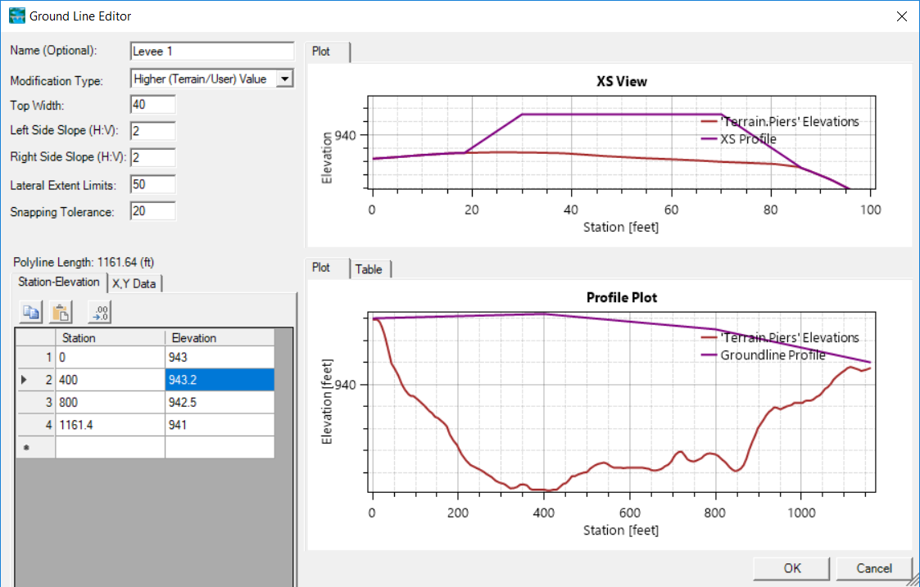
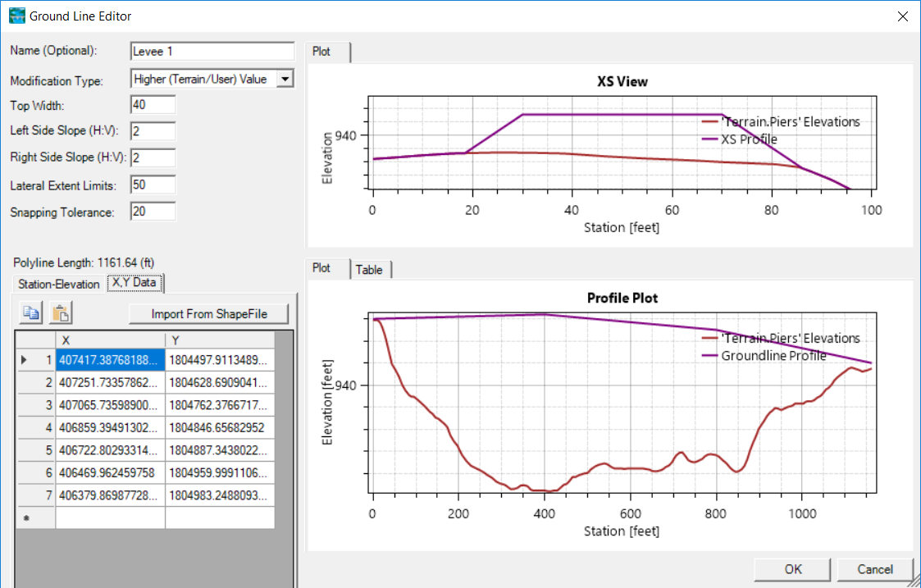
Lines – High Ground

Slide 31
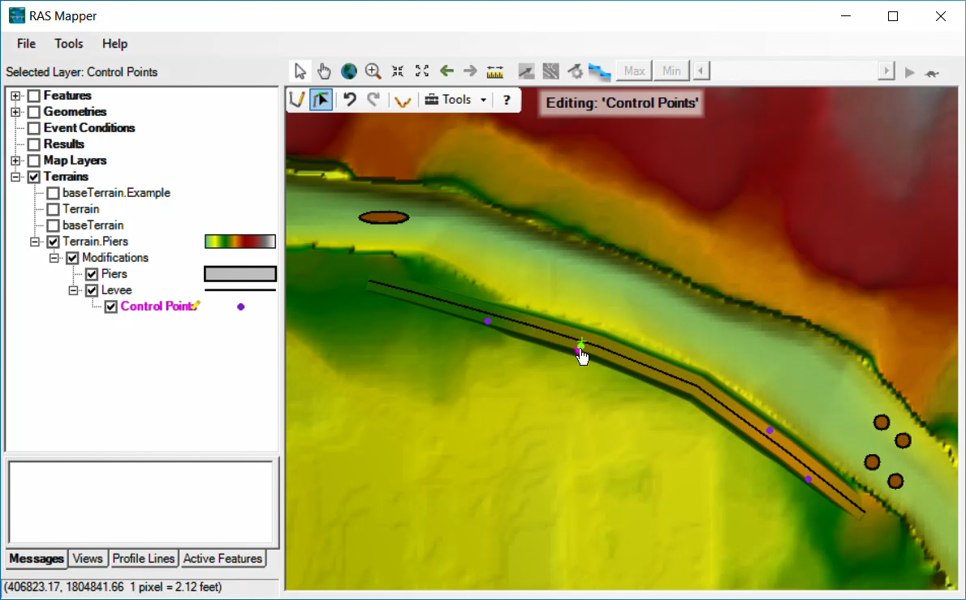
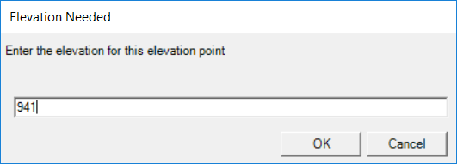
Lines – Elevation Control Points

Slide 32
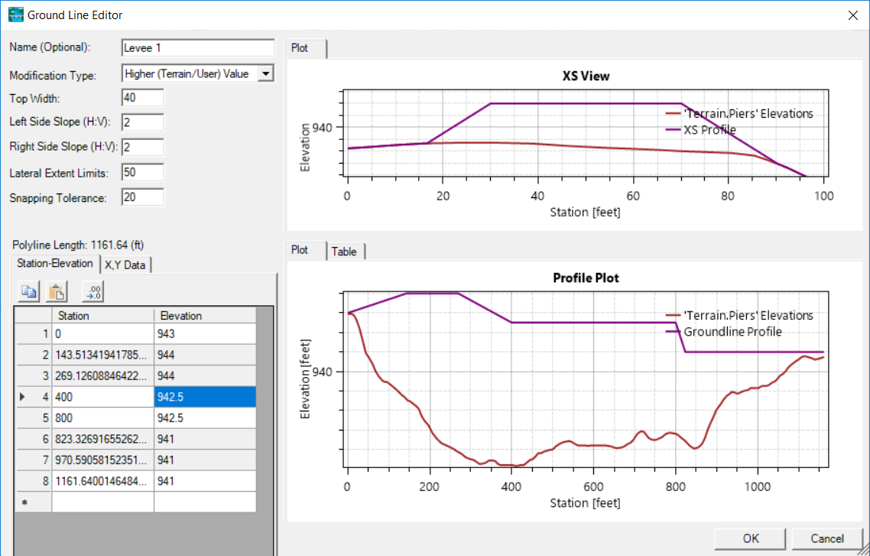
Lines – Elevation Control Point
Elevation control points shown in grey

Slide 33
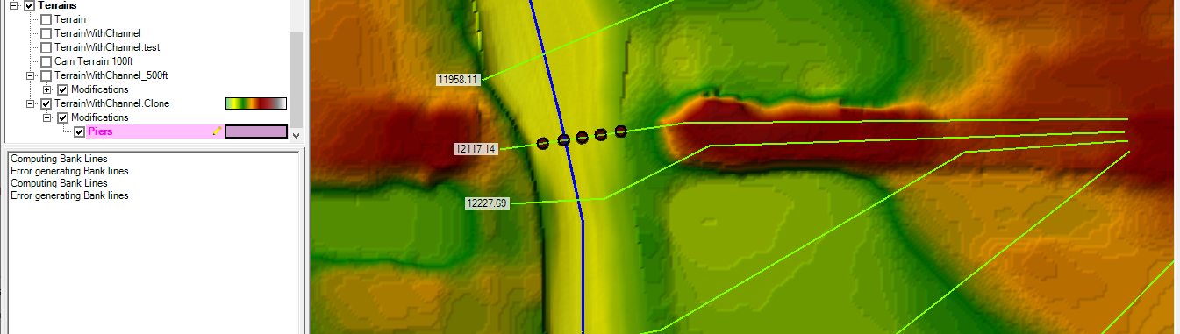
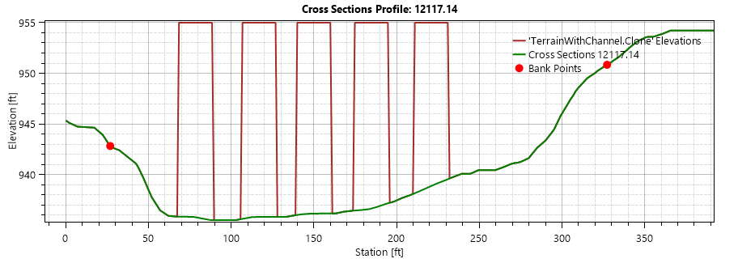
Terrain Modifications

Slide 34
Questions?

