Slide 1

Introduction to Linear Regression
Part I: What is Linear Regression?
Avital Breverman, E.I.T.
Slides provided by: Gregory S. Karlovits, P.E., PH, CFM
US Army Corps of Engineers
Hydrologic Engineering Center
Notes:
This lecture is divided into 4 parts:
Introduction to linear regression,
Constructing a simple linear regression model,
Checking assumptions, and
Making predictions

Slide 2
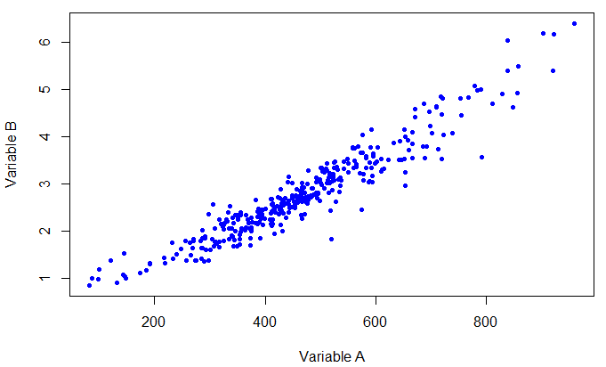
Why Regression?
Predict values of variable B given values of variable A
Notes:
In this lecture, we will build on concepts in exploratory data analysis and multivariate analysis to develop simple linear regression models.
Greg will talk about multiple linear regression models tomorrow morning.
First, we should discuss what exactly linear regression is and why we use it.
Regression is used when we have data that we observe about two (or more) variables jointly, and we want to make inferences about one variable assuming it is dependent on another.
Linear regression is a statistical model.
It lets us assess the strength of relation between two variables.
It also gives us a formal way to talk about our confidence in predictions about the dependent, or response, variable.

Slide 3
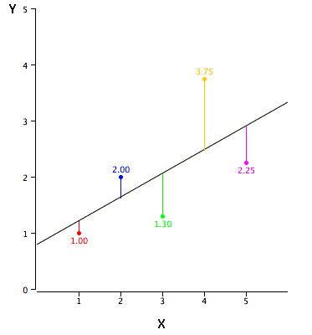

Line of Best Fit
A line with the minimum distance between it and the data
$$y=β_{0}+β_{1}x_{1}$$
https://onlinestatbook.com/2/regression/graphics/reg_error.gif
Notes:
Usually with regression, we are interested in the “line of best fit”, that is, finding the line that passes through the data, and has the smallest possible error.
We measure the error along the y-axis, that is, only in terms of variable B (which is the one we are trying to explain, or the response variable).
The line has two parameters: a slope, and an intercept.
When we first encountered the equations for lines in geometry, we usually see it as y = mx+b, but in statistics we replace the intercept with beta-naught and the slope term with beta-one, so that if we want to add extra predictors to the model, we don’t have to start picking new letters for that coefficient, it just becomes beta-2.
In this situation we search for the values of beta-naught and beta-one that minimize the distance between the line and the points.

Slide 4
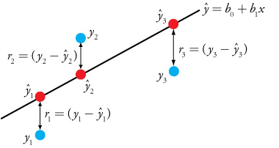
Errors
Unless your data make a perfect line, there is some error left over at each point.
Errors are called residuals
https://community.asdlib.org/imageandvideoexchangeforum/2013/07/19/240/
Notes:
For any straight line you draw, or any value of beta-naught and beta-one, unless your data make a perfect line, there will be some error left over.
At each point, you can apply the regression model by plugging in the observed x-value and getting a predicted y-value.
The predicted value is labeled as y with a circumflex accent. Usually, we just shortcut this by calling it y-hat.
The circumflex accent is usually used for estimators, as in the estimated value of y.
You can take the difference between the observed y-value and the predicted y-value to get the error of the prediction at that point.
In regression we call this error the residual, here labeled r.
Truth be told, the residuals are what regression is all about.

Slide 5

Individual Points
This means that the equation for an individual point becomes:
$$y_{i}=β_{0}+β_{1}x_{i}+r_{i}$$
https://community.asdlib.org/imageandvideoexchangeforum/2013/07/19/240/
Notes:
For any individual point, to get from the predicted value, y-hat, to the actual value, y, we must add in the residual for that point.

Slide 6
Prediction
When making a prediction, you can only talk about an unobserved value in terms of probability.
?
x = 40
https://community.asdlib.org/imageandvideoexchangeforum/2013/07/19/240/
Notes:
Now say you have a model, and you want to predict the value of the response variable y given a value of x.
For example, say you have constructed a model that predicts annual streamflow volume for a watershed using annual total precipitation as a predictor.
You then want to predict the annual streamflow volume for a hypothetical value of annual total precipitation of, say, 40 inches.
You don’t know the residual value in this case, because the streamflow volume for your hypothetical rainfall has not been observed.
You can only talk about the predicted value in terms of probability. The outcome is random and therefore uncertain.

Slide 7
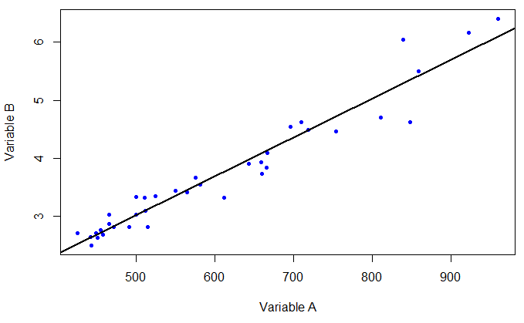
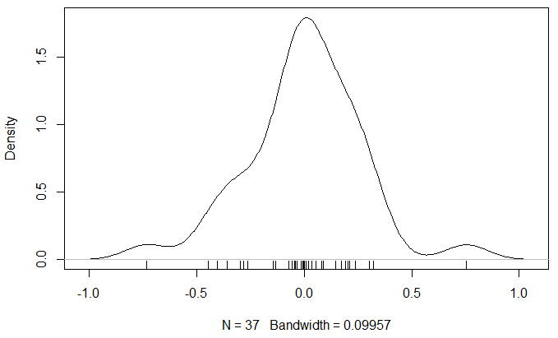
Residuals
The collection of residuals in the fit form a probability distribution.
Notes:
On the left is a best-fit line through some data points in blue.
This line has a slope and an intercept that minimize the total error between the points and the line in the y-direction.
When you take all the residuals, the left-over error from the regression, and plot them as a density, you get the result on the right.
The density is a way to show the probability distribution empirically.
Each tic along the x-axis is one residual value.
The density gives a relative sense of how frequent those residual values are, with a higher density value meaning those values come up more often.
You should see a couple of things in the density on the right.
One, most of those residual values are clustered close to zero. That means for most points, the residual error is small.
Two, you should see that the errors are about even in both directions away from zero; that is, there are positive and negative errors of about the same magnitude.
Third, there are only a small number of very large residuals.
Which probability distribution does the error distribution resemble?
The shape of the empirical density on the right helps us see what the distribution of these errors looks like, and as the sample gets larger, this will look more and more like a normal distribution.

Slide 8
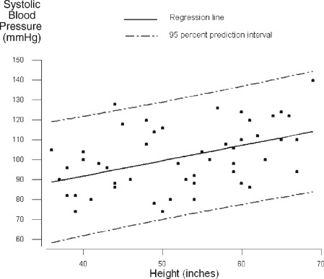

Full Regression Equation
Considering the distribution of the residuals:
$$y_{i}=β_{0}+β_{1}x_{i}+ε_{i}$$
ϵ_{i} is a random error with:
$E\left[ε_{i}\right]=0$
$$var\left[ε_{i}\right]=σ^{2}$$
https://www.sciencedirect.com/topics/mathematics/prediction-interval
Notes:
Because the regression line isn’t a perfect fit, the regression equation does not explain all the variability in the y-values.
This leftover amount of variability is a random error centered at zero.
This means that a prediction of a y-value corresponding to any desired x-value depends on the regression line, but also the error term added on the end.
The true y-value is unknowable for the given x-value.
Using the regression equation provides the mean estimate for the predicted y-value, but the real value can only be described in terms of a prediction interval which is an interval with a width defined by the variance of the residual.
The plot on the right shows a regression line with the 95% prediction intervals around it. The red line is at approximately x = 52.
The mean estimate, or expected value, of the y-value corresponding to this x-value is about 100.
However, due to the random error of this model, there is a 95% probability that the true unobserved value of y is between 70 and 130.

Slide 9
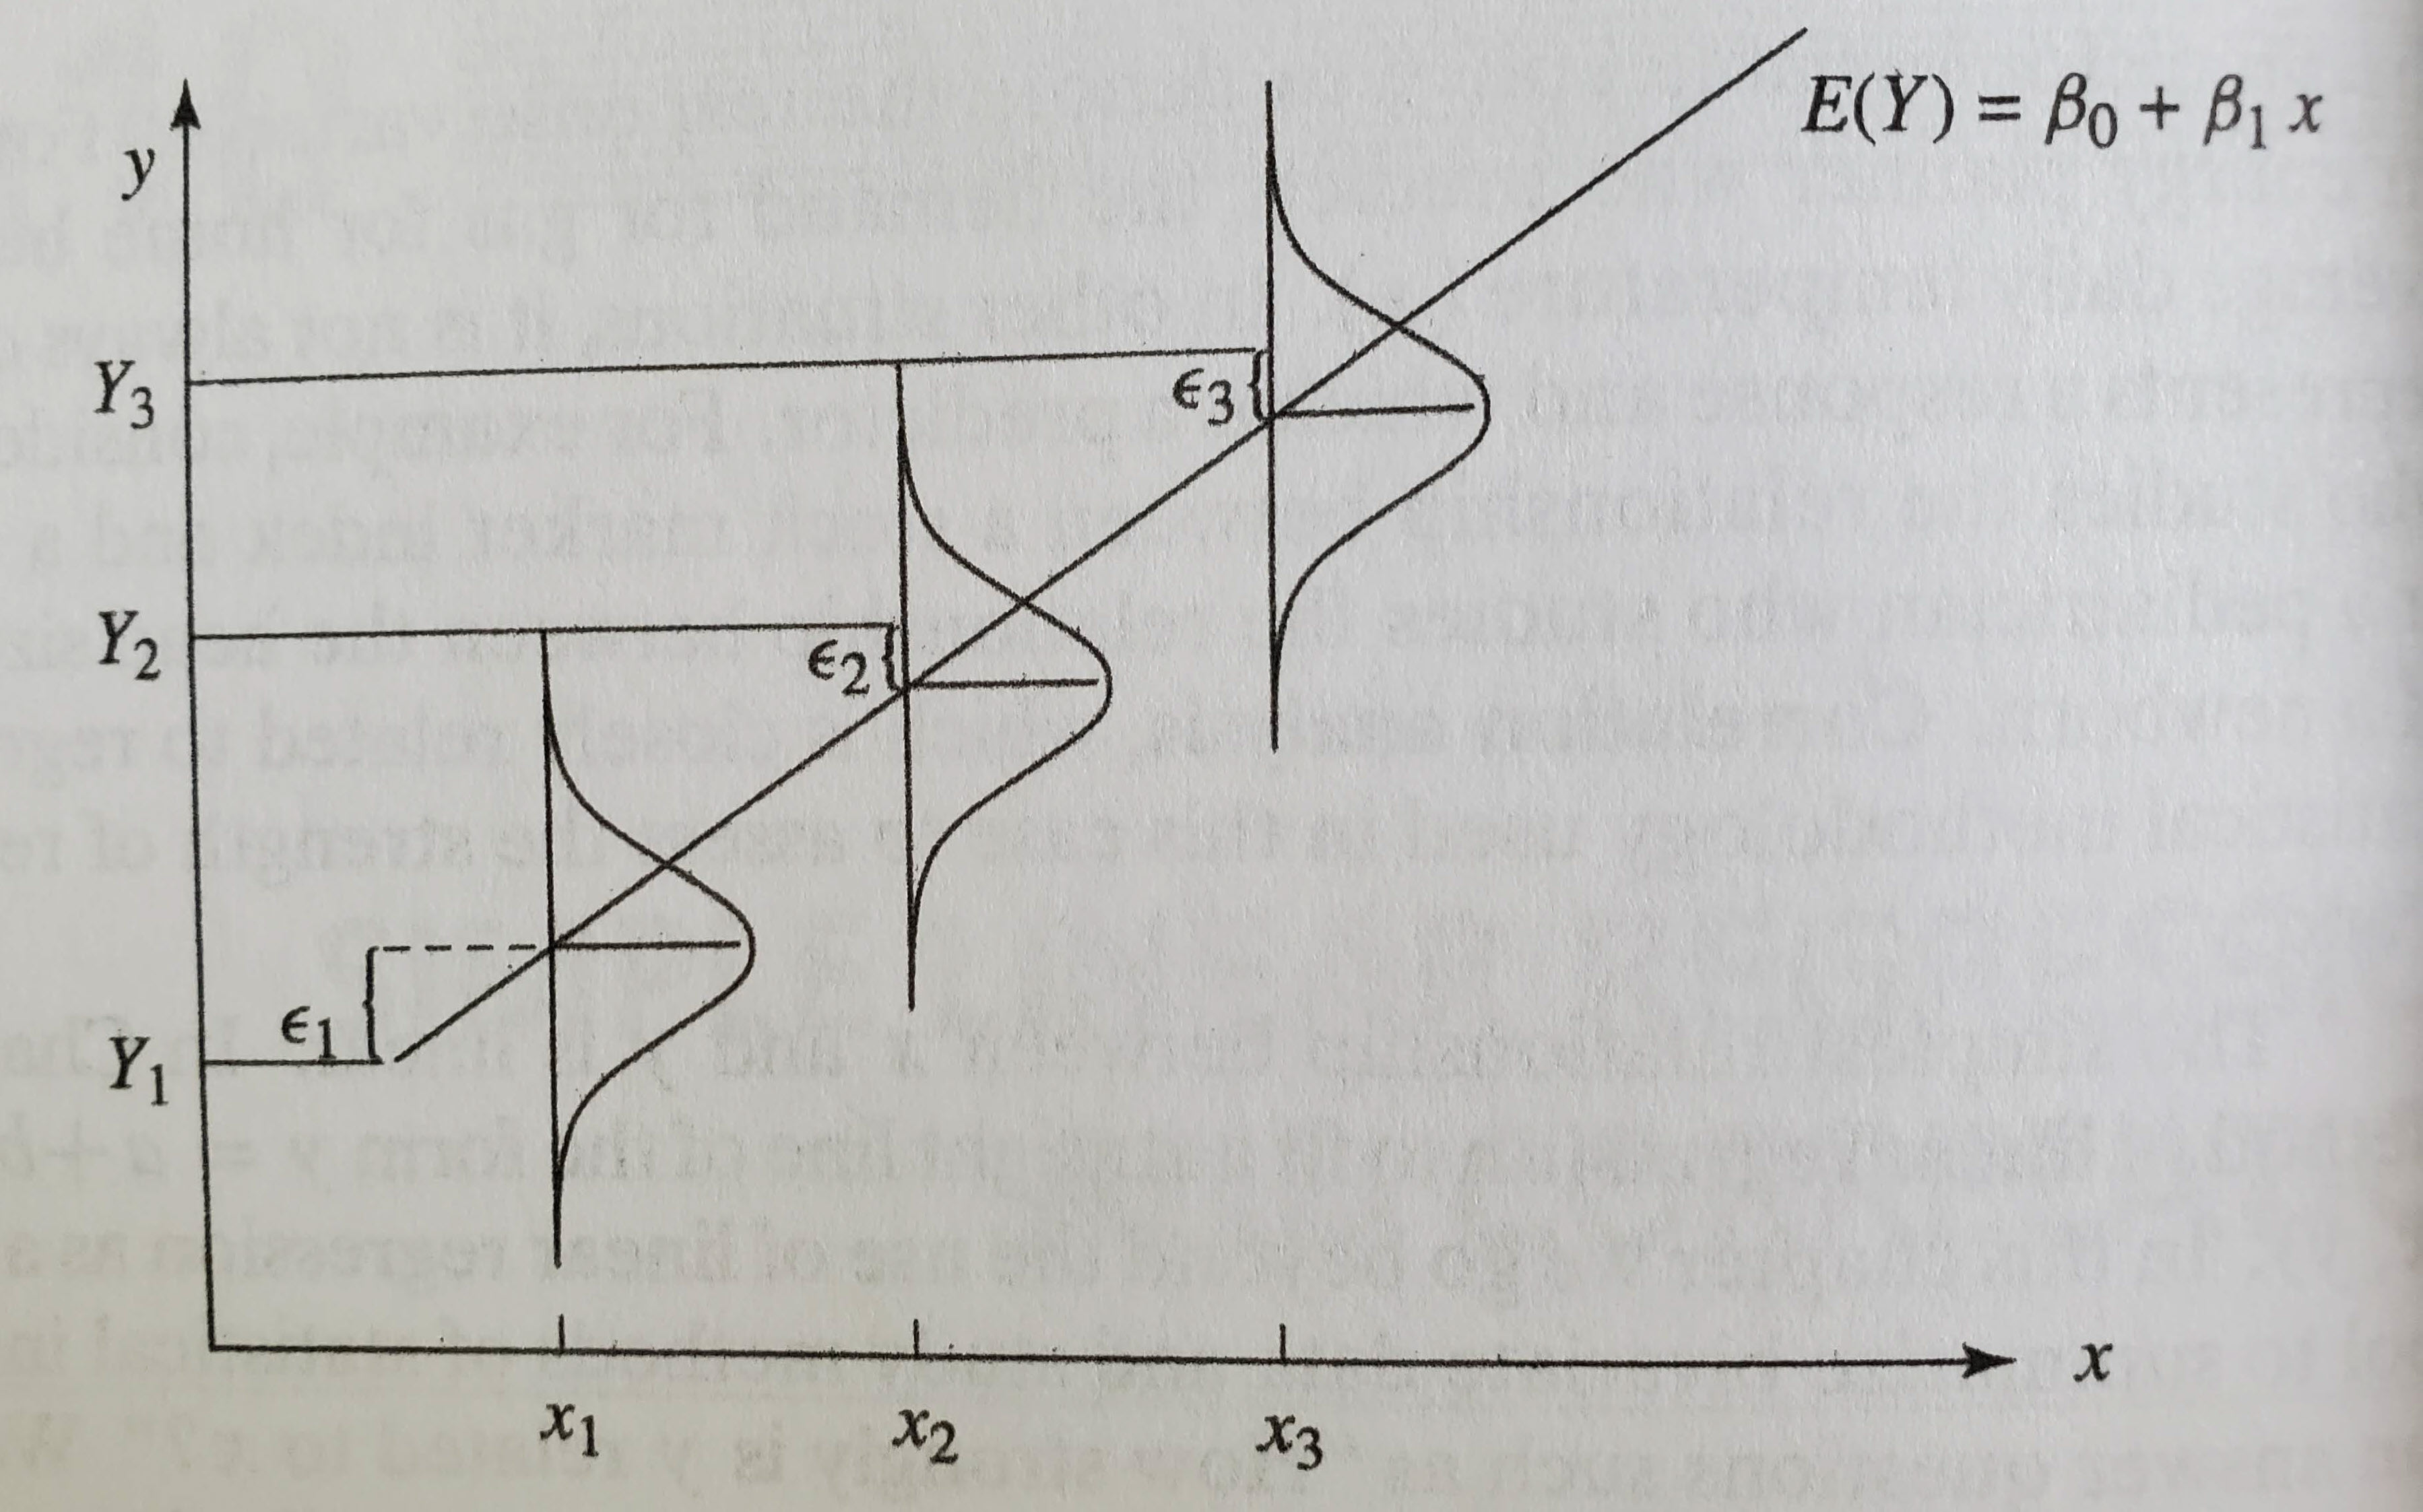

Full Regression Equation
Considering the distribution of the residuals:
$$y_{i}=β_{0}+β_{1}x_{i}+ε_{i}$$
This means that
$$E\left[y_{i}|x_{i}\right]=β_{0}+β_{1}x_{i}$$
Because $E\left[ε_{i}\right]=0$
Notes:
Creating the prediction interval we just saw involves taking the distribution of the residuals and sliding it along the regression line.
The 95% prediction interval contains the yet-unobserved y-value 95% of the time, and it is a symmetrical interval so 2.5% of the values fall above and 2.5% below this interval.
This means while sliding the residual distribution along the regression line, we mark off the 2.5% and 97.5% percentiles of the distribution while moving it along.
This assumes that we know the true values of beta-naught and beta-one, while in reality there is uncertainty in those values.
We will see later how to compute intervals that account for this uncertainty.
Remember that the regression line is the conditional mean value of Y given some value of X. The true value is unknowable and we can talk about it only in terms of a probability distribution.

Slide 10
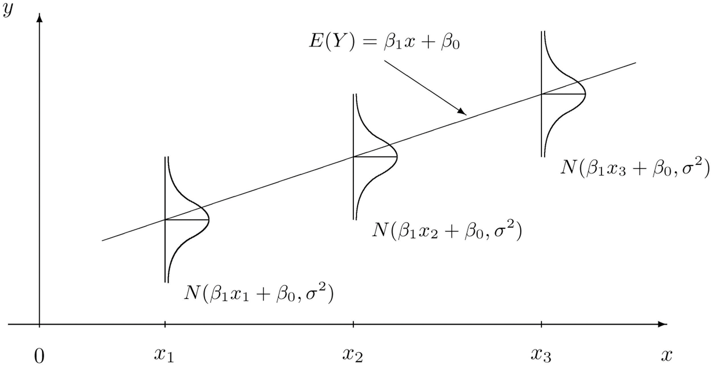

What is the Distribution of the Residuals?
Assume that the residuals are normally-distributed.
Response variable is then also normally-distributed, with:
$μ=β_{0}+β_{1}x$
$$σ^{2}=var\left[ε\right]$$
https://saylordotorg.github.io/text_introductory-statistics/s14-03-modelling-linear-relationships.html
Notes:
It is important then to determine what the distribution of the residuals is, in order to be able to do things like create a prediction interval, or to get a sense of how reliable our estimates are using this model.
For simple linear regression, we assume that the residual is normally-distributed.
On the plot you can see that for each value of x, the corresponding output is not a single value, but a conditional normal distribution with a mean determined by the regression equation, and a variance computed from the variance of the residuals of the model fit.
This means we are fitting the conditional distribution of Y given X. This implies that there is some joint distribution of X and Y, as we saw in multivariate analysis.
As a result, the response variable Y is also normally-distributed.
This is one of the major assumptions made when performing linear regression.
In the situations where we find that we have violated this assumption, there are options for fixing it, which we will discuss in part three.
However, there are three other assumptions also being made when using linear regression.

Slide 11
Four Assumptions of Linear Regression
The mean of y_{i} is a linear function of x_{i}
All y_{i} have the same variance σ²
The errors are normally-distributed
The errors are independent
Notes:
There are four assumptions being made when using a linear regression model.
These assumptions represent several trade-offs. On one hand, it seems restrictive and narrow, with some specific assumptions.
On the other hand, when we meet these assumptions, the model is easy to fit and to use to make inferences.
The first assumption states that the relationship between the variables is linear, and not something else, like polynomial.
The second assumption states that the variance is constant, and that the residuals from the model fit have the same spread across the range of fitted values.
The third assumption states that the values of the residuals have a normal distribution or are reasonably like a normal distribution.
The fourth and final assumption states that each error is independent of the others and does not exhibit serial correlation (correlation between a variable and a lagged version of the variable).
We will go over checking these assumptions in part three.

Slide 12
Summary
Regression helps us evaluate the dependency of a response variable on an independent predictor variable
There are four key assumptions being made in a linear model
Notes:
In this section, we covered an introduction to simple linear regression. Two key points to take away from this video are:
Regression is a tool that helps us evaluate the dependency of a response variable on some independent predictor variable, and
There are four important assumptions to keep in mind when building a linear model.
Next, we will talk about constructing a simple linear regression model.

Slide 13
Introduction to Linear Regression
Part II: Constructing a Linear Regression Model
Avital Breverman, E.I.T.
Slides provided by: Gregory S. Karlovits, P.E., PH, CFM
US Army Corps of Engineers
Hydrologic Engineering Center
Notes:
In this section, we will discuss constructing a linear regression model.

Slide 14

Getting the Line of Best Fit
Goodness of fit is measured by the sum of squared errors (SSE)
Line of best fit minimizes SSE
$SSE=\sum_{i=1}^{n}{r_{i}^{2}}$
https://community.asdlib.org/imageandvideoexchangeforum/2013/07/19/240/
Notes:
Solving the line of best fit is an optimization problem.
We want to find the parameters beta-naught and beta-one that make the line agree with the points the best.
We measure the agreement between the points and the line using an objective function for our optimization called the sum of squared errors.
This takes each residual, squares it, and adds them all up.
Squaring the residuals is mainly done for mathematical convenience, but the best side effect is that the estimators found in this way have simple distributions.
Applying this technique is called least squares estimation.

Slide 15

Least-Squares Estimation
Find values of β₀ and β₁ that minimize SSE.
$SSE=\sum_{i=1}^{n}{{\left[y_{i}−\left(β_{0}+β_{1}x_{i}\right)\right]}^{2}}$
$\hat{β_{1}}=\frac{\sum_{i=1}^{n}{\left(x_{i}−\overline{x}\right)\left(y_{i}−\overline{y}\right)}}{\sum_{i=1}^{n}{{\left(x_{i}−\overline{x}\right)}^{2}}}$
$\hat{β_{0}}=\overline{y}−\hat{β_{1}}\overline{x}$
Notes:
The goal of least squares estimation is to find the value of the coefficient and intercept that minimizes the sum of squared errors.
Here we re-write SSE in a slightly different way but recognize that the term inside the brackets is just the residual: observed minus predicted.
We want to minimize this term.
Every traditional discussion of least-squares estimation shows this derivation, but I will be brief with it. I do like this result because it is elegant.
To find the value of each of the parameters beta-naught and beta-one that minimize SSE, we take the partial derivative of SSE with respect to each parameter and set them equal to zero, and then solve for beta-naught and beta-one.
I will spare you the calculus and get right to the solution, which is very satisfying.
The equation for beta-one can be simplified even further as the covariance of x and y divided by the variance of x.
Covariance and variance each have a denominator of (N-1) which cancels out and leaves you with the equation shown.

Slide 16
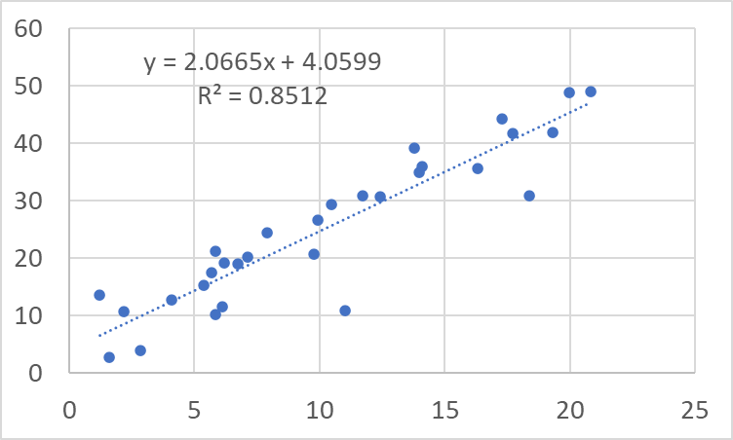
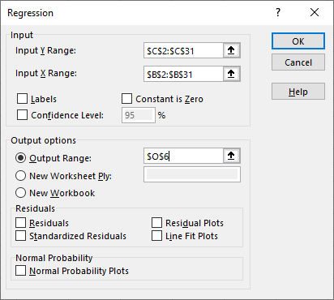
In Practice
Most statistical tools have linear regression estimation built in.
Notes:
I showed you the equations but in practice you will rarely use them.
Most statistical software has regression built in so that you can directly estimate the slope and intercept terms without ever looking at the least squares formulas.
Even the chart function in Microsoft Excel can compute a regression slope and intercept automatically.
It also has a better regression analysis tool available in the Data Analysis add-in that produces results more similar to standard industry applications such as R, SAS, SPSS, Maple, etc.

Slide 17
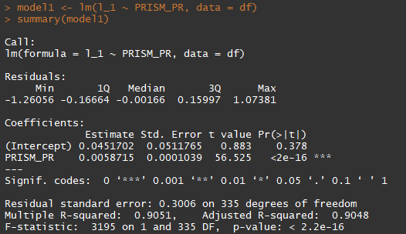
In Practice
In R the lm function is used to create a linear regression model.
Notes:
The R statistical programming language is quickly becoming the standard for statistical analysis.
If you are familiar with programming in any language, R can be very quick to learn.
Even if you don’t have extensive programming experience, there is a wealth of online help for R, and the documentation for R is excellent.
Greg and I can also provide support and we will use R in 3 of the workshops in this class.
Notice here that there is no appearance of the least squares equations – only calling the lm function on some data, and then getting a summary of the model.
We will talk about the information that a regression model provides next.

Slide 18
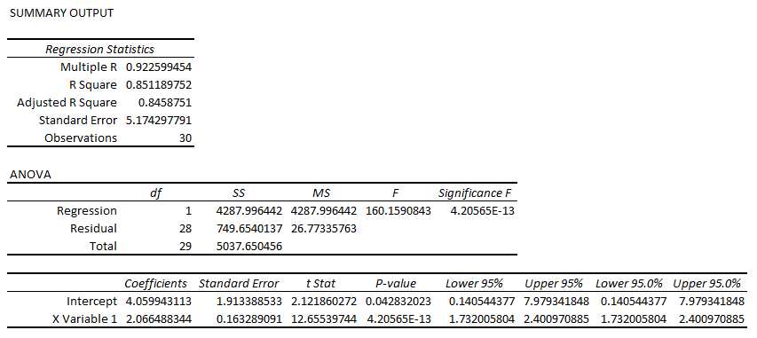
Model Summaries
Regression output provides important information.
Notes:
This is an example of the regression output from Excel’s Data Analysis add-in.
The bottom part of the table is called the ANOVA table, for “Analysis of Variance.”
Much of the information shown here is the same as shown in other tools like R.
They all vary a little bit, but all of the most important stuff is here. It’s a lot to take in but we will dive into only the most important items.
Discussions and interpretations of this information are available in many statistics texts and in many places online.

Slide 19
Model R²
Notes:
Let’s look at the table.
The first thing I want to identify is the R-squared value for the model. This is also called the coefficient of determination.
In simple linear regression, this is one of the most important metrics for your model’s performance.
This value can be thought of as the percent of the variability in the y-values that is explained by the model.
Larger values are better, and the range of values is between zero and one.
In this case, an R-squared value of 0.85 means that the model explains about 85% of the variability in the data.
The value below it is the adjusted R-squared, which becomes valuable in multiple regression. The adjusted R-squared adjusts for the number of terms in the model and is used when there is more than one x variable.
Keep this value in mind when you work with multiple regression models.

Slide 20
Coefficient and p-value
Notes:
Next, let’s look at our regression coefficient. This is the estimated value of beta-one using the least squares equations.
In a good regression, this value is significantly different than zero.
If the coefficient is zero, then the values of the predictor variable don’t matter when predicting the response variable.
The t-test is used to test the difference between the coefficient beta-one and 0. The result of this test is shown in the p-value column.
The p-value states the probability that a coefficient of this magnitude could be different than zero by random chance only.
Alternative p-value explanation: the p-value for each term tests the null hypothesis that the coefficient is equal to 0 (i.e. predictor variable has no effect on the response variable)
A low p-value indicates that you can reject the null hypothesis → change in predictor’s value is related to change in response variable. A small value indicates strong evidence against the null hypothesis (less than a p*100% chance that the null hypothesis is correct). This is termed statistically significant.
On the other hand, a high p-value suggests that changes in the predictor has little impact on changes in the response variable
Note that in this case it is extremely small, which means that the evidence is very strong that the coefficient is not close to zero.
This is good news and means the coefficient is worth keeping in the model.
Normally we choose a level above which we won’t call the difference significant before we start modeling.
Normally we choose a value like 0.05, and if the p-value is greater than this, we don’t consider the coefficient significantly different than zero.

Slide 21
Model F-test p-value
Notes:
One more metric to keep an eye on is the p-value for the model F-test.
The model F-test checks whether the model is significantly better than a model that only has an intercept (no predictor variables).
Small p-values like this reject the hypothesis that an intercept-only model is better.
If you have a significant predictor coefficient, you will almost always find a significant result for the F-test as well.
This becomes more important in multiple regression when you start adding in extra predictors.
However, it is always good practice to check both the coefficient significance level and the model F test significance level.

Slide 22
Standard Error of Regression
Notes:
One final important value to consider in this table is the standard error of the regression, shown below the adjusted R-squared.
This value is the sample estimate of the standard deviation of the error. Small values are better.

Slide 23
Notes:
This is the regression output from R, and it also contains all the important things we’re looking for.
I like that it is a little more concise than the Excel Data Analysis output but still contains everything I am looking for.
The model R-squared is on the lower left, labeled “multiple r-squared.”
The predictor coefficient is in the table labeled “Coefficients”, under “estimate” and next to the predictor name.
The significance level, or p-value, is shown as the last column of the table.
R also uses a little graphical code to show what range of significance level the p-value falls in.
In this case we have three asterisks, which is a p-value between zero and one in a thousand.
The model F-test p-value is in the very lower right, on the last line of model output.
Finally, the standard error of the regression is in the middle of this output, in the first row of the last grouping of output, labeled “residual standard error.”

Slide 24
Summary
Least squares estimation is a technique for finding the parameters of a regression line that minimize its error
Regression output provides several important metrics for evaluating the quality of the fitted model
Notes:
In this section, we discussed constructing a simple linear regression model. Two key points to take away from this video are:
Least squares estimation is a technique used for finding the slope and intercept of a regression line that minimize the error between the line and the data, and
Regression model output provides several important metrics for evaluating the quality of the fitted model.
Next, we will talk about checking model assumptions.

Slide 25
Introduction to Linear Regression
Part III: Checking Assumptions
Avital Breverman, E.I.T.
Slides provided by: Gregory S. Karlovits, P.E., PH, CFM
US Army Corps of Engineers
Hydrologic Engineering Center
Notes:
In this section we will talk about checking model assumptions.

Slide 26
Four Assumptions of Linear Regression
The mean of y_{i} is a linear function of x_{i}
All y_{i} have the same variance σ²
The errors are normally-distributed
The errors are independent
Notes:
Let’s revisit the assumptions that we made in building our regression model.
The first is that the relationship between our variables is linear.
The second is that the variance of the residuals is constant.
The third is that the distribution of the residuals is normal.
Finally, the fourth assumption is that the errors are independent.
Not all these assumptions are equally important nor have equal impacts on the validity of our model.

Slide 27
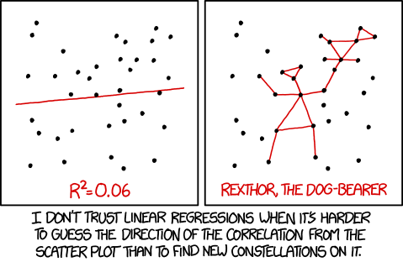
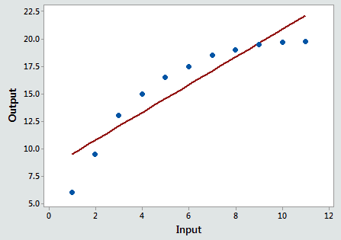
Consequences of Assumption Violation
Biased estimates
Incorrect estimate of uncertainty
Incorrect estimate of significance
https://blog.minitab.com/en/adventures-in-statistics-2/curve-fitting-with-linear-and-nonlinear-regression
Notes:
There are three major consequences to violating the assumptions we made.
First and foremost is that our model can end up being systematically wrong, that is, biased, in one direction or another.
This goes for the estimates of the intercept and coefficient, as well as the residual variance.
The other two consequences affect model confidence and prediction intervals, but also tests of significance for the model as well.
In some cases, the impact of these violations is pretty obvious.
In the plot on the right, the data are clearly not linear, so any estimate based on the linear model is going to be wrong, especially when used outside the range of the data. However, it’s not always this obvious.
Luckily, there are tools that make it simple to check our assumptions.
Three of the four assumptions can be straightforward to fix, with the fourth assumption (independence of errors) a bit more challenging.
Let’s look at a set of tools provided by default in R that let us check these assumptions.

Slide 28
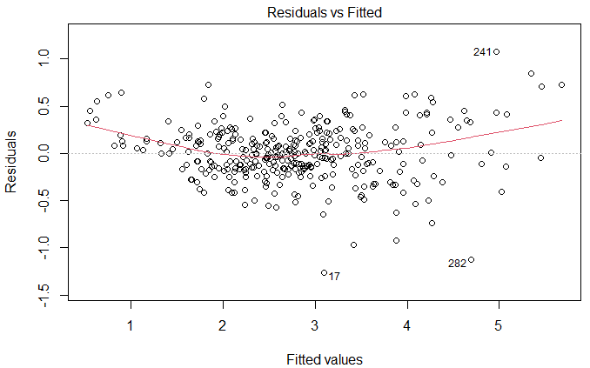
Linearity
Notes:
This plot of residuals vs. fitted values helps us check linearity. Any systematic pattern that appears in this plot is a sign that there is a deviation from linearity in the data.
Each point is plotted as the fitted value on the x axis and the residual for that fit on the y-axis. The red line is a smoothing line meant to make patterns easier to see.
This plot for a model with good linearity will show a random scatter of points around the value y = 0 with no trend in the points. The red line will be close to the y = 0 line.
In this case, we see that there is curvature in the points, highlighted by the upward curvature of the red line.
This systematic pattern is a sign that these data are probably not linear.
When this occurs, the first thing we try to do is transform the data.
Transformations involve using a monotone function like square root, logarithm, and so on, on the variable and then using the transformed variable in the regression.

Slide 29
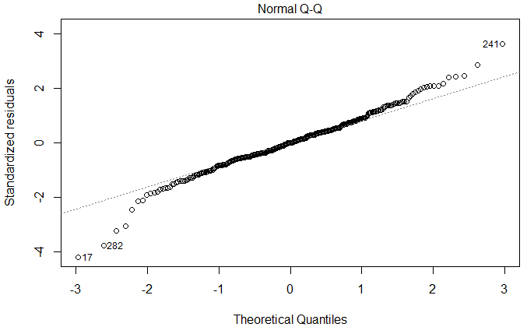
Normal Residuals
Notes:
Recall the normal quantile-quantile plot from exploratory data analysis.
A normal quantile-quantile (or Q-Q) plot helps us identify if the residuals are normal or not.
Data with a normal distribution will fall neatly along the dotted line in the plot.
Non-normal data will deviate in any number of ways as we saw in the discussion in exploratory data analysis.
These data seem to behave well enough within about 1.5 to 2 standard deviations of the mean, but then have curling in the tails that seem to indicate that the residuals have heavier tails than the normal distribution.
There are typically two options for dealing with non-normal residuals. The first, and preferred option, is to take transformations of the variable so that it becomes normally-distributed and continue with simple linear regression.
If this can’t solve the problem, often the solution is to use a more robust method like generalized linear models, which is beyond the scope of this discussion.

Slide 30
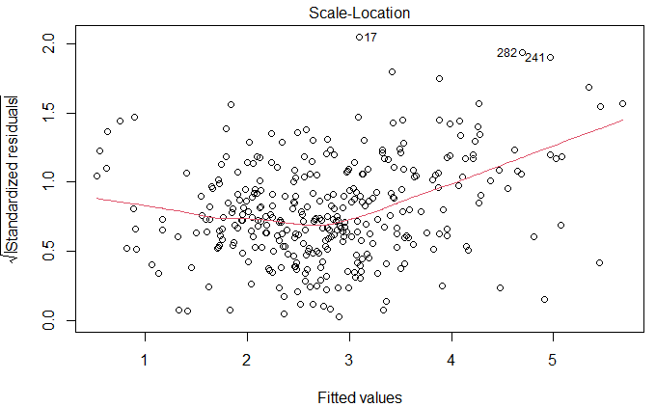
Constant Variance: Scale-Location Plot
Notes:
The scale-location, or spread-location, plot is one way to identify if the residual variance is constant with respect to x.
This uses a transformation of the residuals plotted against the fitted values to help identify if the variance is changing.
It is shown with a red smoothing line to help see patterns. They key here is to see if the red line is increasing which implies heteroscedasticity.
No pattern would be indicated by a relatively flat red line. This example shows potentially increasing variance towards the right side, as shown by the slope of the red line.

Slide 31
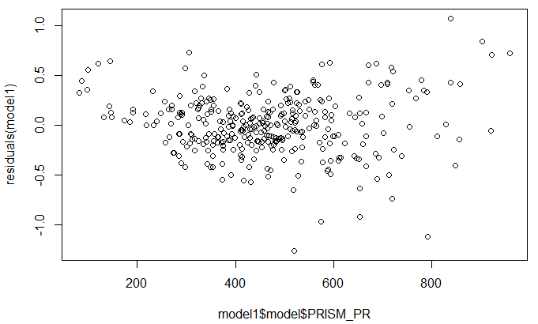
Constant Variance: x vs r_{i}
Notes:
Another way to look at the constant variance assumptions is to plot the residuals against the x-values and to check the pattern.
Non-constant variance appears as an increasing scatter in the points as the x-variable increases.
This often results in a plot like this where the shape of the residuals cloud is like a cone or a sideways parabola.
I added in the red lines so you can see the general shape that indicates that there is a problem.
The increasing spread on this plot is the same as the upward sloped line on the last plot.
When the residuals aren’t constant, we have the same options as when the residuals aren’t normal.
First, we try transformations of the x, y, or both variables, and see if the residual behavior improves.
If transformations can’t fix the problem, then we must turn to heavier machinery like generalized linear models.

Slide 32
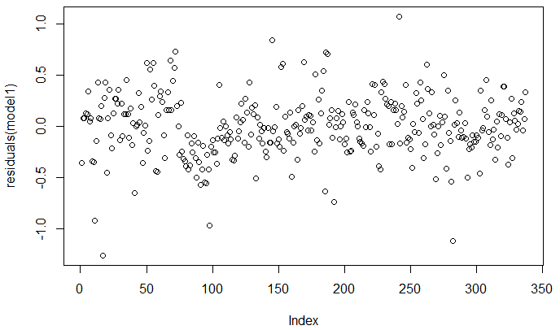
Independent Residuals: Run Sequence
Notes:
Another tool from exploratory data analysis we can use to check our regression is the run sequence plot.
Recall that we can create a run sequence plot simply by plotting the residuals in the order they were observed (the x value is just the index.)
Any systematic pattern or trend in the run sequence plot is an indication that the residuals may not be independent.
In this case there is a small systematic pattern, like a small wave, in the first quarter of the plot.
It is more likely that this is due to the non-linearity we saw in the residuals vs. fitted plot, than it is due to dependence.

Slide 33
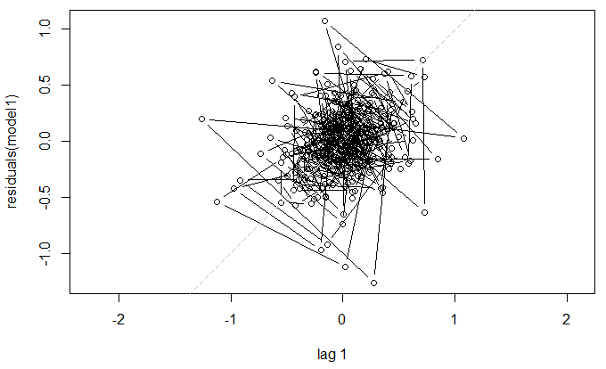
Independent Residuals: Lag Plot
Notes:
We can also use the lag plot from exploratory data analysis to evaluate the independence.
Recall that you can create a lag plot by taking a sequence of values and plotting it against the shifted values.
In other words, plot x1 vs. x2, x2 vs x3, x3 vs x4, and so on.
If the points cluster along the diagonal, or look linear, then there is probably some dependency.
If there is more of a scatter-shot cloud like this, then there is not strong evidence for dependence.
When the residuals are dependent, the solution is not easy. Often this involves using a much more complex model in order to capture the serial correlation. Such models are beyond the scope of this discussion.

Slide 34
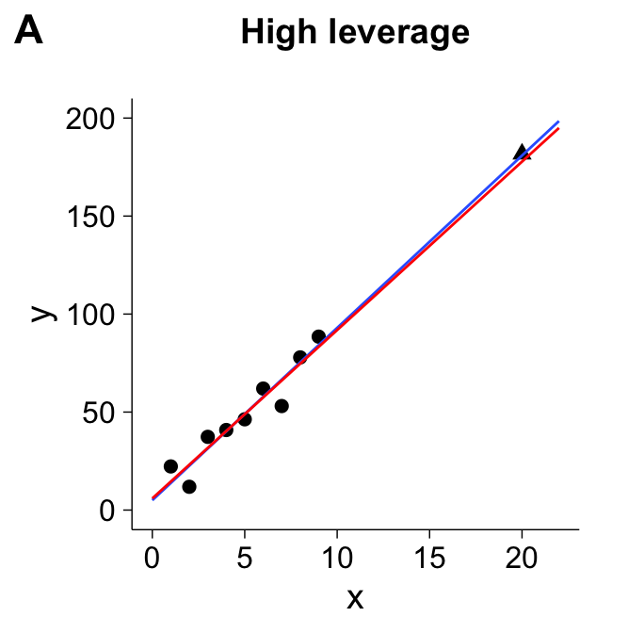
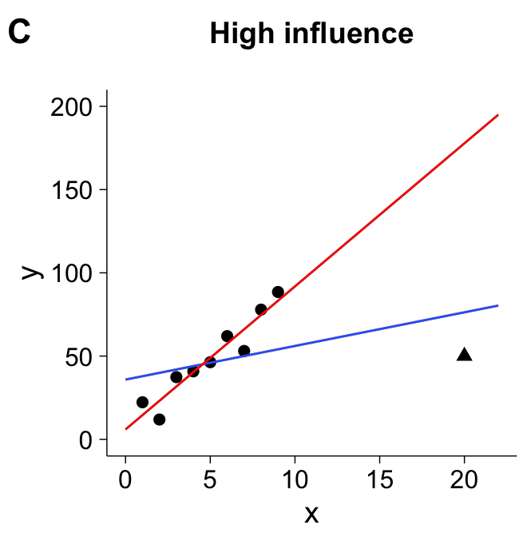
Leverage and Influence
Notes:
Leverage and influence aren’t so much of a check of assumption as they are a model quality question.
Data with an extreme x or y or x and y values can have disproportionate influence on a regression.
This typically happens when an observation is extreme in x and/or y and doesn’t follow the pattern of the remainder of the points.
Least squares estimation is not robust to this situation and will attempt to fit the line through that observation because it is influential.
An observation is said to have high leverage if it is far away from all of the other points.
However, if it follows the general trend of the other points, it may have high leverage but low influence; that is, removing it would have a small effect on the model results.
The plot on the right shows a point that is influential – the result would change vastly if the extreme point were removed.
It is important to identify these values and treat them appropriately because they can make or break your entire analysis. You don’t want one influential observation making up your entire model.

Slide 35
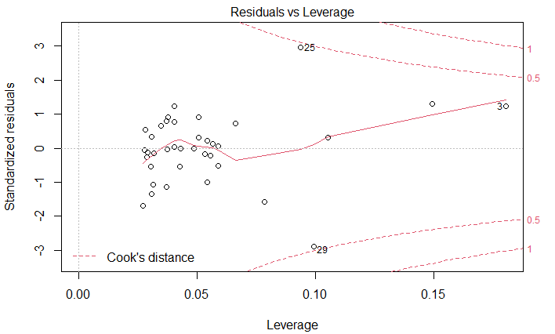
Leverage and Influence
Notes:
One additional diagnostic worth discussing is a leverage plot.
The least-squares estimates are not resistant to big outliers, and they can have a disproportionate influence on the result of the regression.
The leverage plot is created by plotting a data point’s leverage (its distance from the rest of the data) and also its residual value.
The combination of a large leverage and large residual means a large influence.
Contours of constant influence, measured by a metric called Cook’s distance, are shown in dotted red.
Values worth checking have a Cook’s distance that is much larger than the others.
In this case we have a few observations with larger Cook’s distances, but the top two have a value of about 0.5 and there are others with values close to that, which is less concerning.
If you identify influential observations, you can try the regression without the point included and see how much the result changes.
If it does not change significantly, then there isn’t likely to be a problem.
If it does change significantly, you might need to consider changing the structure of your model, or diving into the problematic observation a little bit more.

Slide 36
Summary
We have a responsibility to check that our model does not violate the four key regression assumptions
We also want to check to make sure none of our data are concerningly influential
Notes:
In this section, we discussed checking model assumptions. Two key points to take away from this video are:
We have a responsibility to check that our linear model does not violate the four key regression assumptions that we covered previously, and
We also want to check to make sure that none of the data used to fit the model are concerningly influential.

Slide 37
Introduction to Linear Regression
Part IV: Making Predictions
Avital Breverman, E.I.T.
Slides provided by: Gregory S. Karlovits, P.E., PH, CFM
US Army Corps of Engineers
Hydrologic Engineering Center
Notes:
In this last section, we will talk about making predictions using linear models.
We ultimately use linear regression for making predictions (like most modeling applications).

Slide 38
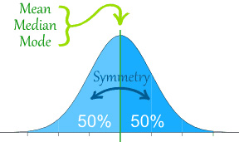

Best Estimate for a Single Value
The least-squares line is the best-estimate of Y* | X = x*
The most likely value of $Y^{∗}=β_{0}+β_{1}x^{∗}$
https://dietassessmentprimer.cancer.gov/learn/distribution.html
Notes:
Prediction is one of the payoffs for building a regression model.
In many applications, the most important value is the best estimate for a new Y, labeled Y*, given some new value of x, labeled x*.
Consider the following example from a topic we’ve already seen.
In regional skew studies, a regression model is sometimes used to estimate the coefficient of skew for flow frequency distributions over a large number of sites.
Then, the model can be used to estimate the skew coefficient for a new site that was not included in the study.
If the regression model uses drainage area above the gage in square miles as the predictor, then to estimate the skew coefficient for the basin you would take that basin’s drainage area, put it into the least-squares line as x*, and then get a value of Y*, which is the best-estimate of the skew coefficient for that basin.
This is the most likely value of the skew coefficient for that basin given the model we built.
We can say that this is the most likely value because of the distribution of the error terms, and the conditional distribution of Y | X.
We have assumed, and checked, that the errors are normally-distributed.
The normal distribution has a mode, or most likely value, at its mean.
We know that the errors have a mean of zero, so the most likely value from the model occurs when the error is zero.

Slide 39
Two Types of Inference
Estimation: what is the mean response for the population of all data with a predictor of x*?
Confidence interval
Prediction: What is the response of this specific outcome when its predictor is x*?
Prediction interval
Notes:
We know that according to the distribution of the residuals in our model that the error in predicting with the model should be close to zero.
However, the model still contains uncertainty, because unless our model R² is 1, there is still unexplained variability in our response variable.
There are two things we are often interested in understanding once we have fit and checked our model.
The first is the question of estimation.
This asks, “what is the mean value of the response variable Y for the entire population that has a predictor value of x*?”
We are uncertain about the true value because of uncertainty in the model parameters.
We talk about a range that contains the true value some percentage of the time, and refer to that as a confidence interval.
For example, we might say that the range 2.5-5.5 contains the population mean for a predictor value of 10, 95% of the time.
This would be the 95% confidence interval for the population mean given x* = 10.
The second question is that of prediction.
This asks, “what is the response of this specific outcome when its predictor is x*?”
We are uncertain about the true value because of uncertainty in the parameters in our model, but also the residual error.
Again, we provide a range that contains the true value some percentage of the time, but in this case, refer to it as a prediction interval.
For example, we might say that the range 1.1-7.8 contains the true value of Y for a predictor value of 10, 95% of the time.
This would be the 95% prediction interval for the response given x* = 10.
Typically, the prediction interval is the more useful of these two intervals, because we are usually more interested in the uncertainty in predicting a single outcome, than we are in the population mean at a specific value.

Slide 40
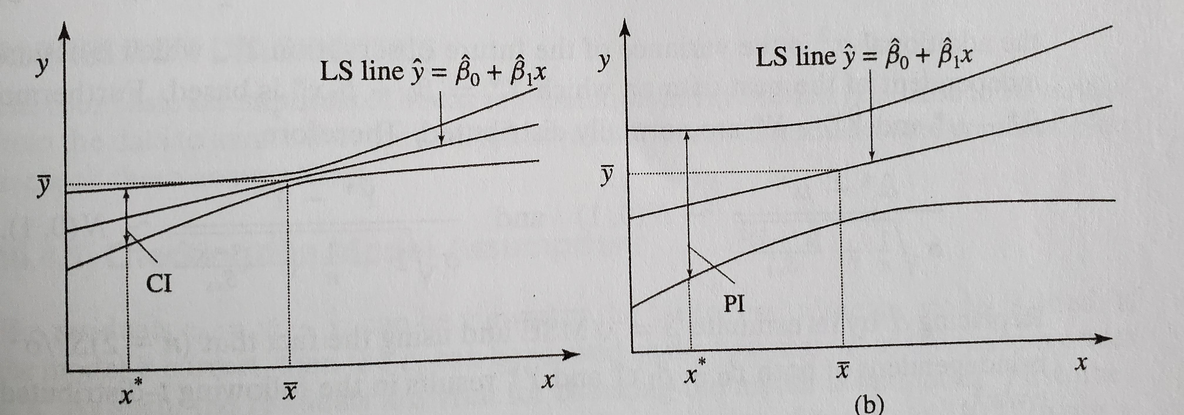

Confidence Interval
Gives precision in the estimate of $μ^{∗}=E\left[Y^{∗}|X=x^{∗}\right]$
Caused by the error in estimating β₀ and β₁
Notes:
The confidence interval tells us how precise our estimate is of the mean response.
We usually choose some significance level, for example 5%.
For the selected significance level, the corresponding width of the confidence intervals contains the true population mean with a probability of one minus that significance level, in this case 95%.
There is uncertainty in the mean response because of imperfect estimation of the regression coefficients.
On the left is an example of how the confidence intervals around a least-squares line looks.
This shows the precision, or confidence, in our ability to estimate the mean response for any x*.
Note that the intervals get the narrowest at x* equal to the mean observed value of x, and flare out from there.
Note that this only talks about the uncertainty in the mean of the estimate, not about the range of hypothetical values that might occur.
It is less sensitive to the assumption we made previously that the errors are normally distributed, because we are not considering the residual error.

Slide 41

Prediction Interval
Gives precision of $Y^{∗}|X=x^{∗}$
Caused by the error in estimating β₀ and β₁ and the residual error
Notes:
The prediction interval gives a sense of precision on some yet-to-be observed x*.
It is affected not only by uncertainty in the coefficients for the line, but also because the residual error comes into play as well.
Recall that the full regression equation contains not only the least-squares line but also the additive error term on the end.
The plot on the right shows the prediction interval for all x*.
What you can see is that it minimizes at the mean of x and expands outward from there.
Note that in comparison to the confidence intervals on the left that the prediction intervals are much wider.
This is because the first one does not include residual error, but the second one does.
It is more sensitive to the assumption we made previously that the errors are normally distributed, because the residual error is now included.

Slide 42


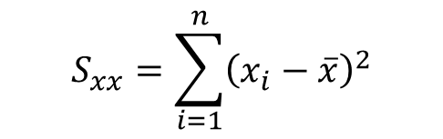
Computing Intervals
Confidence interval
$$μ^{∗}±t_{n−2,α/2}s\sqrt{\frac{1}{n}+\frac{{\left(x^{∗}−\overline{x}\right)}^{2}}{S_{xx}}}$$
Prediction interval
$$Y^{∗}±t_{n−2,α/2}s\sqrt{1+\frac{1}{n}+\frac{{\left(x^{∗}−\overline{x}\right)}^{2}}{S_{xx}}}$$
$${\hat{Y}}^{∗}={\hat{μ}}^{∗}=β_{0}+β_{1}x^{∗}$$
$$S_{xx}=\sum_{i=1}^{n}{{\left(x_{i}−\overline{x}\right)}^{2}}$$
Notes:
Here are the equations for computing the confidence interval and prediction interval. I want you to get a conceptual feel for these, because in practice software like R will compute these for you.
They are similar with one key difference.
The intervals are centered at the same value, which is the value of the least-squares line at x*, except we interpret these intervals differently and use a different symbol to represent where the center of the interval is.
What I want to bring to your attention are t, and the form of the expression under the radical.
The t-value is a critical value t-statistic for the selected significance level.
You will choose how wide of an interval that you want in terms of a percentage, for example, 95% coverage.
Then, based on the sample size n, you will consult your trusty t-table and find the associated t-statistic.
This sets how wide the interval will be based on your selected coverage.

Slide 43
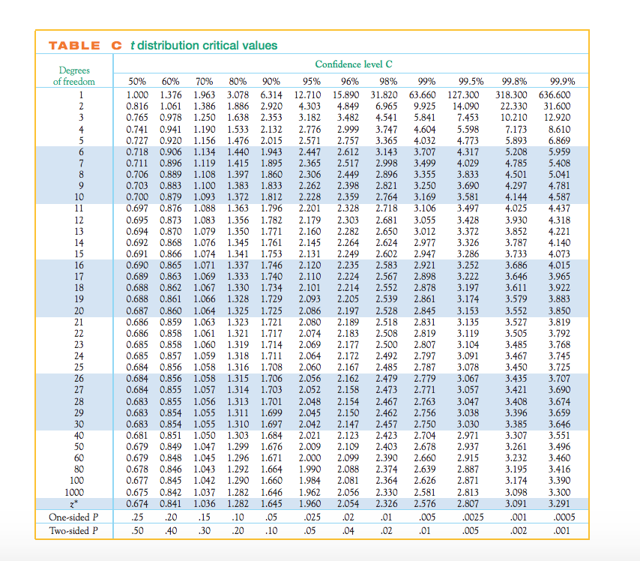
T-table
https://media.cheggcdn.com/media/724/724b3c64-a23f-499d-849d-e8ebfee1afcf/phpglNTAC.png
Notes:
Nowadays we usually use software to compute this for us, but many of us have spent years looking at the tables in the front or back of our statistics textbooks to go hunting for our t-values.
Let’s assume our selected confidence level is 95%, and our model sample size is 9.
Our number of degrees of freedom is 7, because we lose one each for estimating the intercept and coefficient of the model (n – 2 = 7).
This means we are looking at the 6th column of this table.
Our t-value is 2.365.

Slide 44
Computing Intervals
Confidence interval
$$μ^{∗}±t_{n−2,α/2}s\sqrt{\frac{1}{n}+\frac{{\left(x^{∗}−\overline{x}\right)}^{2}}{S_{xx}}}$$
Prediction interval
$$Y^{∗}±t_{n−2,α/2}s\sqrt{1+\frac{1}{n}+\frac{{\left(x^{∗}−\overline{x}\right)}^{2}}{S_{xx}}}$$
$${\hat{Y}}^{∗}={\hat{μ}}^{∗}=β_{0}+β_{1}x^{∗}$$
$$S_{xx}=\sum_{i=1}^{n}{{\left(x_{i}−\overline{x}\right)}^{2}}$$
Notes:
Now let’s look at what makes these two intervals different.
The key difference is underneath the radical.
The confidence interval does not have the 1, but the prediction interval does.
The impact of this is that the prediction interval will always be wider, because there is more uncertainty associated with predicting a random variable than with estimating a fixed parameter.
The population mean is a fixed parameter.
The outcome of Y* for a given x* is a random variable.

Slide 45
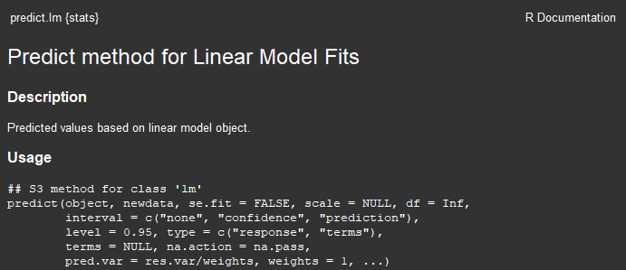
In Practice
Use the R predict.lm function
Notes:
Normally when we are modelling we are in an environment that makes prediction straightforward. In R, once you have your model fit to some data and you’ve checked your assumptions, you can make predictions by passing your fitted regression model to the “predict” function.
The predict function takes an extra parameter called newdata, that asks you where you want to make the predictions. It also lets you set what kind of interval you want, with “none” providing the best-estimate. It lets you set the significance level as well, although the default value of 0.95 is generally fine to use. There are several other options that you can accept the defaults on.

Slide 46
In Practice
Notes:
Here is the function in action.
Don’t worry if you aren’t familiar with R yet, the workshop on this material will give you time to learn how some of these R functions work.
The first is an example of the prediction interval.
The name of our model fit object is “model1”, and then we give it a data frame with a new value for our predictor value.
The new value is 1000, so the predictions will be made at x* = 1000.
We ask it for the 95% prediction interval, remembering that the default value is 95%.
The result has three values: the fitted value or best estimate, the lower prediction interval, and the upper prediction interval.
Then for comparison’s sake, we also ask it for the confidence interval at x* = 1000.
Note how everything else is the same, except we switch the interval argument to “confidence.”
The result is printed on the next line.
Note how much narrower the interval is. We haven’t switched the confidence level for this, it is still 95%, but remember that the confidence interval will always be narrower than the prediction interval.

Slide 47
Summary
Once a model has been fit and checked, it can be used to make several types of inferences
Best estimate of a response given a predictor
Confidence interval of the population mean given a predictor
Prediction interval of a response given a predictor
Notes:
In this video, we discussed making predictions using linear models. The key points to take away from this video are:
Once a model has been fit to data and checked, it can be used to make several types of inferences:
We can make a best estimate of a response variable given a value of a predictor variable;
We can estimate the confidence interval of the population mean for a response given a value of a predictor variable; and,
We can estimate the prediction interval for a yet-unseen response given a value of a predictor variable

