Slide 1
Data challenges – missing data, low or high values, and historical/paleo information
Lecture 7
Flood Frequency Analysis
Beth Faber, PhD, PE
Hydrologic Engineering Center

Slide 2
Goals
To be aware of the data challenges we’re likely to encounter in frequency analysis
To understand how “challenging data” can impact the resulting frequency curve
To discuss former (17B) and current (17C) methods for handling these issues to produce robust estimates
do well, even when assumptions are wrong

Slide 3
Outline
Missing values (broken record)
Censored values, zero flows, outliers
  low flows (PILFs)
  high flows
Historical/Paleo information
Missing values (broken record)

Slide 4
Broken Record
Two or more periods of systematic record separated by unobserved periods
Periods can be combined and analyzed as a single record
  if we have absolutely no information about the unobserved years, they are treated the same as years before or after the systematic record
If we have some information, such as knowing flows are below a threshold, EMA lets us use that non-exceedance information…
1924
1970
1979
2010

Slide 5
The gage record is missing the years 1980 – 1988
Combine data into a single record for analysis
Define a non-exceedance threshold for the missing years
OR
B17B
B17C
Threshold T
Q ≤ T
Or, define perception range as (∞, ∞)
Notes:
Sometimes the gage is out of service causing missing years. If there were known to be relevant flow values (floods) during that time, they should be investigated. But if nothing is known, B17B just closed the record around those years to make a single record of before and after.
The same result can be achieved with B17C by assuming a perception threshold range of infinity to infinity. But if you can say that large events would have been noted, and define a perception threshold, can use a flow range for the missing years.

Slide 6
Outline
Missing values
Censored values, zero flows, outliers
  low flows (PILFs)
  high flows
Historical/Paleo information

Slide 7
Censored Records:
Flows above or below recording level of gage
Some gages have a lower bound (and/or upper bound) of channel stage that can be measured
  Flows/stages that are below the lower bound (or above the upper bound) are referred to as censored values – unable to measure
Unobserved historical flows are also “censored”
  There can be evidence in the watershed that some threshold was exceeded, or knowledge it wasn’t
Though flows are not measured, knowing they were above or below a threshold is valuable info in estimating the flood distribution
censored
adjective
Notes:
This slide describes CENSORED as an adjective – they are flows whose values are not known precisely, though some information might be available.

Slide 8
Outliers: values notably different from the rest of the data
verb
Low Outliers are censored
analysis excludes the values, but not the fact they occurred
B17B used Conditional Probability Adjustment
B17C uses intervals for excluded values
High Outliers are NOT censored
high values are left in the data set
seek historical information to either add a past large event, or determine that the largest gaged event has a longer return period (is the largest in a longer period of time.)
B17B used Weighted Moments Algorithm
B17C uses intervals for unobserved years
B17B used Grubbs-Beck test for high and low outlier thresholds
B17C uses Multiple G-B
test
Notes:
Outliers are values that are notably different from the rest of the data. B17B used a Grubbs-Beck test for both high and low outliers.
Here, CENSORED is a verb, ie to specify some years as censored means to acknowledge they occurred but not use their precise value in computation.
Low outliers are censored in this way. High outlier are not – they simply prompt the analyst to seek historical or paleo data. In Bulletin 17C, the concept of high outliers is not present, and historical data should always be sought.

Slide 9
Umpqua River @ Elkton, OR
1906 – 2012, 107 years
Notes:
Here is the empirical distribution from plotted annual maximum points for a 107 year record in Oregon.

Slide 10
Umpqua River @ Elkton, OR
1906 – 2012, 107 years
when skew < 0, LP3 has an upper bound
upper end of curve does not make sense, given the data
Notes:
The LP3 estimate is not only a bad fit, but it will reach an upper bound that is below the largest value. (A negatively skews LP3 distribution has an upper bound. A positively skewed LP3 has a lower bound.)
The problem is that the low values cause a negative skew, which pulls down the high end of the frequency curve as well. A probabilistic model that says the largest event could not have happened is not a good model.

Slide 11
Umpqua River @ Elkton, OR
1906 – 2012, 107 years
Grubbs-Beck low outlier threshold finds 2 low outliers
B17B used Conditional Probability Adjustment
Default GB
Low Outlier Threshold
Notes:
The GB test finds 2 values below the computed low outlier threshold. Censoring them (not using their precise values) increases the skew and raises both upper and lower tails of the frequency curve.

Slide 12
Umpqua River @ Elkton, OR
1906 – 2012, 107 years
Might choose to identify a third low outlier…
Low Outlier Threshold
Notes:
But why are these values low outliers? Are they a different flood type, or maybe not a flood at all? Hydrologically, might choose to also include the similar flow and censor 3…

Slide 13
Umpqua River @ Elkton, OR
1906 – 2012, 107 years
Bulletin 17C / EMA fit to LP3 distribution
Multiple Grubbs-Beck Test Threshold
Flow interval is
0 – MGB threshold
Notes:
Bulletin 17C has a new test that is more aggressive, and it censors at a higher level. Though engineering judgement is still needed.

Slide 14
Any Censored Values
Values below a recording level are censored, by definition
  but must be incorporated in the estimate of the flood frequency distribution – ie, they happened, flow was low
Flood years with zero flow
  log(0) is undefined, handled as censored low flows
Low-outliers intentionally censored and accounted for the same way
In B17B, used the Conditional Probability Adjustment to deal with all of these cases
In B17C, these cases are handled with flow intervals

Slide 15
Dealing with ZERO FLOW
Graphical Curve, zero flows no problem. Frequency of non-zero values based on rank.
zero flows
Notes:
Zero flows are a problem with a log distribution because the parameters are based on log of flow, and the log of zero is undefined.
Defining the curve graphically would not have a problem with zero flows, because they would not affect the fit at the top, which is dependent only on plotting positions of the larger data points.
But an analytical distribution fit must account for all the data points. So the zero flows are treated as if they were censored flows.

Slide 16
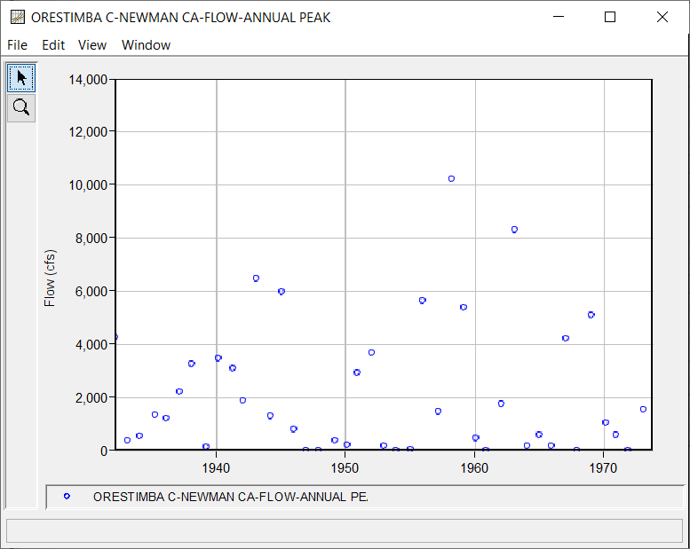
Orestimba Creek @ Newman, CA

Slide 17
Dealing with Zero flows
Graphical Fit
Adding small increment to flows
  does not work well
  standard deviation and skew are sensitive to small values (deviations from mean are squared or cubed)
Use a different distribution (no log transform).
Conditional Probability Adjustment (B17B)
Expected Moments Algorithm, replace with intervals (B17C)
Maximum likelihood

Slide 18
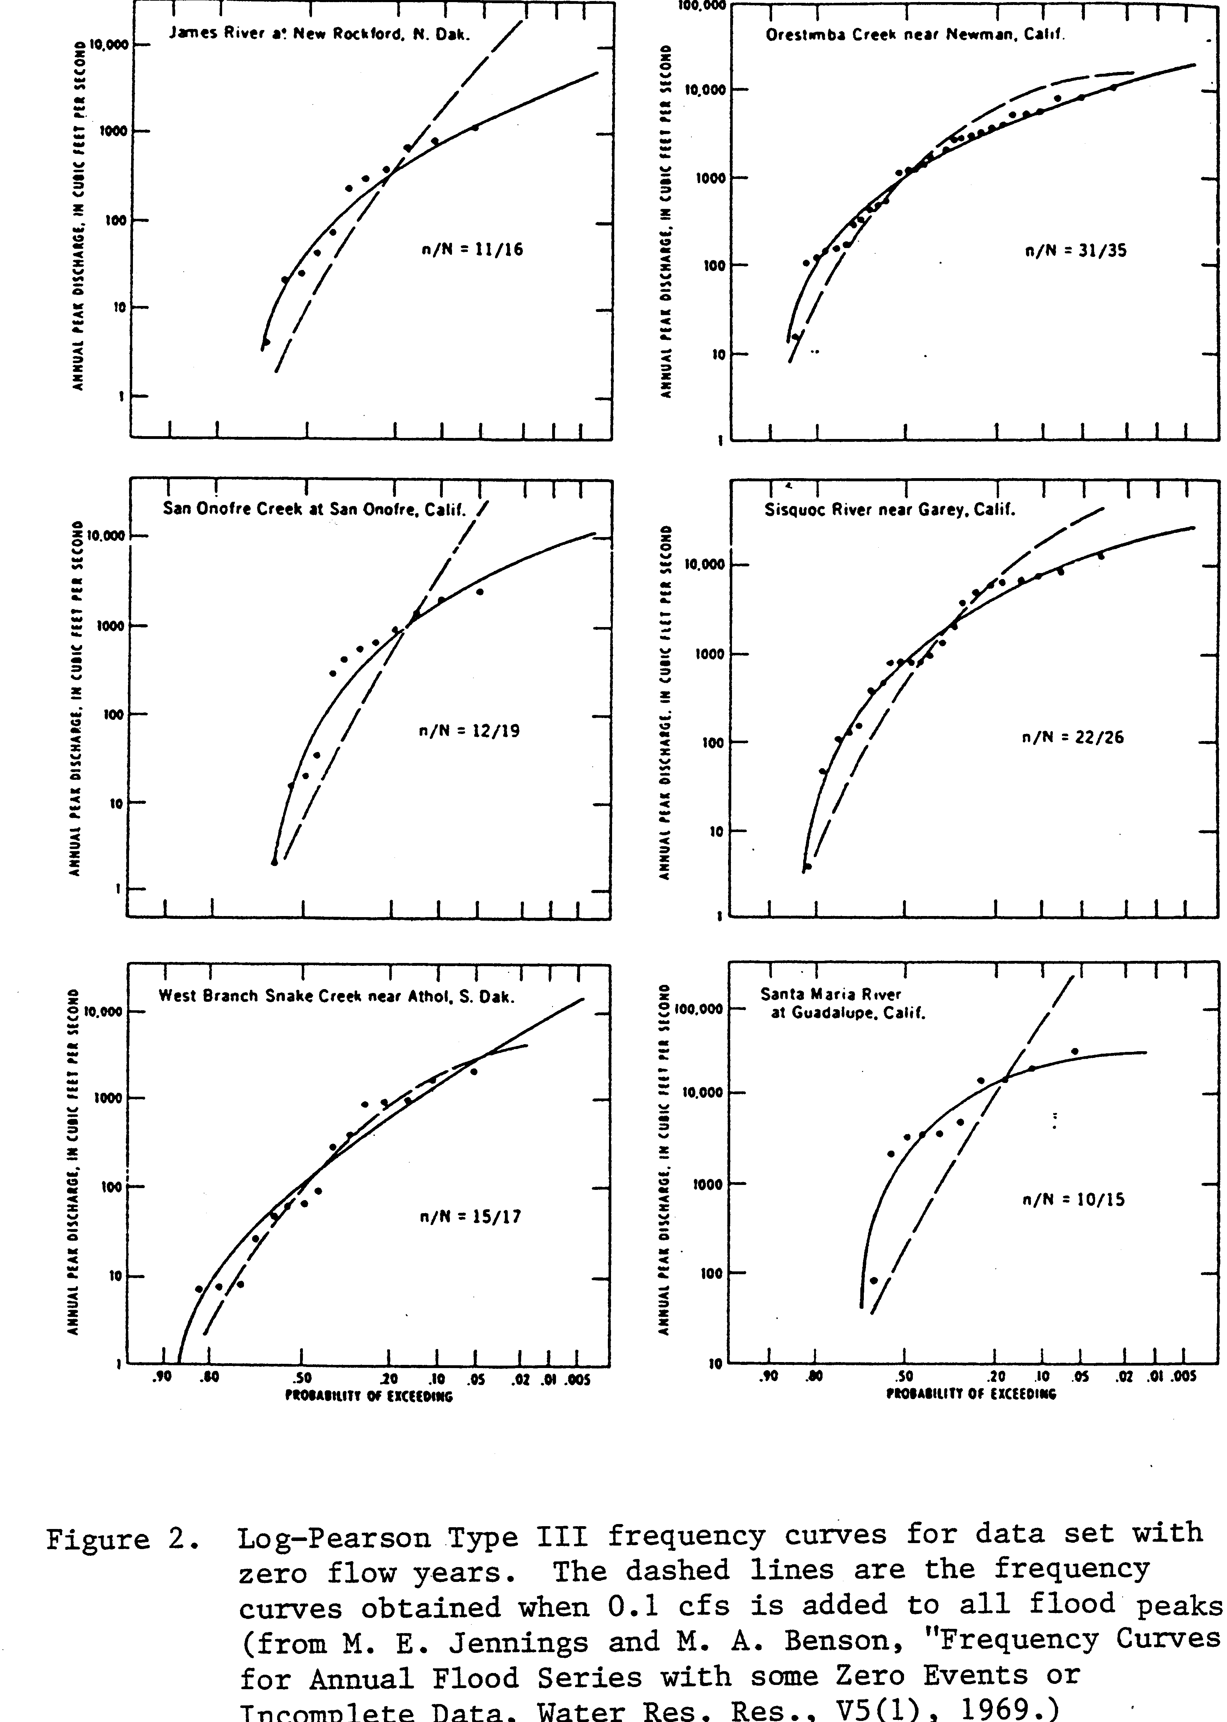
Increment to Zero Flow vs Conditional Probability Adjustment
Figure 2.
Log-Pearson Type III frequency curves for data set with zero flow years. The dashed lines are the frequency curves obtained when 0.1 cfs is added to all flood peaks (from M.E.Jennings and M.A.Benson, “Frequency Curves for Annual Flood Series with some Zero Events or Incomplete Data, Water Resources Res. V5(1). 1969.)

Slide 19
Conditional Probability Adjustment in 17B
Synthetic Statistics are used to estimate LogPearsonIII curve
Notes:
Bulletin 17B used a method called the conditional probability adjustment for accounting for censored flows. This curve results from just censoring the zeros.
The conditional probability adjustment have several steps.
Fit an LP3 frequency curve with the non-censored data
Adjust the probability of each flow value based on the ratio of data points included to total data points. For example, if 35 of 43 points were included, a probability of 3/35 should more correctly be 3/43, and so all probability values were multiplied by 35/43 to correct.
The new frequency curve with adjusted probabilities is not LP, so the parameters of the LP3 are estimated with equation for “synthetic statistics”
The synthetic statistics were based on Q(50%), Q(10%), and Q(1%), so the top half of the frequency curve, which is more important than the bottom.

Slide 20
Conditional Probability Adjustment in 17B
censoring 1 more increases skew
Notes:
The frequency curve changes to the solid from the dashed line when also censor the extremely low value. Removing the low value raises the skew, and so raises both top and bottom of the curve.

Slide 21
Conditional Probability Adjustment in 17B
censoring next group decreases standard deviation
Notes:
Censoring a few more low values to produce the solid blue line decreases the standard deviation, fitting the upper end more closely to the plotted points.

Slide 22
range = 0 – lowest remaining value
using Bulletin 17C / EMA and Multiple Grubbs-Beck test to fit LP3 to the same data
Notes:
The multiple Grubbs Beck test in EMA censors even more values, replacing them with flow ranges.

Slide 23
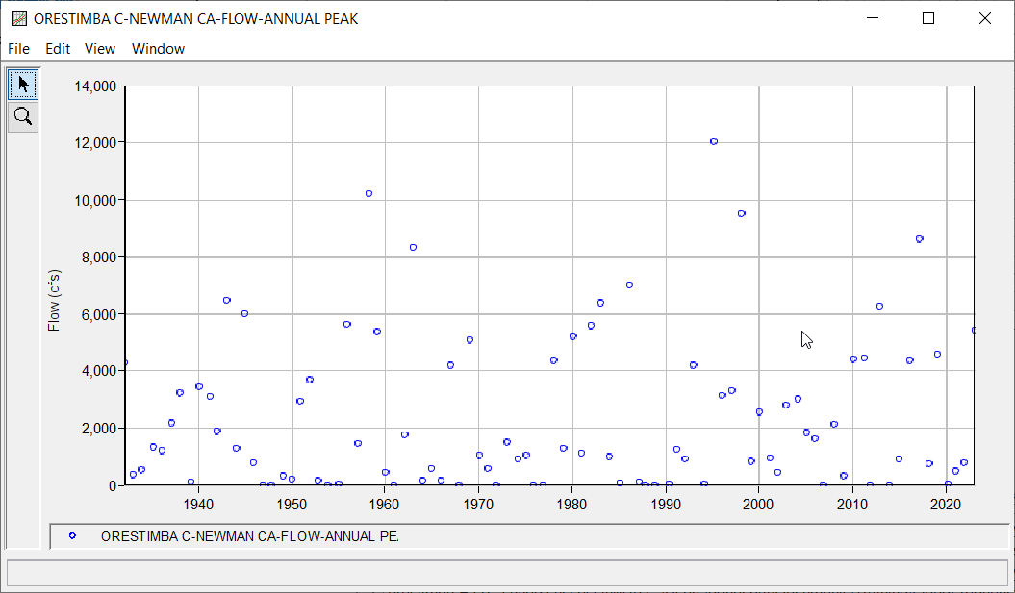
Orestimba Creek @ Newman, CA

Slide 24
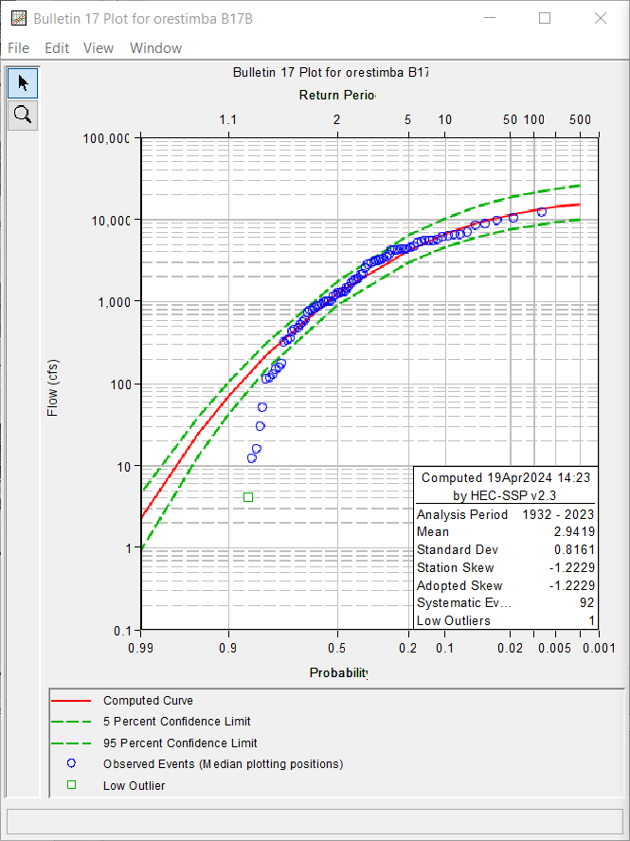
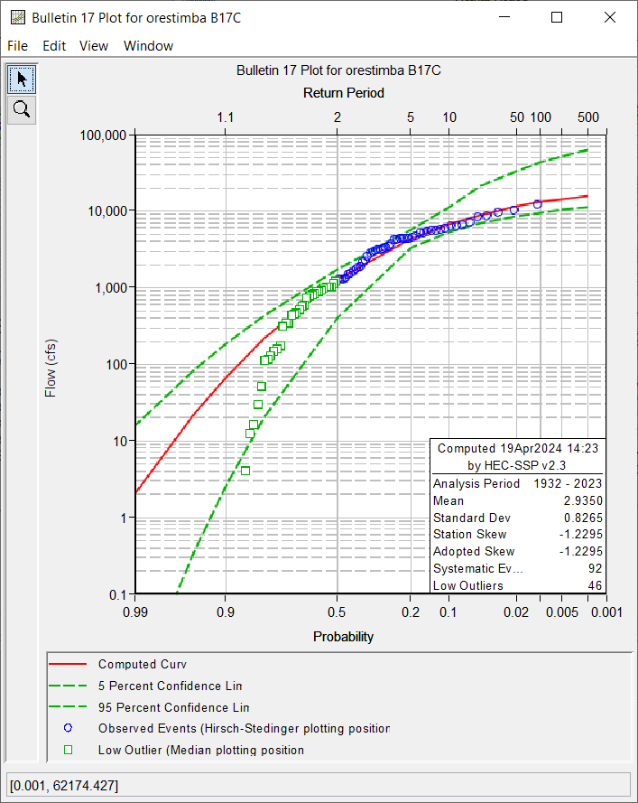
B17B

Slide 25
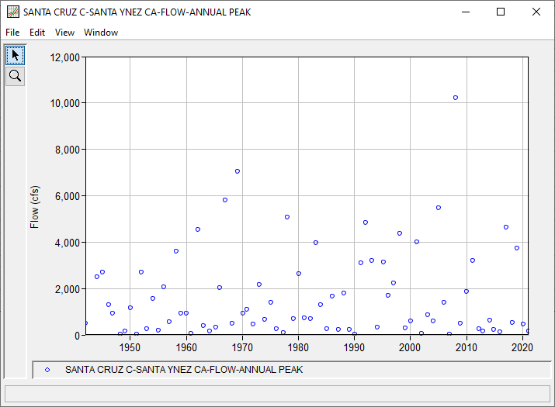
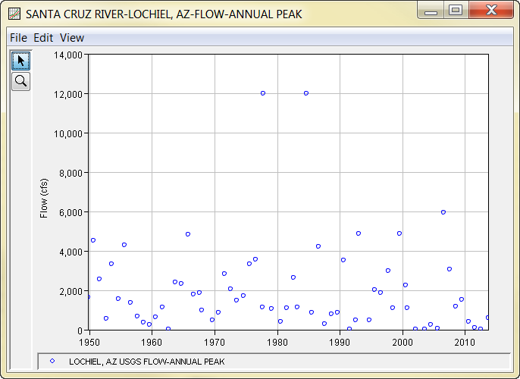
Another Example: Santa Cruz CREEK, CA
Notes:
The Santa Cruz Creek at Santa Inez is another interesting example.

Slide 26
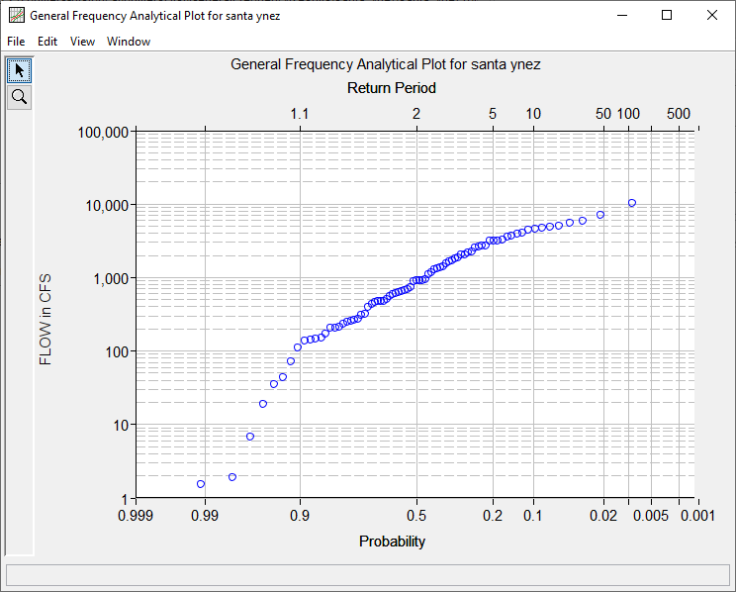
Another Example: Santa Cruz CREEK, CA
Notes:
This figure is the empirical distribution of just the annual maximum flows versus plotting positions.

Slide 27
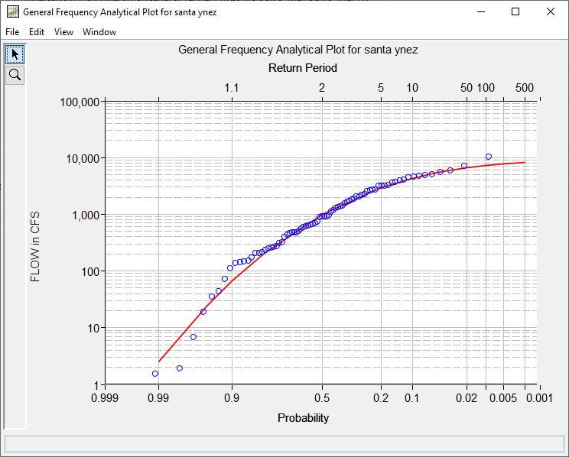
Another Example: Santa Cruz CREEK, CA
very negative skew, upper bound, largest value couldn’t happen
Notes:
This example is another that the upper end of the frequency curve doesn’t make sense. The upper bound of the negatively skewed distribution is below the two highest values. Clearly more low values must be censored to produce a distribution (model) that does make sense for the data.

Slide 28
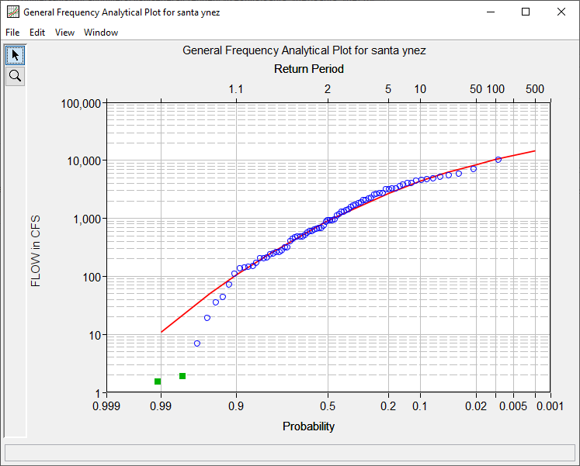
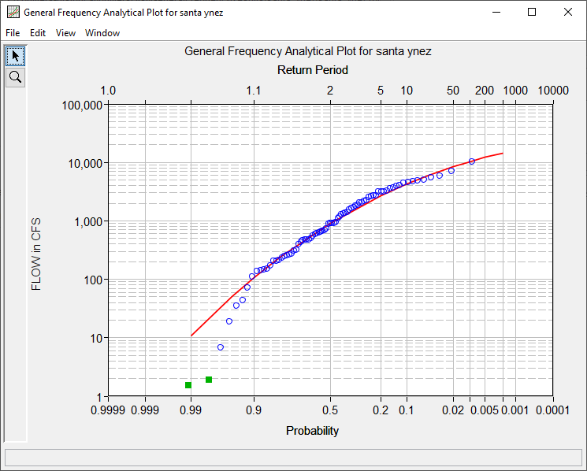
Another Example: Santa Cruz CREEK, CA
GB outlier threshold
Notes:
With the Grubbs-Beck test outlier threshold, two outliers are censored, and a sensible frequency curve results.

Slide 29
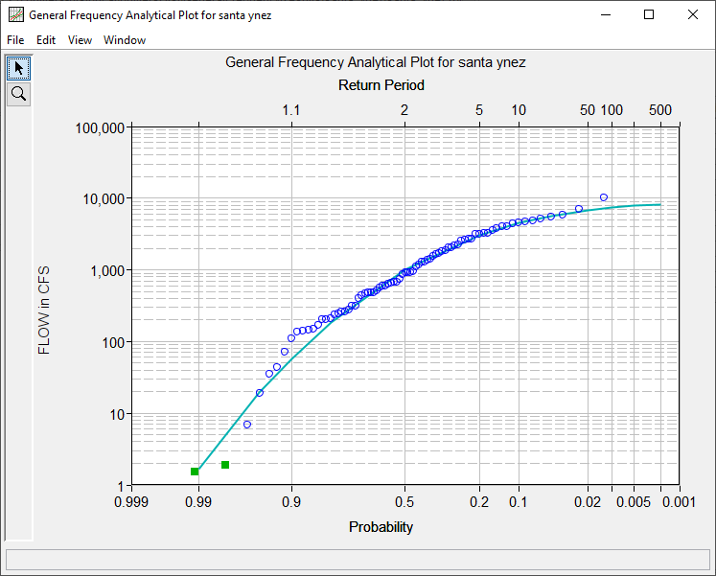
Another Example: Santa Cruz River
EMA fit of LP3
GB outlier threshold
Notes:
Using the same threshold choice to censor the lowest 2 values does not work as well with an EMA fit of LP3. EMA is much more sensitive to the values of the remaining low values.

Slide 30
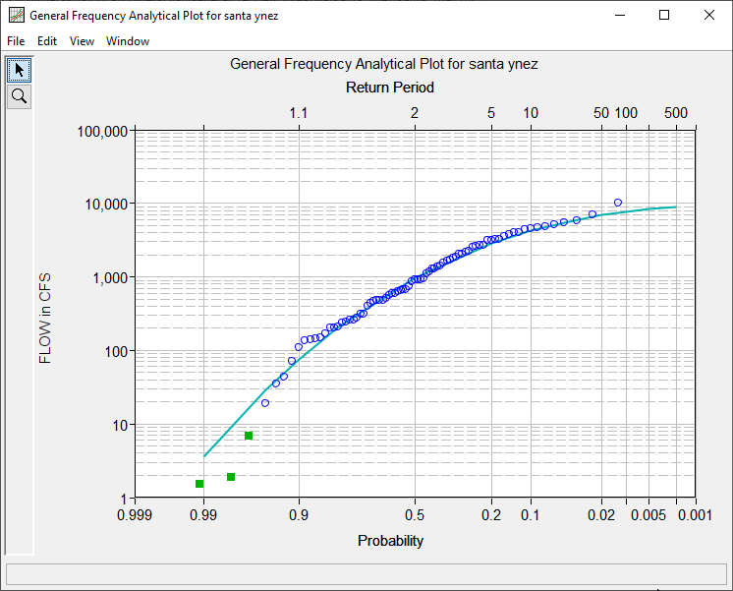
Another Example: Santa Cruz River
EMA fit of LP3
higher outlier threshold
Notes:
Even using a higher threshold to censor another value doesn’t make it much better.

Slide 31
…what’s the issue?
EMA is more sensitive to the low values
  Some low values have an unwarranted effect on the upper end of the fitted frequency curve, but are not identified by Grubbs-Beck test
Developed a Multiple Grubbs-Beck test – more aggressive
Identifies values that depart significantly from the rest of the data, and so are potentially influential
  PILFs Potentially Influential Low Floods
Recodes them as censored observations, interval = (0, PILF-thresh)
We don’t want the lowest values to define the upper-tail
Notes:
Since EMA is more sensitive to the low values, more aggressive censoring is needed. A Multiple Grubbs Beck test was developed that identifies more low values.
Rather than call them outliers, because of their potential for influencing the upper end of the distribution adversely, the are called Potentially Influential Low Floods, or PILFs.

Slide 32
Potentially influential low floods (PILFs)
“PILF” describes small observations that may have an inappropriately large impact on the higher flood quantiles
A PILF might be:
Unusually small flood given sample size and selected distribution (outlier)
A flow that reflects a different physical process than the largest flow in other years
  perhaps a zero or almost-zero flood year
Regular small observation (not “outlier”) whose potential impact upon estimated upper-tail quantiles is just too large
high leverage

Slide 33
Why Low Values Matter: Leverage and Influence
Observations with high leverage have potential to alter model results
Observations with high influence DO alter model results
Leverage without Influence
Leverage AND
Influence

Slide 34
Robustness in Flood Frequency Analysis
Robust – do well, even when you’re doing the wrong thing
Analytical distributions can’t really duplicate the true distribution of flood flows
  Especially when flood records include very low values or zeros in dry years, and due to different flood processes
  LP3 is not the truth…
Need robust procedures that provide good estimates when the true physical process isn’t captured by the simple model MGBT
assumptions aren’t quite true
Neither is GEV or LogNormal
Notes:
In general, we need a method that does a good job even when some assumptions aren’t true or the model is too simple to represent the process. This is called a ROBUST method.

Slide 35
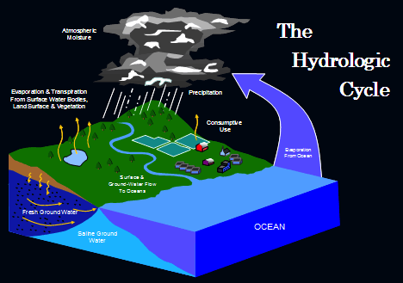
In the Humid East…
…LP3 Usually Fits
http://www.ecy.wa.gov/climatechange/reducedsnow_more.htm
Notes:
http://www.ecy.wa.gov/climatechange/reducedsnow_more.htm

Slide 36
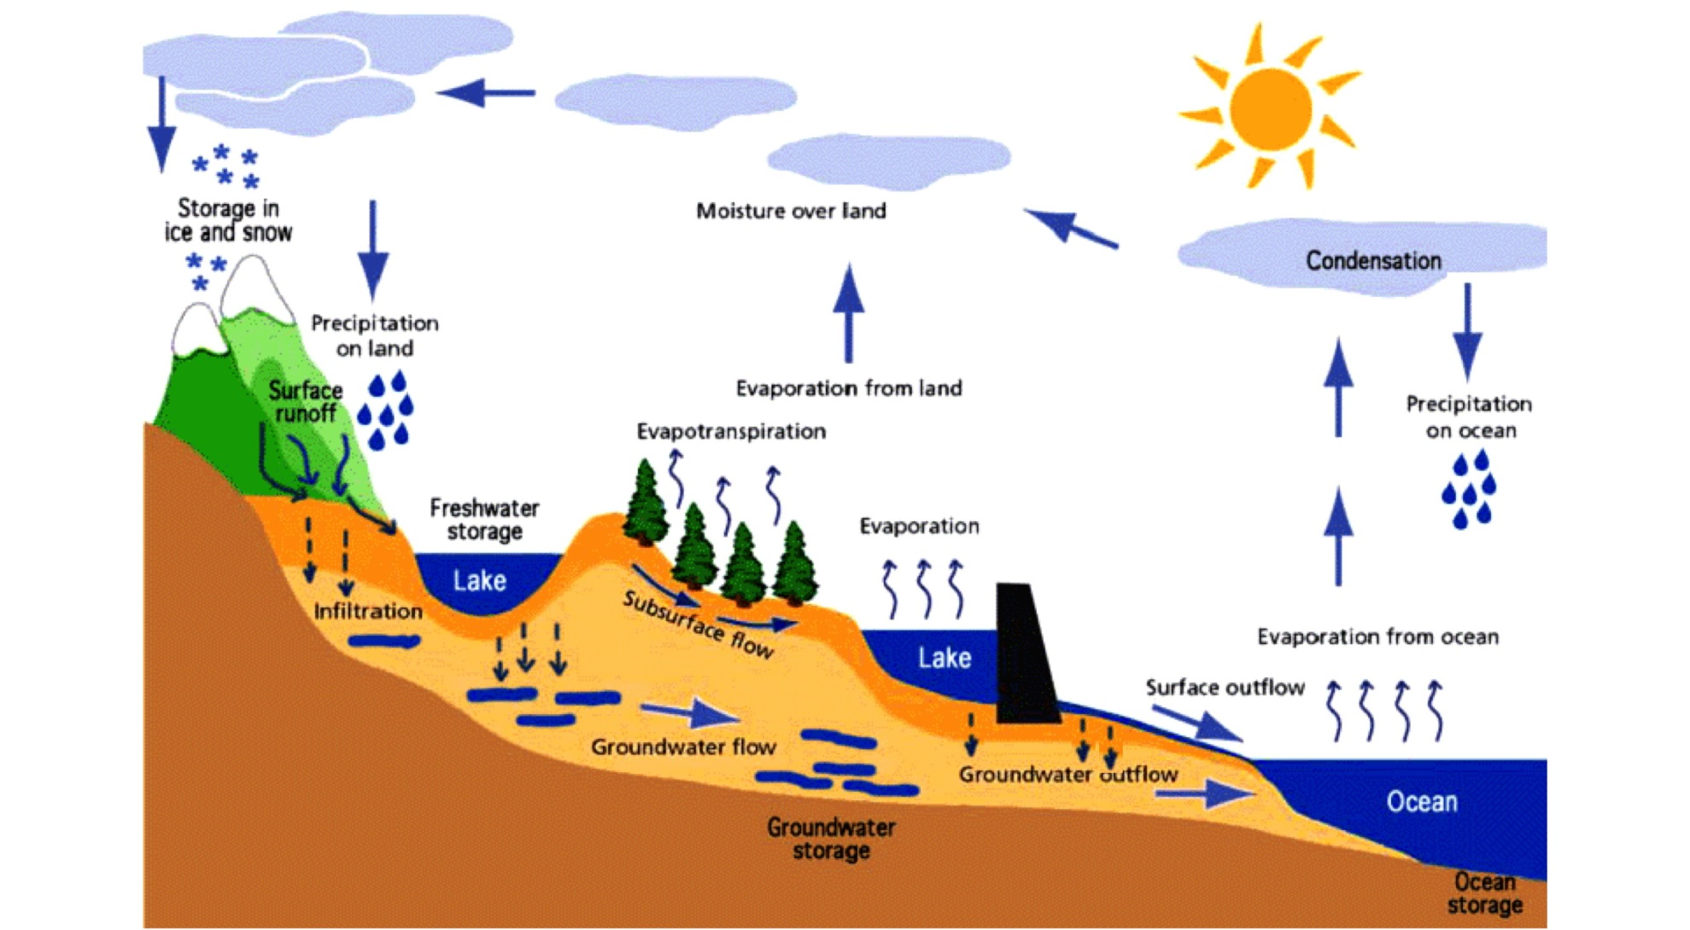
In the Arid West…
…things are more complicated
http://geofreekz.files.wordpress.com/2008/10/hydrologic_cycle.gif
Notes:
The Arid West
http://geofreekz.files.wordpress.com/2008/10/hydrologic_cycle.gif

Slide 37
Sometimes, there are
Multiple Physical Processes
- Channel Losses
= Left-Hand Tail Problems

Slide 38
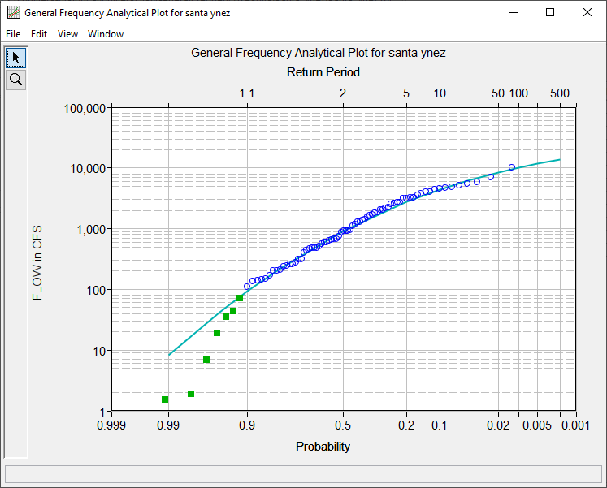
Another Example: Santa Cruz CREEK, CA
EMA fit of LP3
higher low outlier threshold
Notes:
EMA gets a more successful fit when censoring several more values. It needs a more aggressive low outlier censoring threshold

Slide 39
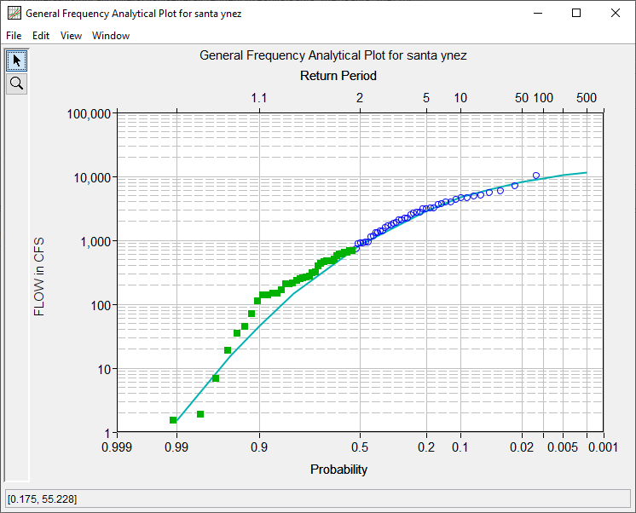
Another Example: Santa Cruz CREEK, CA
Note the difference between POTENTIALLY influential and ACTUALLY influential
B17C / EMA fit of LP3
MGB low outlier censoring
Notes:
The Multiple Grubbs-Beck MGB test censors even more values. The fit is good, but it is up to the analyst to check the sensitivity to the censoring threshold to see if a more defensible value can be chosen while still maintaining a good fit.
The important aspect there is that that MGB test will result in a good fit in the first compute of the data set.

Slide 40
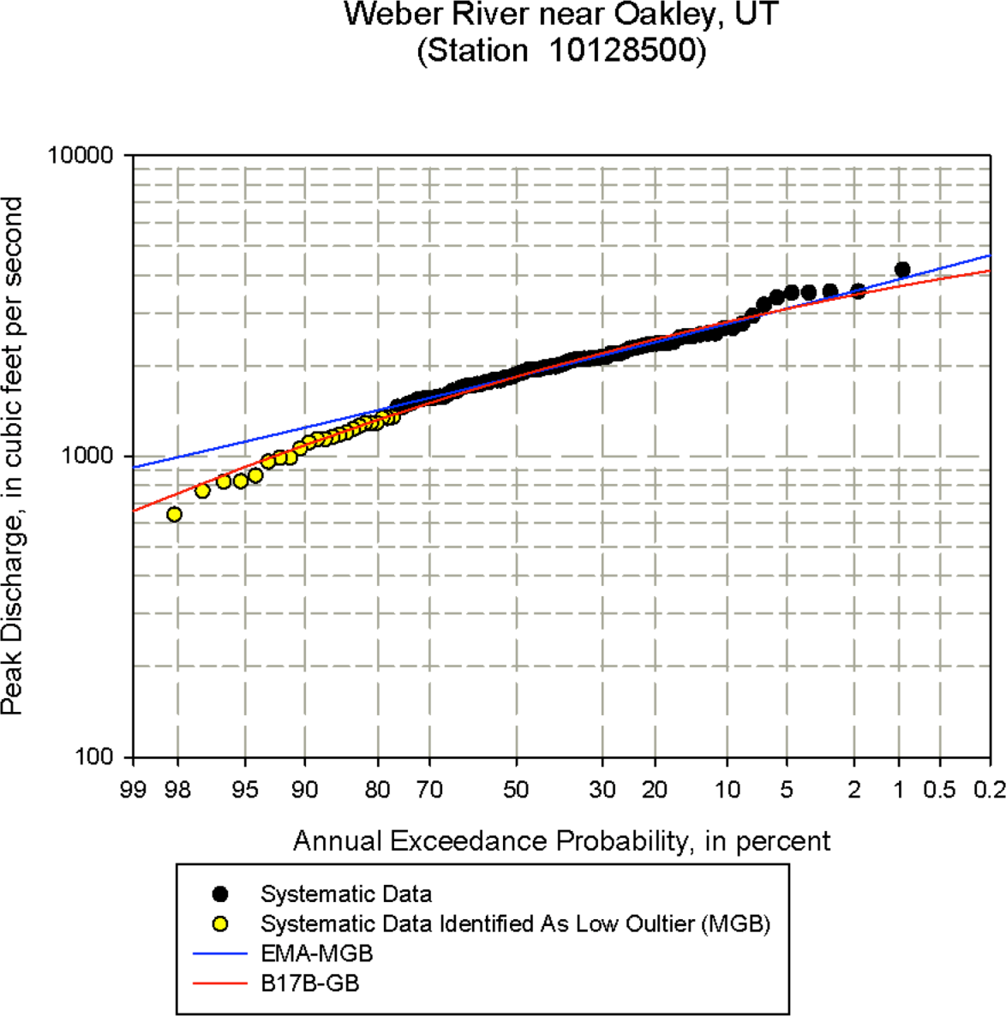
Comparison of B17B/GB (0) and EMA/MGB (24)
B17C / MGB
B17B / GB
Notes:
Here, largest event would be 1000 year event (or so) on red B17B curve. EMA curve says 200 year event
In this case, the MGB test and the censoring of many PILFs results in a higher upper end.

Slide 41
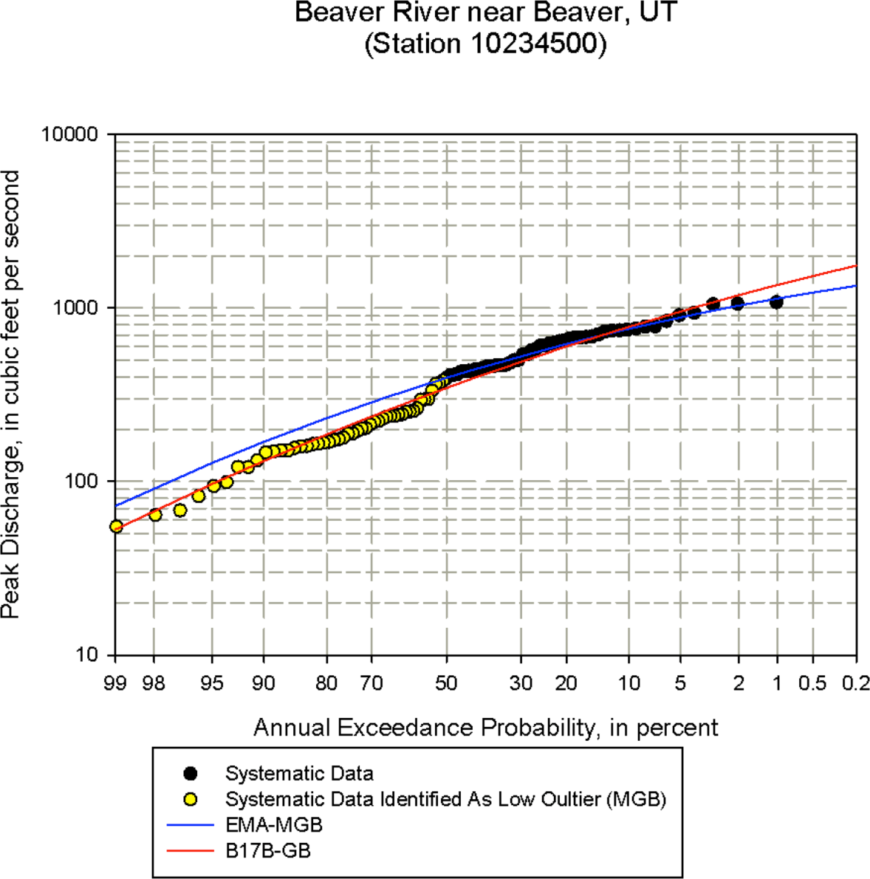
Comparison of B17B/GB (0) and EMA/MGB (48)
B17B / GB
B17C / MGB
Notes:
What’s probabilty that 3 largest events in 100 years do not exceed the 20 year flow? (B17B fit says this.) Compute using binomial…
In this case, the MGB test and the censoring of many PILFs results in a lower upper end.

Slide 42
Outline
Missing values
Censored values, zero flows, outliers
  low flows (PILFs)
  high flows
Historical/Paleo information

Slide 43
Values Above a Threshold
Since we are interested in extreme flow, we should estimate any flows that were above the highest recording level, or known high flows before the gage (historical or paleo-flood).
B17B noted about High Outliers:
  If information is available that implies the high value is the largest in a longer period of time, the largest events during a systematic period can be given historical weighting in the Bulletin 17B procedure.
  Therefore, when there are high outliers, should seek historical information, even non-exceedance

Slide 44
Outliers: values notably different from the rest of the data
Low Outliers are censored
analysis excludes the values, but not the fact they occurred
B17B used Conditional Probability Adjustment
B17C uses intervals for excluded values
High Outliers are NOT censored
high values are left in the data set
seek historical information to either add a past large event, or determine that the largest gaged event has a longer return period (is the largest in a longer period of time.)
B17B used Weighted Moment Algorithm
B17C uses intervals for unobserved historical years
B17B used Grubbs-Beck test for high and low outlier thresholds
B17C uses Multiple GB
Notes:
Outliers are values that are notably different from the rest of the data. B17B used a Grubbs-Beck test for both high and low outliers.
Bulletin 17C doesn’t designate high outliers at all. But there is still a suggestion to seek historical and paleo information if its available.

Slide 45
Historical/Paleo Information
Historical Information = evidence from human records
Paleo Information = physical evidence in the watershed
Systematic record = years in which flow is gaged
Historical period = includes years that are not gaged, but some information is known, for example:
  Large flow happened, and can be estimated
  There were flows that exceeded some threshold (at least 1), or
  There were NO flows that exceeded some threshold
  For example: might determine that systematic event in 1997 was not exceeded since 1862 = 161 years
45

Slide 46
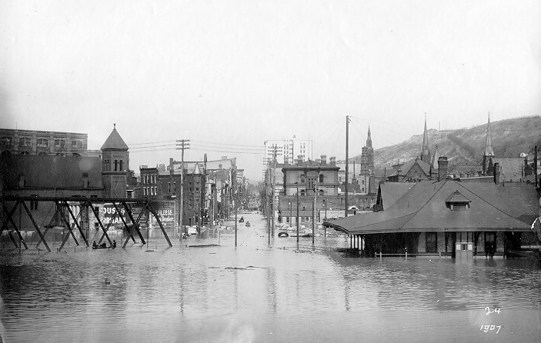
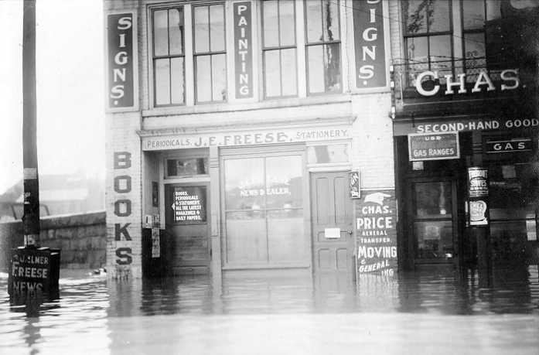

Historic Flood Information
Wheeling (Ohio) Flood (1907)
“...The worst flood since the memorable 1884 flood now holds sway in the Ohio valley. A new high water record has been established in Pittsburg, and though the mark of '84 was not passed at Wheeling the second flood stage to that destructive water will be attained here this morning. ..”
--The Intelligencer, March 15, 1907, p. 1
(Source: Tim Cohn, USGS)
46
Notes:
Historical information might be a newspaper article, such as this one about a flood on the Ohio River in 1907. The article also mentions it being the worst flood since the 1884 flood, so that provides an additional piece of information about the minimum return period of the 1907 flood.

Slide 47

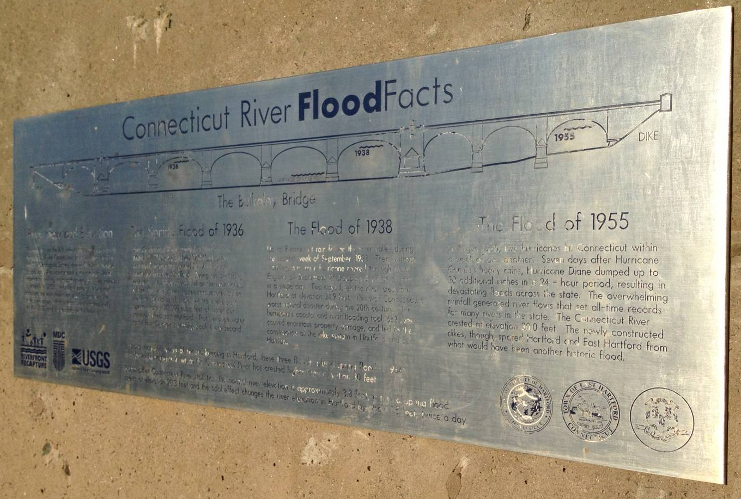
Connecticut River, Hartford, CT
(Source: John England)

Slide 48
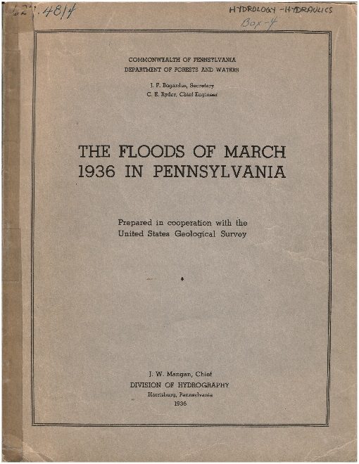
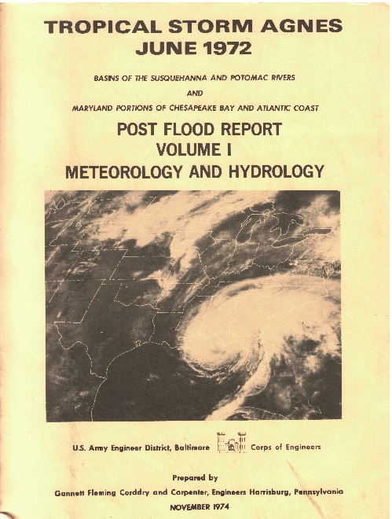
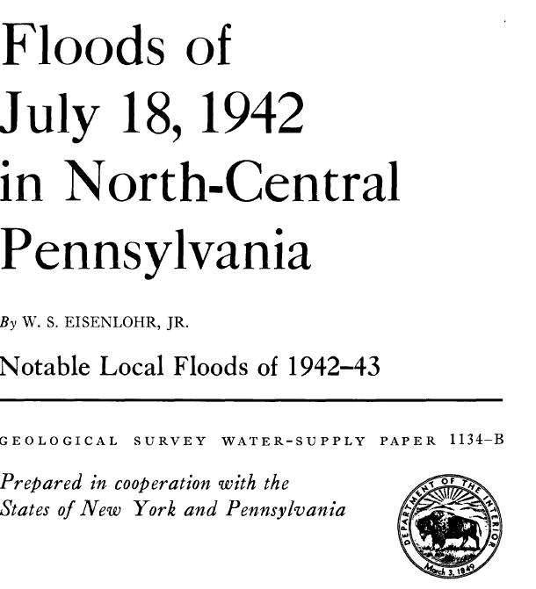
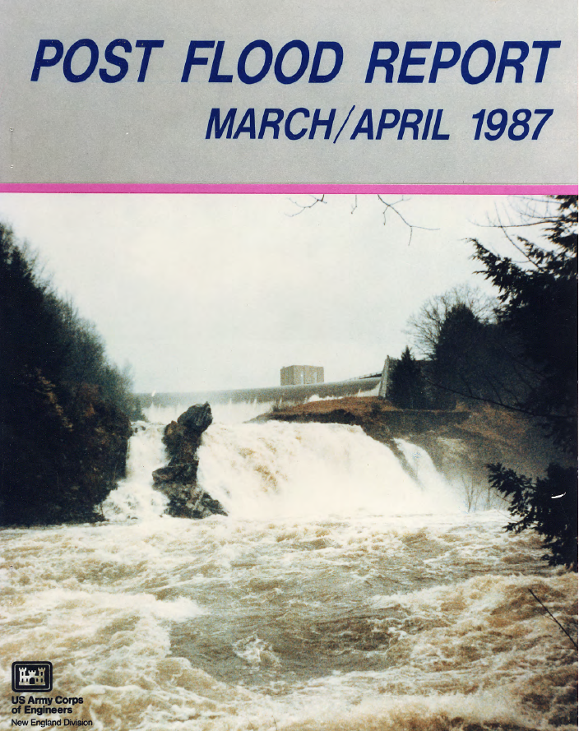
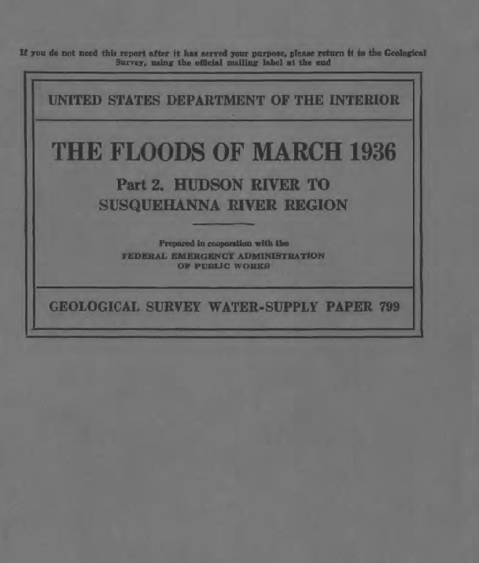
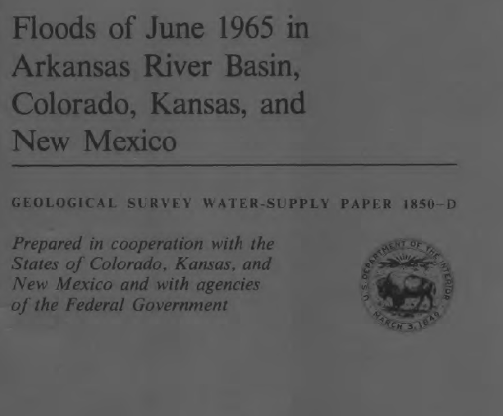

Sources of Data
Post Flood Reports
Source: Mike Bartles
$$https://pubs.er.usgs.gov/$$
Notes:
Post Flood Reports are oftentimes prepared following major flood events. Information within these reports can be used for a multitude of purposes.
These reports are available through a multitude of sources ranging from the U.S. Geological Survey, USACE districts, Bureau of Reclamation, state agencies, etc.
Google is your friend when searching for these types of documents.
The following slides present just a small sample of the information that is usually contained within these publications. Getting copies of them and doing research is a MUST!

Slide 49
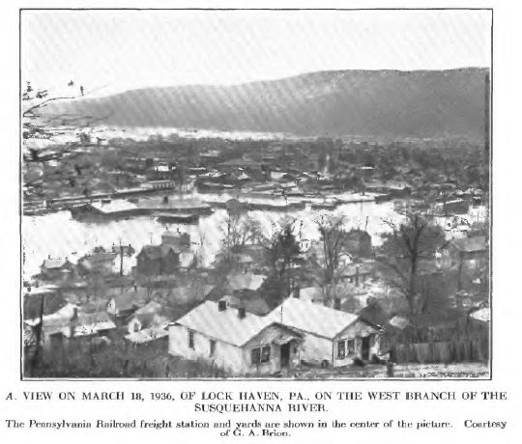
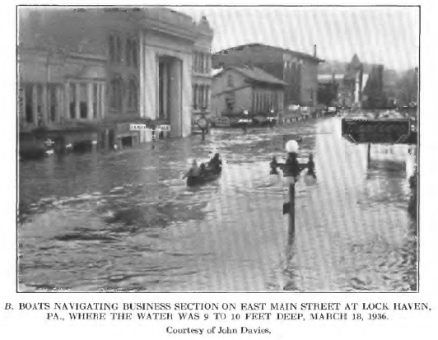
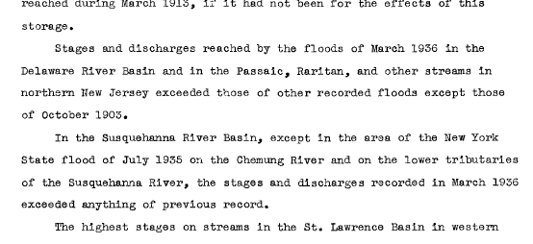
Sources of Data Post Flood Reports
Pictures and Text Descriptions of Flooding
March, 1936
Source: Mike Bartles
Notes:
Post Flood Reports will usually contain pictures and textural depictions of flooding conditions, antecedent conditions, operations at reservoirs, timelines of events, etc.
This information can be used to inform flow- and volume-frequency analyses, recreate conditions w/in a hydrologic model, etc.
For instance, the highlighted sections can be used to inform the selection of perception thresholds to extend and/or fill in missing information for flow- and volume-frequency analyses.

Slide 50

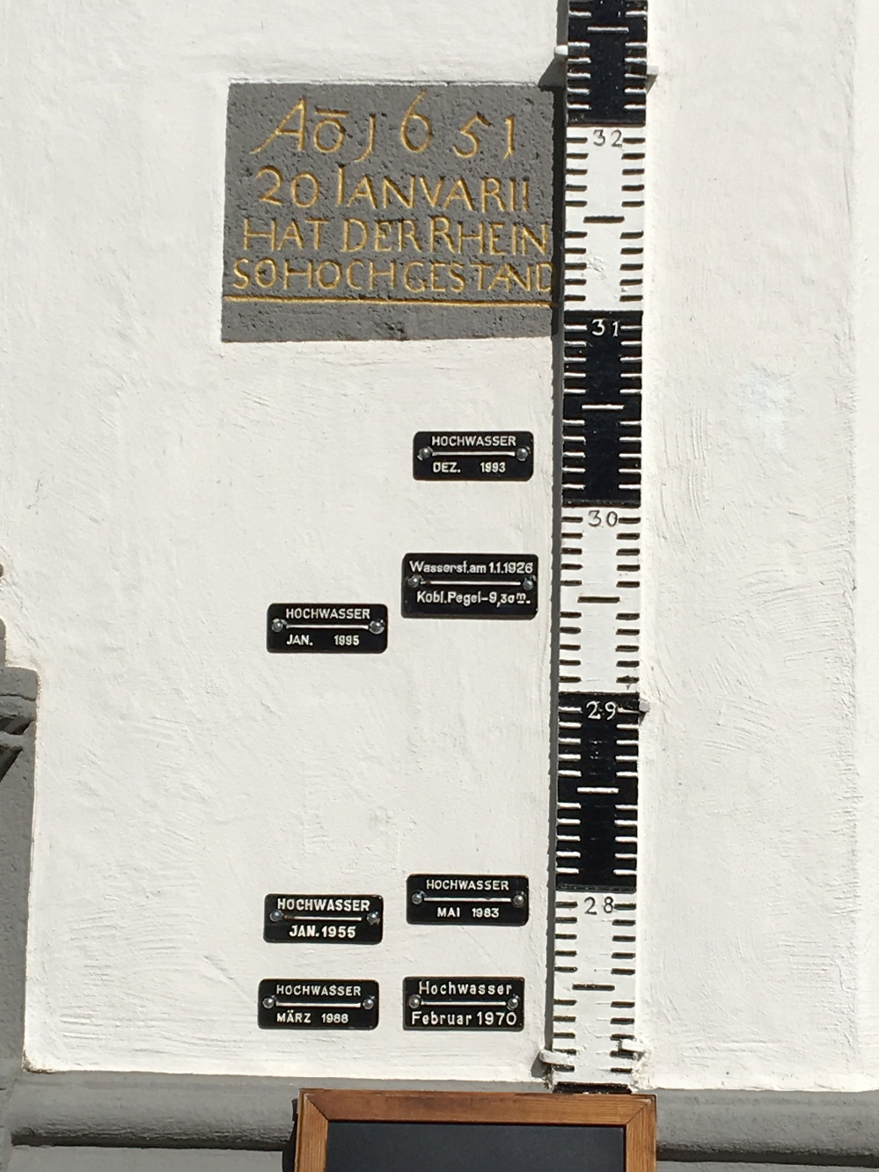
Historical flood data
651
1993
1926
1985
1983
1955
1988
1970
Rhine and Moselle Rivers
Koblenz, Germany
Notes:
Here’s an example of historical information shown as high water marks – going back to the year 651.

Slide 51
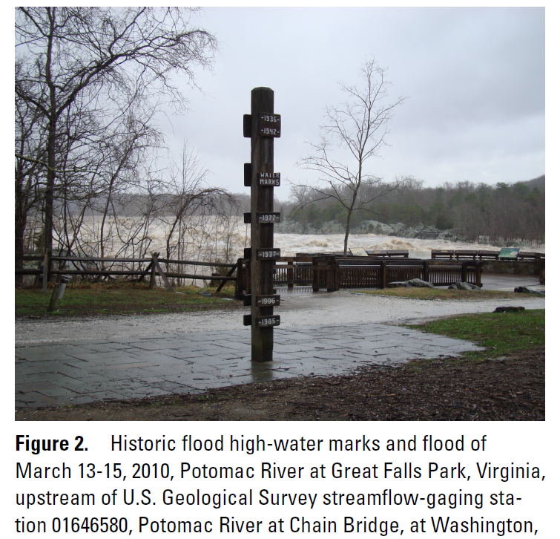
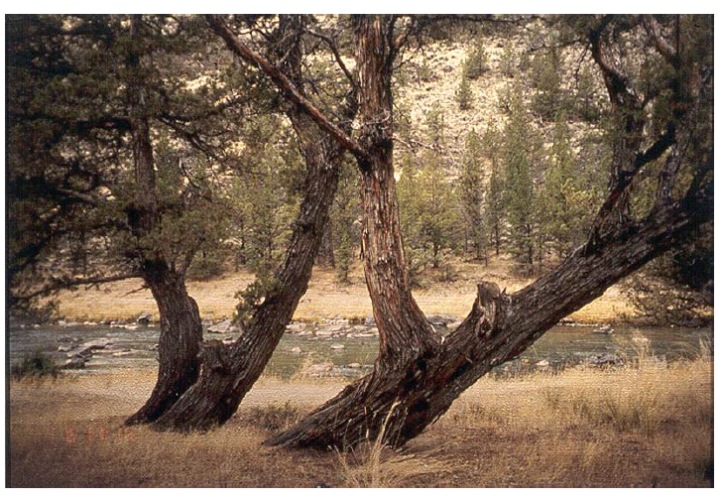
Crooked River near Prineville, OR, 1861 flood
Potomac River at Great Falls Park, VA
(Source: John England, USBR)
Notes:
These are other forms of historical information. The flood level sign along the Potomac River shows the levels of the large floods.
Paleo: The “schooner” trees in Oregon are physical evidence of a large flood. A flood large enough to knock over the trees happened, but they lived and sent up new trunks vertically. By coring and dating the new trunk, we can determine the data of the flood. This flood is a threshold exceedance, because we only know it was at least to the level of the tree, but not how much higher it was.

Slide 52
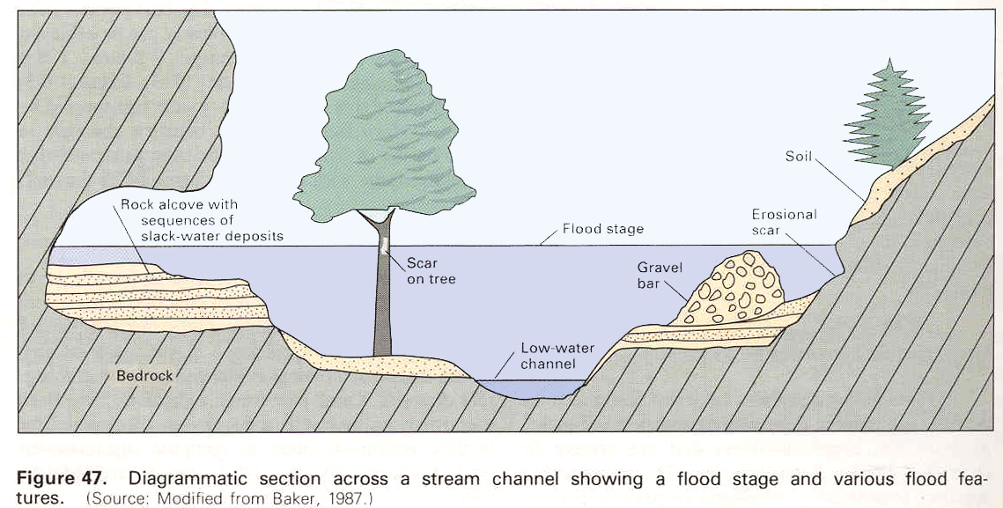
Paleoflood Data Sources
Non-exceedence level (bound)
Paleoflood stage
Threshold level
(Source: Jarrett 1991, modified from Baker 1987)
Notes:
These are other types of physical evidence of large floods, such as tree scars, slack water deposits and a non-exceedance bound.

Slide 53
Example: High Outlier, Historical Info
1933 – 2010 annual peaks
78 years of data
Notes:
Here’s an example that includes what Bulletin 17B would have called a high outlier.

Slide 54
Example: High Outlier, Historical Info
1933 – 2010 annual peaks
78 years of data

Slide 55
1933 – 2010 annual peaks
78 years of data
empirical probability is largest in 78 yrs = 1/79 = 1.3%
1940 event
Notes:
In the original data set, the most we can say about the large flow in 1940 is that it’s the largest in 78 years. The fitted LP3 distribution will make that assumption. But, the return period of that event is probably greater than 78 years.

Slide 56
1933 – 2010 annual peaks
78 years of data
empirical probability is largest in 78 yrs = 1/79 = 1.3%
1940 event
GB high outlier threshold
Notes:
The Grubs-Beck test would call this a high outlier, suggesting we seek historical information.

Slide 57
1933 – 2010 annual peaks
78 years of data
GB high outlier threshold
3382 cfs
LogPearson III fit
Notes:
This figure has the simple MoM (Method of Moments) LP3 fit to the gaged data.

Slide 58
The following are excerpts from a newspaper account of the 1940 flood:
Millville Daily Republican
Tuesday, September 3, 1940
“Yesterday’s flood conditions were the worst ever to strike Millville. In all the years other communities have suffered from floods, Millville has been unscathed….
….Dozens of workmen continuously piled sand and sandbags high along the sluiceway inside the Millville Manufacturing Company yard. Millville’s dam at Union Lake, built in 1867, held fast all day yesterday even though there was more pressure brought to bear against it than at any time in its long and useful career.”
Notes:
This newspaper article from 1940 says that the flood event is the worst known. It mentions a dam build in 1867 which has never experienced a worse flood, meaning the 1940 is the largest back to at least 1867.

Slide 59
1933 – 2010 annual peaks
78 years of data
now we say it’s the largest in 143 years
= 1/144 = 0.07%
Historical Period goes back to 1867
we’ve added 66 years to the return period of the 1940 flood
Notes:
The plotting position of the 1940 event can be adjusted to largest in 143 years. This adjustment does not change the LP3 fit, but does show visually what assumptions we can make about the 1940 event.

Slide 60
1933 – 2010 annual peaks
78 years of data
GB high outlier threshold
3382 cfs
2644 cfs
Historical Period goes back to 1867
adjusted 17B LogPearson III fit
Notes:
The LP3 curve adjusted to include 1940 as largest since 1867 has a lower skew and so lower upper end.

Slide 61
Historical and Gauged Record
Z events above threshold
S years, systematic
H years, historical
In Bulletin 17B, we adjust the statistics of the LP3 distribution by assuming the characteristics of the systematic record apply across the entire record S + H – Z, and then include Z
Notes:
Systematic years plus historical years including some historical events that exceed a perception threshold.

Slide 62
Historical and Gauged Record
Note, with 17B, if no high outlier or historic event occurred, H could not be used
Z events above threshold
S years, systematic
17B: Statistics for systematic period used to represent unobserved years in the historical period
H years, historical
17B: Systematic years were given a weight greater than 1 to represent unobserved historical years when computing sample statistics
Notes:
The 17B weighted moments algorithm used the statistics of the systematic record to represent the unobserved years in the historical period. This worked very well for a limited historical period.

Slide 63
Historical and Gauged Record
17C can use H even if no exceedances noted
Z events above threshold
S years, systematic
17C: unobserved years are replaced with flow range 0 - PerceptionThreshold
H years, historical
In 17C, include flow ranges for the unobserved years equal to the complement of the perception range
Notes:
Bulletin 17C replaces the unobserved years with a range of flow from 0 to the perception threshold. This method works better for much longer historical periods from paleo information.

Slide 64
1933 – 2010 annual peaks
78 years of data
GB high outlier threshold
3190 cfs
2644 cfs
Historical Period goes back to 1867
why so high?
EMA fit
Notes:
This curve shows the initial EMA fit of the same data, with 1940 largest since 1867. However, the curve seems as high at the original….

Slide 65
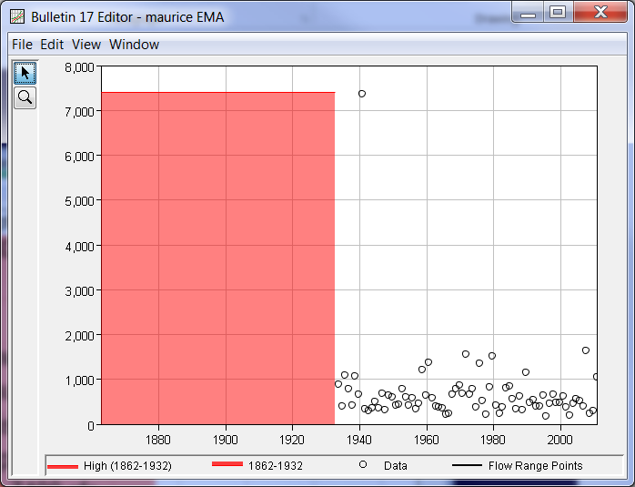
perception threshold = 7,400 cfs
flow range assumed for historical period
0 – 7400 cfs
Notes:
The LP3 curve fit with EMA was high because the perception threshold for the historical period was as high as the event itself, implying that anything lower than 7,400 cfs would not have been perceived.

Slide 66
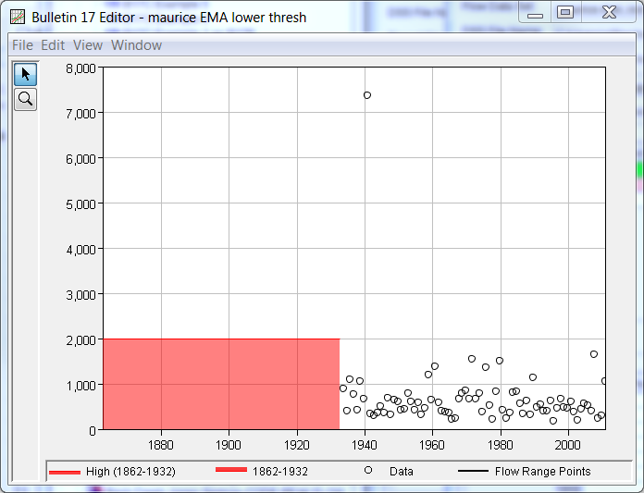
flow range assumed for historical period
0 – 2,000 cfs
What does the evidence say about what magnitude of flow would have been perceived?
perception threshold = 2000 cfs
Notes:
It is more likely that events much smaller than 7,400 cfs would have been perceived and recorded if they occurred in that period of time. Perhaps as low as 2,000 cfs. So, a perception threshold is set at 2000 cfs, meaning that flow ranges of 0 to 2000 cfs are used for the unobserved years between 1867 and 1935.

Slide 67
1933 – 2010 annual peaks
78 years of data
GB high outlier threshold
2678 cfs
2644 cfs
Historical Period goes back to 1867
EMA fit, lower threshold
Notes:
The resulting LP3 fit by EMA is therefore lower at the upper end.

Slide 68
Example: historical information
Notes:
Here is another example – the Meherrin River in Virginia

Slide 69
1951 – 2010 annual peaks
60 years of data
Notes:
The 60 years of systematic data plot like this.

Slide 70
1951 – 2010 annual peaks
60 years of data
25,600 cfs
Notes:
This curve is the LP3 fit of the systematic data.

Slide 71
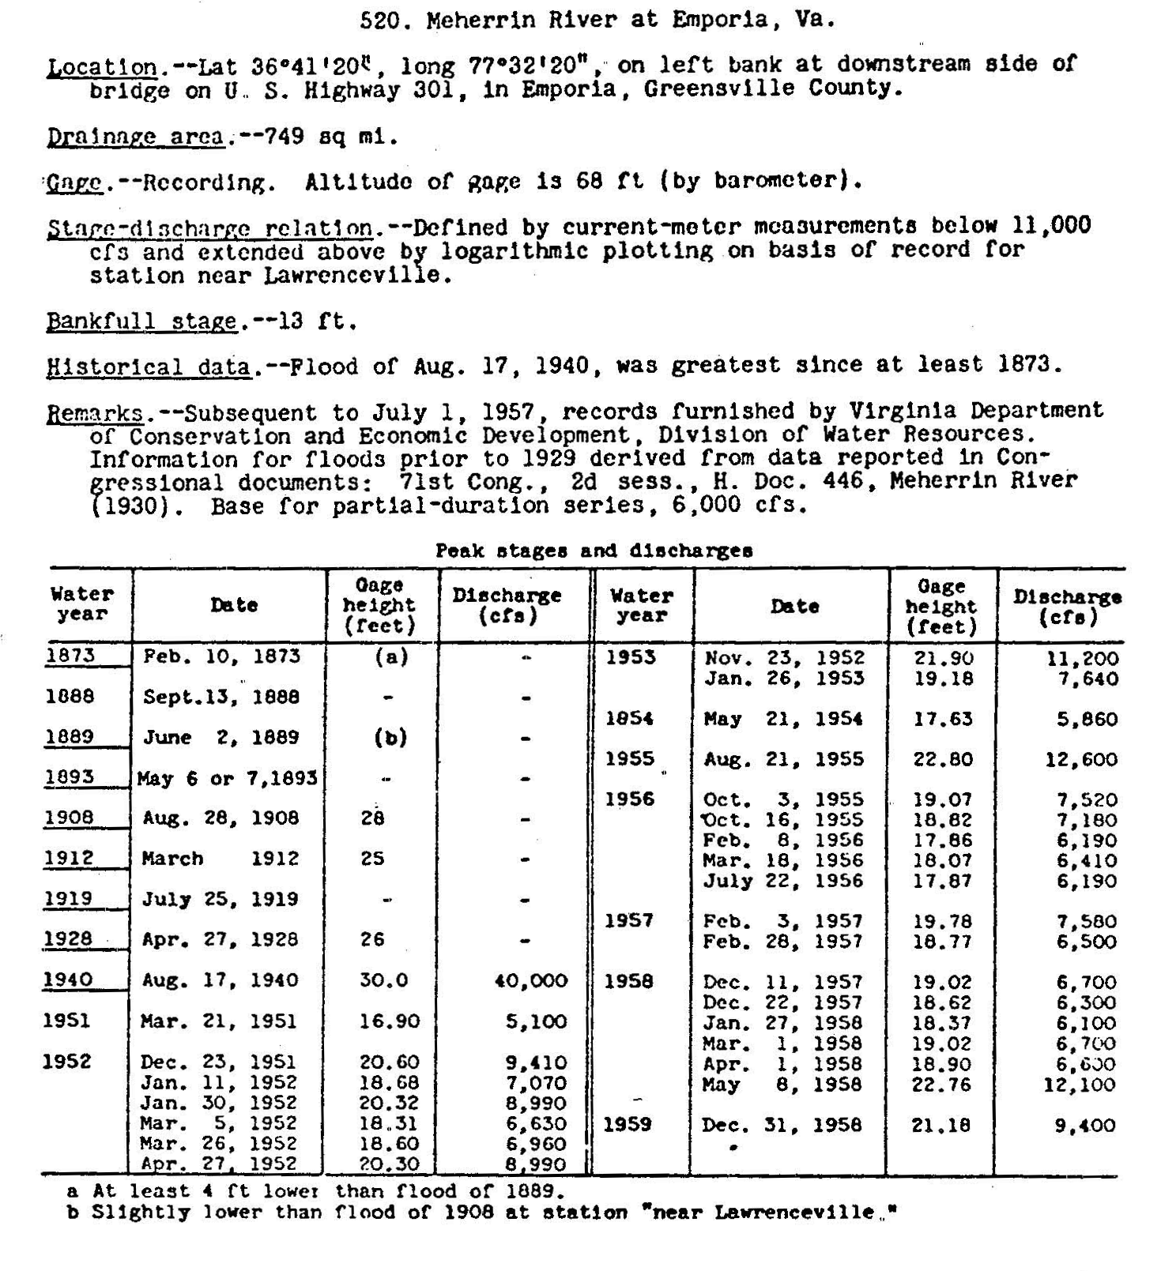
Meherrin River at Emporia, VA
many additional forms of information available from USGS
Notes:
But, there was a lot more information available from the USGS than just the systematic starting in 1951. There was a flood of 40,000 cfs in 1840 that was estimated to be the largest since 1873. And there were also stage estimates for several of the years between 1873 and 1940.
This is good information that we should bring into the frequency analysis, if possible.
Here, we’ll work with this information one piece at a time to see how it affects the frequency curve.

Slide 72
Example: historical information
Notes:
Here, we’ve included the 1940 event estimated at 40,000 cfs.

Slide 73
1951 – 2010 annual peaks
60 years of data
70 year historical period
1940 event, as largest since 1940
Notes:
When add the 1940 event, can see from the plotting positions that, at this point, we’re considering it the largest since only 1940 – the return period is about 1 in 70. We expect a higher frequency curve will result from this data.

Slide 74
1951 – 2010 annual peaks
60 years of data
70 year historical period
1940 event, as largest since 1940
31,200 cfs
25,600 cfs
Notes:
This is the higher LP3 fit including 1940. Note, the plotting position didn’t affect the LP3 fit, but it can be seen to be consistent.

Slide 75
Example: historical information
Notes:
Here we include the fact that the 1940 event was the largest since 1873.

Slide 76
1951 – 2010 annual peaks
60 years of data
138 year historical period
1940 event, as largest since 1940
1940 event, as largest since 1873
Notes:
We can see the plotting position of the largest event now shows it as the largest since 1873, with a return period of 1 in 138. We expect this information will lower the frequency curve from the previous.

Slide 77
1951 – 2010 annual peaks
60 years of data
138 year historical period
1940 event, as largest since 1873
28,400 cfs
25,600 cfs
Notes:
The dark blue is the LP3 fit with 1940 as largest since 1873. It’s higher than the pink it with no historical data, but lower than the estimate that did not add the “largest since 1873” information.

Slide 78
determine flow/stage rating from 1951 – 1958
estimate historical flows from stage
NOTE: in B17B, lowest historical flow becomes new high outlier threshold…
Notes:
Now we can try to use this additional information about peak stages.

Slide 79
Estimate flow from stage for historical events
30 ft = 40,000 cfs 1940 event
1908: 28 ft = 30,400 cfs
1889: 27.5 ft = 28,300 cfs
1928: 26 ft = 22,600 cfs
1912: 25 ft = 19,200 cfs
1873: 23.5 ft = 14,800 cfs
1951 to 1958
Notes:
Here’s a simple estimate of the historical flows made by plotting 1951 to 1959 flow versus stage along with the 1940 estimate of flow of 40,000 cfs from stage of 30 feet. The polynomial fit is used to estimate flow for the recorded stages.

Slide 80
Example: historical information
Notes:
This image shows the additional historical events in the historical period. We can safely assume that since the flow of 15,000 cfs was observed in 1873, that flow would have been observed at any time since then, and so it can be used as a perception threshold in a B17C EMA fit.

Slide 81
1951 – 2010 annual peaks
60 years of data
Historical events in
and 1873, 1889, 1908, 1912, 1928 and 1940
31,600
29,836 cfs
25,600 cfs
EMA fit with all historical events, perception thresholds set to earliest/lowest
Notes:
EMA is able to do a better job of using all of the historical information without needing to specify more of the historical events or systematic flows as high outliers.

Slide 82
Assumptions?
What assumptions are we making by including historical or paleoflood information?
  stationarity – those events are part of the same population as the recent events, i.e., the same physical processes are in place: hydrology, hydraulics, etc
  consistency – that the estimates of the historic flow are equivalent to systematic measurements
Consider whether these are safe assumptions
Notes:
By using the historical data in the frequency analysis, we are saying we believe it to be from the same flood population as the gaged flows, and thus identically-distributed. Other ways to word this assumption are that the data is homogeneous, and since we collect the data over time, that it is stationary. Using the historical data means we are saying the watershed was similar enough to the current watershed to produce the same distribution of flood events (with the same likelihoods).
We are also using the historical data here as point values, implying the estimates are equally as reliable. However, we could choose to represent them as intervals instead.
Are these assumptions valid?

Slide 83
Summary of how we use historical info
Bulletin 17B method
can use historical events that have estimated values
Can use non-exc info only if observed large event
extend record to length of historical, assuming syst record also represents unobs years
works well for historical length, too weak for paleo length
Bulletin 17C - EMA
can use a point or an interval for an historical event
can use intervals for all of the unobserved events, even if no historical event (non-exc. info)
can also use other info:
  the fact that a flow is below any threshold
  the fact that a flow is above any threshold

Slide 84
Summary of all Data Adjustments
Bulletin 17B
Broken record – missing years excluded
Zero flow years – conditional prob adj
High and Low outliers:
  Low outliers – conditional prob adj
  High outliers – seek historical info
Historical Information – use Weighed Moment algorithm
  Historical events
  Periods of known non-exceedance, if hi-out
  Note whether systematic events become high outliers
Bulletin 17C (EMA)
Broken record – missing years represented by a range, (∞, ∞) or (T, ∞) if some info
Low values
  Zero flow years: censored, replaced by range
  Low outliers and PILFs, replaced by range
Historical Information
  Historical events
  Periods of known non-exceedance, or exceedance
  Set thresholds for historical periods

