Slide 1
Partial Duration Series and Peaks Over Threshold
Flood Frequency Analysis PROSPECT
May 2024
Gregory S. Karlovits, P.E., PH, CFM
Statistical Hydrologist
US Army Corps of Engineers
Hydrologic Engineering Center

Slide 2
Purpose
Understand a different approach for estimating flood frequency
Identify when applying peaks over threshold can be beneficial

Slide 3
Outline
Peaks over threshold approach
Models for partial duration series
Computing AEP using partial duration series
Why PDS?
Bonus section: Mixed Populations

Slide 4
Peaks Over Threshold Approach

Slide 5
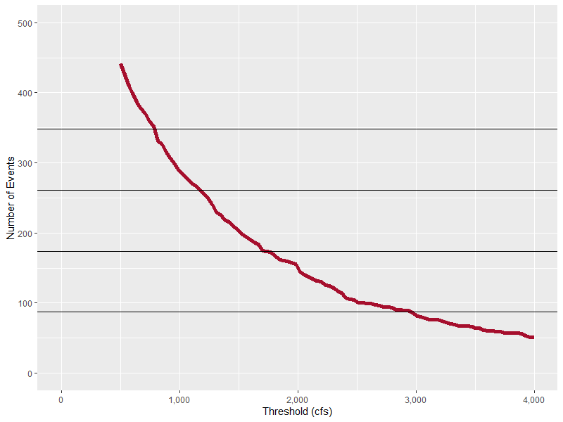
Peaks Over Threshold
Choose a high flow value as a threshold
Keep all independent flood peaks greater than the threshold
Varying number of floods per year
  0 or more
Average rate:
4 events / year
3 / yr
2 / yr
1 / yr
Notes:
Values above that threshold are high flow events that you’d consider a representative sample of floods.

Slide 6
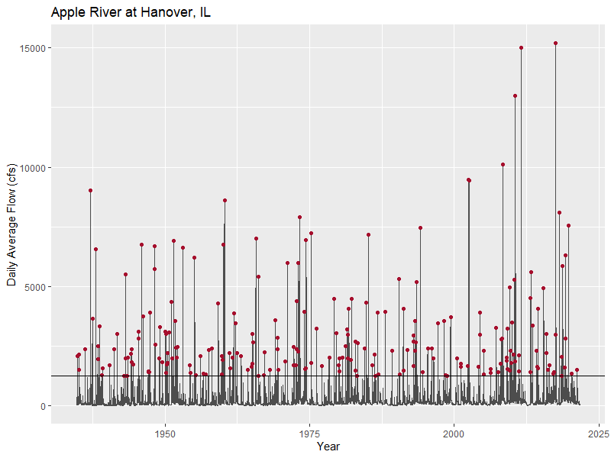
Peaks Over Threshold
Threshold = 1,250 cfs

Slide 7
Partial Duration Series
The collection of independent peaks over a sufficiently high threshold is called the partial duration series (PDS)
Events can be different than annual maximum series (AMS)
PDS
Secondary, tertiary, etc. peaks
Events in both series
AMS
Annual maxima less than threshold
Notes:
The size of the PDS circle is dependent on how high of a threshold you choose. Potentially, if you choose a low enough threshold, the red circle engulfs the purple one (all the AMS events are in the PDS).

Slide 8
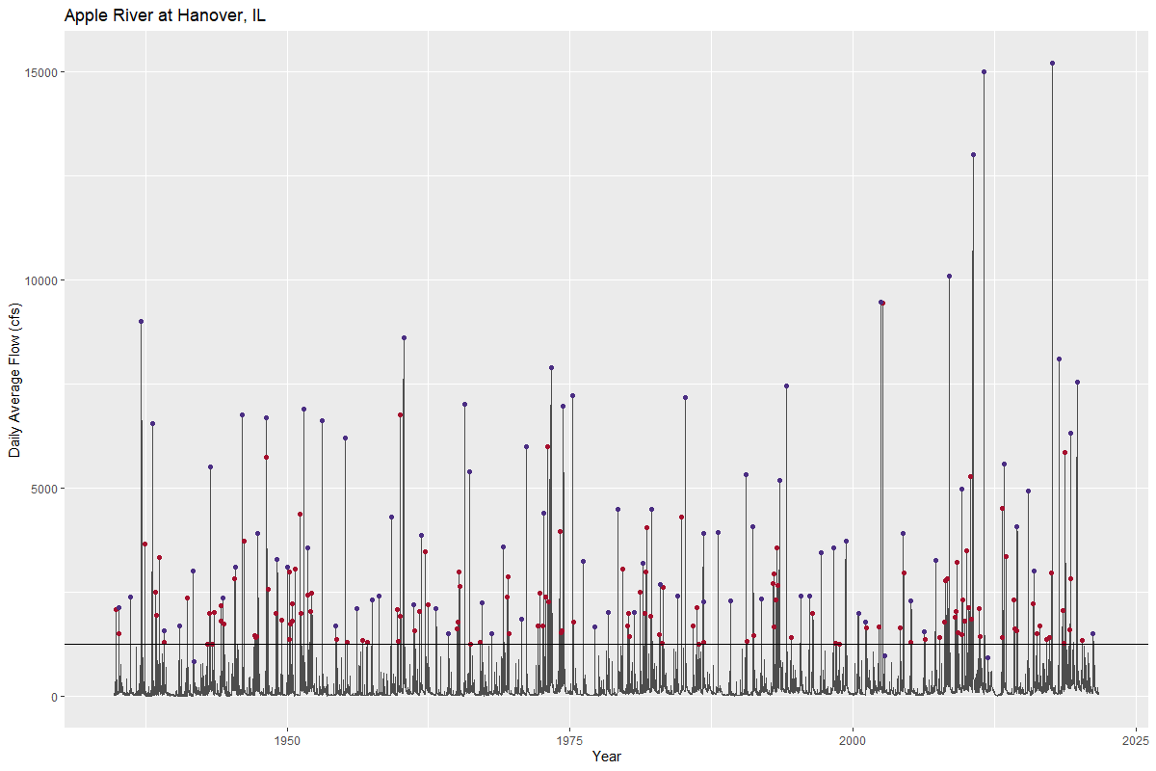
Peaks Over Threshold
AMS (87 events)
PDS (220 events)
Threshold =
1,250 cfs
Notes:
Any points above the line in purple are both in the AMS and PDS. Any points in red are in the PDS, but not the AMS. Any purple points below the line are not in the PDS.

Slide 9
Inference Assumptions
Sample is representative of population
Sample values are independent
Sample values are identically-distributed
I.I.D.

Slide 10
Representative Sample
High threshold ensures sample made only of floods, but:
  Too high of a threshold limits sample size
Assumption violation: we build an unrepresentative model

Slide 11
Identical Distribution
High threshold ensures sample made only of floods
May still be a mixture of flood-generating mechanisms
Assumption violation: population model misrepresents extremes
Notes:
Remembering the mixed population lecture/workshop we saw the consequence of failing to handle a mixture – our estimates for frequency events over a range of probabilities were low.

Slide 12
Independence
Floods you keep should be independent of others
Enough time passes between floods
Hydrograph sufficiently recedes between floods
Assumption violation: we think large floods happen more often than they actually do
Notes:
Independence is the hard part about using peaks over threshold – it’s up to you to determine how to ensure the peaks you get are independent of one another.

Slide 13
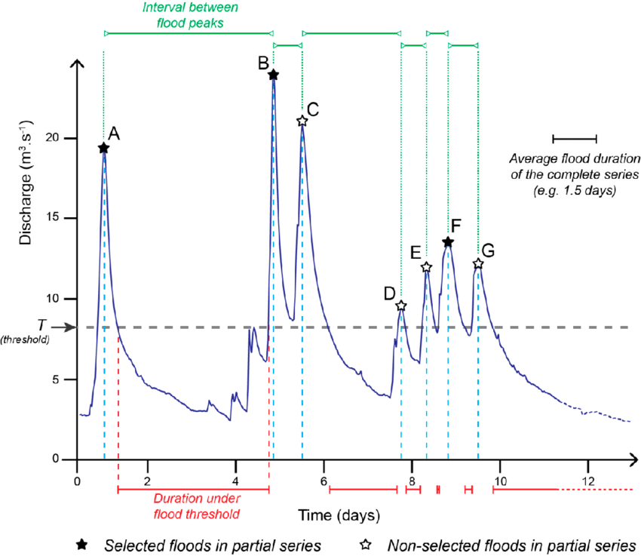
Independence
Van Campenhout, et al. (2020)
Notes:
We only want to keep the largest peak of a cluster of peaks (the process is sometimes called declustering)

Slide 14
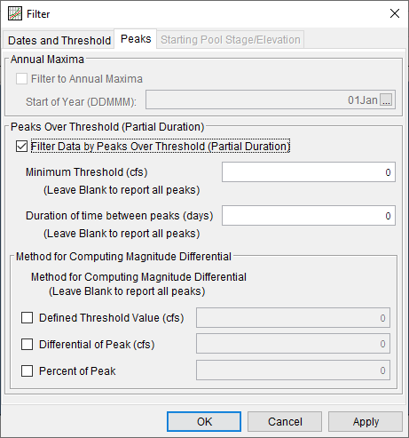
Filtering Peaks in HEC-SSP
Threshold
Time between peaks
Magnitude difference
  Recede below a threshold
  Recede by x cfs
  Recede by y% of peak

Slide 15
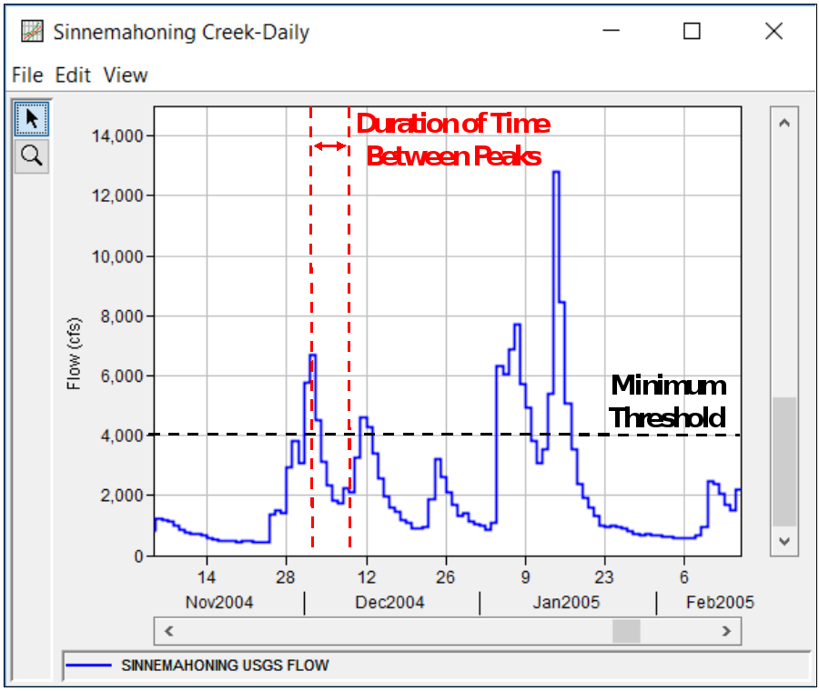
Filtering Peaks

Slide 16
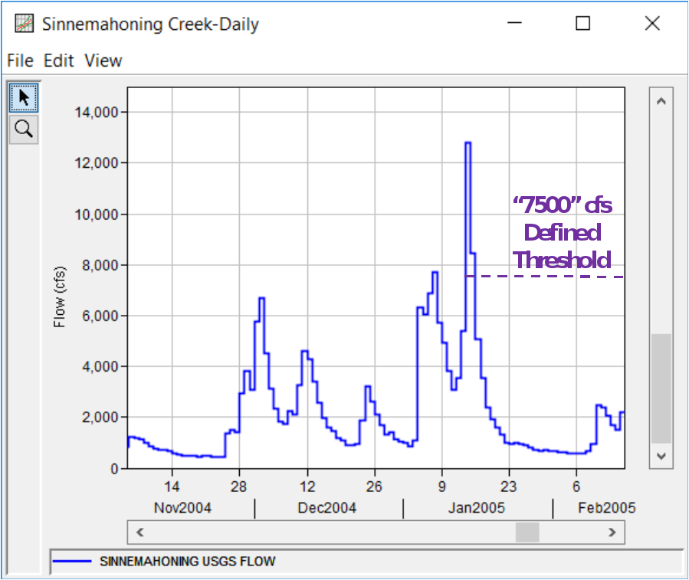
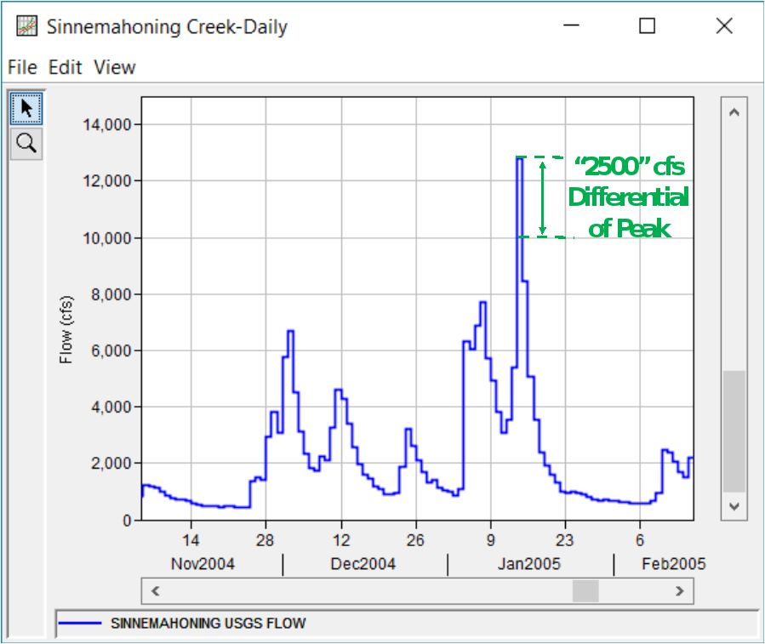
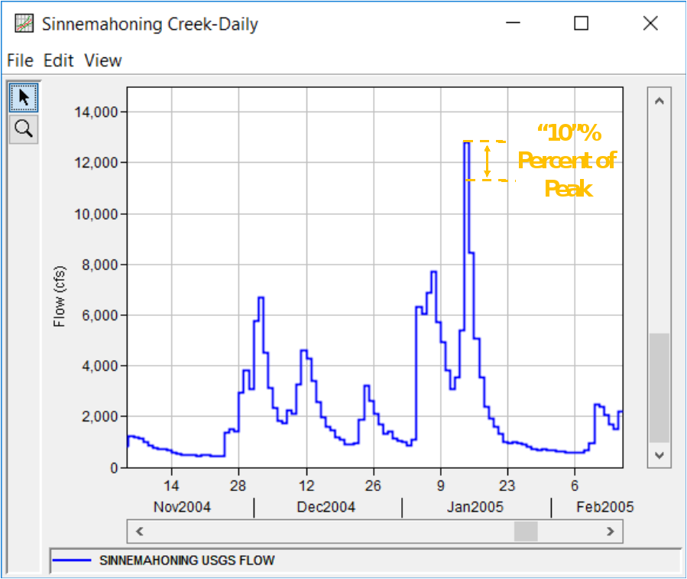
Filtering Peaks

Slide 17
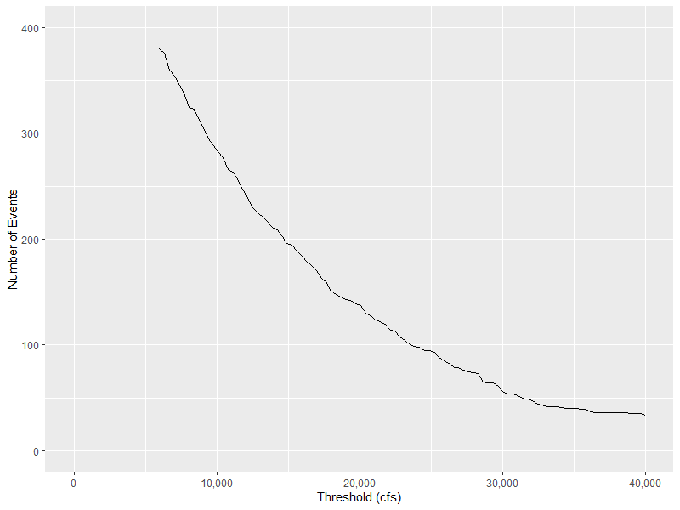
Choosing a Threshold
Sufficiently high threshold necessary
  Helps with assumptions
  Makes our model work
Too high a threshold results in
small sample sizes
Tradeoff

Slide 18
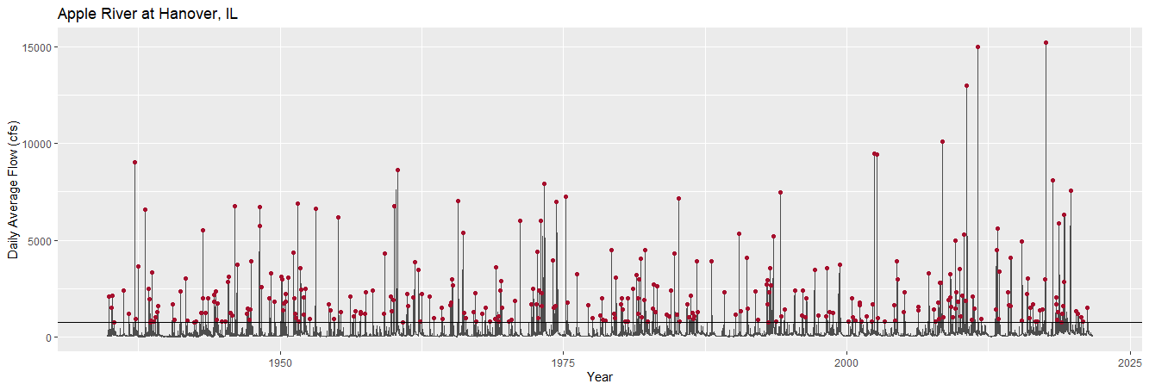
750 cfs
11 days minimum separation
250 cfs minimum recession
318 events (3.7 / year)

Slide 19
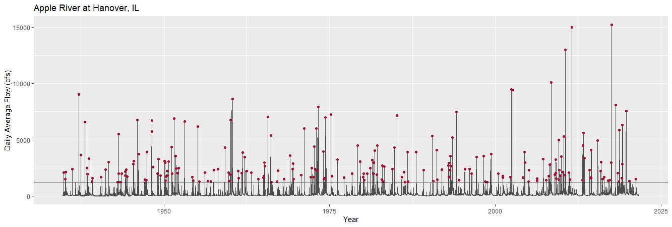
1,250 cfs
11 days minimum separation
250 cfs minimum recession
220 events (2.5 / year)

Slide 20
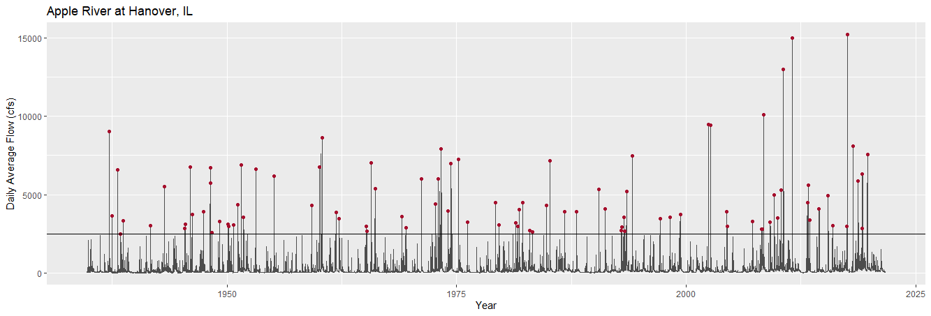
2,500 cfs
11 days minimum separation
250 cfs minimum recession
93 events (1.1 / year)

Slide 21

Choosing a Threshold: Ideas
Minimum annual maximum value
Bankfull discharge
Mean rate = 1 event / year (# events = # years)
More “advanced” diagnostics
  Pareto shape plot
  Mean excess plot
Automated techniques
  Solari et al. (2017) using GoF statistics

Slide 22
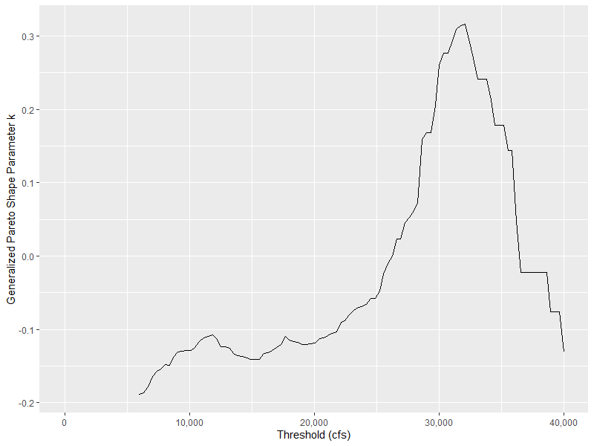
Other Diagnostics: Pareto Shape Plot
Extract PDS for range of thresholds
Fit generalized Pareto distribution to each
Plot threshold vs. Pareto shape parameter
Check for flat spot or change in shape
Notes:
We will talk more about the generalized Pareto distribution in Section 2. If you’re uncomfortable with fitting this model and taking its parameter, imagine it is the same procedure as fitting a log-Pearson type III distribution and taking the skew out. It’s like that but a different distribution with different parameters.
This plot is pretty subjective, as is the next one. Here we are looking for the largest threshold value where the shape parameter is stable, creating a modestly flat spot in the plot. Here the plot increases from a low threshold to about 10,000 cfs, and then is relatively flat until about 20,000 cfs, and then starts increasing by a lot. Here I would choose a threshold of about 20,000 cfs.

Slide 23
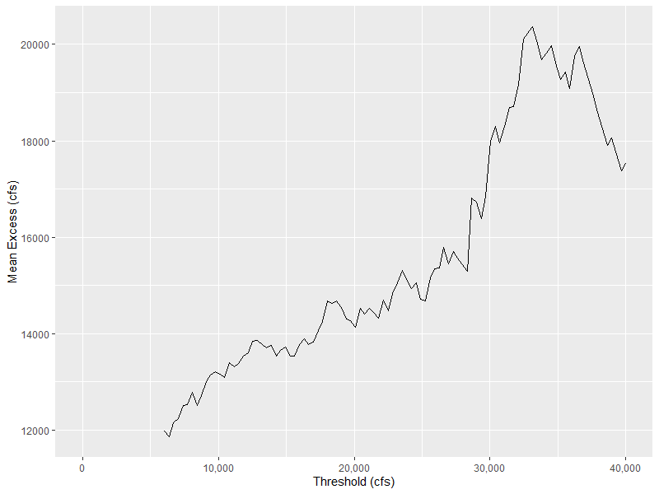
Other Diagnostics: Mean Excess Plot
Extract PDS for range of thresholds
Compute mean amount peaks exceed threshold
Plot threshold vs. mean
Check for linearity or change in shape
Notes:
Both of these plots are pretty subjective and don’t always produce easy to interpret results. For this plot, find the (largest) threshold value where the linearity in mean excess stops, and that is your threshold. Here it’s something like 28,000 cfs.
Increasing ME plot usually indicates a heavy tailed distribution (negative shape parameter for GPD)

Slide 24
Result
Collection of IID flood events
Variable number of events per year
All events greater than a specified threshold
Partial duration series (PDS)

Slide 25
Models for Partial Duration Series

Slide 26
Flood Frequency Guidance: Review
Annual maximum series (AMS) +
Log-Pearson type III distribution (LP3) +
Expected moments algorithm (EMA) =
Bulletin 17C
Notes:
Here’s an extremely quick rundown of what we’ve talked about this week so far. For flood frequency analysis in the United States, your typical recipe looks like this.
First, your data are an annual maximum series. We take block maxima based on water years at a gage site. Other data may be involved but it is expected that historical or paleoflood records are annual maxima.
Next, you use the log-Pearson type III distribution as the model for the frequency of these events.
Finally, you estimate the parameters of the LP3 using a procedure called the expected moments algorithm. This is a technique that lets you handle all kinds of non-standard data, such as censored observations, historical floods, paleostage indicators and non-exceedance bounds, etc.
In aggregate these tools make up the foundation of Bulletin 17C.

Slide 27
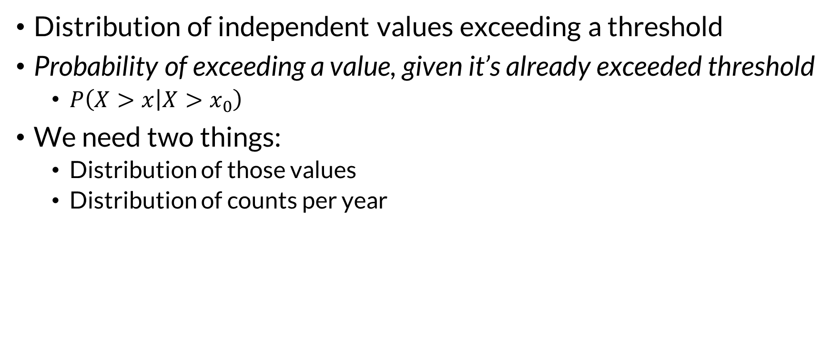
Partial Duration Series Models
Distribution of independent values exceeding a threshold
Probability of exceeding a value, given it’s already exceeded threshold
  $P\left(X>x | X>x_{0}\right)$
We need two things:
  Distribution of those values
  Distribution of counts per year
Notes:
On the second bullet, we are conditioning – remember conditional probabilities with the Venn diagrams from earlier? We restrict our universe such that we’re only considering events where the value is greater than the threshold x0. That means the probability of se

Slide 28

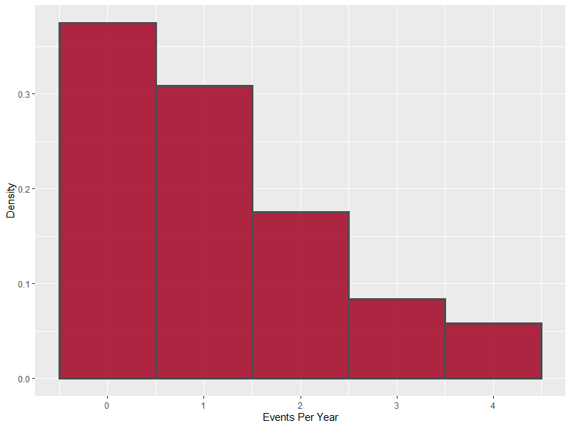
Counts
0 or more events per year in PDS
Two key questions:
  Probability of at least one event in a year?
  Typical number of events in a year?
Notes:
At the beginning of the class, we talked about two general kinds of probability distributions that represent how many outcomes our random variable can take on. For the most part we’ve discussed continuous distributions, where the value of the random variable can take on an uncountably infinite number of values. Here we have a discrete random variable (counts are the most common kind of discrete RV) which has finitely many, or “countably” infinitely many outcomes.

Slide 29
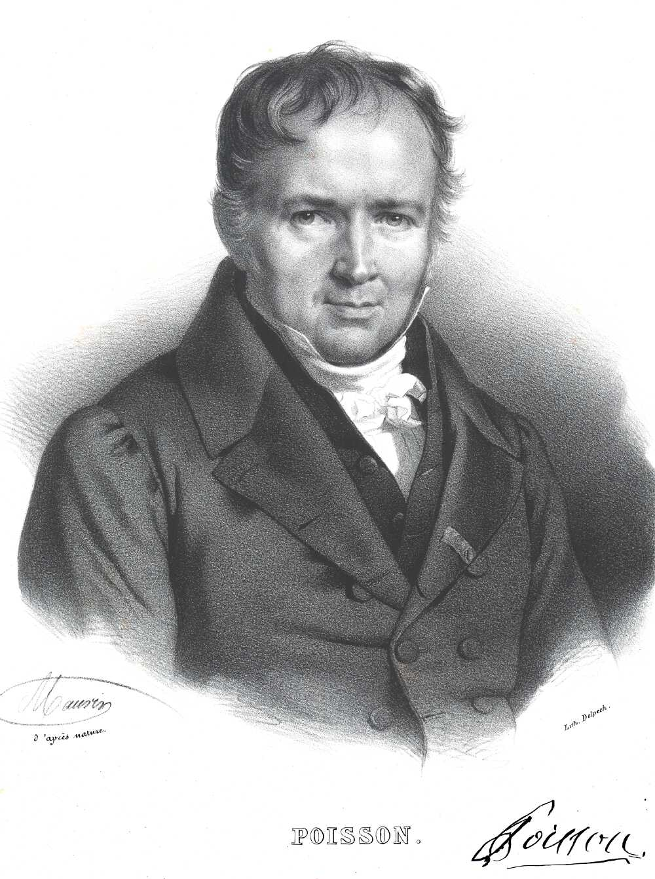

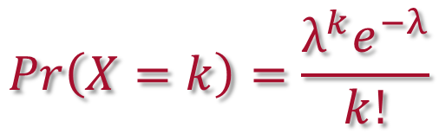

Counts
$$Pr\left(X=k\right)=\frac{λ^{k}e^{−λ}}{k!}$$
Usually assumed to have a Poisson Distribution
$$k∈ℕ$$
Notes:
If you know me, you know I like to talk about where these distributions get their names. This is Simeon Denis Poisson, a French physicist and mathematician who contributed to a pretty wide collection of fields. He also independently arrived at a derivation of the famous Navier-Stokes equations (our hydraulics friends care about this) after Claude-Louis Navier’s original work.
If you can’t say the name of the distribution or the scientist, you can just call it the fish distribution ☺

Slide 30
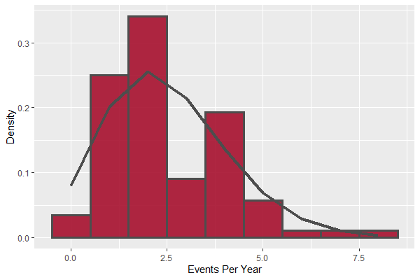
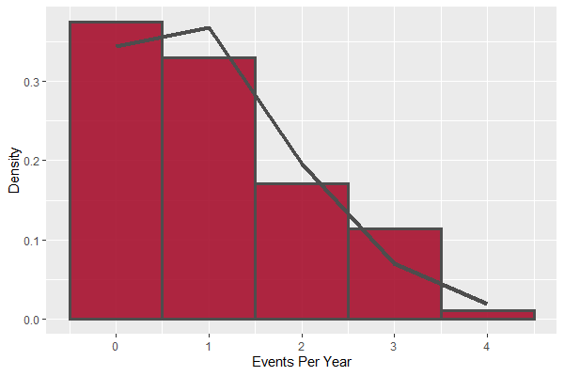
Counts
Threshold choice affects count distribution
1,250 cfs
2.5 / yr
2,500 cfs
1.1 / yr

Slide 31
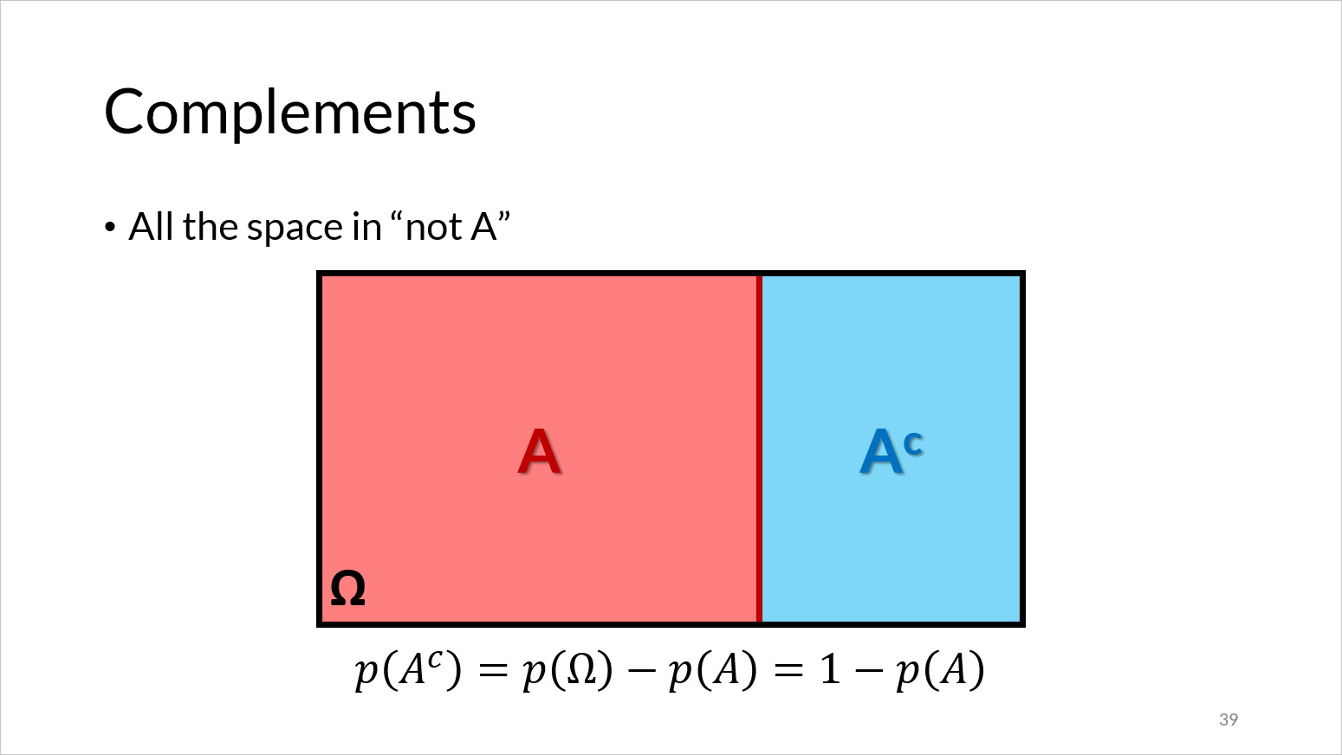
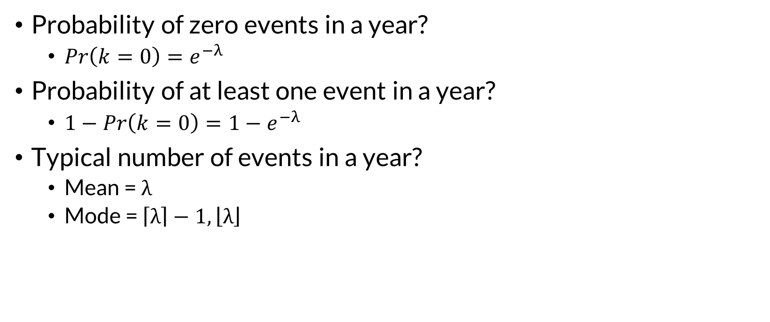
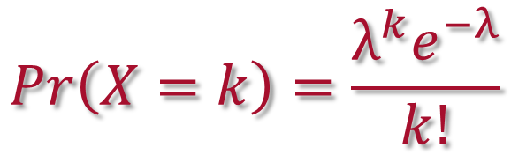
Counts
$$Pr\left(X=k\right)=\frac{λ^{k}e^{−λ}}{k!}$$
Probability of zero events in a year?
  $Pr\left(k=0\right)=e^{−λ}$
Probability of at least one event in a year?
  $1−Pr\left(k=0\right)=1−e^{−λ}$
Typical number of events in a year?
  Mean = $λ$
  Mode = $\left\lceil λ\right\rceil −1, \left\lfloor λ\right\rfloor$
Notes:
When I was in a graduate probability theory class

Slide 32
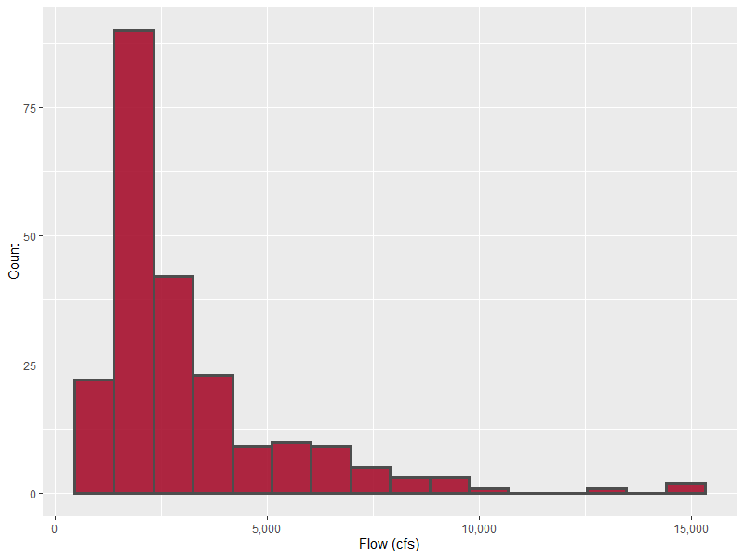
Distribution of Values
Threshold
Model magnitude of values greater than threshold
Tend to cluster close to threshold
Partial Duration Series

Slide 33
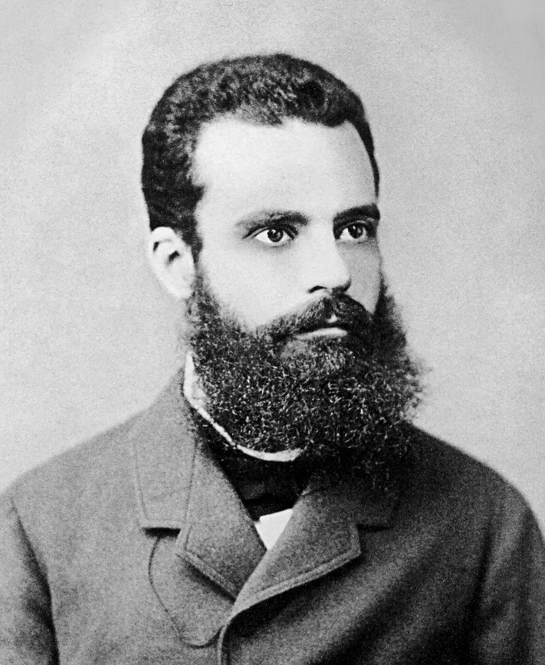
Distribution of Values
Lean on extreme value theory
  We have a model for this situation!
Generalized Pareto Distribution (GPD)
  3 parameters: ξ (location) α (scale) κ (shape)
For more information, come to the Statistical Methods class!
Vilfredo Pareto
Notes:
Pareto is so hipster he was hipster before it was cool. Pareto was a civil engineer and later an economist whose most famous contribution is the 80-20 distribution of income that applies to many other power law situations.

Slide 34
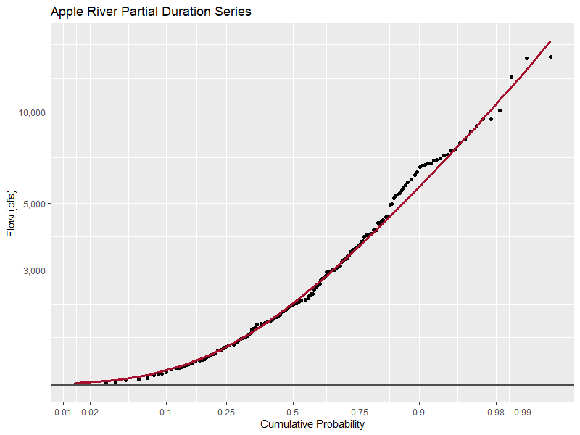

Distribution of Values
Cumulative probability, given the values exceed the threshold
NOT AN AEP
GPD Fit to PDS
Threshold = 1,250 cfs

Slide 35
Interpreting the Distribution
50% of floods that exceed 1,250 cfs are greater than 2,330 cfs
1% of floods that exceed 1,250 cfs are greater than 13,400 cfs
Threshold = 1,250 cfs

Slide 36
Computing AEP from PDS

Slide 37
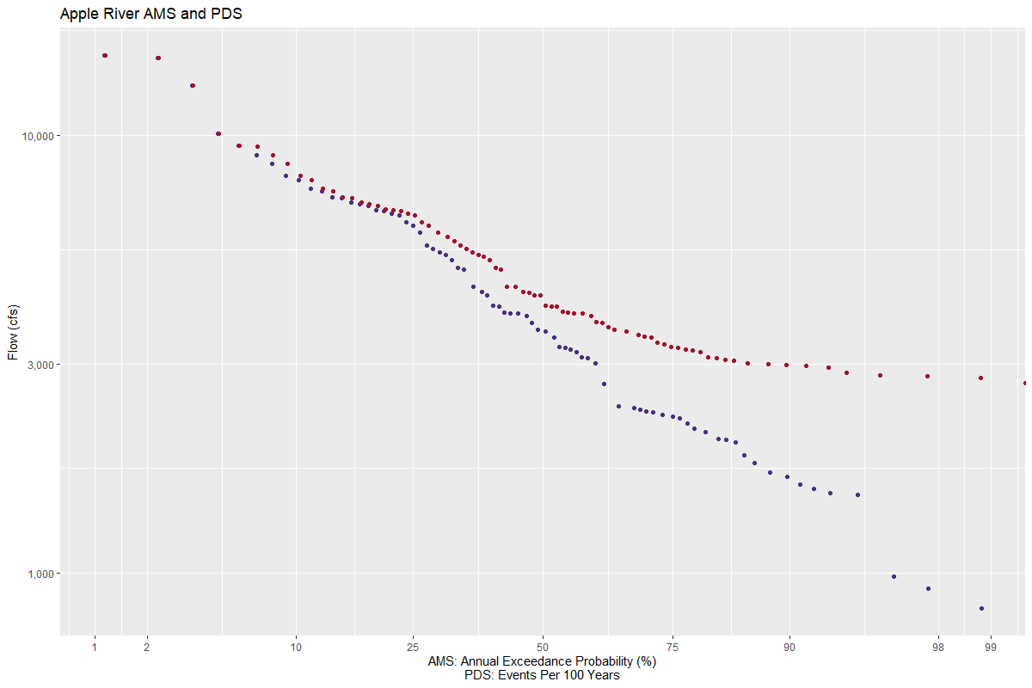
See EM1110-2-1415
Section 2-4.f
PDS plotted at i / n
AMS plotted at i / n+1
133 other events
n = 87 years
Notes:
The top yellow circle is where we get our first event that is in the PDS but not in the AMS – a secondary peak. These only become more likely and possible as we get lower and lower flow events, causing the divergence between the two.
The lower right circle is the 1-year event. It’s not possible in an AMS, but it is in a PDS – and it’s the event you expect to exceed at least once per year (or 100 times in 100 years).

Slide 38
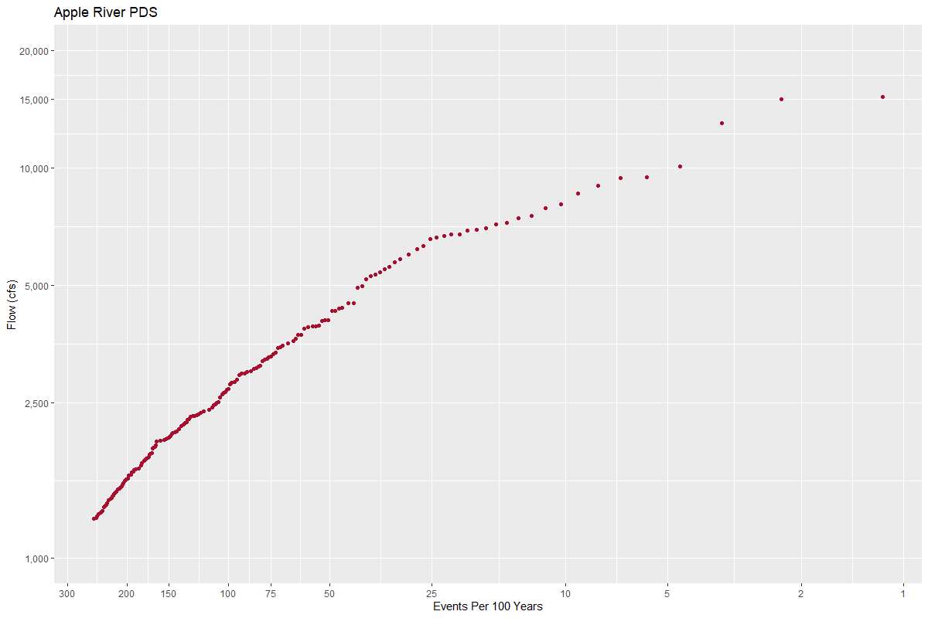
See EM1110-2-1415
Section 2-4.f
All 220 events
Notes:
This is just looking at the PDS events without the AMS, and we’ve rescaled the x-axis and flipped it. The higher yellow circle is the 1-year event again (100 events in 100 years on average), and the lower one is 200 events in 100 years, a magnitude you expect to see exceeded twice per year on average.

Slide 39
Annual Exceedance Probability
AMS analysis provides AEP events
PDS analysis provides conditional exceedance events
We need AEP for things like annualized damages!
  Most of our processes assume one damaging event per year

Slide 40
Computing AEP from PDS
Two general approaches:
Empirical
Analytical
“Annualization”

Slide 41
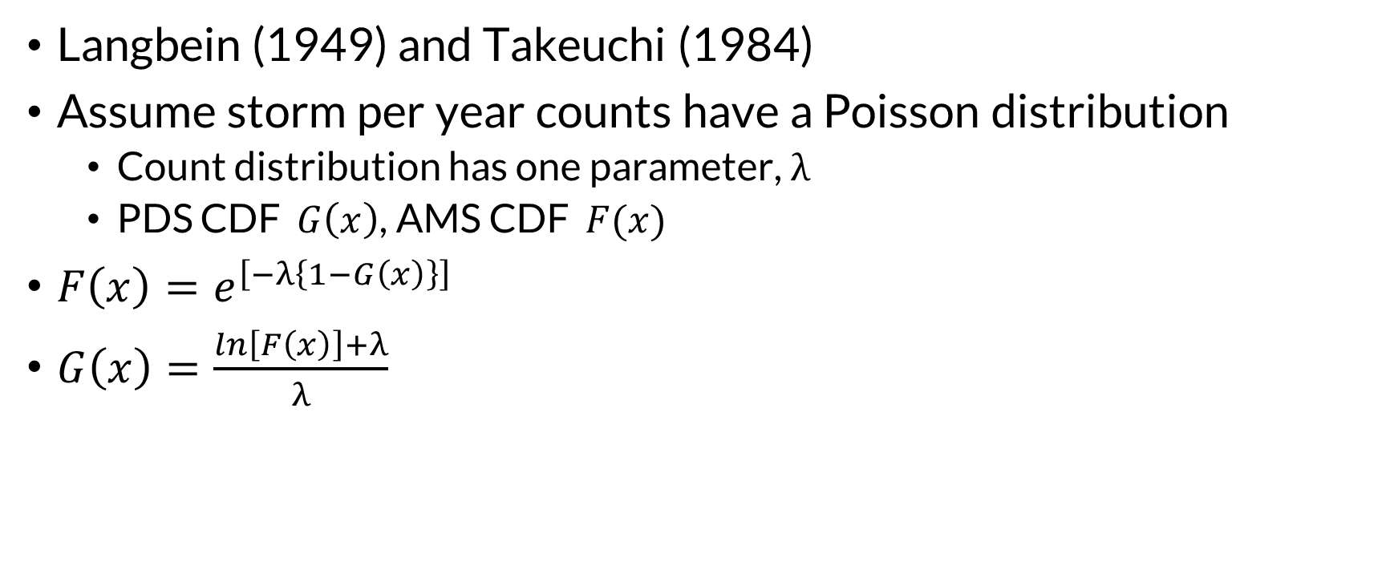
Empirical Annualization
Langbein (1949) and Takeuchi (1984)
Assume storm per year counts have a Poisson distribution
  Count distribution has one parameter, λ
  PDS CDF $G\left(x\right)$, AMS CDF $F(x)$
$F\left(x\right)=e^{\left[−λ\left\{1−G\left(x\right)\right\}\right]}$
$G\left(x\right)=\frac{ln\left[F\left(x\right)\right]+λ}{λ}$
Values between (0, 1)
For AMS, 1-AEP

Slide 42
Applying Empirical Annualization
Get AEPs you want to compute
Convert them to PDS CDF values
Plug them into your GPD distribution quantile function
Can also be used to plot observed peaks
  Convert the plotting positions

Slide 43
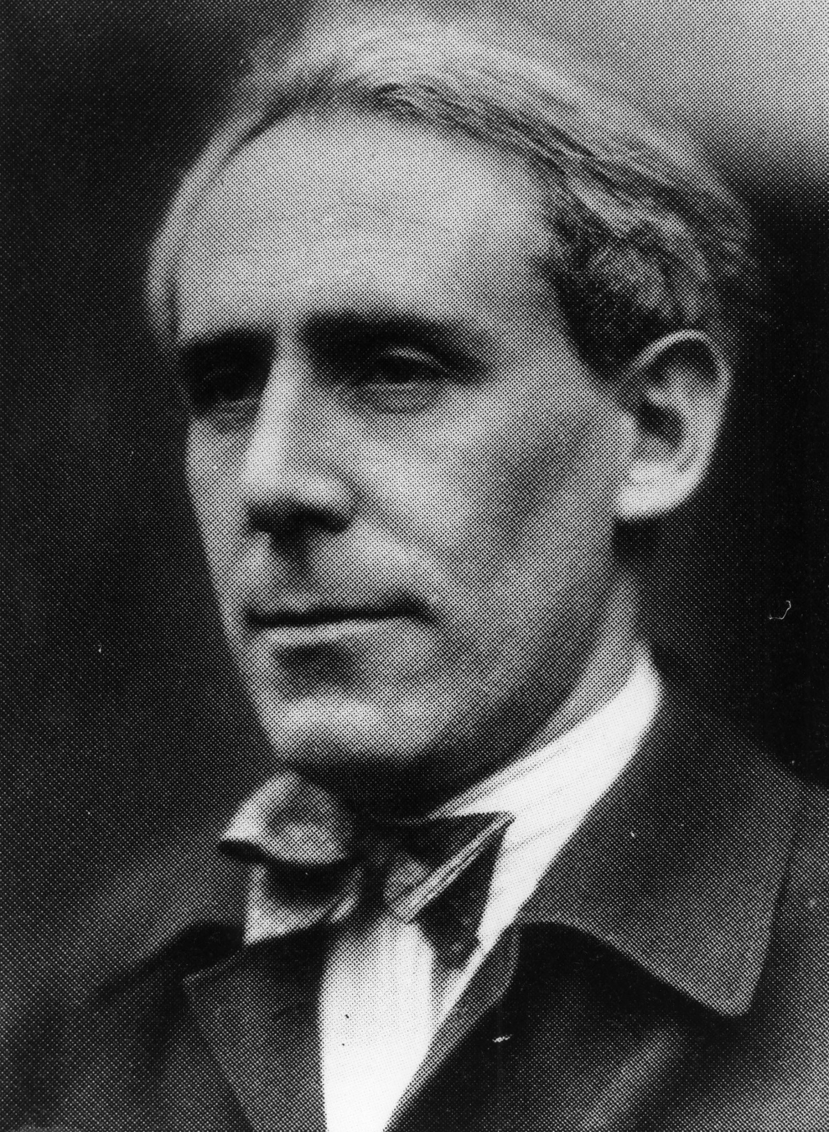
Analytical Annualization
Stedinger et al. (1993), Madsen et al. (1997)
  Generalized Pareto + Poisson → Generalized Extreme Value
Have:
  Poisson parameter λ
  Generalized Pareto parameters ξ, α, κ
Get:
  GEV* parameters ξ*, α*, κ*
E.J. Gumbel
$ξ^{∗}=ξ+\frac{α}{κ}\left(1−λ^{−κ}\right)$ $α^{∗}=αλ^{−κ}$ $κ^{∗}=κ$

Slide 44
Applying Analytical Annualization
Compute equivalent GEV* parameters from GPD/Poisson
Plug AEP values into GEV* quantile function

Slide 45
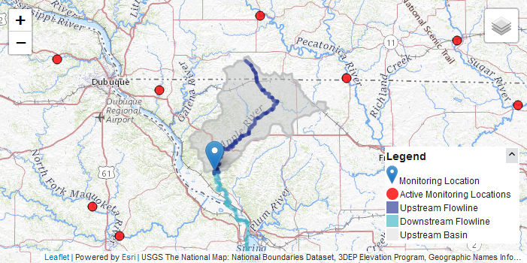
Fit and Annualization Example
Apple River at Hanover, IL
  246 mi²
  WY1935-2021
  Daily average flows
  Unregulated
  Little urbanization
Notes:
Anyone know which USACE District this is in?

Slide 46
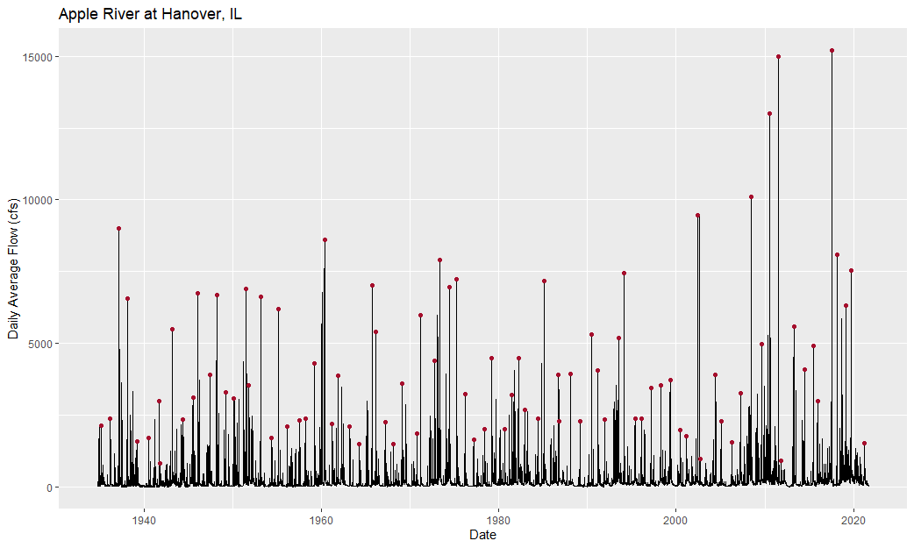
Annual Maximum Series (Daily)
Min = 830 cfs
Mean = 4,388 cfs
Max = 15,200 cfs
Notes:
The AMS has some small peaks that might not really be considered floods, and there are some independent large events that are not annual maxima.

Slide 47
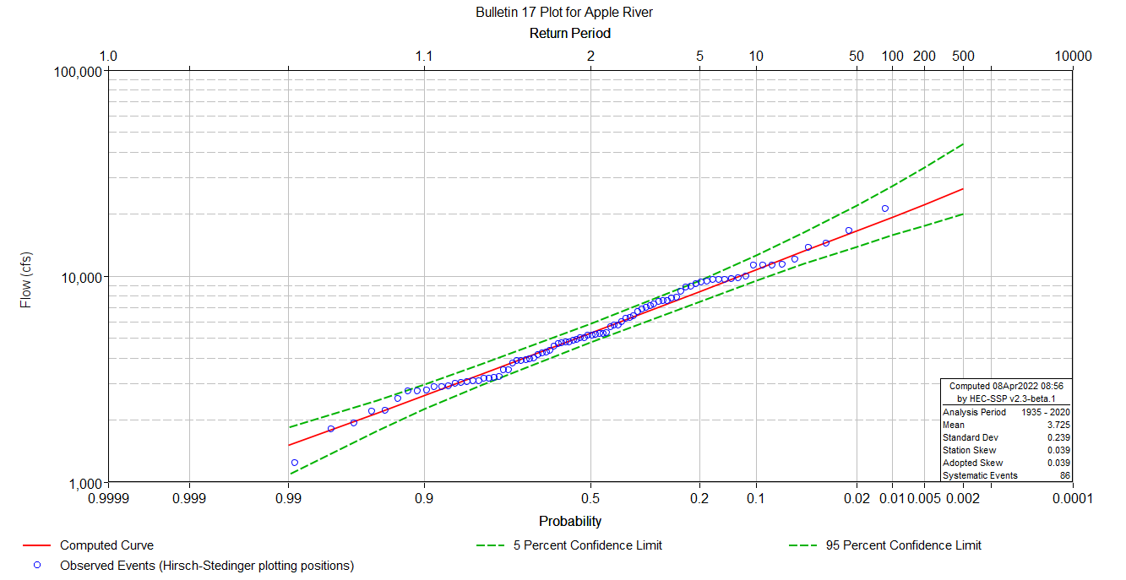
Annual Maximum Series (Peak)
LP3-EMA

Slide 48
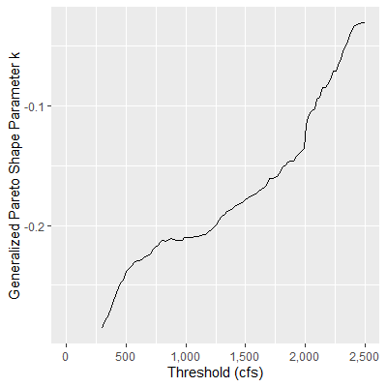
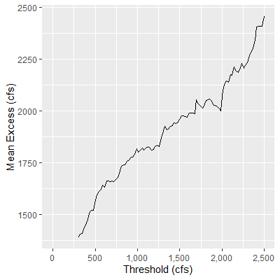
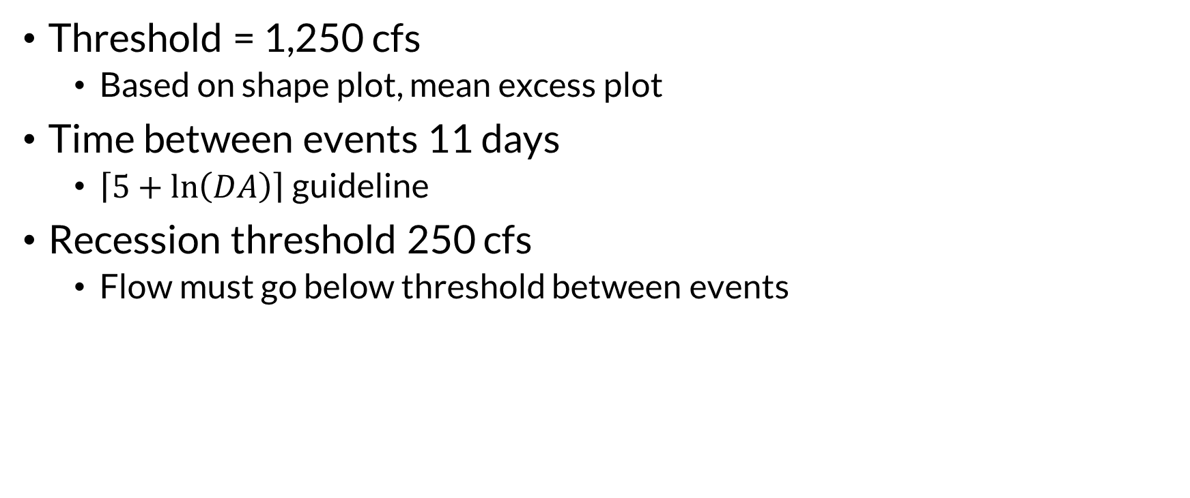
Filtering for PDS
Threshold = 1,250 cfs
  Based on shape plot, mean excess plot
Time between events 11 days
  $\left\lceil 5+\ln\left(DA\right)\right\rceil$ guideline
Recession threshold 250 cfs
  Flow must go below threshold between events

Slide 49
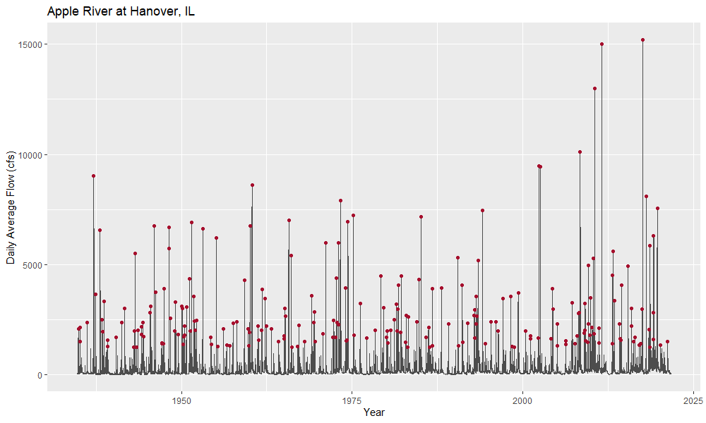


$$λ=2.53$$
$$p\left(N>0\right)=0.92$$

Slide 50
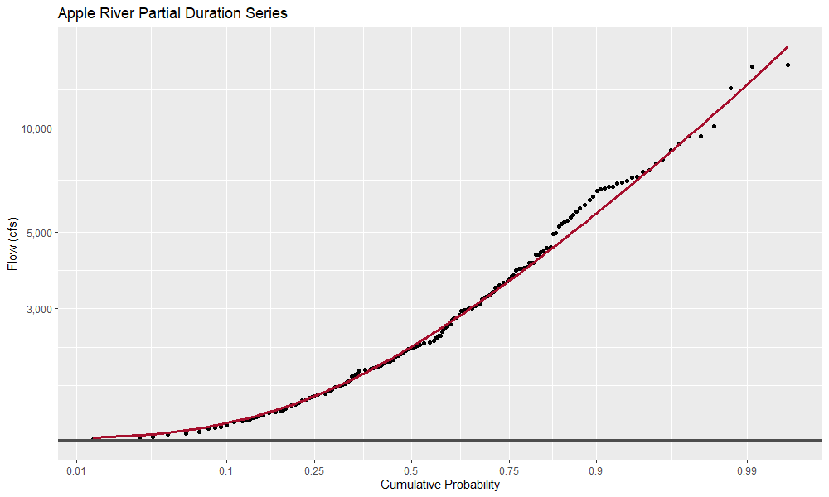



$$ξ=1250$$
$$α=1433$$
$$κ=−0.242$$
Generalized Pareto Distribution
Method of L-Moments
Partial Duration Series
Weibull Plotting Position

Slide 51
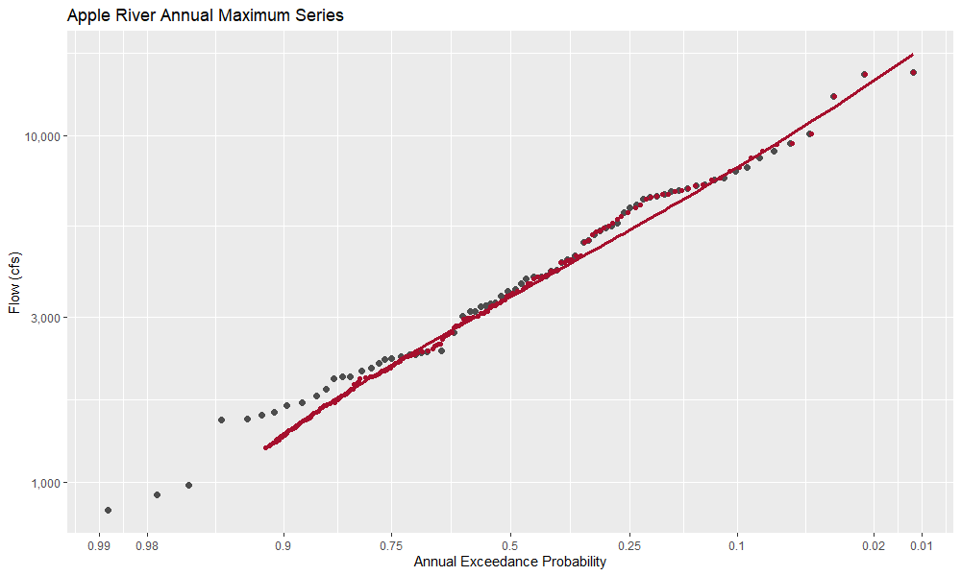

Annual Maximum Series
Weibull Plotting Position
Generalized Pareto Distribution
Partial Duration Series
Weibull Plotting Position
Langbein Adjustment
$$p\left(N>0\right)=0.92$$

Slide 52
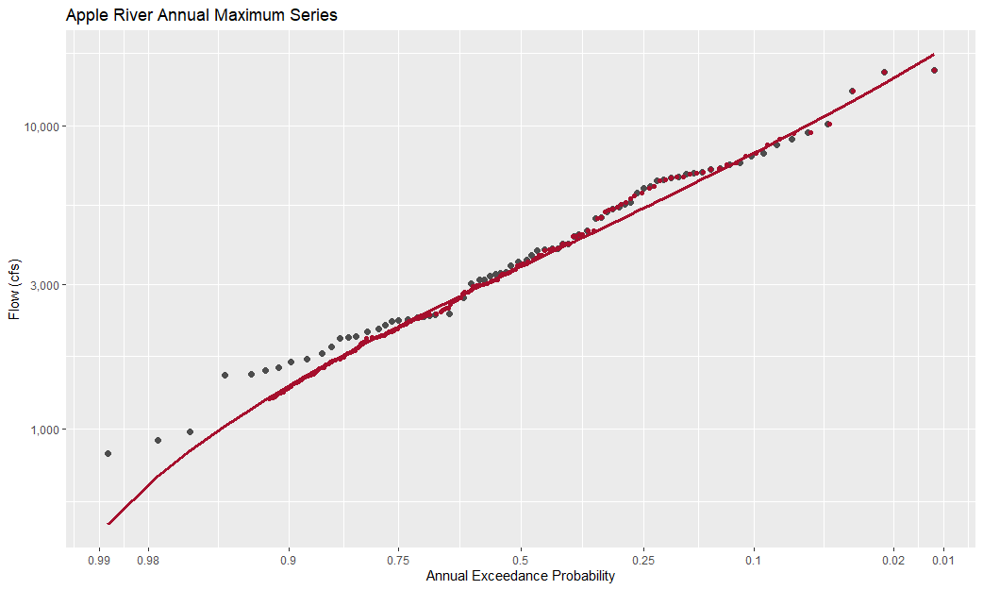
Annual Maximum Series
Weibull Plotting Position
Generalized Pareto Distribution
Partial Duration Series
Weibull Plotting Position
Equivalent GEV Distribution

Slide 53
Why PDS for Streamflow?
Notes:
The case is very strong for precipitation analysis because it’s very easy to delineate discrete events, in comparison with streamflow. There are also many storm events per year that we would naturally consider for a PDS, compared to not as many events we would consider floods.

Slide 54
Partial Duration Series Limitations
Usually has to be done on daily average data
  Instantaneous data have a short record
  Requires approximation of peaks
Takes extra work to ensure independence
Some subjectivity involved
  Choosing a threshold and separation criteria can be hard!

Slide 55
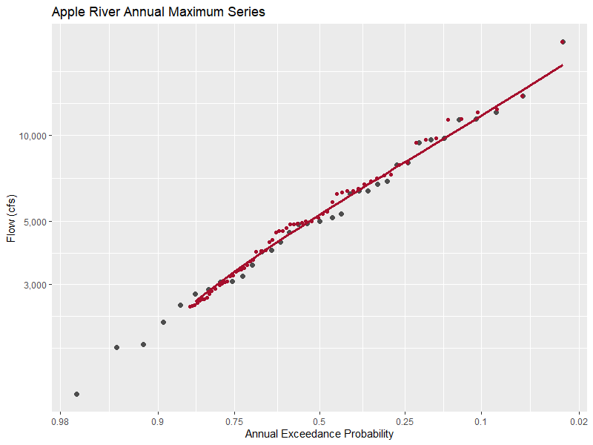

PDS with Instantaneous Data
Shorter record, but:
  No conversion
Threshold = 2,500 cfs
$$λ=1.91$$

Slide 56
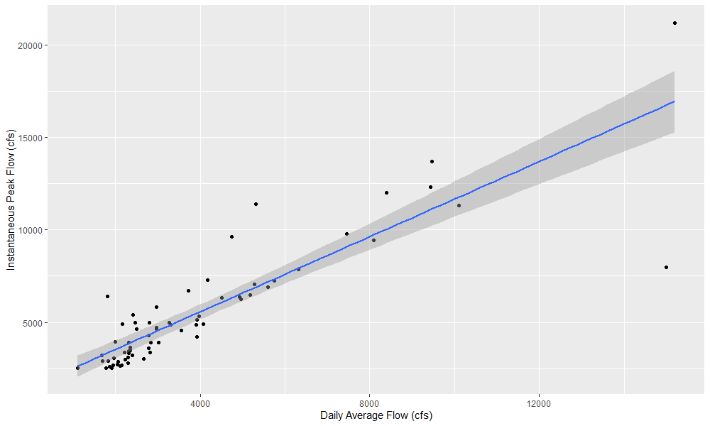
Approximating Peaks
Average ratio = 1.51
Notes:
This is the coincidence of the PDS from instantaneous peaks with the corresponding daily average values. One downside to daily average is that these are calendar day averages, which means events can be split across a couple days resulting in a low average (like that one in the lower right.)
In this situation I’d be more inclined to use the average ratio than trying to use regression because of that bad outlier. (Yikes factor is off the charts on this regression)

Slide 57
Partial Duration Strengths
Sample sizes often larger than AMS
More samples of floods
Automatic rejection of small annual maxima
Lower error in estimating rare quantiles in many circumstances
Samples are easier to sub-divide
  Good for mixed population analysis
Biggest limitation: short records of instantaneous secondary/tertiary peaks

Slide 58
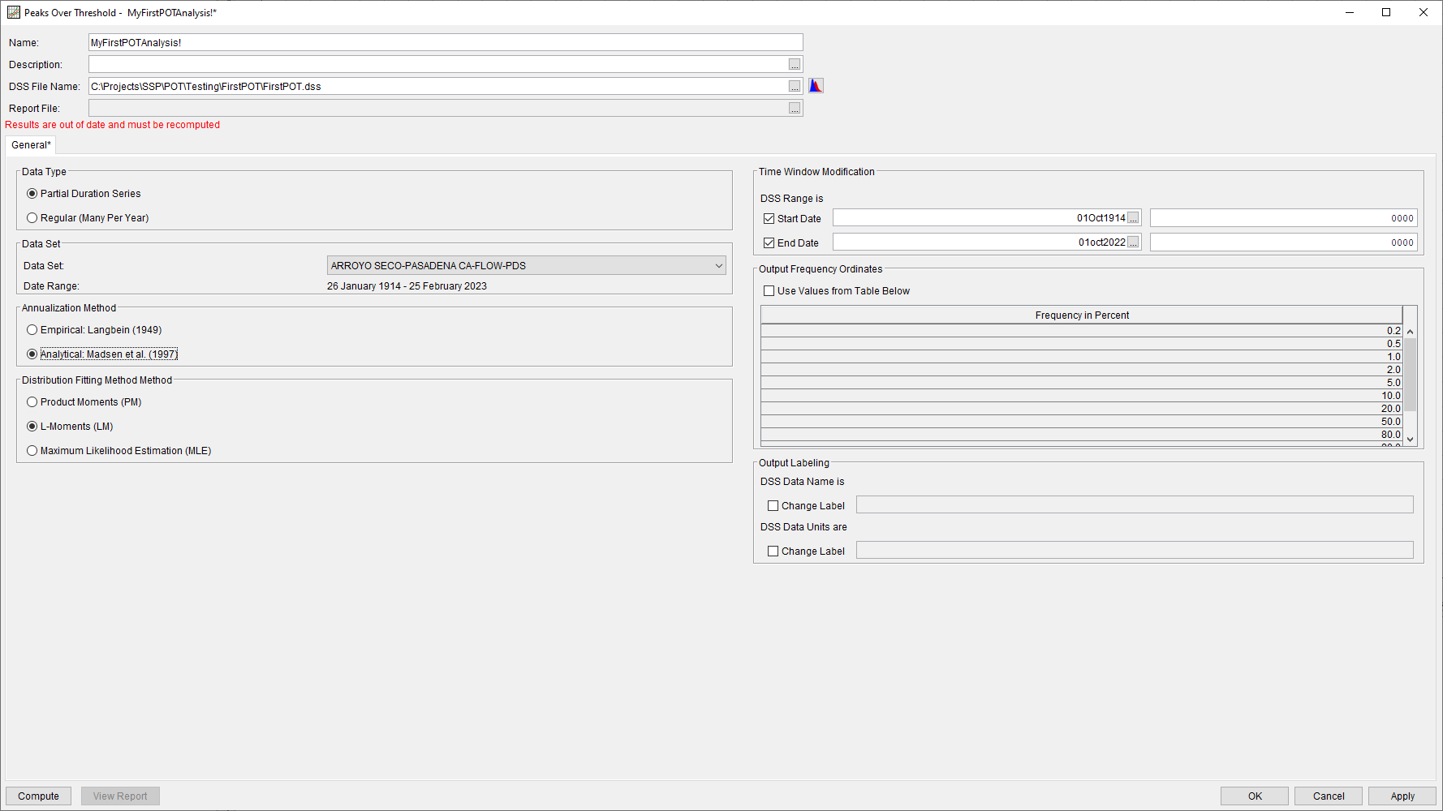
The Future
Work is underway to build a POT analysis in HEC-SSP

Slide 59
Questions?

Slide 60
Mixed Populations
Bonus Material

Slide 61
Mixed Population
Split the PDS by flood-causing mechanisms
Bigger sample size for each part compared to splitting AMS

Slide 62
Seasonal Analysis Example (Apple River)
Season 1
Season 2
Nov – Apr
1.75 events/year
Mean event = 2,800 cfs
Snow/synoptic meteorology
May – Oct
1.10 events/year
Mean event = 3,500 cfs
Convective meteorology

Slide 63
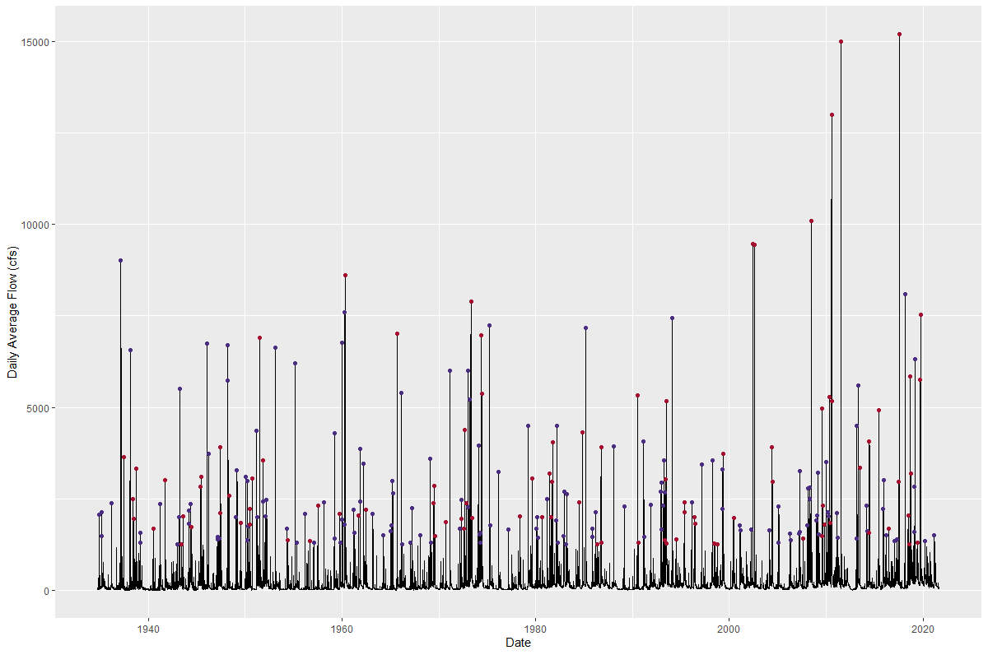
Season 1
Season 2

Slide 64
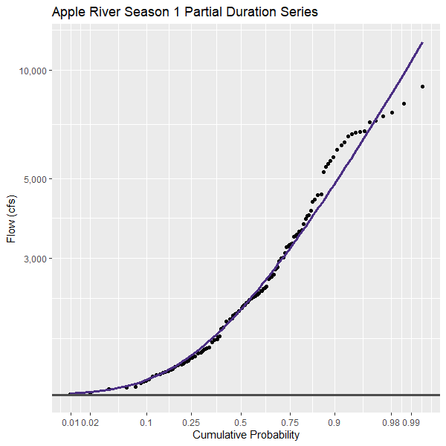
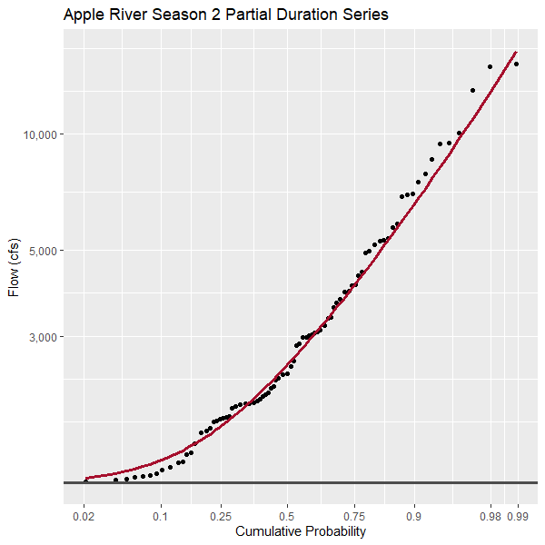
Season 1 GPD
Season 2 GPD

Slide 65
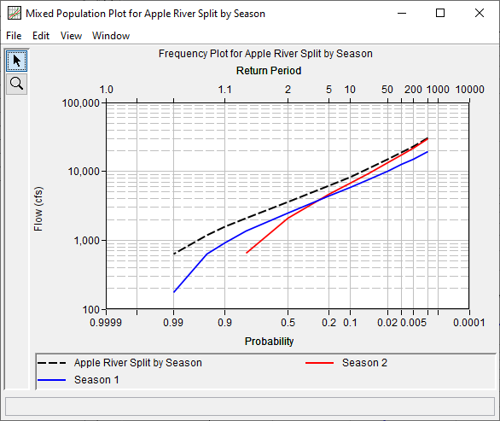
Analytical annualization
Compute mixed curve from equivalent GEV

Slide 66
