Slide 1

Introduction to HEC-SSP
Mike Bartles, P.E.
US Army Corps of Engineers
Hydrologic Engineering Center

Slide 2
Overview
Provide a brief history of HEC-SSP
Demonstration of HEC-SSP
  Import, inspect, and manipulate data
  Create, compute, and visualize results of various analyses
Detail DSS usage and conventions within HEC-SSP
2

Slide 3
History, Status, Future…
HEC-FFA, STATS, and REGFRQ developed by HEC in response to Corps statistical needs in 1970’s
Evolved with addition of new capabilities and platform support
In late 1980’s, HEC-FFA, STATS, and REGFRQ reconfigured for PC and UNIX
3
Notes:
Over a period of many years, the Hydrologic Engineering Center has supported a variety of statistical packages that perform frequency analysis and other statistical computations.
Historically, the programs that received the most use within the Corps of Engineers were HEC-FFA (Flood Frequency Analysis) and STATS (Statistical Analysis of Time Series Data).
FFA incorporates Bulletin 17B procedures that have been adopted by the Corps for flow frequency analysis.
The STATS software package is used for statistical analysis of time series data. STATS can provide either analytical or graphical frequency analysis, specified by the user. STATS has the capability of computing monthly and annual maximum, minimum and mean values along with flow-duration analysis.
Two other packages that used to receive a lot of use within the Corps of Engineers are REGFRQ (Regional Frequency Computation) and MLRP (Multiple Linear Regression Program).
REGFRQ performs regional frequency analysis and MLRP is a multiple linear regression analysis tool.

Slide 4
History, Status, Future…
HEC-SSP started development in FY2005
  Gary Brunner, Beth Faber, Jeff Harris, and Matt Fleming
Version 1.0 Beta (Released June 2006)
  Only computation is Bulletin 17B analysis
Version 1.0 (Released August 2008)
  Included General Frequency and Volume Frequency analyses
Version 1.1 (Released April 2009)
Version 2.0 (Released October 2010)
  Included Duration, Coincident Frequency, and Curve Combination analyses
Version 2.1 (Released August 2016)
  Included B17C/EMA methodology and Balanced Hydrograph analysis
Version 2.1.1 (Released January 2017)
  Updated USGS Plugin and recompiled EMA Fortran code
Version 2.2 (Released June 2019)
  Updated EMA code, Mixed Population, and Distribution Fitting analyses
4
Notes:
The goal of HEC-SSP is to ultimately combine all of the statistical analyses capabilities of HEC-FFA, STATS, REGFRQ and MLRP.
New features and additional capabilities will be added in future releases.

Slide 5
History, Status, Future…
TEAM MEMBERS
H&S Division Lead | Matt Fleming
Lead Developer / Project Lead | Mike Bartles
Development and Application | Beth Faber
Development and Application | Greg Karlovits
Development and Application | Avital Breverman
Development and Application | Matt Fleming
Development and Application | Dave Margo
Development and Application | Haden Smith
Development and Application | John England
Development | Mark Ackerman
Development | Paul Ely
Development | Caleb DeChant
Development | Stephen Ackerman
5

Slide 6
History, Status, Future…
New analytical tools to meet Corps needs
  Updated Distribution Fitting Analysis
  Updated Bulletin 17 Analysis
  New Correlation Analysis
  New Record Extension Analysis
Improved user experience
  Easier data input
6

Slide 7
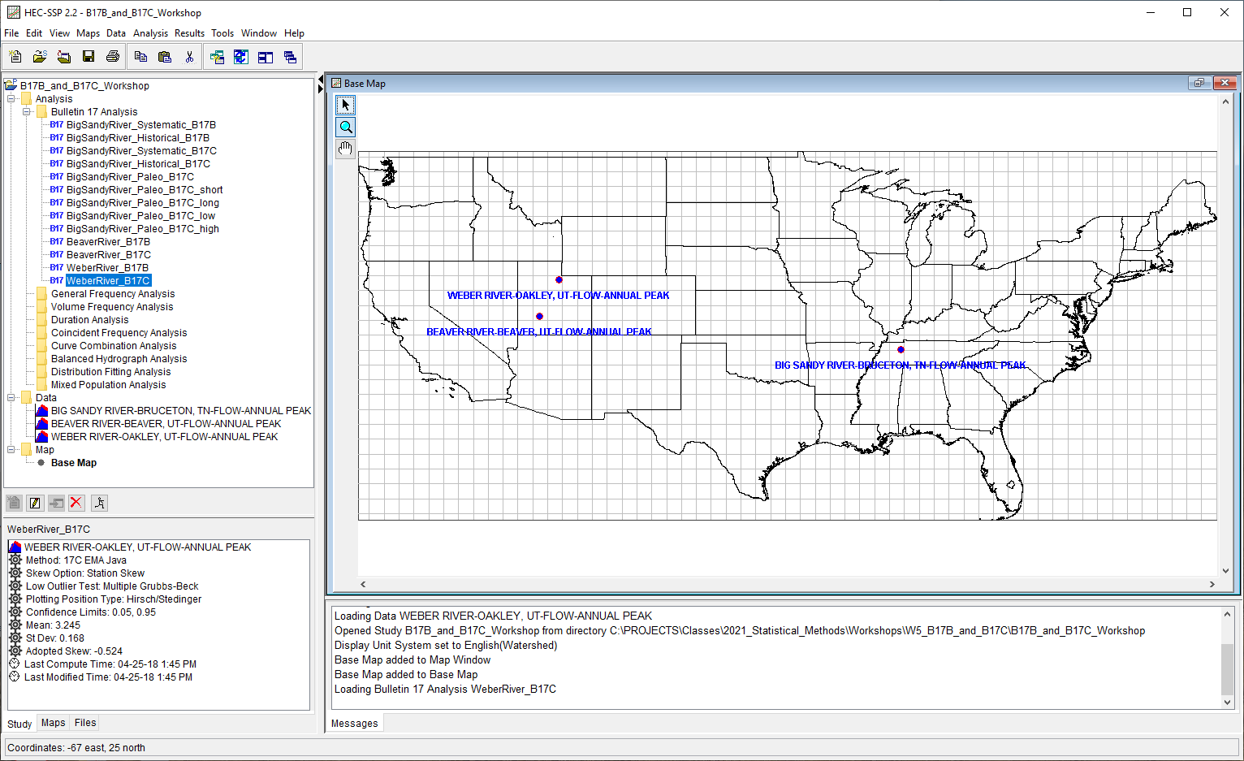
HEC-SSP Software
Study Explorer
Desktop
Summary
Message Window
7
Notes:
The upper right pane (which represents most of the window area) is the Desktop Area. This area is used for displaying maps, data editors, and analysis windows.
The upper left pane is called the Study Explorer. The Study Explorer acts like an explorer tree into the study. The top level of the tree is the study. Below the study is an analyses branch, a data branch, and a map branch. Under the analyses branch, the first level is the types of analysis in the current study. Under each analysis type will be the current user-defined analyses for that type. The data branch lists all of the available data sets that have been brought into the current study. The lower left pane, and associated tabs, also belongs to the study explorer. This window is used to show additional information about items selected in the study explorer tree. The tabs are used to switch to different views within the study explorer window. The first tab, labeled Study, shows the explorer view of the study. The second tab, labeled Maps, lists the available maps and map layers associated with each map. The last tab, labeled Files, shows all of the files that make up the current study.
The Message Window is used to display messages from the software as to what it is doing.
The Summary is used to display summary information about the currently selected node within the Study Explorer.

Slide 8
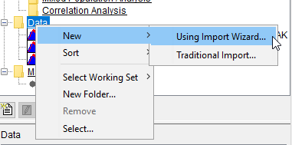
Data Importer
New Import Wizard or Traditional Import
Import Time Series and Paired Data
DSS, USGS website, manual entry, Excel, and text files
Importing Data Tutorial
8

Slide 9
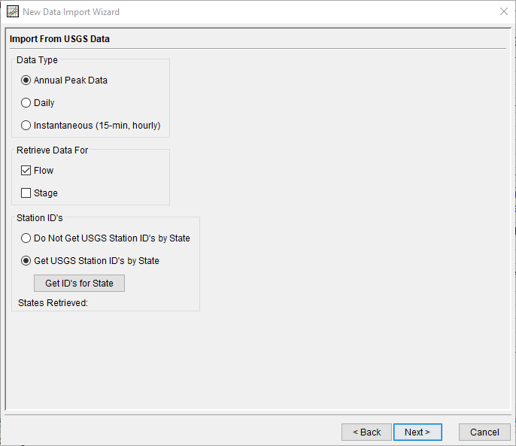
Data Importer - USGS Website
9

Slide 10
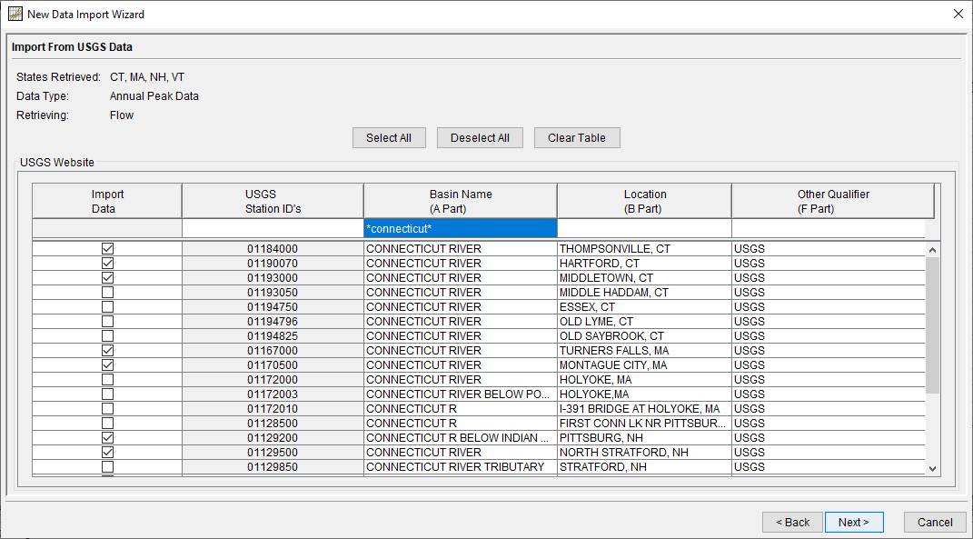
Data Importer - Multiple State Searches
10
Notes:
Here’s an example showing how multiple gages along a river that passes through multiple states can be searched, selected, and downloaded all at once. This is especially useful for regional frequency analyses.

Slide 11
Background Maps
Background Maps are Optional
Types of Map Layers:
  Internet Maps (Google, Bing, OSM), Shapefiles, rasters, Google Earth .kml, etc
Gage Locations displayed on top
Map is interactive for Editing Data and Viewing Results
11
Notes:
By default, when you start a new project in HEC-SSP a default map window (called Base Map) will open in the Main View window pane. Having a background map is optional in HEC-SSP. Not having a map does not prevent the user from importing and entering data, or performing an analysis and viewing results. The map is mostly a visual aid of the study area. Additionally, when you bring in gage data you can enter the map coordinates of the gage and it will show up on the map. Once a gage is located on the map you can right click on it and get a pop up menu for editing the data, or graphing and tabulating the results.
To add a map layer to the default map, go to the Maps menu and select Add Map Layers. When this option is selected a file chooser window will appear allowing the user to select map layers to bring into the map. The Create Copy option on the window will make a copy of the selected map and place it in the Maps subdirectory of the study.

Slide 12
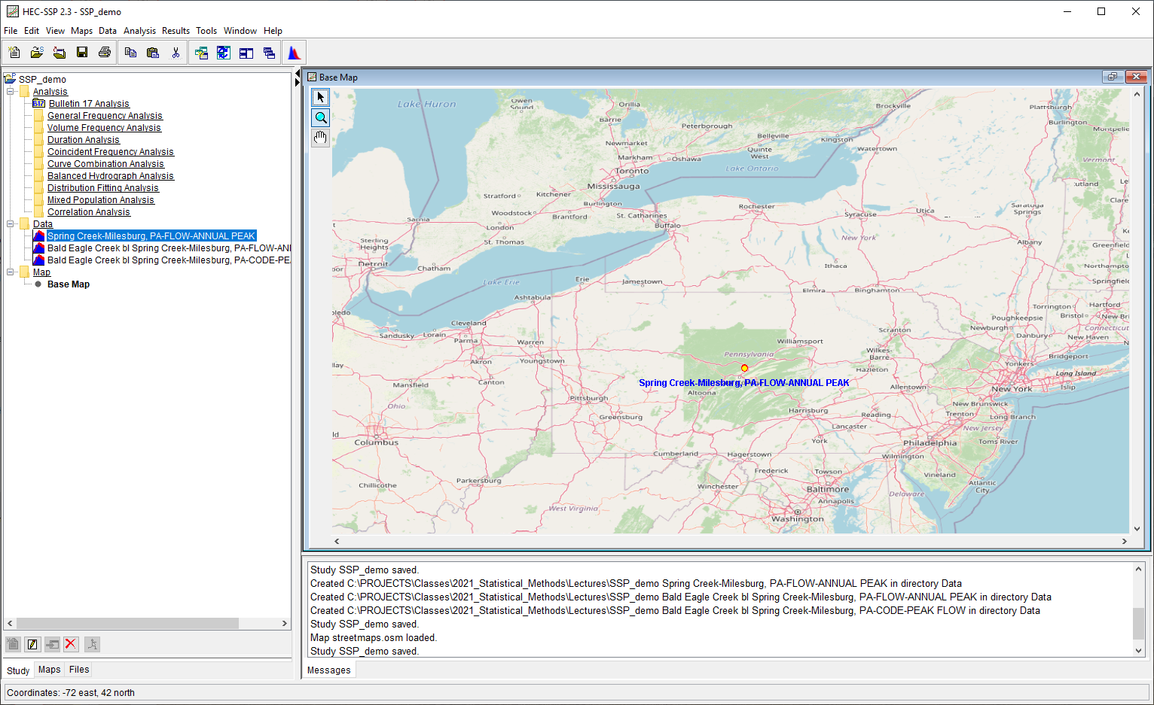
Example Background Map
12
Notes:
An example map is shown in the figure above. This is an internet map from Open Street Maps.
If more than one map layer is going to be used to make up a map, then it is up to the user to ensure that all map layers are in the same coordinate system. HEC-SSP does not perform coordinate system projections, it will only display map layers that are in a consistent coordinate system. Also, HEC-SSP can not always determine the coordinate system for all map layers entered. However, under the Maps menu item is an option called Default Map Properties. This menu option can be used to set the default coordinate system for the map layers displayed in HEC-SSP. The user should set the default coordinate system first, then begin to bring in map layers to the study.

Slide 13
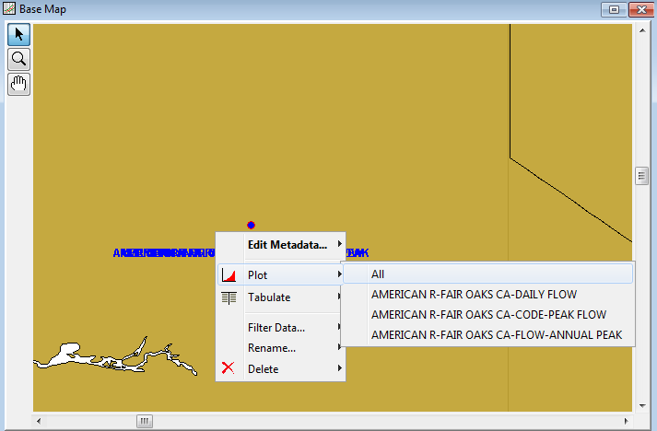
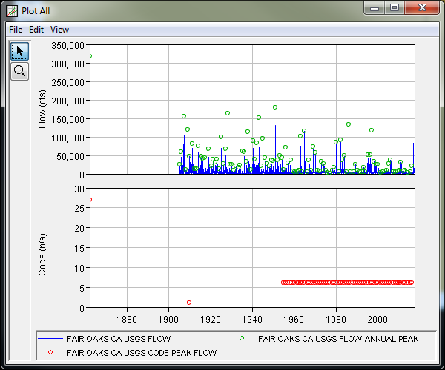
Data Visualization
13

Slide 14
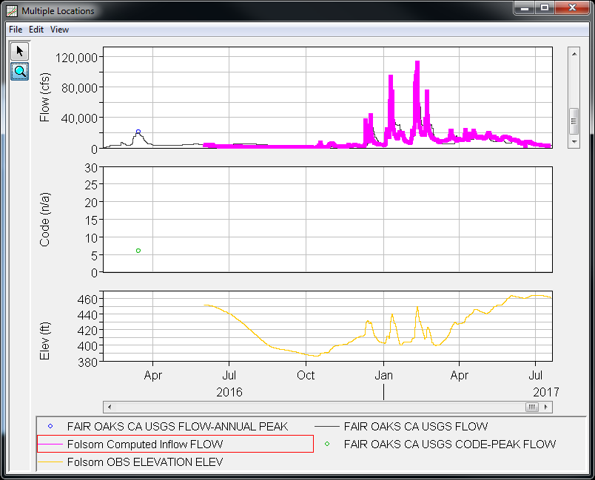
Data Visualization
Clicking on a legend item will highlight the selected curve
14

Slide 15
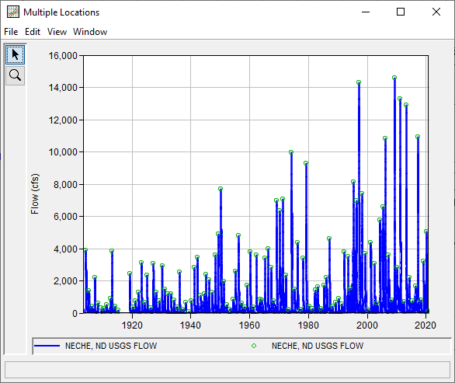
Data Visualization
15

Slide 16
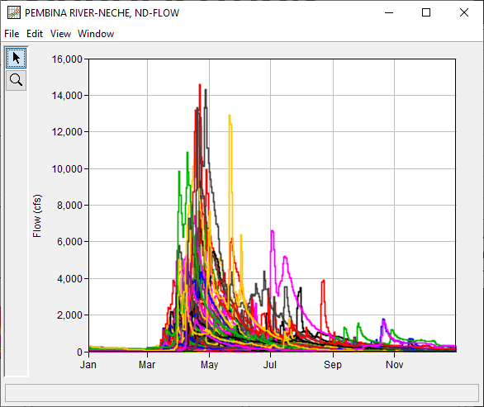
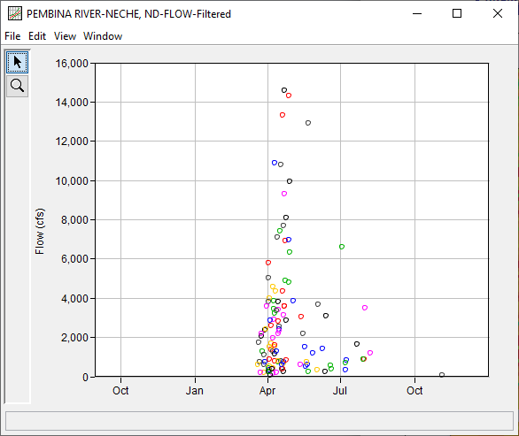
Data Visualization
Daily Average Flow
Annual Maximum Daily Average Flow
16

Slide 17
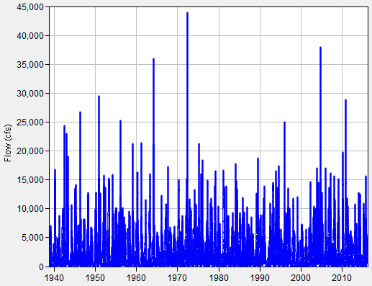
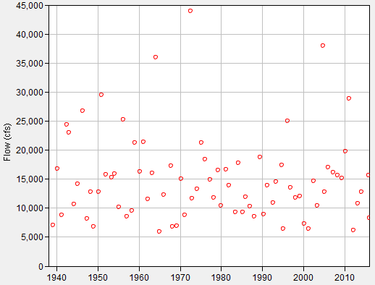
Data Filtering
Original Data
Filter data using:
  Time Window
  Season
  Min/Max Threshold
  n-day Duration
  Annual Maxima
  Peaks Over Threshold
  Starting Pool Stage/Elev
Data Filtering Examples
Filtered Data
17

Slide 18
Data Storage System (DSS)
Data is stored within the file in “blocks”, for example:
  Time Series (hourly data stored in months)
  Paired Data (flow vs stage curve w/ single stage axis and multiple flow axes)
  Gridded (single radar scan)
Multiple blocks may make up a single “data set”, e.g., 50 years of hourly data is one data set
Each block is called a “record”
A HEC-DSS file can have many records
Name of a record is called a “pathname”
Each pathname within a file must be unique
18

Slide 19
DSS - Time Series Data | Pathnames
Pathname self-documents the data
Consists of 6 parts, separated by forward slashes “/”
Parts are labeled A – F: “/A/B/C/D/E/F/”
Each part can be 0 to 64 characters long
A single pathname can be up to 391 characters long
Example:
  /SACRAMENTO/RED BLUFF/FLOW/01MAR1972/1HOUR/OBS/
19

Slide 20
DSS - Time Series Data | Pathnames
/A/B/C/D/E/F/
Part Description
A Group, basin, river, region or study name
B Location or gage name
C Data parameter
D Starting date for block (not 1st data)
E Time interval (standard)
F Version or additional information
/SACRAMENTO/RED BLUFF/FLOW/01MAR1972/1HOUR/OBS/
20

Slide 21
DSS - Conventions
Use optional part names
Be descriptive, but not “overly” descriptive
Please do not do this:
“///FLOW/01JUN1972/1HOUR//” (i.e. no A-, B-, or F-parts)
Instead, do this:
“/BALD EAGLE CREEK/SAYERS/FLOW/01JUN1972/1HOUR/COMPUTED/”
21

Slide 22
DSS - Time Series Data | Interval
Each record contains a “header”
  Data Units (e.g., FEET, CFS)
  Data Type:
    PER-AVER Period Average (daily average flows)
    INST-VAL Instantaneous (15-min flows)
    PER-CUM Period Cumulative (daily precip accumulation)
    INST-CUM Instantaneous Cumulative (incremental precip)
  Time offset (e.g., daily data read at 8:00 am)
Missing data flags (-901.) are used as a place holder
22

Slide 23
DSS - Time Series Data | Regular
Blocks are “standard size” (there are always 365 or 366 values for one year of daily data)
Interval Block Length
1MIN, 2MIN, 3MIN, 4MIN, One day
5MIN, 6MIN, 10MIN, 12MIN
15MIN, 20MIN, 30MIN, 1HOUR, One month
2HOUR, 3HOUR, 4HOUR,
6HOUR, 8HOUR, 12HOUR
1DAY One year
1WEEK, TRI-MONTH, One decade
SEMI-MONTH, 1MON
1YEAR One century
23

Slide 24
DSS - Time Series Data | Irregular
Same as regular-interval, except:
Date and time store with each data value (which makes data sets much larger)
Blocks (E parts) are:
  IR-DAY
  IR-MONTH
  IR-YEAR
  IR-DECADE
  IR-CENTURY
Block sizes are (user) variable length. Try to limit sizes between 100 and 1000 values per block
24

Slide 25
DSS Data within HEC-SSP
Bulletin 17 (and General Frequency) analyses require the use of irregular data sets
  Please use IR-CENTURY
Regular data sets will not be selectable
  If you don’t see the data set you just entered, it’s because it’s not irregular
Volume Frequency analyses require the use of regular data sets
  Use 1DAY
Irregular data sets will not be selectable
25

Slide 26
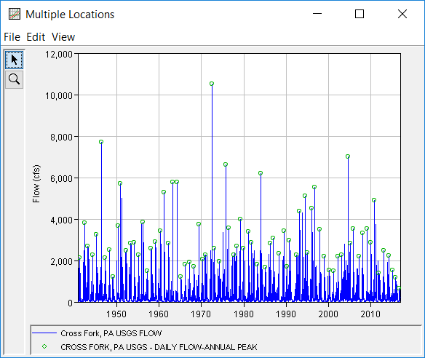
Extracting Annual Maximum or Partial Duration Series
Download data
Right-click | Filter Data…
Select Filter Options
  Absolute Time Window
  Seasonal Time Window
  Min/Max Threshold
  Filter to Annual Maximum Series
  Filter to Partial Duration Series
Data Filtering Examples
Daily Flow
Annual Maximums
26

Slide 27
Calendar Year vs. Water Year
Within SSP, Bulletin 17 analyses using EMA/B17C require that only one peak be present in any given water year
  i.e., If the linked DSS data set contains two values in water year 1969 (01Oct1968 – 30Sep1969), your analysis will not compute
If your watershed has more than one peak in a water year that must be included (e.g., partial duration) or calendar year is more appropriate to use, contact HEC for help
27
Notes:
Water Year: the 12-month period from October 1 to September 30. The water year is designated by the calendar year in which it ends and which includes 9 of the 12 months.
Calendar Year: the 12-month period from January 1 to December 31.

Slide 28
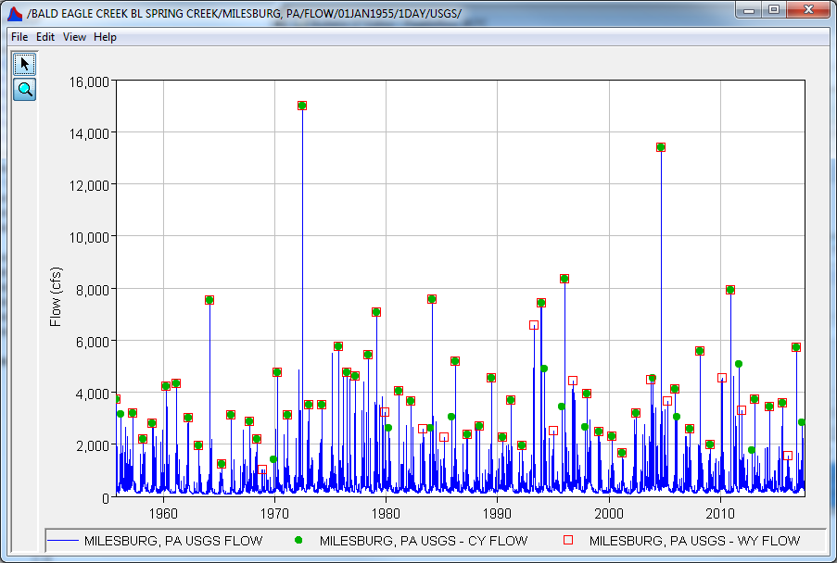
Calendar Year vs. Water Year
Water Year
Calendar Year
28

Slide 29
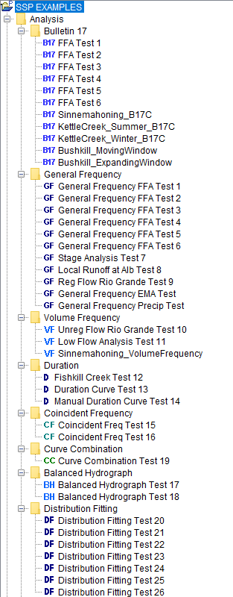
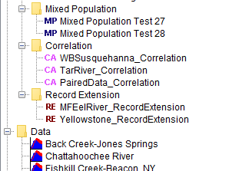
HEC-SSP Analysis Types
Eleven Analysis Types
  Bulletin 17
  General Frequency
  Volume-Frequency
  Duration Analysis
  Coincident Frequency
  Curve Combination
  Balanced Hydrograph
  Distribution Fitting
  Mixed Population
  Correlation
  Record Extension
29

Slide 30
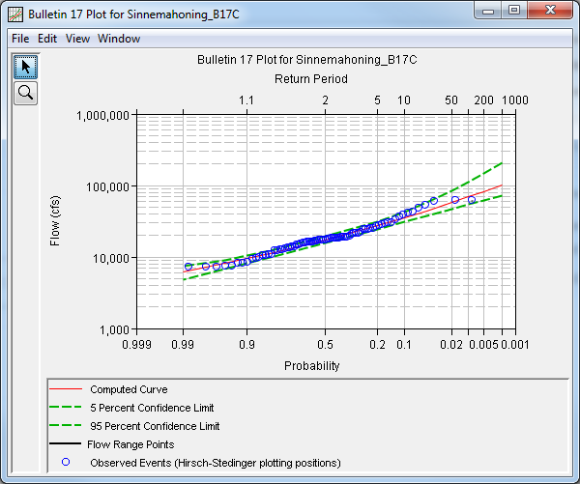
Bulletin 17 Analysis
“Strict” flow-frequency analysis using either Bulletin 17B or Bulletin 17C procedures
Can evaluate moving or expanding time windows
IRREGULAR data required
  IR-CENTURY
Bulletin 17C Examples
30

Slide 31
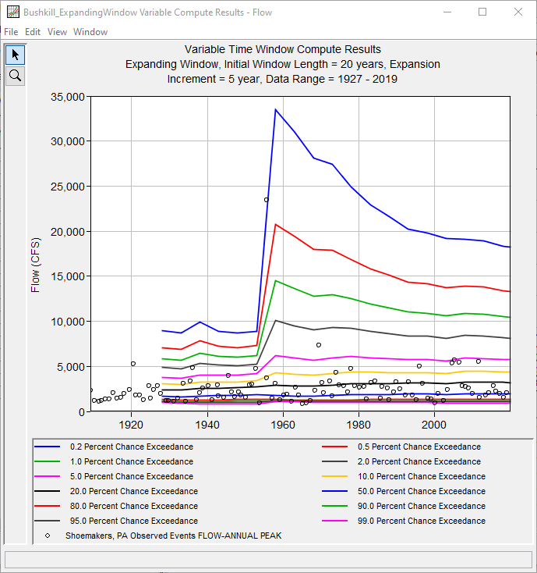
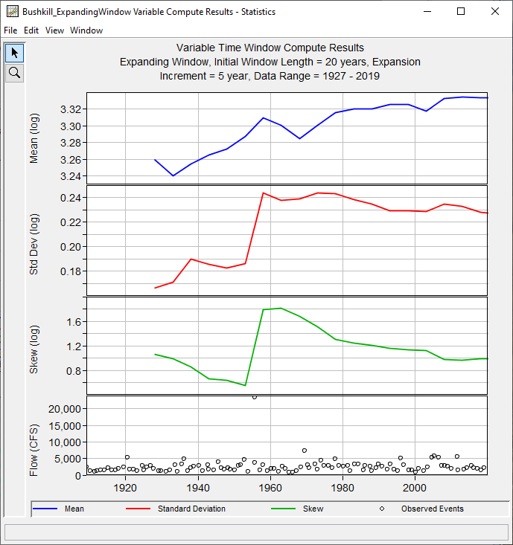
Bulletin 17 Analysis
31

Slide 32
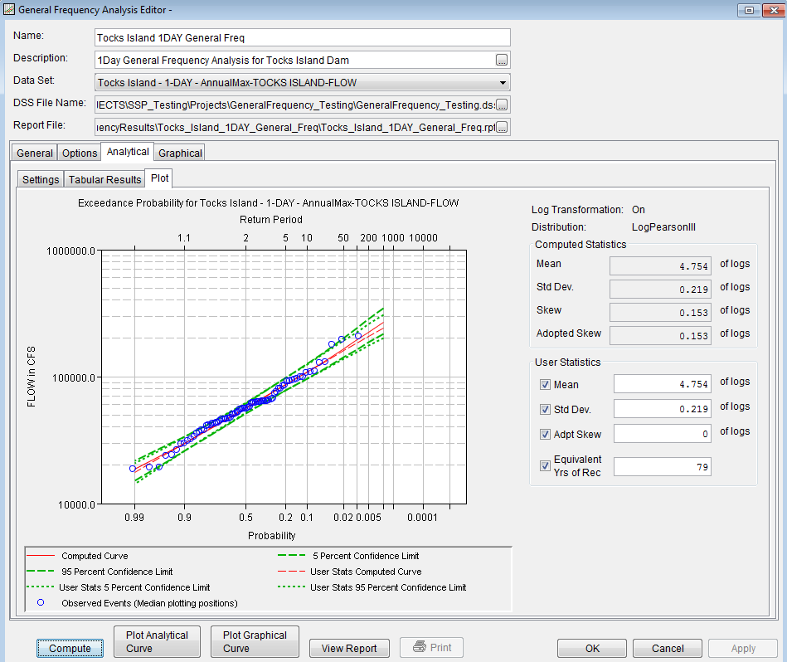
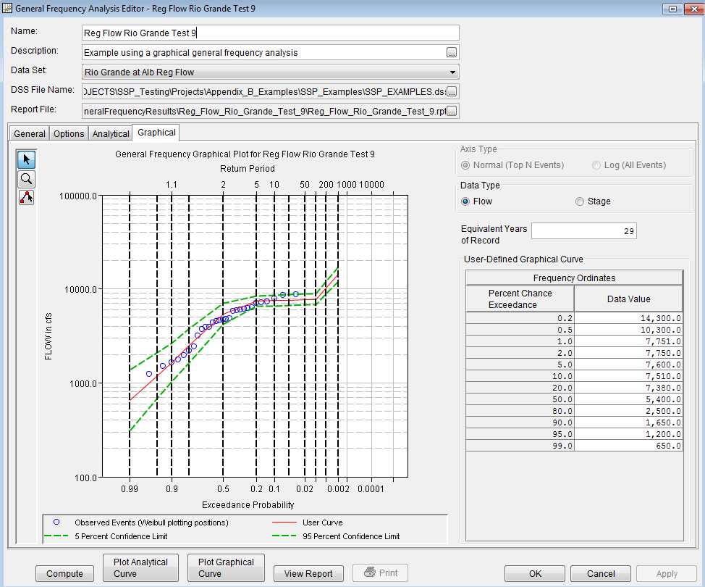
General Frequency Analysis
Analytical
“Less strict” flow-, stage-, precipitation-, etc. frequency analysis
  Mix and match procedures
Numerous analytical distributions
  Product Moments-LPIII
  EMA-LPIII
  Linear Moments-GEV
  Etc.
Manually define distribution parameters
Graphical/Empirical distribution
Annual or Partial Duration series
IRREGULAR data required
  IR-CENTURY
General Frequency Analysis Examples
Graphical
32

Slide 33
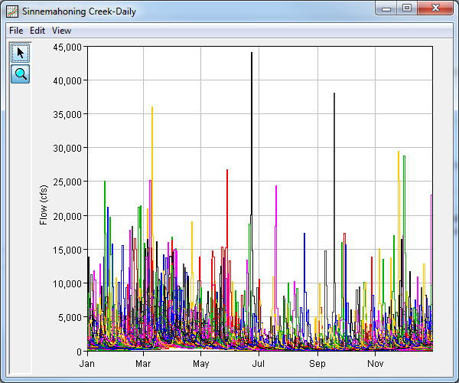
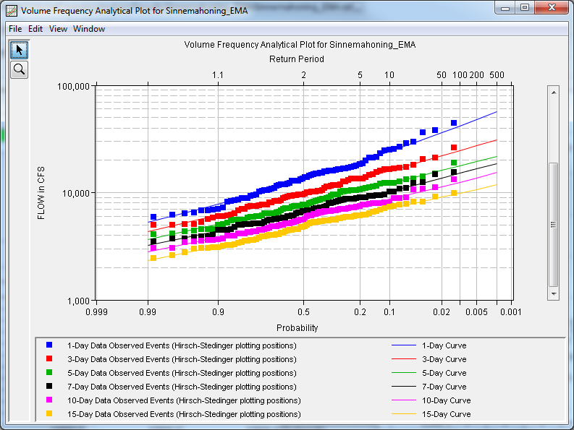
Volume Frequency Analysis
Plot Yearly Data
Iterative/duplicative frequency analysis
  Mix and match procedures
Extract annual maximum series from input data and fit distribution
Numerous analytical distributions
  Product Moments-Normal
  Product Moments-LPIII
  EMA-LPIII
  Etc.
Manually define distribution parameters (i.e., smooth statistics)
Graphical/Empirical distribution
REGULAR data required
  1DAY
Volume Frequency Analysis Examples
EMA-LPIII
33

Slide 34
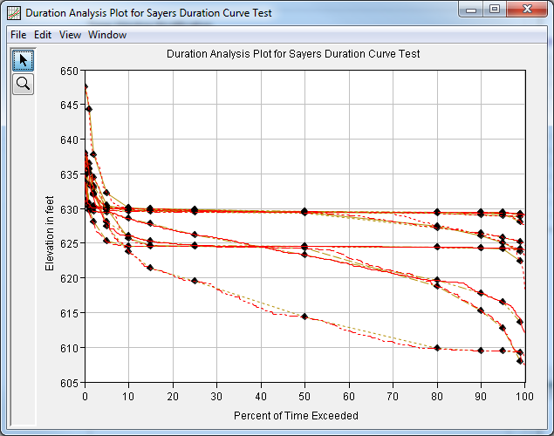
Duration Analysis
Computes Stage- or Flow-Duration
  Percent of time stage/flow was in excess of a certain value
Rank/Sort and STATS methods
Annual, Quarterly, Monthly, or User-Defined Periods
REGULAR data required
  1DAY
Duration Analysis Examples
34

Slide 35
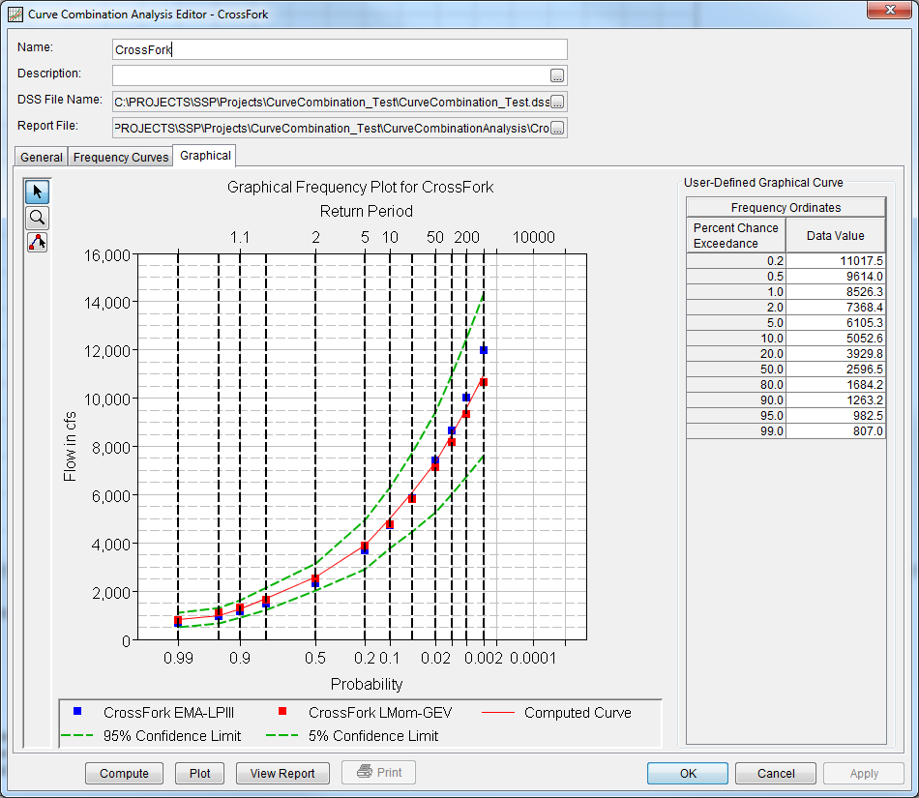
Curve Combination Analysis
Graphically-define an empirical distribution for two or more input frequency curves
  Best-fit pool stage-frequency curve
Results from other analyses can be imported
  Bulletin 17, General Frequency
Curve Combination Analysis Examples
35

Slide 36
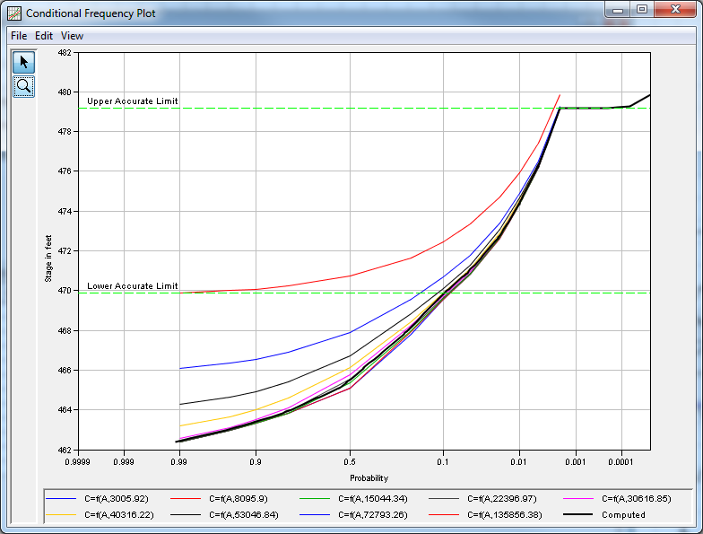
Coincident Frequency Analysis
Uses Total Probability Theorem to compute a frequency curve that is a function of two variables (A and B)
Two conditions are available:
  Variable A and B are independent
  Variable A and B are not independent
Variable A
  Flow- or Stage-Frequency Curve
Variable B
  Index Points from Flow- or Stage-Duration Curve
Response Curves
  Variable A results for each Variable B
  Can have different Variable A for each Response Curve
Coincident Frequency Analysis Examples
36
Notes:
Independence refers to the coincident of inflow magnitude and pool elevation at the beginning of the large flood event.
An independent assumption means that the starting reservoir elevation/storage prior to a flood event is not a function of the magnitude of flood event.
The dependent scenario would be where the reservoir starting elevation/storage is typically higher, or lower, as the magnitude of the flood event increases, or decreases.

Slide 37
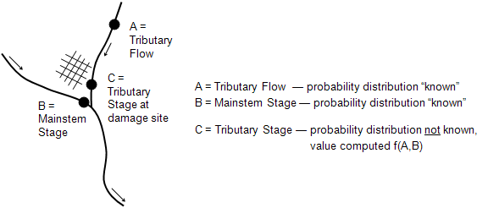
Coincident Frequency Analysis
37
Notes:
A coincident frequency analysis can be performed on any data type, flow, stage, precipitation, wind, etc. The coincident frequency analysis requires both duration and frequency curves. These can be computed by existing analyses in the HEC-SSP study or they can be entered manually in the coincident frequency analysis.
The Coincident Frequency Analysis is designed following guidelines in EM 1110-2-1415. This analysis tool can be used to compute the exceedance frequency relationship for a variable that is a function of two other variables. An example is illustrated above. In this example, the stage at the damage site on the tributary, variable C, is a function of stream flow from the tributary, variable A, and the stage in the mainstem river, variable B.

Slide 38
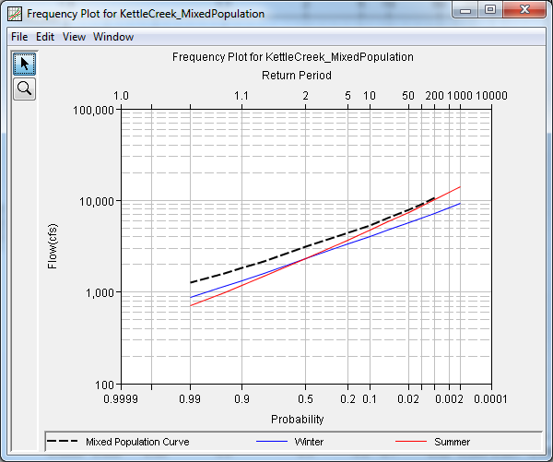
Mixed Population Analysis
Uses Total Probability Theorem to compute a frequency curve from two or more different runoff/causative mechanisms
  Rainfall-only vs rain-on-snow vs snowmelt-only vs tropical storms
  Annual maximum series cannot be fit using the same analytical distribution
  Resultant empirical distribution takes into account the relative probability of a flood occurring in any year due to any of the input runoff mechanisms
Results from other analyses can be imported
  Bulletin 17, General Frequency
Mixed Population Analysis Examples
38

Slide 39
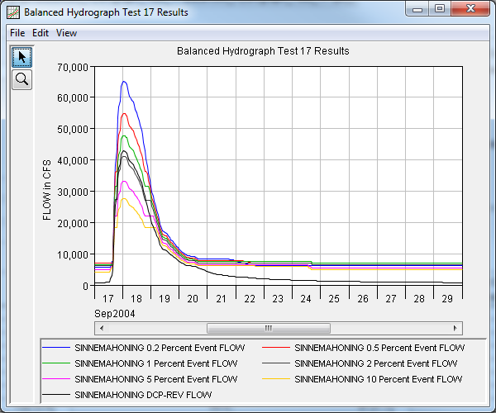
Balanced Hydrograph Analysis
Computes hydrograph shapes that have been modified to contain specific exceedance flow rates/volumes across one or more durations
Results from other analyses can be imported
  Bulletin 17, General Frequency, Volume Frequency
REGULAR data required
  1DAY
Balanced Hydrograph Analysis Examples
39

Slide 40
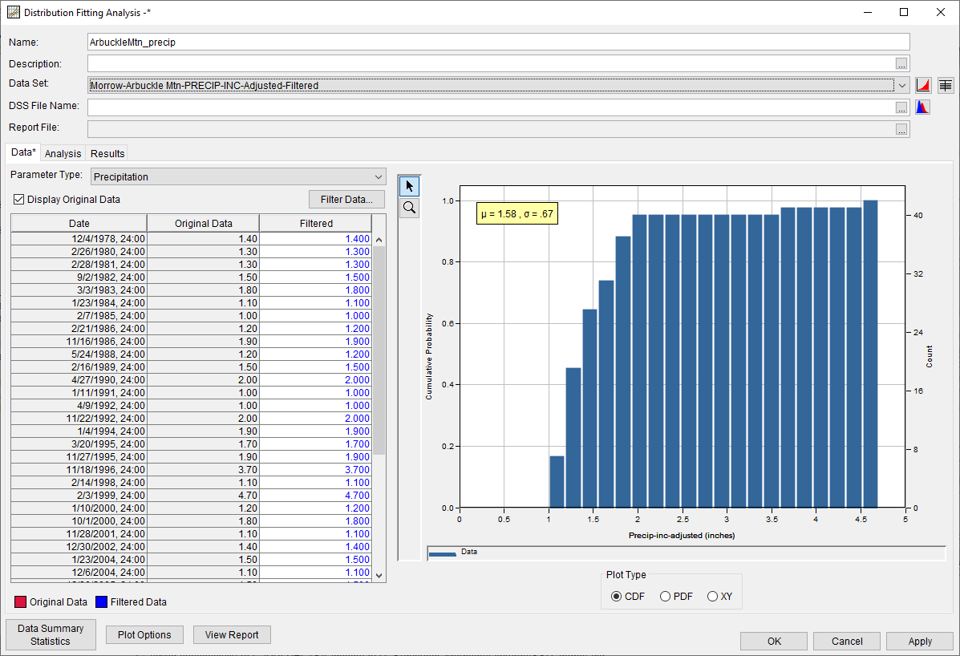
Distribution Fitting Analysis
Have you ever wondered what 19 analytical distributions look like when fit to the same data set?
How much uncertainty is due to the choice of analytical distribution?
IRREGULAR, REGULAR, and PAIRED DATA accepted
Can be used for flow, stage, precipitation, wind speed, wind direction, flood/event seasonality, etc.
Distribution Fitting Analysis Examples
40

Slide 41
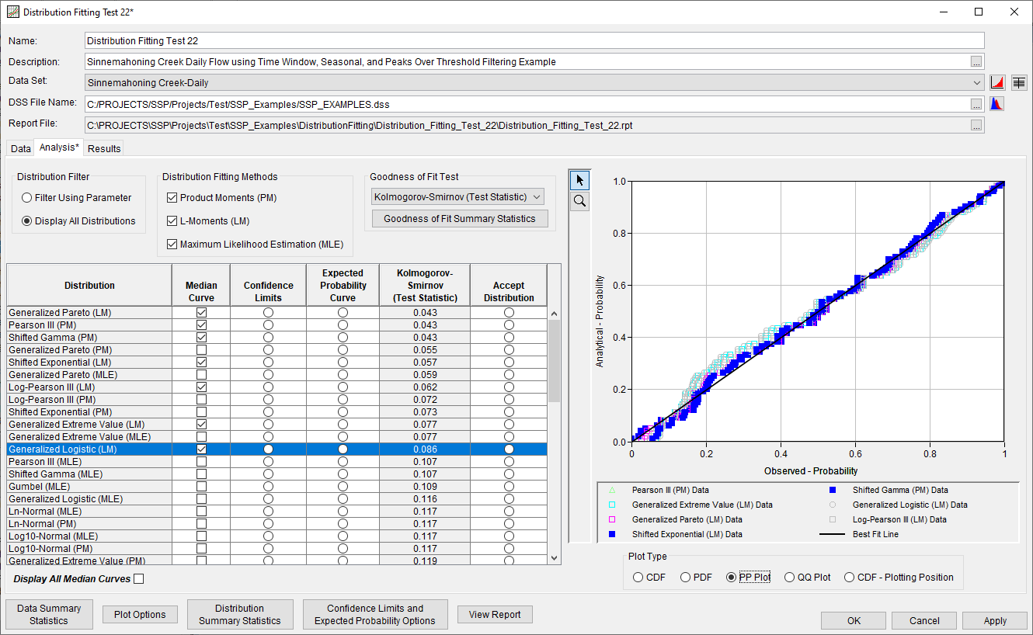
Distribution Fitting Analysis - Analysis Tab
41

Slide 42
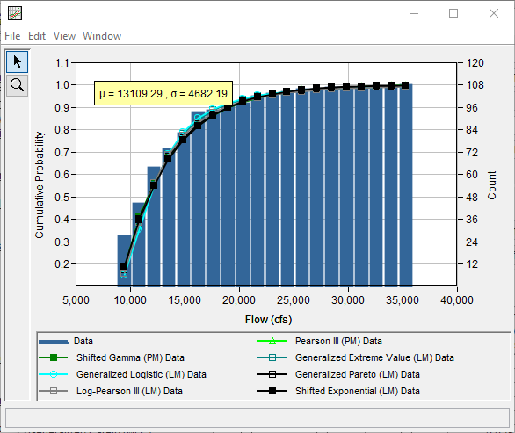
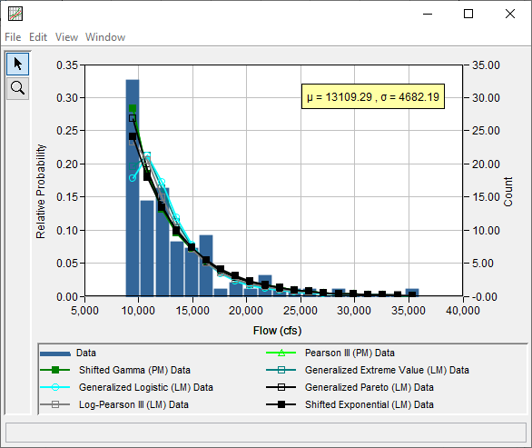
Distribution Fitting Analysis - Analysis Tab
42

Slide 43
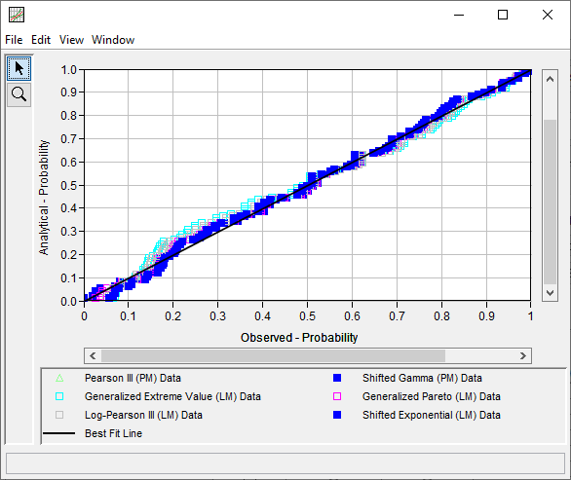
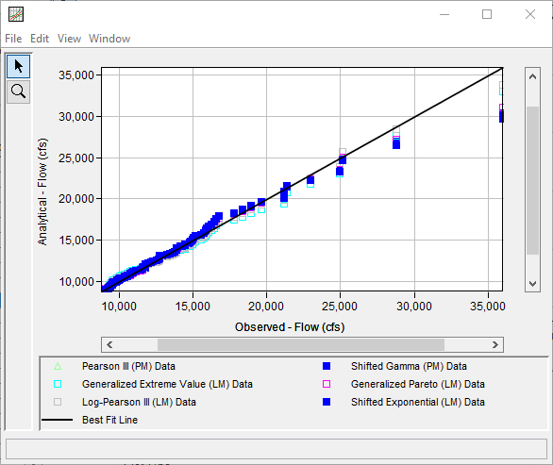
Distribution Fitting Analysis - Analysis Tab
43

Slide 44
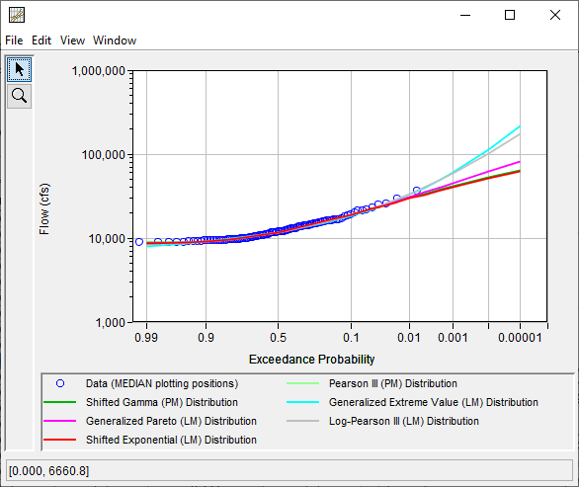
Distribution Fitting Analysis - Analysis Tab
44

Slide 45
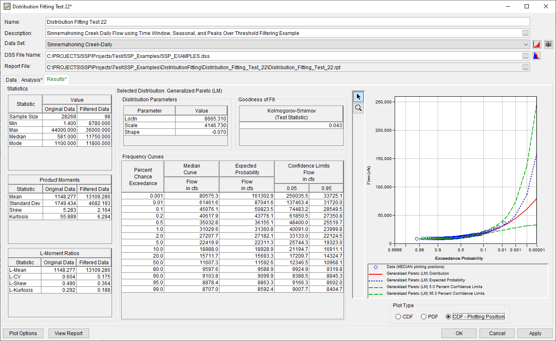
Distribution Fitting Analysis - Results Tab
45

Slide 46
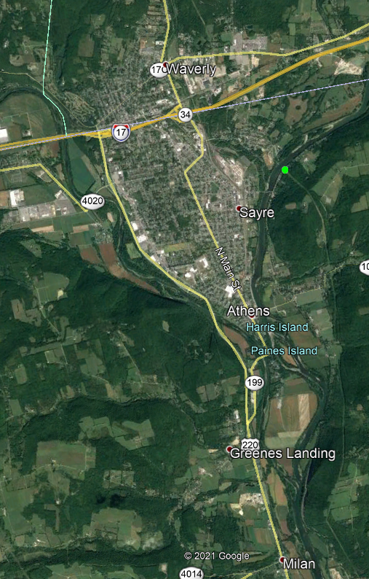
Correlation Analysis
Compute the amount of correlation between various data sets
  Tributary peak flow vs. mainstem stage
  3-day precipitation accumulation vs. 3-day average temperature
  Annual maximum SWE vs. annual maximum 24-hour precipitation accumulation
Results from B17 analyses can be imported
IRREGULAR and REGULAR data accepted
Correlation Analysis Examples
Susquehanna River
Chemung River
46

Slide 47
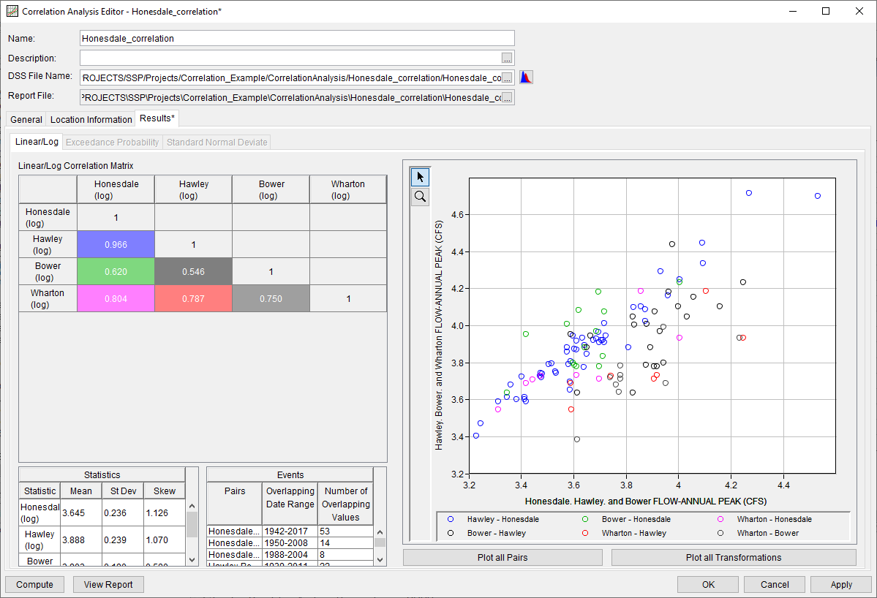
Correlation Analysis
47

Slide 48
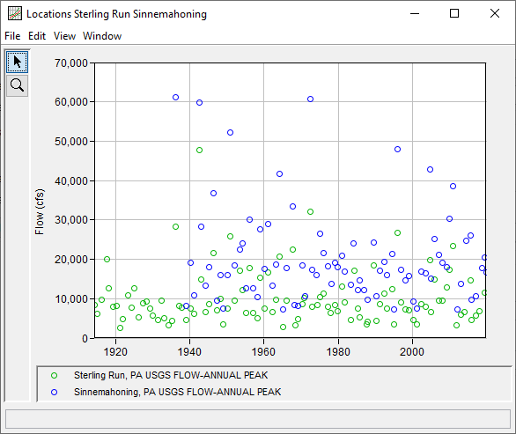
Record Extension Analysis
Extend a short record using a longer record
Multiple computational methods
  MOVE.1
  MOVE.3
    Vogel et al., 1985
  MOVE.3 – B17C
Results can be used within other analyses to infer flow- or volume-frequency for the extended record
IRREGULAR and REGULAR data accepted
Record Extension Analysis Examples
Short Record
Long Record
?
48

Slide 49
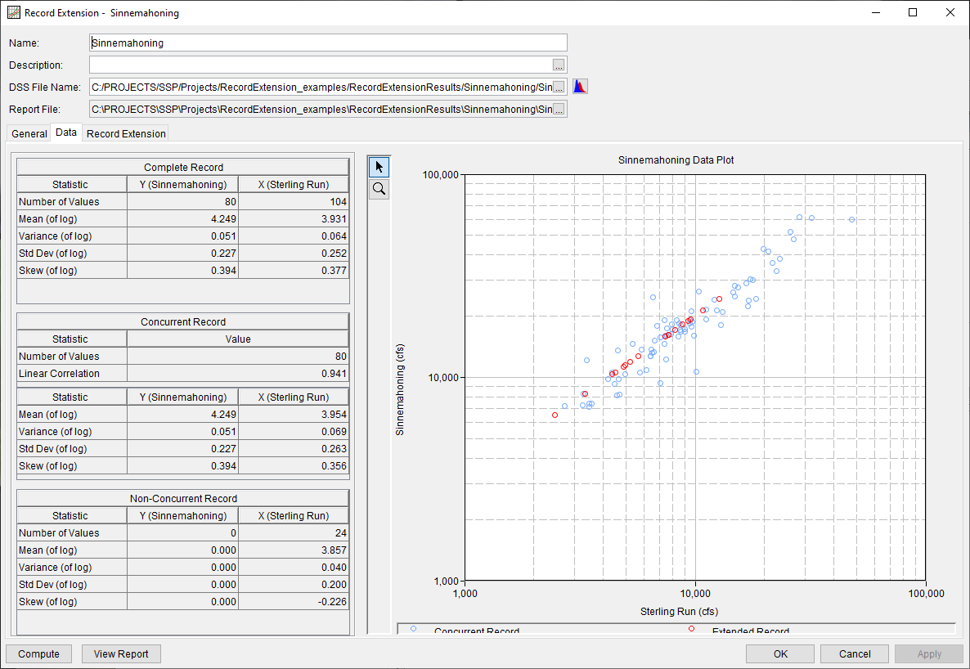
Record Extension Analysis
49

Slide 50
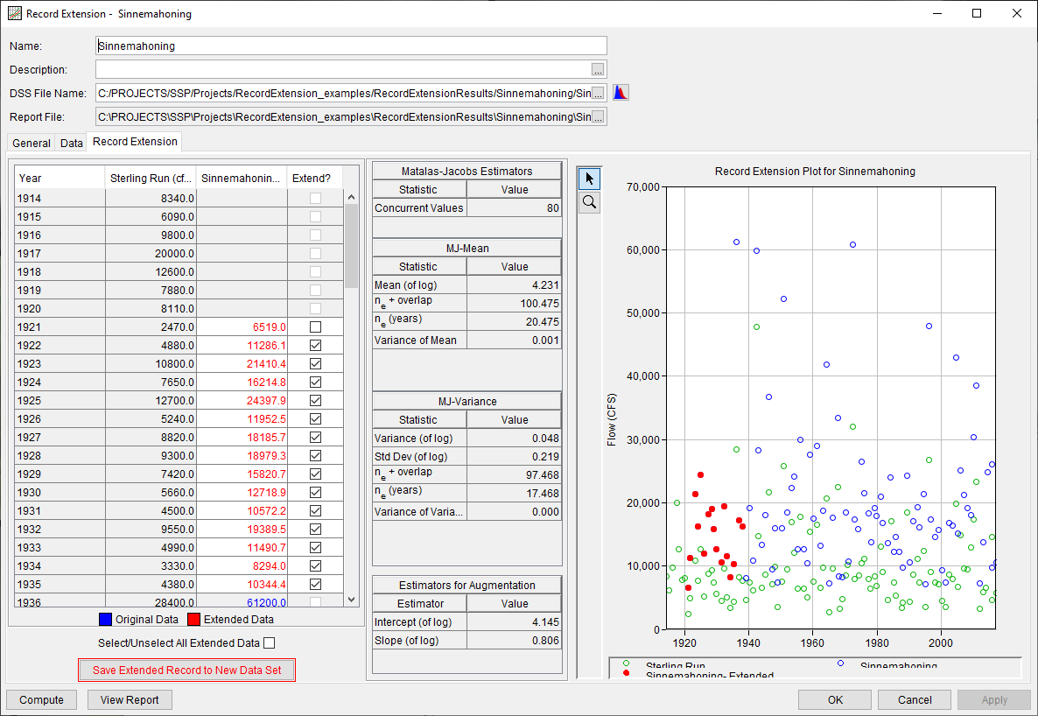
Record Extension Analysis
50

Slide 51
History, Status, Future…
New web-based application
New Partial Duration analysis
Improved Mixed Population analysis
Bulletin 17 updates
Improved user experience
Improved data entry/manipulation
51

Slide 52
Summary
Currently contains eleven different statistical analyses
Developed primarily to meet USACE needs
If you have ideas for future enhancements or questions about existing features, let us know
52

