Slide 1

Parametric Modeling and EMA Basics
Mike Bartles, P.E.
Beth Faber, PhD, P.E.
US Army Corps of Engineers
Hydrologic Engineering Center
Notes:
Hey everybody, this is Mike Bartles from the Hydrologic Engineering Center.
This lecture is devoted to parametric modeling from a hydrologic and hydraulic modeling perspective.

Slide 2
Overview
Describe parametric modeling, its advantages, disadvantages, and steps.
Define data requirements and how to develop a data set for analysis.
Detail commonly used probability distributions.
Outline fitting methods and parameter estimation.
  Special attention given to the Expected Moments Algorithm (EMA).
Explain multiple ways of validating goodness of fit.
Briefly describe uncertainty.
2
Notes:
This lecture is meant to serve as an introduction and will not be an exhaustive, detailed look at all the various aspects of parametric modeling.
We won’t be deriving equations or even delving into too much math.
Instead, we’ll talk about the topic from a 30000 ft perspective and focus more on concepts.
The next few lectures will delve into more detail.

Slide 3
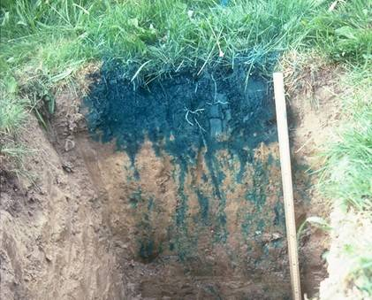
What is a Model?
A model is a “formal representation of a theory” (Ader, Bollen)
All models are simplifications of the real world
  Some are better than others…
Analytical models usually include general principles and a set of statements
Empirical models usually omit these principles and simply represent the data
  Cannot extrapolate (at least not easily)
Infiltration in the real world…
3
Notes:
First, let’s discuss what we mean when we talk about a “model” in a hydrologic or hydraulic modeling context
A model is a formal representation of a theory
Take, for instance, infiltration into soil
Infiltration in the real world is complicated, as shown in the image to the right. Water with blue dye was placed on top of this soil and allowed to infiltrate over a few hours. After a while, a backhoe dug this hole and allowed for us to see how far individual strands of dye had progressed downward.
A specific representation of infiltration would be the Green and Ampt method which simplifies this process but still preserves important aspects.
Modeling allows engineers to estimate the behavior of a system that is not otherwise captured in time and/or space. Questions that could be answered with a model include:
What will the river flow be 3 days from now?
How much runoff will be generated given 20 inches of precipitation over three days?
How will the water surface elevation change if a levee were to be constructed?
What is the likelihood of streamflow exceeding 20,000 cfs?
Analytical models, like the aforementioned Green and Ampt method, usually include general principles and a set of statements. This allows for analytical models to be extrapolated beyond what has been observed, which is of particular interest to us in this profession given that we’re often times interested in extreme events, like the 1/100 annual exceedance probability for floodplain studies or the probable maximum flood for dam safety studies.
Conversely, empirical models usually omit any principles and simply use the data. This is analogous to interpolating between known points. However, this leaves us high and dry when we want to extrapolate because you can’t extrapolate with empirical models or at least it’s not easy or straightforward.

Slide 4
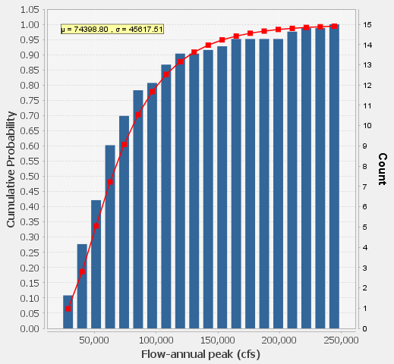
What is Parametric Modeling?
Parametric Modeling is equivalent to Analytical Frequency Analysis
The result of this type of analysis is a fully parameterized probability distribution (with parameters than are in finite-dimensional space)
  Log Normal distribution with defined mean and std dev
  Provides median values
Mean = 74000
Std Dev = 45625
Data
Model
4
Notes:
Parametric modeling and analytical frequency analysis are equivalent and can be used interchangeably
The result of this type of analysis is a fully parameterized probability distribution and median values (additional steps can be taken to estimate confidence limits and mean estimates)
For something to be parametric, the parameters must be located in “finite dimensional space”; they cannot be imaginary
An example of an analytical model is shown on the right, which visualizes the cumulative distribution function of a fully parameterized log-normal distribution. The two parameters of this distribution are a mean and standard deviation. The median values are signified by the red line. Observed data is shown with the blue bars.

Slide 5
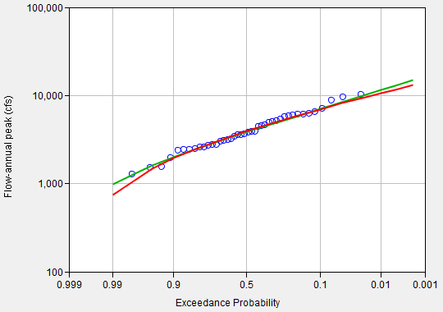
What is Parametric Modeling?
Requires a combination of analytical distribution and fitting method
Fitting method is used to parameterize the analytical distribution using data
Dist. A | Fit Method 1
Dist. A | Fit Method 2
5
Notes:
A “model”, in the sense that we’re interested in within this set of lectures, consists of both an analytical distribution and a fitting method.
The same analytical distribution can be parameterized using two different fitting methods to produce a different parameterization. This is shown on the right. The green and red lines are both the same analytical distribution (for example, Generalized Extreme Values), but they have different parameterizations because they were fit to the blue observed data using different fitting methods.
I’ll describe some of the more commonly used analytical distributions and fitting methods in a future lecture.
The complement of parametric modeling is fitting an empirical distribution using graphical techniques. That would be the equivalent of drawing a line of “best fit” through the blue observed data in the image to the right. However, like I said before, you can’t easily extrapolate beyond the range of the observations.

Slide 6
Purposes of Parametric Modeling
What is the probability that a given flow, stage, precipitation depth, etc will exceed a particular value?
For a given probability, what is the corresponding flow, stage, precipitation depth, etc?
Complement of fitting an empirical distribution using graphical techniques
6
Notes:
Parametric modeling is performed all the time by tons of hydraulic engineers and modelers all across the world.
Two examples of a commonly asked questions that can be answered using parametric modeling are:
“what is the probability that a quantile will exceed some value?” and
“given some probability, what is the corresponding quantile?”

Slide 7
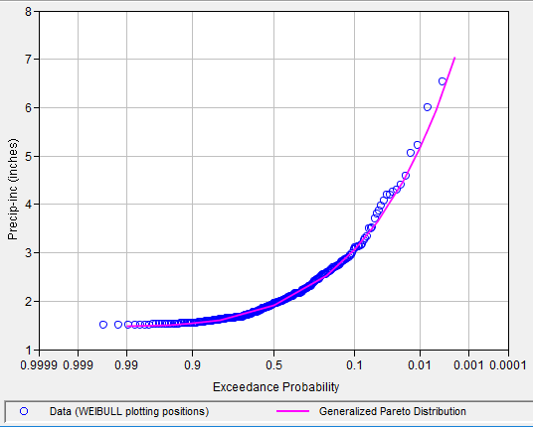
Purposes of Parametric Modeling
7
Notes:
This image is an instance of the first question: “what is the probability that a quantile will exceed XXX?”
Start on the y-axis at some important value. For example, 4 inches of precipitation. Then, trace a horizontal line until you intersect the model. Then, trace a vertical line down to estimate a corresponding probability.
In this case, there is an approximate 1/50 annual chance of exceeding 4 inches of precipitation.

Slide 8
Purposes of Parametric Modeling
8
Notes:
This image is an instance of the second question: “given YYY probability, what is the corresponding quantile?”
This time, start on the x-axis at some important probability. For instance, the 1/500 exceedance probability. Then, trace a vertical line upwards until you intersect the model. Then, trace a horizontal line to estimate a corresponding quantile.
In this case, the 1/500 annual exceedance probability precipitation is approximately 6.75 inches.

Slide 9
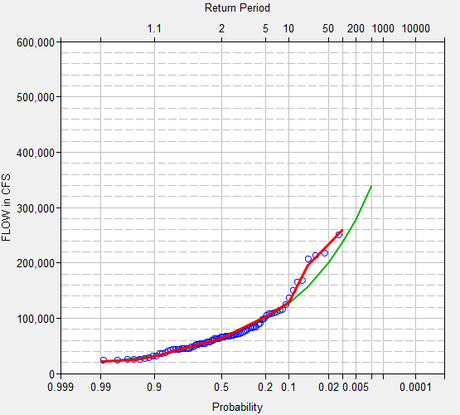
Advantages of Parametric Modeling
Extrapolation throughout the entire range of probability
Allows for regionalization of parameters
Analytical processes exist to estimate confidence intervals
Process the data using numerical techniques
  No “eyeballing” it
Provides a consistent procedure and uniform estimates
  Important for the NFIP!
?
Empirical
Analytical
?
9
Notes:
Parametric modeling has many advantages when compared to graphically fitting an empirical distribution.
The biggest advantage is that a fully-parameterized analytical distribution allows the user to estimate quantiles throughout the entire range of probability from 1 -> 0.
Also, parameters can be “pooled” and regionalized to improve estimates everywhere.
Confidence limits can be computed.
The calculations that are used to fit an analytical distribution are tractable and repeatable by other engineers. This isn’t the case when graphically fitting an empirical distribution.
This becomes incredibly important when comparing, say, 1/100 annual exceedance probability floodplains in the eastern United States against those developed on the west coast. They better mean the same thing in order to prioritize funding for infrastructure or management!

Slide 10
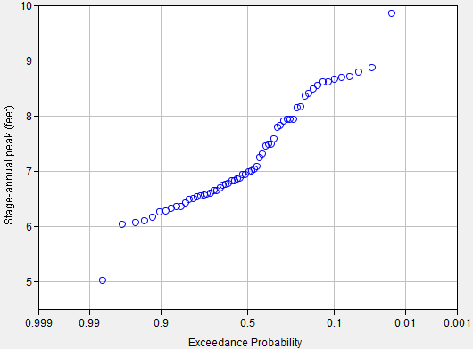
Disadvantages of Parametric Modeling
Must assume a model up front
Some types of data will not be well fit
May provide a false sense of accuracy
  Precision vs. Accuracy
Can take more time than graphical techniques
Obs Events
10
Notes:
However, there are some disadvantages to parametric modeling when compared to graphically fitting an empirical distribution.
First and foremost, a model must be assumed up front. We’ll discuss the implications of this assumption in greater detail later.
Some data will not be well fit using commonly employed models. This includes regulated data or stages, which are shown to the right. Notice the sharp discontinuities and multiple changes in slope throughout the full range of probabilities. It’ll be really hard to fit a meaningful analytical distribution to this data.
A false sense of accuracy can also be inadvertently implied when using parametric modeling. This is analogous to reporting precision to the millionth decimal place.
Finally, computations can take more time than graphical techniques.

Slide 11
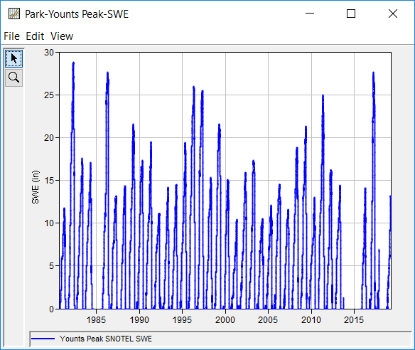
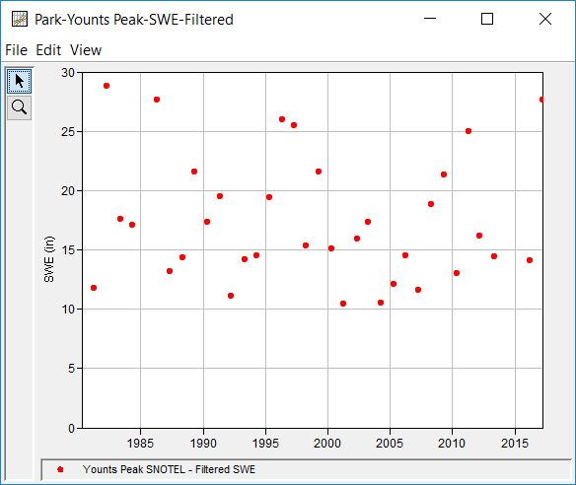
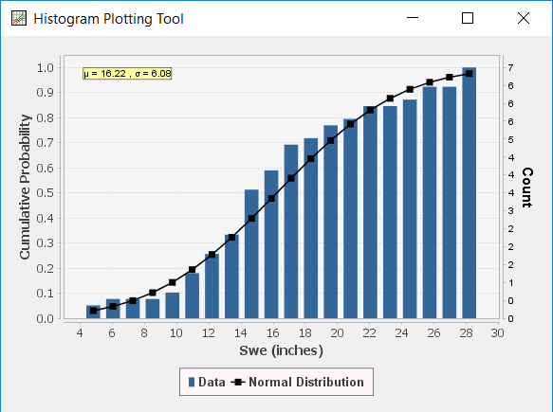
Parametric Modeling Steps
Representative Data
Develop a representative data set
Select a probability distribution and fitting method (“model”)
Compute parameters of the model using the data (i.e. fit the distribution)
Verify appropriateness of the model
Use model to predict quantiles of interest
Distribution | Fitting Method
11
Notes:
Now, let’s introduce the steps that are used when performing a parametric modeling exercise or fitting an analytical distribution.
First, you must develop a representative data set.
Second, you must select a probability distribution and fitting method, which constitutes a “model”.
Third, you have to fit the selected distribution to the data in order to compute the parameters of the distribution.
Fourth, you must verify the appropriateness of the model given the sample.
And finally, you can then use the model to predict variables (i.e. quantiles) of interest.
Each of these points will be discussed in greater detail within the next few slides.
Step 1: Developing an adequate data set is foundational to any parametric analysis. You’ve heard the common phrase “garbage in, garbage out”. That can’t be more true with parametric analyses. If the data is junk, your conclusions will be as well.

Slide 12
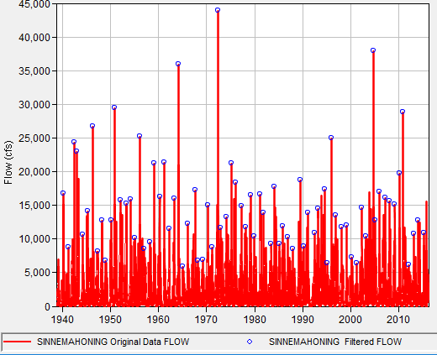
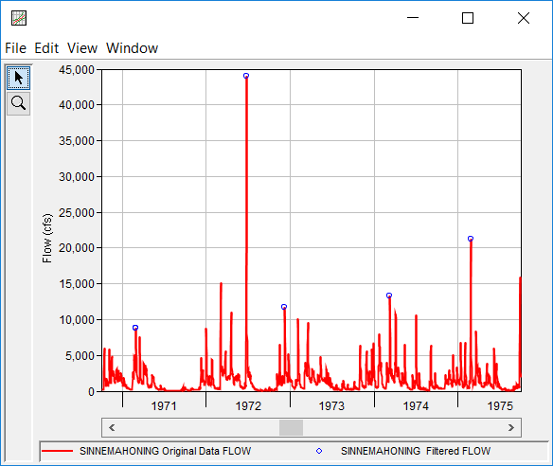
Data Requirements
Data set must be comprised of homogeneous, independent, and identically distributed values
Original Data
Filtered Values
12
Notes:
When performing a parametric analysis, the data must be a representative sample of the “parent” population and be comprised of homogenous, independent, and identically distributed values.
Throughout these lectures, I’ll refer to the representative sample, which is what we typically have to analyze, as a “child” population
To be representative, the sample should be a random sample of possibilities from the parent population, which accounts for natural variability.
The data should not include, or at least minimize, the effects of things like:
changing land use (including increasing/decreasing urbanization)
regulation, for example reduction in stages/flow due to upstream reservoir and/or diversions
large climactic variations/oscillations
There are other data considerations, but these are the big ones that we typically run into as modelers and engineers.

Slide 13
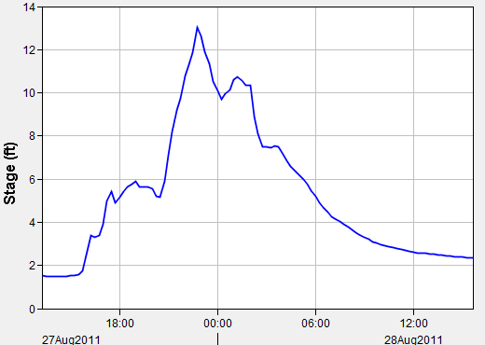
Independent and Identically Distributed (IID)
Independent
  Is the magnitude of one peak dependent upon another?
  How many independent peaks are there in this stage hydrograph?
Frankford Creek at Castor Ave, Philadelphia, PA
13
Notes:
The previously mentioned independent and identically distributed, or IID, data assumption is super important. Let’s talk about the first part, which is independence.
When assessing independence, ask yourself: Is each peak unique and independent? Or are the magnitudes dependent upon one another?
In the image to the right, certainly the first peak is unique, right? But are the others truly independent? The third and fourth peaks aren’t. What about the largest peak? Is that independent?
In the realm of hydrology and hydraulics, we typically look at the entire hydrograph shown here as a quote/unquote “event” and extract a peak for the entire thing.
The largest peak for the event would be the second peak denoted in the image to the right.
We typically extract maxima for the entire calendar year or water year in an effort to achieve independence because most watersheds settle back to a quote/unquote “normal state” within a year.
But, be careful with peaks that are close to your year demarcation. For instance, when using a water year which begins on October 1st and ends on September 30th, be vary cautious to avoid using peaks at the end of September or beginning of October because you might not be able to ensure that they’re independent.

Slide 14
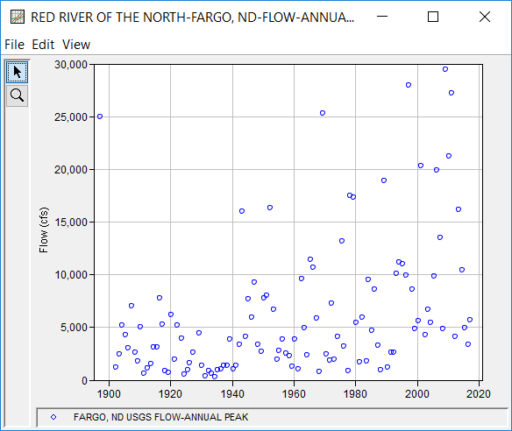
Independent and Identically Distributed (IID)
Identically distributed
  The sample (child population) is randomly drawn and is representative of the parent population
Red River of the North at Fargo, ND
14
Notes:
Similarly, the child population must be an identically distributed sample of the parent population.
This means that the sample should be randomly drawn from the parent population and not, or at least minimize, sampling bias
If climate varies over time (which it can sometimes do) and the sample is pulled from one time period that isn’t representative of the entire range of climactic possibilities, then the data will likely not be identically distributed
A classic example of this phenomena is exemplified in the image to right, which is the annual maximum flow time series for the Red River of the North at Fargo, ND
Climactic variations are evident in the sample. Visualize the average of the data. You can see that the average, or mean, appears to be increasing over time. Also, look at the variability, or highs and lows. They also appear to increase over time.
How do you fit a model to this data set? That’s a very difficult question to answer adequately.
An analysis which used a moving time window was computed for the Red River of the North at Fargo, ND.
In this example, a window length of 30 years was used. After the statistics of the first 30 year time window were computed, the time window was moved forward by 5 years and the next 30 year time window was computed. This process was repeated until the entire data set was analyzed.
Notice how the mean, which is the blue line, standard deviation, which is the red line, and skew, which is the green line change pretty dramatically over time.
Is the entire 1925 – 2019 time window homogeneous and identically distributed over time? Probably not.
But, a follow-up question for you to ponder is, how many violations of the IID assumption are you willing to live with when doing parametric modeling? It’s not too hard to nit pick and find little violations of that assumption in most analyses. In fact, many of the most-commonly used parametric modeling approaches, for instance Bulletin 17C procedures, includes some tools that are intended to minimize the negative consequences of this common violation.

Slide 15
Other Data Considerations
Multimodal data
Annual maximum vs. Partial duration series
Point vs Interval data
Outliers
Data transformations
Record extension
15
Notes:
Some other considerations to keep in mind when analyzing data for a parametric analysis include the following:
Multimodal data
Annual maximum vs. Partial duration series
Outliers
Interval data
and Data transformations. All of the aforementioned topics will be discussed in this video.
However, record extension is such a voluminous topic that this warrants its own lecture/video series.

Slide 16
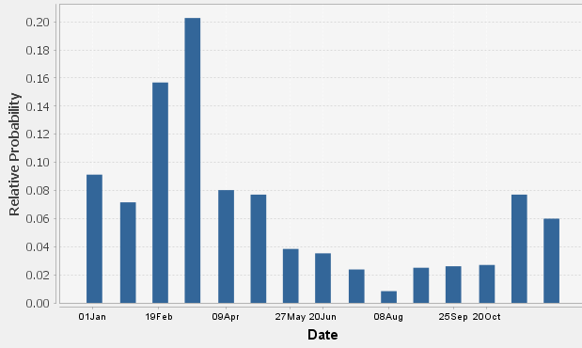
Multimodal Data
Could be caused by multiple mechanisms:
  Rain and snow floods
  Early and late season floods
  Etc.
Usually indicative of a mixed population
Should be separated into different mechanisms and combined in a mixed population analysis
Data
16
Notes:
First up, is multi-modal data. An example of a multi-modal data set is shown on the right as a probability density function. Notice the multiple peaks in this plot? They’re all separate modes.
Multimodal data is likely caused by a mixed population. If this situation is encountered, you definitely should work on separating out the various causal mechanisms into individual data sets.
Mixed populations can be caused by, for example, a location being subjected to floods emanating from rain-on-snow events, summer thunderstorms, extratropical storms (i.e. nor'easters), and tropical storms.
It’s unreasonable to expect that a single model could fit and accurately predict the probability distribution of floods due to all of these mechanisms.
To best predict the exceedance probabilities of flood quantiles of interest (i.e. what is the likelihood of exceeding XXX cfs in any given year?), it is best to split the data set into the individual mechanisms, fit a model to each data set, and combine the results into a single probability distribution using a mixed population analysis.
We’ll talk more about how to do that in a later lecture.

Slide 17
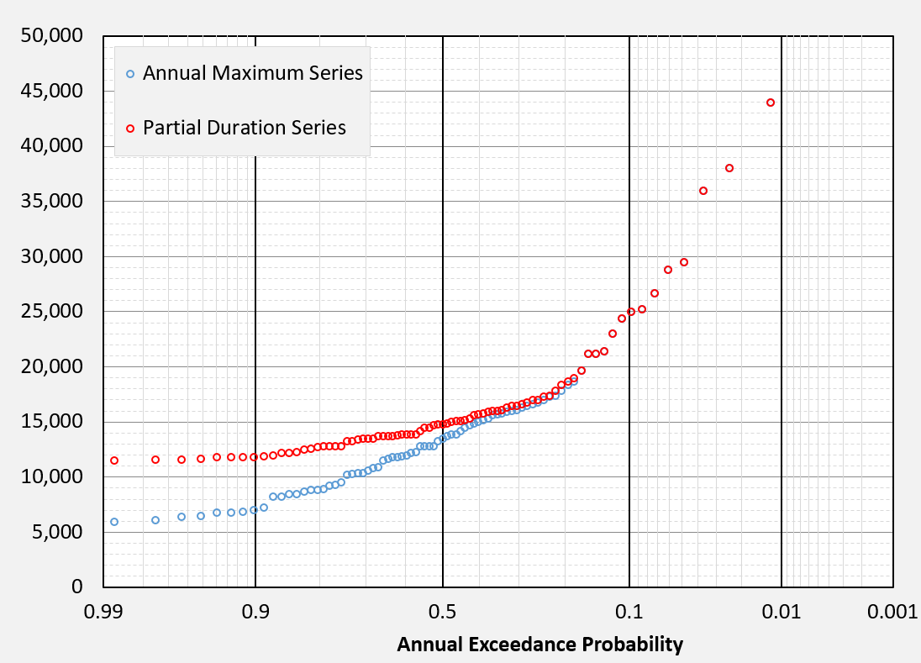
Annual Maximum vs Partial Duration Series
One event per year (AMS) or multiple events per year (PDS)
Fitting an analytical distribution to a partial duration series can be difficult
  Usually leads to the skew parameter being overestimated
95% of the time, use an annual maximum series
More to come on this topic later…
17
Notes:
An annual maximum series contains one and only one value per year. This is the most commonly utilized type of data set when estimating flow-frequency with, say, Bulletin 17C procedures.
Conversely, a partial duration series can contain more than one value per year. This type of data is commonly used to estimate precipitation-frequency.
Fitting an analytical distribution to a PDS can be done, but it’s not as straightforward as when fitting to an AMS
More to come on this topic later in the week
When plotted together on a normal probability axis, these two types of data, for the same location and time window, commonly merge somewhere between the ½ and 1/50 annual exceedance probability.
Just to reiterate, the 95% use case when analyzing large or extreme things will be to use an annual maximum series.

Slide 18
Point vs Interval Data
Conventional (“Point”):
Represent each observation, Q_{Y}, by a single value, Q_{Y}
Generalized (“Interval”):
Represent each “observation,” Q_{Y}, by an interval, (Q_{Y,lower}, Q_{Y,upper})
- for a point, just (Q_{Y}, Q_{Y})
Q_{Y}
Peak flow (cfs)
1961 1962 1963
Q_{Y, upper}
Q_{Y, lower}
Peak flow (cfs)
Q_{Y}, Q_{Y}
1961 1962 1963
18
Notes:
Above is the typical point data we are accustomed to. Below is an interval, that allows an annual peak flow value to be specified as a range.

Slide 19
Interval Data Can Represent
Uncertain flow estimates
Limited range of measurable flow
  Crest stage gages …below a threshold
Low outliers, or PILFs
    Censored, and redefined as interval below
Historical and paleoflood information
Years with information about threshold exceedance or non-exceedance
  Tree or slack water deposit provides minimum for an occurrence
  Landmark never flooded provides maximum for unobserved years
19
Notes:
Historical and paleo – knowledge that large event happened in the past, and some info on return period, or knowledge that gaged flow has longer return period, or that no large floods happened…
Historical = information from record keeping, often during the period of human habitation. This includes large flood before the gage, large flood during gage record that is known to be largest in longer period, years before gage known not to exceed some value
Paleo = geological and physical evidence, often before human record though can be during. Includes rare floods, or absence of floods
Estimate of flood magnitude, or defined threshold which has either been exceeded, or not been exceed. (slack water deposits, scars on trees, overturned trees with new sprouts

Slide 20
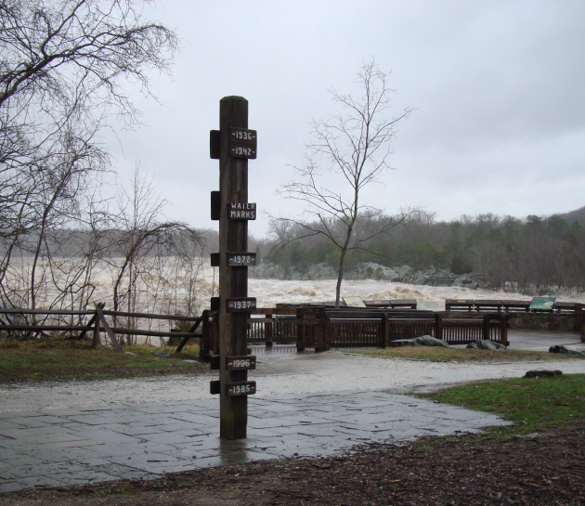
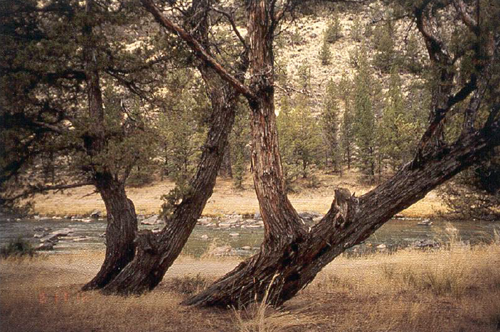
Historical and Paleoflood Data Examples
Crooked River near Prineville, OR
Potomac River at Great Falls Park, VA
20
Notes:
These are other forms of historical information. The flood level sign along the Potomac River shows the levels of the large floods.
Paleo: The “schooner” trees in Oregon are physical evidence of a large flood. A flood large enough to knock over the trees happened, but the trees lived and sent up new trunks vertically. By coring and dating the new trunk, we can determine the date of the flood. This flood is a threshold exceedance, because we only know it was at least to the level of the tree, but not how much higher it was.

Slide 21
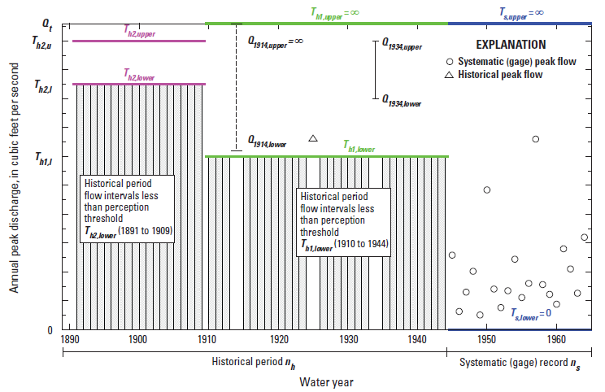
Flow Intervals
Continuous Gage (Systematic Data)
  Gaged estimate of annual peak flow:
    (Q_{Y,lower}, Q_{Y,upper}) = (Q_{Y}, Q_{Y})
  Other types of data
  Uncertain estimate (perhaps historical event):
    (Q_{Y,lower}, Q_{Y,upper}) = (Q_{Y,lower}, Q_{Y,upper})
  Censored exceedance:
    (Q_{Y,lower}, Q_{Y,upper}) = (Q_{Y,min}, ∞)
  Censored non-exceedance:
    (Q_{Y,lower}, Q_{Y,upper}) = (0, Q_{Y,max})
21
Notes:
For systematic gage data, the interval has no width and is just the measured value.
For an uncertain estimate, can describe a range. For a year where it is only known that a flood exceeded a given value, the range is the value to infinity. For a year in which it is known that a flow did NOT exceed some value, the range is zero to that value.

Slide 22
Perception Thresholds
Reflects what flow range we can/could perceive
The range of flows that would have left some kind of evidence in the watershed, had they occurred
(T_{Y,lower}, T_{Y,upper}), usually (T_{Y,lower}, ∞)
    T_{Y, lower} = smallest peak that would result in a documented flow
    T_{Y, upper} = largest peak that would result in a documented flow (usually ∞)
Perception thresholds are, theoretically, independent of actual peak discharges that have occurred
22
Notes:
Perception thresholds describe our ability it perceive floods in the watershed, generally flood large enough that they would leave some physical evidence in the watershed or would have been noted by people nearby and recorded.
The low end of the range is the smallest value that would leave evidence. The high end of the range is nearly always infinity.
Theoretically, our ability to perceive flows in the watershed is independent of what has actually occurred. However, sometimes our only information about perception thresholds is the fact that some large events occurred and were noted in the historical period before the gage.

Slide 23
Perception Thresholds
For periods of continuous, full-range streamgage, systematic:
  (T_{Y,lower}, T_{Y,upper}) = (0, ∞)
For periods with no information about streamflow:
  (T_{Y,lower}, T_{Y,upper}) = (∞, ∞)
For periods prior to (or after) direct observation, but with historical or geologic evidence, or potential for evidence:
  (T_{Y,lower}, T_{Y,upper}) = (threshold, ∞)
Perception thresholds imply a complementary flow range for unobserved years in an analysis period (e.g., below the threshold)
23
Notes:
When a gage is present, it is assumed all flows would have been perceived, so the range is 0 to infinity
When nothing is known, such as the gage out of service, the range is infinity to infinity.
For periods when some threshold is known for flows that would have brought attention or left evidence if they were exceeded, the range is the threshold to infinity.
For unobserved years, saying that we would have observed the flow if it was above the threshold implies that if we didn’t, it was below the threshold, which suggests a complementary flow range of 0 to the threshold.

Slide 24
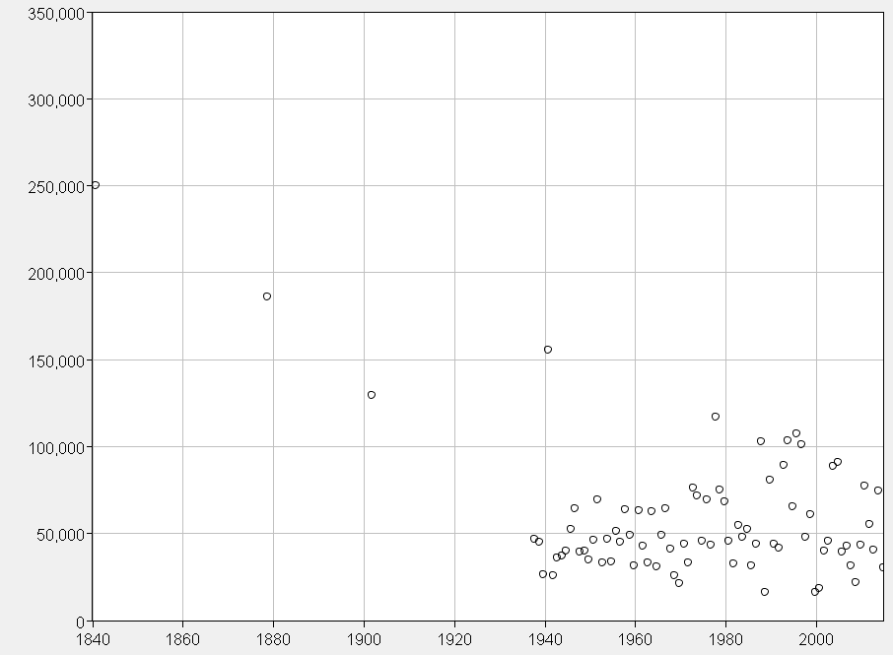
Data, Ranges, and Thresholds
added historical period
systematic record
1840
range of perception 120,000 - ∞
1937
range of perception
0 - ∞
1840
1878
Railroad Grade
120,000
1902
Implies flow intervals of [0 – 120,000 cfs]
24
Notes:
The perception threshold for the historical period implies a flow range for all the unobserved years in the historical period. If they were not noted, they must not have exceeded the threshold.

Slide 25
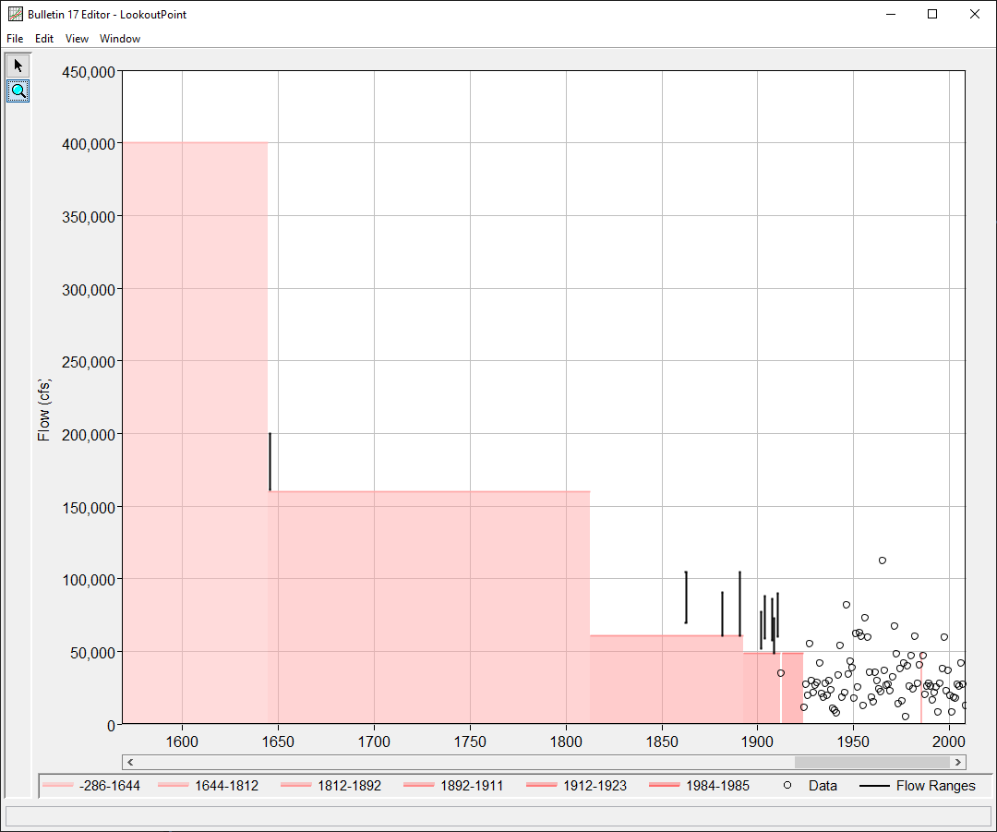
Perception Thresholds
Without a recognizable threshold in the basin, historical events can be used as thresholds
In either case, justification must be provided
25
Notes:
When there is no recognizable threshold in the basin, we might use the historical events, which were observed in some way and recorded, as thresholds for the period since the event occurred

Slide 26
Outliers
High and low outliers
If encountered, search for additional data
  Is the high outlier(s) rarer than indicated by the sample?
  Is the low outlier(s) more common than indicated by the sample or not part of the same population?
Bulletin 17 procedures give them special treatment
More to come on this topic later…
Obs Events
26
Notes:
Outliers are a common occurrence in most data sets
Sometimes they’re on the high side and sometimes they’re low.
However, their inclusion, without special treatment, can violate the IID assumption, specifically the identically distributed part.
When you encounter them, search for additional data and ask yourself these questions:
Is the high outlier(s) rarer than indicated by the sample? In the figure to the right, this would be analogous to moving the highest point to a smaller, or rarer, exceedance probability.
Is the low outlier(s) more common than indicated by the sample? In the figure to the right, this would be analogous to moving the smallest point to a larger, or more common, exceedance probability.
Bulletin 17B and C procedures include tools that can be used to identify and treat these outliers.

Slide 27
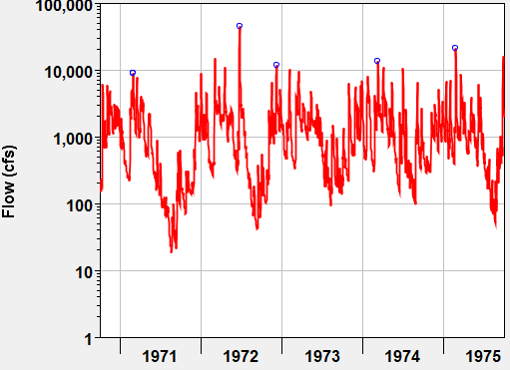
Data Transformations
Why transform data?
  Analyze relative changes rather than absolute changes
  Obtain a symmetrical distribution about zero
  Remove heteroscedasticity
Common transforms:
  Log base 10
  Log base e (i.e., natural log)
  Standard Normal Distribution
  Square or square root
  Inverse (i.e., 1/x or x⁻¹)
27
Notes:
Sometimes data must be transformed to analyze relative changes instead of absolute changes. Other times, engineers and modelers are more interested in obtaining a symmetrical distribution about zero. Also, engineers may be interested in removing the effects of heteroscedasticity, which refers to the circumstance in which the variability of a variable is unequal across the range of values of a second variable that predicts it.
Think of flow vs stage or something similar where the variability of flow changes drastically as the stage increases in a typical, incised cross section with a very wide flood plain.
For a small change in stage, the corresponding change in flow could be small or extremely large depending upon whether the flow is in or out of bank.
In terms of common transforms, Log base 10 is probably the most commonly used transform when dealing with flow.
This transformation allows for the user to analyze relative changes rather than absolute changes and an example is shown to the right.
Remember that the mean of the log transformed values is NOT the same as log of the mean of the values.
However, this is by no means the only data transform that is used. I list out a few common transforms at the bottom of the slide.

Slide 28
Parametric Modeling Steps
Representative Data
Develop a representative data set
Select a probability distribution and fitting method (“model”)
Compute parameters of the model using the data (i.e., fit the distribution)
Verify appropriateness of the model
Use model to predict quantiles of interest
Distribution | Fitting Method
28
Notes:
Step 2 is the selection of a distribution and fitting method. When put together, a distribution and fitting method create a model.
Step 3 focuses on computing parameters of the model.

Slide 29
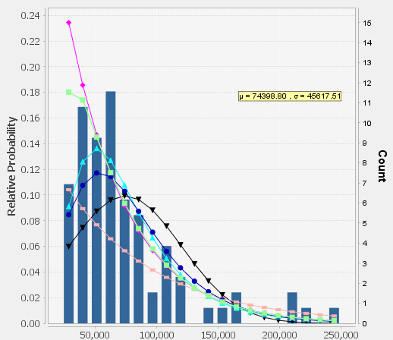
Examples of Commonly-Used Probability Distributions
Exponential
  1 parameter
Gumbel
  2 parameters
Normal
  2 parameters
Pearson Type III
  3 parameters
Extreme Value Distributions
  Hosking and Wallis (1996) parameterizations
  Generalized Extreme Value (GEV), Generalized Pareto (GPA), and Generalized Logistic (GLO)
  3 parameters
Data
Pearson III
Gumbel
GEV
GPA
Exponential
Normal
29
Notes:
Here are some common continuous probability distributions that are utilized within water resources applications.
Aside from the familiar Exponential, Gumbel, Normal, and Pearson Type III, I’d like to highlight the extreme value distributions noted at the bottom of the list.
These distributions are part of the family of three-parameter distributions for which parameterization schemes were devised by Hosking and Wallis.
Each has location ξ, scale α, and shape κ parameters.
First is the Generalized Extreme Values, or GEV, distribution.
This distribution subsumes the three extreme value distributions: Gumbel (EV type I), Frechet (EV type II), and Weibull (EV type III).
Which distribution it represents is dependent upon the shape parameter. For instance, GEV = Gumbel when shape = 0.
The GEV distribution is commonly used for precipitation-frequency studies within the U.S. and many other applications like flow-frequency outside of the U.S.
The GEV distribution was derived by taking the maximum of repeated independent samples from a homogeneous population, which is what is commonly used to create annual maximum series.
Next up is the Generalized Pareto, or GPA, distribution.
An underlying assumption of the GPA distribution is that subsamples exceeding a sufficiently high threshold from repeated samples of a homogeneous population will converge to the GPA distribution.
In other words, if repeated samples are taken from a population, and only the values in those samples that are greater than a selected value are retained, then those retained values will follow the GPA distribution.
This type of data set is called a partial duration series, which is something that we discussed in the previous lecture.
Finally, I’d like to mention the Generalized Logistic, or GLO, distribution.
Like the GEV distribution, the GLO distribution is commonly used in precipitation-frequency studies.

Slide 30
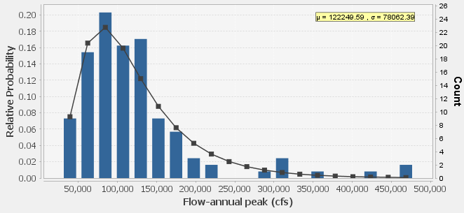
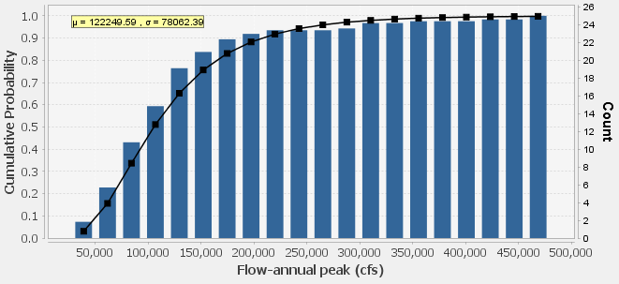
What is a continuous probability distribution?
Continuous probability distributions are the most commonly used distributions within water resources applications
  Data is comprised of a continuous random variable
Area under PDF must equal 1
CDF spans probability between 0 -> 1
  Cannot decrease either
30
Notes:
Discrete probability distributions are used to describe the expected results from experiments where only a certain number of outcomes can be realized, like flipping a coin or rolling a die.
These distributions aren’t used as much within water resources applications, but they are still used from time to time to model things like will it rain tomorrow, if it is going to rain, what type of storm will it be, etc?
Continuous probability distributions are used much more commonly within water resources applications. This arises from the fact that we tend to model phenomena that is comprised of continuous random variables, like streamflow, precipitation, or stage.
Similar to a unit hydrograph, the area under the probability density function, or PDF, must sum to 1. An example of a PDF is shown in the upper right image.
Also, the cumulative distribution function, or CDF, must span 0 -> 1 and cannot decrease. An example of a CDF is shown in the lower right image.

Slide 31

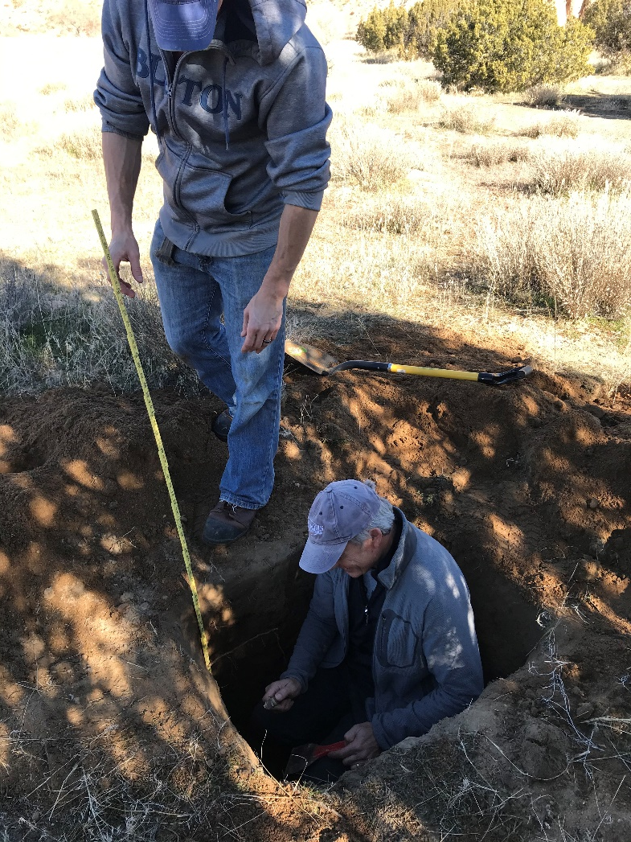
Everybody Up and Stretch!
31

Slide 32
Probability Distribution Fitting Methods
Fitting a probability distribution to an unknown and unknowable parent population through the use of a representative sample (child population)
Commonly used fitting methods:
  Method of moments
    Expected Moments Algorithm (EMA)
    Linear moments
  Maximum likelihood
32
Notes:
Now, let’s discuss fitting methods.
As mentioned before, the same analytical distribution can be fit to the same data set using different fitting methods to obtain different parameterizations and, as such, different quantile estimates.
When we fit a distribution, we are using the child population because we don’t know the true parent population. In fact, within all real-world applications, we can’t know the parent population. We can only know the parent population in contrived examples.
Some commonly used fitting methods are method of moments and Maximum Likelihood Estimation.
Some special extensions of the method of moments are Linear Moments and the Expected Moments Algorithm, or EMA.
Greg will go into more detail regarding Linear Moments and their applications while Beth will present several videos detailing EMA and it’s uses.

Slide 33
Method of Moments
Simple and widely used
Assume that the parameters of the sample (child population) are the same as the parent population
Equal weights are given to the transformations of the observations
Used within Bulletin 17 methods
  EMA also uses method of moments (but iterates)
33
Notes:
The method of moments fitting method is widely used within water resources applications because it’s fairly simple and robust.
The underlying assumption of this method is that the parameters of the child population are the same as the parent population.
Remember last lecture when I stressed how important it was to develop an IID and representative data set? This assumption is the reason why a fair amount of time should be spent processing your data set.
Within this method, equal weights are given to the transformations of the observations.
As I said before, the method of moments is used within both Bulletin 17B and Bulletin 17C procedures. However, Bulletin 17C makes use of a generalization called EMA that allows for the use of some unique types of data like intervals.

Slide 34
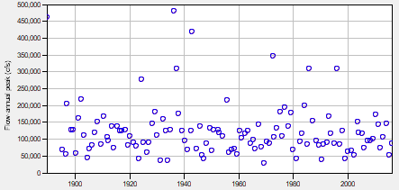
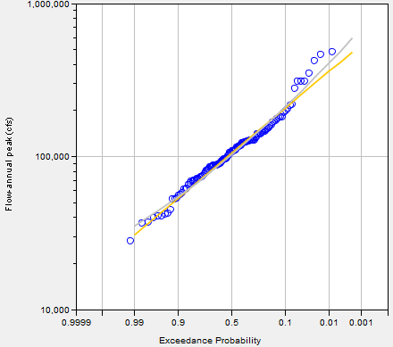
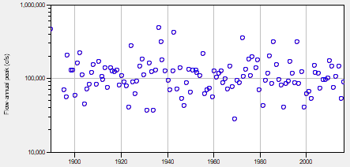
Method of Moments Example
What about Interval or Censored data?
Obs Events
Obs Events
Log10 Normal
LogPearsonIII
Mean (of logs) = 5.023
Std Dev (of logs) = 0.230
Skew (of logs) = 0.325
Mean (of logs) = 5.023
Std Dev (of logs) = 0.230
Skew (of logs) = 0.325
34
Notes:
Now, let’s step through an example.
In the upper left image, I have an annual maximum series of streamflow.
In the lower left image, this annual maximum series has been transformed to log10 values.
Next, the (log) parameters of the sample are computed and shown in the blue text.
Then, those parameters are used to fit the both the Log Normal and Log Pearson Type III distributions in the orange text.
The Log10Normal does not use the skew parameter; only the LPIII distribution does (in this case).
Notice that the parameters of the sample match the parameters of these two distributions? That’s the consequence of assuming that the parameters of the child population are the same as the parameters of the parent population.
Finally, the fitted distributions are plotted along with the plotting positions of the data in the right hand image.
But, what about interval data? How can this type of data be used?

Slide 35
Expected Moments Algorithm
EMA still estimates product moments from a sample
  Mean, standard deviation, skew coefficient
However, the LPIII parameter estimates are updated in an iterative fashion
  Because a distribution is assumed up-front and calculations are iterative, interval and censored data CAN be incorporated!
  However, the calculations are not easily performed by hand, but they can: EMA Study Guide
  HEC-SSP to the rescue!
35
Notes:
Enter the Expected Moments Algorithm
EMA iteratively estimates the distribution parameters in an attempt to converge on a best-estimate answer
Because EMA iterates, it CAN incorporate interval and censored data, which is a huge win
However, because it is an iterative solution, EMA isn’t done by hand.

Slide 36
Expected Moments Algorithm
For every year in the systematic and historical period of record, two pieces of data must be defined:
  Flow interval
    Range that describes the annual peak flow of that year
  Perception threshold range
    Reflects the range of flow that would have been recorded (in some way) had it occurred in each year
      meaning, the flows that would have left some evidence
      implies a flow range for unobserved
36
Notes:
Every year of the record must have both a flow interval and a perception threshold range, but these can be very simple and are pre-defined for systematic gage data.

Slide 37
EMA | Estimating Moments from Point Data
Mean (M), Standard Deviation (S), and Skew (G)
Method of Moments
estimate population moments from sample moments
37

Slide 38
EMA | Estimating Moments from Censored Data
Moments are estimated with the assumption of LPIII, so can use LPIII to define the likelihood of an interval or censored observation
Given population moments
  We can compute expectation of mean, variance and skew of interval or censored data
Given expected mean, variance and skew, we can estimate population moments
Initial guess and iterate the moments converge…
Iterate…
38
Notes:
Start with the known data
Estimate LP3 parameters (M,S,G)
Using the LP3 parameter estimates
Estimate expected moments for censored data
Using the known data and the expected moments
Update estimate of the LP3 parameters

Slide 39
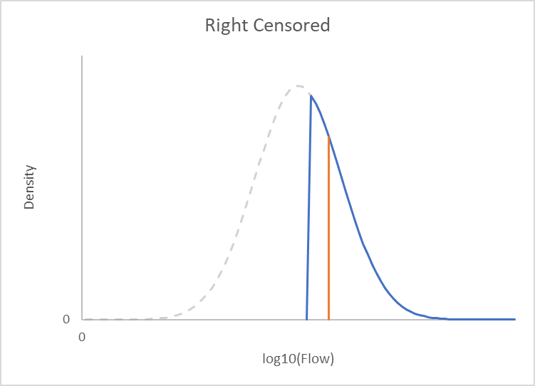
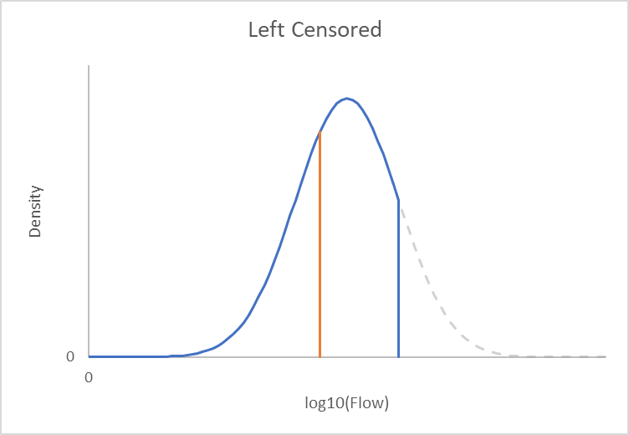
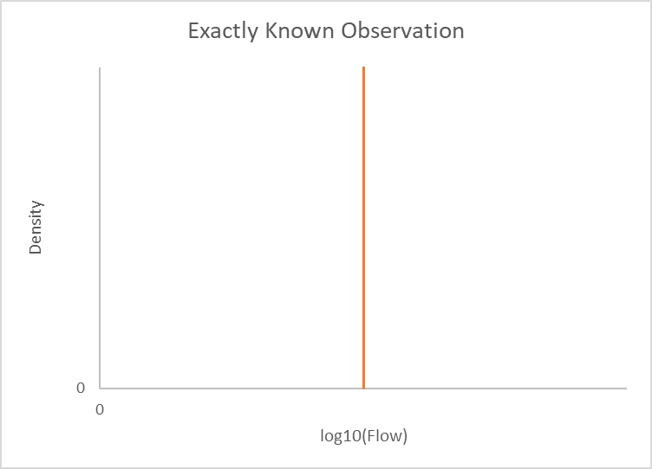
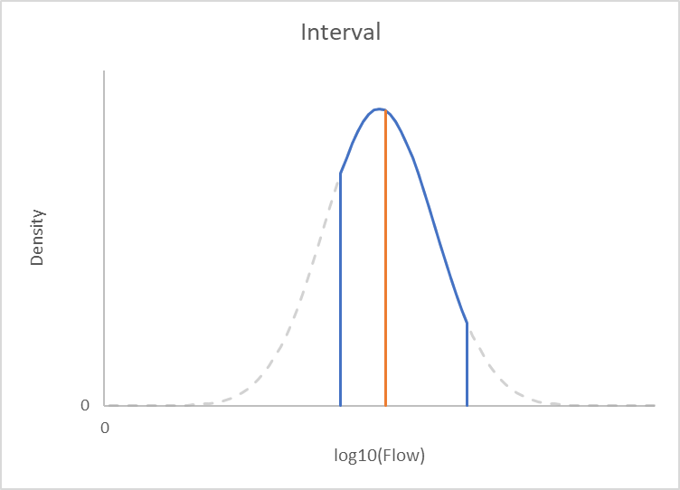
EMA Data Types
    (Q_{Y,min}, ∞)
    (0, Q_{Y,max})
    (Q_{Y}, Q_{Y})
    (Q_{Y,min}, Q_{Y,max})
Moment (n) | Statistics | Mechanics
0 | Probability | Mass
1 | Mean | Centroid
2 | Standard Deviation | Moment of Inertia
3 | Skew | ?
39
Notes:
When EMA is iterating over the right censored, left censored, or interval data, the shape of the LPIII distribution is unknown (i.e., blue curve in the figures above)
In the top-left figure, an exactly known observation (i.e., systematic) is plotted. No distribution assumption is required to get the moments.
In the top-right figures, the blue line is the data (left/right/interval censored), grey is the assumed LPIII distribution, and orange is the mean of the data.
The flow interval defines the limits of integration between the lower (X_{L}) and upper (X_{U}) flow values that define the flow interval and similar for left/right censored
The parameter estimates (μ, σ, γ) define the value of the function f(x) which is just the LPIII frequency curve in the format of a probability density function
Must iteratively guess and check until the moments of the LPIII distribution and data converge to an acceptable degree
Each iteration will change the shape of the grey/blue curves for left/right/interval censored data but the limits will stay the same
Need to determine the 1st, 2nd, and 3rd moments of each left/right/interval censored data
You likely did this in undergraduate Statics/Dynamics/Mechanics classes

Slide 40
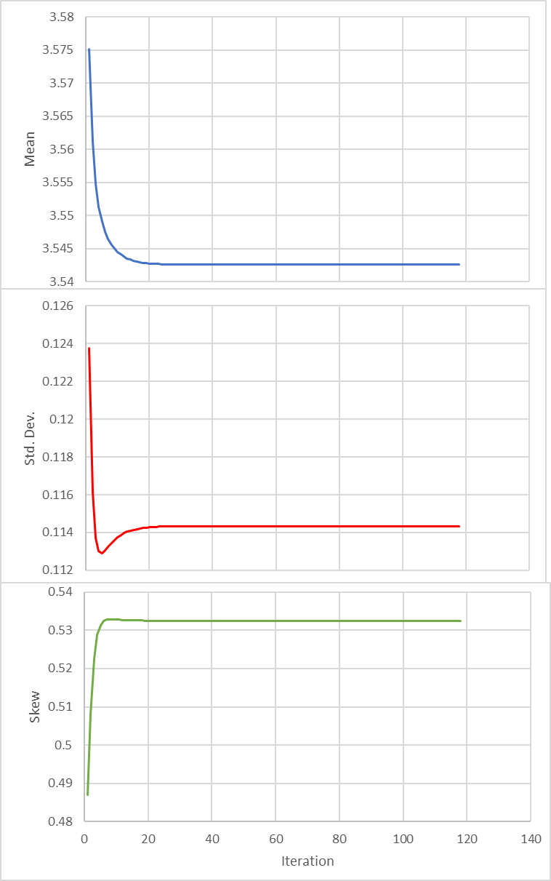
EMA Iteration
Iterate until moments of the sample and LPIII converge
Max 3000 iterations
40

Slide 41
Benefits of EMA
Consistent with Bulletin 17B (LPIII, MOM, etc)
  Identical result if no historical info or low outliers
Statistically efficient and robust
41

Slide 42
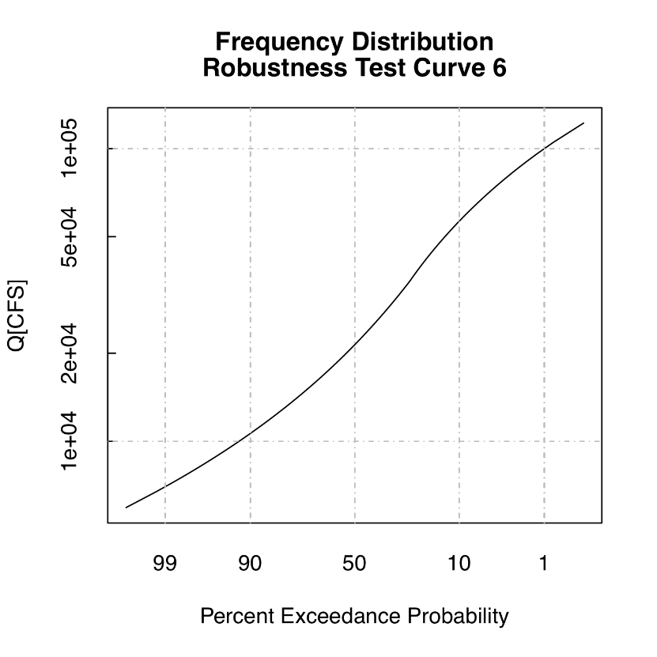
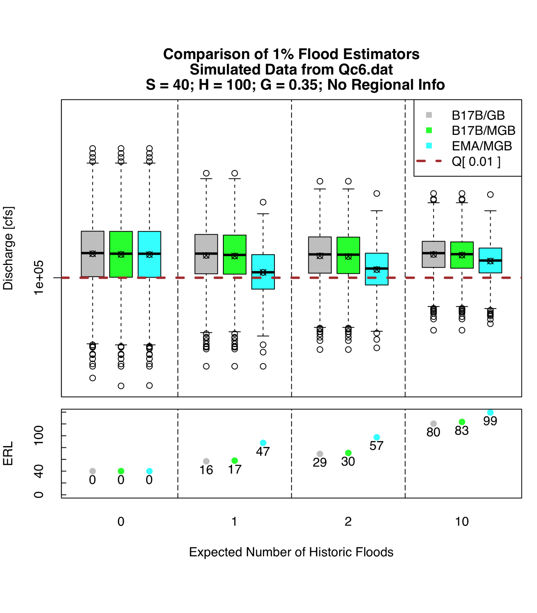
Estimating 1% event
Systematic = 40 years
Historical = 100 years
17B / GB
17B / MGB
17C / MGB
Not an LP3 distribution!
historical event threshold
none 1/100 AEP 1/50 AEP 1/10 AEP
42

Slide 43
Benefits of EMA
Consistent with Bulletin 17B (LP3, MOM, etc)
  Identical result if no historical info or low outliers
Statistically efficient and robust
Statistically tractable
Simultaneous consideration of low outliers, historical information and regional skew
43
Notes:
Tractable Problem: a problem that is solvable by a polynomial-time algorithm. The upper bound is polynomial.
Intractable Problem: a problem that cannot be solved by a polynomial-time algorithm. The lower bound is exponential.

Slide 44
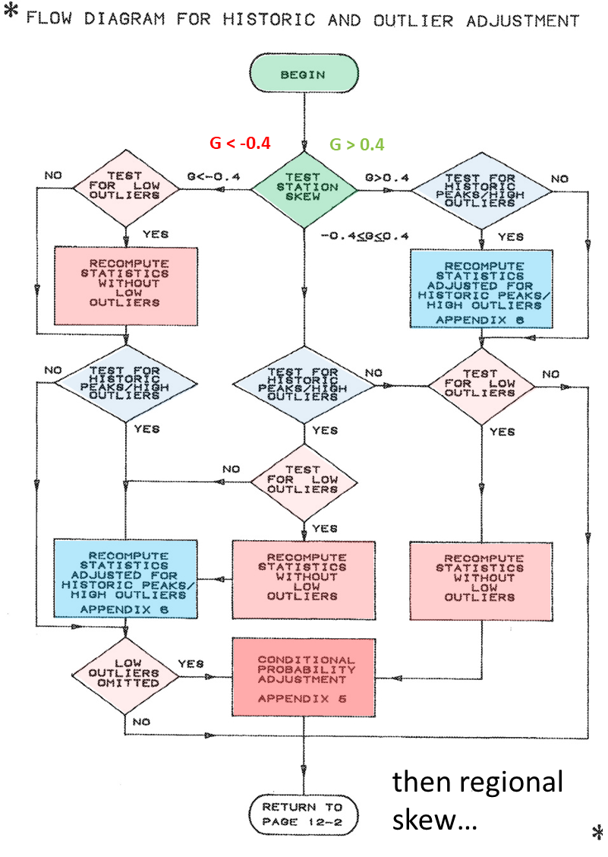

Bulletin 17B Flow Chart
44

Slide 45
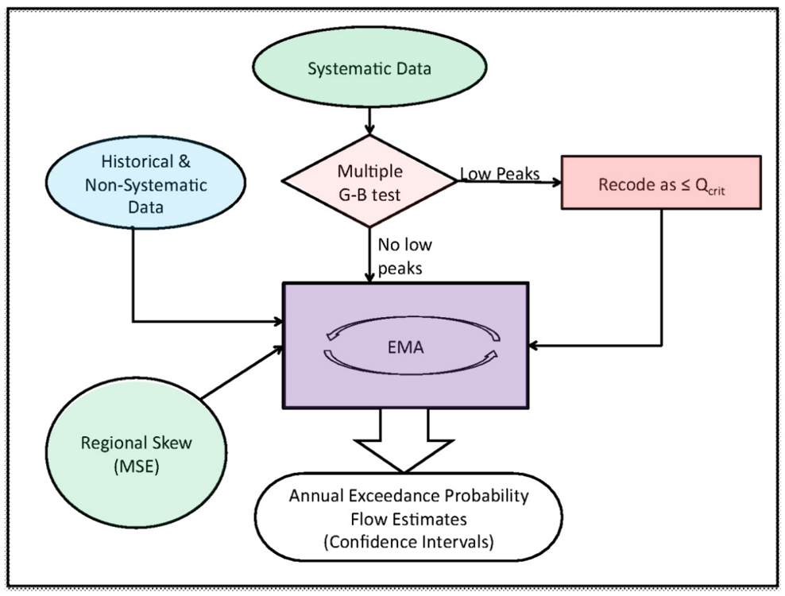
Bulletin 17C/EMA Flow Chart
45

Slide 46
Benefits of EMA
Consistent with Bulletin 17B (LP3, MOM, etc)
  Identical result if no historical info or low outliers
Statistically efficient and robust
Statistically tractable
Simultaneous consideration of low outliers, historical information and regional skew
More accurate confidence intervals
46

Slide 47
Linear Moments
A little more complicated but still widely used
Still assume that the parameters of the sample (child population) are the same as the parent population
Used heavily within regional and precipitation frequency analyses
Unequal weights given to order statistics of observations based upon their ranks
Less weight is given to the tails of the distribution
Hosking and Wallis (1990 and many, many others)
More to come on this topic later…
47
Notes:
Linear, or L-moments are widely used in precipitation frequency studies.
This becomes especially useful when regionalizing parameters.
This fitting method is an extension of the method of moments in that it still assumes the parameters of the child population are the same as the parent population
However, unequal weights are given to order statistics of observations based upon their ranks
In particular, less weight is given to the tails of the distribution
Hosking and Wallis revolutionized the use of this fitting method along with the three aforementioned distributions.
More on this fitting method will be presented within other videos.

Slide 48
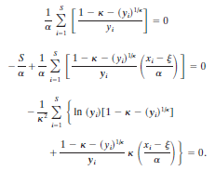
Maximum Likelihood Estimation
Much more complicated and not as widely used in water resources applications as previous methods
Though, this method is widely used in other statistical applications
Can incorporate point, censored, and interval data
Can integrate arbitrarily complex distributions
Requires log (actually natural log) likelihood functions (since ln() is a continuous strictly increasing function)
  Calculate the first derivative and set equal to 0 to maximize
GEV log-likelihood functions
48
Notes:
Maximum Likelihood Estimation, or MLE, is a much more complicated fitting method than the previous two fitting methods.
As such, this method has not been as widely used in water resources applications.
But, it is commonly used in other arenas, like the financial and actuarial applications.
This fitting method, like EMA, is able to incorporate point, censored, and interval data. However, this fitting method is able to integrate arbitrarily complex distributions.

Slide 49
Other Model Considerations
Regionalization of parameters
Analysis for ungaged areas
Historical and Paleoflood data
More to come on all of these topics later…
49
Notes:
Other topics related to model fitting include regionalizing data, analyzing ungaged areas, and incorporating historical and/or paleoflood data. Historical and paleoflood data are oftentimes missing direct observations and are best represented by interval or censored observations.
These topics will be covered in additional videos.
We also have another class dedicated to these topics. If you’re interested, please check out our Flood Frequency Analysis for more information as well.

Slide 50
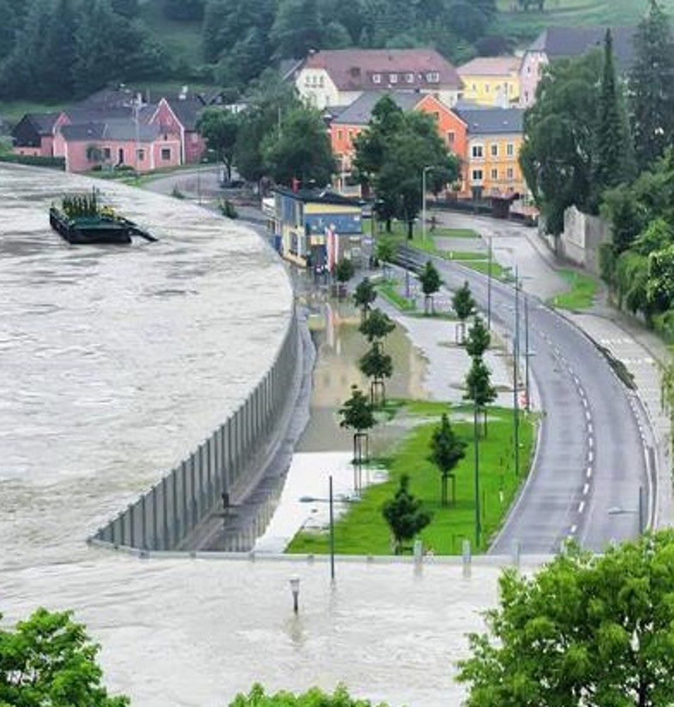
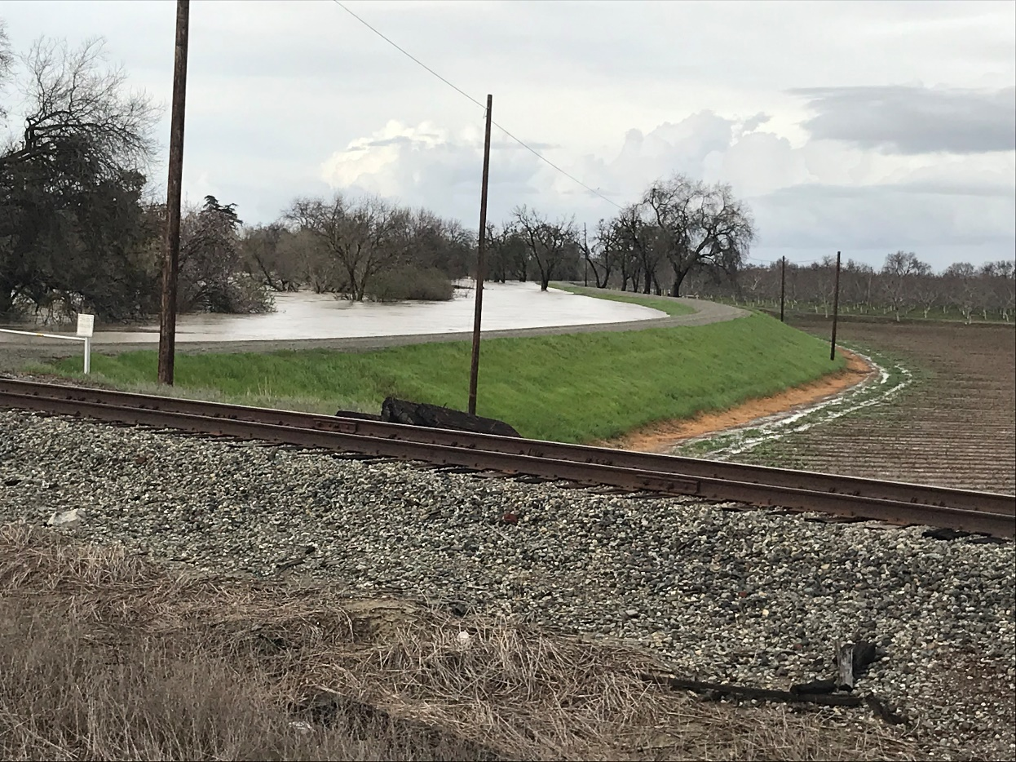
Everybody Up and Stretch!
50

Slide 51
Parametric Modeling Steps
Representative Data
Develop a representative data set
Select a probability distribution and fitting method (“model”)
Compute parameters of the model using the data (i.e. fit the distribution)
Verify appropriateness of the model
Use model to predict quantiles of interest
Distribution | Fitting Method
51
Notes:
Step 4 emphasizes verifying that the model is appropriate for use with the data in question.
Step 5 uses the parameterized model to make predictions.

Slide 52
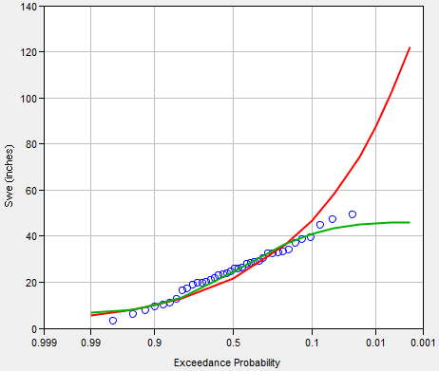
Model Result Visualization
There are multiple ways to ascertain goodness of fit
  Visualize the model results against the data (multiple ways to do this)
  Goodness of fit tests
    Kolmogorov-Smirnov
    Chi-Square
    Anderson-Darling
  Split sample tests
All should be used!
Data
Model A
Model B
52
Notes:
There are multiple ways in which the model and data can be visualized together in order to form a qualitatively comparison.
This includes things like visualizing the model against the plotting positions of the data, as shown to the right.
This is the most commonly-used visualization within water resources applications.
This type of plot can provide a quick means to weed out bad models.
For instance, both of the models visualized here are probably not good choices to represent this data because the tail behavior of both don’t adequately represent the data, which is usually where we’re most interested in obtaining estimates.
However, there are other ways to visualize the data, which we’ll describe on the next few slides.
Also, there are numerous quantitative tests, called goodness of fit tests, that can be used to ascertain the appropriateness of the model.
Instead of relying on just a single visualization or quantitative test, all should be used to justify the selection of a model.

Slide 53
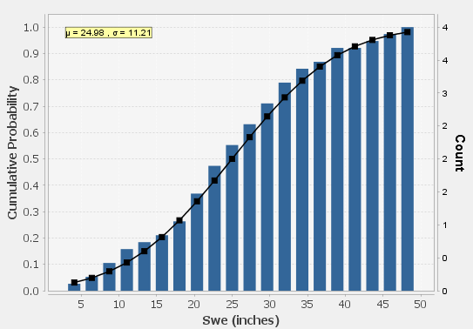
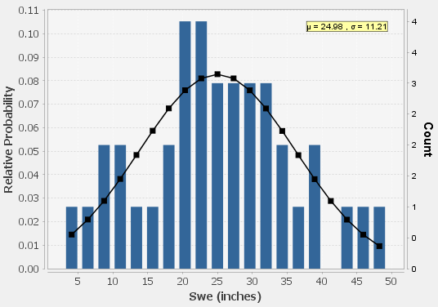
Model Result Visualization
Data
Model
Data
Model
CDF
PDF
53
Notes:
Plotting the observed data against the model on a Cumulative Distribution Function, or CDF, plot and Probability Density Function, or PDF, plot can provide valuable insight to the goodness of fit provided by the model.
In the plots shown here, the same model is fit to the same data within a CDF and PDF plot. Also, the same number of bins and bin sizes are used in both plots.
The model appears to fit the data much better within the CDF plot than the PDF plot, but how much of that visual cue is based upon the chosen bin size in the PDF plot?
Perhaps less bins would allow better visualization of the model fit within the PDF plot.
You can use different numbers of bins and/or bin sizes when visualizing the data in this way.

Slide 54
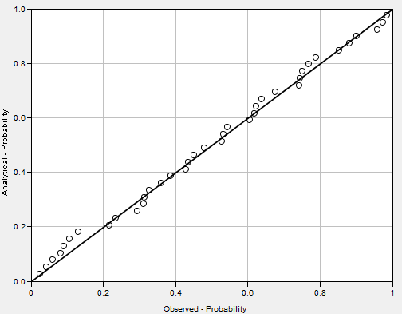
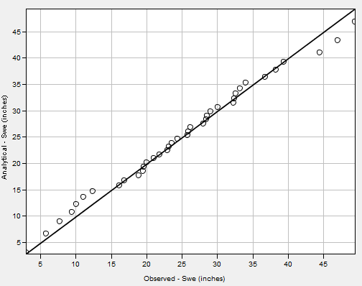
Model Result Visualization
Data
Line of Best Fit
Data
Line of Best Fit
Analytical Probability
Analytical Value
Observed Probability
Observed Value
Probability-Probability Plot
Quantile-Quantile Plot
54
Notes:
Probability-Probability, or PP, plots compare the probability of the data (using the chosen plotting position formula) against the inferred probability of the model.
Quantile-Quantile, or QQ, plots compare the values of the actual data against the inferred value as predicted by the model.
Both plots are valuable for comparing trends. However, the QQ plot is better at visualizing tail behavior while the PP plot is better at visualizing and comparing the “center” of the data.
In both plots, solid black lines of perfect agreement are included for comparison.

Slide 55
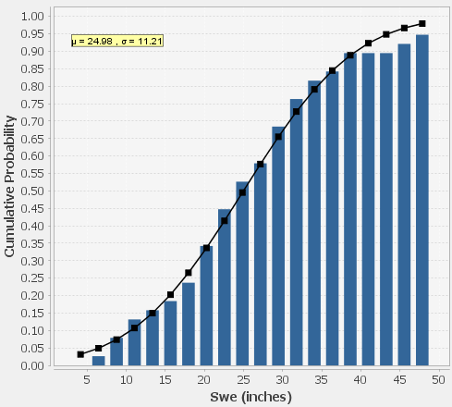
Kolmogorov-Smirnov Test
Kolmogorov-Smirnov (K-S)
Non-parametric method
Uses the maximum difference in CDF between the model and the data
If the difference is large based on the sample size, the null hypothesis that the data come from the proposed model would be rejected
Example:
  K-S Test Statistic = 0.05
Kolmogorov-Smirnov Test Tutorial
K-S Test Statistic
Data
Model
55
Notes:
Now, let’s talk about quantitative goodness of fit tests.
First up, is the Kolmogorov-Smirnov, or K-S, test.
This test is probably the most commonly-used goodness of fit test in water resources because it’s simple and non-parametric in that it doesn’t rely upon the assumption of an underlying distribution.
This test measures the largest difference in the CDF between the model and the observed data.
In the example on the right, the largest difference between the CDF of the model and observed data is approximately 0.05.
Therefore, the K-S test statistic is 0.05.

Slide 56
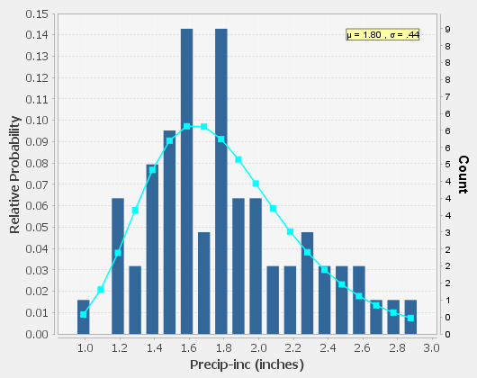
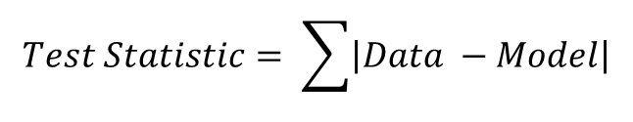
Chi-Square Test
(Pearson) Chi-Square
Parametric method
Is there a significant difference between the expected frequencies and the observed frequencies?
Create a number of “bins” for the data and compare the observed proportion of the data in each bin compared to the expected proportion of the data according to the model
If the proportions are significantly different, then the null hypothesis that the data arose from the proposed model would be rejected
Chi-Square Test Tutorial
Data
Model
Difference
$$Test Statistic= \sum{\left|Data −Model\right|}$$
56
Notes:
The Pearson Chi-Square test, which is often shortened to just Chi-Square, compares the entire model and distribution of data, not just the maximum in the CDF.
It essentially asks, “Is there a significant difference between the model-predicted frequencies and the frequencies within the observed data?”
This test first ranks the data then places the values within bins. In HEC-SSP, exactly five values are placed in each and every bin. This can result in the use of bins that are not uniform in size. Values can not be shared within bins; every possible value is in exactly one and only one bin. Finally, the first bin edge has a CDF value = 0 and last bin has a CDF value = 1.
Once the bins are created, the test statistic is computed using the sum of squared residuals between the model and data across the entire probability range. In the figure above, only a few bins are compared with red arrows, but all bins are compared.
The name “Chi-Square” test arises from the fact that when the number of sampled elements in each bin is equivalent to the expected value, it is predicted by the chi-square distribution with n-1 degrees of freedom.

Slide 57
Other Goodness of Fit Tests
Anderson-Darling
Bayesian Information Criterion
Akaike Information Criterion
Many, many others…
Goodness of Fit Tests Tutorials
57
Notes:
There are many, many goodness of fit tests that have been developed for different types of data, distributions, and fitting methods. I’ll briefly describe three additional tests that are available within HEC-SSP. This list is by no means exhaustive as everybody and their brother has a goodness of fit test.
The Anderson-Darling test assesses whether a sample comes from a selected distribution.
This test works by first assuming that the data does arise from the chosen distribution and then tests the data for uniformity with a simple distance test.
Bayesian Information Criterion, or BIC, and Akaike Information Criterion, or AIC, are similar tests
Both the BIC and AIC tests make use of likelihood functions, which were briefly introduced in the last lecture for use with the maximum likelihood fitting method.
This means that these tests aren’t appropriate for use with fitting methods like method of moments, which limits their applicability.
However, these tests are really cool in that they penalize complex models in an attempt to weed out overfitting.
In this case, model complexity refers to the number of parameters. So, if you use a 3-parameter model like Log Pearson Type III, it’ll be penalized more than a 2-parameter model, like Log Normal.

Slide 58
Uncertainty in Results
Sources of uncertainty within the results include (but aren’t limited to):
  Small sample sizes
  Measurement uncertainty
  Choice of distribution and/or fitting method
  Others…
Not all sources are equal. Some are more “important” or “dominant” than others.
More to come on this topic later…
58
Notes:
There are multiple ways in which uncertainty enters into Parametric Modeling and 99.9% of the time, uncertainty should be shown and discussed along with the results.
Uncertainty in your results can arise from things like small sample sizes, uncertainty in measurements in inferences of measurements, and modeling choices. This is by no means an exhaustive list, but only meant to provoke some discussion. We’ll discuss a few of these sources in more detail in the next few slides.
I gotta mention that not all sources of uncertainty are equal. Some sources provide greater uncertainty in different “portions” of the results than others. For instance, source “X” may provide greater uncertainty in the more frequent range of the resultant probability distribution than source “Y”. But, source “Y” provides much greater uncertainty in the extremely rare range of probabilities.

Slide 59
Confidence Intervals
Model results (i.e. median curve) account for natural variability
Confidence intervals account for knowledge uncertainty
Uncertainty in the model results can be visualized through the use of confidence intervals
  Uncertainty is actually a distribution.
  B17 procedures provides these intervals
  But, they can also be determined using other approaches
randomly-generated
20 year records
59
Notes:
Uncertainty is most commonly visualized using confidence intervals, which are meant to encompass many sources of uncertainty (but usually not all). Confidence intervals typically represent knowledge uncertainty, which can be reduced with additional study (conversely, epistemic uncertainty or natural variability cannot be reduced with additional study).
Confidence intervals simply show two values with each side of a “confidence interval” implying a “confidence limit”. However, in actuality, the true uncertainty is best represented using a distribution of uncertainty.
Confidence intervals can be estimated using monte carlo approaches where multiple samples of the model are made using an effective record length many, many times. This approach is visualized in the figure within this slide. Each blue line is a separate sample.
In specific cases, confidence intervals can be estimated using closed-form equations. For instance, both Bulletin 17B and Bulletin 17C procedures will produce confidence interval estimates for the Log Pearson Type III distribution. However, closed-form equations aren’t available for all distributions.
Both Beth and Greg will go into much greater detail regarding this topic within later lectures.

Slide 60
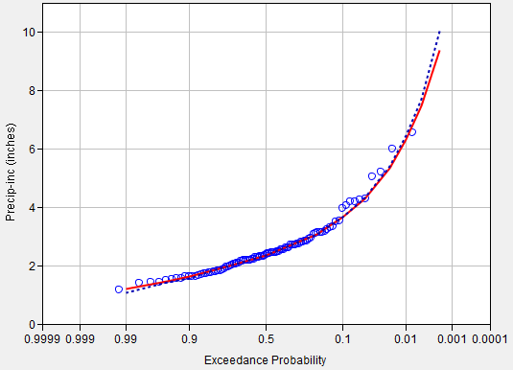
Uncertainty Due to Sample Size
Expected probability of exceedance represents the combined uncertainty due to both natural and knowledge uncertainty
  Exp. Prob. curve = mean
  At ½ AEP, median = mean
  B17B procedures included an approximation (B17C does not)
  Adjustment can be determined using other approaches
Expected Probability Webinar
Data
Median
Mean
60
Notes:
Parametric modeling uncertainty can also arise from small sample sizes. This is a very common problem that is encountered in nearly all water resources applications. From a frequentist standpoint (which I found to be much, much easier to understand early in my career), as the sample size gets larger and larger, the uncertainty should get smaller and smaller. Essentially, a model that is fit to 100 years of data should have tighter confidence intervals than a model that is fit to 50 years of data, all other things being equal.
To correct for small sample sizes, an expected probability adjustment can be made. Remember that the result of a parametric modeling exercise is a parameterized distribution which provides a median quantile estimates. Also, remember that the median represents the point in which 50% of the possible values are above that value and 50% of the possible values are below. The best representation of the true likelihood is the mean.
At the ½ annual exceedance probability, or AEP, the mean and median values are the same.
For AEP less than ½, the mean value is greater than the median.
For AEP greater than ½, the mean value is smaller than the median.
However, it’s not necessarily straightforward to estimate the mean, or an expected probability curve, at the various quantiles of interest. Bulletin 17B included procedures to estimate the expected probability curve but Bulletin 17C does not.
However, we’ve recently added tools to HEC-SSP to estimate the mean and produce an expected probability curve when using Bulletin 17C procedures.
The expected probability curve is most often determined using monte carlo approaches.

Slide 61
Uncertainty Due to Measurement Error
Uncertainty can also arise due to errors in the measurements of data
  Prevalent within stage-flow, radar reflectivity-precipitation rate, etc
Errors can get larger with magnitude
  Heteroscedasticity
61
Notes:
Uncertainty can also arise from errors in the measurements of the data itself.
For instance, the United States Geological Survey operates a network of thousands of stream gages throughout the United States.
At these gages, stages are typically measured, not flow.
Estimates of flow are then based upon the measured stage, an assumed or measured cross sectional shape, and an assumed or measured velocity distribution.
The stage is commonly measured in regular intervals, like 5-, 15-, 60-minutes, while the cross sectional shape and velocity distribution are measured from time to time and updated when large changes or floods occur.
The measurements are combined to create a rating curve which transforms the measured stage to a volumetric flow rate.
This conversion introduces error which carries forward to our analyses since we commonly fit models to flow and not stage (since stage doesn’t “behave” as well as flow).
The errors aren’t linear either due to heteroscedasticity, which I mentioned in the “Developing a Representative Data Set” video.
Remember that common cross section shapes exhibit this behavior due to different portions of the channel and floodplain being active at different stages/flow rates.
The image DOES NOT denote that there’s less uncertainty at higher flows.
We know less about uncertainty at higher flows.

Slide 62
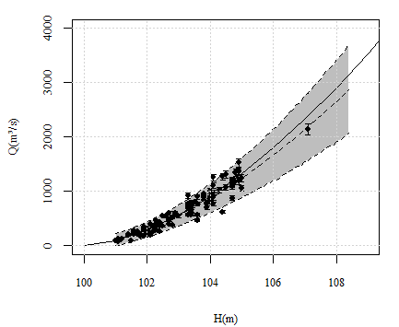

Uncertainty Due to Measurement Error
Real Rating Curve
Real flow-frequency
Estimated Rating Curve
Estimated flow-frequency
Rating Curve +
Uncertainty
Flow-Frequency Curve +
Uncertainty
Complete Bayesian Model for Incorporating Rating Curve Uncertainties and Hydraulic Knowledge in Flood Frequency Analysis
Ana Luisa Nunes de Alencar Osorio Castañon (2017)
62
Notes:
A super duper awesome master’s thesis delving into this topic was performed by a woman from Brazil named Ana Luisa who came to HEC to work with us for a short time a few years ago.
Within this study, she incorporated rating curve uncertainty into estimated flow-frequency curves.
As expected, there is a lot of uncertainty and the uncertainty becomes larger as the stage and/or flow rate increases.

Slide 63

Uncertainty Due to Model Choice
What if all the models fit the sample reasonably well and you must extrapolate to rare exceedance probabilities?
How much uncertainty is due to the choice of model?
The problem gets worse with smaller sample sizes…
This problem is encountered within many types of studies (not just dam safety)
63
Notes:
Uncertainty in your results are also due to the modeling choices that were made.
Here’s a commonly encountered problem within water resources applications: “If all the models fit the sample reasonably well, how do you have confidence in your extrapolation?”
How accurately are you predicting?:
The extents of the floodplain at the 1/500 AEP?
The likelihood of SWE exceeding 20 inches given a sample of 15 years?
This source of uncertainty gets worse and worse with smaller sample sizes.
The USGS published a really cool paper that quantified this uncertainty for several locations in the U.S. and I show the cover here.

Slide 64

Uncertainty Due to Model Choice
Depending upon the model choice, huge amounts of uncertainty can result!
What if all the models reasonably fit the sample?
Must fall back upon the underlying assumptions of the model…
1/500 AEP
800,000 cfs
350,000 cfs
64
Notes:
Here’s a screen capture from that paper. In this image, multiple models have been fit to the same data. These models are visualized as the various solid and dashed lines.
At the 1/500 AEP, the different models (excluding the Generalized Pareto model) predict a range of 450,000 cfs in the instantaneous peak discharge.
As the AEP decreases or becomes rarer, these differences increase.
The moral of the story is that, depending upon the model choice, a huge amount of uncertainty can exist within your quantile predictions, especially at rare exceedance probabilities.
If several models fit the sample reasonably well, you must fall back upon the underlying assumptions of the model when making a determination of which one is best.
For instance, this data set is comprised of annual maximum flows. Therefore, the Generalized Pareto model isn’t an appropriate distribution choice because that’s only meant for use with partial duration series.

Slide 65

Combining Multiple Models
Mixed Population
Curve Combination
  Bulletin 17C recommendations
More to come on these topics later…
Bayesian hierarchical modeling
Model 1
Model 2
Mixed Population
65
Notes:
There are ways to combine multiple models including mixed population analyses, curve combination, and Bayesian hierarchical modeling. Mixed population analysis uses the probability of union theory while curve combination analyses typically use user-defined weights to combine the multiple inputs into a single resultant probability distribution.
Bayesian hierarchical modeling is a much more complicated topic and would take far too much time completely explain than is allowed within this lecture. In short, this type of analysis combines multiple models using Bayes theorem. Our colleagues from the Risk Management Center have developed a piece of software that can perform this type of analysis, which is especially useful for dam safety applications. If you’re interested in giving it a try, reach out to us and we’ll point you in the right direction.

Slide 66
Summary
Described parametric modeling, its advantages, disadvantages, and steps.
Defined data requirements and how to develop a data set for analysis.
Detailed commonly used probability distributions.
Outlined fitting methods and parameter estimation.
Discussed the Expected Moments Algorithm in detail.
Explained multiple ways of validating goodness of fit.
Briefly described sources of uncertainty and ways in which multiple models can be combined.
66
Notes:
I introduced parametric modeling along with some of the theory, advantages, and disadvantages when using this method.
We talked at length about data that goes into a parametric modeling analysis.
It’s super important to investigate your sample to ensure it’s comprised of independent and identically distributed values that are representative of the parent population.
We talked about the selection of both an analytical distribution and a fitting method. When put together, these two create a model from which we can draw conclusions.
We discussed commonly utilized distributions within water resources as well as several examples of fitting methods.
we talked about the visualization of model results against observed data.
Several qualitative visualization tools were presented in addition to several quantitative goodness of fit tests.
Remember that when you ascertain whether your chosen model is appropriate for use, your judgement shouldn’t be based upon a single visualization or quantitative test.
Instead, you should use all of the tools that are available.
Remember that uncertainty arises from multiple sources like small sample sizes, measurement error, and model choices.
Not all sources of uncertainty are equal.
Also, we briefly talked about combining different models together to form a single model and what tools are available to perform those combinations.

