Slide 1
Annual Peak Flow Record
Wet Period
Dry Period

Slide 2
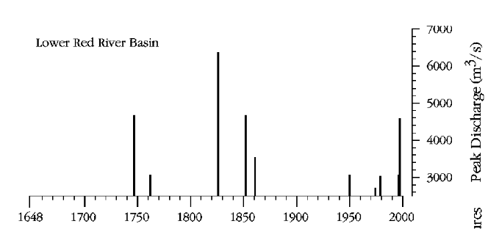
Suggestion of wet/dry cycle
Tree-ring evidence of historical flood peaks suggests a reoccurrence of wet and dry periods in the last few centuries
gaged
Figure 10 Estimated peak discharge for the Lower Red River basin at Winnipeg and flood signatures in the Upper Red River basin.
from: St. George, S. and Nielsen, E. “Palaeoflood records for the Red River, Manitoba, Canada, derived from anatomical tree-ring signatures,” The Holocene, 13,4 (2003) pp. 547-555.

Slide 3
Where to split the record? – Pettitt Test
Two samples are compared to test whether the means are significantly different. The Pettitt Test repeats the comparison for every possible break point between the samples, and finds the one with the greatest evidence of difference
1941
Statistical Evidence of Difference between samples
1961
5% significance level

Slide 4
Annual Peak Flow Record
Split record in 1941
Wet Period
Dry Period

Slide 5
Frequency Analysis on Wet and Dry Records
The standard deviation (slope of curve) is much less for the wet and dry records than for the full record, because in either period, range of observed flow is less

Slide 6
Re-Combining the Wet and Dry Frequency Curves
Theorem of total probability:
P(Q>q) = P(Q>q|wet) * P(wet) + P(Q>q|dry) * P(dry)
where:
P(Q>q) =
exceedance probability for a given flow, q
P(Q>q|wet) =
exceedance probability given that we're in the wet condition
P(wet) =
probability we're in the wet condition.

Slide 7
Choosing P[wet] and P[dry] for future years
Analysis requires a single frequency curve for any future year.
Recombining the wet and dry frequency curves with the total probability theorem requires, for every year, the probability that year is in wet part of cycle, and complementary probability year is in dry part of cycle
Year 0: seem to be in the wet period now, 100% wet, 0% dry
Year 25: between 0 and 50, chose 80% wet, 20% dry
Year 50: far enough in the future that we can’t make any statement about which part of the cycle it might be, so steady-state probability of 65% wet, 35% dry (following ratio in observed record)

