Slide 1
Basic Probability and Statistics
Statistical Methods in Hydrology
Beth Faber, PhD, PE
Hydrologic Engineering Center, May 2025

Slide 2
Goal
Because students’ backgrounds differ, as does their current use of these topics….
….we’ll revisit concepts in probability and statistics, to bring us to a common jump-off point for upcoming material
Notes:
We all have different backgrounds and experience with probability ideas, so this review of the college course will hopefully bring us to a similar place.
This lecture is kind of a slow walk through the basic topics, to give a chance to dwell on the ideas a bit. Much or most of it will be summarized more briefly in later lectures.

Slide 3
Important Relationship – Statistical Inference
observations
2 directions using the same theories
statistics
probability
probability relationships
Consider how statistical inference is used to estimate probabilities of occurrence of random hydrologic variables….
….and how probability distributions are used to “predict” likelihood of future random occurrences
Notes:
This is an idea that summarizes the relationship between probability and basic statistics. We use statistical analysis to estimate probability from data or observations, and then use that probability description to determine the likelihood or frequency of future observations. Once those future observations occurred, we can use them to improve probability estimates, and so on…

Slide 4
Topics of Discussion
Describing probability
  Definitions
  Discrete and Continuous random variables
Estimating probability from observations
Review common probability distributions
Inferring probability distributions, parameters
  Sample moments
  Working with the Normal distribution
Describing probability
  Definitions

Slide 5
Definitions
Probability, Frequency
Random
Random Variable
Probability Distribution
Natural Variability
Knowledge Uncertainty
Population and Sample
Parameters and Statistics

Slide 6
Probability
A measure of likelihood or the chance of an outcome or event
Magnitude: 0 ≤ probability ≤ 1
0% ≤ probability ≤ 100%
Sum of probabilities of all possible outcomes = 1 or 100%
won’t /can’t happen
will happen
Notes:
… what’s really important in our dealings with probability is where the estimates come from.

Slide 7
Frequency
The rate at which something random happens, or how often it happens
  generally based on a given data set or sample
Used to estimate probability
In the Corps, “frequency” is often used interchangeably with “probability”
Notes:
How likely something is to happen is closely tied with how often it happens.

Slide 8
Random
Lacks a clear purpose, intention or method.
Has no pattern, is unpredictable
  …but frequency of outcome might be predictable
Happens by chance rather than by plan
Outcome is uncertain
Has a probability of occurrence
Notes:
There are many definitions of “Random.” Some outcomes are naturally random. But the word is sometimes used to describe a process so complex we can’t understand it completely enough to predict.

Slide 9
Random Variable, RV
A variable that’s subject to chance, and can take on different values with associated probabilities
Use RV to describe something that:
  naturally keeps changing, or
  we can’t estimate well
We describe a random variable with a probability distribution: outcome vs probability
Notes:
Any value that’s relevant to our analysis, that either hasn’t happened yet or can’t be measured accurately, is a random variable.

Slide 10
Probability Distribution
A relationship between a RV’s value and probability
A function that describes all possible values of a random variable, and their likelihoods
  but, sometimes NOT a mathematical function
We use probability distributions to describe what is random, and what is unknown
natural variability
knowledge uncertainty

Slide 11
Natural Variability
Aleatory Uncertainty
Some variables are naturally random in that they change or vary unpredictably through time or space
Examples
  annual peak streamflow
  February 1 snow-water equivalent (SWE)
  channel roughness, which can be affected by a flood event
  soil properties (vary in space, rather than time)
Notes:
When dealing with hydrologic phenomena such as flood events, natural variability tends to be things that vary from flood event to flood event.

Slide 12
Knowledge Uncertainty
Epistemic Uncertainty
The degree to which we are unsure about any parameters and relationships used in computation: economic, hydraulic or statistical
Might be reducible with more information…
Examples
  estimates of probability
  value of structures in flood plain
  channel roughness, which we don’t know precisely
  a model that is too simple
decision metrics often encompass NV, but KU still adds “spread”
Notes:
When dealing with hydrologic phenomena such as flood events, knowledge uncertainties tend to be things that are true across all flood events, but just aren’t known or able to be estimated well.

Slide 13
Population and Sample
Population - the “universe”
- all possible outcomes of a RV, and their likelihoods
    - sometimes, a probability distribution
Sample - a subset of the parent population
- observations (measurements) of the variable
- results of an experiment
- a representative sample will maintain the probabilistic structure of the population (e.g. distr. & parameters)
Population
Sample
important question: is a random sample representative of the population?
Notes:
As an example, for flood frequency the population is any flood that could occur in the watershed, and how likely each magnitude is. The sample is what’s been observed.

Slide 14
Parameters and Statistics
Parameter
  A descriptive measure of a POPULATION
Statistic
  A descriptive measure of a SAMPLE
A sample statistic is often used to estimate a population parameter
truth (unknowable)
estimate

Slide 15
Estimating Probability
System characteristics
  Based on physics of the system (often intuitive)
  Judgment, Analysis, Experience in similar situation
Observations (using statistical inference)
  Recorded data
    Streamflow gage
    Economic surveys
  Data from experiments

Slide 16
Topics of Discussion
Describing probability
  Definitions
  Discrete and Continuous random variables
Estimating probability from observations
Review common probability distributions
Inferring probability distributions, parameters
  Sample moments
  Working with the Normal distribution

Slide 17
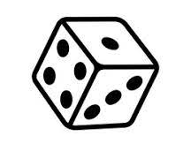


Rolling a 6-sided Die: Physics
probability mass function, PMF
Central Tendency:
expected value, mean
1/6 = 0.167
$$μ=\sum_{iϵI}{p_{i}X_{i}=}$$
= Probability weighted sum of all possible outcomes
= (1/6) * (1 + 2 + 3 + 4 + 5 + 6)
$μ$= 3.5
Notes:
This is the estimate of probability that results from recognizing the simple system of a 6-sided die suggests that each side is equally likely. Therefore, the total probability of all outcomes of 1.0 divided by the 6 possible outcomes provides probability 1/6 for each outcome.
The mean of the discrete distribution is the probability weighted sum of all possible outcomes, and is not necessarily a possible outcome.

Slide 18
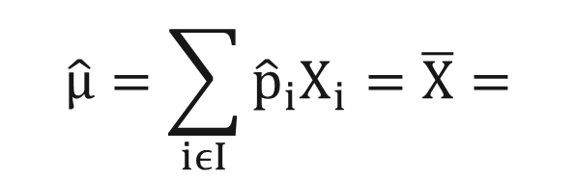
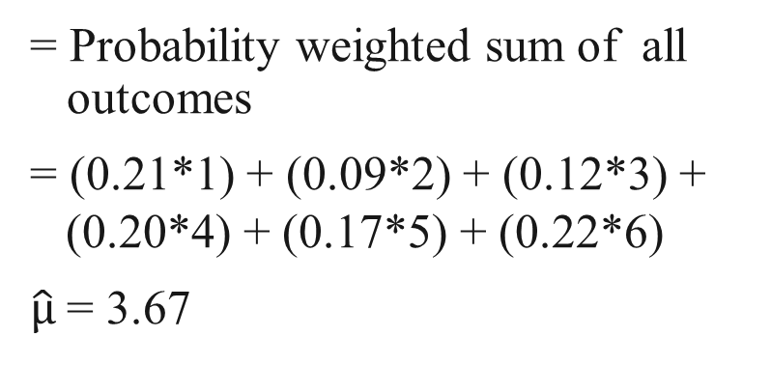
Rolling a 6-sided Die: Experiment
histogram - estimate of PMF
Central Tendency:
expected value, mean
$$\hat{μ}=\sum_{iϵI}{{\hat{p}}_{i}X_{i}=\overline{X}=}$$
sample estimate of mean
= Probability weighted sum of all outcomes
= (0.21*1) + (0.09*2) + (0.12*3) +
(0.20*4) + (0.17*5) + (0.22*6)
$\hat{μ}$= 3.67
Sample size = 100
same number from average of the values
Notes:
This is the same example of the 6-sided die, with probability estimated by experimentation. This method is only possible with systems that can be repeated replicated at will, to produce a sample. The relative frequency of each possible outcome is used to estimate the probability of each outcome, with the resulting histogram becoming the estimate of the PMF. The sample estimate of the mean is either the probability weighted sum computed with estimated probabilities, or simply the average of all outcomes.

Slide 19
Probability Estimates from Data
Use Relative Frequency
Estimated Probability = # of Occurrences
# of Independent Trials
= Relative
Frequency
for the 6-sided die: = # times rolled that value
# of rolls
Observed Frequency
Notes:
Relative frequency is a very simple but very effective means of estimating probability from a random sample.

Slide 20
Part 1 of Excel Exercises
Excel function =RAND() produces a value equally likely between 0 and 1, i.e., a Uniform(0,1) random value
consider natural variability
and knowledge uncertainty…
cumulative probability
outcome
Notes:
After repeatedly rolling a real 6-sided die to estimate probability, we’ll be using Excel to simulate the rolling of a 6-sided die using pseudorandom numbers.

Slide 21
from
100 rolls
One experiment
Twenty experiments
Dice Experiment Confidence Intervals
experiment number
from
1000 rolls
can compute by experiment, or approximate with a Normal distribution
experiment number
from
10,000 rolls
experiment number
Notes:
These are images from the Excel exercises. A reason for repeating an experiment in which we estimate probability from a limited sample, rather than just pooling all the samples for a better estimate, is to explore the uncertainty in an estimate from a limited sample.
These figures show single-sample histograms on the left for increasing sample size, and 20 replicates of the experiment on the right. From repeating the experiment, we see how much error is in our estimates from limited samples and can draw 90% confidence intervals. The interval shows the range in which 90% of random sample estimates of probability will fall, but can also be drawn around a single estimate as an interval for the “population” probability.

Slide 22
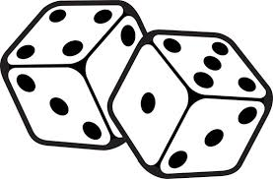
Sum of 2 Dice: Physics & Experiment
36 possible rolls resulting from 2 random numbers, but the function we’re interested in is the SUM of both dice.
Die #2
only 11 possible outcomes of the function “SUM”
1
2
3
4
5
6
Expected Value of the Sum =
2 * ¹/₃₆ + 3 * ²/₃₆ + 4 * ³/₃₆ +
5 * ⁴/₃₆ + 6 * ⁵/₃₆ + 7 * ⁶/₃₆ +
8 * ⁵/₃₆ + 9 * ⁴/₃₆ + 10 * ³/₃₆ +
11 * ²/₃₆ + 12 * ¹/₃₆ = 7
1
2
3
4
5
6
7
2
3
4
5
6
7
8
Die #1
3
4
5
6
7
8
9
4
5
6
7
8
9
10
5
6
7
8
9
10
11
6
7
8
9
10
11
12
the 36 rolls are mutually exclusive and exhaustive
Notes:
This is a similar system using two dice, and computing the sum. The system is simple enough to estimate probability from the basic understanding. There are 36 possible rolls, as each value on die 1 can be paired with each value on die 2. There are 11 possible sums, between 2 and 12. The likelihood of each possible outcome is simply the number of ways to produce that outcome, divided by the 36 possible outcomes, with 7 the most likely as 6 out of 36.

Slide 23
Sum of 2-dice, PMF from physics
PMF = Probability Mass Function
refer to spreadsheet experiment…
Notes:
This is the PMF of the sum of two dice, estimated by understanding the simple system. It can also be estimated by repeated random sampling, like the just-completed workshop, as shown in a spreadsheet.

Slide 24
Estimated Probability of Rolling a 7
The ERROR in our estimate of probability decreases
as sample size increases
Notes:
This figure shows how, in using repeated random sampling to estimate probability, the estimate gets closer to the true value as the number of rolls increases.

Slide 25
Central Tendency Parameters
Mode = most likely
Median = 50% of prob above,
50% of prob below
Mean μ = prob weighted sum of outcomes (expected value)
For a symmetrical distribution, these are the same.
For an asymmetrical distribution, they are not…

Slide 26
Accumulating Probability - CDF
PMF
Cumulative Distribution Function =
probability of being less than or equal to a value
CDF
non-exceedance probability
Notes:
It is sometimes more useful to work with cumulative probabilities. The Probability Mass Function (PMF) displays the probability of a discrete outcome occurring. The PMF can be accumulated from the bottom into a Cumulative Distribution Function (CDF) that displays the probability that an occurrence is less than or equal to than each discrete outcome. The probability of an occurrence less than or each to 5 is the sum of the probabilities of 2, 3, 4 and 5. The sum of all possible outcomes is 1.0, and so the CDF spans the range between 0 and 1.

Slide 27
Accumulating Probability - CDF
PMF
Cumulative Distribution Function =
probability of being greater than or equal to a value
Can be called Complementary CDF
CDF
exceedance probability
Notes:
Sometimes the probability of being greater than or equal to some value is more interesting than less than. So we can accumulate the PMF from the top to compute the probability of an occurrence greater than or equal to each possible outcome. The produce is still a Cumulative Distribution Function, but is sometimes referred to as a complementary CDF.

Slide 28
Continuous Random Variables
…the 6-sided dice were DISCRETE random variables
Outcome of a trial is a real number.
Probability distribution is a continuous function.
Probability of an exact number is zero!
Thus, we are interested in incremental or cumulative probabilities:
P[ 2.5 < X < 3.5 ] = 0.4 (Incremental)
P[ X < 3 ] = 0.7 (Cumulative)
P[x=3] = 0
Relationship: P[ 2.5 < X < 3.5 ] = P[ X < 3.5] – P[ X < 2.5 ]
incremental
cumulative
Notes:
Continuous random variables have an infinite number of possible outcomes, making the probability of any exact outcome equal to zero. Therefore, we work with either cumulative or incremental probabilities with continuous random variables.

Slide 29
Defining a Continuous Distribution
Probability Density Function (PDF), f(x), defines the probability of occurrence for a continuous random variable.
area under curve = probability
Cumulative Distribution Function
(CDF) = ∫ PDF, F(x) = P(X ≤ x), is the probability the random variable is less than some value
curve = probability
P(x₁<X<x₂)
Area = 1
p
PDF
x
x₁
x₂
X
F(x₂)
F(x₁)
CDF
p(x₁<X<x₂) = F(x₂) - F(x₁)
p
=F(x)
x
X
x₁
x₂
Notes:
These are the basic images and definitions of the Probability Density Function and the Cumulative Distribution function for a continuous random variable.

Slide 30
Defining a Continuous Distribution
Probability Density Function (PDF), f(x), defines the probability of occurrence for a continuous random variable.
area under curve = probability
Cumulative Distribution Function
(CDF) = ∫ PDF, F(x) = P(X < x), is the probability the random variable is less than some value
curve = probability
Area = 1
p_{e}
p
PDF
x
X2
X
CDF
1-p = p_{e}
exceedance probability
p
=F(x)
x
X
X2
Notes:
These are the basic images and definitions of the Probability Density Function and the Cumulative Distribution function for a continuous random variable.

Slide 31
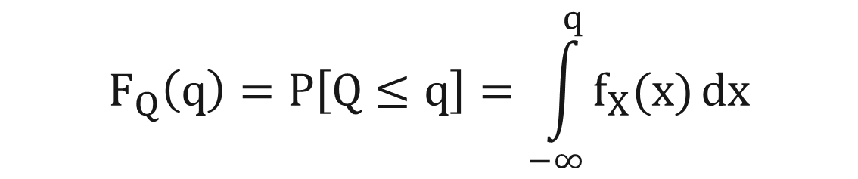
Definition of PDF and CDF
A Probability Density Function (PDF), f(x), describes the probability of occurrence for a random variable.
A Cumulative Distribution Function (CDF), F(x) is the probability of being less than some value:
Equation:
which reads:
The probability that Q (e.g.,flow) is less than or equal to q (e.g., 1000 cfs) is equal to the integral of the probability density function (PDF), from minus infinity to q
$$F_{Q}\left(q\right)=P\left[Q≤q\right]=\int_{−∞}^{q}{f_{X}(x)}dx$$
f_{X}(x) is the PDF
the integral is the CDF
Notes:
The CDF is the integral of the PDF, and a probability for a given value is the integral up to that value.

Slide 32
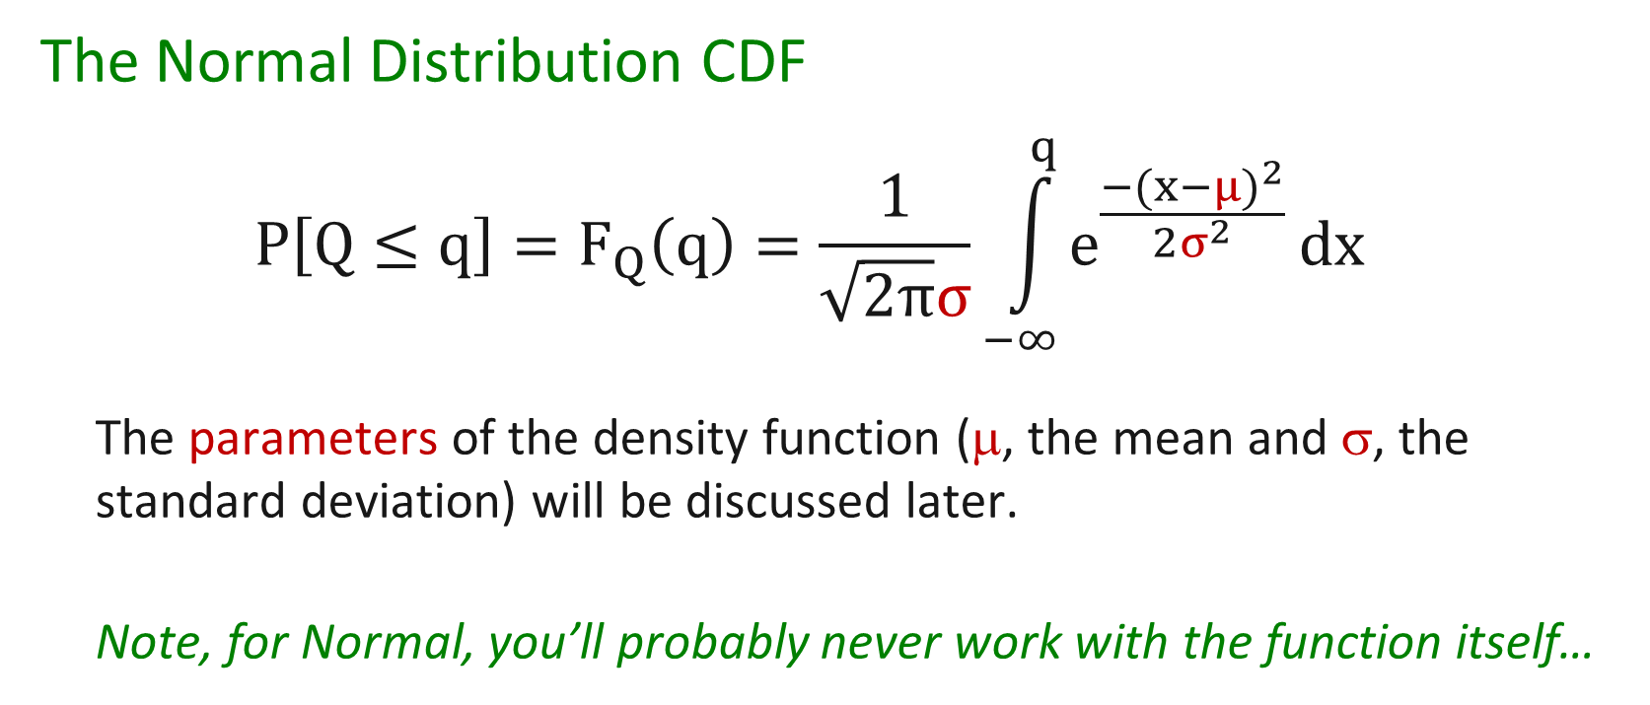
Example CDF
The Normal Distribution CDF
$$P\left[Q≤q\right]=F_{Q}\left(q\right)=\frac{1}{\sqrt{2π}σ}\int_{−∞}^{q}{e^{\frac{{−(x−μ)}^{2}}{2σ^{2}}}}dx$$
The parameters of the density function (μ, the mean and σ, the standard deviation) will be discussed later.
Note, for Normal, you’ll probably never work with the function itself…
Notes:
The equations for the Normal distribution are awkward. We typically use a tabulation, or an approximation.

Slide 33
Topics of Discussion
Describing probability
  Definitions
  Discrete and continuous random variables
Estimating probability from observations
Review common probability distributions
Inferring probability distributions, parameters
  Sample moments
  Working with the Normal distribution

Slide 34
Probability Estimates from Data
Estimated Probability = # of Occurrences
# of Independent Trials
= Relative
Frequency
Notes:
Relative Frequency is a very simple but very effective method of estimating probability from observations. Outcomes that are more probable to occur more frequently.

Slide 35
A Key Point
As the number of observations becomes very large, the estimate of probability by relative frequency approaches the true value - population value
Problem: we usually have relatively little data.
Notes:
As an estimator, relative frequency improves as the number of observations increases. This is true of most of the estimators we will use this week. Unfortunately, except with systems that can be made to produce an outcome at will, natural systems provide us a limited number of observations that only increases with time.

Slide 36
Probability Estimates from Data
largest flow of each year
note: this variable is continuous, rather than discrete as the 6-sided die
Notes:
This is an example data set of the annual maximum flow value of each year for an 85 year period of record. Note this is a continuous random variable, because flow can be any value in the range of possibility.

Slide 37
Probability Estimates from Data
histogram
count
histogram approximates the PDF
divide count by 85 to get relative frequency
0
0
Notes:
One way to view the variable probabilistically is to discretize the range and produce a histogram. We see higher bars where there are more occurrences, implying higher probability of those values. The histogram is an estimate of the PDF.

Slide 38
Histogram
Estimating the Probability Density Function, PDF
Histogram, or class interval analysis
Placing observations in intervals (bins) and calculating relative frequency results in a histogram of the observations
As the number of observations becomes very large, and the interval becomes very small, the histogram approaches the true probability density function, PDF, for a continuous random variable.
Notes:
We’ll see this phrase “as the number of observations becomes very large” a few times in the next few slides. Estimators that get better with more data are called “consistent” estimators.

Slide 39
Density function (PDF) vs. histogram
histogram of very large sample
area under the probability density function is probability, and so the area under the entire curve is equal to 1.0
PDF
area = p
q
Notes:
The green PDF is a parent population, and the purple histogram represents a very large sample from that population. This is intended to show that for a very large sample, the histogram approaches the PDF.

Slide 40
Cumulative Histogram
Cumulative Count
Cumulative Frequency
Cumulative Frequency
0
0
Notes:
Histograms can be accumulated for continuous random variables in the same way they are for discrete random variables, and are an estimate of the CDF. This is the cumulative histogram of the sample of 85 values, as count on the left and as relative frequency on the right.

Slide 41
Cumulative Histogram vs
Cumulative Distribution Function, CDF
But, not always the best way to estimate the CDF for a smaller sample
Cumulative Frequency
Notes:
Similarly, the green CDF is a parent population, and the purple cumulative histogram represents a very large sample from that population. This is intended to show that for a very large sample, the cumulative histogram approaches the CDF.
However, the cumulative histogram is not the ideal representation of the CDF…

Slide 42
Another Estimate of CDF
adjust bins for 1 observation each
plot every value!
have a histogram bar for every data point
What would non-cumulative look like?
%
Notes:
A better estimate of the CDF involves plotting all the data points, rather than condensing them into a histogram. It generalizes the histogram idea by assuming that bins are sized such that there is exactly one value per bin. This is the sample of 85 values. The vertical lines are an approximation of showing this as a form of cumulative histogram.

Slide 43
Another Estimate of CDF
If every bin has one value, every bin has an equal frequency of 1/N
then we switch the axes…
each event has equal frequency of 1/N
%
Notes:
In this method of estimating the CDF, the axes are switched to put the variable on the vertical and frequency on the horizontal. Note that cumulative frequency increases by the same amount with each event, because the count of events equal to or below that value is increasing by 1 each time.

Slide 44
Another Estimate of CDF
change to Normal probability axis…
Normally-distributed data plots as a straight line on a Normal probability axis
Annual
%
Notes:
Next, the formerly linear probability/frequency axis has been turned into a Normal Probability axis. Note, this axis scaling brings values in the middle closer together than the ones at the tails farther apart. Normally distributed data will plot as a straight line on a Normal probability axis.
The Normal probability axis is scaled based on the Normal PDF that can be seen sitting on the horizontal axis. Starting on the left, the value on the axis represents the area under the PDF that has been accumulated by that point. 5% of the area has been accumulated to the left of where the axis shows 5. 50% has been accumulated to the left of where the axis shows 50. So, plot a probability where that PDF has accumulated that probabilty.
The Normal probability axis is actually linear in the standard Normal deviate, Z, which will be discussed in later slides.

Slide 45
Standard Normal ~ N[0, 1]
reflection line
Notes:
This figure shows the creation of a Normal probability axis.

Slide 46
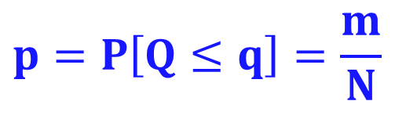
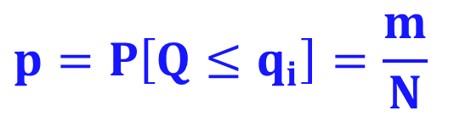
Plotting the Data Itself – Plotting Positions
We estimate cumulative probabilities of the data points using Plotting Positions – by the relative frequency of sample values
With histogram analysis, we estimated the cumulative distribution function CDF by:
where m = number of values less than q
N = total number of values
With plotting positions, estimating cum.probability by place in the sample
The estimated probability is still:
for q = upper edge of a bin
relative frequency
$$p=P\left[Q≤q\right]=\frac{m}{N}$$
$$p=P\left[Q≤q_{i}\right]=\frac{m}{N}$$
where m = rank
smallest = 1,
largest = N
for q_{i} = sample member
Notes:
In general, we’re using relative frequency to estimate the probability of being less that a certain value by how often the observations WERE less than that value, given our available data. That probability estimate by relative frequency is called a PLOTTING POSITION, because is defines where to plot the observation on the probability axis.
For a histogram, we compute that relative frequency at the edge of every bin. The probability that variable Q is less than value q is the number of values that were less than q. m is the number of values less q, and is the sum of all histogram bins below q. N is the total number of values. m/N is thus the relative frequency of values less than q.
For a plotting positions, we compute that relative frequency for every member of the sample. The probability that variable Q is less than value q is still the number of values that were less than q. We sort the observed values and rank them from 1 to N. The rank, m, is the number of values less than or each to that observation. N is the total number of values. m/N is thus the relative frequency of values less than q, which is now computed for every sample member, rather than only for every bin.

Slide 47
Flow Frequency Curves
Return Period 1.25 2 5 10 20 50 100 200 500
2nd largest in 85 years, probability ≈ 2/85 ≈ 2.4%
largest in 85 years, probability ≈ 1/85 ≈ 1.2%
change to prob greater than,
P[Q>q_{i}] ≈ m/N
m = rank
largest = 1
smallest = N
Annual
100
%
.024
.012
0
Notes:
The next adjustment is switching from P[Q>q], the probability of being less than, to P[Q>q], the probability of being greater than. We do this by sorting the data from high to low, so m represents the number of values greater than or equal to.
The axis is now Exceedance Probability (the probability of being greater), but has been reversed so that zero is on the right. There is now also an upper horizontal axis showing return period. Return period is the average number of years between exceedances of the flow value, and is equal to 1 / exceedance probability. Note that the largest sample member plots as the largest in 85 years, and plots at approximately 1/85 = 1.2 % chance of exceedance. The second largest sample member is equaled or exceeded twice in 85 years, and so plots about 2/85 = 2.4 %. Each sample member plots at the relative frequency of exceedance of its value as defined by its rank in the sample.

Slide 48


Plotting Positions
Want to avoid a value equal to 1 (N/N)!
Some common plotting positions:
Weibull mean estimate of probability
Median median estimate of probability
Hirsch-Stedinger based on threshold-exceedance
$$p=\frac{m}{N+1}$$
$$p=\frac{m−0.3}{N+0.4}$$
where m = rank
N = total # of values
Notes:
Since either the largest or smallest event will have rank m = N, the simple m/N plotting position can equal 1.0. For non-exceedance, this implies that it’s impossible to have an event larger than the largest in the record, which is a poor assumption. Even for exceedance, the assumption that we can’t have an event smaller than the smallest is problematic, and either way, this outcome implies a bias in all of the plotting positions.
There are many other plotting positions derived using m and N that have good properties. Weibull and Median, shown on this slide, are commonly used. Weibull estimates the mean of the PDF describing the uncertainty in the estimate of probability, which means it is unbiased. Median provides the median of the PDF of uncertainty, which is a good comparison to fitted analytical probability distributions.

Slide 49
Cumulative Distribution Function
We can estimate a CDF from ranked observations versus plotting positions.
As the number of observations becomes very large, the estimated cumulative distribution function (CDF) approaches the true cumulative distribution function (CDF) for a continuous random variable
- population CDF

Slide 50
Flow Frequency Curves
Return Period 1.25 2 5 10 20 50 100 200 500
last change is a log axis for flow
%
Notes:
The final axis adjustment is to put streamflow on a log axis. Often this brings the plotted data closer to a straight line, which would imply a log Normal distribution or something close to it. In the case of this data, it is more curved on a log axis.
So far, we’ve done an empirical analysis in which we’ve looked only at the data set itself and made no further assumptions. The next step is estimating an analytical probability distribution for this data, which is the green line on the plot.

Slide 51
Assumptions
What did we just do?
Treated observations as a random, representative sample of the population of interest
We assumed the sample is IID
  annual peak flows are random and independent
  peak flows are identically-distributed – from the same probability distribution, homogeneous, stationary
  sample is adequately representative of the population
  estimate of the distribution improves with sample size
  we compute confidence intervals to quantify our error (uncertainty) due to NOT being representative
Notes:
Not so much that they ARE identically distributed as that it is reasonable to fit a single distribution to them.
ID: All value from the same prob distr. OR, all values can be effectively represented by the same probability distribution

Slide 52
Alternate Labels for Frequency Axis
Annual
Exceedance Probability = Prob. of being greater than value
Exceedance Frequency = Exc. Probability * 100
%-Chance Exceedance = Exc. Probability * 100
Return Period = 1 / Exceedance Probability
Recurrence Interval = 1 / Exceedance Probability
Exceedance Interval = 1 / Exceedance Probability

Slide 53
Frequency Curve Review
(1) What is the median of the distribution?
(2) What is the 2-year event?
(3) What is the 0.01 exceedance probability event?
(4) What is the likelihood of exceeding 10,000 cfs in any given year?
Notes:
This figure shows a fitted analytical distribution and a 90% confidence interval, which we’ll discuss further in later slides. Once we have an estimated probability distribution, it is a relationship between our variable (annual maximum flow) and probability that can answer questions in either direction. We can specify flow and determine its exceedance probability, and we can specify exceedance probability and determine the flow that has that probability, called a flow quantile.

Slide 54
Topics of Discussion
Describing probability
  Definitions
  Discrete and continuous random variables
Estimating probability from observations
Review common probability distributions
Inferring probability distributions, parameters
  Sample moments
  Working with the Normal distribution

Slide 55
Some Continuous Distributions
Uniform:
Triangular:
Normal:
Log-Normal:
these are probability density functions (PDFs)
Gaussian
log of variable is Normally distributed
Notes:
In this lecture, we’ll be looking at these four common probability distributions. These are useful for different purposes. Some can be used for describing hydrologic variables, and others are more useful to describe uncertainty distributions.

Slide 56
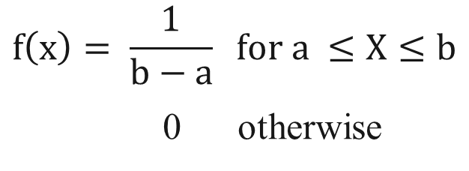
Uniform Distribution
Interpretation:
  All values in range are equally likely
Parameters:
  Range (a, b) (min, max)
What is the mean, median, mode?
What does the CDF look like?
CDF
1
PDF
= f(x)
0
$$f\left(x\right)= \frac{1}{b−a} for a ≤X≤b$$
0 otherwise
Notes:
A common use of the Uniform distribution with min and max of 0 and 1, designated as U[0,1], is for generating values to act as cumulative probabilities to randomly sample from any probability distribution for Monte Carlo simulation, as we did with the dice-rolling spreadsheet.

Slide 57
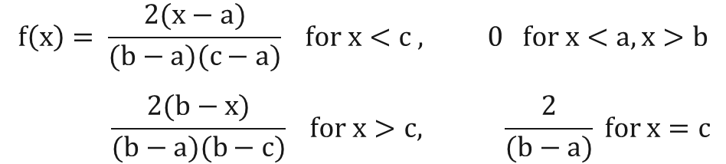
Triangular Distribution
More informative than uniform distribution
Parameters:
  Mode c
  Range (a, b) (min, max)
May be asymmetrical
In this case, Mode < Median < Mean
What does CDF look like?
= f(x)
1
CDF
PDF
0
$$f\left(x\right)= \frac{2(x−a)}{(b−a)(c−a)} for x<c , 0 for x<a, x>b$$
$$\frac{2(b−x)}{(b−a)(b−c)} for x>c, \frac{2}{(b−a)} for x=c$$
Notes:
The triangular distribution can be useful in describing uncertainty around an estimate because it can be either symmetrical or asymmetrical.

Slide 58
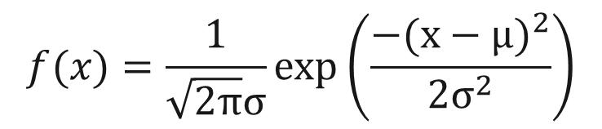
Normal (Gaussian) Distribution
Very useful, a common distribution found in nature
Has a defined shape, eqn
Parameters:
  Mean μ
  Variance σ² (standard deviation σ)
Symmetrical
  Mean = Median = Mode
  Skew coefficient = 0
Scalable from Standard Normal
Mean = 0, St.Dev = 1 ~N(0, 1)
What does CDF look like?
1
CDF
PDF
σ
μ
0
$$f(x)=\frac{1}{\sqrt{2π}σ}exp\left(\frac{{−(x−μ)}^{2}}{2σ^{2}}\right)$$
Notes:
The Normal distribution is useful both to describe variables and to describe uncertainty.

Slide 59
Normal to Standard Normal and back
Standard Normal Z
X = Z σ + μ
(X - μ) = Z ~ N(0,1)
σ
Normal
X ~ N(μ, σ)
-4
4
Notes:
This slides shows the transformation between Normal and Standard Normal distributions. Since Standard Normal has mean of zero and standard deviation of one, we produce a Standard Normal variate by subtracting the mean and the dividing by the standard deviation. We transform back to the Normal distribution by multiplying by the standard deviation and adding back the mean.
NOTE, the area under a PDF is 1.0, and so the two PDF in this image SHOULD have the same area. They do not, to make an easier image to read, but note that the red PDF should be much lower.

Slide 60
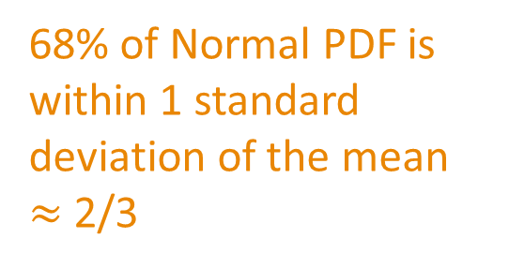
Normal Distribution
68% of Normal PDF is within 1 standard deviation of the mean $≈$2/3
95% of Normal PDF is within 2 standard deviations of the mean
μ = mean
σ = standard
deviation
σ
μ

Slide 61
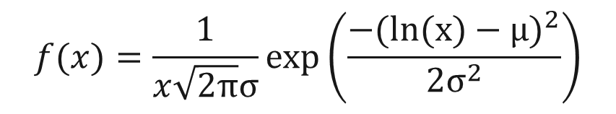
LogNormal Distribution
The LOG of the variable X has a Normal distribution
natural or base-10 logarithm
Has a defined shape, eqn
Parameters:
  Mean of logX = μ
  Variance of logX = σ² (st.dev σ)
Has “fixed” skew defined by μ and σ
Can’t be less than zero!
What does CDF look like?
1
CDF
PDF
σ
μ
0
$$f(x)=\frac{1}{x\sqrt{2π}σ}exp\left(\frac{{−(ln(x)−μ)}^{2}}{2σ^{2}}\right)$$
Notes:
A log transform of the Normal distribution is useful when a variable has a positive skew and cannot have values less than zero. The parameters are based on the log transform of the variable.

Slide 62
Parameters and Statistics
Parameter
  A descriptive measure of a POPULATION
Statistic
  A descriptive measure of a SAMPLE
A sample statistic is often used to estimate a population parameter
TRUTH (unknowable)
estimate

Slide 63
Topics of Discussion
Describing probability
  Definitions
  Discrete and continuous random variables
Estimating probability from observations
Review common probability distributions
Inferring probability distributions, parameters
  Sample moments
  Working with the Normal distribution

Slide 64
Probability Distribution for Flow
This is our “model” of probability
Defines exceedance probability as a function of flow (or vice versa)
cumulative function:
CDF
Flow
1
Exc. Prob.
0
Notes:
A probability distribution is just another kind of model that represents the relationship between the variable of interest and its probability of occurrence.

Slide 65
Distribution Fitting Procedure
Selection
which distribution?
Calibration
estimate parameters
Sample
Verification
compare to plotted data
We don’t “predict” a future value, just the value with a certain likelihood
observations
Prediction
define quantiles
Quantile = value exceeded with a certain probability, p
Notes:
We use the same steps in fitting a probability model as we do in developing other models. All steps are based on the sample of data that we assume is representative of parent population probability distribution.
We select a probability distribution, estimate its parameters from the sample, compute the CDF of that distribution, and compare that CDF to the sample, either as histogram or plotted points.
Because of how they’re defined, the “prediction” step comes before the “verification” step because the CDF (the quantiles) must be computed before it can be compared to the data.

Slide 66
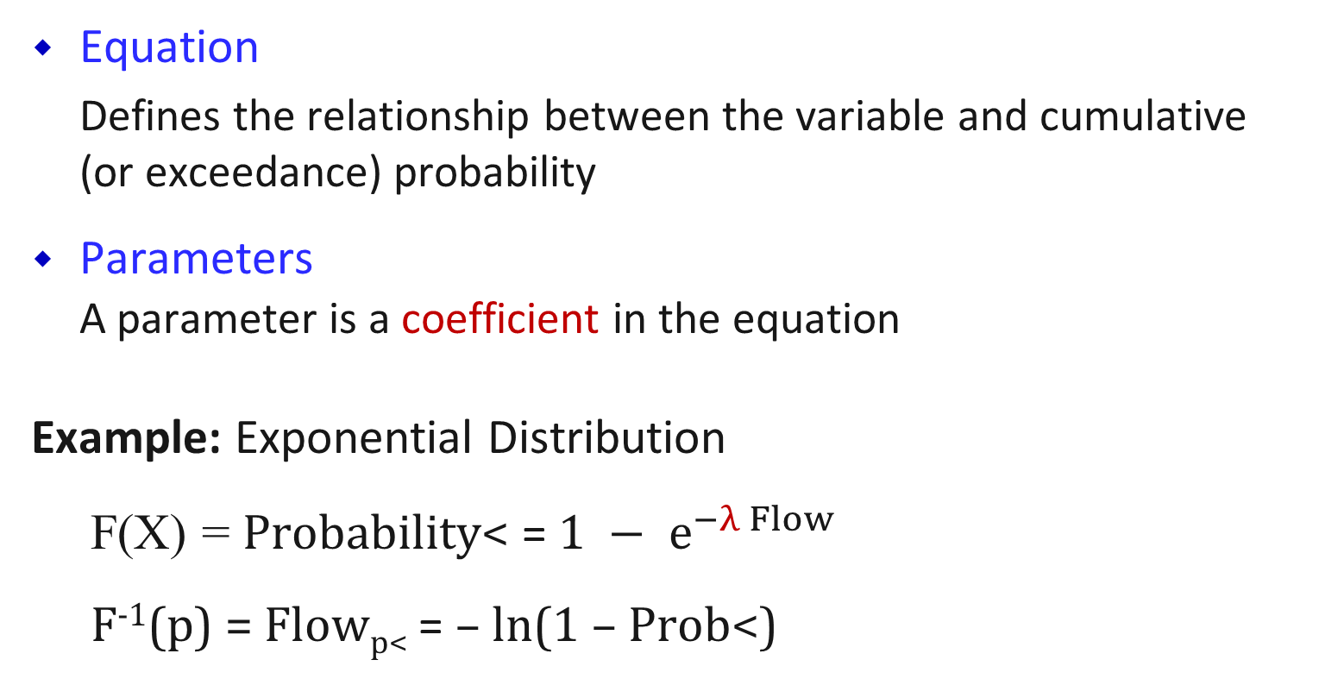
Elements of a Distribution
Equation
Defines the relationship between the variable and cumulative (or exceedance) probability
Parameters
A parameter is a coefficient in the equation
Example: Exponential Distribution
F(X) = Probability< = $1 − e^{−λ Flow}$
F⁻¹(p) = Flow_{p<} = – ln(1 – Prob<)
cumulative distribution function, CDF
λ = rate
quantile function
λ

Slide 67
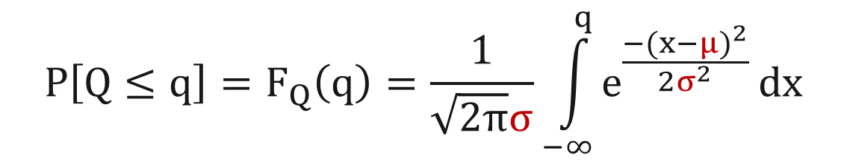
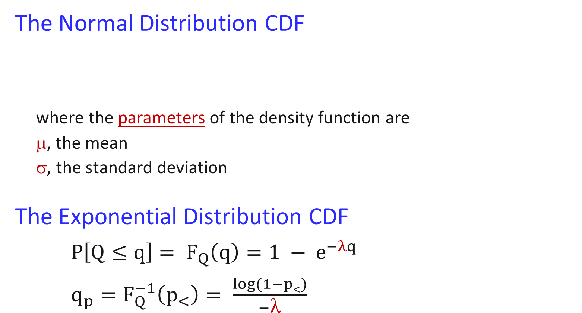
Examples
The Normal Distribution CDF
where the parameters of the density function are
μ, the mean
σ, the standard deviation
The Exponential Distribution CDF
$P\left[Q≤q\right]= F_{Q}\left(q\right)=1 − e^{−λq}$
$q_{p}=F_{Q}^{−1}\left(p_{<}\right)= \frac{log⁡(1−p<)}{−\text{l}}$
$$P\left[Q≤q\right]=F_{Q}\left(q\right)=\frac{1}{\sqrt{2π}σ}\int_{−∞}^{q}{e^{\frac{{−(x−μ)}^{2}}{2σ^{2}}}}dx$$
CDF
no quantile function
- can’t solve for q
where the parameter is
λ = rate
CDF
quantile function

Slide 68
Challenges in Fitting a Distribution
Form (equation) of parent population’s distribution is not known.
Parameters of parent population’s distribution are not known, and are estimated from a small sample.
Most interested in extremes (tails), which have the most error from calibration, selection
Selection
Calibration
Prediction

Slide 69
Selection of Distribution
sample size = 65
observed histogram
Normal PDF
West Branch, Oswegatchie River, Harrisville, NY
Notes:
This is the histogram of a 65 year record of annual flow volumes for a river in New York. By examining the histogram as a first step, we can decide what of the distributions we’ve looked at might be reasonable.
Uniform is clearly incorrect. Triangular is possible, but there are more values cluster in the middle, which is closer to Normal. It’s not completely symmetrical, with a longer upper tail than lower, but perhaps close enough that the sample could have been generated by a symmetrical PDF.
The example will proceed with fitting a Normal distribution to the 65-member sample of flow volume.

Slide 70
Calibration:
Estimating Distribution Parameters
Can estimate parameters using sample statistics.
The general descriptive parameters are:
Central Tendency where? (location)
Dispersion or Spread how wide? (scale)
Asymmetry (shape)
symmetrical?
Distribution Moments
PDF
Notes:
These description parameters are also known as the MOMENTS of the probability distribution.

Slide 71
Central Tendency Statistics
Mode = most frequently occurring
Median = middle of ranked list
  (50% of data above, 50% of data below)
Mean X (average) = sum of values
expected value number of values
Notes:
These are the statistics of central tendency as estimated from a sample. The earlier mention of the these measures described their definitions for a probability distribution. These sample statistics can be used to estimate the distribution values.

Slide 72

Sample Mean, X average
Central value statistic
Sample mean is an estimate of population mean, μ
where: X_{i} = sample member, i
N = sample size
1st moment about 0
$$\overline{X}=\frac{1}{N}\sum_{i=1}^{N}{X_{i}}$$
X = μ
X was initially used for the center of inertia
X_{bar}
mu_{hat}
has same unit as variable
Notes:
Sample mean is also known as expected value, and is noted as X-bar, or whatever variable designation with a bar over it.
A change in the mean moves the PDF left (for lower) or right (for higher).

Slide 73
Dispersion Statistics
Standard Deviation, S = average distance
from mean
Variance, S² = (standard deviation)²

Slide 74
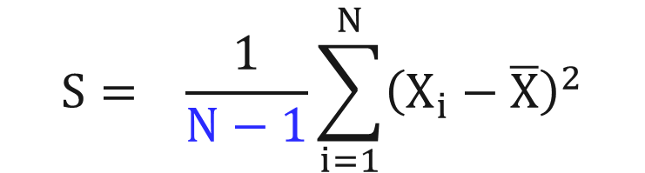
Sample Standard Deviation, S
Dispersion Statistic (average distance from mean)
Sample standard deviation S is an estimate of population standard deviation, σ
where: X_{i} = sample member, i
N = sample size
X = sample mean
2nd moment about mean
$$S= \frac{1}{N−1}\sum_{i=1}^{N}{{\left(X_{i}−\overline{X}\right)}^{2}}$$
S = σ
has same unit as variable
S
Notes:
Standard deviation, noted S, is the average distance from the sample mean. Because the sum of distances from the sample mean is equal to zero, this estimator squares the distances Xi – Xbar to remove the sign and make all values positive. After averaging, the square root it taken to return the metric to the original unit of the variable. The equation divides by N-1 rather than N as a correction for bias, to produce an unbiased estimator.
A change in the standard deviation makes the PDF narrower (for smaller) or wider (for larger).

Slide 75


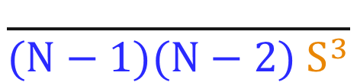
Sample Skew Coefficient, g
Asymmetry statistic
Sample skew is an estimate of population skew, γ, but is volatile for small samples
where: X_{i} = sample member, i
N = sample size
S = sample standard deviation
3rd moment about mean
$$N\sum_{i=1}^{N}{{\left(X_{i}−\overline{X}\right)}^{3}}$$
g = γ
γ = 0
$$g=$$
$$\frac{ }{(N−1)(N−2){ S}^{3}}$$
γ < 0
dimensionless
γ > 0
Normal Distribution
Notes:
The skew coefficient again uses distances from the sample mean, but cubes them, which reestablishes the sign (positive or negative) and exaggerates the value. Values far from the mean, above or below, have more influence on the statistic than values close to the mean. More values far above the mean than far below the mean will produce a positive sum, and more values far below will produce a negative sum.
N-1 and N-2 are again corrections for bias. But with a single N on top and two Ns on the bottom, this is still an average cubed distance from the mean. Finally, it is divided by the standard deviation cubed, both normalizing the value and making it dimensionless (unitless).
A symmetrical sample will have a skew of zero, because the distances above and below the mean are balanced. Values much larger than the mean, producing a positive skew, show as a long upper tail and short lower tail. Values much smaller than the mean, producing a negative skew, show as a long lower tail and short upper tail.

Slide 76
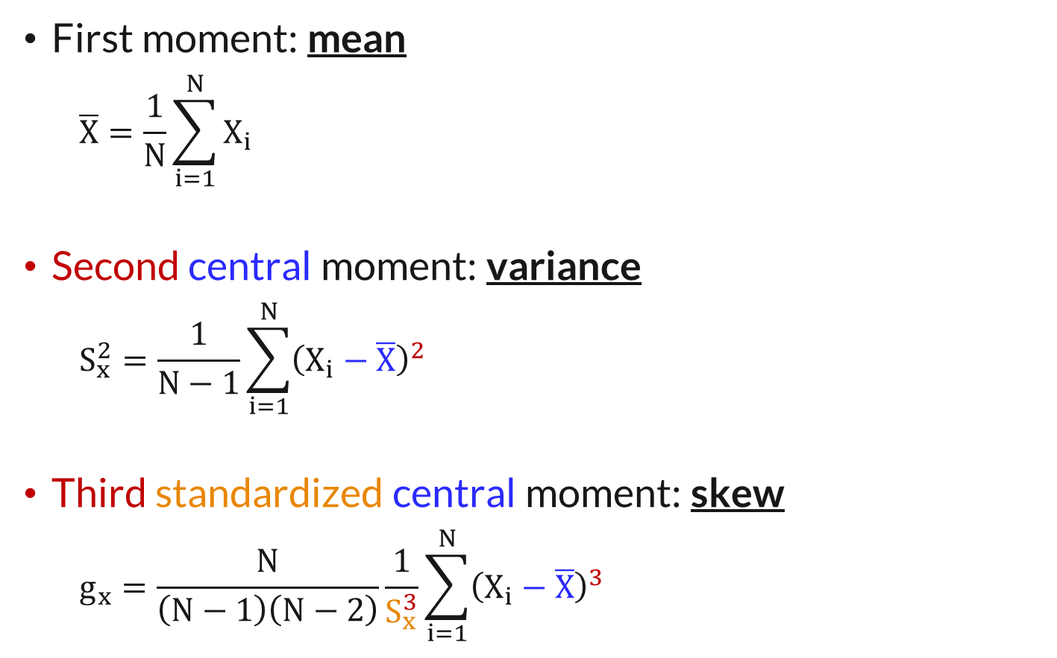
Distribution Moments
First moment: mean
  $$\overline{X}=\frac{1}{N}\sum_{i=1}^{N}{X_{i}}$$
Second central moment: variance
  $$S_{x}^{2}=\frac{1}{N−1}\sum_{i=1}^{N}{{\left(X_{i}−\overline{X}\right)}^{2}}$$
Third standardized central moment: skew
  $$g_{x}=\frac{N}{\left(N−1\right)\left(N−2\right)}\frac{1}{S_{x}^{3}}\sum_{i=1}^{N}{{\left(X_{i}−\overline{X}\right)}^{3}}$$

Slide 77
Distribution Parameters
CDF, frequency curve form
difference in the mean
Peak
difference in the standard deviation
100 x probability of exceeding
Notes:
Earlier slides showed the sample statistics, and the parameters they estimate, on the PDF form of the distribution or sample. This figure shows them on the frequency curve form, which is the CDF with the axes switched to put the variable on the vertical and probability or frequency on the horizontal.
A change in the mean moves the frequency up or down. A change in the standard deviation changes the slope of the frequency curve. A larger standard deviation produces a steeper slope that spans a wider range of the variable on the vertical axis. A smaller standard deviation thus produces a smaller slope.

Slide 78
Distribution Parameters
CDF, frequency curve form
negative
skew = 0 is straight line on this Normal prob axis
changing the skew
Peak
positive
100 x probability of exceeding
Notes:
Earlier slides showed the sample statistics, and the parameters they estimate, on the PDF form of the distribution or sample. This figure shows them on the frequency curve form, which is the CDF with the axes switched to put the variable on the vertical and probability or frequency on the horizontal.
A Normal distribution has a zero skew, and plots as a straight line on a Normal probability axis. A positive skew produces an upward curvature, as the long upper tail reaches higher vertically on the right. A negative skew produces a downward curvature, as the long lower tail reaches downward on the left, and the short upper tail pulls downward on the right.
As a mnemonic, positive skew is happy and produces a smiling upper curvature, and negative skew is sad and produces a frowning downward curvature.

Slide 79
Topics of Discussion
Describing probability
  Definitions
  Discrete and continuous random variables
Estimating probability from observations
Review common probability distributions
Inferring probability distributions, parameters
  Sample moments
  Working with the Normal distribution

Slide 80
Normal to Standard Normal and back
Standard Normal Z
X = 40 + Z * 5
X = Z σ + μ
(X - μ) = Z ~ N(0,1)
σ
Normal
X ~ N(μ, σ)
-4
4
(X - 40) = Z
5
N(40, 5)
Notes:
This slides shows the transformation between Normal and Standard Normal distributions. Since Standard Normal has mean of zero and standard deviation of one, we produce a Standard Normal variate by subtracting the mean and the dividing by the standard deviation. We transform back to the Normal distribution by multiplying by the standard deviation and adding back the mean.
NOTE, the area under a PDF is 1.0, and so the two PDF in this image SHOULD have the same area. They do not, to make an easier image to read, but note that the red PDF should be much lower.

Slide 81
Computing Quantiles
specify p, compute Q_{p}
prediction
Normal Distribution, N[μ,σ]
Q_{p} = μ + Z_{p} σ
discharge of specified probability (quantile)
standard deviation
mean
Standard Normal Deviate, N[0,1]: number of standard deviations away from the mean
Why?
Equation is ugly, and can’t be solved for Q_{p}
(no quantile function)
use estimates:
σ
p = prob
greater
Q_{p} = X + Z_{p}S
μ
Q_{p}
Q
Notes:
The Normal distribution has an equation that is hard to work with, and so we generally work with the Standard Normal distribution that is fully tabulated in all statistics text books. The Standard Normal distribution has mean of 0 and standard deviation of 1, and is referred to as Z. Zp is the value for a given probability p.
To produce a quantile from the Normal distribution for probability p, we first look up the value Zp from the Standard Normal, then multiply it by our standard deviation and add our mean. The Z value can be interpreted as the number of standard deviations above or below the mean.

Slide 82
Standard Normal CDF, Zp
1%
10%
25%
why is 10% noted at 0.9?
75%
-0.67
0.67
1.28
2.32
Notes:
This is the CDF of the Standard Normal distribution, showing values that are also tabulated in text books.
Cumulative probability (probability less than) is on the vertical and the Z variate is on the horizontal. Note that most of the distribution is between -3 and 3, and nearly all is between -4 and 4.

Slide 83
Selected Values of Z_{p}
Probability of exceeding, p | Return Period, 1/p | Standard Normal Deviate, Z(p)
0.75 | 1.333 | -0.67
0.5 | 2 | 0.00
0.25 | 4 | 0.67
0.1 | 10 | 1.28
0.01 | 100 | 2.33
0.001 | 1000 | 3.09
values from Standard Normal distribution
Notes:
Here we have several exceedance probabilities, the associated return periods 1/p, and the Zp value.

Slide 84
Quantile Computation
Quantile
X = 397
S = 77
g = 0.4
Prob of exceed, p | Return Period | Z(p) | μ + Z(p)*σ from sample N[397,77]
0.75 | 1.333 | -0.67 | 397 + (-0.67)(77) = 345
0.5 | 2 | 0.00 | 397 + (0.00)(77) = 397
0.25 | 4 | 0.67 | 397 + (0.67)(77) = 449
0.1 | 10 | 1.28 | 397 + (1.28)(77) = 496
0.01 | 100 | 2.33 | 397 + (2.33)(77) = 576
0.001 | 1000 | 3.09 | 397 + (3.09)(77) = 635
N(μ,σ)
Notes:
A fourth column is added showing the transformation from the Standard Normal back to the Normal distribution using the computed sample mean and standard deviation. Mean + SD * Zp produces the quantiles of the distribution, given the sample statistics shown.
Sample statistics computed as sample mean Xbar = 397, sample standard deviation S = 77 and sample skew coefficient g = 0.4. Note, the skew coefficient is not a parameter of the Normal distribution, which has a skew coefficient of zero, and so was not used here.

Slide 85
Verification
X = 397
S = 77
g = 0.4
Notes:
The blue PDF is the computed Normal Distribution, compared to the sample histogram. How well does the distribution agree with the data?
Sample statistics computed as sample mean Xbar = 397, sample standard deviation S = 77 and sample skew coefficient g = 0.4. Note, the skew coefficient is not a parameter of the Normal distribution, which has a skew coefficient of zero, and so was not used here.

Slide 86
Verification
X = 397
S = 77
g = 0.4
449
497
576
Notes:
This is the CDF form, plotted with the sample values against median plotting positions. How well does the distribution agree with the data?

Slide 87
Verification
576
496
X = 397
S = 77
g = 0.4
449
Notes:
This is the frequency curve form, plotted with sample values versus plotting positions. How well does the distribution agree with the data? This seems a good fit except the highest three points, as expected when the original histogram showed a longer upper tail than lower.

Slide 88
Goodness of Fit -- QQ and PP plots
X = 397
S = 77
g = 0.4
Vol ~ N(397,77)
R = 0.992
sample members
R = 0.997
plotting positions
based on plotting position
Qpp from Normal
F(Qi) from Normal
based on sample volume
Notes:
Another way to assess how well the distribution fits is with Goodness of Fit tests. These two plots compare the sample values to what a Normal distribution would have expected the sample values to be.
The QQ plot shows the sample data on the vertical axis, paired with the value of the Normal distribution that goes with its plotting position on the horizontal axis. The closer to the straight 1:1 line, the better the fit. We often compute a correlation coefficient for the pairs, with a value closer to 1.0 showing better fit, to have a numerical value of fit to work with.
The PP plot is similar, with the plotting positions for any 65-member sample on the vertical, and the cumulative probabilities of the fitted Normal distribution for each of the sample members on the horizontal. Again, a correlation coefficient can be used to produce a numerical value of the fit.

Slide 89
Part 2 of Excel Exercises
fitting probability distributions

Slide 90
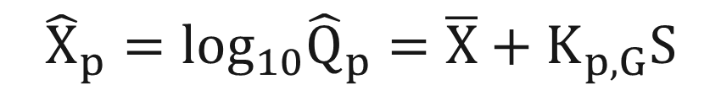
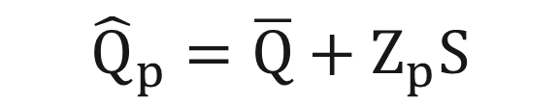
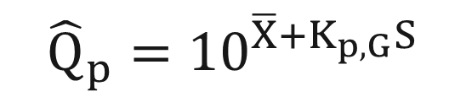
Computing Quantiles: LP3
Log-Pearson type III is similar to Log-Normal, w/skew
standard deviation
mean
$${\hat{X}}_{p}=\log_{10}{\hat{Q}}_{p}=\overline{X}+K_{p,G}S$$
p = exceedance probability
$${\hat{Q}}_{p}={10}^{\overline{X}{+K}_{p,G}S}$$
K_{p,g} is a lookup value from B17B
also “shifted” Gamma distribution
Remember normal distribution frequency equation…
$${\hat{Q}}_{p}=\overline{Q}+Z_{p}S$$
# of standard deviations from the mean
mean
standard deviation
Notes:
The LogPearson III curve is estimated by computing its quantiles. Recall the estimation of the Normal distribution curve, defined as the mean plus Zp standard deviations, where Zp is the “standard normal deviate” for probability p.
The LogPearson III curve is estimated in the same way, except that the deviate K is based on both probability p and skew g.

Slide 91
Goals addressed so far….
revisit probability concepts
estimating probability
  from understanding the system or from data
using probability distributions to describe what is random, and what is unknown
reviewing common probability distributions
fitting probability distributions to data
computing subsequent probabilities

Slide 92
Using Standard Normal table
negative Z:
Z = -1.6
prob < Z = 5.5%
positive Z:
Z = 2.0
prob > Z = 2.3%
Z
Notes:
Because the distribution is symmetrical, most Standard Normal tabulations only show half, and leave it to the user to reverse to result for values on the other half of the distribution.
In the table coming up in this lecture, the negative side of the distribution is tabulated. So the pairing of Z = -1.6 having cumulative probability (P<Z) of 5.5% can be read directly. But to determine the cumulative probability (P<Z) of Z = 2.0, we must transform a value assumed from the upper half of the distribution. The table will tell us that Z = -2.0 has cumulative probability (P<Z) of 2.3%, and we therefore know by symmetry that that Z = 2.0 has exceedance probability (P>Z) of 2.3%.

Slide 93
Using Standard Normal table
For Z > 0 from a table of lower half cumulative probability (Prob < Z)
negative Z:
Z = -1.6
prob < Z = 5.5%
positive Z:
Z = 2.0
prob > Z = 2.3%
looked up as prob < -2.0
prob < Z = 100 – 2.3%
= 97.7%
Z
Notes:
Because the distribution is symmetrical, most Standard Normal tabulations only show half, and leave it to the user to reverse to result for values on the other half of the distribution.
In the table coming up in this lecture, the negative side of the distribution is tabulated. So the pairing of Z = -1.6 having cumulative probability (P<Z) of 5.5% can be read directly. But to determine the cumulative probability (P<Z) of Z = 2.0, we must transform a value assumed from the upper half of the distribution. The table will tell us that Z = -2.0 has cumulative probability (P<Z) of 2.3%, and we therefore know by symmetry that that Z = 2.0 has exceedance probability (P>Z) of 2.3%. We can then compute the probability of Z < 2.0 as 100 – 2.3% = 97.7%.

Slide 94
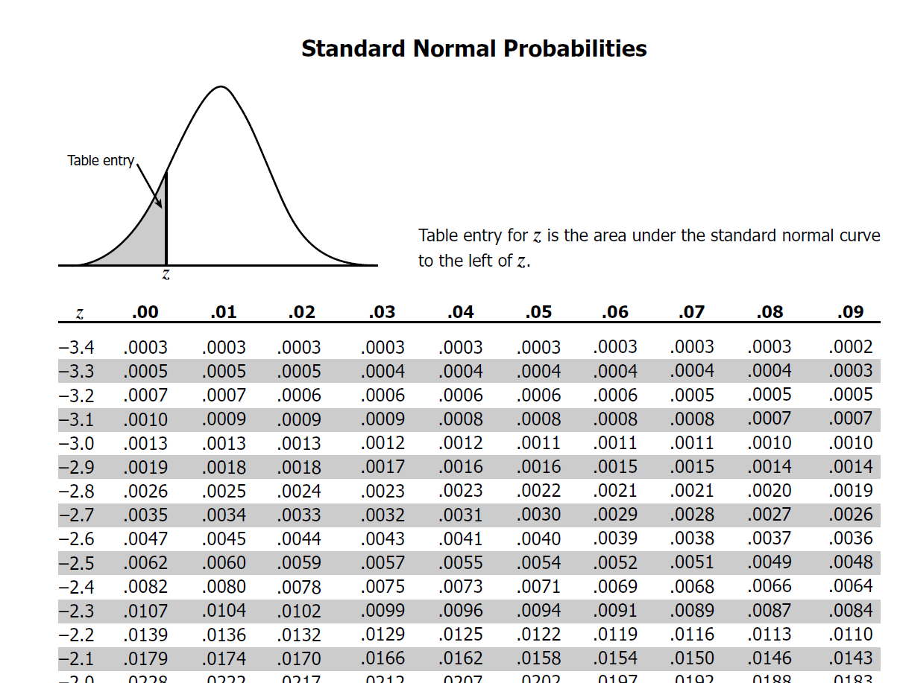
What is prob that z < -2.57
(1) break z into A = -2.5, B = 0.07
(2) probability is at the intersection = 0.0051
B
A
Notes:
This is a tabulation of the lower half of the Standard Normal distribution, providing cumulative probability P<Z. The value of Z is the headers of the rows and columns, with Z to the first decimal as the row, and the second decimal as the column, and the cumulative probability (P<Z) is the value in the table.
Thus, for Z = -2.57, we go to the row for -2.5, the column for .07 and read the P<Z = 0.51%
If we actually have Z = 2.57, we look up the probability of Z = -2.57 and assume symmetry. Thus cumulative probability P<Z of Z = 2.57 is 1 – 0.0051 = 0.9949 of 99.49%.

Slide 95
What is z_{p} such that prob < z = 0.01?
(1) Find probability in the table
(2) z = A + B = -2.3 + 0.03 = -2.33
B
A
Notes:
This is a tabulation of the lower half of the Standard Normal distribution, providing cumulative probability P<Z. The value of Z is the headers of the rows and columns, with Z to the first decimal as the row, and the second decimal as the column, and the cumulative probability (P<Z) is the value in the table.
To start with probability and look up Z, find the probability of interest in the table, and read the row and column headers. For (P<Z) of 1% or 0.01, the closest value is .0099, which has Z of -2.3 from the row and .03 from the column for a total of -2.33.
Note symmetry of the distribution and we know Z = 2.33 has exceedance probability (P>Z) of 1%.

