Slide 1
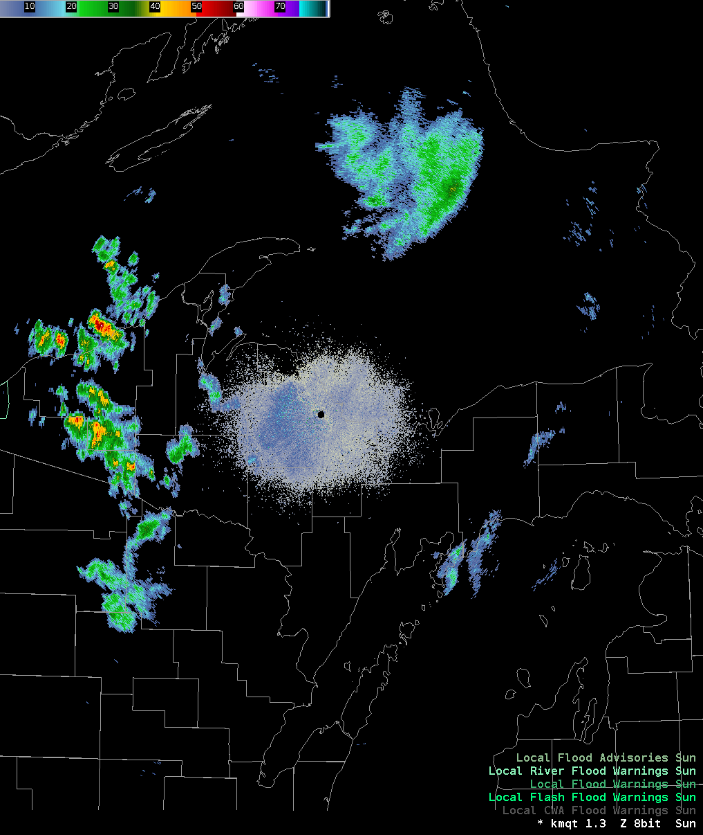

Regional Precipitation Frequency Analysis
Part I: Introduction to Regional Frequency Analysis
Melissa Mika, P.E.
USACE Hydrologic Engineering Center
April 2025

Slide 2
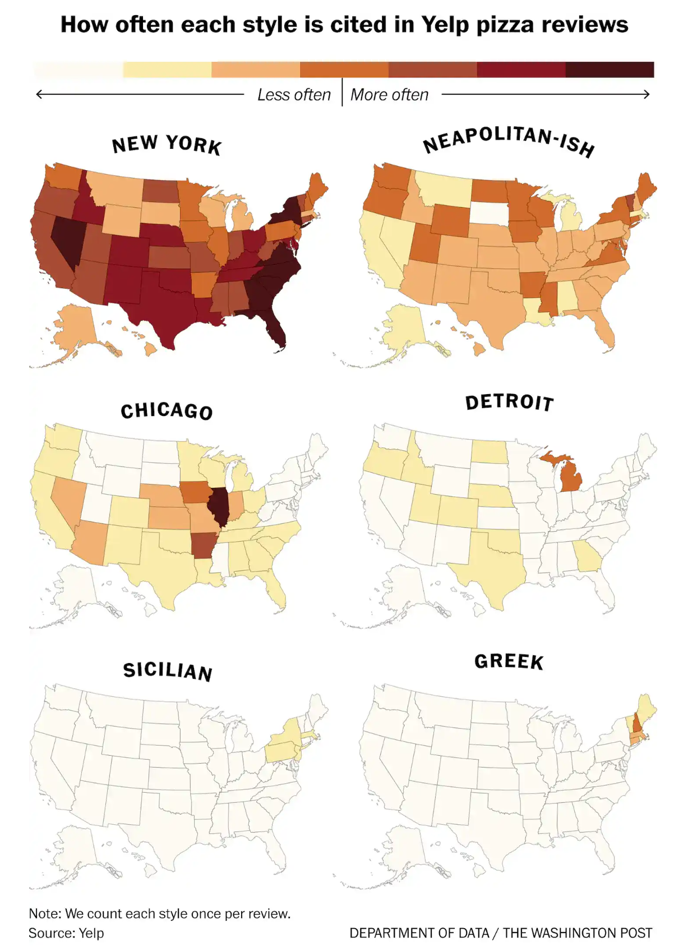
What does it mean to regionalize?
Scenario: You want to predict the thickness of a pizza crust for any pizza joint that you haven’t been to before.
You walk into your local pizza joint, order a slice, and measure the crust
You randomly survey pizza joints all across the United States
You measure many pizza crusts for only Detroit style pizza joints
Notes:
Suppose you would like to predict the thickness of pizza crust of any given pizza restaurant.
If you were to measure the crust from a single restaurant, it would be nearly impossible to extrapolate those findings to any other restaurant. Pizza crust thickness varies widely by pizza style, such as Detroit versus New York style.
If you were to take a bunch of random samples of pizza crust for restaurants all across the nation, you would certainly have more data to work with from which to draw conclusions, but you run into the same issue above where you might be sampling from completely different styles of pizza. This doesn’t give you the information you need.
If you were to sample pizza crusts just in a specific city, or just whose pizza style is described as Detroit style, now this information is more meaningful! You’ve successfully expanded your dataset beyond a single restaurant, but you’ve only included information that is reasonably similar to each other.
In this hypothetical, each pizza restaurant is like a precipitation gage. If we only have information from a single gage, it’s hard for us to extrapolate or make predictions. Collecting data from *multiple* gages allows us to effectively expand our total sample size, so long as those data are coming from the *same population*.

Slide 3
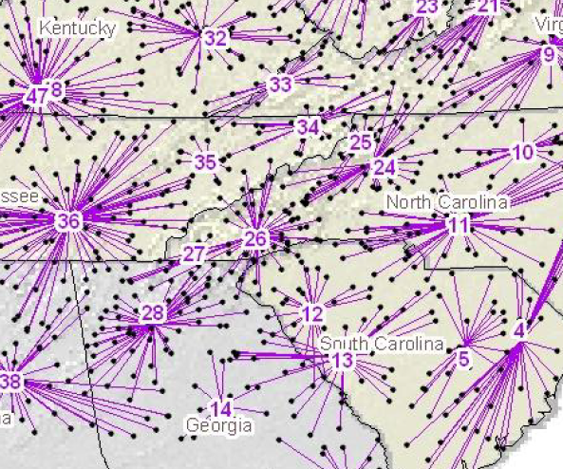
What does it mean to regionalize?
Regionalization is all about analyzing random samples of the same phenomenon that occur over a region
Samples have the same distribution, except for:
  Sample error affecting the parameter estimates
  Systematic local variations we can explain
Notes:
Regionalization is all about analyzing random samples of the same phenomenon that occur over a region. A region can be defined by the relevant study area or by the extents of an area that could be considered meteorologically homogeneous.
The assumption we make in a regional analysis is that the samples of the meteorological phenomenon we observe have the same probability distribution, except for two key differences: first, the parameters at any site are affected by sample error as a result of their limited record, and second, there is systematic variation in the observations that arise due to a physical cause, and we can explain.

Slide 4
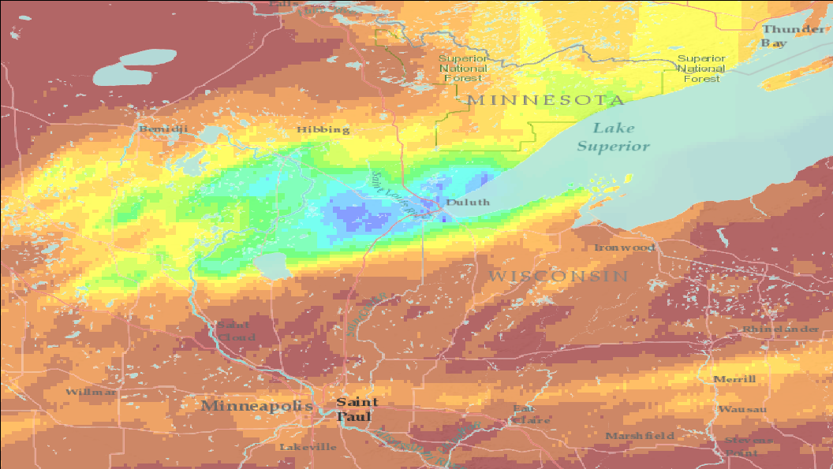
June 2012
Notes:
Here is a map of a heavy rain event in the Upper Midwest that occurred in June 2012. The areas in blue received the most rain, with green the next lower, then yellow, then orange and red.
Keep an eye on these three locations.
The red dot is Duluth, MN (where in this event, two seals and a polar bear escaped from the Duluth Zoo due to the flooding…)
The purple dot is near Ironwood, MI.
The grey dot is a location along Interstate 35 in east-central Minnesota.
Notice that the spatial pattern of this storm event is highly variable, with regions of concentrated heavy rainfall shown in blue, not very far away from the lowest accumulations shown in dark red.

Slide 5
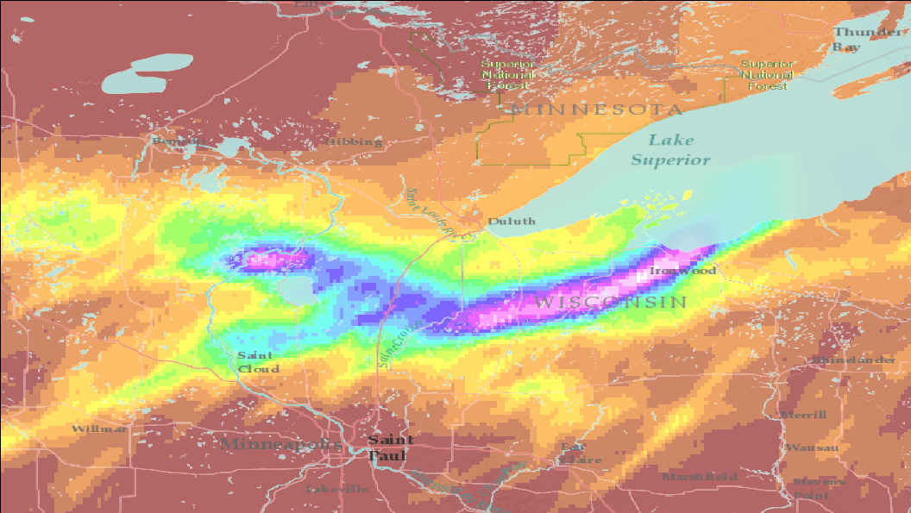
July 2016
Notes:
Here is a similar map for an event that occurred in July 2016 (with the same color scale, but now the event also has higher intensities shown in pink, purple and white.) This event included a tornado.
These two patterns look remarkably similar and have similar magnitudes. However, the storm center is in a different location between the two events.
If you were to perform an at-site rainfall frequency analysis for three sites – Duluth, Ironwood and somewhere in-between, you would find that the 2012 event has significant impact on the analysis in Duluth, that 2016 event really affects Ironwood, but a site in-between would likely have larger rainfall depths for the same frequencies than either of those two cities since it received very heavy rain twice in five years.
If we regionalize this information, we will find that heavy rain occurs more often in Duluth and Ironwood than the at-site analysis would indicate, and less often for the site in between.
The meteorology in this area is similar, and the mechanisms that create heavy rainfall can reasonably create that heavy rainfall anywhere in this domain. The storms that we see are a random sample of this meteorology. Individual stations may or may not receive heavy rainfall in any given event simply due to the location of the storm. However, we can tell that for any site in this region, that the rainfall there is related to the rainfall at other sites, and that together they contain more information about the meteorology than any one station at a time.

Slide 6
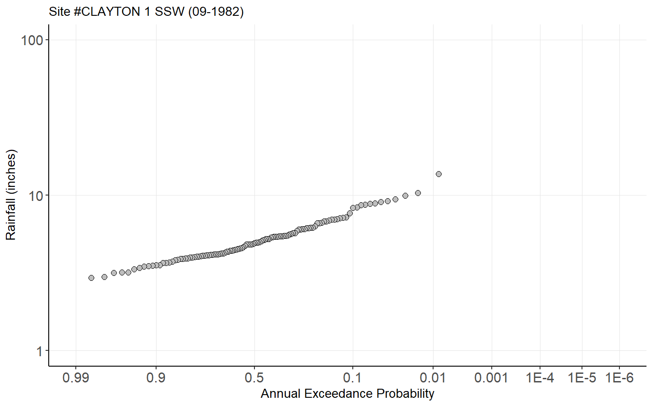
Why do we regionalize?
Motivations:
Increase the sample size used for building probability models
Make frequency estimates in locations with no observations
Limitations:
Observed records at individual sites can be short
Sparseness of observations in space
?
Notes:
We are motivated to regionalize our frequency estimates so that we can increase the sample size that we use when we build a probability model. This helps us reduce sample error and increase confidence in our estimates. We can also use regional models to make frequency estimates in locations where there are no observations, so we are not limited by the location of weather stations or other instrumentation.
The limitations that we have to overcome in a regional analysis are that individual sites recording data can have short, limited records that reduce confidence in understanding the frequency distribution at that location. The sites where observations are available may also be sparse in space, meaning we have significant gaps between them where we have no observations. This tends to occur in less-populated places, where the weather also tends to be highly variable, such as deserts and high mountains.

Slide 7



What can we regionalize?
Notes:
Imagine you have two very different watersheds located in close proximity to each other. A storm falls directly over one watershed and produces runoff. At a later date, a storm with very similar characteristics and magnitude falls over the second watershed. Would you expect the runoff response to be similar?

Slide 8
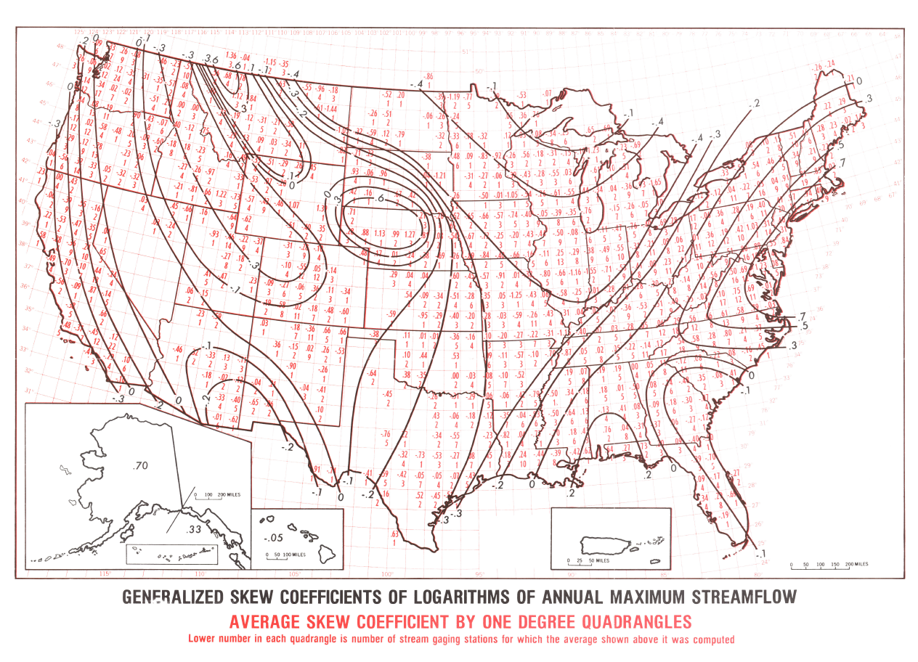
What can we regionalize?
Weather observations represent a sample at the location of the station
Streamflow measurements reflect the entire watershed above the gage
  Hydrologic processes
  Meteorology
  Drainage area
Much harder to regionalize streamflow
Notes:
Hydrologists spend a lot of time analyzing streamflow because it is typically the basis for design and planning. It is also unique and requires some special treatment compared to other hydrometeorological variables.
When we take observations of the weather, at a backyard rain gauge or at a weather service coop station, it reflects a sample of the meteorology right at that point.
Measurements of streamflow reflect the entire watershed that drains to that stream gage. Hydrologic processes and meteorology interact to create runoff, baseflow, and streamflow, and these processes occur across the entire watershed above that point. They vary in space, and for large watersheds potentially spanning tens of thousands of square miles, may not be the same everywhere. The behavior of streamflow at these gages is a unique combination of all of the conditions of the watershed, and it can be very hard to find a collection of stream gages that have similar combinations of conditions to facilitate regionalization. This makes it harder to regionalize streamflow than something like precipitation or wind speed.
Generally, this is why streamflow regionalization is limited to the skew coefficient: we acknowledge that estimating the skew is prone to sample error and want to reduce it, but recognize that regionalization may not contain as much information for streamflow as we want, and can only reduce that uncertainty a little bit.
This is the skew contour map from Bulletin 17B. It is an outdated product at this point, and as we saw in the skew regionalization lecture there are many better resources for regional skew estimates today.
However, this shows exactly what the goal in regionalization is: identify the broad trends in the parameters of the probability distribution so that we have a basis for improving our estimates of the frequency of hydrometeorological extremes. For streamflow we use a map like this to identify what the average skew coefficient for a large number of sites close to the area we are studying might be, and use that to add information to the analysis we perform at our study site.

Slide 9
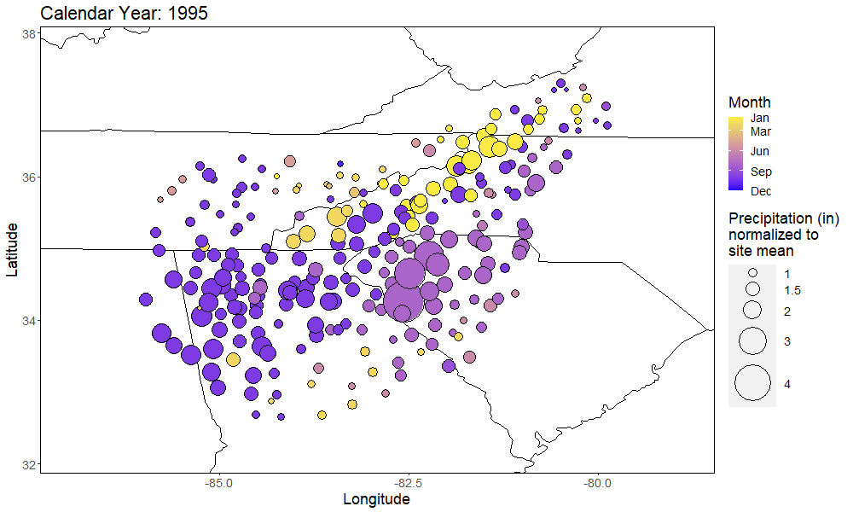
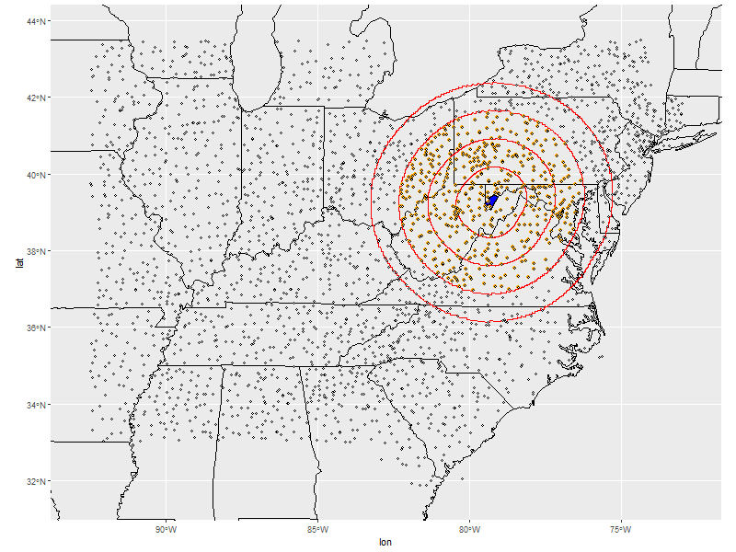
How do we regionalize?
Trading “space for time”
Could this storm event have happened here? Or here?
Notes:
The tool we use to regioinalize is called space-for-time substitution. Space for time substitution lets us group together observations in space in a systematic way so that we can treat them as a single, much longer record, of the variable of interest.
The figure on the right shows the maximum observed 3-day precipitation across many gages in the eastern US, for the year 1995 . This clump of pink observations occurred from a tropical storm remnant in September. But what about the neighboring gages that weren’t directly in the storm’s path? Could that large of an even have occurred at another gage?
The key with regionalization is not only to pool together data from multiple gages, but to ensure the pooled data is meaningful – that is, it represents the same phenomena.

Slide 10
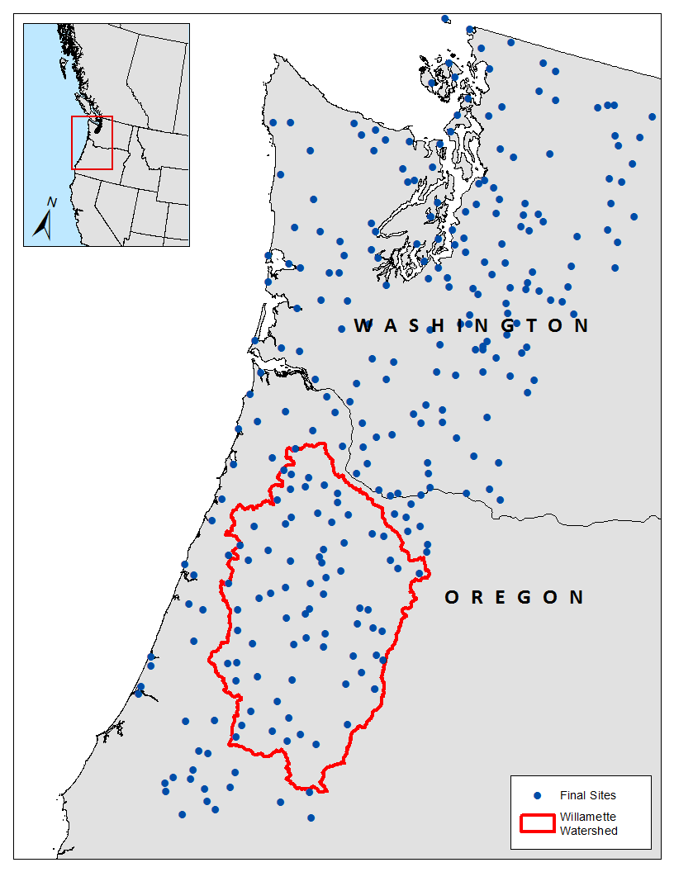
How do we regionalize?
Group together observations that are likely similar due to physical causes
Test their similarity though a statistical lens
  “Create physically, check statistically”
We are usually most interested in extremes
    Annual maxima
    Peak-over-threshold
Sites get a random sample of the overall meteorology in this area
Sites here are more similar to each other than to the sites above
Notes:
Regions don’t arise naturally; it is up to us to create them.
The general plan in regionalization is to group together sites that are likely to be similar due to physical causes. Using the First Law of Geography as our principle, we want sites that are closer together because they are likely to be related. However, we know that there are physical differences with sites that are close together, such as elevation, or which side of a mountain range they are on. We need to take into consideration more than just proximity, and try to explain why we think the sites are related.
After grouping our sites together on a physical basis, we test to see if the sites are statistically related as well. This allows us to apply the regional frequency analysis technique. The mantra is, “create physically, check statistically,” meaning that you should create your regions with regard to the physical cause of the observation you are modeling, but you need to check the groupings to make sure the observations don’t vary more than you would expect in a truly homogenous region.
When doing a regional frequency analysis, we are usually not regionalizing the data for the entire record – it is usually limited to the extremes, either annual maximum series or peaks over a threshold.

Slide 11
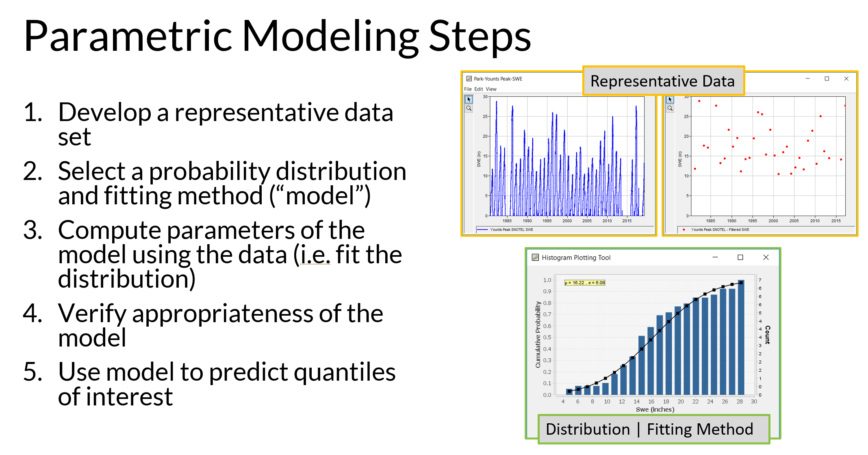
Recall: Parametric Modeling
Notes:
You may recall these steps from the earlier Parametric Modeling lecture and other lectures in the class. Regional frequency analysis follows a very similar process! We take data, select and fit a probability distribution, and estimate quantiles from it. The biggest difference in regional frequency analysis is at the first step. Rather than develop a representative dataset from a single gage, there is a much more complex process for collecting and pooling together data from multiple gages to develop our dataset.

Slide 12

Summary
Regionalization is where we trade “space for time”
This is important in hydrology because our gages typically have short records (100 years or less)
Precipitation is easier to regionalize than streamflow
It’s important to ensure the data are reasonably homogeneous, meaning they come from the same population

Slide 13
Regional Precipitation Frequency Analysis
Part II: Introduction to Linear Moments
Melissa Mika, P.E.
USACE Hydrologic Engineering Center
April 2025

Slide 14

Product Moments (Review)
Central tendency: mean
  $\overline{x}=\frac{1}{n}\sum_{i=1}^{n}{x_{i}}$
Dispersion: variance
  $s_{x}^{2}=\frac{1}{n−1}\sum_{i=1}^{n}{{\left(x_{i}−\overline{x}\right)}^{2}}$
Asymmetry: skew
  $g_{x}=\frac{n}{s^{3}\left(n−1\right)\left(n−2\right)}\sum_{i=1}^{n}{{\left(x_{i}−\overline{x}\right)}^{3}}$
Peak/tail weight: kurtosis
  $k_{x}=\frac{n\left(n+1\right)}{\left(n−1\right)\left(n−2\right)\left(n−3\right)s^{4}}\sum_{i=1}^{n}{{\left(x_{i}−\overline{x}\right)}^{4}}$
Key take-away:
Product moments accumulate powers of deviations from the mean
Notes:
In our regional frequency analyses, especially for precipitation, the statistics of the sample and population are measured in a different way than what we use for streamflow frequency analyses. In this video, we will explore L-moments, an alternative way to characterize the statistical properties of our samples and populations.
But first, let’s take a look back at product moments, which we have seen several times already. Product moments are used to summarize the properties of a sample or a population, by quantifying their central tendency spread, asymmetry and peak and tail weight.
The formulas for the first four product moments, mean, variance, skew, and kurtosis, are shown here. The key to each formula is that as the moment gets higher in order, the power of the deviation of the mean gets higher. This change in order allows for varying parts of the sample to contribute differently, making it possible to quantify these different shapes to the sample.
The key thing to keep in mind is that product moments are characterized by these powers of deviations from the mean. We will see shortly that this can lead to problems in using sample moments to estimate population moments.

Slide 15
Two studies using Monte Carlo to study the properties of product moments
“…unexpected and profoundly disturbing [results].”
Wallis et al. (1974)
Kirby (1974)
Not one sample in a run of 100,000 replicate samples of size 10 drawn from a lognormal distribution with (population) skew 5.0 had a sample skew exceeding 2.67.
Raising the population skew as high as 15.0 merely accentuated the discrepancies between population and sample skews.
Notes:
Two studies in 1974 using Monte Carlo simulation studied the properties of product moments and their utility in estimating the population properties of a sample.
The Monte Carlo simulations in these studies started with a known population, and drew large samples from the known population. The samples were used to compare how well these subsets were able to be used to estimate the original population parameters.
The authors found, in their words, “unexpected and profoundly disturbing results.”
In a population with a skew of 5, which is a large value, none of the samples they drew from the population had a skew greater than 2.67. When they increased the population skew to 15, which is extremely high, the only result they saw was that the discrepancy between the population and sample grew.
This poses a serious problem when our goal in frequency analysis is to use the sample of data we have to estimate the properties of the population we can’t see.

Slide 16
Limitations of Product Moments
Linear Moments:
Sensitive to outliers
Algebraically bounded
Introduction of bias
Large sampling variability (especially with small sample sizes)
More robust to outliers
Unbounded
Nearly unbiased
Lower sampling variability of L-moment estimators
= Better for characterizing environmental data with moderate to high skews
Notes:
Specifically what this study found is that the samples we take from a population have a bound that has nothing to do with the true population value. For example, a sample coefficient of variation can never be larger than the square root of the sample size minus one, no matter what the population coefficient of variation is. The skew and kurtosis suffer from similar issues.
What this means for us is that using these measures potentially introduces bias and error, especially when our sample sizes are small. This is even more consequential because as we’ve seen before the population skew is already difficult to estimate from a limited sample size. We see that skew is very sensitive to sample size and can vary considerably with additional observations, and that outliers can disproportionately affect the estimate. On top of that, we may not even be able to achieve the population skew in a sample if the sample size is too small.
From Kirby (1974), “As a concrete example, this bound actually is attained by a sample having n – 1 observations all concentrated at one value and the nth observation at any larger value.”

Slide 17

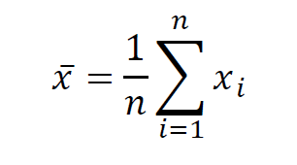
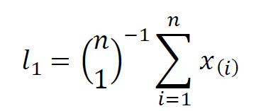
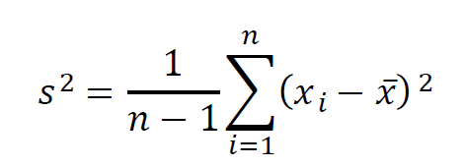
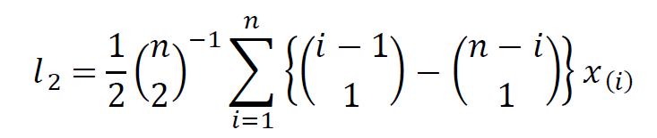
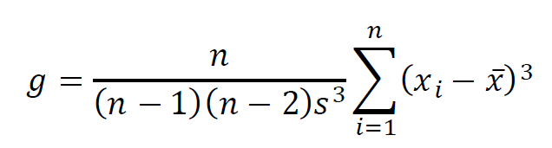
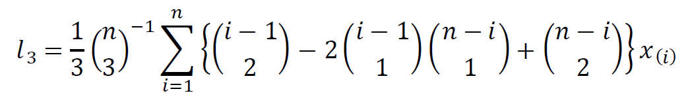
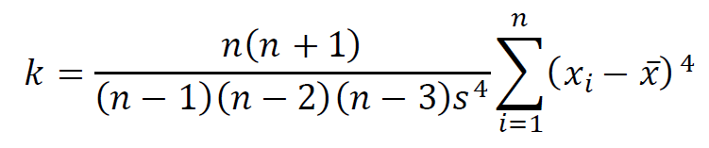
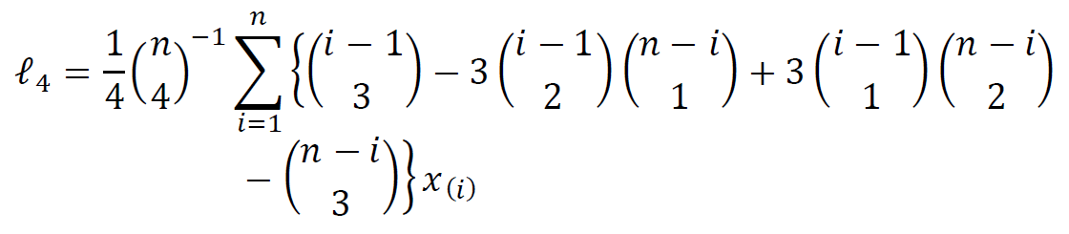
Linear Moments (L-Moments)
Much easier using:
HEC-SSP
An alternative to product moments
Uses linear combinations of data
L-moments do not take higher powers of data
Product Moments | Linear Moments
Notes:
As an alternative to conventional product moments, another way of measuring the shape of a sample or populations was introduced by Hosking in 1990. Linear, or L-moments, estimate the same properties of a sample as conventional moments, except they use linear combinations of the observations instead of taking higher powers. The general form of L-moments is shown here. The terms to the left of the x are used to emphasize different parts of the sample in order to quantify its properties, instead of taking higher powers of deviations from the mean as in product moments.

Slide 18
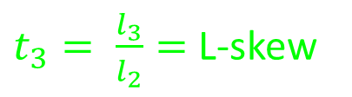


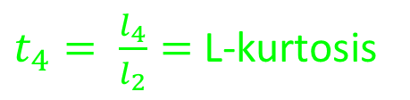
L-Moment Ratios
$l_{1}$ = L-mean
Dimensionless!
$t= \frac{l_{2}}{l_{1}}=$ L-CV
Product Moments | Linear Moments
Range: [0,1]
$t_{3}= \frac{l_{3}}{l_{2}}=$ L-skew
Range: [-1,1]
$t_{4}= \frac{l_{4}}{l_{2}}=$ L-kurtosis
Range: [-1,1]
Notes:
When we use L-moments, typically we summarize them with some dimensionless quantities called L-moment ratios. They are much easier to work with, and especially to regionalize, because they don’t have units associated with them. This is similar to the coefficient of skewness or kurtosis with product moments, which do not use units.
Dispersion is summarized with the L-CV, which is similar in principle to the regular coefficient of variation we saw in exploratory data analysis. It has values between 0 and 1 for data that are positive. It is computed as L2 divided by the mean.
Asymmetry is summarized with L-Skewness, which is the ratio of L3 to L2. It has values between -1 and +1, with the same convention as product moments. Negative values indicate a left-skewed sample, and positive values indicate a right-skewed sample.
Peak and tail weight is summarized with L-kurtosis, which is the ratio of L3 to L2. It also has values of -1 to +1, with the convention that the uniform distribution has an L-kurtosis of zero.

Slide 19
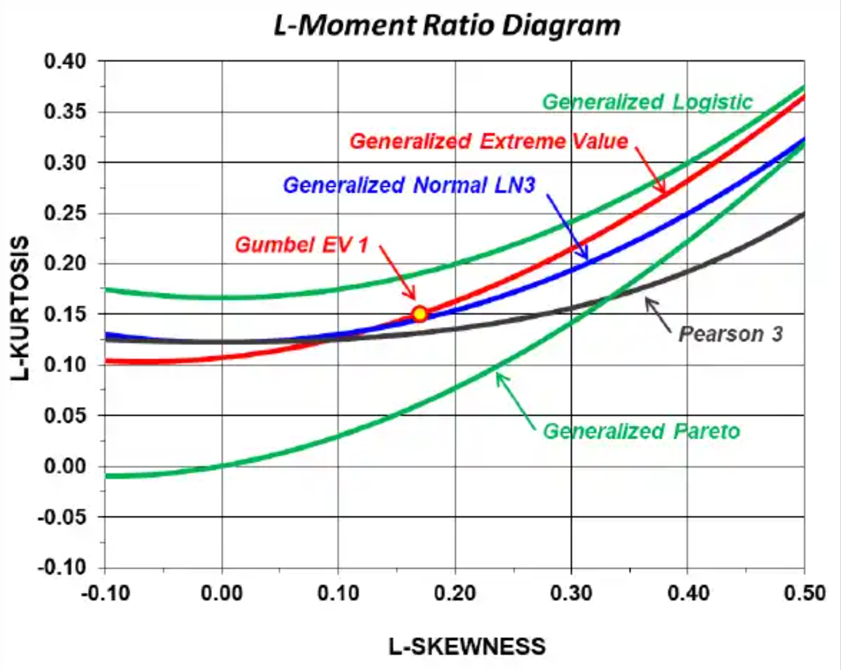

L-Moment Ratio Diagram (LMRD)
Visual plot of the relationship between L-skew and L-kurtosis for common probability distributions
Recall:
$t_{3}= {l_{3}}/{l_{2}}=$ L-skew
$t_{4}= {l_{4}}/{l_{2}}=$ L-kurtosis
Recall from Extreme Value Theory Lecture!
The distribution of the maximum of repeated samples of a homogeneous population converge to the Generalized Extreme Value distribution
Example:
Site at Roanoke, VA has 86 years of precipitation data.
L-skew = 0.25
L-kurtosis = 0.16
Which is the best distribution?
Notes:
Here, we introduce the L-moment ratio diagram. The LMRD has a ton of information. It is a plot of L-skewness on the x-axis, and L-kurtosis on the Y-axis.
First, the LMRD shows the relationship between L-skew and L-kurtosis for a number of probability distributions. 2-parameter distributions have a fixed value of L-skew and L-kurtosis and show up as points labeled with letters. 3-parameter distributions have a value of L-kurtosis which is dependent on L-skew and they show up as colored lines.
Next, you can look at the behavior of individual sites and see how closely related the L-moment ratios for sites in a region are. If your region has a large spread in points, as is shown here, it is likely that your H statistic is going to be large for that region. Sites with a large D statistic are likely to fall far from the center of the grouping.
The LMRD can help you identify a probability distribution that might be able to model your data. If your points tend to cluster along one of the colored lines, that 3-parameter probability distribution might be a good model for the data.
Another feature is where the central tendency of the data is. The center of mass for the points, weighted by the record length for each site, is the region-average L-skew and L-kurtosis.

Slide 20

Summary
L-moments are a robust alternative to conventional product moments
Many regional analyses use L-moments as summary statistics
  Robust
  Ratios are dimensionless
  Sampling distributions are normal
  Can be used to fit distributions to data
Homogeneous regions of observations should have similar L-moment ratios of extremes

Slide 21
Regional Precipitation Frequency Analysis
Part III: Methods of Regionalization
Melissa Mika, P.E.
USACE Hydrologic Engineering Center
April 2025

Slide 22
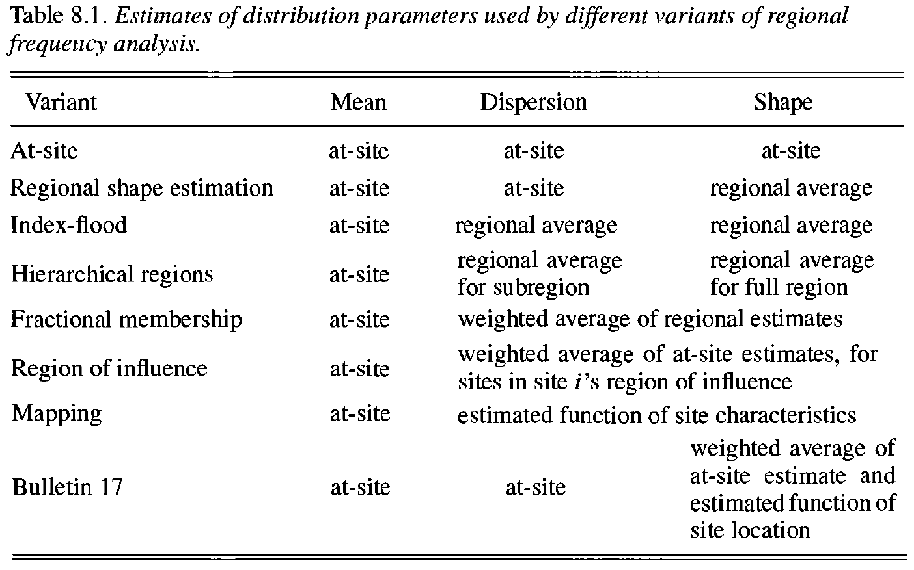
Regionalization Methods
Notes:
This table is from Hosking and Wallis (1997) and has more details about several different regionalization methods.
At-site is where we started – you do an analysis for the site you’re interested in, and use the parameter estimates you get for the period of record there.
Regional shape estimation is a step in the direction of regionalization by doing a regional analysis and regionalizing, and then pushing down, a regionally-estimated shape parameter to the site predictions.
Index flood is what we’ve talked about so far.
Hierarchical regions gives more refinement but does not solve the discontinuity problem. Within a large region there are a number of subregions. The large regions are intended to capture variability in shape parameters while the subregions capture variability in dispersion parameters.
We will talk about fractional membership next, but this is the first one that addresses some of the spatial discontinuity. It is like index flood with an additional step.
Region of influence is extremely different than the others and has been used in Atlas 14, so it’s worth understanding.
Mapping is an excellent way to produce spatially-coherent maps, and is my preferred method (something I got from Mel Schaefer.)
Bulletin 17 is shown for comparison – you can see that it’s similar to regional shape estimation, except instead of replacing the at-site shape parameter, it uses a weighted average of a regional shape parameter and the one at the site.

Slide 23

Index Flood
Sites in a homogeneous region have the same distribution, except for a site-specific scaling factor called the “index flood”
For precipitation or streamflow, usually use the mean annual maximum value, 𝓁₁
Regional growth curve (RGC)
Prediction for a site:
  $${\hat{Q}}_{i}\left(F\right)={\hat{μ}}_{i}\hat{q}\left(F\right)$$
Site frequency curve = index flood * regional growth curve
Has 𝓁₁ = 1
Predicted site i
quantile function
Site i
index flood
Has 𝓁₁ = 2.5
Index flood = 2.5
Notes:
From the previous discussion, we recall how the index flood method works. We find a regional frequency curve, called the regional growth curve, that tells us how much the index flood for the sites in the region gets larger depending on the frequency of the event. Then to make estimates at any site, you multiply that regional growth curve by the site’s index flood, which is typically the mean annual maximum event.
The limitation is that every place you want to make an estimate has to be placed inside a specific region. Usually these are non-overlapping geographic boundaries. One frequently-used example is the National Weather Service climate regions. If the regional frequency curve for two adjacent regions has a very different shape, the geographic boundary can cause a sharp and abrupt change in the precipitation maps. This can be caused by a large difference in the regional L-moments, or also if you choose a different probability distribution for your regions. Early volumes of Atlas 14 had this issue. In some locations this was solved by using a smoothing algorithm after the fact to fix these abrupt changes, but in some volumes the sharp boundaries can still be apparent.

Slide 24


Fractional Membership
Perform index flood analysis as usual
When applying the RGC $\hat{q}\left(F\right)$, use a weighted average RGF from all regions by similarity
$${\hat{Q}}_{i}\left(F\right)={\hat{μ}}_{i}\sum_{j}{w_{j,i}}{\hat{q}}_{j}\left(F\right)$$
Spatially-based weighting can perform well
$$\sum_{j}{w_{j,i}}=1$$
Site i frequency curve
Site i index flood
RGC for region j
Weight for region j at site i
Notes:
Fractional membership is an extension of index flood that lets each site’s region assignment be a little more fluid. The process starts with a normal index flood regionalization analysis, but instead of using a single regional growth curve to make predictions, you use a weighted average of all of the regions’ growth curves based on how similar the site is to each region. Usually, the similarity is measured by things like how close the site is to a region, its similarity in climatic properties like precipitation and temperature, its elevation, and so on. This means that the regions in the analysis that the site shares physical properties with, have more weight in estimating that site’s precipitation frequency curve. This can also be used to fill in the gaps between stations and draw a continuous map fairly easily. It requires a spatial estimate of the index flood, and then a way to measure the site’s characteristics that is spatially-continuous. An example is shown next.

Slide 25
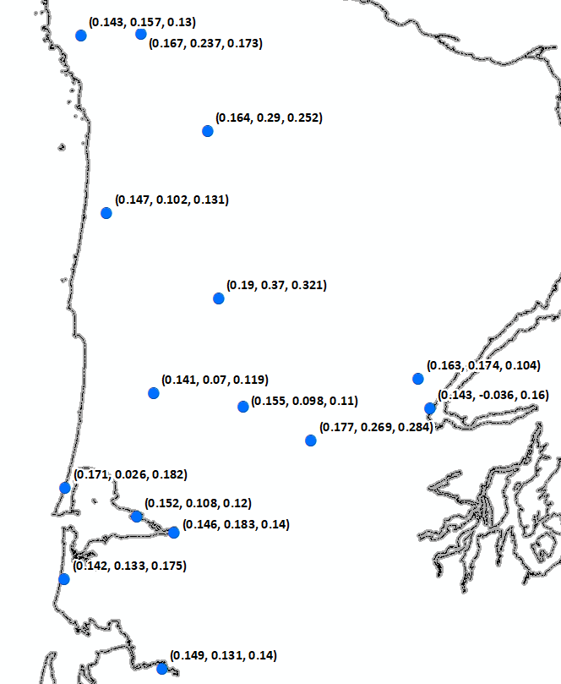
Region of Influence (“ROI”)
Every site is a “region”
For every site, select k similar other sites
Compute regional average L-moment ratios
Estimate regional probability distribution directly
k = 3
Physical proximity
Notes:
Region of influence does not start the same way as index flood. ROI fundamentally changes how regions are created and uses the mantra “every site is a region.” This works by iterating over every site in the study area, finding some number of sites that are similar to the site using similar criteria we saw in fractional membership, and creating a region out of those sites, and estimating the regional growth curve. The number of sites in each region might vary from site to site. Typically there is some target number that it aims to gather together, but in situations where a site doesn’t have a lot of other sites that are similar, some criteria that cuts off the maximum dissimilarity metric might reduce the total number of sites in the region. On the other hand in areas where sites are very dense, more sites in a region may be allowed.

Slide 26
Mapping
Goal: Explain how L-moment ratios vary in space
1. Provide estimates anywhere you can reliably predict
2. Avoid assigning particular locations to a single region
Two approaches to mapping:
  Interpolation
  Spatial regression
No physical explanation for variation and results are dominated by nearest observation.
Build a regression model that explains the why. Uses spatially-based predictors in the model.
Notes:
Finally, we reach mapping. Mapping allows you to provide estimates for L-moments or the frequency distribution any place you can make a reliable prediction. It also allows you to avoid assigning a site or location to a single region, similar to fractional membership.
There are two general approaches to mapping. One is to do interpolation, where you estimate the L-moments for all of the sites and then use an interpolation scheme to fill in between sites. Then with the maps for each L-moment you can estimate the parameters of the frequency distribution anywhere you have mapped the L-moments, and then the frequency rainfall.
The other option is to use spatial regression, which predicts the L-moment ratios using a regression model based on spatially-distributed predictors. This is the method I use the most frequently.

Slide 27
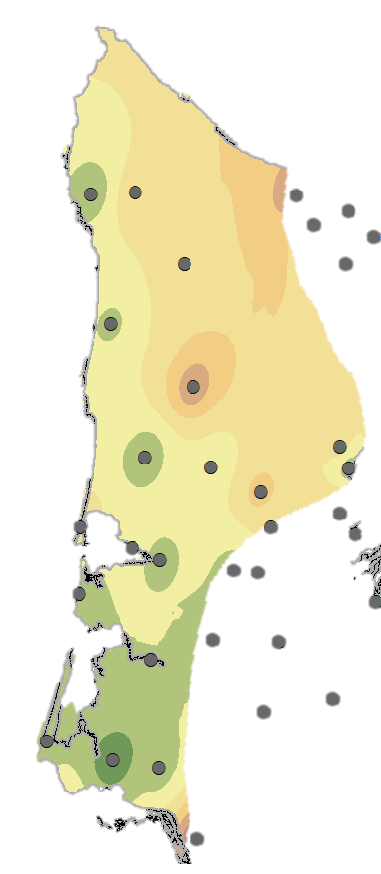
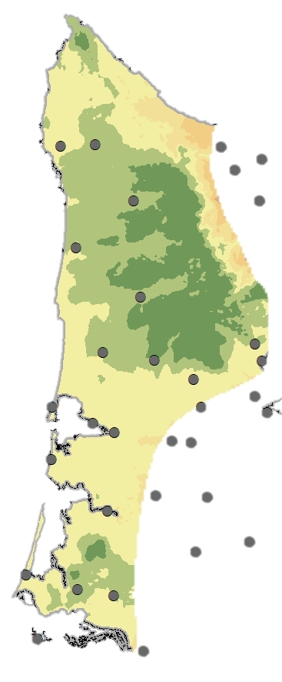
IDW interpolation
Region-level spatial regression
Notes:
Here is the result of using IDW interpolation and region-level spatial regression for L-CV. On the left, L-CV was computed for each site and then interpolated using IDW. On the right, a regression model was built for L-CV based on physical properties of the sites.
The difference shows that the site in the middle of the pink bull's-eye might be an outlier and has completely wrecked the interpolation. In this area, the elevation and total annual precipitation increases very quickly. Total annual precipitation and L-CV of maximum precipitation usually have an inverse relationship, and the interpolation fails to capture the physical behavior occurring in this area.
The spatial regression result makes the assumption that the regions are homogeneous and so their physical characteristics and L-moment ratios are very related. This means that we can identify small scale features such as rapid changes in elevation, as long as our regression model identifies them. In this situation, the model captures the intensification of rainfall at high elevations, resulting in the dark green patch in the middle, and then the variability induced by the rain shadow to the northeast of the mountains.

Slide 28
What to regress?
𝓁₁ at site level, against a precipitation predictor
t at site level, sub-region level, or region level
t₃ at region level
t₄ prediction at region or super-regional level
Increasing
sample error
Notes:
For l1 you can build a model with any number of predictors, but I doubt it’s going to get much better than a precipitation-based predictor like annual or seasonal total precipitation (available from PRISM). Across several studies I’ve performed, the L-mean can consistently be predicted with a seasonal or annual precipitation predictor very well.
For L-CV, there is substantially more sample error in these estimators, and depending on the behavior of sites in your region, you may elect to use anything from a site-level regression, to a regression that uses groupings of small sub-regions, up to region-level averages. In less dynamic terrain, site-based regression may be possible. In highly dynamic areas some amount of averaging may be necessary to uncover trends. Sub-regions are occasionally in studies. Sometimes the study will rigidly use the weather service climate regions as the regional boundaries, which may or may not be homogeneous regions. Then, the regions are subdivided into smaller homogeneous sub-groupings (maybe 2-5 per region) to create homogeneity in each sub-region. Then, you could capture the variability within regions for the parameter you want.
For L-skew and L-kurtosis, the sample error is substantial and estimating these generally require regressing region averages, or in the case of L-kurtosis, using a study-area-average value as the regional L-moment.

Slide 29
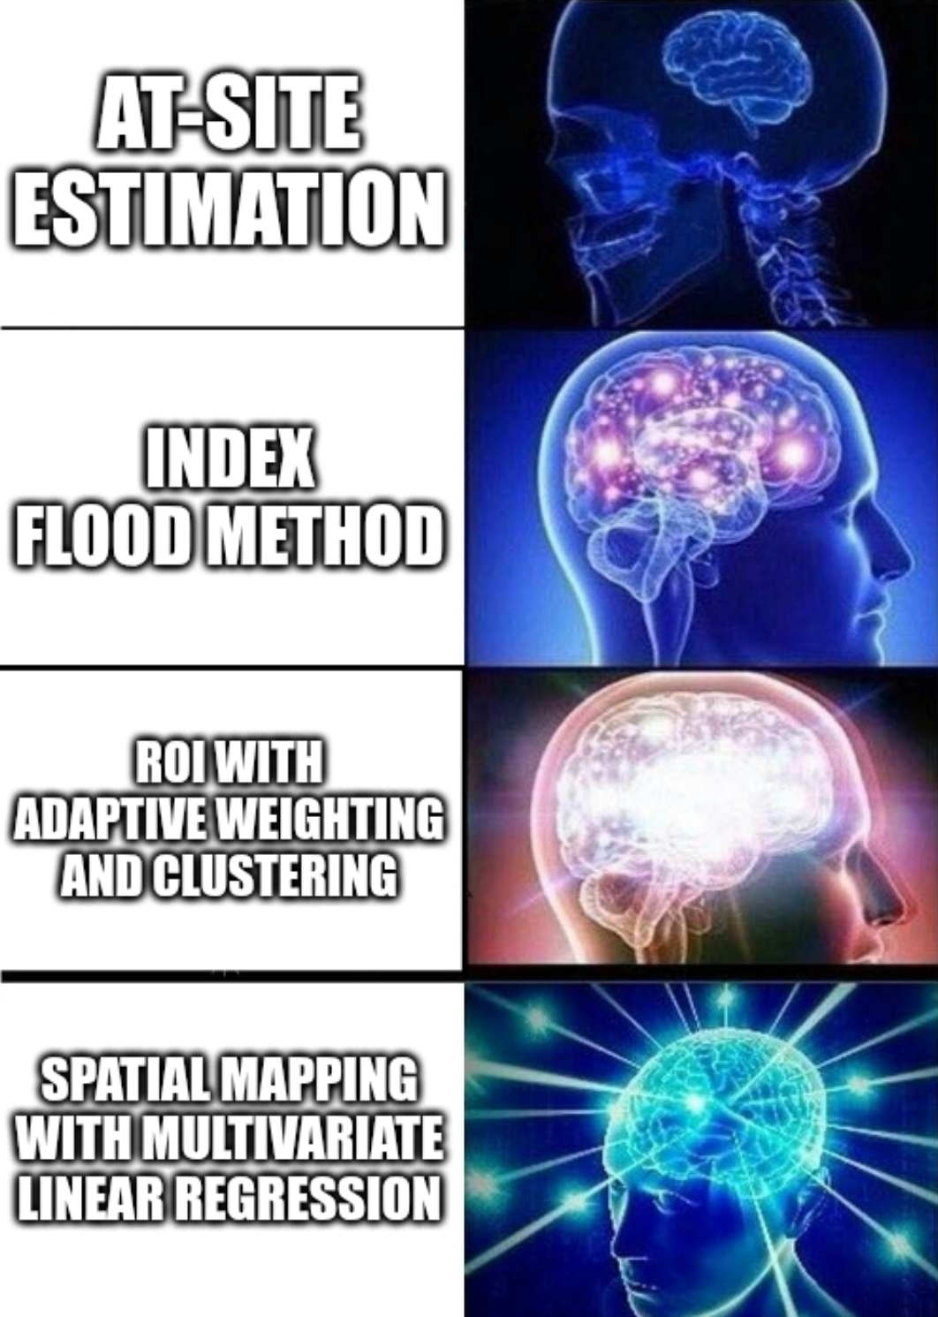
Summary
There are many regionalization methods
More sophisticated regionalization techniques can help produce spatially-coherent frequency maps
Rigid regions can create mapping artifacts that require smoothing

Slide 30
Regional Precipitation Frequency Analysis
Part IV: Framework for Regional Frequency Analysis
Melissa Mika, P.E.
USACE Hydrologic Engineering Center
April 2025

Slide 31

Hosking & Wallis (1997)
Notes:
When we want to perform regional frequency analyses for variables other than streamflow, most prominently for precipitation, we don’t have federal guidance in a document like Bulletin 17. However, a book published in 1997 serves as the framework for regional frequency analysis of hydrometeorological data. Regional Frequency Analysis: An Approach Based on L-Moments, also called “Hosking & Wallis 1997” has been used as the basis for nearly every precipitation-frequency analysis since its publishing and is a valuable resource. Much of the technique in this book has also been implemented in R packages, making it much easier to perform these kinds of analyses yourself. Much of the material in this video series parallels what you will find in this book.

Slide 32
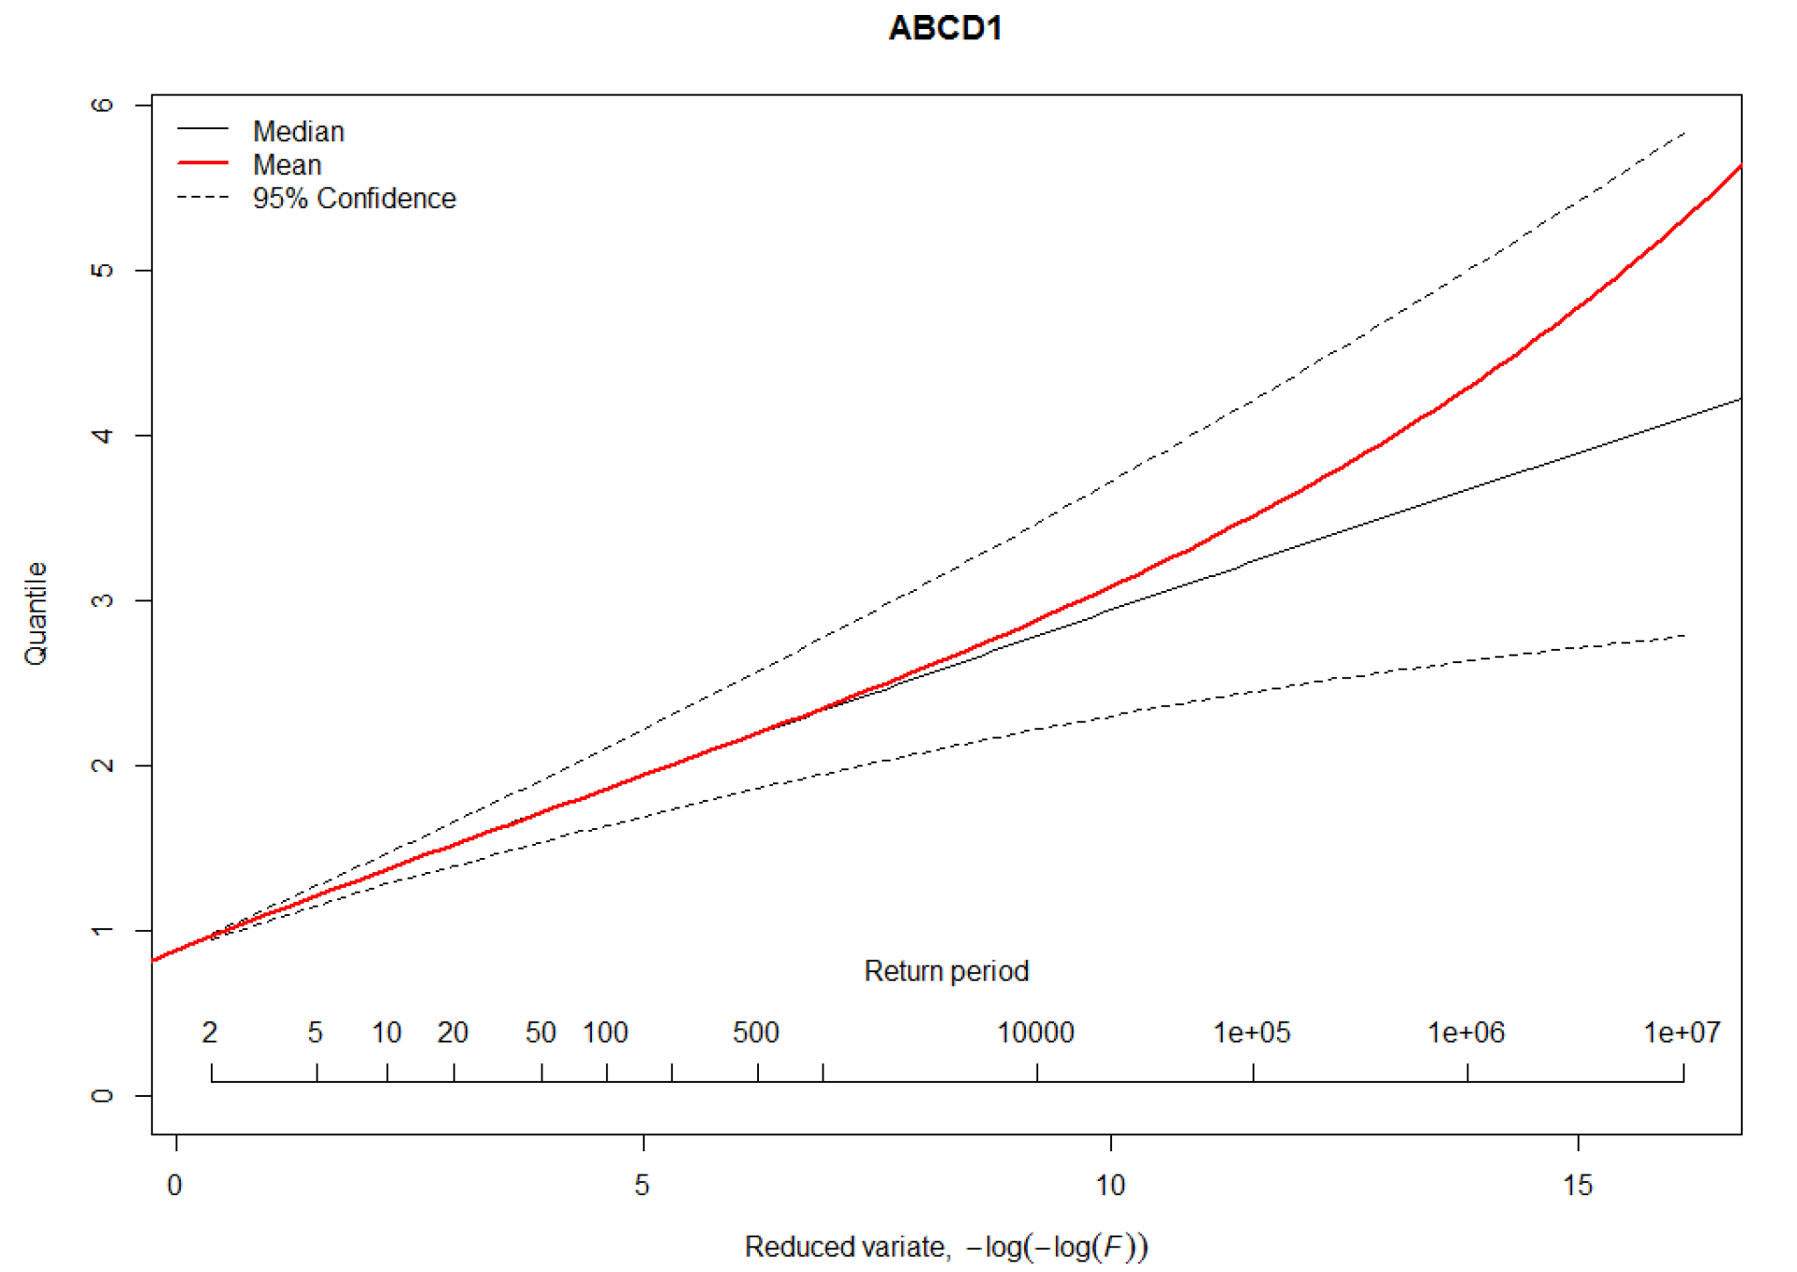
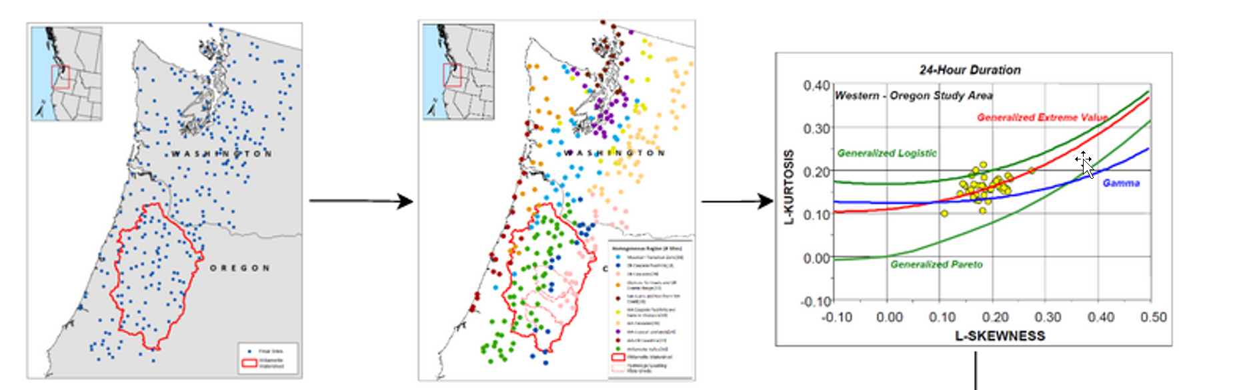
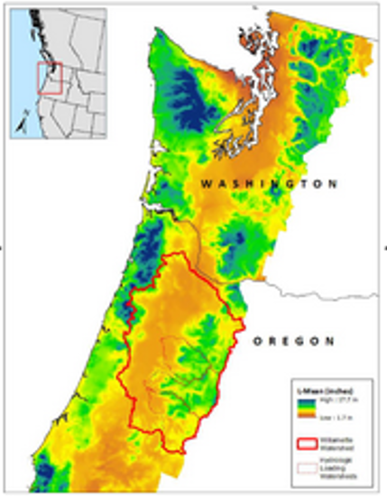
Summary of Steps
Collect data
Create homogeneous regions
Compute L-moment ratios
Identify appropriate probability distribution
Estimate parameters

Slide 33
Summary of Steps
Collect data
Create homogeneous regions
Compute L-moment ratios
Identify appropriate probability distribution
Estimate parameters
IID samples!

Slide 34
Summary of Steps
Collect data
Create homogeneous regions
Compute L-moment ratios
Identify appropriate probability distribution
Estimate parameters

Slide 35

– Tobler’s First Law of Geography
Everything is related to everything else, but near things are more related than distant things.
Notes:
This is the so-called “First Law of Geography” which states that in a geographic context: everything is related to everything else, but near things are more related than distant things. What this means is that observations taken closer together are likely to observe similar things. This seems fairly intuitive, but is actually foundational for concepts of spatial dependence and interpolation.

Slide 36
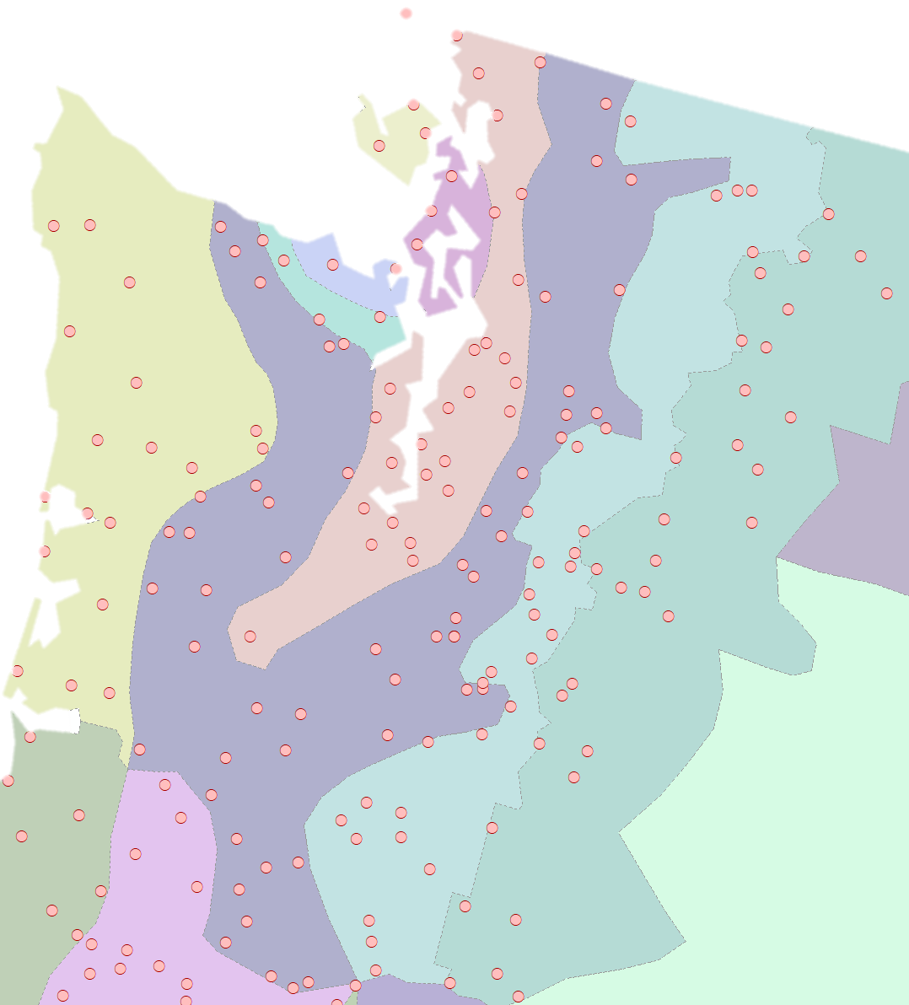
Creating Physical Regions
Goal: Partition sites into homogeneous regions
Typical spatial variables to define regions:
  Climate divisions
  Location (latitude/longitude)
  Elevation
  Climatology (annual or seasonal mean temperature, precipitation, etc.)
  Proximity to coasts, mountains, etc.
R: cluster
Notes:
Creating regions using a physical basis is important. This ensures that we are grouping together sites that plausibly observe the same thing. A good place to start in the United States is the National Weather Service climate regions, which are used as reasonably similar groupings of meteorology broken up by state. There are limitations to these regions, such as discontinuity across state boundaries, and differences in the way they are drawn by state, but as a first attempt they are generally consistent.
After initially grouping sites using a high-level grouping like the climate regions, we should refine these groupings. Usually these climate regions are quite large and may contain an impractical number of sites. A rough guideline is that regions should contain 20-30 sites per region, but this number can vary if the sites are more highly correlated, or more dense such as in urban areas, and so on.
When refining the regions, here are some physical variables worth exploring.
Location is a good first choice, again pointing back to Tobler’s First Law. We can quantify location in latitude and longitude or in planar coordinates.
Elevation is a critical part of precipitation intensification in many places and can be a good divider of the behavior of sites between valleys and mountains.
Climatology, or long-term meteorology, can give an idea of the variation in weather on a finer scale than the climate regions. Mean annual or seasonal temperature or precipitation can be used as climate normals used for making divisions.
Geographic features that affect the formation and intensity of rainfall such as the ocean or mountains can be identified by using the distance from a coastline or a mountain range.
There are other variables that you might consider depending on your application but these are some of the most commonly used ones.

Slide 37
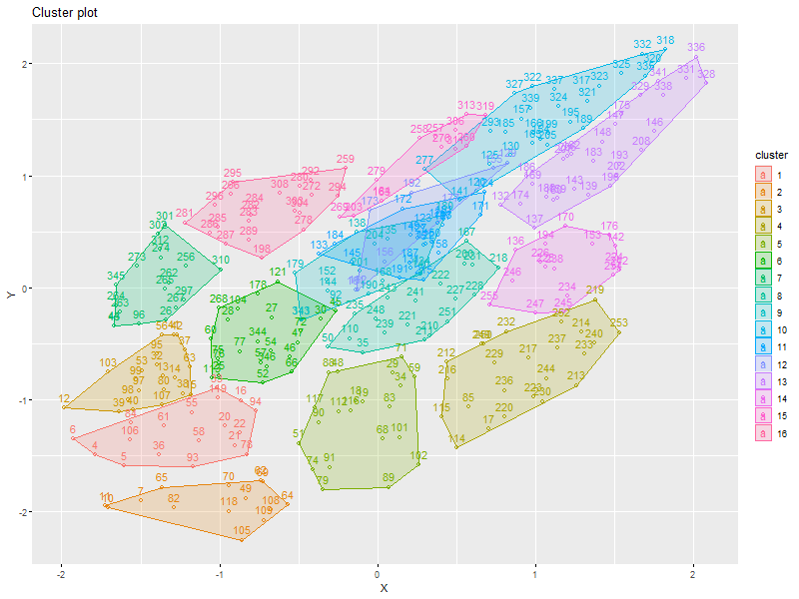
“Of all the stages in a regional frequency analysis involving many sites, the identification of homogeneous regions is usually the most difficult and requires the greatest amount of subjective judgement.”
–Hosking & Wallis (1997)

Slide 38
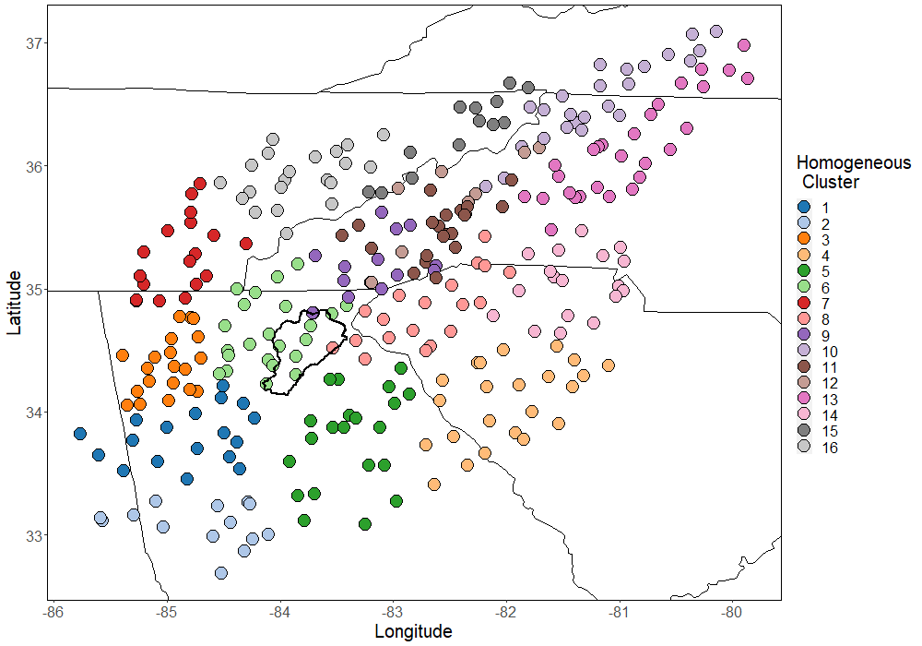
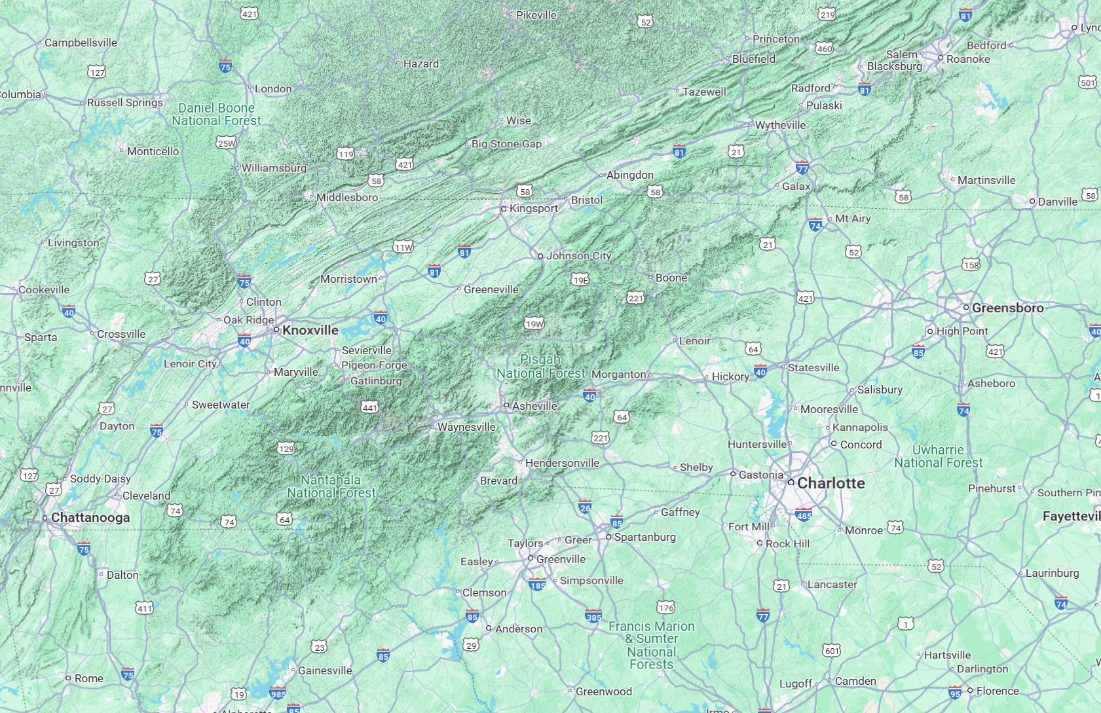
Non-Contiguous Regions
Regions do not have to be spatially contiguous
More common in areas with large differences in elevation or other defining features
Notes:
Although spatial proximity is one of the best predictors of whether or not sites will be similar, in some areas there are other more dominant features that control the behavior of stations. The points in the plot on the right are plotted by longitude and latitude, and the four colors represent four regions carved out of this dense network of stations. These are all stations within 100 miles of Whittier Narrows Dam, and the watershed above the dam is roughly in the dotted box. There is very high station density in this area, so all of these sites are close together, relatively speaking. However, the San Gabriel Mountains have a pronounced effect on precipitation in this area, and depending on the site’s location relative to the mountains, the rainfall characteristics can change drastically. The regions here are primarily defined by their elevation, and which direction the slope of the mountains face. The region in green is the collection of sites at higher elevation on the windward side of the San Gabriels, where the heaviest rainfall is possible. There are also some sites in the green region atop the coastal mountains west of the city, which also experience heavier rainfall than the surrounding area.
These are examples of non-contiguous regions. They tap into the key properties of the rainfall extremes in this area, which spatial proximity alone can’t explain.

Slide 39
Statistical Tests for Homogeneity
There is a balance
  Regions that are too large or too uncorrelated may no longer be homogeneous
  Regions that are too small or too correlated may not be independent
Events perfectly uncorrelated
All independent observations
Possible heterogeneity
Events mildly correlated
Sweet
Spot
Many independent observations
Probable homogeneity
Events perfectly correlated
No independent observations
Probable homogeneity
Notes:
For sites in a region, there is a continuum of relatedness.
On one end, the event occurrences are perfectly uncorrelated – that is, they are independent of each other. For a regional analysis where the goal is to gather up as many independent observations as possible in order to improve our models, this sounds good. However, independence is a sign that the region isn’t in fact homogeneous, and it’s possible and even probable that the region is heterogeneous. This means that they are not really sampling the same thing.
On the other end, the event occurrences are perfectly correlated, in other words, completely dependent. This means that there are no independent observations – if it rains hard in one place, it rains hard everywhere in the region. While this is a sign that the region is homogeneous, it means that looking at the behavior of multiple sites in the region offers us no new information. You know as much by looking at one site as you do the entire region.
The sweet spot in these kinds of analyses is when the events are mildly correlated. This means that event occurrences generally affect several sites at a time, but each year the collection of sites collectively observes several different events and capture the variability. The small amount of correlation strengthens the assumption that the region is homogeneous, but it is not so correlated that adding sites to the region doesn’t matter.
We have a balancing act of making sure our regions are homogeneous, but also that they contain more information than just the longest record site in the region.

Slide 40
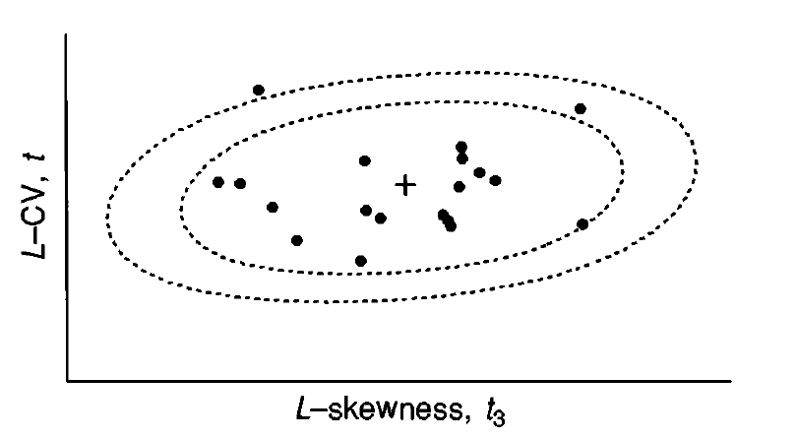
Statistical Tests for Homogeneity
Goal: Check if the variation in the L-moment ratios in the region are more than expected (from sample error)
If the variation is too high, re-formulate the regions
Homogeneity metric (H statistic)
    H < 1 Acceptably homogeneous
    1 ≤ H < 2 Possibly heterogeneous
    H ≥ 2 Definitely heterogeneous
Discordancy metric
    D > Critical value
    Critical value depends on number of sites in the region, but typically 2-3
  Others (Silhouette Width…)
Notes:
Homogeneity is a measure of the similarity of the statistical properties of the observations of sites in a region. It is measured by comparing the amount of variability of the L-moments of the sites to a standard dependent on sample error. This produces a single statistic that tells us whether the variation is too high or acceptably low. If we find that the variation is too high, then we need to reformulate this region, and likely others around it. If we find that the variation in the site L-moments is low, and we designed the region using physical means, then the region is probably homogeneous.
The H statistic measures heterogeneity – the amount of variability in the site L-moments. We assume that low values of H, associated with a low likelihood of heterogeneity, means that the region is homogeneous.
H is computed by comparing the spread of the L-CV for the sites against a simulated “perfect” region. The so-called perfect region is set up to look just like the region you are testing: it has the same number of sites, the same record length at each site, and the same regional probability distribution. It assumes the sites are perfectly uncorrelated, however. Monte Carlo simulation is then used to create artificial periods of record from this perfect region. For each period of record, the standard deviation of the perfect region L-CVs is computed. After a large number of these artificial periods of record are created, the observed spread in the site L-CVs is compared to the simulated spread. If the observed spread is too big, the heterogeneity measure H is high, and the region is probably heterogeneous. If H is low, usually under 1, then the region is probably homogeneous. If H is between 1 and 2, then the region might be homogeneous, but regional refinement is beneficial and is likely to improve the model. Regions with values greater than 2 almost definitely need to be refined.
Another tool that helps identify stations that might not belong in a region is called the discordancy measure, or D. D measures how far a site’s L-moment ratios are from the region average. If the D-statistic for a site is too big, it might indicate a few things. One is that the site belongs in another region. It might mean that including that site in a region is causing it to be labeled as heterogeneous. It can also identify a site with an error, because its L-moments are affected by an error in the data. It is worth looking in more detail at sites with high D-statistics to see what might have caused the value to be so large.

Slide 41
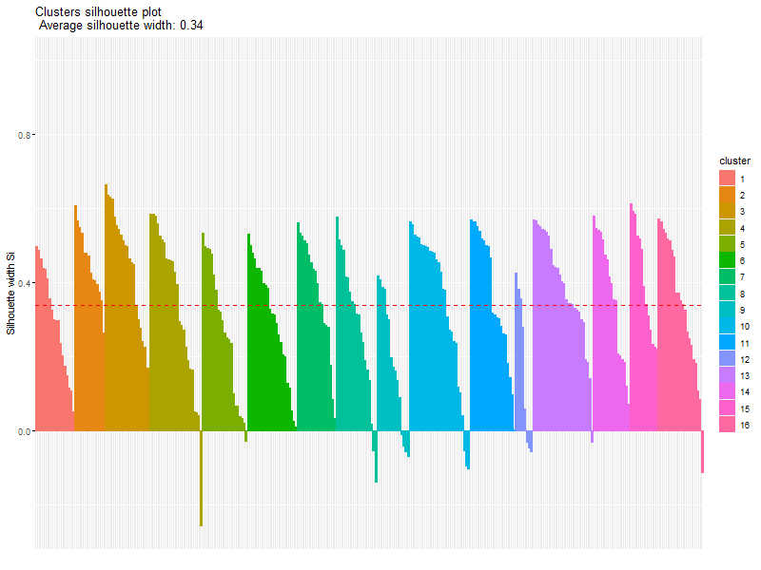
Region Refinement
Should try many different combinations of spatial variables and number of “clusters” (regions)
Once these have been optimized:
  Check region homogeneity (H)
  Check site discordancy (Discordancy, Silhouette Width, etc.)
  Make adjustments
    Merge or split regions
    Move sites from one region to another
    Remove sites
    Check site data quality
  Iterate
Notes:
If you detect that regions are heterogeneous then there are three typical courses of action, which are taken iteratively with further checks of the H statistics. You might try to split a region into parts, for example splitting it in half by the upper half and lower half of annual total precipitation. This works best if your region has a large number of sites to start. On the other hand, it might make sense to combine up some smaller regions into a larger region based on physical characteristics. Occasionally you need to work at the level of granularity where you are moving individual sites around between regions.
Cluster analysis can be used to identify subgroupings using physical predictors with some success. However, an automated method like this doesn’t replace your judgment.

Slide 42
Summary of Steps
Collect data
Create homogeneous regions
Compute L-moment ratios
Identify appropriate probability distribution
Estimate parameters

Slide 43

Regional L-Moment Ratios
Regional L-moment ratios (LMR) are a weighted average of the k sites in the region, weighted by each site’s record length
Site j LMR
  $$t_{R,i}=\frac{\sum_{j=1}^{k}{t_{j,i}∗n_{j}}}{\sum_{j=1}^{k}{n_{j}}}$$
L-CV, L-skew, L-kurtosis
Site j record length
Regional LMR
L-CV, L-skew, L-kurtosis
Notes:
The region average L-moments L-CV, L-skew, and L-kurtosis, are computed as weighted averages of all the sites in a homogeneous region. These L-moments are weighted by the record length of the sites used in the computation.
This is actually a very similar mechanism to how regional skews are done. Regional skew weights a regional value with the at-site value by the mean squared error of each value. The MSE is inversely proportional to the record length. These regional averages are done the same way. The region average l-skew for example is influenced more by site l-skew with longer records, which are expected to have smaller sample error and therefore smaller MSE.

Slide 44
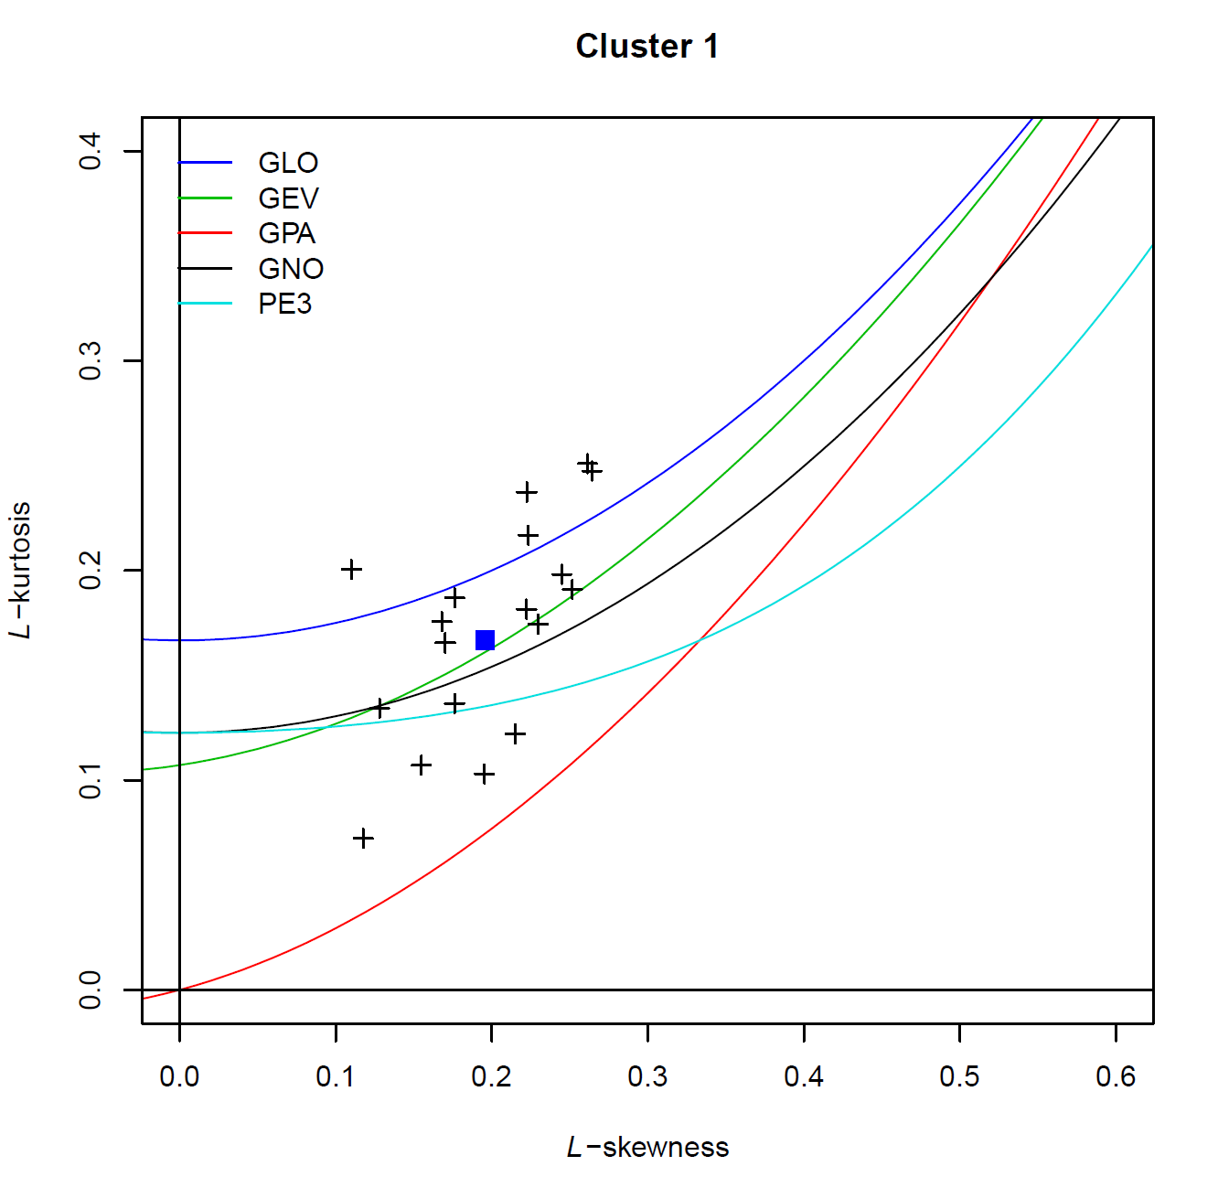


Regional L-Moment Ratios
These ratios can be plotted on a L-Moment Ratio Diagram (LMRD)
Example for a single region:
  The black crosses show the L-skew and L-kurtosis for each site in the region
  The blue square shows the regional L-skew and L-kurtosis
Site j
$$t_{4}$$
Regional Average
$$t_{3}$$
Notes:
Here is the LMRD again, and instead of plotting each station as a point, each station is plotted as its record length. For example the site in the upper right where the arrow is pointing has a record length of 40 years.
The regional average L-skewness and L-kurtosis are computed, and then the resulting point is plotted on the LMRD. Sites with longer record lengths have more leverage on the overall computation.
These data are pretty spread out, but the weighted average finds a place near the center. Notice also that the longest record stations tend to be towards the middle of the cluster with the shorter record lengths generally further away. This is a symptom of sample error.

Slide 45
Summary of Steps
Collect data
Create homogeneous regions
Compute L-moment ratios
Identify appropriate probability distribution
Estimate parameters

Slide 46
Identify the Probability Distribution
The L-Moment Ratio Diagram (LMRD) can help determine the most appropriate probability distribution
For this example (Cluster 1), using the regional ratios, the best distribution is the Generalized Extreme Value (GEV)
$$t_{4}$$
$$t_{3}$$
Notes:
A probability distribution can be applied to a region by estimating its parameters using the method of L-moments. The method of L-moments is the same as the method of moments that we have talked about before, except instead of measuring the moments using conventional product moments, we use L-moments instead. Probability distribution parameters can be expressed in terms of L-moments so that a distribution can be fit to the sample.
In the back of the Hosking and Wallis book, Appendix A, has the distribution parameters for several probability distributions expressed in terms of the L-moments. The example here is for the generalized Pareto distribution. You can see how you would plug in the region-average L-moments to get the parameters of a distribution that represents the region.
In R there is a package called “lmom” that has a number of distributions built in, which will give parameter estimates when given a set of l-moment ratios. It makes fitting distributions to samples using L-moments very easy.

Slide 47
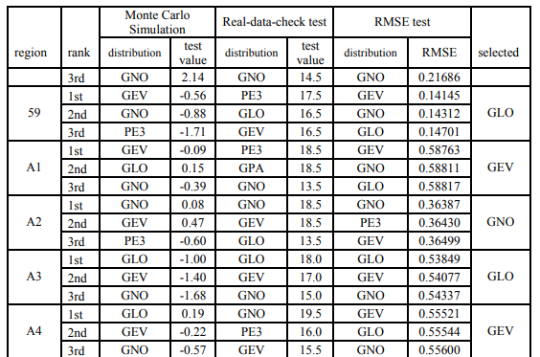
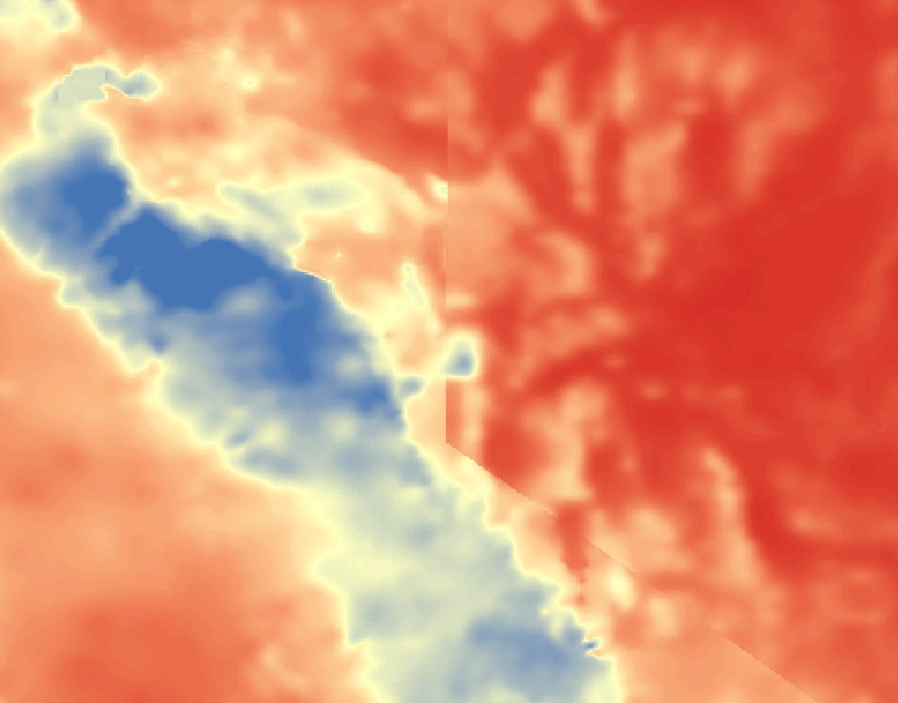
Identify the Probability Distribution
This process is repeated for each region
The same distribution does not have to be used for all, but this could lead to spatial discontinuities depending on the method of regionalization used
Earlier volumes of NOAA Atlas 14 did this
NOAA Atlas 14, Volume 1, Table 4.5.1
NOAA Atlas 14, Volume 1, 24-hour, 1/1,000 ACE

Slide 48
Summary of Steps
Collect data
Create homogeneous regions
Compute L-moment ratios
Identify appropriate probability distribution
Estimate parameters

Slide 49
Index Flood (Recap)

Slide 50

Index Flood (Recap)
Mean:
At-site
Standard deviation:
Regional average
Skew:
Regional average
Recall the index flood method:
  ${\hat{Q}}_{i}\left(F\right)={\hat{μ}}_{i}\hat{q}\left(F\right)$
  Site prediction =
  site index flood * regional growth curve
Appropriate for a single region or regions that are spatially contiguous
Limitations:
  Limited by regional membership
  Adjacent regions can form a sharp boundary

Slide 51
Parameter Estimation

Slide 52
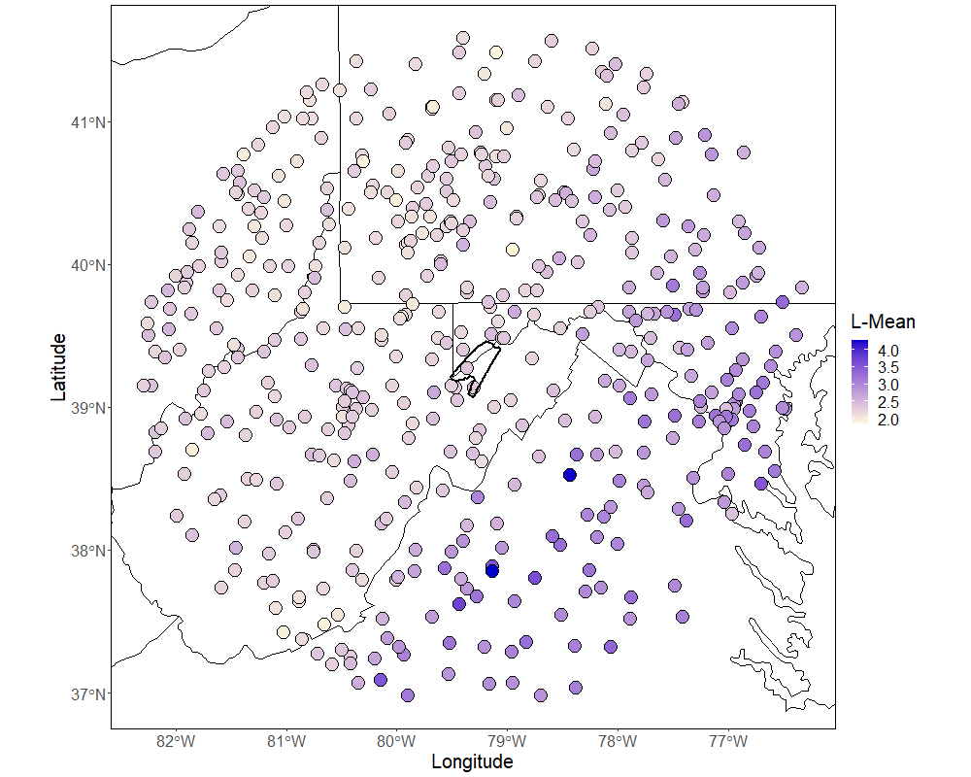
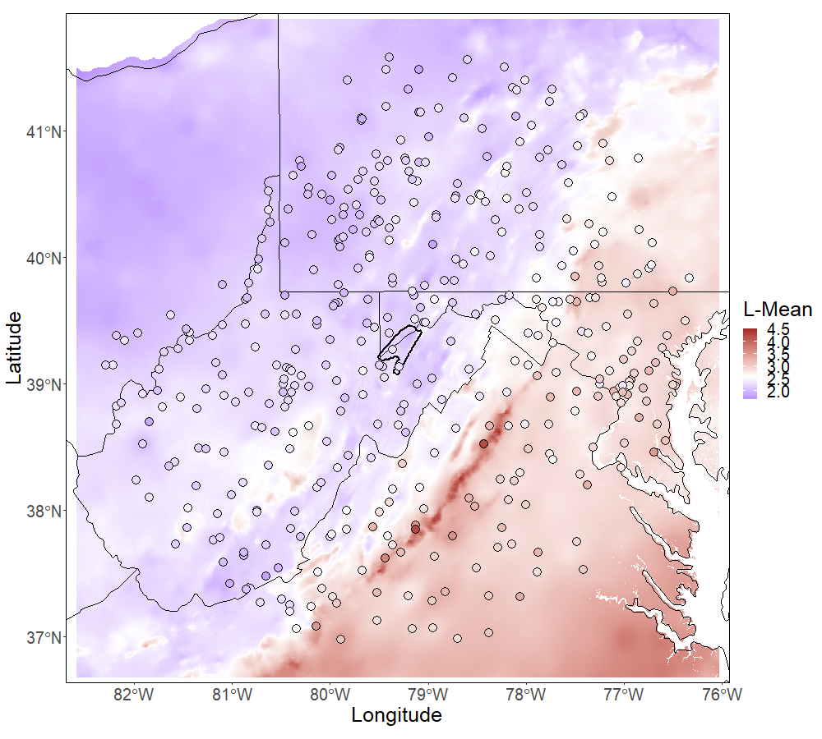
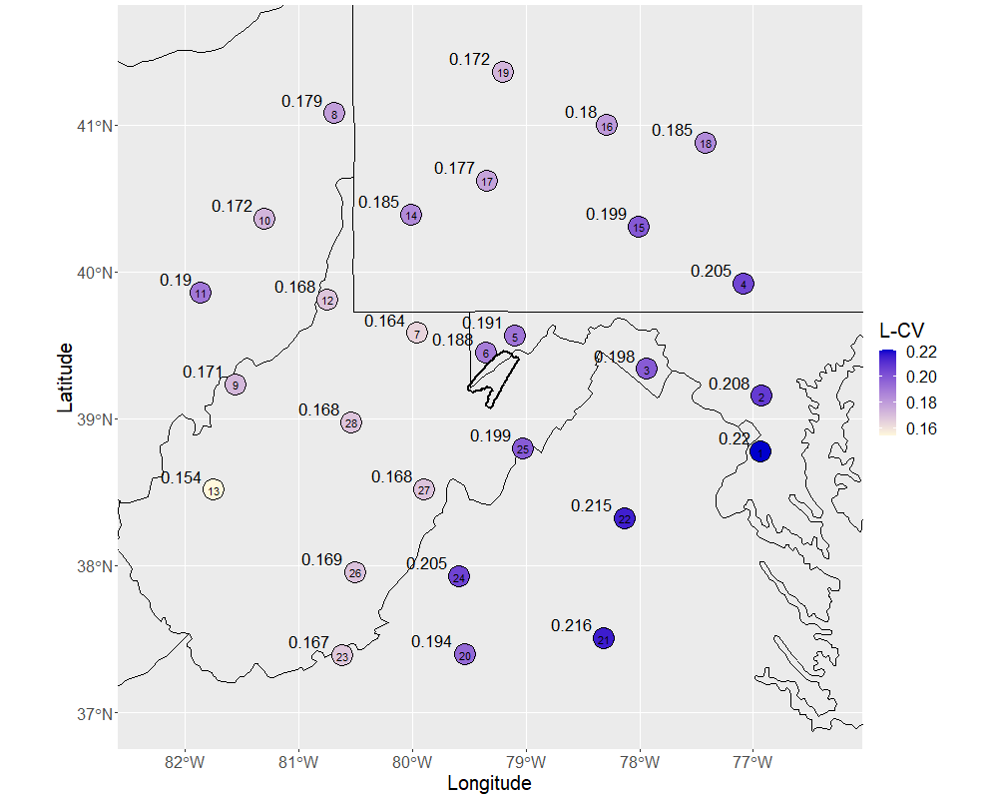
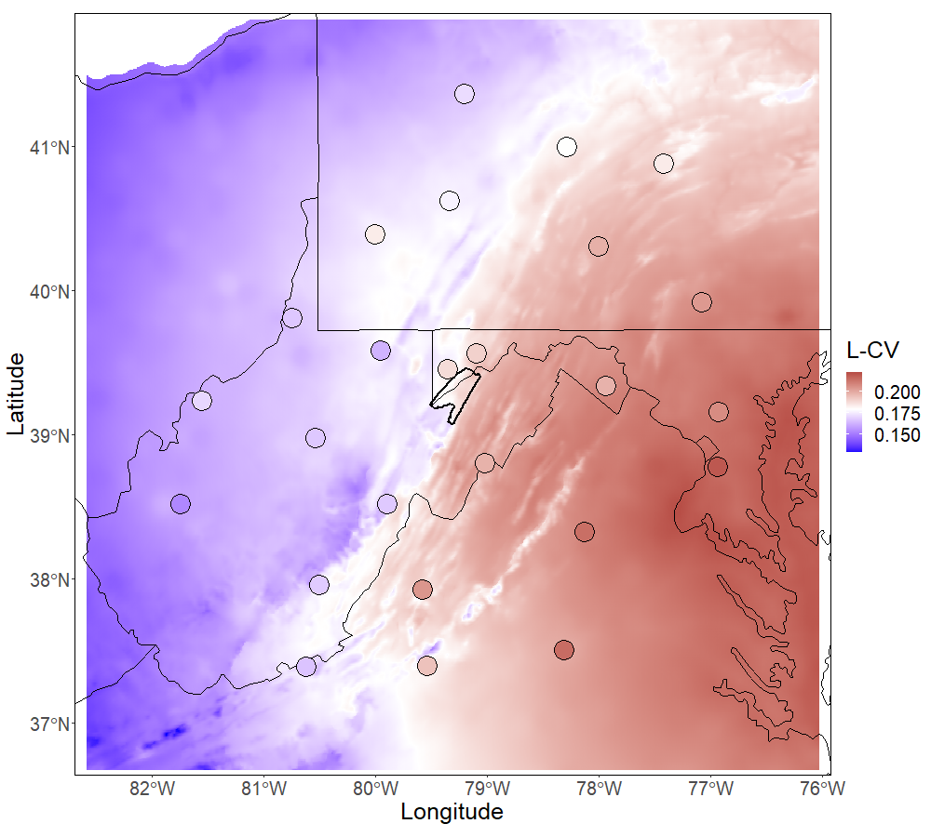
Spatial Mapping
Using the Index Flood variants of regionalization
  At-site: L-mean
  Regional-average: L-CV, L-skew
Perform spatial regression or interpolation
Spatial covariates such as:
  Latitude/longitude
  Elevation
  Mean Annual Precipitation
  Etc.
Notes:
We would like to avoid regionalization artifacts like these sharp boundaries. “Making pretty maps” is somewhat tongue-in-cheek, but maps that are spatially consistent tend to be visually appealing. Discontinuities look and feel wrong when we see them on a map of something that’s natural, so we tend to want to make them look “pretty”.
I mentioned that Atlas 14 has used a spatial smoothing technique to avoid these kinds of discontinuities. This is certainly an option for making the maps spatially consistent. It also uses smoothing across durations to ensure that shorter duration storms never have more depth than longer duration storms at the same frequency.
One key effect is that in looking at the results,, at any point it is almost impossible to estimate the point frequency distribution even when you know the quantiles and the probability distribution. This comes up when people try to use the results at a point (presented as an IDF table) and back out what the distribution parameters would be for that point so that they can extrapolate beyond the 1/1,000 ACE event. I wouldn’t recommend trying to do that.
Eventually, as further volumes of Atlas 14 were developed, the process was refined and more sophisticated regionalization techniques that address some of these problems were used. We will talk about a few of these methods next.
--mention there’s less points to use in the regression for regional-average ratios

Slide 53
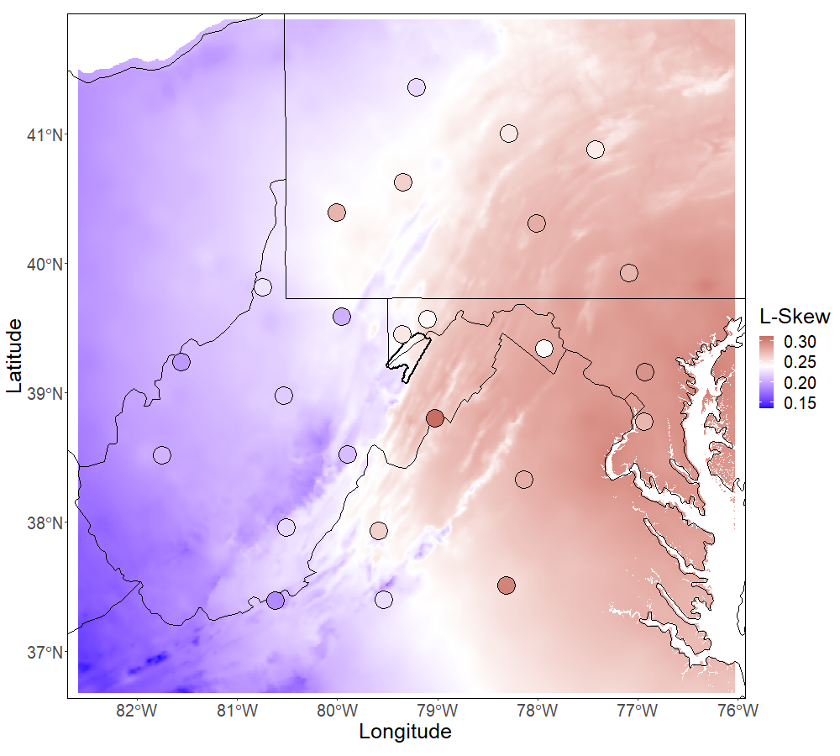
Parameter Estimation
For a point or an area, estimate:
l₁, t, t₃
Then fit to the chosen probability distribution:
xi, alpha, k
GEV, in this example

Slide 54
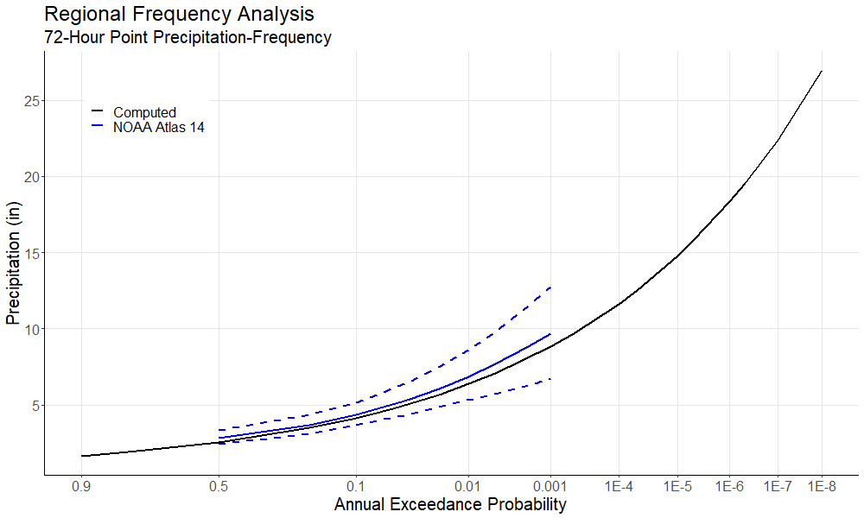
Parameter Estimation
This is our frequency curve with Generalized Extreme Value (GEV) parameters:
xi, alpha, k
Recall the Parametric Modeling Lecture!

Slide 55

Summary
Regional frequency analysis follows the general process:
  Determine an analysis domain
  Collect data for many gages
  Create homogeneous regions
  For each region, compute regional L-moments
  Choose and fit a probability distribution
From there, the index flood method can be used for sites where the region and L-mean are known
Mapping should be used to interpolate to any point in the domain, even where no gage exists

Slide 56
Regional Precipitation Frequency Analysis
Part V: Regional Frequency Analysis Applications
Melissa Mika, P.E.
USACE Hydrologic Engineering Center
April 2025

Slide 57
Topics
Data considerations
NOAA Atlas 14
Storm typing
Stochastic Storm Transposition (SST)

Slide 58
Streamflow
Precipitation
Measures effect over an area
High serial correlation
One source of data in the United States
Data is meticulously quality-controlled
Historical/paleo information can be estimated
Measures effect at a point
Low serial correlation
Many different sources of United States data
Inconsistent quality control of data
No real mechanism for paleo/historical information
Notes:
Previously, we identified some of the key differences between regionalization of streamflow frequency estimates, and precipitation frequency estimates. The lists we see here expand on some of the differences and offer insight into why we have to do different things for precipitation frequency.
Streamflow at a gage is the aggregation of the hydrometeorology of the entire watershed above it. To contrast this, a precipitation gage measures a small area of the landscape that is essentially one point.
Streamflow records have what we would call a longer memory than precipitation. The flow of a river at any given time is strongly related to the flow that happened in the recent past and will happen in the near future. For precipitation, the process is much more chaotic and storm events may be very brief, with periods of dry punctuating storm events.
In the United States, streamflow measurements are primarily provided by the USGS and form a single point of service for obtaining them. While the NCEI catalogs several precipitation observation datasets, they are not uniform in nature. The NCEI catalog is also not exhaustive, and source of precipitation are available from a wide range of providers. Partly this arises because it is much easier to measure precipitation than streamflow.
Another upside to the USGS being a central clearinghouse for streamflow data is that it is meticulously quality-controlled prior to being published. Quality control for precipitation is much more variable, and errors can be introduced into precipitation observation in a number of ways.
Finally, historical and paleoflood information can be used in streamflow frequency analysis in a meaningful way. Bulletin 17C and the Expected Moments Algorithm was developed in part to use these data to their fullest. Unfortunately there is not a similar way to use paleoflood or historical precipitation information in a precipitation frequency analysis.

Slide 59

Precipitation Data Quality
A healthy dose of skepticism is a good thing
There are many ways a record can be incorrect
  Mis-transcribed from paper forms
    Decimal places
    Entirely incorrect value
  Sensor malfunctions
  Incorrect volunteer reporting
  Unit mismatch
  Etc.
It’s up to you to decide if it’s right or not
Notes:
A problem we identified that exists moreso in precipitation than streamflow is the possibility of incorrect or erroneous data. When you encounter values that don’t seem to make sense, a healthy dose of skepticism is a good thing. Your judgment will lead you to identifying if an observation truly belongs in the record or not.
In precipitation data especially, there are a multitude of ways the value you download can go wrong. Early precipitation records can be mistranscribed from paper forms, where the data entry missed a decimal place or simply digitized the wrong value. Sensor malfunctions can occur. Sometimes volunteer reporting can go wrong. For example I once heard a story about a volunteer observer who brought their rain gauge with them on vacation so they didn’t miss an observation. In some situations values are recorded with the wrong units. I’m sure there are a lot of other ways that a value can be wrong. The biggest problem is that a huge number of the errors result in an unreasonably large value, when what we are trying to analyze the most is extremes.
The amount of data in a precipitation frequency analysis can make it hard to look at all of it in a meaningful way, so plots are usually generated for problematic sites or data instead of all the records. It’s up to you to use the tools at your disposal to identify if a value represents reality or is an error, because it’s not always clear.

Slide 60
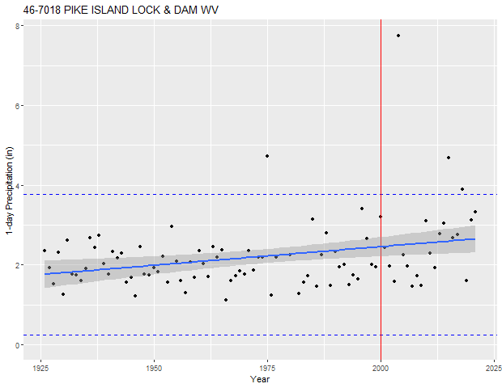
Detecting Errors
Most “busts” occur in the large direction
Quality control usually performed on AMS
Some tests:
  Largest observation ratio test
  Outlier tests
  Trend checks
  Extreme L-moment ratios
Outlier test
Ratio test
Trend check
Notes:
Detecting errors requires doing some testing. I use the word “bust” for these errors from my days in land surveying. The errors you are likely to encounter and detect are going to be in the large direction; that is, recording a value that is much larger than the true value. This can be detectable in the annual maximum series or partial duration series because these typically crop up as an annual maximum or value exceeding the threshold. This means that you will not need to quality control all of the daily or sub-daily observations, only the maxima you are interested in.
There are four tests that I’ve used in the past with good success at identifying busts in precipitation records, and they are certainly not exhaustive. These tests are useful because they can be quickly run on every gauge in the study and produce a summary of the most unusual sites using a metric, which avoids having to pore over hundreds of plots trying to find the busts.

Slide 61
Missing Data
It is difficult to judge if a value is truly the annual maximum if many days of the year are missing
Keep/Case by case
Reject/Case by case
Keep
Magnitude of Maximum
Reject with small consequence
Keep
Reject
Percent of Year Missing
Notes:
Missing data occur quite frequently in precipitation. The problem is that in a year with many missing days of data, it gets less and less certain that you have actually observed the annual maximum value. This chart has four areas on it that tell you what to do.
On the very left of the plot, and in the upper left, is the “keep” region. This simply states, if the percentage complete is high (e.g. 90-95% complete) or if there are more missing data but the annual maximum is a big value, then keep the observation. You are likely to have captured the annual maximum in this situation.
On the lower left is the “reject with small consequence” region. Simply stated, the magnitude of the maximum is small and less likely to affect your analysis if you have to reject it, so rejecting it to be safe is ok.
The lower right is pretty easy – if you are missing quite a bit of data and the maximum is small anyway, rejecting it is easy.
The hard work is in the upper right region. When you are missing a lot of data, but the value you have is large, you need to work to substantiate the value. Including it but missing a possibly larger maximum value is a possibility, but as the magnitude of the value you have gets larger and larger this probability gets smaller. If there is a higher percent completeness but the value isn’t as large, you will still need to evaluate if you think it is the maximum or not. Just remember, the higher the percent complete and the larger the value, the easier it is to accept the value.
There are no real guidelines on values to use for these thresholds, but I would recommend rejecting any small maxima, say smaller than the median of the remaining values, if it is less than 90% complete. If it is above the median, then you need to check it.

Slide 62
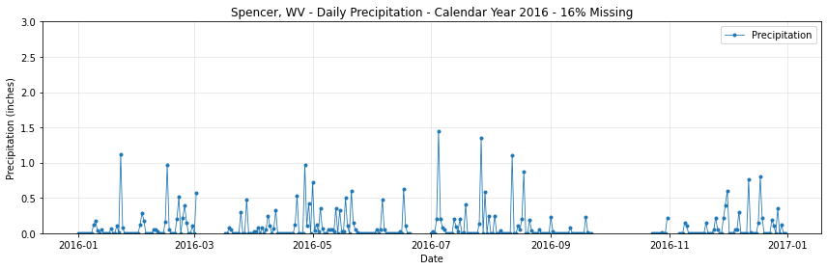
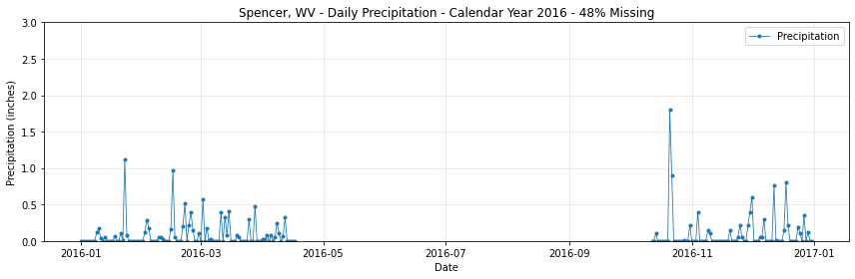
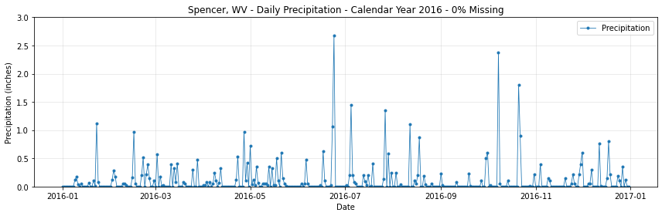


Missing Data
Now the year has 16% of the data missing, but none of the observed values are significantly large compared to the other years. We would likely reject this year with little consequence to the frequency analysis
It is difficult to judge if a value is truly the annual maximum if many days of the year are missing
Now the year has 16% of the data missing, but it includes one of the largest measurements in the gage’s entire period of record. It would be a shame to miss out on a large measurement! We would most likely keep this year.
Now the year has 48% of the data missing. You can see it would be hard to draw a conclusion as to whether this peak is the true annual maxima or not
So we would likely reject this year from the annual maximum series
Now the year has only 4% of the data missing. We would most likely keep this year in the AMS.
Here’s the full calendar year of precipitation data for a gage near Spencer, WV
Keep an eye on this annual maxima

Slide 63


Constrained Observations
Does the largest 72-hour precipitation depth in a year always coincide with the largest 3 calendar days?
3-day maximum: 2.54 inches
72-hour maximum: 2.78 inches
Notes:
Constrained observations are our last topic on quality control. This is an artifact of how we record precipitation data. Typically, we are interested in durations that are agnostic to the calendar, so we use analysis periods such as 48 or 72 hours for our maxima. The problem is, precipitation tends to be observed on a calendar day basis. For sites with hourly or sub-hourly data, which are much less common, you can capture the 72 hour maximum. With daily, you can only get a 3-day maximum, which does not always coincide with the 72 hour maximum. The adjustment is performed using hourly data, and finding the regression line between the calendar-day maximum and the hourly maximum for sites that can measure both. This plot shows the analysis for 3-day calendar maximum vs. 72 hour maximum. The 72 hour maximum cannot be less than the 3-day maximum, but it can be greater. Imagine a storm that starts at noon on the first day, quiets down for all of days two and three, and then rains hard until noon on the fourth day. In 3 calendar days it only includes one or the other 12 hour burst. The 72-hour maximum contains both of them.
TP-49 and Atlas 14 both include these kinds of analyses. For studies with durations greater than 7 days the adjustment is negligible. For 3 days compared to 72 hours the adjustment is 3-4% greater. At 1 day compared to 24 hours the adjustment can be more than 10%, so don’t neglect these adjustment..

Slide 64
Topics
Data considerations
NOAA Atlas 14
Storm typing
Stochastic Storm Transposition (SST)

Slide 65


NOAA Atlas 14
NOAA Atlas 14 precipitation frequency estimates
Standard source of data for the US
Limitations
  Annual exceedance up to 1E-4
  Outdated
  Not all regions represented
  National level analysis

Slide 66


Getting NOAA Atlas 14 Data
NOAA Precipitation Frequency Data Server (PFDS)
Point estimates (selected by address or from a map)
Rasters (.asc) for all volumes
  Select AEP and Duration
Time series (AMS and PDS)
  Used to develop each volume

Slide 67


NOAA Atlas 15 – Coming Soon
https://water.noaa.gov/about/atlas15

Slide 68
Topics
Data considerations
NOAA Atlas 14
Storm typing
Stochastic Storm Transposition (SST)

Slide 69



Storm Typing
We typically define homogeneous regions as those that are subject to similar meteorology
Sometimes, we may wish to separate out different storm-producing mechanisms
  Mixed populations analysis
Storm typing is where meteorology meets statistics

Slide 70

Storm Types
© The COMET Program
Four general types in North America:
  Mid-latitude cyclone (MLC)
  Tropical cyclone and remnants (TS/TSR)
  Mesoscale storm with embedded convection (MEC)
  Local storms (LS)
Width of USA (CA to VA)
Notes:
We will very briefly delve into an extremely high-level overview of the relevant meteorology here.
In North America, we typically use four broad meteorological themes as our storm types. These are the mid-latitude cyclone, tropical storm and tropical storm remnants, mesoscale storm with embedded convection, and local storms. These vary by spatial and temporal scale, the source of moisture, and the type of uplift.
There are two types of synoptic scale storms. MLCs are non-tropical source cyclones sometimes called extra-tropical cyclones. They share a lot of properties with TSRs but do not get their moisture from the tropics. They are the largest spatially and temporally, covering over 1,000 kilometers at a time, an affecting a given location the most over a 48-72 hour window. The storm itself will remain organized and last longer than that overall, but it is likely to rain the hardest at a single location over about a 48-72 hour window. Frontal precipitation is associated with cyclones.
MECs are smaller in scale and duration, but may still be fiercely intense. They belong to the mesoscale classification of meteorological events, with a typical scale from 5 – 1,000 km. They are typically well-organized convective systems such as mesoscale convective complexes, that have complex spatial patterns of precipitation with cells that can be very intense locally. The typical analysis duration for these kinds of storms is 6 hours, although a mesoscale convective system can be longer lived than that. They are typically very fast-moving, so the rainfall at any location can be very brief but very intense.
Finally local storms represent locally-intense precipitation such as supercell thunderstorms. These are usually very short lived, and typically do not contribute to the record of the most extreme events. They are analyzed using a 2 hour duration.

Slide 71
Benefits of Storm Typing
Regionalization by type can draw on even larger regional basis
Samples drawn from single storm type are homogeneous
  Decrease prevalence of mixed populations
  Better agreement with classical extreme value theory
Simulations can use correct spatial and temporal patterns for the type of storm
Notes:
Storm typing has two benefits for the precipitation-frequency analysis itself, and one major benefit for the application of the findings.
First, when regionalizing by storm type, the analysis can consider a wider regional basis as long as the predominant storm types exist in those places. This helps draw on even more data when building the regional analysis. Ordinarily, in a normal precipitation frequency analysis, the data are drawn from annual maxima regardless of storm type. When the dominant storm type changes, so does the makeup of the annual maximum series. By considering homogeneous storm types, this variation goes away.
The homogenization has the effect of decreasing the prevalence of mixed populations. By looking at the annual maximum series by type, we know that the same causal mechanism is in play and the samples are more likely to be drawn from the same population. Homogeneous time series also tend to work better with a classical extreme value analysis, with a result that gains strength from having that foundation.
Finally, when applying the data, the frequency estimates can be combined with spatial and temporal pattens and depth-area reductions that are appropriate for the type of storm being modeled, instead of mixing and matching frequency-intensity relationships with spatial and temporal patterns.
There is a downside to this, as there is no such thing as a free lunch. Storm typing is a labor and resource intensive procedure that requires a great deal of expertise to perform successfully. We have also learned that there aren’t really any shortcuts worth taking when trying to do it, either.

Slide 72


Connection to Extreme Value Theory
Homogeneous populations behave more predictably
Better confidence in choice of probability distribution
Notes:
There is an important connection to extreme value theory from this storm typing discussion. When we make sure our populations are homogeneous, and not mixed, their properties can reliably be predicted by extreme value theory. This aids us in choosing the right probability distribution for these extremes. Why is selecting the right model so important? The graph on the right shows the contribution to uncertainty at varying AEPs for a study area. At the extremes, the choice of distribution and its associated uncertainty becomes the largest source of uncertainty. When we are using these kinds of analyses for investment decisions about things like dam safety, reducing the substantial uncertainty at the end of the curve that affects the decision the most is valuable.

Slide 73
Topics
Data considerations
NOAA Atlas 14
Storm typing
Stochastic Storm Transposition (SST)

Slide 74


Regionalization
What if we regionalize storm spatial and temporal patterns instead of annual maximum gage data?

Slide 75

Idea
Build a large catalog of independent observed storm space-time patterns from a homogeneous area
Move storms around that homogeneous area
Estimate variability in precipitation that could result at a location of interest
Wright, Smith, and Baeck (2013)

Slide 76

Storm Data
Time series of rasters
Catalog contains all significant storms relative to watershed
  Transpose storm to watershed
  Compute watershed average
  Keep all storms above a threshold
    Not annual maxima!

Slide 77
SST Simulation Procedure
Select a storm from the catalog with equal probability
Transpose to new location within the domain with equal probability
Compute watershed-averaged precipitation
  Or, run a hydrologic model
Repeat 1...n times for a year of simulation
  n usually Poisson-distributed
  Mean rate λ determined by catalog
  Extract annual maxima
Repeat 1...S times for a realization of simulation
  S controls the rarest frequency that can be estimated
  (usually 1,000)

Slide 78
Two Very Different Approaches
Traditional
Precipitation-Frequency
Stochastic Storm Transposition
Gage data
Annual maxima
Parametric frequency curves
Loss of information due to correlation
Many assumptions in application
Point results
Gridded data
Peaks over threshold
Non-parametric (model-free)
Events are explicitly separate
Simplified application
Area-average results
Need to apply areal reduction (ARF)

Slide 79

Summary
Data considerations
  Performing quality control on precipitation data
NOAA Atlas 14/15
Storm typing
  Good for mixed populations analysis
Stochastic Storm Transposition (SST)

