Slide 1
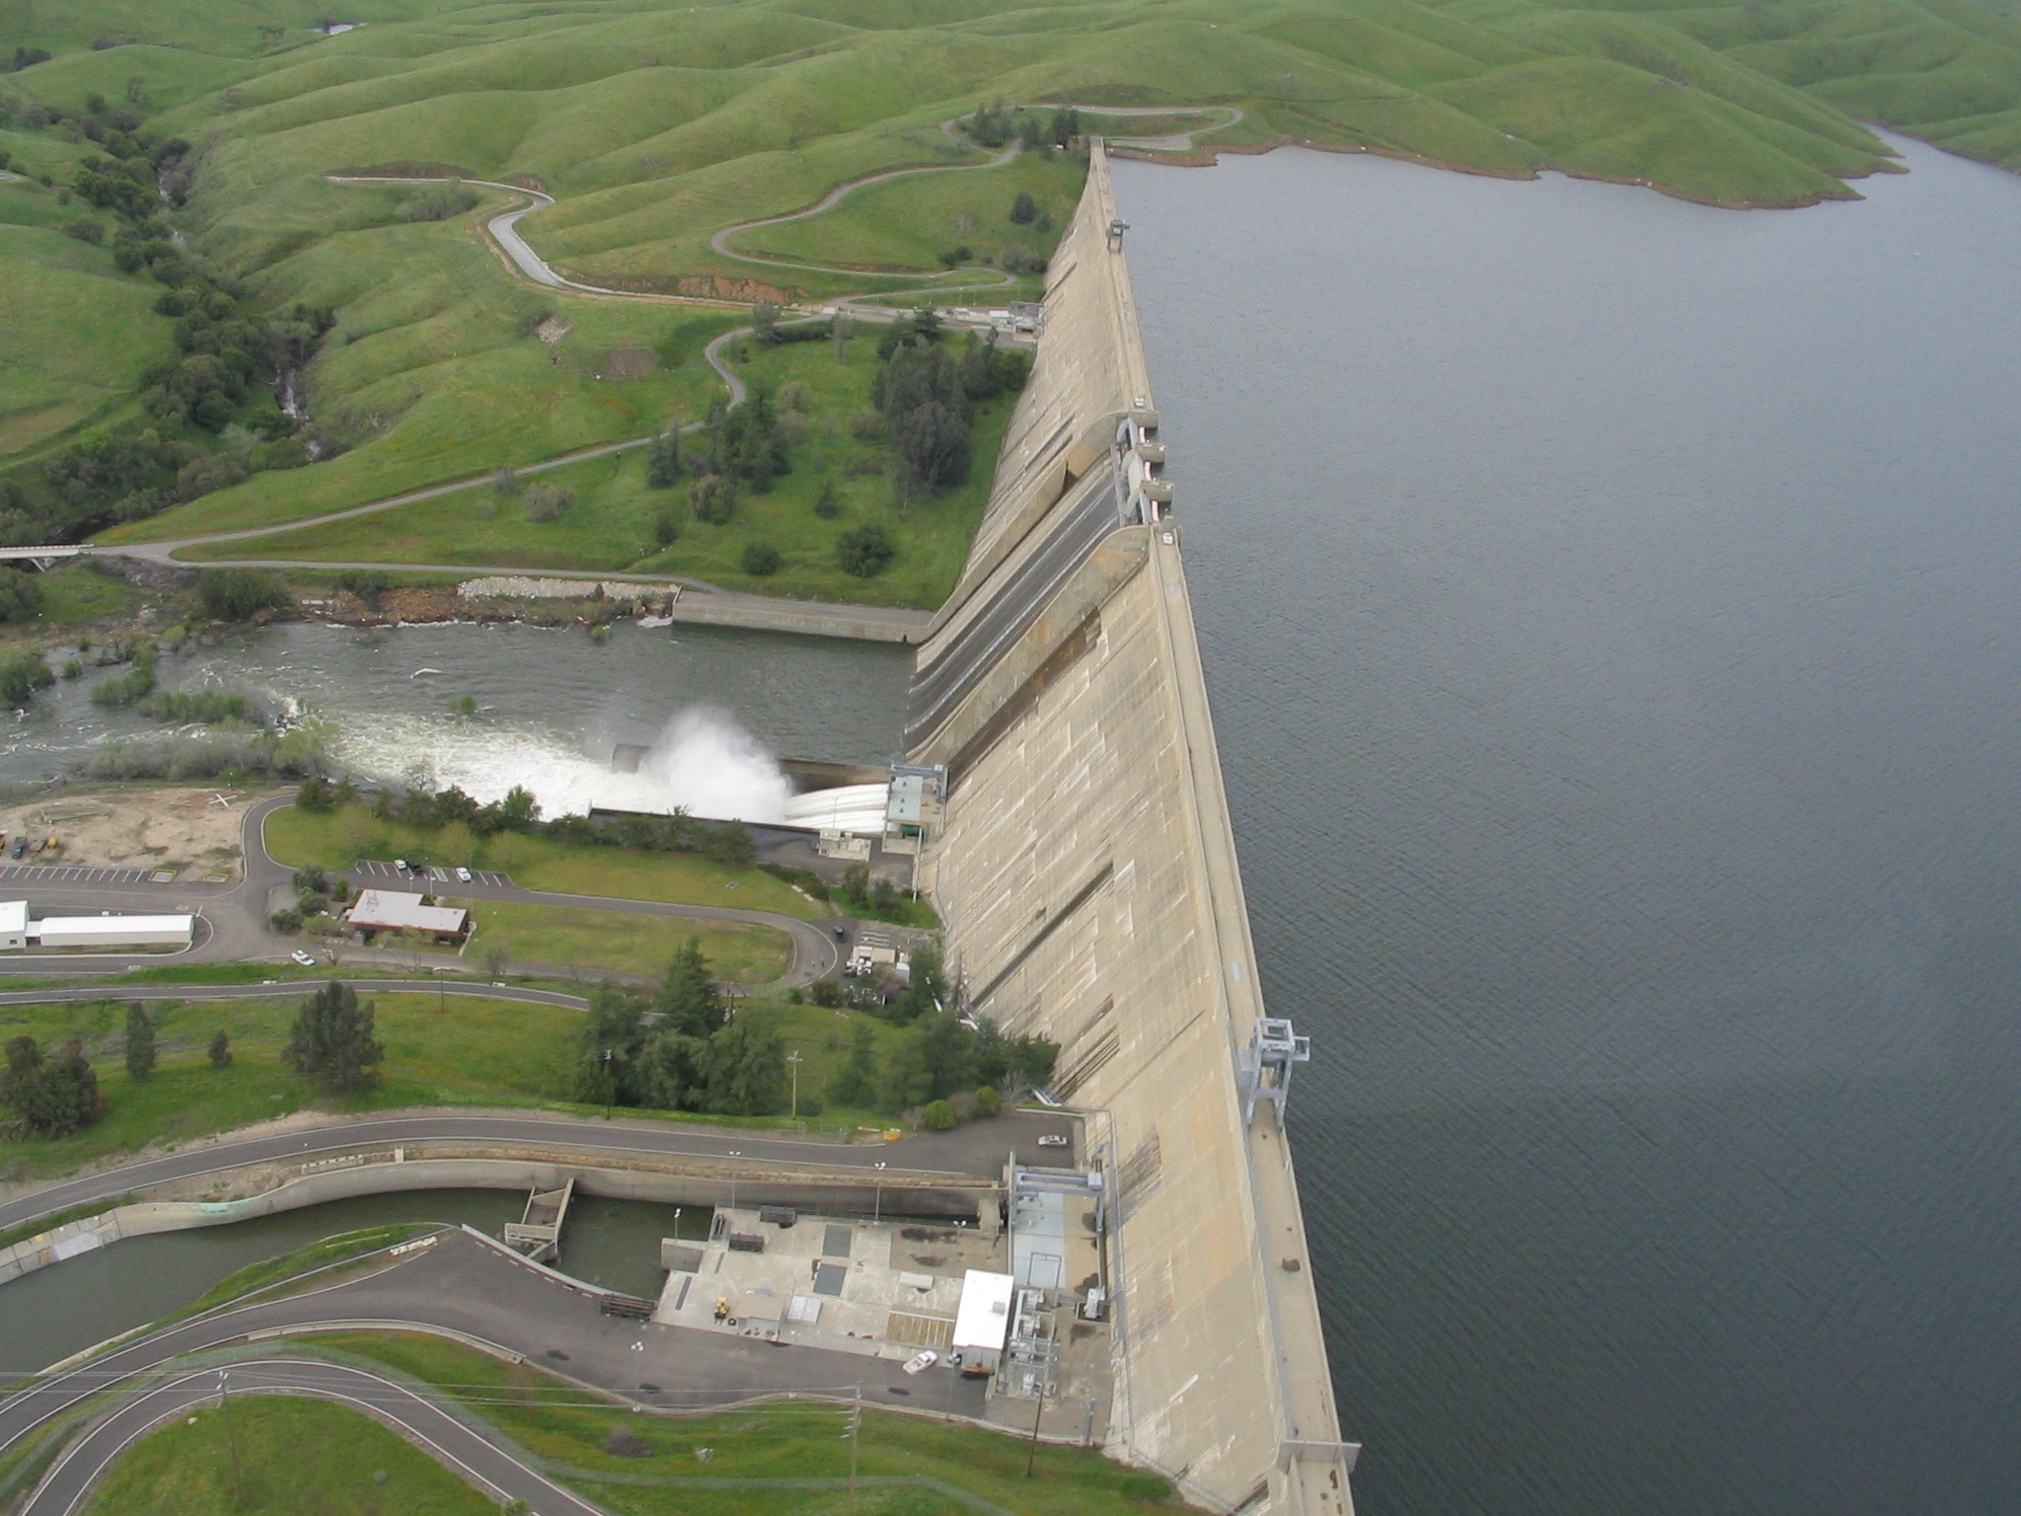
CA DSOD Clark Unit Hydrograph Regression Equations
Statistical Methods in Hydrology
Mike Bartles, P.E.
2 May 2025
Notes:
Hello everyone. This is Mike Bartles from HEC.
Within this presentation, I’m going to talk about an analysis that we completed a few years ago which developed Clark Unit hydrograph parameter regression equations for the entire state of California.
This presentation builds upon previous lectures devoted to simple and multiple linear regression. You should notice several of the tools and techniques that were discussed in those lectures being applied here.
This video is part one within a series of videos devoted to this analysis.

Slide 2
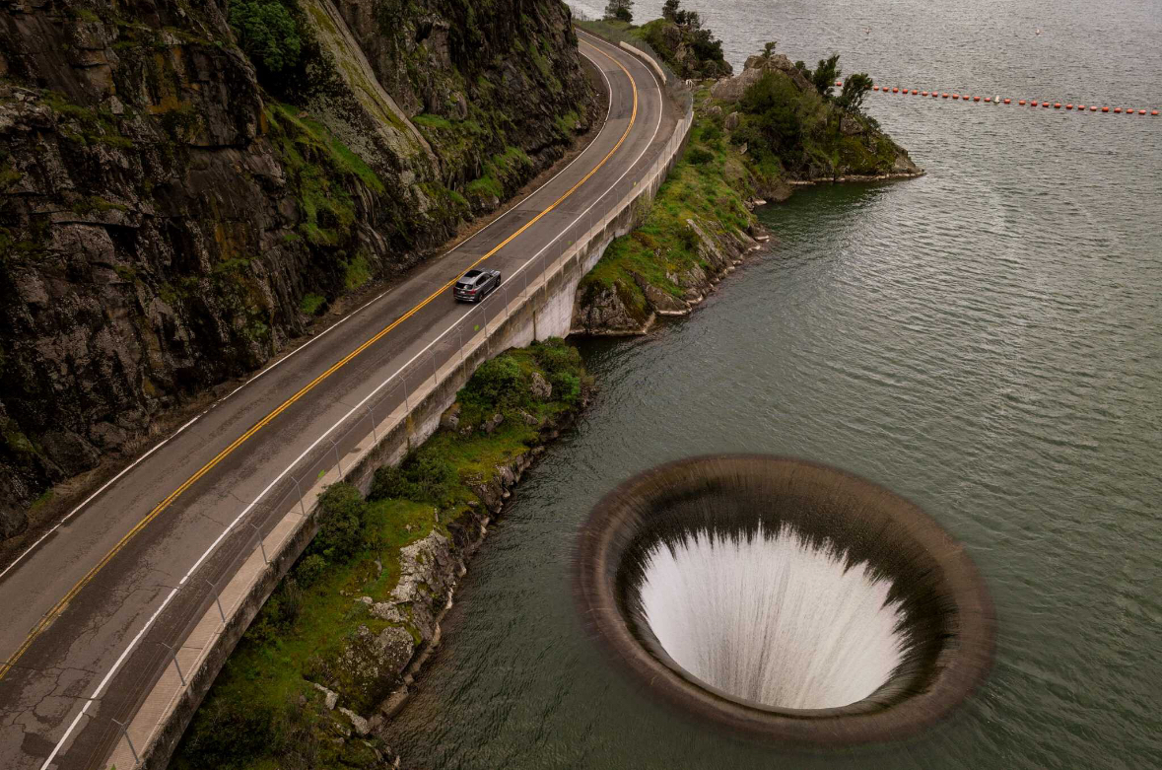
Overview
Background Info
Location Selection
Data Compilation
HEC-HMS Model Development
Regression Equation Development, Validation, and Uncertainty
Example Application
2
Notes:
First, I’ll present some background info on the agreement that led to the study, some of the key players, and the Clark unit hydrograph method
Then, I’ll jump into
How we selected locations that were used in this analysis,
How data was compiled,
Methods that were used to construct and calibrate 100+ HEC-HMS models,
Regression equation parameterization techniques,
How the regression equations were validated and their uncertainty was quantified, and
Finally go through an example application

Slide 3
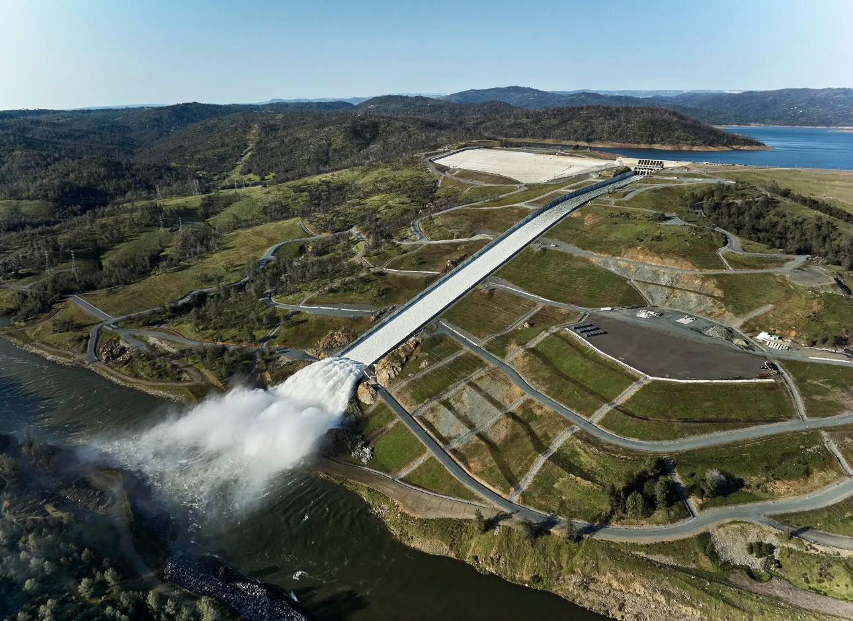
CA DWR DSOD
Created in 1929
CA DWR DSOD provides oversight to the design, construction, and maintenance of over 1200 “jurisdictional sized” dams in California
DSOD engineers perform independent structural, hydrologic, hydraulic, and geotechnical evaluations
Use HEC tools to perform H&H analyses
3
Notes:
First, some background on our partner in this effort
California Department of Water Resources, Division of Safety of Dams (CA DWR DSOD) provides design, construction, and maintenance oversight for more than 1200 dams throughout the state of California
Engineers that work for DSOD perform a multitude of services related to dam safety including hydrologic, hydraulic, and geotechnical evaluations
Their H&H analyses typically utilize HEC tools like HEC-HMS, HEC-ResSim, and HEC-RAS

Slide 4
CA DWR DSOD – HEC Agreement
DWR and USACE entered into a Memorandum of Agreement in 2019
DSOD requested assistance from HEC regarding training and support:
  Design storm precipitation values
  Snowmelt modeling
  Development of unit hydrograph parameters, loss rates, and other hydrologic modeling parameters
  Provide guidance on the adjustment of Clark unit hydrograph parameters when simulating extreme floods
4
Notes:
In 2019, HEC and CA DWR DSOD entered into a memorandum of agreement to provided training and support
Specifically, they requested assistance from HEC regarding:
Design storm precipitation values,
Snowmelt modeling,
Development of unit hydrograph parameters, loss rates, and other hydrologic modeling parameters, and
Provide guidance on the adjustment of Clark unit hydrograph parameters when simulating extreme floods
The rest of this presentation will focus on a specific task that was part of the 2019 agreement: develop tools and techniques that can be used to predict Clark unit hydrograph parameters for DSOD’s use in dam safety evaluations

Slide 5
Clark Unit Hydrograph Method
Mature, well established, well documented, and simple method to parameterize and use
Clark’s method derives a watershed unit hydrograph using two critical processes:
  Translation excess runoff to the watershed outlet (time-area histogram and Tc)
  Attenuation as the excess is stored throughout the watershed (R)
For more information on the Clark unit hydrograph method, see https://youtu.be/uReJjcwtyWc?si=vsR_idpBGQ5FVc39
5
Notes:
Before we talk about the regression equation analysis, let’s talk about the Clark unit hydrograph method
Clark developed this method in the 1940s by representing two critical processes, that of translation and attenuation.
Translation is the movement of excess runoff to the watershed outlet in response to gravity.
Translation in the Clark method is modeled using a time-area curve and the critical parameter to estimating translation is the time of concentration.
The second process is attenuation which is the reduction of the discharge magnitude due to frictional forces and/or storage within the channel or basin that resist flow.
The attenuation effects are modeled using a linear reservoir and the parameter that controls attenuation is the storage coefficient.
The Clark unit hydrograph method is the most widely used transform method in the world. It’s been around for over 80 years now and engineers continue to use it in thousands upon thousands of individual analyses each year.
For more information on this method, check out the link here for a detailed video explaining it’s derivation

Slide 6
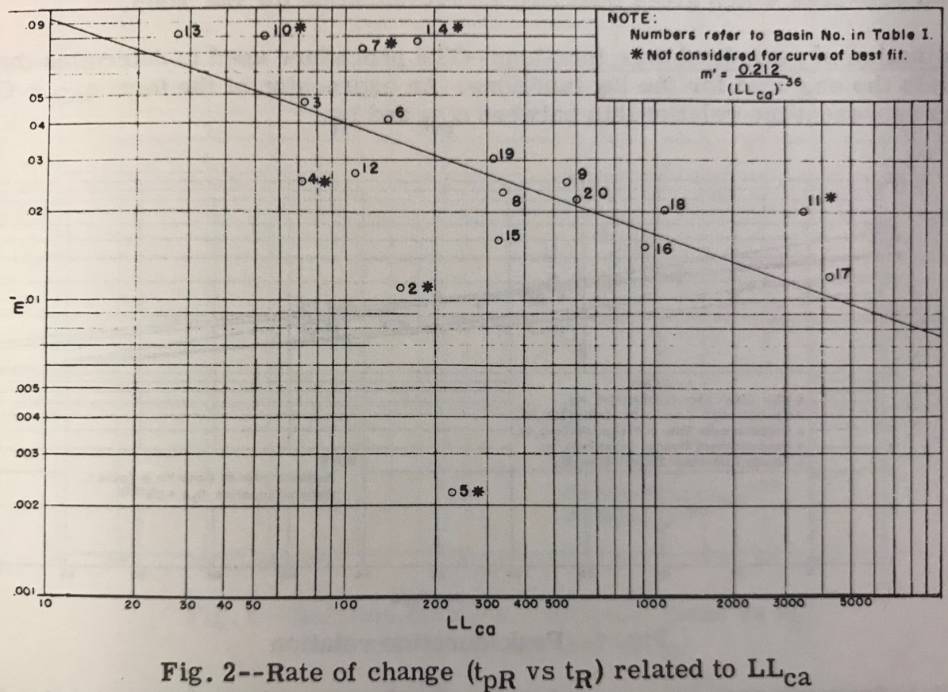
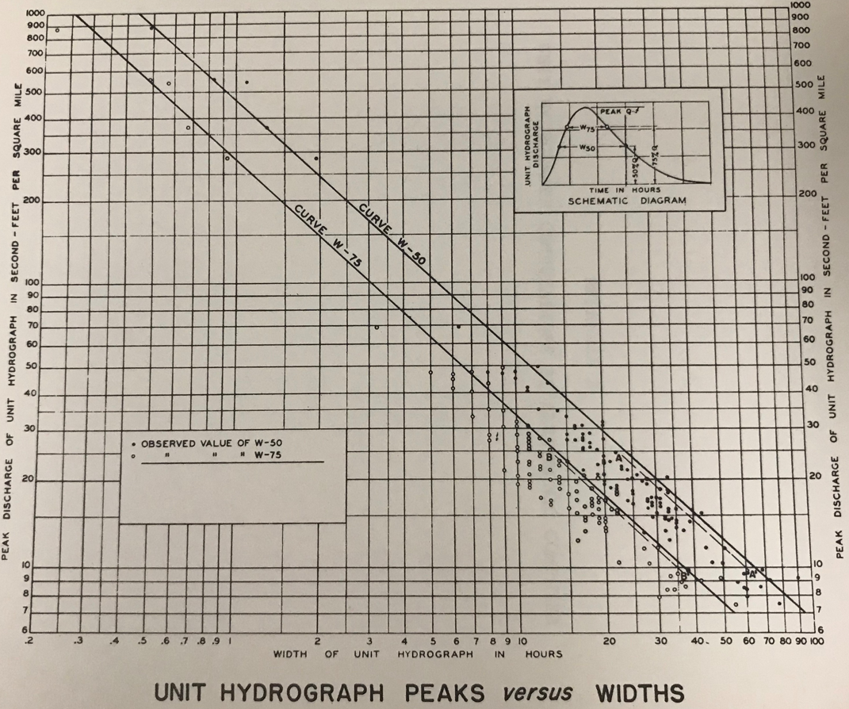
Unit Hydrograph Parameter Regression Analysis
Develop regression equations that relate Clark unit hydrograph parameters (Tc and R) to physically measurable watershed characteristics
6
Notes:
Now, for some specifics related to the unit hydrograph parameter regression analysis
DSOD required methods to estimate Clark (and Modified Clark) unit hydrograph parameters throughout the state of California for use within their hydrologic modeling applications
Numerous studies have shown that relations between synthetic unit hydrograph parameters and watershed characteristics can be developed and successfully used to predict parameters for independent watersheds (U.S. Army Corps of Engineers, 1982; Sabol, 1988; Holnbeck & Parrett, 1996; Melching & Marquardt, 1997; Wilkerson & Merwade, 2010)
Through the use of these equations, synthetic unit hydrograph parameters may be derived for independent watersheds as long as the watershed characteristics are hydrologically similar to the watersheds for which the relation was developed
Hydrologic similarity includes similarity in topography, geomorphology, soil types, land cover/ land use, and climate, amongst others.
These images show historical examples of such regression equations which were developed to predict Snyder unit hydrograph parameters within the Tulsa and Fort Worth USACE Districts (reproduced from U.S. Army Corps of Engineers, 1963)

Slide 7
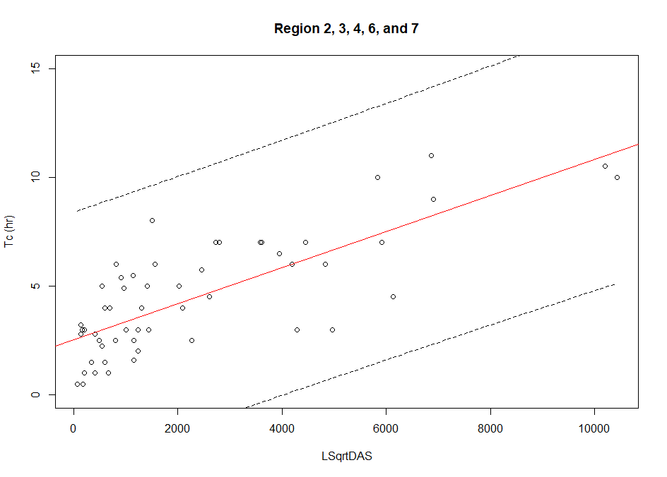
Regression Analysis Steps
Selection locations
Build HEC-HMS models
Extract physical characteristics
Calibrate parameters to representative events
Extract and organize Clark parameters
Parameterize regression equations
Validate
Quantify uncertainty
7
Notes:
Here’s a general outline of the steps that were used w/in this analysis:
Select locations for use
Build HEC-HMS models for each location
Extract physical characteristics for each location
Calibrate each HMS model to a representative storm event
Extract and organize Clark parameters from each HMS model
Parameterize regression equations using the Clark parameters
Validate the regression equations
And finally develop a way to quantify uncertainty in the regression equations

Slide 8
Location Selection and HEC-HMS Model Construction
8

Slide 9
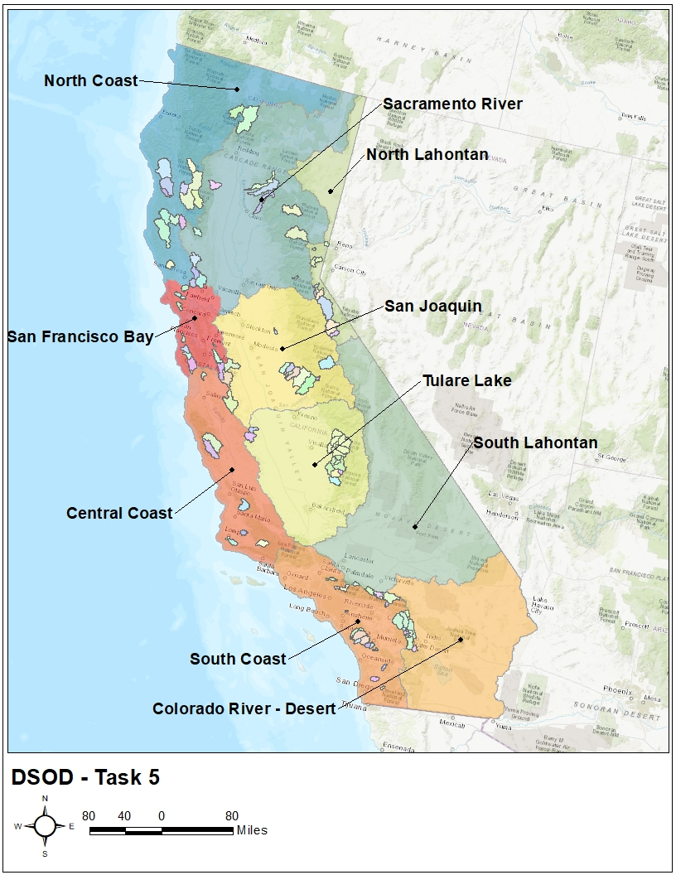
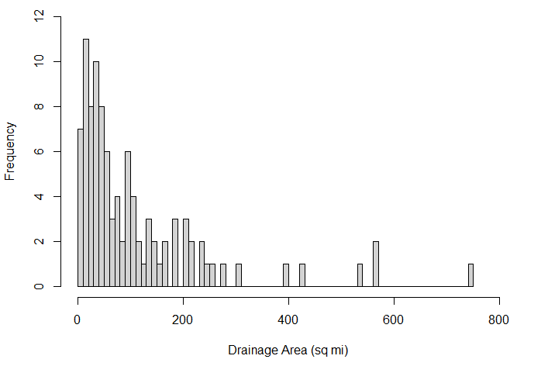
Location Selection
Choose 100 sites throughout California
Split the state into discrete hydrologic areas
  CDEC Hydrologic Regions
Pick approximately 10 locations per region
Concerns:
  Lack of available observational data
  Impacts of regulation
Led to less than 10 locations in some regions and more than 10 locations in others
9
Notes:
California is home to approximately 40 million residents and has a land area of approximately 155,000 square miles (sq. mi.)
Within California, one can find extremely diverse geography ranging from the Pacific Coast in the west to the Sierra Nevada mountains in the east.
In the northwestern portion of the state, coniferous forests are prevalent while the Mojave Desert can be found in the southeast. Additionally, the approximately 50-mile wide and 450-mile long Central Valley stretches across the center of the state.
Similar to geography, the climate within California is also tremendously varied. A Mediterranean climate is prevalent throughout the Central Valley while moist temperate rainforests can be found in the north. Additionally, arid desert regions are widespread in the southern half of the state while snowy alpine areas can be found in the Sierra Nevada mountains.
All this is to say that, deriving only one or two regression equations to predict Clark unit hydrograph parameters is difficult, to say the least
Thus, we divided the state into ten regions using 4-digit hydrologic unit codes (HUC). These regions are shown here.
One hundred locations, corresponding to either USGS stream gages or USACE reservoirs, were chosen throughout the ten hydrologic regions to develop the Clark unit hydrograph parameter regression equations. Approximately ten locations were chosen within each region. However, due to a lack of available observational data, some regions contained fewer or more than ten locations.
Attempts were made to choose locations that were unimpacted by the effects of impaired flow. However, due to the widespread use of regulating structures (e.g. dams and diversions) throughout the state, some locations were impacted by impaired flow. These effects were investigated and quantified for each location and only locations that demonstrated minimal impacts were selected for use.

Slide 10
HEC-HMS Model Development
Created a standard operating procedure that could be used to construct and calibrate HEC-HMS models
Once sites were selected, assign locations to team members
Large team to collect and process data as well as perform modeling:
  HEC (9)
  San Francisco District (1)
  Sacramento District (6)
  Los Angeles District (5)
Construct and calibrate the various HEC-HMS models in ~1 day
10
Notes:
Created a standard operating procedure that could be used to construct and calibrate HEC-HMS models
Once sites were selected, locations were assigned to various team members from HEC, the San Francisco, Sacramento, and LA Districts
Team members then collected and processed data as well as performed modeling
The intent was to construct and calibrate the various HEC-HMS models in ~1 day

Slide 11
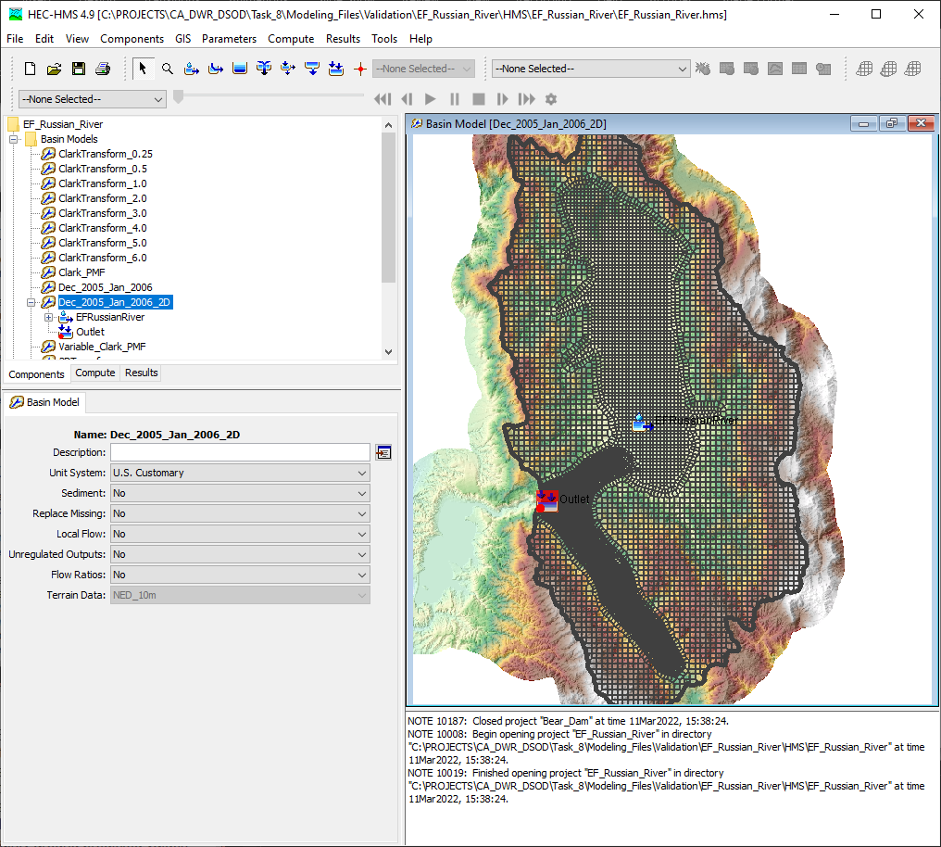
Data Compilation
For each location, gather and process:
GIS data
  Terrain
  Hydrography
  Watershed boundaries
Boundary conditions
  Gridded precipitation
  Gridded temperature*
  Gridded snow*
Observed data
  Streamflow
  Computed reservoir inflow*
  Snow water equivalent (SWE)*
11
Notes:
For each location, multiple sources of GIS, boundary condition, and observed data were gathered.
Information such as terrain, hydrography, gridded precipitation, streamflow, and computed reservoir inflow were used to construct and calibrate numerous HEC-HMS projects
The items with asterisks were only required if a selected location was appreciably impacted by snowmelt

Slide 12
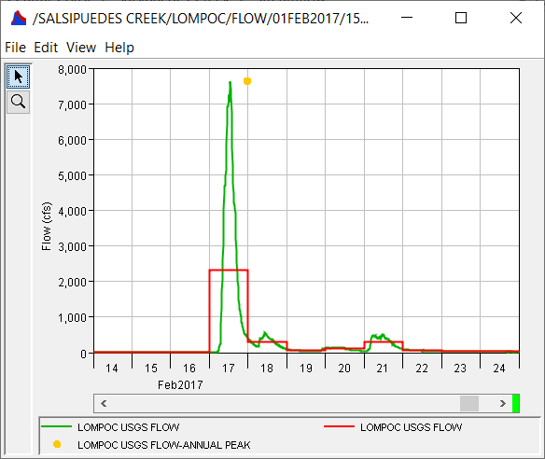
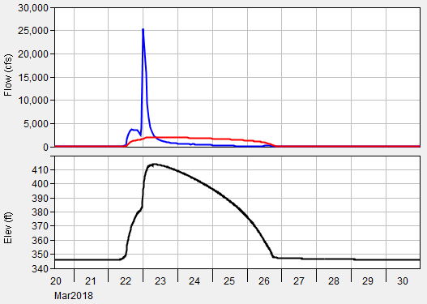
Streamflow
USGS
  Inst. Peak
  Daily Average
  15-/30-/60-minute
USACE
  Outflow
  Pool Elevation
  Computed Inflow
Computed Inflow
Outflow
Pool Elevation
12
Notes:
Stream gages operated by the U.S. Geological Survey (USGS) in addition to reservoir gages operated by USACE were used to identify locations with observed data.
Observed streamflow data at USGS gages was downloaded from NWIS.
Observed reservoir data at USACE projects was downloaded from Corps Water Management System (CWMS) servers at the Sacramento (SPK) and Los Angeles (SPL) Districts. Inflow to these USACE projects was computed using change in storage and observed outflow.

Slide 13
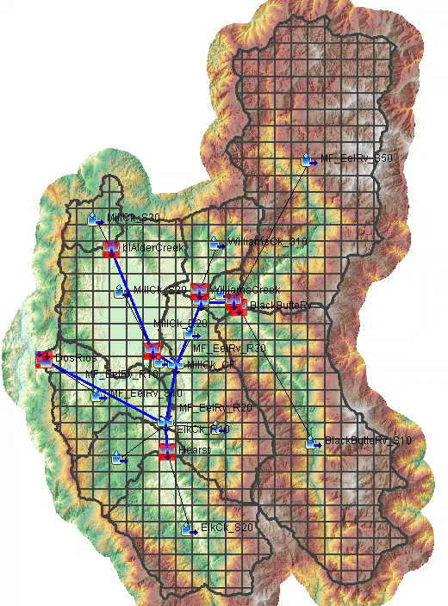
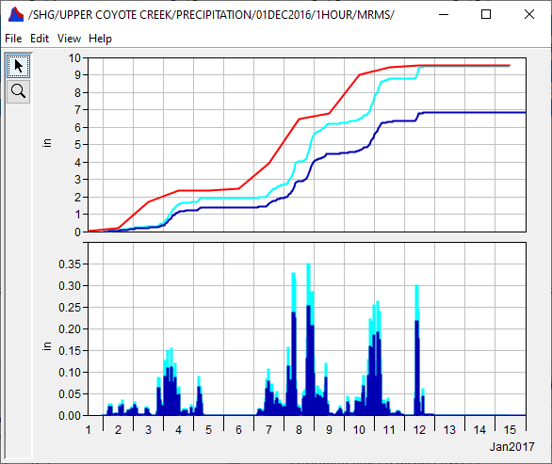
Precipitation Data
MRMS (2015 – present)
RTMA (2006 – present)
PRISM (1981 – present)
  Used to normalize
NEXRAD (2002 – 2011)
Stage IV (2002 – 2015)
AORC (1979 – present)
Corrected MRMS
Raw MRMS
PRISM
Precip Depth (in)
0
50
13
Notes:
Multiple sources of gridded precipitation were used. The gridded precipitation data source that was used for each modeling domain depended upon the age of the event used for model calibration.
For instance, MRMS data was used for events that occurred after 2015.
However, in all instances, sub-daily precipitation was initially used to best capture the temporal distribution of precipitation.
The Gridded Data Import tool within HEC-HMS was used to import the data.
During the import process, each data set was reprojected to the previously mentioned CRS, resampled to a 2 km grid size, and clipped to the boundary of the modeling domain.
Following the import process, the sub-daily gridded precipitation data was contrasted against the PRISM data set.
In particular, precipitation mass curves were calculated for both the sub-daily and PRISM data sets and compared in order to ascertain whether the sub-daily precipitation, which captures the temporal distribution of rainfall, adequately captured the cumulative volume of precipitation.
The image above shows an example where the sub-daily precipitation underpredicted the precipitation accumulation during the time period of interest and required normalization

Slide 14
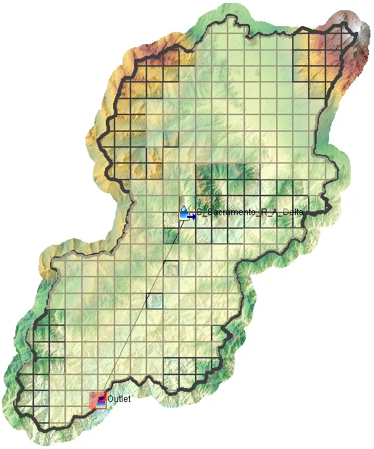
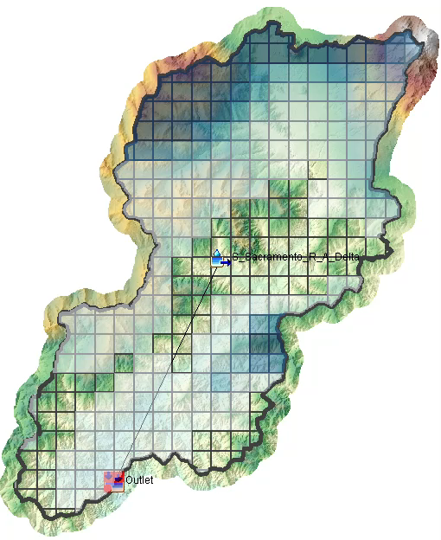
Temperature and Snow Data
Temperature
  RTMA (2006 – present)
  AORC (1979 – present)
Snow
  SNODAS (2003 – present)
  University of Arizona (1982 – present)
Meltrate ATI (Deg F - Day)
0
15
SWE Depth (in)
0
5
14
Notes:
Multiple sources of gridded temperature and snow data were used when a location was impacted by snowmelt
Similar to precipitation data, the selected temperature and snow data source depended upon the age of the event used for model calibration

Slide 15
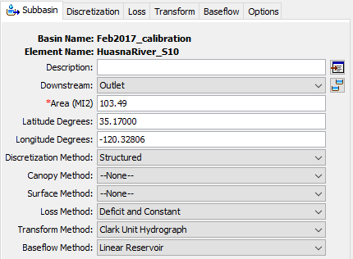
HEC-HMS Model Development
For each location:
Construct an HEC-HMS model using GIS data
  Structured discretizaton
  Deficit and Constant losses
  Clark unit hydrograph transform
  Linear Reservoir baseflow
  Gridded Temperature Index snowmelt*
15
Notes:
Once all relevant data was collected, an HEC-HMS project was created and the required components like a basin model and a meteorologic model, were created.
The same modeling techniques were used for each location:
Structured discretizaton
Deficit and Constant losses
Clark/ModClark* unit hydrograph transform
Linear Reservoir baseflow
Gridded Temperature Index snowmelt*
Again, the asterisked items were only required if the location was appreciably impacted by snowmelt

Slide 16
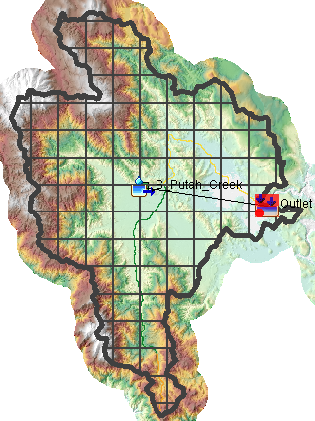
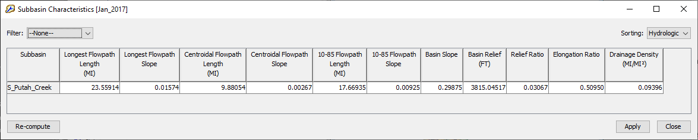
Watershed Characteristics
For each location:
Extract physical parameters (e.g., longest flowpath, etc.)
13 characteristics
  Directly measurable
    e.g., L
  Indirectly measurable
    e.g., LSqrtS
16
Notes:
Multiple directly measurable and indirectly measurable watershed characteristics were evaluated for the contributing drainage area at each location
These characteristics included:
Drainage Area (DA)
Longest Flowpath Length (L)
Centroidal Flowpath Length (Lca)
10-85 Flowpath Length (L10-85)
10-85 Flowpath Slope (S10-85)
Basin Slope (S)
Basin Relief (BR)
Relief Ratio (RR)
Elongation Ratio (ER)
Drainage Density (DD)
LSqrtS
Basin shape factor (BSF)
LSqrtDAS
HEC-HMS was utilized to extract these parameters for each location
This was done in preparation for eventual use in the derivation of the regression equations, which each utilized one or more of these parameters

Slide 17
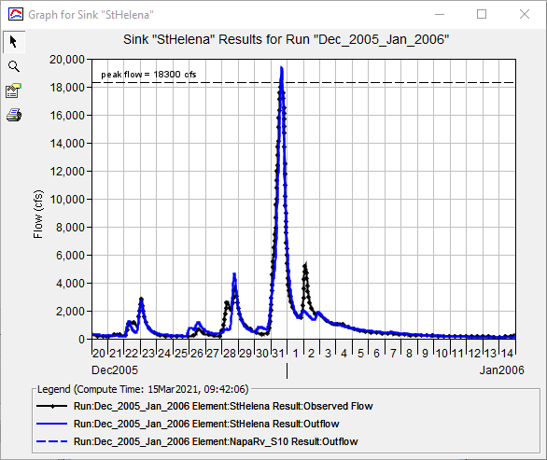
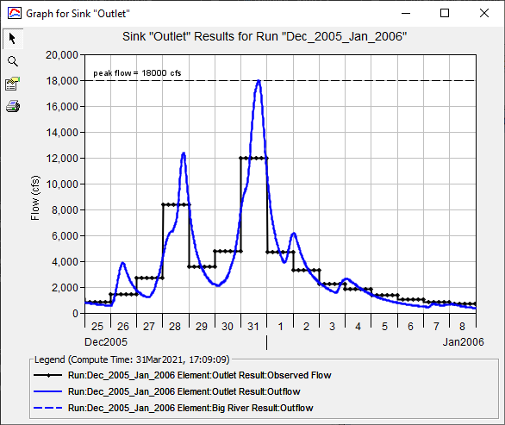
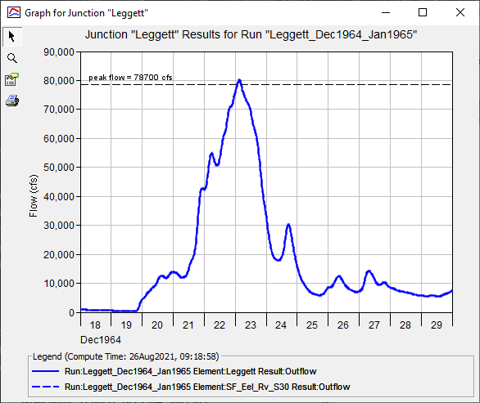
HEC-HMS Model Calibration
For each location:
Select an extreme event
Calibrate infiltration, transform, baseflow , and temperature index* parameters using observed data
Use multiple statistical metrics to evaluate performance
17
Notes:
It is anticipated that DSOD were going to utilize these regression equations to estimate Clark unit hydrograph parameters to simulate extreme events within dam safety studies.
As such, extreme storm events were selected for use during model calibration.
However, observed data availability, reliability, and ease of use were also considered.
Observed data that was available for use varied by location and flood event.
When available, 15-, 30-, or 60-minute observed streamflow was used.
When that data was not available, daily average and instantaneous peak streamflow was used (animate).
Finally, when all other data was not available, instantaneous peak streamflow was used (animate)
Model performance was evaluated by comparing computed results against observed results at each location.
Model parameters were altered to minimize the differences between computed and observed hydrograph shape, peak flow rate, and discharge volume.
When adequate observed data was available (at a minimum, daily average streamflow), summary statistics were used to quantify model performance
Statistical metrics included Nash-Sutcliffe Efficiency (NSE), Ratio of the Root Mean Square Error to the Standard Deviation (RSR), and Percent Bias (PBIAS).

Slide 18
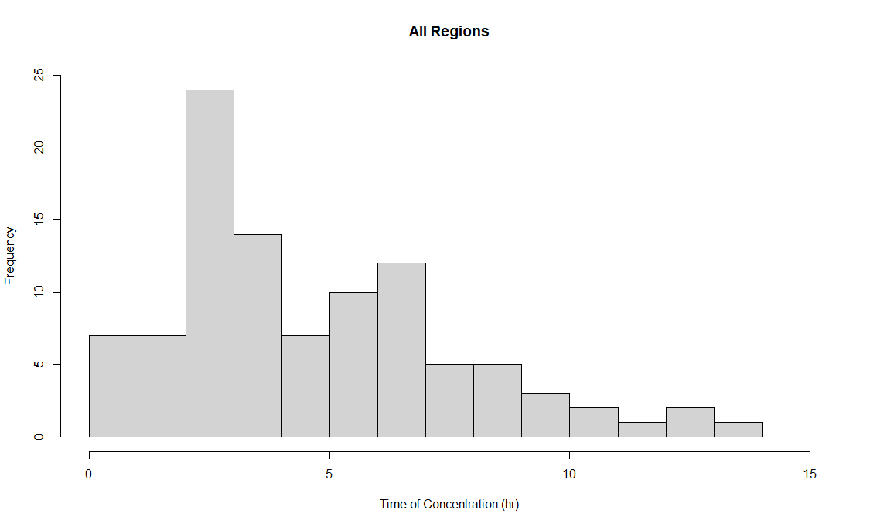
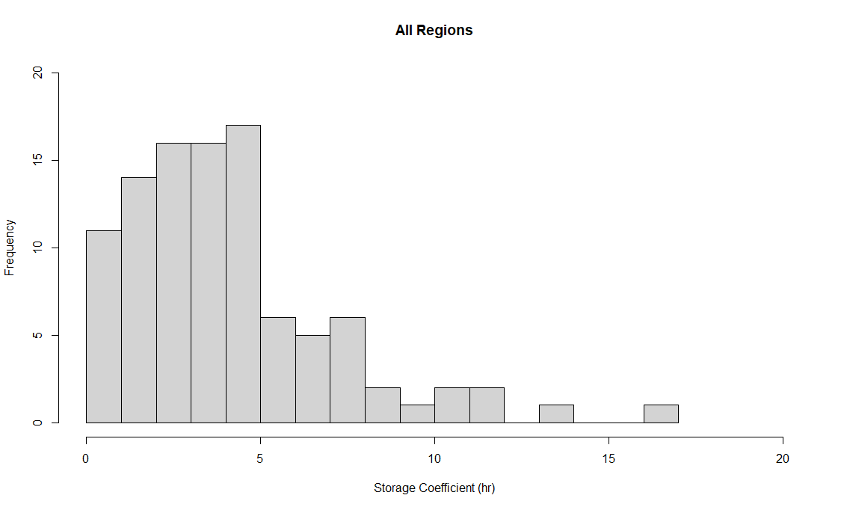
HEC-HMS Model Calibration
18
Notes:
Following calibration, we collected data from each of the 100 HMS projects
These are histograms showing all 100 calibrated Tc (left) and R (right) values
It’s important to cover a wide range of possible parameters such that the regression equations that are developed are robust over an equally wide range

Slide 19
Regression Equation Development and Validation
19

Slide 20
Regression Equation Development
Consider two multiple linear regression models
Determine constant and coefficients using method of least squares
Use stepwise selection techniques along with adj-R², t-statistic tests, and p-values to select the most performant characteristics
Group equations to increase sample size/decrease uncertainty
  Regions 2, 3, 4, 6, and 7
$$Y={a+b}_{1}x_{1}+…+b_{n}x_{n}$$
$$\log_{10}{Y}={a+b}_{1}\log_{10}{x_{1}}+…+b_{n}\log_{10}{x_{n}}$$
20
Notes:
Now for some discussion on how we parameterized the regression models themselves
Two multiple linear regression models were considered within this study, as shown on the right. In both forms, Y is the dependent variable (e.g. Tc or R); a is a regression constant; x1, x2, …, xn are independent variables (e.g. watershed characteristics); and b1, b2, …, bn are unknown coefficients.
The regression constant and unknown coefficients were determined utilizing the method of least squares. When using multiple linear regression with several watershed characteristics, some of the proposed characteristics may have little to no effect on the dependent variable of interest. When this occurs, these characteristics were removed from consideration
In order to simultaneously evaluate the usefulness of the regression models and avoid overfitting, an adjusted coefficient of determination (adjusted R²) was used. The nice thing about this metric is that it’s value increases when a new term improves the regression model more than would be expected by chance.
Variables with p-values ≤ 0.05 were desired. However, this criterion was not the only determining factor when evaluating explanatory variables. Stepwise selection techniques were employed with Adjusted R² and p-values to select the most performant watershed characteristics.
Regression equations were first developed individually for each region. Then, attempts were made to develop regression equations for multiple regions that exhibited approximately the same predictive power. This was done to increase the sample size, reduce uncertainty in the results, and make the regression equations easier to apply. Models developed separately for Regions 2, 3, 4, 6, and 7 were found to exhibit similar behavior. As such, they were combined to form a single model that spanned all six regions. However, Region 1, Region 5, Region 8, Region 9, and Region 10 could not be combined and still be performant.

Slide 21
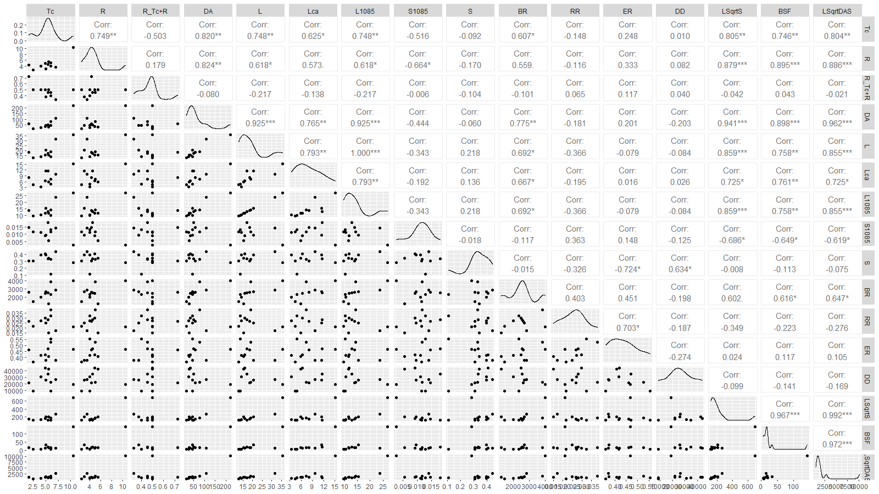
Characteristic Selection
21
Notes:
Scatterplots relating T_{c} and R to the watershed characteristics were developed for each of the ten previously-mentioned hydrologic regions using the ggpairs() function from the GGally package in R
The resultant plots and information were used to make informed decisions as to which variables were most impactful

Slide 22
Errors
Watershed characteristics were considered to be error free
Clark unit hydrograph parameters were not considered to be error free
Parameterization errors could arise from multiple sources including (but not limited to):
  Boundary condition information
  Modeling techniques
  Observed data availability
As a solution, include weights corresponding to the data availability
  Locations with 15-, 30-, or 60-min data = 3
  Locations with daily average/inst. peak data = 2
  Locations with instantaneous peak data = 1
22
Notes:
The watershed characteristics were considered to be error free because of the computational accuracy of using remote sensing and GIS datasets.
However, the Clark unit hydrograph parameters were not considered to be error free:
Errors within these parameters could arise from numerous sources including, but not limited to, boundary condition information, modeling techniques, and observed data availability.
Clark unit hydrograph parameter error was included by including weights corresponding to the data availability:
Locations with 15-, 30-, or 60-min stream streamflow data were given a weight of 3
Locations with daily average and instantaneous peak streamflow data were given a weight of 2
Locations with instantaneous peak streamflow only were given a weight of 1

Slide 23
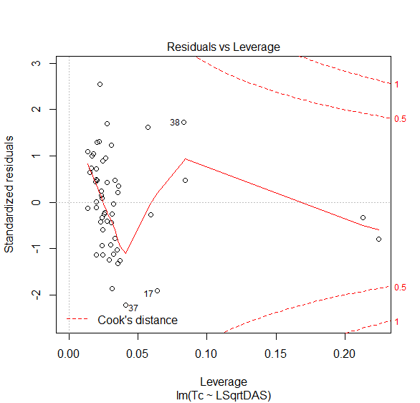
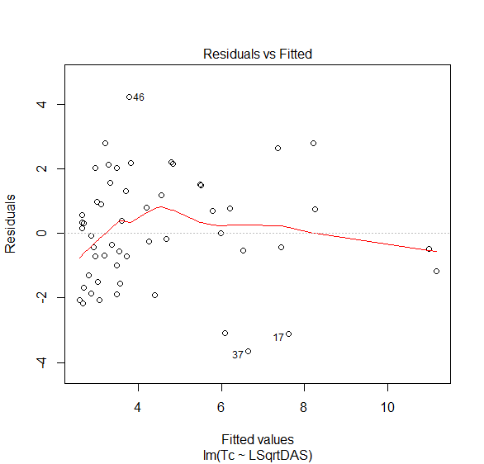
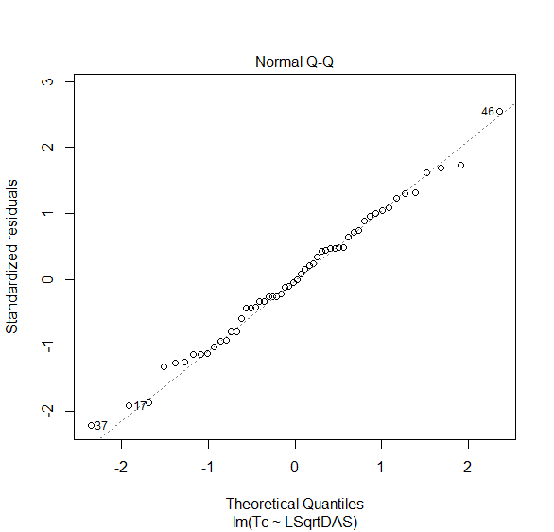
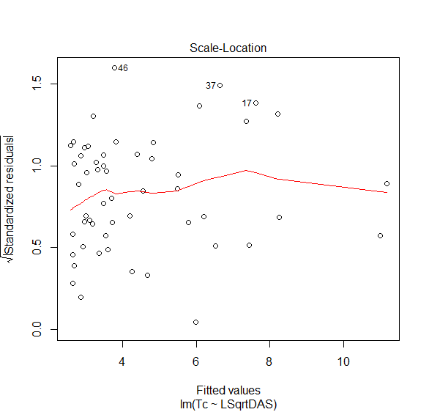
Diagnostics
23
Notes:
The various regression models developed for each region or set of regions were examined using several diagnostic tests to ascertain whether the models obeyed general assumptions of multiple linear regression. These diagnostic tests included checking whether:
A linear relationship exists within the model,
Residuals (or errors) are evenly distributed over the range of predicted values,
Residuals are normally distributed, and
One or more residuals do not exert excessive leverage on the model.

Slide 24
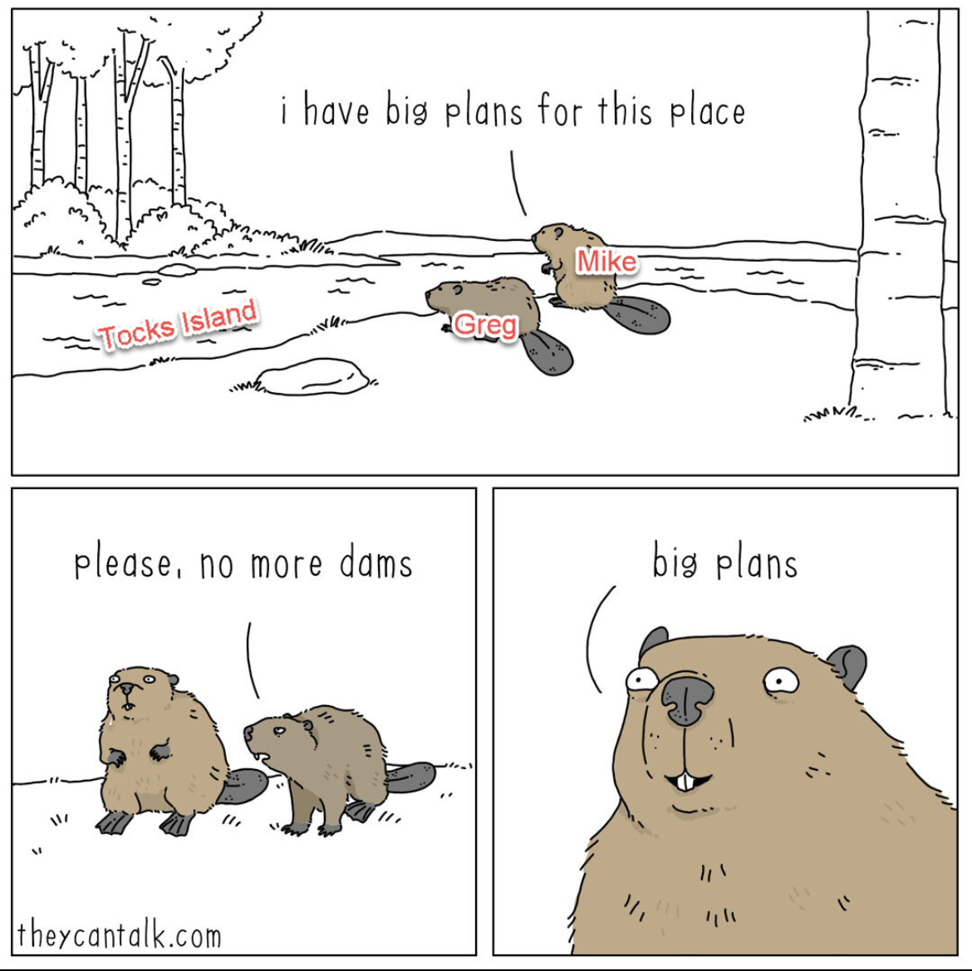
Task 5 – Results
Region | Region Number(s) | Variable | Equation
North Coast | 1 | T_{c}
 |  | R
SF Bay, Central Coast, South Coast, Sacramento River, and San Joaquin River | 2, 3, 4, 6, and 7 | T_{c}
 |  | R
Colorado River - Desert | 5 | T_{c}
 |  | R
Tulare Lake | 8 | T_{c}
 |  | R
North Lahontan | 9 | T_{c}
 |  | R
South Lahontan | 10 | T_{c}
 |  | R
24
Notes:
At this point, I’d show you the actual equations, but we can’t share them due to their ongoing use by CA DWR DSOD and the way in which they operate.
Sorry!
I can tell you that there were two equations for each region or group of regions, one for Tc and one for R. If you work for USACE, please reach out to us and I can share them with you.
So, instead of showing you the equations, I’ll share a cartoon about my spirit animal, the beaver
Specifically, a beaver named Greg is telling me that he appreciates my enthusiasm for big dams

Slide 25
Validation Workflow
Build HEC-HMS models for independent locations
Use the regression equations to predict Tc and R
Compare results against observed data
Calibrate Tc and R and compare against predicted values
25
Notes:
Now that regression equations have been developed, their accuracy needed to be quantified using a validation process where hydrologic model results were compared against observed data.
Specifically, hydrologic models were constructed for numerous independent locations that were not included when developing the regression equations.
These models were constructed and parameterized using the same process that was previously described.
However, Clark unit hydrograph parameters were estimated using the regression equations that were developed for the specific region of interest.
Additionally, the Clark unit hydrograph parameters were then calibrated and compared against the predicted values.

Slide 26
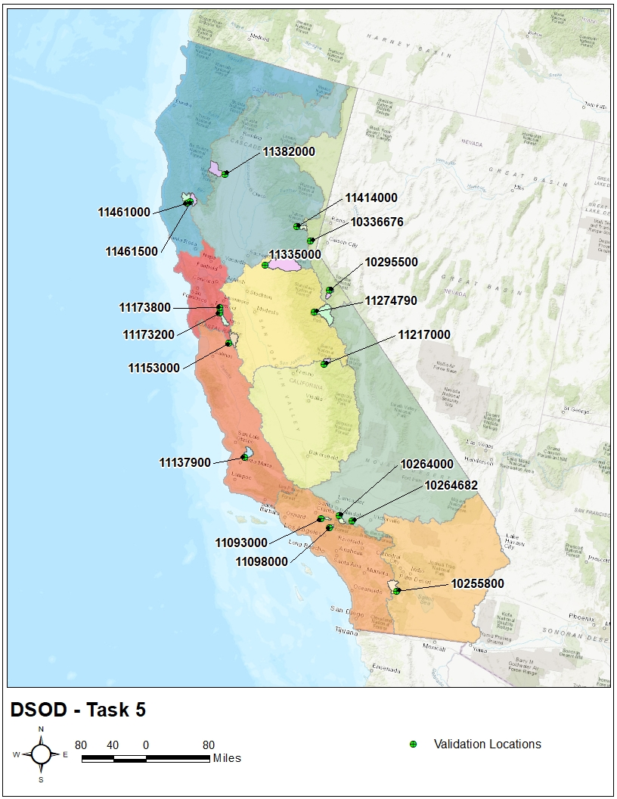
Validation Locations
Attempt to find 2 locations per region
Only one suitable location within Region 5 and Region 8
Drainage areas between 5 and 536 sq mi
26
Notes:
We went back to the map of California and attempted to find 2 locations per region
However, only one suitable location was found within Regions 5 and 8; there just simply aren’t that many locations with observed data in those regions
This led to a total of 18 locations statewide with drainage areas ranging between 5 and 536 sq mi

Slide 27
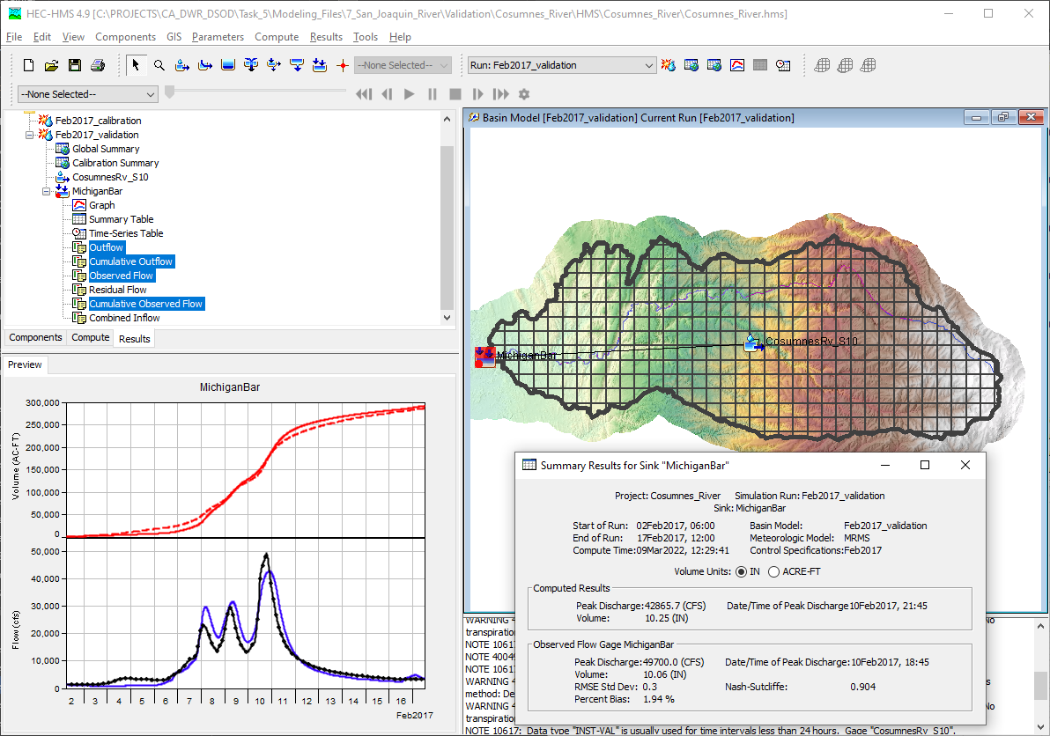
Validation Results
27
Notes:
Here is an example of the validation process for the Cosumnes River at Michigan Bar
An HMS project was created for this location using GIS data, Clark unit hydrograph parameters were estimated using the regression equations, and the precipitation-runoff process was simulated for a large event to test how well the regression equations performed
As you can see, the predicted Tc and R produce very good results at this location

Slide 28
Validation Results
28
Notes:
This process was then repeated at the other 18 locations
Here are two plots demonstrating the validation process for Regions 2, 3, 4, 6, and 7
The first plot on the left compares predicted Tc on the x-axis against the calibrated Tc on the y-axis.
The second plot on the right compares predicted R on the x-axis against the calibrated R on the y-axis (animate).
The predicted Tc and R for several validation locations displayed a slight overestimation when compared against the observed Tc and R achieved through model calibration.
However, the validation results are well within the bounds of acceptability.

Slide 29
Regression Equation Uncertainty and Example Application
29

Slide 30
Uncertainty
Data
Fitted Model
95% Pred. Int.
30
Notes:
The Clark unit hydrograph regression equations represent the most likely Tc or R value for a given location (animate), as shown by the green star.
However, these equations contain uncertainty which cannot be completely eliminated and they cannot completely explain the variability in the response.
To quantify the amount of uncertainty present when estimating a Tc or R for a specific location, prediction intervals can be used (animate).
Prediction intervals and confidence intervals are similar.
A confidence interval only addresses the model parameter uncertainty - when making a prediction for a CI it gives you the error around the population mean at the input value
A prediction interval accounts for not only the model parameter uncertainty but also the leftover variability
Prediction intervals should be used in lieu of confidence intervals when estimating the uncertainty around a yet-to-be-observed data point since they incorporate both the model parameter uncertainty (e.g. error around the population mean at the input value) in addition to the residual uncertainty.

Slide 31
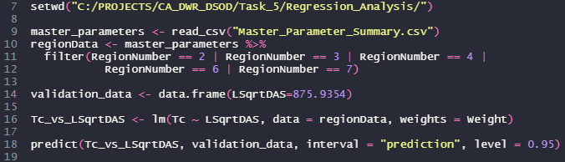
Uncertainty
31
Notes:
When using weighted multiple linear regression, as is the case within this study, the estimation of prediction intervals is complex
As such, statistical software (e.g. R Statistical Language) should be used to estimate prediction intervals
An example of code that can be used to calculate prediction intervals around an estimate value is shown above

Slide 32
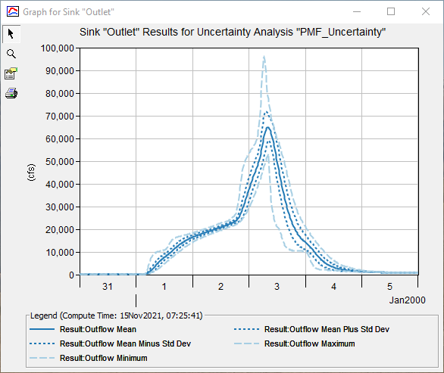
Uncertainty
32
Notes:
Uncertainty about any predicted Tc or R value is assumed to be normally distributed. As such, prediction intervals can be used to estimate the amount of uncertainty in hydrologic model outputs (e.g. runoff volume, peak discharge, peak reservoir elevation, etc) that is due to use of Clark unit hydrograph parameters predicted using the regression equations.
Output from an example application of the Uncertainty analysis capabilities within HEC-HMS is shown
Within this figure, mean (solid dark blue line), mean +/- 1 standard deviation (dashed dark blue lines), and minimum/maximum (dashed light blue line) outflow hydrographs are displayed
This example represented the error in both predicted Tc and R through the use of a normal distribution with a mean equivalent to the predicted value and a standard deviation equivalent to the 68% prediction interval width
The Uncertainty analysis then sampled from these input distributions and applied the specified boundary conditions using Monte Carlo procedures for the specified number of iterations (in this example, 100 iterations were used)

Slide 33
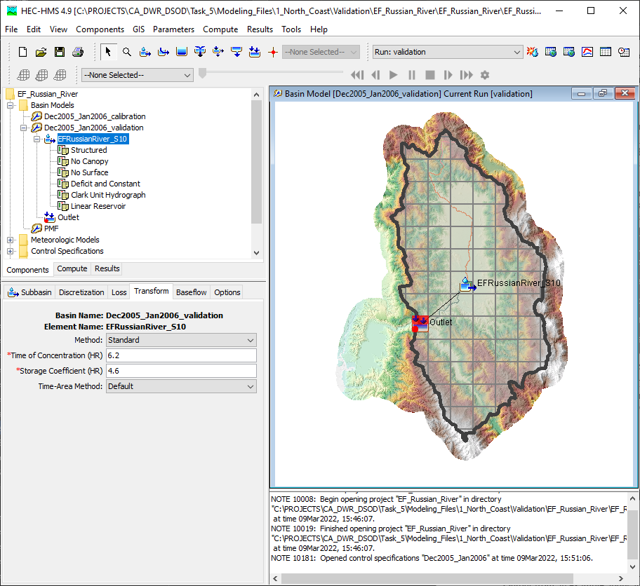
Example Application
Download terrain data
Create an HEC-HMS project
Delineate watershed
Extract subbasin characteristics
Apply regression equations for the region
Input parameters
Compute
33
Notes:
An example application for the EF Russian River upstream of Coyote Valley Dam is shown here
Terrain data was downloaded, an HMS project was created, basin elements were delineated, subbasin characteristics were extracted, the previously mentioned regression equations were used to predict Clark parameters, and the precipitation-runoff process was simulated for a large event
The time necessary to complete this analysis was approximately 1 hour

Slide 34
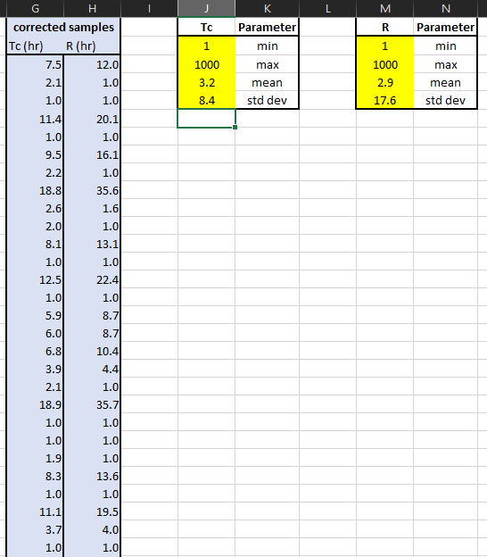
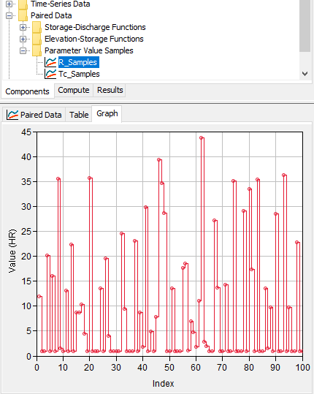
Example Application
To estimate uncertainty:
Use R scripts to generate 5- and 95-pct prediction intervals
Compute mean and std dev
Use Excel to generate random samples
Create Parameter Value Samples objects for Tc and R
Compute
34
Notes:
Additionally, uncertainty in pertinent hydrologic variables due to the use of these equations was quantified using the uncertainty analysis in HEC-HMS
R scripts were used to generate 5- and 95-percent prediction intervals
The mean and std dev of a normal distribution was then parameterized to represent those prediction intervals
Excel was then used to generate 100 random samples and Parameter Value Sample objects were created for both Tc and R
The uncertainty analysis was then computed

Slide 35
Review
CA DWR DSOD required the development of regression equations that can predict Clark unit hydrograph parameters for the entire state of California
100 HEC-HMS models California were built and calibrated
Regression equations were developed using calibrated parameters
Regression equations were then validated using 18 locations
Uncertainty around predicted values can be included within HEC-HMS
35
Notes:
In review, CA DWR DSOD required the development of regression equations that can predict Clark unit hydrograph parameters for the entire state of California
100 HEC-HMS models California were built and calibrated
Regression equations were developed using calibrated parameters
Regression equations were then validated using 18 locations
Uncertainty around predicted values can be included within HEC-HMS

