Slide 1

Multivariate Analysis
Gregory S. Karlovits, P.E., PH, CFM
US Army Corps of Engineers
Hydrologic Engineering Center

Slide 2
Outline
Marginal, conditional and joint probability (review)
Correlation
Joint probability distributions and copulas

Slide 3
Marginal, Conditional and Joint Probability
A Review

Slide 4
Notation
Marginal
  P(A)
Joint
  P(A,B) or P(A and B) or P(A ∩ B)
Conditional
  P(A|B)

Slide 5
Marginal Probability
What is the probability of A occurring irrespective of what happens with B?
Ω
A
B
Notes:
Imagine the rectangle has an area equal to one. If the area of a circle (less than or equal to 1, greater than or equal to zero) is equal to its probability, then in this case P(A) is the area inside A regardless of whether it’s in B, or an undrawn C, etc.

Slide 6
Joint Probability
What is the probability of A and B occurring together?
Ω
A
B
Notes:
Now imagine that we’re concerned with the region that belongs in both A and B, so that both things have to happen. The area of this lens is less than A or B. It can be at most the area of the smaller of the two, assuming it is completely within the other.

Slide 7
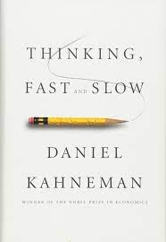

Joint Probability
$$P\left(A,B\right)≤min\left(P\left(A\right),P\left(B\right)\right)$$
Ω
A
B
Conjunction Fallacy (“Linda the Bank Teller”)
Conspiracy Theories
Notes:
If B is completely contained within A, then P(B) = P(A,B)
Linda is 31 years old, single, outspoken, and very bright. She majored in philosophy. As a student, she was deeply concerned with issues of discrimination and social justice, and also participated in anti-nuclear demonstrations. Which is more probable?
Linda is a bank teller.
Linda is a bank teller and is active in the feminist movement.
Why does it suddenly become easier to believe that the government is controlled by lizard people if we also believe there is a massive conspiracy to cover it up involving the entire Federal government?
The sticking power of conspiracy theories arises from the fact that evidence against the first (lizard people) becomes evidence for the second (giant coverup.)

Slide 8
Independence
A and B are independent iff:
  P(A,B) = P(A) * P(B)
Then we write A ⊥ B
Not easy to show on a Venn Diagram

Slide 9
Conditional Probability
Given that B has occurred, what is the probability that A occurs?
Once we have observed that B has occurred, it becomes our “universe”
A
B
Ω
A^{c}
B
A

Slide 10
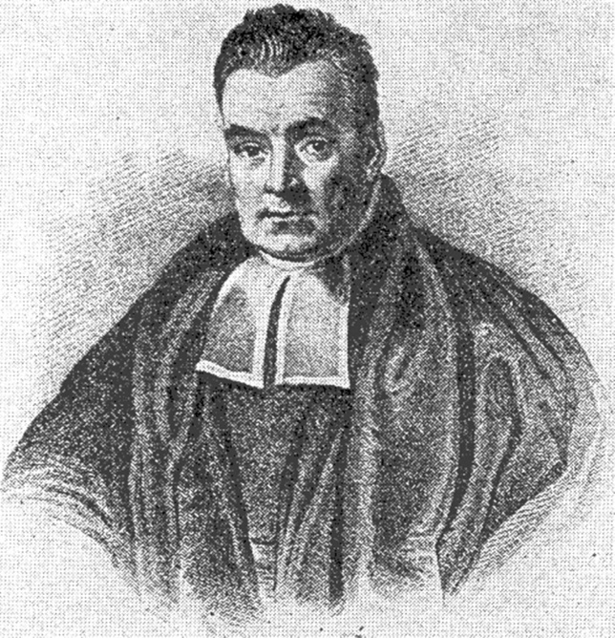


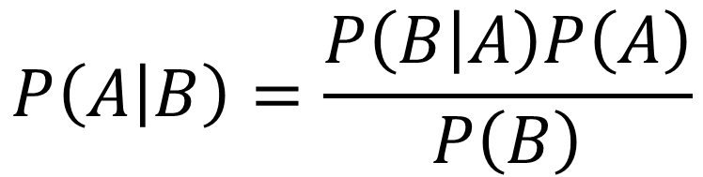
Conditional Probability
$P\left(A | B\right)≠P\left(B | A\right)$ unless $P\left(A\right)=P\left(B\right)$
$$P\left(A | B\right)=\frac{P\left(B | A\right)P\left(A\right)}{P\left(B\right)}$$
Bayes’ Theorem
Notes:
Reverend Thomas Bayes was a pretty cool dude.

Slide 11

Relationships
$P\left(A\right)=\int{P\left(A,B\right)dB}$
$P\left(A | B\right)=\frac{P\left(A,B\right)}{P\left(B\right)}$
  if A ⊥ B, $P\left(A | B\right)=\frac{P\left(A\right)P\left(B\right)}{P\left(B\right)}↔P\left(A\right)$
Notes:
If they are independent, conditioning doesn’t add any information. If B occurs, it makes not no more or less likely that A will.

Slide 12
Handling the Difference
Joint probabilities can never be larger than marginal
  P(A,B) ≤ P(A)
Imposing a condition can vastly change the answer
  Large P(A|B) says nothing about P(A)
Ω
A
B
Notes:
This is important because if you have a situation where the outcome of interest requires a bunch of things happening, and one of those has a very tiny probability, the probability of your outcome of interest is smaller than even that very tiny value (unless all the other events have probability 1).
In this case we may be cool with the result that P(A|B) = 1. If B happens, there is no way for A^{c} to happen (A to not happen). But what does that say about the probability of A occurring any time? It can be large but definitely not 1 as in this case. In this case, B occurring only tells us A is certain to happen. But if B doesn’t happen, A seems to still be pretty likely to happen. That’s because P(A)/P(B) is pretty large. This also means that P(B|A) is much smaller than P(A|B). If we see that A has happened, there’s still a pretty good chance that B doesn’t happen.

Slide 13
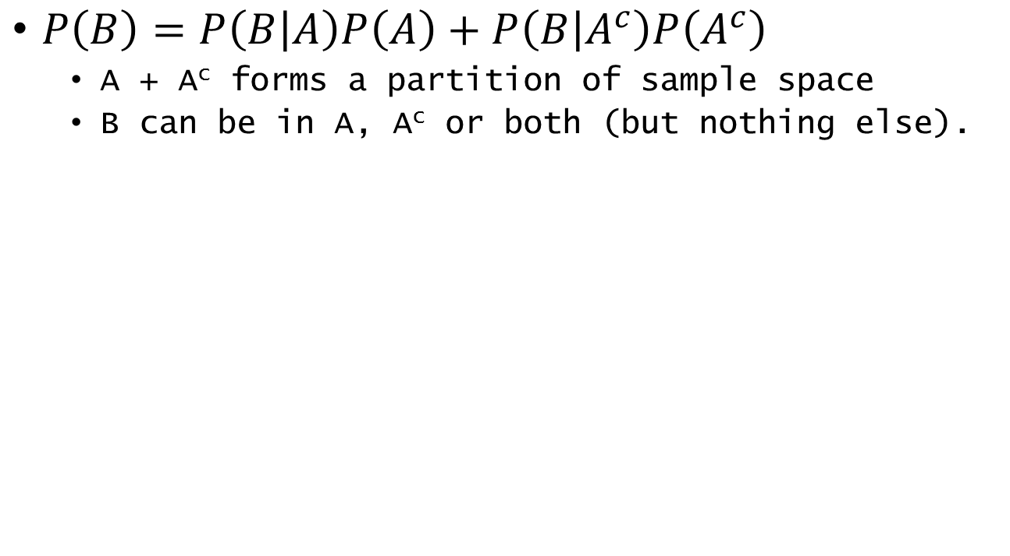
Law of Total Probability
$P\left(B\right)=P\left(B | A\right)P\left(A\right)+P\left(B | A^{c}\right)P\left(A^{c}\right)$
  A + A^{c} forms a partition of sample space
  B can be in A, A^{c} or both (but nothing else).
A^{c}
A
B
Ω

Slide 14
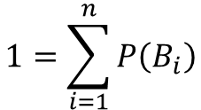
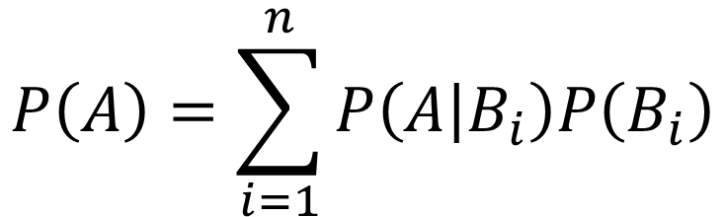

Law of Total Probability
$$1=\sum_{i=1}^{n}{P\left(B_{i}\right)}$$
$$P\left(A\right)=\sum_{i=1}^{n}{P\left(A | B_{i}\right)P\left(B_{i}\right)}$$
$$P\left(B_{i},B_{j}\right)=0 ∀i≠j$$
B₁
B₂
B₃
B₄
A
Ω
Notes:
Starting with this diagram,
If we establish the Bs are a partition of the sample space (they do not overlap, and there’s nothing that can happen that’s not in one of the Bs) then we can generalize the equation.

Slide 15
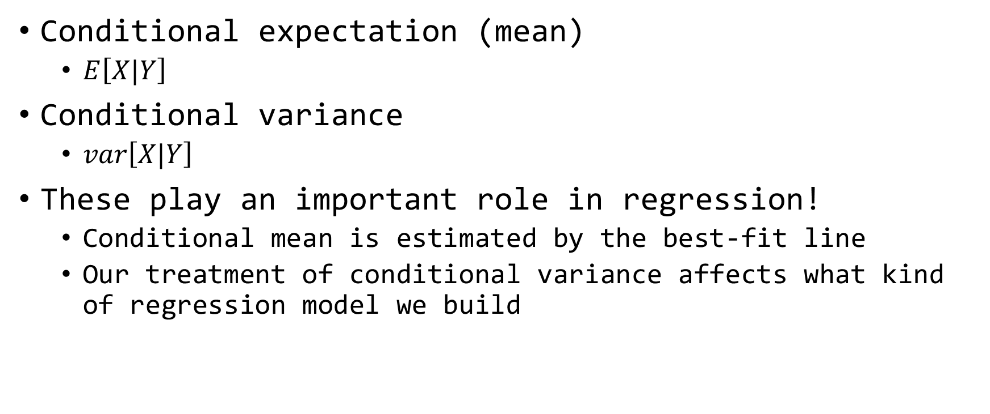
Conditional Moments
Conditional expectation (mean)
  $E\left[X|Y\right]$
Conditional variance
  $var\left[X|Y\right]$
These play an important role in regression!
  Conditional mean is estimated by the best-fit line
  Our treatment of conditional variance affects what kind of regression model we build

Slide 16
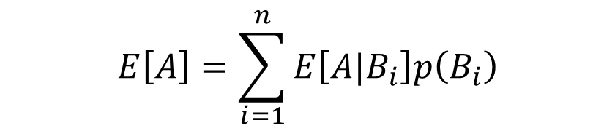
Law of Total Expectation
Weighted average under a number of conditions
As long as B forms a partition of the sample space,
Variance (and covariance) have similar rules.
$$E\left[X\right]=E\left[E\left[X|Y\right]\right]$$
$$E\left[A\right]=\sum_{i=1}^{n}{E\left[A|B_{i}\right]p\left(B_{i}\right)}$$

Slide 17
Correlation

Slide 18

Variance
How much do observations of a variable vary from its mean?
$s_{x}^{2}=\frac{1}{n−1}\sum_{i=1}^{n}{{\left(x_{i}−\overline{x}\right)}^{2}}$

Slide 19
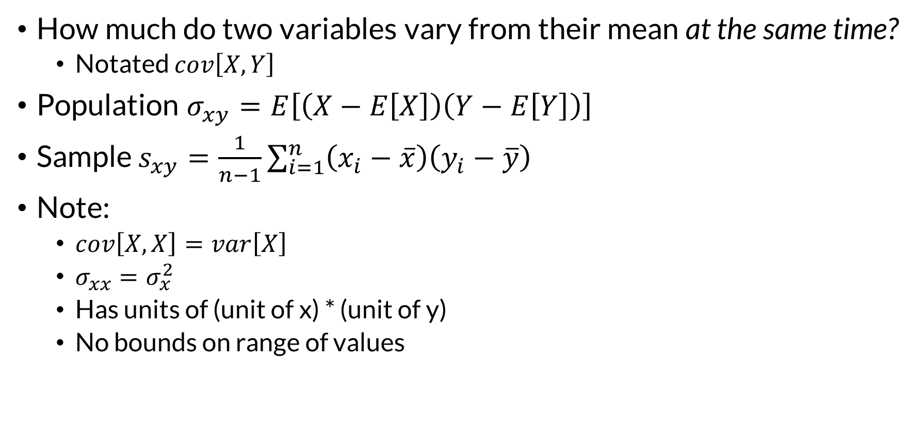
Covariance
How much do two variables vary from their mean at the same time?
  Notated $cov\left[X,Y\right]$
Population $σ_{xy}=E\left[\left(X−E\left[X\right]\right)\left(Y−E\left[Y\right]\right)\right]$
Sample $s_{xy}=\frac{1}{n−1}\sum_{i=1}^{n}{\left(x_{i}−\overline{x}\right)\left(y_{i}−\overline{y}\right)}$
Note:
  $cov\left[X,X\right]=var\left[X\right]$
  $σ_{xx}=σ_{x}^{2}$
  Has units of (unit of x) * (unit of y)
  No bounds on range of values
Notes:
Because sample covariance doesn’t have a fixed range, it’s not useful for comparing across variables. Standardizing it is much more helpful.

Slide 20
Three Ways to Measure Correlation
Pearson’s product-moment correlation coefficient (r)
Kendall’s rank correlation coefficient (τ)
Spearman’s rank correlation coefficient (ρ)
Range of -1 (perfect negative correlation) to +1 (perfect positive correlation)
Notes:
The fixed range is extremely helpful for comparisons.

Slide 21
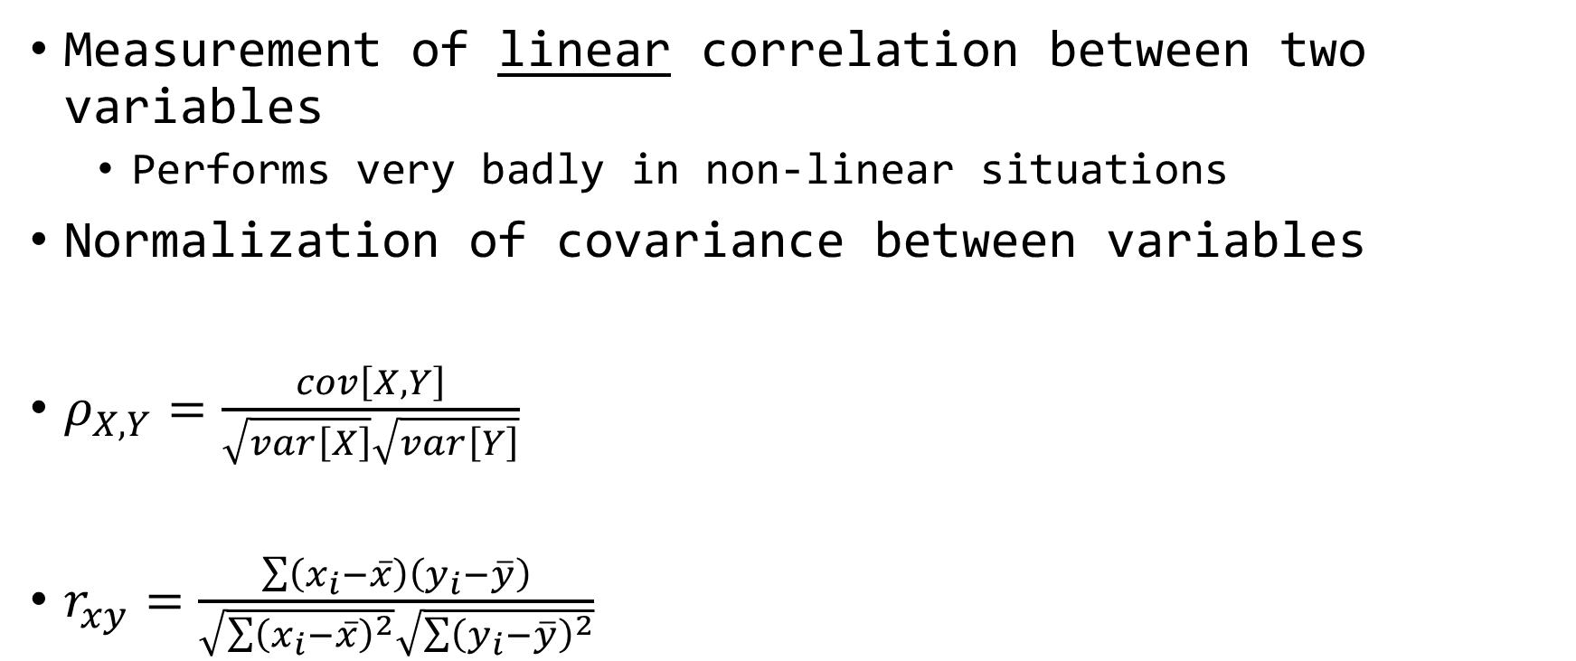
Pearson’s Correlation Coefficient
Measurement of linear correlation between two variables
  Performs very badly in non-linear situations
Normalization of covariance between variables
$ρ_{X,Y}=\frac{cov\left[X,Y\right]}{\sqrt{var\left[X\right]}\sqrt{var\left[Y\right]}}$
$r_{xy}=\frac{\sum{\left(x_{i}−\overline{x}\right)\left(y_{i}−\overline{y}\right)}}{\sqrt{\sum{{\left(x_{i}−\overline{x}\right)}^{2}}}\sqrt{\sum{{\left(y_{i}−\overline{y}\right)}^{2}}}}$
R:
cor(x)
x is a data frame with 2 or more columns

Slide 22
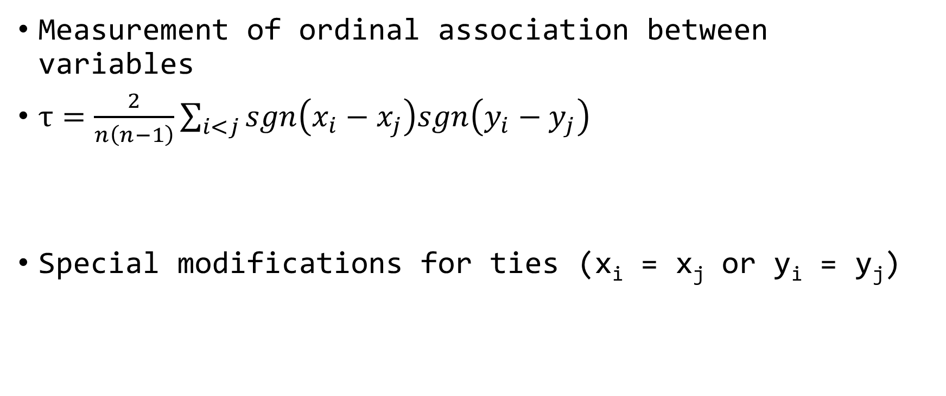
Kendall’s Tau
Measurement of ordinal association between variables
$τ=\frac{2}{n\left(n−1\right)}\sum_{i<j}{sgn\left(x_{i}−x_{j}\right)sgn\left(y_{i}−y_{j}\right)}$
Special modifications for ties (x_{i} = x_{j} or y_{i} = y_{j})
Term is -1 if both x and y do not increase (or decrease), +1 otherwise
R:
cor(x, method = “kendall”)
x is a data frame with 2 or more columns

Slide 23
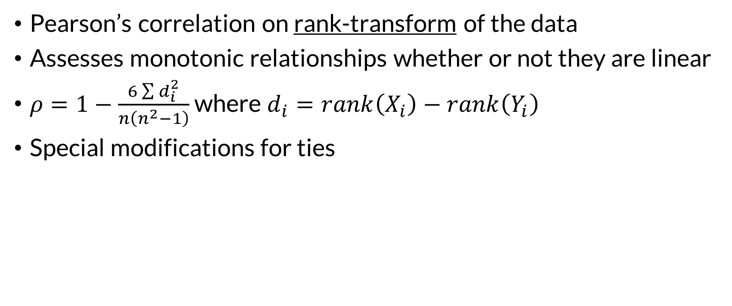
Spearman’s Rho
Order Statistics!
Pearson’s correlation on rank-transform of the data
Assesses monotonic relationships whether or not they are linear
$ρ=1−\frac{6\sum{d_{i}^{2}}}{n\left(n^{2}−1\right)}$ where $d_{i}=rank\left(X_{i}\right)−rank\left(Y_{i}\right)$
Special modifications for ties
R:
cor(x, method = “spearman”)
x is a data frame with 2 or more columns
Notes:
During the Extreme Value material you were all like, “Greg, why are we spending this time on order statistics?!?” Order stats come up surprisingly often and are incredibly useful!

Slide 24
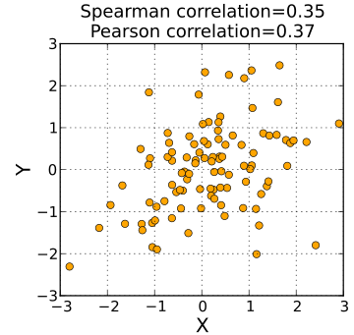
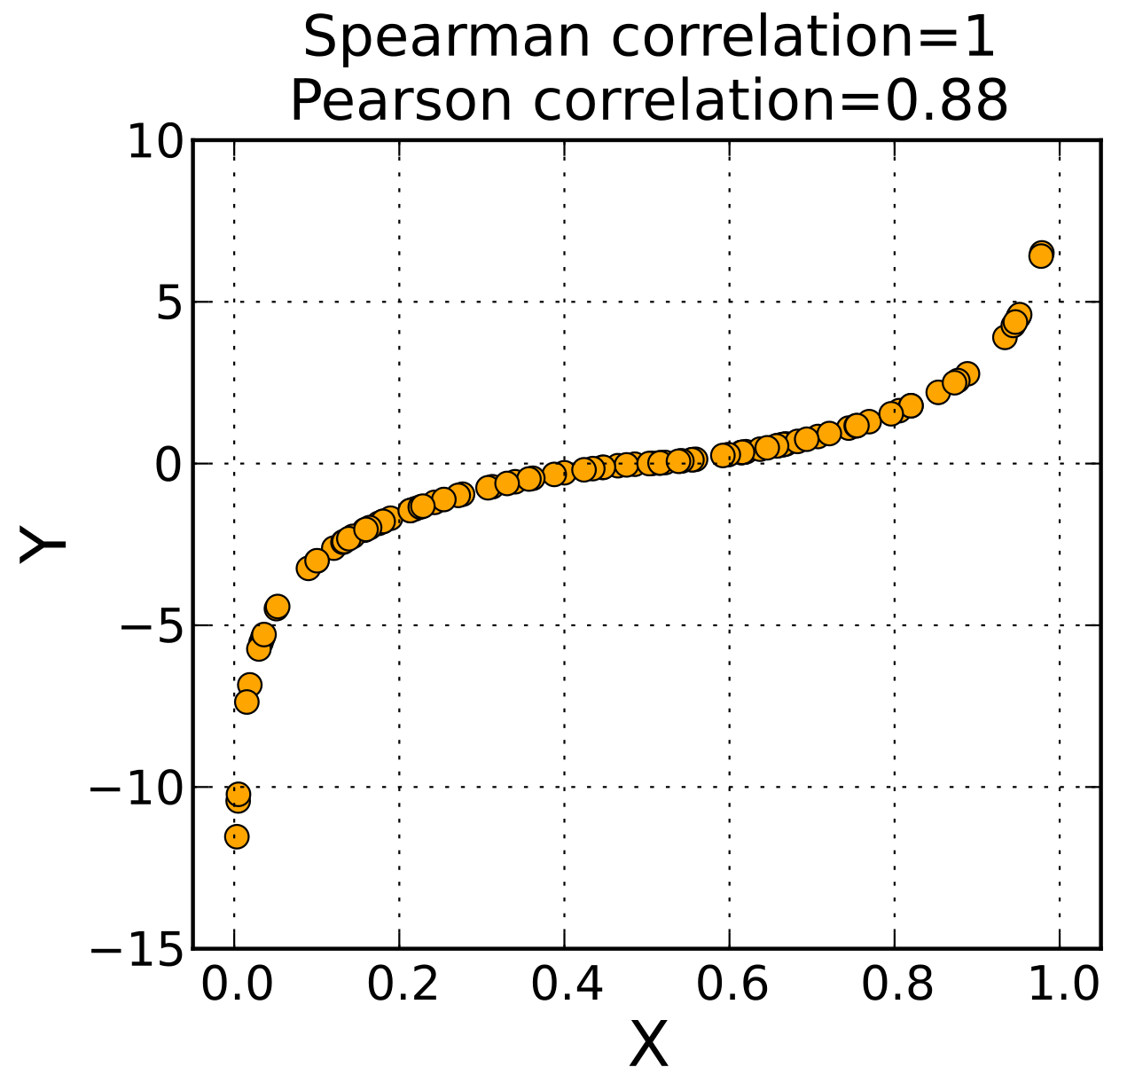
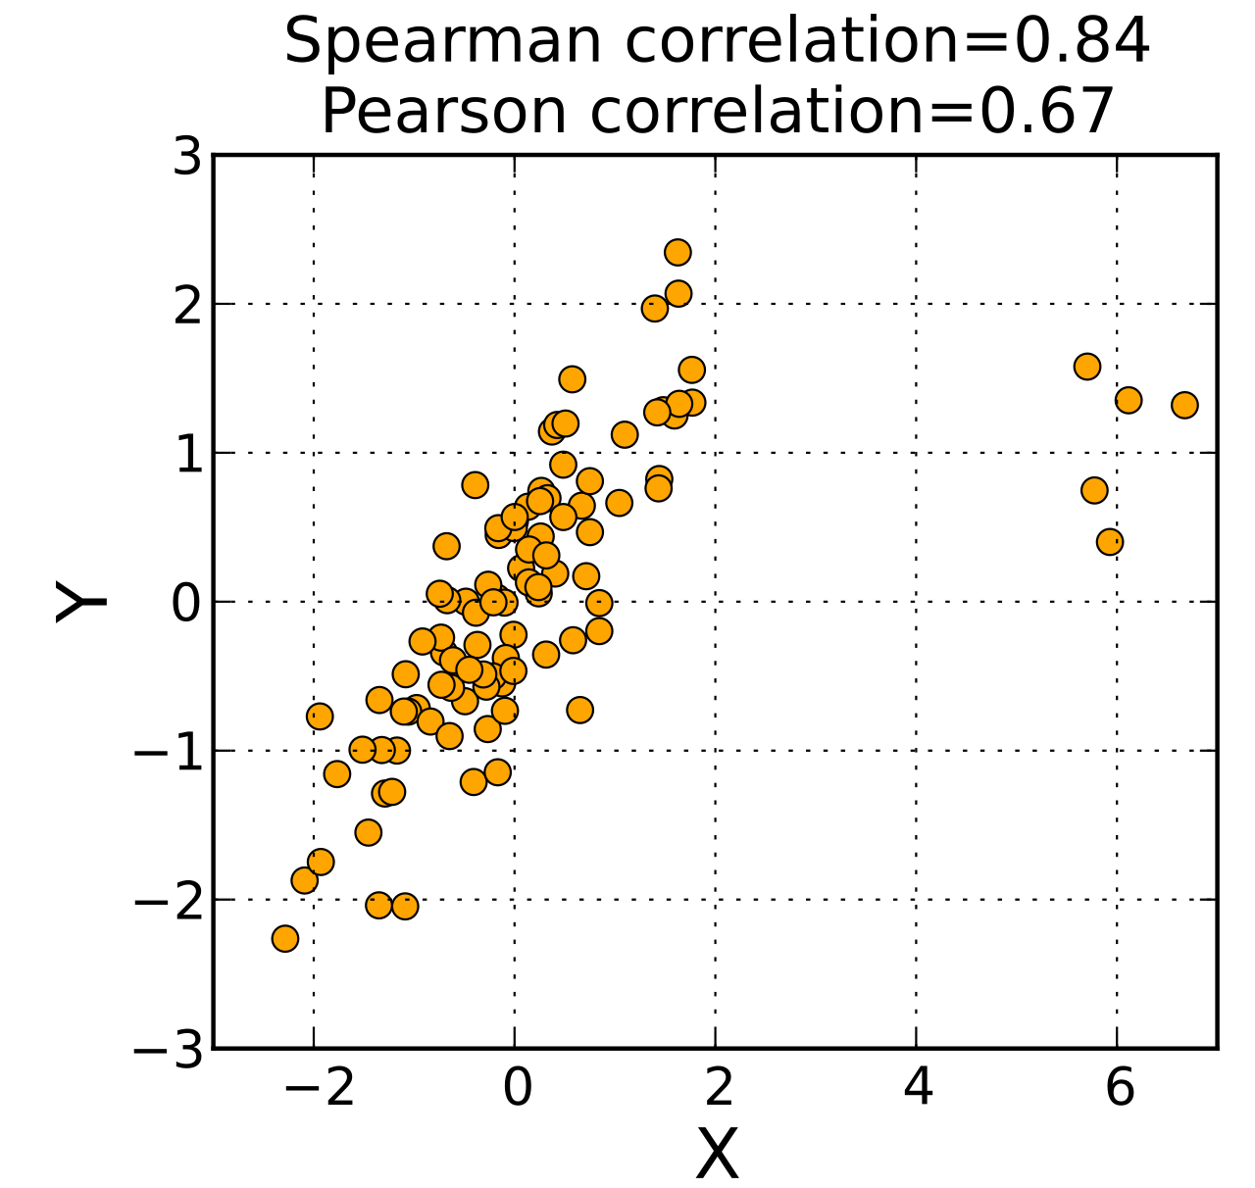
Product-Moment vs Rank Correlation
Monotonic
Non-Linear
Kendall and Spearman have similar performance

Slide 25
Joint Probability Distributions and Copulas

Slide 26
Joint Probability Distributions
Probability distributions for multiple variables are less common
Must describe the behavior of each variable and the relationship between them
A sample of analytical models:
  Multivariate normal
  Multivariate t
  Dirichlet
  Wishart
Nobody* uses these
*Except Bayesians

Slide 27
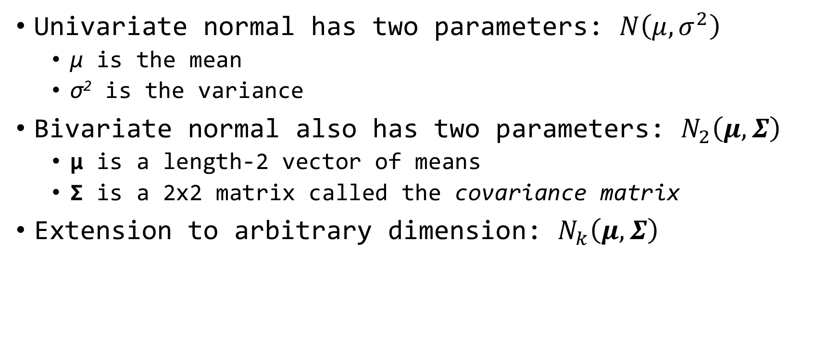
Multivariate Normal
Univariate normal has two parameters: $N\left(μ,σ^{2}\right)$
  μ is the mean
  σ² is the variance
Bivariate normal also has two parameters: $N_{2}\left(μ,Σ\right)$
  μ is a length-2 vector of means
  Σ is a 2x2 matrix called the covariance matrix
Extension to arbitrary dimension: $N_{k}\left(μ,Σ\right)$

Slide 28
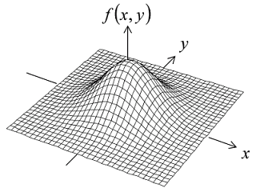









Multivariate Normal
Random samples taken from a k-variate normal are collection of vectors with covariance defined by Σ
$$\left(z_{1},z_{2}\right)$$
$$\left(z_{1},z_{2}\right)$$
$$\left(z_{1},z_{2}\right)$$
$$\left[\overline{z_{1}},\overline{z_{2}}\right]=μ$$
$$\left(z_{1},z_{2}\right)$$
$$cov\left(z_{1},z_{2}\right)=Σ$$
$$\left(z_{1},z_{2}\right)$$
$$\left(z_{1},z_{2}\right)$$
Bivariate Normal
k = 2
$$\left(z_{1},z_{2}\right)$$

Slide 29
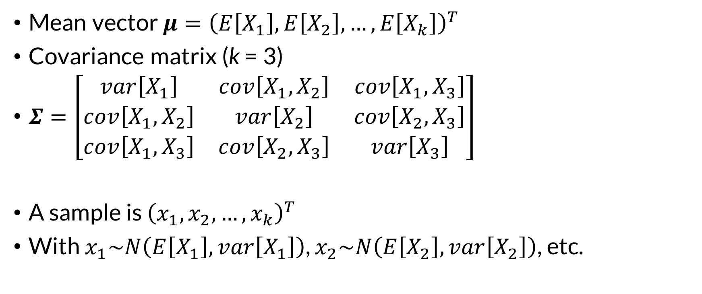
Multivariate Normal
Mean vector $μ={\left(E\left[X_{1}\right],E\left[X_{2}\right],…,E\left[X_{k}\right]\right)}^{T}$
Covariance matrix (k = 3)
$Σ=\left[\begin{matrix}var\left[X_{1}\right] & cov\left[X_{1},X_{2}\right] & cov\left[X_{1},X_{3}\right] \\ cov\left[X_{1},X_{2}\right] & var\left[X_{2}\right] & cov\left[X_{2},X_{3}\right] \\ cov\left[X_{1},X_{3}\right] & cov\left[X_{2},X_{3}\right] & var\left[X_{3}\right]\end{matrix}\right]$
A sample is ${\left(x_{1},x_{2},…,x_{k}\right)}^{T}$
With $x_{1}\sim N\left(E\left[X_{1}\right],var\left[X_{1}\right]\right)$, $x_{2}\sim N\left(E\left[X_{2}\right],var\left[X_{2}\right]\right)$, etc.
symmetrical

Slide 30
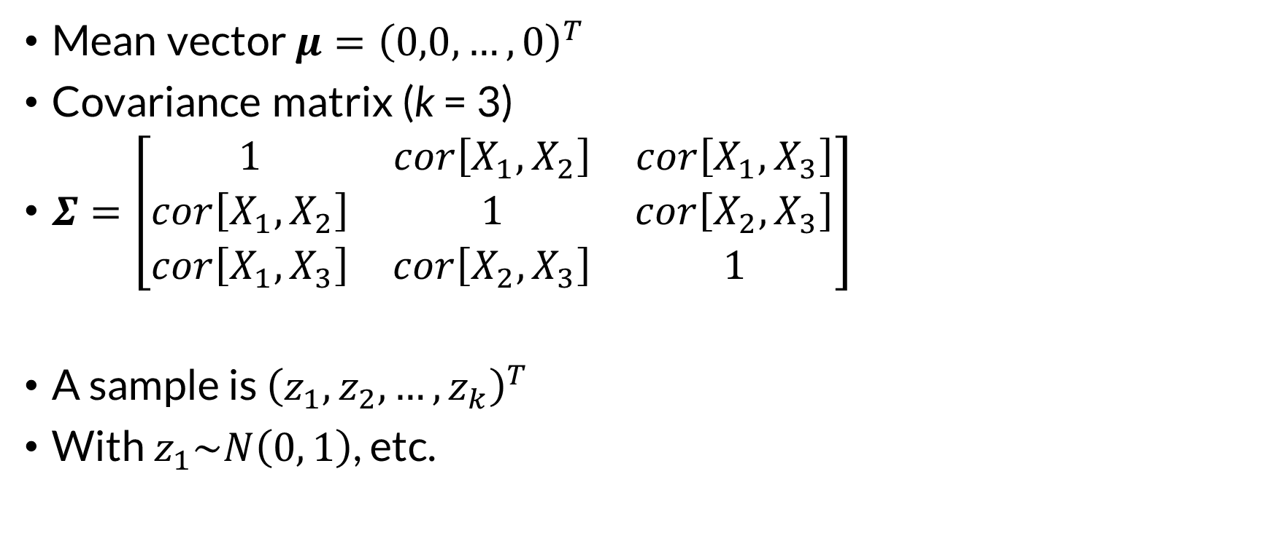
Multivariate Standard Normal
Mean vector $μ={\left(0,0,…,0\right)}^{T}$
Covariance matrix (k = 3)
$Σ=\left[\begin{matrix}1 & cor\left[X_{1},X_{2}\right] & cor\left[X_{1},X_{3}\right] \\ cor\left[X_{1},X_{2}\right] & 1 & cor\left[X_{2},X_{3}\right] \\ cor\left[X_{1},X_{3}\right] & cor\left[X_{2},X_{3}\right] & 1\end{matrix}\right]$
A sample is ${\left(z_{1},z_{2},…,z_{k}\right)}^{T}$
With $z_{1}\sim N\left(0, 1\right)$, etc.
symmetrical

Slide 31
Others
Multivariate t distribution
  Multivariate version of Student’s t distribution
  Similar to multivariate normal with extra parameter ν
  (degrees of freedom)
Dirichlet distribution
  Multivariate version of the beta distribution
Wishart distribution
  Multivariate version of the gamma distribution

Slide 32
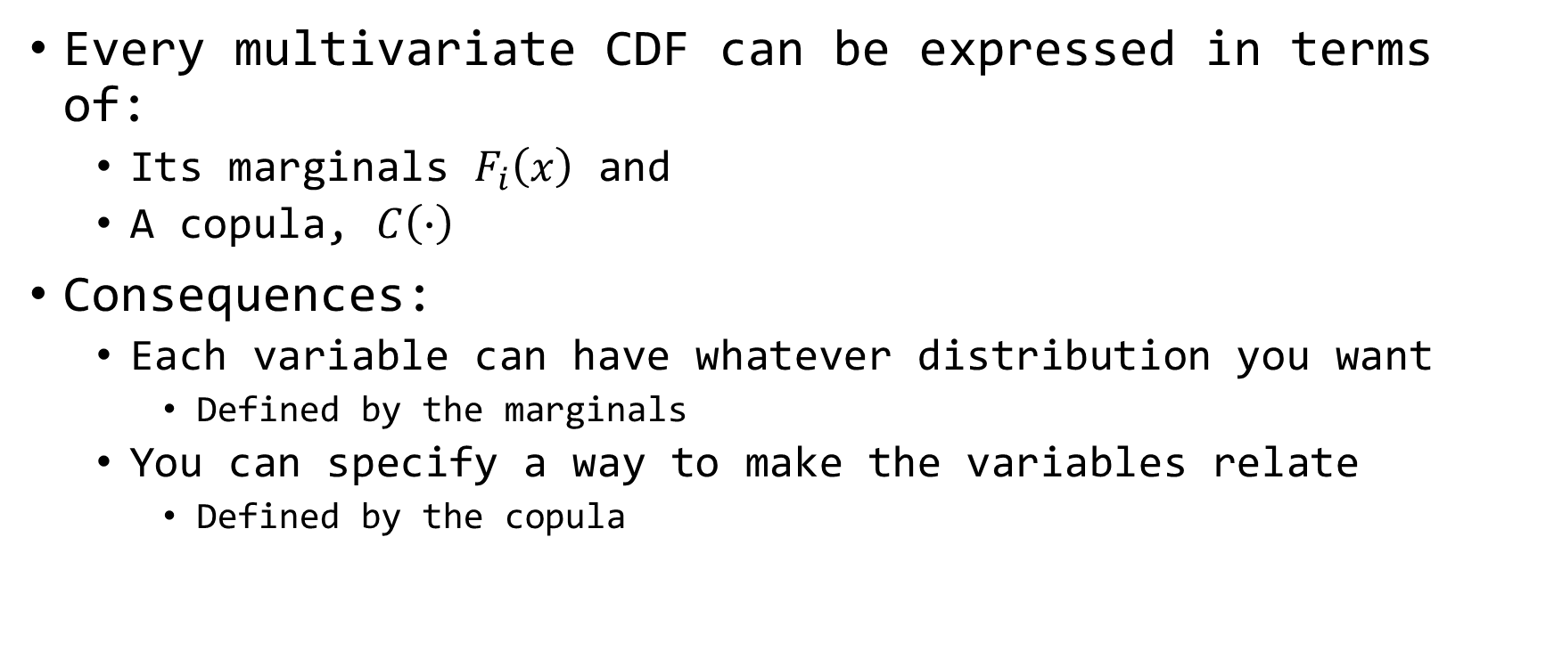
Sklar’s Theorem
Every multivariate CDF can be expressed in terms of:
  Its marginals $F_{i}\left(x\right)$ and
  A copula, $C\left(∙\right)$
Consequences:
  Each variable can have whatever distribution you want
    Defined by the marginals
  You can specify a way to make the variables relate
    Defined by the copula

Slide 33
Two of Many Kinds of Copulas
Gaussian Copula
  Structure uses the multivariate normal distribution
  Familiar elliptical shape
  Dominantly defined by Pearson’s coefficient
Archimedean Family of Copulas
  Other interesting shapes
  Single parameter
  Definable using Kendall’s tau

Slide 34
Gaussian Copula
Assume underlying structure well-represented with a multivariate normal distribution
However, variables of interest do not have a normal distribution
Generate normal variates with specified correlation
Transform them into the target distributions
HEC-WAT Hydrologic Sampler uses this!

Slide 35


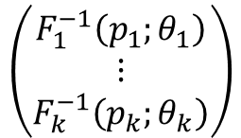


Gaussian Copula
Sampled
Vector
Vector of
U(0, 1)
$$\left(\begin{matrix}Z_{1} \\ ⋮ \\ Z_{k}\end{matrix}\right)$$
$$Φ\left(x\right)$$
$$\left(\begin{matrix}U_{1} \\ ⋮ \\ U_{k}\end{matrix}\right)$$
Standard Normal CDF
$$\left(\begin{matrix}F_{1}^{−1}\left(p_{1};θ_{1}\right) \\ ⋮ \\ F_{k}^{−1}\left(p_{k};θ_{k}\right)\end{matrix}\right)$$
Vector of
Marginal
Quantile
Functions
Next Sample
Multivariate
Standard Normal
$$\left(\begin{matrix}X_{1} \\ ⋮ \\ X_{k}\end{matrix}\right)$$
Vector of
Values with
Desired Target
Distributions

Slide 36
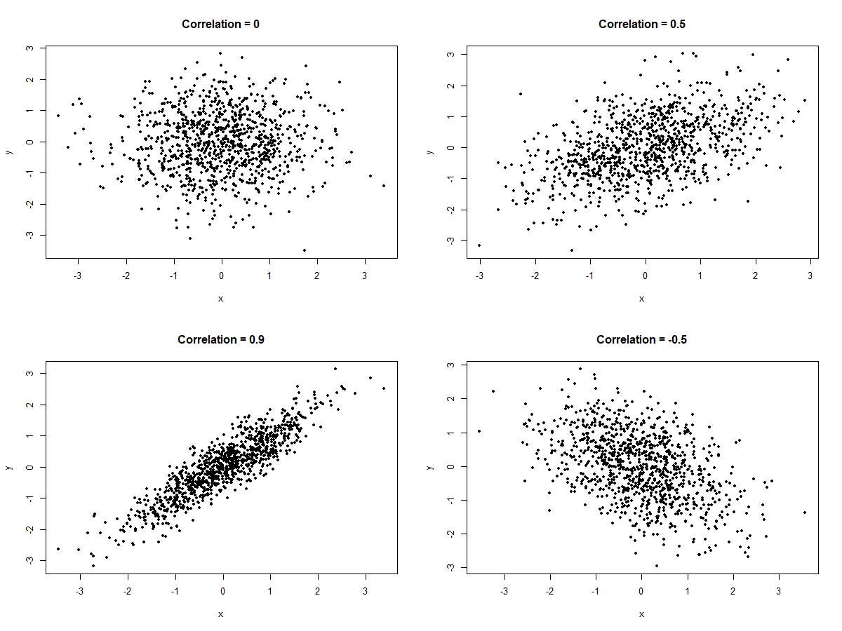
Notes:
Here are four plots of bivariate standard normal noise with varying correlation between the two variables. These shapes should be pretty familiar.
We will focus on the highly-correlated cloud of points in the lower-left.

Slide 37
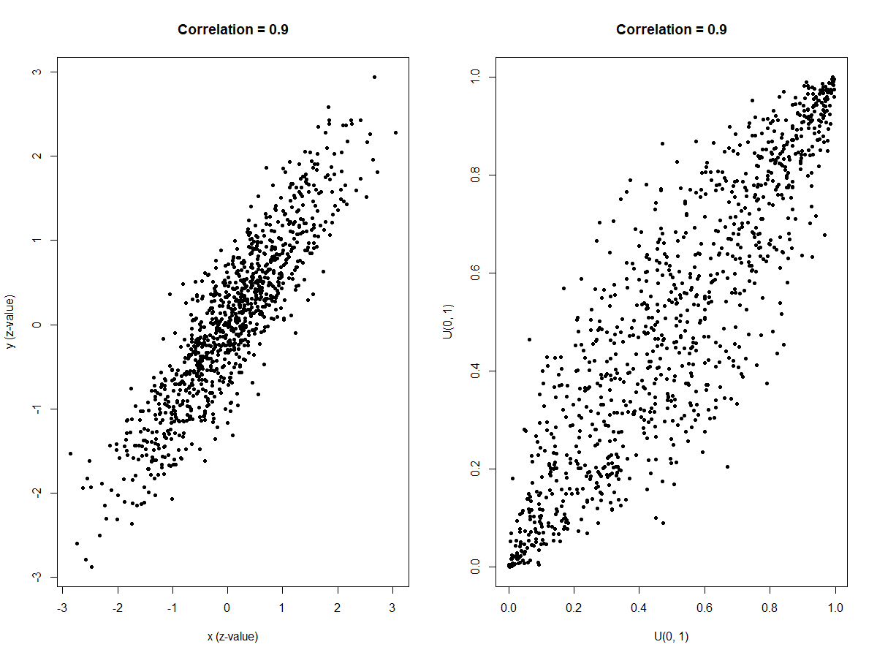

$$Φ\left(x\right)$$
Standard Normal CDF
Notes:
The plot on the left is the same as the Correlation = 0.9 plot on the last slide.
The plot on the right is what happens when we take each of the x and y and compute the cumulative probability using the standard normal CDF. Each of the values is now on the range (0, 1) and actually has a Uniform(0, 1) distribution.

Slide 38
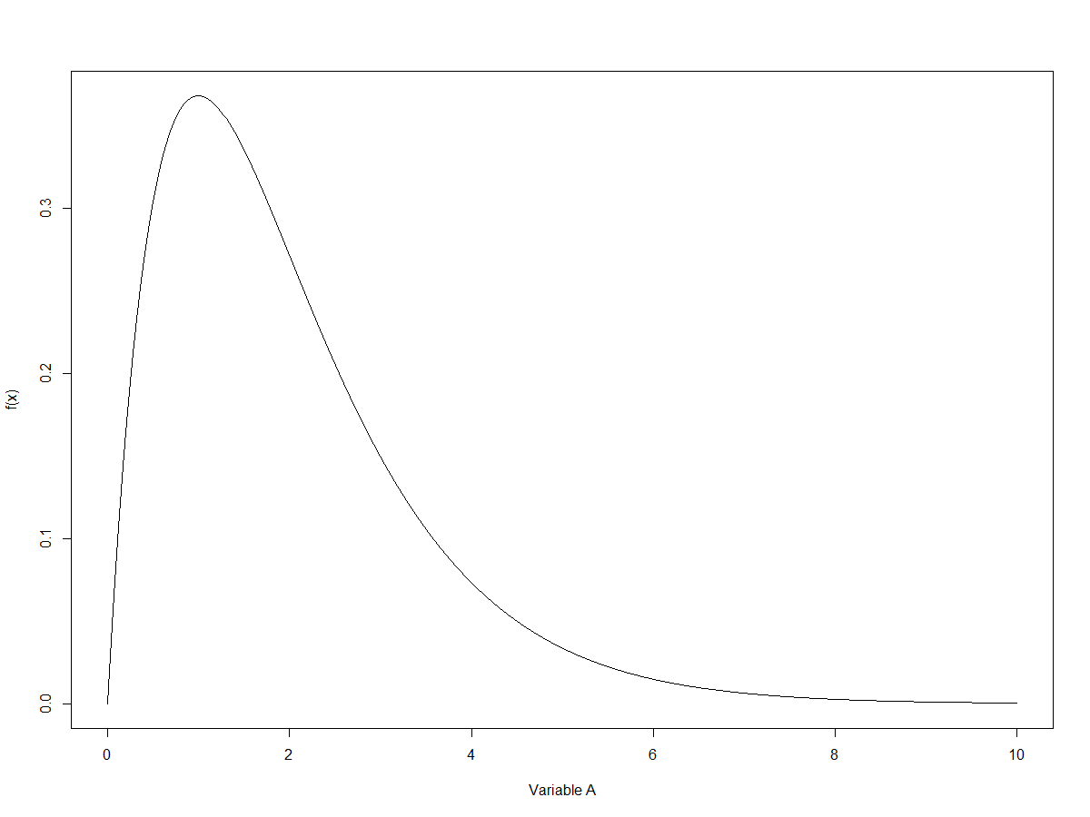
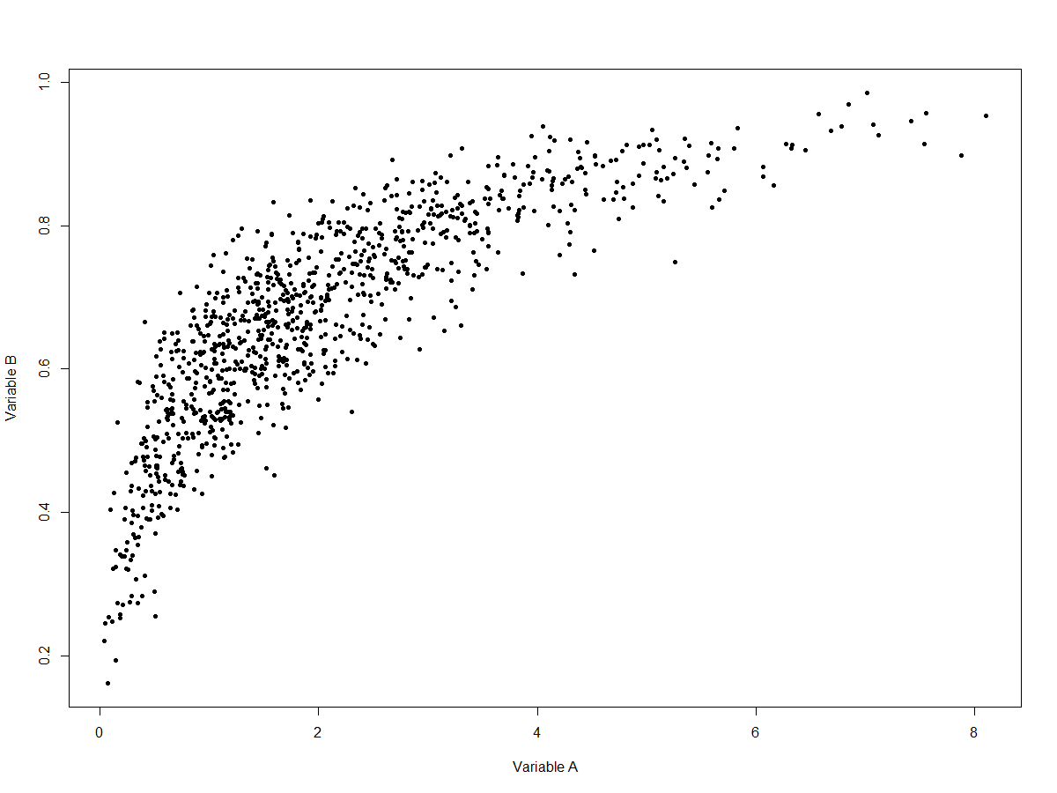
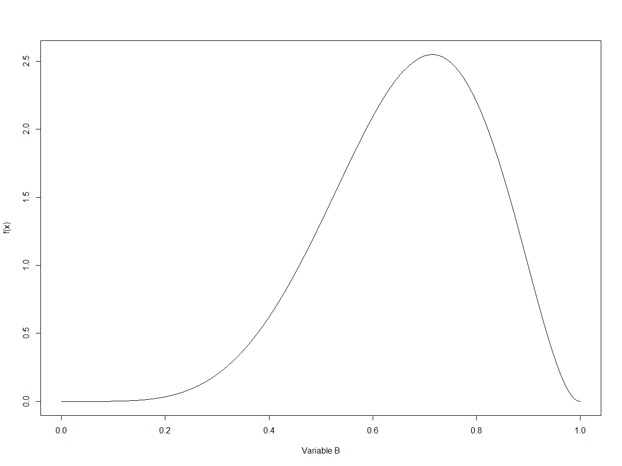
Variable A
Density
B
Joint Distribution
Gaussian Copula
r = 0.9
Variable B
Density
A
Notes:
Let’s define two distributions that we want our output to look like. Here are two density plots.
Variable A is a positively-skewed variable with a lower bound at zero and no upper bound.
Variable B is a negatively-skewed variable with bounds at both zero and one.
For each of these variables, we can turn U(0, 1) random variables in to variables with the target distribution using the quantile function (inverse CDF), a property called the “probability inverse transform.” Inverse transform sampling is extremely common in statistical simulation.
The U(0, 1) variables we feed the two quantile functions have been provided by the Gaussian copula, so we know that the underlying structure is bivariate normal with correlation = 0.9.
The resulting joint distribution is on the right. Notice how the density of the scatter for each axis reflects the densities. For x, more points are concentrated on the left than the right. For y, more points re concentrated towards the top (right side of the density) than the bottom (left side of the density.)

Slide 39
Questions?

