Slide 1

Multiple
Linear Regression
Part I: Extending the Linear Model
Gregory S. Karlovits, P.E., PH, CFM
US Army Corps of Engineers
Hydrologic Engineering Center
Notes:
Hello everyone, I'm Greg Karlovits from the Hydrologic Engineering Center. Welcome to our course on statistical methods in hydrology. This video is part one of two on the topic of multiple linear regression and will discuss extending the simple linear model. Let's get started.

Slide 2
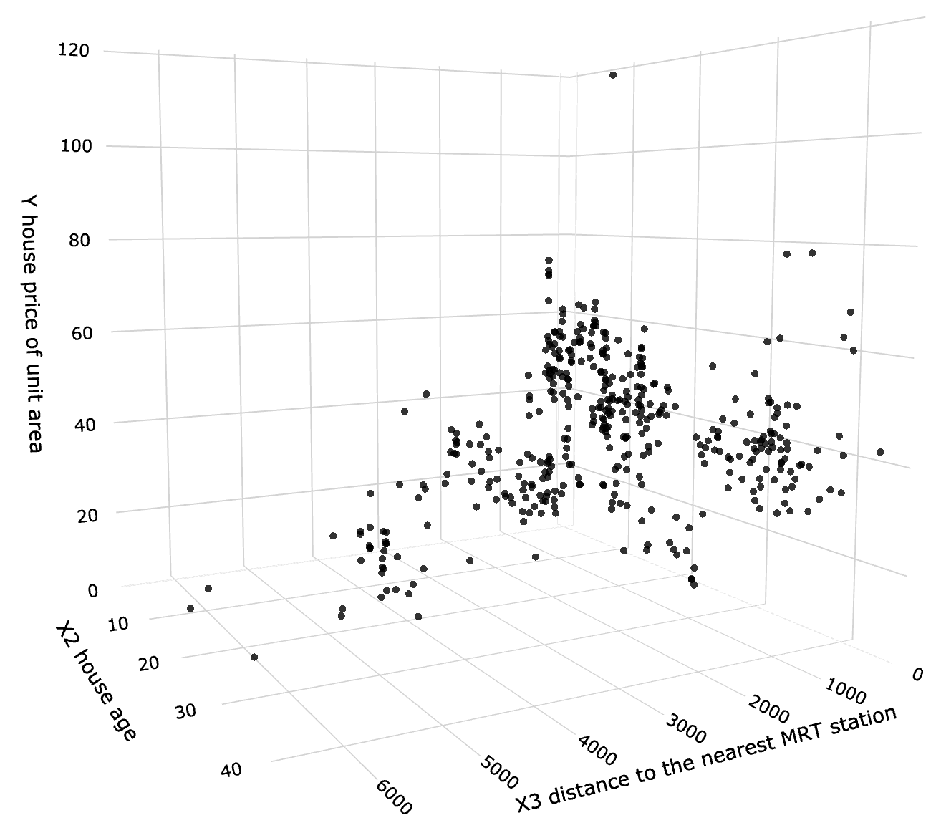
Why Multiple Regression?
Predict values of variable A, given values of variable B,
variable C, …
https://towardsdatascience.com/linear-regression-made-easy-how-does-it-work-and-how-to-use-it-in-python-be0799d2f159
Notes:
In the next two videos, we will build on concepts in exploratory data analysis, multivariate analysis, and simple linear regression, to build multiple linear regression models.
When explaining the variability in some observations, sometimes one explanatory variable is not enough. Making predictions about that variable may be possible when adding additional variables to the equation.
Alternatively, the response variable may not be linear in the predictor variable, and you may need to use a higher-order polynomial to explain the variability. You might think of the predictor as one variable, the predictor squared as another, the predictor cubed as a third, and so on.
Most of these visualizations we will see will involve two predictor variables, since these representations are possible in three dimensions. However, there is no real limit to the number of predictors a model can have. There are practical limits, however.

Slide 3
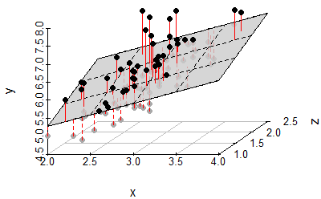
Geometry of Best Fit
A plane replaces the line when we go from one to two predictors
https://stackoverflow.com/questions/47344850/scatterplot3d-regression-plane-with-residuals
Notes:
With two predictors, the problem is in three dimensions. The resulting predictions are made using a plane, which is defined by its slope between the response variable and predictor 1, and and a second slope between the response variable and predictor 2.
The errors, or residuals, are still the same – the difference between the real response variable value and the predicted value. However, instead of this being the point distance to a line, it is now to a plane. For higher dimensions the geometry is more complex but has the same principle.

Slide 4
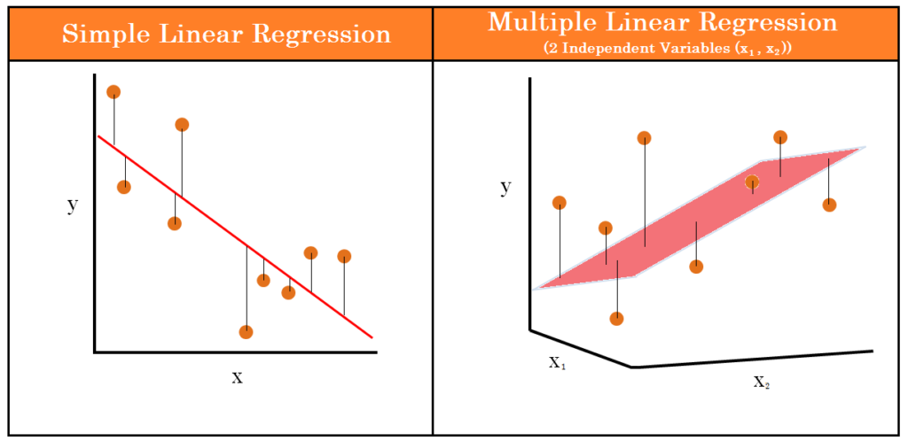

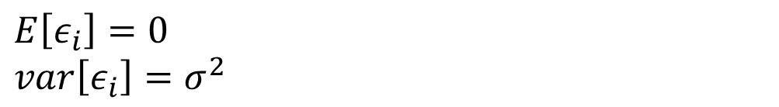
Full Regression Equation
Simple Linear
Regression
$$y_{i}=β_{0}+β_{1}x_{i}+ε_{i}$$
Multiple Linear
Regression
$$y=Xβ+ε$$
$E\left[ε_{i}\right]=0$
$$var\left[ε_{i}\right]=σ^{2}$$
https://medium.com/@thaddeussegura/multiple-linear-regression-in-200-words-data-8bdbcef34436
Notes:
Recall the simple linear regression equation – the two beta terms are the intercept and slope, and the epsilon term is the random error. The best-fit line is the line with a beta-naught and beta-one that minimize the overall error between the line and the data used to fit it.
When we expand the model to include more variables, each of the terms is now multivariate. All of the terms in bold are multivariate – that is, either vectors or matrices.
Y, beta, and epsilon are n-length vectors, where n is the number of data in the model, and X is a k+1 x n matrix where k is the number of predictor variables in the model.
Each of the individual epsilons in the epsilon vector are mean-zero normal variates with a common variance sigma-squared. This hasn’t changed from the simple linear model.

Slide 5


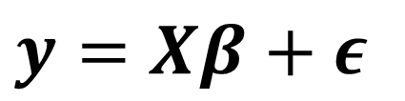
Matrix Notation
$$y=Xβ+ε$$
$$y=\left[\begin{matrix}y_{1} \\ ⋮ \\ y_{n}\end{matrix}\right] X=\left[\begin{matrix}1 & x_{1,1} & ⋯ & x_{1,k} \\ 1 & x_{2,1} & ⋯ & x_{2,k} \\ ⋮ & ⋮ & ⋯ & ⋮ \\ 1 & x_{n,1} & ⋯ & x_{n,k}\end{matrix}\right]$$
$β=\left[\begin{matrix}β_{0} \\ ⋮ \\ β_{k}\end{matrix}\right]$ $ε=\left[\begin{matrix}ε_{1} \\ ⋮ \\ ε_{n}\end{matrix}\right]$
Notes:
Unless you’re a big fan of linear algebra, looking at the vector and matrix notation here is probably not a lot of fun.
The y vector is the value of the response variable at each of the n points.
The x matrix starts with a column of ones. These are here so that the intercept can be estimated. The intercept is lumped into the beta vector with the coefficient for all of the predictor variables. Since it is a constant for the model and doesn’t vary by point, we have to indicate that it is a constant, and that is done with this column of ones. Then, there is a column for each of the k predictor variables, with each column essentially being a vector containing the values of that predictor variable at each of the n points. The result is a matrix with n rows and k+1 columns, because the first column of constant values is added in for the intercept term.
The beta vector has length k+1, with one entry for each predictor plus an extra one (beta-naught) for the intercept term.
Finally the epsilon vector contains the residual for each point.
This notation will still work for simple linear regression and only one predictor – the X matrix would have two columns and the beta vector would have a length of two.

Slide 6
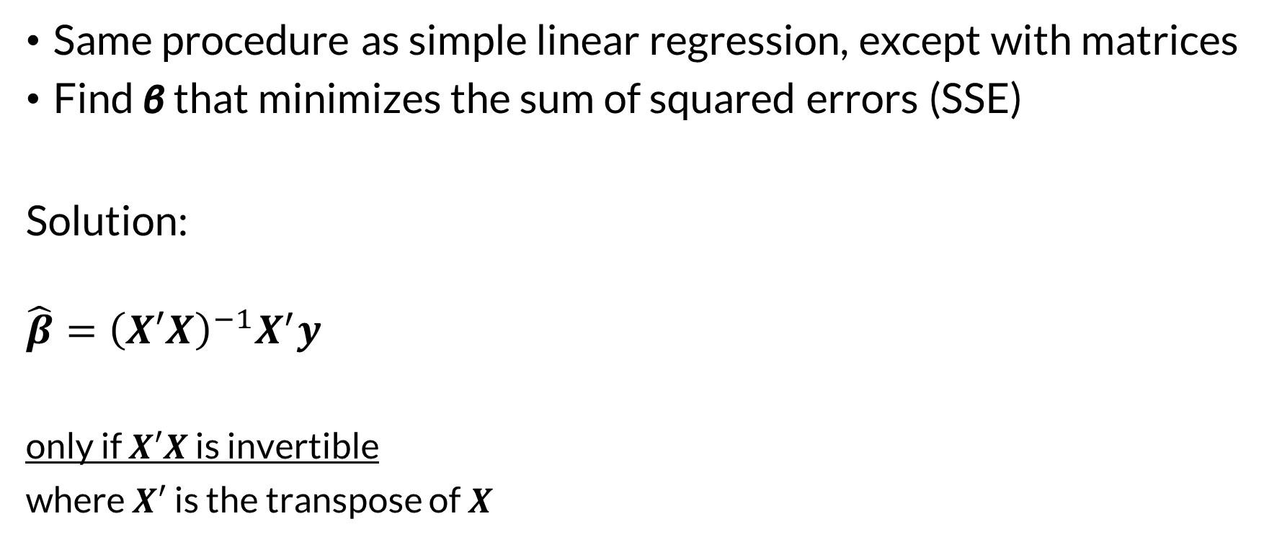
Least Squares Estimation
Same procedure as simple linear regression, except with matrices
Find β that minimizes the sum of squared errors (SSE)
Solution:
$$\hat{β}={\left(X′X\right)}^{−1}X^{′}y$$
only if $X′X$ is invertible
where $X′$ is the transpose of $X$
Notes:
Least squares estimation is still the tool we are going to turn to in order to find our model parameters. We want to find the values in vector beta that minimize the sum of squared errors, just as before.
I will spare you the math, but the payoff is this solution. Note that it has the condition that the x-transpose-x product has to be invertible. If it is not invertible, another means for solving this equation must be used. This matrix product being not-invertible can happen when two columns of X are linear combinations of other columns, for example if two columns measure the same predictor variable except in different units. In those situations, instead of turning to a more complicated solving method, it is better to simply remove the redundant predictors from the model.

Slide 7
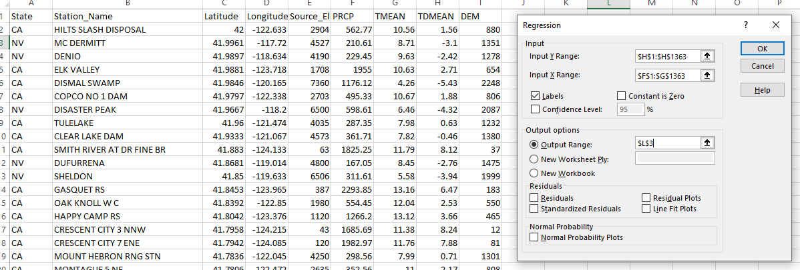
In Practice (Microsoft Excel/Data Analysis)
Notes:
When we go to perform these analyses ourselves, luckily we are not dealing with matrix math. Tools like Microsoft Excel’s Data Analysis add-in make regression analysis pretty straightforward.
The regression input is the same as it was in the simple regression case, but now for the input x, you specify multiple columns. The columns must be continuous, so you may need to rearrange your data to make it work.
In this example, the three columns of data for precipitation, mean temperature, and mean dewpoint are being used. The precipitation and mean temperature predictors are being used to build a model predicting mean dewpoint.

Slide 8
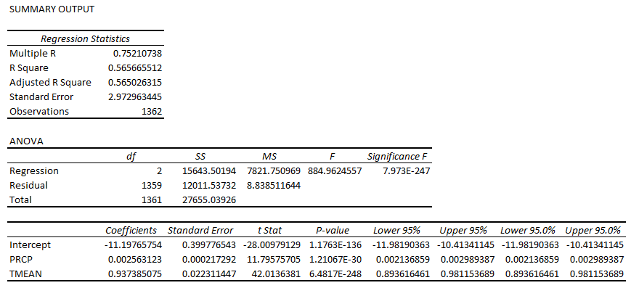
In Practice (Microsoft Excel/Data Analysis)
Notes:
The regression output looks the same as the simple linear regression case, with one notable difference: the extra row in the coefficients table. Here we can see that the data for both the precipitation and the mean temperature predictor are included, and each has their own coefficient and p-value.

Slide 9
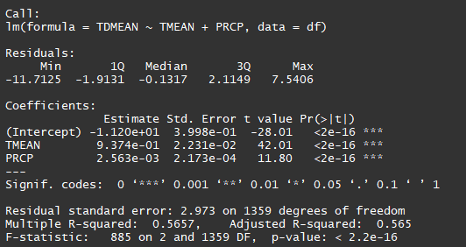
In Practice (R)
Notes:
This is the same data and model except now in R. Notice in the model call at the top, all we had to do was include another predictor by adding it into the model formula with a plus sign.
The model output looks much the same as the simple regression case, except just as it was in Excel, it has an extra row in the coefficients table.

Slide 10
In Practice (R)
Notes:
The output has the same look and feel for multiple regression as it does in the simple regression case. In the output we are still mostly concerned with the same values that summarize the performance of the model.
The biggest points of emphasis for a multiple regression model are the adjusted R-squared, the p-value for each predictor coefficient, and the model F-statistic p-value.
The adjusted R-squared, listed on the second to last line of the summary, is a metric that summarizes model goodness-of-fit, but also penalizes the goodness-of-fit metric for adding extra model complexity. This comes in handy when you are considering different predictor variables and you want to know if adding a predictor to your model is worth the extra complexity. Every time you add a predictor, the multiple R-squared will go up or at least not decrease. However, for adjusted R-squared, each additional predictor is penalized, and if the increase in goodness-of-fit for the model with the new parameter doesn’t overcome the additional complexity, adjusted R-squared will go down. For multiple regression models I pay the most attention to the adjusted R-squared values when summarizing performance.
Second, you will want to check the coefficient p-value for each predictor variable. When you add predictors to your model, you want to make sure their coefficient is significantly different than zero, which is indicated by a small p-value (usually less than 0.05.) In most cases you want all your predictors to be significant, but there are circumstances where the inclusion of a predictor makes the model better without the predictor having a small p-value. This brings us to the last statistic.
The model F-statistic p-value indicates the strength of evidence that the model is better than one that has an intercept only, in other words has no predictors. If the value is very small then the model is better than the intercept-only case. For multiple regression models this statistic is important because it helps roll up the significance of the total model even if some of the predictors have weaker evidence for their significance. There are circumstances where a predictor added to the model will not be significant itself, but the adjusted R-squared goes up and the F-statistic p-value indicates the model better than an intercept-only model. In this case I might be inclined to keep that additional parameter in the model even though it isn’t significant, especially if I have a physical explanation for why that predictor should be included.

Slide 11
Checking Assumptions
The mean of y_{i} is a linear function of the x_{i,j}
All y_{i} have the same variance σ²
The errors are normally-distributed
The errors are independent
Notes:
The assumptions made in simple linear regression still hold for the multiple regression case, and should be checked in the same way.
You can check the linearity assumption using a fitted values vs. residual plot.
Constant variance can be checked using a scale-location plot.
Normal Q-Q plots can be used to check residual normality.
Finally the lag plot can be used to check residual independence.

Slide 12
Summary
Multiple regression is a generalization of simple linear regression
All the same assumptions hold and need to be checked
Notes:
In this video, we discussed extending the simple linear model. Two key points to take away from this video are:
Multiple linear regression is a generalization of simple linear regression, and
All of the same assumptions made in simple linear regression still hold for multiple linear regression, and they need to be checked.
Thanks, and tune into the next video in this series on multiple linear regression to learn about additional considerations for multiple linear regression models.

Slide 13
Multiple
Linear Regression
Part II: Additional Considerations for Multiple Regression
Gregory S. Karlovits, P.E., PH, CFM
US Army Corps of Engineers
Hydrologic Engineering Center
Notes:
Hello everyone, I'm Greg Karlovits from the Hydrologic Engineering Center. Welcome to our course on statistical methods in hydrology. This video is part two of two on the topic of multiple linear regression and will discuss additional considerations for multiple linear regression models. Let's get started.

Slide 14
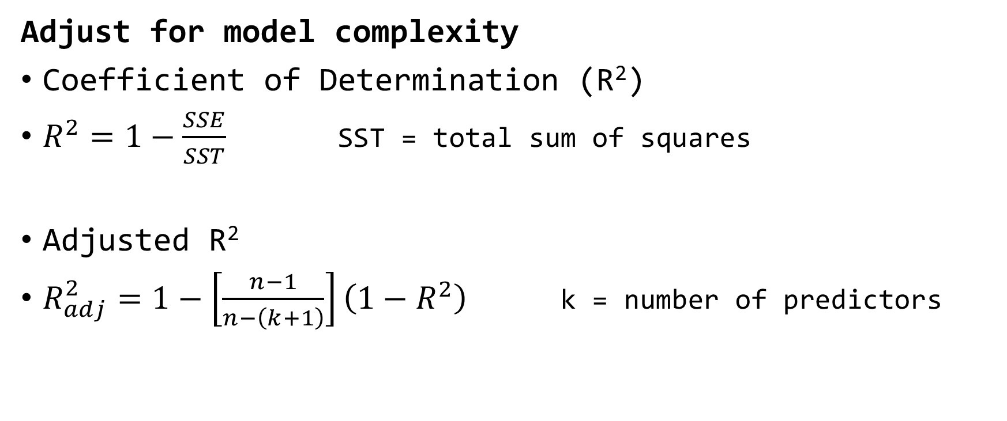
Goodness of Fit
Adjust for model complexity
Coefficient of Determination (R²)
$R^{2}=1−\frac{SSE}{SST}$ SST = total sum of squares
Adjusted R²
$R_{adj}^{2}=1−\left[\frac{n−1}{n−\left(k+1\right)}\right]\left(1−R^{2}\right)$ k = number of predictors
Notes:
The coefficient of determination gives us the percentage of the variability in the response variable that is predicted by our model. Remember that the SSE is our objective function and we want that to be as small as possible. SST is the total sum of squares, which is in essence the variance of the response variable. As the SSE approaches 0, r-squared approaches 1. SSE equals SST if the regression line is y = mean of the response variable. Then the r-squared is zero.
We use adjusted R-squared to compare models of varying complexity. The adjustment factor reduces adjusted R-squared with each additional parameter that is added. This means that the gain in regular R-squared has to be bigger than the penalty for adding a parameter in order for adjusted R-squared to go up. These two metrics are equal in the case k = 0, which is an intercept-only model. However, we just saw that for an intercept-only model the R-squared is zero. This means that the adjusted R-squared is always less than the R-squared unless R-squared is zero.

Slide 15
Multicollinearity
Occurs when predictors are linearly related
Causes serious difficulties in model fit
Coefficients are unreliable
  Signs can be wrong
  Large changes in magnitude with small changes in data
  Large standard errors
  Low significance for predictors with significant F-statistic
Notes:
Multicollinearity is a problem that arises in models with multiple predictors which are linearly related. If one predictor is a linear transformation of another, for example if two predictors are the same variable measured in different unit systems, then they are collinear. Another way that multicollinearity can occur is if multiple columns always add up to the same value, for example percentages adding up to 100%.
Multicollinearity can cause serious difficulties in fitting the model. The matrix math we saw previously can fall apart with highly collinear predictors, resulting in a complete failure to estimate the parameters, or with very unreliable estimates. You can wind up with all kinds of unexpected results, such as the wrong sign for the model coefficients. Almost always the model fit has large standard errors, resulting in a high p-value for the coefficients. This can happen even though the entire model, using the F-test, is significantly better than an intercept-only model.
This can be the most significant problem facing multiple linear models. It is definitely good practice to check if your predictors are multicollinear. The remedy if you have identified one or more predictors that are multicollinear is to remove the worst offenders from the model until the multicollinearity subsides.

Slide 16
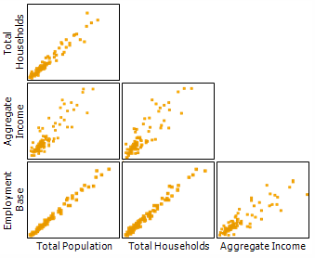
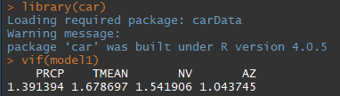

Testing Multicollinearity
Correlation between predictor variables
Variance Inflation Factor
(VIF)
${VIF}_{j}=\frac{1}{1−r_{j}^{2}}$
https://medium.com/@mackenziemitchell6/multicollinearity-6efc5902702
Notes:
One way to test if your predictors are multicollinear is to compute the correlation matrix between each pair of predictors. Sometimes this can detect if variables are multicollinear, but it can occasionally fail. Multicollinearity will be presented by large positive or negative correlation between the predictor variables.
A more reliable predictor of multicollinearity is the variance inflation factor. The VIF for a predictor is computed using this formula, where the r-squared-j comes from computing the regression model between the predictor you are testing and the remaining k-1 predictors in the model, and extracting the model r-squared value. If the model r-squared is small, the VIF approaches 1. As the R-squared gets larger, VIF approaches infinity. Most statistical software packages can compute the VIF for each predictor for you. In R, you can compute them using the vif() function out of the companion to applied regression library.
Generally, VIF values greater than 5 require a closer look, and greater than 10 are problematic and require treatment. Usually the treatment is to remove the highly collinear predictor variable from the model.

Slide 17
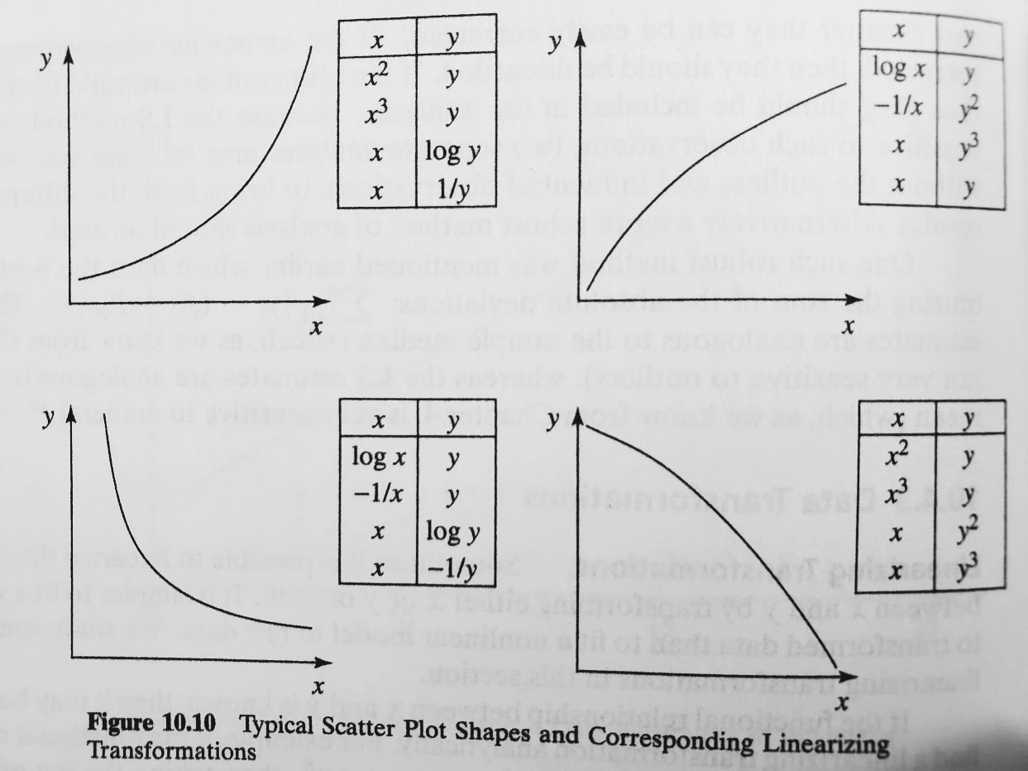
Transformations
Monotonic changes to the predictor and response variables
  Improve model fit
  Avoid model assumption
  violations
Most common transformations:
  Logarithm
  Reciprocal / negative
  reciprocal
  Square/cube
Notes:
Transformations can be very important in linearizing your model in the multivariate case. By using transformations on your predictor variables and your response variable you may be able to improve the model fit and better meet the linearity assumption.
The figure on the lower right shows the general shape of the scatter points and then a list of various transformations on x and y you might try depending on the shape of the scatter. The most commonly applied one by far is the logarithm, which takes data spread across orders of magnitude and linearizes them. The reciprocal and negative reciprocal have the opposite effect, taking data spread over a small range and expanding it. Finally, polynomial powers such as squaring or cubing are commonly used as well.

Slide 18
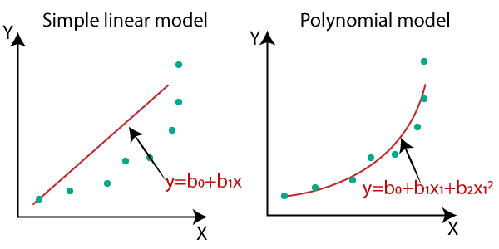
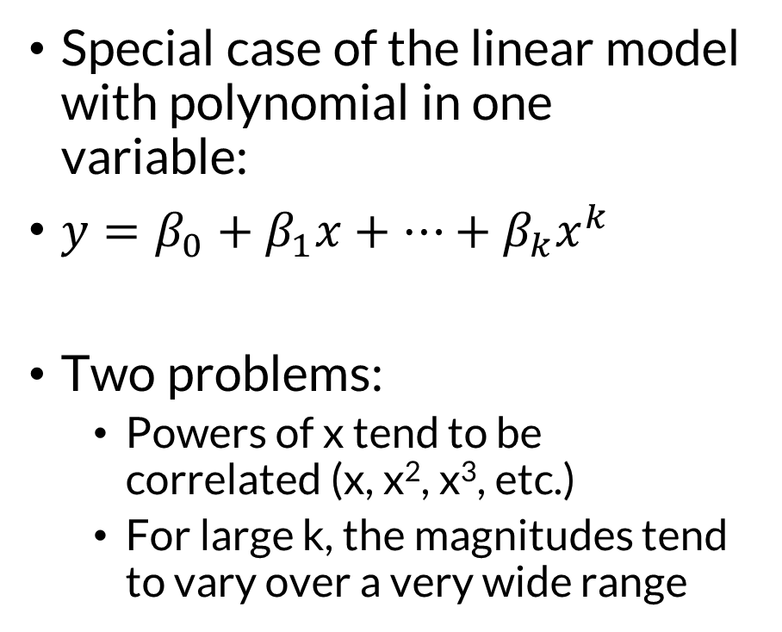
Polynomial Regression
Special case of the linear model with polynomial in one variable:
$y=β_{0}+β_{1}x+…+β_{k}x^{k}$
Two problems:
  Powers of x tend to be correlated (x, x², x³, etc.)
  For large k, the magnitudes tend to vary over a very wide range
https://www.javatpoint.com/machine-learning-polynomial-regression
Notes:
Sometimes there is a good theoretical basis for the relationship between two variables that take the form of a polynomial. To fit this as a linear model, each polynomial term is treated as a separate predictor, so x, x-squared, x-cubed, etc. are each a predictor that get a coefficient.
There are typically two problems that occur with polynomial regression. The first is that powers of x tend to be correlated, which can lead to multicollinearity issues. The second is that high powers of x tend to create a very wide range of magnitudes which can result in coefficients with very different orders of magnitude.
Both of these problems tend to lead to numerical errors in the least squares procedure.

Slide 19
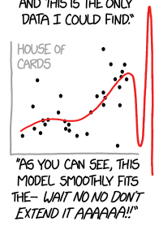

Polynomial Regression Best Practices
Center x-variable to reduce
multicollinearity
  $y=β_{0}+β_{1}\left(x−\overline{x}\right)+…+β_{k}{\left(x−\overline{x}\right)}^{k}$
Limit to cubic (k = 3) if possible
Never exceed a quintic (k = 5)
https://imgs.xkcd.com/comics/curve_fitting.png
Notes:
Aside from the fitting issues that occur, extreme caution should be taken with polynomial models as their fits can be exceptionally unreliable outside the range of data. High-order polynomial models tend to be overfit to the data, meaning they will perform well within the range of the predictor data, but fail, sometimes spectacularly, outside the data.
If you use polynomial regression, consider centering the x variable, that is, subtracting off the mean of x, which can help reduce multicollinearity. Just remember that for predictions with the model you also have to subtract off the original sample mean you used in the model fit in order for the coefficient to be appropriate.
Generally it is best to limit the powers you use to a cubic model if you can. This prevents excessive overfit and avoids problems where the fitted curve has very different behavior outside of the data than inside of it. Cubic curves only have one inflection point and either has two critical points or is monotonic.
However, in the situations where the theory justifies going to higher powers, a quartic or quintic may be used, but there need to be enough data to support that decision, and extra care should be used. It is best to never exceed a fifth-degree polynomial.

Slide 20

Variable Standardization
$$θ^{∗}=\frac{θ_{i}−\overline{θ}}{s_{θ}}$$
Standardization can help address three issues:
  Multicollinearity
  Wide ranges of powers in polynomials
  Different units and ranges for predictor variables
Two effects:
  Eliminates the constant term from the model
  Effect magnitude of predictors directly comparable
Notes:
We just saw centering the variables, which can reduce multicollinearity, and here we take it one step further after centering the variables by scaling them. This results in standardized variables.
Standardization is the same as computing a z-score: you subtract the sample mean from each value, and then divide by the sample standard deviation. This puts the predictors and response variable all in the same scale, centered at zero. This also reduces the magnitude of polynomial terms, which can grow in orders of magnitude with higher exponents. Standardization should be used on both the response variable and all the predictors.
There are two effects of standardizing the variables. First, because all of the involved variables are centered at zero, the constant term is eliminated from the model. This actually has the side effect that estimation of the remaining coefficients in the model is simpler and numerically more stable.
Second, with all of the variables on the same scale, the magnitude of the effect of each predictor can be directly compared by looking at the coefficients. A larger coefficient indicates a larger magnitude effect on the response variable.

Slide 21
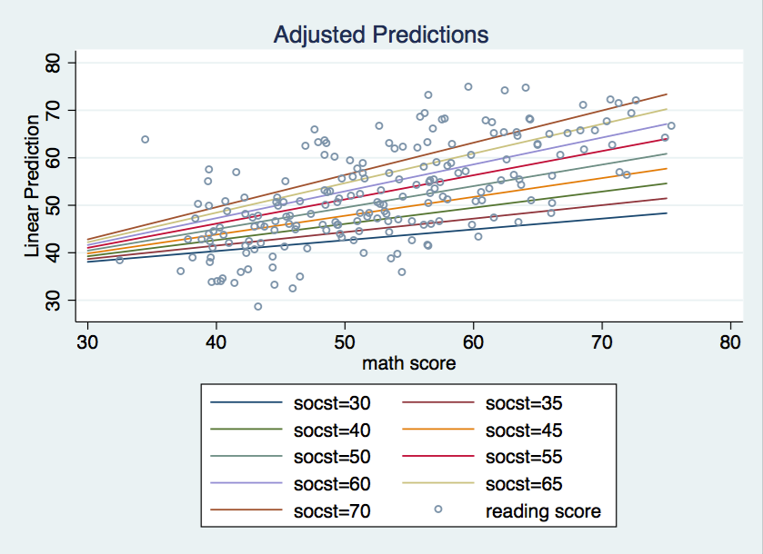

Interaction
The slope of one continuous variable on the response variable changes as the values on a second continuous variable change
$y=β_{0}+β_{1}x_{1}+β_{2}x_{2}+β_{3}x_{1}x_{2}$
In R: lm(y ~ x1 * x2)
https://stats.idre.ucla.edu/stata/faq/how-can-i-explain-a-continuous-by-continuous-interaction-stata-12/
Notes:
Continuous interaction is a somewhat difficult topic, but we will cover a brief overview of it here.
Interaction occurs when two variables interact to create a bigger (or smaller) response when their values are larger. In other words, the effect of x1 on y is not the same depending on the value of x2.
In the model above, the effect of a one-unit increase of x1 when x2 is held constant is beta-1 + beta-3 times x2. If beta-3 is positive, this means that the impact of x1 is greater when x2 is larger. Hence, the two variables interact to characterize the response.
You can always try to combine variables in this way in your model if you think that the effects of one predictor are enhanced or diminished with varying values for the other predictor.
In R, when you use formula notation for your model, using the * symbol for your predictors will build the model structure shown above – it will estimate the coefficients for x1, x2, and the product of x1 and x2. If you only want the product of the two, then use the colon symbol between them.
The plot on the right shows an interaction. The plot here is x1 vs. y, and each line is a varying value of x2, starting with small values on the bottom and high values of x2 on the top. The slope of the x1 vs y line increase as the values of x2 increase. This means for the model structure on the left, the value of beta-3 is positive.
https://stats.stackexchange.com/questions/4964/is-interaction-possible-between-two-continuous-variables

Slide 22
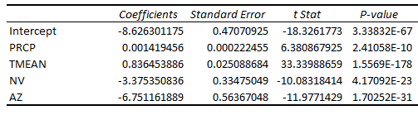
Dummy Variables
Used to indicate categorical predictor variables
PRCP | TMEAN | TDMEAN | CA | NV | AZ
563 | 10.6 | 1.6 | 1 | 0 | 0
211 | 8.7 | -3.1 | 0 | 1 | 0
229 | 9.6 | -2.4 | 0 | 1 | 0
1955 | 10.6 | 2.7 | 1 | 0 | 0
1176 | 4.3 | -5.4 | 1 | 0 | 0
495 | 10.7 | 1.9 | 1 | 0 | 0
599 | 6.5 | -4.3 | 0 | 1 | 0
287 | 8.0 | 0.6 | 1 | 0 | 0
362 | 7.8 | -0.5 | 1 | 0 | 0
1825 | 11.8 | 8.1 | 1 | 0 | 0
167 | 8.4 | -2.8 | 0 | 1 | 0
312 | 5.6 | -3.9 | 0 | 1 | 0
2294 | 13.2 | 6.5 | 1 | 0 | 0
554 | 12.0 | 2.5 | 1 | 0 | 0
1266 | 13.1 | 3.7 | 0 | 0 | 1
Notes:
Sometimes you want to encode categorical data in your model. This can be done using “dummy variables” which are 1/0 representations of whether an observation belongs to a category or not. In order to avoid collinearity, you generally want to use c – 1 variables where c is the number of categories in the data. Otherwise, these three columns always add up to one, which creates strong multicollinearity because the three columns are a linear combination.
In the example shown here, the data shown are the first fifteen rows of a dataframe drawn from three states: California, Nevada, and Arizona. If the site is in California, then it has a 1 in the CA column and a zero in the other two columns. The same goes for Nevada and Arizona.
In this situation, if we wanted to identify the effects of these three categories, we would use c – 1 = 2 dummy variables, with the implication that an observation with a zero in both columns is the third category. Imagine in this situation that California is our baseline, and we want to see the effects of switching to Nevada or Arizona, we might use Nevada and Arizona as the dummy variable columns with the implication that a site with a zero in both the NV and AZ columns is a site in California.
If we set up a model to predict TDMEAN, which is the mean annual dewpoint, and we use these four other variables, the coefficient output in Excel Data Analysis is on the right. Here we can see that all four predictors are significant at alpha = 0.05. Increasing annual precipitation and annual mean temperature increase mean dewpoint. However, for sites in Nevada, they on average have a dewpoint 3.4 degrees Celsius lower than the same precipitation and temperature as California, and in Arizona this value is 6.8 degrees less.

Slide 23
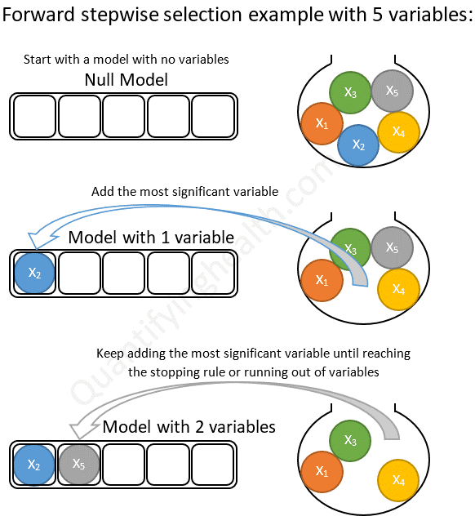
A Note on Automated Variable Selection
Stepwise regression (forward/backward)
Best subsets regression
Use these to support a hypothesis, not build one
https://quantifyinghealth.com/stepwise-selection/
Notes:
Personally I don’t like automated variable selection techniques, such as stepwise or best subsets regression. I think that the risk for building a model that is hard to explain is high, and that spurious relationships can sneak in. When you start with a large number of variables and automate the selection of some set of those such that they maximize an objective (such as finding the maximum adjusted R-squared among combinations of predictors in a big pile), it is not very scientific. The predictors you test and evaluate should prove or disprove some hypothesis about the relationship between the variables. I should have a hypothesis that says that variables A and B together explain variability in the response if I include. both variables A and B in my model.
If you have a large number of variables that you’ve gathered that can all plausibly (and possibly physically) explain the response variable, then sometimes automated variable selection can be helpful, but I would rather stick to well-planned models that are simpler when possible.

Slide 24
Multiple
Linear Regression
Part III: Use in USGS Regional Studies
Gregory S. Karlovits, P.E., PH, CFM
US Army Corps of Engineers
Hydrologic Engineering Center

Slide 25
Regionalization Studies
Regionalization is the use of MLR to develop prediction equations for some hydrologic variable (usually a streamflow characteristic in the USGS).
MLR is used to develop a linear equation relating known values of the streamflow characteristic at a number of gaging stations in the region of interest to one or more measured characteristics of the basins above the gages (eg., basin drainage area, basin slope).
Notes from Chuck Parrett, USGS

Slide 26
Regionalization Studies
Relate a flow characteristic (peak flow, 7Q10, etc) to one or more readily available basin attributes (e.g., drainage area, slope, average precip)
Assumes that a linear relationship is suitable (can transform variables using logarithms or other functions to help meet this assumption)
Notes from Chuck Parrett, USGS

Slide 27
Regionalization Studies
Define the region of interest
Select appropriate gaging stations in the region and compute desired flow characteristics
Select potential predictor variables for use in analysis
Set up GIS database and measure predictor variables for selected stations
Notes from Chuck Parrett, USGS

Slide 28
Regionalization Studies
Select variables
Consider defining subregions
Model Validation / Error Analysis. Test each model carefully for violations of regression assumptions, outliers, and other problems
If developing equations for a series of statistics (i.e. flow-duration percentiles or T-year flows) check for inconsistencies in predictions, and if found, adjust predictor set to eliminate or minimize inconsistencies
After using OLS to initially determine model, use WLS or GLS regression, if necessary, to develop final models, again checking for problems with selected model. In USGS, WLS is commonly used for low flow studies and GLS is commonly used for peak flow studies.
Notes from Chuck Parrett, USGS

Slide 29
Advanced Error Structures
Ordinary Least Squares (OLS) – all y-data (dependent variable) are equally reliable and independent
  Variance of observations equal, no correlation
Weighted Least Squares (WLS) – all y-data are independent but not equally reliable. Weights are used to account for differences
  Variance of observations unequal, no correlation
Generalized Least Squares (GLS) – y-data are neither independent nor equally reliable. More complicated weights are used to account for differences
  Variance of observations unequal, correlation
Notes adapted from Chuck Parrett, USGS

Slide 30
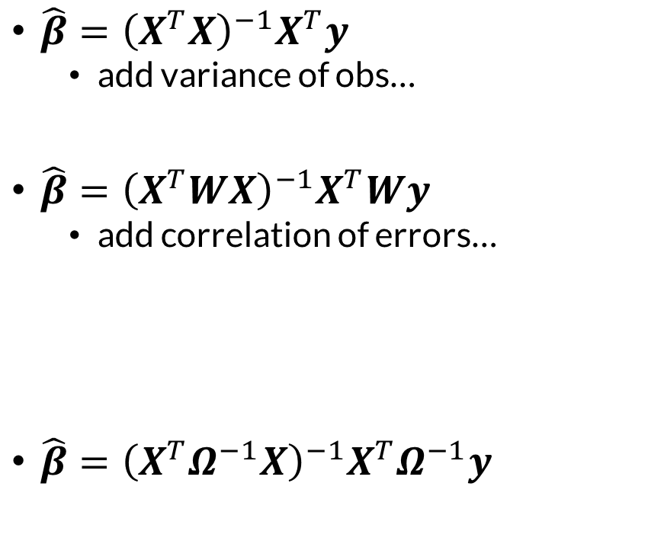

OLS vs. WLS vs. GLS
OLS
$\hat{β}={\left(X^{T}X\right)}^{−1}X^{T}y$
  add variance of obs…
$\hat{β}={\left(X^{T}WX\right)}^{−1}X^{T}Wy$
  add correlation of errors…
$\hat{β}={\left(X^{T}Ω^{−1}X\right)}^{−1}X^{T}Ω^{−1}y$
$W=\left[\begin{matrix}1/{σ_{y_{1}}^{2}} & ⋯ & 0 \\ ⋮ & ⋱ & ⋮ \\ 0 & ⋯ & 1/{σ_{y_{n}}^{2}}\end{matrix}\right]$
$Ω=\left[\begin{matrix}w_{11} & ⋯ & w_{1n} \\ ⋮ & ⋱ & ⋮ \\ w_{n1} & ⋯ & w_{nn}\end{matrix}\right]$
WLS
Variance
Correlation
GLS
Variance

Slide 31
Summary
The additional model complexity in multiple regression requires checking for multicollinearity as well as all the assumptions in simple regression
Multiple regression opens the types and forms of predictors you can include in your model
Notes:
In this video, we discussed additional considerations for multiple linear regression models. Two key points to take away from this video are:
The additional model complexity introduced in multiple linear regression requires checking for multicollinearity in addition to the four regular assumptions made in simple linear regression, and
Multiple linear regression opens up the types and forms of predictors that you are able to include in your linear model.
Thanks, and come back soon to learn about other topics in our statistical methods in hydrology course.

