Slide 1

Exploratory Data Analysis
Greg Karlovits
USACE Hydrologic Engineering Center

Slide 2
Lecture Outline
Data Types and Summary Statistics
Quantitative Visualization
Analysis Questions

Slide 3
Data Types and Summary Statistics

Slide 4
Data are the result of observing or measuring selected characteristics of the study units, called variables.
Variables
Numerical
(Quantitative)
Discrete
Continuous
Categorical
(Qualitative)
Ordinal
Nominal
Discrete set of numbers
Continuous set of numbers
Ranked categories
Distinct labels
See Tamhane and Dunlop (2000), chapter 4

Slide 5
USGS Flow Measurements
USGS
Measuring Agency
USACE
Nominal
Other
Excellent
Good
Fair
Measure Rating
Ordinal
Poor
Unknown
Unspecified
Measure Duration
[<blank>, 0.0, 0.1, 0.2, …] hours
Discrete
Streamflow
in ft³ s⁻¹
Continuous

Slide 6
Numerical Variables
Interval vs. Ratio
Comparable by difference, but not ratio
Comparable by both, has “natural zero”
STRONGER
SCALE
Example:
Temperature
Example:
Distance
80°F is not 4 times hotter than 20°F.
50 km is 10 times farther than 5 km.

Slide 7
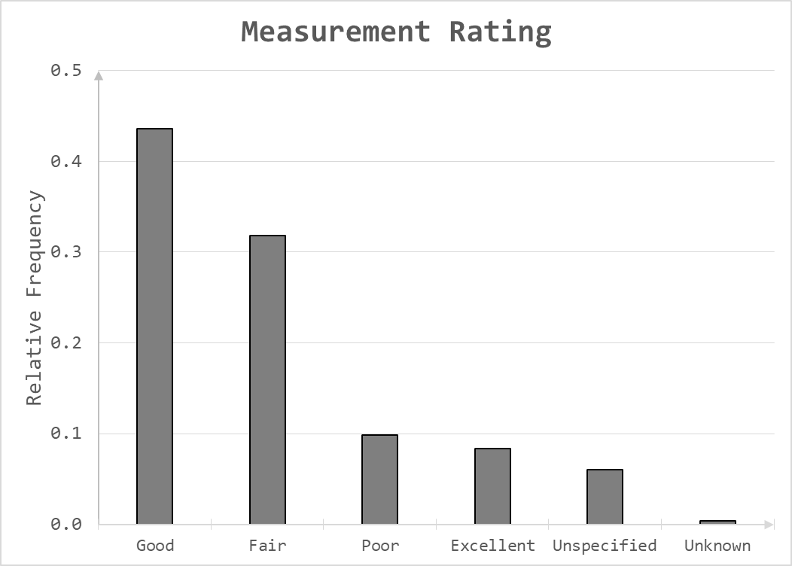
Categorical Data Summaries
Arithmetical operations are not meaningful for categorical data.
Summary statistic:
Count
Rating | Frequency | Relative Frequency (%)
Excellent | 22 | 8.3
Good | 115 | 43.6
Fair | 84 | 31.8
Poor | 26 | 9.8
Unknown | 1 | 0.4
Unspecified | 16 | 6.1
Total | 264 | 100
Frequency Table
Pareto Chart

Slide 8
Numerical Data Summaries: Percentiles
10.0
100%
10
10
10
9
9
9
9
8
8
8
7
6
6
6
5
5
5
4
4
4
4
4
3
3
2
2
2
1
1
1
The α-percentile of a dataset is the data value where α% of the data are below it.
9.1
90%
8.0
75%
Values shown at right have been interpolated.
5.0
50%
3.25
25%
Excel:
=PERCENTILE.INC(x, k)
[R]:
quantile(x, probs)
1.9
10%
1.0
0%
Notes:
Rank data from largest to smallest
Multiply the sample size n by selected α
If result is not a whole number, round up, then:
Count data from smallest to largest
Stop when you hit your rounded value
If the result is a whole number:
Count data from smallest to largest
Stop when you hit your n * α value
Average that value with the next largest value

Slide 9
Numerical Data Summaries: Five-Number Summary
10.0
100%
10
10
10
9
9
9
9
8
8
8
7
6
6
6
5
5
5
4
4
4
4
4
3
3
2
2
2
1
1
1
A quick, standard way to represent a dataset.
Other measures can be derived from it.
8.0
75%
Minimum
25th percentile (first quartile)
50th percentile (median/second quartile)
75th percentile (third quartile)
Maximum
5.0
50%
3.25
25%
[R]:
fivenum(x)
1.0
0%

Slide 10
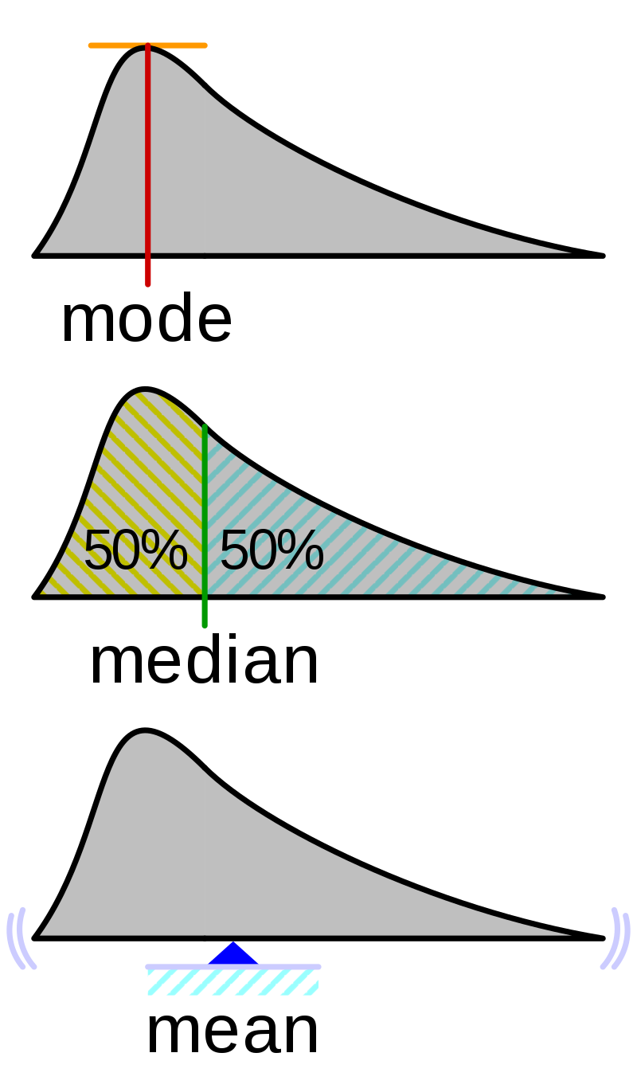
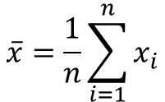
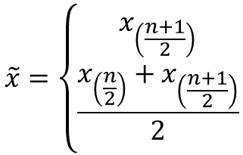
Numerical Data Summaries: Central Tendency
Mean
$$\overline{x}=\frac{1}{n}\sum_{i=1}^{n}{x_{i}}$$
$$x_{min}=x_{\left(1\right)}≤x_{\left(2\right)}≤…≤x_{\left(n\right)}=x_{max}$$
Median
$$\tilde{x}=\left\{\begin{aligned}x_{\left(\frac{n+1}{2}\right)} \\ \frac{x_{\left(\frac{n}{2}\right)}+x_{\left(\frac{n+1}{2}\right)}}{2}\end{aligned}\right.$$
n odd
n even
Mode
Most frequently-occurring value
Notes:
Mean is the first moment of the sample. It is also the center of mass.
Median is the point where 50% of the data are on either side. For symmetrical distributions the mean and median are the same.
Mode is the most frequently-occurring value. For discrete data this might be pretty simple to compute. (Find the value that occurs the most often.)
For continuous data, it’s harder. You might construct a histogram of the data and find the middle value of the tallest bar. You could construct a kernel density plot and find the value corresponding to the tallest part of the density plot (like the image above.) You could fit a parametric model (i.e. a probability distribution) and get the distribution’s mode.
Data can have multiple local maxima (be multi-modal) but in general we won’t deal with data like that here. Typically multi-modal data arise in hydrology due to some amount of inhomogeneity – that is, they data were not actually sampled from the same population.

Slide 11
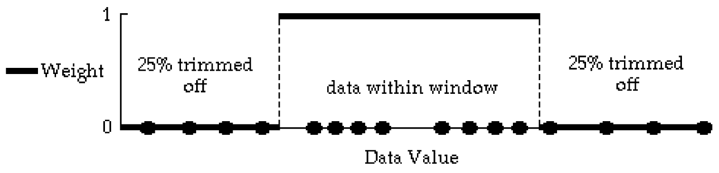


Numerical Data Summaries: Central Tendency (Robust)
Weighted averaging schemes
Trimmed Mean
Weighted average of many values
[R]:
mean(x, trim = 0.25)
$$MH=\frac{Q_{1}+Q_{3}}{2}$$
Midhinge
Weighted average of 2 values
Q₁ – first quartile (25th percentile)
Q₃ – third quartile (75th percentile)
$$TM=\frac{Q_{1}+2Q_{2}+Q_{3}}{4}$$
Trimean
Weighted average of 3 values
Q₁ – first quartile (25th percentile)
Q₂ – median (50th percentile)
Q₃ – third quartile (75th percentile)
Notes:
Trimmed mean is a weighted average where the weight is 0 for anything “outside” the window and 1 for anything “inside” the window. It uses all values in the middle 50% to compute the mean.
Trimean is a weighted average of the quartiles with double the weight given to the median. It’s a surprisingly good estimator and can be derived from the five number summary.
If I review a report and you gave me a Trimean for a sample, I will definitely give you a high-five the next time I see you.

Slide 12
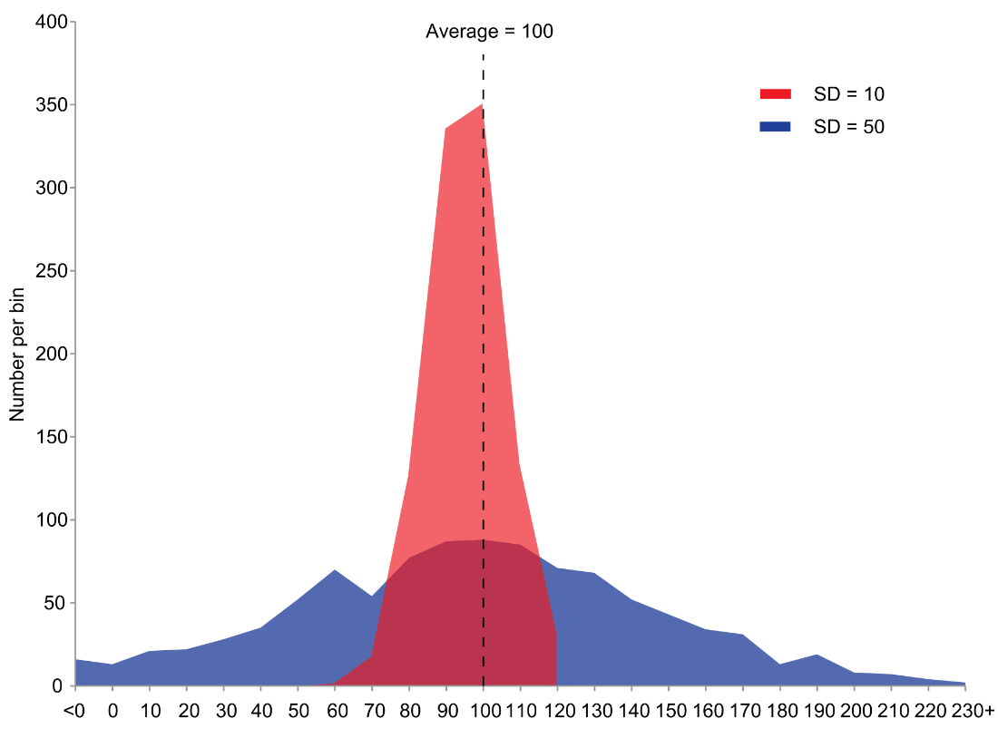
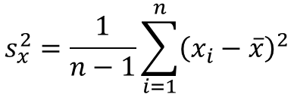


Numerical Data Summaries: Dispersion
Variance
$$s_{x}^{2}=\frac{1}{n−1}\sum_{i=1}^{n}{{\left(x_{i}−\overline{x}\right)}^{2}}$$
Standard Deviation
$$s_{x}=\sqrt{s_{x}^{2}}$$
Coefficient of Variation
$$CV=\frac{s_{x}}{\overline{x}}$$
Notes:
For the structural engineers, variance is conceptually similar to the moment of inertia of the data where the axis is at the mean of the data (which is the center of mass).
The CV is great for comparing things that don’t have the same mean (this can come up when comparing measures from different unit systems, but are both ratio scales) but can be finicky when the mean gets close to zero.

Slide 13


Numerical Data Summaries: Dispersion (Robust)
Inter-Quartile Range
Q1 – first quartile (25th percentile)
Q3 – third quartile (75th percentile)
$$IQR=Q_{3}−Q_{1}$$
Median Absolute Deviation
median distance between each data point and the sample median
$$MAD=median\left(\left|x_{i}−\tilde{x}\right|\right)$$
Notes:
Another one is the quartile coefficient of dispersion – I don’t see it used a lot but it’s attractive. It’s the IQR divided by the sum of Q1 and Q3 which makes it scale-invariant like the coefficient of variation.

Slide 14
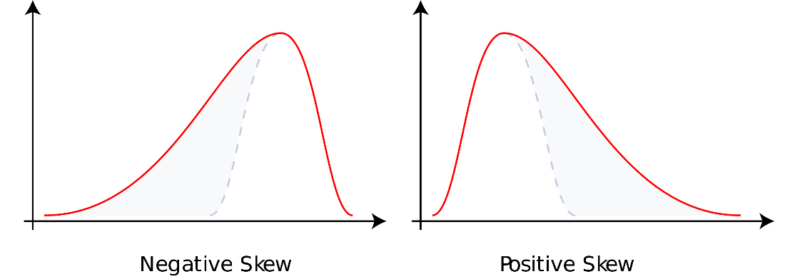
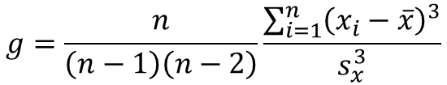
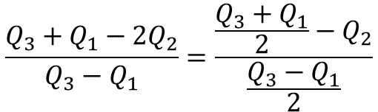
Numerical Data Summaries: Asymmetry (Skew)
Coeff. of skewness
$$g=\frac{n}{\left(n−1\right)\left(n−2\right)}\frac{\sum_{i=1}^{n}{{\left(x_{i}−\overline{x}\right)}^{3}}}{s_{x}^{3}}$$
Yule’s
Coeff.
$$\frac{Q_{3}+Q_{1}−2Q_{2}}{Q_{3}−Q_{1}}=\frac{\frac{Q_{3}+Q_{1}}{2}−Q_{2}}{\frac{Q_{3}−Q_{1}}{2}}$$
Notes:
Coefficient of skewness is used in Bulletin 17 computations. The fanciness with the n terms at the start is a degrees-of-freedom correction that tends to 1/n as n -> infinity. The coefficient of skewness is a central moment, and it is also a standardized moment – by dividing by the cube of the standard deviation it is made unitless.
Yule’s coefficient makes a lot of sense when you look at the unsimplified version. It’s the difference between the average of Q1 and Q3 and the median, normalized by (half of) the IQR.

Slide 15
Visualization
Notes:
The stem-and-leaf plot is often talked about and used as an example of a visualization technique but I think it’s obnoxious and outdated. It’s like a poorly-functioning histogram.

Slide 16
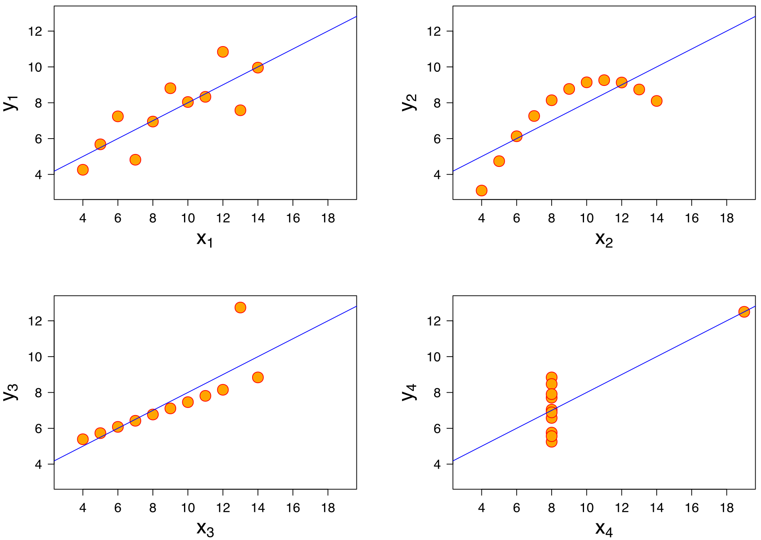
Why should you look at your data?
Property | Value
Mean of x | 9
Sample variance of x | 11
Mean of y | 7.50
Sample variance of y | 4.125
Correlation between x and y | 0.816
Linear regression line | y = 3.00 + 0.500x
Coefficient of determination of the linear regression | 0.67
Notes:
https://en.wikipedia.org/wiki/Anscombe%27s_quartet

Slide 17
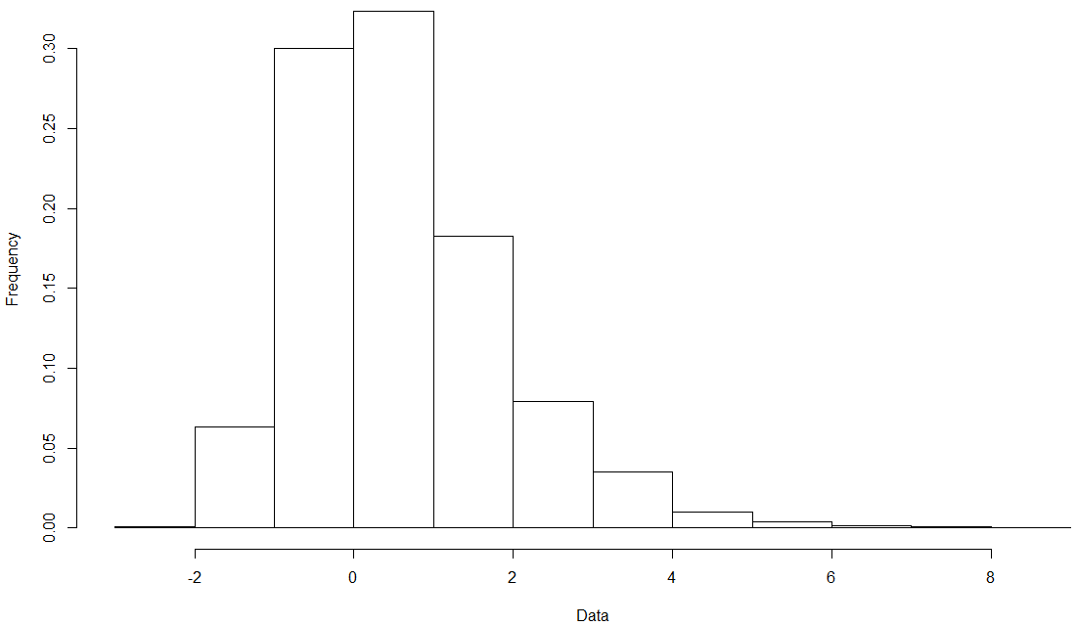
Histogram
Excel:
=FREQUENCY(data, bins)
[R]:
hist(x)
Notes:
A histogram is a technique for viewing univariate data. Multiple histograms could be overlaid to observed the difference between variables if they have the same scale or are properly normalized.
The data are discretized into “bins”, which are usually equally-sized intervals of the data. The data are counted by the number that fall within each bin.
Histograms are sometimes displayed with raw counts (i.e. the counted number of data within a bin), and sometimes with the frequency (which is the count divided by the total sample size).
Coming up with what boundaries to use for the bins can be tricky. There are a multitude of “rules”, usually based on the underlying sample size, for estimating the bin “edge” values to use. The default in the [R] programming language is Sturges’ formula, which computes bin sizes using ceil(log2(n)) + 1 – and is very simple. Sometimes it is a hand optimization problem to make the figure look how you’d expect. The bin sizing is a “parameter” in the sense that you can change it, and your results will change.
What does this plot show?
Right skewed (positive skew) data
A mode somewhere between 0 and 1

Slide 18
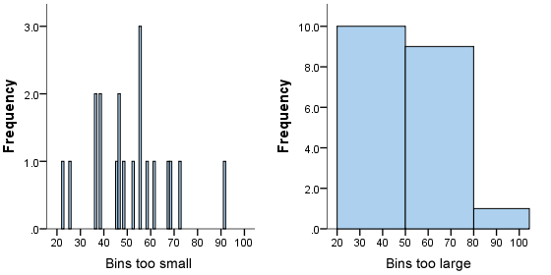
Histogram
https://statistics.laerd.com/statistical-guides/understanding-histograms.php
Notes:
Bins too small don’t help you see the general shape of the data.
Bins too big overgeneralize the data as well. Finding the right size in-between might take a little hand optimization.

Slide 19
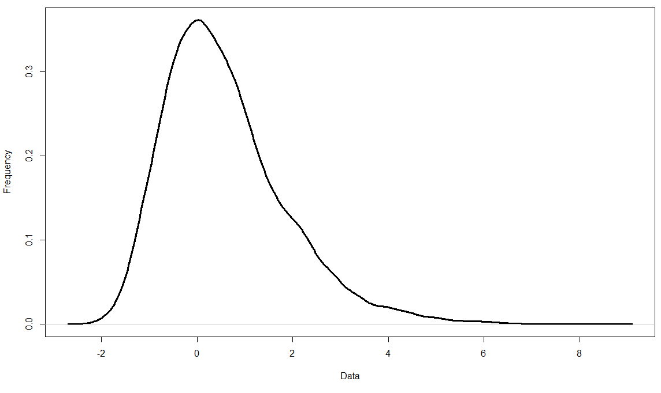
Kernel Density Estimation
[R]:
density(x)
Notes:
Kernel density estimates represent the same thing as histograms, except instead of counting the points in discrete bins, it represents each data point as a “kernel”. Then, for a range of values of the data, it sums up the kernels for each of the data points.
Similar to the histogram, the density is sensitive to choice of kernel and a parameter called the “bandwidth”, which controls the shape of the kernel. These two items might be thought of as parameters, but realistically you still can’t go outside the range of your data with this method.
Common kernels include the Gaussian (which makes little bell curves), the uniform (also called the “boxcar” function), the triangular, parabolic, and so on. For many applications the Gaussian is perfectly appropriate.
This process is much easier to do using something like [R] or Python than doing it by hand.
What does this plot (which is illustrating the same population as the histogram two slides ago, standard Gumbel noise) show?
Still right-skewed
Mode is right around zero

Slide 20
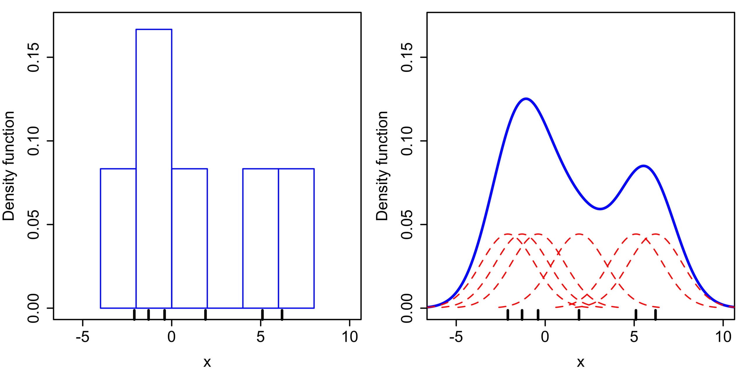
Kernel Density Estimation
Notes:
On the left is a histogram, with vertical tics on the x-axis representing the data observations. On the right is the same data represented using a density plot and Gaussian kernels. Note that the peaks of each of the dashed red bell curves corresponds to a single observation. The bandwidth controls the width of the little red bell curves. To compute the thick blue line, imagine for several values on the x-axis, projecting a vertical line through the red dashed lines and adding up all of their values.
Computing density plots is far easier with computer tools.
Note that the second plot shows evidence of bimodality, which could potentially be challenging for using some kinds of models (most are unimodal.)

Slide 21
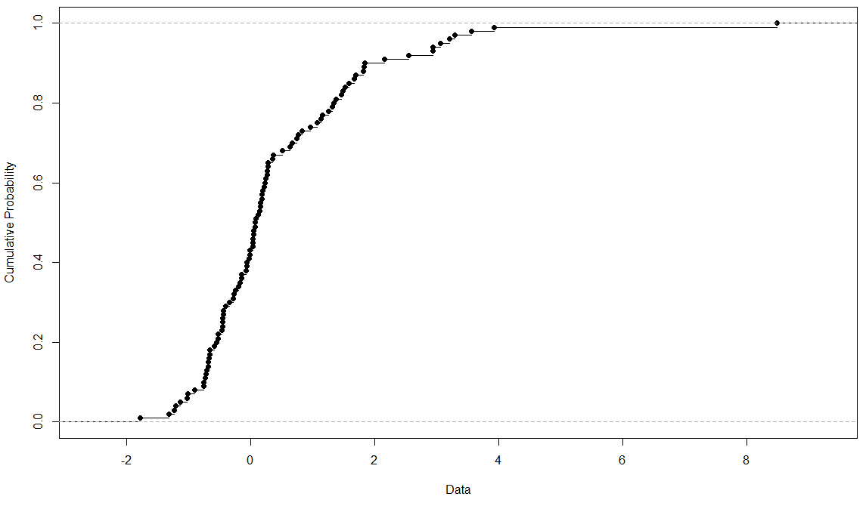
Empirical CDF (eCDF)
[R]:
ecdf(x)
Notes:
What does CDF stand for? Cumulative distribution function.
The eCDF is similar to the histogram except instead of having constant width bins of data and finding the frequency of data in that bin, you have a constant width of probability for each data point. In most cases this weight is 1/n where n is the sample size. There are no parameters in this way of displaying the data, although there is the implicit assumption that each observation has a probability of occurring of 1/n. Truly this value only exists in the limit (n appr inf) with p(X = x) appr 0.
What is the cumulative probability of the largest datum in this sample? 1. What does this imply? The probability of exceeding the largest value in the data is 0.
What can you learn from this plot?
The data are right-skewed, there is a long tail out to the right.
The mode of the data is around zero (the points are clustered close to that area).

Slide 22
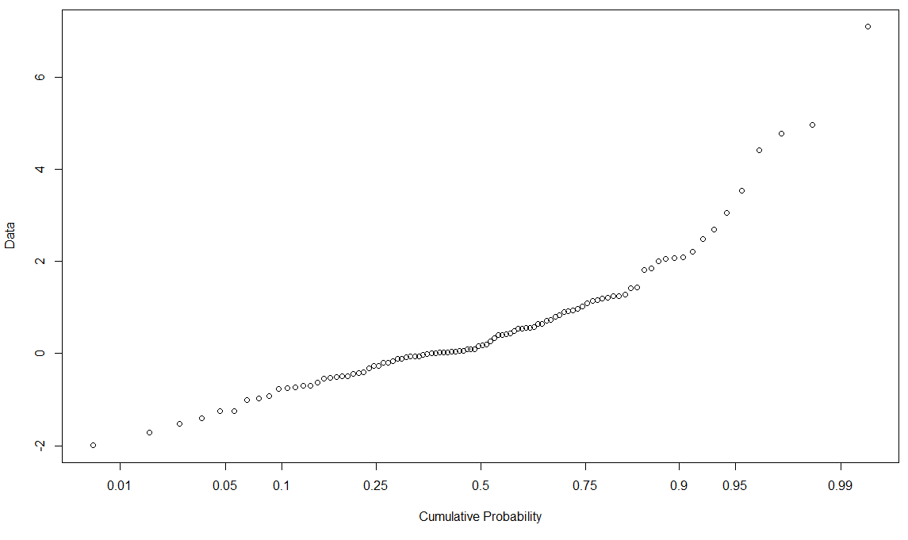
Empirical Quantile Plot
Data Value
Estimated
by plot pos
Notes:
Recall plotting positions from this morning. Plotting positions are an empirical way of representing data and much in the same way represent the same thin as an eCDF, but what’s the difference?
Probability is on the x-axis
The probability axis is not linear, it has been stretched/transformed
The largest value does not have a cumulative probability of 1
Each of the points is associated with an empirical estimate of its frequency which is only based on the sample size. Any time you see a plotting-position based plot, or an eCDF, keep in mind that the points have a position on the plot which is defined by the magnitude of the value, and some frequency estimated from the sample size. The estimate for frequency only comes from the sample size, so there is a profound amount of uncertainty around the estimate when you get to the far left (or right) side, and it is sensitive to the way you compute the plotting position (there are multiple methods.) The plotting position is therefore “parameterized” in only a weak way. You can’t make inferences outside the sample based on the plotting positions well.
This plot has an x-axis that has been transformed using the normal distribution, so data drawn from a normal distribution will show up as a straight line. Keep this idea in your back pocket.
A normal distribution has a skewness equal to zero. If it shows up as a straight line on the normally-transformed plot, what does curvature show?
It is an indicator for skewness – upward curvature (a long left side with values on the right side that curl up like a hockey stick) means positive (right) skew. Downward curvature (a long right side, with values dropping off drastically on the far left) indicates negative (left) skewness.

Slide 23
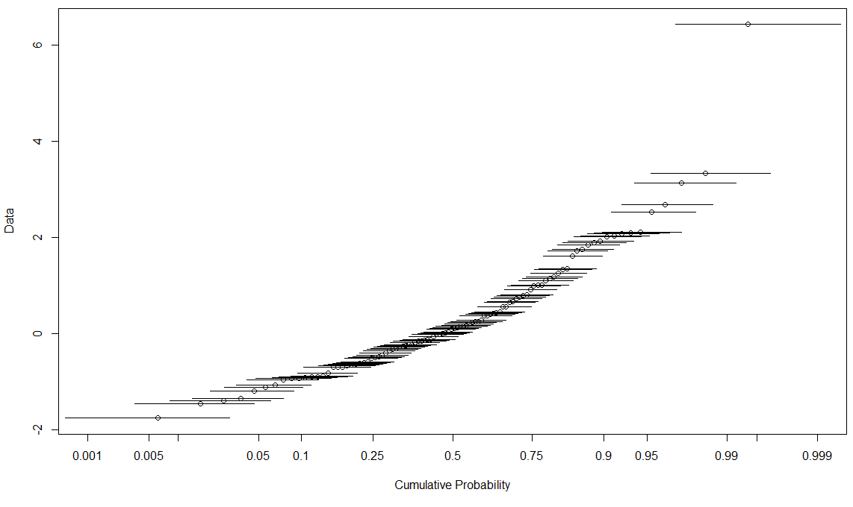
Plotting Position Uncertainty
5%
95%
Notes:
Plotting positions are only estimators for the cumulative probability for the data. They are based only on the rank of the data and the sample size and attempt to make an appropriate estimate of the cumulative probability based on that. There is substantial uncertainty about the actual non-exceedance probability.
One model for this uncertainty is based on the beta distribution and can produce limits like this. Note that the value for the data is treated as constant but may, in real life, also be uncertain.

Slide 24
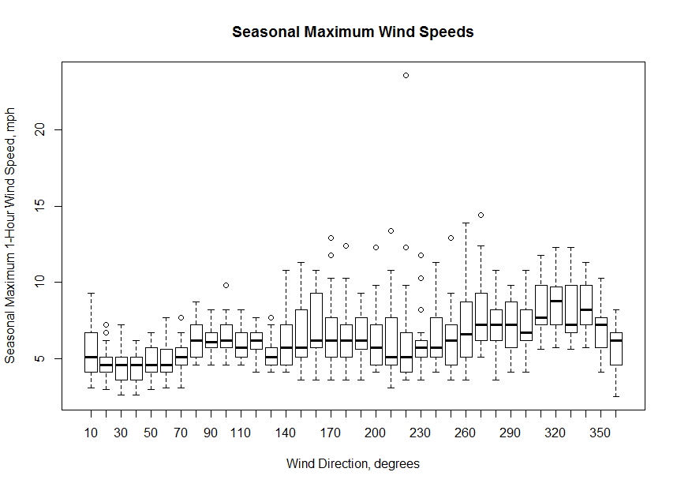
Box Plots
Notes:
Also called “box-and-whisker” plots. You can start to look at multivariate information with these, with one categorical (discrete) variable and one continuous variable.
Here is a box plot looking at the effect of one variable on another. Both variables are continuous, but the x variable is discretized into 10-degree groupings.
What does this show you?
The directions with the highest central tendency is in the range of 300-340, but the highest variability is in the range of 170-260 (wide boxes, long whiskers, outliers).
Most of the data are highly asymmetrical, with most being right-skewed (some looking left skewed around north, 10-40 and 350-360.)
What doesn’t this tell you?
Anything about the behavior of wind direction! This says nothing about how often these directions occur.
You can use these for univariate data but they are most often used to visually represent the difference between two or more sample groups.

Slide 25
Box Plots
Outlier
Q₃ + 1.5 * IQR
75th percentile “Q₃”
Inter-quartile range
(IQR = Q₃ – Q₁)
Median “Q₂”
25th percentile “Q₁”
Q₁ - 1.5 * IQR
210°
Notes:
How would you construct these by hand?
Here is the box (and whiskers) for the slice of wind speed data within ±5° of 210°. It can be viewed as a conditional distribution for wind speeds, conditioned on 205° < x < 215°.
The IQR is a non-parametric measure of dispersion and can mean something similar to variance.
The whiskers are drawn to the value of the last data point within the range which is why the lower whisker seems so short.
Where do you think the mean would be for these data? Somewhere between Q2 and Q3 but closer to Q2.
Would you say that these data are skewed (i.e. have a non-zero skewness)? Yes.
If so, which direction has the longer tail (larger or smaller values)? Larger values.
How can you tell? The distance from Q1-Q2 is smaller than Q2-Q3; the upper whisker is longer; there is a high outlier.
Would you use a normal distribution to model this data? Why or why not? Probably not, a normal distribution would not do a great job capturing the asymmetry of the data.

Slide 26
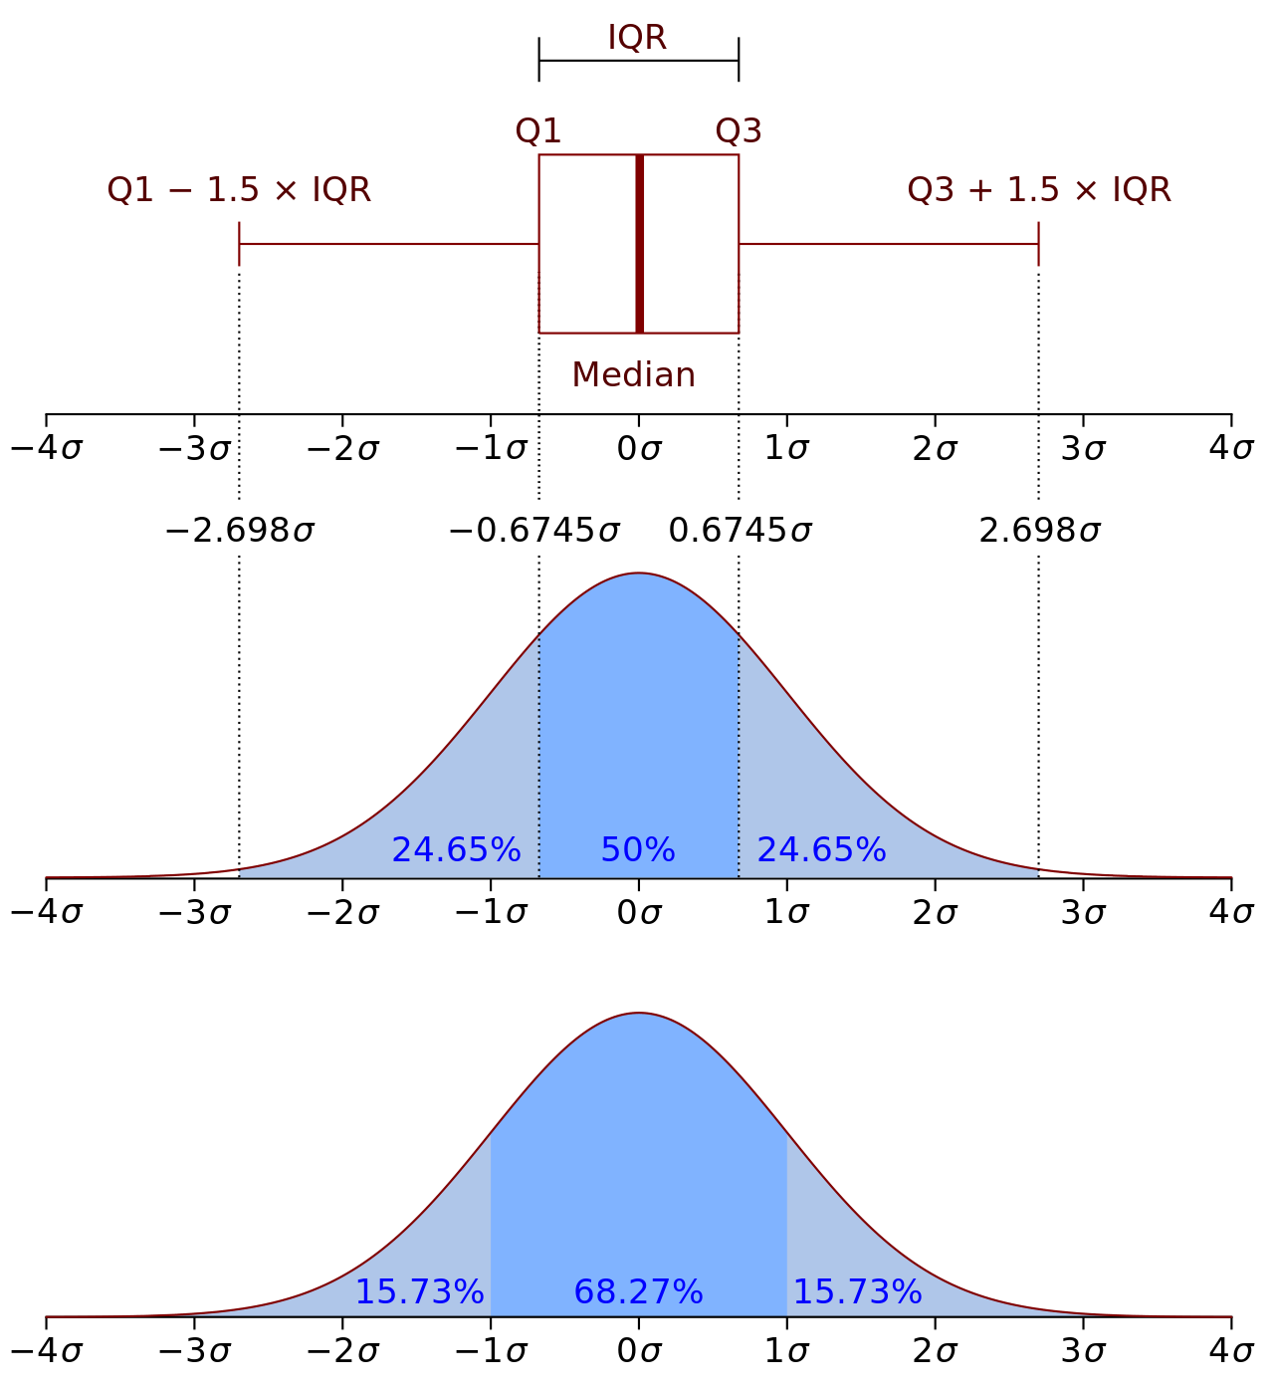
Box Plots
Notes:
Here is a boxplot corresponding to a standard normal distribution.
The top of the three plots shows a boxplot lined up so you can see where the box and whiskers would line up in terms of standard deviations. The IQR is a little bit narrower than a ±σ interval.
The second plot shows how the regions between the whisker and box, and between the boxes, lines up in terms of probability mass underneath the standard normal bell curve. The IQR always has the middle 50% of the data. The distance to the whisker spans quite a bit of data, so in order for a datum to be classified an outlier, it’s greater than (less than) the 99.65 (0.35) percentile – a pretty rare value.
The third plot shows in the middle the ±σ range with about 68% of the data. Outside of that range lives about 16% of the data on either side.

Slide 27
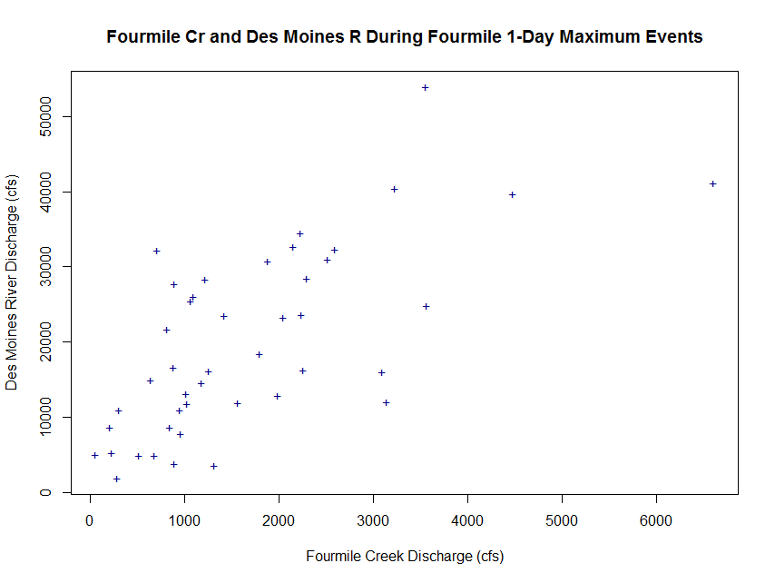
Scatter Plots
Notes:
The scatter plot is a very popular way to visualize 2-dimensional (bivariate) data. It’s very simple to plot each pair with a Cartesian (x, y) coordinate and observe what’s going on.
What does this plot seem to tell us?
Large values of the x-variable tend to also have large values of the y-variable, and small values work the same.
Small values are more likely than large values for both the x-variable and the y-variable.
The scale of the values for the y-variable is about an order of magnitude larger than for the x-variable.

Slide 28
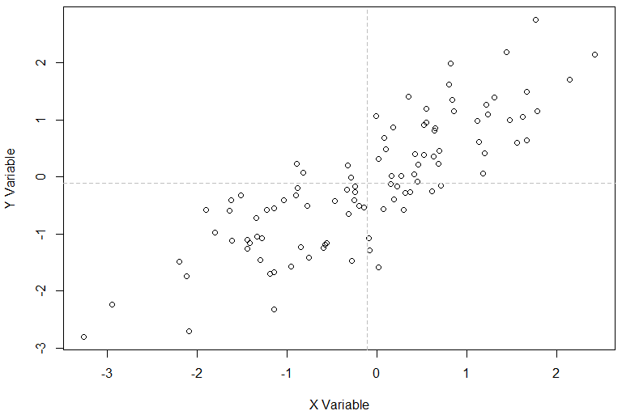

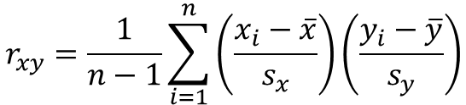

A Note on Correlation
Covariance is a multivariate extension of variance.
Correlation is a normalized version of covariance.
$$\overline{x}$$
$$\overline{y}$$
$$r_{xy}=\frac{1}{n−1}\sum_{i=1}^{n}{\left(\frac{x_{i}−\overline{x}}{s_{x}}\right)\left(\frac{y_{i}−\overline{y}}{s_{y}}\right)}$$
Excel:
=CORREL(x, y)
[R]:
cor(x, y)

Slide 29
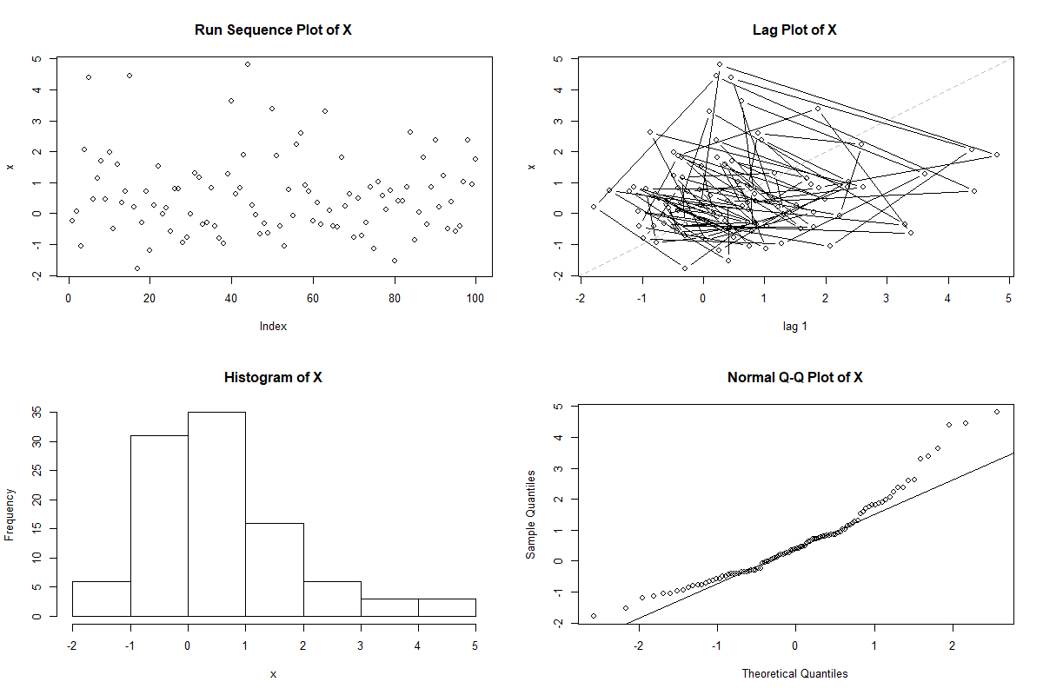
The 4-Plot
Test 4 major assumptions:
Randomness
Fixed distribution, with:
  Fixed location
  Fixed variation
Independent and Identically-Distributed (IID)
Notes:
See NIST 1.2.3

Slide 30
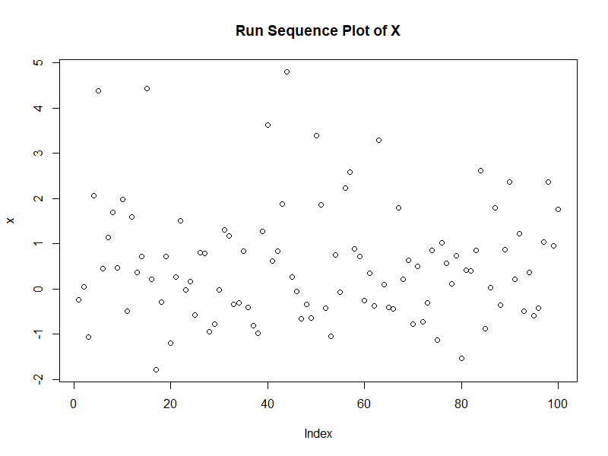
Run Sequence Plot
Plot the data in the order they were observed
Use the order (index) as the x-axis variable
Used to test:
Randomness
Fixed location
Fixed variation
[R]:
plot(x)
Notes:
If the run sequence plot is flat and non-drifting, the fixed-location assumption holds. If the run sequence plot has a vertical spread that is about the same over the entire plot, then the fixed-variation assumption holds.

Slide 31
Run Sequence Plot
Well-Mixed

Slide 32
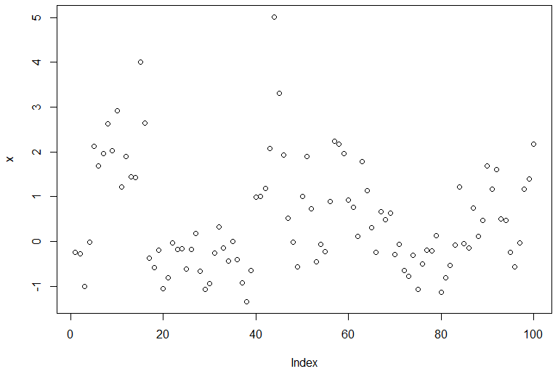
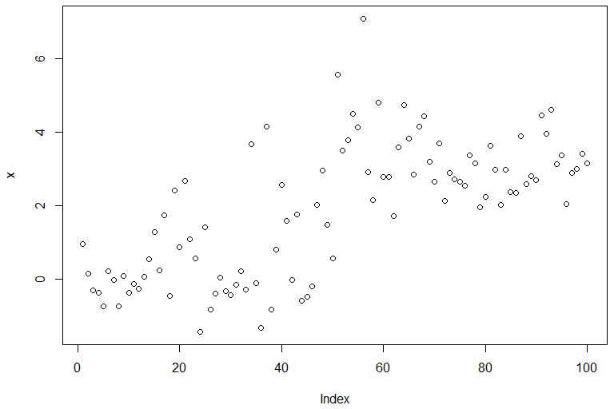
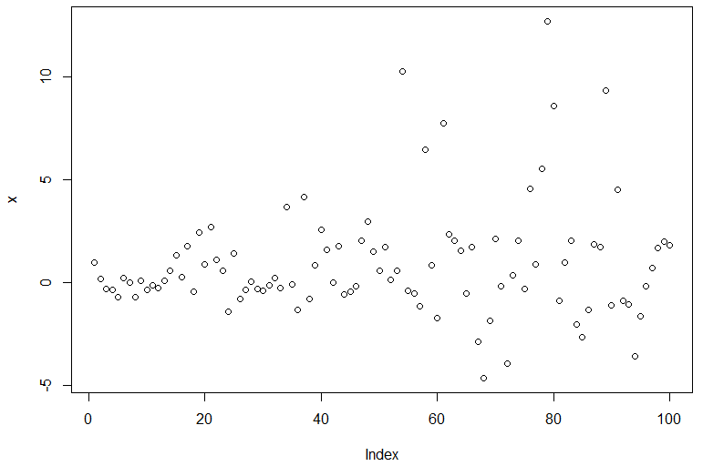
Run Sequence Plot Diagnostics
Potentially
Autocorrelated
Non-Stationary
in Mean
Non-Stationary
in Variance
Notes:
What do you do in each of these cases?
If your data are not stationary in mean, you might need to take one or more sub-sets of the data creating periods where the data have the same mean. You might also consider a model which has a variable mean (especially if the observations are successive in time and the mean can be modeled simply).
If your data are not stationary in variance, you probably have larger issues. You might consider one or more sub-sets here as well. Transformation may help (e.g. logarithms.) A model with variable variance may be possible but can be complicated, as detecting shifts in the variance can be fairly tricky.
If your data show autocorrelation you might not have to do anything, but you’ll have to treat your sample as containing less information than just the number of samples it contains. You might also consider explicitly modeling the autocorrelation, such as through a sinusoidal or AR model (getting into time-series modeling techniques) or by modeling the difference between successive observations, which may be independent.

Slide 33
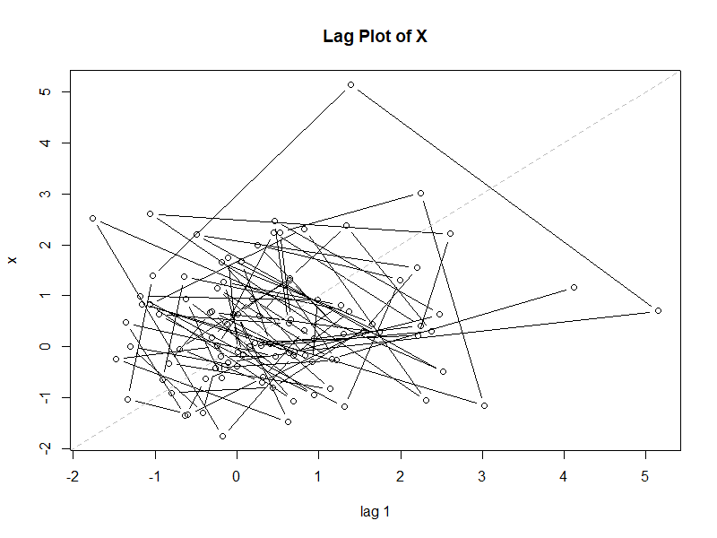
Lag Plots
Plot x_{i-1} vs x_{i}
Add a 1:1 line
Used to test:
Randomness
[R]:
plot(x[-1], x[-length(x)])
abline(a = 0, b = 1)
Notes:
If the lag plot is structureless, then the randomness assumption holds.

Slide 34
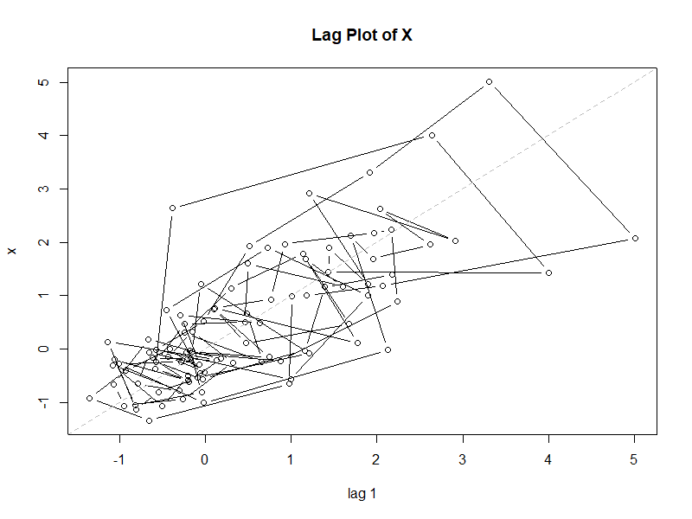
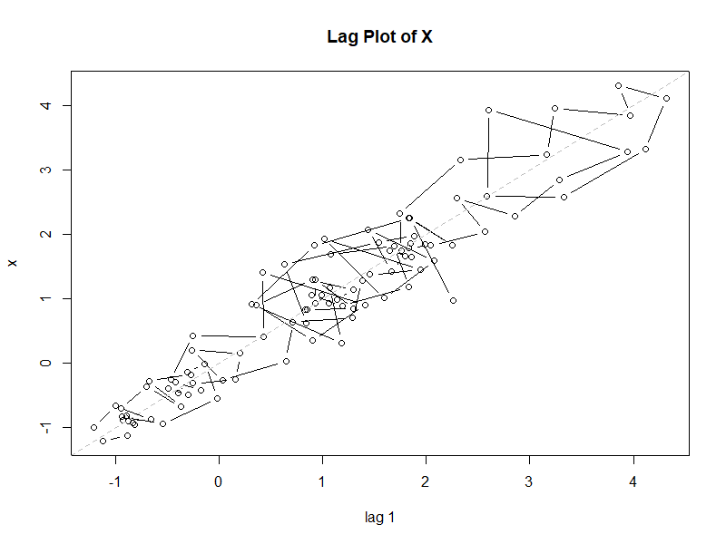
Lag Plot Diagnostics
Potentially
Autocorrelated
Well-Mixed
Definitely
Autocorrelated
Notes:
Looking at the lower-right plot, you can see how you might be able to guess at successive values for this dataset by looking at the previous one. This is actually the basis for autoregressive time-series models.

Slide 35
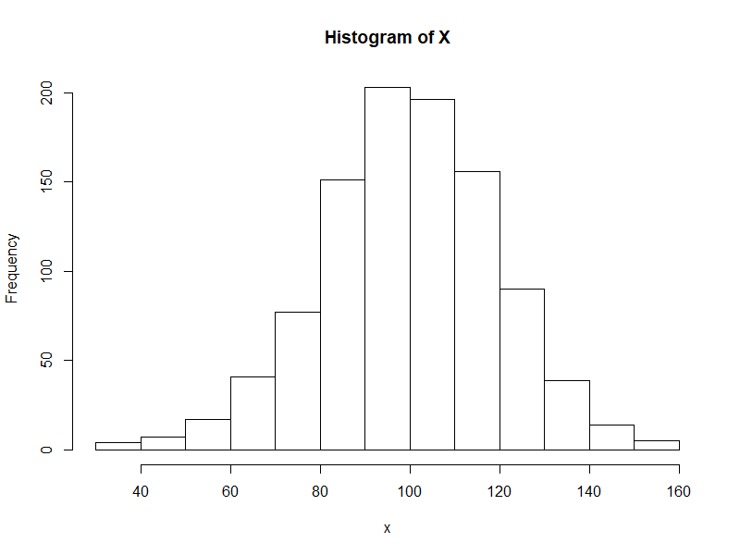
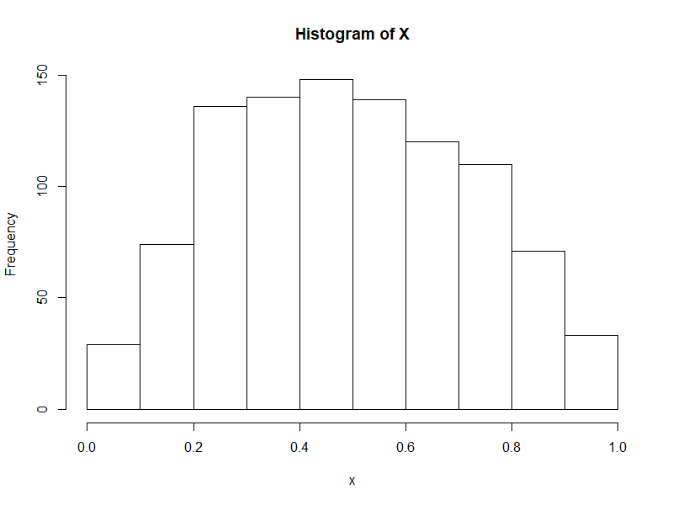
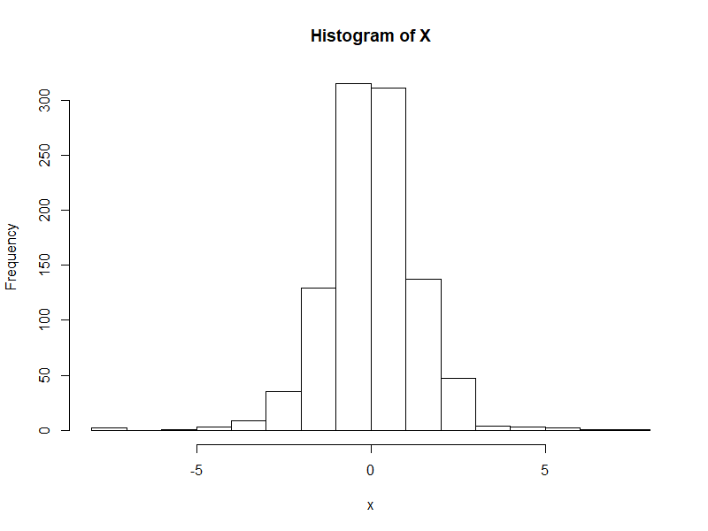
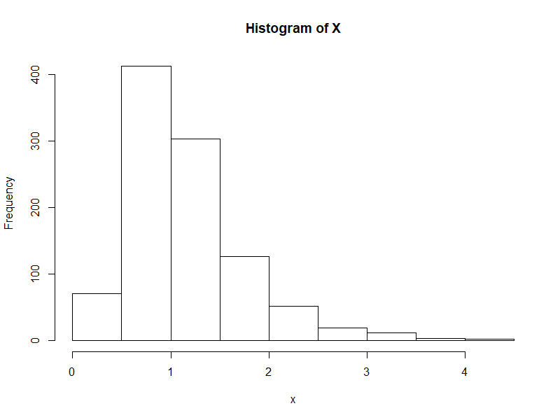
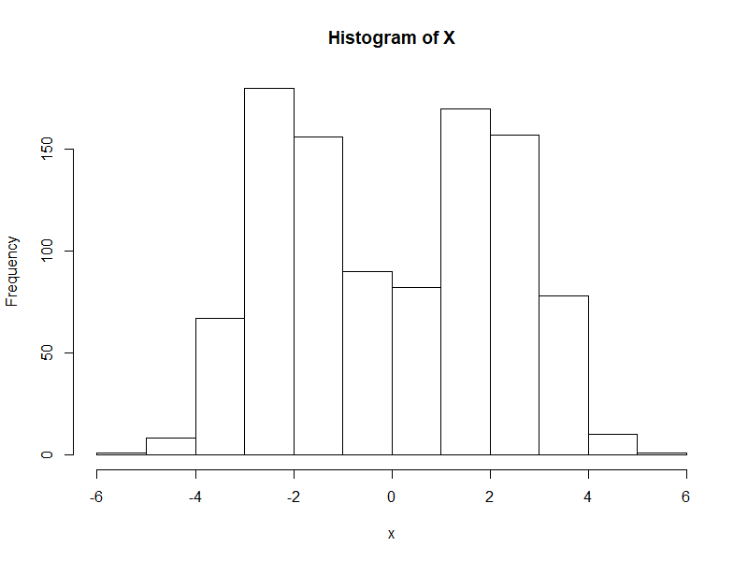
Histogram
Diagnostics
Bell Curve
Short-Tailed
Long-Tailed
Skewed
Bimodal
Notes:
1.3.3.14
The histogram shapes should start to point towards models you might apply to answer questions.
Bell-curves are nice when for when you want to apply the normal distribution, as is the case in many situations. The normal distribution is kind of our null hypothesis for a distribution choice – unless we have a reason to do something else, the normal distribution often works for what we’re trying to do.
Short-tailed samples can be harder because they are not many platykurtic distributions in common use. The beta distribution could be useful.
Long-tailed distributions arise quite often, but not always in the symmetrical case. For symmetrical and long-tailed you might consider the t-distribution or maybe even the Cauchy distribution. Asymmetrical and long-tailed is more common and there are a lot of distributions for that.
Skewed distributions come up all the time. Log-normal and gamma are two very common cases. This example happens to be the Gumbel distribution which is useful in extreme value modeling.
Bimodal distributions are usually mixtures of multiple distributions (for example two normal distributions with different means). There aren’t any distributions which come out bimodal.

Slide 36
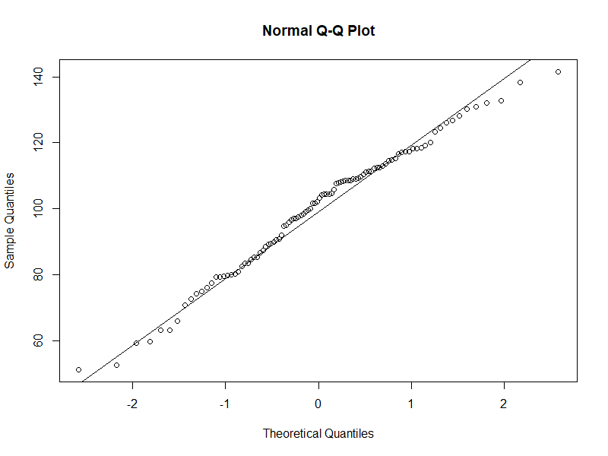

Normal Q-Q Plot
Compute z-scores for data
Plot against sorted data
Plot line through Q₁ and Q₃
Used to test:
Normality
$$z_{i}=\frac{x_{i}−\overline{x}}{s_{x}}$$
Linear
[R]:
qqnorm(x)
qqline(x)

Slide 37
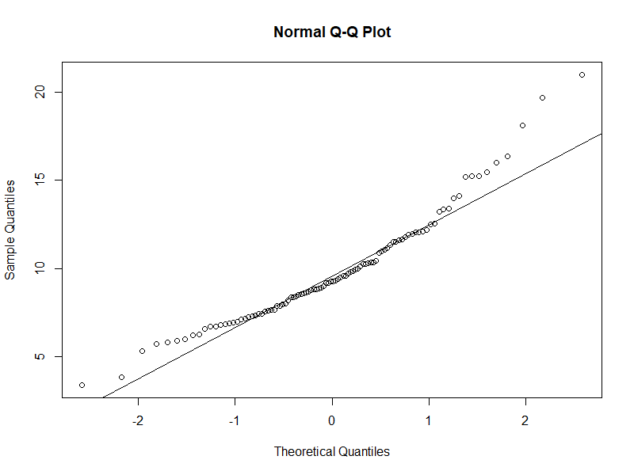
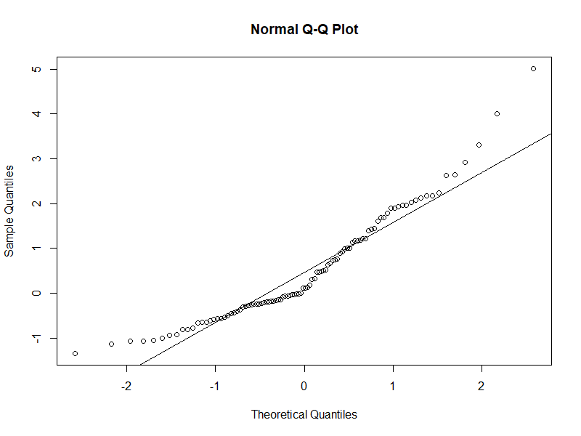
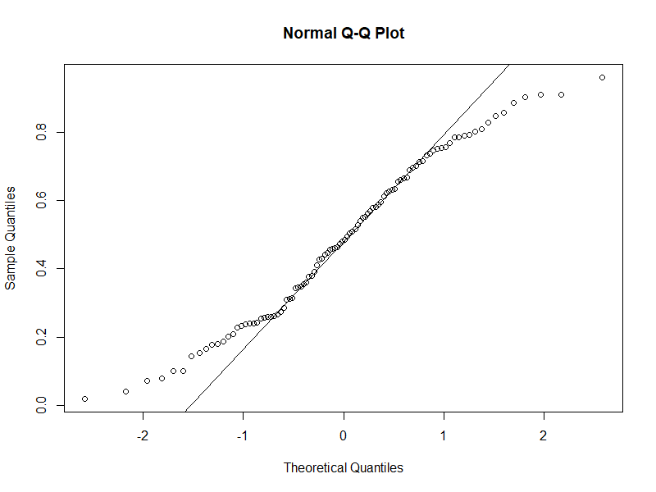
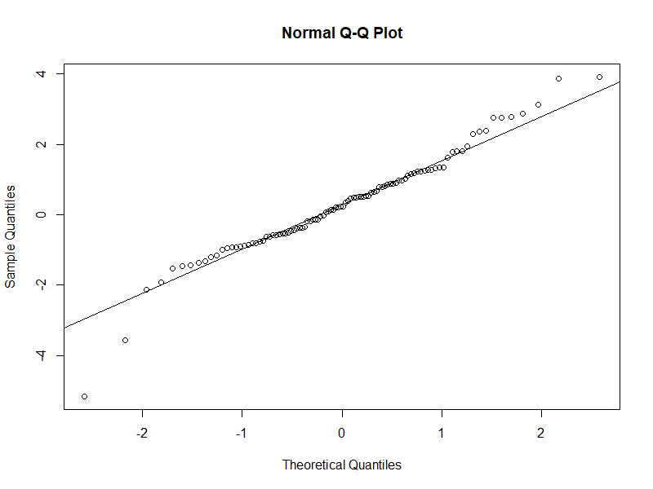
Normal Q-Q
Plot
Diagnostics
Non-Linear
Non-Linear
Bulging
Curled Tails
(Short)
Curled Tails
(Long)
Notes:
Nonlinearity that is either concave up or concave down is usually a mismatch in symmetry (concave up is more positively skewed, concave down is more negatively skewed.)
Bulging is usually a symmetry issue as well, but might also be an indicator that the shape of the peak of the distribution is different.
If the sample quantiles are high on the low end (lower left) and low on the high end (upper right) it means that the normal distribution expects more observations on the extremes than there are in both cases and that the sample is short-tailed.
If the sample quantiles are low on the low end and high on the high end, it means the normal distribution expects fewer observations on the extremes than there are in both cases and that the sample is long-tailed.

Slide 38
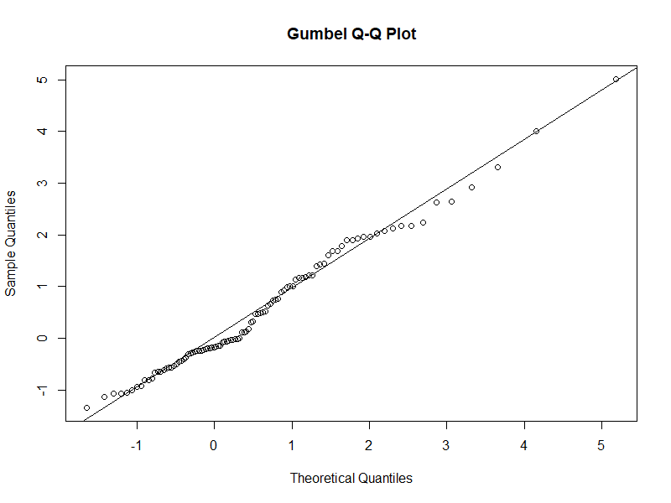
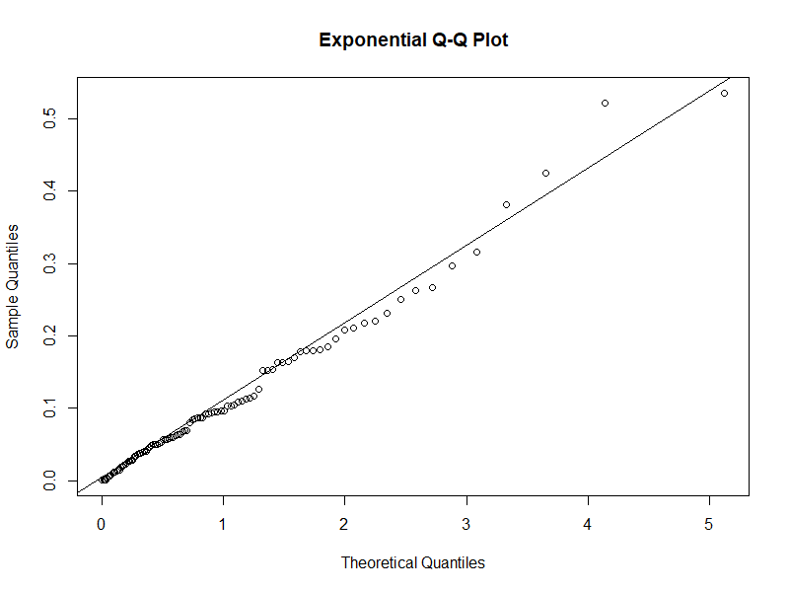


Other Distribution Q-Q Plots
$$x=−ln\left(−ln\left(p\right)\right)$$
$$x=−ln\left(1−p\right)$$
Notes:
The q-q plot is typically used in two ways.
The way shown here is with the “theoretical quantiles” coming from a “standard” version of the probability distribution being considered. For normal q-q this is with mean = 0 and standard deviation = 1. For Gumbel, this is with location = 0 and scale = 1. For exponential this is with rate = 1. You check these plots for linearity, which can be measured with a correlation coefficient. The plotted line goes through Q1 and Q3 of the data so you can see if there’s bulging (the middle of the data curves away from this line) or curling in the tails. The previous example had both of these behaviors. For plots that show strong linearity, you might consider fitting a model of that type to the data.
An alternative use (like the way SSP uses it) is to assess how good a distribution’s fit is. Once you fit a model to the data, you estimate what the “theoretical quantiles” should be for the fitted model, and plot those against the observed data. The line that is plotted is a 1:1 line (i.e. a 45° line) instead of a like through Q1 and Q3 of the data. A perfect fit is shown by all of the points falling right on this line.

Slide 39
Analysis Questions

Slide 40
What Questions Should I Ask of a Set of Data?
What does the data look like?
What is a typical value?
How much do data in a sample vary?
What is a good model for a set of data?
How different are two sets of data?
Is a dataset taken from a single population?
Were the samples taken independently?
This is not an exhaustive list!

Slide 41
What do the data look like?
Use visualization methods appropriate for data type
If the data look this way, what may have created them?

Slide 42
What is a typical value?
Consider measures of central tendency
Look at dispersion measures to see how much the data spread out
Look at histograms or density plots

Slide 43
How much do data in a sample vary?
Frequency-based visualizations can show where the observations fall and how often
  e.g. histogram, density plot
Summary visualizations may tag outliers or show data far from the rest
  e.g. box plots, eCDFs, empirical quantile plots
Measures of dispersion

Slide 44
What is a good model for a set of data?
First check to make sure the sample behaves well enough to use the typical models
  Start with the 4-plot
Look at the shape of the histogram
Examine the Q-Q plot for various distributions

Slide 45
How different are two sets of data?
Look at measures of central tendency
Compare dimensionless measures for higher moments if the centers seem different
Compare samples on the same plot
Use box plots
Use scatter plots

Slide 46
Is the dataset taken from a single population?
Look at the run-sequence plot for drifting central tendency
Look at the run-sequence plot for changes in the spread of the data
Do summary statistics line up with what you see in histograms?

Slide 47
Were the samples taken independently?
Look at the run-sequence plot for periodic behavior
Look at the lag plot for clustering along the diagonal

Slide 48
References
NIST/SEMATECH Engineering Statistics Handbook
Helsel and Hirsch (2002) Statistical Methods in Water Resources
Tamhane and Dunlop (2000) Statistics and Data Analysis from Elementary to Intermediate

Slide 49
Questions?

