Slide 1
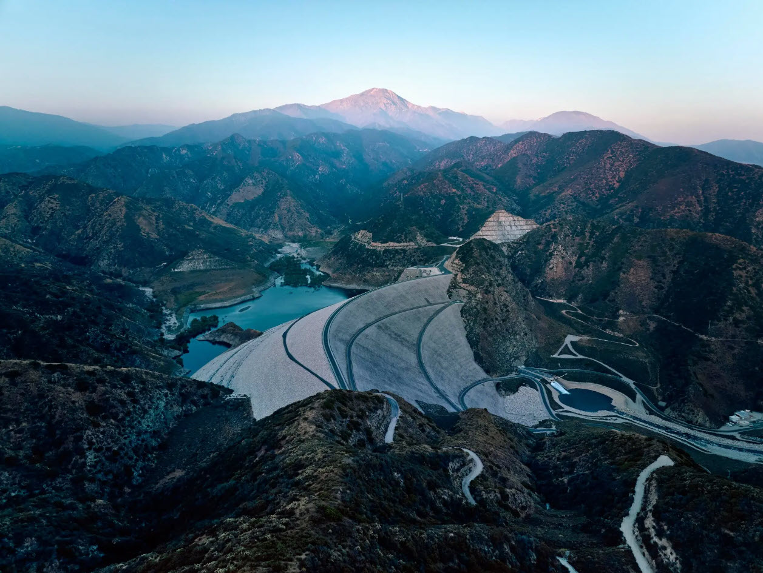
Future of Flood Risk Data (FFRD) Application
Statistical Methods in Hydrology
Mike Bartles, P.E. (some slides adopted from Greg Karlovits, Matthew Dirksen, and Corby Lewis)
2 May 2025
Notes:
Hello everyone. This is Mike Bartles from HEC.
Within this presentation, I’m going to talk about the Future of Flood Risk Data Initiative, or FFRD.
This presentation builds upon several previous lectures that are a part of this class including regional precipitation frequency analyses as well as monte carlo analysis techniques. You should notice several of the tools and techniques that were discussed in those lectures being applied here.
This video is part one within a series of videos devoted to the FFRD topic.

Slide 2
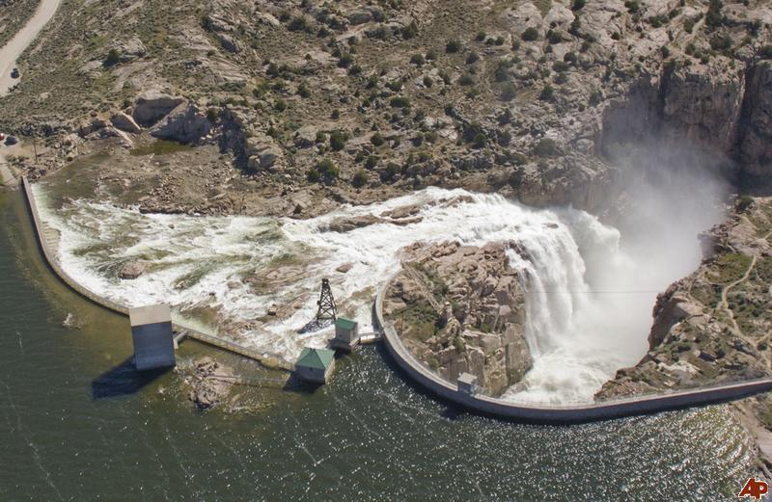
Objectives
FFRD Background
Stochastic Storm Transposition Background
Duwamish Pilot Study
  Modeling Workflow
2
Notes:
First, I’ll present some background information pertaining to the FFRD initiative itself
Then, I’ll provide a primer related to the stochastic storm transposition technique, which is foundational to the
If you know which dam this is, or more specifically which spillway this is, please write it in the comments

Slide 3
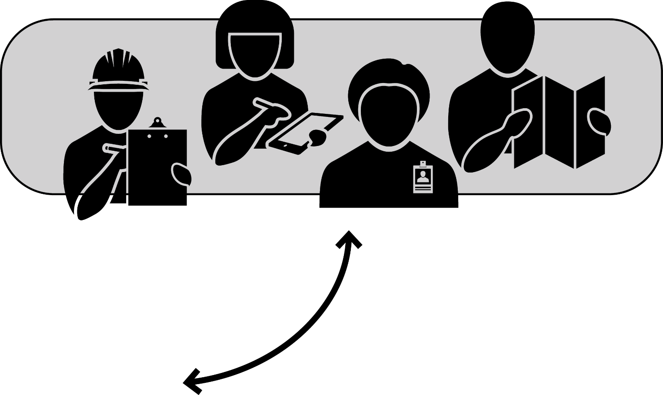
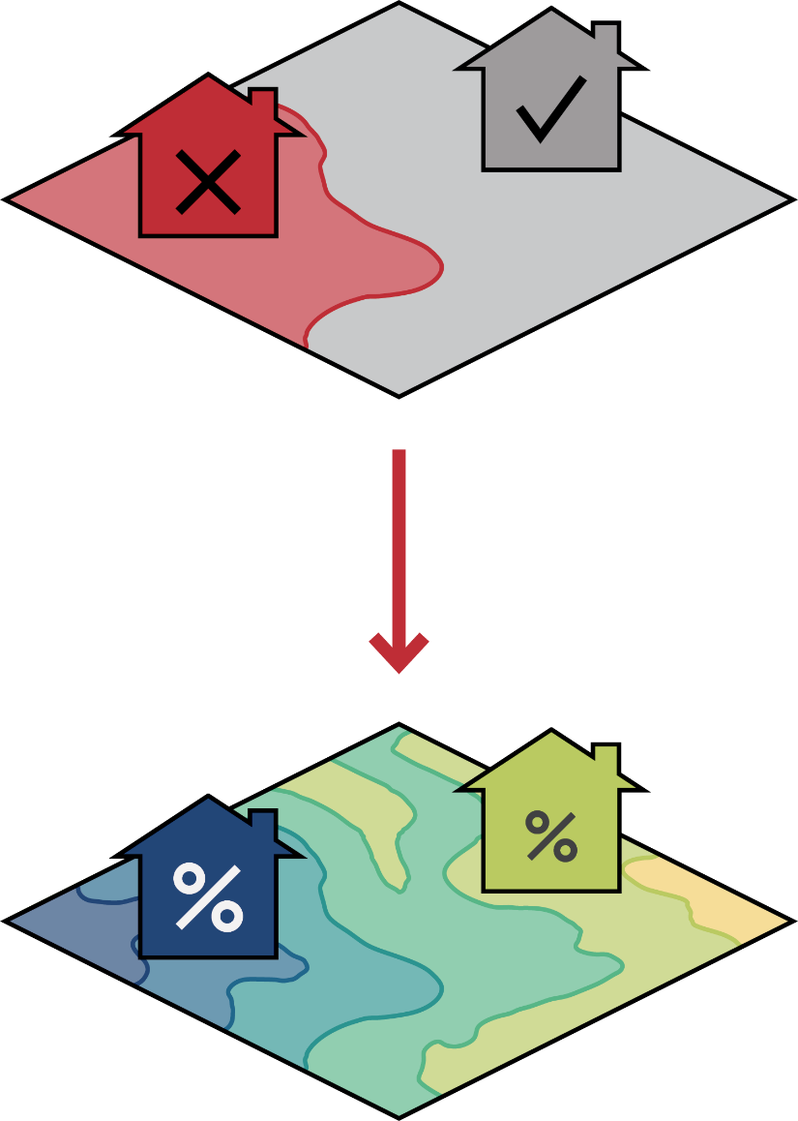
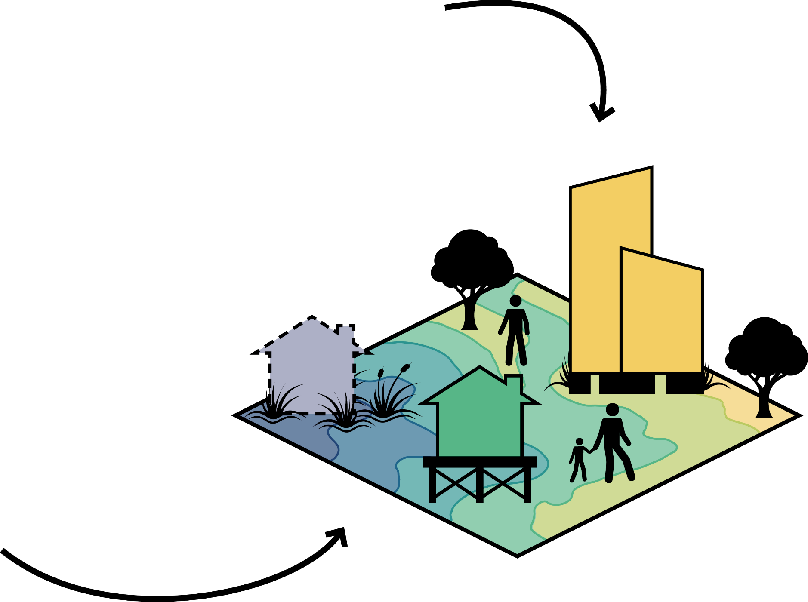
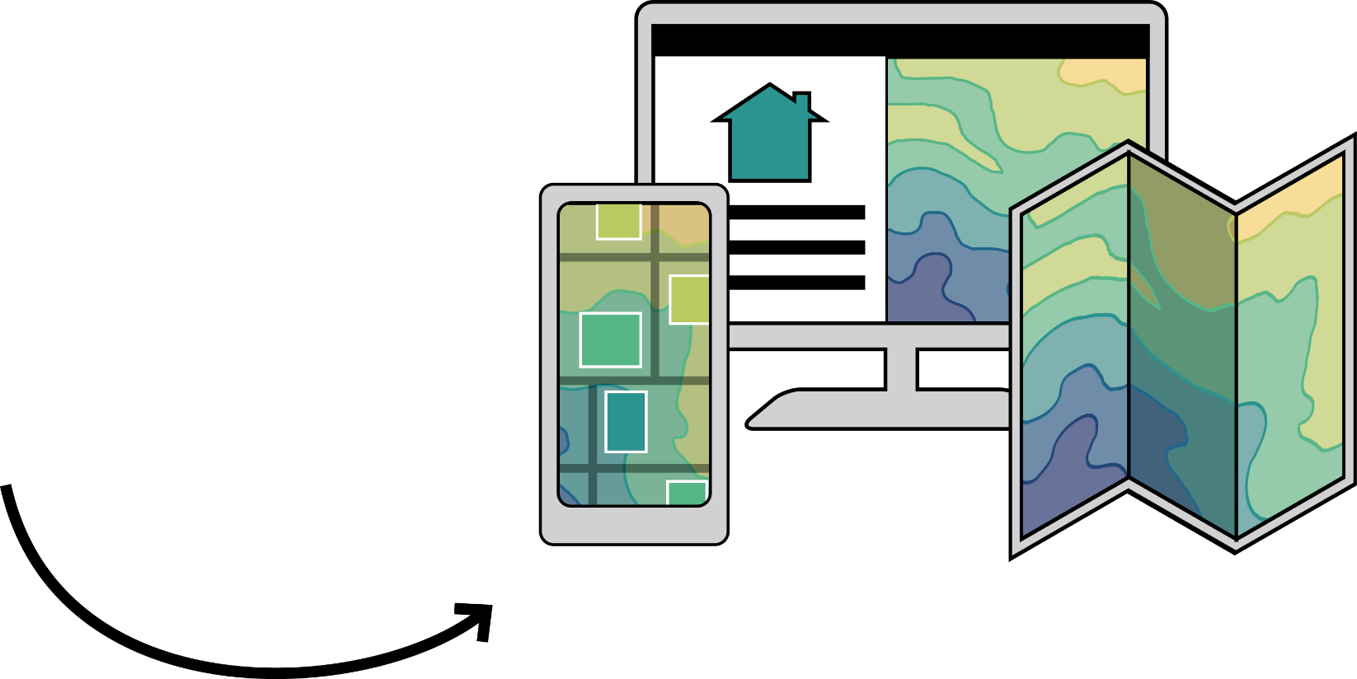
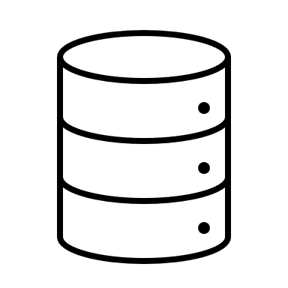
FEMA’s Future of Flood Risk Data (FFRD) Initiative
3
Empower private and SLTT stakeholders
1
Shift from binary to probabilistic analysis
4
Drive risk-informed actions
2
Modernize data management and delivery
3
Notes:
FEMA’s Future of Flood Risk Data Initiative is grounded in four key objectives:
FIRST CLICK: First, to shift from a binary hazard and risk analysis – for example, is a structure in or out of a certain floodplain? – to a probabilistic one that depicts hazards in a graduated manner.
SECOND CLICK: Second, FFRD aims to modernize FEMA’s management and delivery of flood data through the creation of dynamic and flexible services and tools.
THIRD CLICK: These resources should empower stakeholders in the private sector, federal government, and other state, local, tribal, and territorial entities who would have a role in both the development and deployment of such tools.
FOURTH CLICK: And finally, increasing access to rich hazard data should ultimately drive risk-informed mitigation, planning, and insurance actions.
Together, these four objectives can drive a more risk-informed National Flood Insurance Program (NFIP), one that works for many types of users and decision-making scenarios.
In support of FFRD, the U.S. Army Corps of Engineers (USACE) is collaborating with FEMA to provide a methodology recommendation on the framework modeling and data service capability allowing other federal agencies, communities, and individuals to leverage the models to explore structural and non-structural measures for flood risk mitigation.
The framework and base level output data are intended for reuse to evaluate consequences to compute risk-based outputs along with risk reduction measures that do not impact the frequency or scope of the base level output data.
To succeed in achieving all four tenants of the initiative, FFRD data must include a mixture of frequency-based hydraulics and hydrology (H&H) data and consequence data resulting in graduated hazard and graduated risk products.

Slide 4
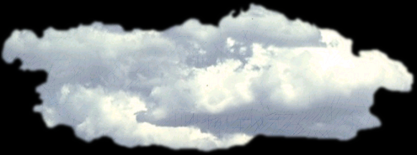
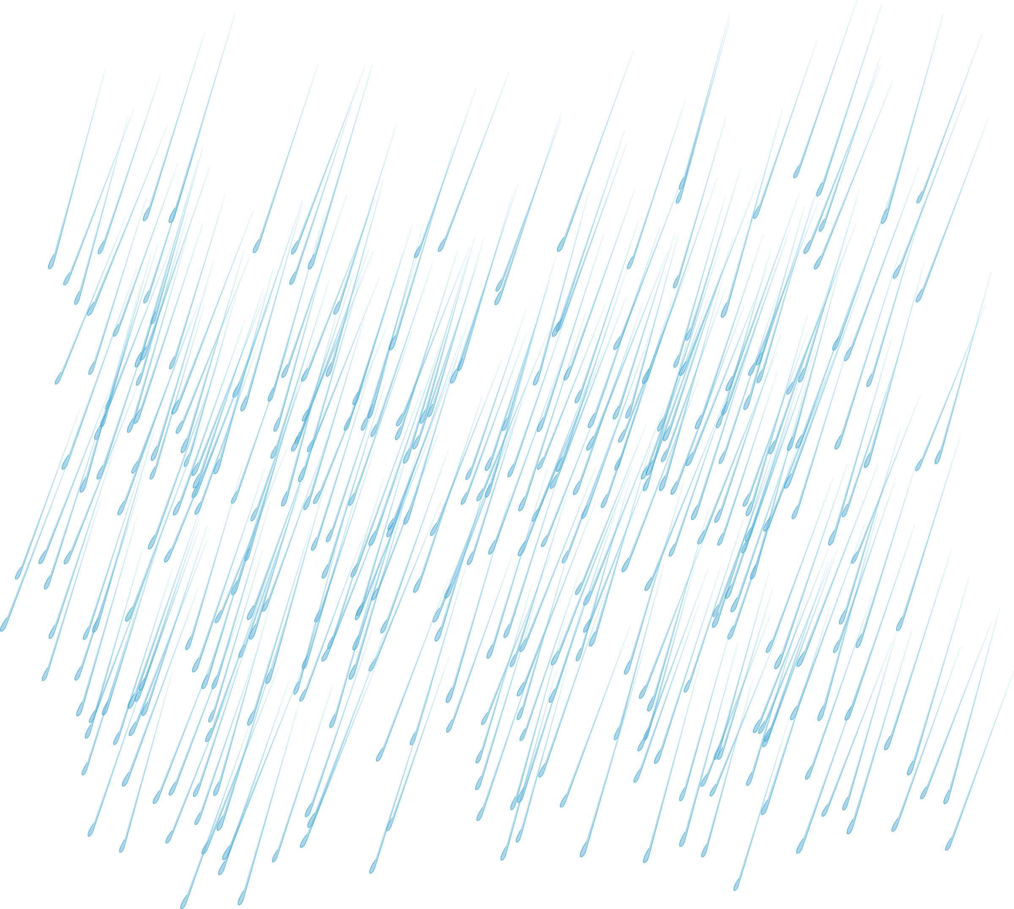
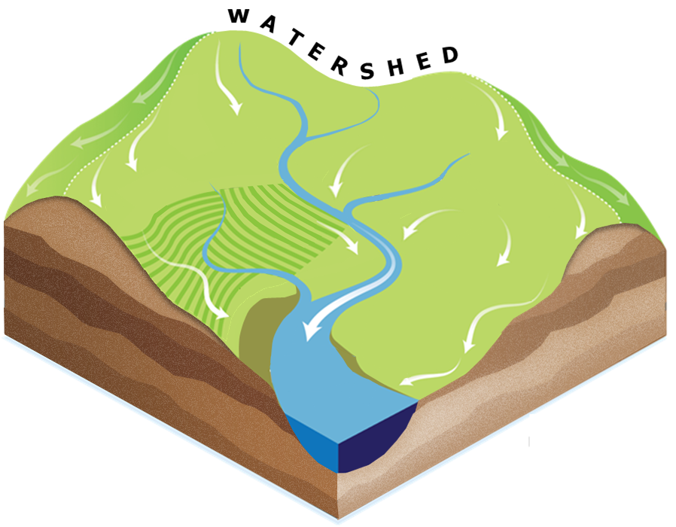
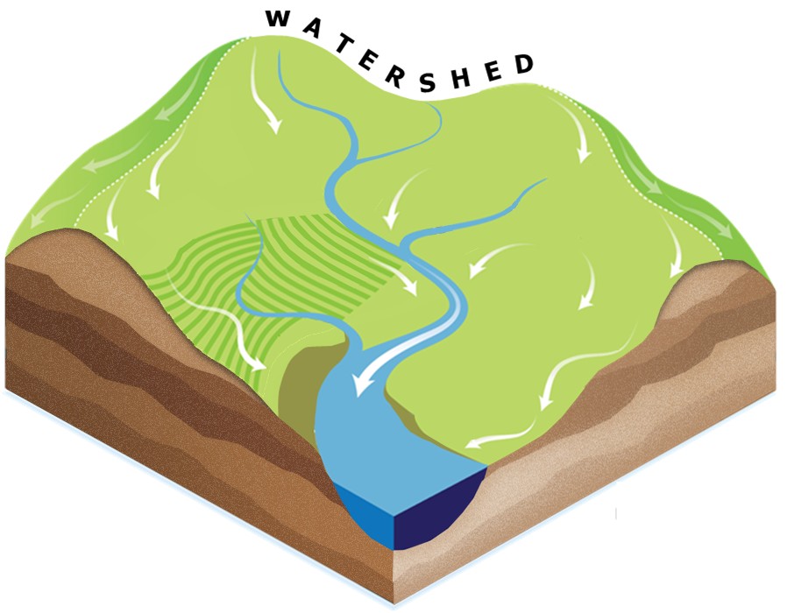
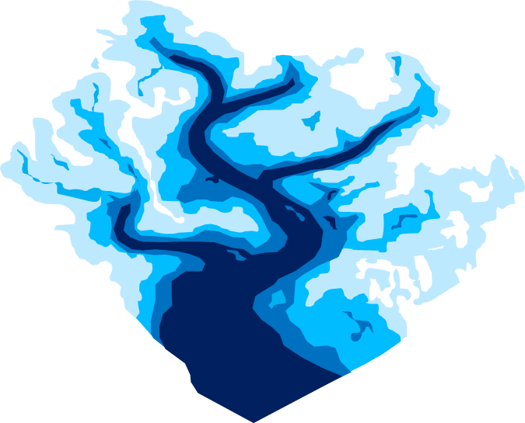







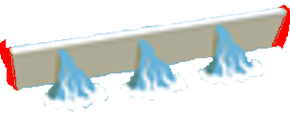
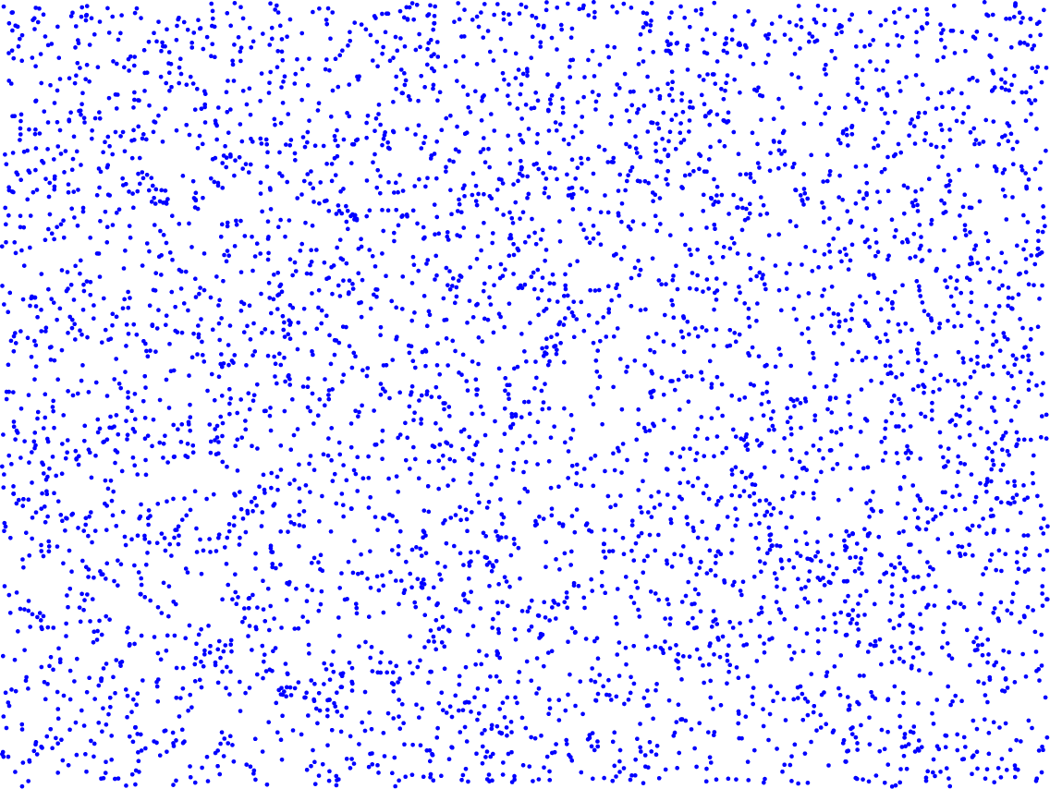
1D Hydraulic Modeling
Fluvial flooding only
Event-based analyses
Analysis Framework
TRADITIONAL / BINARY
CURRENT APPROACH
PROBABILISTIC / GRADUATED
FUTURE APPROACH
Upper Confidence Limit (95%)
Precipitation (in)
2D Hydraulic Modeling
Fluvial and pluvial flooding
Probabilistic analyses
Inland/Riverine Flooding Examples
Lower Confidence Limit (5%)
100%
10%
1%
0.1%
0.01%
Annual Exceedance Probability (AEP)
4
Notes:
FIRST CLICK: For inland flooding sources, in the past and up until recently, much of FEMA’s analyses have been based on 1D hydraulic modeling, where cross-sections are relied upon to define floodplain characteristics. FEMA typically analyzes the most hazardous flooding sources in the watershed and have covered more than 1 million miles of river and stream nationwide following this approach.
SECOND CLICK: As FEMA advances into the future, FFRD will continue building on what they’ve started and will leverage more 2D modeling approaches that are able analyze more flooding sources within an area – both fluvial and pluvial. Some of this has been implemented and can be seen through statewide Base Level Engineering studies.
Even so, historically, most FEMA analyses have been “event-based” in that they’ve traditionally analyzed only a handful of very specific flood events – namely the 1% annual exceedance probability, 0.2% AEP, and a few others, in large part due to the connection to their regulatory and statutory requirements.
THIRD CLICK: As FEMA advances into the future, their analyses will look different in that they will be based on probabilistic methodologies, whereby they evaluate the flood hazards for many different flooding scenarios across a wide range of storm probabilities, intensities, durations, and temporal distributions that a given watershed might experience.
In many ways this is what has been done for a long time within dam and levee safety studies as well as coastal studies, where many different potential storm paths are analyzed in an attempt to account for their associated likelihoods as part of the analysis. It is within this probabilistic environment that FEMA also anticipates being able to extend their analyses to account for both current and future conditions, as well as to look at scenarios that evaluate the impact that flood control structures and other mitigation measures will have on flood hazards and risks.

Slide 5

FFRD Information Usage
Insurance
Building Science
Floodplain Management
Disaster Response
Mitigation & Planning
Risk Communication
Data Retrieval, Processing, & Analysis
Engineering Models and Data
5
Notes:
How Can FFRD Information be Used?
FFRD models and data will:
Be accessible to the public and support a future federal model repository serving both flood data consumers and producers.
Be re-creatable by the public to show alternative structural and non-structural measures or allow for local refinement of the model.
Be applicable for all watersheds within the United States and its territories, despite differences in methodology or local conditions.
Leverage data from federal partners, (e.g., the United States Geological Survey [USGS], USACE, and the National Oceanic and Atmospheric Administration [NOAA]), where possible and contribute to national level datasets with newly generated data.

Slide 6
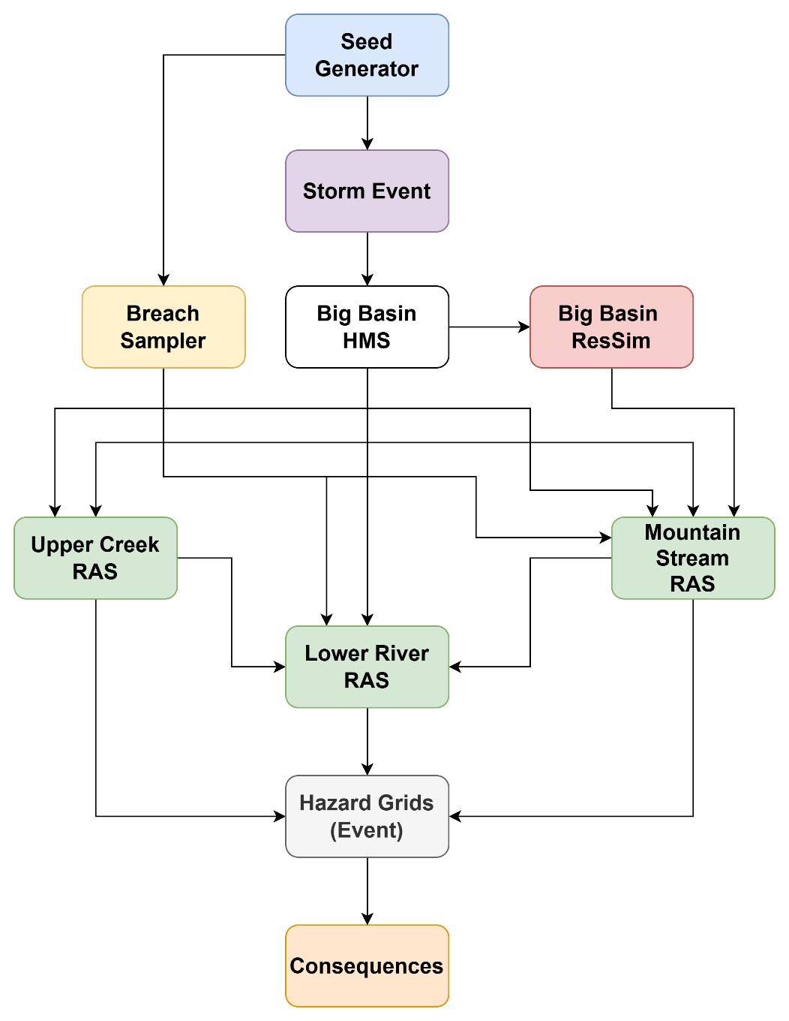
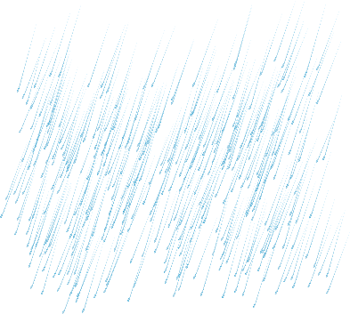
FFRD Modeling Approach
Iterate
PROBABILISTIC / GRADUATED
FUTURE APPROACH
Monte Carlo simulation:
If brute force doesn’t work, you aren’t using enough. – Sherrilyn Kenyon
6
Notes:
The generalized modeling approach that is used within FFRD analyses includes:
Generating storms
Simulate the precipitation-runoff response within HEC-HMS. Outputs from HMS are used as boundary conditions by both ResSim and RAS. ResSim needs time series everywhere and RAS needs excess precipitation grids and baseflow time series.
Simulate reservoir operations within HEC-ResSim. Reservoir outflow time series from ResSim are used as boundary conditions by RAS.
Compute inundation depths, extents, and arrival times within HEC-RAS. 2D simulations are used to compute the required hydraulic outputs throughout the entire modeling domain using excess precipitation grids and baseflow time series for each subbasin provided by HMS and reservoir outflow time series provided by ResSim.
Finally, compute consequences for each structure in the modeling domain.
In order to estimate probabilistic flood hazard estimates with uncertainty, many, many iterations within a monte carlo framework is utilized (animate)
One of my favorite quotes is that of Sherrilyn Kenyon: “If brute force doesn’t work, you aren’t using enough.” This applies very well to this situation as we use a lot of brute force to simulate upwards of a million events to adequately describe flood hazards within a watershed of interest within FFRD analyses.
FFRD methodology leverages a system of models across the hydrologic cycle and across the spatial domain of a watershed to characterize water movement through the atmosphere and landscape to infrastructure and damageable assets throughout a floodplain. To achieve this modeling approach, individual models must be linked together passing data from one to another. This requires models to be ordered within their compute for a given event. Models, once calibrated and linked, are computed many times for many events to create a graduated view of hazard and risk.

Slide 7
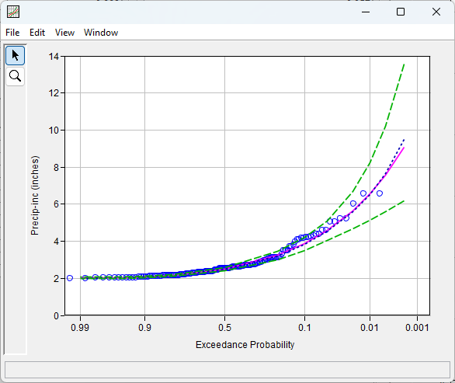
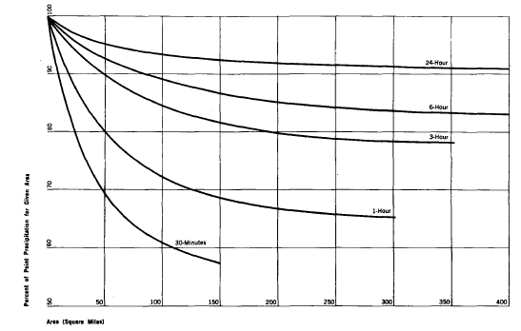
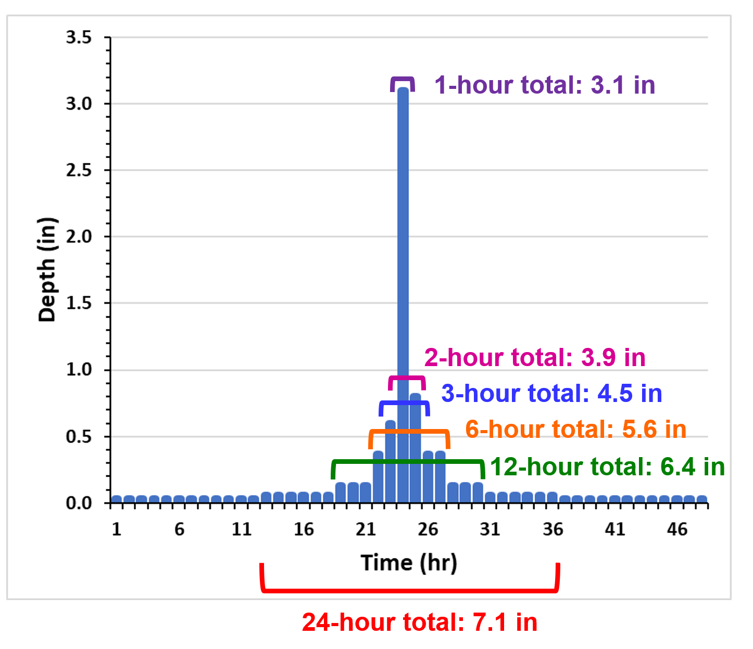
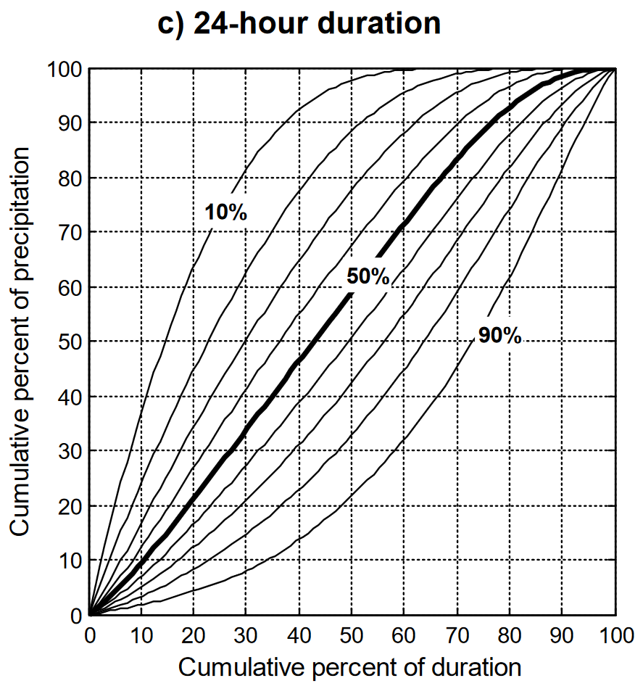
Storm Generation
How to simulate plausible meteorologic boundary conditions?
Does the largest precipitation depth in any given year always produce the largest runoff response?
Sample from precipitation-frequency curves?
  Depth-area reduction functions?
  Spatial and temporal distributions?
There’s gotta be a better way!
Enter Stochastic Storm Transposition
7
Notes:
But how should we simulate plausible meteorologic boundary conditions in order to derive graduated risk for all locations in a watershed throughout CONUS?
Do we
Commonly, simple analyses will begin by sampling from an input precipitation-frequency curve in order to construct a storm event (animate). A random number is generated and assumed equal to the AEP of interest. A precipitation depth is then inferred for that AEP.
However, how do you convert precipitation-frequency curves from point estimates to areal estimates which require depth-area-reduction functions (animate)? These functions are dependent upon the watershed location, analysis point, storm type, storm magnitude, and so many other considerations. Using them introduces another significant source of uncertainty and requires many, MANY iterations to adequately sample.
Also, how do you distribute the sampled and reduced precipitation depth in time and space (animate)? For nearly all watersheds in the U.S., storms are incredibly heterogeneous in both space and time that this is an even bigger source of uncertainty.
There’s gotta be a better way than that process! (animate)
In fact, there is a better way. It is called stochastic storm transposition. (animate)

Slide 8
Modern Stochastic Storm Transposition Background
8

Slide 9
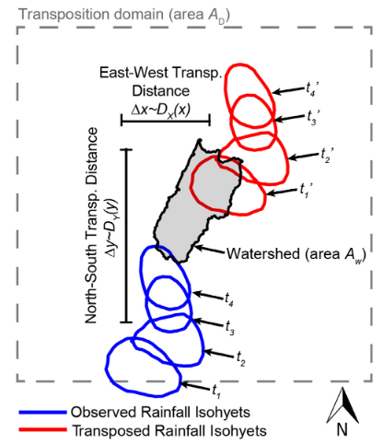
Stochastic Storm Transposition (SST)
Non-parametric space-for-time substitution
Resample severe storm events from a catalog
Preserve properties of real storms
Transpose multiple storms per year
Use a data-driven approach to reduce assumptions
Check out Greg’s presentation here: https://youtu.be/vy1alePFTg4?si=lmqqYW2DKVkwJ0Vp
Wright, Smith, and Baeck (2013)
9
Notes:
SST makes use of a data driven approach to reduce assumptions like those I talked about before.
No models are fit to the data and the storms speak for themselves.
This highly contrasts with the traditional precipitation-frequency based approaches for developing design storms and was selected to address many of the shortcomings of the traditional approach.
SST is much more like how real rain falls – there isn’t one annual maximum event and that’s it for the year – there are a variety of storm events that fall over a watershed in any given year. Any of those storm events can produce floods.
These storms are built from real storms that have occurred in the past and are all equally probable throughout the watershed of interest. For instance, just because the June 2006 flood event was caused by rain falling heavily in location X doesn’t mean that it couldn’t have also happened in location Y. If you were to move the real June 2006 storm event to location Y, that could have realistically happened.
SST as a concept isn’t new. In fact, it was originally proposed in 1962. However, the modern approach of using a storm catalog made of multiple storm events per year using multisensory precipitation products is a fairly recent phenomenon.
Multiple transpositions per year lets us get away from having to make a lot of assumptions about the way an “annual maximum event” should work.
We can extract annual maxima for whatever properties we want after we do all the transpositions.
Please please check out Greg Karlovit’s presentation on SST using the link I provide above. His presentation is awesome and provides so much more detail than I have time for in this presentation.
Also, I want to give a shout out to Dr. Dan Wright who is one of the main proponents of these new and improved SST techniques. He’s authored several publications demonstrating the usefulness of SST that are definitely worth reading, so please check them out as well.

Slide 10
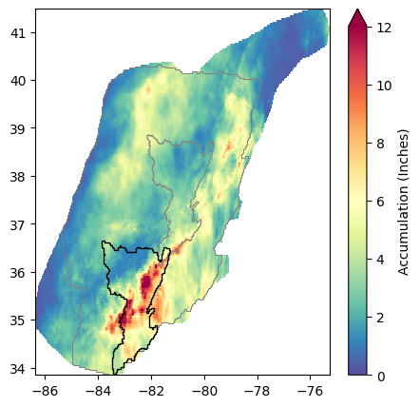
Storms
Fine resolution representation of severe historical events
Drawn from a meteorologically homogenous region around the watershed
“Worst” storms for the watershed
Collection of rasterized rainfall for each timestep
Multiple events per year
  Top ranked events, or events that exceed a threshold
Data: Kitzmiller et al. (2018)
Vizualization: Dewberry
10
Notes:
Credible estimation of flood hazard using SST is highly reliant on good quality precipitation data as it is a non-parametric method for statistical inference.
SST uses a catalog of observed storm events from a region of similar meteorology to the study watershed
Storm observations are taken from a high-resolution precipitation dataset with a long period of record and contains many events per year, spread out through a region much larger than the watershed
It contains a large sample of significant rainfall events that quantify the variability in the intensity and spatial and temporal patterns of storms in the area
The uncertainty around the interaction of these storms with the study watershed is quantified by selecting storms and moving them around the region of homogeneous meteorology at random
Each time this process is repeated, it creates one plausible alternate realization of the observed record and can be used to drive a hydrology model to estimate flood response throughout the watershed.

Slide 11
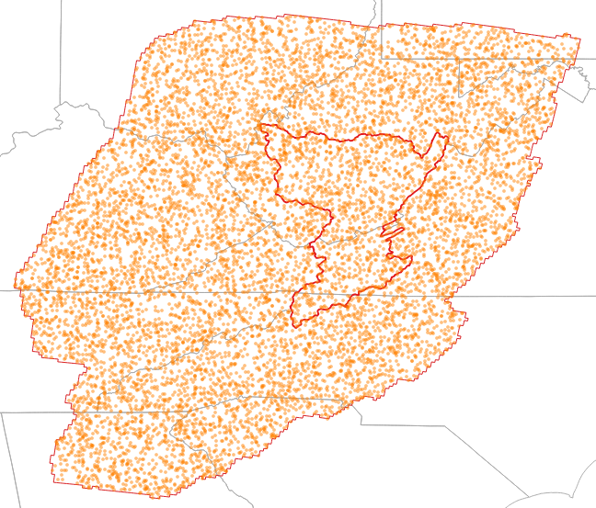
Fundamental Assumptions
Transposition domain
  Storms can be freely transposed from anywhere to anywhere else in the domain
Representative data
  Data adequately captures the rainfall that occurred
Catalog is representative
  Storms collected in catalog are sufficient for describing the hazard
10,000 random transposition positions
11
Notes:
The fundamental assumption made by using SST is that a region of homogenous meteorology containing the study watershed can be constructed.
The domain is used for the process of identifying and selecting storm events to use in the catalog and for defining the limits of where they can be moved during the stochastic simulations.
A storm is selected for inclusion in the catalog based on a value called its potential precipitation, which measures how much total rainfall the storm would bring to the study watershed if its position were optimized by transposition.
All storms with a potential precipitation over a certain threshold are included. The threshold is chosen to achieve a specific catalog size.
The storms that are collected within catalog must be sufficient for describing the hazard. So we typically utilize a high-resolution precipitation data with a long period of record like the AORC dataset. It is available as both a 1 km and a 4 km product with a 1-hour timestep and a period of record beginning in 1979.

Slide 12
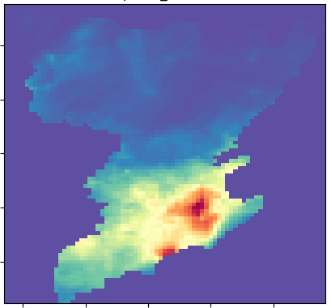
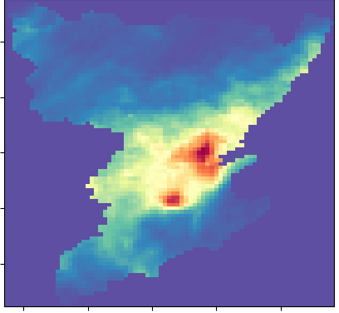
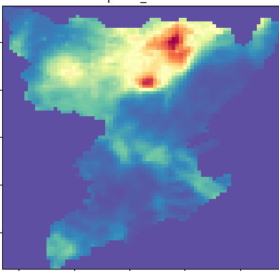
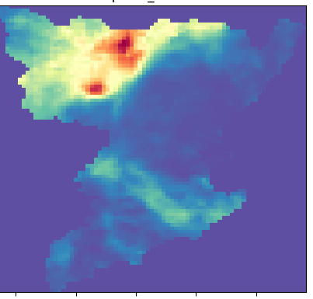
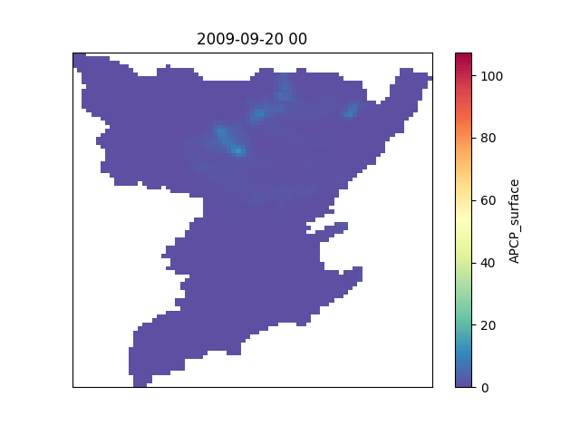
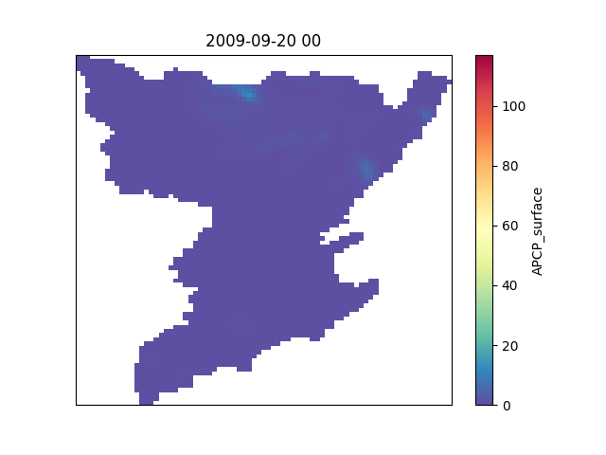


Sample Results
Accumulation
Hourly
4 Transpositions, 1 Storm
12
Notes:
This slide shows the exact same storm transposed to four different locations throughout the Kanawha River watershed in West Virginia
All of these storms are equally valid and of interest. But each storm produces different runoff responses throughout the watershed of interest.

Slide 13
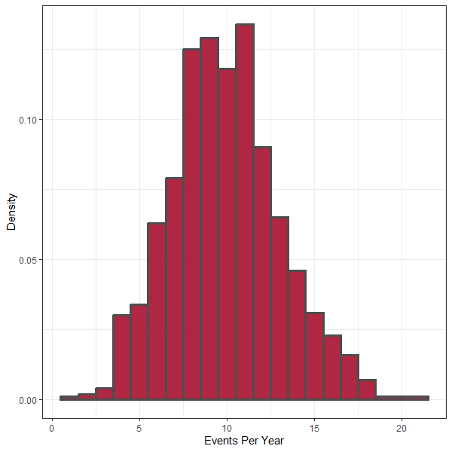
SST Simulation Structure
Repeat 0...n times for each year of simulation
  n usually Poisson-distributed
  Mean rate λ determined by catalog
  Extract annual maxima
Repeat 1...S times for a realization
  S controls the rarest frequency that can be estimated (usually at least 1,000)
Repeat 1...R times (# of realizations)
  R controls how well knowledge uncertainty is described
1,000 years with λ = 10
13

Slide 14
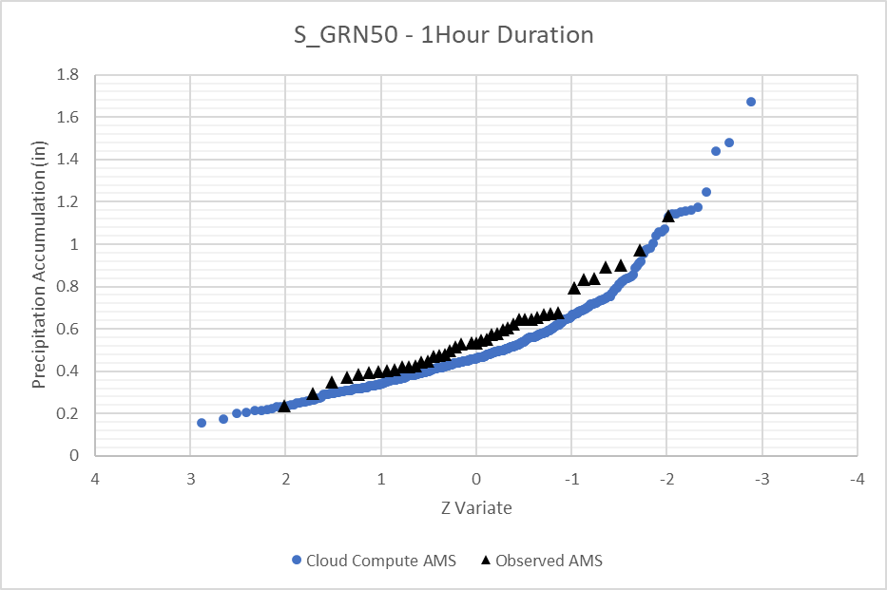
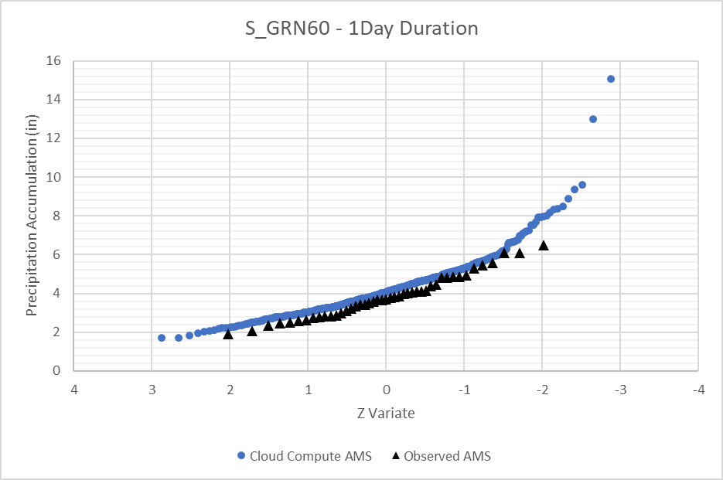
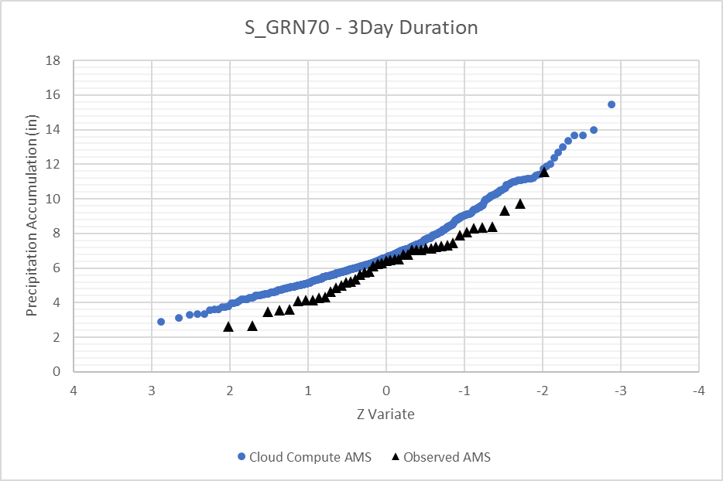
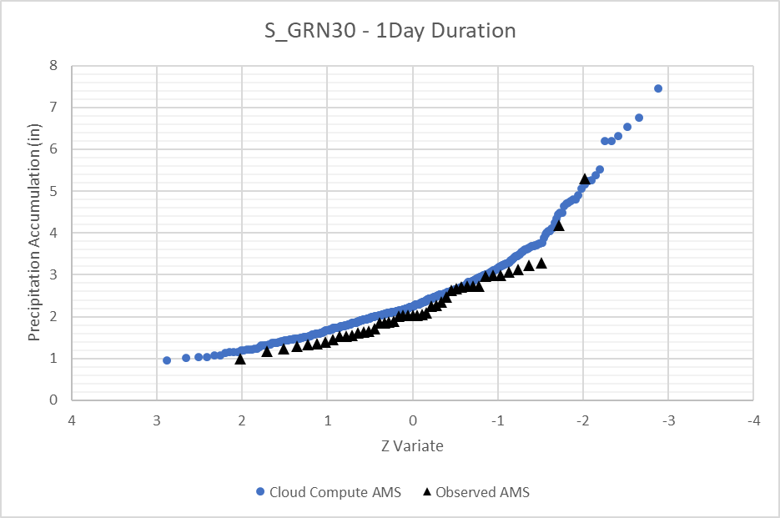
SST Results
14
Notes:
The results shown here compare basin-average precipitation-frequency curves generated using SST against observed precipitation-frequency for several subbasins within the Duwamish River watershed which is highly complex.
These curves represent areas and not points. Areas are much more important for hydrologic modeling.
Multiple durations including 1-hour, 1-day, and 3-days are shown
The observed data was extracted from the AORC data set
In all cases, the SST-derived precipitation-frequency closely matches the observed data but also does an excellent job of extrapolating since the SST-derived precipitation-frequency curves are built using transposed observed data

Slide 15
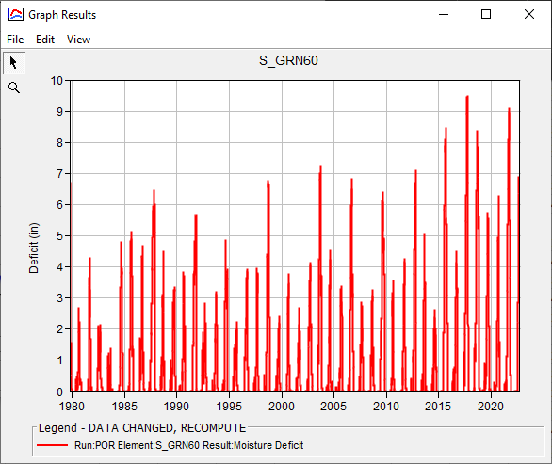
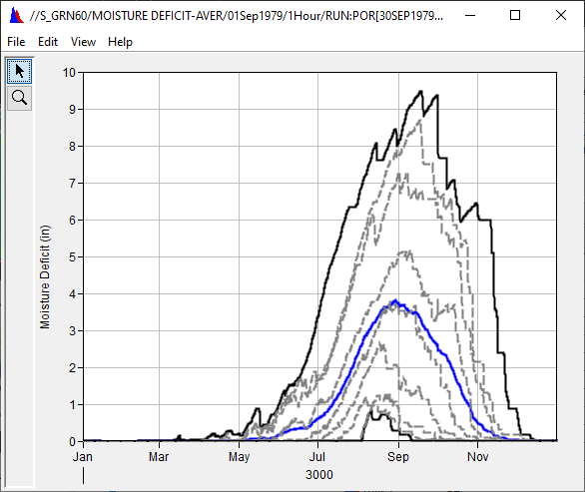
Getting to Flood Frequency
Utilize quasi-continuous hydrologic modeling
Initialize hydrologic model with seasonally-dependent parameters
Generate conditions based on historical simulation
Capture variability in key state parameters
  Soil moisture
  Snowpack
  Channel flow
  Reservoirs
  etc.
15
Notes:
In order to get to flood frequency, we have to simulate the precipitation runoff response of the storms that are created using SST
As previously mentioned, we use HEC-HMS, HEC-ResSim, and HEC-RAS to simulate that precipitation runoff response all the way to inundation depths, etc.
However, floods can be caused by more than just a lot of precipitation. For instance, if the ground is very saturated, even a modest amount of precipitation can result in a lot of runoff. Also, if there’s a lot of snow on the ground and a little bit of precipitation falls, a massive flood can ensue.
In order to adequately capture the flood variability that true watersheds exhibit, we sample from seasonally-dependent parameters and initial states.
This includes things like soil moisture, snow water equivalent, antecedent reservoir pool elevations, etc.
We develop a representative set of initial states using a POR simulation from 1979 – current. Within that POR simulation, we compute all the variables of interest.
Then, within the stochastic simulations, representative state variables are extracted within each simulation using the sampled event date from the set of computed POR results and are used as initial conditions
This leads to a more accurate representation of uncertainty in the results, which is a good thing.

Slide 16
Duwamish River Pilot Study – Overview
16

Slide 17
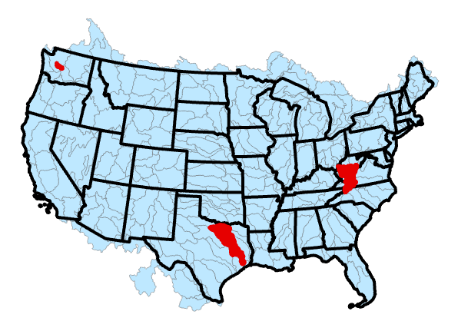

FFRD Pilot Studies
Duwamish Basin (HUC8)
*within Puget Sound
Nationwide
~250 HUC 4 Basins
~2400 HUC 8 Basins
2 of 3 Pilot Projects targeting HUC 4
1 Pilot Project targets HUC 8
Kanawha Basin
Pilot Project Lessons Learned
Nationwide Standard Operating Procedure for FFRD Modeling
Trinity Basin
17
Notes:
The FFRD program is being executed at the 4-digit Hydrologic Unit Code (HUC4) watershed level based on the Watershed Boundary Dataset (WBD) as the standard study unit
The Average HUC4 size is 15,000 sq mi while the average HUC8 size is 1,500 sq mi
HUC4 basin modeling includes smaller areas for hydraulic models (approx. HUC 8 level)
To develop FFRD simulation tools and procedures, we are completing 3 pilot studies:
The first pilot was completed within the Kanawha River watershed in WV
The second pilot was completed within the Duwamish River watershed in Washington
The third pilot study, which is still in progress, is taking place within the Trinity River watershed in Texas
Once we’re done with these pilots, we’ll have a set of standard operating procedures that can be utilized throughout CONUS

Slide 18
Duwamish – Modeling Team
Model Development Team
HEC-HMS | Lauren Coe
HEC-ResSim | Amanda Walsh
USACE NWS Liaison | Ethan Cheng
HEC-RAS | Jake Allgeier
Technical Oversight | Corby Lewis
Cloud Compute | Will Lehman
Other Roles
Coordination | Dana Moree, Russ Wyckoff, Heath Sand
Geospatial & Data Management | Adrian Christopher
PM & Documentation Support | Holly P., Tabetha H., Keil N.
Guidance & Support | Will L., Greg K., Mike B., Evan H., others
18
Notes:
Now, I’ll talk about the Duwamish River watershed pilot study to give you an example of all the interactive components that go into an FFRD implementation
First and foremost, credit should be given to the large team of USACE personnel that contributed to this effort.
The list shown here isn’t complete as there were numerous others that made significant contributions as well

Slide 19
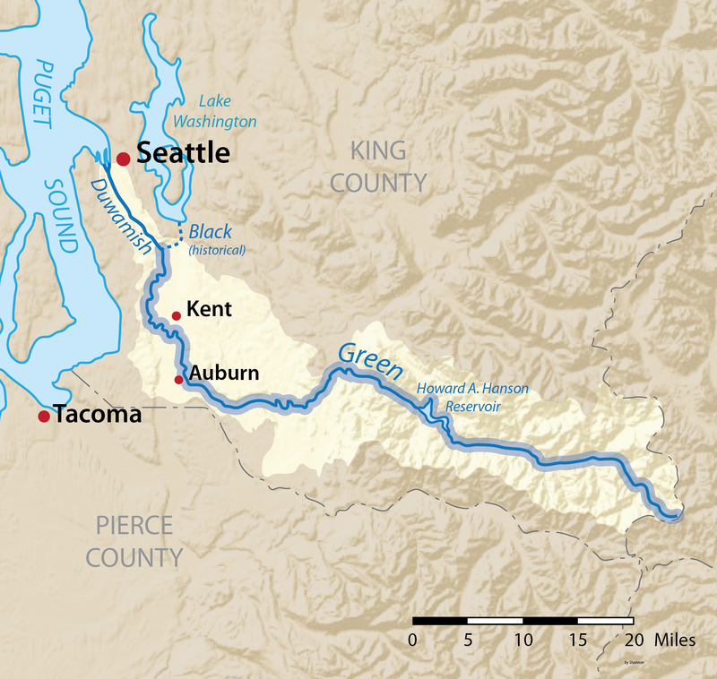
Duwamish River Overview
Green – Duwamish River
Drains into the Puget Sound near Seattle, WA
Cities of Kent, Auburn, Renton and Tukwila
~500 sq mi total drainage area
Howard Hanson Dam
19
Notes:
The Duwamish River is the name of the lower 12 miles of the Green River
All together, the Duwamish and Green Rivers span about 70 miles in length with a watershed size of approximately 500 sq mi
The terrain within the watershed is mountainous in the upper part of the watershed with some peak exceeding 5000 ft.
Snow accumulation and melt is also an important source of runoff within this watershed
Howard Hanson Dam is a major dam located within this watershed. It is owned and operated by the Seattle District Corps of Engineers.

Slide 20
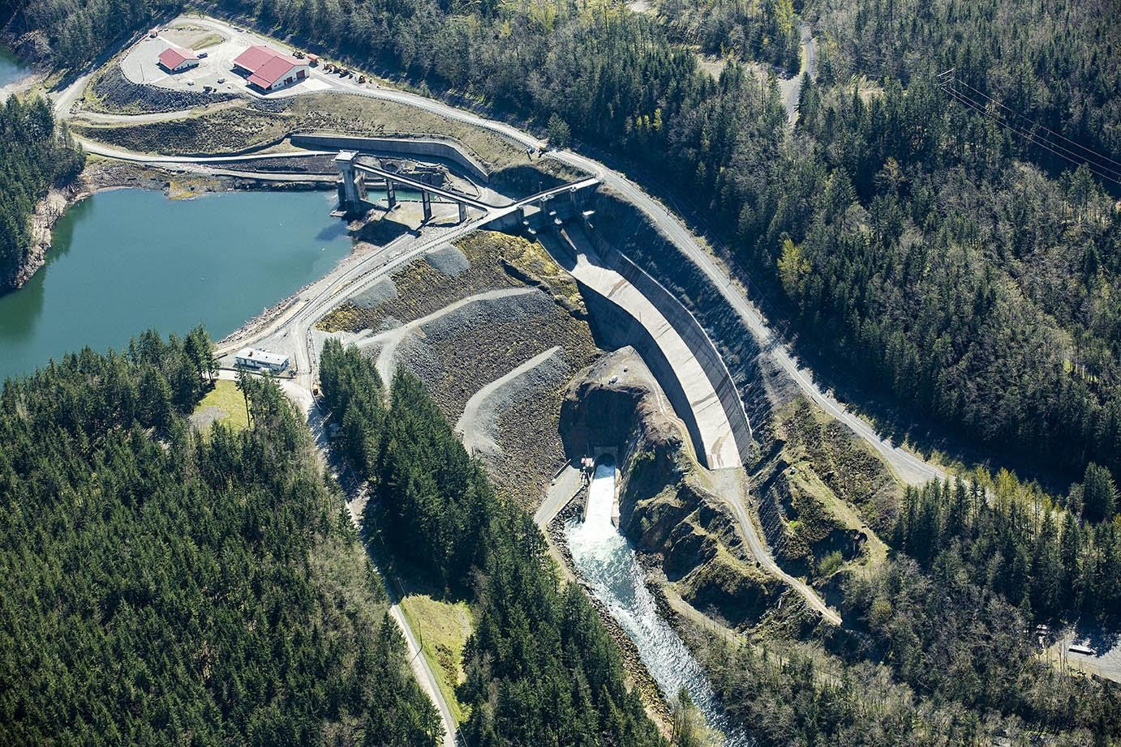
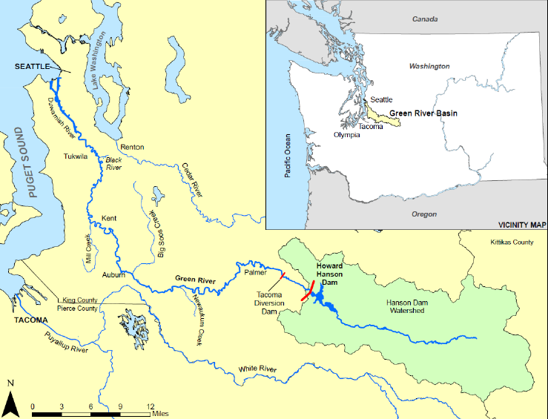
Howard Hanson Dam
Howard Hanson Dam (HAHD)
Flood risk management, low flow augmentation and M&I water supply
221 sq mi drainage area
Howard Hanson Dam provides flood risk management benefits to over 200,000 people and $25 billion in infrastructure
20
Notes:
Howard Hanson Dam is a multiple purpose project for flood risk management, low flow augmentation and municipal and industrial water supply
Howard Hanson Dam provides huge amounts of flood risk management benefits in the lower Green River valley
It is estimated that over 200,000 people and $25 billion in infrastructure are located downstream of Howard Hanson Dam
The estimated flood damages prevented by the dam during the January 2009 flood were approximately $3.9 billion!

Slide 21
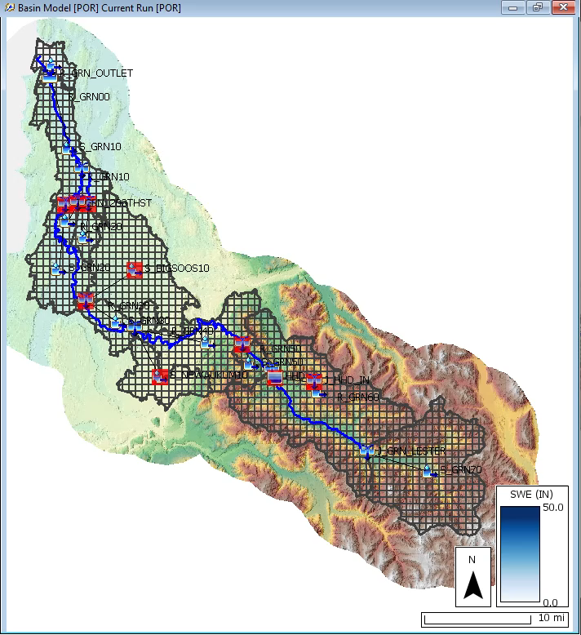
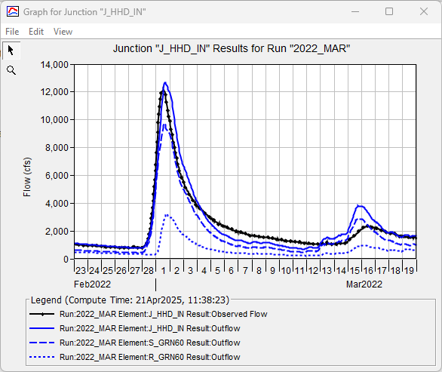
Hydrologic Modeling
21
Notes:
An HEC-HMS model was constructed for the entire Duwamish River watershed
To reiterate past topics, the purposes of this model was to:
Compute runoff hydrographs for the reservoir model to consume,
Compute gridded excess precipitation in gridded format and baseflow time series for the hydraulic models to consume,
Provide a distribution of reasonable starting states for every day of the year across the entire historic period of record to support epistemic uncertainty estimation, and
Accurately simulate the precipitation-runoff response of stochastic storms transposed throughout the watershed within a reasonable amount of computation time
The animation on the left shows the simulated accumulation and melt of snow for a historic event while the image on the right shows the computed runoff (in blue) compared against observed runoff (in black.

Slide 22
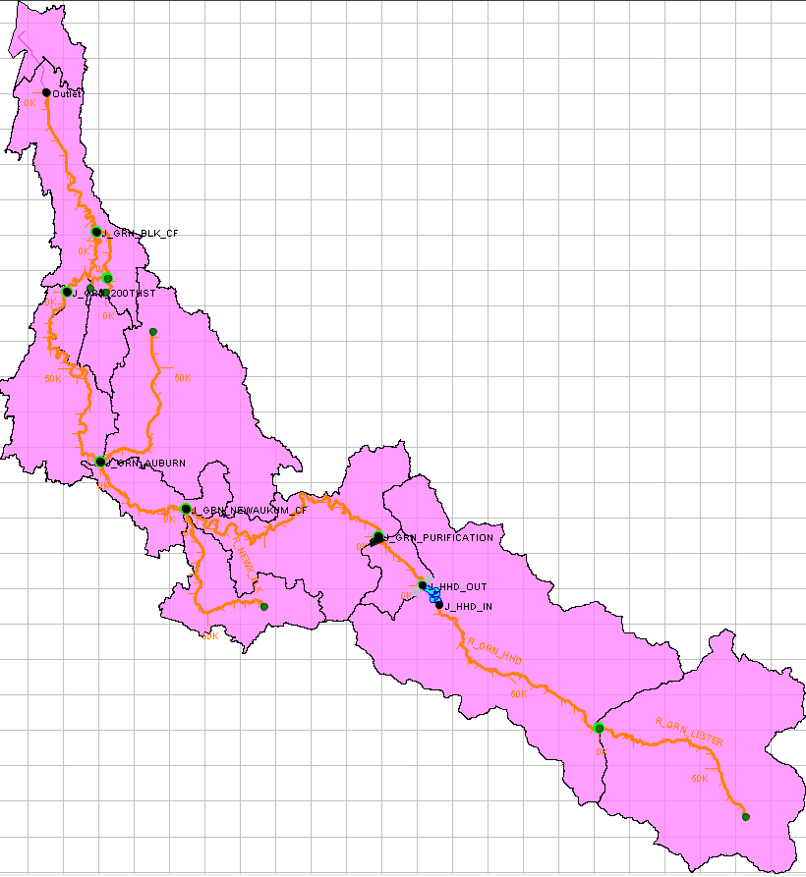
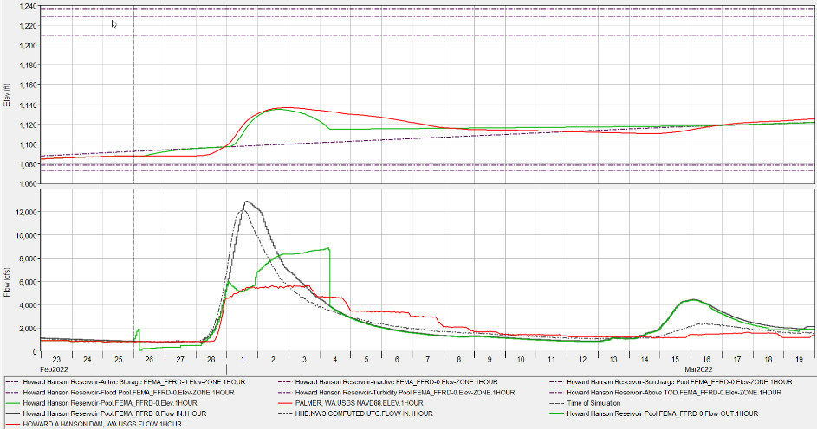
Reservoir Operation Modeling
22
Notes:
An HEC-ResSim project was constructed for the Duwamish River watershed as well
The purposes of this model was to simulate operations at Howard Hanson Dam and compute reservoir releases for the hydraulic model to consume
The image on the left shows the watershed that was included while the image on the right shows the computed reservoir operations for Howard Hanson Dam

Slide 23
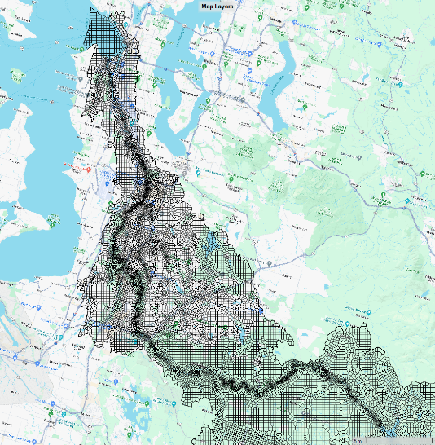
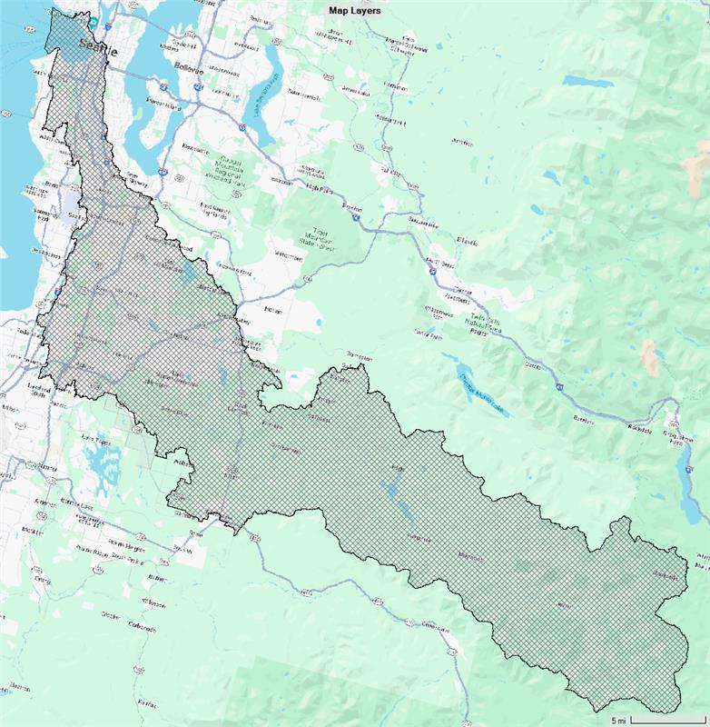
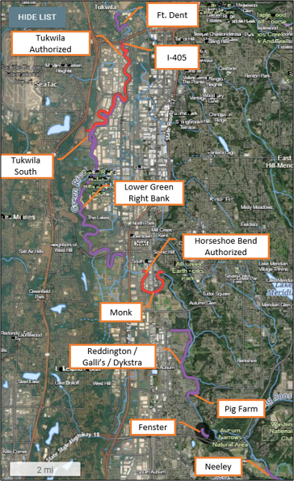
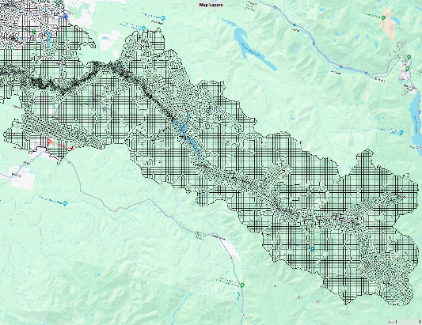
Hydraulic Modeling
23
Notes:
A single HEC-RAS project was used to compute hydraulic variables of interest
As was previously mentioned, the entire modeling domain was included and 2D computations were used everywhere.
The hydraulic modeler attempted to strike a balance between accuracy and runtimes.
In essence, including more detail requires longer compute times.
This isn’t a problem when only one or two simulations are required, but we need upwards of 1,000,000 to adequately describe risk within this watershed and provide the necessary outputs for FFRD.
That being said, 2D mesh resolution was added at locations that warranted additional detail (animate)
While only one major dam is located within the Duwamish River watershed, there are over 10 levee systems of significant size (animate)
Each of the levees was included in the hydraulic model and allowed to breach
Also, Howard Hanson Dam was allowed to breach if the sampled conditions within the stochastic simulations were significant enough

Slide 24
Duwamish River Pilot Study – Results
24

Slide 25
FFRD Modeling Workflow
Pre-model Data Preparation
Calibration
6 Historic Event Hydrographs (HMS, ResSim, and RAS)
Conformance
500-year long simulation
Apply metrics for AMS for Flow & Stage
Production
50 Realizations each spanning 2000 Years with ~10 events per year
RAS Peak Stage-Discharge
Period of Record HMS (~40 year AORC POR)
Calibrate Based on Frequency-based Results
Total of 1,000,000 events
Deliver Results
25
Notes:
The purpose of the POR simulation is to develop of an array of antecedent conditions that can be used to accurately define initial states like soil moisture content for any given day from 1979 – current
The calibration phase of the project begins after the HMS, ResSim, and RAS models are constructed
Within this phase, six historical events are used to calibrate model processes and parameters using observed data
Also, the period of record simulation is computed in order to generate representative sets of initial states
Observed meteorologic data, without transposition, are used as inputs to the hydrologic model
The conformance phase of the project begins after the models have been calibrated to historic events and the period of record simulation has been completed.
Within this phase, a single realization of 500 years (with approximately 10 events per year) is simulated
SST is used to generate the meteorologic inputs to the hydrologic model
Accurate linking between the various models is verified
Frequency-based results are calibrated using observed data
The production phase of the project begins after demonstration that models achieve the standards set in the conformance phase of the project
Within this phase, 50 realizations of 2000 years (with approximately 10 events per year) are simulated
SST is used to generate the meteorologic inputs to the hydrologic model
A total of approximately 1,000,000 individual events are simulated in order to generate hazard curves along with uncertainty at all locations of interest

Slide 26
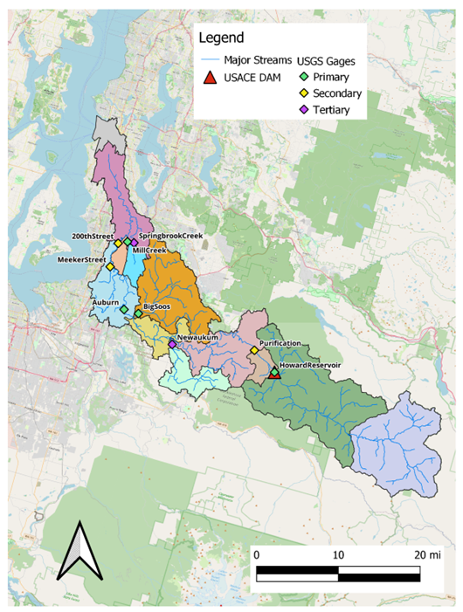
Calibration Locations
Category | Treatment
Primary Gages | Statistical comparisons of computed and observed flow/stage at all primary locations are in the satisfactory or higher range.
Secondary Gages | Statistical comparisons of computed and observed flow/stage at all secondary locations are in the satisfactory or higher range but are considered more leniently than for primary locations.
Tertiary Gages | Statistical comparisons of computed and observed flow/stage at all tertiary locations are in the satisfactory or higher range but considered more leniently than for secondary locations.
26
Notes:
All stream gages with a significant period of observed data are used for calibration of the FFRD models within the calibration and conformance phases.
Each of the gages are categorized as either primary, secondary, or tertiary gages to describe the hierarchy for use in model calibration.
More rigorous calibration metrics (as described in separate chapters of this SOP) are used for primary gages than for secondary or tertiary gages.
Within the Duwamish River watershed, 9 locations were identified as either primary, secondary, or tertiary gages

Slide 27
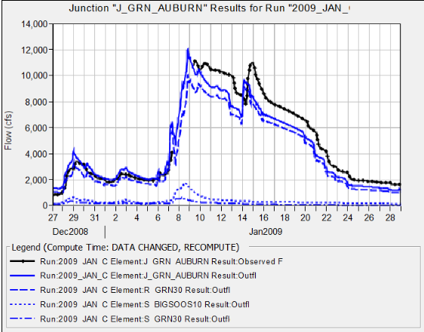



Historic Event Calibration
27
Notes:
During the calibration phase, multiple statistical metrics are used to ascertain model performance
The metrics that are used include:
Coefficient of Determination,
Nash-Sutcliffe Efficiency,
Ratio of the Root Mean Square Error to the Standard Deviation, and
Percent Bias
Upper left image shows HMS results for a single historic event while the lower left image shows the corresponding RAS results along with the statistical metrics

Slide 28

POR Simulation
28
Notes:
Following model calibration for the six historical events, the hydrologic model was computed for the entire 1979-current time period
The left and center images compare the computed and observed annual maximum series of flow for a single location
The upper right image shows the moisture deficit within a single subbasin
At this point, we were ready to move onto the conformance phase

Slide 29

Cloud Compute
Conformance: ~5000 events
Production: ~1,000,000 events
Cannot be efficiently performed on a single computer
Scale using cloud resources
Notes:
Within the conformance and production phases, cloud compute resources were utilized to perform the actual computations
Remember, within the conformance phase, 5000 individual events are simulated and within the production phase, approximately 1,000,000 individual events are simulated.
In order to execute this many hydrologic, reservoir, hydraulic, and consequence model simulations within a reasonable amount of time, computations cannot be performed on a single computer. If we did that, we’d be waiting forever to actually get results.
Thus, these computations are performed within the cloud where 1000s of compute nodes can be utilized to perform simulations in parallel

Slide 30


Model Library
30
Notes:
I would be remiss if I didn’t mention the terabytes of data that are generated within these types of analyses
We generate an absolutely mammoth amount of data and
This data needs to be accessed by multiple teammates and remote computation processes
To achieve these outcomes in a reasonable manner, all input and output data is stored in the cloud
To navigate this treasure trove of data, a web-based application called Model Library is used
Model Library allows easy access Cloud storage on s3 buckets

Slide 31

Conformance | SST
Initial results from the Conformance phase
Computed precipitation-frequency magnitude was much larger than observed precipitation-frequency
31
Notes:
During the conformance phase, the first round of computed precipitation-frequency magnitudes were much larger than observed precipitation-frequency
Essentially, too much precipitation was being applied to the modeling domain which caused erroneous results in all subsequent processes
We needed to do something to correct the precipitation amounts that were being applied to the modeling domain before going any further

Slide 32



Conformance | SST
Demonstrates the need for precipitation normalization
Meteorology is homogeneous, but terrain is dynamic
Normalized transposition handles this:
Divide storm by normalizing raster
Transpose to new location
Multiply by normalizing raster
Normalized transposition results in much improved results
NOAA Atlas 2
100-year 24 hour
32
Notes:
Within the Duwamish River watershed, these effects were primarily due to the heterogeneity of the terrain
Specifically, within the upper portion of the watershed, orographic effects result in lots of precipitation falling from the sky while the lower elevations receive less precipitation
To account for this, a normalization raster was used when transposing each storm event
In this application, the NOAA Atlas 2 1% AEP 24-hour duration map of precipitation depths was used as the normalization raster
First, the sampled storm was normalized into probability space using this raster
Second, the normalized storm was transposed to a new location
Finally, the normalized transposed storm was then multiplied by the normalization raster to bring it back into real space
Using this approach within the Duwamish River watershed resulted in much improved results (animate)

Slide 33



Conformance | Flow- and Stage-Frequency
33
Notes:
These images show the results of the conformance phase
The resultant annual maximum frequency curves span approximately 500 years due to the size of the specified events and realization structure
The upper left rehashes the precipitation-frequency results by comparing the SST outputs against observed data
(animate) The middle image shows flow-frequency results computed by HMS against observed data
(animate) The right image shows stage-frequency results computed by RAS against observed data
At this point, we were ready to move on to the production phase

Slide 34


Production | Flow- and Stage-Frequency
34
Notes:
Within the production phase, approximately 1,000,000 individual events are simulated within HMS, ResSim, and RAS.
The resultant annual maximum frequency curves span approximately 200 years due to the size of the specified events and realization structure
We like to call these spaghetti plots. Each realization produces a frequency curve (shown in blue), and when they’re all plotted together, there are lines all over the place
However, we can compute mean, median, and confidence limits around those observations, as shown by the red curves.
We’re nearly there!

Slide 35



Production | Hazards
1/100 Depths – Realization 1
35
Notes:
Finally, we can also compute depth and consequence-frequency at every single structure within the watershed with uncertainty, which is so cool
This image demonstrates those types of outputs for a small area
Keep in mind that the inundation results shown here were gathered from multiple events -> there isn’t a single simulation or event that represents the 1/100 AEP conditions everywhere
But we can visualize AEP-specific depth grids

Slide 36
Review
FEMA is working with USACE to implement the Future of Flood Risk Data (FFRD) Initiative
FFRD is pioneering the transition from binary to probabilistic assessments that depict hazards in a graduated manner
Stochastic Storm Transposition (SST) is foundational to FFRD
Three pilot studies are being undertaken to develop standard operating procedures (SOP) for model construction and simulation
The Duwamish River pilot study improved the FFRD SOP
36
Notes:
In review, FEMA’s FFRD initiative is attempting to produce a more risk-informed National Flood Insurance Program (NFIP)
In support of FFRD, the U.S. Army Corps of Engineers (USACE) is collaborating with FEMA to provide a methodology recommendation on the framework modeling and data service capability allowing other federal agencies, communities, and individuals to leverage the models to explore structural and non-structural measures for flood risk mitigation.
FFRD is pioneering the transition from binary to probabilistic assessments that depict hazards in a graduated manner
SST is foundational to FFRD and produces a variety of storm events that fall over a watershed in any given year. Any of those storm events can produce floods.
Three pilot studies are being undertaken to develop standard operating procedures (SOP) for model construction and simulation
I spent a lot of time talking about the Duwamish River pilot study and showed how this pilot study improved the FFRD SOP and produced graduated estimates of flood hazards and risks.

