Slide 1
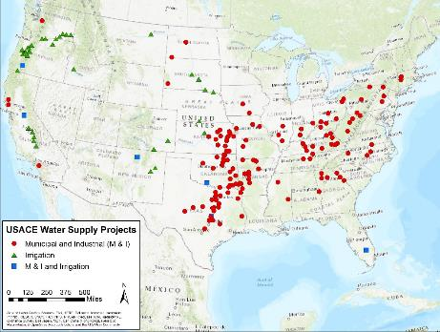


Overview of the USACE Water supply program
Storage-Yield Analysis
Training Class

Slide 2
Universe of water supply
Water Supply Sources
Surface water Groundwater Desalination Reuse
Water Supply Infrastructure
Dams & Reservoirs Wells Intakes & Pumps Transmission Treatment Plants Distribution
Water Users
Domestic Municipal Industrial Agriculture
Wastewater
Notes:
Here is a simplified illustration of how we interact with the water cycle in using water for human needs. The main focus of the Civil Works program on water supply is highlighted in red – sharing storage space in Corps multipurpose reservoir projects with non-federal water supply users. Of course there are exceptions to every rule, and the Corps has also constructed some pumping, transmission and treatment facilities – the Washington Aqueduct project operated by Baltimore District, for example, treats water from the Potomac River and supplies it to the Washington D.C. area, we do store water for agricultural irrigation supply in some projects (mostly in the Western U.S. where the water is typically supplied through Bureau of Reclamation projects), we advise and assist with planning and construction of water supply projects for military installations, and the Regulatory program touches many non-federal projects through Section 404 permitting. But this course will be focusing on how we establish water supply storage agreements for municipal and industrial use at multipurpose reservoir projects under the authority of the 1958 Water Supply Act.
Why do users want storage space in Corps reservoirs? Two main reasons:
Mainly, of course, reservoir storage enhances the reliability of variable streamflow in rivers (in other words, storage increases the reliable yield – that’s what we’ll be talking about for the next three days – but also,
You can’t build a reservoir just anywhere, and the most economical sites have already been taken through the dam-building era in the 20th century.

Slide 3
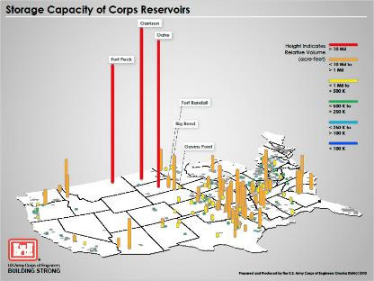
water supply storage in corps reservoirs
Construct new reservoir project
Add storage to an existing project
Reallocate storage within an existing project
System operations with other non-federal projects
Surplus water
Notes:
How does storage space in a Corps reservoir get set aside for M&I water supply? Most of our M&I water supply agreements were established when the reservoir was being planned, designed or constructed. Of course, these days we’re not building any new reservoirs, so storage space can be added to an existing project, or we can look at reallocating storage space within an existing project. In some cases we are being asked to look at accommodating system operations with non-federal projects, for example, by taking dedicated releases or transfers from non-federal projects and holding them in a Corps reservoir for water supply use. You might also hear about surplus water. These are typically short-term uses of the reservoir for water supply under another authority – Section 6 of the 1944 Flood Control Act.

Slide 4
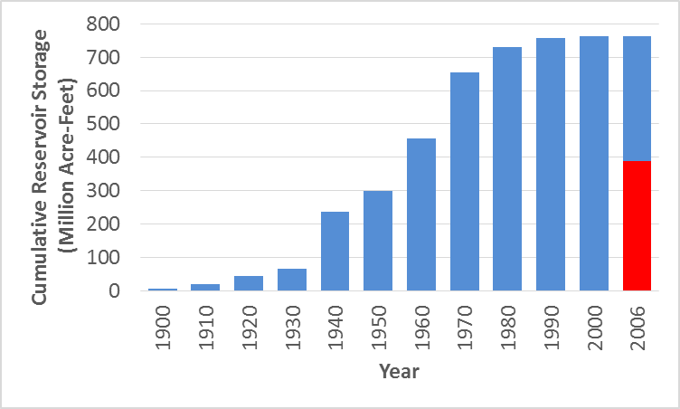

Reservoir Storage Space in the U.S.
USACE M&I
Water Supply
83,000 Dams
465 Dams [1]
(Reallocated)
(Original)
(Sec. 7)
[2]
(USACE)
Flood
(USACE)
Conservation
Notes:
[1] 465 multipurpose reservoir projects
with flood risk management storage
controlled by USACE
[2] “Section 7” projects are owned by other
agencies, but USACE prescribes operating
rules for flood risk management
(Sec. 7)
[2]
Storage in 465 Dams [1]
Notes:
Of the reservoir storage in US, about half is USACE operated. Includes Corps projects and Section 7 storage.
Almost all this storage is flood control and general conservation with a small amount of specific M&I water supply. A lot of the general conservation has an assigned use, but not a storage owner (authorized for navigation, water supply, etc)
1. This is a summary of reservoir storage space in the country by Dr. John Hickey/HEC with data from around 2008. The 465 dams are those that USACE either owns and operates or that we manage the FRM operations under Section 7 of the 1944 FCA (33 CFR 208.11). Together these 465 major reservoirs make up about half of the storage in the country or about 400 million acre-feet (MAF). The pie chart further breaks down this 400 MAF of storage. In the pie chart, conservation storage = blue + green + grey and flood storage = orange. USACE M&I water supply agreements (light and dark blue) are a relatively small piece of the pie (about 10MAF total, or 3% of the pie) and the amount of storage that’s been reallocated to water supply (about 900 thousand acre-feet, or 0.3% of the pie)from other authorized purposes is very small in the big picture.
2. Building a new reservoir project that includes water supply storage was like Christmas – every stakeholder got something new that they didn’t have before. Reallocating storage in an existing project is more like Festivus with the airing of grievances – there will be winners and losers as we reduce some outputs to accommodate the new water supply use. As demand for water changes and increases in parts of the country we are likely to see continuing requests for reallocation studies as the green, grey and orange slices of the pie – storage space in an existing reservoir that was built before environmental reviews and mitigation costs - are likely attractive alternatives to the water supply stakeholders.

Slide 5
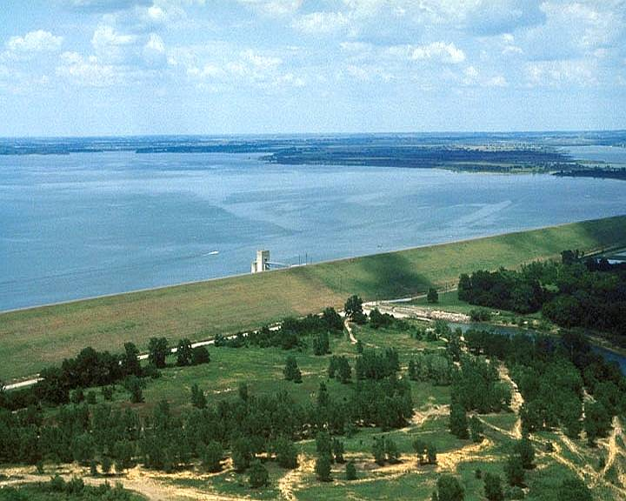
Multi-purpose Reservoir Projects
Elev. 580
Authorized Purposes:
  Flood Risk Management
  Navigation
  Hydroelectric Power
  Municipal and Industrial
  Water Supply
  Irrigation
  Water Quality
  Fish and Wildlife
  Recreation
  Other
Flood Storage
Elev. 550
Conservation Storage
Elev. 500
Inactive Storage
Notes:
“The User shall have the right to utilize an undivided X percent of the usable conservation storage space in the project between elevations Y and Z, which is estimated to contain X acre-feet after adjustment for sediment deposits.” - Article 1b(1) of the model agreement
So we are talking about sharing the storage space in the conservation pool, although there are a few projects where the entire conservation pool is allocated to water supply.
We often illustrate a water supply storage agreement as a vertical slice of the conservation pool. A typical model water supply agreement states that:
“The User shall have the right to utilize an undivided X percent of the usable conservation storage space in the project between elevations Y and Z, which is estimated to contain X acre-feet after adjustment for sediment deposits.” - Article 1b(1) of the model agreement
So we are talking about sharing the storage space in the conservation pool, although there are a few projects where the entire conservation pool is allocated to water supply.
The model agreement goes on to say:
“The User shall have the right to withdraw water from the lake, or to request releases to be made by the Government through the outlet works of the Project” - Article 1b(2)
With two important caveats:
“The Government reserves the right to control and use all storage in the Project in accordance with authorized Project purposes…”, and
“The Government further reserves the right to take such measures as may be necessary in the operation of the Project to preserve life and/or property…” – Article 1b(3)
In return for having the right to use a percentage of the usable storage space in the project, the must reimburse the Government for a first cost (typically related to the construction cost of the project) and an ongoing percentage of our OMRR&R expenditures at the project. Note that all water supply payments go directly to the Treasury as miscellaneous receipts – the Corps does not get to keep and use water supply payments.

Slide 6
Usace municipal and industrial water supply storage
IWR Report # 2017-R-02, available at https://iwrlibrary.planusace.us/
MSC | WS Agreement Data |  |  | WS Storage Space Data (acre-feet)
 | No. of Projects | No. of Agreement/ Future Activations | Yield (MGD) | Present | Future | Not Under Contract | Total
NAD | 7 | 7 / 0 | 451 | 167,435 | 0 | 0 | 167,435
SAD | 10 | 25 / 0 | 471 | 209,623 | 0 | 0 | 209,623
LRD | 28 | 53 /1 | 612 | 602,632 | 0 | 7,060 | 609,692
MVD | 8 | 14 / 0 | 305 | 230,597 | 202,220 | 13,293 | 446,110
NWD | 17 | 36 / 4 | 443 | 498,676 | 413,630 | 101,847 | 1,014,153
SPD | 4 | 4 / 0 | 259 | 573,820 | 0 | 0 | 573,820
SWD | 62 | 211 / 77 | 4,332 | 5,698,999 | 770,800 | 310,699 | 6,780,498
TOTAL | 136 | 350 / 82 | 6,873 | 7,981,782 | 1,386,650 | 432,899 | 9,801,331
About 90% of storage was originally authorized during planning, design
and construction
Remaining 10% has been reallocated after construction
About 90% of reallocations have occurred since 1980
Notes:
Here is a summary of our M&I water supply storage agreements from the most recent report on the program – the FY16 Municipal, Industrial and Irrigation Water Supply database report. This data is tracked through the OMBIL database system, and we need every district’s help in keeping the information correct and up to date. You can see that most of the agreements and storage space is in the Southwestern Division (and most of those agreements are in the states of Texas, Oklahoma and Kansas, as well as in the White River Basin in Arkansas and Missouri). If you think about that geographically, many of those reservoir projects help support the large populations centers as you transition from the edge of the semi-arid rain shadow of the Rocky Mountains towards the Mississippi River and the generally wetter eastern regions.
Per the bullets, about 90% of our water supply storage agreements are “originally authorized” as part of planning, design and construction of the projects. Only about 10% have been reallocations, but we have seen a steady demand for those since the 1980s.

Slide 7
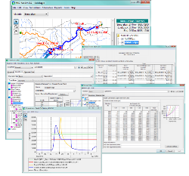
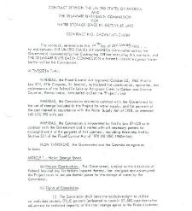
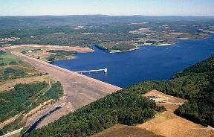
Water Supply Storage Agreements
Effects on other authorized project purposes
Study
Agreement
Operations
Volume of water that user may withdraw/ order released through duration of a drought
Assumed inflows and other conditions
Right to use % of usable conservation storage space
Storage accounting?
Credit for return flows?
Actual
inflows
State water rights
Notes:
New water supply agreements follow a “simple” pattern of study, agreement, and operations.
Study – storage-yield and impacts (EA / IES)
Agreement – finalize legal description on what is being provided and at what cost
Operations – changing normal pool levels, increasing storage zones, ect
The percentage of conservation storage space allocated to the water supply user needs to be consistent with the use they need to make of the agreement, i.e. how much water they will need to withdraw from storage in a critical drought, and our assessment of how the new agreement will impact other project purposes (as the Water Supply Act requires Congressional approval for changes that would “seriously affect the purposes for which the project was authorized, surveyed, planned, or constructed, or which would involve major structural or operational changes…”, 43 USC 390d).
This slide tries to show how the agreement needs to be consistent between the study and operational phases. Note that EM 1110-2-3600 documents that we consider water supply storage agreements to be a “firm commitment of reservoir storage.” (can’t seem to download the 2017 version for citation, but it’s pg. 2-18 of the 1987 version). Keeping in mind that PL 88-140 made water supply storage agreements permanent as long as the user continues to make their required repayments, one question is whether the operational interpretation of an agreement is still consistent with the original study’s assessment of its impacts on other authorized purposes 50 years later, 100 years, etc.?
Editorial: as long as our H&H analysis is conservative and consistent with limitations placed on withdrawals under operational storage accounting and/or exercise of state water rights, it’s unlikely that a water supply user will be able to “harm” other project purposes in a future drought by withdrawing more water than was originally contemplated in the study leading up to the agreement.
Note that dashed lines in this slide highlight issues in the current draft rule on water supply authorities.

Slide 8







Allocated Storage in a Conservation Pool
Inflow
apportionment
WS #1
Conservation pool
WS #1
WS #2
Hydro
Hydro
WS #2
Sediment
reserve
Notes:
Here is another slide that might help illustrate how a water supply agreement functions in operations, particularly when administered through a storage accounting scheme. You could think of each purpose or user’s storage as a savings account with credits (from inflows) and debits (from withdrawals/releases and losses). This graphic illustrates those accounts like an ink-jet printer cartridge. You could also think of a shared conservation pool with allocated storage/water supply agreements as a set of reservoirs operating in parallel (see the small inset picture). Imagine there are gates on the upstream end and we could actually control how much inflow went into each reservoir. In theory, depending on how they manage their withdrawals, a water supply user could exhaust their account/empty their reservoir while there is still water remaining in the other accounts/reservoirs, i.e. the red cartridge could run out while green and blue still have ink to print. As editorialized on Slide 6, as long as the H&H analysis leading to the agreement was conservative, and the user doesn’t increase their use above what their storage space can reliably yield, this should be very rare, for example, in an extreme drought worse than the historical record. But in such a case, do we allow that user to continue making withdrawals, possibly harming the ability of other users and purposes to continue operating, or do we cut them off?
Editorial: I’m personally unaware of any instance where we have been in this position, so that would seem to indicate that for the most part we’ve done a pretty good job of using conservative firm yield estimates and storage amounts to set up agreements. But it’s definitely a possibility, for example “Lake Lanier has 70 days of water remaining…” type of headline.

Slide 9
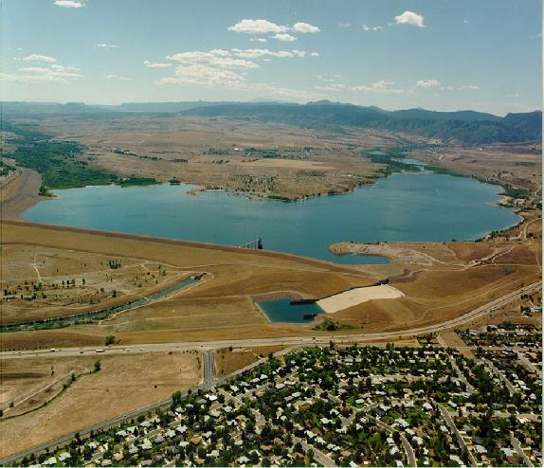
Reallocation with western water rights
Chatfield Dam upstream of Denver, CO
Water users funded a reallocation, but did not assign a specific water right to the storage

Slide 10
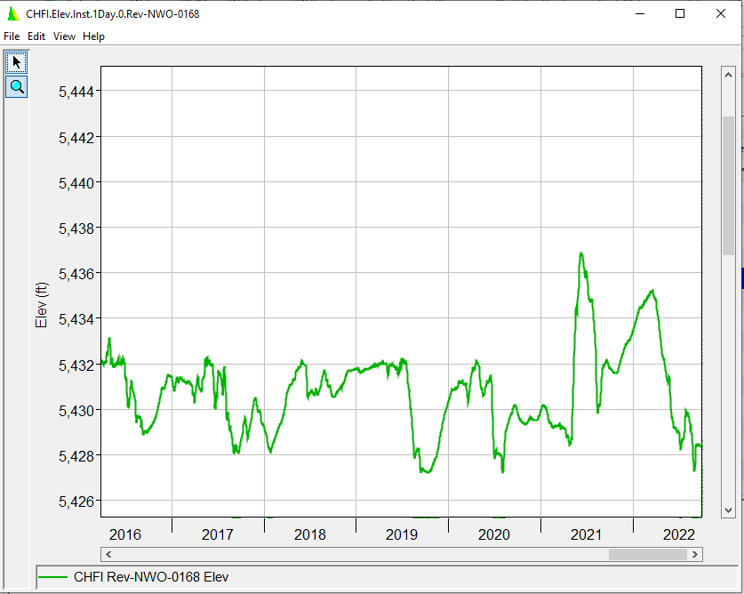
Reallocation with water rights
Top of Conservation after Reallocation
Top of Conservation before Reallocation

Slide 11
Bottom line
Water supply users get what they pay for…
  Translate storage to withdrawals
  Public Law 88-140
    Permanent right to storage space
    Effects of sedimentation
  Subject to life/ safety considerations
And pay for what they get…
  Reimburse Government for costs of storage space
    First and implementation costs
    Annual O&M
    Major Capital/RR&R
  For reallocated storage, costs are proportional to storage space

Slide 12
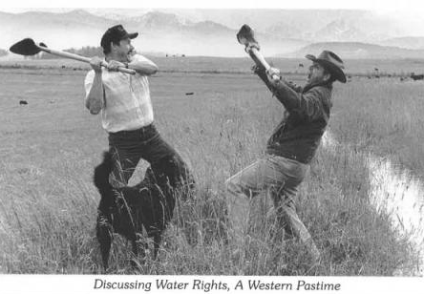
discussion
Whiskey is for drinking…
Water is for fighting…

Slide 13
BACKUP Slides

Slide 14
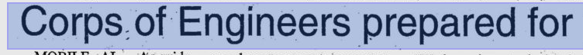
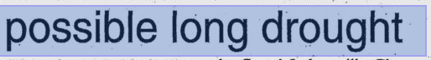
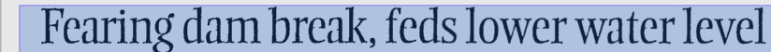
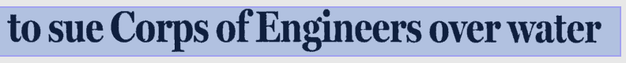
Common Engineering issues in water supply storage analyses
Study hydrology and assumptions
“Usable storage” and sedimentation
Dam safety policy and analyses
Evaluating impacts to other purposes
Operational storage accounting
Other issues
“cattle survived years-long drought
only to die in flood…”
Notes:
This slide tries to outline the major topics for E&C/HH&C team members to consider as part of a water supply storage reallocation study and decision. This class will be focusing on the first bullet – the hydrologic simulation of reservoir storage and yield. But it’s important to keep these other bullets in mind as they may influence the types of analyses you are required to do.

Slide 15
Example of Storage Accounting Spreadsheet
WATER SUPPLY STORAGE ACCOUNTING
WISTER LAKE
 |  | Beginning | Inflow | Inflow | Total | Withdrawn | Ending | Excess | Excess | Final | Remaining
End of Period |  | Storage | Share | Share | Loses | Storage | Storage | Share | Storage | Storage | Storage
Date | Users | (ac-ft) | (percent) | (ac-ft) | (ac-ft) | (ac-ft) | (ac-ft) | (percent) | (ac-ft) | (ac-ft) | (percent)
6/30/2005 | Lake Storage
 | Lake Conservation Storage | 61037 | 100% |  | 0 | 0 | 61037 |  | 0 | 61037 | 100.00%
 | Un-contracted Storage | 47384 | 77.63% | 0 | 0 | 0 | 47384 | 0.00% | 0 | 47384 | 100.00%
 | HEAVENER UTILITIES AUTH | 1600 | 2.62% | 0 | 0 | 0 | 1600 | 0.00% | 0 | 1600 | 100.00%
 | POTEAU VALLEY IMPROV AUTH | 4800 | 7.86% | 0 | 0 | 0 | 4800 | 0.00% | 0 | 4800 | 100.00%
 | AES SHADY POINT | 7253 | 11.88% | 0 | 0 | 0 | 7253 | 0.00% | 0 | 7253 | 100.00%
 |  | Beginning | Inflow | Inflow | Total | Withdrawn | Ending | Excess | Excess | Final | Remaining
End of Period |  | Storage | Share | Share | Loses | Storage | Storage | Share | Storage | Storage | Storage
Date | Users | (ac-ft) | (percent) | (ac-ft) | (ac-ft) | (ac-ft) | (ac-ft) | (percent) | (ac-ft) | (ac-ft) | (percent)
7/31/2005 | Lake Storage
 | Lake Conservation Storage | 61037 | 100% |  | 0 | 0 | 61037 |  | 0 | 61037 | 100.00%
 | Un-contracted Storage | 47384 | 77.63% | 0 | 0 | 0 | 47384 | 0.00% | 0 | 47384 | 100.00%
 | HEAVENER UTILITIES AUTH | 1600 | 2.62% | 0 | 0 | 0 | 1600 | 0.00% | 0 | 1600 | 100.00%
 | POTEAU VALLEY IMPROV AUTH | 4800 | 7.86% | 0 | 0 | 0 | 4800 | 0.00% | 0 | 4800 | 100.00%
 | AES SHADY POINT | 7253 | 11.88% | 0 | 0 | 0 | 7253 | 0.00% | 0 | 7253 | 100.00%
Notes:
This is an example of a spreadsheet template used by one district for storage accounting of water supply agreements. This doesn’t show actual numbers but you can see from the column headings that it is relatively straightforward math. Issues can relate to getting users to report their withdrawals, whether or not we will credit the user for specific inflows they make (e.g. wastewater treatment effluent, interbasin transfers) and how to allocate losses among accounts - mainly evaporation.

