Slide 1
Conducting Reservoir Storage-Yield Analyses Using HEC-ResSim
Lecture #2 – Storage-Yield Theory

Slide 2
Introduction
What is Yield? What is Firm Yield?
Storage / Yield theory
What methods can be used to calculate yield?
What is the USACE recommended method?
Notes:
In this lecture we will go over these topics. By the end of the lecture you should know the answer to these questions.

Slide 3

Yield
What is Yield?
  “Yield is the amount of water that can be supplied from the reservoir to a specified location and in a specified time pattern.” (EM 1110-2-1420)
Definitions can vary, be careful!
Don’t assume a definition, and be sure to define yield for your own studies
Notes:
Define what yield is. Also talk briefly about other ways yield can be defined.
The yield may be the direct result of an analysis, or could include a factor of safety.
It is important to record and consider the assumptions that were made when determining a particular yield number.
What period of record was used?
How was evaporation handled?
Was reliability or uncertainty considered?
Many other possible assumptions

Slide 4
Yield
What are some yield types you have seen in your work?
Firm Yield is typically used for water supply studies
  “Firm yield is the largest consistent flow rate (demand) that can be provided throughout a period of historic stream-flow” (EM 1110-2-1420)
Firm Yield is limited by a critical period which will vary based on the demand and storage capacity.
There are other types of yield
There are other terms: critical yield, safe yield, dependable yield, etc
Notes:
Take this opportunity to brainstorm about yield types and definitions.
Some other potential yields:
Safe yield – “Safe yield typically includes a factor of safety over the firm yield to account for possible events outside the period of streamflow record” (EM 1110-2-1420)
Yield during drought with specific exceedance – Can be a drought with 2% exceedance, 1%, or otherwise as defined for that study.

Slide 5
Storage / Yield Theory
Why we store water: to re-distribute the occurrence of water in time
Desire water at a certain rate
The natural occurrence of water is inconvenient, often too low or too high
Storage of water allows usage to change from the natural arrival rate to a more convenient rate
Store water when it comes, use water when needed
  Use stored water when we need more than natural
  Refill when we need less than natural
Store high flow and release at tolerable level
Notes:
Now we will talk about some fundamental concepts related to yield (of any kind). How does storage affect the yield of a river?
While diversions and pipelines can change the distribution of water in space, taking water from one place to another, storing water can change how it is distributed in time. We can take water that is naturally flowing down a river and store it for use at another time.
From EM 1110-2-1420: “Whatever the ultimate use of water, the main function of a reservoir is to stabilize the flow of water, either by regulating a varying supply in a natural stream or by satisfying a varying demand by the ultimate consumer.“

Slide 6
Storage / Yield Theory
Within-year Reservoir Storage
  stores wet season water for use in the dry season
Over-year Reservoir Storage
  stores wet year water for use in dry years or drought

Slide 7
Storage / Yield Theory: Minimum Yield Problem
Average flow = 1900 cfs
High flows in spring, low flows in fall
Historical firm yield = min flow = 100 cfs
Notes:
1. Lets look at an example. Here is a record of natural flows in a river for 41 years. The flow varies significantly from month to month, with most of the annual flow coming in a few months in the spring while some fall and winter months have very little flow.
2. The average flow is 1900 cfs, but the firm yield is limited to the driest point in the record, at only 100 cfs, about 5% of the average. To increase the yield, we need to store some of the high spring flows for use in the rest of the year or even in later drier years.

Slide 8
Storage / Yield Theory: Conservation and Flood Pools
Redistribution in time, need a higher minimum
Notes:
What does storing water do to the flow in the river? If we want to increase the minimum flow to 1000 cfs, we need storage. We will store water when the natural flow is above 1000 cfs, and use stored water when it is less. Once the available storage is full, we will pass inflows through.

Slide 9
Storage / Yield Theory: Conservation and Flood Pools
Redistribution in time, need a higher minimum

Slide 10
Storage / Yield Theory: Conservation and Flood Pools
Redistribution in time, need a lower maximum

Slide 11
Storage / Yield Theory: Conservation and Flood Pools
Redistribution in time, need a lower maximum
Notes:
What about the opposite case where we want to limit the flow to reduce flooding? Again, we need storage.
Here we will limit the flow to less than 5000 cfs.
This requires storing water when the natural flow is above 5000 and releasing it (in this case at 5000 cfs) when the natural flow drops.

Slide 12
Storage / Yield Theory: Conservation and Flood Pools
Redistribution in time, change min and max

Slide 13
Storage / Yield Theory: Conservation and Flood Pools
Redistribution in time, change min and max
flood pool
Reallocation….
Guide Curve
conservation pool
Notes:
Now lets combine those two ideas.
If we put limits on both the minimum and maximum flow, we can keep the flow in a more useful and safe range using our storage reservoir.
The point at which we decide to stop storing water to help increase the minimum flow becomes the guide curve for this reservoir, and the storage below it is the conservation pool.

Slide 14
Storage / Yield Relationship
Firm yield is focused on the minimum flow.
In a study, there are 2 ways to ask the question:
Planning: For a given demand, how large must the reservoir at that location be? (storage requirement)
Reassessment: For a given reservoir, what is the largest demand that can be supplied? (firm yield)
To generate the storage/yield relationship, fix one variable, compute the other
Supply Contract – what volume is needed in existing reservoir to supply requested yield? (...share of inflow, share of space)
Notes:
Now we will talk about some fundamental concepts related to yield (of any kind). How does storage affect the yield of a river?
While diversions and pipelines can change the distribution of water in space, taking water from one place to another, storing water can change how it is distributed in time. We can take water that is naturally flowing down a river and store it for use at another time.
From EM 1110-2-1420: “Whatever the ultimate use of water, the main function of a reservoir is to stabilize the flow of water, either by regulating a varying supply in a natural stream or by satisfying a varying demand by the ultimate consumer.“

Slide 15
Storage / Yield Theory: Storage / Yield Curve
The most basic evaluation is the at-site Storage / Yield relationship.
Average Flow
Actual yield
Firm Yield
Actual reservoir storage volume
Reservoir Storage Volume
Notes:
So far our example has been for a single reservoir of a particular size. Our example reservoir was sized to provide a firm yield (minimum flow) of 1000 cfs. What if we only needed 500 cfs? Or we needed 1500 cfs? The relationship between the available storage and the firm yield it provides can be shown as a storage/yield curve. For a given storage volume and inflow record, we can calculate the firm yield. Doing this for a range of volumes creates the storage/yield curve.
Note how the curve flattens as the storage increases. This is because the efficiency of the storage volume gets lower as the volume increases. In other words, the additional yield provided by each additional acre-foot of storage is smaller than the yield provided by the previous acre-foot. The limit is the average natural flow. Once we are storing enough water to provide the entire average flow as firm yield, we have re-distributed the water in time so much that the flow rate will be constant. We can not distribute more thoroughly than that.
We can use the curve to look at the actual yield of a particular storage volume (studying an existing reservoir). We can also go the other direction and look at the required storage for a particular firm yield (studying a potential new reservoir).
Note that the average flow is a theoretical limit, but evaporation and other losses will make the actual yield smaller than the average flow.

Slide 16
Storage / Yield Theory: Storage / Yield Curve
The most basic evaluation is the at-site Storage / Yield relationship.
Average Flow
Desired Demand
Firm Yield
Required storage volume
Reservoir Storage Volume
Notes:
So far our example has been for a single reservoir of a particular size. Our example reservoir was sized to provide a firm yield (minimum flow) of 1000 cfs. What if we only needed 500 cfs? Or we needed 1500 cfs? The relationship between the available storage and the firm yield it provides can be shown as a storage/yield curve. For a given storage volume and inflow record, we can calculate the firm yield. Doing this for a range of volumes creates the storage/yield curve.
Note how the curve flattens as the storage increases. This is because the efficiency of the storage volume gets lower as the volume increases. In other words, the additional yield provided by each additional acre-foot of storage is smaller than the yield provided by the previous acre-foot. The limit is the average natural flow. Once we are storing enough water to provide the entire average flow as firm yield, we have re-distributed the water in time so much that the flow rate will be constant. We can not distribute more thoroughly than that.
We can use the curve to look at the actual yield of a particular storage volume (studying an existing reservoir). We can also go the other direction and look at the required storage for a particular firm yield (studying a potential new reservoir).
Note that the average flow is a theoretical limit, but evaporation and other losses will make the actual yield smaller than the average flow.

Slide 17
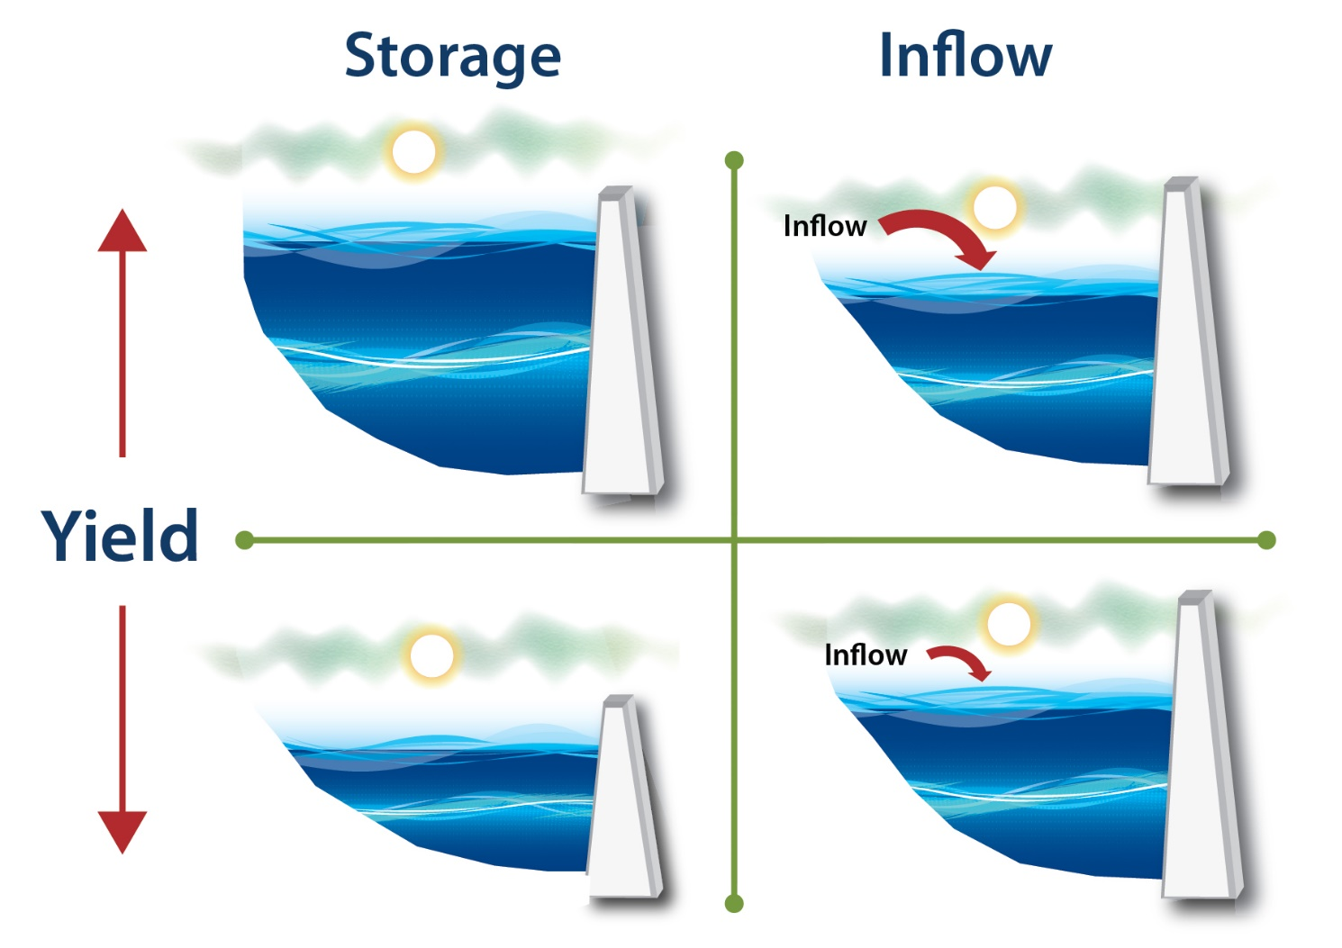
Storage / Yield Theory: Yield as a Function of Storage and Inflow
Firm Yield depends on storage volume and reservoir inflows
Notes:
The consistency of the inflow impacts firm yield, in coordination with the storage volume. Inflows that vary widely, especially between seasons or years, require more storage space for a particular firm yield, compared to more consistent inflows.

Slide 18
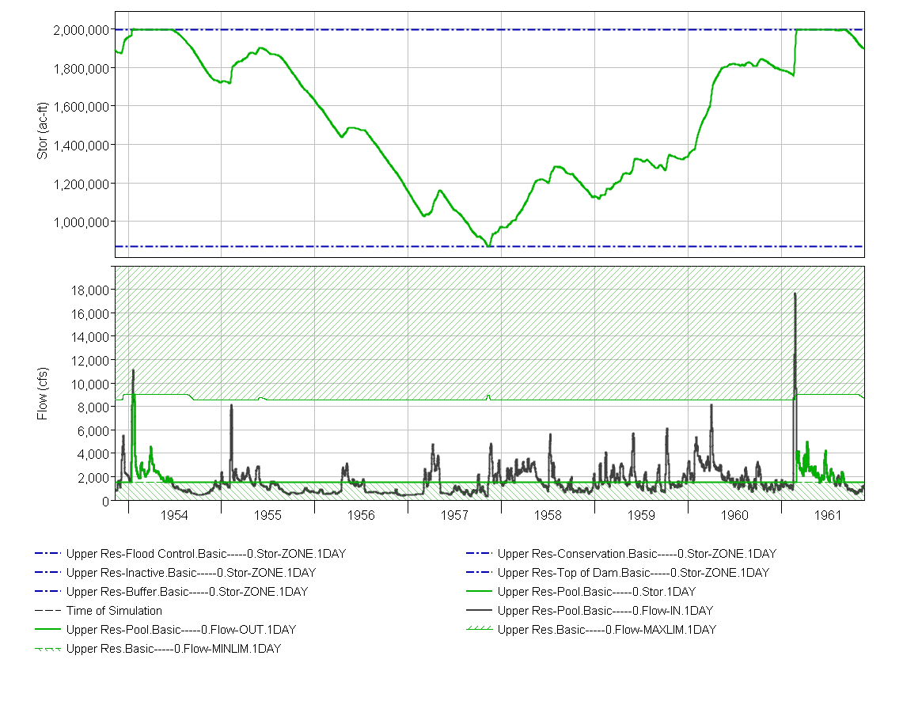
Storage / Yield Theory: Critical Period
Firm Yield is limited by the “critical period” – diverting the firm yield will bring the stored water exactly to zero during this period
Top of Con Pool
Critical Period
Bottom of Con Pool
Notes:
The critical period can vary depending on the size of the diversion and the total storage available. Short, intense droughts can be critical for smaller reservoirs, while longer more spread out droughts are critical for larger sizes.

Slide 19
Firm Yield Analysis
How do we determine the firm yield of a reservoir (or a portion of a reservoir), or needed storage?
Simpler methods are based on determining the maximum cumulative deficit, which tells us how much water needs to have been stored
  Rippl Mass Diagrams
  Sequent Peak Method
Simulation methods instead find the maximum demand that can be met with specific storage capacity and operations
  Iterative Simulation
Optimization (Linear Programming) can solve for either yield or required storage
Notes:
Now we have looked at firm yields and the storage/yield relationship at a site, how do we actually calculate a firm yield for a given storage?
Rippl Mass Diagrams and Sequent Peak Method are older methods, suitable for simple analyses. Iterative simulation is more computationally intensive but more detailed.
All methods will give the same firm yield under simple assumptions, for both a whole reservoir or a portion of the reservoir pool. As assumptions get less simplified, the methods will diverge.

Slide 20
Firm Yield Analysis
= 4,857 cfs
Notes:
Here is an example of streamflow at a point on a river. Note that there are wet and dry periods of varying magnitudes and lengths. We will look at using this data to calculate required storages for a given yield using the 3 different methods.

Slide 21
Firm Yield Analysis
Demand = 100 kaf/mo
demand = 100 kaf/mo
Notes:
For a small demand, the need to pull from storage is not frequent, and the most critical period is the single year that did not have a wet season.

Slide 22
Demand = 100 kaf/mo
Notes:
For a small demand, the need to pull from storage is not frequent, and the most critical period is the single year that did not have a wet season.

Slide 23
Firm Yield Analysis
Demand = 100 kaf/mo
Demand = 200 kaf/mo
demand = 200 kaf/mo
demand = 100 kaf/mo
Notes:
For a larger demand, frequently pulling from storage. More storage capacity will be needed, and the most critical period is several years in a row that needed to withdraw from storage.

Slide 24
Demand = 200 kaf/mo
demand = 200 kaf/mo
Notes:
For a larger demand, frequently pulling from storage. More storage capacity will be needed, and the most critical period is several years in a row that needed to withdraw from storage.

Slide 25
Rippl Mass Diagrams
Simple method, usable for constant demands
Graphical comparison between cumulative inflows and cumulative demands
Notes:
Rippl Mass Diagrams (also known as mass curves) have been used since the 1880s to estimate necessary reservoir sizes.
This graphical method is less suitable to modern computing.

Slide 26

Rippl Mass Diagrams
Notes:
First plot the accumulation of the inflow over the full period (blue line).
Then identify the periods with the smallest accumulation and flattest slope (green circles).
Then determine the demand to be examined and plot a line at that slope (red lines). These lines will be moved to match the potential critical periods next.
Refer back to the streamflow time series to help understand the relationship between the time series and the Rippl diagram.

Slide 27
Rippl Mass Diagrams
1st critical period
Notes:
This is a zoomed view of the first critical period from the previous slide.
By moving the sloped demand lines so they touch the accumulated inflow at the start of the dry period, we can determine the required storage to provided the demand reliably over the whole dry period.
The required storage is the maximum vertical difference between the demand line (red) and the accumulated inflow (blue)
If instead we knew the storage size, and wanted to find the yield, we would draw a line vertically up from the accumulated inflow with the length matching our storage. Then we would draw a demand line down to the tangent point and determine the slope, which is the yield.

Slide 28
Rippl Mass Diagrams
2nd critical period
Notes:
This is a view of the second critical period.
The 200 KAF/month demand is greater than the inflow over this period, and would require a higher storage than the first period we looked at.
However, the 100 KAF/month demand is not large enough to make this a critical period for that demand level. The inflow accumulates faster than the demand does.
This indicates that the first period is critical for a 100 KAF/month demand, and this second period is critical for 200 KAF/month.
To get a storage/yield curve, we would look at different yields and determine the storage required during each drought, then combine the curves as we will see shortly.

Slide 29
Sequent Peak Method
More flexible, allows seasonally varying demands
Accumulate Net Inflow = Inflow – Demand for each time step, find greatest dip
OR, calculate a deficit (Demand - Inflow) each time step and accumulate as long as positive
The amount of storage needed to supply the input demand is determined from the maximum accumulated deficit
Notes:
The sequent peak method is more suited to automatic calculation. It works well with spreadsheets. While it is more flexible than Rippl Mass Diagrams, there are still limitations regarding including other reservoir operations or accounts.

Slide 30
Sequent Peak Method
Notes:
This slide shows an example of the Sequent Peak method for the same data as before. This first plot is using a 100 KAF/month demand.
For the sequent peak method, we don’t accumulate total inflow as in the Rippl method. Instead we accumulate net inflow (inflow minus demand, blue, left axis).
The required storage is then the largest difference between a peak and a subsequent trough (669 KAF in this example). Note that the critical period for this demand is the same as in the Rippl method (1977).
We can also plot the accumulated shortage between inflow and demand (pink, right axis), limiting the accumulation to 0 during periods of surplus. The maximum accumulated shortage is the same as the required storage.

Slide 31
Sequent Peak Method
Notes:
This is the same data but using a demand of 200 KAF/month.
We can see the first critical period in 1977 has a required storage of 2,600 KAF. But the later period in 1992 has the total difference between peak and trough at over 4,000 KAF. So this second period is more critical than the first.
For the sequent peak method, it is more difficult to find the yield of a given storage. It would be easier to use one of the other methods in this case.

Slide 32
Iterative Simulation
Most complex, most accurate and detailed
With reservoir simulation model, allows consideration of other reservoir purposes, losses, interaction with other reservoirs, and downstream requirements
Requires mass balance of reservoir inflows, outflows, and storage each timestep
By trial & error, finds demand that exactly empties storage volume
  set firm yield, iterate for minimum storage (simple mass balance) or
  set storage, iterate for max firm yield (reservoir simulation model)
Notes:
Iterative simulation relies on a rule-based model of the reservoir’s operations. By using rule-based models, any reservoir operation that can be modeled can be included as a factor in the firm yield analysis.
We can run the model many times (iteratively) with successively improved estimates of yield to find the storage required to meet that yield without fail.

Slide 33
Demand = 100 kaf/mo
Notes:
This is the results of an iterative simulation using the same inflows as the other methods.
Here we are using a 100 KAF/month demand and a storage of 669 KAF. We see that the storage drops to zero one time, during the critical period.
We would iterate to determine the 669 KAF storage size.

Slide 34
Demand = 200 kaf/mo
demand = 200 kaf/mo
Notes:
Here are results using a 200 KAF/month demand and a larger storage volume of about 4,000 KAF. We can see how the earlier period is not dry enough to draft the storage to zero, but the later period is.

Slide 35
197 KAF / mo
182 KAF / mo

Slide 36
Iterative Simulation
This is the recommended USACE method for yield calculation
  Highly flexible and accurate
  Efficient with current computing power
HEC-ResSim is the focus of this training course
  Other reservoir models that can be used for studies include:
    RiverWare
    OASIS
    SUPER
    HEC-5
    MS Excel
Notes:
Many modeling systems exist, but this class will focus on HEC-ResSim. Many USACE reservoirs already have HEC-ResSim models created that can be adapted for use in firm yield analyses. We will discuss modeling details further on in the class.

Slide 37
Storage / Yield Theory: Storage / Yield Curve
Firm Yield
Firm Yield
669
4068
Notes:
As a reminder, we will be dealing primarily with firm yield in this class. Reference EM 1110-2-1420, Chp. 12: “Most designs of reservoir storage for municipal and industrial water supply are based on supplying the firm yield during the most critical drought of record.”)
Now we will look in more detail at the creation of the storage/yield curve. We can use our chosen method to calculate the required storage for many different firm yields (or the yield given many different storages). That will generate a storage/yield curve like we saw before.
We will start with the curve calculated from the early 1990s drought. In this period, to get a yield near the full average flow of 294 KAF/month requires a storage of around 12000 KAF.
Next, looking at the drought from the mid-1970s we get a different curve. This drought was more intense, but shorter than the 1990s drought. So with smaller reservoir sizes, the yield is less than the first drought. However as the storage increases, the ability of the reservoir to get through the drought without emptying increases more quickly due to the shorter drought.
Thus the critical period depends on the yield and storage size and is not always the same period. The final storage/yield curve for this site is a composite of the curves from both drought periods. If we had not looked at both periods (and any other dry periods in case they were more critical) we would not get the correct curve.

Slide 38
Storage / Yield Theory: S/Y Curve as firm yield per volume

Slide 39
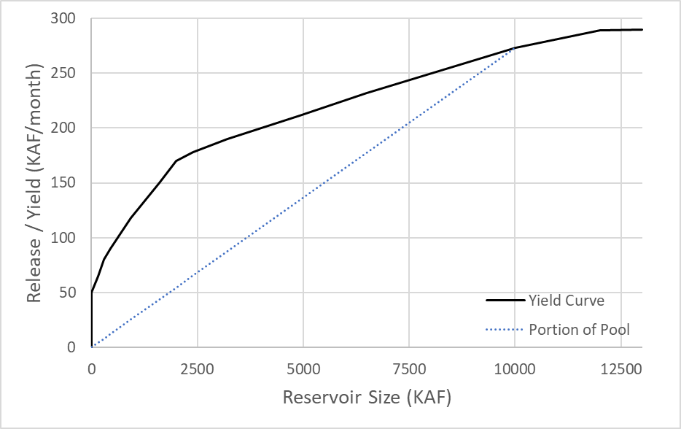
Storage / Yield Theory: Yield for Portions of Storage
270
210
Shared Conservation Pool
135
Notes:
When looking at a portion of the conservation pool, it is commonly assumed that one half of the storage of a given reservoir has one half the total firm yield of that reservoir. This does not apply between reservoirs, the firm yield of a reservoir with 5,000 KAF is not the same as the firm yield of 50% of a reservoir with 10,000 KAF.
We can see why here with our storage/yield curve. A reservoir of a different size (2,500 KAF vs. 10,000 KAF) will have a different yield, with a non-linear relationship.
But if we only wanted to look at the yield of a portion of a reservoir (2,500 KAF in a reservoir with a total storage of 10,000 KAF), the yield reduction would be linear and the 2,500 KAF portion would have a yield 25% as large as the full 10,000 KAF reservoir (blue line).
Generally, a portion of a reservoir will yield less than an entire reservoir the same size as the portion (the blue dashed line is below the black line). This is caused by what we discussed earlier: The efficiency of storage decreases as the storage size increases. A 10,000 KAF reservoir will yield fewer cfs/KAF than a 2,500 KAF reservoir. A portion of the pool will have the same yield per KAF as the entire pool. So the 2,500 KAF portion has the same yield per KAF as the 10,000 KAF reservoir.
This assumption can be wrong depending on the details of inflow and release allocation between portions of the pool! We will see examples of this later in the class.

Slide 40
Other Yields
Firm Yields can be calculated for uses other than water supply
  Hydropower, downstream minimum flows, water quality requirements
Simpler methods don’t apply…
Requires iterative simulation with models that capture those uses
  Additional information may be required: power head, other flows, etc.
Notes:
The calculation procedure follows the same principles for any type of yield analysis. Iteration while changing the operation of interest is done until the available storage is completely depleted once.

Slide 41

Hydropower Yield
Hydropower yield can also be calculated with iterative simulation using the same model
  Need turbine characteristics in model
Here we look at minimum energy generation instead of flow
  KWH or similar units

Slide 42
Usable Storage
What are the limits of the con pool?
What do we mean by zero storage?
Concept of “usable storage”
Usable storage does not include:
  Dedicated hydropower head
  Sediment reserve (“inactive pool”, “sediment pool”, “dead storage”)
  Forecasted sedimentation over the life of the project is defined as 100-year for reservoirs and 50 years for navigation projects.
Notes:
While the guide curve is the upper limit on the con pool, we need to define the lower limit. This will allow us to know how much storage is available for water supply and other conservation uses.
When we say that the critical period is when the storage is brought to zero, what exactly is zero? We usually don’t want to (and can’t physically) empty a reservoir to the very bottom.
USACE policy uses the concept of usable storage. There are several different policy sources that speak to the definition of usable storage. More detail is available in backup slides at the end of this lecture.

Slide 43
Knowledge Check
What is the definition of yield?
  “Yield is the amount of water that can be supplied from the reservoir to a specified location and in a specified time pattern.”
How does Firm Yield differ from this general definition?
  Firm Yield is defined as the highest consistent flow rate that can be provided through a period of historical streamflow. A firm yield is limited by a critical period, and is calculated using the historical period of record.

Slide 44
Knowledge Check
How does the Sequent Peak Method compare to Iterative Simulation?
  The Sequent Peak Method is simpler, but is limited to using a constant guide curve and no other reservoir uses. Iterative Simulation can be much more detailed and complex, and can include other reservoir purposes, competing demands and losses.
What is the USACE recommended method? Why?
  Iterative Simulation, because it provides the best balance of usability and power.
Notes:
Iterative simulation can use a very simple model, or have near-limitless complexity. It can scale to the demands of a particular study.
Current computing power and available software make iterative simulation a good method for almost any water supply study.

Slide 45
Knowledge Check
How is the firm yield affected by increasing conservation storage in the reservoir? What about increasing flood storage?
  Increased conservation storage will increase the firm yield but will decrease the marginal yield per acre-ft. The increase will generally not be linear. Increasing the flood storage by raising the dam will not impact firm yield, but increasing flood storage by reallocating from conservation storage will impact firm yield.
If a water user cuts back use during an extreme drought, does that affect the firm yield?
  In studies, firm yield is usually defined as a constant theoretical amount based only on available storage size. Changing actual diversion amounts will not affect the firm yield calculation. Cutbacks and other drought contingency measures can add a factor of safety for droughts worse than the critical period.
Notes:
This question is intended to stimulate discussion related to what factors affect firm yield. A key point is understanding that the critical period starts with a full conservation pool and no flood storage. A reservoir that is only authorized for flood control may have a firm yield of zero, despite a large storage capacity.
Discuss the relationship between calculated firm yield and actual diversions. Firm yield is defined by storage and critical period, not use. Diverting less water during a drought may help the supply last longer, but it does not increase the firm yield of the reservoir. The discussion can also note that a given future drought may be more or less severe than the critical period the firm yield calculation was based on, touching on reliability and uncertainty which will be discussed later in the course.

Slide 46
Knowledge Check
Is firm yield impacted by outlet capacity limits at low pool elevations?
  A study can define firm yield as the theoretical available diversion, regardless of current diversion capacity. Or it can use the actual current outlet works to limit yield. It depends on the needs and purpose of the study. Again, be clear about assumptions and definitions.
Notes:
This is one of many details that may come up during a study. This and similar questions should be answered by thinking about the goals for your study, and how to best model your system to meet those goals.

Slide 47
Knowledge Check
Is dead/inactive storage included in a firm yield calculation? Does having a buffer zone at the bottom of the conservation pool impact firm yield?
  Firm yield study results will depend on the specific formulation of the study. Firm yield will typically be based on “usable storage” as defined in USACE policy. Inactive storage, future sedimentation space, and storage reserved for hydropower head are generally not included in usable storage. It is important to clearly identify and clearly record your definitions and assumptions.
Notes:
The goal of this question is to emphasize the importance of thinking about and writing down your assumptions and definitions. There is no one right answer for many questions, different Districts and different studies can have different needs.

Slide 48
Usable Storage
Usable storage does not include:
  Dedicated hydropower head
  Sediment reserve (“inactive pool”, “sediment pool”, “dead storage”)
  Forecasted sedimentation over the life of the project is defined as 100-year for reservoirs and 50 years for navigation projects.
How current is sedimentation data used in the study?
P.L. 88-140 and Article 1e. of model WS agreements
  Law discusses “equitable reallocation of reservoir storage capacities” as necessary due to sedimentation
  Model WS agreements require:
    Periodic sediment surveys
    Redistribution of the project sediment reserve
  Not clear if intent of “reallocation” language in law was limited to just the original sediment reserve or intended to continue past the reserve
Notes:
Dedicated hydropower head (per 1989 ASACM memo)
Sedimentation data is used to fully assess the available storage within the reservoir. It is thought to be a “no go zone” for available storage within the reallocation study mainly because this storage was designed to be set aside with the expectation that at some point in the project life – the “storage” would be exhausted by actual sediment. In some cases this is holding true and in some cases not. Based on initial engineering assessments of sediment within the basin (100 years projection), USACE would then account for some accretion rate of the life of the project, thus setting aside that much storage to be occupied as the dam captures the material behind the reservoir. Historically there have not been allowances for passage of sediment from behind the reservoirs – this has been and is becoming a much larger issue over time due to the age of the infrastructure (seeing its design life – Muskingum Example).
PL88-140 stipulates that no law defines the duration of the entities’ interest in the storage space so long as the purchase of said space is maintained (to continue throughout the life of the project). And so long as that space is physically available.
Basing the water supply agreements on usable storage is meant to make sure the storage-yield analysis used as a basis for the percentage of conservation storage reallocated and contracted is conservative and will hold up for a reasonably foreseeable future, e.g. 100 year forecast of sedimentation. Along with excluding designated hydropower head storage, requiring the user to contract for a conservative amount of storage also helps to protect the other authorized purposes in the project.
Editorial: note that correctly defining usable storage has been a recurring problem from time to time in policy and technical reviews.
Article 1e of the model agreements (note the discretion given to the District Engineer):
Sedimentation surveys will be made by the District Engineer during the term of this agreement at intervals not to exceed fifteen (15) years unless the District Engineer determines that such surveys are unnecessary. When, in the opinion of the District Engineer, the findings of such survey indicate any Project purpose will be affected by unanticipated sedimentation distribution, there shall be an equitable redistribution of the sediment reserve storage space among the purposes served by the Project including municipal and industrial water supply. The total available remaining storage space in the Project will then be divided among the various Project features in the same ratio as was initially utilized. Adjusted pool elevations will be rounded to the nearest one-half foot. Such findings and the storage space allocated to municipal and industrial water supply shall be defined and described as an exhibit, which will be made a part of this agreement, and the water control manual will be modified accordingly.
The Government assumes no responsibility for deviations from estimated rates of sedimentation, or the distribution thereof. Such deviations may cause unequal distribution of sediment reserve storage greater than estimated, and/or encroachment on the total storage at the Project.
The original language in PL 88-140 is a bit more broad: “The [water supply storage] right thus acquired by any such local interest is hereby declared to be available to the local interest so long as the space designated for that purpose may be physically available, taking into account such equitable reallocation of reservoir storage capacities among the purposes served by the project as may be necessary due to sedimentation…”

Slide 49
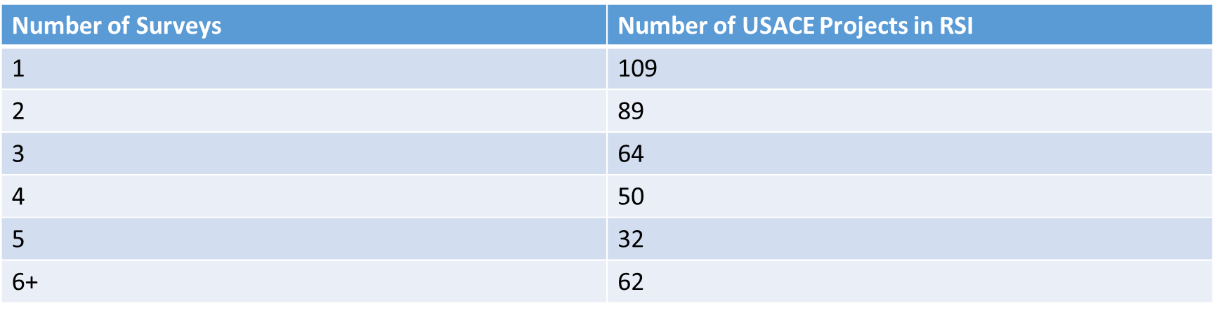
Usable Storage
Notes:
This table shows the reservoirs currently in the Reservoir System Information (RSI) database maintained by ERDC. Note that 109 out of 406 total reservoirs in the database only have one sedimentation survey, and thus have no information about the rate of sedimentation over time.

Slide 50
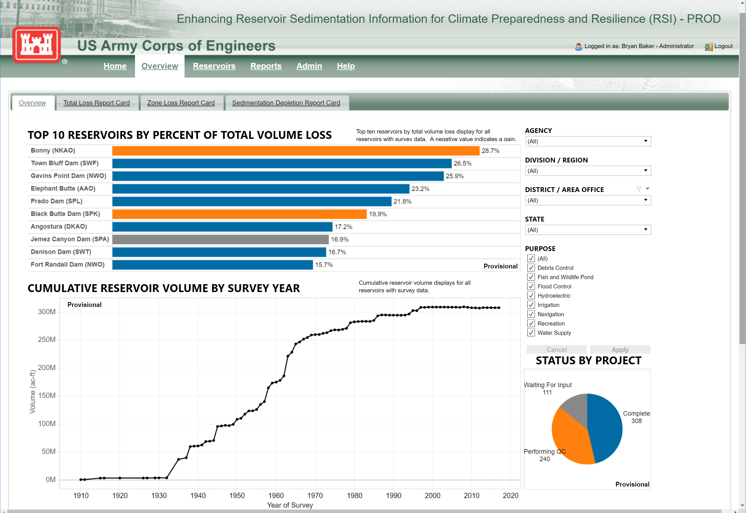
Usable Storage
Notes:
This screenshot shows the top 10 reservoirs in terms of storage space lost to sediment. The top 5 have lost over 20% of their total volume. This shows that sedimentation can have a significant impact on future storage availability and should be considered in a water supply study.

Slide 51
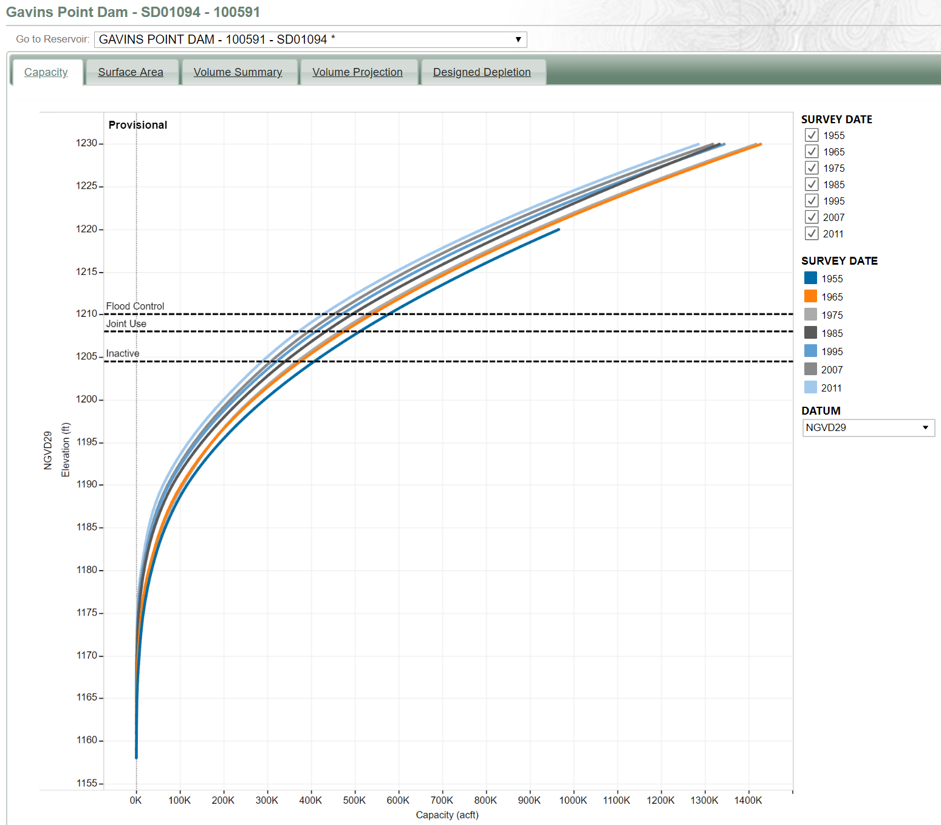
Usable Storage
Notes:
This screenshot shows all of the sediment surveys for Gavins Point Dam on the mainstem Missouri River. The earliest survey is the rightmost dark blue line, and subsequent surveys move to the left as storage is lost to sediment.
We can see that the storage at the bottom of the joint use pool (Inactive line) at 1204.5 ft has decreased from 400,000 ac-ft to less than 300,000, more than a 25% decrease. The Joint Use zone used to have about 100k ac-ft of storage, but now only has about 70k.

