Slide 1
Conducting Reservoir Storage-Yield Analyses Using HEC-ResSim
Lecture #3 – HEC-ResSim Overview

Slide 2
Introduction
What is HEC-ResSim?
How are HEC-ResSim models built?
Introduce the first workshop.
Notes:
This lecture will remind students what HEC-ResSim is and how it is used. We will go over the basic components of an HEC-ResSim model. We will also introduce the first hands-on workshop.

Slide 3
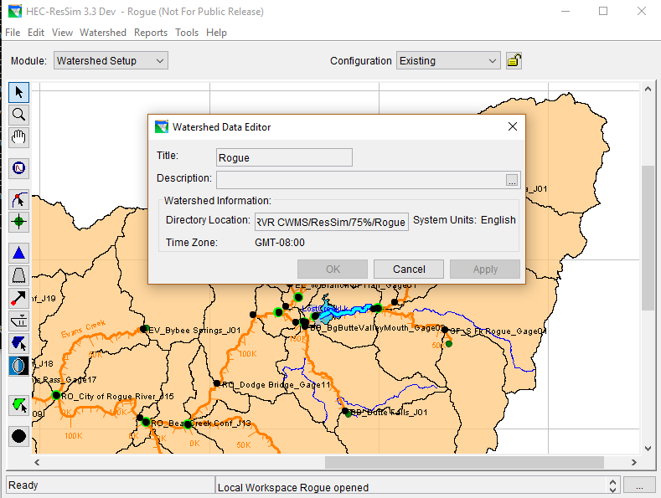
HEC-ResSim
USACE Reservoir simulation tool
Allows rule-based simulation of reservoir operations
Under active development
Example HEC-ResSim model showing reservoir and river network
Notes:
While this class will assume familiarity with HEC-ResSim, we will quickly review how it works and the basic structure of a HEC-ResSim watershed.

Slide 4
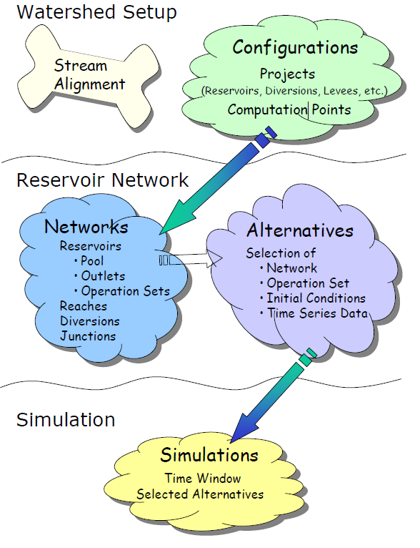
HEC-ResSim
Models organized into watersheds – configurations – networks – alternatives – simulations
From HEC-ResSim User’s Manual
Notes:
The number of different items in a given model (number of networks, alternatives, etc.) will depend on the complexity of the modeled system and the different uses for that model. It is possible to perform a yield analysis using existing items or to create dedicated networks, alternatives, and simulations.

Slide 5
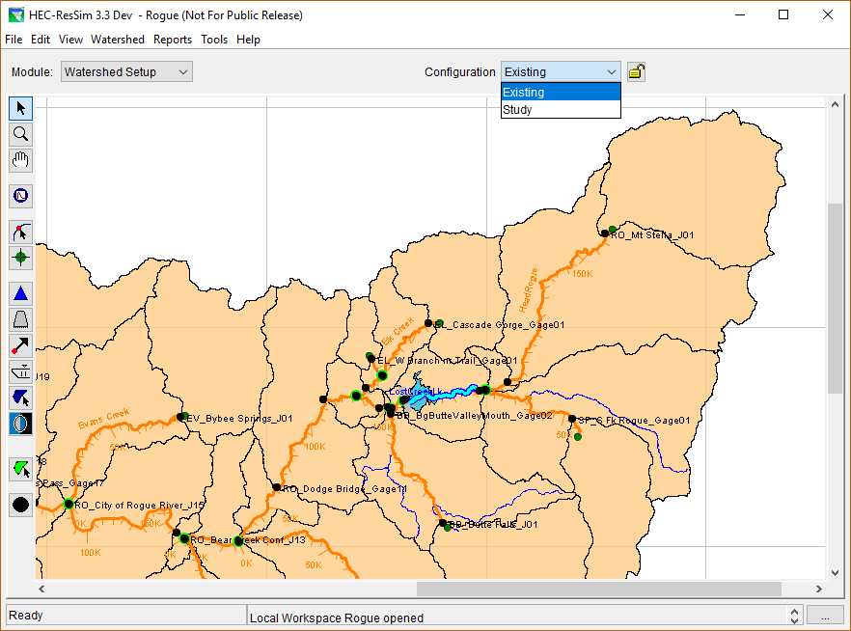
HEC-ResSim: Watersheds
A watershed contains Stream Alignments and Configurations
Configurations
Streams
Reservoir
Notes:
The stream layout and connectivity are defined in the stream alignment. Common computation points, reservoirs, and any other modeled items like diversions are also defined in the Watershed Setup module.

Slide 6
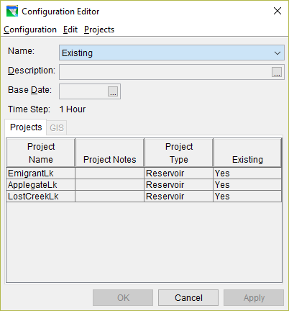
HEC-ResSim: Watersheds
Configurations define a list of projects. A watershed can have multiple configurations
Networks are built on top of a specific Configuration
Notes:
Different configurations can be used to model different scenarios. You can model a future with or without a future project by using configurations that include or exclude that project.

Slide 7
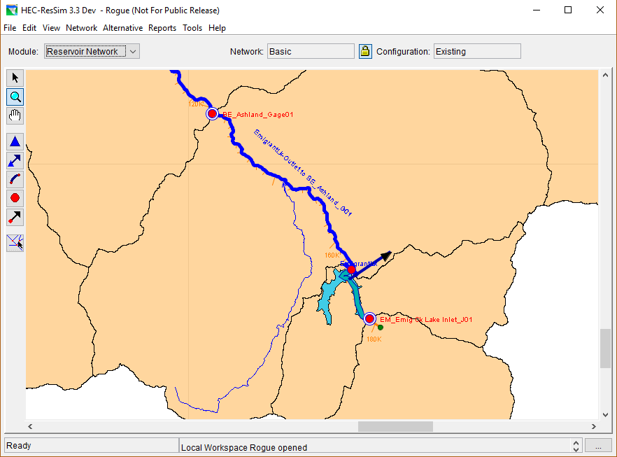
HEC-ResSim: Networks
Networks define reservoirs, reaches, and diversions
Diversion
Reach
Reservoir
Notes:
The network is where the physical properties of the system are defined. Features relevant to yield analysis that can be set here include the location of a diversion and the routing parameters in reaches below a reservoir.

Slide 8
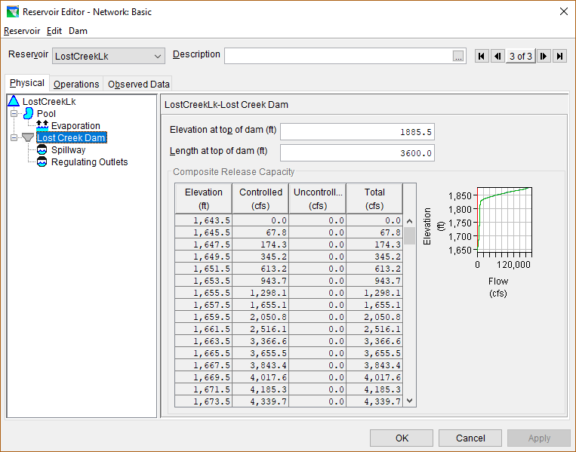
HEC-ResSim: Reservoirs
Reservoirs have physical parameters defined
Important parameters include:
  Storage-elevation curve
  Outlet capacity, especially at lower storages
  Evaporation (time series may be better than monthly average)
  Turbine characteristics if looking at hydropower yield
Notes:
It is important to remember that the values input as physical parameters should only include physical limitations. A model builder should put in the full outlet capacity even if the reservoir typically does not release at capacity due to operating restrictions.
Accuracy in defining these physical parameters is important to performing an accurate yield analysis. Storage and outlet characteristics can affect the resulting yield, especially as the modeled storage drops to near the bottom of the conservation pool.
Evaporation can have a very significant effect on the overall safe yield, and handling evaporation properly in both the model and in the inflow calculations will be discussed in a later lecture.

Slide 9
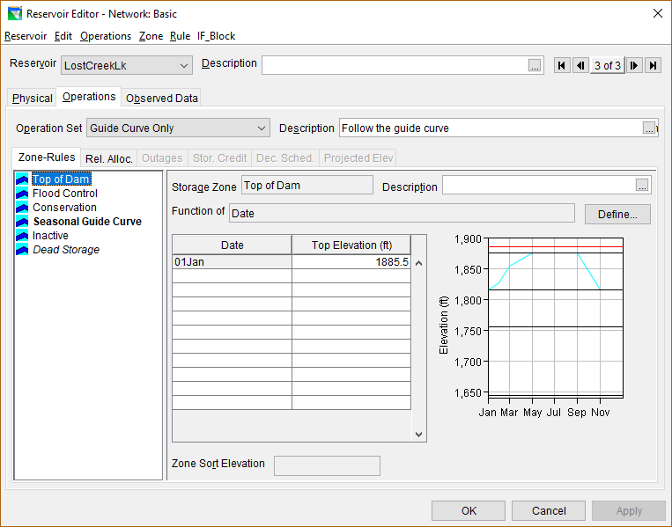
HEC-ResSim: Reservoirs
Operation zones divide the reservoir storage horizontally
Can vary seasonally
Different rules can be used in different zones
Defined Operation Zones
Plot of zones
Notes:
Yield analysis will typically be focused on operations within the conservation zone. This zone may be named differently or be split into multiple operation zones (such as Conservation and Buffer).
Note that the zones shown in this example are not necessarily typical. Often the Inactive and Dead Storage zones will be the same, and there may be more or fewer zones.

Slide 10
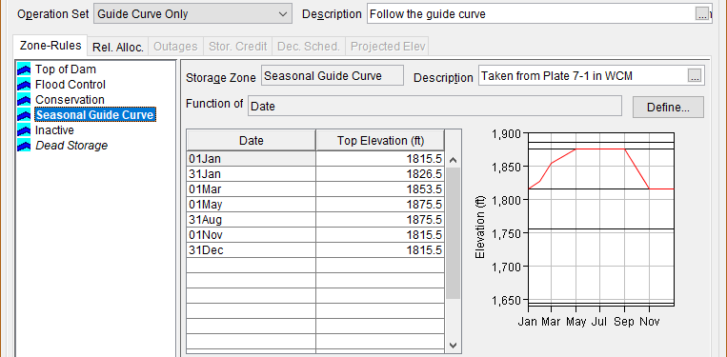
HEC-ResSim: Reservoirs
Guide Curve – storage level that HEC-ResSim will always attempt to follow
  Generally represents the top of the conservation pool / bottom of the flood pool
Selected as Guide Curve (bold text)
Notes:
Very simple models can have no rules defined, and the model will follow the guide curve at all times unless the physical outlet capacity won’t allow it.
Models can also have minimum flow rules defined in the conservation zone preventing zero releases in that pool, but have no rules defined in the flood zone, allowing releases up to outlet capacity in that pool.

Slide 11
HEC-ResSim: Reservoirs
The top of the Conservation Zone is typically the Guide Curve
The bottom can vary depending on the reservoir
  Conservation zone should match the usable storage discussed in Lecture #2
  The top of dead storage or inactive storage zones is often the bottom of the Conservation Zone
  Sometimes a project might define the Conservation Zone differently
Notes:
As discussed in the previous lecture, there is no one right answer for what to use as the Conservation Zone. Use policy guidance to help determine the right usable storage for your study, and clearly state what you used.

Slide 12
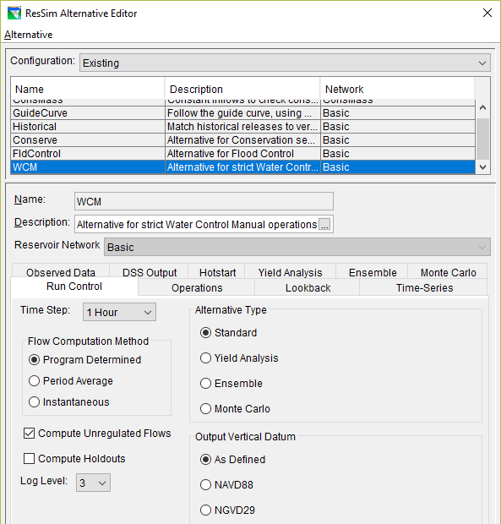
HEC-ResSim: Alternatives
Alternatives define time series input and run options
Each Alternative is based on a specific Network
Notes:
There are many options that can be set on an Alternative. It is important to verify that your Alternative is setup correctly.

Slide 13
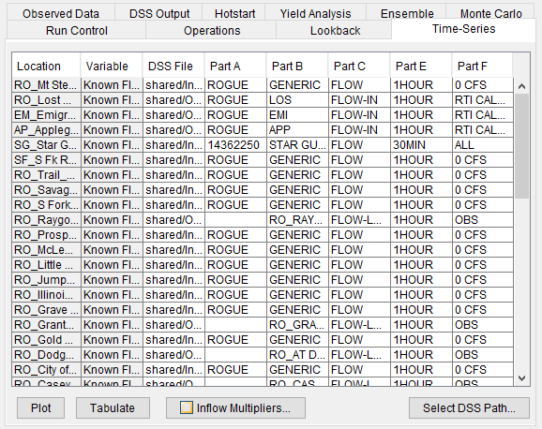
HEC-ResSim: Alternatives
HEC-ResSim does not calculate inflows or local flows
Calculate before running HEC-ResSim
Must be input as time series from a HEC-DSS file
Notes:
This screenshot shows the tab for linking time series from an HEC-DSS file to an HEC-ResSim model. Every input time series in the HEC-ResSim model must be linked.

Slide 14
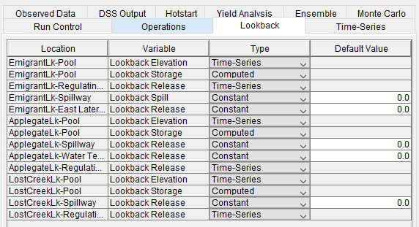
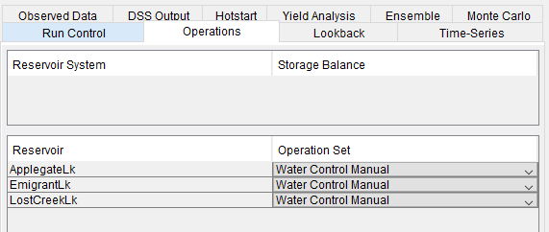
HEC-ResSim: Alternatives
An Operation Set must be chosen for each reservoir. This will define what rules are used for this Alternative.
Initial conditions are input as Lookback values. They can be constant values or linked to a time series.
Notes:
Using a time series for lookback means you don’t have to change your lookback values each time you change your simulation period. The model will automatically read the value that matches the beginning of your run. Lookback Elevation and Storage are linked, only one needs to be entered, the other will be computed.

Slide 15
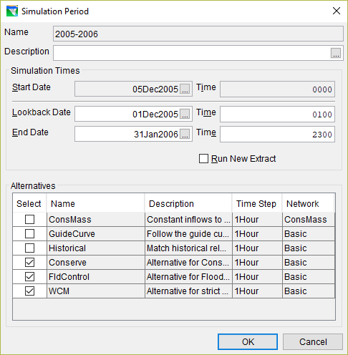
HEC-ResSim: Simulations
Simulations define the run period
Each Simulation can contain multiple Alternatives
Simulations are where you actually run the model and get results
Each Simulation creates a copy of the Alternatives and Networks it contains. Changes made in the Simulation are separate from changes made to the base Network.
Notes:
Simulations have a lookback time, start time, and end time. The lookback time is used to load initial conditions based on linked time series in the Alternative. The start and end times define the limits of the run. Simulations for water supply studies will often run for the full period of record.

Slide 16
Complexity of Yield Models
A simplistic model might include these assumptions:
  Annual guide curve
  Constant demand
  No other reservoir uses
A more complex model might require:
  Seasonally-varying demand
  Other reservoir purposes/uses
  Downstream conditions
  Joint reservoir operations
  Inflow allocation
  Storage targets based on seasonal forecasts
Notes:
It is important to understand and acknowledge the assumptions implicit in a modeling effort. Simple models will have different assumptions than more complex models.

Slide 17
Knowledge Check
What are the components of an HEC-ResSim model?
  Watershed (overall model), Configuration (collection of projects to model), Network (projects and reaches with physical parameters and rules), Alternative (time series links and run options), Simulation (run period and alternative selection)
Where is the elevation-storage curve defined in an HEC-ResSim model?
  On the reservoir object as part of a Network. The Physical tab inside the Reservoir Editor contains this curve as well as the outlet capacities and other parameters.
Notes:
The different components have various sub-components and all interact with each other to result in a model run.

Slide 18
Knowledge Check
What is an Operation Zone?
  A range of pool elevations defined in the reservoir that contains specific rules that are active when the elevation is within the range. The top elevation of each zone is defined in a table, and can vary over a year.
What is a Guide Curve in a HEC-ResSim model?
  A seasonally-varying target elevation that the model will attempt to follow at all times, if possible. Rules will constrain the model’s ability to follow the guide curve.

Slide 19
Workshop #1 – Simple Yield Analysis
Sequent Peak Method
You will determine the yield of a reservoir using this method
HEC-ResSim
You will determine the yield for the same reservoir by manually iterating among different demands
Notes:
We will work through some exercises using pre-built models. First, we will use an Excel spreadsheet to demonstrate the sequent peak method. Then we will look at doing a similar analysis using HEC-ResSim.

