Slide 1
Conducting Reservoir Storage-Yield Analyses Using HEC-ResSim
Lecture #8 – Water Accounting

Slide 2
Introduction
Water accounting principles
Inflow allocation
Model operation priority under accounting
Iterative Simulation with water accounts is the USACE recommended method for firm yield analysis for water use contracts
Notes:
Now we will go over water accounting. Water accounting is a way of keeping track of specific uses of different portions of the total usable conservation storage space.
Before we learned that iterative simulation is the recommended method for firm yield analysis, and you have worked through some iterative simulation workshops. Now we will add the other half of the USACE recommended method, which is including water accounts in the simulation model.

Slide 3
Water Supply Analysis
Remember the first main question from Lecture #5:
The HEC-ResSim Yield Analysis Tool finds firm yield for a given amount of storage
We ultimately want the storage needed for a given firm yield
What percent of the conservation pool could be contracted to provide supply?
Notes:
Knowing the yield for a portion of the Con Pool will help us answer the primary question for this course: What % of the Con Pool do I need to contract to provide a certain firm yield?
The yield analysis tool gets us part of the way there, but we typically want to flip the question around with a set firm yield and varying storage.

Slide 4
Water Supply Analysis
So far we have calculated firm yield for the entire Con Pool
  Single minimum release rule
  Multiple operational rules
Now we will use water accounts to find firm yield for a portion of the Con Pool
  Could assume yield is proportional to storage portion, but not always true
Storage needed for a given yield can be found with manual iterations of the yield tool
Notes:
Yield will not always be proportional to storage size, due to interactions between purposes and details of how the accounting is done.
HEC-ResSim will tell us the yield for a given storage. We can then change the size of the storage until we get a yield that matches the request. We will look at this idea more in the final workshop.

Slide 5
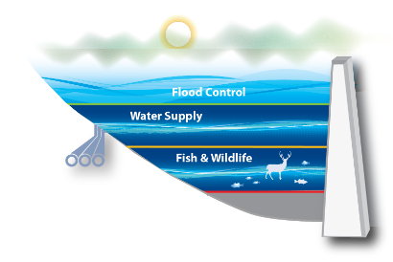
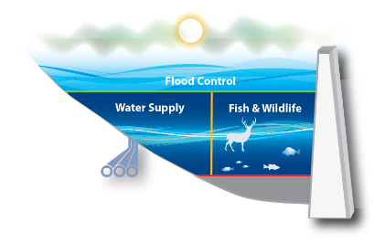
Water Accounts
Operation zones (flood, con pool) are horizontal
Accounts are like a vertical or floating zone
  Availability of water in the account is not directly related to pool elevation
Notes:
While operating zones have many benefits, using single-purpose horizontal zones does not necessarily work well. For example, if a reservoir’s con pool was split into a water supply zone on top, and a fish and wildlife zone below that, it would setup odd incentives. The fish and wildlife user would not be able to access their water until water supply storage was exhausted. They would hope for a drought so they could use more water. This is a silly example but does illustrate a complication with horizontal zones.

Slide 6
Water Accounts
We discussed earlier that competing uses can sometimes harm water supply
Water accounts can help this issue
  Can also prevent water supply harming other uses
Accounts reserve water for the future for a specific use
Water in the account is only for that use
Notes:
In the previous lecture and workshop, we saw that it can be difficult to balance releasing water for the future when operating for multiple purposes. Water accounting is one method to help with that decision. Having a dedicated water account for each user allows the users to plan more effectively for future needs because they know how much water they have and don’t need to worry about other user’s decisions as much.

Slide 7
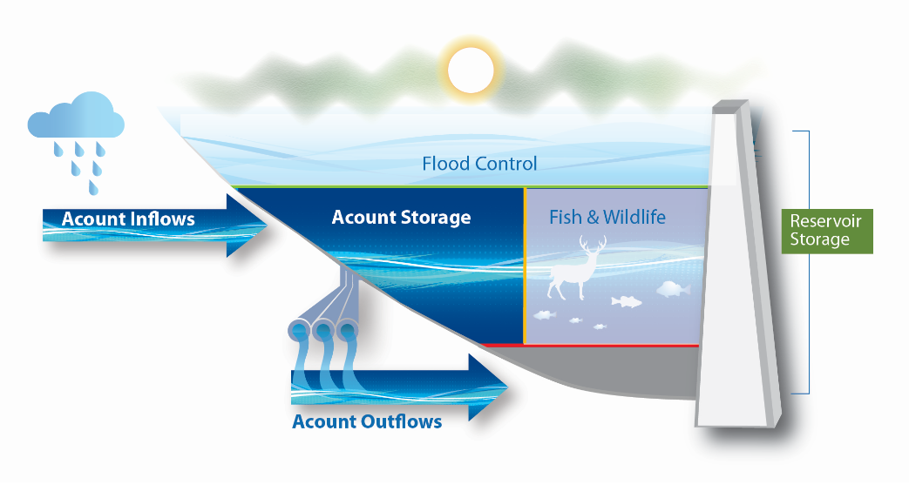
Water Accounts
Yield analysis for an account is performed the same as for a single-purpose reservoir
Iterative Simulation is again the recommended method
Track inflows, outflows, and storage; determine critical period and firm yield
Notes:
We treat yield analysis for a water account the same as yield analysis for the whole con pool. We perform the same steps in the same way, we just use the values for the account rather than the whole pool. That means we need to define and track account inflows, account outflows, and account storage.

Slide 8
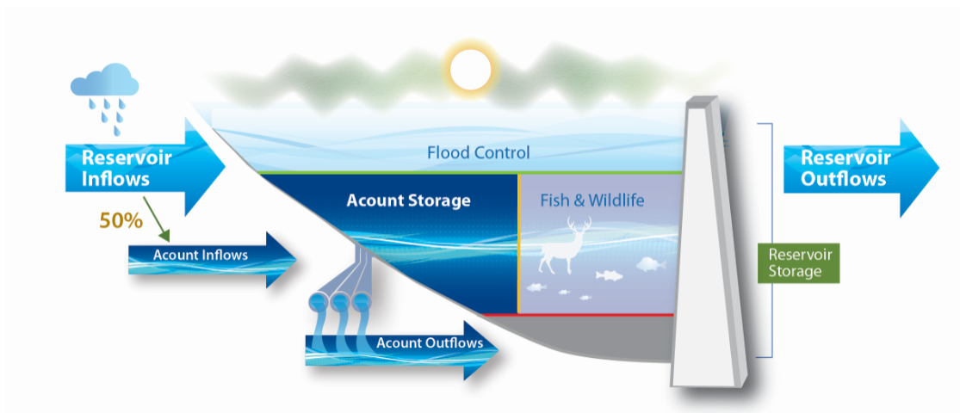
Inflow Allocation
HEC-ResSim currently divides inflow proportionally among accounts
  50% of the Con Pool will get 50% of the inflow
  Seasonal guide curve may impact percentage
Notes:
For this class, we need a method of allocating reservoir inflows to accounts that we can work with in the time we have. We also need to use a method that HEC-ResSim can work with. We will choose to assign inflows proportional to the size of the account.
Note that for reservoirs with a seasonal guide curve, an account with a fixed volume will have a varying percent size, and vice versa.
We do not allocate outflows the same way. Outflows from accounts are determined by the operations of that account, and the total reservoir outflow will be the sum of the different account outflows and any other outflows needed to operate the full reservoir.

Slide 9
Inflow Allocation
USACE has no official policy on how to allocate
Decisions may depend on state water rights laws and the specific supply contract
No right or wrong methods, do what is right for your district and your reservoir
  Currently, methods besides proportional will require HEC-ResSim enhancements or use of another model
Notes:
While HEC-ResSim follows a common proportional allocation method, there are other methods that your reservoir may follow. Deciding what method to use is beyond the scope of this course. There is no definitive answer available to cover all situations.

Slide 10
Storage-Yield USACE POCs
Policy
  Sean Smith (HQ – H&H Principal & CoP Lead)
  Amy Frantz (HQ – Senior Policy Advisor)
  Dan Inkelas (HQ – Office of Litigation)
Policy/Technical Liaisons
  Brad Hudgens (IWR – Technical SME)
  Cherilyn (WMRS-PCX – Director)
Technical
  Chan Modini (HEC)
  Beth Faber (HEC)
  Fauwaz Hanbali (HEC)
  Joan Klipsch (HEC)

Slide 11
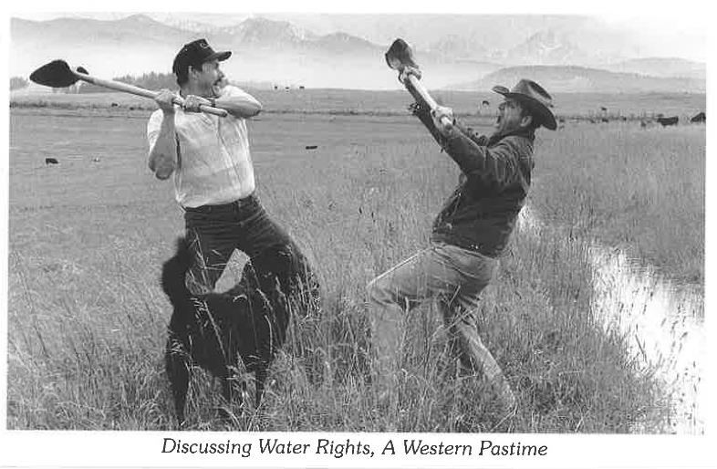
Inflow Allocation
True Riparian, Prior Appropriation and In-between
  East vs. West
True riparian rights typically share flows proportionally among users
Prior Appropriation prioritizes uses by seniority
  First in time, first in right
USACE does not obtain state water rights to operate reservoir projects.
Notes:
The primary difference across different states is riparian states vs prior appropriation states. Lawsuits are common and can be acrimonious. Currently USACE takes no position on the correct method of allocating water to different users.

Slide 12
Losses
Also need to allocate losses (evap, leakage, etc.)
HEC-ResSim currently allocates proportionally
Again, no policy or right answer
Important issue that requires careful consideration
Make your assumptions explicit
More discussion tomorrow
Notes:
Allocating losses can be as complicated as allocating inflow. There are again several different methods, and your study will require its own determination of the best method. We will talk more about this issue in Lecture #9 tomorrow.

Slide 13
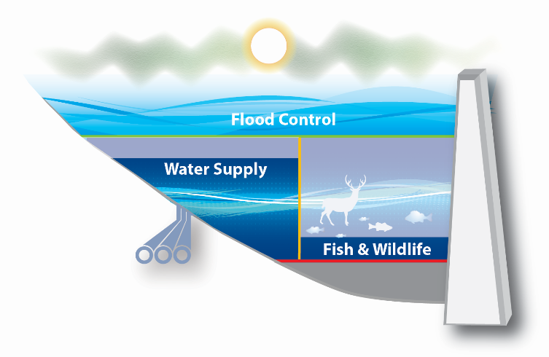
Competing Uses
Water accounts can help clarify operations at multipurpose reservoirs
Water is reserved and cannot be used by other purposes
Helps ensure competing uses don’t adversely impact other commitments
Notes:
Using water accounts allows us to model different uses at the same time with less impacts among uses. If the fish and wildlife user uses most of their water, the water supply user can still have their account mostly full, or the other way around. F&W decisions don’t affect the water supply account.

Slide 14
Water Accounting
Iterative Simulation with water accounts* is the USACE recommended method for firm yield analysis for water use contracts
  Allows for detailed consideration of uses and operations each timestep
  Water allocation for different uses is respected
  Impacts between uses and of new uses can be quantified
  * The term water accounts is being used synonymously with storage accounts or storage accounting
Notes:
Using water accounts allows us to better model the operations at a reservoir. It also matches how many reservoir’s conservation pools are actually allocated. It is common for a reservoir to have portions of the con pool devoted to different users with different contracted storage amounts per user.

Slide 15
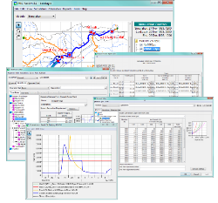
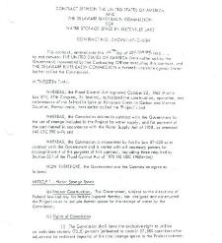
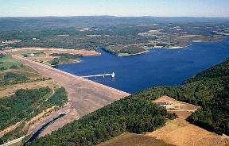
Water Supply Storage Agreements
Effects on other authorized project purposes
Study
Agreement
Operations
Volume of water that user may withdraw/ order released through duration of a drought
Assumed inflows and other conditions
Right to use % of usable conservation storage space
Storage accounting?
Credit for return flows?
Actual
inflows
State water rights
Notes:
The percentage of conservation storage space allocated to the water supply user needs to be consistent with the use they need to make of the agreement, i.e. how much water they will need to withdraw from storage in a critical drought, and our assessment of how the new agreement will impact other project purposes (as the Water Supply Act requires Congressional approval for changes that would “seriously affect the purposes for which the project was authorized, surveyed, planned, or constructed, or which would involve major structural or operational changes…”, 43 USC 390d).
This slide tries to show how the agreement needs to be consistent between the study and operational phases. Note that EM 1110-2-3600 documents that we consider water supply storage agreements to be a “firm commitment of reservoir storage.” (can’t seem to download the 2017 version for citation, but it’s pg. 2-18 of the 1987 version). Keeping in mind that PL 88-140 made water supply storage agreements permanent as long as the user continues to make their required repayments, one question is whether the operational interpretation of an agreement is still consistent with the original study’s assessment of its impacts on other authorized purposes 50 years later, 100 years, etc.?
Editorial: as long as our H&H analysis is conservative and consistent with limitations placed on withdrawals under operational storage accounting and/or exercise of state water rights, it’s unlikely that a water supply user will be able to “harm” other project purposes in a future drought by withdrawing more water than was originally contemplated in the study leading up to the agreement.
Note that dashed lines in this slide highlight issues in the current draft rule on water supply authorities.

Slide 16
Accounting in HEC-ResSim
Reservoirs and systems can have water accounts
Limits of the conservation pool are defined
A rule is selected to draw from the account
Accounts are either % of total or a fixed volume
Notes:
Now we will look at how HEC-ResSim models water accounts. Keep in mind that accounting features are under active development and may change over time.

Slide 17
Accounting in HEC-ResSim
Default Account
User water accounts represent assigned conservation storage per user
Default account represents all conservation storage not assigned to a single user water account
User A
User B

Slide 18
Accounting in HEC-ResSim
User Account Size
Total Conservation Storage
Default Account Size
User Account Size (% Con)
X
Net Inflow
Default Acct Size (% Con)
X
Net Inflow
Total Reservoir Net Inflow

Slide 19
Water Account Simulation
Account Storage Size
  Specified Amount, or
  Percent of Conservation Storage
Account Inflow
  Net Inflow Share (ratio of account size to Conservation Storage)
  Surplus from full accounts
  Transfers from the default water Account
Account Withdrawal (Demand)
Surplus
Account Balance
1
Demand
Inflow
2
3

Slide 20
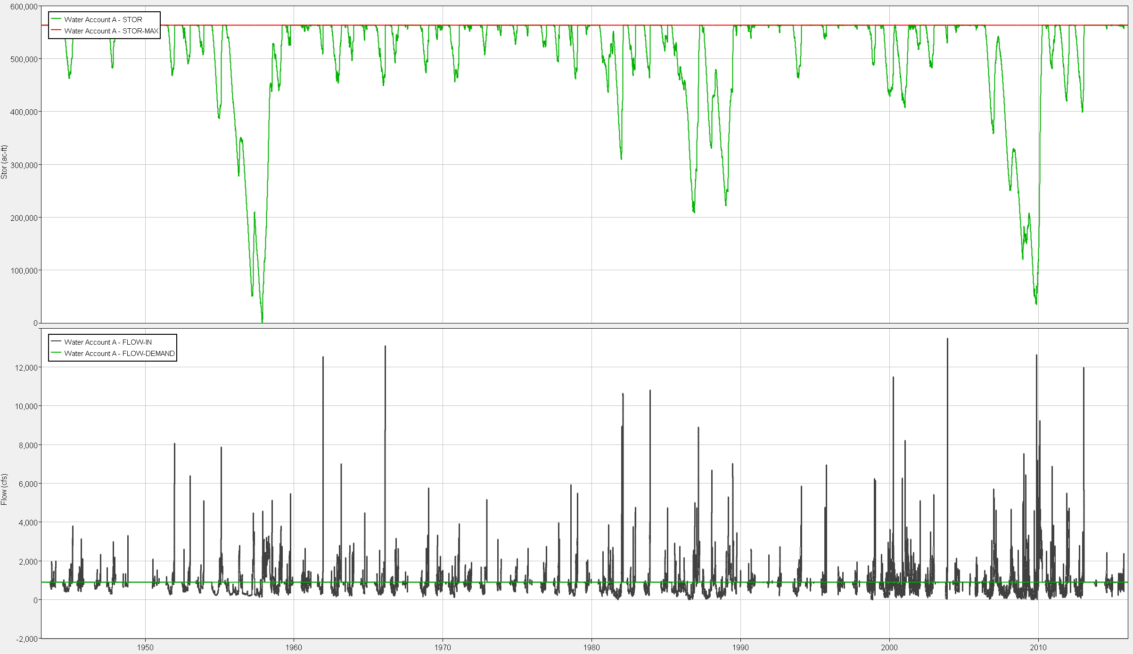
DSS Output for Water Account Simulation

Slide 21
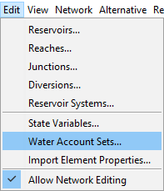
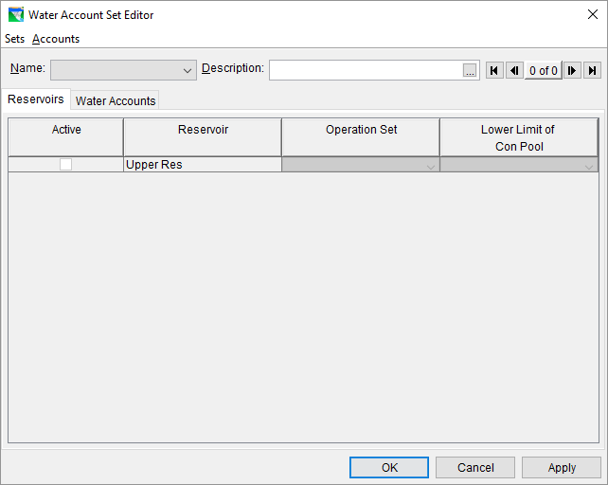
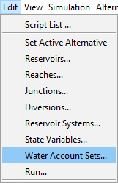
Water Account Setup in HEC-ResSim
Network Module
1
Simulation Module
2
Notes:
We will go over the steps to create and model a water account in HEC-ResSim. Water accounts are part of the Network, and can apply to multiple reservoirs if needed.
Select the Water Account Sets option from the Edit menu (on either Network or Simulation modules, with a Network or Simulation open)
The water account set editor will open

Slide 22
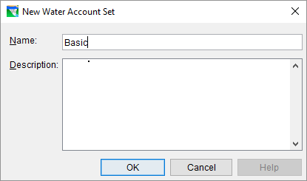

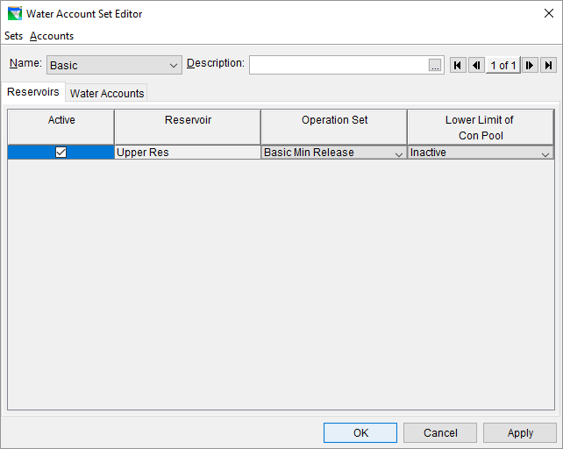
Water Account Setup in HEC-ResSim
1
2
3
4
5
Notes:
Accounts are held in account sets, so first we need to create a set to hold our account.
We need to choose a name for our set that will be meaningful to us and other model users
We have to tell ResSim which reservoirs include storage for our account, which is simple for now since we only have one reservoir, but later we will look at multiple reservoirs as well.
For each reservoir, we need to choose which operations this account should be linked to. Later we will choose a specific rule from the operations set.
We also have to define the limits of the con pool. ResSim automatically assumes the guide curve marks the top of the con pool, but we need to specify the bottom.

Slide 23

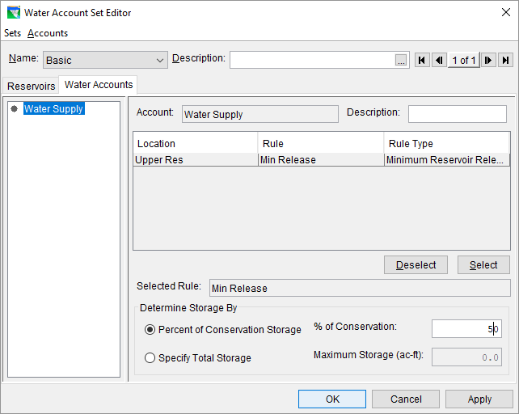
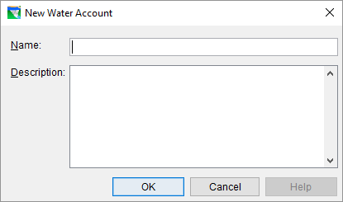
Water Account Setup in HEC-ResSim
1
3
4
2
6
5
Notes:
After we create our account set, we can create an account to put in it.
We can name the account after the user or purpose it belongs to.
The available rules from the operations set we chose are shown here. Only one rule can be attached to an account. The rule is used to define outflows from the account. Releases requested by the selected rule will be deducted from the account storage.
We need to select the rule we want attached to the account.
We have two choices for defining the size of the account, percent of con pool or an absolute volume.
Once we choose the method, we need to enter a size either as a percentage or as a value in acre-feet.

Slide 24
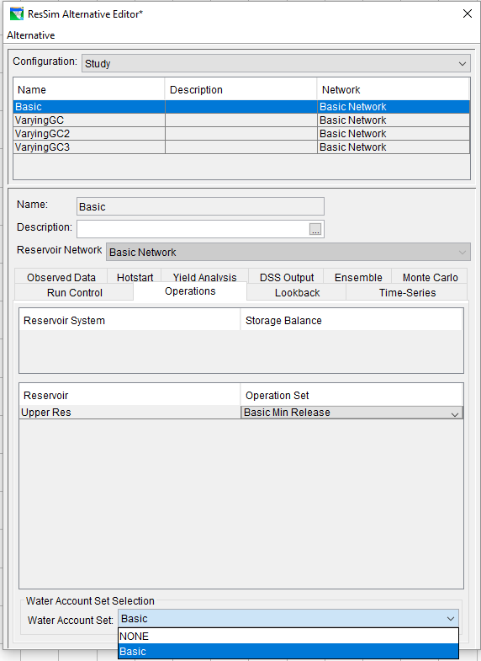
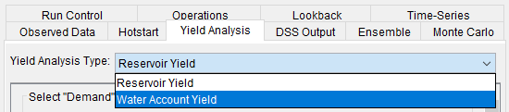
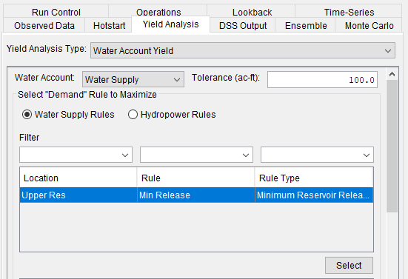
Water Account Alternative
2
3
4
5
1
6
7
Notes:
Once we have created our account we need to modify some alternative options to include the account in the run.
We can choose the account set to use the same way we chose an operations set, in the Alternative.
We need to change yield analysis options as well. The other choice for yield analysis type is to determine yield just for one account instead of the whole reservoir.
We need to specify what account we are finding a yield for.
Just like the full reservoir yield analysis, we need to set a tolerance for how close to empty the account storage needs to be to be considered empty.
We have to choose what type of yield we want to determine, just like in the full reservoir analysis.
We then choose the rule that the tool will iterate over. It should be the same as the rule we attached to the water account.
We need to select the rule to make it active in the tool.

Slide 25
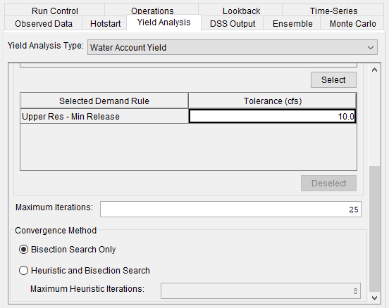
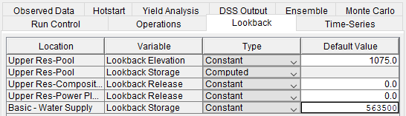
Water Account Alternative
1
2
3
4
Notes:
Continuing down the yield analysis tab, we have to set a flow tolerance to define how much shortage is acceptable. The tolerance will affect how quickly the tool converges on a yield, and how precise that yield is.
We can also limit the number of iterations to prevent excessive run times.
We have the same choices for search method we did for the full reservoir analysis.
Finally, we need to set an initial lookback storage amount for the account, anywhere from empty to full. Typically a yield study will assume full storage at the start of the period of record.

Slide 26
Knowledge Check
What is a reservoir water account?
  An account is a virtual storage container that reserves stored water available for a particular use or user. The account will track inflows and outflows, in order to calculate the storage available at all time steps. An account can be thought of as a vertical storage slice in the reservoir.
Why would we want to use accounts? What are the benefits?
  Accounts can provide clarity to the use and allocation of the water in the reservoir. Accounts allow different uses to reserve water according to the account size and reservoir storage level. Accounts allow us to determine the firm yield for a portion of the Con Pool. They also ensure that lower priority uses do not impact higher priority uses.

Slide 27
Knowledge Check
How do horizontal zones differ from vertical / floating zones? What are some pros and cons of each?
  Horizontal zones define regions of the pool where specific operations should take place. Zones are useful for separating regions of the pool and limiting operations to certain pool levels. However, it can be difficult to have different con pool uses and maintain proper balance between them with only horizontal zones. Vertical zones (accounts) define storage volumes to allocate to different uses, but the storage can be used anywhere in the con pool. Accounts would not help define different levels in the reservoir where operations are required or prohibited (flood pool, inactive pool). Accounts do help different uses coexist at the same elevation without interfering with one another. They also allow users to save water for the future without risk of another user taking that water.

Slide 28
Workshop #5 – Water Accounting
Create water accounts
Determine firm yield for account
Explore convergence tolerances

