Slide 1
Conducting Reservoir Storage-Yield Analyses Using HEC-ResSim
Lecture #9 – Multiple Water Accounts

Slide 2
Introduction
Multiple water accounts on a reservoir
Further detail on inflow allocation
Loss allocation
Other complications
Dependable yield mitigation storage
Notes:
Now we will go into further detail about water accounts and look at how to model more than one account on a reservoir. This will include more in-depth discussion of inflow and loss allocation. We will finish up with some discussion of dependable yield mitigation storage.

Slide 3
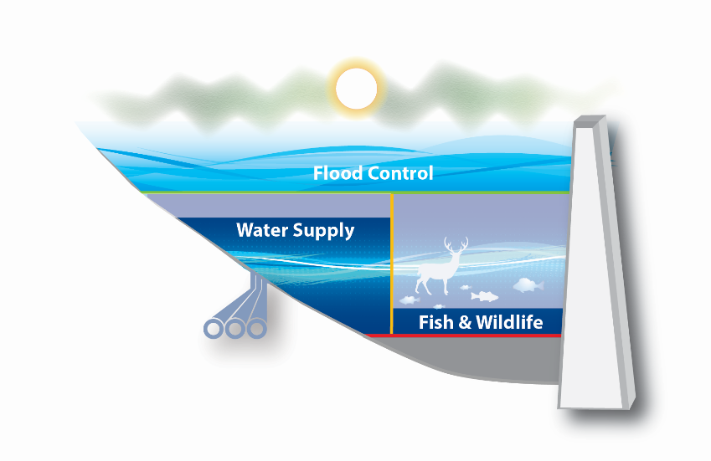
Multiple Accounts
A reservoir can have many water accounts
Each use or user can be assigned to an account
Each account is tracked individually
Inflow will be apportioned between all accounts
  Currently ResSim automatically apportions in proportion to account size.
  For now, different allocation schemes will require enhancements to ResSim or a different model.
Notes:
Multiple accounts work basically the same way as a single account. Each account has its own storage and inflows/outflows.

Slide 4
Multiple Accounts
Multiple accounts are useful for reservoirs with multiple conservation purposes
Accounts ensure each user gets to use their share of the water
Using accounts instead of elevation zones provides dependability
Notes:
Like we saw earlier, accounts provide flexibility for each purpose to operate as best fits that purpose. Using multiple accounts allows us to look at more than one purpose in our analysis.

Slide 5
Multiple Account Modeling
Multiple accounts makes models more complex
How to allocate inflows, releases, and losses
  HEC-ResSim currently allocates inflows and losses proportional to account size
Modeled operations should reflect the WCM and other relevant policies
No universal right answers, just answers for your study
Notes:
There are complexities that come with modeling multiple accounts that are not present with just one account. Inflow allocation is more complicated, and release allocation is no longer as easy.
The most important point is that decisions on how to handle multiple accounts should be made in a way that makes sense for your reservoir and follows project authorizations, relevant laws, and the WCM. Like we have been emphasizing in this class, document your decisions and your modeling assumptions so that others can understand what you did and can extend your analysis in the future.

Slide 6
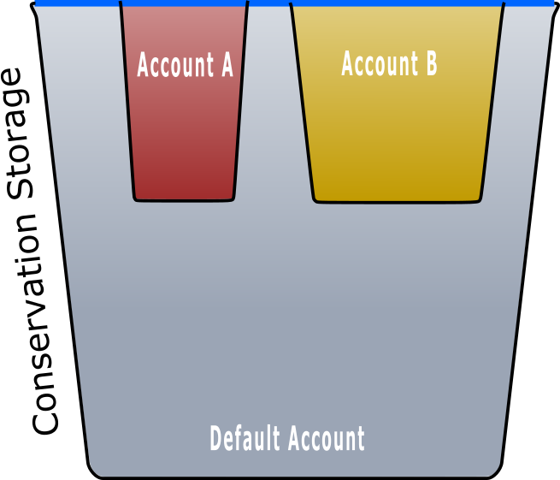
Floating Buckets
Notes:
Here is an analogy for understanding how multiple water accounts work with the default account and the overall conservation storage.
Think of the individual water accounts like buckets floating in a larger bucket. The larger bucket represents the full conservation storage volume. The default account volume is represented as the volume in the larger bucket, minus the volume taken up by the smaller buckets.
Here, the conservation pool and both accounts are full.

Slide 7
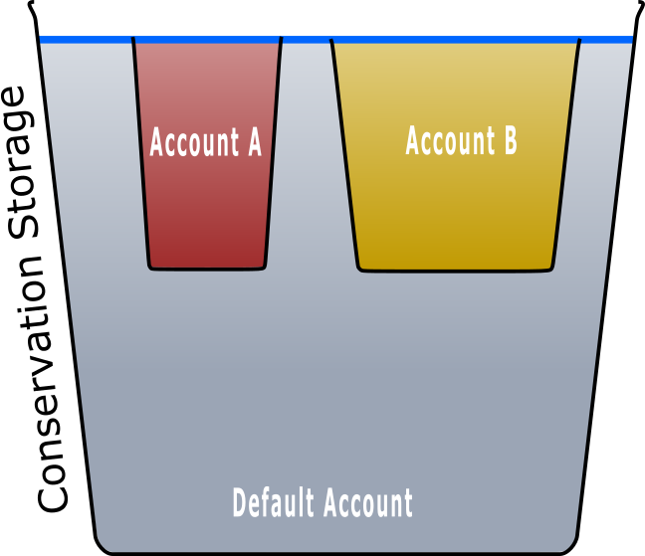
Floating Buckets
Notes:
If the conservation pool is drawn down without drawing from either water account, the overall water level will decrease but both accounts are still full. The draw down is charged to the default account in this case.

Slide 8
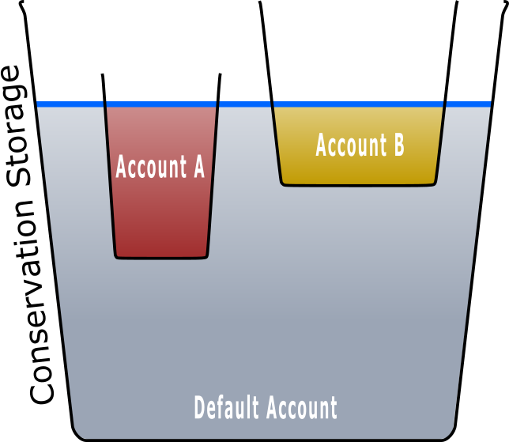
Floating Buckets
Notes:
Now imagine that both accounts are drawn down partially. As the volume in each account bucket decreases, the bucket will float higher in the overall pool. This means that while the overall conservation storage decreases when an account makes a release, the default account stays the same volume.

Slide 9
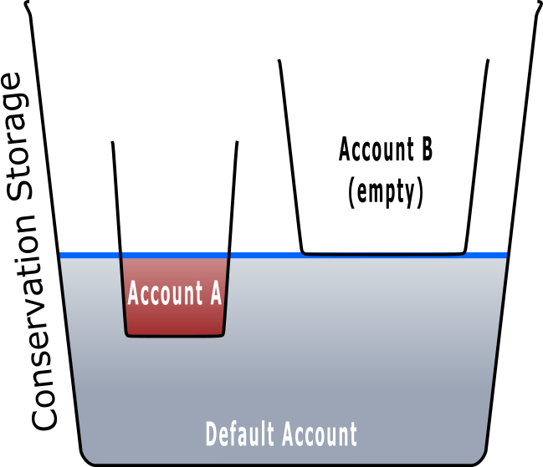
Floating Buckets
Notes:
It is possible to empty one water account while water is still available to the other account, and in the overall conservation pool for purposes without dedicated accounts.

Slide 10
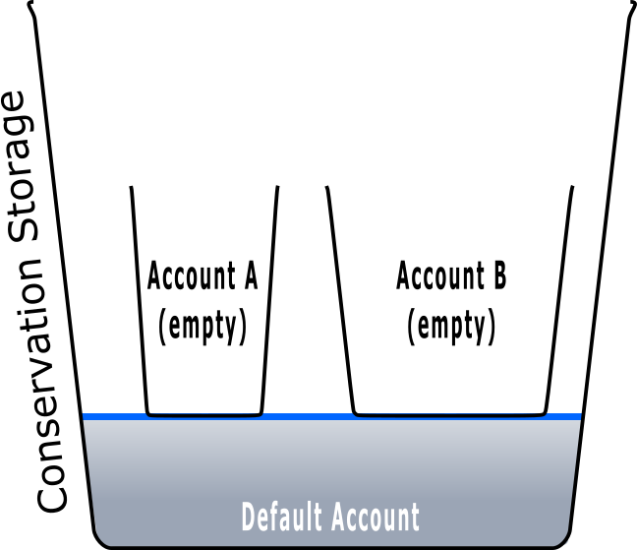
Floating Buckets
Notes:
Here, both water accounts are empty while the conservation pool retains some water, assigned to the default account.

Slide 11
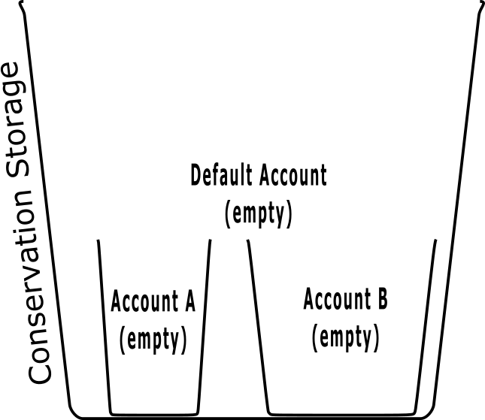
Floating Buckets
Notes:
Here the entire con pool is empty, and none of the accounts have water remaining.

Slide 12
Inflow Allocation
Inflow must be allocated to each account
Allocation should match the reservoir plan of operations with potential consideration of state water laws
What are your experiences with inflow allocation?
Notes:
Adding multiple accounts adds more options for inflow allocation. For this course we will continue with our simple assumption of proportional allocation.
Have some class discussion on what allocation methods people have used or seen.

Slide 13

Inflow Allocation
What if an account is full?
  Where should the inflows allocated to a full account go?
  Inflow allocated to a full account is called “surplus” inflow
https://www.flickr.com/photos/kamoteus/2347650751
Notes:
With multiple accounts, handling of surplus inflows is subject to decisions as well. Lets look at some of the decisions we need to make.

Slide 14
Surplus Inflow
Once an account is full,
allocated inflow > withdrawals = surplus
Surplus inflow may be allocated to other accounts that are not full
Remember that currently ResSim automatically allocates surplus to other accounts that are not full in proportion to the account size (including default account)
Modeled allocation should follow operating plan
Clearly document how you are modeling surplus inflow
Notes:
There are different ways to treat surplus inflows. It usually makes sense to allocate the surplus to other accounts that are not yet full, but how you do that allocation depends on the specific operations of your reservoir.
Like we keep stressing, it is important to document!

Slide 15
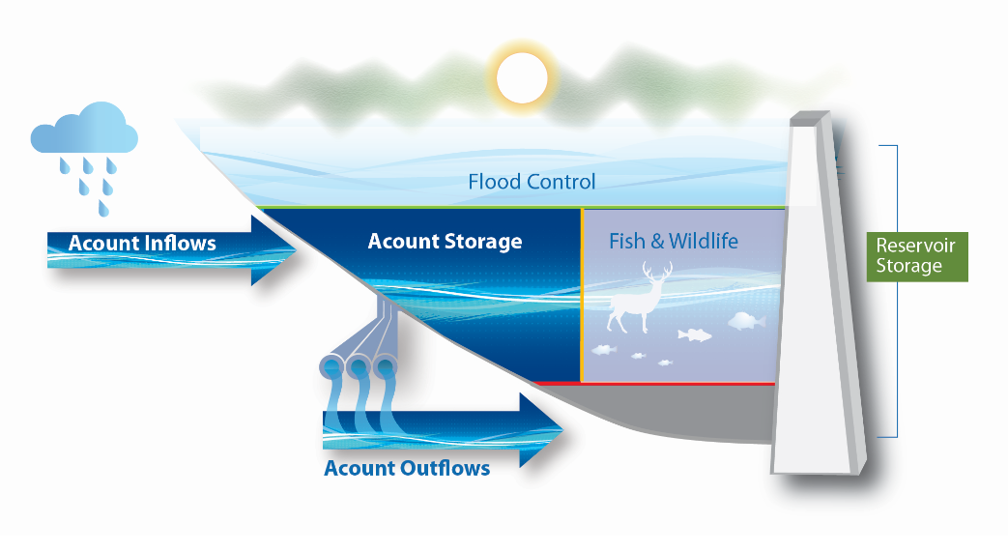
Surplus Inflow and Firm Yield
Firm yield will be affected by the specific surplus inflow allocation
Allocating surplus to water supply accounts will usually increase firm yield
Surplus
Notes:
Allocating surplus to an account will tend to increase the firm yield of that account, and using a surplus inflow system that allocates more water to a particular account will increase the yield more.

Slide 16


Surplus Inflow and Firm Yield Example
Conservation pool = 10,000 ac-ft
Water supply account
  Max = 6,000 ac-ft
  Current = 5,700 ac-ft
  Release = 100 ac-ft
Fish and wildlife account
  Max = 4,000 ac-ft
  Current = 500 ac-ft
  Release = 0 ac-ft
Total inflow = 1,000 ac-ft
1000
500/4000
5700/6000
100
Notes:
Here is an example to clarify inflow allocation and surplus inflows.

Slide 17
Surplus Inflow and Firm Yield Example
Total inflow = 1,000 ac-ft
Water supply account
  Inflow = 60% x 1,000 = 600 ac-ft
  Release = 100 ac-ft
  Storage increase = 500 ac-ft
Fish and wildlife account
  Inflow = 40% x 1,000 = 400 ac-ft
  Release = 0 ac-ft
  Storage increase = 400 ac-ft
1000
900/4000
6200/6000
100
Notes:
The total reservoir inflow is split proportionally between the two accounts. After account releases are subtracted, the new storage for each account can be calculated. Note that the water supply account cannot hold its full inflow.

Slide 18
Surplus Inflow and Firm Yield Example
Water supply account
  Excess storage = surplus inflow = 200 ac-ft
  Final storage = 6,000 ac-ft
Fish and wildlife account
  Additional inflow from surplus = 200 ac-ft
  Final storage = 1,100 ac-ft
200
1000
1100/4000
6000/6000
100
Notes:
The excess storage in the water supply account is treated as surplus inflow, which is allocated to the less full fish and wildlife account.

Slide 19
Release Allocation
Releases can benefit multiple users
  Flood storage releases can generate power and provide instream flows
  Hydropower releases can be diverted downstream for water supply
How should we charge accounts for these releases?
  According to the reservoir plan of operation (WCM) and operational account administration
Notes:
Release allocation is simple with a single water account: the account is charged for any releases it requests. Things are less simple with multiple accounts.
Some releases can reasonably be charged to more than one account.

Slide 20
Release Allocation Options
Can charge the account that requested the release
Can charge all accounts that benefit proportionally
Can charge accounts based on any other factors consistent with the WCM
Notes:
ResSim currently charges the account that requested the release. If multiple accounts are requesting releases at the same time, HEC-ResSim will charge the account whose rule is higher priority, unless it runs out of storage, then the lower priority rule will be charged. Some reservoirs may operate differently than this. If so, accurately modeling the storage accounting may require another model or enhancements to ResSim.
There is no need to choose the same method for all releases and all accounts either. You can mix and match as needed.

Slide 21
Drawdown
Reservoir drawdown can generate “surplus” releases
Example: Lowering the reservoir seasonally to increase flood space
  Water must be released in this case, even if no user requests it
  How should these releases be accounted for?
  Will benefiting accounts be charged?
  Is the water free?
Make sure your model operates how you expect
Notes:
ResSim will continue to charge accounts tied to rules that dictate the release. Rules are considered at a higher priority than the guide curve is. So if the water supply rule specifies a release, the water supply account will be charged, even if the reservoir would have released anyway due to the guide curve. If the water supply rule doesn’t ask for a release during the drawdown, the release will be free for water supply use without charging the account.

Slide 22
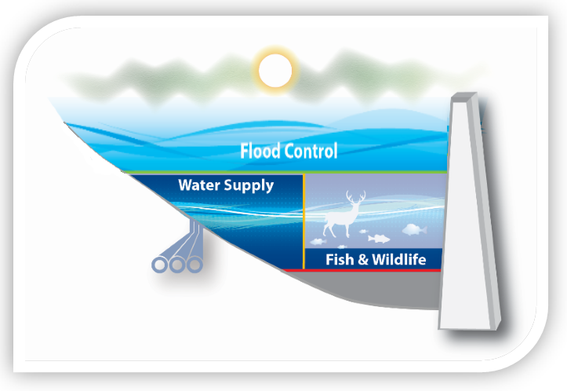
Drawdown
Drawdown can also help accounts fill
  Paradox?
Fixed size accounts increase in share of the Con Pool, and inflow share
Percentage accounts are filled because “full” becomes a smaller volume
Notes:
The pictured reservoir has the same amount of storage in its water supply account in both pictures. As the reservoir guide curve draws down, the same volume of water will better fill the new smaller water supply account as specified as a % of the conservation pool.

Slide 23
Losses
Losses (evaporation, seepage, etc.) must be charged to accounts
As usual, your model should match the reservoir plan of operations
These allocation decisions can have significant effects on firm yield – make them deliberately

Slide 24
Losses
Can allocate losses same as inflow, by % of total pool
  Shares losses between accounts
  Could empty an account even without releases
Can allocate losses by current account storage
  Reduces losses on nearly empty accounts
  Puts a heavier burden on accounts that more carefully conserve water
No “fair” method, there are pros and cons to any allocation scheme
Notes:
Allocating losses can be as complex as allocating inflows or releases. ResSim will allocate losses proportionally to account size, regardless of current account storage.
Does anyone have examples of how a district handles loss accounting? Any different options besides these two?

Slide 25
Accounts and Competing Uses
Water accounts help solve the problem we saw in Workshop #4
  New hydropower rule harmed water supply firm yield
With accounts, account storage is reserved for future use
  Water supply storage is treated separately from hydropower storage
Adding new uses should not affect existing uses
  Unless…
Notes:
Operating with water accounts for each use in the con pool can help reduce competition between uses. Modeling with water accounts for each use can help the model reserve water for the future so that one use doesn’t harm another use.
That doesn’t mean that uses will never compete or harm another use. In HEC-ResSim, if storage is moved from the default water account to a new water user account, that may reduce surplus inflows to an existing account and thus reduce yield.
Now, lets look at a case where harm can be caused despite using accounts, and how to mitigate that harm.

Slide 26
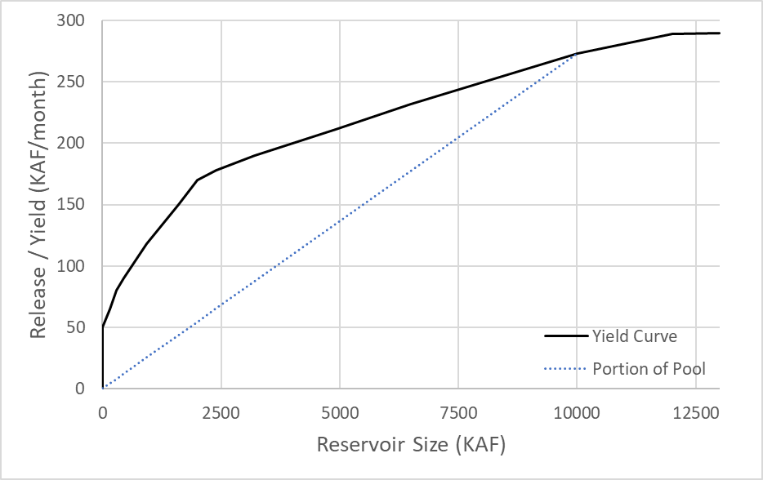
Dependable Yield Mitigation Storage
Increasing the total size of the Con Pool can impact existing users’ firm yield, even if their account stays the same
Remember that firm yield is not linear with storage size
  Increasing total conservation storage increases total yield, but reduces yield per unit of storage
Notes:
This graphic from Lecture #2 shows the yield of a particular con pool at different pool sizes as well as the yield curve for different %s of the total con pool. Remember that firm yield per unit of storage decreases as the storage increases if other factors stay the same.
DYMS concepts presented here are adapted from presentation by Mary Ann Duke, USACE-SWT: http://www.iwr.usace.army.mil/Portals/70/docs/CleanWaterSupplyWorkshop/Duke%20DYMS%20(2).pdf

Slide 27
Dependable Yield Mitigation Storage
A con pool with 2500 KAF of storage has a yield of 180 KAF/month = 0.072 KAF/month/KAF
Reallocating 2500 KAF to the con pool increases yield to 210 KAF/month = 0.042 KAF/month/KAF
This decrease in yield per storage affects any accounts as well
  Firm yield for a 1000 KAF account drops from 0.072*1000 = 72 KAF/month to 0.042*1000 = 42 KAF/month
Notes:
The yield per acre-foot affects all accounts equally. All yields decrease if the unit yield decreases.

Slide 28
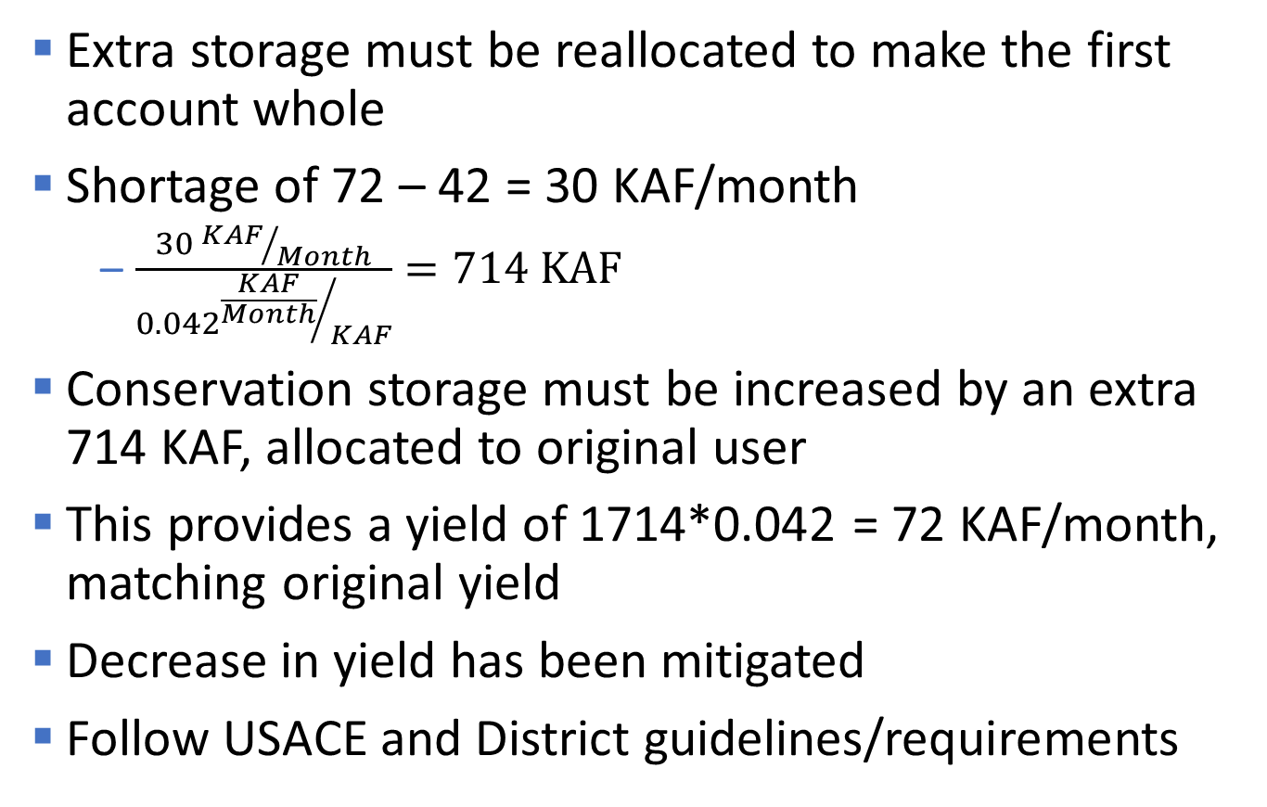
Dependable Yield Mitigation Storage
Extra storage must be reallocated to make the first account whole
Shortage of 72 – 42 = 30 KAF/month
  $\frac{30 {KAF}/{Month}}{0.042{\frac{KAF}{Month}}/{KAF}}=714 \text{KAF}$
Conservation storage must be increased by an extra 714 KAF, allocated to original user
This provides a yield of 1714*0.042 = 72 KAF/month, matching original yield
Decrease in yield has been mitigated
Follow USACE and District guidelines/requirements
Notes:
The extra allocation to the original user can be counted as part of the reallocation for the new user.
DYMS policy is found in ER 1105-2-100.

Slide 29
Knowledge Check
How should inflows be allocated to a water account?
  The allocation depends on the needs and laws relevant to the specific study. USACE has no official policy on inflow allocation. Inflow allocation should be carefully considered and documented to make all assumptions clear. Currently, ResSim allocates inflows proportionally among all accounts, including the default account which holds all storage not allocated to another account.
What sort of uses benefit from water accounts? Does Flood risk management need an account?
  Generally, purposes that use water from the conservation pool and sometimes want to hold water for the future can benefit from accounting. These purposes include water supply, fish and wildlife, navigation, and hydropower. Flood risk management is usually defined using a guide curve and a designated flood pool. Water is usually evacuated from the flood pool as soon as feasible. Flood risk management modeling would not benefit from accounting.

Slide 30
Knowledge Check
Is it better to charge accounts for evaporation by size of account or by current account storage?
  Neither option is better. The choice depends on the needs and regulations governing your reservoir. Charging by size of account can spread losses more evenly, but may also charge low accounts so much they go negative without using any water. Charging by current account storage prevents negative balances, but can “punish” users that were better at conservation during a drought.

Slide 31
Knowledge Check
How can a release benefit multiple accounts at once? Is “free-riding” a problem?
  Releasing for one purpose can provide benefits to another automatically. These are complimentary uses, as we discussed yesterday. A user could avoid requesting releases, waiting for another complimentary user to do so and forcing them to use the water from their account, but getting benefits anyway. This could be a problem or not depending on the individual situation. It could even be official policy for that reservoir that a certain account must be used before another higher-priority account is charge.
When is dependable yield mitigation storage required? Why?
  When the total size of the conservation pool is increased, a new user is required to purchase DYMS for any existing users who see their total firm yield decrease due to the overall decrease in yield/ac-ft of storage. The extra storage is needed to eliminate the impact to the existing user.

Slide 32
Workshop #6 – Multiple Water Accounts
Add another account to our reservoir
Investigate yield changes compared to a single account
Explore effect of accounts on priority
See example of need for DYMS

