Slide 1
Conducting Reservoir Storage-Yield Analyses Using HEC-ResSim
Lecture #7 – Multipurpose Reservoirs

Slide 2
Introduction
Consider reservoirs with multiple purposes
Discuss effects of other purposes on firm yield
Evaluate different kinds of operations and diversions and how they interact
Discuss modeling challenges with multipurpose reservoirs

Slide 3

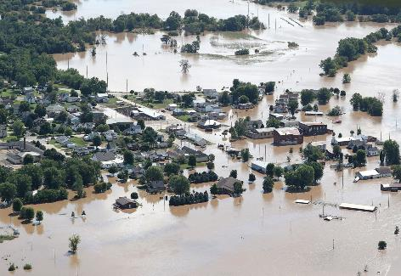
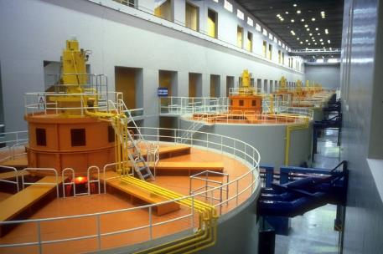
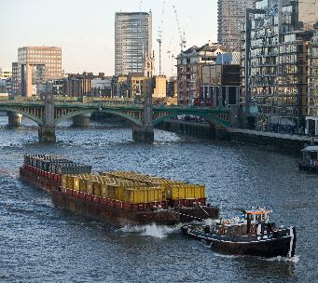
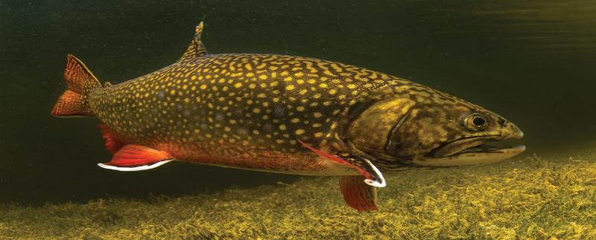
Multiple Purposes
Reservoirs can have many authorized purposes
  Water Supply
  Flood risk management
  Hydropower
  Navigation
  Fish and Wildlife benefits
  Recreation
Notes:
These are some common reservoir purposes. Have any of you worked with reservoirs that had different purposes or uses?

Slide 4

Multiple Purposes
Purposes will interact and affect each other, and operating for one purpose may constrain others
The Water Control Manual defines operational balance for all purposes
  Operators do have some discretion within WCM limits
Some purposes will lower
firm yield, while others
will not
  Competing vs.
  complementary
  purposes
Notes:
For USACE reservoirs, the Water Control Manual will define the authorized purposes and how those purposes should be balanced. Other reservoirs may have their own documentation.

Slide 5
Water Supply
Water supply is the primary focus of this course
Many yield studies are concerned with firm yield for water supply
Our lectures and workshops so far have assumed water supply is the only purpose of the reservoir
Water supply will benefit from larger storage volumes and lower releases to other purposes
Notes:
Next, we will look at the other purposes a reservoir can have and how those purposes might compete with or complement water supply.

Slide 6
Flood Risk Management
Flood risk management typically competes with yield
  Flood risk management requires keeping empty space in the reservoir
  Water supply requires storing water until needed
The competition can be reduced if the flood season is limited
  More water can be stored for supply during seasons that floods are unlikely
  Seasonal guide curves
  Conditional guide curves
Notes:
Many reservoirs are operated with a flood pool and a conservation pool. This division balances flood risk management needs with water supply (and other conservation purposes).

Slide 7
Hydropower
Hydropower requires releasing water from the reservoir through turbines
Impact on firm yield for water supply depends on the layout of the system
  Supply diversions pulled directly from the reservoir pool will compete with hydropower
  Supply diversions below the turbines are complementary with hydropower
Notes:
Many purposes can vary between competing and complementary depending on the specific layout and operations of the reservoir and the use.

Slide 8
Hydropower
Diversions from reservoir pool vs. downstream diversions
Downstream diversion
Town
Powerplant
Res
City
Diversion from reservoir pool
Notes:
One example of competing vs. complementary uses is the location and method of a diversion. Diverting from the pool competes with uses that require downstream releases, while diverting below the reservoir can cooperate with those uses.

Slide 9
Hydropower
Diversions from reservoir pool typically compete with all uses (except flood risk management)
  Less water is available in the reservoir to release for other purposes
  The diverted water does not benefit any other purpose
Downstream diversion
Town
Powerplant
Res
City
Diversion from reservoir pool
Notes:
In this example, we can see that diverting water from the reservoir pool causes that water to bypass the powerplant, the downstream reach, and the downstream city.
Note that competing uses such as this need to be taken into account during modeling.
In some situations, return flows from the diversion may impact other purposes.

Slide 10
Hydropower
Downstream diversions can be complementary with some purposes
  Releasing for the diversion can also generate power
  Navigation or environmental benefits are created between the dam and the diversion point
Downstream diversion
Town
Powerplant
Res
City
Diversion from reservoir pool
Notes:
We can see in this example that the diverted water first is passed through the powerplant, then flows along the downstream reach and through the city before being diverted.

Slide 11
Navigation
Navigation benefits require water in the channel to keep it deep enough
  will typically compete with water supply
Impact on firm yield depends on location
  Downstream diversions will pull water from the channel while navigation requires the water to stay in the channel
  But, navigation above the diversion is cooperative
Timing of use of stored water can also be in competition
  Diversions from the reservoir will allow less water for navigation releases later
Notes:
Other purposes that require instream flows (environmental, fish and wildlife, etc.) will act the same way relative to water supply.

Slide 12
Fish and Wildlife
The impact of Fish and Wildlife benefits will depend on the specific benefit
Holding the reservoir higher during certain seasons may improve yield overall
Increasing downstream flow will hurt reservoir pool diversions, but could benefit diversions below the critical reach
  Releasing more water downstream uses storage and so reduces later releases
Notes:
The interaction between fish and wildlife flows and water supply can be complex. Both purposes can apply to water in the reservoir or water downstream in the channel.

Slide 13
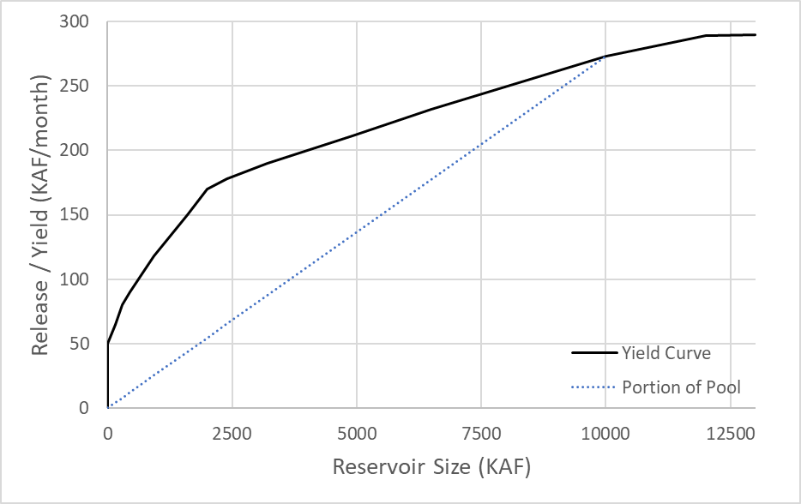
Portion of Pool
Is yield of 50% of the pool equal to 50% of the full yield?
  Earlier, we assumed yes
  More complicated with multiple purposes
Can depend on specific operation details
Can be difficult to model precisely
Notes:
For water supply at a Corps reservoir, a typical water supply agreement reserves a percentage of the conservation pool for the water supply user. But is the yield of the 50% of the pool storage equal to 50% of the yield of the full pool?
In Lecture #2, we said that the yield for part of the pool scaled linearly with the size of the part, but only in simple cases. Now we will consider the more complicated case of a multipurpose reservoir.
The answer can depend on how the different purposes interact, and how operational decisions are made between competing purposes.
This segues into how we model multipurpose reservoirs and their operations.

Slide 14
HEC-ResSim Decision Process
Goal is to represent actual operation and policy accurately
  Includes operating for multiple purposes
In ResSim, we can use rules and operating zones
  Rules define release thresholds in the current time step
  Rules are placed in zones, in a priority order
  Rule priorities are needed to resolve conflicts between rules
It can be difficult to fit operational decision making into a set of prioritized rules
Notes:
So far we have talked about how purposes complement and compete in general, now we will move on to looking at how we can model multipurpose reservoirs and what challenges we will face.
We won’t discuss all the possible challenges, just some common issues.

Slide 15
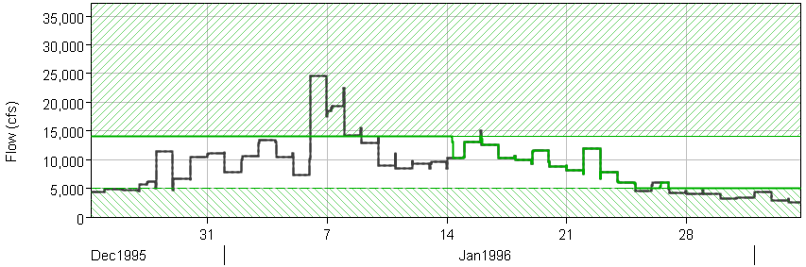
HEC-ResSim Decision Process
Min and max rules create an envelope of acceptable flows
The model will try to reach guide curve quickly, subject to envelope limits
The most constraining rule of each limit type will set the release limits -- ie, the smallest max, largest min
If min and max rules conflict (min is larger than max, vice versa) rule priority is used
Notes:
Here we look at some details of how HEC-ResSim solves and how it uses rule priorities. The min and max rules create an envelope of acceptable flows. The reservoir will attempt to reach the guide curve as quickly as possible within that limiting envelope.
Specified release rules are a special case that set both the minimum and maximum flow constraints to the same value.
Here is an example of the envelope curve in ResSim. The stripped areas represent flows outside the envelope, either above the max or below the min. The white area is the envelope. The green line is the actual release. It follows the upper limit for a while, then reaches the guide curve in mid-January and follows the inflow for a while. Then the inflow drops below the minimum flow and the envelope constrains the outflow again.

Slide 16
HEC-ResSim Decision Process
How do we make sure the water supply rule does not harm other purposes, or other purposes don’t harm water supply?
Yield Analysis Tool will ensure that all higher-priority rules are satisfied in every time step, while maximizing yield
  A higher priority minimum release rule failing to meet its minimum flow will cause the water supply rule to also fail, prompting another iteration
Operating zones can help separate different operations.
  Flood risk management is needed at higher elevations, some operations like recreation releases may be curtailed at low elevations
Notes:
HEC-ResSim looks at all higher priority rules when iterating to find the maximum demand that can be met. This prevents the water supply purpose from using all the storage and taking water from the other purposes.

Slide 17

Operations
Notes:
Often, balancing uses comes down to deciding whether to release water now, or to save it for the future.
This is difficult to model, as HEC-ResSim simulates one timestep at a time, and does not know that it must reserve water for the future. A release today for recreation may lead to water supply shortages in the future. It is the same balance we all deal with when we decide whether to save money for a rainy day or spend it now on something else.

Slide 18
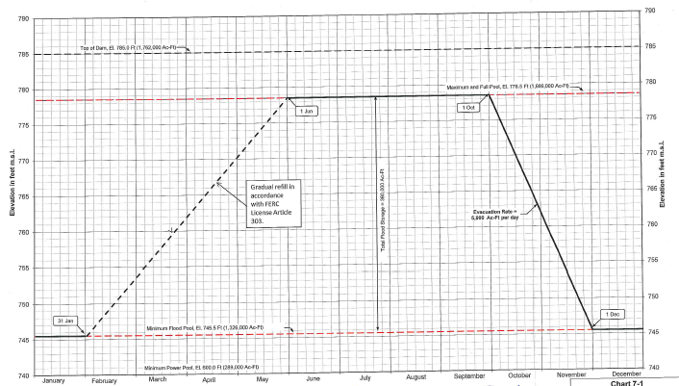
Operations
One possibility is operating zones
  Each purpose can be limited to certain zones
  Does not always work well for purposes that operate in the same zone.
Notes:
This is an example of guide curve and operating zone definition from a water control manual. It is common for guide curves to vary over the year as flood risk drops and other needs become more important.
A flood risk management pool and conservation pool are standard in USACE reservoirs. But having water supply, navigation, and hydropower all in the conservation zone makes it difficult for water supply to reserve water for the future without having that water released for power generation or navigation support.

Slide 19
Class Discussion
How might we setup zones and rules to model flood risk management, water supply, and hydropower in this system?
Downstream diversion
Town
Powerplant
Res
City
Diversion from reservoir pool
Notes:
Time permitting, discuss as a class on how this system could be modeled. The model should cover flood risk management, hydropower generation, and diversions from the pool as well as from the channel for the town.
What zones might be needed? What rules? What order should the rules be in?

Slide 20
Operations
Are there other options?
  Inflow apportionment?
  Vertical Zones?
Stay Tuned!
Notes:
Without knowledge of what future inflows and demands will be, we can’t know what the optimal choice is now. Discuss as a class if anyone is familiar with projects that require operational consideration of inflow apportionment.
Later in the course we will go over one method for modeling this balance.

Slide 21
Workshop #4 – Multipurpose Reservoirs
Adding other purposes to our model
Prioritizing rules
Analyzing different system layouts

Slide 22

Knowledge Check
What is the difference between competing and complementary purposes?
  Competing purposes compete for available water. Improving one purpose requires reducing the other. Prioritizing is needed in order to fully specify operations for modeling.
  Complementary purposes can both benefit from the same water, and both can be improved at the same time. Prioritizing may not be needed.
Do flood risk management and hydropower compete with or compliment each other?
  They can do either, depending on the reservoir condition. Passing stored flood water through the turbines will benefit power. However, keeping the reservoir lower to provide more flood risk management space will reduce head for the turbines, and limit storage of water that could be used for power in a future drought.

Slide 23
Knowledge Check
How does modeling navigation rules with higher priority than water supply impact firm yield in HEC-ResSim? What if the navigation rule priority is lower?
  High priority navigation will release water from the pool whenever natural downstream flows are too low. If navigation rules are ever shorted, the water supply rule will also fail, and the yield tool will reduce demand in the next iteration. Water released for navigation will not be available for water supply later, and the yield will be lower than without the navigation rule.
  Ideally, if navigation is lower priority, yield should NOT be affected. But, HEC-ResSim does not know to protect water supply storage for future use, and so yield WILL be affected. Navigation releases made when water is plentiful will lower yield if the plentiful period turns out to be the beginning of the critical drought.

Slide 24
Knowledge Check
How could a model ensure firm yield does not decrease due to lower priority rules?
  Horizontal operation zones such as flood and con pools offer some protection for higher priority rules, but can still allow a lower priority rule to impact yield. Splitting the pool vertically (water accounts), so that each rule can use water at any reservoir elevation AND reserve its own water, can help reduce impacts between objectives. We will discuss this idea in more detail later.

