Slide 1
Conducting Reservoir Storage-Yield Analyses Using HEC-ResSim
Lecture #10 – Reliability and Uncertainty

Slide 2
Introduction
What is the uncertainty in firm yield estimates?
How reliable is a given firm yield?
How can we answer these questions?
Notes:
Until now we have treated our modeling and yield analysis as exact, with no uncertainty. That is easier for the modeler, but doesn’t really represent real life. Now we will take a look at the uncertainty of our estimates and the reliability of a given firm yield.
This is a big topic. We cannot fully explore it today, but just give some concepts and examples to stimulate thought.

Slide 3
Uncertainty versus Reliability
Uncertainty exists because information used in the analysis might not be known precisely
  Storage/elevation relationship (sedimentation)
  Evaporation is hard to measure and predict
  Complex reservoir operations can be difficult to model
Error in these evaluation parameters causes error in firm yield estimate
But, a more severe drought can happen in the future, and firm yield will not be sustainable through it
Reliability describes the likelihood the firm yield can be met without “failure” in the future
  If presume firm yield can be met in the future, then the actual value of firm yield is uncertain
Notes:
The Corps defines uncertainty differently than variability. Knowledge Uncertainty is from not knowing values precisely. Natural variably is based on things that are random, in time or space.
Reliability is based on variability, which means that we don’t know future streamflows.

Slide 4
Uncertainty
As with other uncertain information, we don’t know the true value of the storage/yield relationship
firm yield curve
Notes:
This is the same storage/yield curve we have been looking at, but in reality, we don’t know the precise yield provided by each storage level. There is uncertainty around that curve. We expect the true yield to be somewhere in the uncertainty bounds.

Slide 5
Is the streamflow record representative?
Firm Yield is calculated using historical inflows
  Historical period is not a complete picture of possibilities
Observed records ~ 25 – 100 years (….more in CA?)
Are those years representative of future years?
What if the basin changes?
  Type and intensity of other water use in the basin
  Land use change
  Differing climate
What if operation of the reservoir system changes?
Notes:
We use historical inflows because they are what we have, but really what we want is to use future inflows. But we don’t know those! The more years we see, the more extremes we are likely to see, even without change.
But there will be change!
Here are some of the issues that can make the past different from the future.

Slide 6
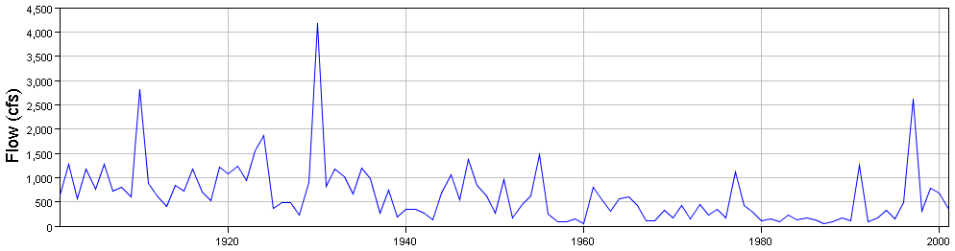
Is the streamflow record representative?
Record is generally too short to record all possibilities, and the full range of climate variability
Even with no basin changes future flows will likely be different
  Potential for longer droughts
  Potential for more intense droughts
  multi-decadal cycles
Notes:
Climate cycles exist at many different scales, from annual up to multi-decadal. These cycles can interact to produce different extremes in the future, even if everything about the basin is the same. Luck plays a role as well.
Here is a 100 year record of natural inflows to a reservoir. An engineer working in 1950 would not have any record of droughts as bad as seen in the 1970s and 1980s. Similarly, if flows were only measured starting in 1950, engineers now would not have records peaks larger than 2500 cfs, which occurred twice in the first half of the century. The next 100 years will likely have additional differences.

Slide 7
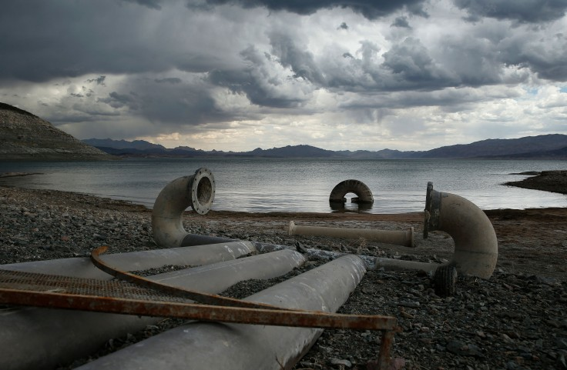
Reliability
How reliable is firm yield estimated from the record?
If a demand didn’t fail historically, will it fail in the future?
How likely is failure?
http://www.cpr.org/news/story/shortages-may-be-looming-for-important-lake-mead-reservoir
Notes:
We know that inflows will be different in the future, so how worried should we be that our yield will not be achievable in the future?
This is an example of a water intake on Lake Mead that does not have enough water to operate.

Slide 8
Reliability
Depending on the worst drought of the record provides inconsistent reliability – depends on length of record and random occurrence of dry periods
  Next, methods to assess reliability
But first…
How reliable does the firm yield need to be?
  Is 100% realistic?
Is an occasional “failure” acceptable?
  How often?
  How deeply?
Tradeoffs
  More reliability = higher cost
Notes:
The firm yield resulting from critical period analysis is completely dependent on the period of record available for inflow, and what the worst drought in that period was. This method provides inconsistent return period and reliability from place to place.
Complete certainty is not possible, there can always be a worse drought than what we planned for. Like any other design decision, it is a trade off between future reliability and present costs.
Failure is not an absolute. Shorting demand by 1 cfs is different than shorting demand by 100 cfs. Just like shorting demand once per century is different than once per year.

Slide 9
Alternatives to Historical “Critical Period”
Options to increase or quantify reliability:
build in a factor of safety – buffer volume or lower planned yield by x%
Drought frequency analysis:
  define likelihood of historical droughts
  develop drought of specified return period
Stochastic Methods:
  compute firm-yield/reliability using long stochastic time-series of flows (annual reliability)
  evaluate many stochastic examples of N-year life-cycle (long-term reliability)
Notes:
I have 2 alternatives here.
The first is drought frequency analysis, either to define the likelihoods of droughts in the record, or to design droughts of specified likelihood
The second is generation of a longer synthetic streamflow records that maintain the probabilistic structure of the record we observe.
We aggregate to annual volumes, and compute mean, variance, perhaps skew, and auto-correlation. The auto-correlation is what causes extended periods of drought as well as extended wet periods.

Slide 10
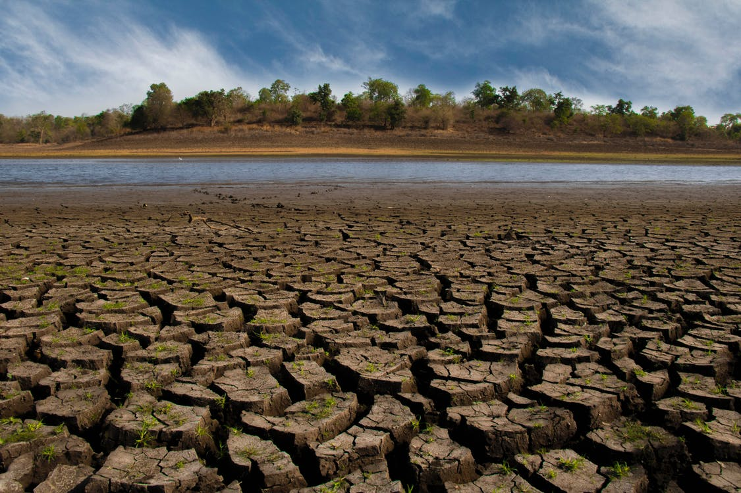
Reliability
Quantify reliability
Drought return interval
Annual reliability
Long-term reliability
https://www.pexels.com/photo/bird-birds-blue-sky-drought-1178291/
Notes:
We will go over a few different ways to quantify the reliability of our firm yield estimates. Each method provides different insight into the reliability.

Slide 11
Drought Return Interval
Drought frequency analysis
To quantify severity of historical drought, or develop synthetic droughts
Results still uncertain
Longer durations have fewer observed events, since periods cannot overlap
Likelihood of past drought could depend on the duration
Return Period 5 10 20 50 100 200
Notes:
The first method we will look at is using a drought return interval. Drought return interval is similar to a flood return interval, and gives the probability of a drought worse than some threshold occurring in a given year. There is still a lot of uncertainty in developing a drought return interval for a reservoir. The return interval is dependent on the length of the drought, and estimating intervals for less-likely droughts requires extrapolating sparse data.
Different events in the historical period can be ranked and plotted as non-exceedance probabilities. This can be done for various durations and the curves plotted together as a set of frequency curves, like shown here.

Slide 12
Drought Return Interval
Develop balanced droughts of specified return periods
Notes:
One way to include drought return intervals in a study is to create synthetic droughts that are analogous to “balanced hyetographs” (EM 1110-2-1417, Sec. 13-4 para. a-4) when looking at precipitation frequency.
These balanced droughts will have the same non-exceedance probability for all durations. The required volume for each duration can be determined from the duration-volume curves we just saw. Balanced droughts of different lengths can be used as inflows in a simulation model to determine available yields for a given duration-storage size pair. The duration with the lowest yield for a particular storage size is the critical duration for that size. The necessary storage for a given yield can be found the same way.

Slide 13
Drought Return Interval
Balanced droughts are disaggregated to shorter time step
Monthly or daily
Use historical flow as pattern
Then: find maximum yield for the specified drought
Notes:
To disaggregate a balanced drought hydrograph for use in a monthly or daily simulation model, actual historical annual flow patterns can be used. Historical flows can be scaled so the annual or multi-year average matches the appropriate drought volume while maintaining realistic intra-year variability.
This is an example of a set of annual patterns that can be chosen from to create synthetic years.

Slide 14
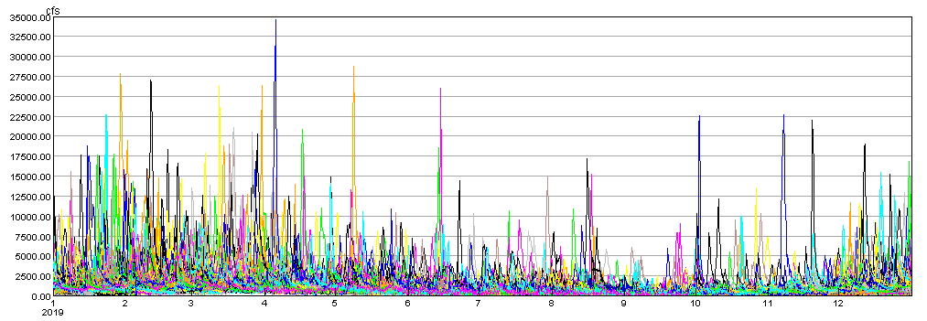
Stochastic Methods
Alternative to drought frequency methods
Uses long records of synthetic hydrology
Can estimate yield at different reliability levels
Calculate annual or long-term reliability
  Represented as a chance of success
Notes:
Due to the various complications with drought frequency methods, it is often easier to use stochastic methods to estimate reliability of firm yields. Stochastic methods generate lots of year of synthetic streamflow, with similar statistical characteristics as the observed record. This allows us to run many yield analyses and examine the failure rate at different yields.
We can think of reliability as either an annual chance of failure, or a chance of failure over the life of the project. Both ways are valid and useful.
This is an example of many synthetic years of data plotted together showing the variability between traces.

Slide 15
Stochastic Methods
Stochastic Streamflow generation
  Use historical observations as the base
  Maintain similar statistics – mean, variance, skew, serial correlation
  Time-series Models:
    Autoregression (AR) model (Box-Jenkins)
    Markov chain methods
    Others?
  Can also alter statistics to reflect knowledge outside the historical observations
    Paleo-hydrology
    Future climate differences
Notes:
There are different ways we can generate synthetic flows. We typically want to base the generated streamflow on our historical observations, so that the new streamflows are similar statistically to what we have seen historically. These are a few example methods, but others may work for your area.

Slide 16
Initial 41-year record of annual volumes (first example)
Use AR(1) to generate longer record
More examples of drought events
compute μ, σ, γ, ρ
serial correlation = ρ = 0.24
Generated 100-year record of annual volumes
Q(t) = μ + (Q(t-1)-μ)*ρ + random error(σ_{e},γ)
serial correlation = ρ = 0.24
Notes:
Here is an example of a lag-1 autocorrelation model used to generate synthetic series of annual flow volumes. We take the historical data and calculate the mean, variance, skew, and serial correlation.
Then we use this equation one year at a time to generate a new year, 100 times.
The result has more drought events, while keeping the mean and other statistics close to the historical dataset. We can then disaggregate the annual volumes in a similar manner as for our synthetic droughts earlier.

Slide 17
Initial 41-year record of annual volumes (first example)
Use AR(1) to generate longer record
More examples of drought events
compute μ, σ, γ, ρ
serial correlation = ρ = 0.24
Generated 100-year record of annual volumes
Q(t) = μ + (Q(t-1)-μ)*ρ + random error(σ_{e},γ)
serial correlation = ρ = 0.8
Notes:
Here is an example of a lag-1 autocorrelation model used to generate synthetic series of annual flow volumes. We take the historical data and calculate the mean, variance, skew, and serial correlation.
Then we use this equation one year at a time to generate a new year, 100 times.
The result has more drought events, while keeping the mean and other statistics close to the historical dataset. We can then disaggregate the annual volumes in a similar manner as for our synthetic droughts earlier.

Slide 18
1000 years of ANNUAL flow volumes
Notes:
Here is an example of 1000 years of synthetic flows that we can use to investigate the annual reliability of a storage volume for a demand.

Slide 19
Annual Reliability
Chance of success or failure in any given year
  90% reliability will be expected to fail 10% of years, i.e., 100 years out of 1000
  99% reliability will only be expected to fail 10 years out of 1000
Generate a long sequence of synthetic years (100s or 1000s)
Run all years through the simulation model
Count failures and divide by # of years, subtract from 1.0 to get reliability
Notes:
Annual reliability denotes the odds of success in a single year. Failure means delivering less than the firm yield at least once during the year. By generating and analyzing many years of data (much longer period than the observed record) we can count the number of failures and estimate the reliability percentage. We need lots of years because failures are rare enough that we won’t get a good estimate of the frequency otherwise.

Slide 20
Reservoir Storage trace for 1000 years, volume needed for 100 kaf/month
Disaggregated annual to monthly, then firm yield simulation
Release = 100 KAF/mo
1 failure in 1000 years, reliability = 99.9%
Required Volume = 1,434 KAF
Reliability is 99.9% (1 failure in 1,000 years)
Notes:
This is the storage trace resulting from performing a simple 1-reservoir yield analysis, determining what volume of storage is needed to satisfy a certain demand. This trace represents no failure or 100% reliability in 1000 years.
The driest in 1000 years is much more extreme than the driest in any record we might observe. But, we can now work with the reliability. If we allow1 failure in 1000 years, we’re aiming for 99.9% reliability…

Slide 21
Reservoir Storage trace for 1000 years, volume needed for 100 kaf/month
Release = 100 KAF/mo
10 failures in 1000 years, reliability = 99%
Required Volume = 783 KAF
10 failures in 1000 years Reliability is 99% (1 in 100)
2 years
Notes:
… if we allow 10 failures in 1000 years, we’re targeting 99% reliability. Now we have some estimate of return period for shortage.
We can produce as many 1000 year records as needed to estimate yield with a particular reliability, and the uncertainty in that reliability given the limited record we’re starting with.

Slide 22
Annual Reliability
Calculate reliability for different yields or storages – plot as curve
Can estimate reliability of historical firm yield
98.7%
Notes:
If we calculate the yield (or required storage size) for different reliability levels, we can plot the results and see the tradeoffs easily.
We can see here that with a constant demand, aiming for higher reliability requires increasingly large reservoirs to make the reliability increase. Small increases in reliability can require large storage increases when reliability is already high.

Slide 23
Annual Reliability
Previous was reliability of storage for a given firm yield
Here, reliability of firm yield for a given storage
98.7%
Notes:
Plotting the demand vs. reliability shows the same thing in another way. With storage size held constant, we again see that higher reliabilities result in lower yields.
We can also plot the yield or storage that we calculated using historical streamflow, and see where it fits on our reliability curve.

Slide 24
Annual Reliability
Can plot storage/yield curve of a given annual reliability
Firm Yield
Firm Yield
Notes:
Or, can choose a reliability, and plot the storage/yield curve that provides that reliability for each pair.

Slide 25
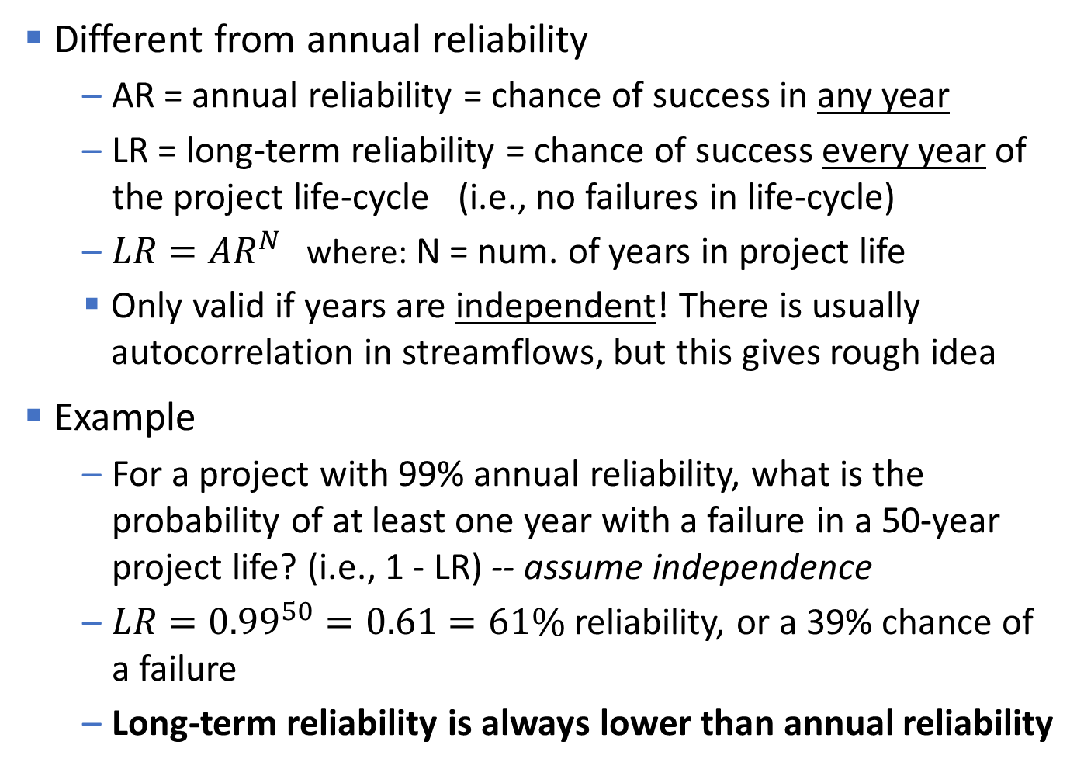
Long-term Reliability
Different from annual reliability
  AR = annual reliability = chance of success in any year
  LR = long-term reliability = chance of success every year of the project life-cycle (i.e., no failures in life-cycle)
  $LR={AR}^{N}$ where: N = num. of years in project life
  Only valid if years are independent! There is usually autocorrelation in streamflows, but this gives rough idea
Example
  For a project with 99% annual reliability, what is the probability of at least one year with a failure in a 50-year project life? (i.e., 1 - LR) -- assume independence
  $LR={0.99}^{50}=0.61=61\%$ reliability, or a 39% chance of a failure
  Long-term reliability is always lower than annual reliability
Notes:
If we assume that annual streamflows are independent from each other, we can transform from annual to long-term reliability and vice-versa.

Slide 26
Long-term Reliability
How do we proceed if we can’t assume independence of annual volumes?
Generate many stochastic traces matching length of project life-cycle period
  e.g. 500 different 50-year traces to get reliability over 50 year project life
Run each trace through simulation model and iterate to estimate firm yield for each trace
This provides a large sample of firm yield estimates, to estimate the probability distribution of firm yield
Define long-term reliability by the likelihood firm yield is greater than a certain value (the CDF)
Notes:
While these stochastic methods can require more processing power and time than other methods, they are conceptually straight-forward and easier to interpret than the drought frequency methods.

Slide 27
Long-term Reliability
500 examples of 50-year record
Calculate storage requirement for each trace
Histogram or PDF
CDF
Demand = 100 KAF/mo
For 90% 50-year reliability, need 943 KAF
669 KAF
669 KAF
Notes:
Here is an example of a long-term reliability calculation using many 50-year long traces. We can calculate the yield for each trace, and plot them all as a histogram.
We can then transform this into a cumulative distribution function that will show the reliability vs. yield.
We can determine the yield for a given reliability level, or we could determine the reliability of a given yield.

Slide 28
Long-term Reliability
500 examples of 50-year record
Calculate yield for each trace
Histogram or PDF
CDF
Storage = 1,000 KAF
not 669 KAF
For 90% 50-year reliability, get 101 KAF/mo
126 KAF
126 KAF
Notes:
Here is an example of a long-term reliability calculation using many 50-year long traces. We can calculate the yield for each trace, and plot them all as a histogram.
We can then transform this into a cumulative distribution function that will show the reliability vs. yield.
We can determine the yield for a given reliability level, or we could determine the reliability of a given yield.

Slide 29
Storage/Reliability/Yield for 50-year project lifecycle

Slide 30
Does it only get worse?
As we get more data, firm yield based on historical critical periods can only get worse
A new critical drought will give lower firm yield, and nothing will cause a higher firm yield based just on historical record
BUT
Reliability of a stated firm yield can become higher or lower, based on a longer record or a new description of the possible future
30 years with no drought will change both the drought frequency and the statistics used in the stochastic streamflow generation.

Slide 31
Reliability Summary
Reliability can provide estimates of the true ability to meet demands in the future
Reliability and contingency discussion should be a part of WS study and formulating alternatives
  Good time to discuss a plan for curtailing demand during drought
Knowledge of expected failure rates will better inform study decisions
Notes:
Here we summarize our discussion of reliability. Modeling reliability can be a good way to better understand your reservoir and your firm yield. Reliability and stochastic modeling can also be good communication tools, to show stakeholders why there is uncertainty in the firm yield estimate, and emphasize that there is always a chance of failure.

Slide 32
Knowledge Check
Firm yield is calculated so that demand is always met, why isn’t it 100% reliable?
  The firm yield is only 100% reliable for the historical years included in the analysis. The calculated yield would guarantee success only if the future is no worse than the past. We know that the observed record does not contain the full range of possible flows, and we could have worse droughts in the future.

Slide 33
Knowledge Check
How could we verify that we used a long enough synthetic record to calculate annual reliability? Is 1000 years enough? Or do we need 10,000?
  It can be difficult to choose a record length that balances accurate and complete results with model run time and memory concerns. We can do a sensitivity analysis and run a few different lengths through our analysis. If there is little change in reliability with longer periods, our period is probably long enough.
  CONVERGENCE

Slide 34
Knowledge Check
What reliability level is acceptable? How high should it be for a water supply contract?
  The desired reliability level will depend on the needs of the water user and the state of the river basin. Acceptable conditions need to be discussed with stakeholders. If in doubt, base analyses on firm yield. If storage requirement is based on less than firm yield, be sure that it is documented, and that everyone understands how the agreement will be put into operation (storage accounting), and what reliability the user will actually have. There’s no right answer!

Slide 35
Knowledge Check
What does a long-term reliability of 95% mean? Is it better or worse than an annual reliability of 95%?
  It means we are 95% confident that firm yield will be met throughout entire project life. In other words, we have a 5% expectation of at least one failure over the project life. An annual reliability of 95% would indicate that 5% of years will not meet the firm yield, which is worse!
  Ignoring autocorrelation, a long-term reliability of 95% equates to an annual reliability of 99.9% for a 50-year term. Annual reliability of 95% equates to just 8% long-term reliability over 50 years.

Slide 36
Other ideas
Buffer (Factor of safety) on yield or needed storage
Simulating with “drought plan” reduction in use
Decrease in usable storage, so less yield
Uncertainty about the reliability – what’s serial correlation? Should we do sensitivity analysis?
Storage reserve for yield analysis – hold 10,000 af out of the conservation pool

Slide 37
Workshop #7 – Reliability and Uncertainty
Explore ensemble of inflows
Run ensemble traces through model, determine yields
Compile yields from different traces, compare to original results

