Slide 1
Conducting Reservoir Storage-Yield Analyses Using HEC-ResSim
Introduction

Slide 2
Introduction
Welcome!
Administrative Info
Introductions
Notes:
Welcome students to the class and to Davis. Cover any administrative items related to the classroom or office.

Slide 3
Training Goals
Understand storage-yield theory
Learn how to use new HEC-ResSim tools to calculate yield for reservoirs and individual water storage accounts
Understand nuances and details of yield calculations
Apply training in the context of allocating storage for water supply needs in a multipurpose reservoir project
Notes:
List the goals for the class.

Slide 4
Format
Lectures
Knowledge Checks
Hands-on Workshops
Notes:
Explain the different components of the module.
Lectures: Powerpoint presentations delivered by expert. Introduce topics, explain ideas, stimulate discussion.
Workshops: Apply knowledge learned from lectures. Interact with HEC-ResSim and learn details of how to perform yield analyses.
Knowledge Checks: Verify understanding of recent topics. Clarify any points that are not clear. Help ensure all students are caught up before moving forward.

Slide 5
Schedule
Day 1
Corps Water Supply Mission
Storage-Yield Theory
HEC-ResSim review
Manual Yield Analysis
Day 2
Water Supply study considerations
Day 3
Day 4
Introductions
Data Requirements
Automated yield analysis tool
Reliability and Uncertainty
Yield from multipurpose reservoirs
Water Accounting
Multiple water accounts
Multiple water accounts
Notes:
Go over the schedule of what topics will be covered each day of the training.

Slide 6
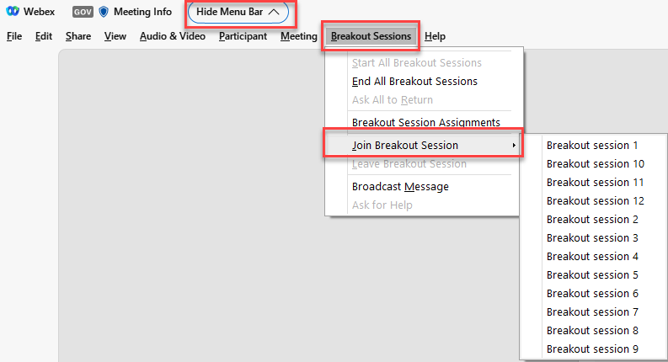
Join a Breakout Room
All Breakout Rooms are accessible by everyone
Menu for Breakout Rooms is available in Hidden Menu Bar

Slide 7
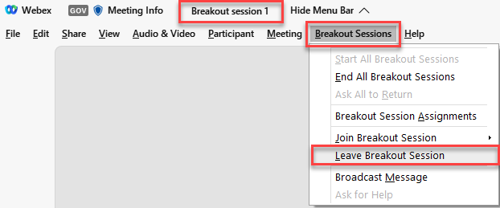
Leave a Breakout Room
The Breakout Room you enter will be indicated at the top of the Menu Bar
You can leave and enter a breakout room using the Breakout Sessions menu options

