Slide 1
System Operation
HEC-ResSim

Slide 2
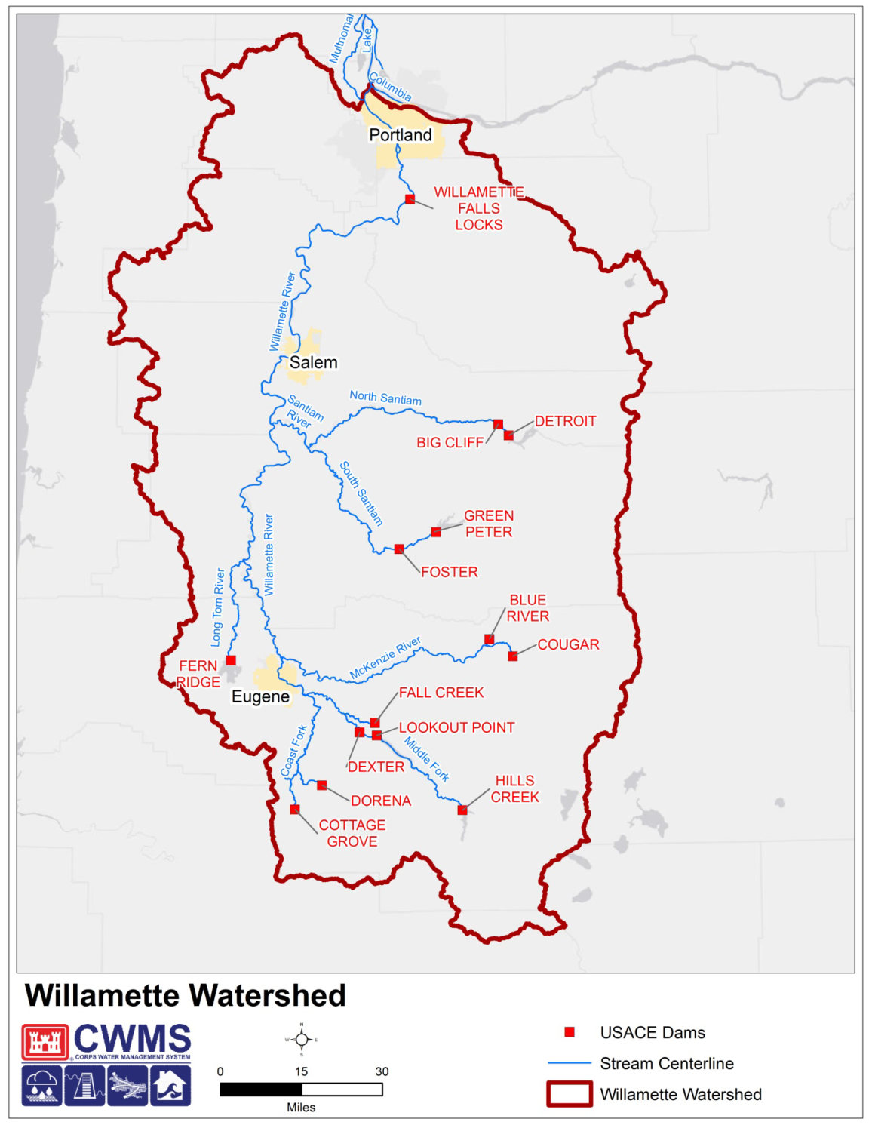


Slide 3
Objectives
Learn how to establish a system operation in ResSim
Learn about implicit and explicit system storage balance
Learn how to use the Reservoir System Editor to create explicit system storage balance operation sets

Slide 4
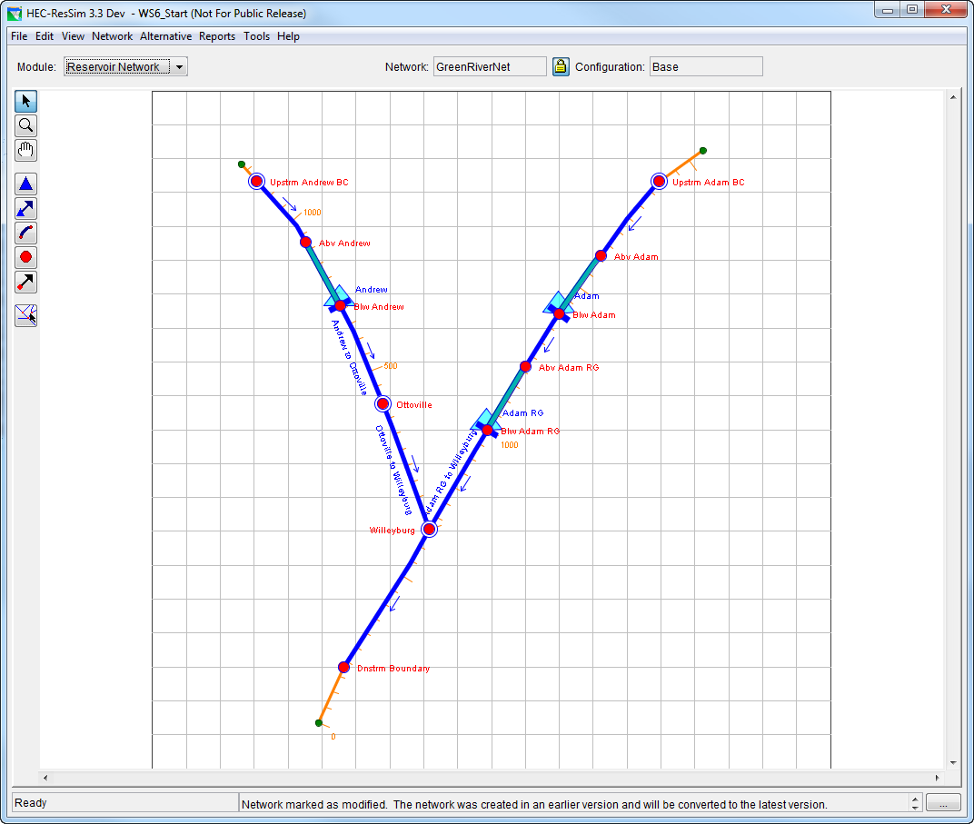
Reservoir Systems in ResSim
ResSim supports two types of reservoir system operation
  Parallel
  Tandem
Both types rely on a System Storage Balance

Slide 5
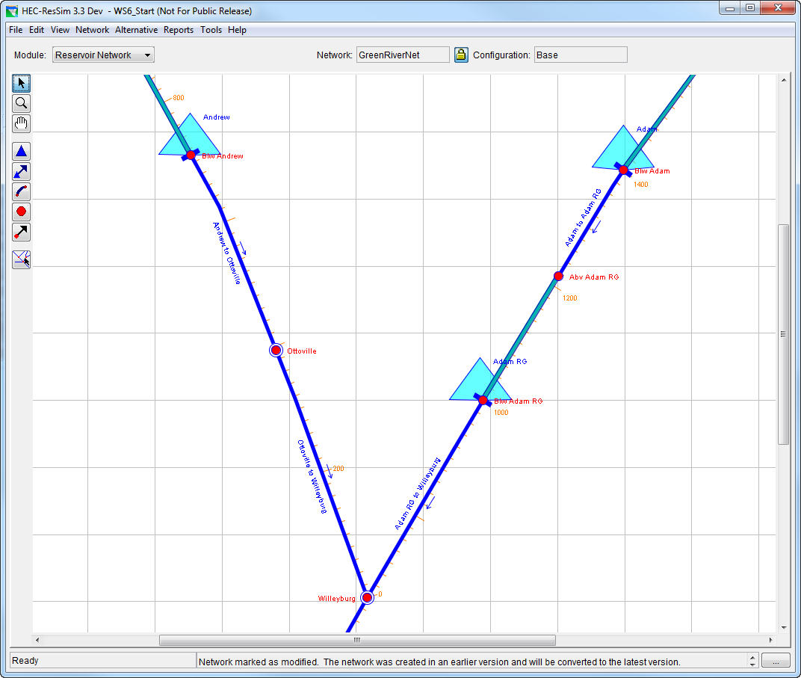
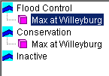
Parallel Operation
Two or more reservoirs operate together for minimum and/or maximum flow limits at common downstream locations
Releases made from each reservoir are determined by storage balance

Slide 6
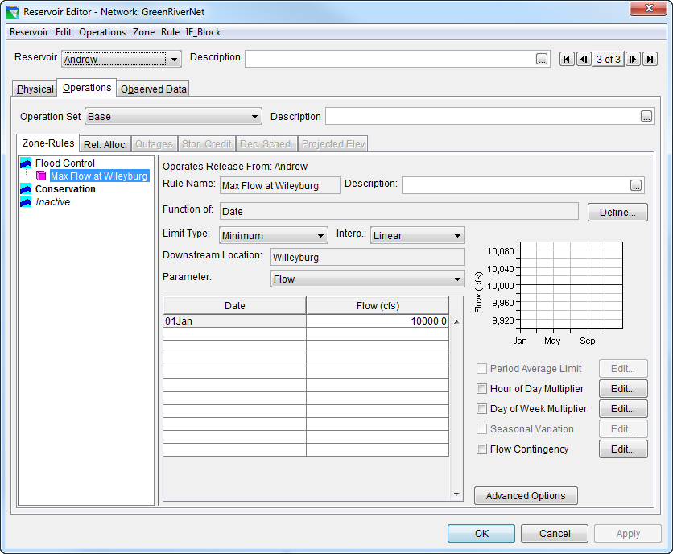
Defining Parallel Operation
In one reservoir…
  Create a Downstream Control rule for the common downstream location.

Slide 7
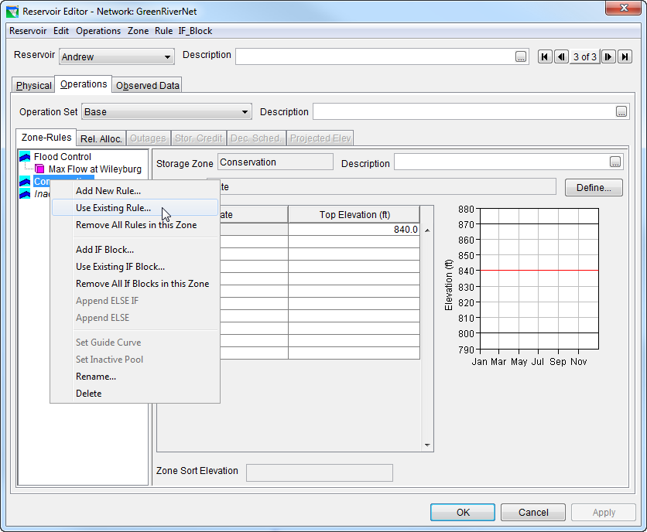
Defining Parallel Operation
In a parallel reservoir…
  Apply the same Downstream Control Flow- Limit rule for the common downstream location

Slide 8
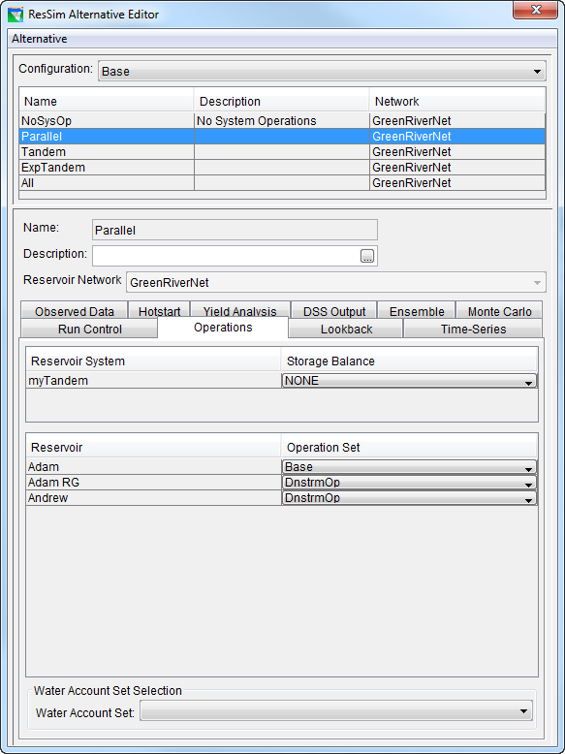
Defining Parallel Operation
In the alternative editor…
  Select the operation set that includes the Downstream Control Rule for each reservoir in the system.

Slide 9
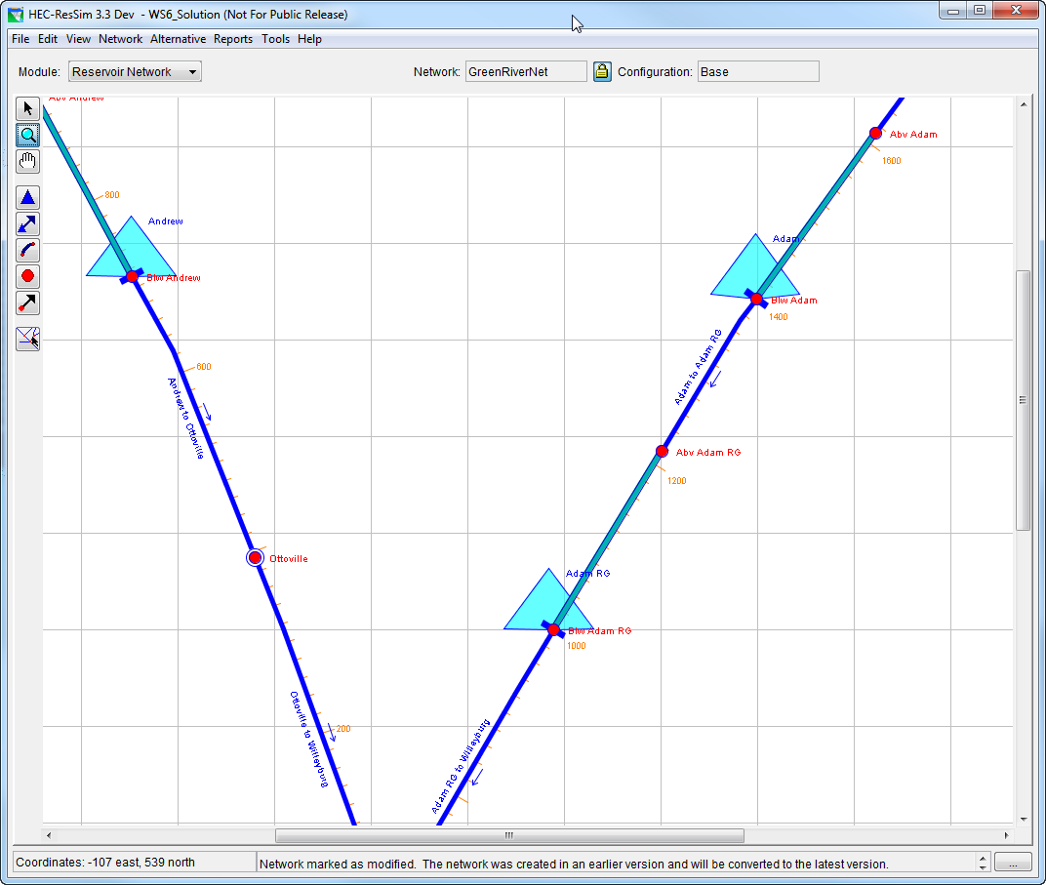

Tandem Systems
A series of two or more reservoirs may be established by having each upstream reservoir operate for the next reservoir downstream
Tandem Operation occurs when an upstream reservoir makes releases to preserve the storage balance with a downstream reservoir

Slide 10
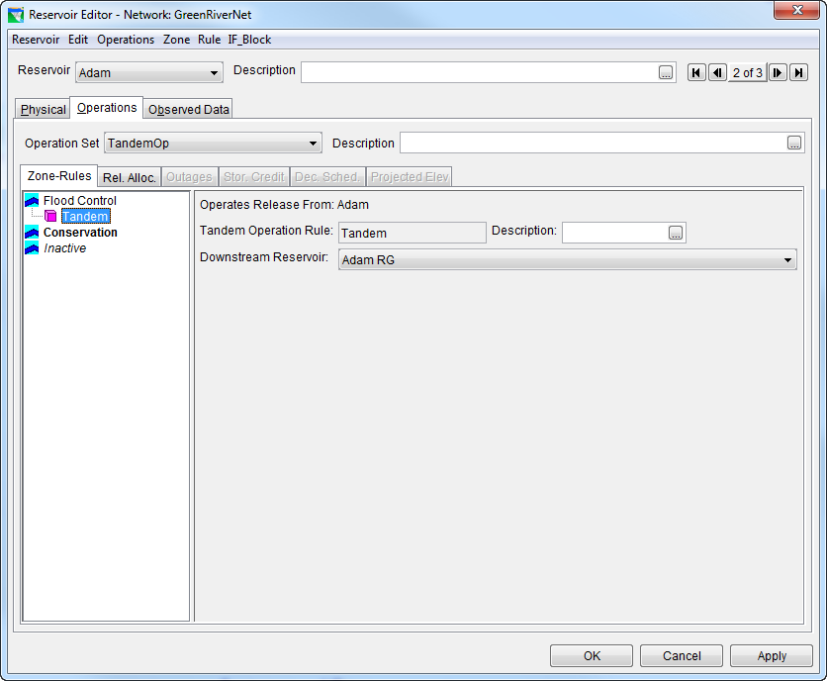
Defining…Tandem Operation
Add a Tandem operation rule to the upstream reservoir of the tandem system

Slide 11
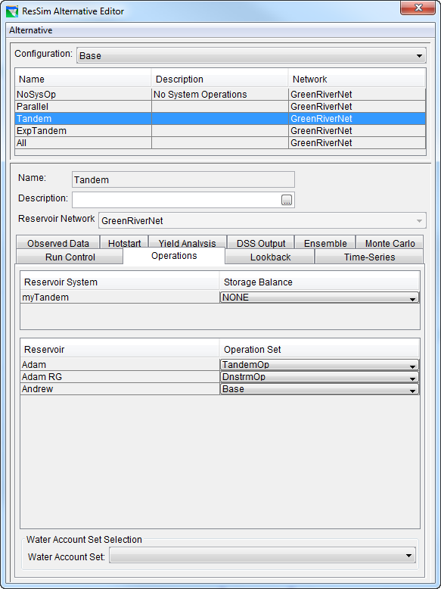
Defining…
Tandem Operation
In the alternative editor…
  Select the operation set that includes the Tandem operation rule for the upstream reservoir.

Slide 12
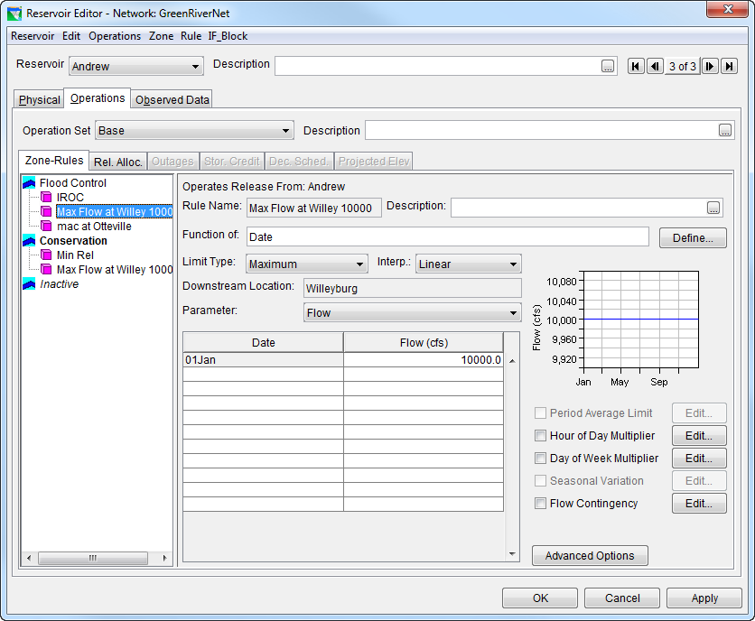
Prioritizing System Operation
System Operating Rules are prioritized for each reservoir within its set of operating rules

Slide 13
System Storage Balance
For every decision interval,
  End-of-period storage is estimated for each reservoir and the system total, accounting for:
    Beginning-of-period storages
    Total inflow volumes
    Total potential outflow volumes
  Total end-of-period system storage and system zone definitions are used to estimate a desired system storage level
  Priority to release is assigned to the reservoir that is farthest from the desired system storage level to achieve balance among reservoirs
  Desired system storage balance releases are compared against other rule priorities and constraints, then final release decisions are made
Loc
Loc
Div
Loc
Div
IN
IN

Slide 14
System Storage Balance
System Storage is the sum of allocated storages in the system
Reservoir Level is % full in Reservoir Zone
Balance exists when each reservoir level equals the system level
Balance can be
  Implicit (default)
  Explicit (user-defined)
Project | Conserve Storage | Flood Storage
Res. 1 | 20,000 | 10,000
Res. 2 | 10,000 | 20,000
System | 30,000 | 30,000
%100
Sys
F.C.
%100
%0
F.C.
%100
%0
F.C.
%100
Sys
Con.
Con.
Con.
%0
%0
Res. 1
Res. 2
System

Slide 15
Reservoir System Operation Equal (Implicit) Storage Balance Targets
Flood Control
Conservation
Res. 1
Res. 2
System

Slide 16
Reservoir System Operation User-Defined (Explicit) Storage Balance Targets
Flood Control
Conservation
Res. 1
Res. 2
System

Slide 17
Implicit System Storage Balance
By default, ResSim uses an Implicit Storage Balance
Implicit Balance treats each reservoir storage equally toward its guide curve
System Storage
Empty
Sys
G.C.
Full
Balance Line
Full
G.C.
Res1 Storage
Balance Line
Empty
Full
Balance Line
Res2 Storage
G.C.
Balance Line
Empty
System Storage

Slide 18
Implicit System Storage Balance
The reservoir that is the farthest above the desired storage balance has release priority
Here, Reservoir 2 should release to draw down to Desired Storage
System Storage
Empty
Sys
G.C.
Full
Full
G.C.
Res1 Storage
Below Desired Storage
Empty
Full
Res2 Storage
G.C.
Above Desired Storage
Empty
System Storage
Desired Storage
Estimated Storage

Slide 19
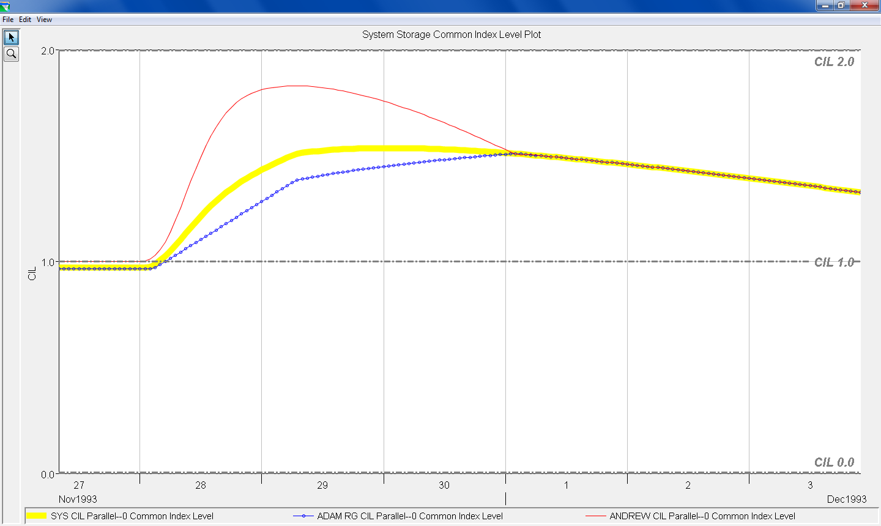
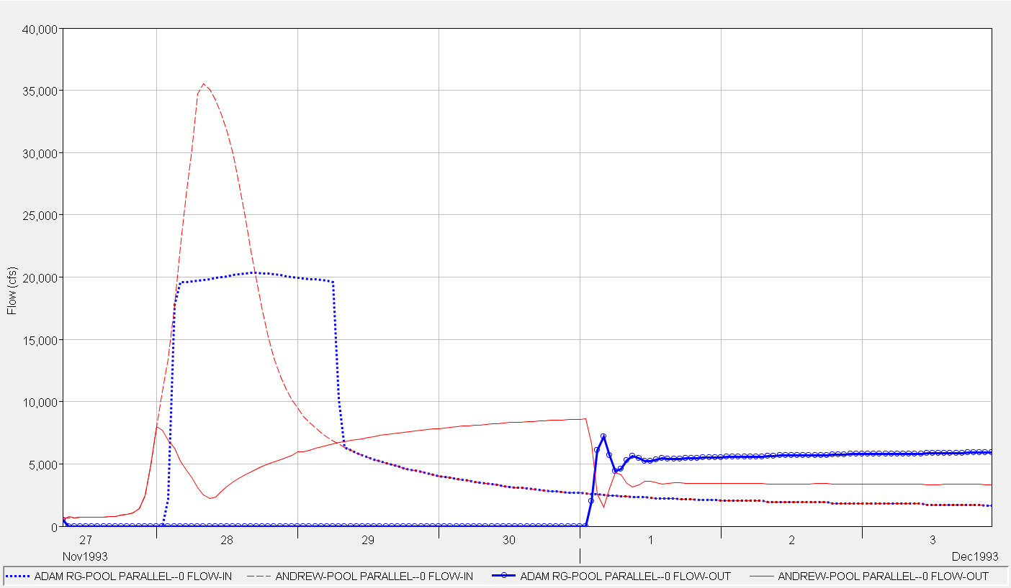
System Flood Control Zone
System Conservation Zone

Slide 20
Explicit System Storage Balance
Explicit System Storage Balance is defined for specific zones
The %Storage desired for balance is defined
E.g., 70% in Res. 1 Con. is balanced with 33% in Res. 2 Con.
System Storage
Empty
Sys
Con
Sys
F.C.
Full
Full
25% F.C.
F.C.
Con.
Res1 Storage
70% Con
Empty
Full
Res2 Storage
75% F.C.
F.C.
Con.
33% Con
Empty
System Storage

Slide 21
Explicit System Storage Balance
 | Example Explicit Storage Balance for the Conservation Storage
 | Reservoir 1 | Reservoir 2 | Equiv. System | Store Index
Storage at Top of Dam | 100,000 | 100,000 | 200,000
Storage at Top FC | 90,000 | 60,000 | 150,000
Storage at Top of Con | 70,000 | 30,000 | 100,000
Con Zone % Storage Balance | 100.0% | 100.0% | 100.0% | 2.0
 | 70.0% | 33.0% | 58.9% | 1.0
 | 0.0% | 0.0% | 0.0% | 0.0
Con Zone Storages: | 70,000 | 30,000 | 100,000 | 2.0
 | 49,000 | 9,900 | 58,900 | 1.0
 | 0 | 0 | 0 | 0.0
Estimated Con Storage | 62,000 | 8,000 | 70,000
Con Zone %full | 88.6% | 26.7% | 70.0%
Index Level | 1.62 | 0.81 | 1.27 | = Target Index
Target Storage | 54,672 | 15,328 | 70,000
Storage Adjustment | -7,328 | 7,328

Slide 22
Explicit System Storage Balance

Slide 23
Explicit System Storage Balance

Slide 24
Explicit System Storage Balance
Explicit System Storage Balance is defined for specific zones
The %Storage desired for balance is defined
e.g. 70% in Res. 1 Con.
is balanced with
33% in Res. 2 Con.
System Storage
Empty
Sys
Con
Sys
F.C.
Full
Full
F.C.
Con.
Res1 Storage
Above Desired Storage
Empty
Full
Res2 Storage
F.C.
Con.
Below Desired Storage
Empty
System Storage
Desired Storage
Estimated Storage

Slide 25
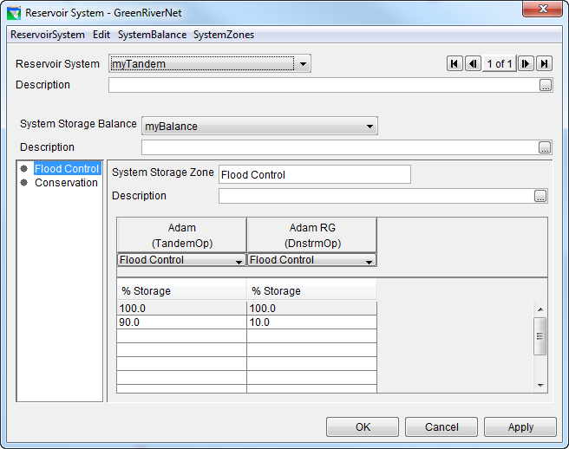
Defining an Explicit
Storage Balance
Explicit System Storage Balance is defined using the Reservoir Systems Editor
Here, Flood Control Storage is Balanced with Adam 90% full & Adam RG 10%

Slide 26
Defining an Explicit
Storage Balance
Components of a System Storage Balance
  Reservoir System (set of reservoirs)
  System Storage Balance (similar in concept to an Operation Set for an individual reservoir)
  System Storage Zones
  Allocation of %Storage for each reservoir in the system

Slide 27
Defining an Explicit
Storage Balance
Procedure
  Create a Reservoir System and edit the set of reservoirs included in the system.
  Create a System Storage Balance, selecting one Operation Set from each of the reservoirs included in the system.
  Create one or more System Storage Zones based on existing Reservoir Storage Zones and enter %Storage in the balancing table. (%Storage defines how you want to balance)

Slide 28
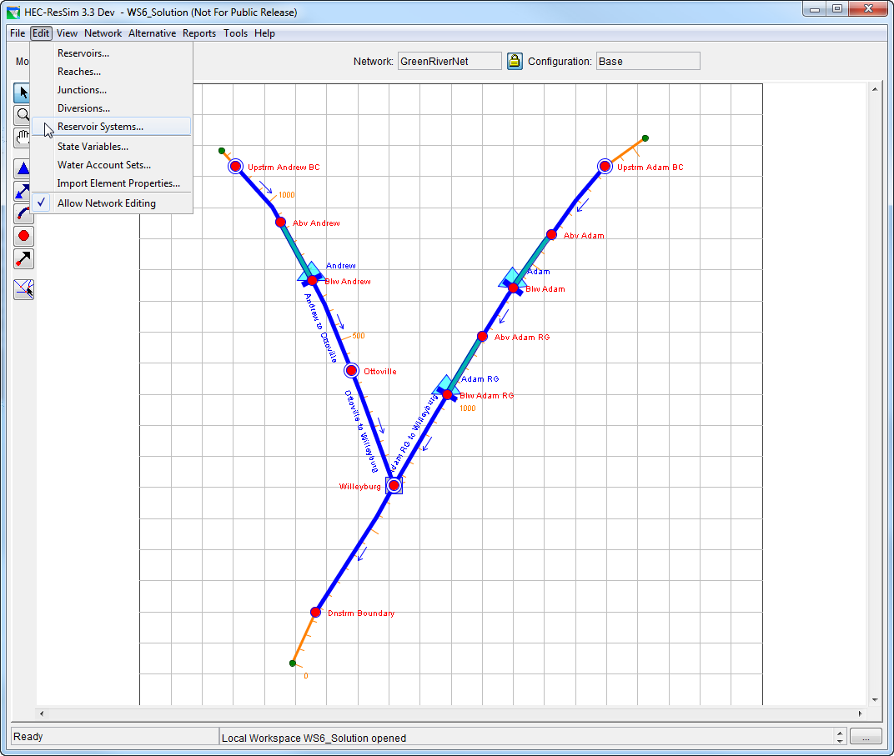
Defining an Explicit
Storage Balance
Edit > Reservoir System (to open the Reservoir System Editor)
Create a New Reservoir System

Slide 29
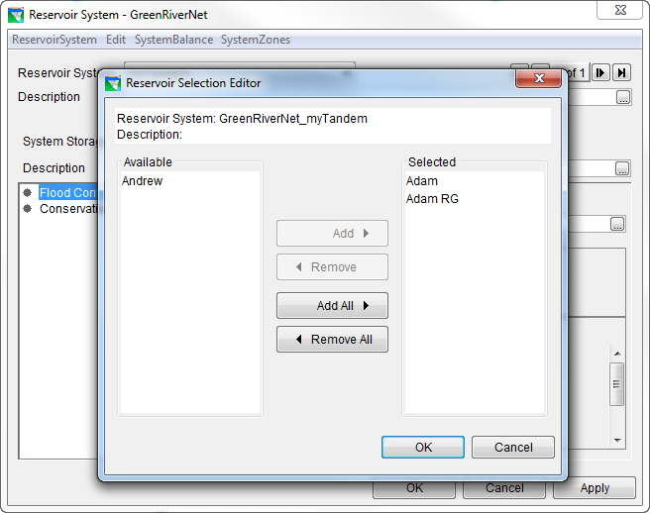
Defining an Explicit
Storage Balance
Next, Edit the Reservoir Set
Select the reservoirs that will use the Explicit Storage Balance

Slide 30
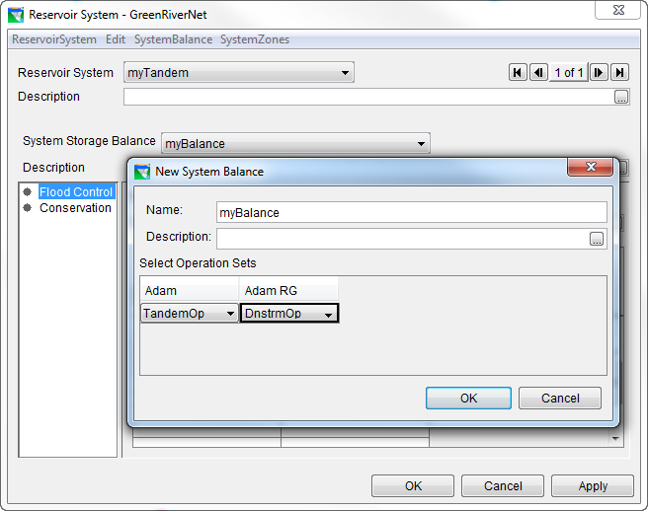
Defining an Explicit
Storage Balance
Next, create a new System Storage Balance
  The System Storage balance is effectively the “operation set” of the system
Select an Operation Set for each reservoir in the system

Slide 31
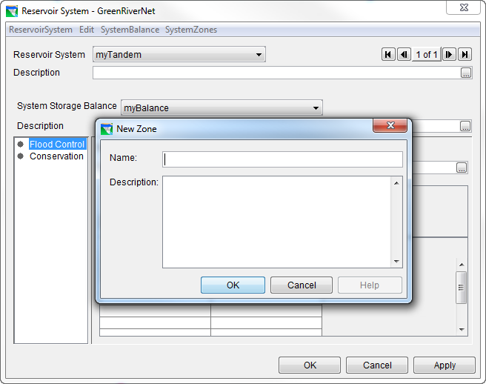
Defining an Explicit
Storage Balance
Create System Storage Zones

Slide 32
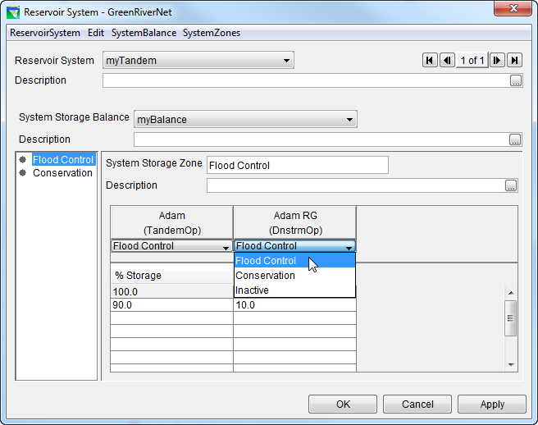
Defining an Explicit
Storage Balance
Select the corresponding Reservoir Storage Zone for each reservoir

Slide 33
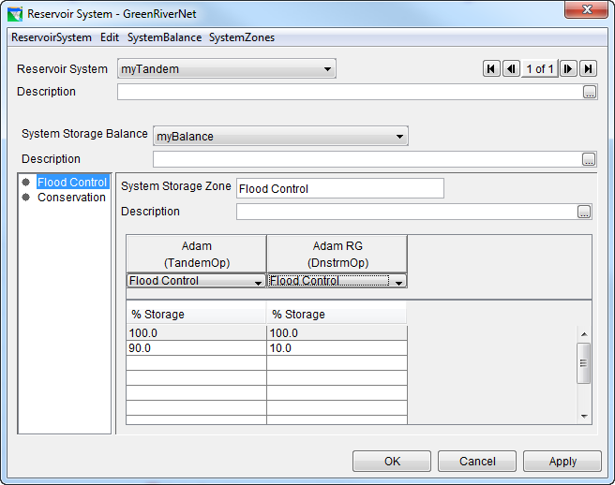
Defining an Explicit
Storage Balance
Fill out the balance table for each zone

Slide 34
Storage Zone Balance Table
System Storage
Reservoir
Res 1
Res 2
Sys
Con
Empty
Full
Full
Zone
Con
Con
90% Con
Con.
Balance
100
100
Res1 Storage
100
50% Con
90
50
0
Empty
50
10
Full
Res2 Storage
Con.
100
50% Con
10% Con
0
Empty
System Storage

Slide 35
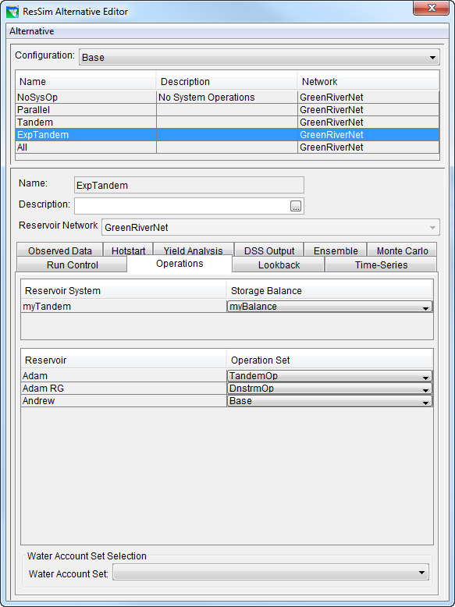
Applying…an Explicit
Storage Balance
In the ResSim Alternative Editor, select one of the defined System Storage Balance sets (or NONE) for each Reservoir System defined in the Network

Slide 36
Review
Parallel System Operations are defined by adding Downstream Control Flow-Limit Rules to all reservoirs operating for a common downstream location
Tandem System Operations are defined by adding a Tandem Operating Rule to the upstream reservoir in a tandem pair
System Operating Rules are prioritized for each reservoir along with other operating rules

Slide 37
Review
Parallel and Tandem operations rely on a System Storage Balance to allocate releases among reservoirs
By default, ResSim applies an Implicit System Storage Balance that balances all reservoirs toward their respective guide curves
You can define an Explicit System Storage Balance that balances reservoirs based on System Storage Zones
Apply an Explicit System Storage Balance by selecting it in the Alternative Editor

