Slide 1
Emergency Spillway Gate Operation
Induced Surcharge Operation
HEC-ResSim

Slide 2
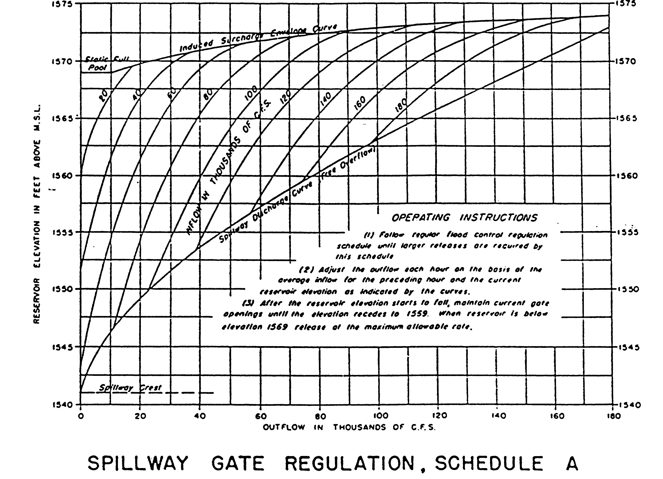
Induced Surcharge Envelope Curve
100 kcfs
140 kcfs
Spillway Discharge Curve (Free Overflow)
Inflow Level
Reservoir Elevation [ft]
Spillway Crest
Reservoir Outflow [1,000 cfs]

Slide 3
Outline
Terms and Background
Induced Surcharge Theory
  How to develop the diagram
  How to use the diagram
Induced Surcharge in ResSim
What to look for in operations
Oroville event

Slide 4
Terms and Background
“Surcharge Storage” is water stored above the top of the flood pool – or above the spillway crest
  surcharge happens naturally with any overflow structure (spillway crest)
  We can “induce” surcharge storage in a controlled way with a gated spillway, restricting release to store higher

Slide 5
Background
Why induced surcharge operation?
Allows maximum use of the available flood storage space in the reservoir
AND
Allows evacuation of flood waters in a planned manner as the reservoir rises, before the flood pool has filled
  as opposed to a “fill and spill” operation
store more
release sooner

Slide 6
Gated Spillway Operation
Flood Objectives (or Constraints)
Do not endanger the dam
  Do not let water flow over the spillway gates
Do not make the flood worse
  Do not let the peak outflow exceed the pre-project natural peak discharge
Do not let the rate-of-increase of outflow exceed acceptable limits

Slide 7
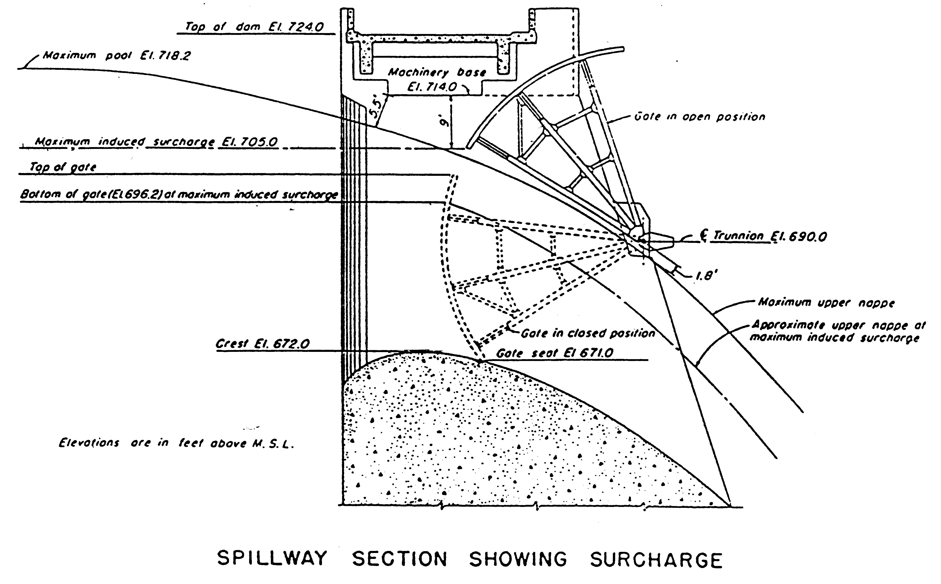
Spillway Gate Section
Top of Flood Pool
Notes:
Right out of the Water Control EM, Gate Regulation section
Picture of a typical spillway gate – too busy, lets break it down
Flood Control Pool – Physical Significance: Up to the level, you can keep the releases at 0 to provide maximum protection for the downstream.
Max Pool – as high as the pool can go without overtopping the gates.
Max Induced Surcharge – this is subjective (a choice). Factors include estimation of risk, physical characteristic of flow and gate stability, …

Slide 8
Spillway Gate Section
Max Pool
Notes:
Right out of the Water Control EM, Gate Regulation section
Picture of a typical spillway gate – too busy, lets break it down
Flood Control Pool – Physical Significance: Up to the level, you can keep the releases at 0 to provide maximum protection for the downstream.
Max Pool – as high as the pool can go without overtopping the gates.
Max Induced Surcharge – this is subjective (a choice). Factors include estimation of risk, physical characteristic of flow and gate stability, …

Slide 9
Spillway Gate Section
Max Induced Surcharge
Notes:
Right out of the Water Control EM, Gate Regulation section
Picture of a typical spillway gate – too busy, lets break it down
Flood Control Pool – Physical Significance: Up to the level, you can keep the releases at 0 to provide maximum protection for the downstream.
Max Pool – as high as the pool can go without overtopping the gates.
Max Induced Surcharge – this is subjective (a choice). Factors include estimation of risk, physical characteristic of flow and gate stability, …

Slide 10
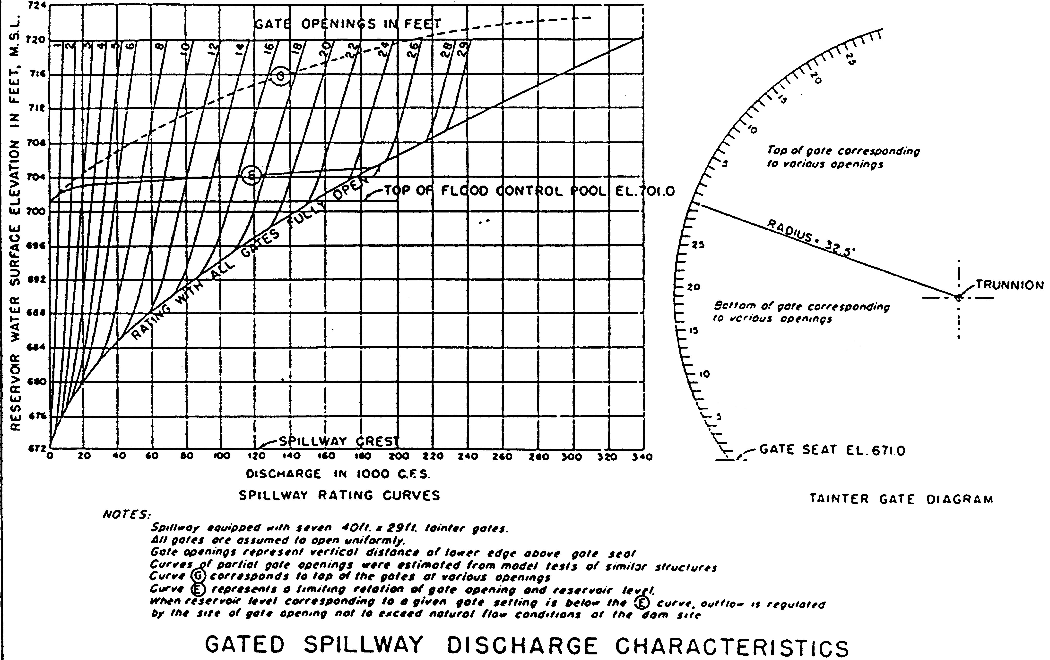
Spillway Gate Capacity Diagram
Induced Surcharge Envelope
Maximum
Permissible
Elevation
Minimum
Permissible
Release
Top Of Flood Pool
Reservoir Elevation [ft]
Release With Gates Fully Open
Spillway Discharge [1000 cfs]
Notes:
Envelope – that’s the thing really subjective – is two things
max elevation at a given discharge
And min discharge at a given elevation
Notice the slope – much steeper at low flow
this means you don’t react as much for small changes in elevation
the flatter slope at higher elevation indicates a much larger reaction for small elevation changes
at the lowest end
as soon as you are in surcharge, you’ve got a min release – you cannot just let it rise.

Slide 11
Induced Surcharge Envelope
The Induced Surcharge Envelope is:
the maximum permissible reservoir elevation at any rate of release
OR
the minimum release at any extreme reservoir elevation
Steeper slope in more-used portion
  required release increases more slowly w/elevation
Flatter slope for more extreme events/elevations
  required release increases rapidly w/elevation
    save the dam!

Slide 12
Induced Surcharge Diagram
The Surcharge Diagram provides release instructions for emergency operation
  a.k.a. Emergency Gate Regulation Schedule or Emergency Spillway Regulation Diagram
Based on not exceeding the envelope in the event
Required release is based on volume of remaining inflow “expected” during the event, and current storage space
For a given pool elevation and inflow (or rate of rise), indicated release should ensure the pool does not rise above the surcharge envelope curve before the end of the event

Slide 13
Induced Surcharge Computation
Decision Point
Recession, Defined By T_{s}
Streamflow
Current Release
Time

Slide 14
Induced Surcharge Computation
Current inflow assumed to be peak, to avoid releasing more than needed. Will revisit in next time-step…
Decision Point
Recession, Defined By T_{s}
Streamflow
Current Release
Time

Slide 15
Induced Surcharge Computation
Later Decision Points
Decision Point
Recession Hydrographs
Recession, Defined By T_{s}
Streamflow
Current Release
Time

Slide 16
Induced Surcharge Computation
Decision Point
Recession, Defined By T_{s}
Streamflow
Larger Value Of T_{s}
Smaller Value Of T_{s}
Time

Slide 17
Induced Surcharge Computation
Decision Point
Recession, Defined By T_{s}
Streamflow
Current Release
Time

Slide 18
Induced Surcharge Computation
Decision Point
Q_{i}
Recession, Defined By T_{s}
Streamflow
Current Release
Volume To Be Managed
Q_{o}
Time

Slide 19
Induced Surcharge Computation
Decision Point
note, cannot solve for Q_{o}
Q_{i}
Streamflow
inflow drops below release
Current Release
volume to be stored
Q_{o}
volume of release
Time

Slide 20
Induced Surcharge Computation
Questions defining the computation of the diagram:
Would the “volume to be stored” put the reservoir above the allowable surcharge envelope (at current release)?
What elevation is low enough that the volume will fit?
Creating and Using diagram:
For many inflow/outflow pairs, plot that elevation. Plotting and connecting points for a given inflow creates the surcharge diagram.
For a real-time inflow and elevation, the surcharge diagram provides the operating instructions to define release.

Slide 21
Induced Surcharge Envelope Curve
vol to store
100 kcfs
140 kcfs
1564
Spillway Discharge Curve (Free Overflow)
Inflow
Reservoir Elevation [ft]
Spillway Crest
26
Reservoir Outflow [1,000 cfs]

Slide 22
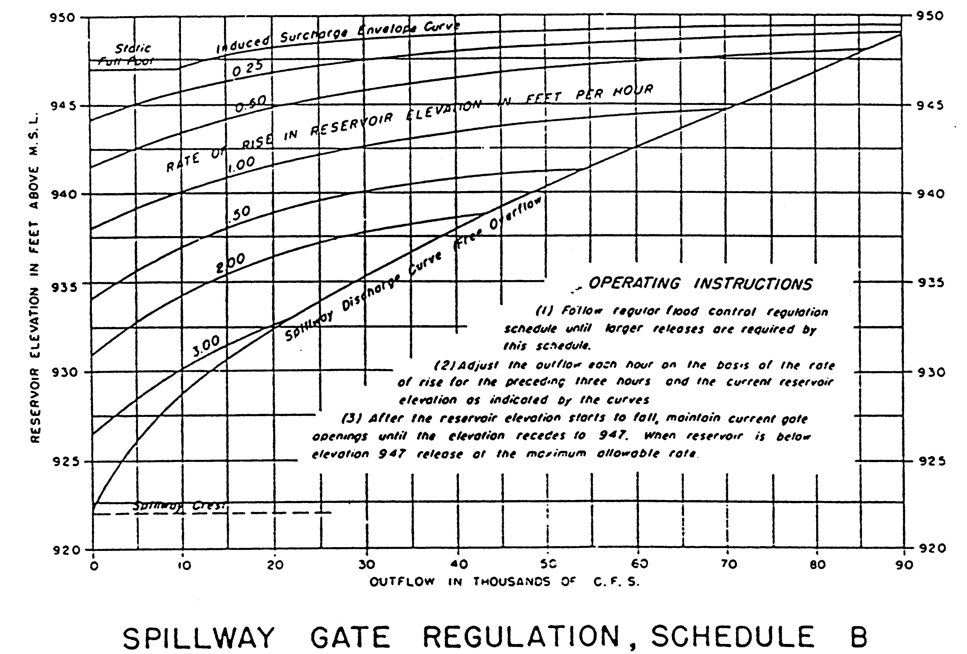
Induced Surcharge Envelope Curve
in Reservoir Elevation
Rate of Rise
1 ft/hour
Spillway Discharge Curve (Free Overflow)
1
Reservoir Elevation [ft]
Reservoir Outflow [1,000 cfs]

Slide 23
Recession Constant, T_{s}
How is the recession constant Ts defined?
  Plot recession limb of project (or spillway) design storm on semi-log paper, and fit a straight line
  Find time needed to decrease from some flow Q_{A} to Q_{B}, where
  Q_{B}= Q_{A}/e (or Q_{B}= Q_{A}/2.71)
Q_{A}
Q_{A}
log_{e} streamflow
Q_{B} = Q_{A}/2.71
Q_{B}
T_{S}
time

Slide 24
When is Induced Surcharge Operation Needed?
When one or more of the following conditions are present…
  Large to very large inflow event
    Rapidly rising inflow
    Multi-peak
    Long duration
  Small or rapidly decreasing flood pool
  Dam stability concerns

Slide 25
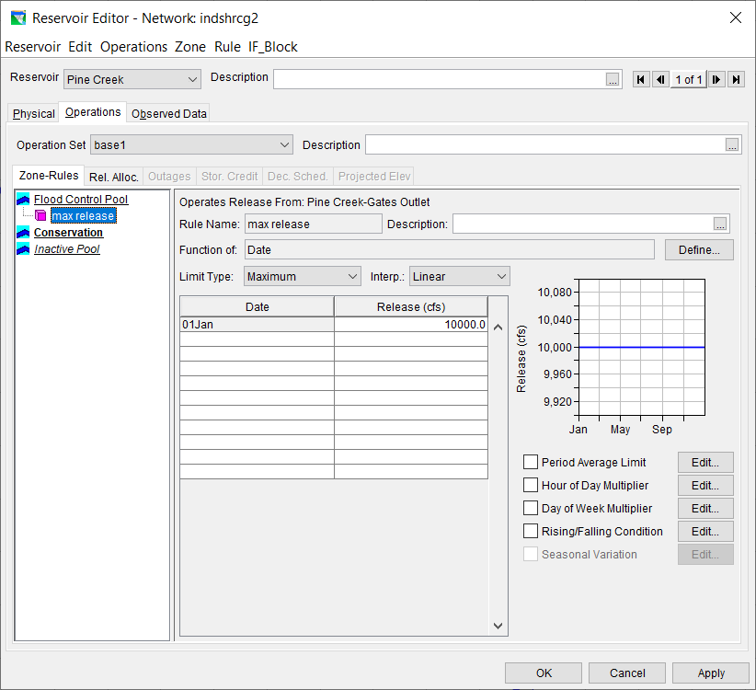

Slide 26
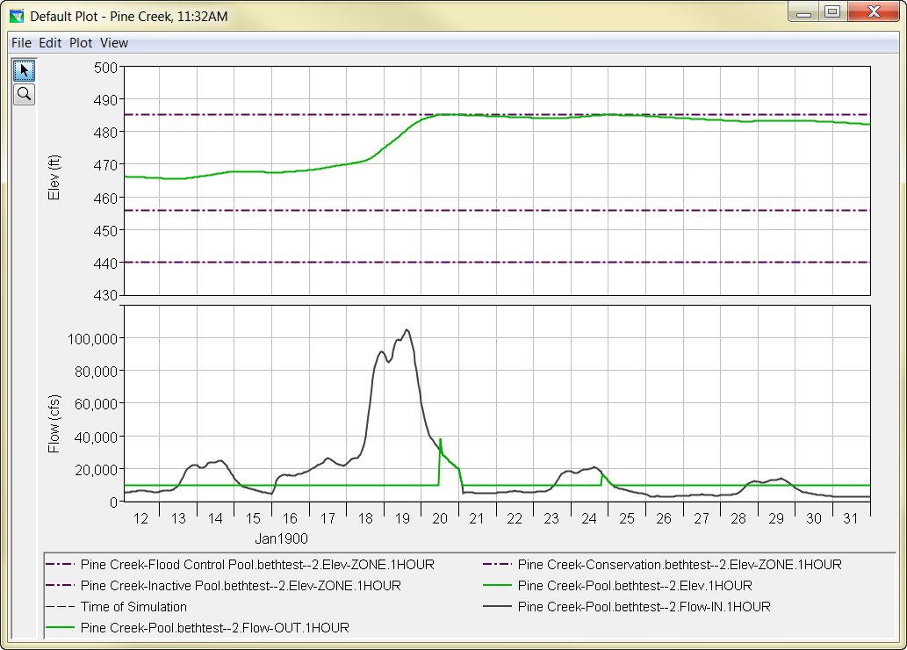
Top Of Flood Pool
fill and spill
Top Of Conservation

Slide 27
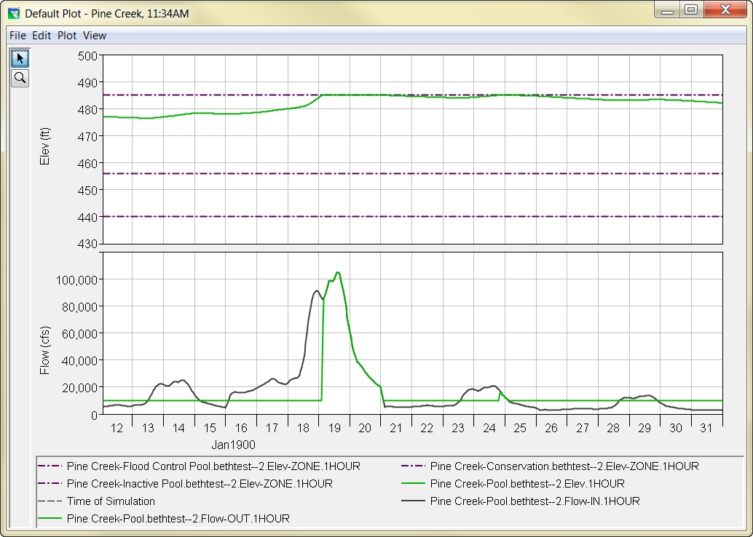
Top Of Flood Pool
fill and spill
Top Of Conservation

Slide 28
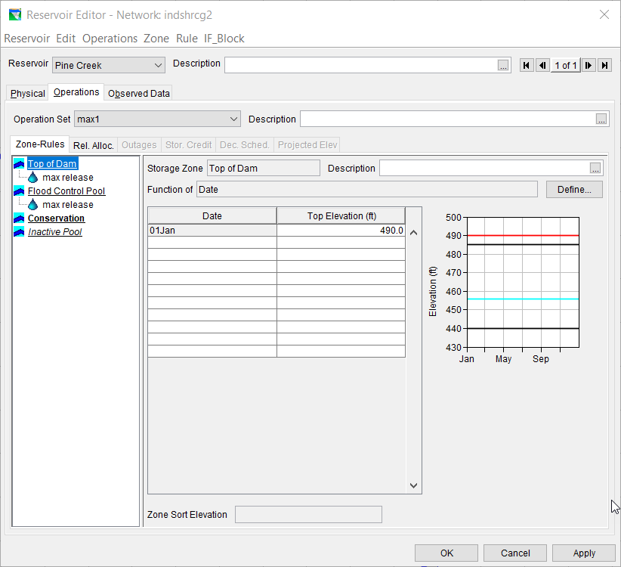

Slide 29
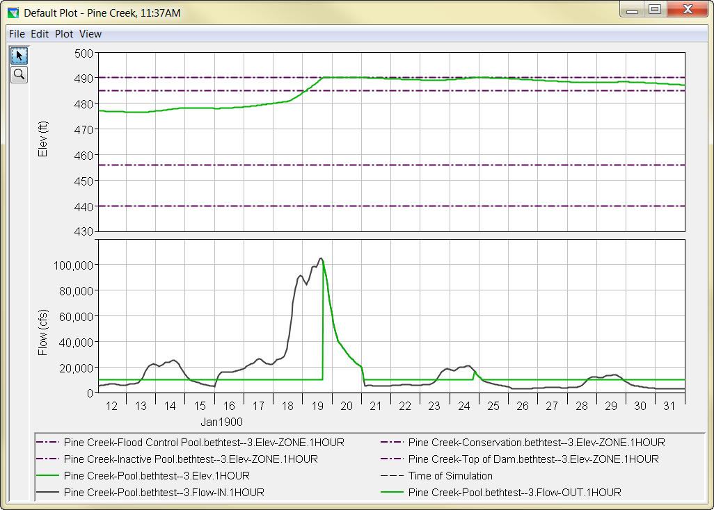
Top Of Dam
Top Of Flood Pool
Top Of Conservation

Slide 30
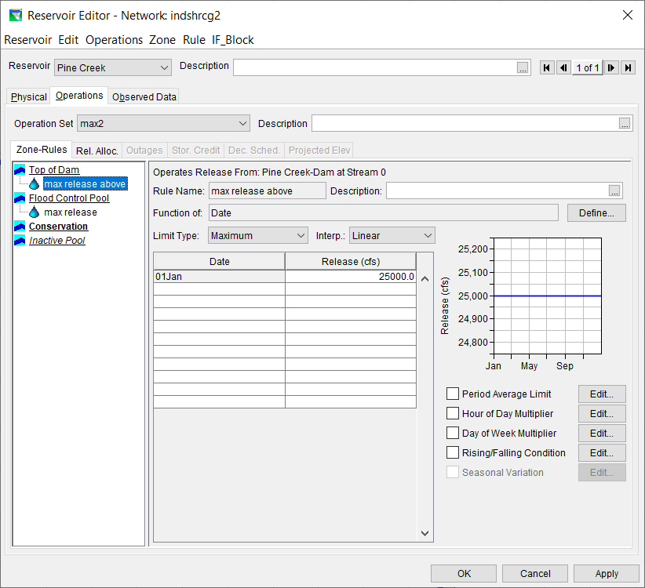

Slide 31
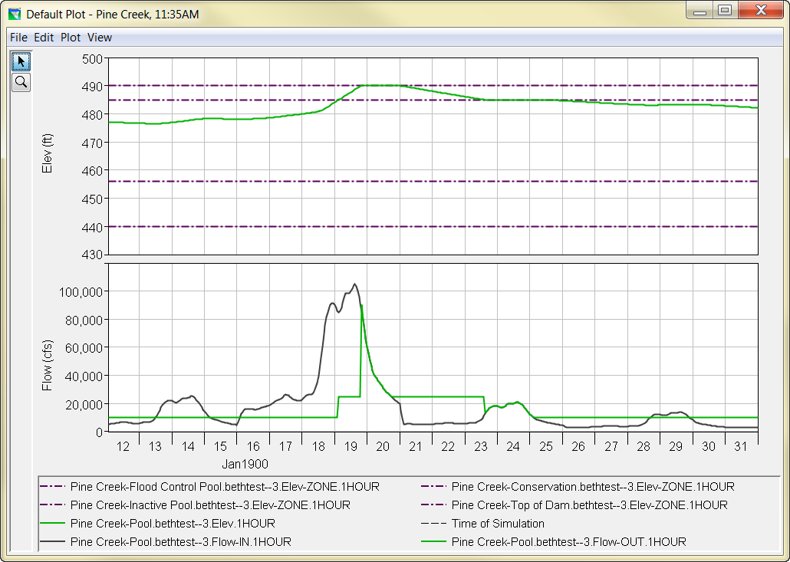
Top Of Dam
Top Of Flood Pool
Top Of Conservation

Slide 32
What’s wrong?
The Problem:
  The model doesn’t know what to do when the reservoir is full
  AND, rules are letting the reservoir become full
The Solution:
  We need a rule to allow a higher release when the reservoir is close to full
  release as function of elevation?
  …but also depends on high inflow…
  use the Induced Surcharge rule!

Slide 33
Induced Surcharge in ResSim
How do we produce induced surcharge operation in the ResSim environment?
  with the Induced Surcharge Rule
In which zones should we put the rule?
  in those zones that appear in the diagram
Does the IS rule apply to the Pool or Dam?
  the pool
What type of limit is the Induced Surcharge rule?
  the induced surcharge rule is a MINIMUM rule

Slide 34
Induced Surcharge in ResSim
What information is needed for the IS rule?
  Surcharge Envelope curve
  Time of Recession, Ts
  Inflow (Time-series) Option
  Falling Pool instructions
    Decrease time
    Transition elevation
    Falling pool release option

Slide 35
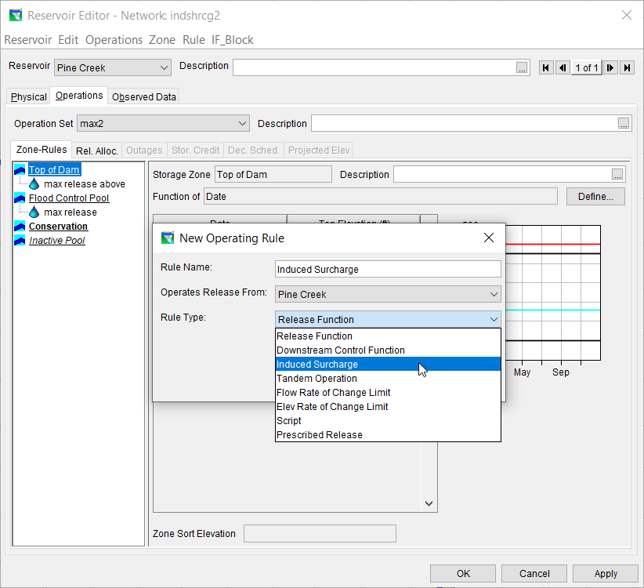

Slide 36
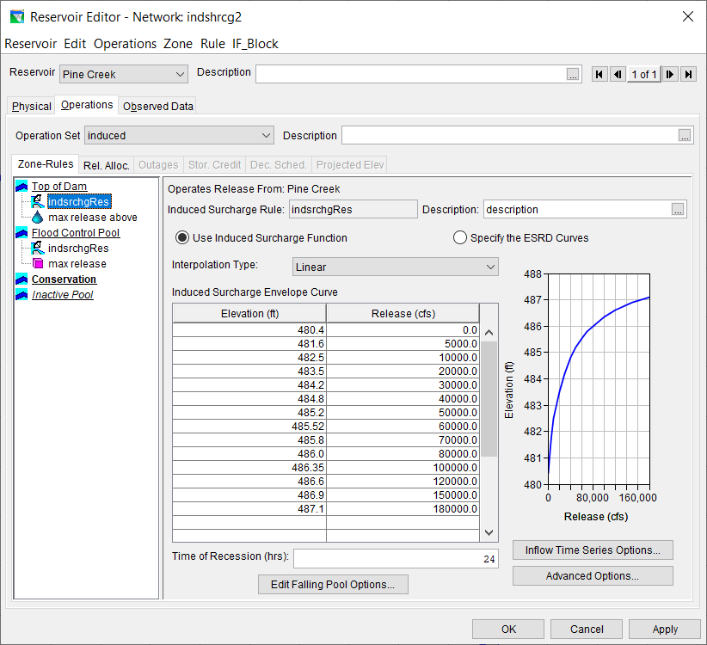

Slide 37
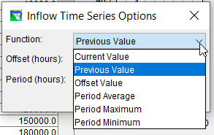
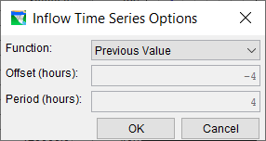

Slide 38
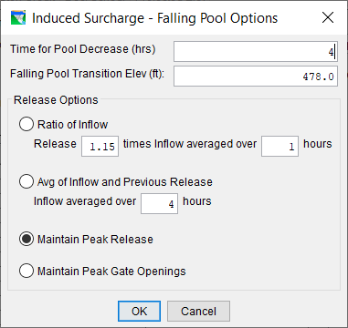

Slide 39
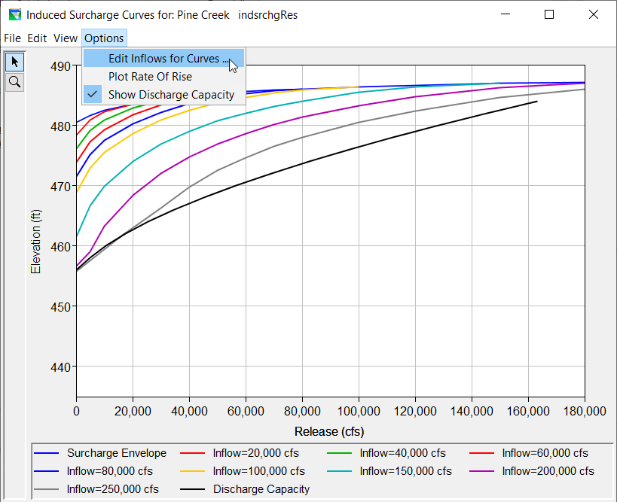
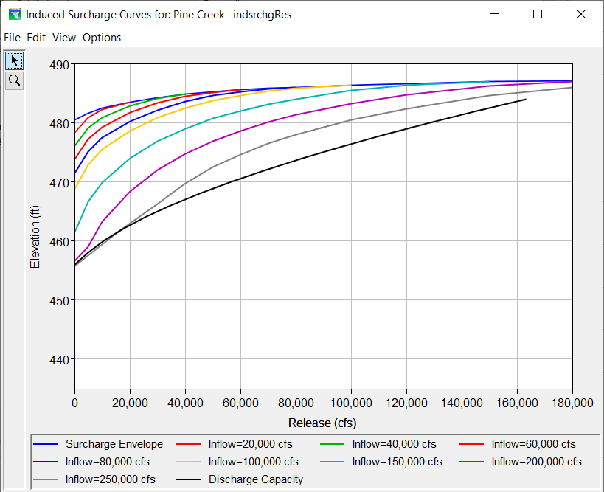
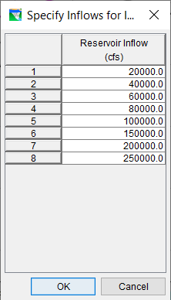

Slide 40
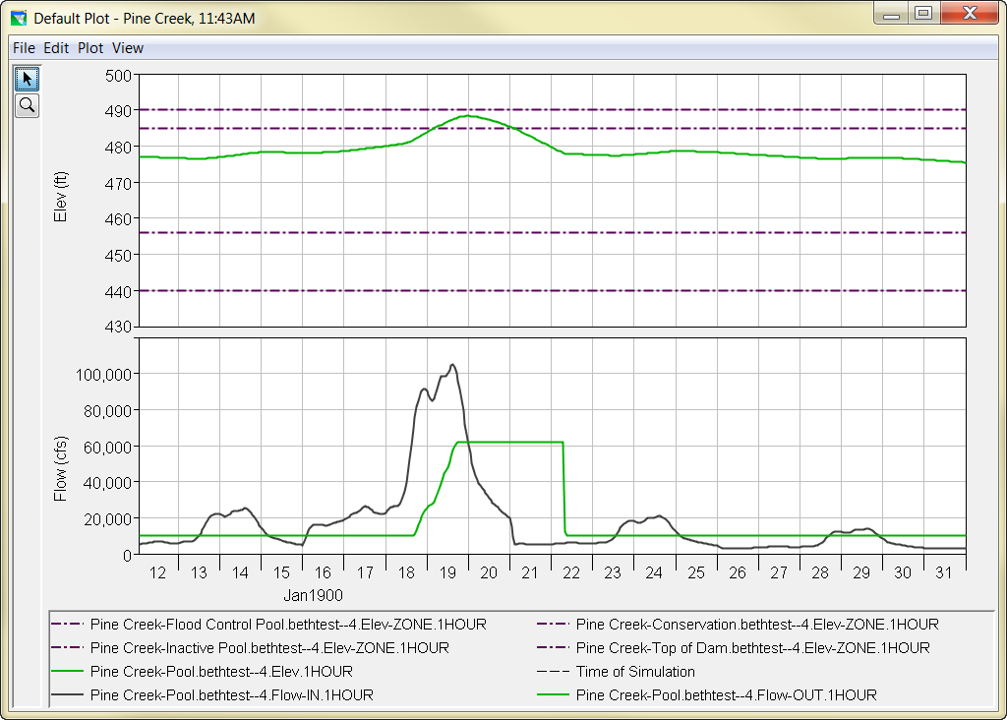
Top Of Dam
Top Of Flood Pool
Top Of Conservation

Slide 41
More to know
The Induced Surcharge rule is a MINIMUM release rule
It MUST be paired with a maximum rule at a lower priority to produce the right operation
physical capacity
IS min rule
max rule
Induced Surcharge release (min rule)
max rule
lower priority, so violated, but restricts release to the min…

Slide 42


Slide 43
Top Of Dam
Top Of Flood Pool
Top Of Conservation

Slide 44
Induced Surcharge in ResSim
What’s “hidden” in the surcharge rule?
  While the rule is active,
    Release may not be higher than previous peak inflow
    Release may not decrease until falling pool condition
    If diagram calls for a non-compliant release, the release is instead held constant
  ResSim knows future inflow, though the chosen settings using previous inflow are meant to mimic what is truly known by operators

Slide 45
More to know
A decreasing rate of change rule will help to temper the transition between the Induced Surcharge operation and normal flood operation

Slide 46
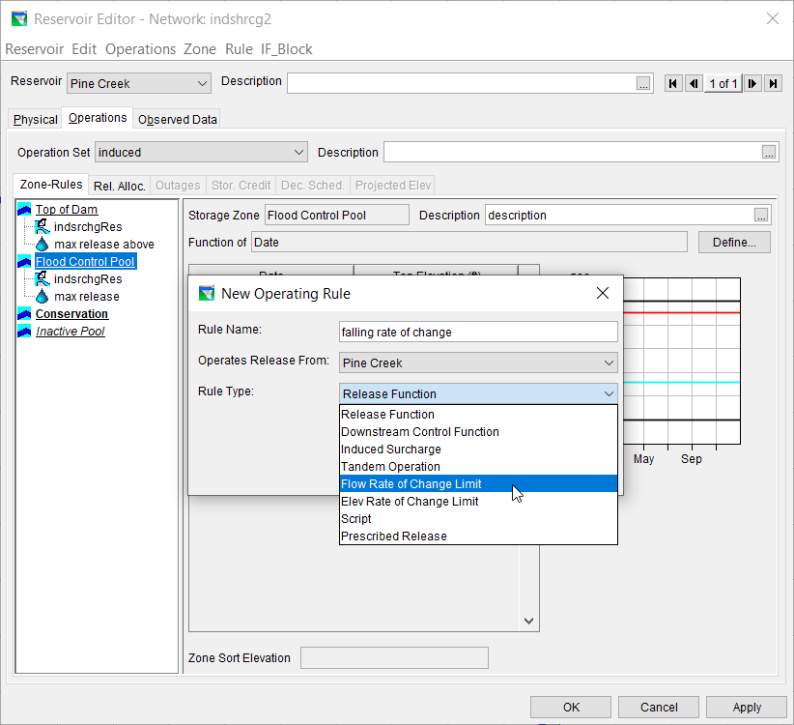

Slide 47
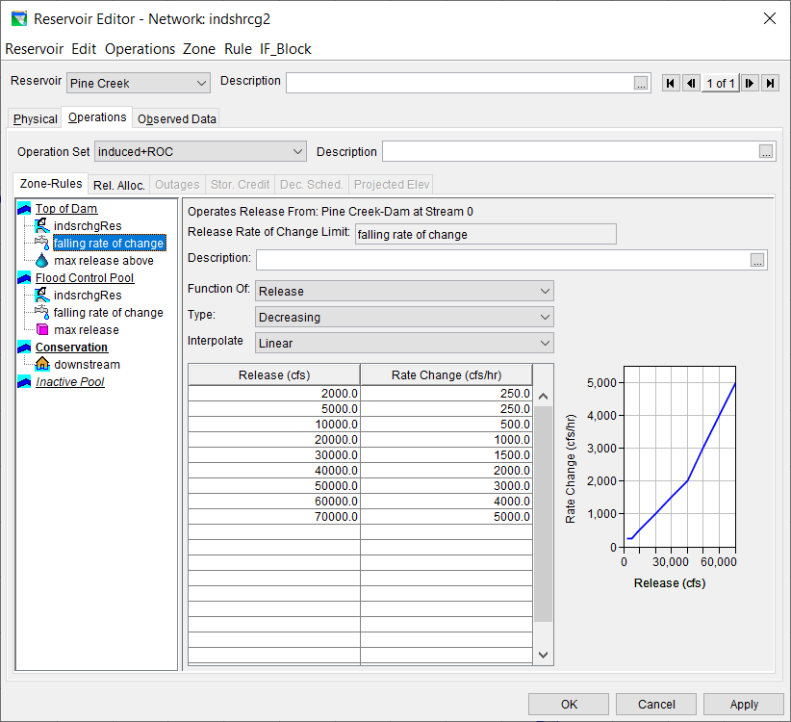

Slide 48

Top Of Dam
Top Of Flood Pool
Top Of Conservation

Slide 49
Analyzing Results
Induced Surcharge operation can often be difficult to analyze because…
  The release decision report does not identify the Induced Surcharge rule as the controlling rule
  If the inflow event has multiple peaks, the Induced Surcharge rule may turn on and off
Use DSSVue
  Plot the FLOW-MIN and FLOW-MAX records for the relevant rules together with the release (Pool, FLOW-OUT) or FLOW-DECISION record.

Slide 50
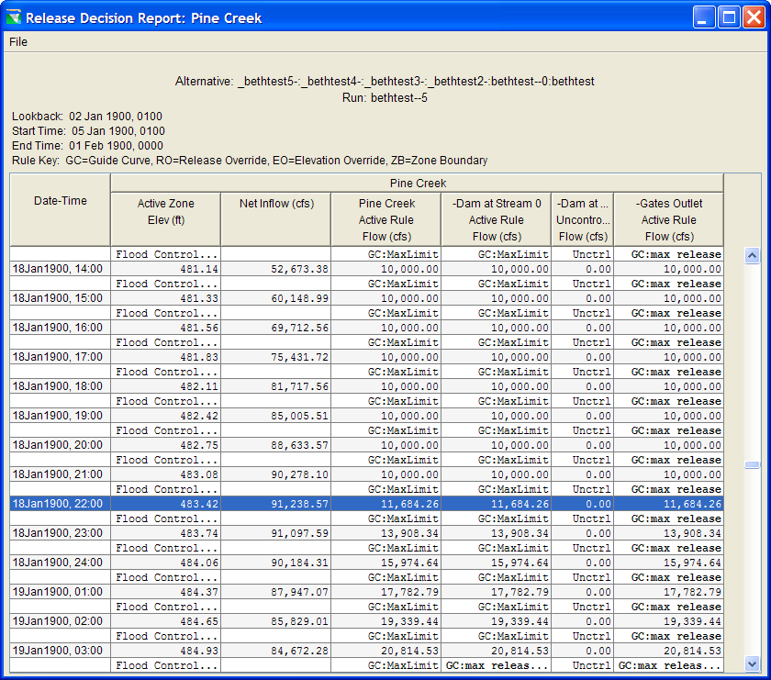

Slide 51
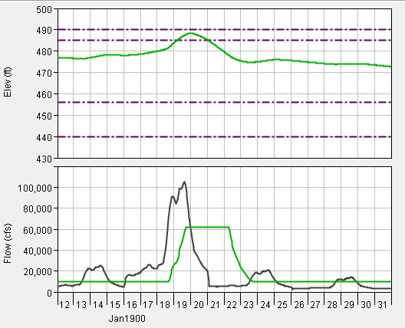
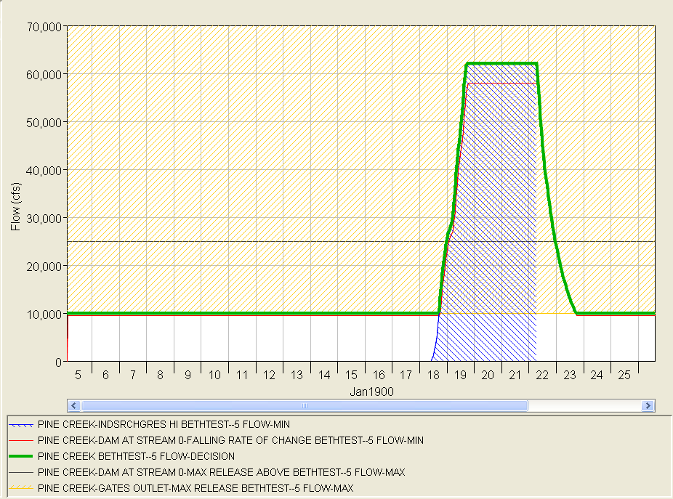
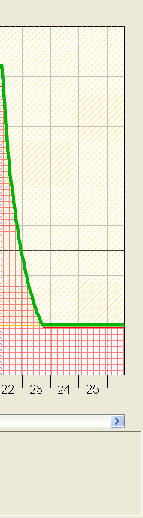

Slide 52
Input ESRD Curves
Originally, only the Induced Surcharge Function Rule was available in ResSim.
The newest form of this rule allows the user to select either the original function method for describing the rule or direct entry of the ESRD family of curves.
  The original function form is appropriate for designing this operation from scratch.
  The ESRD form is appropriate for describing this operation when the curves have been altered from those produced by the function.

Slide 53
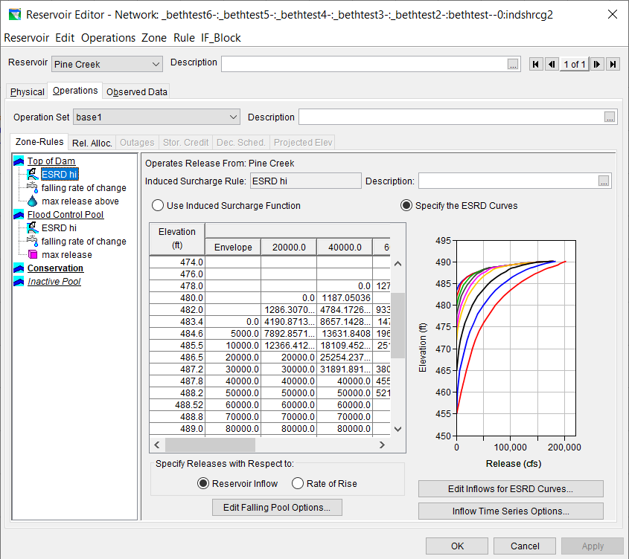

Slide 54
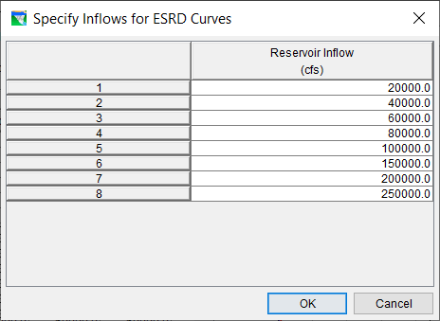

Slide 55
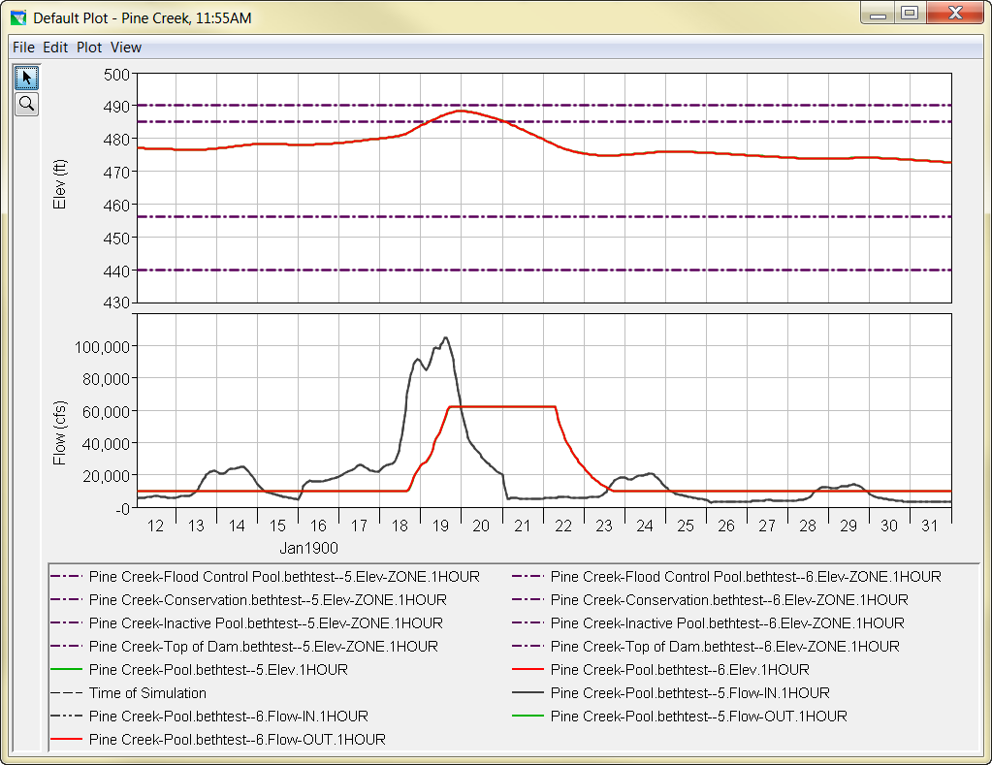

Slide 56
Summary Points
Induced Surcharge Operations…
  Protect the dam
  Allow planned use of the flood pool by releasing early
The Surcharge Diagram (or Emergency Spillway Release Diagram) contains the “instructions”
Release is based on Inflow and Reservoir level
Minimal information needed is:
  Surcharge envelope, Recession constant Ts
  Falling Pool rules

Slide 57
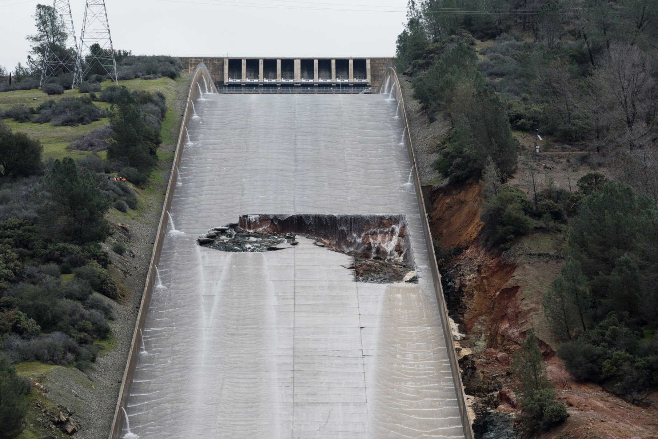
Oroville Spillway Emergency

Slide 58
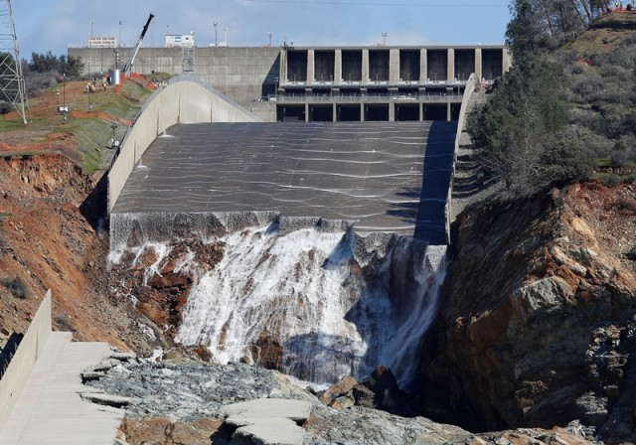
Oroville Spillway Emergency

Slide 59
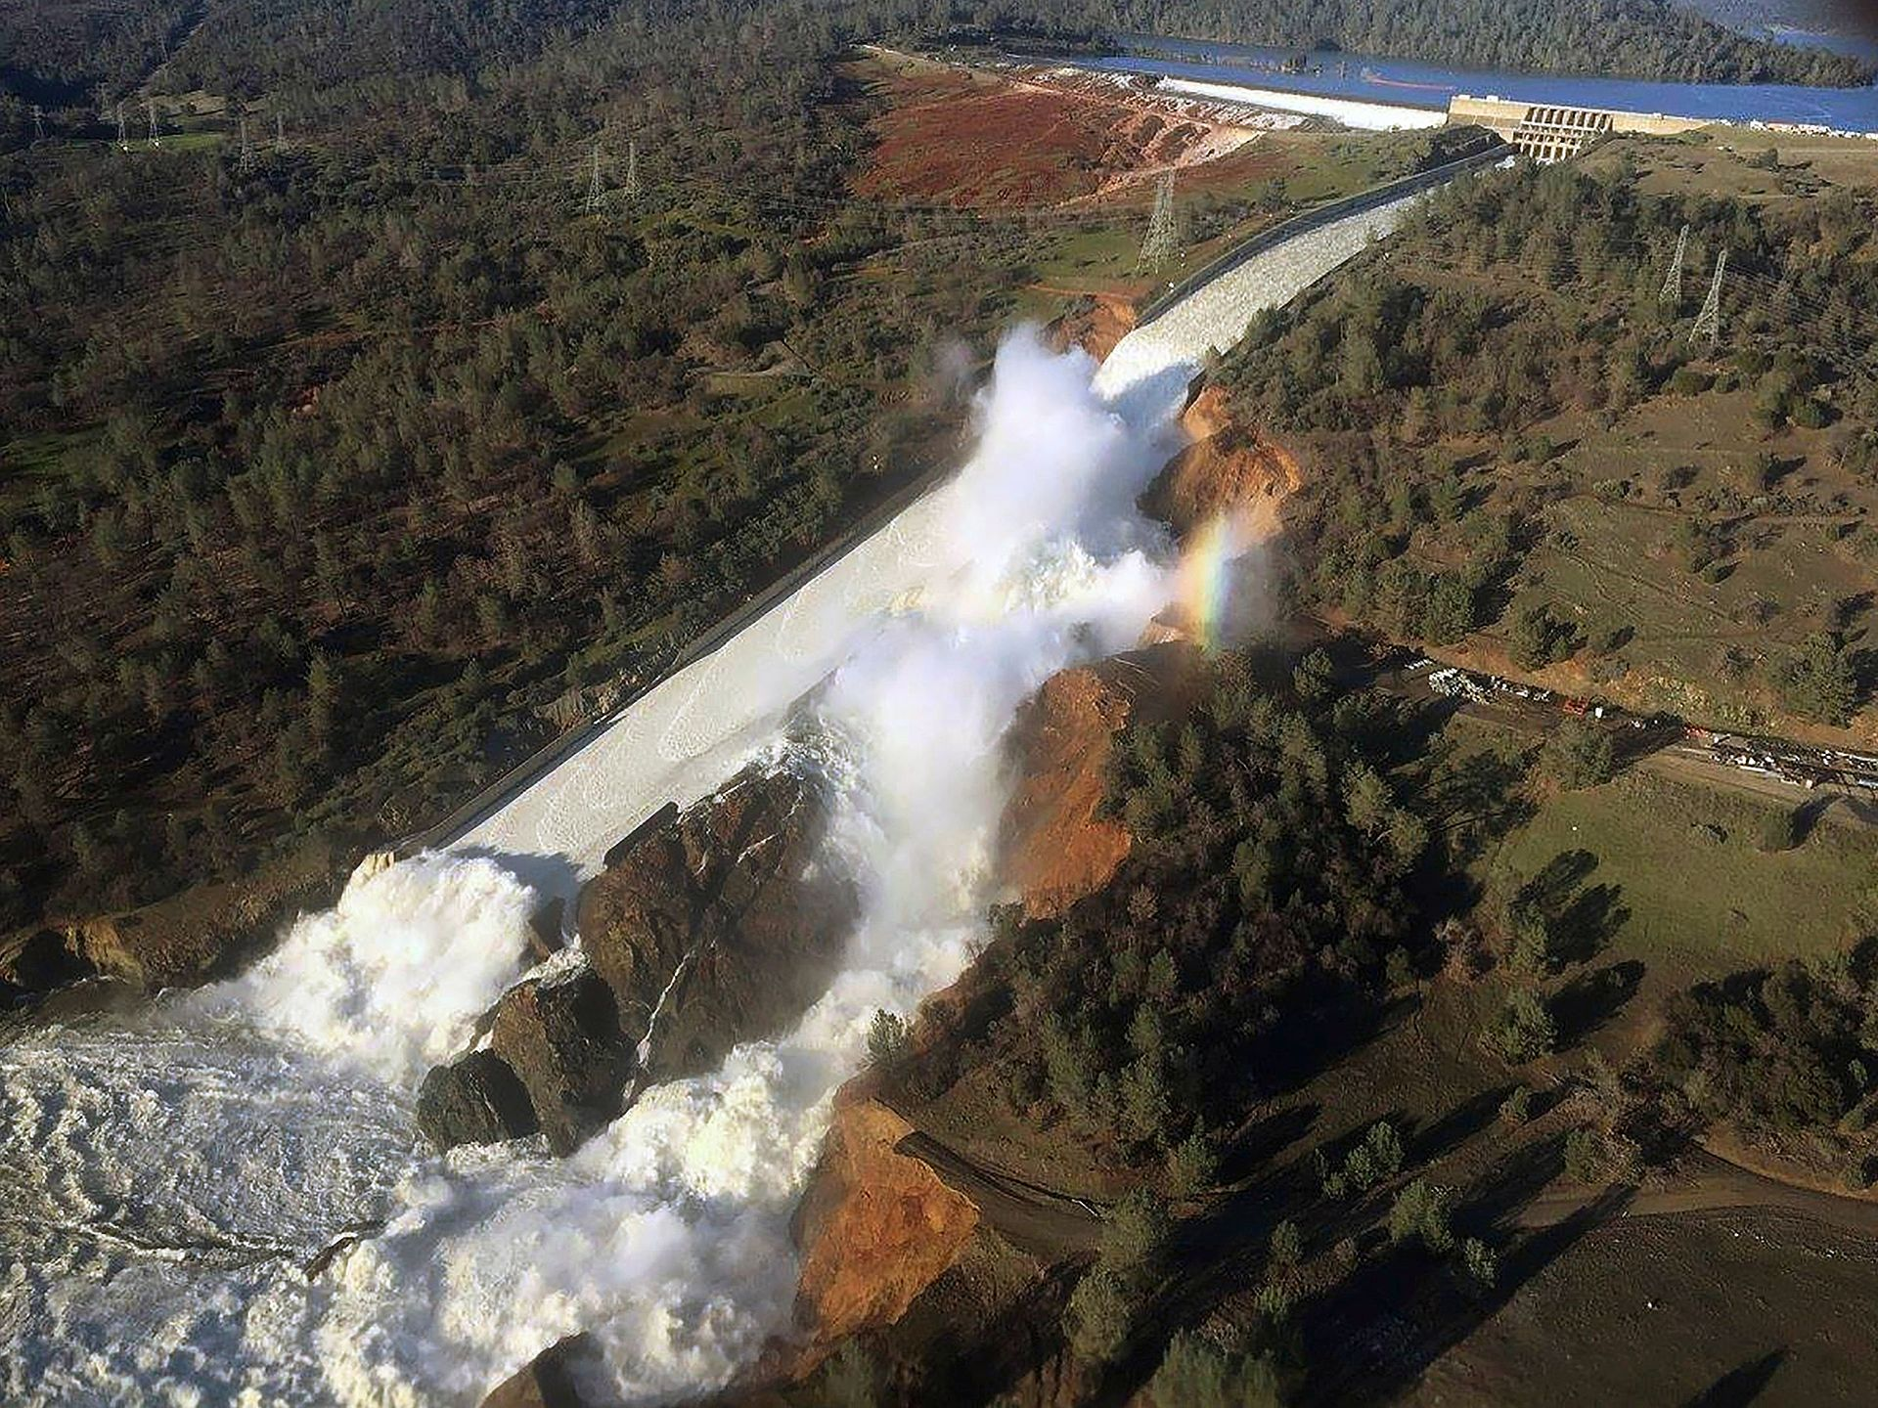
Oroville Spillway Emergency

Slide 60
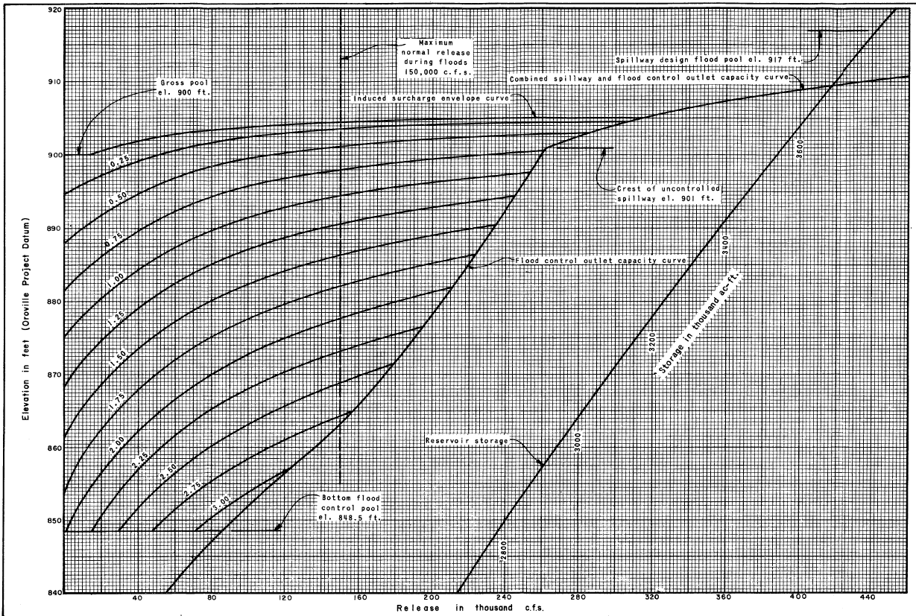
2/11
0.25
2/10
0.50
0.75
2/9
1.00
2/8
2/7

