Slide 1
Alternatives and Simulations
HEC-ResSim 3.5

Slide 2
Overview & Objectives
HEC-ResSim Modules
What are Alternatives?
  How to create one…
What is a Simulation?
  How to create one and what to do with it…
Watershed Setup
Network Module
Simulation Module
Alternative

Slide 3
What is a ResSim Alternative?
An HEC-ResSim Alternative is a specific selection of:
  A Reservoir Network
    Model schematic with physical properties plus operating plan(s)
  The Computation Type and Interval (timestep)
  The Active Operation Set for each Reservoir
  The Initial Conditions for each Reservoir
  The Inflows and other required Time Series Inputs
Alternative 1
Inflow
Diversion
Reservoir
Routing
Reservoir Data
Physical Definition
Initial Storage
Initial Release
Operating Rules
Diversion Data
Initial Diversion
Diversion Schedule
Routing Method
Inflow
Alternative 2
Res. 1
Res. 2
Routing
Res. 1 Data
Physical
Initial State
Op. Rules
Res. 2 Data
Physical
Initial State
Op. Rules
Local Inflow

Slide 4
Composing an Alternative
CONFIGURATION
NETWORK
OPERATION SET
LOOKBACK
INPUT TIME SERIES
ALT 1
Std. Ops
Normal Pool
100-yr
One Reservoir
One Reservoir
Planning Ops
Encr. Pool
ALT 2
500-yr
Normal Pool
ALT 3
Std. Ops
100-yr
Two Reservoirs
Two Reservoirs
Planning Ops
Encr. Pool
ALT 4
500-yr

Slide 5
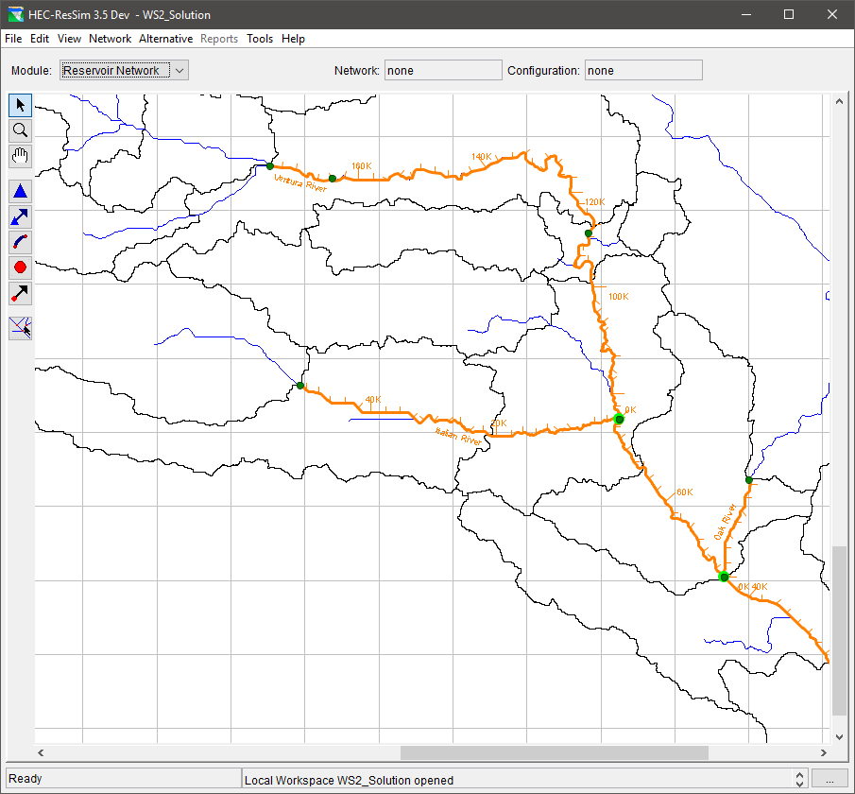
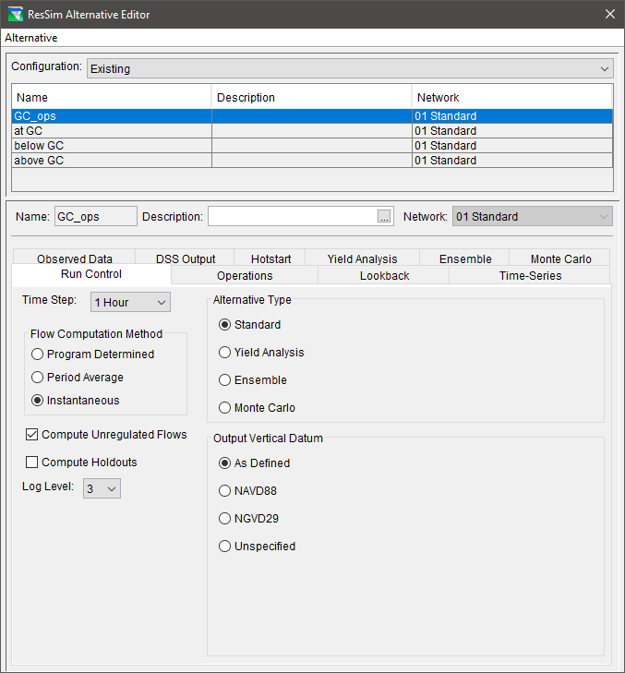
The Alternative Editor
Required Specifications
  Network
    Based on a Configuration
  Run Control
  Operations
  Lookback
  Time-Series
Optional
  DSS Output
  Yield Analysis
  Ensemble
  Monte Carlo
  Observed Data
  Hotstart
Tabs
Notes:
Program Determined—determined by ResSim from reviewing time intervals of the input time series data.
Period Average—typically used when the time interval of the input time series data is daily or longer.
Instantaneous—typically used for short-interval data (e.g., hourly) that is less than a daily time interval.
Compute Unregulated Flows—ResSim performs additional calculations to determine the unregulated conditions in the watershed (i.e., without the regulation of reservoir and diversion projects).
Compute Holdouts—ResSim calculates the amount of water the reservoir stores (as opposed to just releasing inflow). Holdouts indicate the effects of reservoir regulation and are most applicable when you will be performing a subsequent Flood Impact or Flood Damage analysis.
Log Level—(1-10) controls the number of detailed messages that will be displayed during the computations. A log level of 10 will provide the highest level of detailed messages.

Slide 6
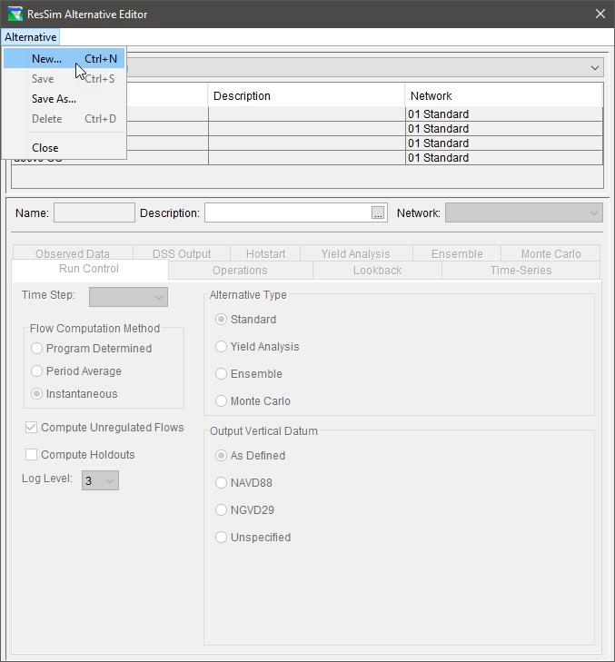
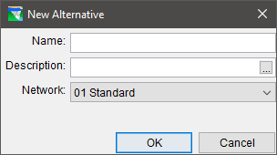
Creating an Alternative…
Create New Alternative
  Name the Alternative
  Add a Description
  Select a Network
    NOTE: Once you press OK here, you cannot change the network selection.

Slide 7
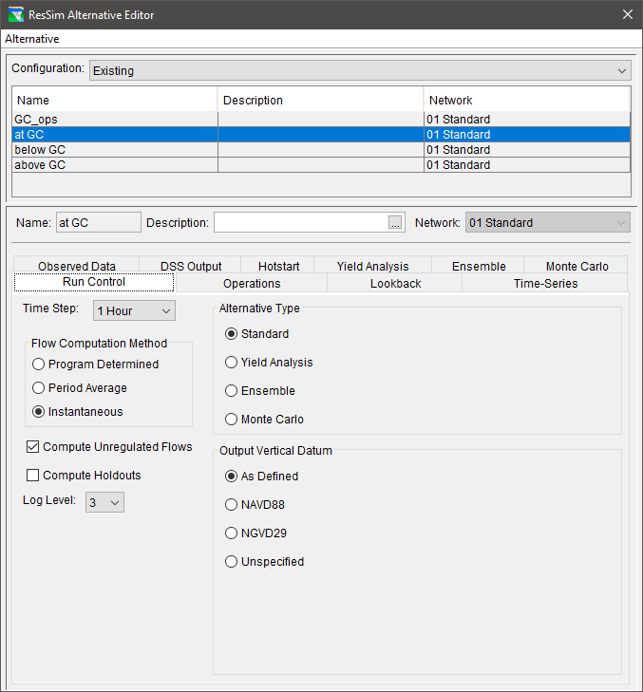
Setting Up an Alternative…
Run Control
Run Control Tab
  Time Step
  Flow Computation Method
  Compute Unregulated Flows
  Compute Holdouts
  Log Level

Slide 8
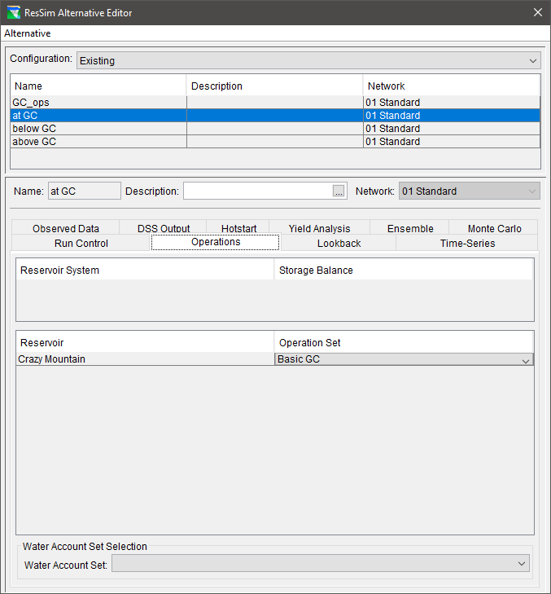
Setting Up an Alternative…
Operations
Operations Tab
  Select an operation set for each reservoir
  Save the Alternative
List of Reservoir Systems
and Associated Storage Balance Operation Sets
List of Reservoirs
and Associated Operation Sets

Slide 9
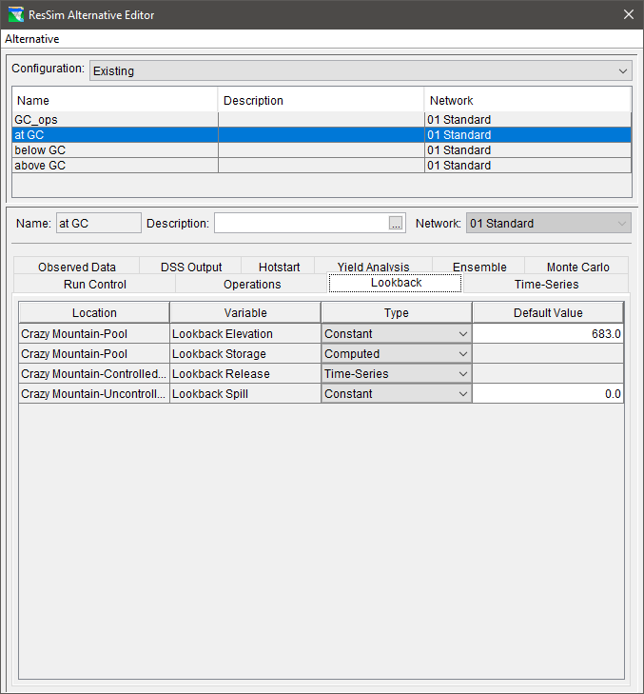
Setting Up an Alternative…
Initial Conditions
Lookback Tab
  Lookback Variables
    Pool Elevation or Storage
    Outlet Releases
    Diversion Flow
    State Variables
  Lookback Types
    Constant
    Time Series
    Computed

Slide 10
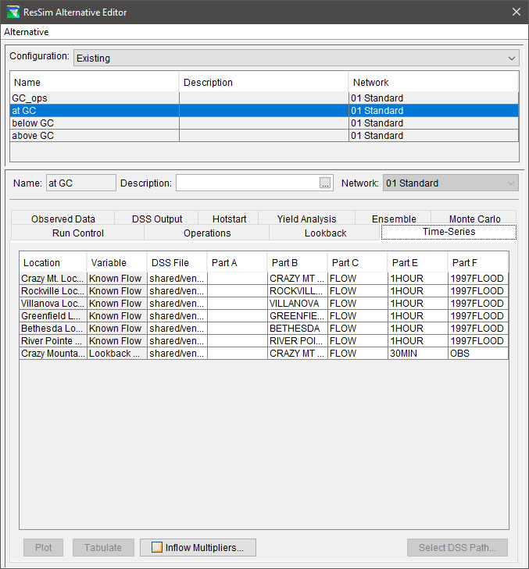
Setting Up an Alternative…
Inflows & Other Time-Series
Time-Series Tab
  Time Series Variables include:
      Inflow (Known Flow)
      Evaporation Rate
      Zone Elevation
      Lookback Elevation & Release
      External Data for a Rule or Diversion
  The DSS Path Selector is used to map (associate) HEC-DSS time series records to each entry in the table.
  Inflow Multipliers
  Plot and Tabulate

Slide 11
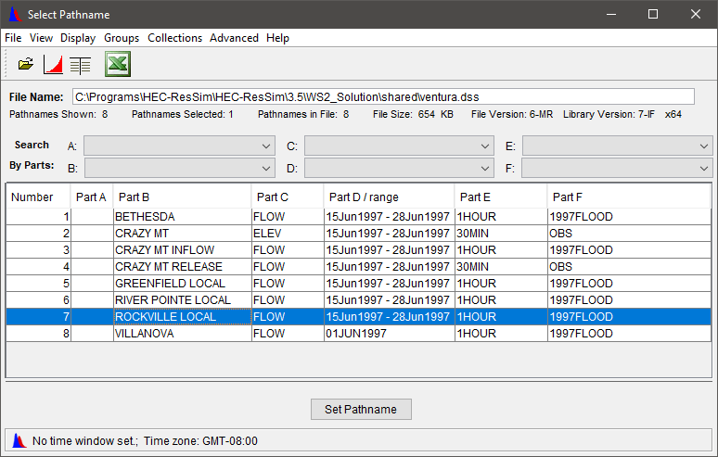
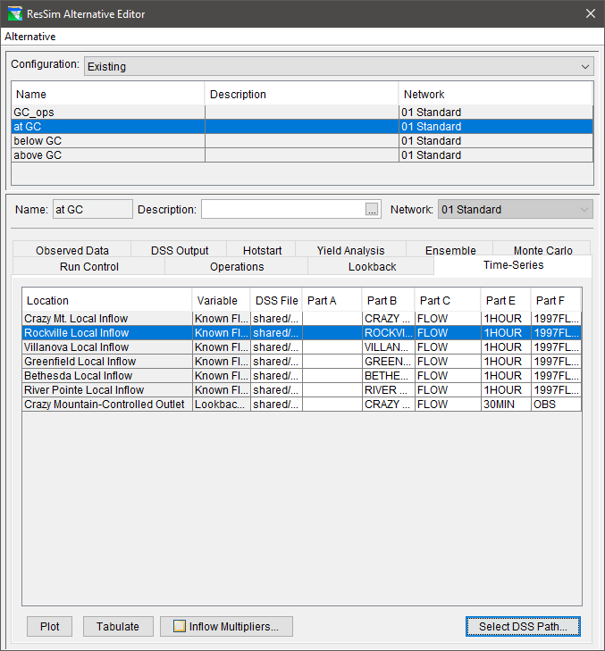
Setting Up an Alternative… The DSS Path Selector
To enter a pathname into a row on the Time Series Tab:
Select the row you want to fill in
From the DSS Path Selector…
  Highlight a record and Double Click
  or
  Highlight a record and Click Set Pathname

Slide 12
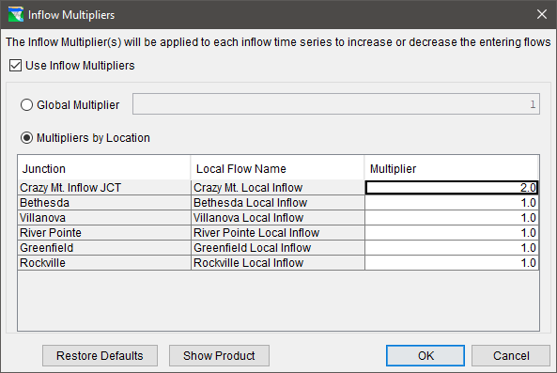
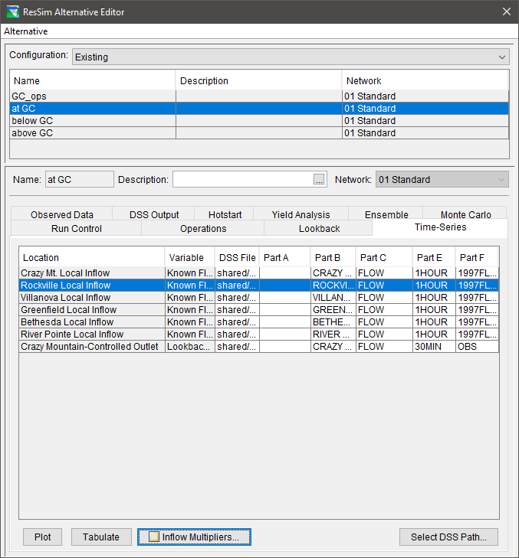
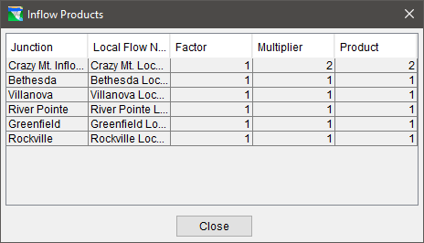
Setting Up an Alternative… Inflow Multipliers

Slide 13
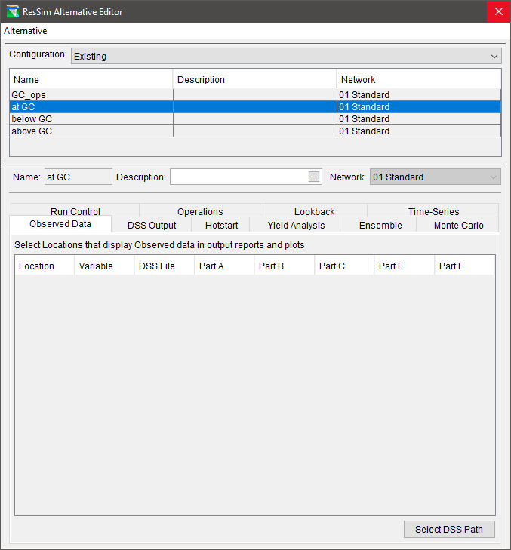
Setting Up an Alternative…
Observed Data
Observed Data Tab
  The Observed Data tab is similar to the Time-Series Tab, however…
  The Locations and Variables are identified in the Network element editors (reservoir, junction, etc).
  Specification of observed data is optional.

Slide 14
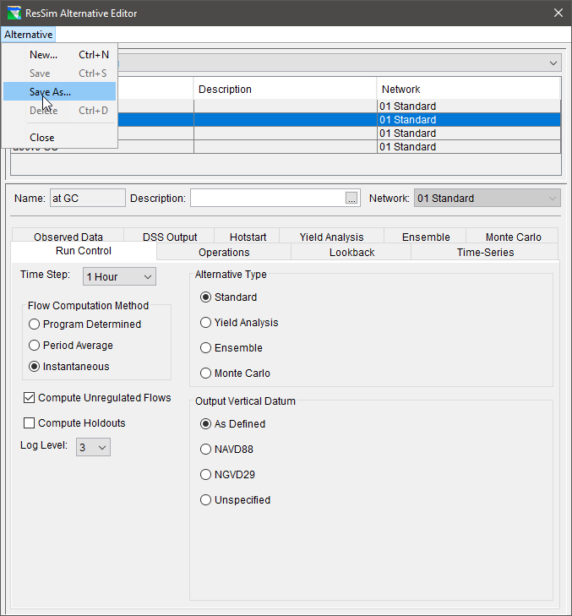
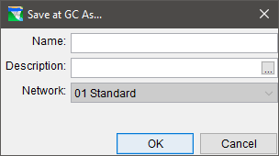
Managing Alternatives
Alternative Menu
  New
  Save
  Save As
    This option will create a COPY of the currently selected alternative.
    The Network selection cannot be changed, but everything else can…
  Delete
  Close

Slide 15
What is a ResSim Simulation?
An HEC-ResSim Simulation is a “workspace” in which you can compute alternatives, analyze results, and refine your model.
  A simulation is defined by the specification of a Time Window and a selection of alternatives.
  The default Name of a simulation is formed from the start time of the specified time window. HOWEVER, a more descriptive name can and should be entered to replace the default.
  A sub-directory or folder is created to hold the simulation’s files. It has the same structure as the watershed and includes copies of all the files that define the alternatives.

Slide 16
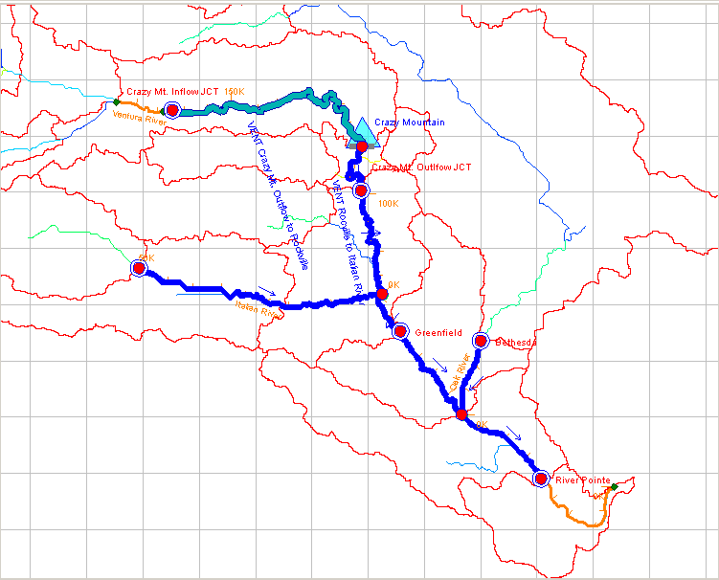
Simulation Time Window
Lookback Period
  To initialize the model elements and routing and reaches
  Should be at least as long as the travel time from the upstream-most reservoir to the downstream-most control point
Simulation Period
  The period during which the model evaluates the input and makes release decisions then routes the releases and inflow through the network
  Should be at least 2x the length of the lookback period
32 Hours
28 Hours
Notes:
More specifically, for downstream control operations or system operations, the lookback period should be at least as long as the travel time from the upstream-most reservoir to its downstream-most control point.

Slide 17
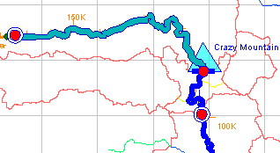
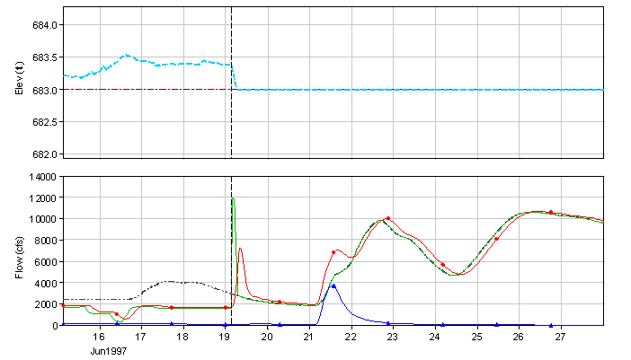






ResSim Simulation
Reservoir Plot + Downstream Junction Flow
Lookback Period
  Stream Flow Routing
  No Reservoir Routing
  No Release Decision
Simulation Period
  Stream Flow Routing
  Reservoir Routing
  Release Decision
Lookback Period
Simulation Period
Guide Curve Elevation
Reservoir Inflow
Cumulative DS Local Flow
Reservoir Pool Elevation
Reservoir Outflow
Regulated DS Flow

Slide 18
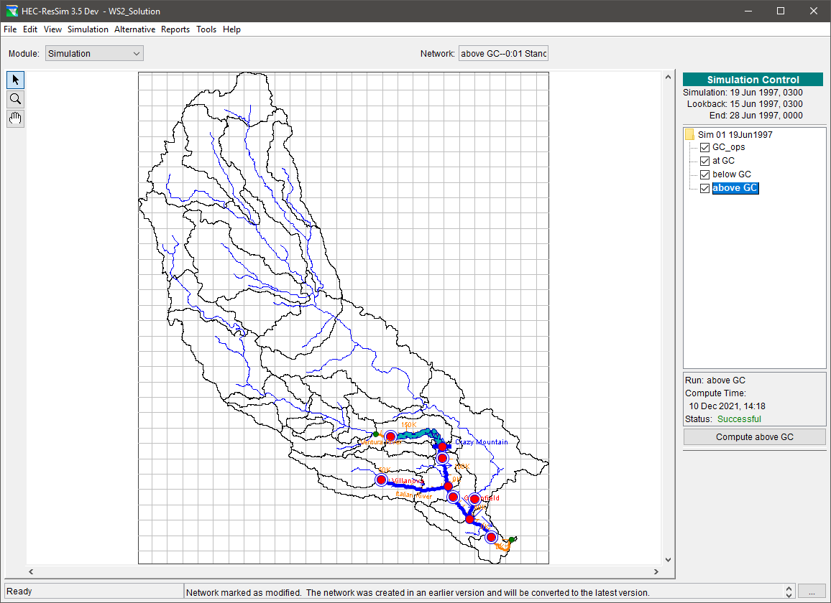
The Simulation Module
Create Simulations
Compute Alternatives
Review Results
Refine the model
Perform “What if..?” scenarios

Slide 19
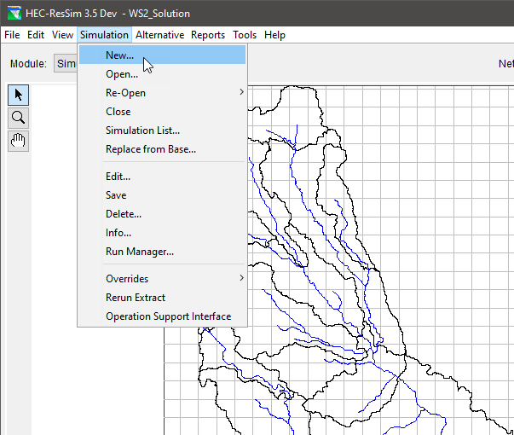
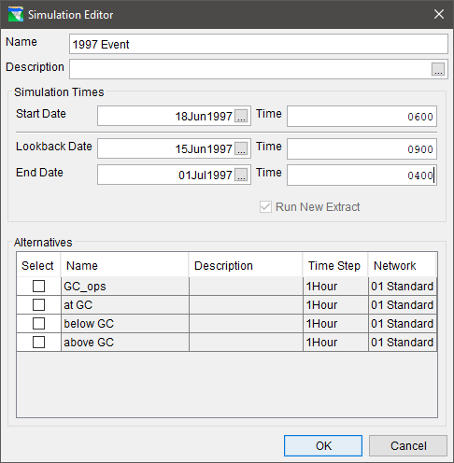
Creating a Simulation
From the Simulation Module’s Simulation Menu, select New…
Enter the Lookback, Start and End Dates and Times for the simulation’s time window.
Select the Alternatives you want to work with.
Enter a Name and Description for your Simulation.

Slide 20
Creating a Simulation
When a Simulation is created, ResSim creates…
  a new folder with the name of the Simulation in the watershed/rss folder and puts a copy of the watershed in it with those files needed to represent the selected alternatives
  a DSS file called simulation.dss in the simulation folder and puts a copy of all the input time-series records needed for the selected alternatives.

Slide 21
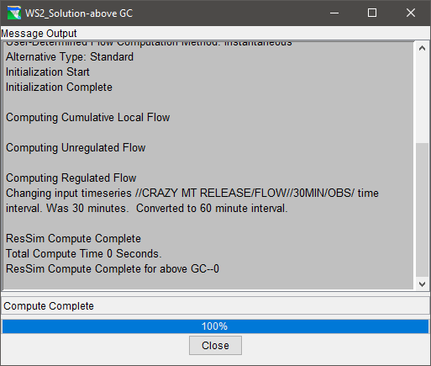
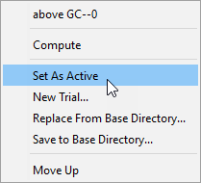
Running a Simulation
Make an alternative “Active” (right click menu)
Compute and check the Compute Dialog for successful computation or errors and warnings

Slide 22
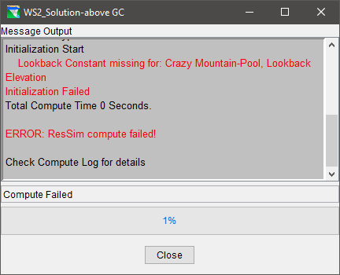
Common Simulation Errors
Choosing a simulation time window that is beyond the coverage of the selected time-series data
One or more Initial conditions are not specified in the Lookback tab of the Alternative Editor
Input time-series has missing data

Slide 23
Common Simulation Errors
Input Time-Series have not been specified on the Time-series tab of the Alternative Editor
A required Time Series is incompletely specified or the specified file &/or pathname cannot be found.
Inflows at Headwater junction(s) are not identified or specified
Routing parameters are not entered
Reservoir data is incomplete (pool definition, outlet capacity, zones, rules)
Incomplete or broken network connectivity

Slide 24
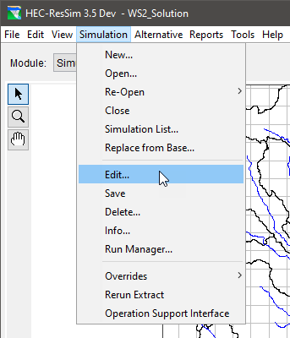
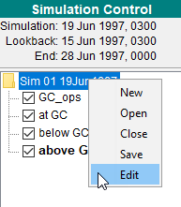
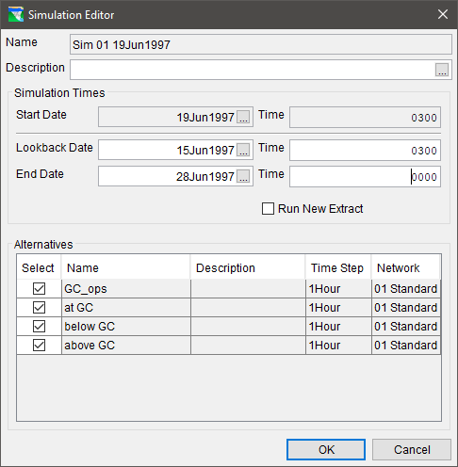
Editing a Simulation
  Open the Simulation
  Editor from the …
    Simulation menu:
      Select New…
  Or
    Context menu:
    Right-click on the simulation name in the Control Panel
  Change Lookback or End date and/or time
  Add or Drop an Alternative
  Run a New Extract

Slide 25
When to make a new Extract?
When changing input time series links
When expanding the simulation time window beyond the dates for which the data was extracted:
  If the lookback is changed to an earlier date
  If the end of the simulation is changed to a later date
Note …
  The simulation start time cannot be changed

Slide 26
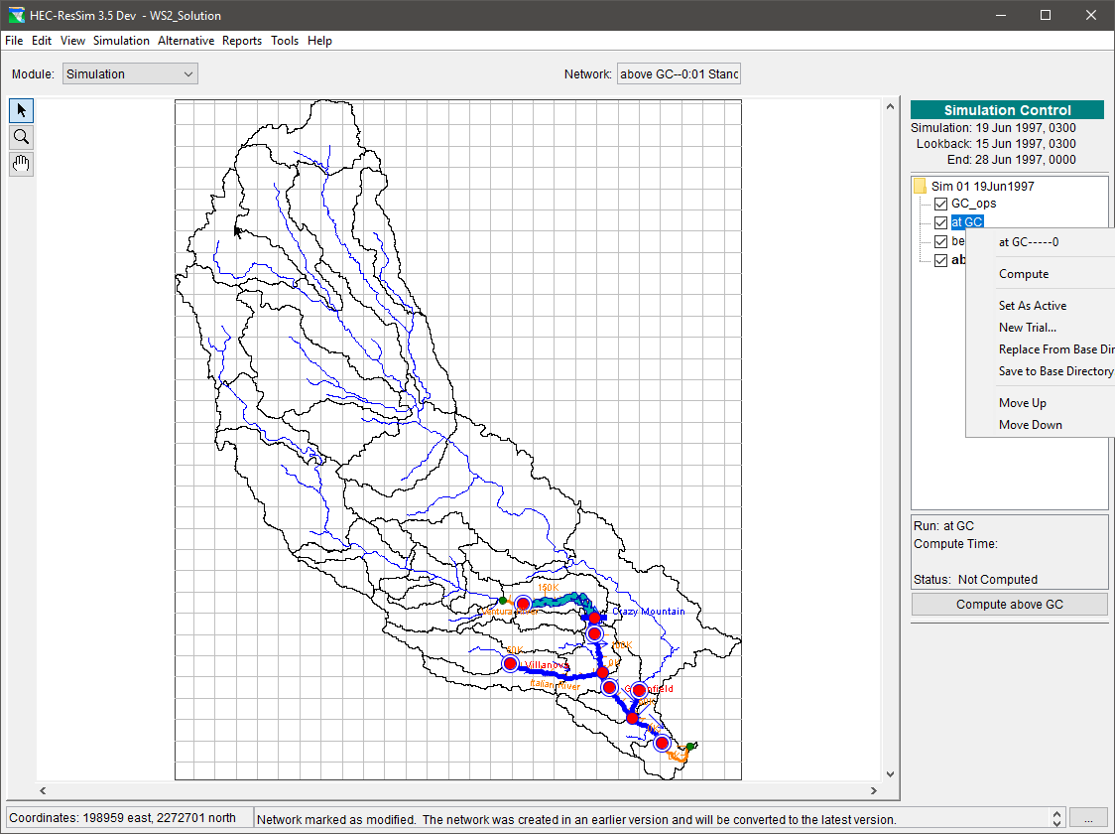
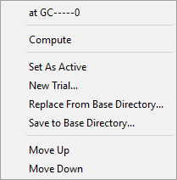
Simulation Control Panel
Set an Alternative Active
Compute an Alternative that is not active
Check the Alternative boxes to access results for the checked Alternatives
Create Trials…

Slide 27
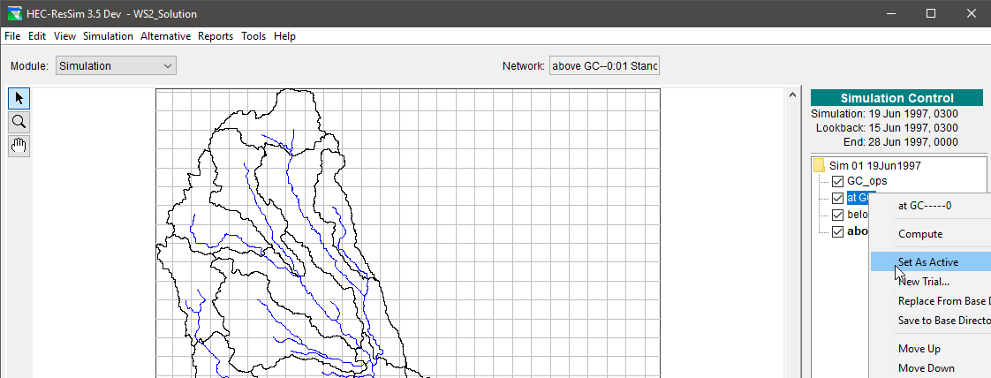
“Set As Active”
Set As Active - This command makes the alternative editable and displays its network in the map region.

Slide 28
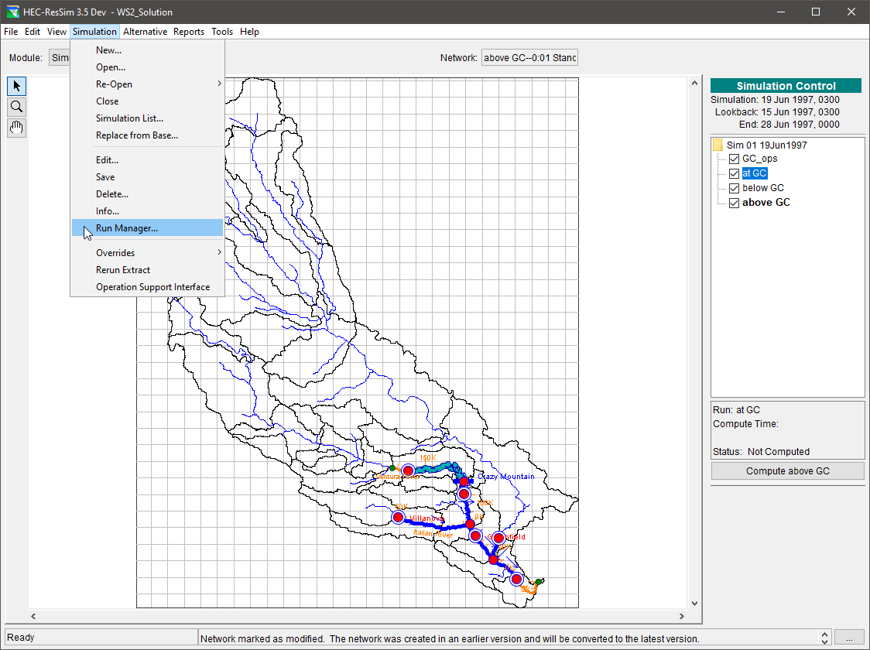
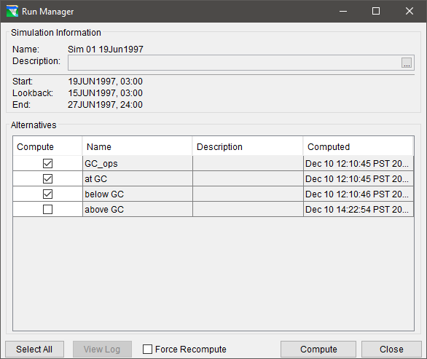
Run Manager
Select and compute multiple alternatives
Review Compute Status
View Compute Logs

Slide 29
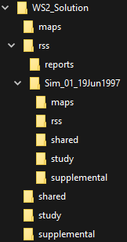
To Save-to-Base or Replace-from-Base?
An Alternative is created in the Reservoir Network module and belongs to the “base” rss folder of the watershed.
When a simulation is created, a copy of the Alternative is made and stored in the simulation’s rss folder of the watershed.
The “base” rss directory
The “simulation” rss directory

Slide 30
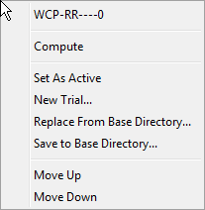
To Save-to-Base or Replace-from-Base?
Save-to-Base: Updates the Reservoir Network module’s (base) copy of the selected alternative and its associated network data from the Simulation module’s copy.
Replace-from-Base: Recreates the Simulation module’s copy of an alternative and its associated network data from the Reservoir Network module’s (base) copy.

Slide 31
Points to Remember
Alternatives are a combination of:
  A network
  An operation scheme
  A set of initial conditions
  A set of inflows
  Run Control selections
Simulations are a combination of:
  A time window
  A set of alternatives to run, refine, and compare

