Slide 1
Hydropower Simulation
HEC-ResSim

Slide 2
Objectives
To know how to:
  Add a Power Plant to a reservoir and define Power Plant Data
  Add Hydropower Rules to the system
  Control Release Allocation to outlets
  Review the hydropower output options

Slide 3
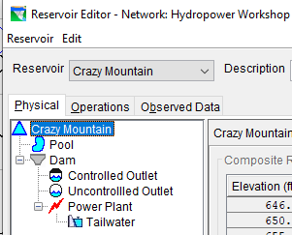

Hydropower Data
Physical Data
Add Power Plant
Define Power Plant Data
  Outlet Capacity
  Power Capacity
  Efficiency
  Losses
    Station Use
    Hyd. Losses
  Operating Limits
Add Tailwater Elevation

Slide 4
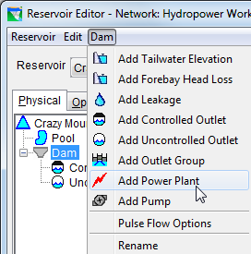
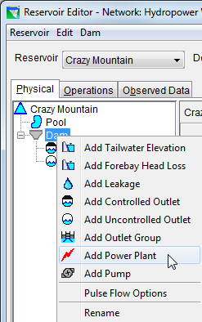
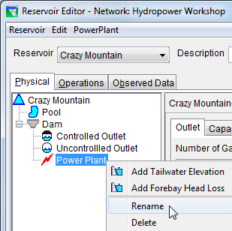
Add a Power Plant
  Add Power Plant
  Use component-specific menu
  Use right-click shortcut menu

Slide 5
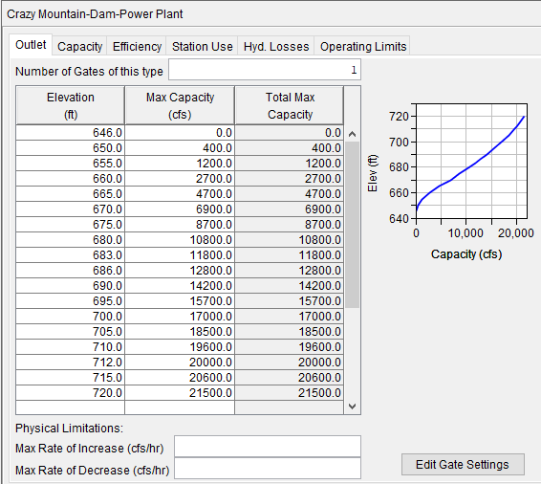
Power Plant Data-Outlet Capacity
Physical Powerhouse Capacity
  Elevation vs Flow
Limits Flow for power generation

Slide 6

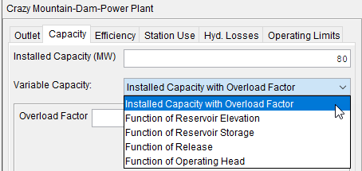
Power Plant Data-Power Capacity
Select Capacity tab in Power Plant dialog
Enter the Installed Capacity (MW).
Select the Variable Capacity option
  Installed Capacity with Overload factor
    Enter the Overload Factor
  Function of Reservoir Elevation
  Function of Reservoir Storage
  Function of Release
  Function of Operating Head

Slide 7
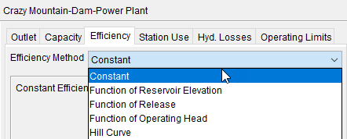
Power Plant Data-Plant Efficiency
Select Efficiency tab in Power Plant dialog
Select the Efficiency Method option
  Constant
  Function of Reservoir Elevation
  Function of Release
  Function of Operating Head
  Hill Curve

Slide 8
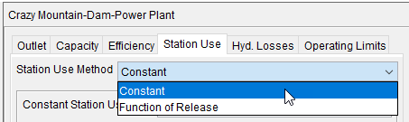
Power Plant Data-Station Use
Select Station Use tab in Power Plant dialog
Select the Station Use Method option
  Constant
  Function of Release

Slide 9
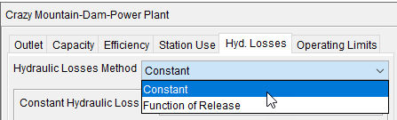
Power Plant Data-Hydraulic Losses
Select Hyd. Losses tab in Power Plant dialog
Select the Hydraulic Losses Method option
  Constant (feet/meter)
  Function of Release (Release vs. loss)
Hydraulic Loss is subtracted from Gross Head in power computations.

Slide 10
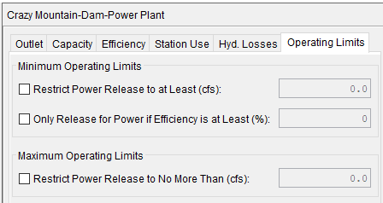
Power Plant Data- Operating Limits
Select Operating Limits tab in Power Plant dialog
  Minimum Operating Limits
  Maximum Operating Limits

Slide 11
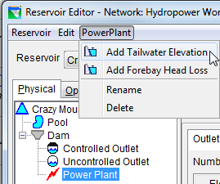
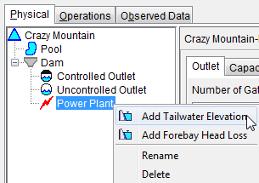
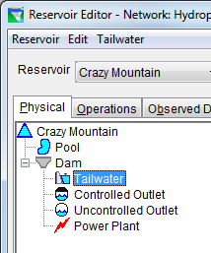
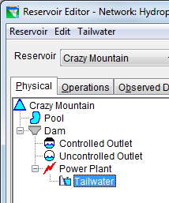

Add Tailwater Elevation
  Add Tailwater
  Use component-specific menu
  Use right-click shortcut menu
  Tailwater
  Tailwater appears in tree below the selected component

Slide 12
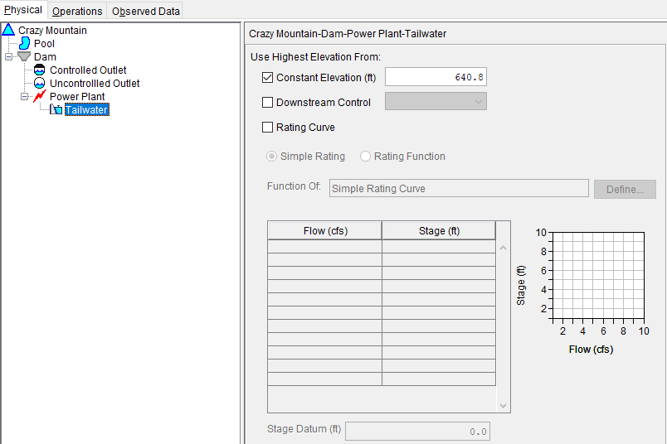
Define Tailwater Elevation
Select Tailwater
Enter data
  Constant Elevation
  Downstream Control
  Rating Curve
If multiple data, higher controls

Slide 13
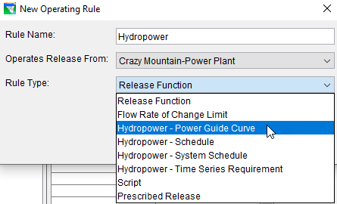
Hydropower Operation Rules
Hydropower - Power Guide Curve
Hydropower - Schedule
Hydropower - System Schedule
Hydropower - Time-series Requirement

Slide 14
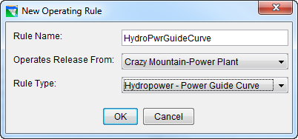
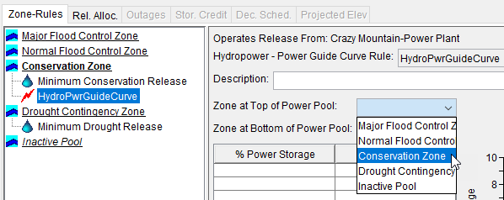
Hydropower-Power Guide Curve
Create the rule
Select the top and bottom zones of the power pool

Slide 15
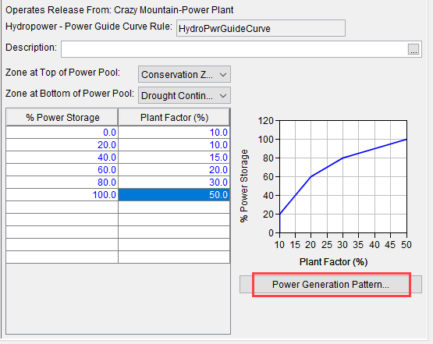
Power Guide Curve
Complete the table to define the rule
% Storage vs. % Plant Factor
Power Generation Pattern

Slide 16
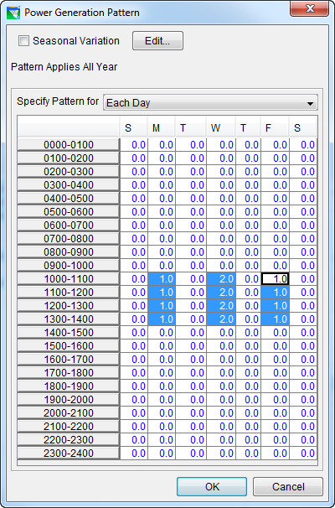
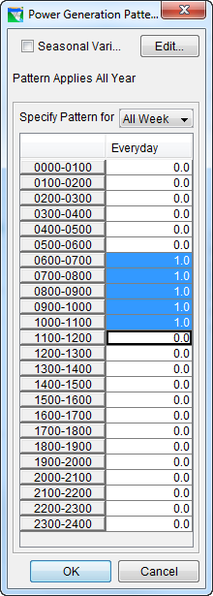
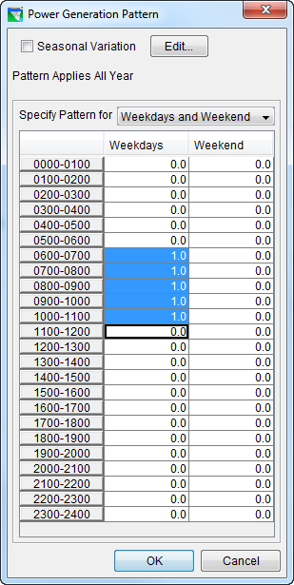
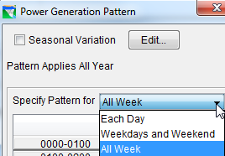
Power Generation Pattern
Pattern applies all year
  Weekly Pattern
  Seasonal Variation
Specify Pattern for:
  Each Day
  Weekdays & Weekends
  All Week

Slide 17
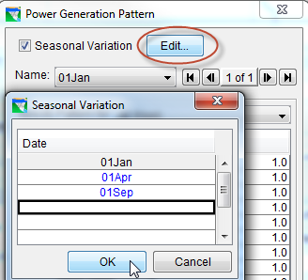
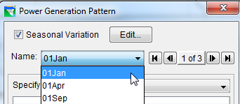
Power Generation Pattern
Seasonal Variation

Slide 18
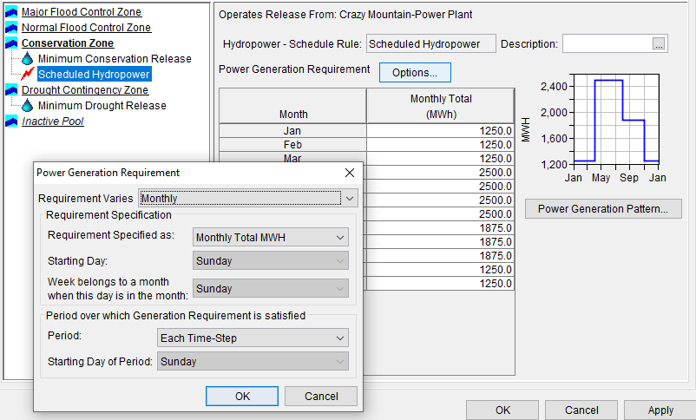
Hydropower-Schedule
Create the rule
Requirement varies
  Monthly
  Seasonally
Specified as:
  Plant Factor
  Daily MWH
  Weekly MWH
  Monthly MWH
Starting Day
Week belongs to a month when this day is in the month of
Period over which Generation Requirement is satisfied

Slide 19
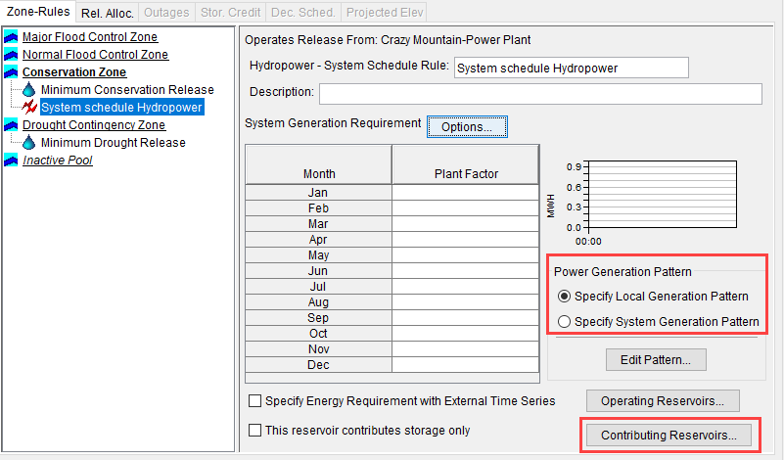
Hydropower-System Schedule

Slide 20
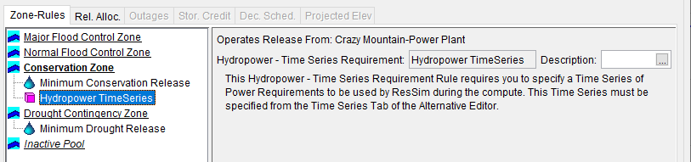
Hydropower-Time Series

Slide 21
Release Allocation - What?
What is Release Allocation?
    Which outlets should release first, next, and so on
    Balanced approach
      Evenly weighted (e.g., 50:50 split (default))
      Unevenly weighted (e.g. 60:40 split)
    Sequential approach
Hydropower reservoirs often direct any release to the power plant first
Other outlets release water when the power plant reaches capacity
Release Allocation is an “operations” option
  Define the priority (or order) to the available outlets

Slide 22
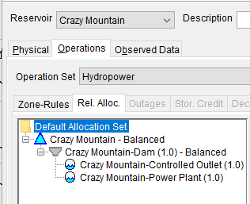
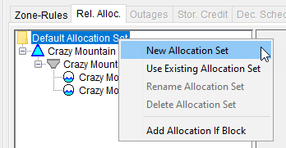
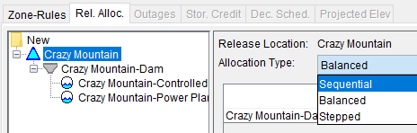
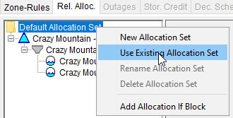
Release Allocation – How?
Default Allocation Set
New Allocation Set
  Specify Allocation Type
    Sequential
    Balanced
    Stepped
      Use Existing Allocation Set

Slide 23
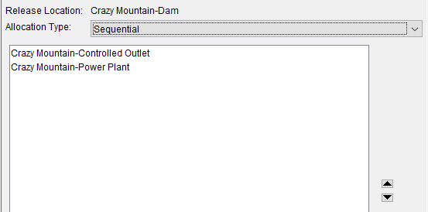
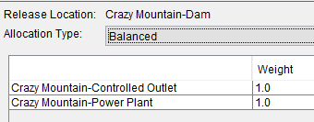
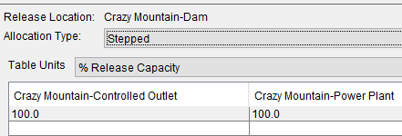
Release Allocation
Sequential
  Specify the component order
Balanced
  Specify the component weighting
Stepped
  Specify the release capacity balance

Slide 24
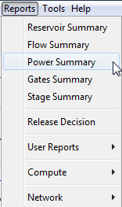
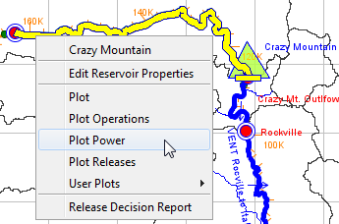
Power Output Options
Reports
  Power Summary
Plots Options
  Plot Power
  User Plots

Slide 25
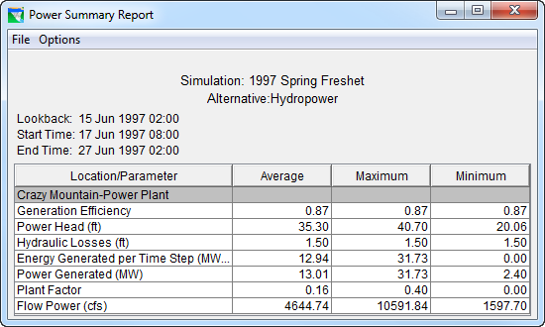
Power Summary Report

Slide 26
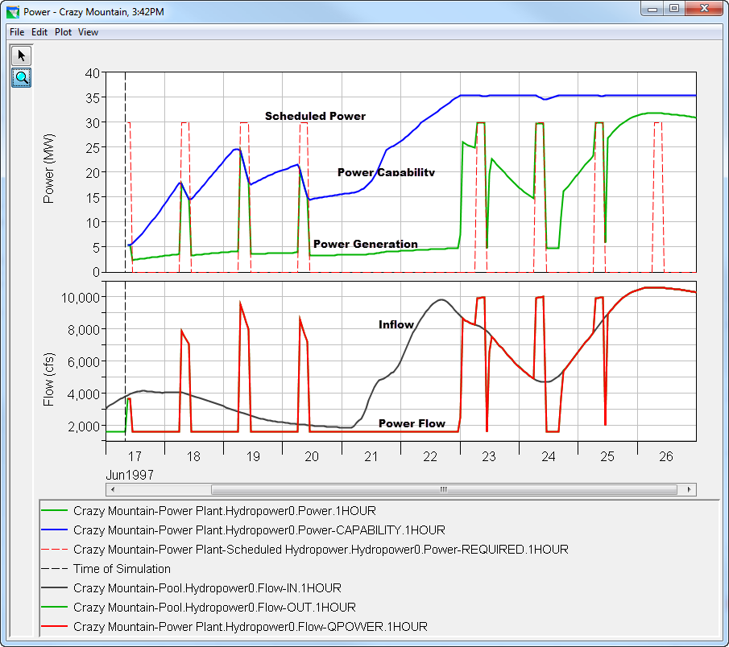
Power Plot

Slide 27
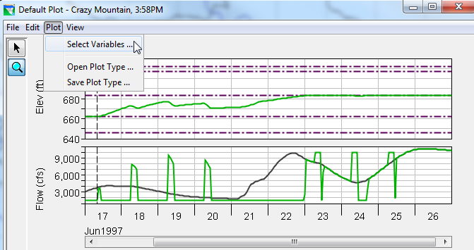
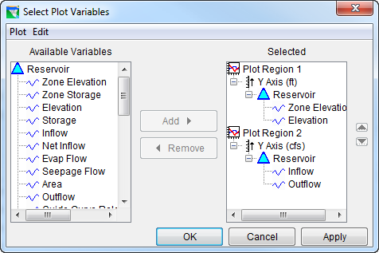
User Designed Plot Example
Bring up the default plot
Open the “Select Plot Variables” dialoge

Slide 28
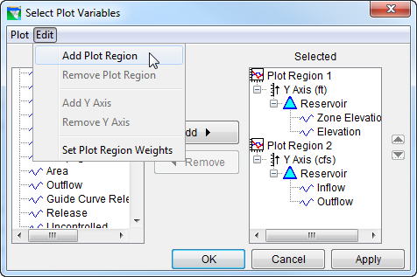
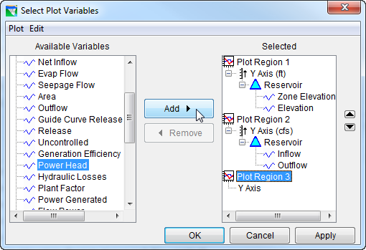
User Designed Plot Example

Slide 29
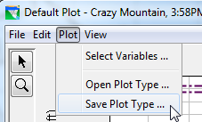
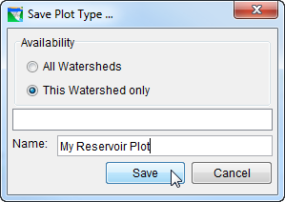
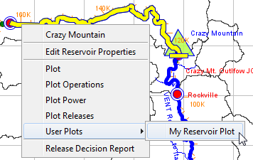
Save Custom Plots for reuse

Slide 30
Summary
In the Reservoir Editor, Physical Tab…
  Add Power Plant
  Define Power Plant Parameters
  Add Tailwater
In the Reservoir Editor, Operations Tab…
  Add Hydropower Rule to an Operating Zone
  Specify Hydropower Requirements
  Specify Release Allocation Type
Analyze results with plots and reports

