Slide 1
Introducing
HEC-ResSim
Notes:
HEC-ResSim
Module 1 of the Reservoir Evaluation System
1. ResSim: Reservoir Operations Simulation
2. ResFloodOpt: Reservoir Flood Operations Optimization
3. ResPRM: Prescriptive Reservoir Optimization Model

Slide 2
Outline
Program Overview
  What is HEC-ResSim?
  Basic Concepts & Terms
  Program Structure
  Model Development Process

Slide 3
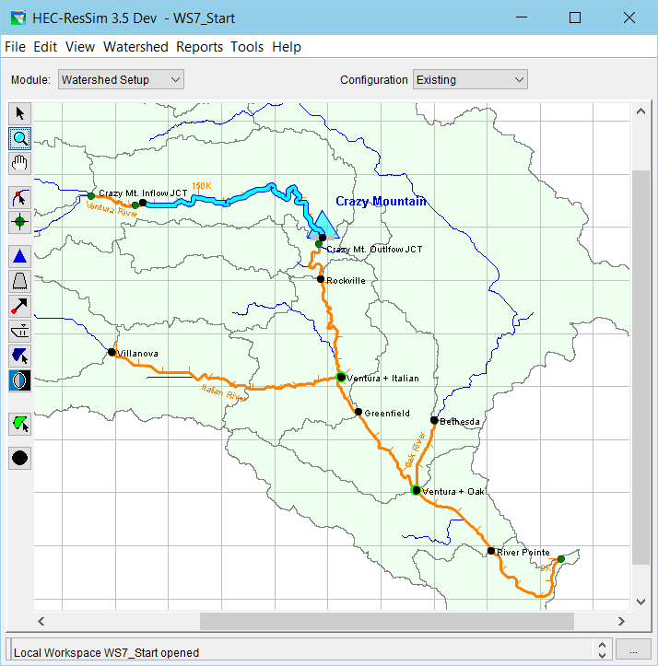
What is HEC-ResSim?
USACE Reservoir simulation tool
Allows rule-based simulation of reservoir operations
Under active development
Example HEC-ResSim model showing reservoir and stream alignment
Notes:
Introduce the HEC-ResSim software

Slide 4
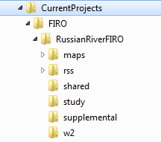
An HEC-ResSim Project…
A ResSim model is called a watershed because it represents all or part of a watershed.
It includes all the data that defines the Reservoir System being studied.
It is stored in a directory tree, not in a single file or folder.
Study = Project = Model = ResSim Watershed
Notes:
[working directory] defined under Tools/Options
/[watershed name] all data stored for the watershed starts here
/maps background for drawing region
/rss ResSim data
/shared extract list
/study Configuration data

Slide 5
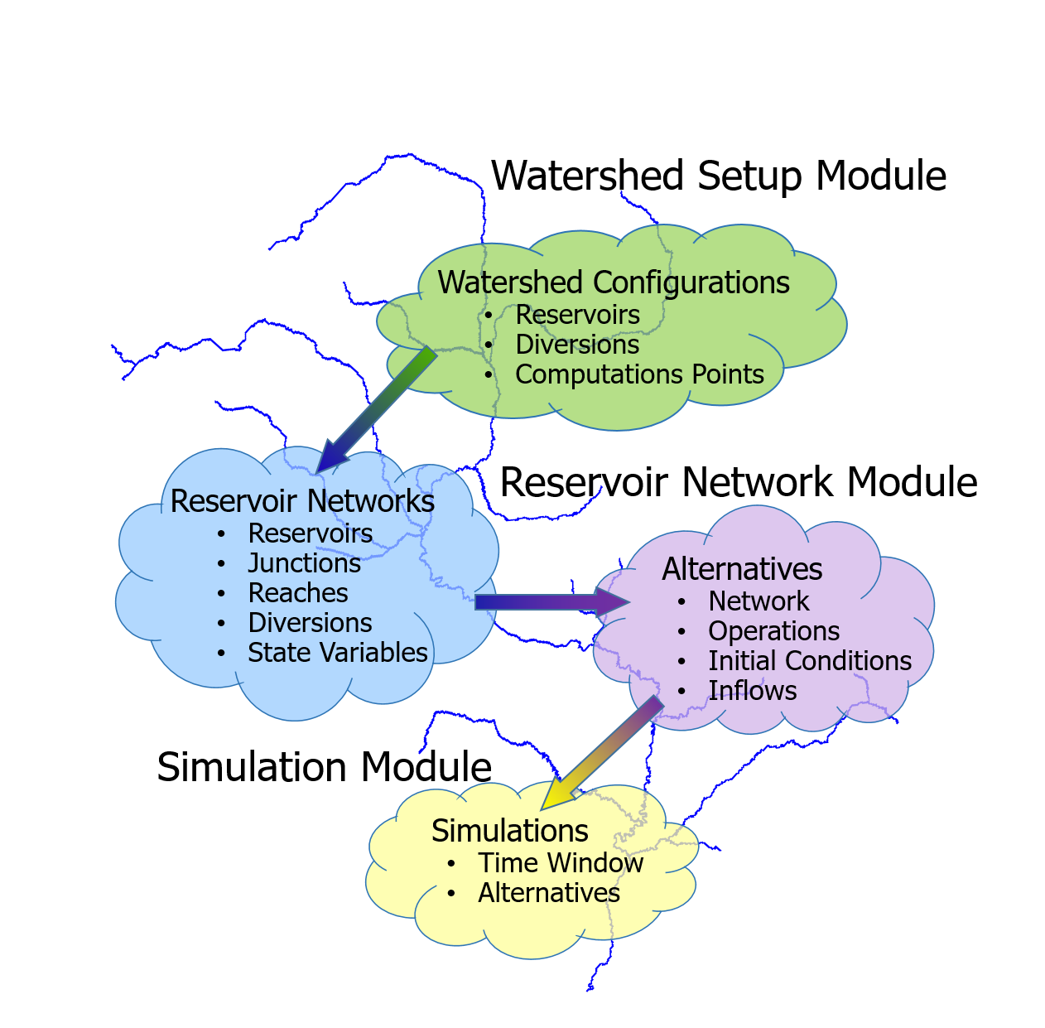
How HEC-ResSim and its models are organized…
A ResSim model is called a watershed.
A watershed contains…
  Configurations
  Networks
  Alternatives
  Simulations
Notes:
TODO: update this graphic to make it clearer.
The number of different items in a given model (number of networks, alternatives, etc.) will depend on the complexity of the modeled system and the different uses for that model. It is possible to perform a yield analysis using existing items or to create dedicated networks, alternatives, and simulations.

Slide 6
Modules
ResSim’s Three Parts
Watershed Setup
  “the big picture”
Reservoir Network
  “the details”
Simulation
  “the analysis”

Slide 7
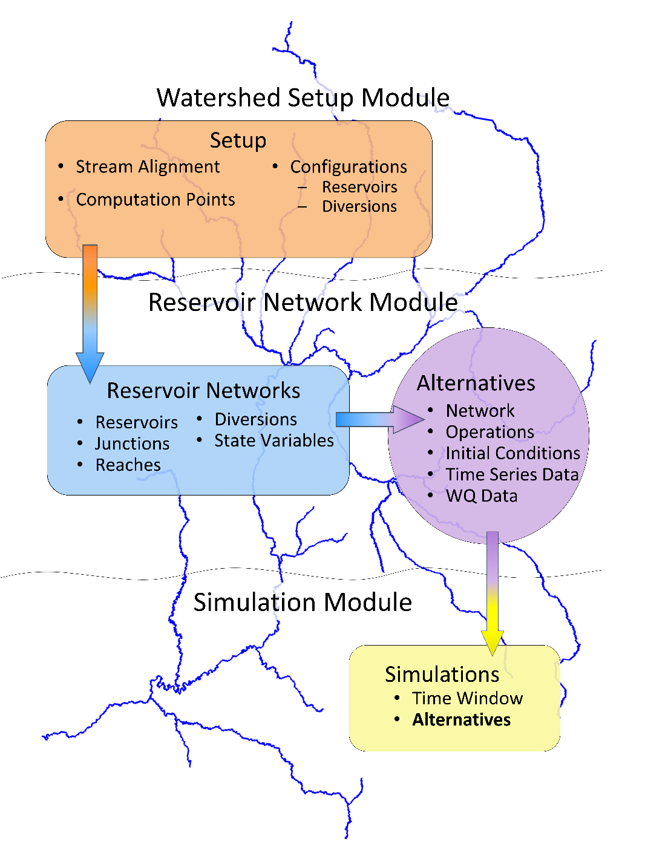
Modules
A ResSim model is called a watershed.
A watershed contains
  Stream Alignment
  Computation Points
  Configurations
  Networks
  Alternatives
  Simulations

Slide 8
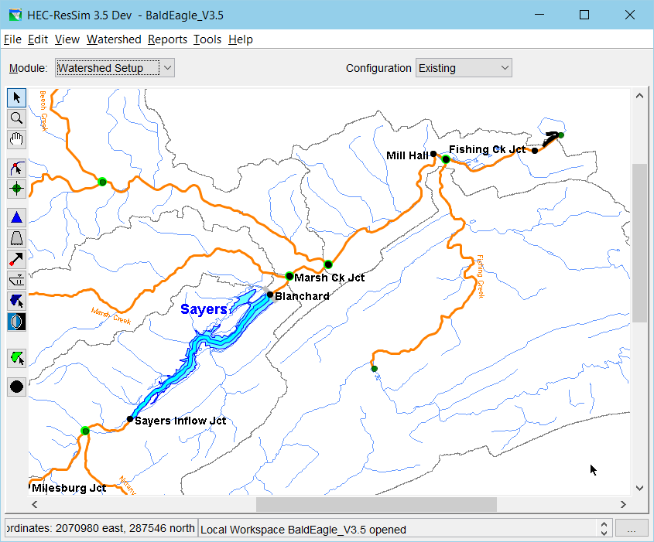
Watershed Setup Module
Activities…
Create watershed
Draw stream alignment
Place elements
  Reservoirs
  Diversions
  Computation Points
  Impact Areas
  Etc.
Define configurations

Slide 9
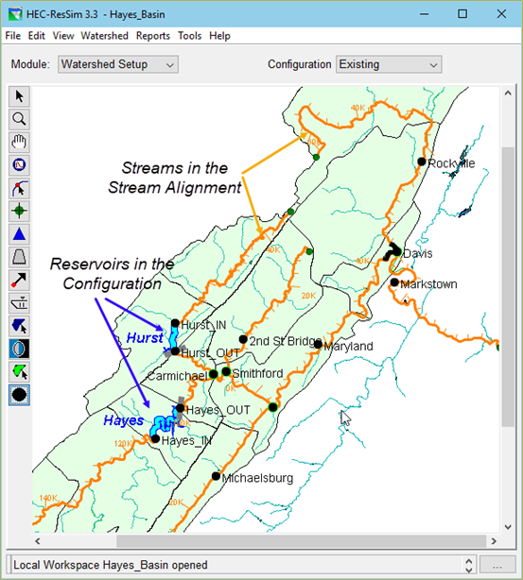
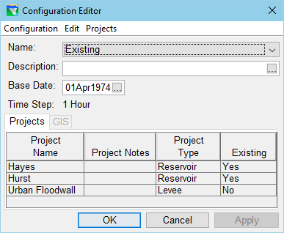
Configurations
Configurations identify the set of projects in the basin to be modeled.
A watershed can have multiple configurations
Networks are built using a configuration as a template.
Notes:
Different configurations can be used to model different scenarios. You can model a future with or without a future project by using configurations that include or exclude that project.

Slide 10
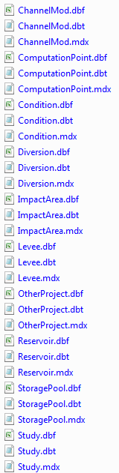
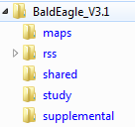

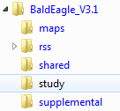
Watershed “setup” files…
Watershed Folders & Files
  maps Folder
    Shapefiles, dlgs, dems,…
  study Folder
Notes:
“Configuration” – an arrangement of physical elements, common computation points, and other physical properties that will be modeled by the set of programs to be used for the study of this watershed. If more than one arrangement of elements will be considered in this study, then more than one configuration will be needed. Configurations should be developed by the whole modeling team before the models for an individual program are produced. While you add elements to your configurations, a special configuration, called Study, is developed by the program to contain all elements from all configurations in the watershed.
“Network” – a reservoir data set that models the relevant elements from a “configuration”. This data set includes the connectivity, the physical properties, and the operational schema for each element in the network.
“Alternative” – a specific selection of configuration, network, operation scheme (per reservoir), inflows, and initial conditions that will be simulated.
“Simulation” – more specifically “Simulation Period”. The Time Window during which ResSim will operate the reservoirs in the network based on a selected operation scheme and the inflow regime. Also associated is the selection of alternatives to be computed for the defined time window.

Slide 11
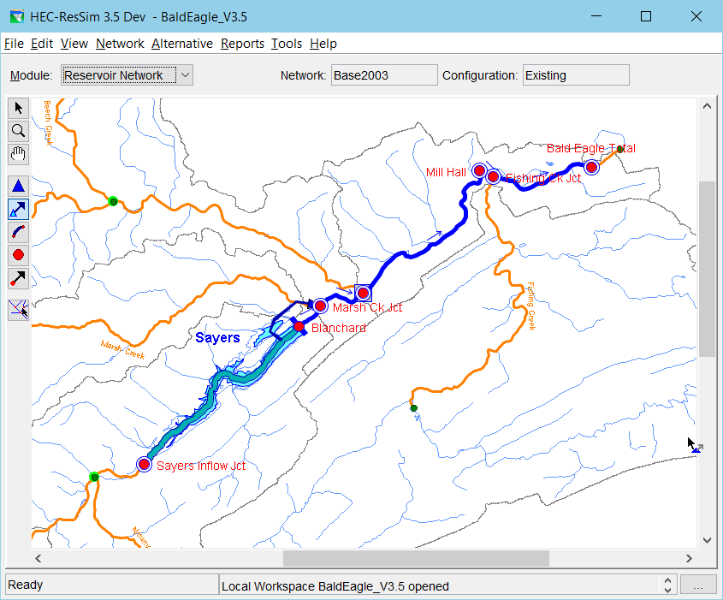
Reservoir Network Module
Activities…
Establish Connectivity
  Reservoirs
  Diverted Outlets
  Reaches
  Junctions
  Diversions
Define the elements
  Physical Properties
  Operation Schemes
Create Alternatives

Slide 12
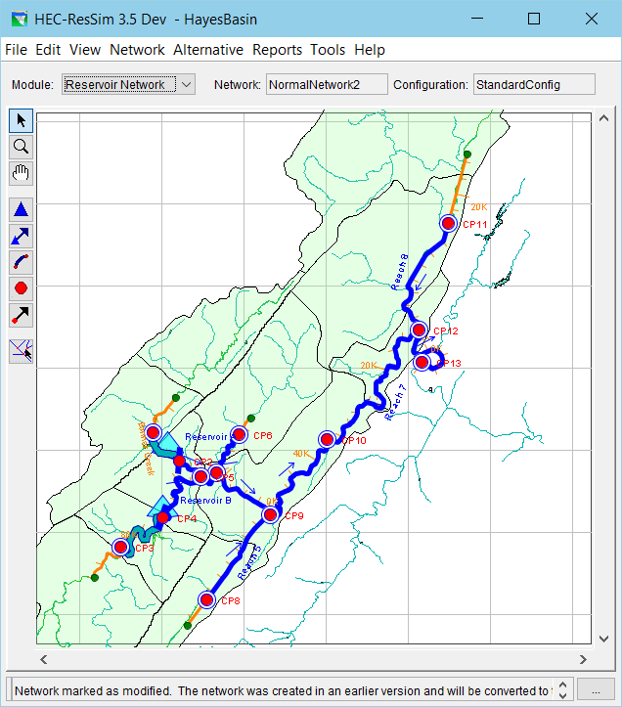
Network
Reservoir Networks are the heart of the model.
They define the reservoirs, reaches, diversions, and inflow locations.
Notes:
The network is where the physical properties of the system are defined. Features relevant to yield analysis that can be set here include the location of a diversion and the routing parameters in reaches below a reservoir.

Slide 13
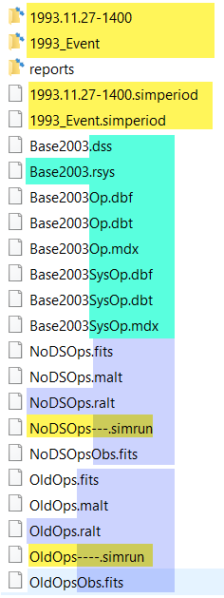
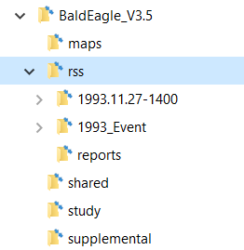
Network files…
rss Folder
  Network Files
    .rsys
    .dbf, .dbt, .mdx
    .dss
  Alternative Files
    .ralt, .fits, .malt
  Simulation Folders
    .simperiod
    .simrun

Slide 14
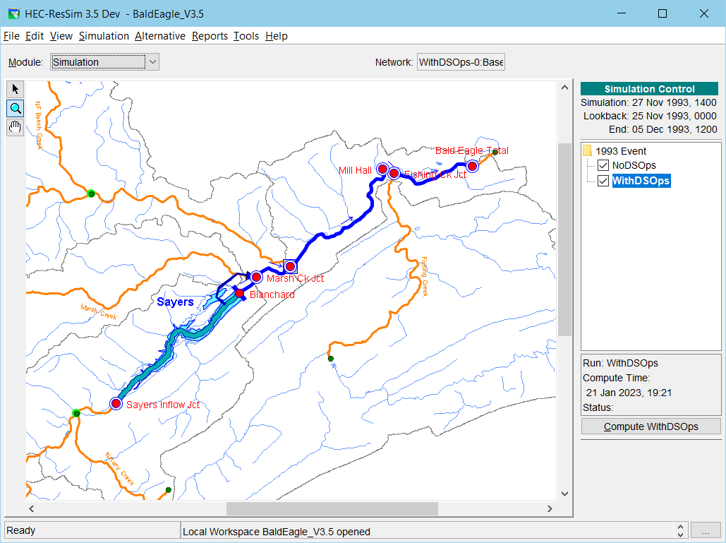
Simulation Module
Activities…
Create a Simulation
  Identify Time Window
  Select Alternatives
Compute
Analyze Results
  Review Plots & Reports
  Create Custom Output
Make Adjustments
  Edit the model
  Perform Overrides

Slide 15
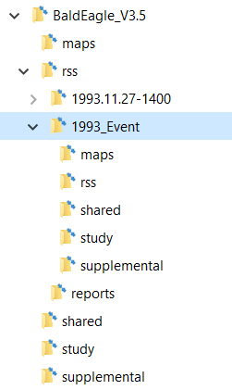
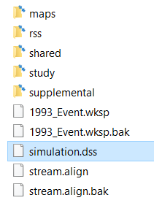
Simulation files…
the Simulation folder…
  Looks like a copy of the watershed tree
  Files of selected alternatives (in rss subfolder)
  simulation.dss

Slide 16
Points to Remember
An HEC-ResSim Project is called a watershed
A watershed is stored in a directory tree, not a single folder
  Collect all files associated with the watershed within the directory tree, especially HEC-DSS files.
HEC-ResSim is made up of three modules –
  Watershed Setup
  Reservoir Network
  Simulation
Some menus change by module

