Slide 1
Reservoir Networks …Continued
Defining the Operation Scheme
- The Guide Curve -
Notes:
Basic Guide Curve Operations
1.5-L-04
Klipsch 1.5-L-04
1

Slide 2
Outline
Definition of Terms
  Reservoir Operations
  Zones (or Pools)
  Guide Curve
  Guide Curve Operations
  Rules
  Operation Sets
Quick Look at Guide Curve Operation
How to’s in ResSim

Slide 3
What is…Reservoir Operation?
The act of storing or releasing water from a Reservoir.
The “to-release or not-to-release” and “how-much” decision-making process
The set of goals and constraints that define the release decision-making process
Notes:
Basic Guide Curve Operations
1.5-L-04
Klipsch 1.5-L-04
3

Slide 4
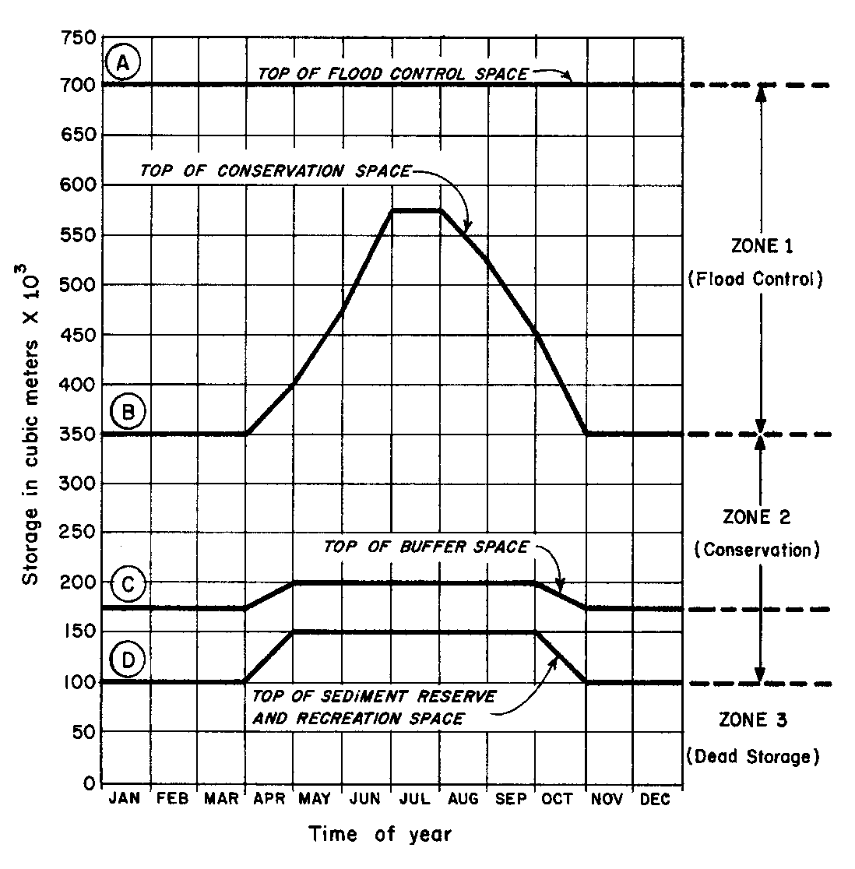
What are…Zones (or Pools)?
The allocation of storage within a reservoir for one or more purposes
Zones are defined by their “top of pool” elevation, which may vary seasonally
Zones should not cross one another

Slide 5
What is…a Guide Curve?
The target or desired reservoir pool elevation or storage
AKA: “normal pool”, “top of conservation”, …
The dividing line between the part of the reservoir pool that is designated as “flood control” from the part that is designated as “conservation”
The foundation of the HEC-ResSim release decision logic

Slide 6
What is…Guide Curve Operation?
In general, “Guide Curve Operation” is the process of determining releases from a reservoir in order to get to and maintain the reservoir pool at its target elevation.
To ResSim, Guide Curve Operation means: “Get to guide curve as fast as possible and stay there.”
Guide Curve Operation is constrained by:
  Physical Outlet Capacity
  Elevation, Release, and Capacity Overrides
  Reservoir Operating Rules
  Zone Boundary Logic
Notes:
Basic Guide Curve Operations
1.5-L-04
Klipsch 1.5-L-04
6

Slide 7
What are…Rules?
The objectives of – or constraints on – the operation of a reservoir or system of reservoirs.
Rules are specified in terms of:
  Flow - minimum or maximum
  Elevation/Stage - minimum or maximum
  Energy Generation - needed
  Maximum Flow Rate-of-Change
  Maximum Pool Elevation Rate-of-Change

Slide 8
What is…An Operation Set?
An Operation Set holds all the information that describes the reservoir’s operating goals and constraints.
The key elements of an operation set are:
  Zones
  Guide Curve identification
  Rules
A reservoir can have more than one operation set, but only one can be “active” for a given alternative.

Slide 9
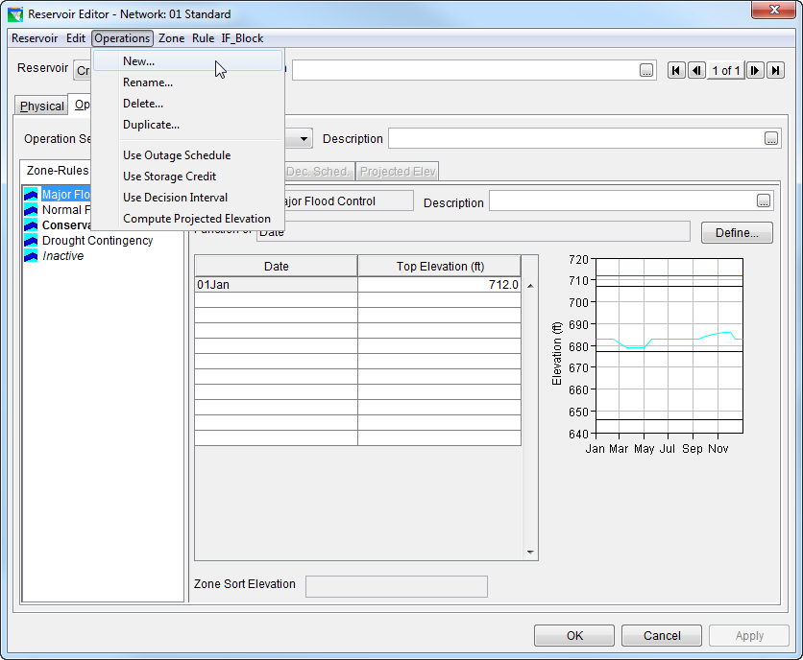
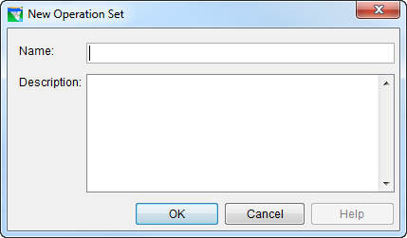
How To…Create an Operation Set
In the Reservoir editor, select the Operations tab
From the Operations menu, select New.
Give it a name and description and click OK.

Slide 10
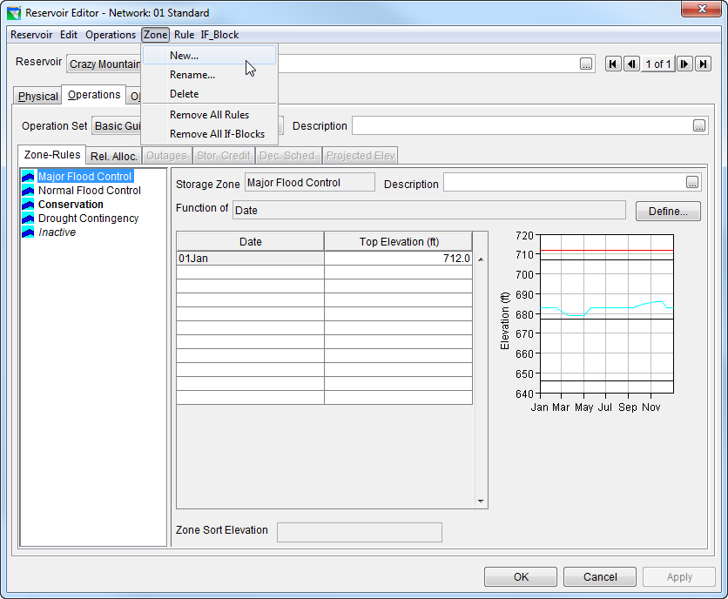
How To…Create Zones
Three default zones are created with each new operation set
Add more zones by selecting New from the Zone menu.
Enter the Top of Zone curve in the table.

Slide 11

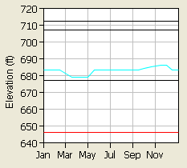
How is the Guide Curve defined in ResSim?
To ResSim, the Guide Curve is the line or curve defining the top of a selected operating zone.
  By default, the guide curve is identified as the top of the default Conservation zone.
  You can re-assign it to a different ‘top of zone’ curve.
  It can vary seasonally.
“Guide Curve”
Notes:
Basic Guide Curve Operations
1.5-L-04
Klipsch 1.5-L-04
11

Slide 12
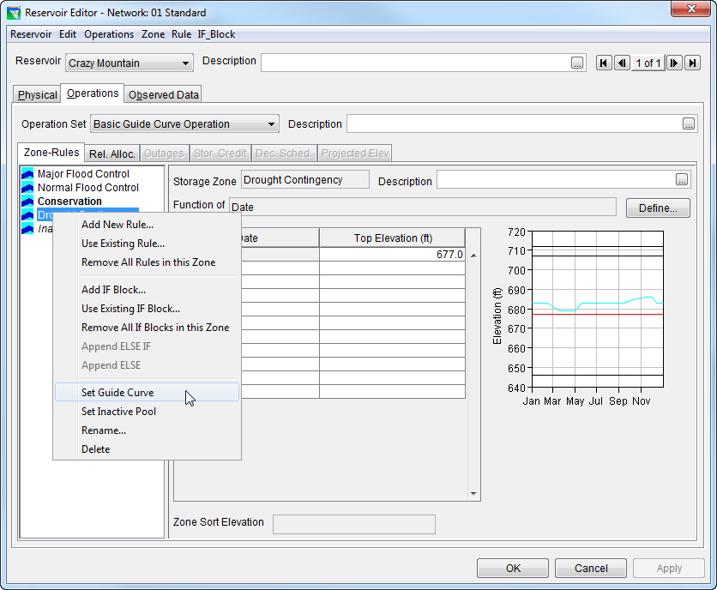
How to…Identify the Guide Curve
Bold Text
To reset, Use “Set Guide Curve” from Context menu
Cyan Curve
Notes:
Basic Guide Curve Operations
1.5-L-04
Klipsch 1.5-L-04
12
From the context (right-click) menu of the current zone in the Zone-Rules Tree, select “Set Guide Curve”.
In the Zone-Rules Tree, the Guide Curve is always bold
In the thumbnail plot (or hotplot), the guide curve is always cyan, unless it’s zone is the currently selected zone. The currently selected zone is red in the plot, and highlighted (not bold) in the tree.

Slide 13
Basic Guide Curve Operation
When the reservoir level is above the Guide Curve, ResSim will increase releases as necessary (or possible) in a given period in an effort to lower the pool elevation to the Guide Curve.
When the reservoir level is below the Guide Curve, ResSim will reduce releases as necessary (or possible) in a given period in an effort to raise the pool elevation to the Guide Curve.
When the reservoir level is at the Guide Curve, ResSim will release “just enough” to maintain the pool elevation at the Guide Curve. This usually equates to “release inflow.”
Notes:
Basic Guide Curve Operations
1.5-L-04
Klipsch 1.5-L-04
13

Slide 14
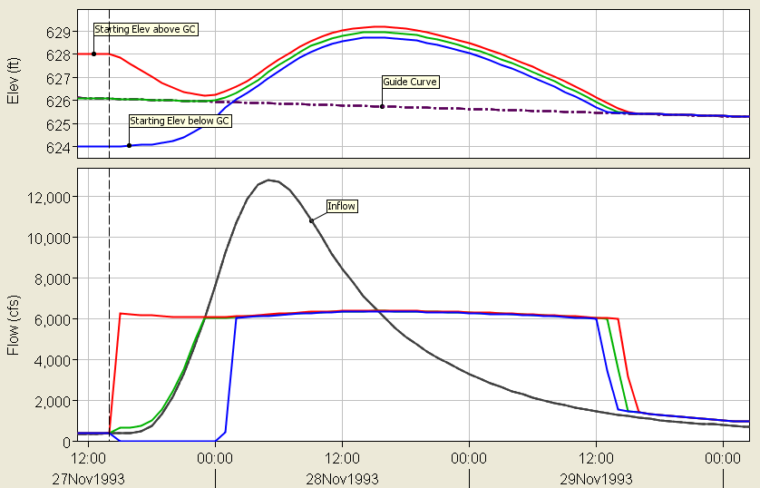
Sample Results –
Guide Curve Operation

Slide 15
Points to Remember
The Reservoir Network is your model. It contains all the details…
  Physical Data – Pool, Outlets
  Operational Data – Operation Sets
    Reservoir Zones
    Guide Curve Designation
    Rules
Guide Curve Operation is “Get to guide curve as fast as possible, and stay there.”
Guide Curve Operation is the basis of the ResSim release decision process!

