Slide 1
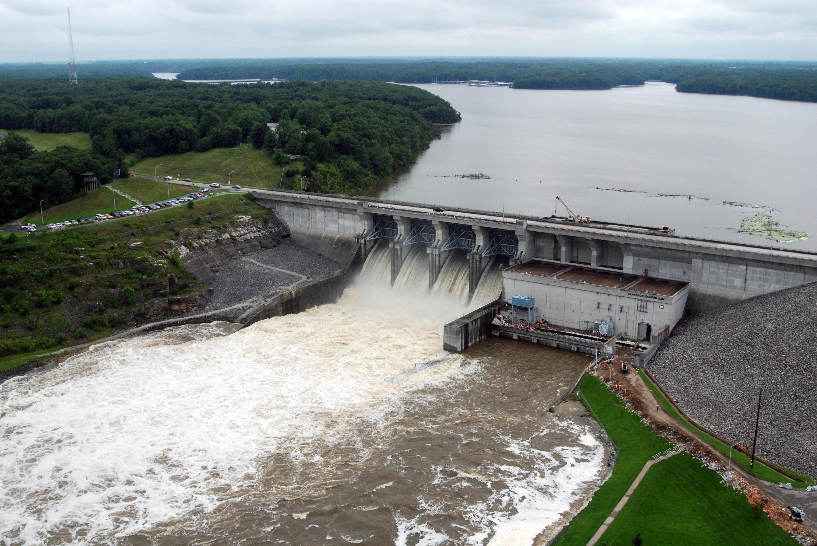
Developing Inflows
and Linking to HMS

Slide 2
Overview
Reservoir Inflows
Methods for Computing Local Inflows
Sources of Local Inflows
Linking to HMS results

Slide 3
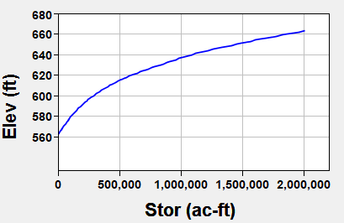
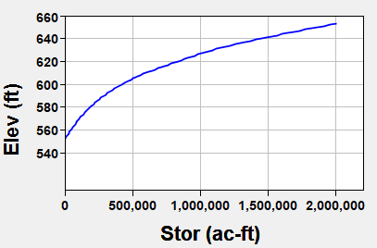
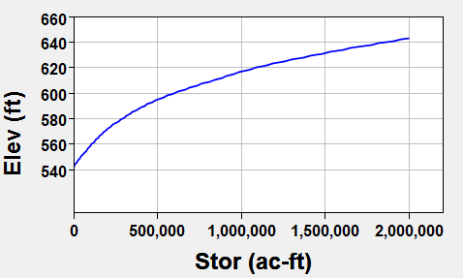

Methods for Computing Reservoir Inflows
Mass Balance Formula
√
√
√
√
√
$$\frac{S_{t+1}−S_{t}}{∆t}=\frac{{I_{t+1}+I}_{t}}{2}−\frac{O_{t+1}+O_{t}}{2}−Losses$$
Elev-Stor Curve (2020)
Known Variables
  Final Storage (S_{t+1})
  Initial Storage (S_{t})
  Final Outflow (O_{t+1})
  Initial Outflow (O_{t})
  Losses
1990
√
√
1970
√
√
√

Slide 4
Methods for Computing Reservoir Inflows
Mass Balance Formula
√
√
√
√
√
$$\frac{S_{t+1}−S_{t}}{∆t}=\frac{{I_{t+1}+I}_{t}}{2}−\frac{O_{t+1}+O_{t}}{2}−Losses$$
Known Variables
  Final Storage (S_{t+1})
  Initial Storage (S_{t})
  Final Outflow (O_{t+1})
  Initial Outflow (O_{t})
  Losses
Losses:
  Reservoir Evaporation
  Seepage
  Gate Leakage
    could be in the outflow already
  Water Supply/Irrigation
√
√
√
√
√

Slide 5
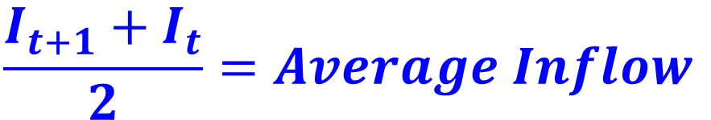
Methods for Computing Reservoir Inflows
Mass Balance Formula
√
√
x
x
√
√
√
$$\frac{S_{t+1}−S_{t}}{∆t}=\frac{{I_{t+1}+I}_{t}}{2}−\frac{O_{t+1}+O_{t}}{2}−Losses$$
Known Variables
  Final Storage (S_{t+1})
  Initial Storage (S_{t})
  Final Outflow (O_{t+1})
  Initial Outflow (O_{t})
  Losses
Unknown Variables
  Final Inflow (I_{t+1})
  Initial Inflow (I_{t})
x
√
√
x
√
√
$$\frac{{I_{t+1}+I}_{t}}{2}=Average Inflow$$
√

Slide 6
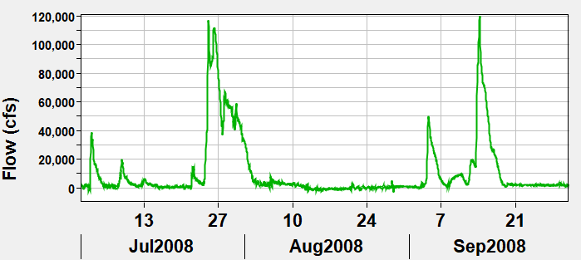
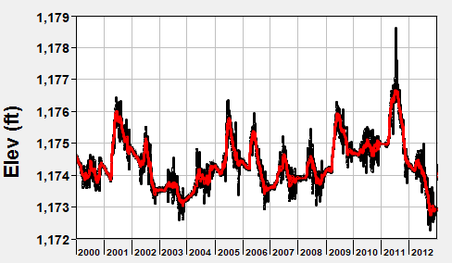

Methods for Computing Reservoir Inflows
Mass Balance Formula
Utilize smoothing techniques to reduce or eliminate negative values while maintaining volume
$$I_{Avg}=\frac{S_{t+1}−S_{t}}{∆t}+\frac{O_{t+1}+O_{t}}{2}+Losses$$

Slide 7
Methods for Computing Local Inflows
Derive the locals from Observed flows
  By hand
  Use a spreadsheet or script
  Use a program like HMS or ResSim
Use a calibrated hydrology (HMS) model to estimate the local inflows

Slide 8
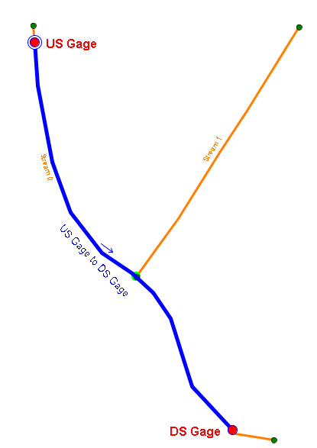
Deriving Locals from Observed
Local Flow = Total flow - Routed flow
Gather observed (total) flows at gages.
  US Gage, DS Gage
Route observed from gage to gage
  US Gage to DS Gage
Subtract.
  DS Gage FLOW-LOCAL =
  DS Gage FLOW – US Gage to DS Gage FLOW
Adjust for “losses” – evaporation, seepage, withdrawals
Utilize smoothing techniques to reduce or eliminate negative values while maintaining volume
Notes:
Note the equation – no matter what tool you use, they all ultimately utilize this basic equation/method.
By Hand
be sure to account for ungaged withdrawals and stream losses
review results then apply one or more smoothing techniques to reduce or eliminate negative values in your inflow time-series.
Use HMS
a) compute locals with a standard basin runoff model
b) compute locals with a routing only model
Use the OSI
Uses the same concepts as the “hand calcs” and HMS, but implemented in ResSim
Complex to setup and use – but the bigger the watershed, the more benefit you gain over hand-calcs.

Slide 9
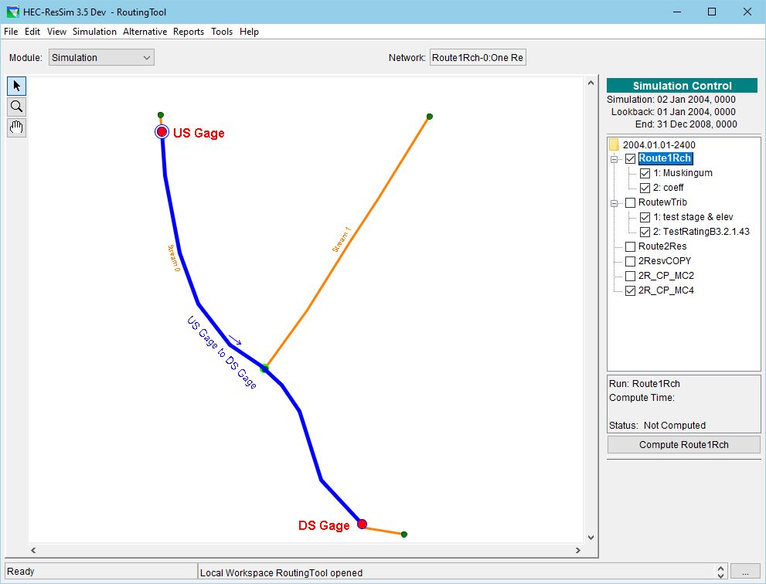
To perform the routing…
Use paper and pencil
Use DSSVue math functions
Script it
Write an Excel Macro
Use HMS
Use ResSim…
Notes:
I use a “routing only” watershed to route flows from one location to another. It may seem clunky but I can swap out the upstream flow time series easily, modify the routing parameters, and compute – over and over and over again.
And I have different networks and alternatives to model special configurations.
I can even use an OSI for these alternatives to “calculate the locals” one local at a time so I don’t have to do it by hand or in a spread sheet.
Of course, I could do this same thing on a larger scale to minimize the repetitive work, but at a small scale, it is easy to locate and correct errors.
And, of course, if I were handier with HMS, I could do the same thing there, instead.

Slide 10
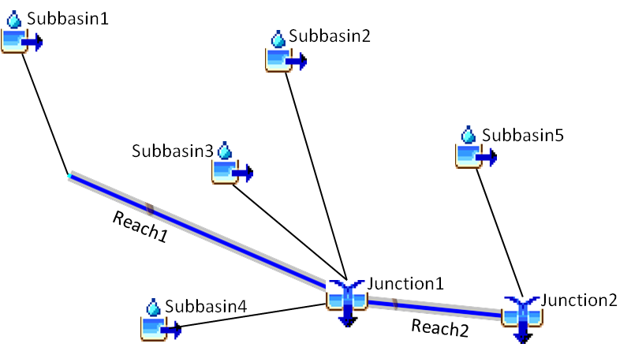
Using HEC-HMS – to estimate local inflow
Rainfall/Snowmelt Runoff Model
Turn ON the Local Flow option in the Basin Model.
  HMS will:
  perform subbasin runoff computations
  route and combine those flows through the basin
  compute local flow at all junctions in the model
  Local Flow = Total Flow – Flow routed in
  = sum of the subbasin flows
Notes:
The flow from a subbasin is an incremental local flow!
There may be multiple subbasins that gather at a given location on a stream.
Let HMS gather the inflows to produce a single composite local flow at a junction.

Slide 11
Using HEC-HMS - to derive local inflow
Runoff Model or Routing Model
Attach an observed flow to each junction representing a gage
Turn ON the Local Flow option in the Basin Model.
Specify Blending at each gage
  HMS will…
  replace simulated flows with Observed Flows at each gage
  route flows through the model
  compute local flow at all junctions in the model
  Local Flow = Total (Observed) Flow – Flow routed in

Slide 12
Using ResSim’s OSI - to derive local inflows
In the network –
  Identify a local inflow at each headwater junction.
  Identify a local inflow at each junction representing a gage.
  “Turn On” observed total flow at each junction receiving inflow
  “Turn On” observed total flow at each reservoir outflow junction
In the alternative –
  Create a unique “dummy” time-series record for each interior inflow junction
  Map each “dummy” time-series to its associated local inflow
  Map an observed time series to each headwater local inflow
  Map an observed time series to the observed total flow of…
    each interior junction (gage location)
    at each reservoir outflow junction
Notes:
Local inflows are identified on the Local Flow tab of the Junction Editor. Each identified inflow will show up on the Time Series tab of the Alternative Editor
Observed “total” flows can be “turned on” on the Observed Data tab of the Junction Editor – it’ll be the first Flow “variable” in the list. Each checked variable will appear on the Observed Data tab of the Alternative Editor.
All Entries on the Time Series tab of the Alternative Editor MUST be mapped to a DSS time series
All Entries on the Observed Data tab of the Alternative Editor are optional, however the key entries needed for computing local inflows MUST be mapped to an observed DSS time series.

Slide 13
Use ResSim’s OSI, continued.
In the OSI -
  Define a “local inflow” OSI Variable at each (interior) gage location
  Compute Locals – click on the OSI Action button Compute Locals
  ResSim will:
    Replace (in memory) the computed total flow at each junction with the observed flow (where it has it),
    Route those flows through the network to each “local inflow” OSI Variable location
    Subtract the routed flow from the observed total flow to get the computed local
    Overwrite the “dummy” time series mapped to the local inflow with the computed local inflow time series (in the simulation.dss file).
    Perform a standard compute, using the newly computed locals
Notes:
The OSI is the Operations Support Interface in ResSim. It is a “fully configurable” interface designed for developing real-time release schedules (overrides) for the reservoirs in your watershed. But it was also designed to enable a real-time OR study modeler to compute local inflows based on observed total flows at key (gage) locations in the model.
An OSI Variable is the specification of a ResSim input or computed “model” variable to be plotted, tabulated, and possibly edited in the OSI.
A “local inflow” OSI variable is special type of OSI variable, only available at junctions, that identifies a specific local inflow that can be computed by ResSim through the OSI “Compute Locals” option.
- note, when using this method, only ONE local inflow should be identified per junction.
After computing the local inflows, ResSim will use the compute locals for each standard compute performed for the current alternative in the current simulation (or forecast)
If you want to use those locals for other alternative and/or other simulations, you must copy the inflow time series from the simulation.dss (or forecast.dss) file into a separate DSS file in the base watershed and map your alternative(s) to that file and its data.

Slide 14
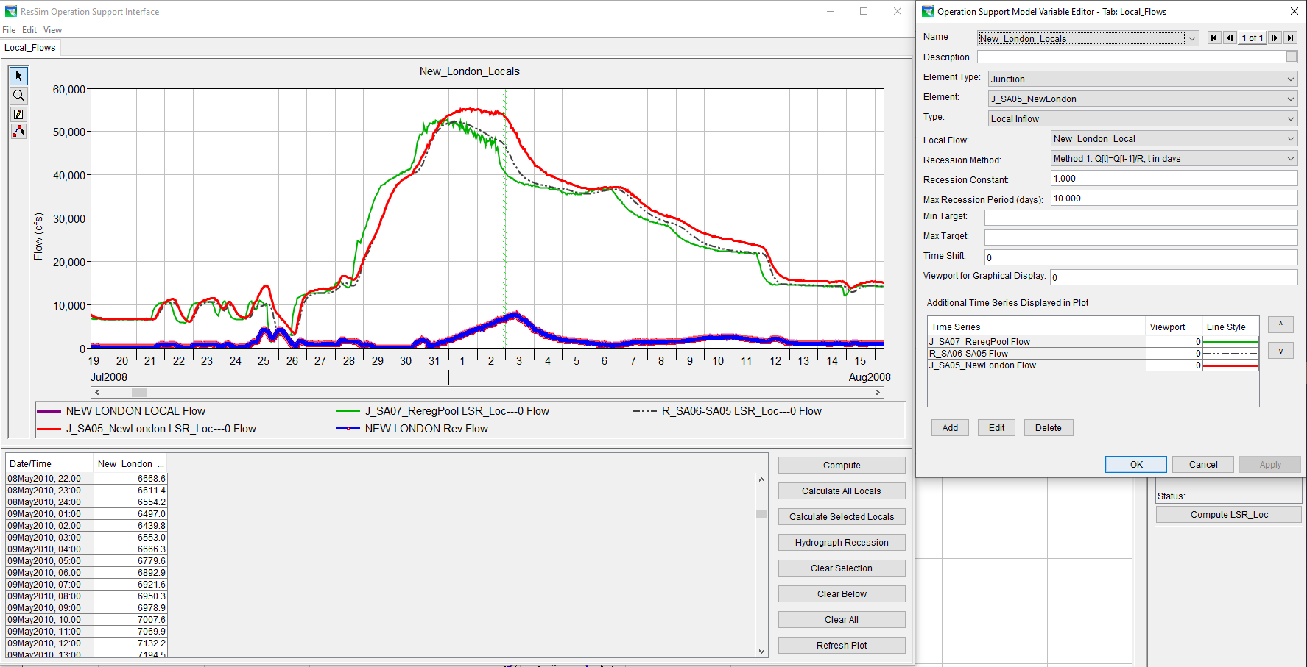
Use ResSim’s OSI, continued.
Notes:
The OSI is the Operations Support Interface in ResSim. It is a “fully configurable” interface designed for developing real-time release schedules (overrides) for the reservoirs in your watershed. But it was also designed to enable a real-time OR study modeler to compute local inflows based on observed total flows at key (gage) locations in the model.
An OSI Variable is the specification of a ResSim input or computed “model” variable to be plotted, tabulated, and possibly edited in the OSI.
A “local inflow” OSI variable is special type of OSI variable, only available at junctions, that identifies a specific local inflow that can be computed by ResSim through the OSI “Compute Locals” option.
- note, when using this method, only ONE local inflow should be identified per junction.
After computing the local inflows, ResSim will use the compute locals for each standard compute performed for the current alternative in the current simulation (or forecast)
If you want to use those locals for other alternative and/or other simulations, you must copy the inflow time series from the simulation.dss (or forecast.dss) file into a separate DSS file in the base watershed and map your alternative(s) to that file and its data.

Slide 15
(Other) Sources of Local Inflows
Existing Study Models
  Rainfall & Snowmelt Runoff Models – e.g., HEC-HMS
Partner Agencies – e.g., NOAA-NWS
Derived from Observed Data- CWMS and/or Study Databases
  Automated Computations
  Specific Study Effort
Notes:
Consider the purpose of your model – is it a study model or a realtime model?
Are other types of models involved in your study or modeling effort – I.e., is a rainfall runoff (HMS) model being built for this study?
If this is a study model, have there been other studies on the same watershed? Could those studies have developed local inflow data the you could use?
Or do you need to perform that effort as part of this study? If so, do you have a complete set of observed data?
If this is a real-time model, are there any automated processes that compute locals from observed? Is an HMS model included in your CWMS watershed?
Or, is there a data stream setup to bring in local inflows from the local RFC’s forecast models?

Slide 16
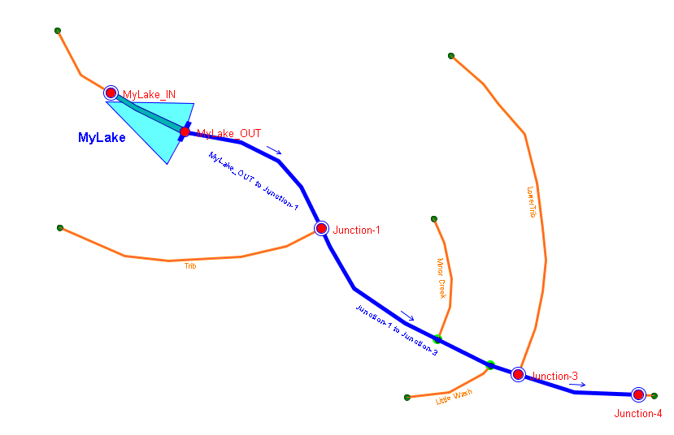
Linking HMS to ResSim (A simple Example)
A Simple ResSim Model:
Notes:
Here’s an Example Watershed in ResSim
MyLake_IN Specify one local – MyLake Inflow or some such. Use the total flow from HMS’s MyLake_IN junction
Junction 1 Specify 2 locals
Junction 1 Local – map it to HMS’s Junction-1 FLOW-LOCAL
Tributary Flow - map it to HMS’s Trib-Mouth FLOW
Junction 3 Specify 2 locals
Junction 3 Local – map it to HMS’s Junction-3 FLOW-LOCAL
Lower Trib Flow – map it to HMS’s Rch 2 to 3 FLOW
Junction 4 Specify 1 local – Junction 4 Local and map it to HMS’s Junction-4 FLOW-LOCAL

Slide 17
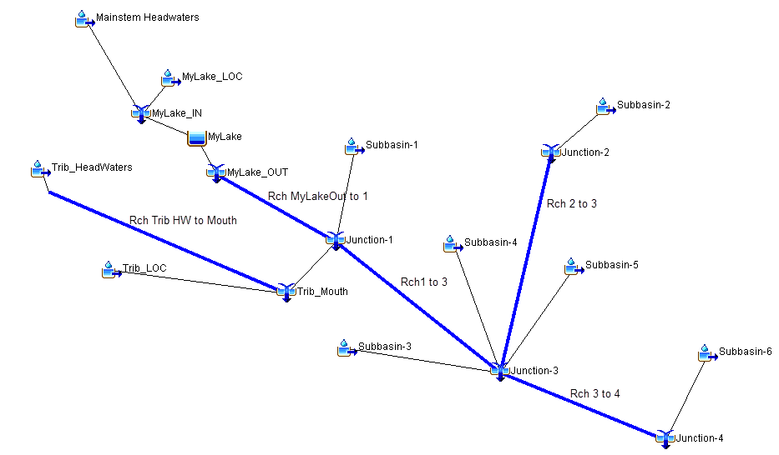
An HMS Model for the same simple watershed
Notes:
And, Here’s the SAME Example Watershed in HMS
HMS is usually going to model more of the watershed and ResSim
HMS models cover the whole watershed – because that’s where the water lands and runs-off from
ResSim models usually cover a subset of the watershed, usually from the reservoirs, down – because that is what is impacted by the reservoir operation
This is an important difference and should be kept in mind when identifying the HMS flows to use in ResSim.
MyLake_IN FLOW = MyLake_IN FLOW-LOCAL You can use either FLOW or FLOW-LOCAL for ResSim’s MyLake Inflow
MyLake_IN FLOW-LOCAL = Mainstem Headwaters FLOW+ MyLake_LOC FLOW
Junction-1 FLOW-LOCAL = Junction-1 FLOW minus flow routed in Use Junction-1 FLOW-LOCAL. But, it won’t capture all the inflows needed here.
= Subbasin-1
Junction-1 flow routed in = Rch MyLakeOut to 1 FLOW plus Trib_Mouth FLOW
The significance here is that the Trib_Mouth flow is considered “routed” to Junction-1 and therefore is not included in the FLOW-LOCAL for Junction-1.
Trib-Mouth FLOW is also needed as a ResSim local inflow.
Junction-2 FLOW = Junction-2 FLOW-LOCAL
Junction-2 FLOW-LOCAL = Subbasin-2 Use Junction-2 FLOW-LOCAL instead of the subbasin flow
Junction-3 FLOW-LOCAL = Junction-3 FLOW minus flow routed in Use Junction-3 FLOW-LOCAL – it captures the sum of the subbasin flows
= Subbasin-3 FLOW + Subbasin-4 FLOW + Subbasin-5 FLOW
Junction-4 FLOW-LOCAL = Subbasin-6 FLOW Use Junction-4 FLOW-LOCAL instead of the subbasin flow
Other elements, not shown – sources and sinks may look like junctions but HMS doesn’t treat them as such, therefore, FLOW-LOCAL is not computed for these elements.

Slide 18
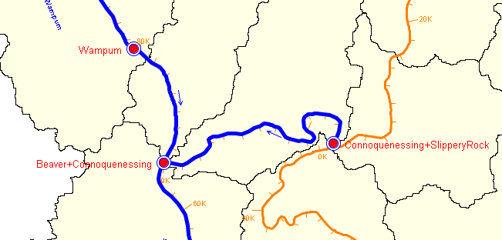
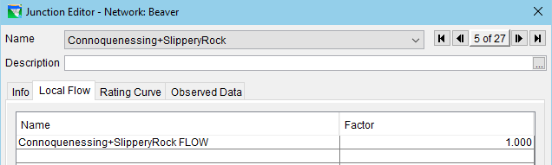
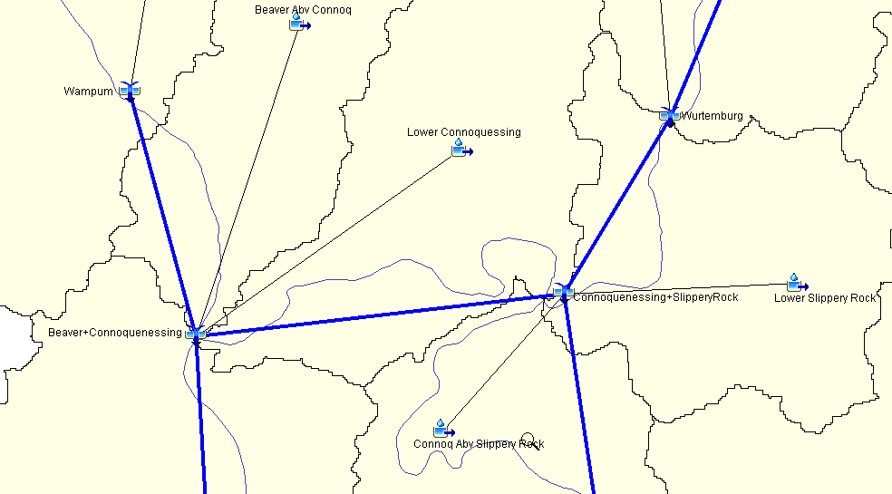
Linking HMS to ResSim
At ResSim headwater junctions,
  Identify a local inflow to represent the total inflow entering at this junction
  Give it a name similar to the HMS element name producing the time series and an indicator of what “kind” of flow is needed – in this case, FLOW or TOTAL FLOW
  In the alternative, map to the associated HMS element’s total flow (c-part = FLOW) to this headwater inflow
Notes:
Headwater junctions – what if there isn’t a matching junction in HMS?
find the subbasin(s) that flow(s) into the headwater reach
convince the HMS modeler to add headwater junctions to his model
what if the HMS model is modeling the subbasins on a grosser scale than ResSim?
consider using basin weighting factors to distribute the subbasin flow to the relevant ResSim headwater junctions.
Interior junctions – what if the there is no matching junction in HMS?
not all ressim junctions must have local inflows
however, if the junction is a control point, consider using basin weighting factors to distribute the next downstream local…

Slide 19
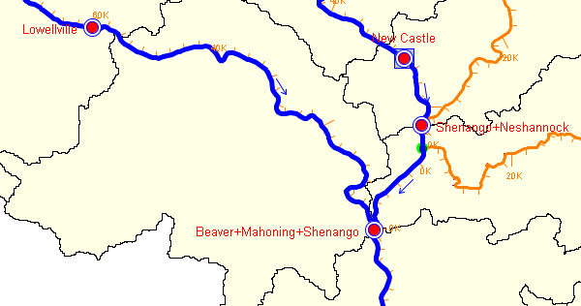
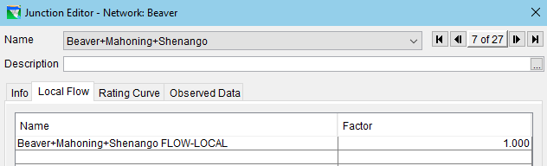
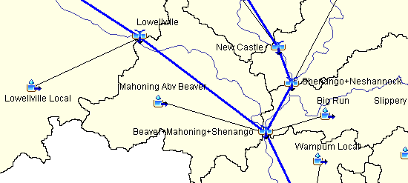
Linking HMS to ResSim
At ResSim interior junctions
  Identify a local inflow to represent the incremental local flow entering at this junction
  Give it a name similar to the HMS element name producing the time series and an indicator of what “kind” of flow is needed – in this case, LOCAL or FLOW-LOCAL
  In the alternative, map the associated HMS element’s local flow (c-part = FLOW-LOCAL) to this local inflow

Slide 20
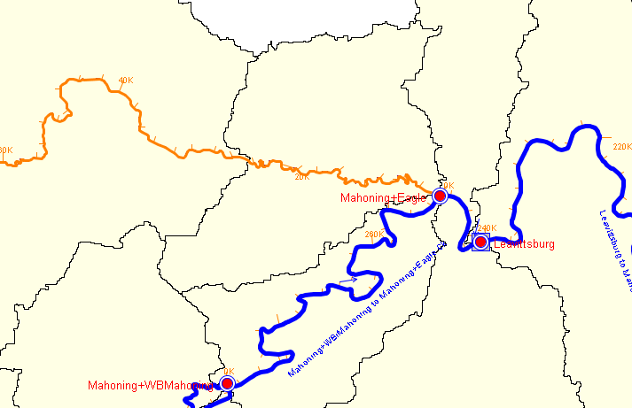
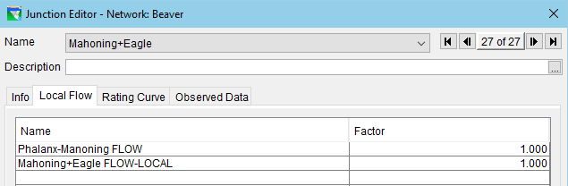
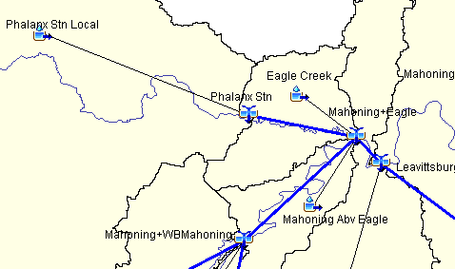
Linking HMS to ResSim
At ResSim interior junctions where HMS has a connected tributary but ResSim does not…
  Identify another local inflow at this junction to represent the tributary inflow
  Give it a name similar to the HMS element name producing the time series and an indicator of what “kind” of flow is needed – in this case, it will usually be FLOW. NOTE: this element is most often a reach, but it could be almost any HMS element type whose computed outflow represents the total tributary flow
  In the alternative, map the associated HMS element’s FLOW to this local inflow

Slide 21
Linking HMS to ResSim
At ResSim Reservoir Inflow junctions
  In general, follow instructions on previous slide
  However, the modeling of reservoir inflows in the two models can vary significantly. Conditions that may make it difficult to identify the appropriate inflow(s) for the ResSim reservoir:
    In HMS, all inflowing elements link directly to a reservoir element
    In HMS, all inflowing elements link to a “sink” element
    In HMS, all inflowing elements link to a single “reservoir inflow” junction, BUT in ResSim, the associated reservoir has two or more inflow junctions
  Consider changing the HMS model – most changes are trivial
  Consider changing the ResSim model - usually not quite as easy as HMS
Notes:
A – convince the HMS modeler to:
Use Junctions to collect the HW subbasin flows, even if there’s only one.
Create a reservoir inflow junction to collect the inflows to the reservoir element (for each associated Reservoir Inflow junction in ResSim).
Use HMS reservoirs (or junctions) instead of Sinks and Sources
If you can’t change the HMS model, Use what’s available – subbasin flows, reach flows, sink total flow (inflow) – identify each HMS element’s flow as a separate local inflow to the ResSim reservoir inflow junction(s)
Note:
HMS Reservoirs produces a FLOW-COMBINE record that represent the reservoir’s “combined” inflow. == to ResSim ResvName-POOL/FLOW-IN record
HMS Sinks produce a FLOW (and a FLOW-COMBINE) record that represents the total flow (inflow) for the element.
B – reevaluate how the reservoir is modeled in ResSim
Are multiple inflow junctions really necessary – are there modeled reservoirs above this one on more of the tribs?
Are the discretized inflows providing needed output –for the modeler? For a “downstream” model?
Use what’s available, consider basin weighting to distribute one HMS flow to multiple inflow locations.
If necessary, apply inflow to one junction and a “dummy” zero inflow to the other. The factor can be used to force any inflow to zero.

Slide 22
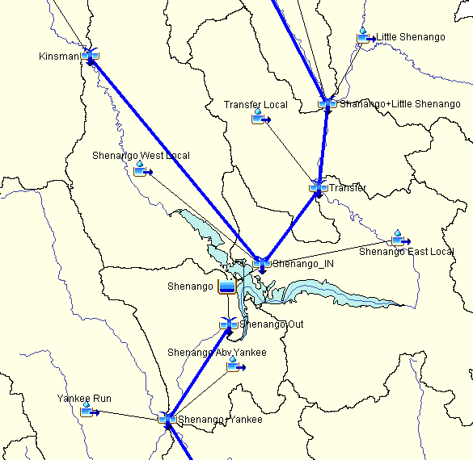
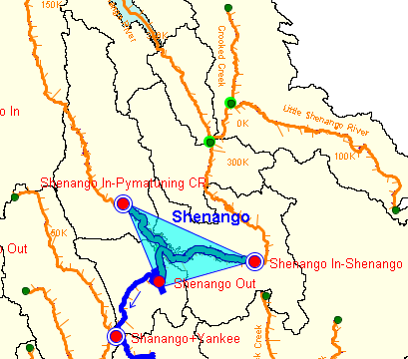

Slide 23
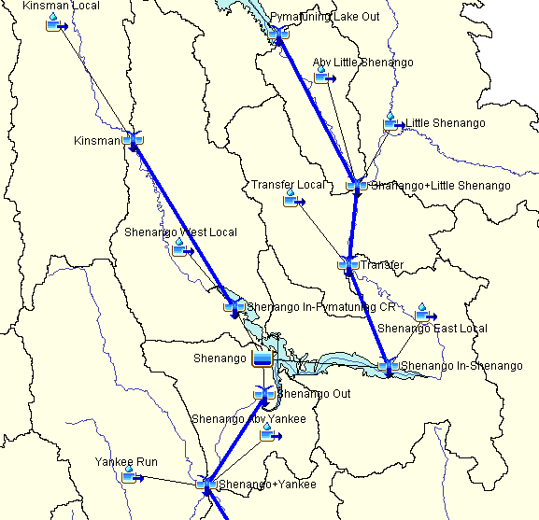

Slide 24
Take-Home Points
ResSim needs
  Total flow for headwater junctions (i.e. reservoirs or tributary headwater)
  Incremental local flows for interbasin junctions, not total flows
Observed / Gaged data reflect total flows
Incremental locals must be calculated
  Modeled – with a Rainfall-Runoff (HMS) model
  Derived from Observed
    By hand, scripts, DSSVue, …
    Using HMS
    Using ResSim

