Slide 1
Scripting HEC-ResSim

Slide 2
Topics
Two Categories of Scripts
Scripts Executed Outside Simulations
  Static Scripts
Scripts Executed During Simulations
  State Variable Scripts
  Scripted Rule Scripts
Jython

Slide 3
Two Categories of Scripts – 1 of 2
Scripts executed outside simulations
  These scripts can:
    Pre-process data for simulations
    Run simulations (some or all alternatives)
    Post-process data from simulations, generate plots, reports, etc…
  These scripts cannot:
    Interact with a running simulation

Slide 4
Scripts Executed Outside Simulations
There is only one type of script executed outside simulations, which we call static or utility scripts.
Static scripts resemble HEC-DSSVue scripts:
  They can be executed from the Script Selector, Script Pane, or Script Editor.
  They are edited and tested in the Script Editor.
  Their location in the Tree Pane of the Script Editor corresponds to a file on disk.
Static scripts go beyond HEC-DSSVue scripts:
  Script location in the Tree Pane determines script visibility.
  Scripts can have knowledge of the current module and current simulation.

Slide 5
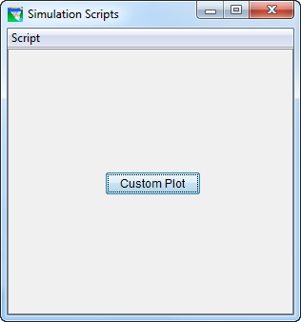
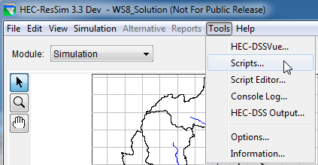
The Script Selector
The Script Selector is accessed by the Tools→Scripts menu item in any module.
The Script Selector is titled according to the current module.
Execute a script by pressing its button.

Slide 6
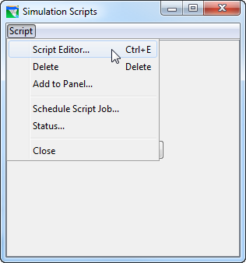
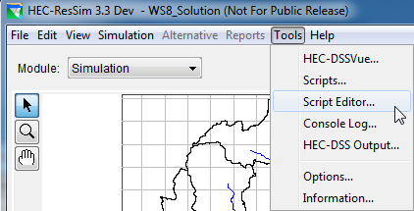
Accessing the Script Editor
The Script Editor is accessed by the Tools→Script Editor… menu item on the HEC-ResSim menu bar, or by Script→Script Editor menu item on the Script Selector.

Slide 7
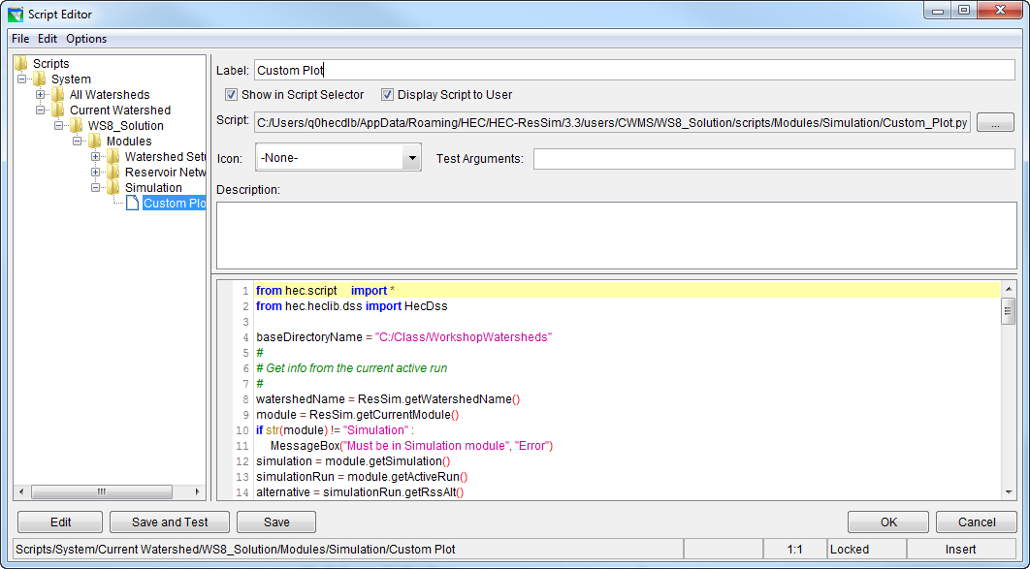
The Script Editor
Tree Pane
Script Name
Visibility Switches
File Name
Description Pane
Icon Selector
Pre-Defined Variables
Editor Pane
Edit/Save/Test Buttons
Dismissal Buttons
Location / Mode Indicators

Slide 8
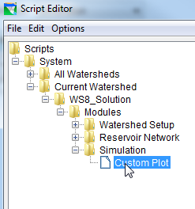
Static Script Visibility
For a static script to be visible:
  its position in the Tree Pane:
    must be in the All Watersheds folder or Current Watershed folder
    must be in Modules folder or folder corresponding to the current module
  its Show in Script Selector switch must be checked to be visible in the Script Selector
  its Display Script to User switch must be checked to be visible in the script pane

Slide 9
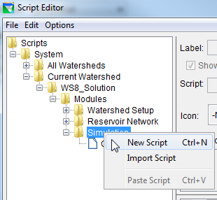
Creating a New Static Script
To create a new static script:
  right-click on one of the folders under either the All Watersheds or Current Watershed:
    Modules
    Watershed Setup
    Reservoir Network
    Simulation
  select New Script from the context menu
  enter a name in the Label field
  enter the script text in the Editor Pane
  press the Save or Save and Test button

Slide 10
Editing Existing Static Scripts
To edit an existing Static Script, do one of the following:
  double-click on its entry in the Tree Pane
  right-click on its entry in the Tree Pane and select Edit Script from the context menu
  select its entry in the Tree Pane and do one of the following:
    select File→Open from the menu bar
    press Ctrl-O
    press the Edit button

Slide 11
Testing Existing Static Scripts
To test an existing Static Script from the Script Editor, select its entry in the Tree Pane and do one of the following:
  select File→Test from the menu bar
  press the Save and Test button

Slide 12
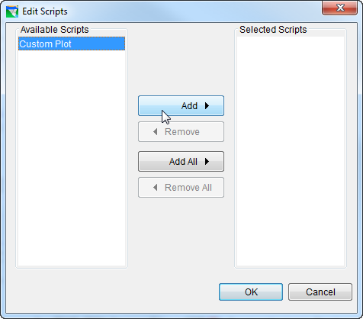
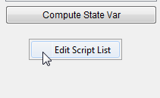
Adding Scripts to the Simulation Module Script Pane
To add a script to the simulation module script pane:
  right-click in the scripts area
  select Edit Script List from the context menu
  use the Edit Scripts dialog to move desired scripts to the Selected list

Slide 13
Static Script Access to ResSim Information
isWatershedOpened()
getWatershed()
getWatershedName()
openWatershed(watershedName)
closeWatershed()
getCurrentModule()
selectModule(moduleName)
getTimeWindow()
getTimeWindowString()
getSimulation() getSimulationName()
openSimulation(simulationName)
getSimulationRun(alternativeName)
getSimulationRuns() getSelectedSimulationRuns() getAlternativeNames() getSelectedAlternativeNames()
extractSimulationData()
computeSimulationRun(simulationRun)
getSimulationDSSFileName()
getFParts()
getFPart(alternativeName)
runSimulation(simulationName, newExtract=False, *alternativeNames)
These functions are included in the ResSimUtils module provided with this workshop.

Slide 14
Two Categories of Scripts – 2 of 2
Scripts executed during simulations
  These scripts can:
    Compute a flow limit (minimum, maximum, specified) at each simulation time step
    Compute and store the state of some (concrete or abstract) portion of the model at each simulation time step
  These scripts cannot:
    Know when they execute in relation to other scripts

Slide 15
Scripts Executed During Simulations
There are two types of HEC-ResSim scripts that are executed during simulations
  Scripted Rules
    a.k.a. User-Defined rules - Scripts that compute a desired release or operating limit of the associated reservoir or release element. Used when none of the standard rule types can adequately reflect the desired operation.
Notes:
State Variables have the benefit of being able to be used by multiple rules and also may be viewed in plots or tables.
Scripted Rules have the benefit of being able to set not just the value of a constraint, but the constraint type, and even whether a constraint exists at all – may need elaboration

Slide 16
Scripts Executed During Simulations
  State Variables
    Scripts that set the value of a state variable, which can be used by rules and IF-THEN-ELSE blocks to specify flow constraints
      A model variable represents the state of some parameter of an element of the network computed by ResSim at each time step of the simulation (thus, a time series). e.g., the reservoir pool elevation.
      A state variable is a model variable-like time series whose values are computed by a user-defined script for each time step; it need not represent the state of a parameter of single element.
Notes:
State Variables have the benefit of being able to be used by multiple rules and also may be viewed in plots or tables.
Scripted Rules have the benefit of being able to set not just the value of a constraint, but the constraint type, and even whether a constraint exists at all – may need elaboration

Slide 17
Scripts Executed During Simulations
Common Properties of State Variables and Scripted Rules
  They are executed and should determine a value at every iteration of every time step
  Computation at any time step may depend on any model variables at previous time steps, and may depend on other State Variables at the current time step
  Scripts are normally only executed when used in an active alternative, but can be forced to execute otherwise
Notes:
Scripts that depend on other State Variables at the same time step must manually ensure they have been executed before the current script

Slide 18
Limitations of Model Variables
Model variables provide the states of single elements within a ResSim model.
Therefore, model variables cannot represent abstract concepts that require analysis of more than one element such as:
  basin wetness
  drought level
  system storage utilization
  depth-area-duration considerations

Slide 19
State Variables vs. Model Variables
Like model variables, state variables are time-series objects that belong to the Network.
Like model variables, state variables are globally accessible, so they may be used in multiple rules and in multiple reservoirs.
Unlike model variables, state variables are not associated with specific network elements (pools, junctions, etc…). As such, they can represent complex or abstract concepts.
Notes:
The Network is the program object that holds all objects that make up the reservoir system being modeled. The GUI refers to it as the Reservoir Network.
Reservoirs, Reaches, Junctions, and Diversions are all objects within the Network. These objects are compound objects, each containing other objects. The reservoir object is the most complex. It contains the pool and outlet objects, as well as the operation sets, zones, and rules.

Slide 20
State Variable Scripts
HEC-ResSim computes a state variable by executing a Jython script for that variable at every time step throughout the simulation period.
The script can access model variables and other state variables for the current and prior time steps.
  Scripts that depend on other State Variables at the same time step must be manually ensured to be executed after the script they depend upon
The script can also perform any function available to Jython to compute the variable.
  Care must be taken not to perform lengthy tasks (e.g. disk or network access) because of the number of times the script is executed!
Notes:
Jython is a Java implementation of the Python programming language and provides the common basis for ResSim, DssVue, and CWMS scripting.
State Variable definition scripts do not return anything. They must “set” the value of the TimeSeries object for the current time step, or have set it in an earlier time step. The script may optionally set values into the future (through the end of the computation time window).

Slide 21
Creating New State Variable Scripts
To create a new State Variable script:
  Select Edit→State Variables from the Simulation Module menu bar.
  Select StateVariable→New from the State Variable Editor menu bar.
  Enter the desired name in the Name field of the New State Variable dialog.
  Press the OK button.
  Enter the desired parameter (DSS C Part) in the Parameter Name field.
  Select the desired parameter type from the Parameter Type list.
  Edit the script text as desired.
  Press the Compile Script button to check for syntax errors.
    Fix any errors and repeat this step.
  Save the script by selecting StateVariable→Save from the menu bar or pressing Ctrl-S.
  Close the State Variable Editor dialog.

Slide 22
Editing Existing State Variable Scripts
To edit an existing State Variable script:
  Select Edit→State Variables from the Simulation Module menu bar.
  Select the desired State Variable name from the Name field.
  Edit the script text as desired.
  Press the Compile Script button to check for syntax errors.
    Fix any errors and repeat this step.
  Save the script by selecting StateVariable→Save from the menu bar or pressing Ctrl-S.
  Close the State Variable Editor dialog.

Slide 23
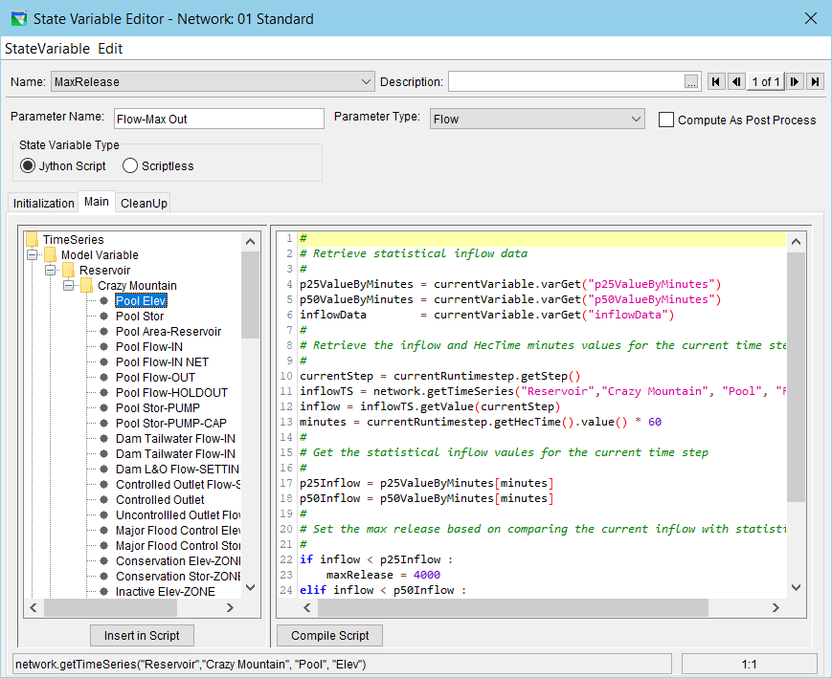
Creating and Editing State Variable Scripts

Slide 24
The State Variable Editor
Script Tabs
Script Pane (editor window)
Object Pane (API window)
API preview & Cursor Location

Slide 25
Using the State Variable Editor API Pane
Selecting a node (not a folder) in the API Pane causes the API insertion text for the selected node to be displayed in the API preview bar.
Double-clicking on a node in the API Pane causes its API text to be inserted at the current cursor position in the Editor Pane.
  The same can be accomplished by selecting a node in the API and then selecting the Insert in Script button under the API Pane.
Dragging a node in the API Pane to some position in the Editor Pane causes its API text to be inserted at that location in the Editor Pane.

Slide 26
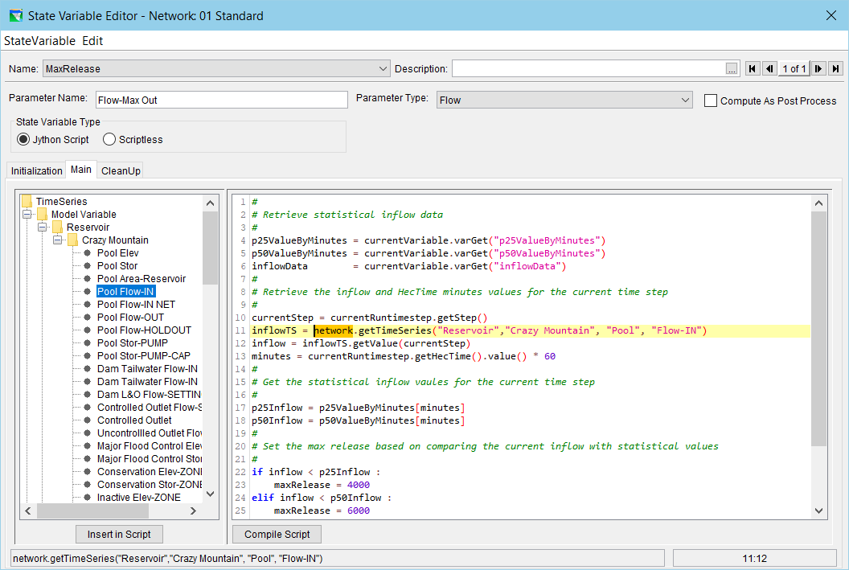
State Variable Editor API Pane Example

Slide 27
Creating New Scripted Rules
To create a Scripted Rule:
  Open the Reservoir Editor to the Zone-Rules tab of the Operations tab.
  Right-click the desired zone and select Add New Rule… from the context menu.
  Enter the desired name and select the desired release element in the New Operating Rule dialog.
    Select Script for the Rule Type.
  Press the OK button.
  Edit and check syntax as with a State Variable.

Slide 28
Editing Existing Scripted Rules
To edit an existing Scripted Rule:
  Select the desired rule in the Zone-Rules tab of the Operations tab of the Reservoir Editor.
  Edit the script as desired. The editor is similar to the State Variable editor.

Slide 29
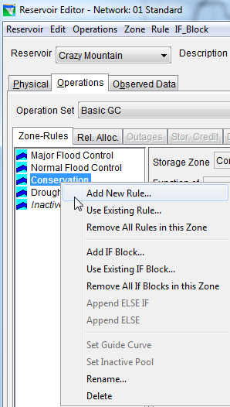
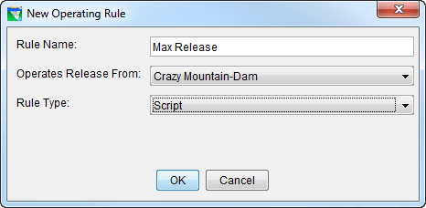
Creating Scripted Rule Example

Slide 30
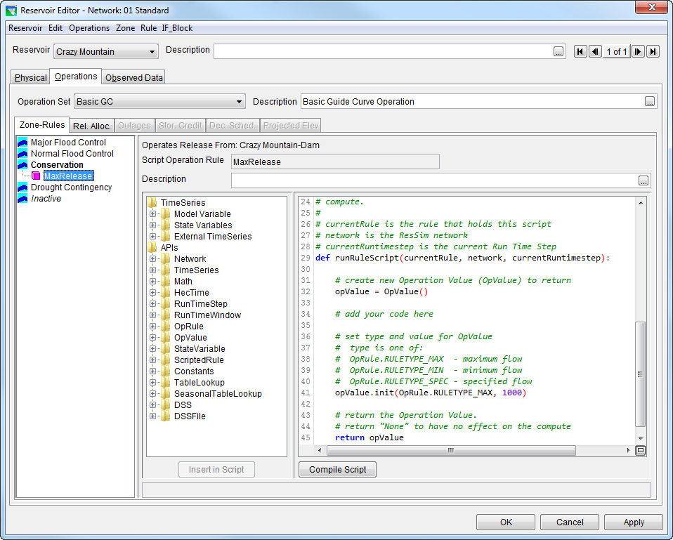
Editing Scripted Rule Example

Slide 31

What is Jython?
http://jython.org
Jython is a Java-based implementation of the Python programming language. This means:
  You learn the Python language to learn Jython.
  Jython code can work seamlessly with Java code.
Anybody with programming experience will pick it up quickly.
Others can quickly become effective by mimicking examples.

Slide 32

What is Python?
http://python.org
Python is a programming language that is
  interpreted
  open source
  object oriented
and has
  simple syntax
  high level dynamic data types

Slide 33


Some Books Available

Slide 34
Review
Scripts Executed During Simulations
  State Variable Scripts
  Scripted Rule Scripts
Scripts Executed Outside Simulations
  Static Scripts
Jython

