Slide 1

Real-time vs planning
HEC-ResSim Modeling Approaches
Fauwaz Hanbali

Slide 2
Outline
Key Model Setup Considerations
Real-time Rule Sets
ResSim Overrides

Slide 3
Key Model Considerations

Slide 4
Key Model Considerations | Real-Time (CWMS) | Planning (ResSim Standalone or HEC-WAT)
Data Sources | Real-time database Web service Real-time rainfall runoff model | Historic database Web service Planning rainfall runoff model Synthetic stream-flow generator
Network | Existing conditions Ad-hoc project/system modifications | Existing conditions (without project) Proposed project alternative(s)
Operation sets | Water Control Manual Simplified rule set for Overrides | Water Control Manual Study alternatives
Compute Time Step | Hourly (most typical) 15min or less (for flashy basins) Daily (for large storage capacity systems) | Hourly (to capture flood operations) 15min or less (for flashy basins) Daily (most typical)
Simulation Time Window | 1 Week or less (most typical) 2 Weeks-1 Month (big river systems) 3-6 Months (snowmelt forecasting) | Historic event(s) Period-of-record
Expected Compute Time | Minutes for short duration events Minutes to hours for long-term forecasts | Minutes for simpler analyses Hours to days for complex analyses

Slide 5
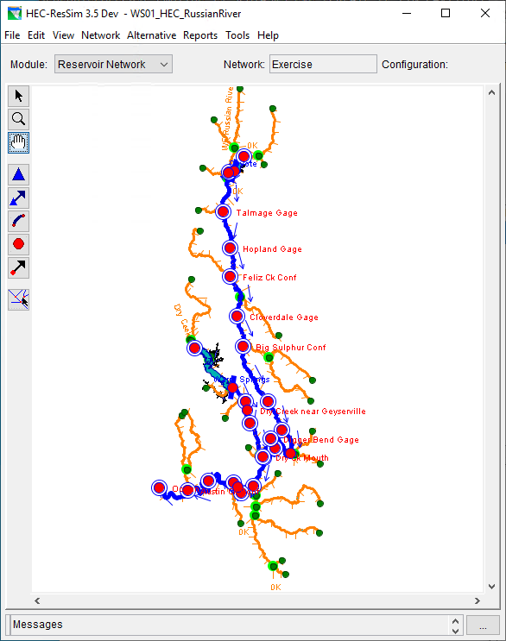
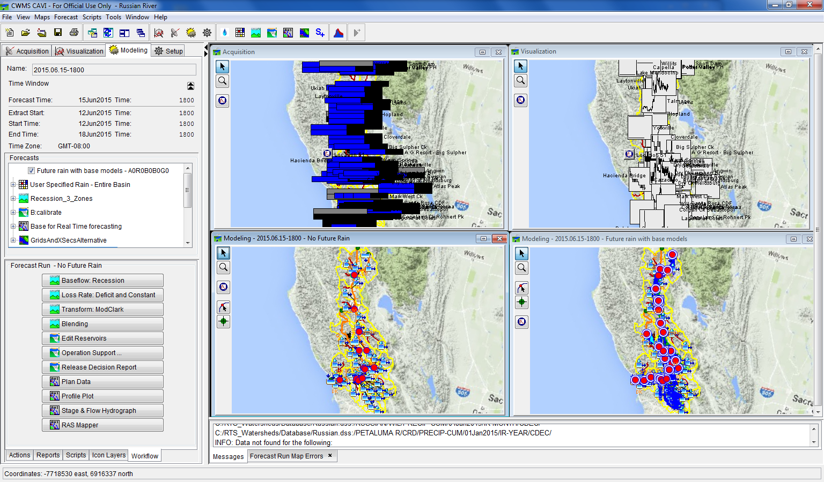
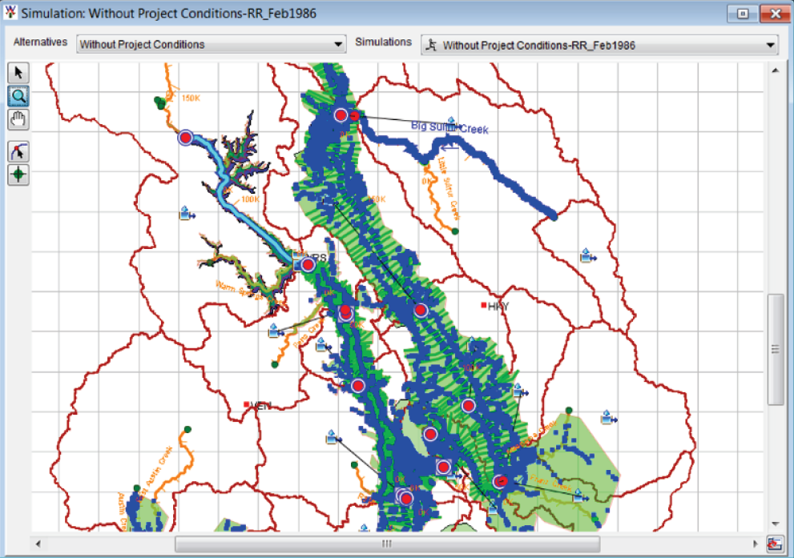
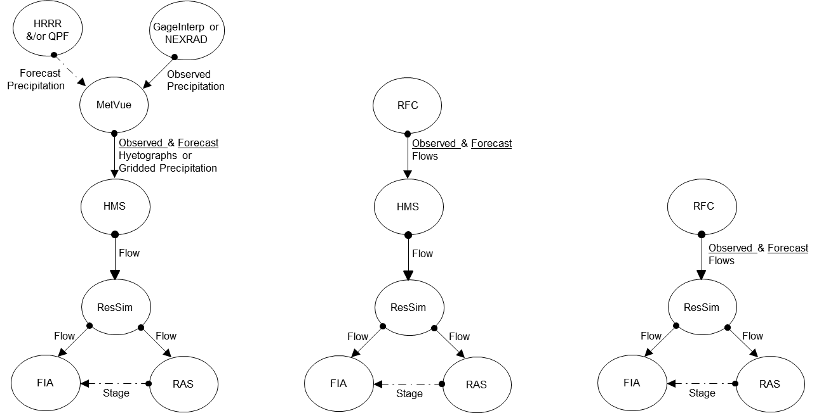
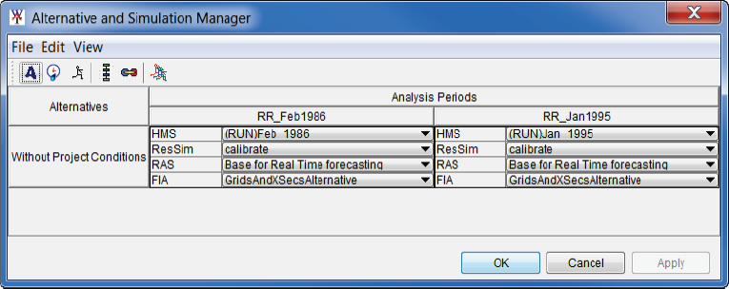
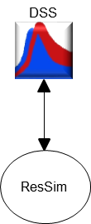
Software Applications
CWMS
HEC-ResSim
HEC-WAT
Data Acquisition
Data Visualization
No Future Rain
Future Rain

Slide 7
Real-time
Rule sets

Slide 8
ResSim’s Role in CWMS
ResSim should provide the water manager with a good first guess to use when determining the upcoming release schedule for their reservoirs
ResSim will make release changes every timestep. But in the real world, a water manager will:
  Issue instructions to the operators for gate setting(s) once a day
  Issue gate changes instructions more often during the day if in a serious situation like a rapidly changing flood.
Notes:
ResSim’s Role in CWMS
KEY POINT – Release Decision Making. The water manager makes decisions on what the reservoirs should release and when.
CWMS and ResSim were designed to support that decision making process.
An effective ResSim model for Real-Time should provide the water manager with a good “first guess”. Usually, such a model will include all (or most) of the goals and constraints that are detailed in the water control manuals or operating plans for the reservoirs in the watershed.
(Go on to explain that:)
We talk about the ResSim model producing a “first guess” because no water manager is going to make releases in quite the same way ResSim does.
A typical ResSim model will make release changes every timestep, but in the real world, a water manager will tell the operators what gate setting(s) he wants and when but he won’t make gate changes too often unless he’s in a serious and rapidly changing flood fight.
Once the ResSim model shows the water manager what the releases “should be” to meet his objectives, the water manager should then test a more reasonable release schedule (with release overrides) and verify that his goals and objectives are still being met.
(Consider talking about:)
HEC-5 – HEC’s original reservoir modeling tool, well used for study modeling, but not favored for Real-Time use.
Riverware – a reservoir modeling tool by CADSWES, very powerful for modeling water supply and hydropower systems. Not as strong on Flood Control. All operations are scripted.
Ask students if they are familiar with other reservoir models… (SSARR/AutoReg, HYDSIM/HYSSR, Oasis, Stella, spreadsheets, ???)
Overlapping development. Model Integration. Same Look and Feel.

Slide 9
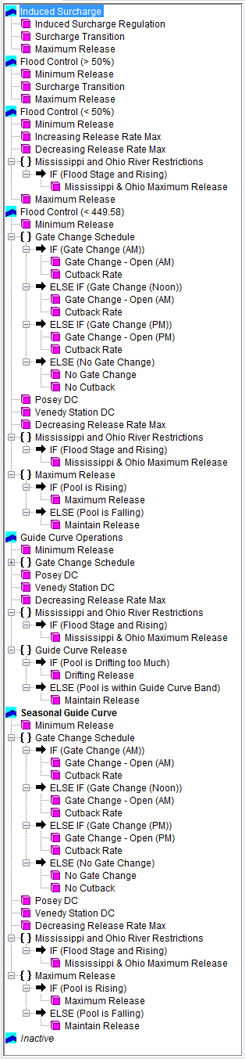
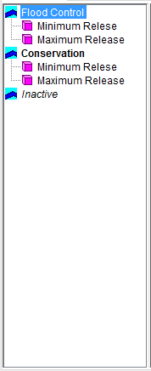
Reservoir Operation Rule Sets
Simple Rule Set
Complex Rule Set

Slide 10
ResSim CWMS Recommendations
Have a standard rule set that covers the majority if not all operating objectives
  Run only once to get a reference result from ResSim
Have a simplified rule set to
  Exclude computationally intensive rules, in particular:
    Downstream control and system rules
    State variable scripts-based rules
  Include the most computationally efficient rules, such as:
    At-site release function rules
    Rate of change rules
  Add release overrides informed by the results of the standard rule set

Slide 11
Real-time overrides

Slide 12
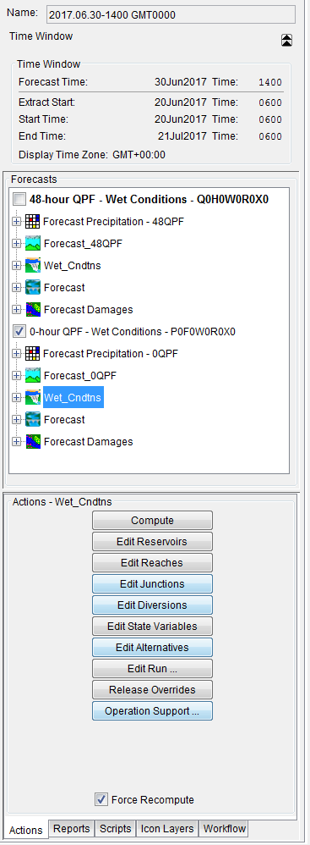
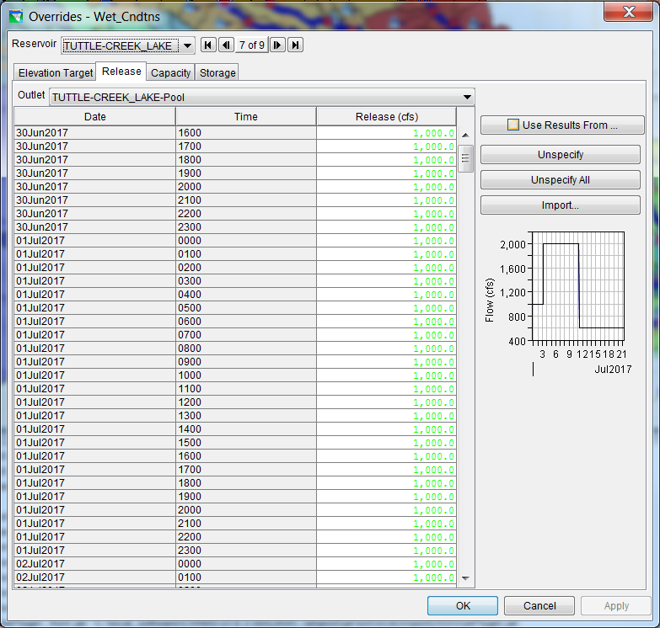
CWMS-ResSim
Overrides
Use Release Overrides tool to enter overrides for each reservoir in each alternative
Or use Operational Support Interface
Or use an “Override” rule
Notes:
We use a spreadsheet to forecast the lakes. Currently we take the 14 day forecast with a daily time step and use a script to convert to hourly data. This time series can be imported in the overrides window.

Slide 13
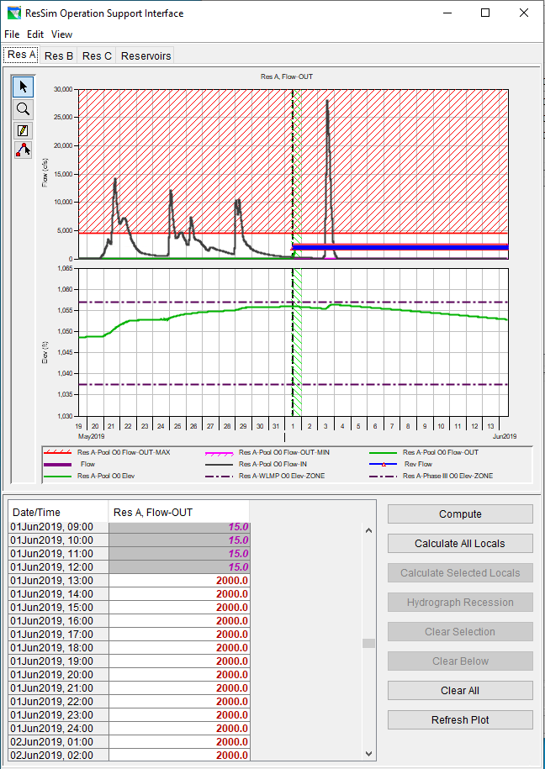
CWMS-ResSim
Overrides
Use Release Overrides tool to enter overrides for each reservoir in each alternative
Or use Operational Support Interface
Or use an “Override” rule
Notes:
We use a spreadsheet to forecast the lakes. Currently we take the 14 day forecast with a daily time step and use a script to convert to hourly data. This time series can be imported in the overrides window.

Slide 14
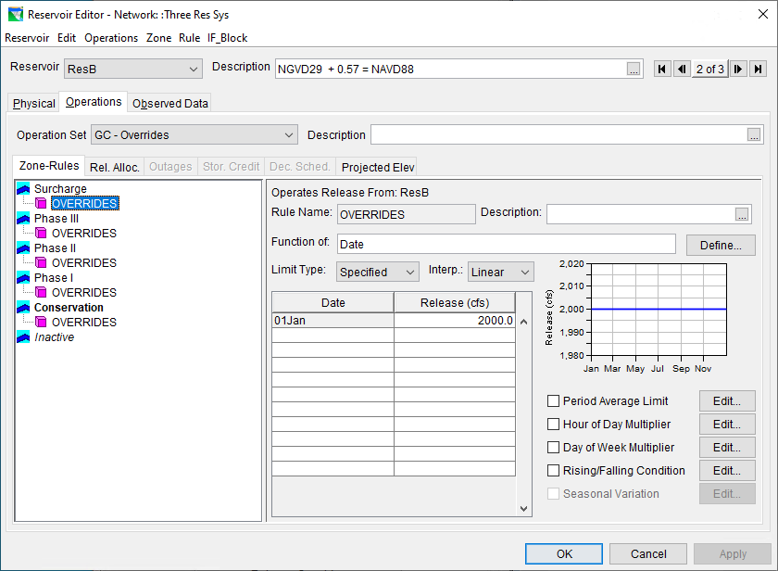
CWMS-ResSim
Overrides
Use Release Overrides tool to enter overrides for each reservoir in each alternative
Or use Operational Support Interface
Or use an “Override” rule
Notes:
We use a spreadsheet to forecast the lakes. Currently we take the 14 day forecast with a daily time step and use a script to convert to hourly data. This time series can be imported in the overrides window.

Slide 15
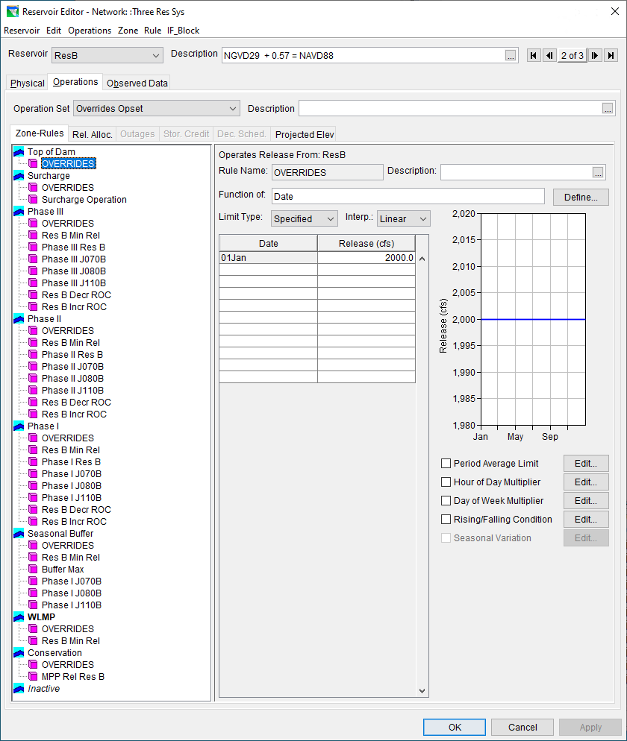
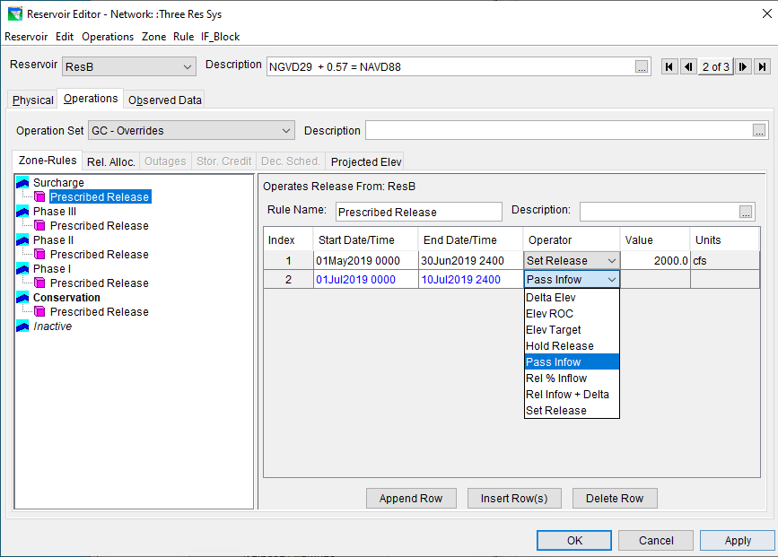

Slide 16
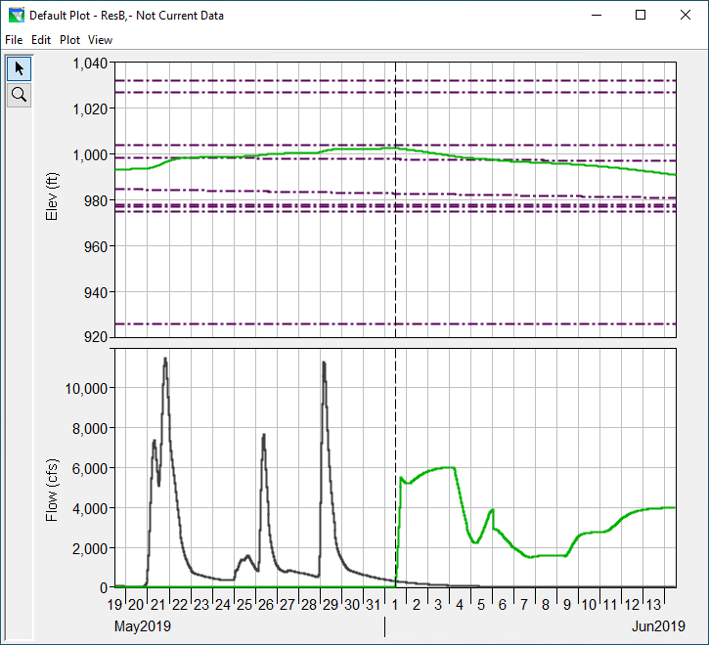
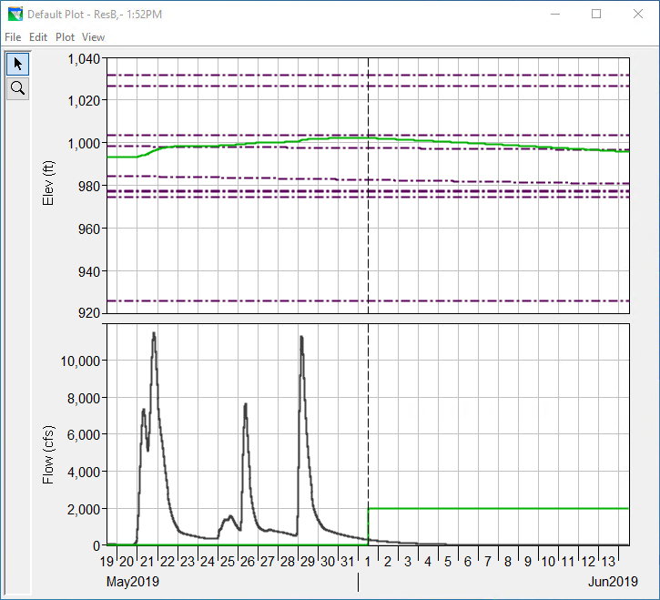
Release based on Rule Set
Release based on Overrides

