Slide 1



Online Help Resources
Fauwaz Hanbali

Slide 2


Outline
Online Resources
CWMS Online
Other… 😉

Slide 3


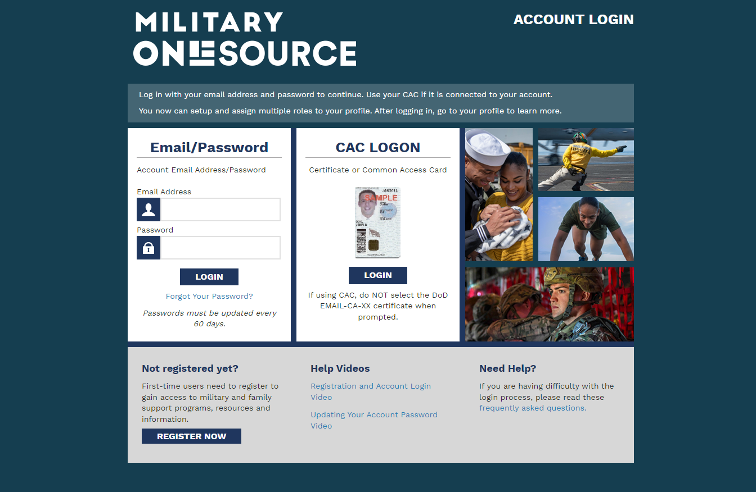
Online Resources

Slide 4
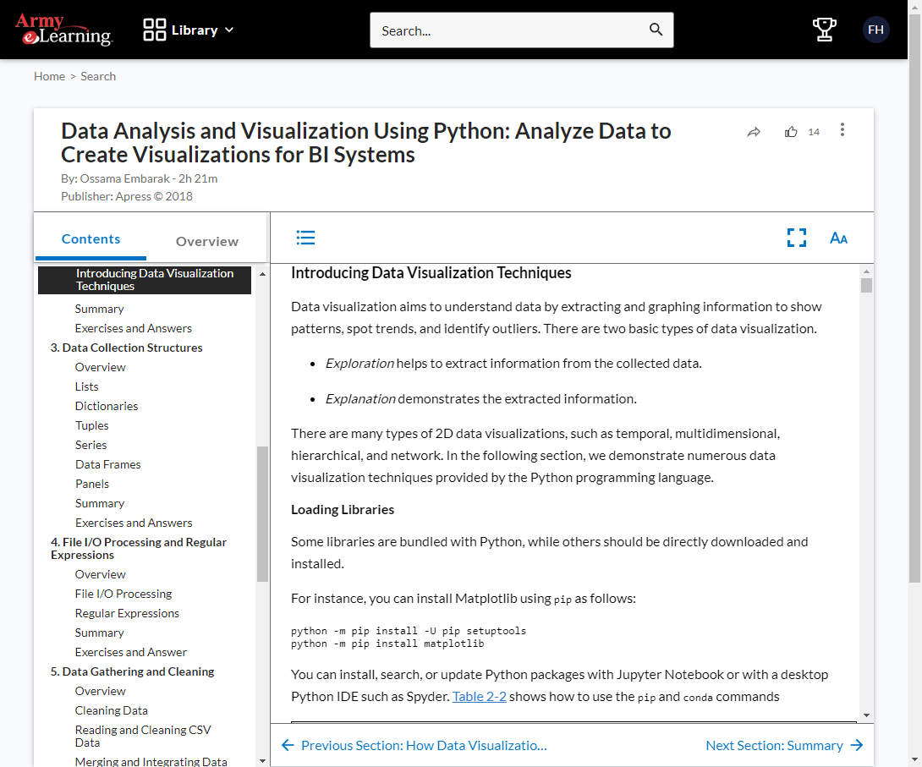
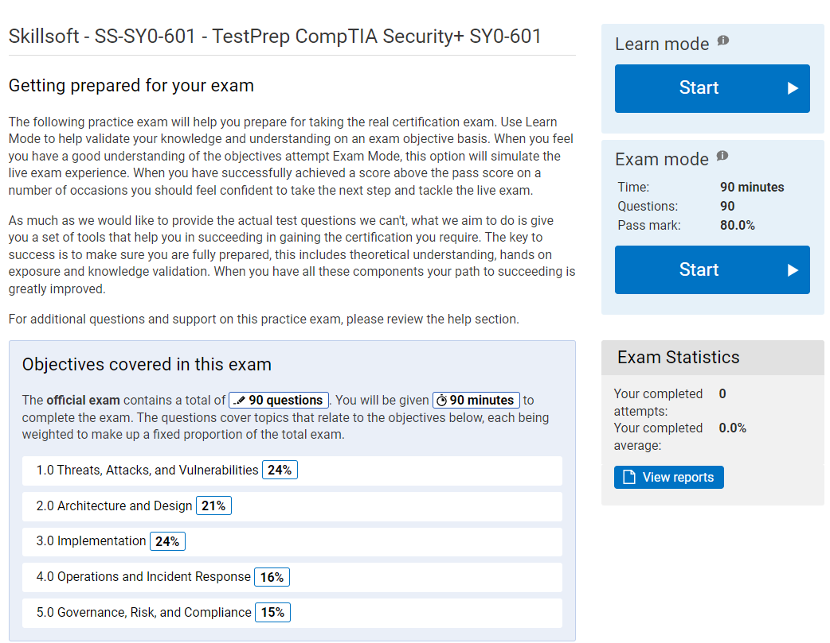
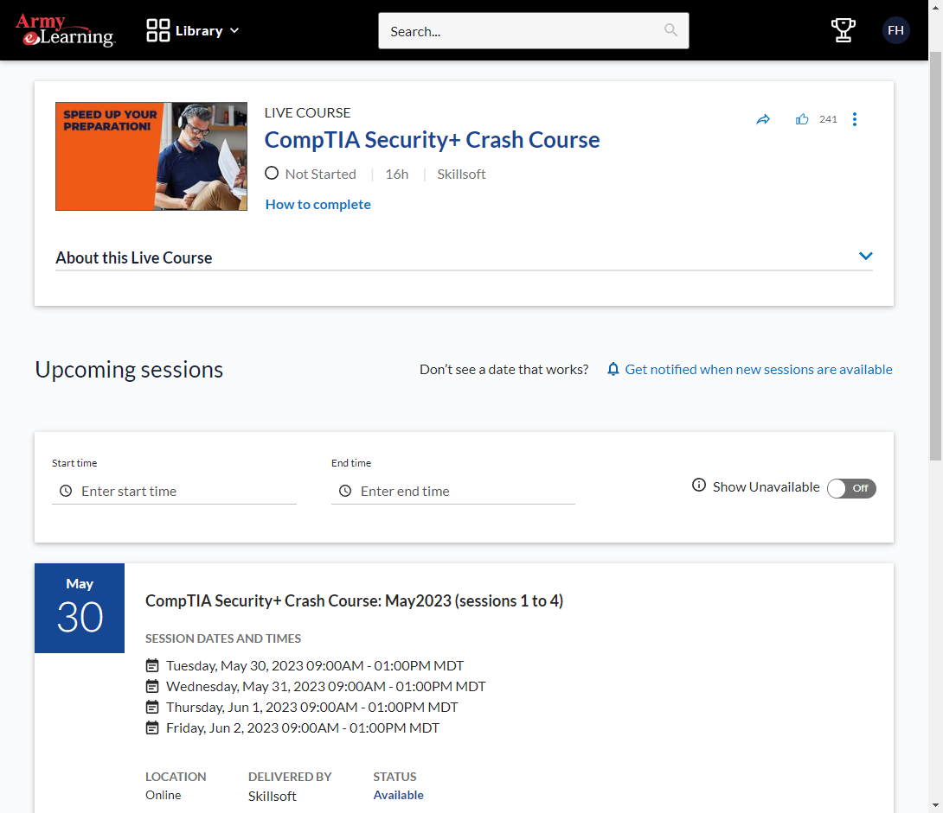
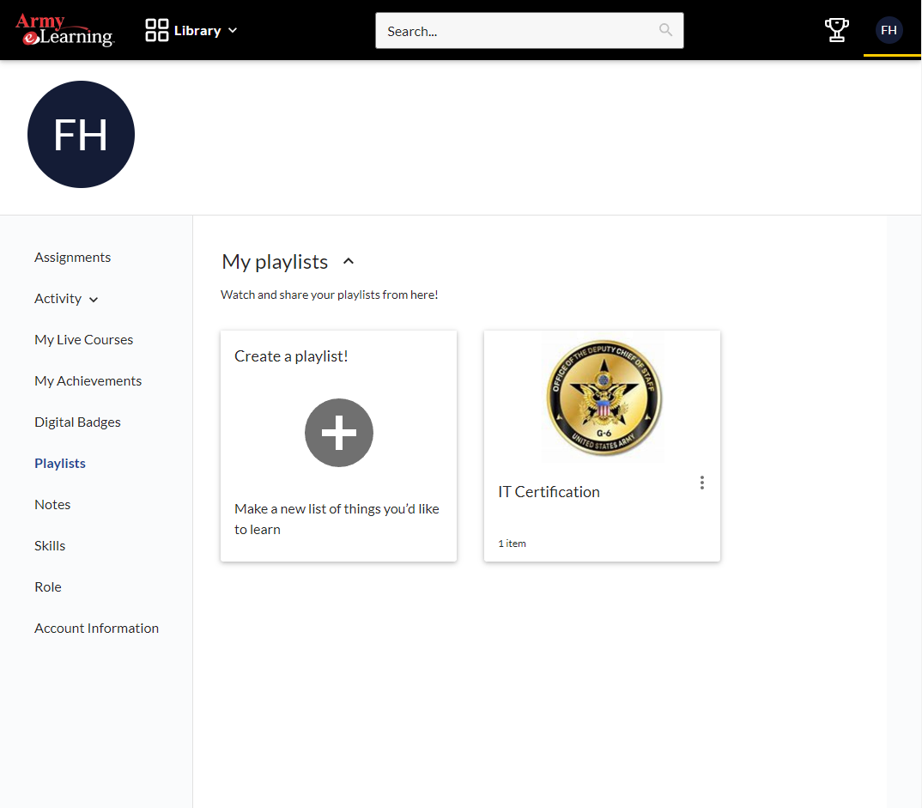
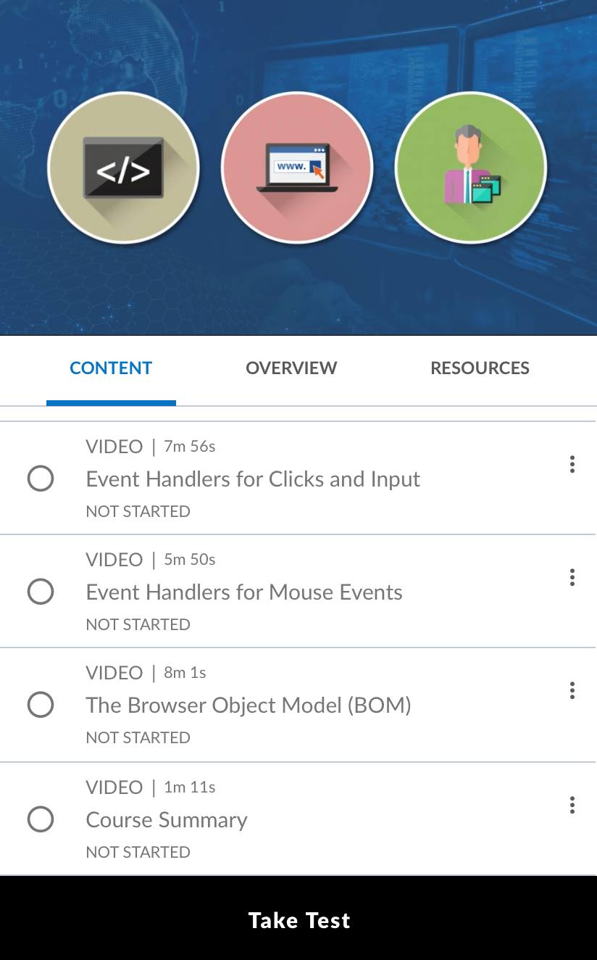
Army eLearning
Books
Audiobooks
Courses
Videos
Tests Prep
Live
Events
Courses
Bootcamp
Playlists
Mobile
https://usarmy.percipio.com/

Slide 5

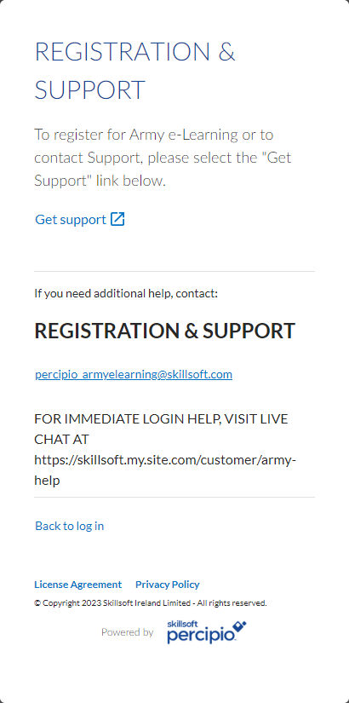
Army eLearning Access through Percipio
https://usarmy.skillport.com/
https://usarmy.percipio.com/

Slide 6


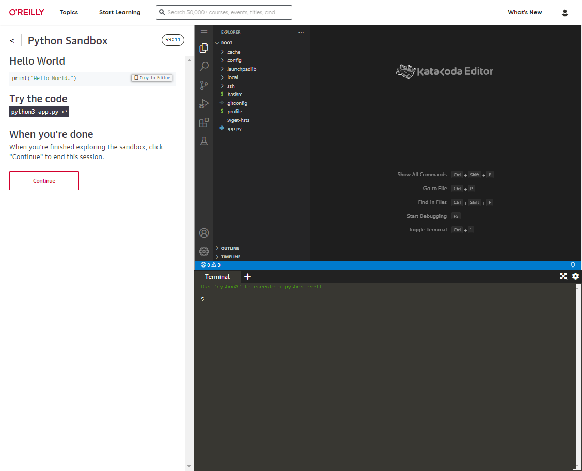
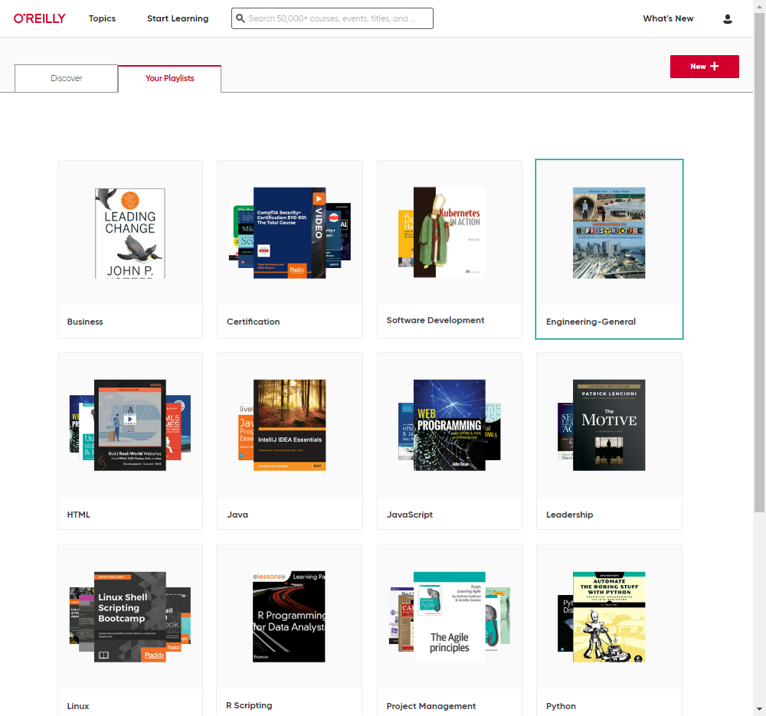
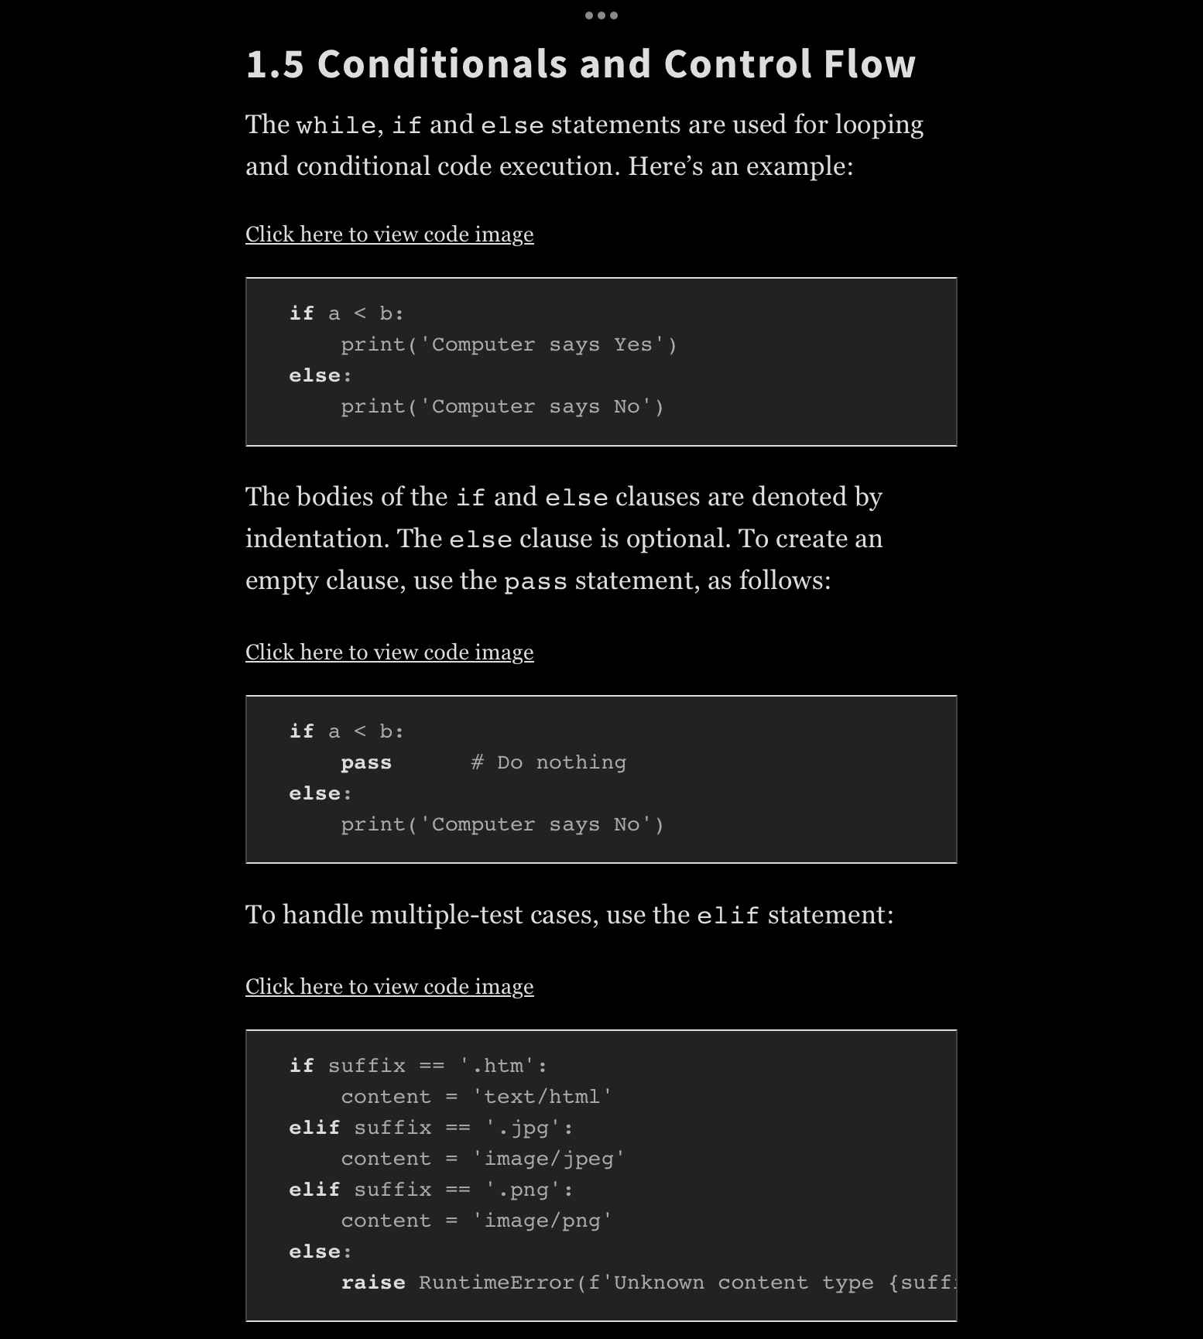
O’Reilly Online Learning
Books
Courses
Videos
Interactive
Playlists
Mobile
CarPlay
https://learning.oreilly.com/home/

Slide 7
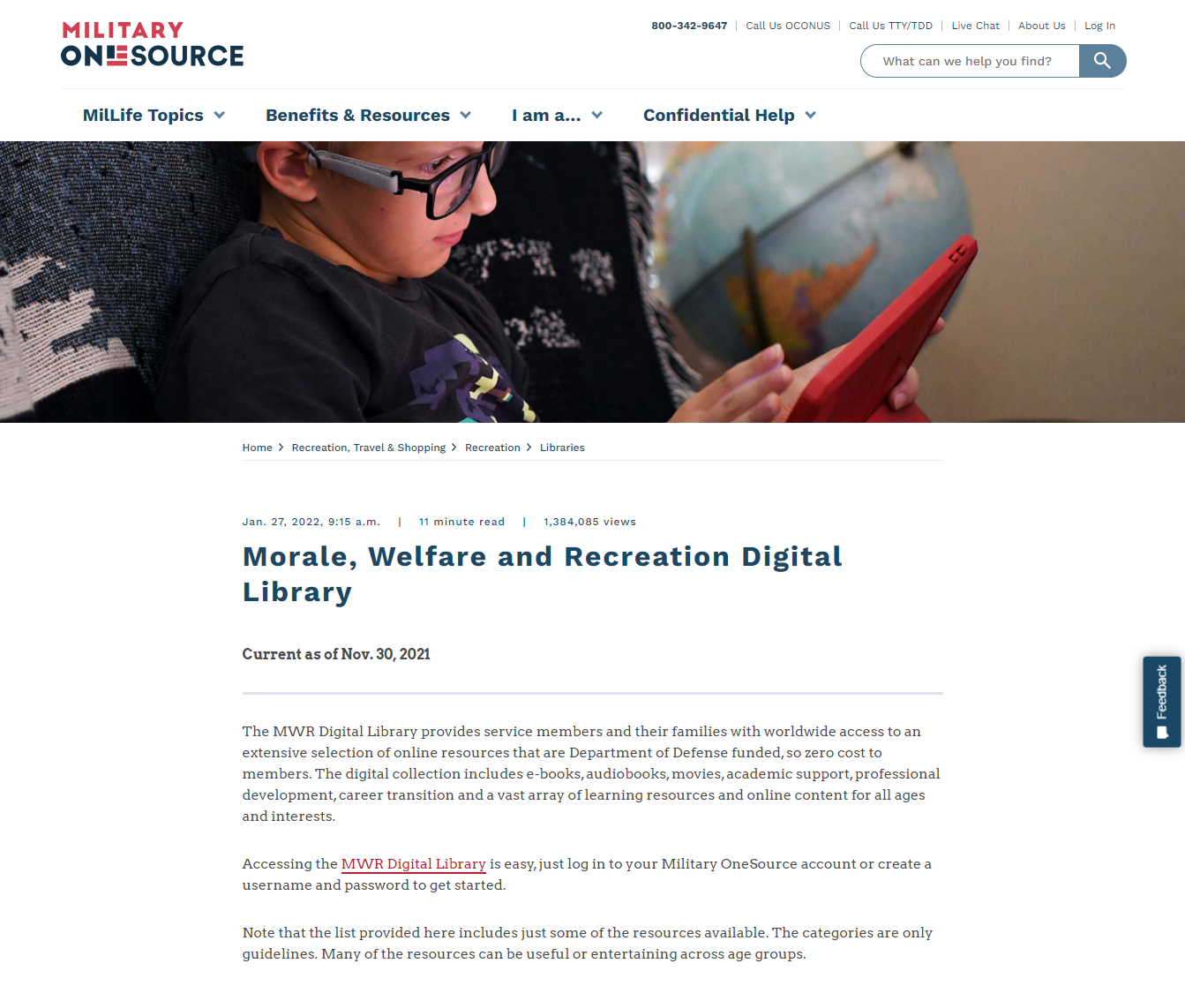
O’Reilly Access Through MWR https://auth.militaryonesource.mil/cas/login?service=https%3a//auth.militaryonesource.mil/MOS/mcfp-prod/sso.cas_auth.cas_login_redirect%3fAPP%3dUIS%26SESSION%3d0%26AID%3d1005
Military OneSource (MWR) Digital Library registration process only needs to be done once in order to register for an O’Reilly Learning Online account:
Once an O’Reilly account is created, registered users may login directly at https://learning.oreilly.com/.
NOTE:
Users must login every 90 days (or every 150 days with two-factor authentication enabled) to keep account active.

Slide 8

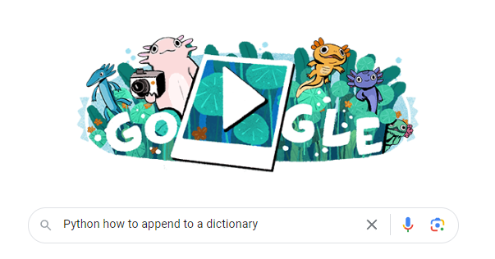
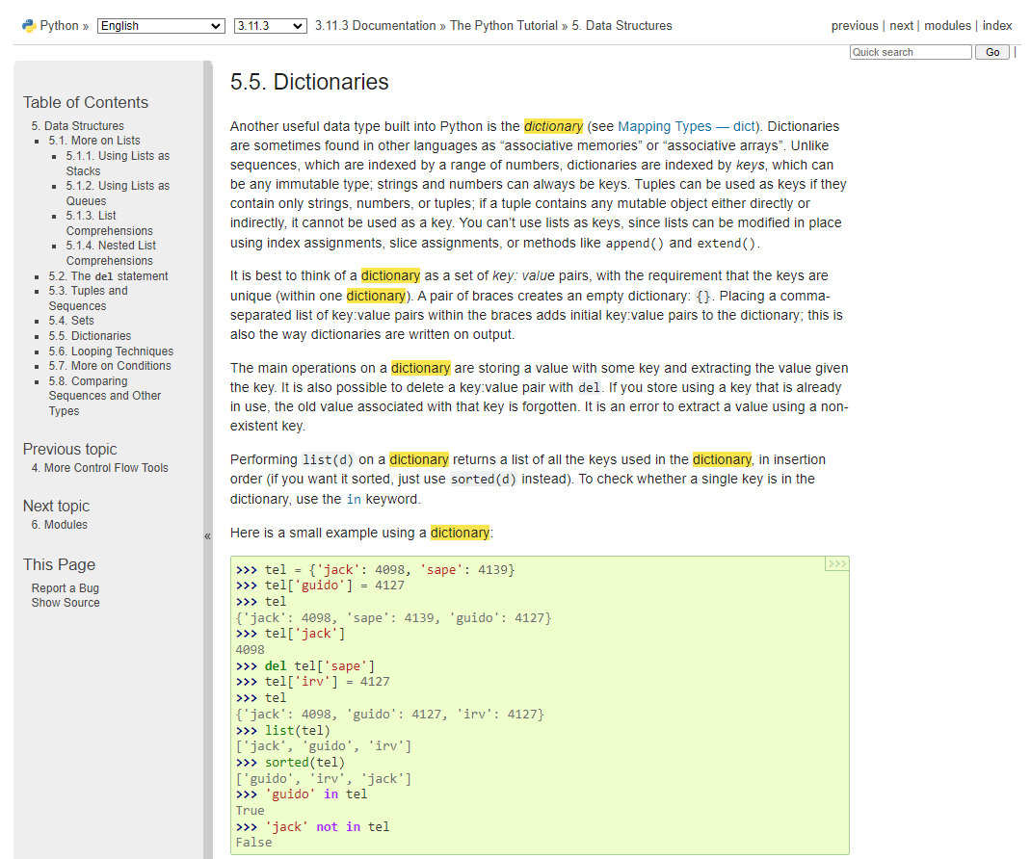
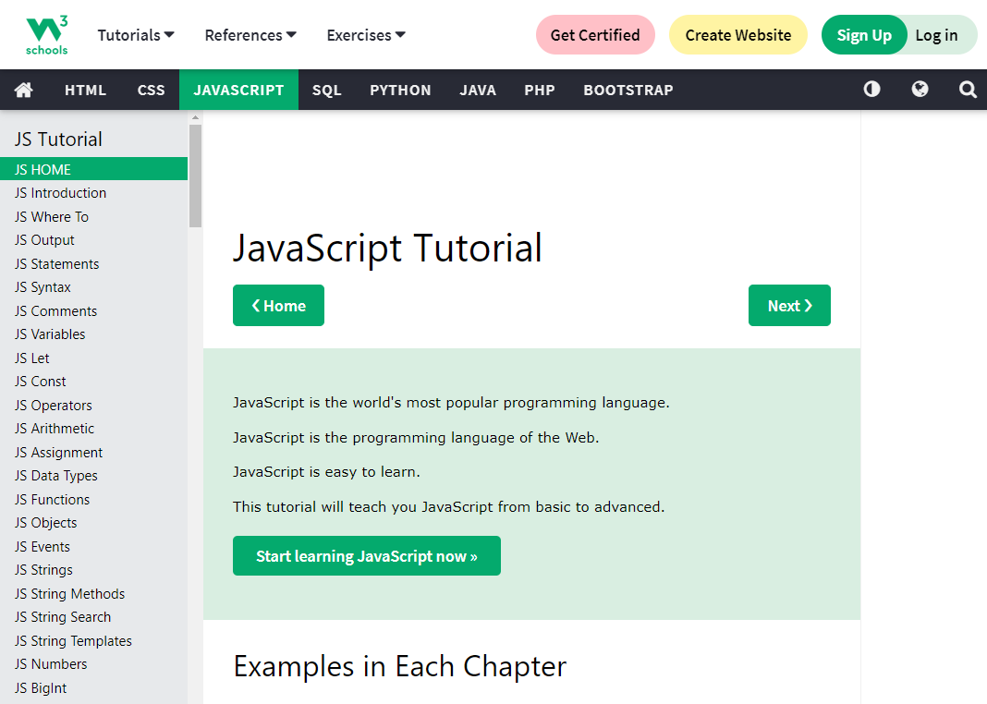
More Free Resources
YouTube.com
Google.com
Python.org
W3Schools.com

Slide 9


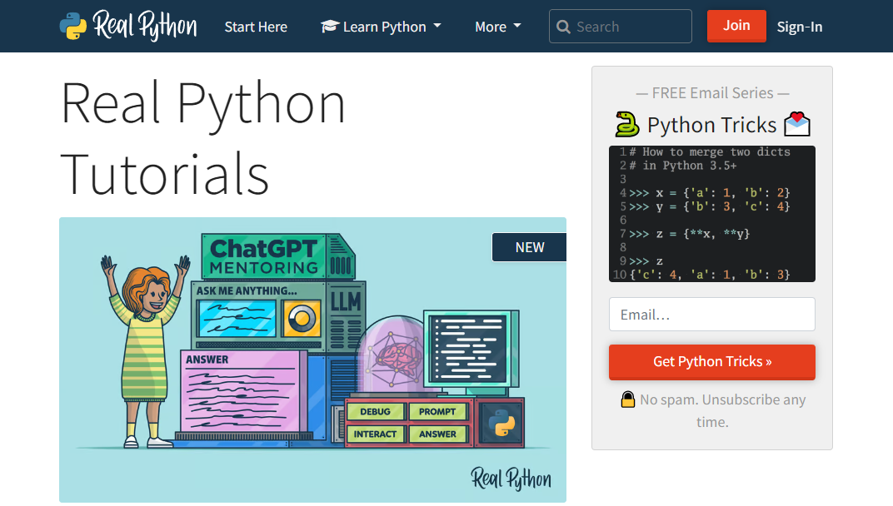
Paid Resources
https://www.pluralsight.com/
Pluralsight
Real Python
  Videos
  Slack Channels for support
  Podcasts
https://realpython.com/

Slide 10
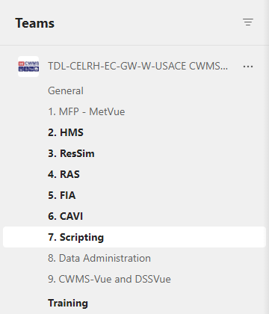
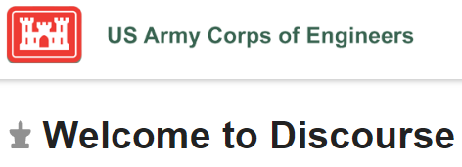

CWMS Online

Slide 11
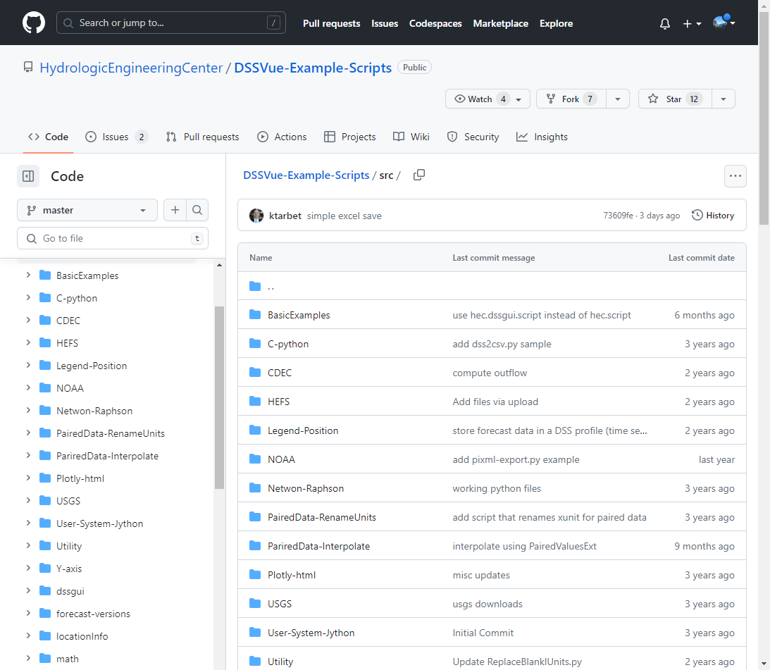
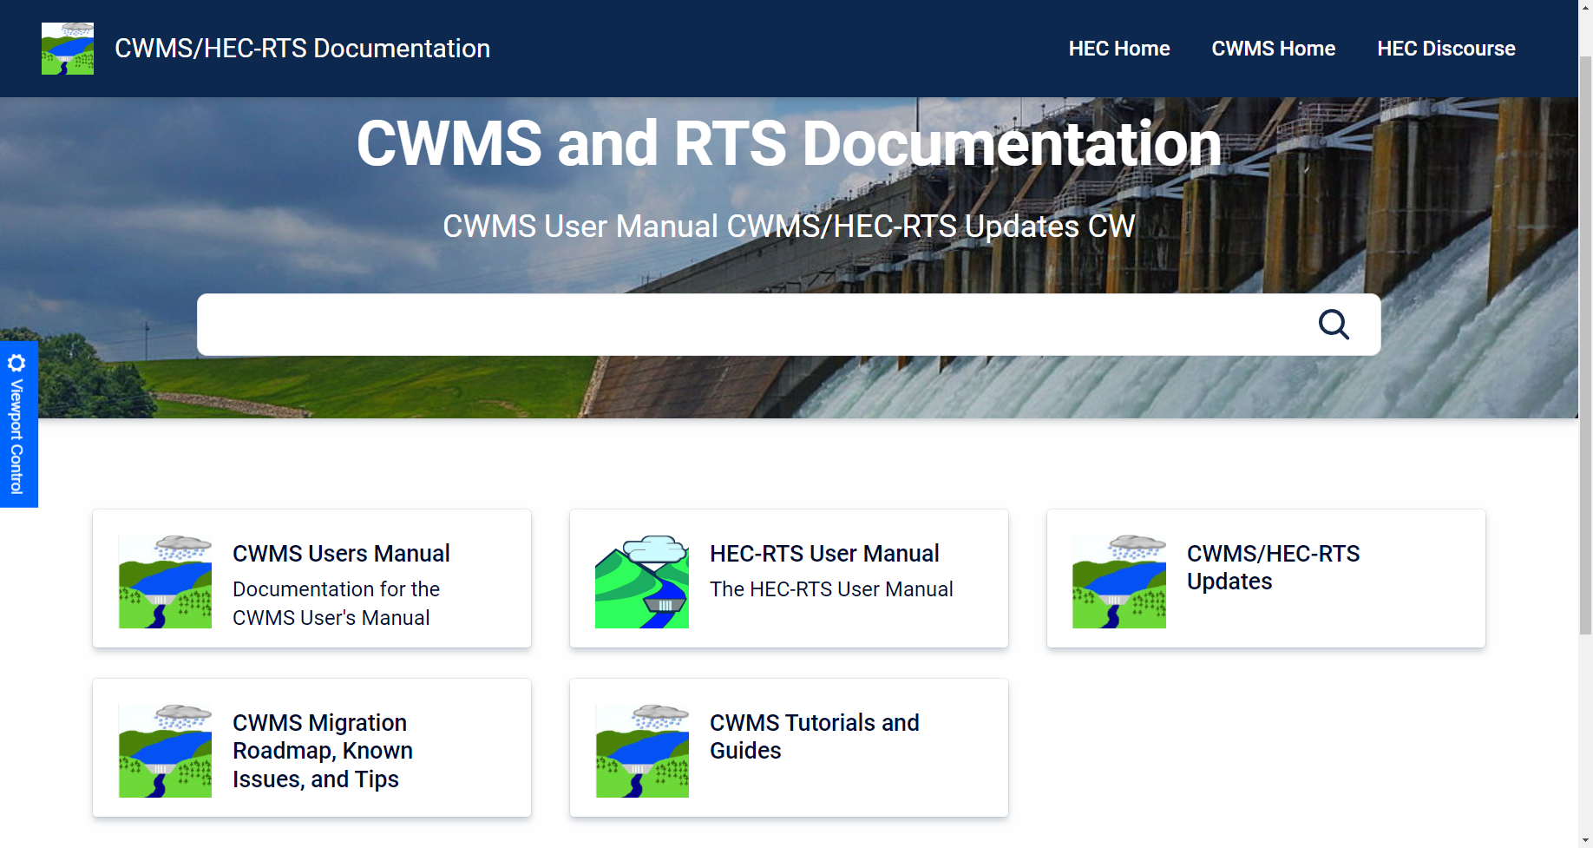
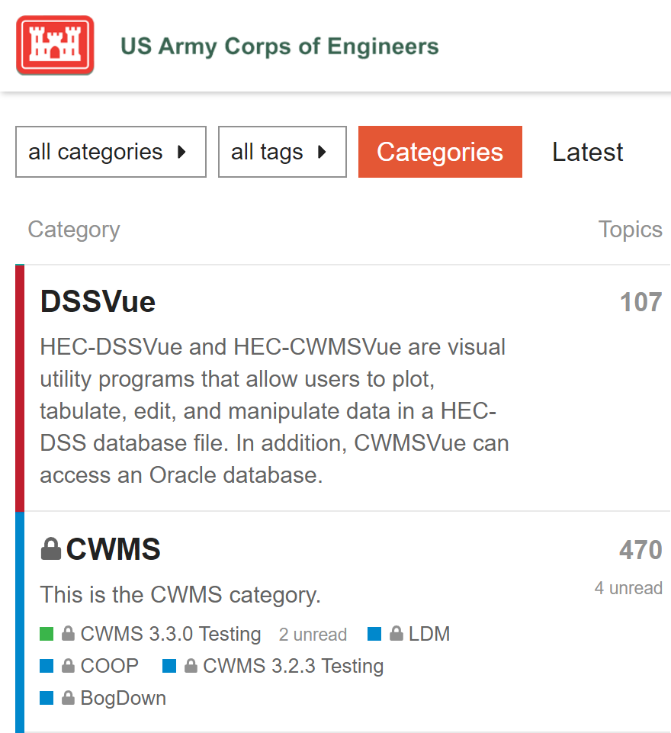
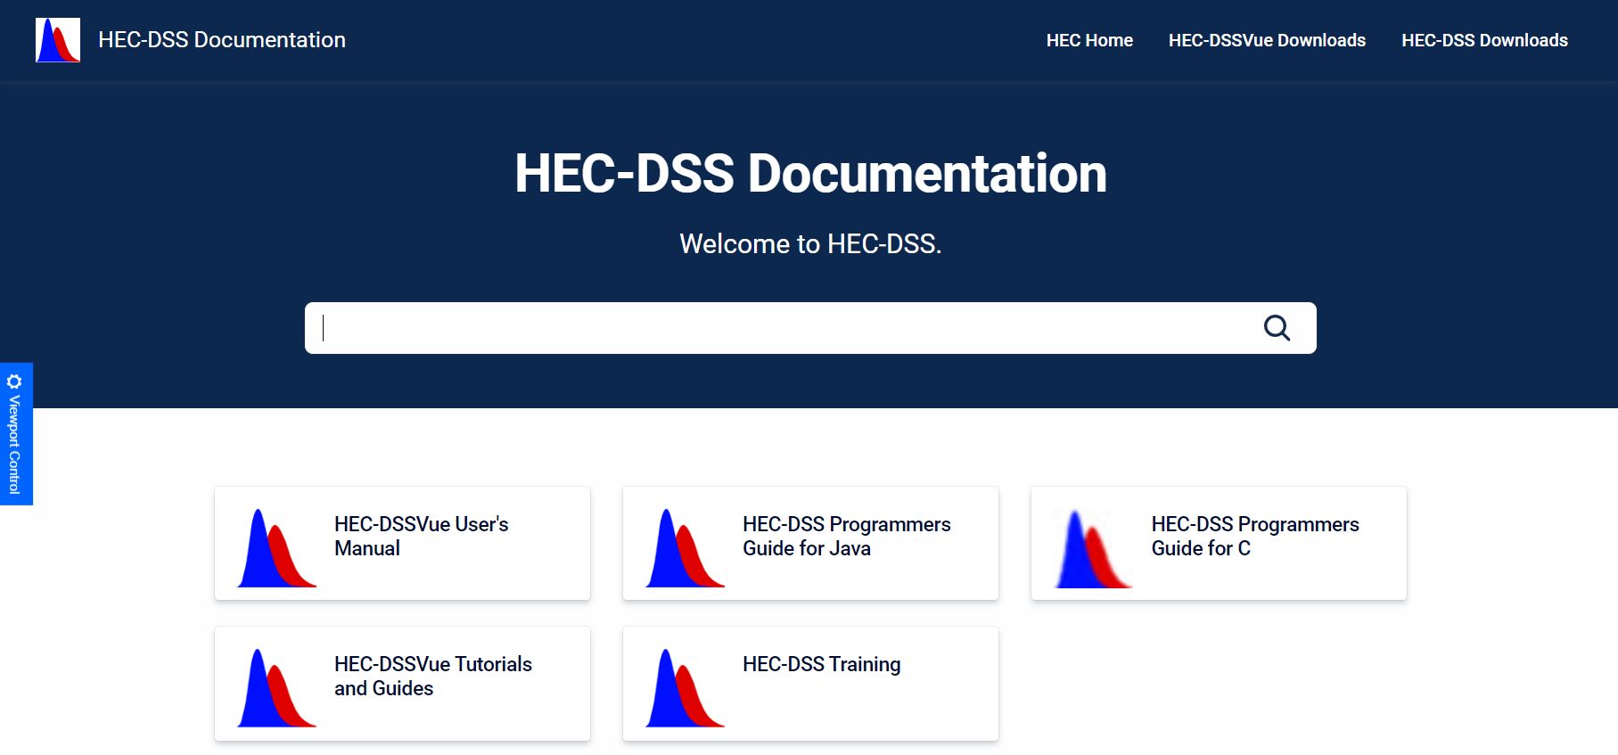
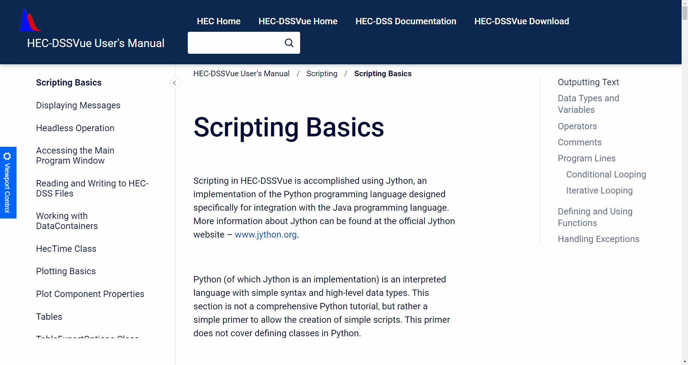
HEC Publications, Training, & Discourse
https://github.com/HydrologicEngineeringCenter/DSSVue-Example-Scripts/tree/master/src
https://www.hec.usace.army.mil/confluence/cwmsdocs
https://discourse.hecdev.net/tags/c/cwms/5/scripts
https://discourse.hecdev.net/tags/c/dssvue/15/scripts
https://www.hec.usace.army.mil/confluence/dssdocs

Slide 12
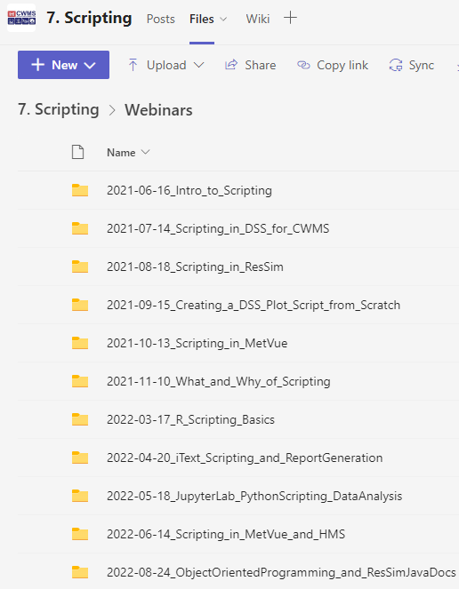

CWMS
MS Teams
CWMS MS Teams
  Group or one-on-one Chats & Meetings
  Live & Recorded Webinars
  Virtual Working Sessions & Workshops
MMC CWMS Team
  Scripting Channel
  Scripting Webinars
CWMS Cloud Migration
  Training

Slide 13
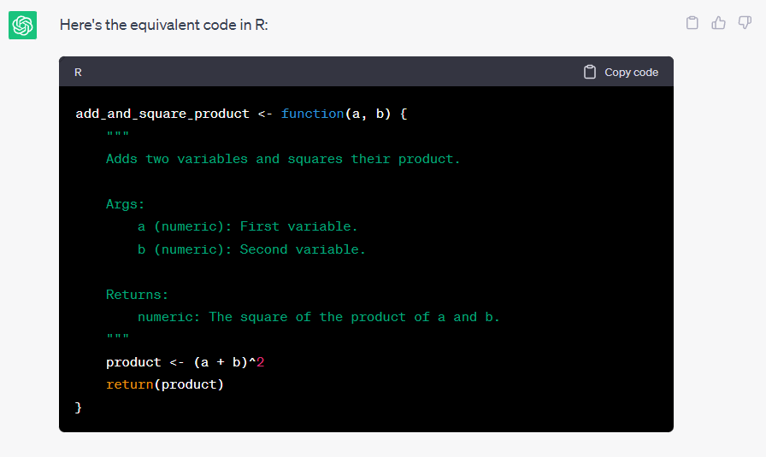
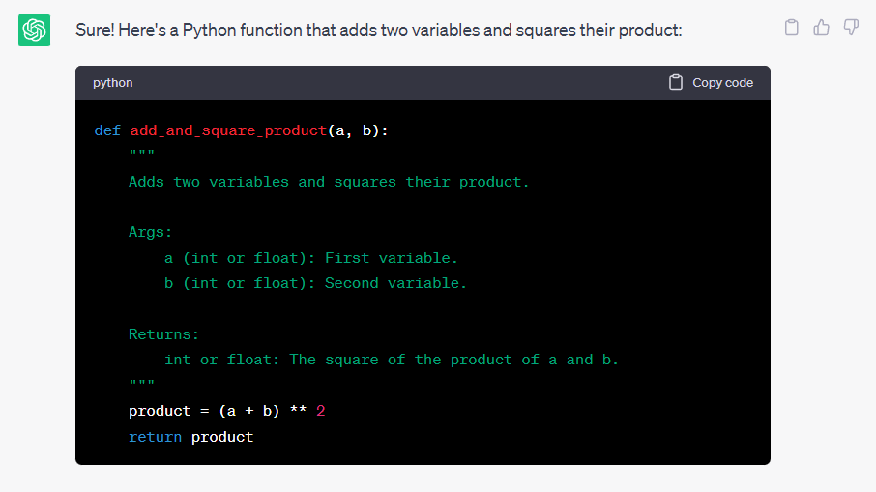

Other…

Slide 14
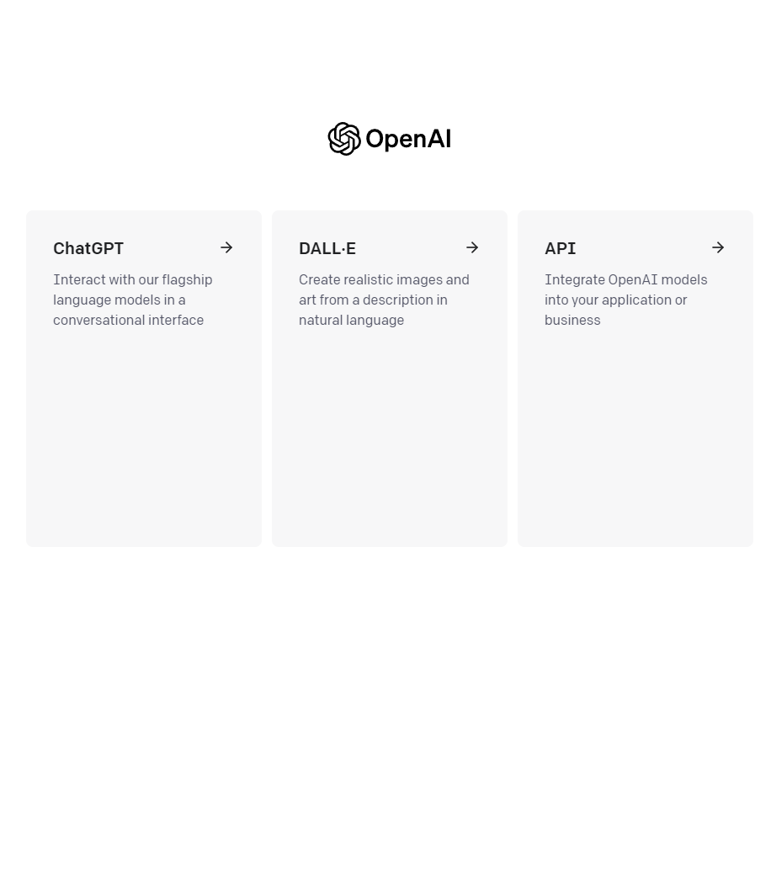

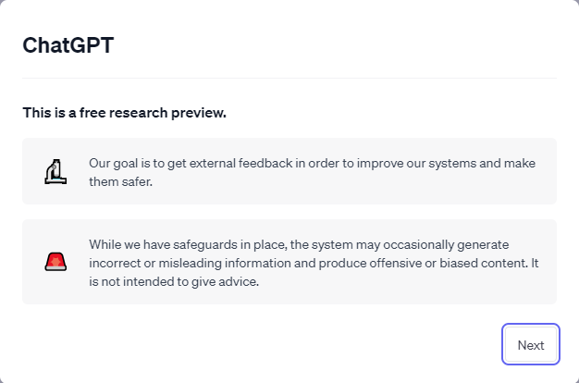
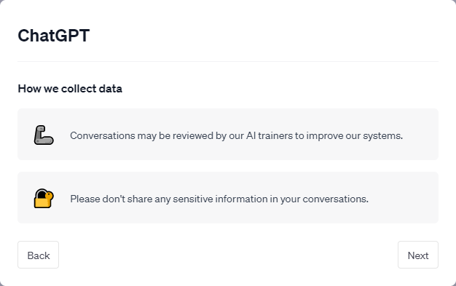
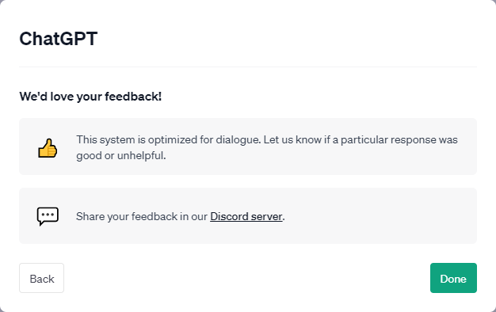
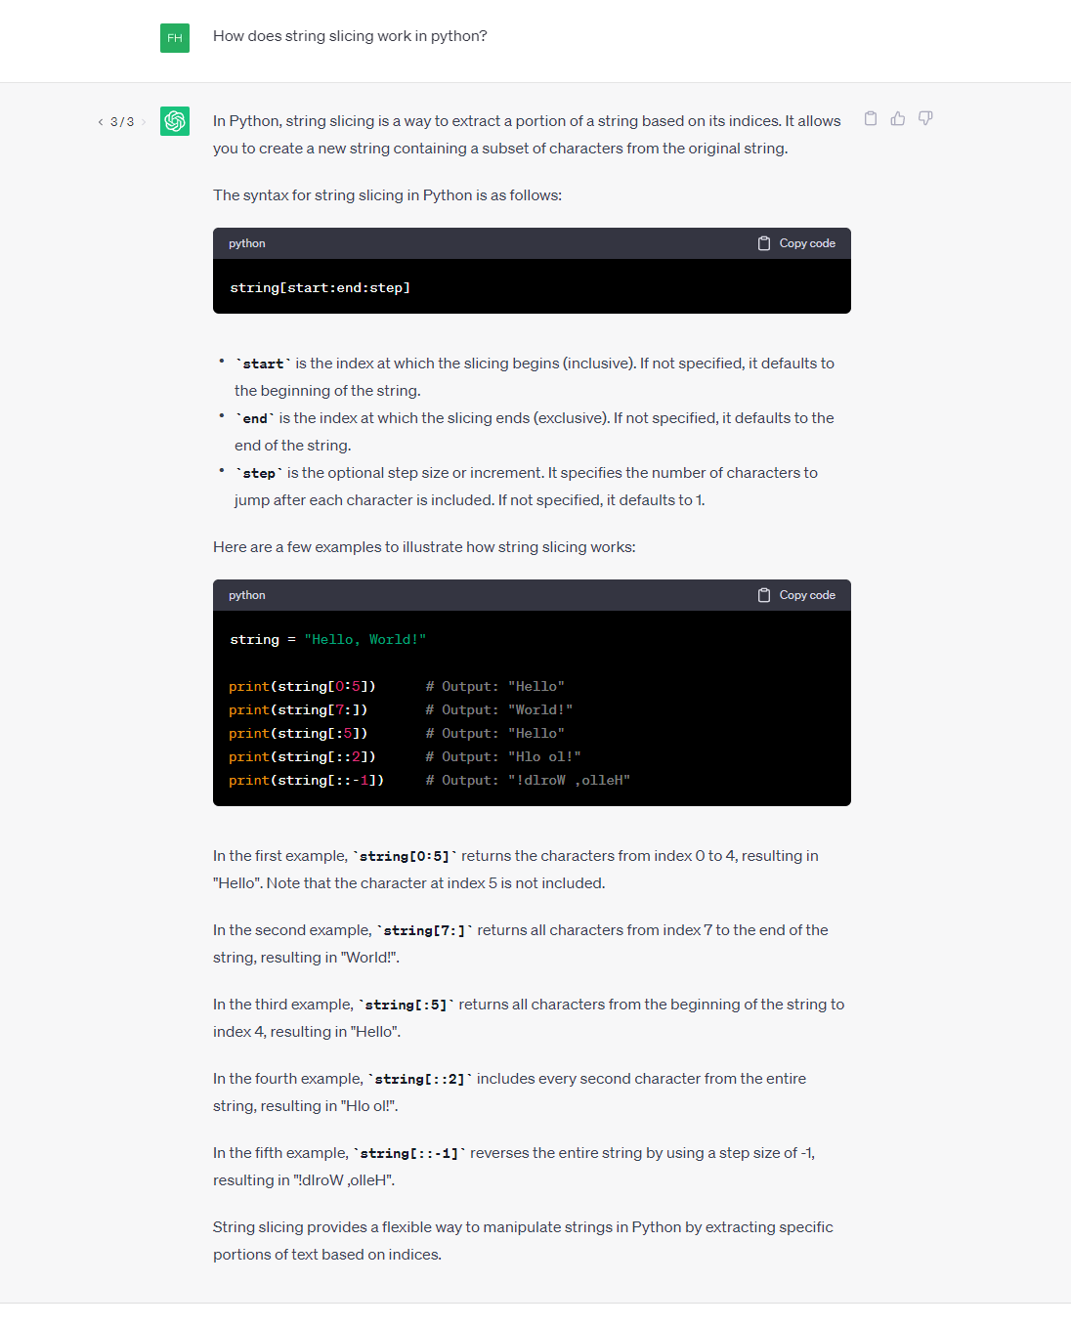
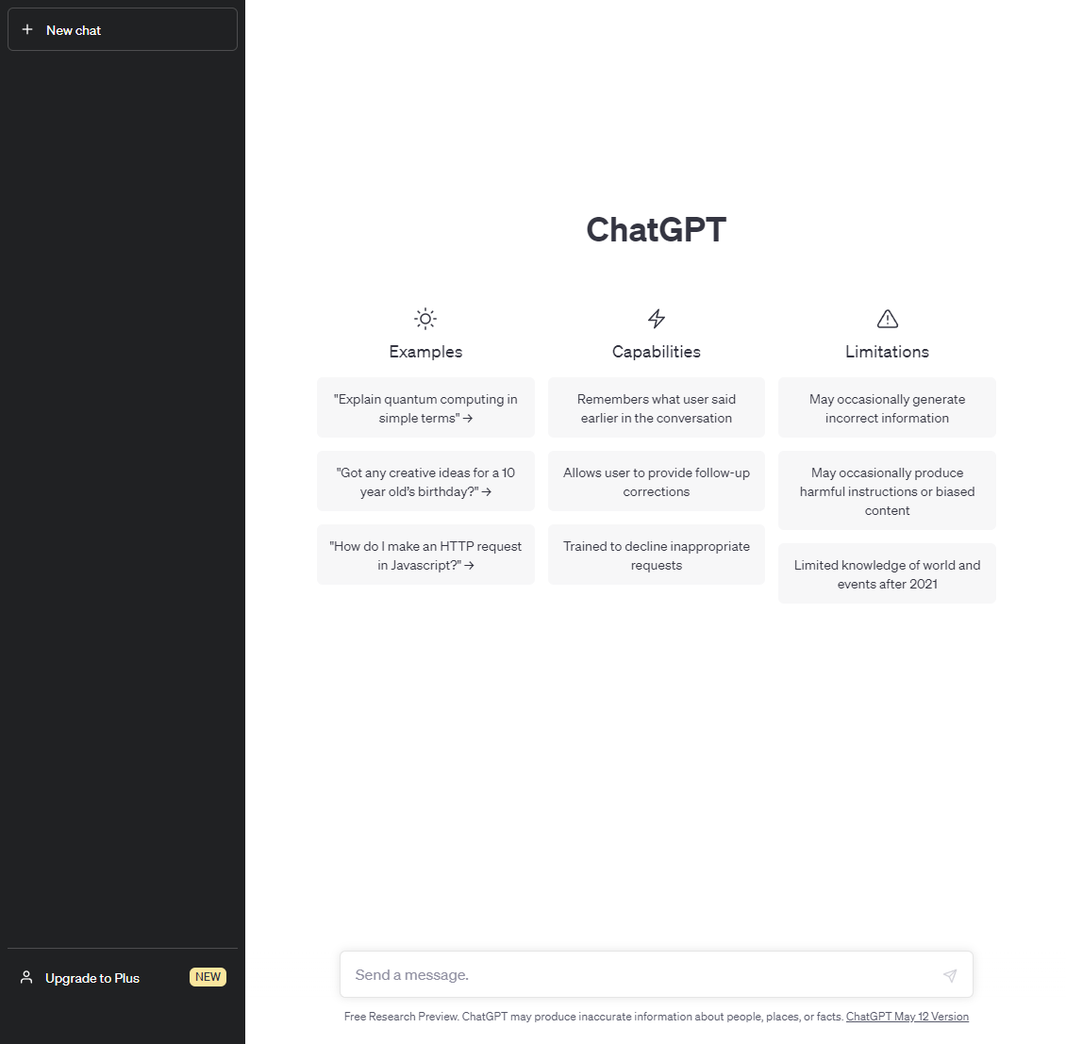
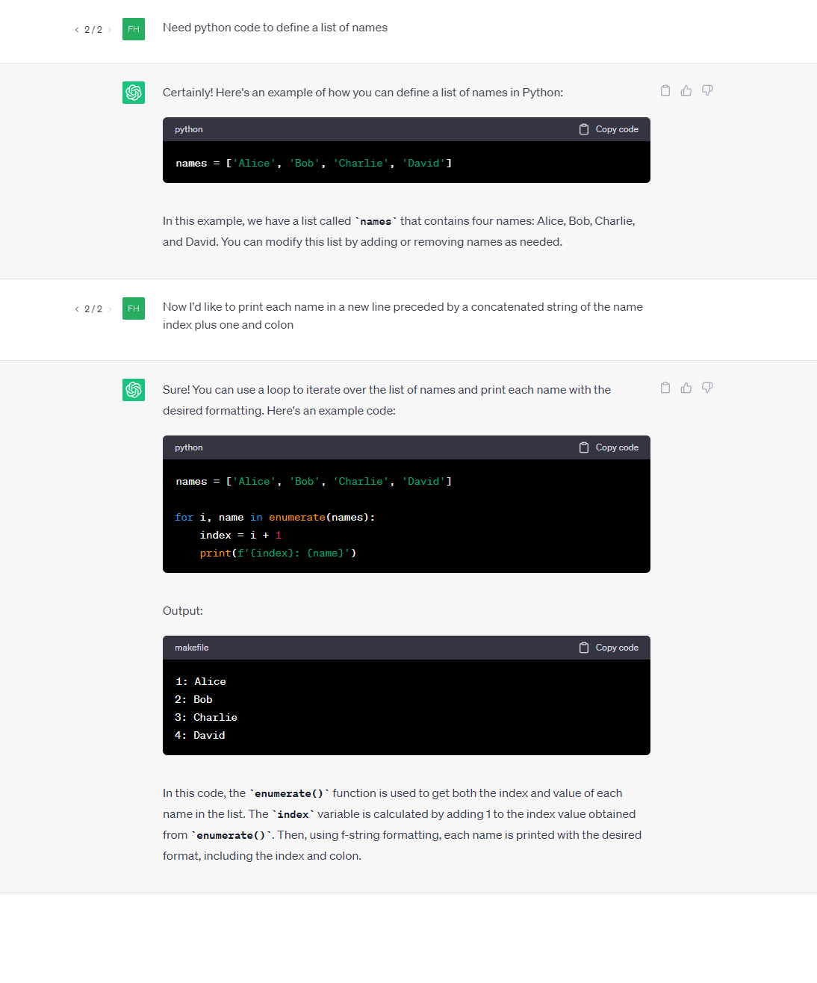
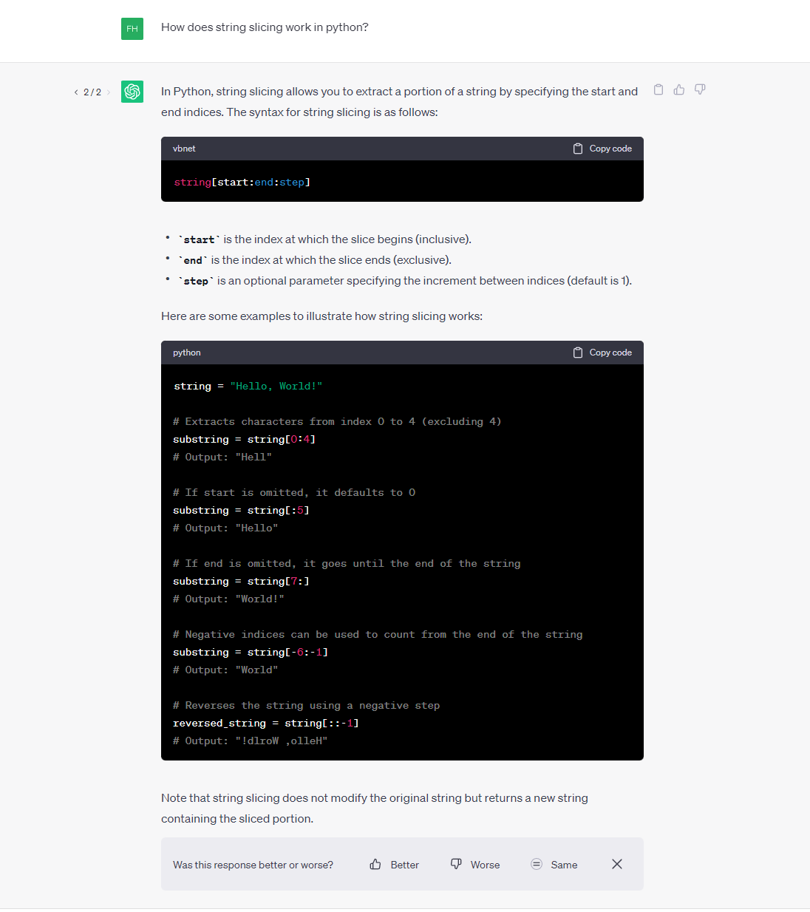
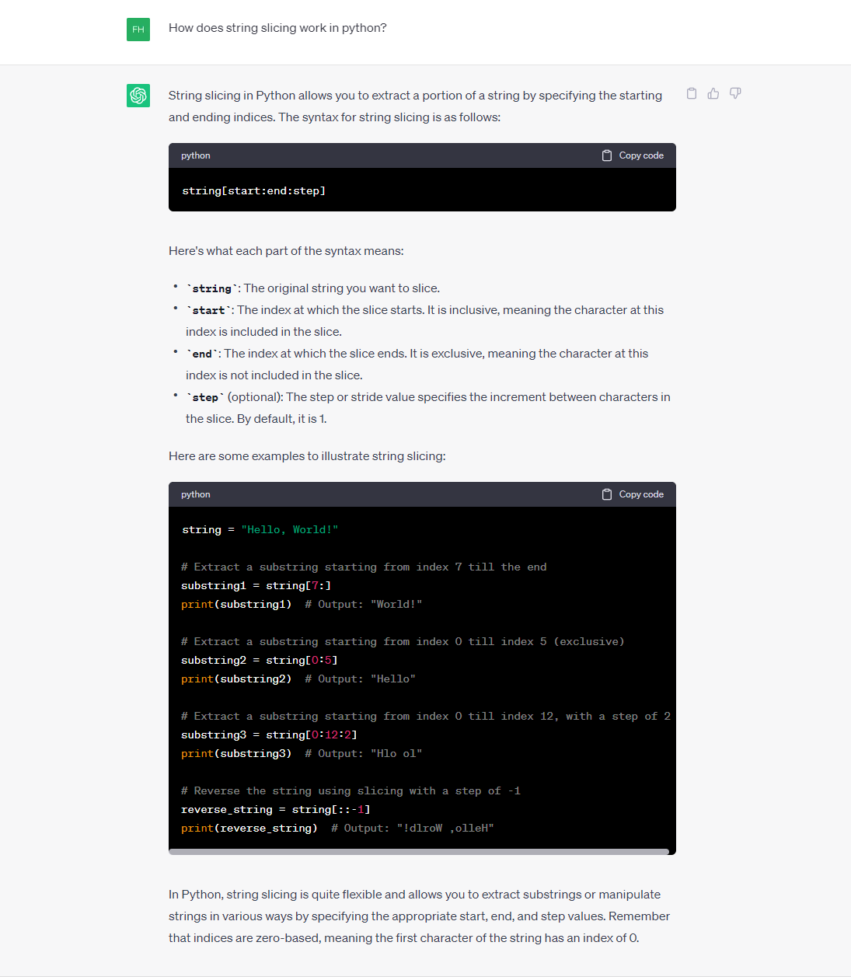

ChatGPT
Conversational AI
Ask for
  Code how-tos and examples
  Code syntax & debug checks, or refactor
  Code explanation or documentation
  Code language conversion
Copy answers and sample code
Like or Dislike answers
Regenerate responses
https://openai.com/blog/chatgpt
https://help.openai.com/en/collections/3742473-chatgpt

Slide 15
Summary of Resources
Free
Paid
CWMS Online
WWW
  YouTube
  Google
  Python.org
  W3School
  ChatGPT
MWR & O’Reilly Online
Army eLearning (Precipio)
Pluralsight
Real Python
  Videos
  Slack Channels for support
  Podcasts
HEC Publications & Training Materials
CWMS Discourse
  Community-wide Questions/Answers
CWMS MS Teams
  Group or one-on-one Chats & Meetings
  Live & Recorded Webinars
  Virtual Working Sessions & Workshops

Slide 16



Pick what you like 😃

