Slide 1

HEC-ResSim
State Variables
Fauwaz hanbali
MMC HEC-ResSim Scripting
August 2023

Slide 2
Topics
State Variables Definition and Editor Orientation
State Variable Editor API Pane
Additional Notes on State Variables
External Code Editor

Slide 3
State Variables
State Variables
State Variable Editor

Slide 4
State Variable Scripts
Executed During Simulations
Scripts that set the value of a state variable, which can be used by rules and IF-THEN-ELSE blocks to specify flow constraints
  A model variable represents the state of some parameter of an element of the network computed by ResSim at each time step of the simulation (thus, a time series). e.g., the reservoir pool elevation.
  A state variable is a model variable-like time series whose values are computed by a user-defined script for each time step; it need not represent the state of a parameter of single element.

Slide 5
State Variables
The Script Environment
State Variable scripts are executed at least once at every time step during the simulation period.
  State Variables are not computed during the lookback period.
  State Variable scripts can determine the current time step from the currentRuntimestep variable.
State Variables scripts may be executed more than once at every time step because of:
  Reservoir system operations
  Operations for downstream constraints
There is no direct way for state variable scripts to know if they are executing for the first or last time, or to pass information between executions except for the value of the State Variable.
Notes:
State variable doesn’t get evaluated in the LookBack period.
There is a method to figure out what comput loop you’re in.

Slide 6
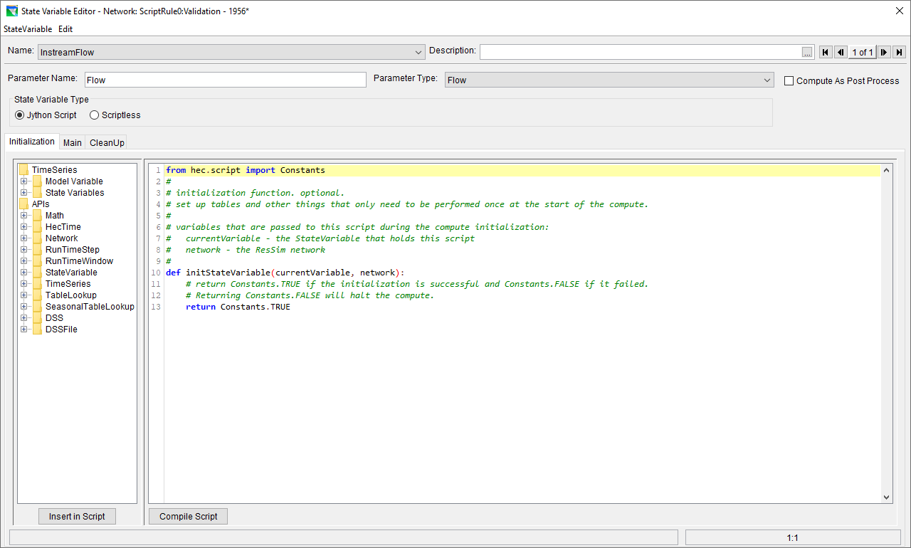
HEC-ResSim Scripting
State Variable Script Editor – Initialization Tab back
State Variable Name
Description
Parameter Name
Parameter Type
Context Tabs
API Pane
Script Pane
Action Buttons
1
2
3
4
5
6
7
8
Notes:
Initialization is to help with speed and if you just need to run it once.

Slide 7
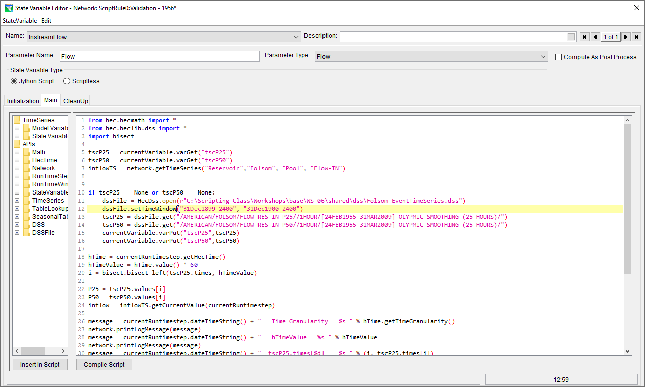
HEC-ResSim Scripting
State Variable Script Editor – Main Tab back
State Variable Name
Description
Parameter Name
Parameter Type
Context Tabs
API Pane
Script Pane
Action Buttons
1
2
3
4
5
6
7
8

Slide 8
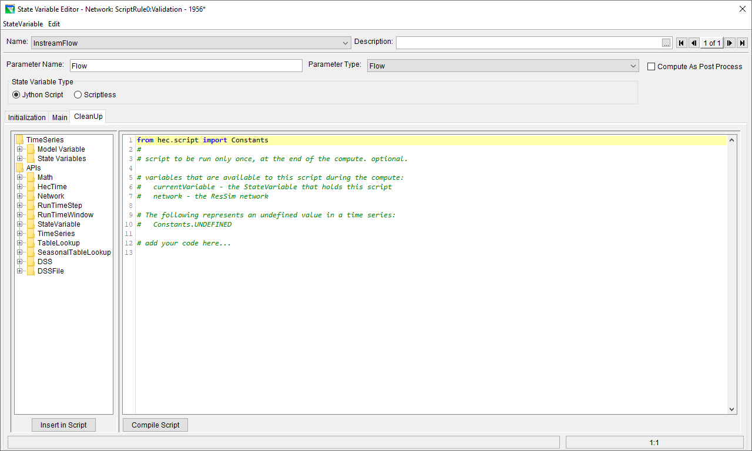
HEC-ResSim Scripting
State Variable Script Editor – Cleanup Tab back
State Variable Name
Description
Parameter Name
Parameter Type
Context Tabs
API Pane
Script Pane
Action Buttons
1
2
3
4
5
6
7
8

Slide 9
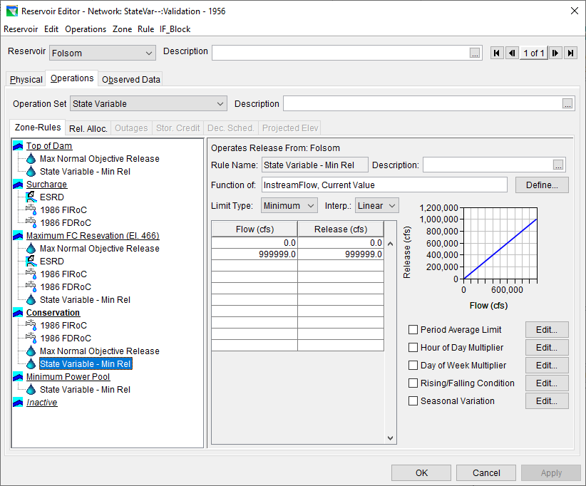
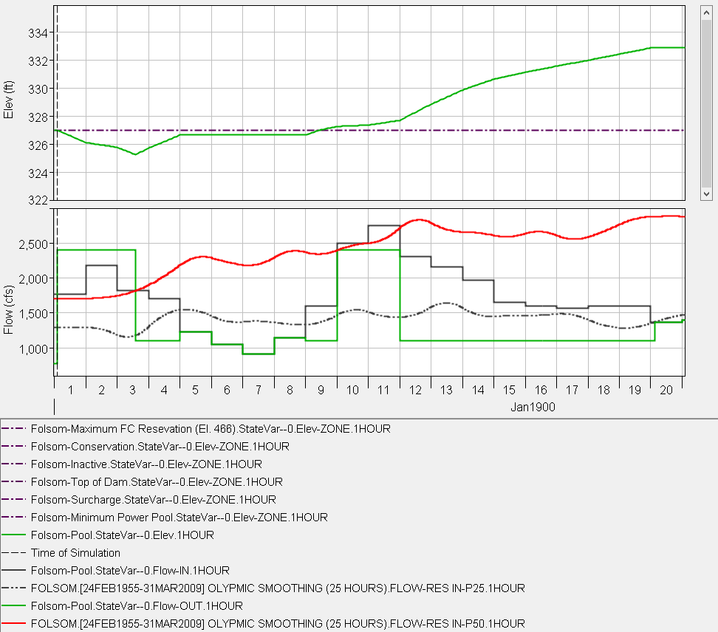
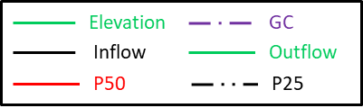
State Variable Example
Primary Script
(Initialization) Upfront only:
  Read Period-of-Record inflow time series
  Perform Cyclic Analysis
  Write out 25- and 50-percentile records
(Main) Every time interval:
  Get 25- and 50-percentiles
  Check using conditional statements where an inflow value falls relative to P25 & P50 values
    Write a secondary state variable
  Set the Minimum Release value accordingly
  (Cleanup)
    Generate a plot and report
Secondary Script
Store inflow states:
  1 when Inflow[i]<P25[i]
  2 when P25[i]<Inflow[i]<P50[i]
  3 when Inflow[i]>=P50[i]
Notes:
This exampe is going to read from dss. In the main script will run the cyclic analysis. Then it will set the min flow . Then the last piece will generatr plots for you.

Slide 10
API
HEC-ResSim API Pane
HEC-ResSim API Examples

Slide 11
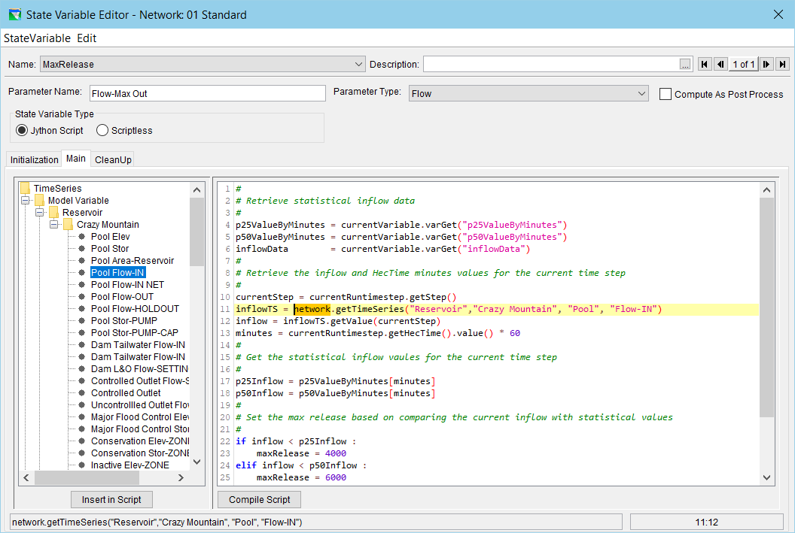
State Variable Editor
API Pane – Model Variables

Slide 12
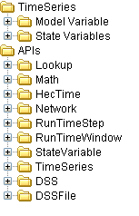
API Pane
Time Series (Time Series Data Retrieval)
  Model Variables
  State Variables
APIs (Packages & Methods)
  Math (hec.hecmath.TimeSeriesMath)
  HecTime (hec.hec.lib.util.HecTime)
  Network (hec.rss.model.RssSystem)
  RunTimeStep (hec.model.RunTimeStep)
  RunTimeWindow (hec.model.RunTimeWindow)
  State Variable (hec.rss.model.StateVariable)
  TimeSeries (hec.model.TSRecord)
  DSS (hec.hecmath.DSS)
  DSSFile (hec.hecmath.DSSFile)

Slide 13
Time Series
(hec.model.TSRecord)
EXAMPLE TIME SERIES RETRIEVAL:
  network.getTimeSeries("Reservoir",“[ReservoirName]", "Pool", "Elev")
  network.getTimeSeries("Reservoir ",“[ReservoirName]", "Pool”, Flow-IN")
  network.getTimeSeries("Reservoir ",“[ReservoirName]", "Conservation", "Stor-ZONE")
  network.getTimeSeries("Reach",“[ReachName]", "", "Flow")
  network.getTimeSeries("Junction ",“[JunctionName]", "", "Flow")
  network.getTimeSeries("Diversion ",“[DiversionName]", “[DiversionName] Cntrl", "Flow")
  network.getTimeSeries("Diversion ",“[DiversionName]", “[DiversionName] Rch", "Flow")

Slide 14
Math
(hec.hecmath.TimeSeriesMath)
multiply(floating-point)
  Parameters: floating-point constant
  Return Type: hec.hecmath.HecMath
  Example:
  from hec.heclib.dss import HecDss, DSSPathname
  from hec.hecmath import TimeSeriesMath
  DssFile = HecDss.open(r”c:/temp/sample.dss”, True)
  tsData = DssFile.read(“/A/B/C///F/”)
  tsData.multiply(5.0)

Slide 15
HecTime
(hec.hec.lib.util.HecTime)
add(integer)
  This method adds the specified increment in minutes to the object’s date and time.
  Parameters: integer timeGranularity/increment
  Return Type: None
  Example:
      hTime = currentRuntimestep.getHecTime()
      hTime.add(60)

Slide 16
Network
(hec.rss.model.RssSystem)
getTimeSeries(string, string, string, string)
Parameters: string elementType
      string elementName
      string childElementName
      string tsRecordParam
Return Type: hec.model.TSRecord
Example:
      network.getTimeSeries(“Reservoir”, “[ReservoirName]”, “Pool”, “FLOW-IN”)

Slide 17
RunTimeStep
(hec.model.RunTimeStep)
getStep()
  This method gets the current time step index.
  Parameters: Takes no parameter
  Returns: The current time step index
  Return Type: integer
  Example:
      currentTimeStepIdx = currentRuntimestep.getStep()

Slide 18
TimeSeries
(hec.model.TSRecord)
max(integer, integer)
  Parameters: integer startingStep
    integer period
  Return Type: floating-point
  Example:
    ts1 = network.getTimeSeries(“Reservoir”, “[ReservoirName]”, “Pool”, “Flow-IN”)
    curStep=currentRuntimestep.getStep()
    ts1.max(curStep, 12)

Slide 19
RunTimeWindow
(hec.model.RunTimeWindow)
getStartTime()
Return Type: hec.heclib.util.HecTime
Example:
currentRuntimeWindow.getStartTime()

Slide 20
State Variable
(hec.rss.model.StateVariable)
getValue(hec.model.RunTimeStep)
  Parameters: hec.model.RunTimeStep currentRuntimestep
  Return Type: floating-point
  Example:
    currentVariable.getValue(currentRuntimestep)
    network.getStateVariable(“[StateVariableName]”).getValue(currentRuntimestep)

Slide 21
DSS
(hec.hecmath.DSS)
open(string, string, string)
Parameters:
      string fileName
      string startTime
      string endTime
Return Type: string
Example:
      from hec.heclib.dss import HecDss
      DssFile = HecDss.open(r”c:/temp/sample.dss”, “01Oct1985 0000”, “30Sep1986 2400”)
  .

Slide 22
DSSFile
(hec.hecmath.DSSFile)
read(string, string)
  Parameters: string pathname
    string timeWindow
Return Type: hec.hecmath.HecMath
Example:
hec.heclib.dss import HecDss, DSSPathname
  DssFile = HecDss.open(r”c:/temp/sample.dss”, True)
  tsData = DssFile.read(“/A/B/C///F/”, “01Oct1985 0000 30Sep1986 2400”)

Slide 23
Additional Notes
Pre-Defined Variables
Getting and Setting the State Variable Value
Using Persistent Script Data
Coordinating Multiple State Variables

Slide 24
State Variables
Pre-Defined Variables
State Variable scripts are executed with three variables pre-defined:
  currentVariable
    contains the State Variable time series, regardless of the name of the State Variable in the Reservoir Network
  currentRuntimestep
    contains the model time step currently being evaluated
  network
    contains the ResSim Reservoir Network object, which is used to access model variables

Slide 25
State Variables
Getting and Setting the State Variable Value
The value is always accessed through the currentVariable identifier.
  currentVariable.getPreviousValue(RunTimeStep)
    Retrieves the value of the state variable for the time step before the one specified.
  currentVariable.getCurrentValue(RunTimeStep)
    Retrieves the value of the state variable for the specified time step.
  currentVariable.setCurrentValue(RunTimeStep, value)
    Sets the value of the state variable at the specified time step to the specified value.
The currentRuntimestep variable is normally used for the RunTimeStep parameter, but other RunTimeSteps can also be used.

Slide 26
State Variables
Data Persistence
It is often useful for a state variable script to be able to save information to be used from one execution to the next, or to be able to tell if it is executing for the first time in a simulation.
File-based access is too slow to be practical for a state variable script.
State variables have the following methods to accomplish this:
varExists(name) | Returns whether the named object exists in the state variable.
varGet(name) | Returns the named object from the state variable.
varPut(name, object) | Stores the named object to the state variable.
varRemove(name) | Deletes the named object from the state variable.
varsListKeys() | Returns a list of names for objects in the state variable.
varsSize() | Returns the number of objects stored in the state variable.
varsClear() | Deletes all objects stored in the state variable.

Slide 27
State Variables
Data Persistence Example
  import time
  thisTime = time.time()
  if currentVariable.varExists(“lastTime”) :
  firstExecution = False
  lastTime = currentVariable.varGet(“lastTime”)
  else :
  firstExecution = True
  lastTime = None
  currentVariable.varPut(“lastTime”, thisTime)

Slide 28
State Variables
Coordinating Multiple State Variables
State Variable scripts are executed in an undefined order.
  One state variable script cannot assume that another state variable script has completed execution for the current time step.
To coordinate, one script must be the “primary” Jython script, which sets the values of all the secondary scriptless state variables to be coordinated.
  The HEC-ResSim state variable API has methods for retrieving and setting the values of other state variables.
    network.getStateVariable(name).setValue(RunTimeStep, value)
  The scripts for the other state variables should contain only comments specifying where the code actually exists.

Slide 29
State Variables
Coordinating Multiple State Variables Example
Primary (Jython Script)
  if elevations[0] > elevations[2] :
  network.getStateVariable(
  "ESRD1956_Pool_RisingCondition"
  ).setValue(currentRuntimestep, True)
  else :
  network.getStateVariable(
  "ESRD1956_Pool_RisingCondition"
  ).setValue(currentRuntimestep, False)
Secondary (Scriptless)
  #
  # The code to set this variable "ESRD1956_Pool_RisingCondition"
  # is in the script “ESRD1956_Pool_RateOfRise”
  #

Slide 30
External
Code Editor
VS Code

Slide 31
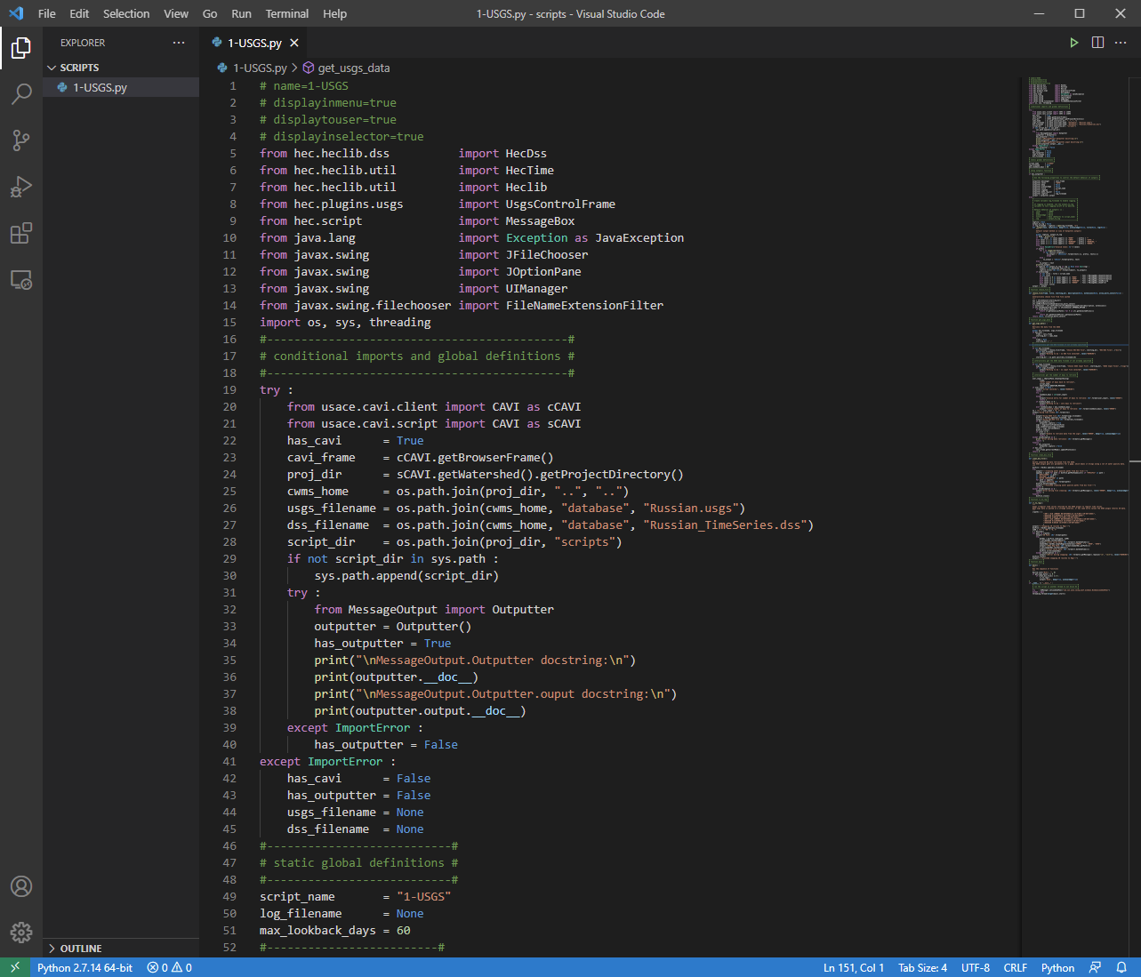
VS Code
Download from code.visualstudio.com
Most popular IDE
Supports many programming languages, including Python
(+)Extremely responsive
(-)Doesn’t support Jython
  No code completion for Java methods
  No source level debugging for Jython

Slide 32
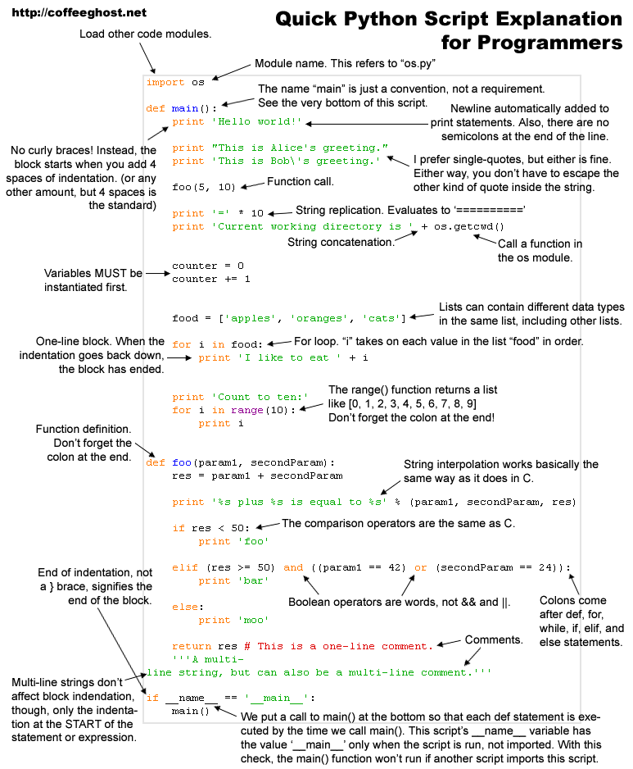
Questions
?

