Slide 1
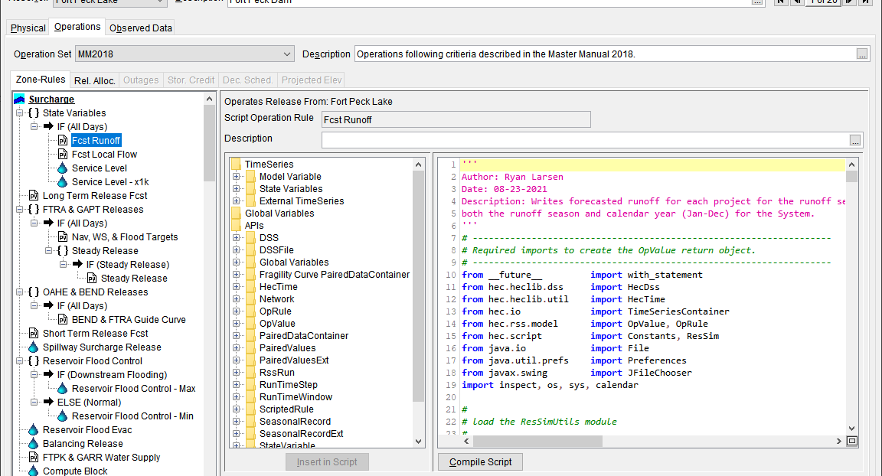
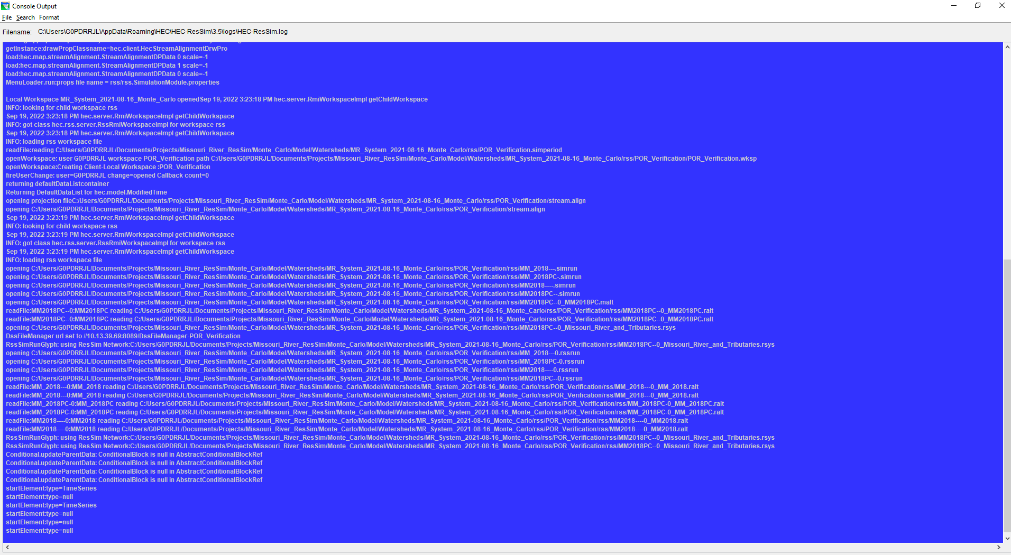
HEC-ResSim Scripting Class
Troubleshooting Broken Scripts

Slide 2
Overview
Error Traceback
  What is traceback?
  Where to Find Error Traceback
    Compute Window
    Console Log
Deciphering Traceback
Error Types
Understanding ResSim Compute Sequence
Print It Out

Slide 3
ErroR Traceback
When Jython encounters an error in compiling or executing a script it prints an exception trace (aka Traceback) that includes:
    A call stack
      represents the state of the script when the error occurred
      hierarchy of module entries and function calls, including file names and line numbers
      bottom line is the actual location of the error
    The error type
    Any available error information

Slide 4
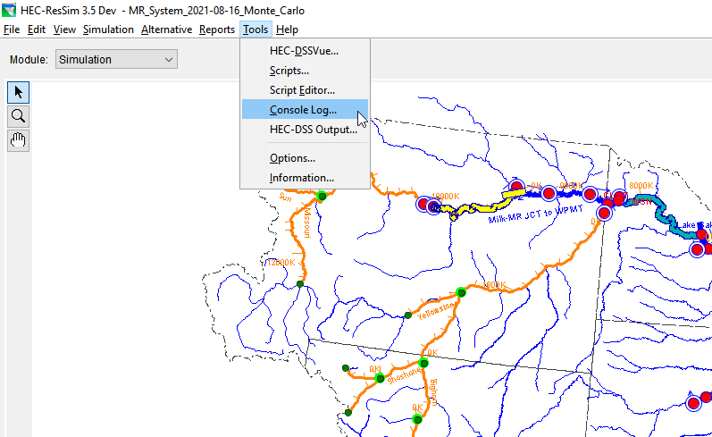
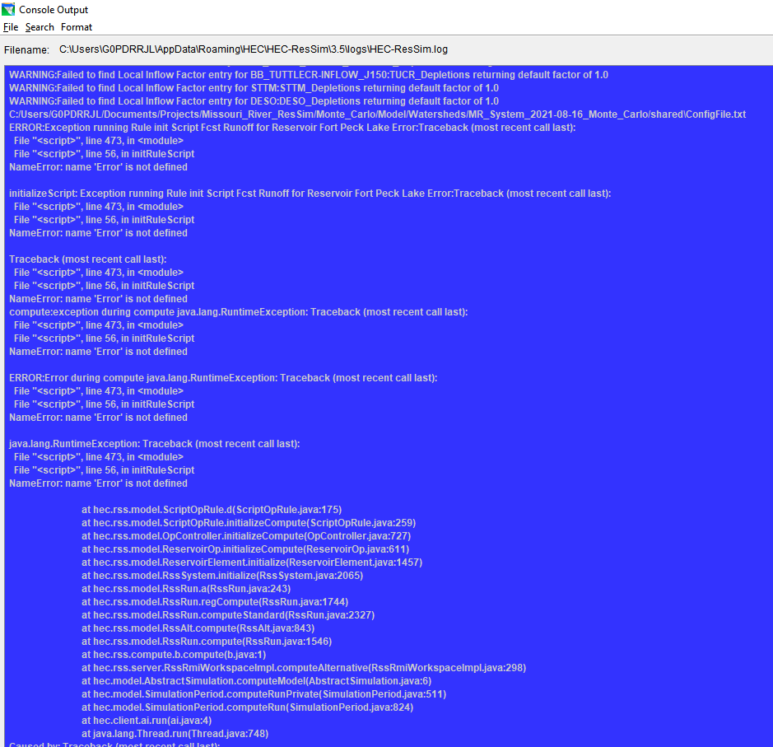
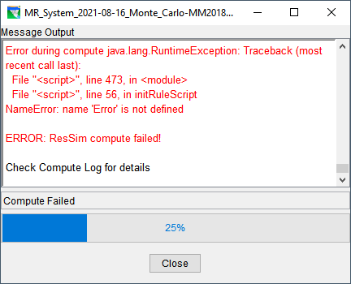
ResSim Traceback

Slide 5
ResSim Traceback
Finding Errors in Console Log
  Click within the Console Log window
  Ctrl + End (moves cursor to bottom of log)
  Scroll up to find “ERROR:Exception running…”
Similar information found in Compute Window
Depending on error, can show less information than Console Log

Slide 6
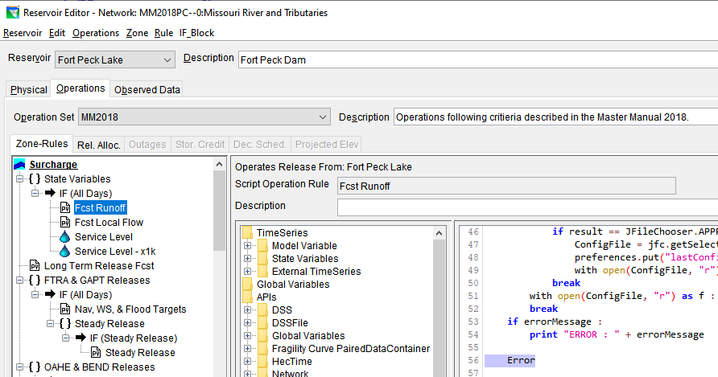
Deciphering Traceback
Call Stack:
File, Line Number, Function, etc.
Error Type
Error Information

Slide 7
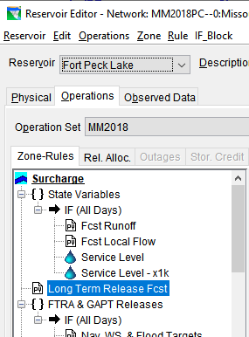
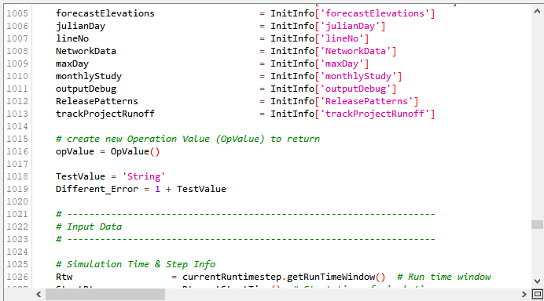
Deciphering Traceback

Slide 8
Error Types
Error Type | Reason for Error
AttributeError | Tried to access a non-existent item in a module or class.
IOError | Error opening, creating, reading, or writing a file.
ImportError | Cannot find the specified module for importing.
IndexError | Sequence subscript is out of range.
NameError | Tried to access a non-existent variable.
SyntaxError | Invalid Jython code. The error is often on the line before the one indicated.
TypeError | Attempted operation using invalid data type.
UnboundLocalError | Tried to access an undefined variable.
ValueError | Attempted operation using correct data type, but invalid value.
ZeroDivisionError | Attempted to divide by zero or perform modulo zero.

Slide 9

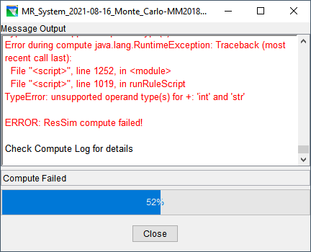
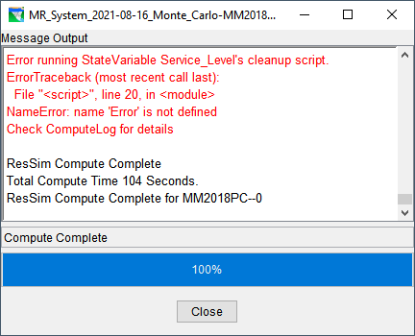
ResSim Compute Sequence
Initialization
RunRule (Scripted Rules) / Main (State Variables)
Clean Up

Slide 10
Print Statements
Print statements are a great way to track the progress of a script and calculations
print ‘This will print to the log file’
print ‘%s’ % ‘This does too’
Filling your script with print statements will slow your compute down
Using a debug function allows you to create print statements that can quickly be turned on or off.

Slide 11
Debugging Function
def lineNo() :
return inspect.currentframe().f_back.f_lineno
def outputDebug( *args
) :
ArgCount = len(args)
if ArgCount < 2 :
raise ValueError('Expected at least 2 arguments, got %d' % argCount)
if type(args[0]) != type(True) :
raise ValueError('Expected first argument to be either True or False')
if type(args[1]) != type(1) :
raise ValueError('Expected second argument to be line number')
if args[0] == True:
DebugStatement = 'Debug Line %d |\t' % args[1]
for x in range(2, ArgCount, 1) :
DebugStatement += str(args[x])
print DebugStatement

Slide 12
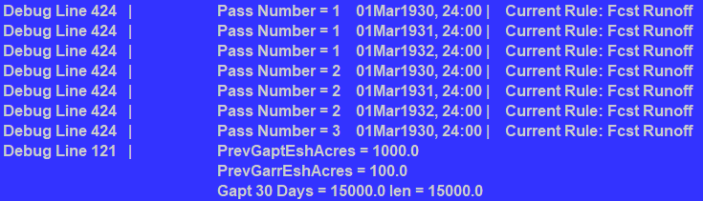
Debug Statement
debug = True
outputDebug(debug, lineNo(), 'Pass Number = %d %s | Current Rule: %s' % (PassNumber, CurrentHecTime.dateAndTime(4), currentRule))
outputDebug(debug, lineNo(), 'PrevGaptEshAcres = ', PrevGaptEshAcres, '\n\t\tPrevGarrEshAcres = ', PrevGarrEshAcres, '\n\t\tGapt 30 Days = ', PrevGaptFlowOut30dayAve, ' len = ', PrevGaptFlowOut30dayAveNew)

Slide 13
Questions?
?

