Slide 1
Version Control With git/GitHub
Evan Heisman, PE

Slide 2
Outline
Why version control?
What is `git`?
`git` basic concepts
Resources to learn more

Slide 3
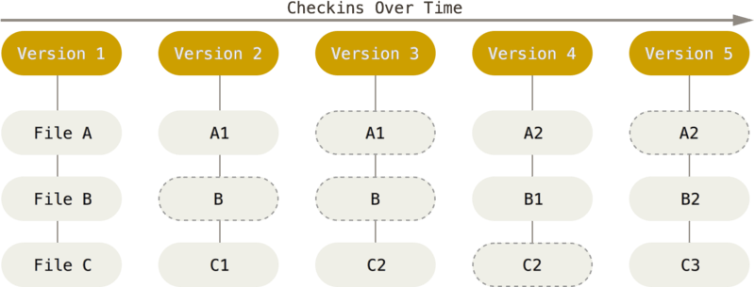
Why version control?

Slide 4
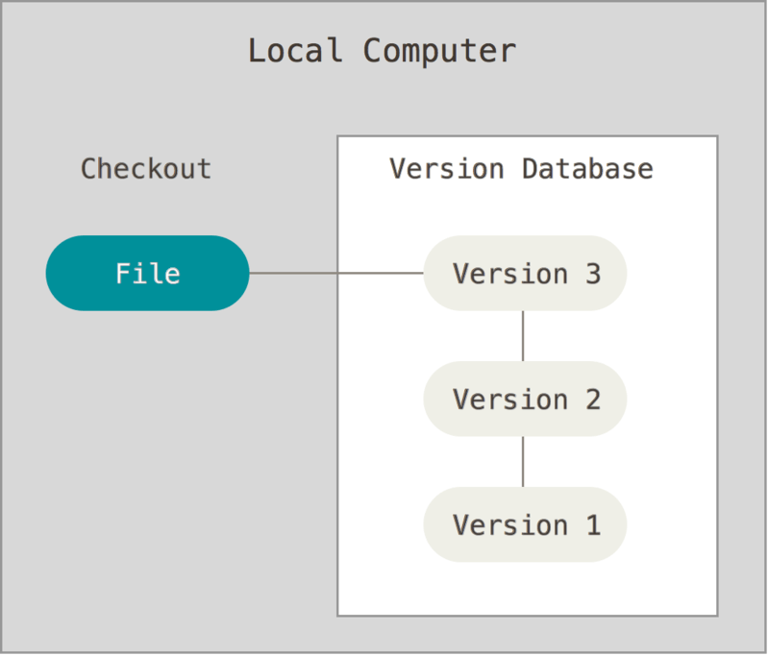
Why version control?
Notes:
Command line interface
“git bash” from windows context menu
Any other command line on a system with git installed
“git <command> <options>
Also has the “git GUI”
Git in IntelliJ
BitBucket UI

Slide 5
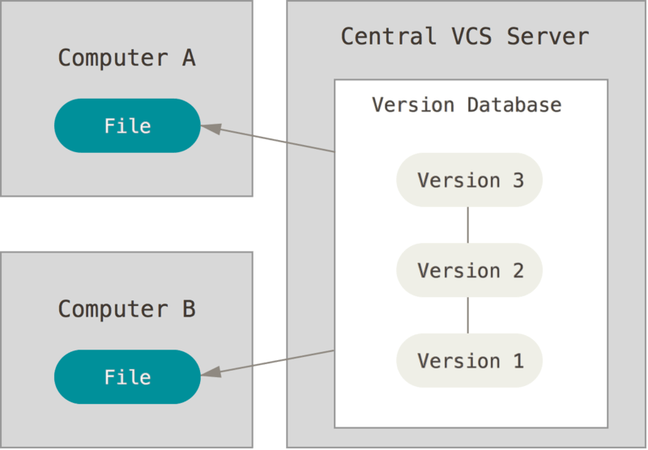
Why version control?

Slide 6
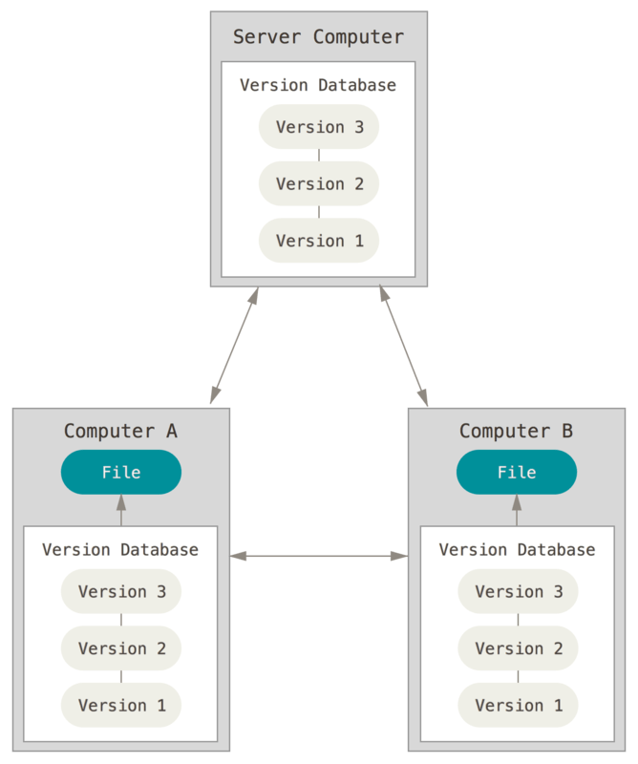
Why version control?

Slide 7
Why version control?

Slide 8
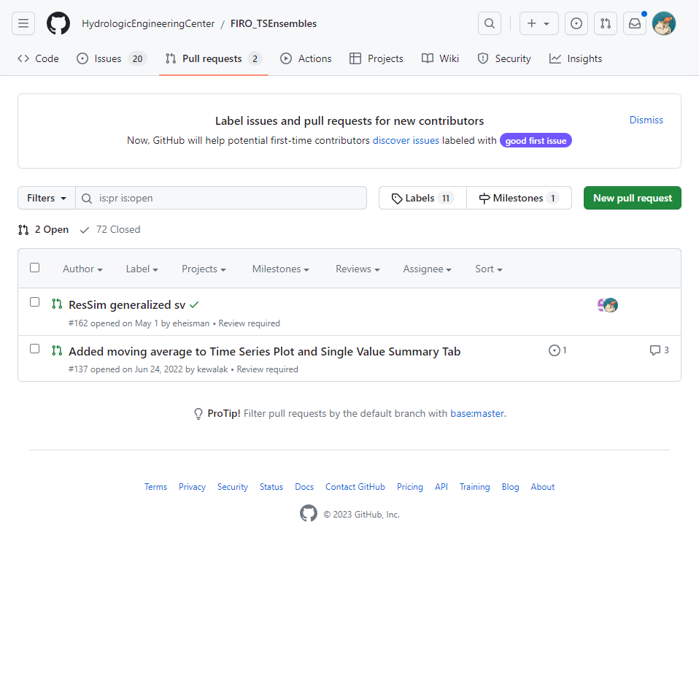
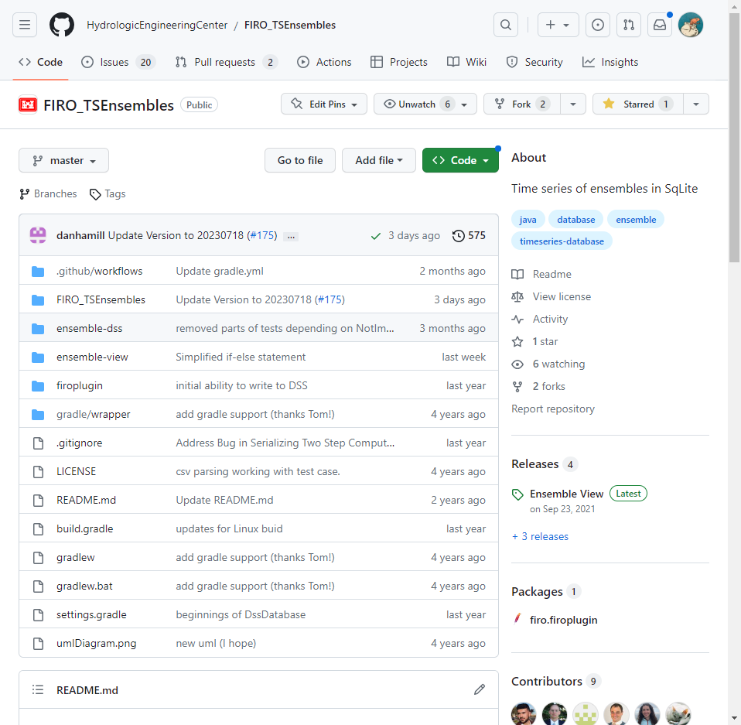
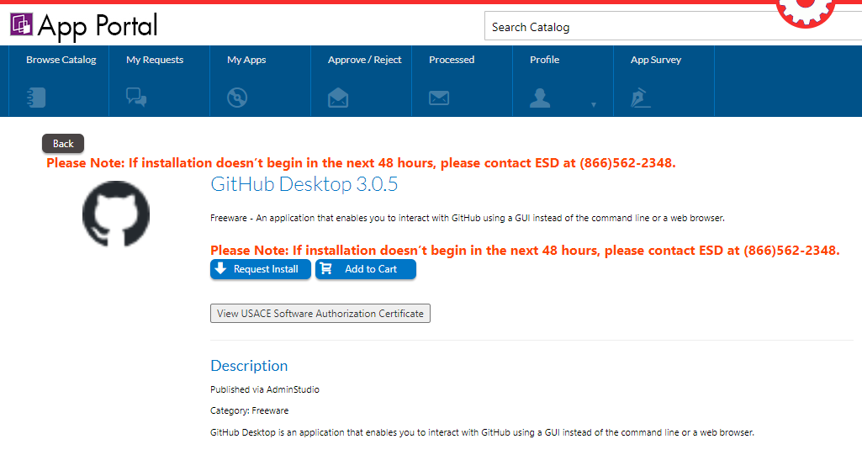
What is `git` vs Bitbucket vs Github
git: version control software / “protocol”
GitHub: popular git repository server with its own issue tracking, documentation, build systems, great for public collaboration
Others: BitBucket, Gitlab, Gitea
Notes:
Command line interface
“git bash” from windows context menu
Any other command line on a system with git installed
“git <command> <options>
Also has the “git GUI”
Github has a GUI
Git in IntelliJ or other IDEs
BitBucket UI

Slide 9
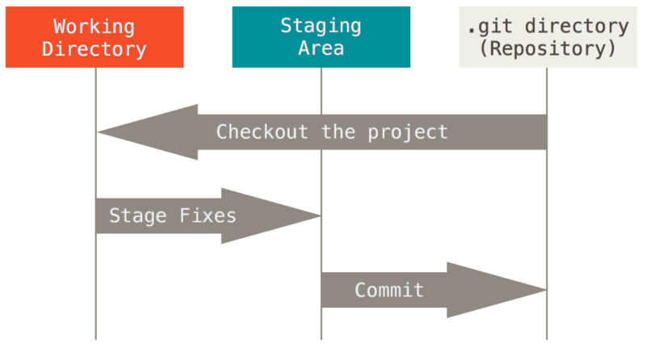
Git basics
What is a repository?
  Init / clone / open project from…
  Git add/commit
  git ignore
  Repository settings
What is a branch?
  Checkout
  Switch
  Merge
  (Stash / rebase)
Working with remote repositories
  Clone/fetch
  Push and pull
  Pull request

Slide 10
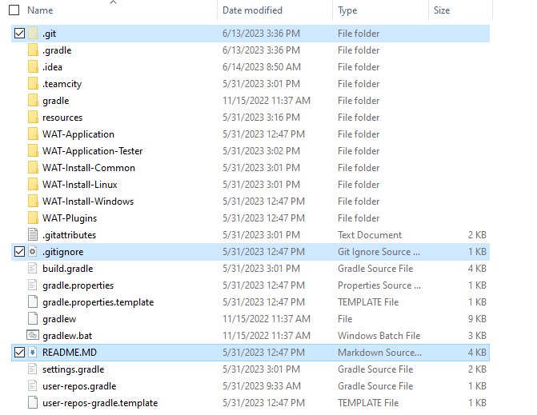
An EXAMPLE REPOSITORY
Your active files
.git directory
  Settings
  Version of files
.gitignore (optional)
README.md (optional)

Slide 11
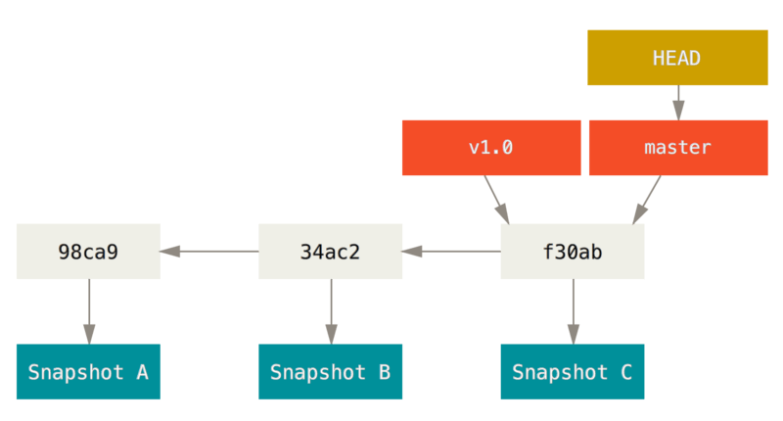
Branches

Slide 12
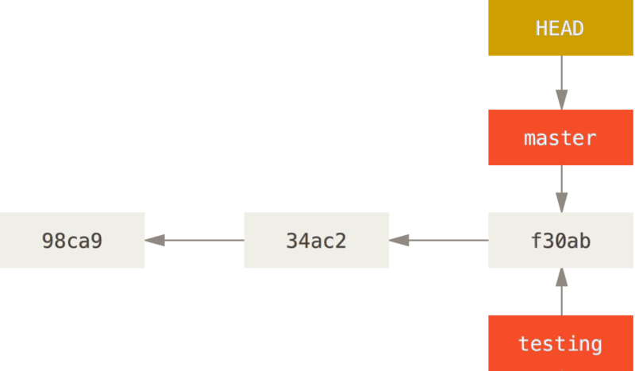
Branches

Slide 13
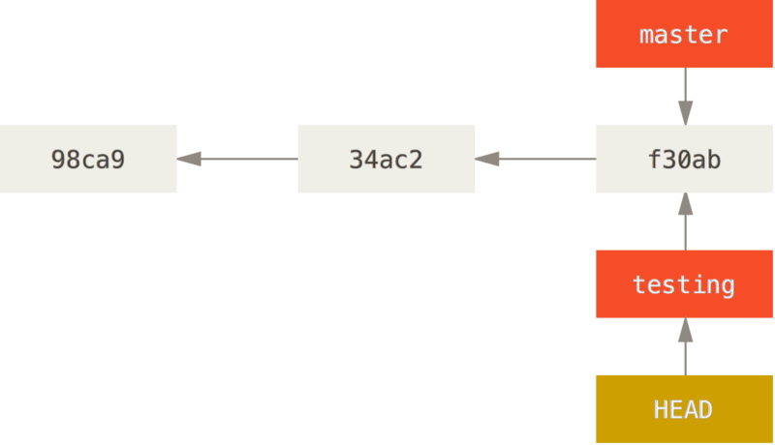
Checkout testing

Slide 14
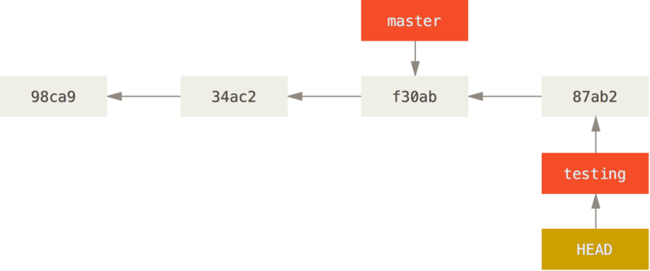
Commit to Testing

Slide 15
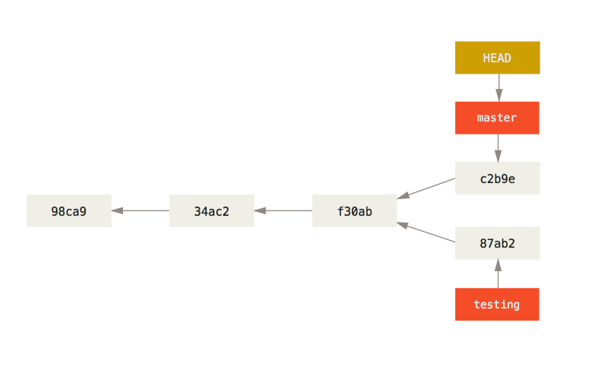
Commit to Testing

Slide 16
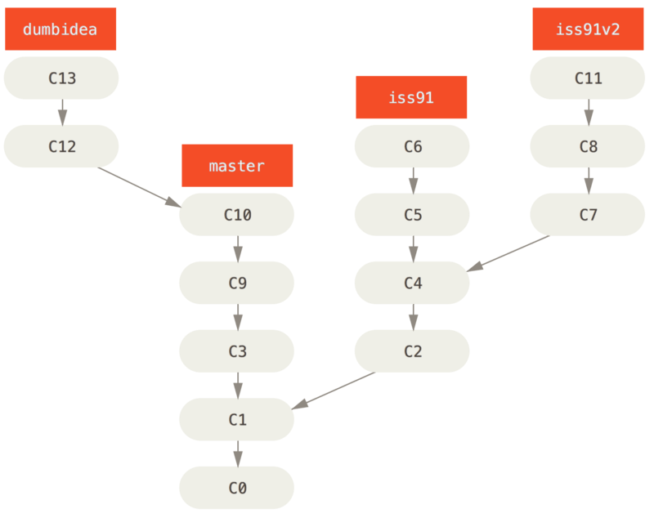
MERGE REPOSITORIES

Slide 17
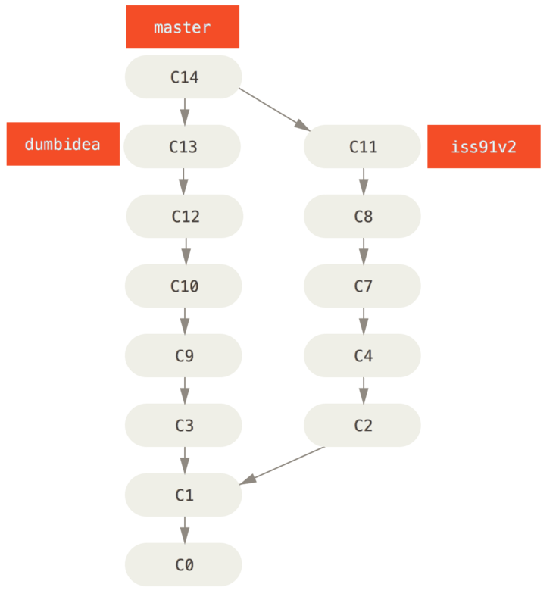
MERGE REPOSITORIES
Notes:
Merging ‘dumbidea’ and ‘iss91’ gets us to a cleaner tree

Slide 18
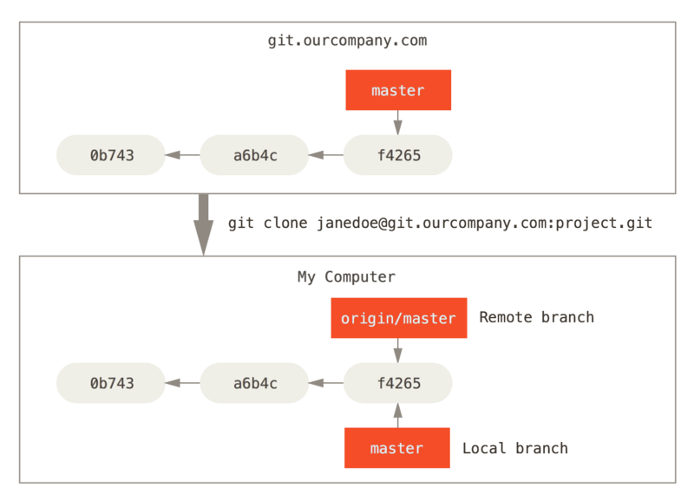
Working with REMOTES

Slide 19
WORKING WITH REMOTES

Slide 20
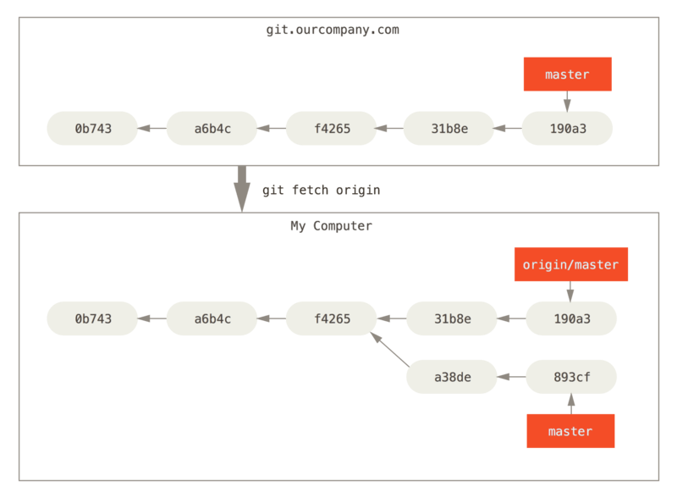
WORKING WITH REMOTES
Notes:
Git pull is “fetch + merge”
Reverse of this doesn’t work – why?
Origin master has different commits on it than local master
Git push moves the changes in the local database back to the server, usually for a single branch

Slide 21
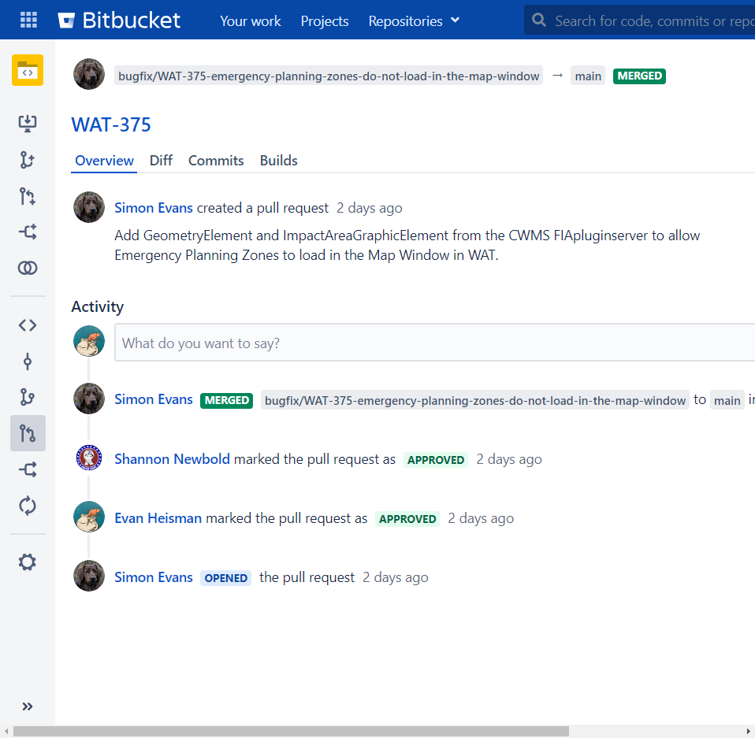
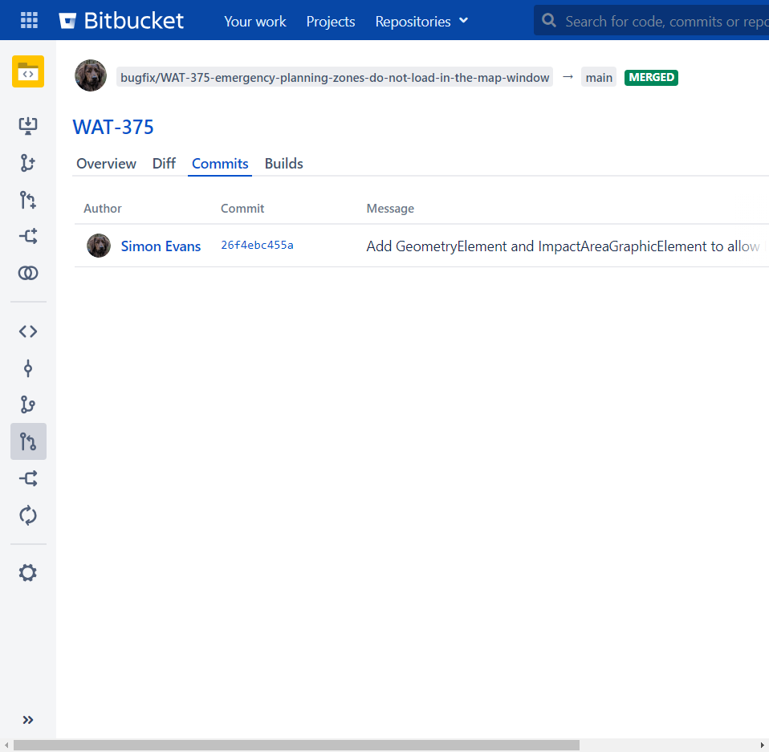
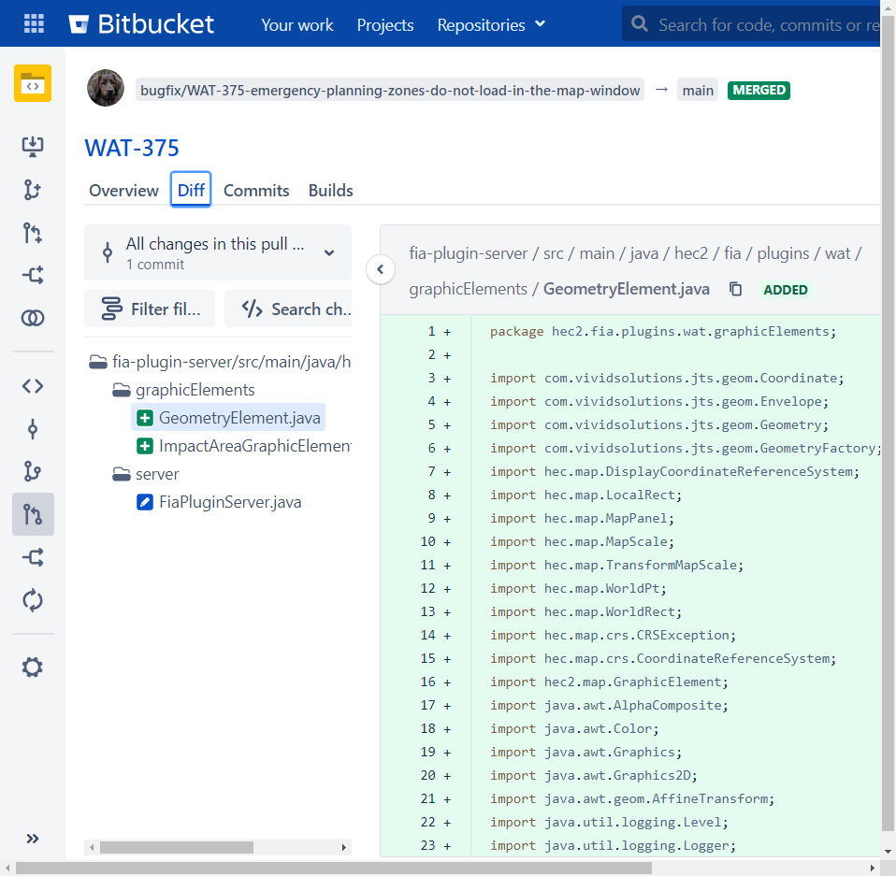
Pull Request?
Notes:
A request to do a merge on a remote server from a branch to another
Offers opportunity to review
Implemented on server software, not a local thing – need to log into view and approve

Slide 22
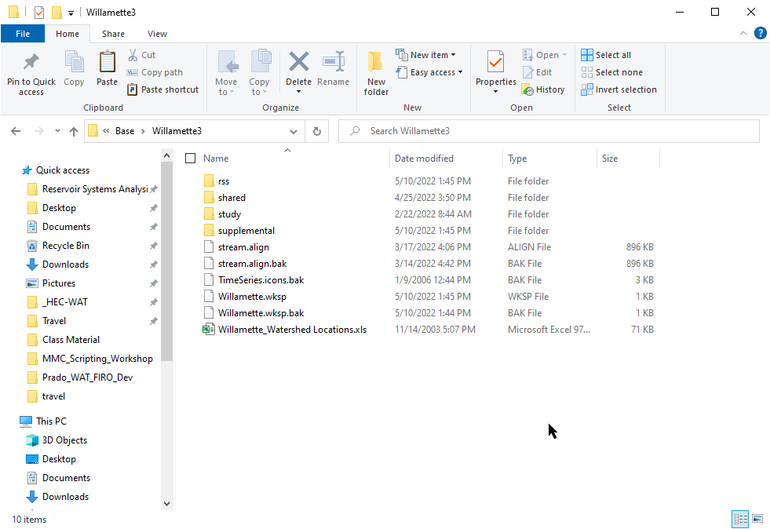
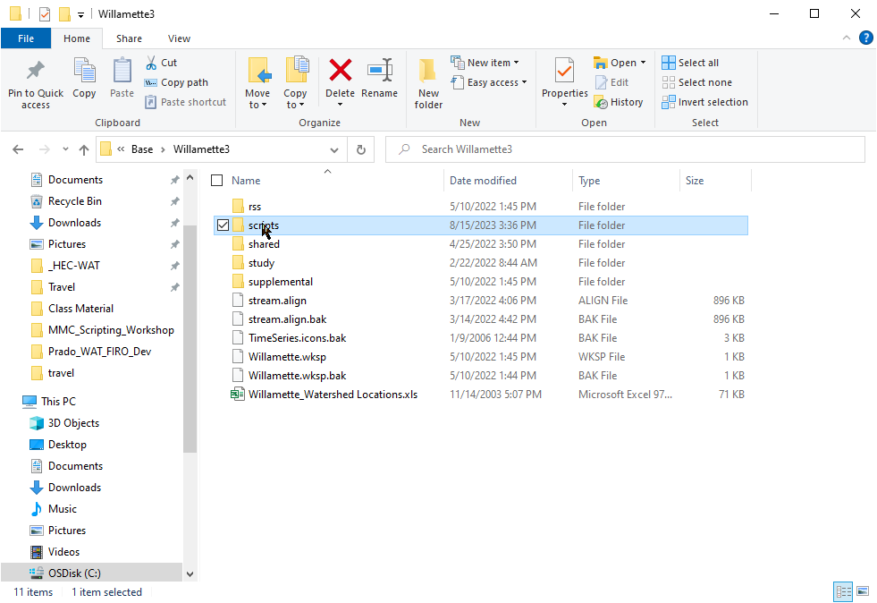
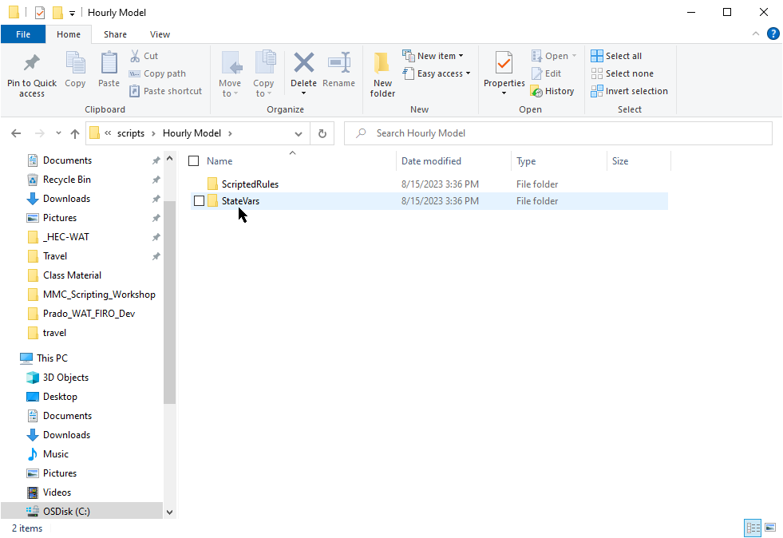
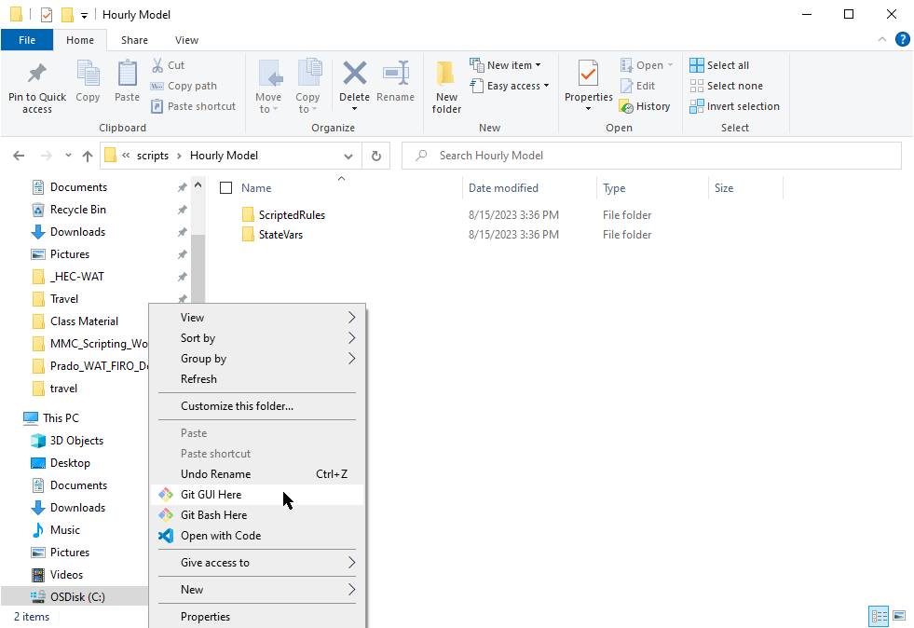
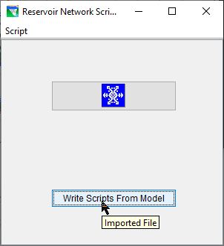
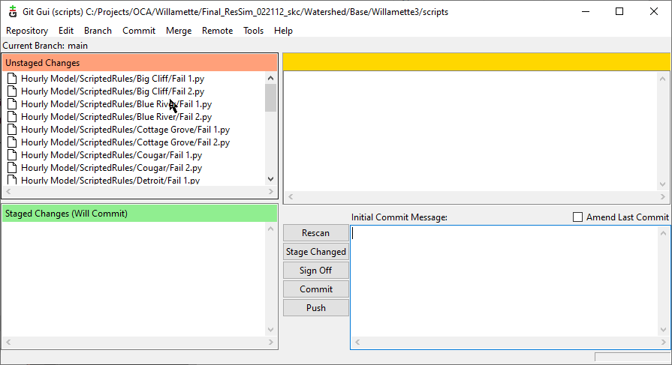
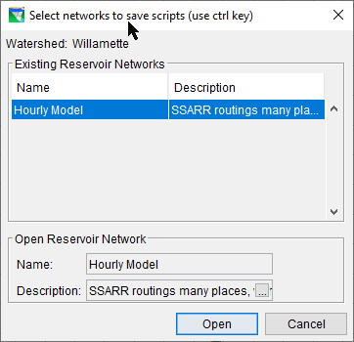
Git with ResSim?
- Don’t track the whole watershed!
Save scripts out of model*, track only script folders, modules, config files!
Keep .git folder

Slide 23
Resources
git book:
https://git-scm.com/book/en/v2
git cheat-sheet and glossary:
https://training.github.com/downloads/github-git-cheat-sheet/

