Slide 1
Scripting HEC-ResSim

Slide 2
Topics
Why does ResSim have scripting?
Types of Scripts in ResSim
  Utility Scripts
  State Variables and Rules
  Useful Scripting Knowledge (if there is time!)
What is Jython? / help!

Slide 3
Why Script ResSim?
ResSim has lots of features!
It doesn’t do everything just the way you need…
Scripting gives an easy way to extend ResSim’s behavior.
Scripts allow you to automate / modify the behavior of ResSim
  Add features to the user interface
  Modify the compute!

Slide 4
Scripting in Ressim
Two Categories of Scripts
Scripts Executed Outside Simulations
  Utility Scripts (also called “static” scripts)
  Running ResSim Headless (not in this lecture)
Scripts Executed During Simulations
  State Variable Scripts
  Scripted Rule Scripts

Slide 5
Categories of Scripts – 1 of 2

Slide 6
Categories of Scripts – 1 of 2
Scripts executed outside simulations
  These scripts can:
    Pre-process data for simulations
      modify input data
      modify models
    Run simulations (some or all alternatives)
    Post-process data from simulations,
      generate plots and reports, etc…
  These scripts cannot:
    Interact with a running simulation
(What? Danger!)

Slide 7
Scripts Executed Outside Simulations
There is only one type of script executed outside simulations, which we call static or utility scripts.
Utility scripts are just like HEC-DSSVue scripts:
  Execute from the Script Selector, Script Pane, or Script Editor.
  Edit/test in the Script Editor.
  Exist on disk ~ location in tree.
Utility scripts go beyond HEC-DSSVue scripts:
  Location in the Tree Pane determines script visibility.
  Scripts have knowledge of the current module and simulation.

Slide 8
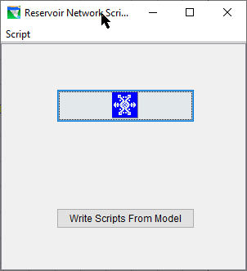
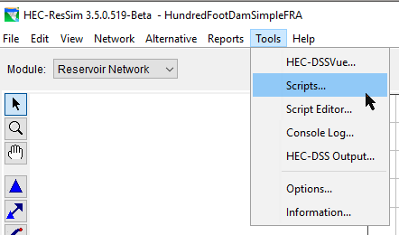
The Script Selector
The Script Selector is accessed by the Tools→Scripts menu item in any module.
The Script Selector is titled according to the current module.
Execute a script by pressing its button.

Slide 9
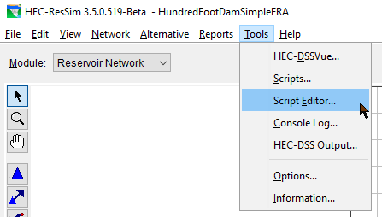
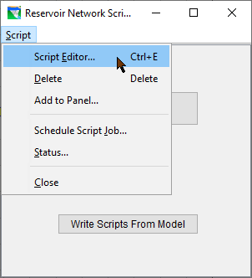
Accessing the Script Editor
The Script Editor is accessed by the Tools→Script Editor… menu item on the HEC-ResSim menu bar, or by Script→Script Editor menu item on the Script Selector.

Slide 10
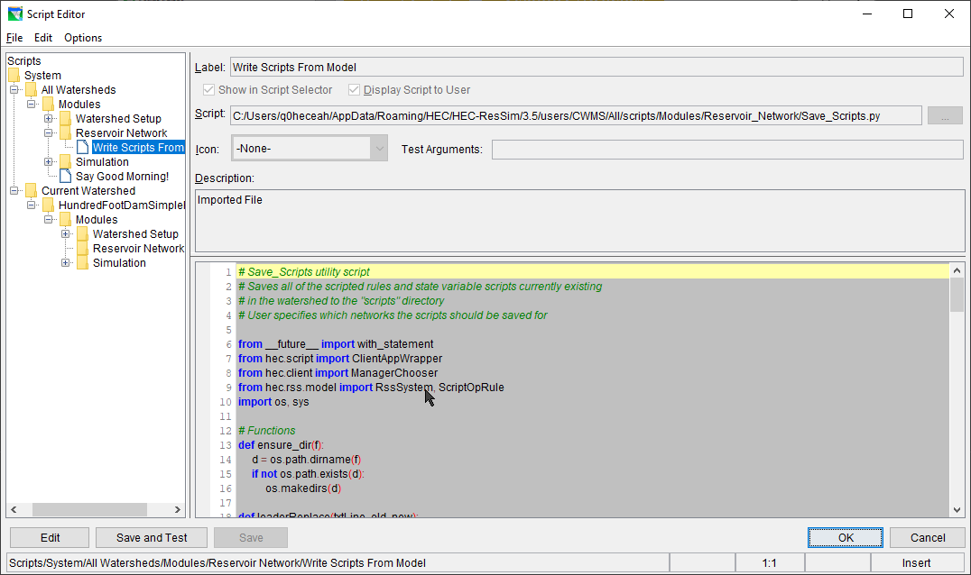
The Script Editor
Also in DSSVue*!
Notes:
DSS Vue has a different script tree on the side

Slide 11
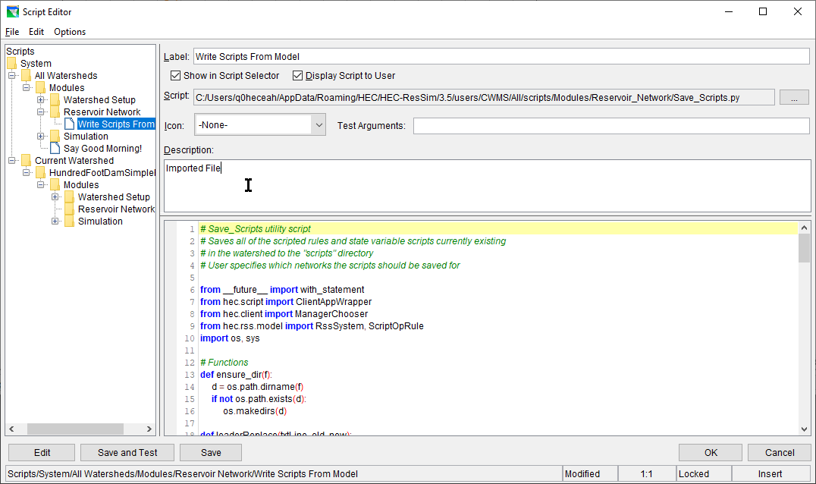
The Script Editor
Script Label
Visibility Switches
Tree Pane
File Name
Icon Selector
Pre-Defined Config Variables
Description Pane
Editor Pane
Edit/Save/Test Buttons
Location / Mode Indicators

Slide 12
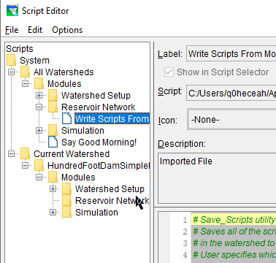
Utility Script Visibility
For a utility script to be visible:
  In the Tree Pane:
    must be in the All Watersheds folder or Current Watershed folder
    must be in Modules folder or folder corresponding to the current module
  its Show in Script Selector switch must be checked to be in the Script Selector
  its Display Script to User switch must be checked to be in the script pane

Slide 13
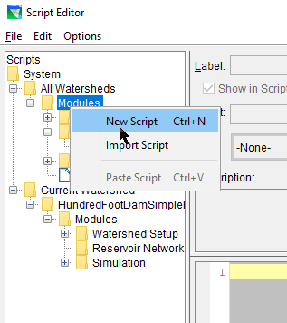
Creating a New Utility Script
To create a new utility script:
  right-click on one of the folders under either the All Watersheds or Current Watershed:
    Modules
    Watershed Setup
    Reservoir Network
    Simulation
  select New Script from the context menu
  enter a name in the Label field
  enter the script text in the Editor Pane
  press the Save or Save and Test button

Slide 14
Editing Existing utility Scripts
To edit an existing Utility Script, do one of the following:
  double-click on its entry in the Tree Pane
  right-click on its entry in the Tree Pane and select Edit Script from the context menu
  select its entry in the Tree Pane and do one of the following:
    select File→Open from the menu bar
    press Ctrl-O
    press the Edit button

Slide 15

Testing Existing Utility Scripts
To test an existing Utility Script from the Script Editor, select its entry in the Tree Pane and do one of the following:
  select File→Test from the menu bar
  OR press the Save and Test button

Slide 16
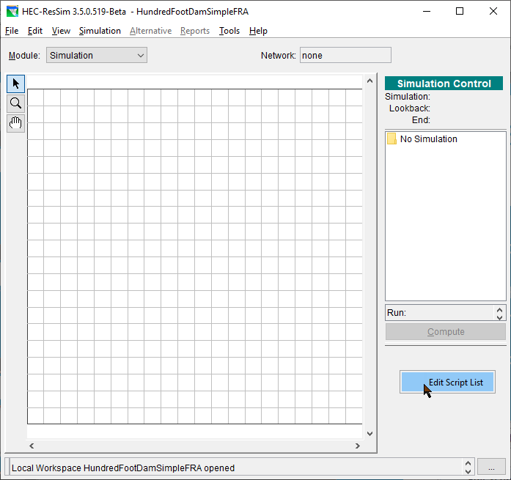
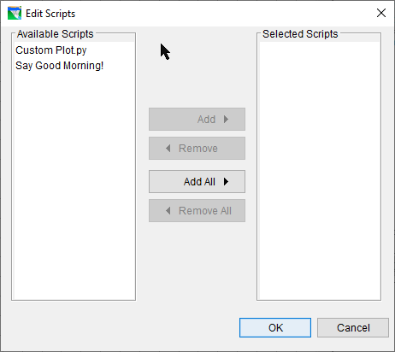
Adding Scripts to the Simulation Module Script Pane
To add a script to the simulation module script pane:
  right-click in the scripts area
  select Edit Script List from the context menu
  use the Edit Scripts dialog to move desired scripts to the Selected list

Slide 17
Categories of Scripts – 2 of 2

Slide 18
Categories of Scripts – 2 of 2
Scripts executed during simulations
  These scripts can:
    Compute a flow limit (minimum, maximum, specified) at each simulation time step
    Compute and store the state of some (concrete or abstract) portion of the model at each simulation time steps

Slide 19
Scripts Executed During Simulations
There are two types of HEC-ResSim scripts that are executed during simulations
  Scripted Rules
    a.k.a. “User-Defined rules”
    Scripts that compute a desired release or operating limit of the associated reservoir or release element. Used when none of the standard rule types can adequately reflect the desired operation.
Notes:
State Variables have the benefit of being able to be used by multiple rules and also may be viewed in plots or tables.
Scripted Rules have the benefit of being able to set not just the value of a constraint, but the constraint type, and even whether a constraint exists at all – may need elaboration

Slide 20
Scripts Executed During Simulations
  State Variables
    Scripts that set the value of a state variable, which can be used by rules, IF-THEN-ELSE blocks, zones, diversions (others?)
      A model variable represents the state of some parameter of an element of the network computed by ResSim at each time step of the simulation (thus, a time series). e.g., the reservoir pool elevation.
      A state variable is a model variable-like time series whose values are computed by a user-defined script for each time step; it need not represent the state of a parameter of single element.
Notes:
State Variables have the benefit of being able to be used by multiple rules and also may be viewed in plots or tables.
Scripted Rules have the benefit of being able to set not just the value of a constraint, but the constraint type, and even whether a constraint exists at all – may need elaboration

Slide 21
Scripts Executed During Simulations
Common Properties of State Variables and Scripted Rules
  They are executed and should determine a value at every iteration of every time step
  Computation at any time step may depend on any model variables at previous time steps, and may depend on other State Variables at the current time step
  Scripts are normally only executed when used in an active alternative, but can be forced to execute otherwise
Notes:
Scripts that depend on other State Variables at the same time step must manually ensure they have been executed before the current script

Slide 22
Limitations of Model Variables
Model variables provide the states of single elements within a ResSim model.
Therefore, model variables cannot represent abstract concepts that require analysis of more than one element such as:
  basin wetness
  drought level
  system storage utilization
  depth-area-duration considerations

Slide 23
State Variables vs. Model Variables
Like model variables, state variables are time-series objects that belong to the Network.
Like model variables, state variables are globally accessible, so they may be used in multiple rules and in multiple reservoirs.
Unlike model variables, state variables are not associated with specific network elements (pools, junctions, etc…). As such, they can represent complex or abstract concepts.
Notes:
The Network is the program object that holds all objects that make up the reservoir system being modeled. The GUI refers to it as the Reservoir Network.
Reservoirs, Reaches, Junctions, and Diversions are all objects within the Network. These objects are compound objects, each containing other objects. The reservoir object is the most complex. It contains the pool and outlet objects, as well as the operation sets, zones, and rules.

Slide 24
State Variable Scripts
HEC-ResSim computes a state variable by executing a Jython script for that variable at every time step (when requested) through the entire simulation period.
The script can access model variables and other state variables for the current and prior time steps.
  Scripts that depend on other State Variables at the same time step must be manually ensured to be executed after the script they depend upon
The script can also perform any function available to Jython
  Care must be taken not to perform lengthy tasks (e.g. disk or network access) because of the number of times the script is executed!
Notes:
Jython is a Java implementation of the Python programming language and provides the common basis for ResSim, DssVue, and CWMS scripting.
State Variable definition scripts do not return anything. They must “set” the value of the TimeSeries object for the current time step, or have set it in an earlier time step. The script may optionally set values into the future (through the end of the computation time window).

Slide 25
Creating New State Variable Scripts
To create a new State Variable script:
  Select Edit→State Variables from the Simulation Module menu bar.
  Select StateVariable→New from the State Variable Editor menu bar.
  Enter the desired name in the Name field of the New State Variable dialog.
  Press the OK button.
  Enter the desired parameter (DSS C Part) in the Parameter Name field.
  Select the desired parameter type from the Parameter Type list.
  Edit the script text as desired.
  Press the Compile Script button to check for syntax errors.
    Fix any errors and repeat this step.
  Save the script by selecting StateVariable→Save from the menu bar or pressing Ctrl-S.
  Close the State Variable Editor dialog.

Slide 26
Editing Existing State Variable Scripts
To edit an existing State Variable script:
  Select Edit→State Variables from the Network or Simulation Module menu bar.
  Select the desired State Variable name from the Name field.
  Edit the script text as desired.
  Press the Compile Script button to check for syntax errors.
    Fix any errors and repeat this step.
  Save the script by selecting StateVariable→Save from the menu bar or pressing Ctrl-S.
  Close the State Variable Editor dialog.

Slide 27
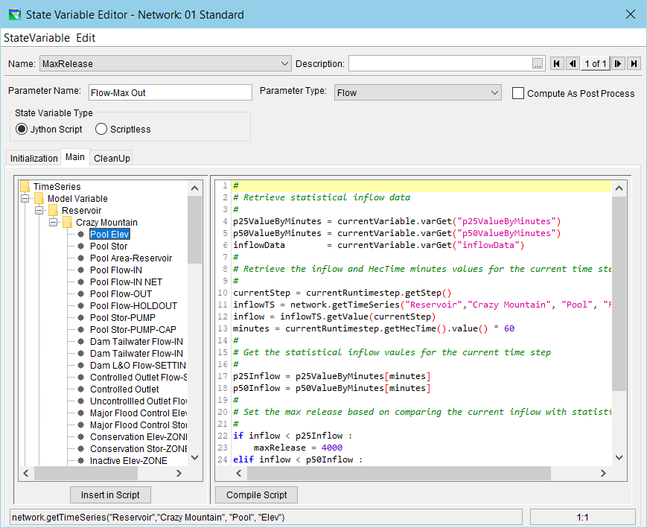
The State Variable Editor
Script Tabs
Script Pane (editor window)
Object Pane (aka API window or “tree)
API preview & Cursor Location

Slide 28
Using the State Variable Editor API Pane
Selecting a node (not a folder) in the API Pane causes the API insertion text for the selected node to be displayed in the API preview bar.
Double-clicking on a node in the API Pane causes its API text to be inserted at the current cursor position in the Editor Pane.
  The same can be accomplished by selecting a node in the API and then selecting the Insert in Script button under the API Pane.
Dragging a node in the API Pane to some position in the Editor Pane causes its API text to be inserted at that location in the Editor Pane.

Slide 29
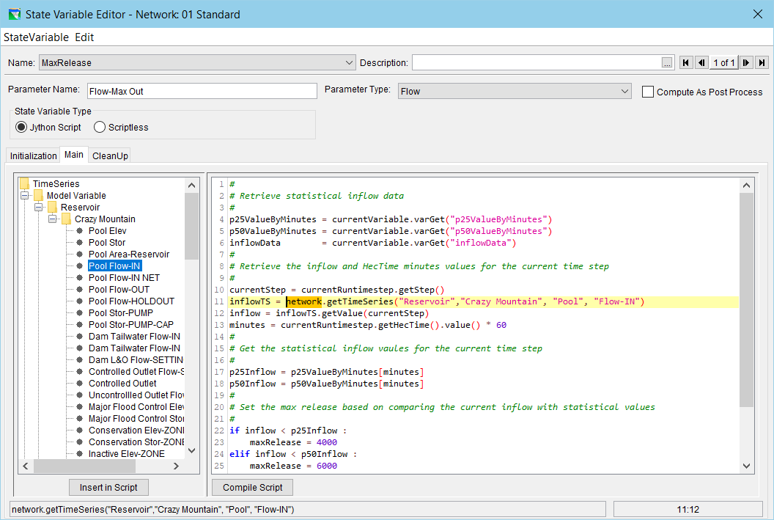
State Variable Editor API Pane Example

Slide 30
State Variable: Three Parts
Initialization (function in script)
  Runs during initialization, after initial conditions set, before any model timesteps
Main
  Runs each time a value is requested from the SV
Cleanup
  Runs after the model is finished

Slide 31
Creating New Scripted Rules
To create a Scripted Rule:
  Open the Reservoir Editor to the Zone-Rules tab of the Operations tab.
  Right-click the desired zone and select Add New Rule… from the context menu.
  Enter the desired name and select the desired release element in the New Operating Rule dialog.
    Select Script for the Rule Type.
  Press the OK button.
  Edit and check syntax as with a State Variable.

Slide 32
Editing Existing Scripted Rules
To edit an existing Scripted Rule:
  Select the desired rule in the Zone-Rules tab of the Operations tab of the Reservoir Editor.
  Edit the script as desired. The editor is similar to the State Variable editor.

Slide 33
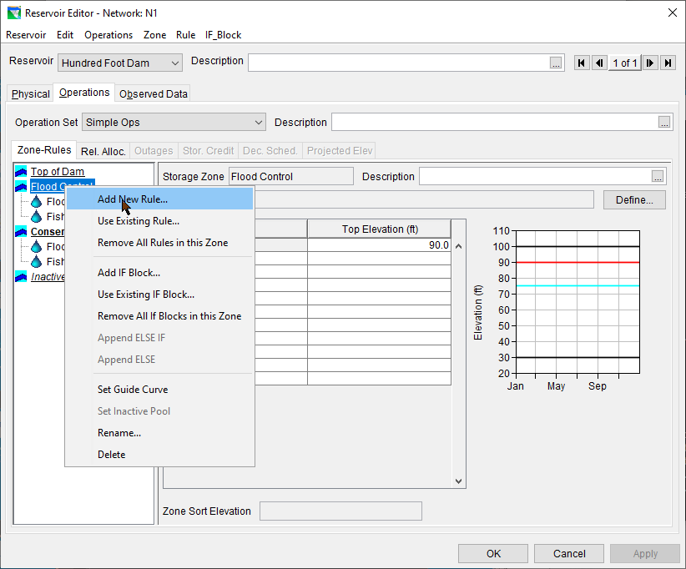
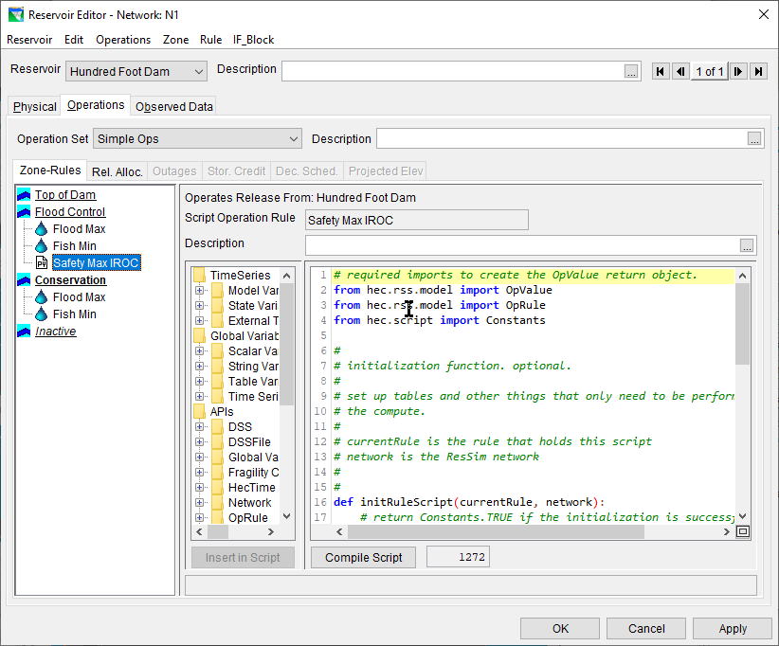
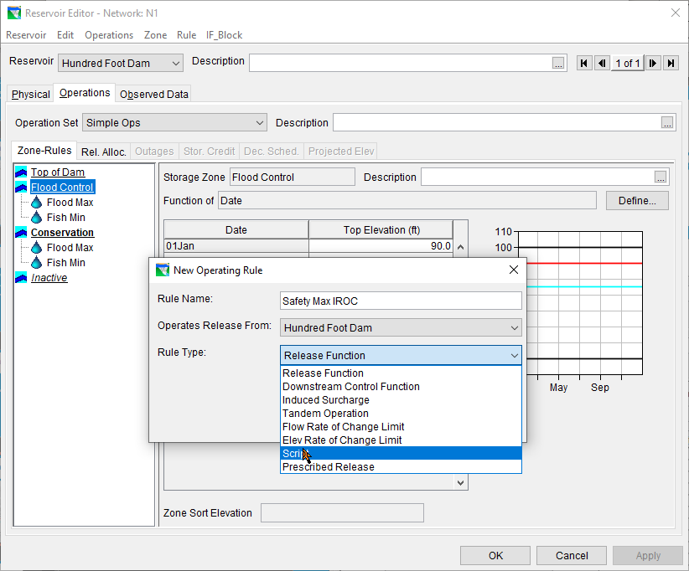
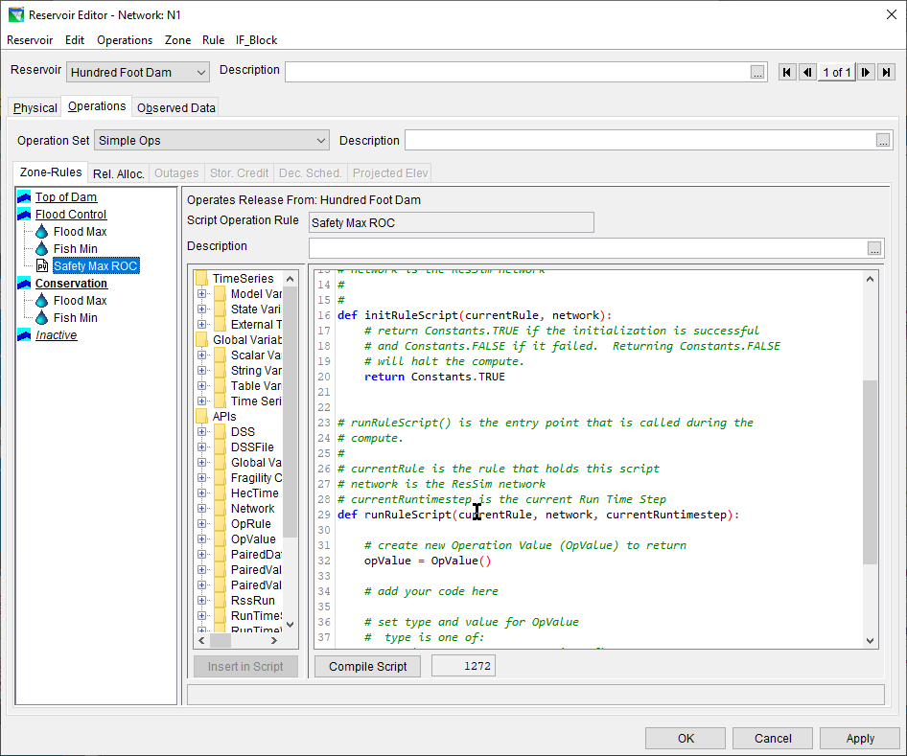
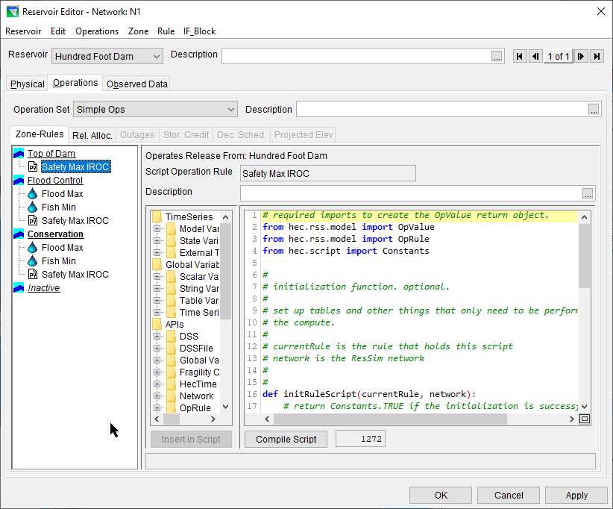
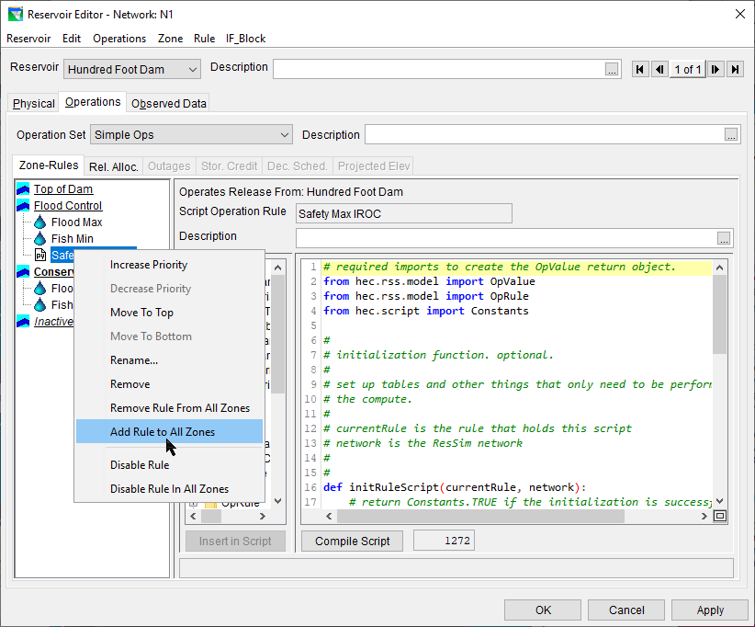
Scripted Rule Example
Operates from…
Rule name
Rule in rule stack
Description
Initialize rule
Run rule
initRuleScript function
API tree
“compile” button
Script length

Slide 34
RunRuleScript function
Runs every timestep, each time the rule stack evaluates!
  (possibly more than once per timestep 😬)
Avoid slow or resource demanding processes!

Slide 35
InitRuleScript Function
Runs once before the simulation’s timesteps
Use this for slow or resource-demanding processes!

Slide 36
Commonly used Objects
network object / RssSystem class
  Represents ResSim Network
  Useful to access just about everything!
currentRunTimestep / RunTimestep class
  Where in the simulation are we?
currentVariable / StateVariable class
  Represents the SV being executed
currentRule / ScriptedRule class
  Represents the rule being executed

Slide 37
Passing Data Between Scripts
Local variables
  for complex objects, configuration data, doesn’t change with time
  Key-value mapping: Acts similar to a python dictionary.
  varPut, varGet, varList, varExists
  Example:
    currentRule.varPut(“initMaxFlowVal”, initMaxflow)
    maxQ = currentRule.varGet(initMaxFlowVal)
Local timeseries
  for scalar data that changes over time!
  Treat like timeseries values.
  localTimeSeriesNew, localTimeSeriesGet, localTimeSeriesExists
Get to other state variables or rules via `network` object

Slide 38
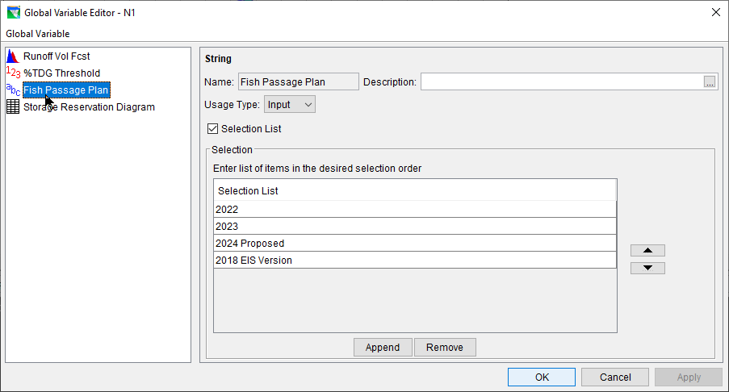
A word on Global Variables
New Feature!
Provides a UI and validation for script configuration.
  Define variable in the network
  Set value by alternative
Types:
  Scalar
  String
  Timeseries
  Tables

Slide 39
Jython
& Scripting Help

Slide 40
What is Jython?
Jython compiles Python code to Java byte-code, runs inside the Java Virtual Machine
- Jython lets you use the Python syntax in a Java program
Jython has access to Java’s libraries
  Import from Java’s library as if Python modules.
Jython uses Python syntax and library
  Jython 2.5 ~= Python 2.5
  Jython 2.7 ~= Python 2.7
  ??? ~= Python 3.x ? 😢

Slide 41




Online Help
Army eLearning
  Books, Courses, Live Events
  https://usarmy.percipio.com/
Army Civilian Udemy access
  https://armyciv.udemy.com.
O’Reilly Safari Learning Online
  Books, Courses
  https://learning.oreilly.com/home/
  Sign up: https://www.militaryonesource.mil/benefits/mwr-libraries/

Slide 42
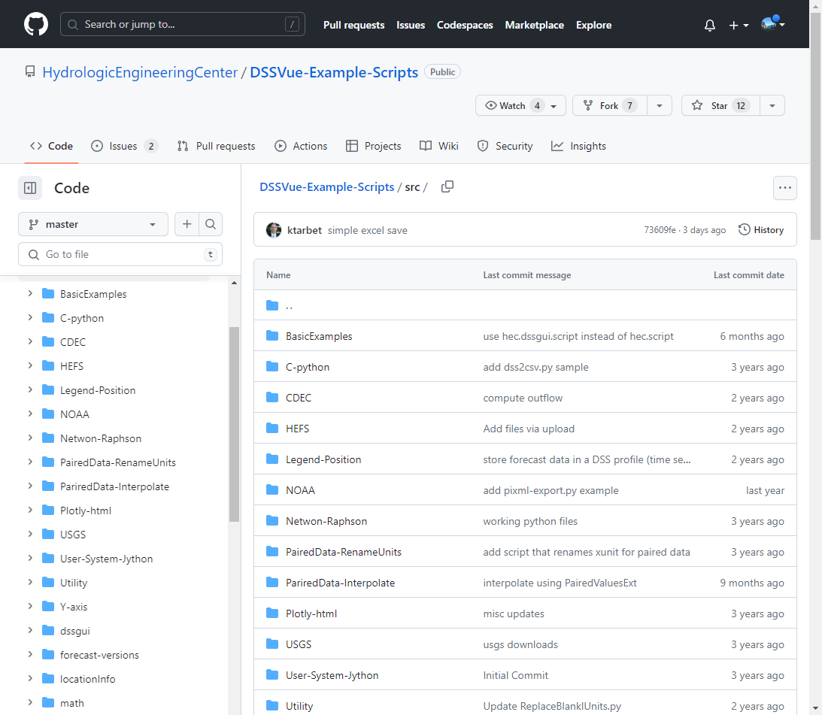
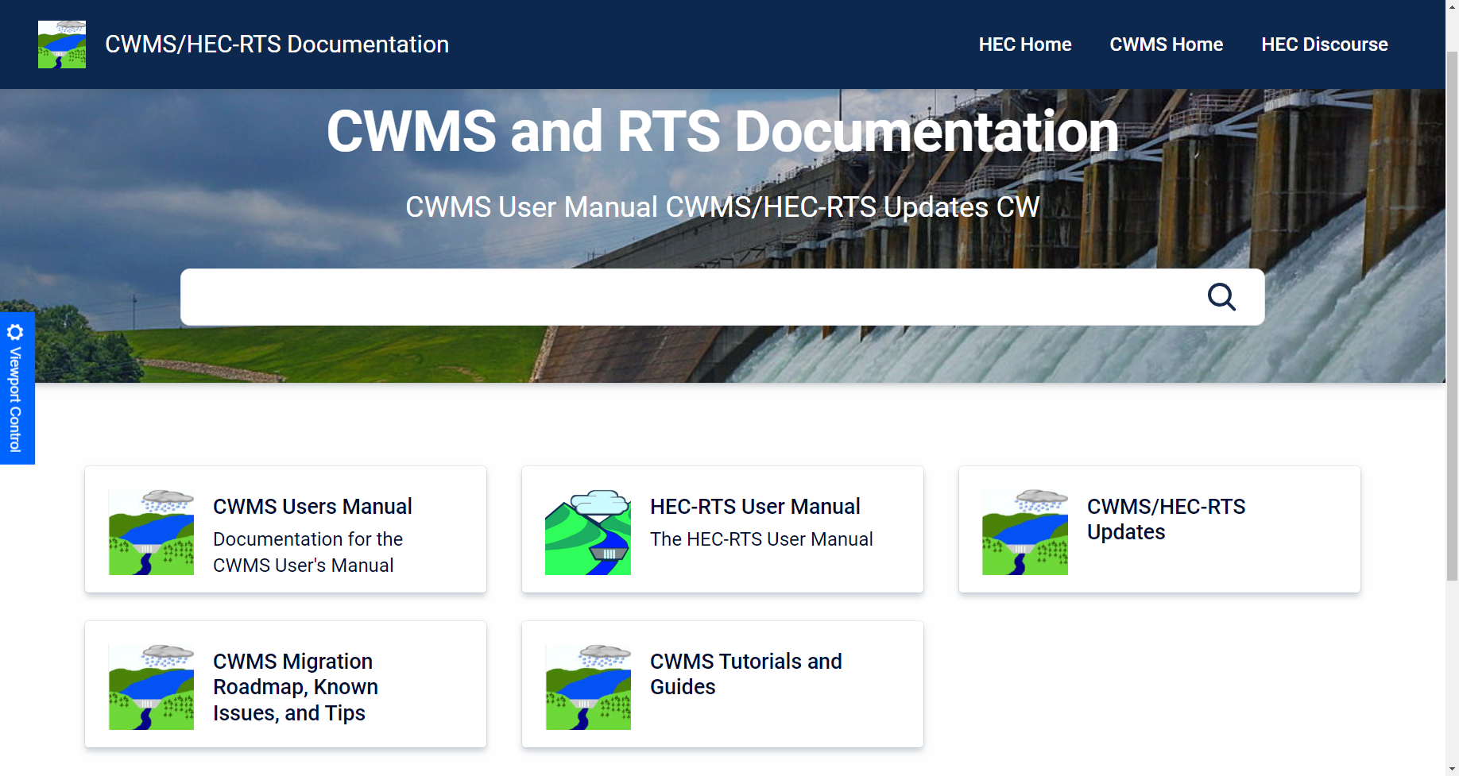
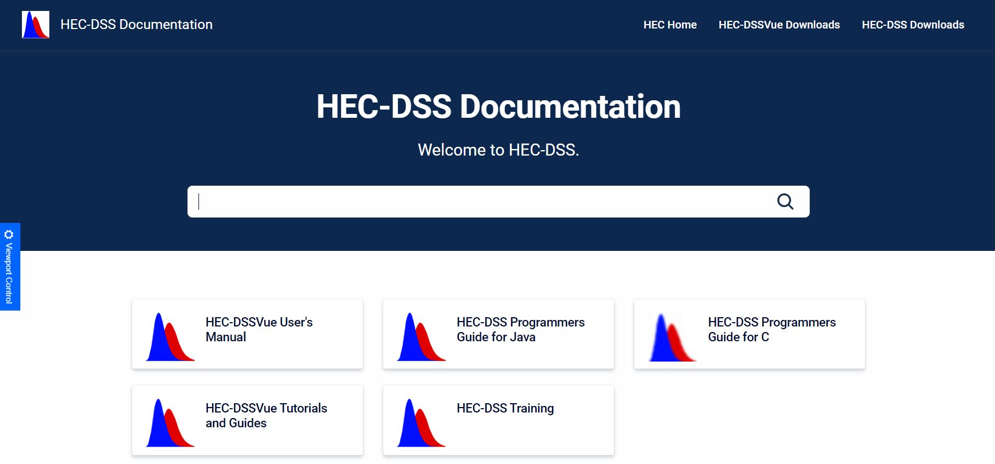
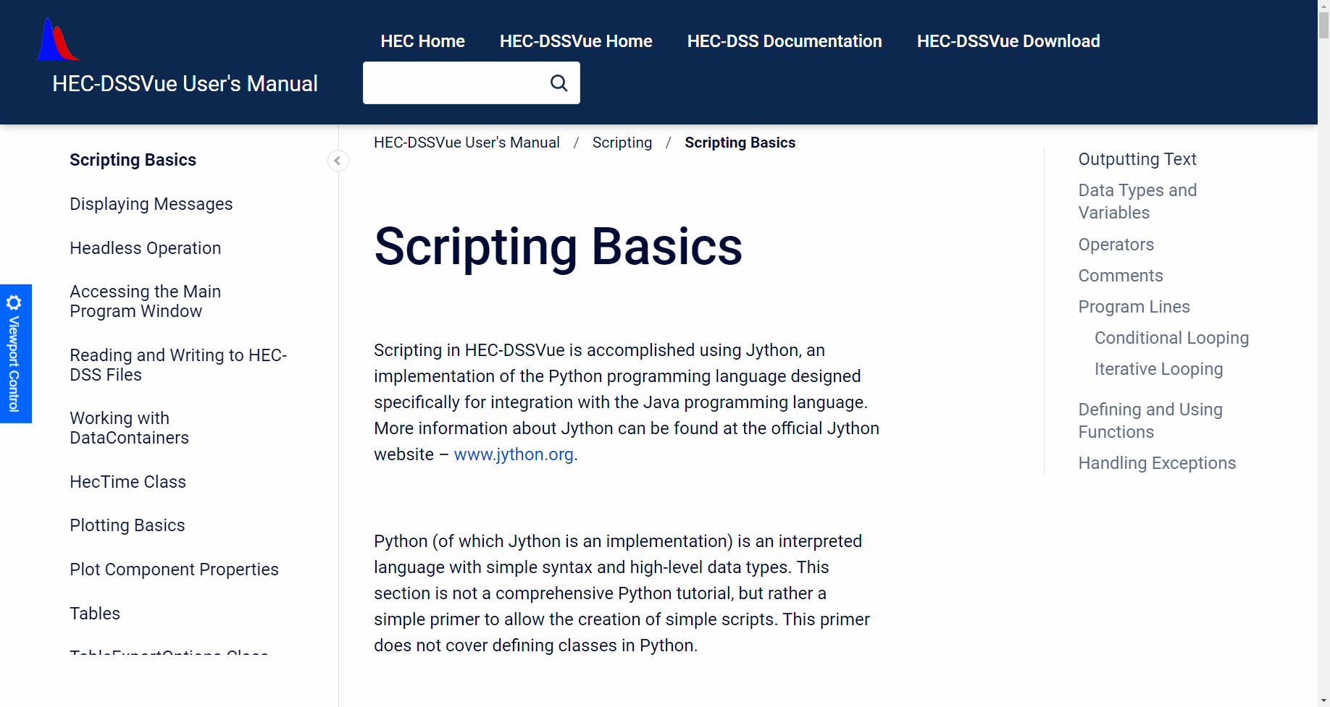
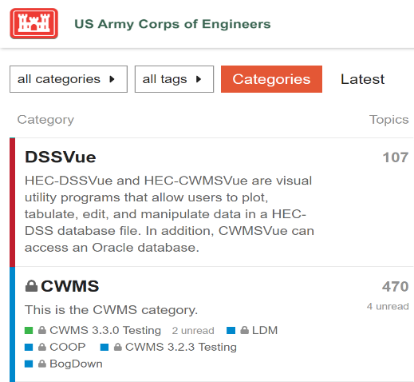
HEC Publications, Training, & Discourse
https://github.com/HydrologicEngineeringCenter/DSSVue-Example-Scripts/tree/master/src
https://www.hec.usace.army.mil/confluence/cwmsdocs
https://www.hec.usace.army.mil/confluence/dssdocs
https://discourse.hecdev.net/tags/c/cwms/5/scripts
https://discourse.hecdev.net/tags/c/dssvue/15/scripts

Slide 43
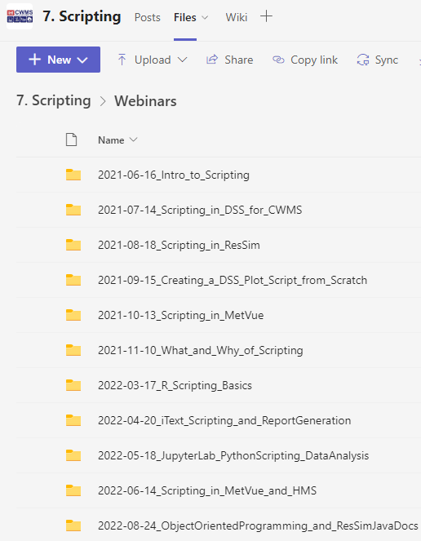
CWMS
MS Teams
CWMS MS Teams
  Group or one-on-one Chats & Meetings
  Live & Recorded Webinars
  Virtual Working Sessions & Workshops
MMC CWMS Team
  Scripting Channel
  Scripting Webinars

Slide 44
Review
Jython is a Python syntax and core library in a Java environment
Scripts Executed Outside Simulations
  Utility Scripts
Scripts Executed During Simulations
  State Variable Scripts
  Scripted Rule Scripts
  Important variables for SVs and Scripted Rules
Jython / Learning Resources

