Slide 1

Rule-based
Reservoir operation
HEC-ResSim
Fauwaz Hanbali, Beth Faber (stand-in)
Hydrologic Engineering Center

Slide 2
Outline
HEC-ResSim Watershed Simulation
HEC-ResSim Reservoir Computations
HEC-ResSim Rule & Limit Types
HEC-ResSim Release Decision Games
HEC-ResSim Rule Types & Assignments
HEC-ResSim Release Decision Report

Slide 3
Watershed Simulation

Slide 4
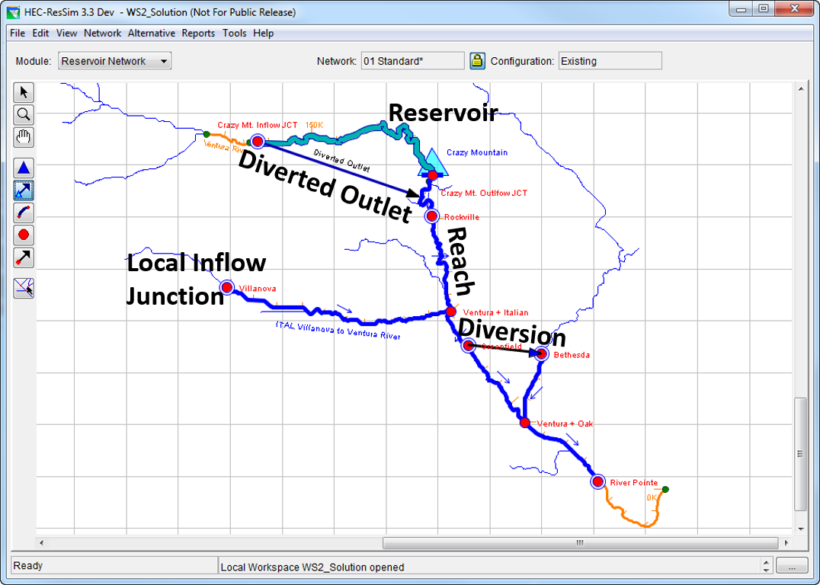
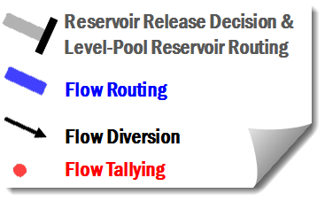
HEC-ResSim Watershed Simulation

Slide 5
Reservoir computations

Slide 6
Reservoir Release Decision Determinations and Mass Balance Computations
Δ Storage = Inflow – Outflow
❖
√
√
√
√
◆
√
Known Variables
  Initial Storage (S_{t})
  Initial (I_{t}) and Forecast Inflow (I_{t+1})
  Initial Outflow (O_{t})
  Losses Estimates
Computed Variables
  Final Outflow (O_{t+1}):
  based on Release
  Decision Logic
  Final Storage (S_{t+1}):
  based on Mass Balance
√
◆
√
√
❖
√

Slide 7
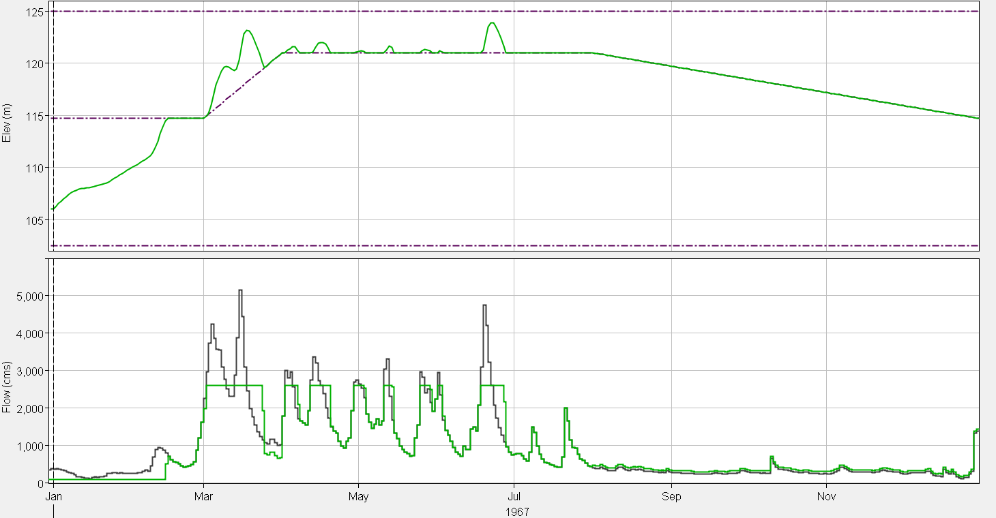
Reservoir Operation
Flood Control Operating Zone
Guide Curve
Normal Operating Level
Reservoir Elevation
Conservation Operating Zone
Inflow
Maximum Release
Outflow
Minimum Release
Guide Curve Release

Slide 8
Rule & Limit types

Slide 9
Release Limit Types
Maximum Limit: Cannot exceed this limit
Minimum Limit: Cannot fall below this limit
Specified Limit: Cannot exceed or fall below this limit

Slide 10
Summary of HEC-ResSim
Rule and Limit Types
Rule | Return Variable | Limit
Release Function | Flow | Min/Max/Specified at Current Time Step
Downstream Control | Flow | Min/Max/Specified at Current Time Step
Flow Rate of Change | Flow | Min/Max at Current Time Step relative to change limit from Previous Time Step Release
Elevation Rate of Change | Flow | Min/Max at Current Time Step relative to change limit from Previous Time Step Release
Hydropower | Flow | Min at Current Time Step
Induced Surcharge | Flow | Min at Current Time Step
Tandem | Flow | Specified at Current Time Step
Script | Flow | Min/Max/Specified at Current Time Step

Slide 11
Release Decision Factors
Outlet Release Capacity (Min & Max Physical Limits)
Operating Rules (Min/Max/Specified Limits)
  Constrain GC Operation to achieve other operating goals
  Temper GC behavior by providing Release Limits
Rule Priorities
  Highest priority is the top of the rule stack
  Lowest priority is the bottom of the rule stack
  Priorities resolve conflicts between rule limits
Guide Curve (GC) Operation (Specified Limit)
  Underlying logic for reservoir Operation
  Specified Release to empty storage above GC
  Curtailed release when pool level is below GC

Slide 12
Release decision games

Slide 13
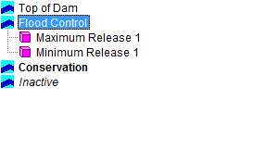
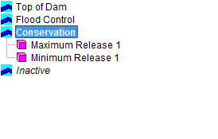
Allowable Range of
Releases & Release Decision

Slide 14
Allowable Range of
Releases & Release Decision
Guide Curve Release is inherently a Specified Limit
When the Guide Curve Release is above the Final Allowable Range of Releases, the Release Decision will be the upper limit of the Final Allowable Range of Releases
When the Guide Curve Release is below the Final Allowable Range of Releases, the Release Decision will be the lower limit of the Final Allowable Range of Releases
When the Guide Curve Release is within the Final Allowable Range of Releases, the Release Decision will be the Guide Curve Release

Slide 15
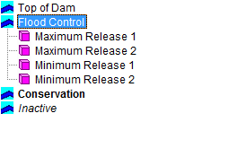
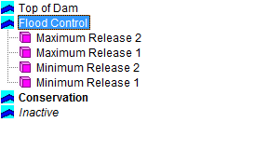
Multiple Rules –
Compatible Limits

Slide 16
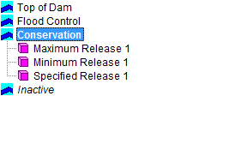
Multiple Rules –
Compatible Limits
For two or more Maximum Limits, the LOWEST maximum limit wins
For two or more Minimum Limits, the HIGHEST minimum limit wins
For Compatible Limits, any rule prioritization order would result in the same Final Range of Allowable Releases

Slide 17
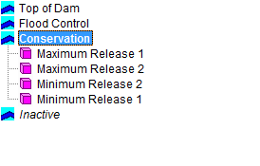

Multiple Rules –
Conflicting Limits

Slide 18

Multiple Rules –
Conflicting Limits
When different limits conflict, lower priority Limits are violated, and the Final Allowable Range of Releases is determined based on the highest priority limits
Physical Capacity limits always have a higher priority than Operating Rule Limits

Slide 19
Multiple Rules –
Multiple Outlets & Limits
Flow (cfs)
Flow (cfs)

Slide 20
Multiple Rules –
Multiple Outlets & Limits

Slide 21
Rule Types & Assignments

Slide 22
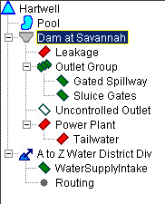
Rule Types & Assignment
Release Function (at-site)
Flow Rate of Change Limit
Elevation Rate of Change Limit
Downstream Control Function
Induced Surcharge
Tandem Operation
Hydropower – Schedule
Hydropower – Power Guide Curve
Hydropower – Time Series Requirement
Hydropower – System Schedule
Pump Schedule
User Defined (Scripted)
O D P
O D P
P
P
P
P
O
O
O
O
O
O D P
*A rule can be applied to:
O=Outlet
D=Dam or Group
P=Pool

Slide 23
Other Complexities…
Rising/Falling Conditions
Operating for a downstream location
Seasonally Varying Release and Downstream Control Functions
Induced surcharge (minimum required release based on inflow and storage)
Jointly operating multiple reservoirs (for same flow objective and/or a balanced pool state)
Hydropower rules

Slide 24
And MORE Complexities…
Allocating Releases
  Prioritizing or Balancing Releases across the reservoir outlets
Outlet Outages and Capacity Overrides
Release overrides
  Release specified timestep by timestep; ignore operating rules
Decision Schedules
  Allowing the reservoir to make release decisions at intervals greater than the compute time-step.

Slide 25
Release decision Report

Slide 26
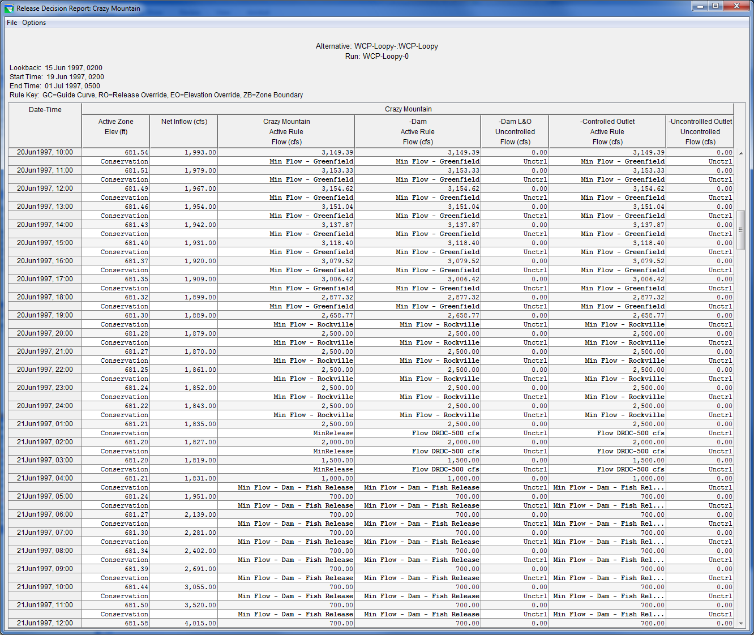
HEC-ResSim’s
Release Decision Report

Slide 27
Summary of HEC-ResSim’s
Release Decision Logic
Determine Outlet Release Capacity (Min & Max Physical Limits)
Apply Overrides (Capacity/Release/Elevation)
Evaluate Operating Rules (Min/Max/Specified Limits)
Respect Rule Priorities & Determine Final Allowable Release Range
Calculate the Desired Guide Curve (GC) Release (Specified Limit)
Make Final Release Decision at the limit of the allowable range of releases that is closest to the desired GC Release

Slide 28
Questions?

